Slide 1


DrTM+R
R
Fast and General Distributed Transactions using RDMA and HTM
YANZHE CHEN, XINGDA WEI, JIAXIN SHI,
RONG CHEN, HAIBO CHEN
Institute of Parallel and Distributed Systems
Shanghai Jiao Tong University, China
Notes:
Thanks for the introduction, I am glad to present our work on providing fast and general distributed transactions using advanced hardware,
Which is a joint work with Xingda, Jaixin and our advisors: Haibo and Rong.

Slide 2



Transaction: Key Pillar for Many Systems
$9.3 billion/day
Demand Speedy Distributed Transaction
Over Large Data Volumes
9.56 million tickets/day
11. 6 million payments/day
Notes:
In-memory transaction system is now the key pillar for many workloads, such as the e-commerce system or the online ticket system.
They typically need to handle billions of requests per day over a large volume of data,
Thus they usually require fast distributed transactions.

Slide 3
Opportunities: Hardware Trends
    HTM: Hardware Transaction Memory
    Allow a group of load & store instructions to execute in an atomic, consistent and isolated (ACI) way
    RDMA: Remote Direct Memory Access
    Provide cross-machine accesses with high speed,
    low latency and low CPU overhead
    NVRAM: Non-Volatile Random-Access Memory
    Provide random-access memory that retains its information when power is turned off (non-volatile)
Notes:
At the same time, there are many advanced hardware features that we could use.
One example is Hardware Transaction Memory, which allows a group of load ...
Another example is Remote Direct Memory Access, short for RDMA, which provides …
What’s more, Non-Volatile Memory also becomes more and more popular as it provides fast random access while retains the content when power is down.

Slide 4
Opportunities with New Hardware
    HTM: Hardware Transaction Memory
  non-transactional code will unconditionally abort a transaction when their accesses conflict
Strong Atomicity
    RDMA: Remote Direct Memory Access
  one-sided RDMA operations are cache-coherent
  with local accesses
Strong Consistency
    NVRAM: Non-Volatile Random-Access Memory
Strong Durability
  data are durable after written to NVRAM
Notes:
Specifically,
HTM provides strong atomicity that non-transactional code will unconditionally abort a conflicting transaction;
RDMA provides strong consistency that one-sided RDMA operations are cache-coherent with local accesses;
What’s more, NVRAM provides the strong durability that data are durable after written to the NVRAM

Slide 5
Opportunities with New Hardware
    HTM: Hardware Transaction Memory
  non-transactional code will unconditionally abort a transaction when their accesses conflict
Strong Atomicity
    RDMA: Remote Direct Memory Access
  one-sided RDMA operations are cache-coherent
  with local accesses
Strong Consistency
    NVRAM: Non-Volatile Random-Access Memory
Strong Durability
  data are durable after written to NVRAM
Fast Distributed TX with High Availability
Notes:
Specifically,
HTM provides strong atomicity that non-transactional code will unconditionally abort a conflicting transaction;
RDMA provides strong consistency that one-sided RDMA operations are cache-coherent with local accesses;
What’s more, NVRAM provides the strong durability that data are durable after written to the NVRAM

Slide 6
Previous Work: DrTM^{SOSP’15}
    Combining HTM with 2PL
    Using 2PL to accumulate all remote records prior to accesses in an HTM transaction
    Low COST distributed TX
  Achieve over 5.52 million TXs/sec for TPC-C on 6 nodes
    Limitations of DrTM
    Require advanced knowledge of read/write sets of transactions
    Preserve durability rather than availability in case of machine failures
Notes:
Of course, this is not the first time to leverage these hardware.
In our previous work called DrTM, we have designed a RDMA-based 2PL scheme to transform a distributed tx to a local one which can be executed using HTM.
The idea is using 2PL to accumulate all remote records before accesses in an HTM transaction.

Slide 7
Overall Idea
    Inherit DrTM’s High Performance
  Use HTM’s ACI properties for local TX execution
  Use one-sided RDMA to glue multiple HTM TXs
    Overcome DrTM’s Limitations
  Use Hybrid OCC Protocol to probe read/write sets
  Use Optimistic Replication to ensure high availability
Notes:
So the overall idea of this work is to inherit DrTM’s high performance by fully leverage advanced hardware
At the same time, we resigned the internal scheme to overcome the previous two limitations
Specifically, we use a hybrid OCC protocol to help probe the read/write sets automatically, and use an optimistic replication scheme
to ensure high availability.

Slide 8
Agenda
  Concurrency Control
  Replication
  Recovery (skip)
  Evaluation
Notes:
So, this is the agenda for the talk, we will first start from our concurrency control scheme.

Slide 9
Main Observation
    Read/write sets are known after the execution phase in Optimistic Concurrency Control
    Do not require advanced knowledge of read/write sets of transactions
    How to design a HTM & RDMA friendly Optimistic Concurrency Control ?
Notes:
The main problem we want to solve is to remove the dependency of advanced knowledge of read / write sets in TXs.
The main observation for this problem is that in traditional Optimistic Concurrency Control, read/write sets are implicitly known after
the execution phase.
So the problem becomes how to design a HTM & RDMA friendly OCC.

Slide 10
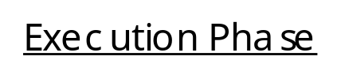
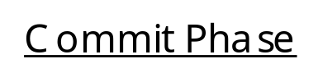








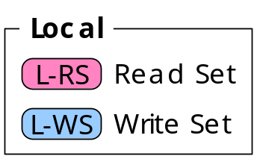









Previous Work: DBX^{EuroSys’14}
    HTM-friendly Optimistic Concurrency Control
  Limitation: can not scale out to multiple machines
Notes:
DBX, which is a previous work published in EuroSys 2014 provide a HTM friendly OCC scheme. Like shown in this graph,
It uses HTM in two places.
In the execution phase, it uses HTM to ensure the consistency, which means txn won’t read any object which is partially updated by others.
In the commit phase, it uses HTM to protect the whole validation and update, which ensures the txn atomicity and isolation.
However, we can not use this scheme directly since it is not designed to scale out for multiple machines.

Slide 11


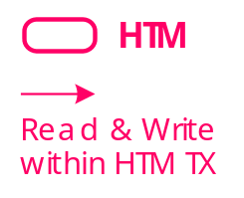



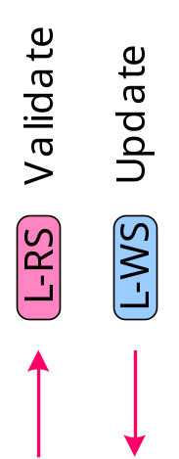



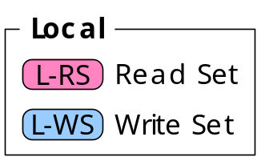
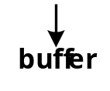

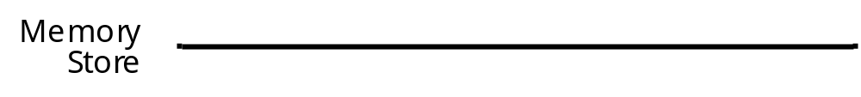
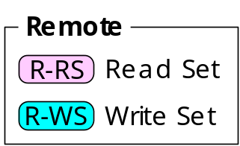


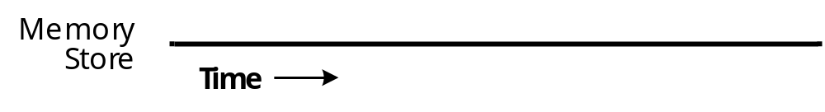
First Attempt
    Use RDMA to fetch and commit remote records
Notes:
We make our first attempt based on the DBX’s scheme.
In the execution phase, we use RDMA to fetch the remote records.
In the commit phase, we use RDMA to do the validation and update the remote records.

Slide 12
Challenge #1: Restriction of HTM
    HTM is only a compelling hardware feature for single machine platform
    Some instructions & system events (e.g. network I/O) will unconditionally abort HTM transactions
    Like any RDMA ops: READ/WRITE, CAS, SEND/RECV
Notes:
However, this design directly reveals our first challenge: Restriction of HTM.
HTM is only a compelling hardware feature for single machine platform. Some instructions & system events will unconditionally abort HTM transactions. Specifically, any RDMA ops will abort the HTM transcation.

Slide 13
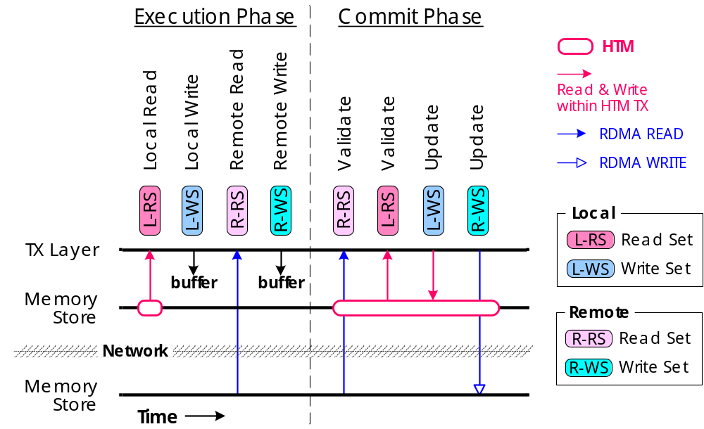

Challenge #1: Restriction of HTM
    RDMA ops will abort HTM transactions
Notes:
Under this restriction, both the validation and the update in the commit phase will unconditionally abort the transaction.
Thus these two can not reply on the HTM to provide atomicity and isolation.

Slide 14
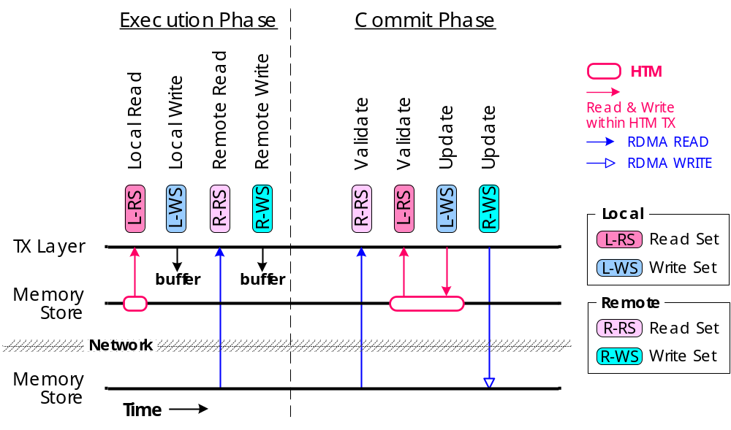

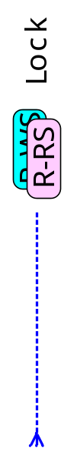




Combining OCC with locking
    Introduce a RDMA-based locking prior to the commit phase
Notes:
Our solution is to introduce a RDMA-based locking before the commit phase.
We add a lock bit to each of our object.
Then we use RDMA CAS to lock the object before the commit phase and unlock it afterwards.
The lock / unlock process will ensure the exclusive commit between two remote transactions.
Further, we explicitly check the lock bit when updating the local objects. And abort the HTM if the lock bit is set. In this way, we ensure the exclusive commit between local and remote transactions.
Notice that the locking phase is happened in the commit phase. As we should have known the read / write sets in the execution phase, we do not require the these knowledge in advance.

Slide 15
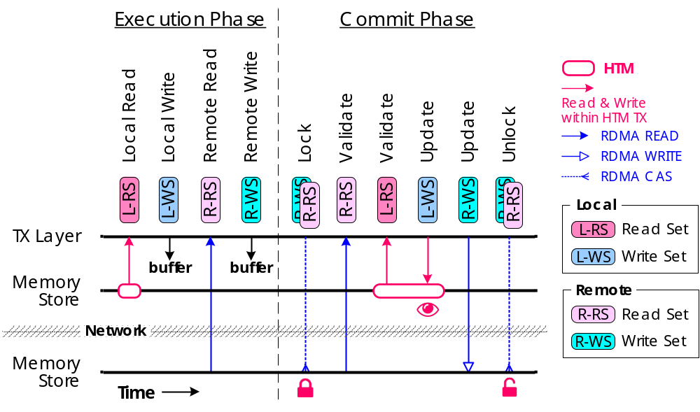

Challenge #2: Consistency of RDMA
Notes:
Based on this fact, we find that both the local and remote read ops are not consistent any more.

Slide 16
Challenge #2: Consistency of RDMA
    One-sided RDMA ops are only cache-coherent within a single cache line
    One RDMA op is multiple sub-ops to the target machine
    The consistency of multiple sub-ops is NOT guaranteed
Notes:
This check further reveals the second challenge in our design: the consistency of RDMA.
One-sided RDMA ops are only cache-coherent within a single cache line.
Specifically, this means one RDMA read or write op could be multiple sub-ops to the target machine.
Although the sub-op itself is cache coherent with the target machine, the consistency of multiple of them are not ensured.

Slide 17
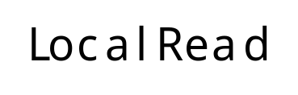





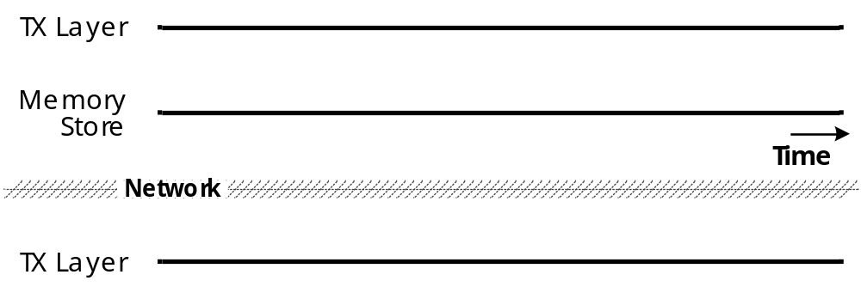
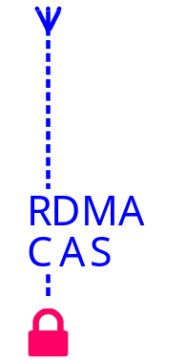
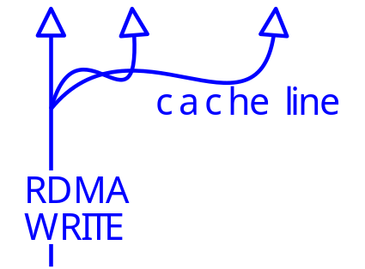
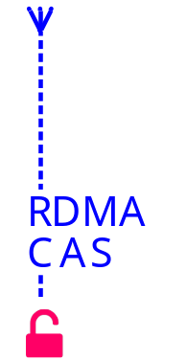

Challenge #2: Local Read Consistency
Notes:
We look into it closely. Like shown in this figure. A remote machine commits its RDMA write to multiple cache lines.
And this single RDMA write is splits to three sub ops to the target machines.
We check the consistency by considering different local reads happened in different times.

Slide 18



Check the lock in Local Read
Notes:
We look into it closely. Like shown in this figure. A remote machine commits its RDMA write to multiple cache lines.
And this single RDMA write is splits to three sub ops to the target machines.
We check the consistency by considering different local reads happened in different times.

Slide 19
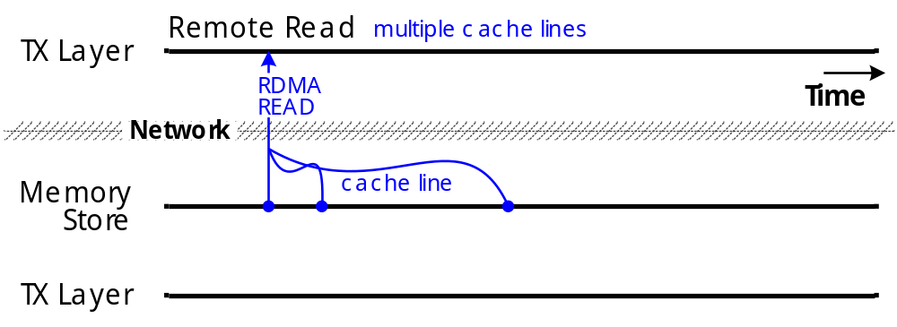

Challenge #2: Remote Read Consistency
Solution: Versioning (similar to FaRM^{SOSP’15})
Notes:
For the remote read case, as shown in this figure, one machine issues a remote read to multiple cache lines using the RDMA.
According to the fact, the request will actually be split into multiple sub-reqs to the target machines.
Suppose the RDMA read first read the first cache line. Which is marked as blue in this figure.
Before the second read and third read starts, an local update successfully updates the three cache lines so the last two read will read
Newly updated cachelines, which is marked as red in this figure.
As a result, this rdma read will be considered as inconsistent.

Slide 20
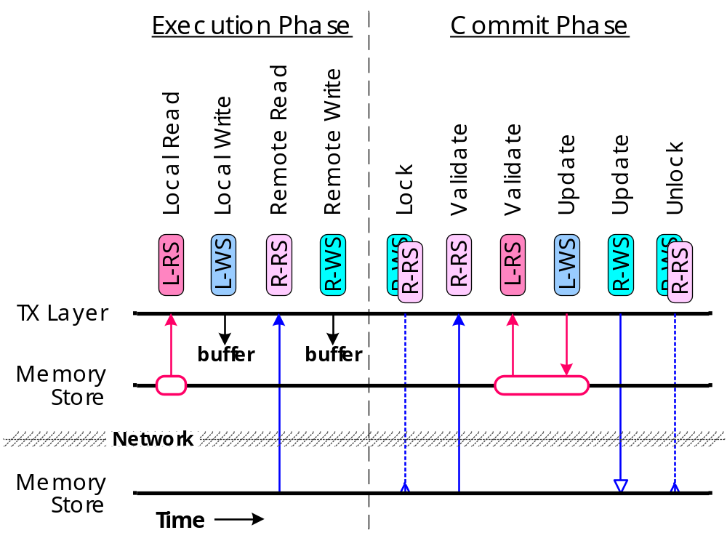



Concurrency Control Summary
ISOLATION | COMMIT/L | COMMIT/R
COMMIT/L | HTM
COMMIT/R |  | Lock
ISOLATION | COMMIT/L | COMMIT/R
COMMIT/L | HTM
COMMIT/R
ISOLATION | COMMIT/L | COMMIT/R
COMMIT/L | HTM | HTM + Check
COMMIT/R | HTM + Check | Lock
CONSISTENCY | COMMIT/L | COMMIT/R
READ/L | HTM | HTM + Lock
READ/R | Version | Version
CONSISTENCY | COMMIT/L | COMMIT/R
READ/L | HTM
READ/R
CONSISTENCY | COMMIT/L | COMMIT/R
READ/L | HTM
READ/R
version
Notes:
So here we have a short summary of our concurrency control.
By locking the objects before commit and check the lock in HTM, we ensure the transaction’s isolation property.
By checking the lock during read and add version to the objects, we ensure the consistency of transaction.

Slide 21
Agenda
  Concurrency Control
  Replication
  Recovery (skip)
  Evaluation
Notes:
Next I will talk about the replication and recovery design.
For the time limitation, I will only talk about how we do the replication, for the recovery details, please refer to our paper.

Slide 22
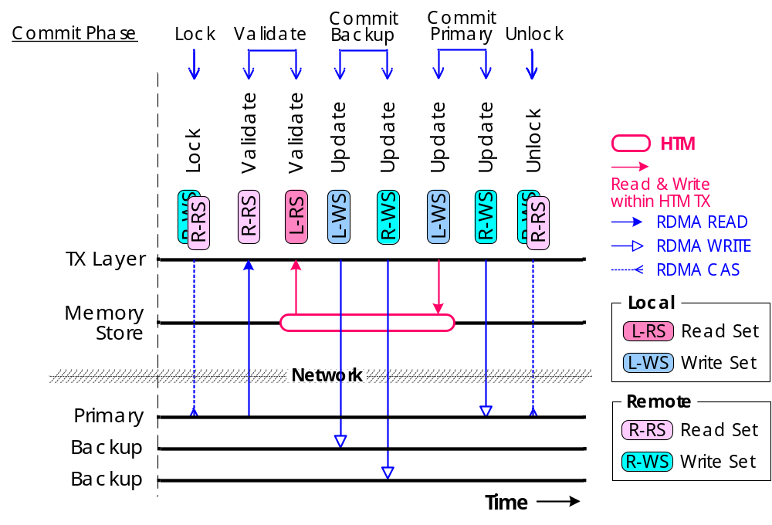
Primary-backup Replication
Notes:
We adopts a primary backup replication for our design, which is similar to FaRM.
Basically the replication consists of the following steps: lock, validate, commit to backups and commit to primaries.

Slide 23
Challenge #1: Restriction of HTM
Notes:
However, simply follows this order won’t work since commit to backups using RDMA will unconditionally abort the transaction.

Slide 24
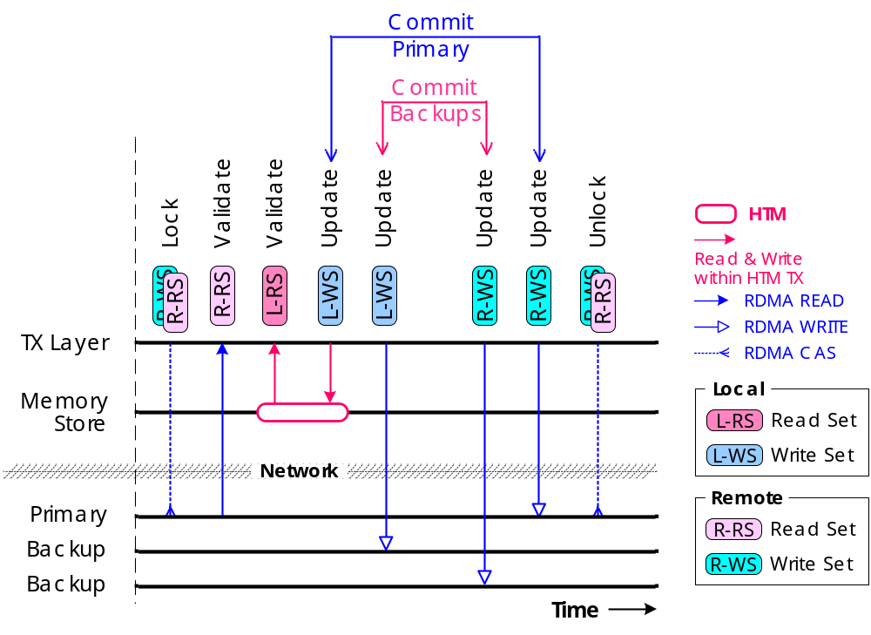
Revision #1: Restriction of HTM
Notes:
So we need to move commit to backups out of the HTM region.

Slide 25
Challenge #2: Visibility of Commit
visible
durable
Notes:
However, this involves our second challenge: the visibility of commit.
On one hand, the partial of the transaction results is visible right after we update the local records.
On the other hand, the transaction is durable until we have successfully commit its backup logs.
Apparently, there is a time gap between the visibility of the commit and durability of the txn. If a system crashed
during this gap, the system may stop in a inconsistent state.

Slide 26
Optimistic Replication Scheme
    Leave all locally written records in an uncommittable status after HTM commits
    Transform to committable status until both primaries and backups of the written records have been applied
    How to diff the committable from uncommittable status？
Notes:
To solve this problem, we adopt an Optimistic Replication Scheme.
It first leave all locally written records in an uncommittable status after HTM commits.
Then transform them to committable status until both primaries and backups of the written records have been applied.
So how we diff the committable from uncommittable status ?

Slide 27
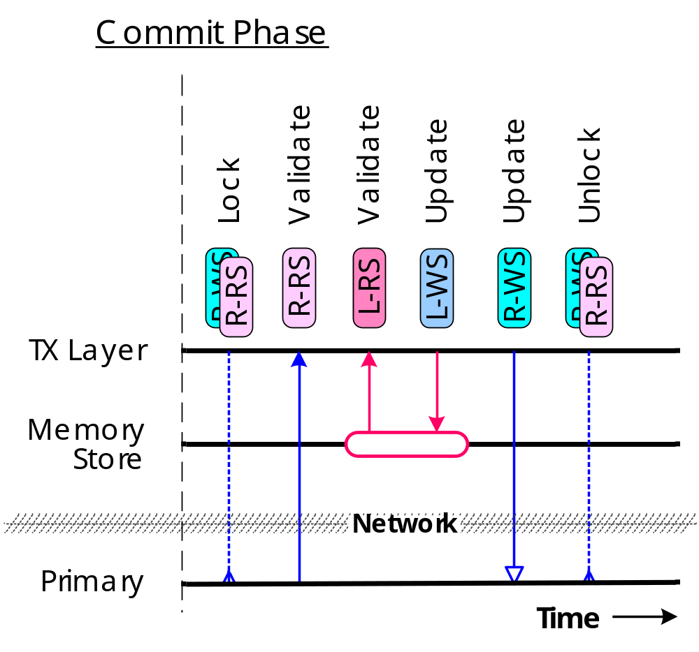
Leverage the Sequence Number
Update
L-WS | SN + 1
R-WS | SN + 1
Validate
R-RS | SN_{old} = SN_{new}
L-RS | SN_{old} = SN_{new}
Notes:
We leverage the sequence number to diff the status.
Originally Sequence Number is used to identify conflict updates.
It is incremented during the updates to both local and remote records and
Is checked in the validation in commit phase.
If the Sequence Number is changed, it means there is a conflict update, so the latter txn can safely abort.

Slide 28
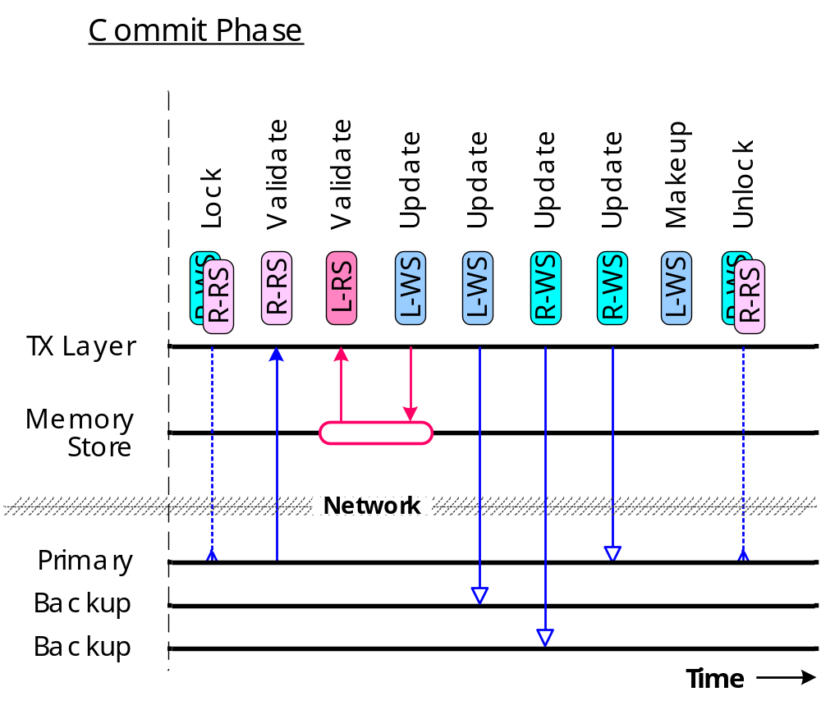
Leverage the Sequence Number
    Even SN = Committed
    Odd SN = Uncommitted
Update
(P) L-WS | SN + 1
(B) L-WS | SN + 2
(B) R-WS | SN + 2
(P) R-WS | SN + 2
Validate
R-RS | SN_{old} / 2 = SN_{cur} / 2
L-RS | SN_{old} / 2 = SN_{cur} / 2
R-WS | SN_{cur} % 2 = 0
R-WS | SN_{cur} % 2 = 0
invisible
durable
Makeup
(P) L-WS | SN + 1
Notes:
We extend the meaning of the Sequence Number: the even SN means a committed state, the odd SN means a uncommitted state.
When commit updates to local records in HTM, we add one to the SN, marking the objects uncommitted.
Any read ops accepts this uncommitted state and pass its validation, however, we add extra validates to writes to ensure not overwriting any uncommitted objects.
Finally, we add a Makeup phase after we successfully commit the primary and backup logs, transit the SN to a committed state.

Slide 29
Agenda
  Concurrency Control
  Replication
  Recovery (skip)
  Evaluation
Notes:
The last part I will talk about the evaluation.

Slide 30
Evaluation
10xCore
10xCore
56GBps IB NIC
RDMA
    Baseline: Calvin (Mar. 2015)
    DrTM (SOSP’15)
    Platforms: A small-scale 6-machine cluster
    Each: two 10-cores, RTM-enabled Intel Xeon E5-2650
    (disabled HT), 64GB DRAM, Mellanox ConnectX-3 MCX353A 56Gbps InfiniBand NIC w/ RDMA¹
    Benchmarks²
    TPC-C
    SmallBank (skip)
40Gbps IB Switch
TPC-C
 | NEW | PAY | DLY | OS | SL
Ratio | 45% | 43% | 4% | 4% | 4%
Type | d+rw | d+rw | l+rw | l+ro | l+ro
SmallBank
 | SP | AMG | BAL | DC | WC | TS
Ratio | 25% | 15% | 15% | 15% | 15% | 15%
Type | d+rw | d+rw | l+ro | l+rw | l+rw | l+rw
¹ All machines run Ubuntu 14.04 with Mellanox OFED v3.0-2.0.1 stack.
² d and l stand for distributed and local. rw and ro stand for read-write and read-only.
Notes:
We compare our system with DrTM and Calvin on two popular OLTP workload: TPC-C and SmallBank.
All experiments are conducted on at a 6-node local cluster with Intel’s RTM processor and RDMA-enabled network.

Slide 31
Performance on TPC-C
NewOrder TX
≈ Standard-mix x45%
NewOrder TX
9.8%
41%
21.5x
Notes:
We first show the performance on TPC-C.
In the left figure shows the scalability in terms of different number of machines.
Overall, DrTM+ can scale very well.
Specifically, compare to DrTM, we trades roughly 9.8% performance for generality.
When enabling the replication, it only incurs up to 41% overhead, and it still can outperform Calvin by up to 21.5x.
In the right figure we show the scalability in terms of different worker threads using 6 machines.
Original DrTM drops over 8 threads due to cross-socket overhead and large working set in HTM.
DrTM+ can scale well up to 16 threads, reaching 9.21x speed up.
When enabling the replication, it stops scaling after 12 threads because the RDMA ops reach the limit of our NIC.

Slide 32
Performance on TPC-C
NewOrder TX
≈ Standard-mix x45%
NewOrder TX
NewOrder TX
9.8%
41%
21.5x
Notes:
We first show the performance on TPC-C.
In the left figure shows the scalability in terms of different number of machines.
Overall, DrTM+ can scale very well.
Specifically, compare to DrTM, we trades roughly 9.8% performance for generality.
When enabling the replication, it only incurs up to 41% overhead, and it still can outperform Calvin by up to 21.5x.
In the right figure we show the scalability in terms of different worker threads using 6 machines.
Original DrTM drops over 8 threads due to cross-socket overhead and large working set in HTM.
DrTM+ can scale well up to 16 threads, reaching 9.21x speed up.
When enabling the replication, it stops scaling after 12 threads because the RDMA ops reach the limit of our NIC.

Slide 33
Impact from Replication
 |  | DrTM+R | DrTM+R=3
Standard-mix (txns/sec) |  | 3,308,555 | 1,849,224
New-order (txns/sec) |  | 1,488,850 | 902,924
Latency (μs) | 50% | 8.93 | 18.98
 | 90% | 26.24 | 55.33
 | 99% | 80.95 | 91.51
Capacity Abort Rate (%) |  | 3.50 | 3.90
Fallback Path Rate (%) |  | 0.67 | 0,68
Overhead
10 ~ 20 μs
Setting: 6 machines with 8 threads
Notes:
To investigate the performance cost for replication, we evaluate
how throughput and latency changes for TPC-C with
3-way replication. Table 6 shows the performance difference
on 6 machines and each with 8 threads. Due to additional
RDMA WRITEs to backups for 3-way replication, the
throughput of the new-order transaction on DrTM+R drops
by 40% and the latency increases 10-20μs. However, we can
see that the rate of validation abort and executing fallback
handler is almost no change, since replicating log to backups
is outside the HTM transaction and does not impact read
validation.

Slide 34
Conclusion
New hardware technologies open opportunities
DrTM+R
    : In-memory transaction system leverages advanced hardware features like HTM and RDMA
    Preserving generality and providing high-availability
  Hybrid OCC Protocol
  Optimistic Replication
    Achieving orders-of-magnitude higher throughput
    and lower latency than prior general designs

Slide 35






Thanks
Questions
R
DrTM+R
http://ipads.se.sjtu.edu.cn/drtm
Institute of Parallel and Distributed Systems
Notes:
That’s all.
Thanks for your listening.

Slide 36
Backup

Slide 37
Recovery
20ms
recovery-done
12ms
config-commit
suspect
Notes:
For those who are curious, even though I didn’t talk about the recovery part due to the time limitation, we do have a evaluation on the recovery in our paper.

Slide 38
Scalability on TPC-C
Each logical machine has fixed 4 threads
LM
LM
LM
LM
10xCore
10xCore
NewOrder TX
NOTE: the interaction btw. two logical nodes sharing the same machine still uses our RDMA-friendly OCC protocol
Notes:
To overcome the restriction of existing cluster size, we use 4 logical machines on one physical machine to
each of which has fixed 4 worker threads. As shown in the figure, DrTM+ can scale well on 24 logical machines.

Slide 39
Impact from Distributed Transaction
Notes:
We further investigate the performance of DrTM+ for distributed transactions.
We adjust the probability of cross-warehouse accesses for new-order transactions from 1% to 100%.
The figure shows that the performance gap between DrTM+ and DrTM becomes narrow with increasing distributed
transactions, since both of them adopts a similar mechanism to update remote records.

Slide 40
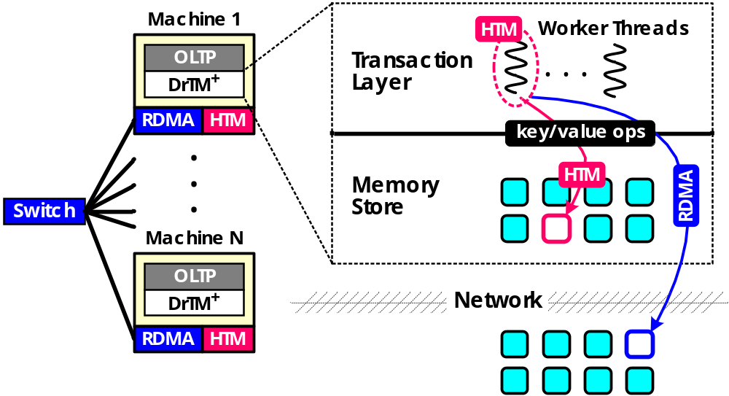
System Overview
DrTM+R
    General TX processing with high availability
    Target: OLTP workloads over large volume of data
    Two independent components using HTM & RDMA
Notes:
The goal of our system is to provide general tx processing with high availability. It targets the traditional OLTP workloads over a large volume of data. It is comprised of two independent components: the transaction layer and the memory store layer
In this talk, we will focus on how to design the transaction layer to overcome the limitations.
If you are interested in the memory store layer, we have put that details in our paper.

Slide 41
Impact from Data Size
Notes:
We further investigate the performance of DrTM+ for distributed transactions.
We adjust the probability of cross-warehouse accesses for new-order transactions from 1% to 100%.
The figure shows that the performance gap between DrTM+ and DrTM becomes narrow with increasing distributed
transactions, since both of them adopts a similar mechanism to update remote records.

