Slide 1


FlexGraph: A Flexible and Efficient Distributed Framework for GNN Training
EuroSys ’21, Online, UK
Lei Wang¹, Qiang Yin¹, Chao Tian¹, Jianbang Yang^{1,2}, Rong Chen²,
Wenyuan Yu¹, Zihang Yao^{1,2}, Jingren Zhou¹
¹Alibaba Group ²Shanghai Jiao Tong University

Slide 2
A Flexible Programming Abstraction
for GNNs

Slide 3
What is graph neural network?
Graph Neural Networks (GNNs)
  Neural message passing framework
  Each vertex aggregates features of its “neighbors”→ neighborhood feature
  Update its feature by combining its own old feature and neighborhood feature
Definition of “neighbors”
Aggregation schemes

Slide 4
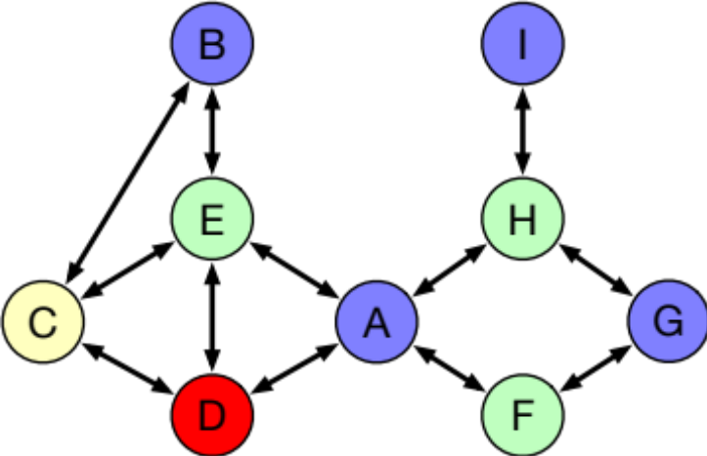
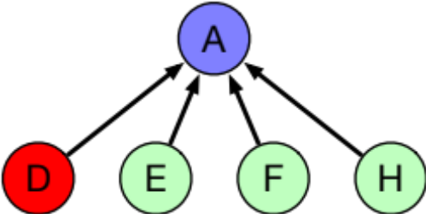
Categorization of GNNs
Direct neighbors with flat aggregation, DNFA model
  1-hop direct neighbors
  Single-step aggregation operation
GCN
Target vertex
Vertex A sums their features.
1-hop neighbors.

Slide 5
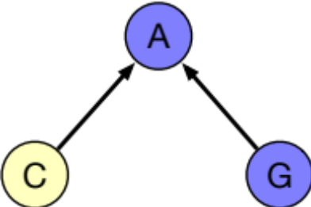
Categorization of GNNs
Indirect neighbors with flat aggregation, INFA model
  Neighbor: a vertex from a nearby subgraph
  Single-step aggregation operation
PinSage
Target vertex
Vertex A sums their features.
The top-k visited vertices in several random walks starting from it.

Slide 6
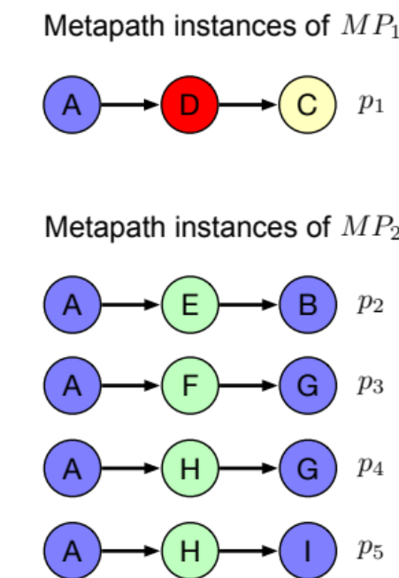


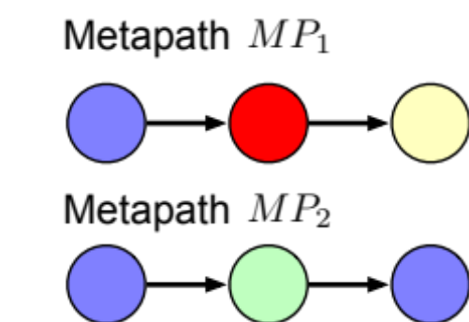

Categorization of GNNs
Indirect neighbors with hierarchical aggregation, INHA model
  Neighbor: any graph-structured data
  Multi-step aggregation operation
MAGNN
Features of each metapath instance
Features of each metapath type
Neighborhood feature for vertex A
Target vertex

Slide 7
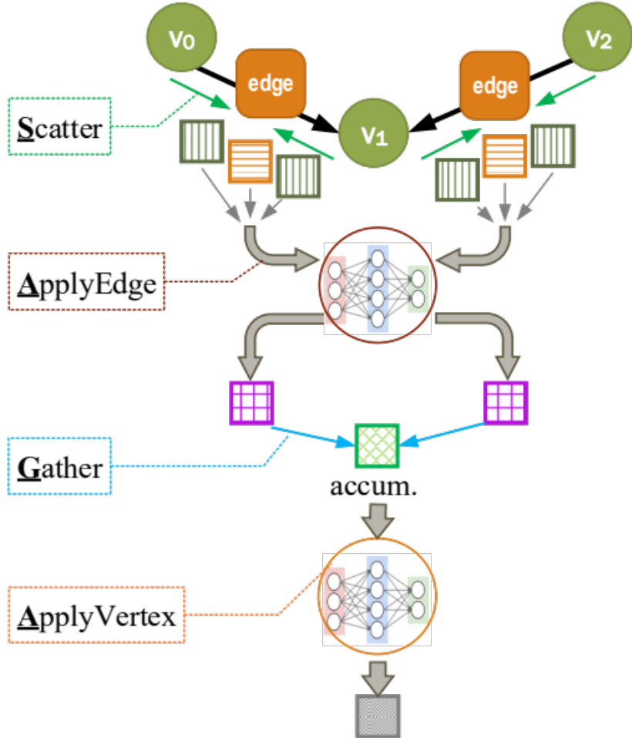
Existing Solutions
GAS-like programming abstractions
  e.g., SAGA-NN
  Only support 1-hop neighbors.
  Single-step aggregation.
Designed for the DNFA category only.
A programming model supporting for all types of models is highly desired.
This figure is from NeuGraph.

Slide 8
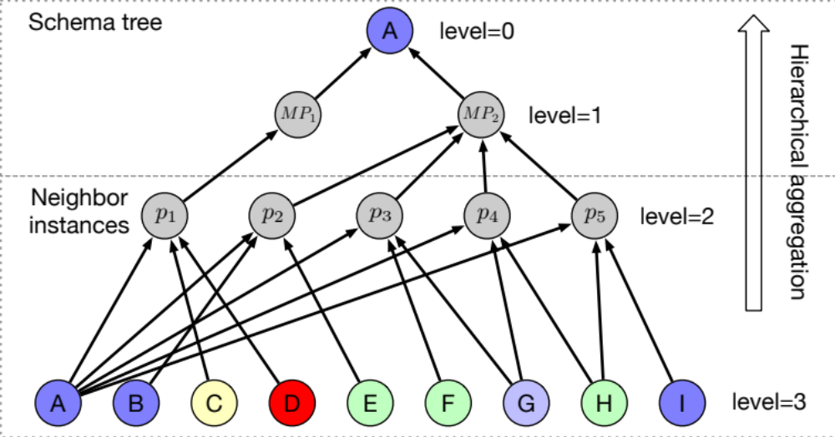
Hierarchical Dependency Graph
Capture hierarchical dependencies among vertices
  Hierarchical structure
  The top and bottom levels contain vertices from the input graph
  Two parts: a schema tree and a set of neighbor instances

Slide 9
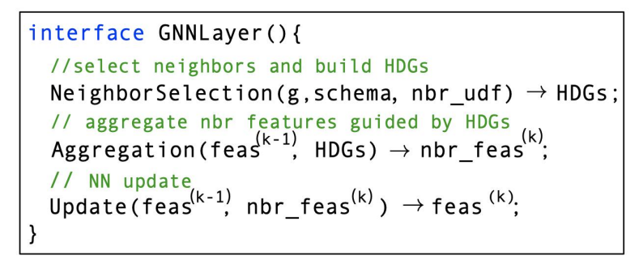
NAU Programming Abstraction
NeighborSelection
  Given a schema tree, how each vertex retrieves its “neighbors” from the input graph
  Build HDGs
Aggregation
  Multi-step aggregation operations is executed in a bottom-up way
Update

Slide 10
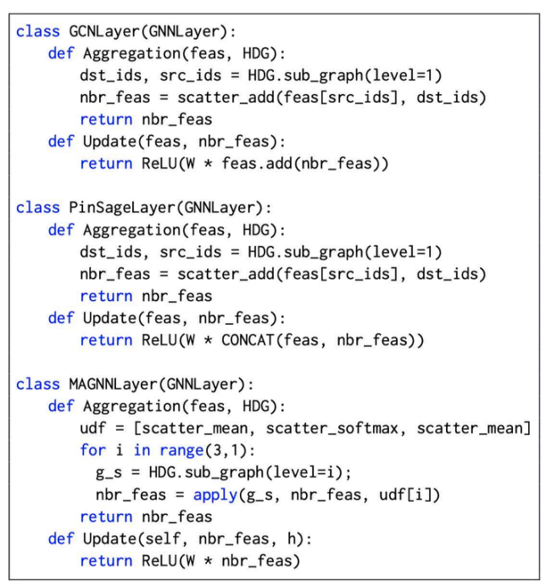
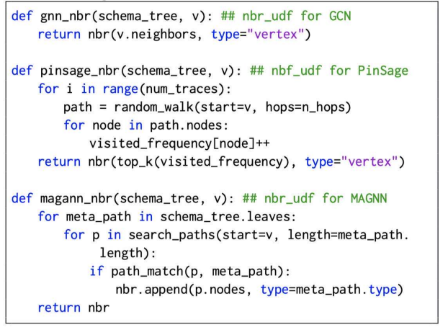
Example Implementations
Implement a UDF
for each neighbor type
Provide an aggregation function for each level of HDGs.
NeighborSelection
Aggregation and Update

Slide 11
Efficient GNN Training

Slide 12
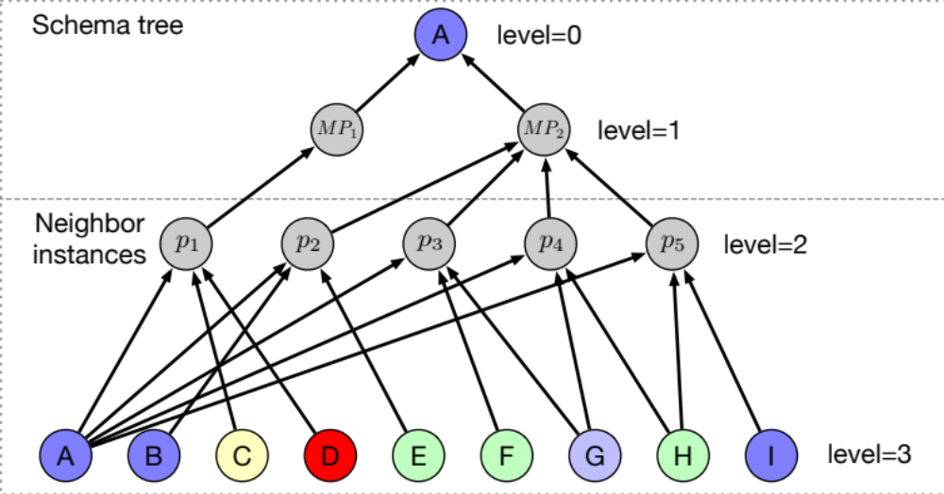
Hybrid Execution
HDGs
  Different levels have unique properties
  A hybrid processing strategy for hierarchical aggregation
All vertices share the same schema tree structure.→ Dense tensor operation.
Each vertex has only one incoming edge.→ Sparse tensor operation.
Each vertex has multiple incoming edges.→ Feature fusion operation.

Slide 13
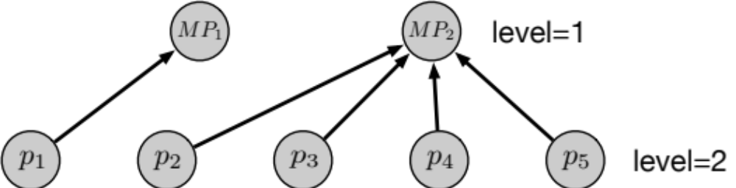
Sparse Tensor Operation
Sparse tensor operation
  Each vertex sends its feature to its outgoing edges as edge features.
  Each vertex collects its neighbors’ features through its incoming edges.
  Edge features are explicitly materialized.

Slide 14
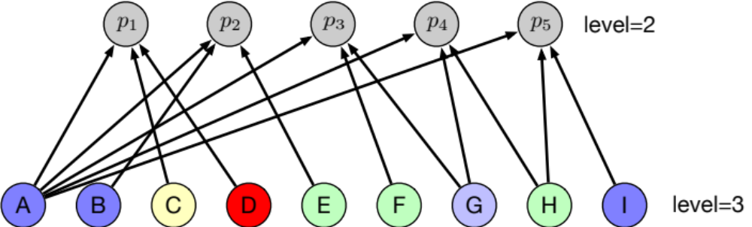
Feature Fusion Operation
Sparse tensor operation will lead to memory explosion
  Each vertex has multiple incoming edges.
Feature fusion operation
  Each thread first loads the features of vertices of level max_level;
  Then performs the aggregation and appends the results to the buffers w.r.t. the designated destination vertices at level max_level − 1.

Slide 15
Dense Tensor Operation
Very efficient in current NN frameworks
  Require a regular form of the input
  All vertices share the same schema tree structure

Slide 16
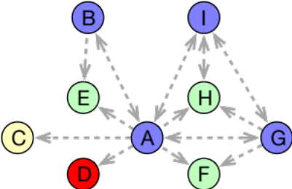
Workload balancing
Current methods
  Conventional graph partitioning on the input graph
  Static metrics, e.g., vertex weight or edge weight
Our method
  Based on an induced graph
  A cost function to characterize the training cost of each vertex
  Application-driven strategy[1]
  [1] Application Driven Graph Partitioning, SIGMOD 2020

Slide 17

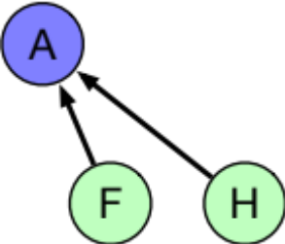

Pipeline Processing
Overlap partial aggregations and communications
  The aggregation function is commutative
Machine 0
Machine 1

Slide 18
Evaluation
Performance of single machine
OOM：Out-of-memory
X ：Not implemented

Slide 19
Evaluation
Performance of multiple machines

Slide 20
Evaluation
Hybrid aggregation
SA: Sparse tensor operation.
SA+FA: sparse tensor operation + feature fusion operation
HA: Hybrid aggregation

Slide 21
Evaluation
Workload & Pipeline Processing

Slide 22
Q & A
Thanks!

