Slide 1

RedBlue
江学强 李新锐 王天下 柳清源 李泽斌
2021.03.08
上海交通大学并行与分布式系统研究所（IPADS@SJTU）

Slide 2
Outline
Part I Paper Presentation
Part II Demo Presentation
Notes:
我们的今天的展示分为Paper和Demo2个部分

Slide 3

Part I: Paper Info – OSDI’12
Notes:
这是发表在OSDI’12 上的工作

Slide 4

Geo-replication is needed
Notes:
异地备份、异地多活的机制已经广泛应用在各大厂商的服务中。保证每个用户都能从最近的站点上获取服务的同时，各个站点之间consistency一致性的保障就成为这个模式下关注的重点。

Slide 5
Distributed systems care about performance and consistency
Performance:
  Good performance means low latency responses to user requests
Consistency: restricts order of operations in the system
  Stronger consistency makes system behavior more intuitive and predictable
Notes:
Decomposition的设计点主要有以下几点
2. 如何进行decomposition，是手动剥离代码，还是借助工具剥离。不同的方法会使得communication接口和实现不同
3. 使用什么隔离机制，通常可以分为如下4种隔离机制

Slide 6
Problem: Consistency contradicts with performance
Strong consistency:
eg: linearizability
Executed in the same order at all sites
High latency
Weak consistency:
eg. Eventual consistency
Order of execution can vary from site to site
Low latency

Slide 7
How to trade off between consistency and performance?

Slide 8
Contribution: RedBlue Consistency
Fast as possible, consistent when necessary
Approach:
  Mixing strong and eventual consistency in a single system
Notes:
Decomposition的设计点主要有以下几点
2. 如何进行decomposition，是手动剥离代码，还是借助工具剥离。不同的方法会使得communication接口和实现不同
3. 使用什么隔离机制，通常可以分为如下4种隔离机制

Slide 9
Method: explicitly divide operations by their needs of consistency
Red operations:
Apply strong consistency
Total ordered
Blue operations:
Apply weak consistency
The division of operations is done manually according to operation semantics

Slide 10
Properties of RedBlue consistency
Causality: the system guarantees causality even for blue operations
Convergence: the system finally reach same state
Correctness: the system is always in valid state

Slide 11
Challenge
How to specify the color of operation?

Slide 12
A Bank Operations Example
float balance, interest = 0.05;
func deposit( float money ):
balance += money
func accrueinterest():
float delta = balance × interest;
balance += delta;
func withdraw ( float money ):
if balance >= money then:
balance -= money;
else
print "failure";

Slide 13
An optimistic division
float balance, interest = 0.05;
func deposit( float money ):
balance += money
func accrueinterest():
float delta = balance × interest;
balance += delta;
func withdraw ( float money ):
if balance >= money then:
balance -= money;
else
print "failure";

Slide 14
Fail: state may not converge
Balance: 100
deposit(20)
Balance: 100
accrueInterest
+20
+5
Balance: 120
accrueInterest
Balance: 105
deposit(20)
+6
+20
Balance: 126
Balance: 125
Not Converge

Slide 15
Observation 1. Blue operation must be commutable (可交换的）
A commutable operation has same effect whenever it executes on each machine
The effect of accrueInterest varies according to the local balance of each machine at execuation time
Balance: 100
deposit(20)
Balance: 100
accrueInterest
+20
+5
Balance: 120
accrueInterest
Balance: 105
deposit(20)
+6
+20
Balance: 126
Balance: 125

Slide 16
Solution 1. split the operation into two parts
Generation operation:
  calculate the change of state basing on current state of initiator
Shadow operation:
  execution the modification on both initiator and remote machines

Slide 17
Modified Bank Operations
func deposit( float money ):
balance += money
func accrueinterest():
float delta = balance × interest
balance += delta
func withdraw ( float money ):
if balance >= money then:
balance -= money
else
print "failure"
func deposit’( float money ):
balance += money
fun accrueinterest’(float delta):
balance += delta
func withdrawAck’( float money ):
balance -= money
func withdrawFail’()
print "failure"

Slide 18
Now, state will converge
Balance: 100
deposit(20)
Balance: 100
accrueInterest
(5)
+20
+5
Balance: 120
accrueInterest(5)
Balance: 105
deposit(20)
+5
+20
Balance: 125
Balance: 125

Slide 19
However, it is not yet correct
Balance: 125
withdraw(70)
Balance: 125
withdraw(60)
withdrawAck’(70)
withdrawAck’(60)
Balance: 55
withdrawAck’(60)
Balance: 65
withdrawAck’(70)
Balance: -5
Balance: -5

Slide 20
Observation 2. Blue operation must not break system invariant
A deposit account balance should be non-negative, while withdrawAck may break it
Balance: 125
withdraw(70)
Balance: 125
withdraw(60)
withdrawAck’(70)
withdrawAck’(60)
Balance: 55
withdrawAck’(60)
Balance: 65
withdrawAck’(70)
Balance: -5
Balance: -5

Slide 21
What this paper proposes ?
RedBlue Consistency
  Mixing strong consistency and eventual consistency
  Red ops to be total ordered
  Blue ops to be fast and eventually consistent
Conditions to Split Red/Blue
Broaden the blue space
  Normal Ops → Generator/Shadow ops
Notes:
怎么样在一致性和性能之间达到一个好的平衡呢，之前已经有工作提出让operation之间有不同的consistency level，但是这需要开发者需要非常地理解这些不同的consistency model，在开发时精心选择，即便这样也很容易出错。
本文主要做了3点贡献
提出了一个red/blue一致性模型
确定了red/blue 操作划分的条件和标准
最后是尽可能将更多的操作划分为blue ops，并以此来增加性能表现

Slide 22
So we make withdrawAck Red to enforce strong order for this op.
Balance: 125
withdraw(70)
withdrawAck’(70)
Balance: 55
Balance: 125
withdrawAck’(70)
Balance: 55
withdraw(60)
withdrawFail’(60)
Balance: 55

Slide 23
Summary: Workflow of coloring operations
A shadow operation u
Commutable?
No
Yes
Break invariant?
Yes
No
Red
Blue

Slide 24
Implementation

Slide 25
Prototype organization
Storage engine (MySQL)
Proxy server
Coordinator
Data writer
Replicate single site across multiple sites

Slide 26
Concurrency coordinator
Use timestamp to coordinate between sites
  <<b₀,b₁,…,b_{k-1}>,r>
  b_{i}: local count of shadow ops initially executed at site I
  r: global count of red shadow ops
OCC for local concurrency control

Slide 27
How the timestamp works?

Slide 28
For primary site
If red: wait if without the global red token
And this will not block other blue ops at this site
Else:
Read the timestamp and do the generation op
Before doing shadow, check the timestamp now(OCC)
Abort or Finish, and then do the shadow op, update timestamp
Send the shadow op with updated timestamp to other sites

Slide 29
For other sites(op from site i to site j)
If red: wait for the global red token
And this will not block any blue op
Else:
Block this op until:
b_{i}(or r) of T_{j} equals b_{i}-1(or r – 1) of T_{i} and
Any other elements of T_{j} not less than T_{i}
Do the operation and update local timestamp

Slide 30
Evaluation

Slide 31
Questions to answer
How common are blue operations?
Does RedBlue consistency improve latency?
Does throughput scale?

Slide 32
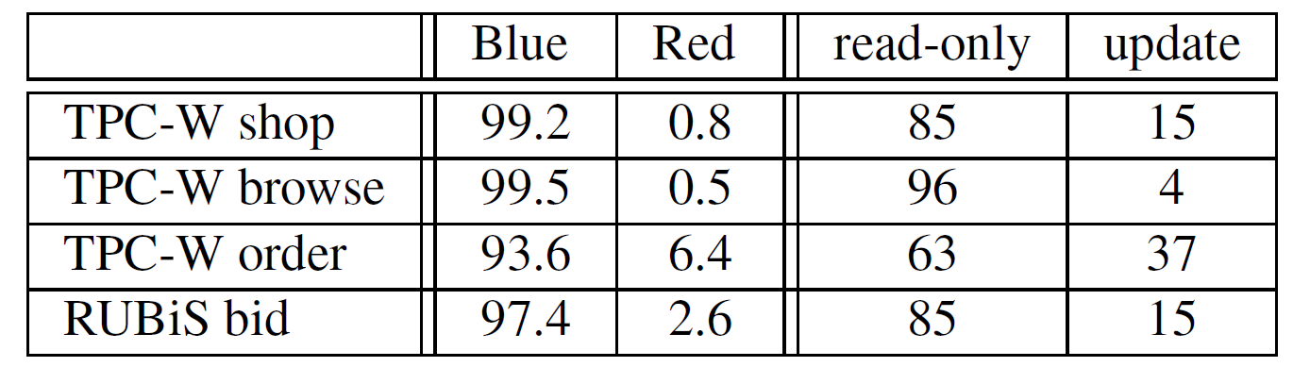
Blue operations are common

Slide 33
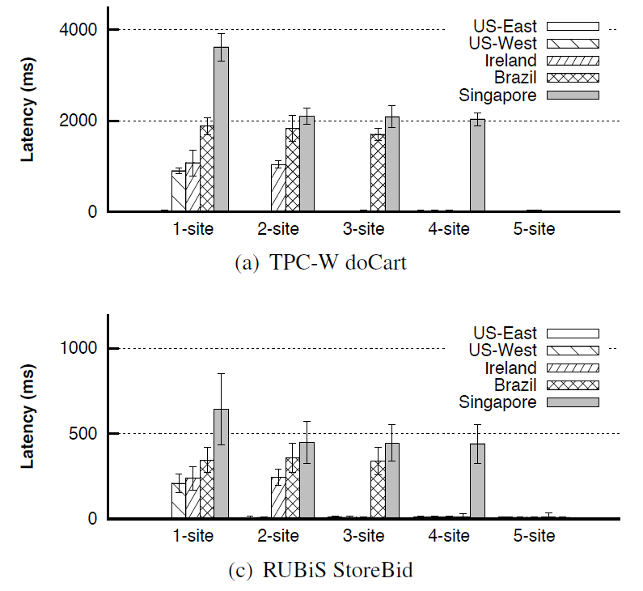
Excellent when always Blue

Slide 34
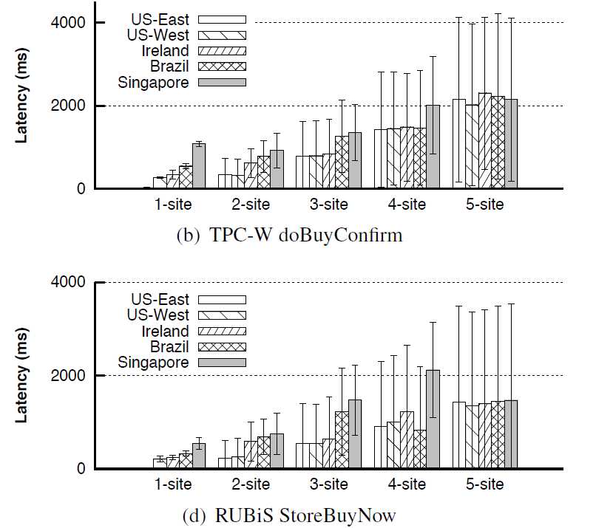
Depressing when always Red

Slide 35
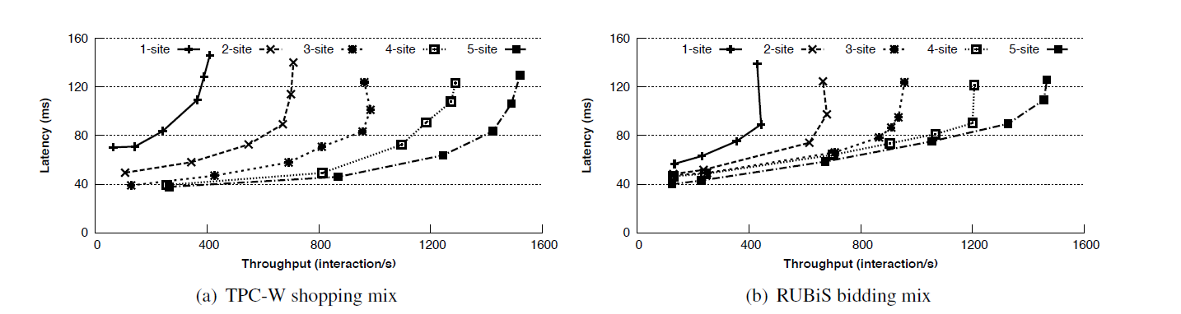
Throughput can scale

Slide 36
Thanks & QA

Slide 37
Demo

Slide 38
记法
(0, 0, 0)
withdraw(51)
Balance: 100
(1, 0, 2)
Balance: 10
-51 (0, 0, 1)
+5 (0, 1, 0)
(0, 0, 1)
Balance: 49
(1, 1, 2)
Balance: 15
操作的编号
(1, 0, 2) 状态编号
+
(0, 1, 0) 操作编号
=
(1, 1, 2) 新操作编号
状态的编号

Slide 39
记法
(1, 0, 2)
Balance: 10
(1, 0, 2)
Balance: 10
+5 (2, 1, 0)
+5 (0, 2, 0)
(1, 1, 2)
Balance: 15
(1, 1, 2)
Balance: 15
(1, 0, 2) 状态编号
+
(2, 1, 0) 操作编号
=
不能相加
(1, 0, 2) 状态编号
+
(0, 2, 0) 操作编号
=
不能相加

Slide 40
简单demo

Slide 41
Alice in EU
Bob in US
Balance: 100
withdraw(51) 取51
withdraw(51) 取51

Slide 42
(0, 0, 0)
Balance: 100
(0, 0, 0)
withdraw(51)
Balance: 100
-51 (0, 0, 1)
-51 (0, 0, 1)
(0, 0, 1)
Balance: 49
withdraw(51)
(0, 0, 1)
Balance: 49
withDrawFail(51) (1, 0, 1)
withDrawFail(51) (1, 0, 1)
(1, 0, 1)
Balance: 49
(1, 0, 1)
Balance: 49

Slide 43
复杂demo

Slide 44
Alice in EU
Bob in US
Balance: 100
deposit(20) 存20
↓
withdraw(70) 取70
↓
withdraw(40) 取40
accrueInterest() 加5%利息
↓
withdraw(60) 取60
↓
deposit(10) 存10
↓
withdraw(30) 取30

Slide 45
剧情1：Bob先操作，Alice后操作

Slide 46
(0, 0, 0)
deposit(20)
(0, 0, 0)
accrueInterest(5)
Balance: 100
Balance: 100
+20 (1, 0, 0)
+5 (0, 1, 0)
(1, 0, 0)
Balance: 120
(0, 1, 0)
withdraw(60)
Balance: 105
+5 (0, 1, 0)
-60 (0, 1, 1)
(1, 1, 0)
Balance: 125
(0, 1, 1)
Balance: 45
deposit(10)
-60 (0, 1, 1)
+10 (0, 2, 1)
(1, 1, 1)
Balance: 65
(0, 2, 1)
Balance: 55
withdraw(30)
+10 (0, 2, 1)
-30 (0, 2, 2)
(1, 2, 1)
Balance: 75
(0, 2, 2)
Balance: 25
-30 (0, 2, 2)
+20 (1, 0, 0)
(1, 2, 2)
Balance: 45
withdraw(70)
(1, 2, 2)
Balance: 45
withdrawFail(70) (2, 2, 2)
withdrawFail(70) (2, 2, 2)
(2, 2, 2)
Balance: 45
withdraw(40)
(2, 2, 2)
Balance: 45
-40 (2, 2, 3)
-40 (2, 2, 3)
(2, 2, 3)
Balance: 5
(2, 2, 3)
Balance: 5

Slide 47
剧情2：Alice先操作，Bob后操作

Slide 48
(0, 0, 0)
deposit(20)
(0, 0, 0)
accrueInterest(5)
Balance: 100
Balance: 100
+20 (1, 0, 0)
+5 (0, 1, 0)
withdraw(70)
(1, 0, 0)
Balance: 120
(0, 1, 0)
Balance: 105
-70 (1, 0, 1)
+20 (1, 0, 0)
(1, 0, 1)
withdraw(40)
(1, 1, 0)
Balance: 50
Balance: 125
-40 (1, 0, 2)
-70 (1, 0, 1)
(1, 0, 2)
Balance: 10
(1, 1, 1)
Balance: 55
+5 (0, 1, 0)
-40 (1, 0, 2)
(1, 1, 2)
Balance: 15
(1, 1, 2)
Balance: 15
withdraw(60)
withdrawFail(60) (1, 2, 2)
withdrawFail(60) (1, 2, 2)
(1, 2, 2)
Balance: 15
(1, 2, 2)
Balance: 15
deposit(10)
+10 (1, 3, 2)
+10 (1, 3, 2)
(1, 3, 2)
Balance: 25
(1, 3, 2)
Balance: 25
withdraw(30)
withdrawFail(30) (1, 4, 2)
withdrawFail(30) (1, 4, 2)
(1, 4, 2)
Balance: 25
(1, 4, 2)
Balance: 25

Slide 49
复杂剧情二则

Slide 50
(0, 0, 0)
deposit(20)
(0, 0, 0)
accrueInterest(5)
Balance: 100
Balance: 100
+20 (1, 0, 0)
+5 (0, 1, 0)
withdraw(70)
(1, 0, 0)
Balance: 120
(0, 1, 0)
Balance: 105
-70 (1, 0, 1)
+20 (1, 0, 0)
(1, 0, 1)
Balance: 50
(1, 1, 0)
Balance: 125
+5 (0, 1, 0)
-70 (1, 0, 1)
withdraw(40)
withdraw(60)
(1, 1, 1)
Balance: 55
(1, 1, 1)
Balance: 55
-40 (1, 1, 2)
withdrawFail(60) (1, 2, 1)
(1, 1, 2)
Balance: 15
(1, 2, 1)
deposit(10)
Balance: 55
withdrawFail(60) (1, 2, 1)
+10 (1, 3, 1)
(1, 2, 2)
Balance: 15
(1, 3, 1)
Balance: 65
+10 (1, 3, 1)
-40 (1, 1, 2)
withdraw(30)
(1, 3, 2)
Balance: 25
(1, 3, 2)
Balance: 25
withdrawFail(30) (1, 4, 2)
withdrawFail(30) (1, 4, 2)
(1, 4, 2)
Balance: 25
(1, 4, 2)
Balance: 25

Slide 51
(0, 0, 0)
deposit(20)
(0, 0, 0)
accrueInterest(5)
Balance: 100
Balance: 100
+20 (1, 0, 0)
+5 (0, 1, 0)
(1, 0, 0)
(0, 1, 0)
withdraw(60)
Balance: 120
Balance: 105
-60
+5 (0, 1, 0)
-60 (0, 1, 1)
(1, 1, 0)
Balance: 125
(0, 1, 1)
Balance: 45
-60 (0, 1, 1)
+20 (1, 0, 0)
withdraw(70)
deposit(10)
(1, 1, 1)
Balance: 65
(1, 1, 1)
Balance: 65
withdrawFail(70) (2, 1, 1)
+10 (1, 2, 1)
(2, 1, 1)
withdraw(40)
Balance: 65
(1, 2, 1)
Balance: 75
-40 (2, 1, 2)
withdrawFail(70) (2, 1, 1)
(2, 1, 2)
Balance: 25
(2, 2, 1)
Balance: 75
+10 (1, 2, 1)
-40 (2, 1, 2)
(2, 2, 2)
Balance: 35
(2, 2, 2)
withdraw(30)
Balance: 35
-30 (2, 2, 3)
-30 (2, 2, 3)
(2, 2, 3)
Balance: 5
(2, 2, 3)
Balance: 5

Slide 52

Thanks

