Slide 1
Aether demo
Notes:
主要是做persistent memory的failure-atomic的

Slide 2
INTRODUCTION

Slide 3
Shore
Shore
  A high-performance, scalable, persistent object repository
  A merger of object-oriented database (OODB) and file system technologies

Slide 4
Shore-MT
Shore-MT
  transactions with ACID properties, with logging and recovery, partial rollback, transaction chaining, early lock release
  two-phased commit
  persistent storage structures
  fine-grained locking for records and B+ tree indexes with deadlock detection
  in-memory buffer management
Notes:
ACID: atomicity, consistency, isolation, durability
persistent storage structures: B+ tree indexes, R* trees (spatial indexes), and files of untyped records

Slide 5

Shore-MT
Shore-MT
  transactions with ACID properties, with logging and recovery, partial rollback, transaction chaining, early lock release
  two-phased commit
  persistent storage structures
  fine-grained locking for records and B+ tree indexes with deadlock detection
  in-memory buffer management
Notes:
ACID: atomicity, consistency, isolation, durability
persistent storage structures: B+ tree indexes, R* trees (spatial indexes), and files of untyped records

Slide 6
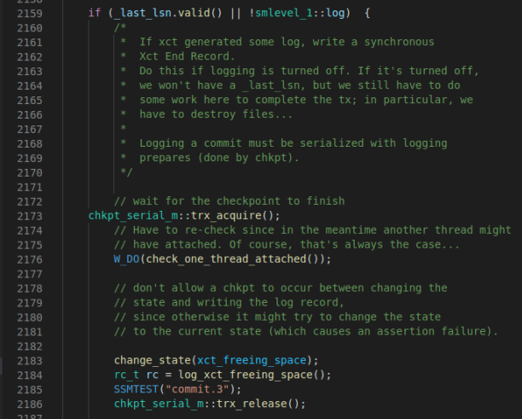
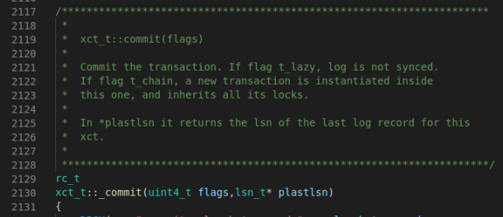
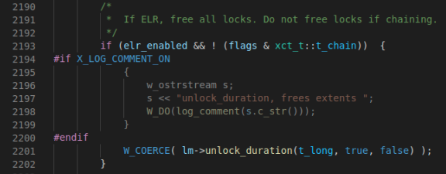
Commit Path

Slide 7
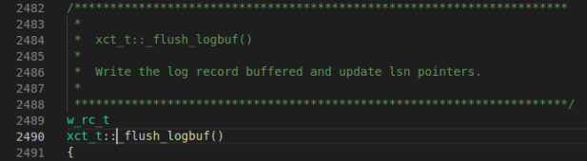
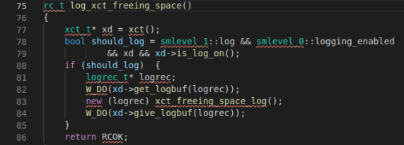
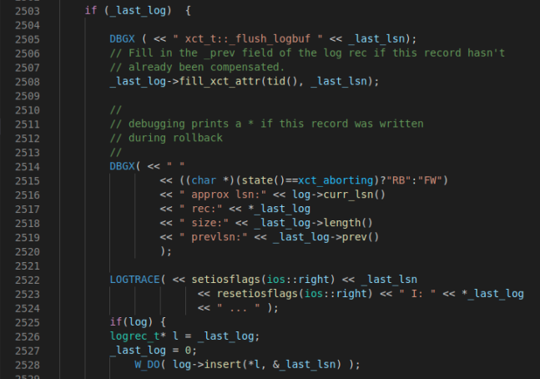

Commit Path

Slide 8
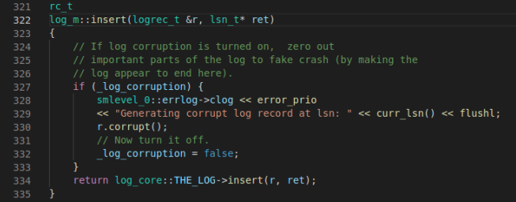
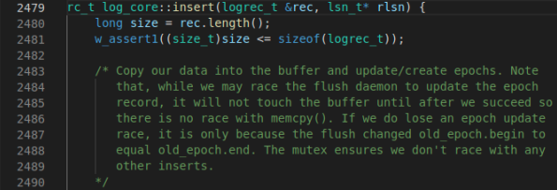
Commit Path

Slide 9
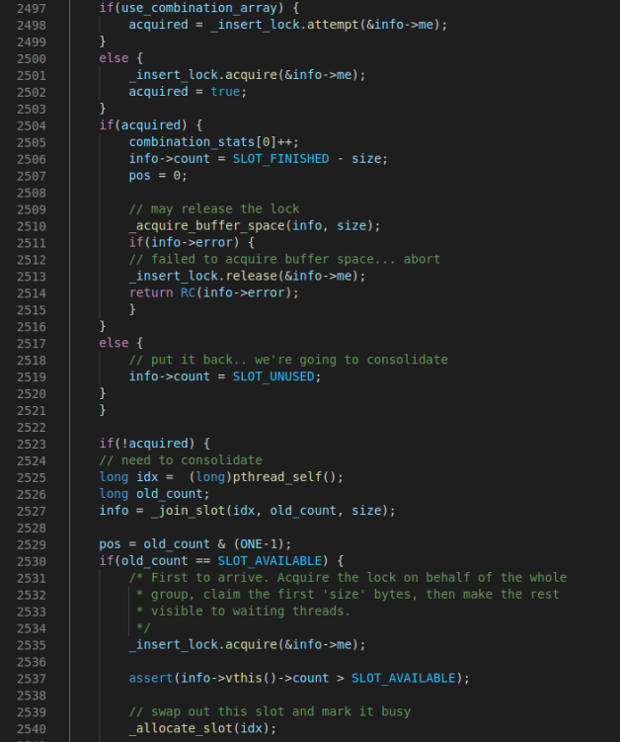
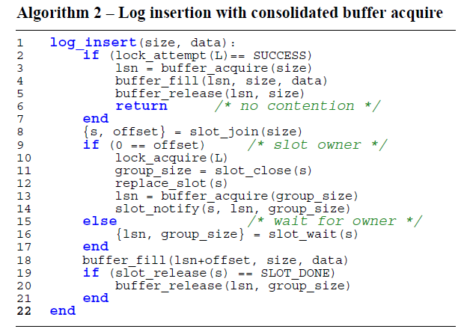
Consolidation array

Slide 10
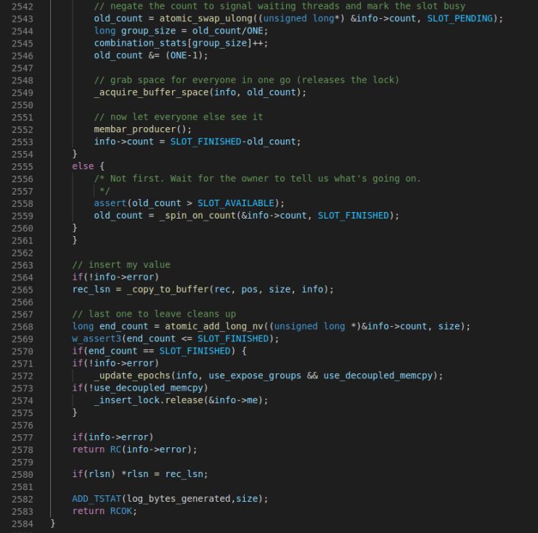
Consolidation array

Slide 11
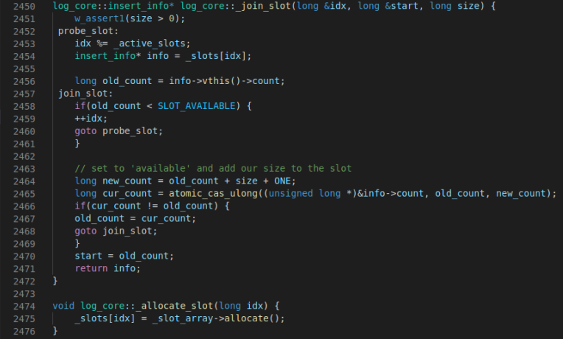
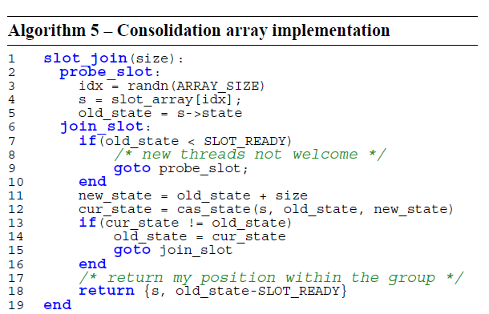
Consolidation array

Slide 12
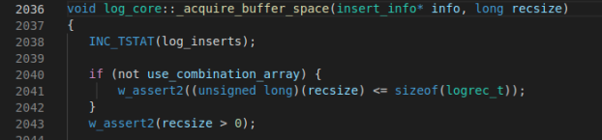
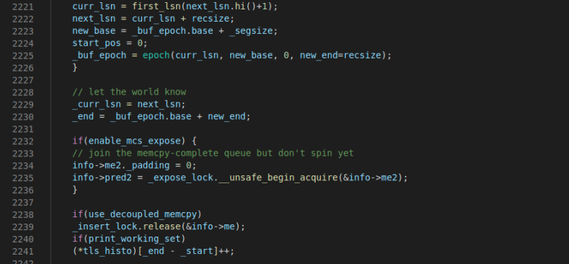
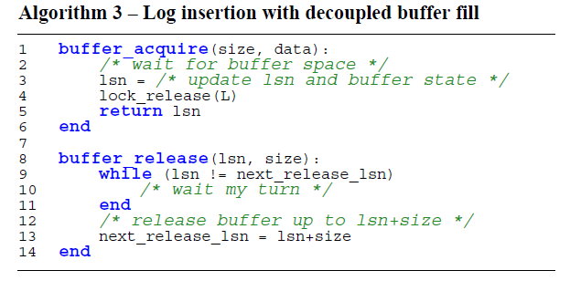
Decoupled Buffer Fill

Slide 13
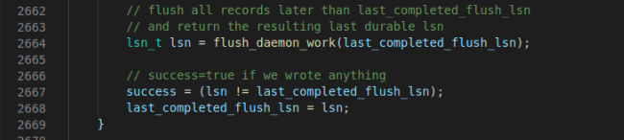
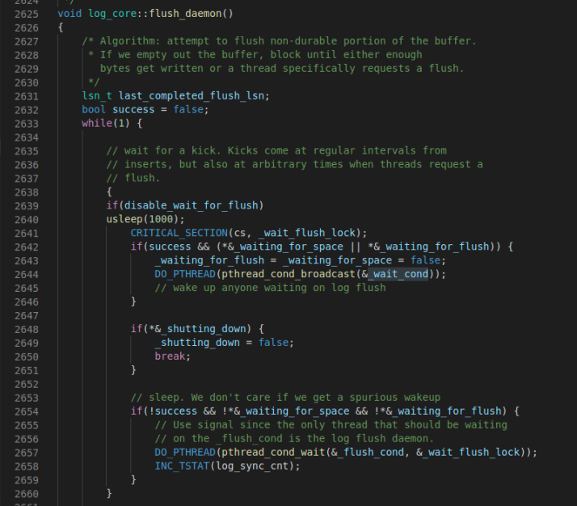
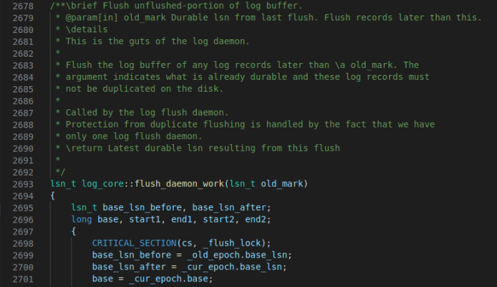
Flush Pipelining

Slide 14
EVALUATION

Slide 15
Evaluation Setup
20-core Intel Xeon CPU 5215M (2.50GHz)
  With Hyperthread
Stroage
  375GB DRAM
  4 x 128GB Optane memory
  1TB Disk
Kernel version 5.8.1

Slide 16
Evaluated systems
Baseline: The original version
ELR: with ELR and flush pipeline
  Because flush pipeline can not be turn on/off by parameter
All: with ELR, flush pipeline and scalable log buffer design
Async: does not wait for the flush returns

Slide 17
Evaluated Benchmark
TPC-B
  AccountUpdate
  MbenchInsertOnly

Slide 18
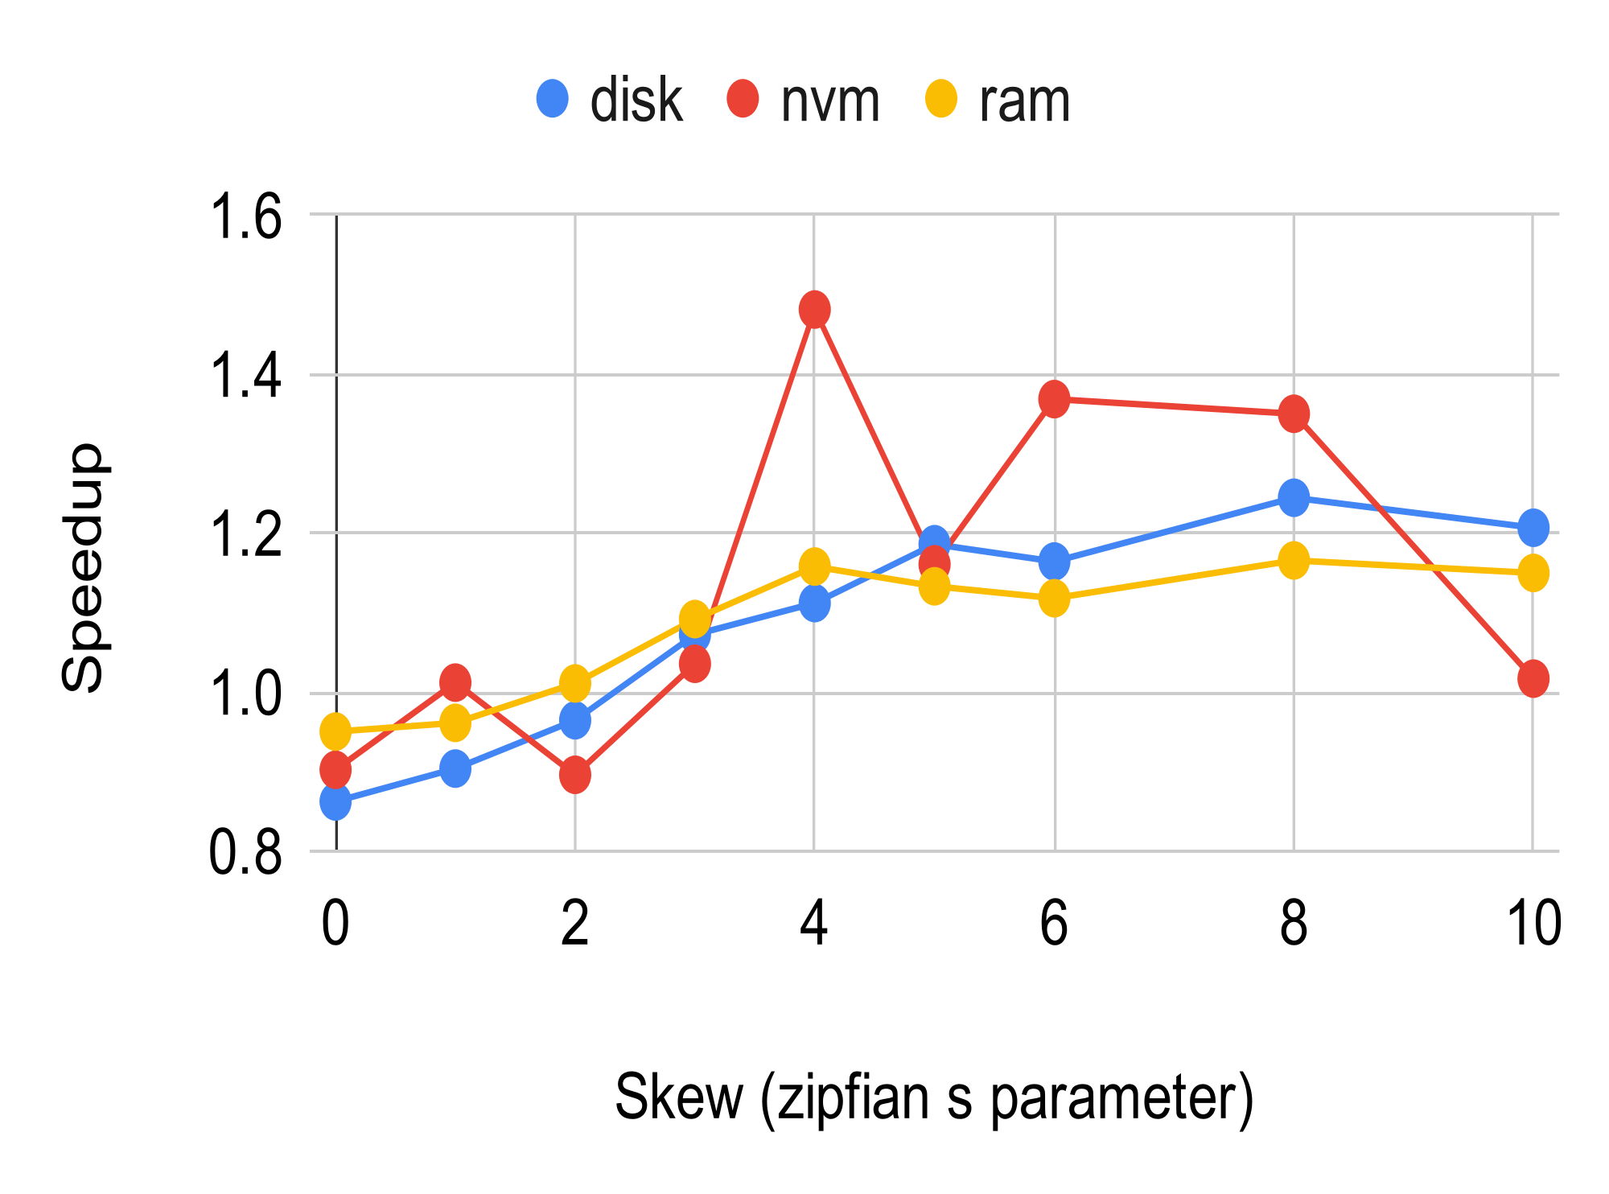
Performance of ELR
Different from the result in the paper
  Maybe due to different workload and environment
TPC-B: AccountUpdate
Notes:
不知道咋解释

Slide 19
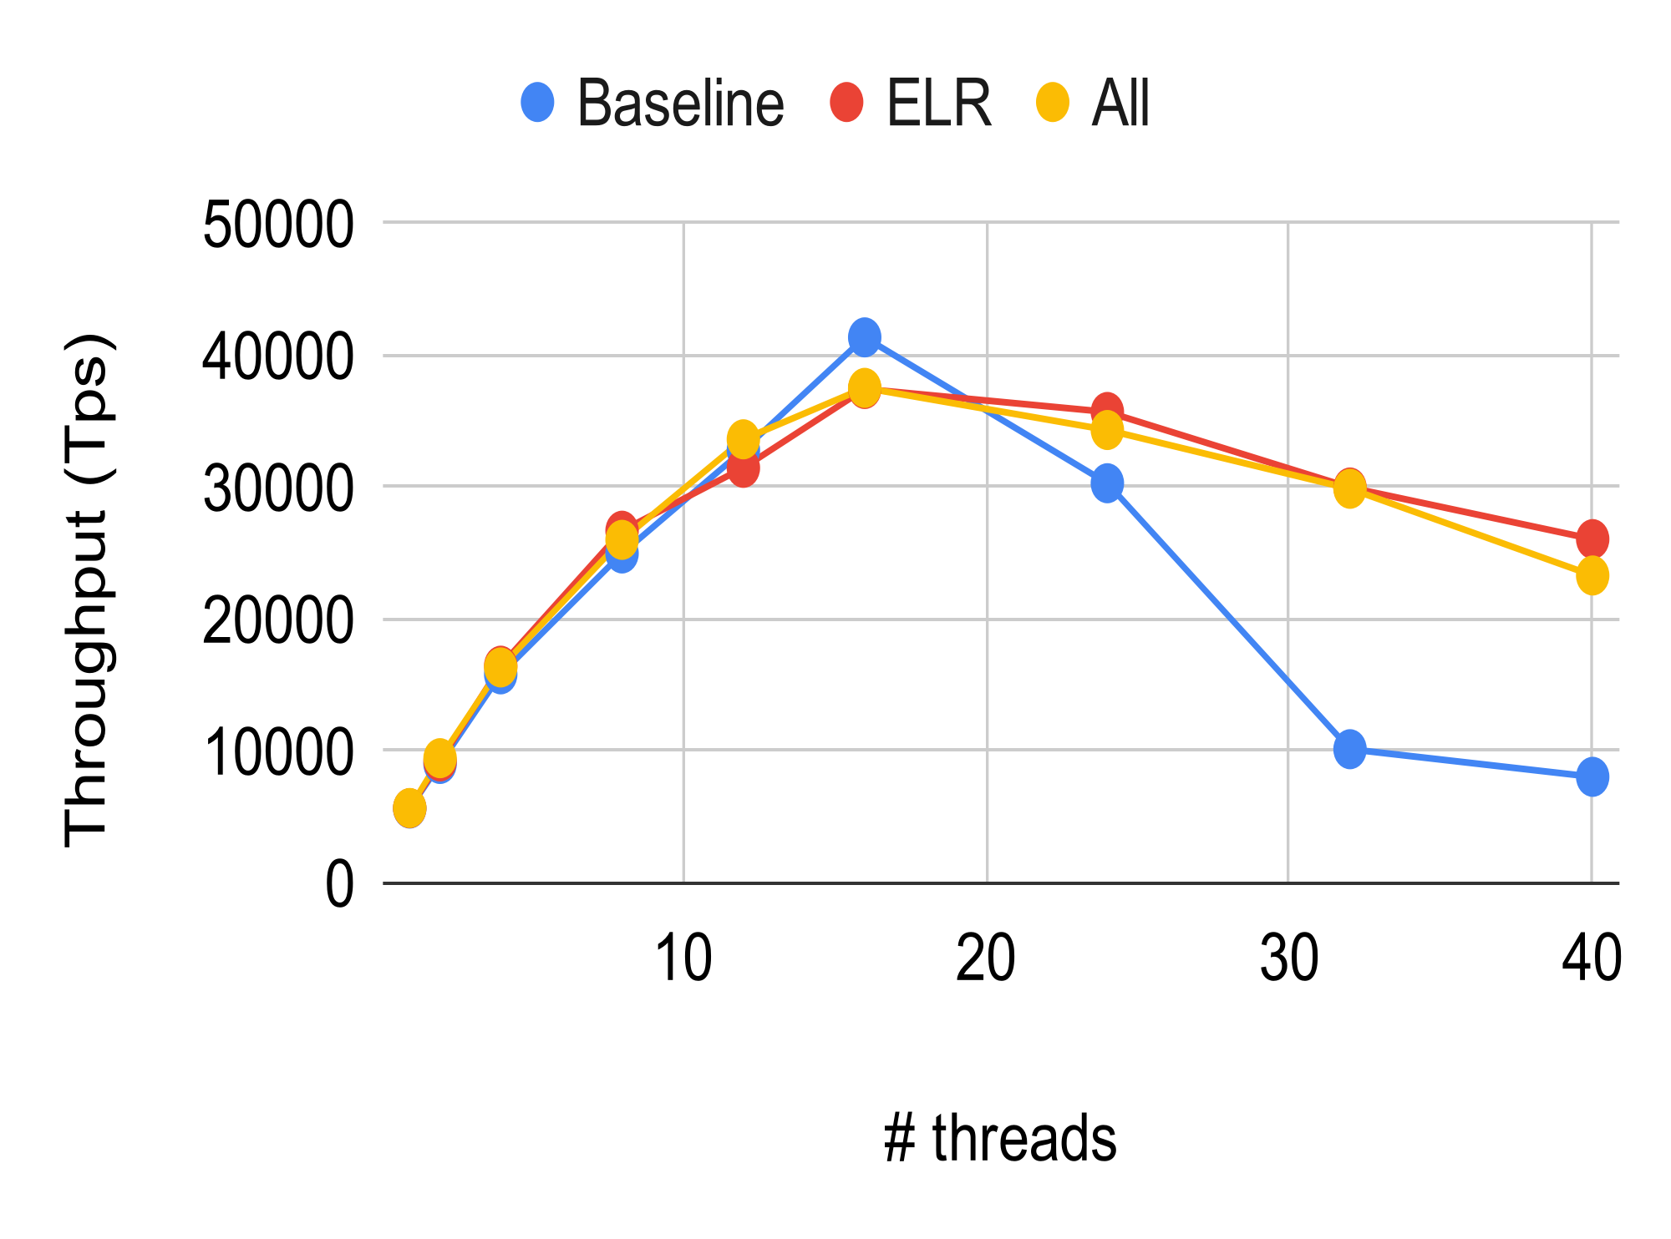
Overall Performance on disk
Similar to the result in the paper
Notes:
仔细看一下这两个benchmark

Slide 20
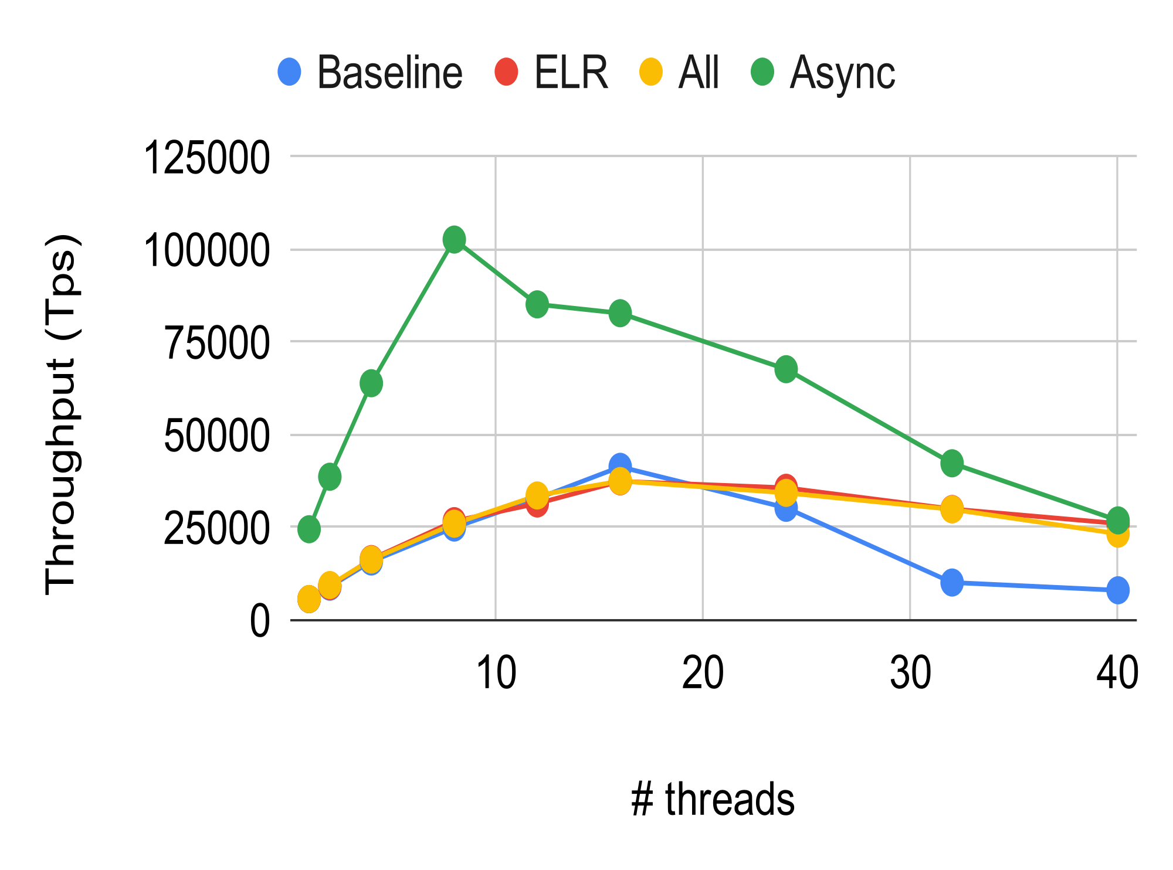
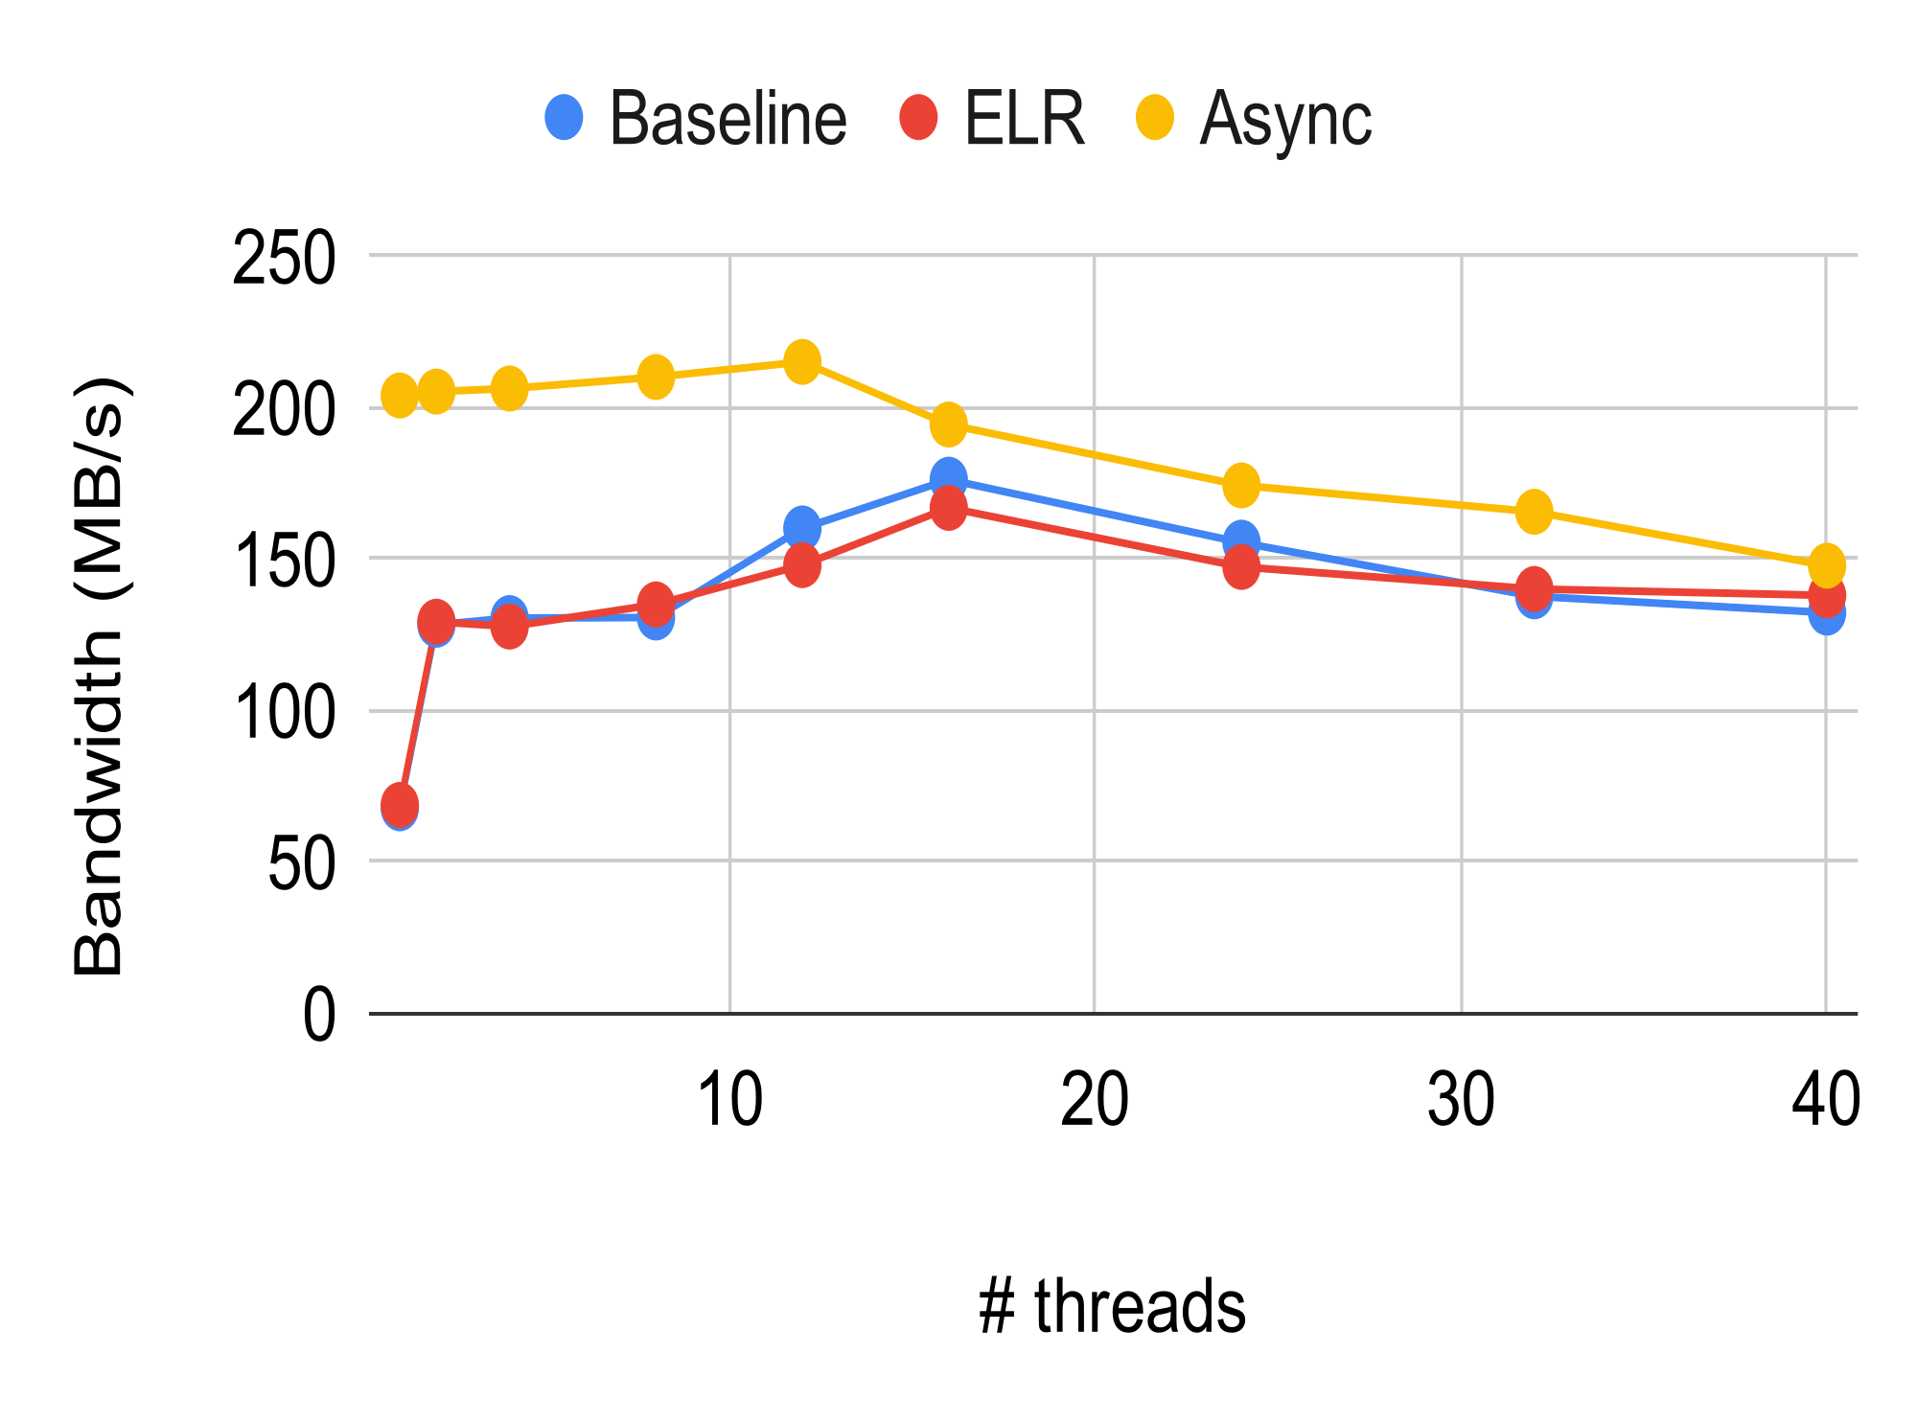
Overall Performance on disk
Async achieves better performance among all threads
Notes:
仔细看一下这两个benchmark

Slide 21
Overall Performance on disk
Async achieves better performance among all threads
Async does not involve disk write
Notes:
仔细看一下这两个benchmark

Slide 22
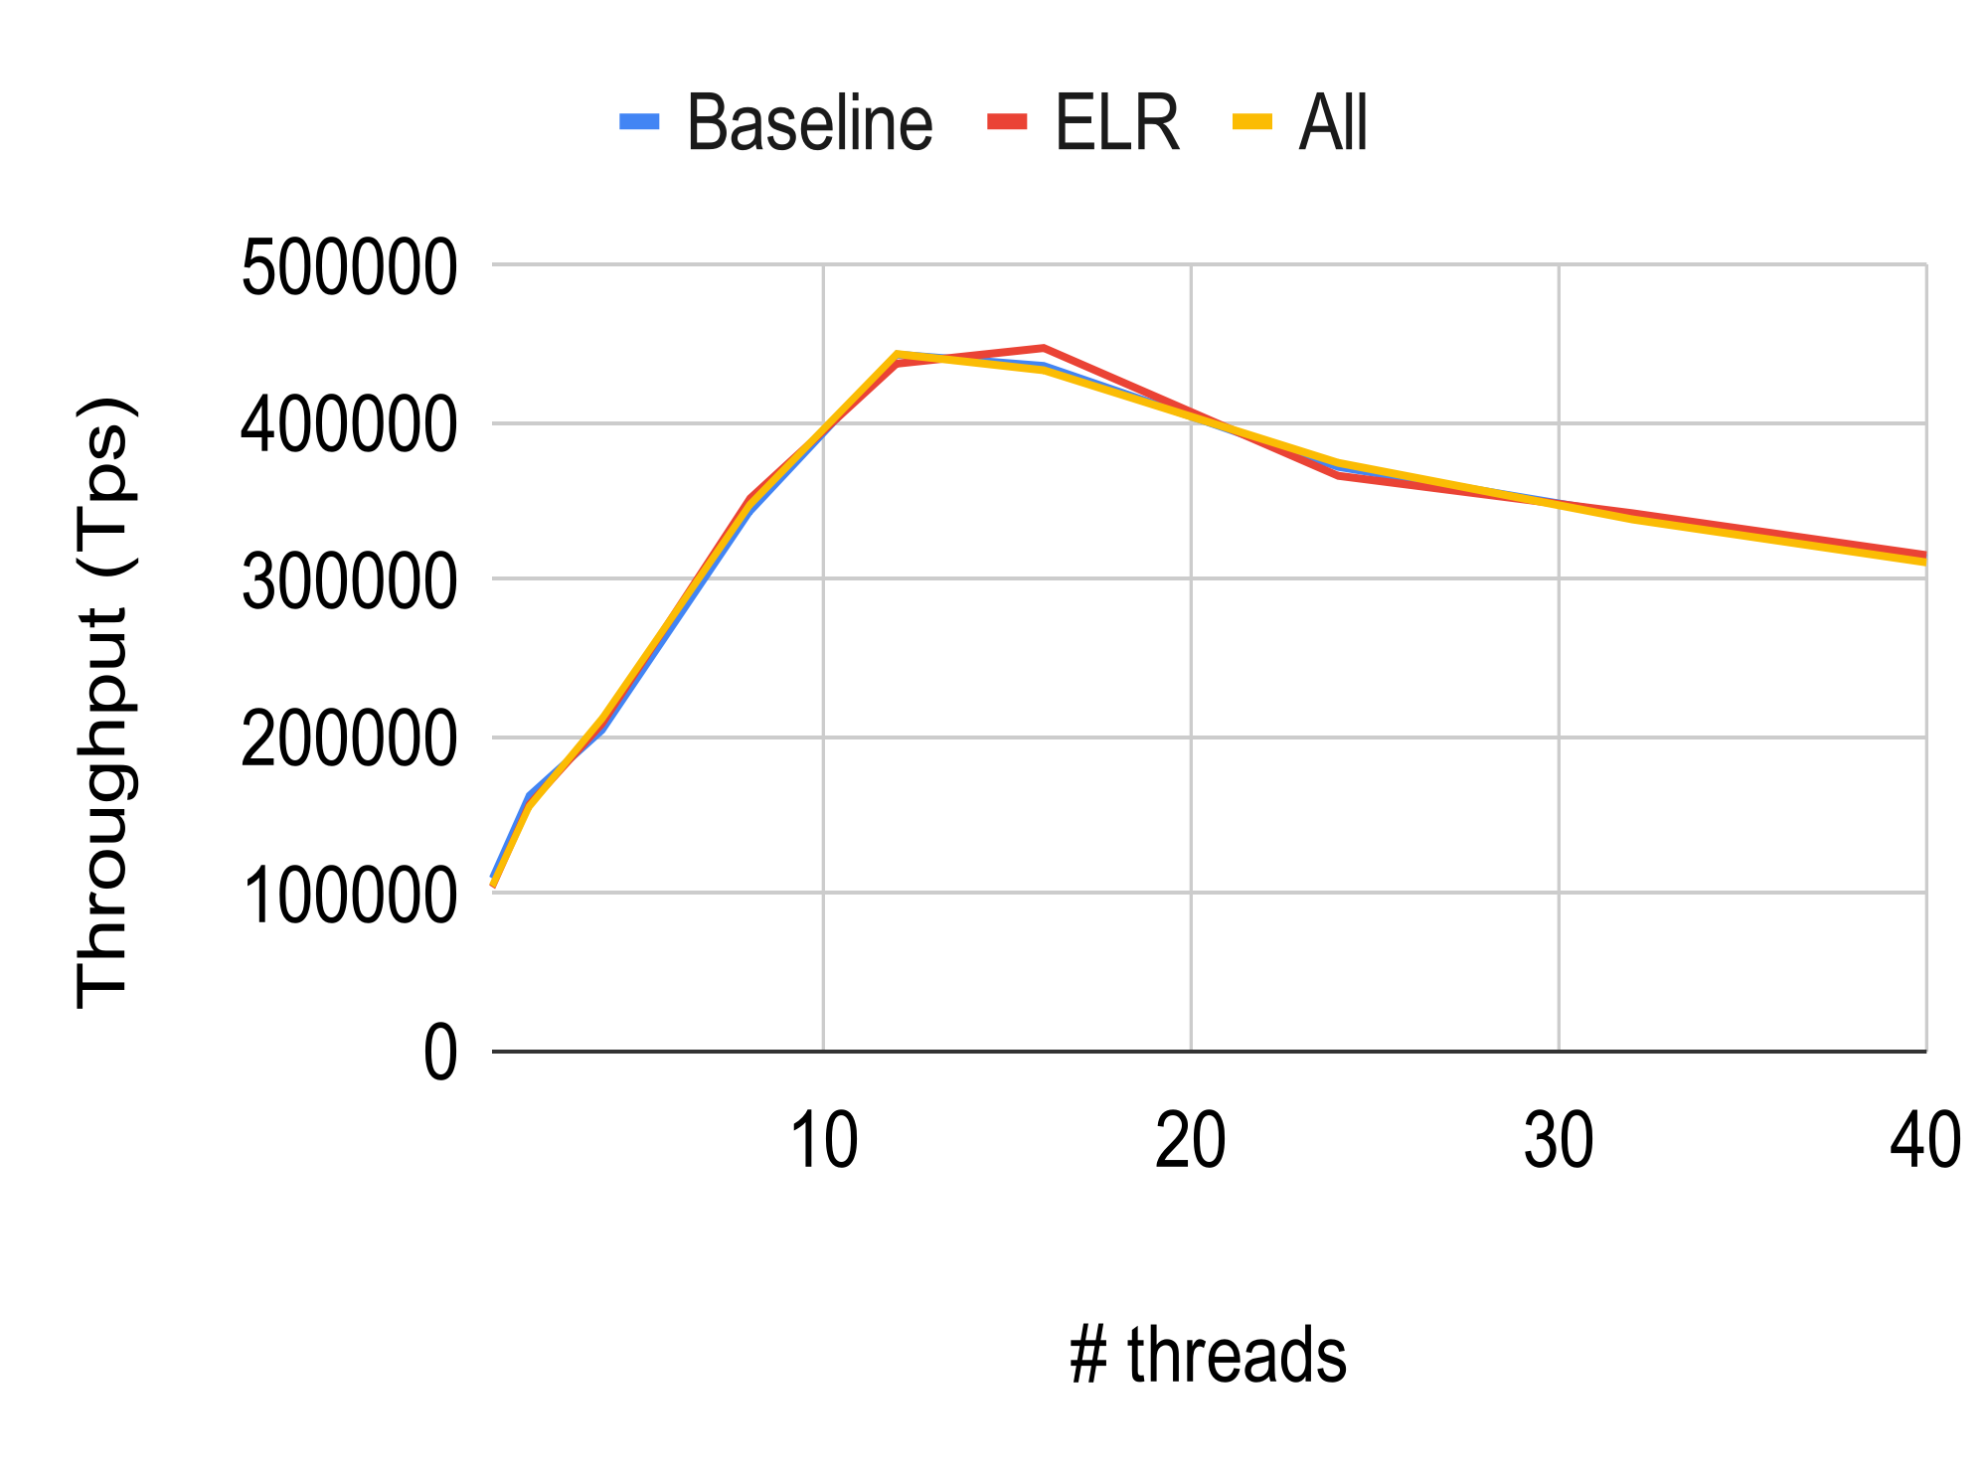
Overall Performance on disk
TPC-B: MbenchInsertOnly
Notes:
仔细看一下这两个benchmark

Slide 23
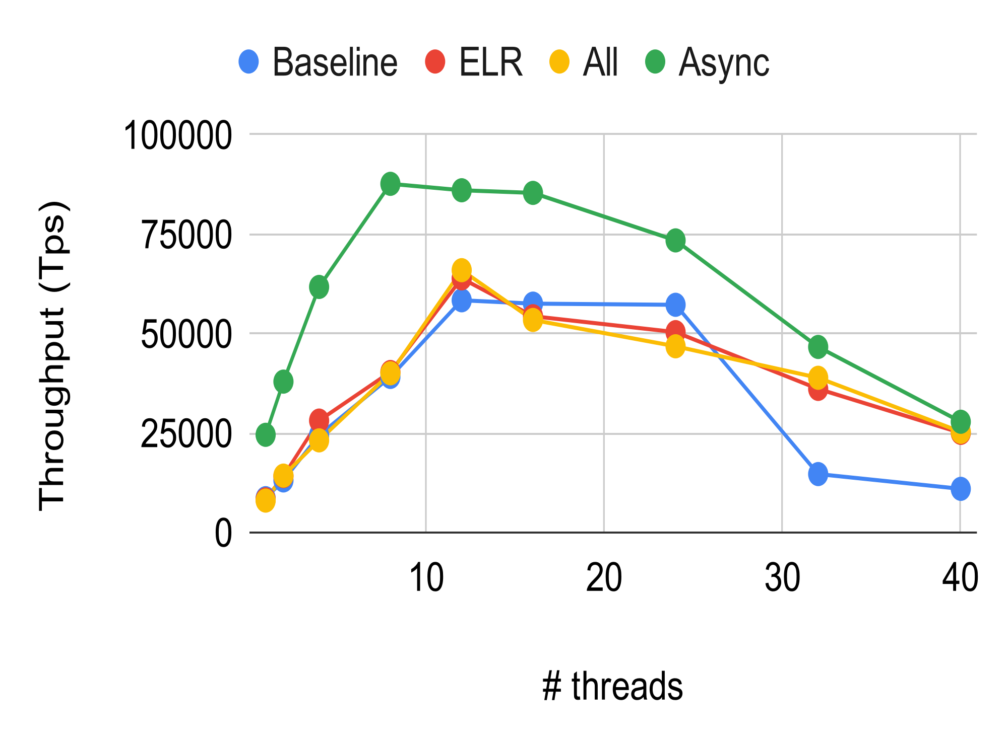
Overall Performance on NVM
Async achieves similar performance compared to disk
Notes:
仔细看一下这两个benchmark

Slide 24
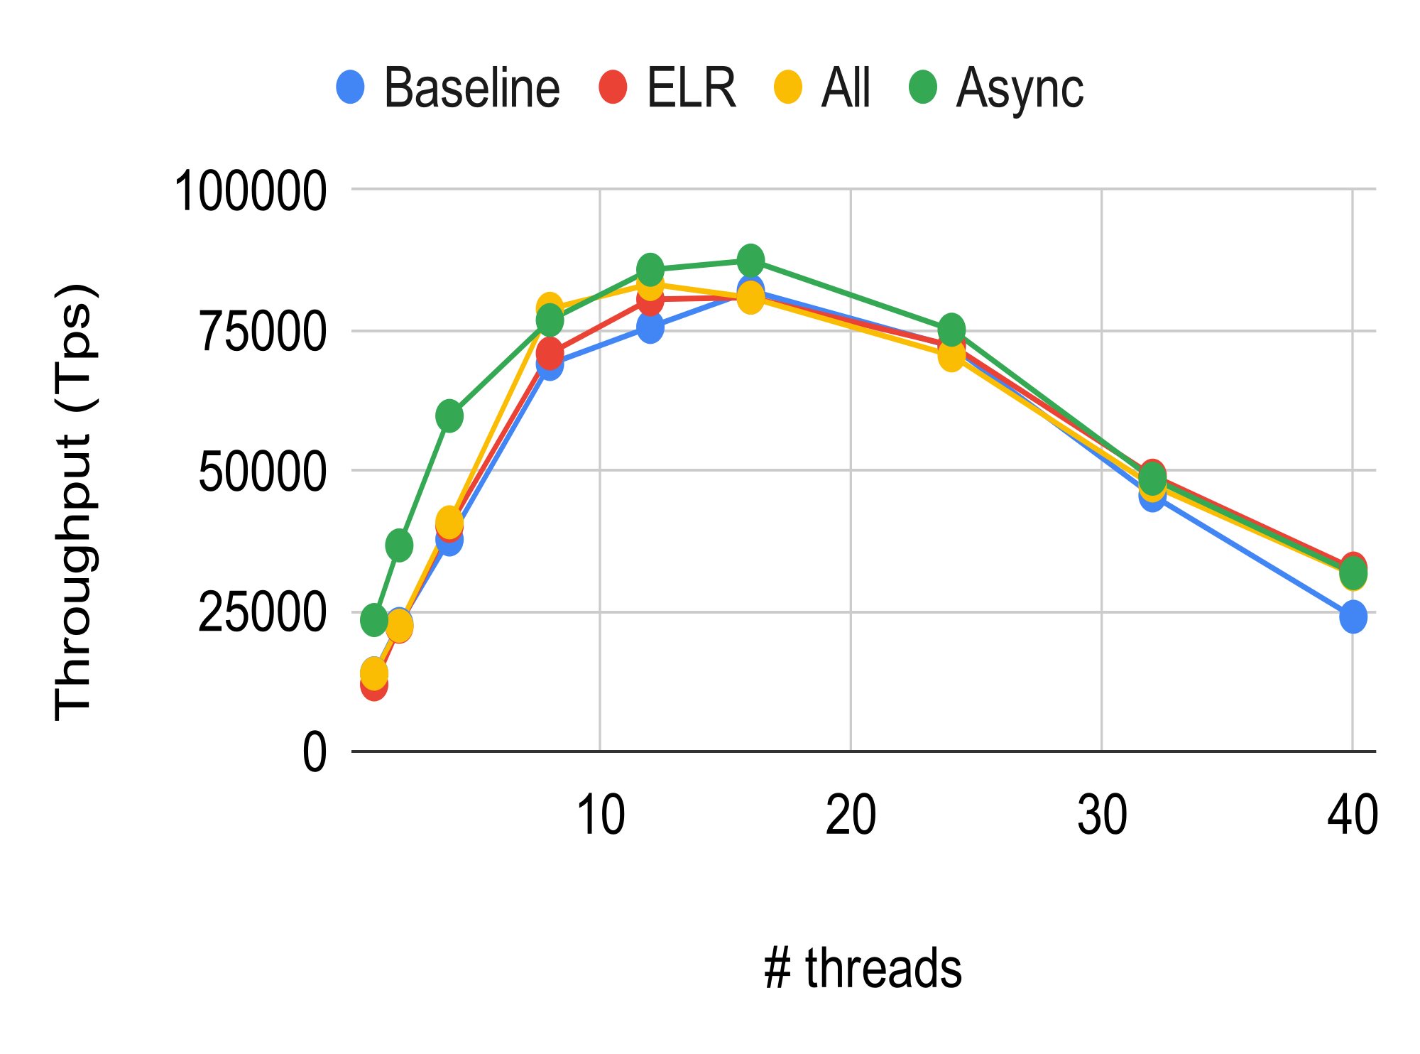
Overall Performance on DRAM
Notes:
仔细看一下这两个benchmark

Slide 25

THANKS

