Slide 1

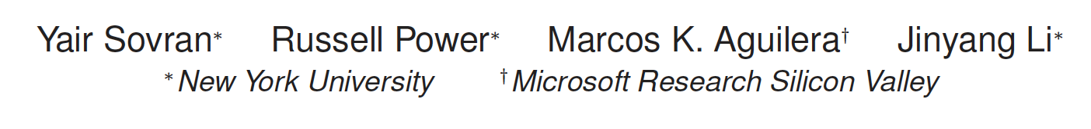
Transactional storage for geo-replicated systems

Slide 2
1. Motivation
Notes:
首先我来介绍一下这篇论文的Motivation。

Slide 3
Background
web applications are increasingly deployed over many data centers or sites
  more capacity
  provide better geographic locality
  disaster tolerance

Slide 4

Consistency vs. performance:
Maximize multi-site performance
Have few anomalies
More coordination
Fewer anomalies
Less coordination
More anomalies
Serializability
Eventual Consistency
Snapshot Isolation
Parallel Snapshot Isolation

Slide 5
2. PARALLEL SNAPSHOT ISOLATION

Slide 6
Snapshot Isolation
PROPERTY 1: (Snapshot Read) All operations read the most recent committed version as of the time when the transaction began.
PROPERTY 2: (No Write-Write Conflicts) The write sets of each pair of committed concurrent transactions must be disjoint.

Slide 7
Snapshot Isolation
The writes of T1 are seen by T3
The writes of T1 can not be seen by T2 because T2 reads from a snapshot prior to T1’s commit

Slide 8
Why SI is inadequate for geo-replicated systems?
It imposes a total ordering of the commit time of all transactions, even those that do not conflict.
The writes of a committed transaction must be immediately visible to later transactions.

Slide 9
Parallel Snapshot Isolation
PROPERTY 1: (Site Snapshot Read) All operations read the most recent committed version at the transaction’s site as of the time when the transaction began.
PROPERTY 2: No Write-Write Conflicts
PROPERTY 3: Commit Causality Across Sites

Slide 10
Parallel Snapshot Isolation
A transaction commits locally first, then propagates to remote sites.
(1) commit time per site, (2) timeline per site,
(3) read from snapshot at site

Slide 11
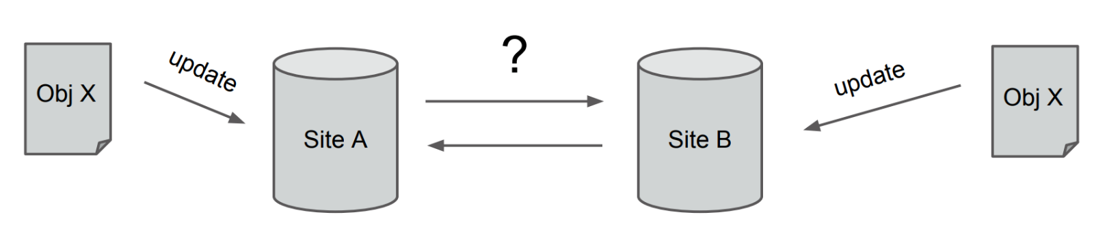
How to implement PSI efficiently?
PSI prohibits write-write conflicts (even across sites)
issue: how to enforce it efficiently?
two techniques
  preferred sites: optimize updates at certain sites
  counting sets: data structure that eliminates conflicts

Slide 12
technique #1: preferred sites
Difference between preferred site and primary site
  primary site is the only site that can update the data.
  non-primary sites are entirely read-only
Each object is assigned a preferred site
  transactions that only modify objects at their preferred site
  can use fast commit (without cross-site communication)
  transactions that modify objects which are not at their preferred site have to use slow commit (coordinate with their preferred sites)

Slide 13
technique #2: counting sets (csets)
A conflict-free data structure for objects modified frequently from many sites.
add(x): increments the counter of x in the cset
rem(x): decrements the counter of x.
negative count is ok:
  removing from empty set: set with “anti-element”
  increment and decrement always commute, so no conflicts

Slide 14
How to use cset in application?
1. The count is useful to the application
  e.g. a cset can keep the number of items in a shopping cart, count represents the number of a data item
2. Hiding the count from user
  e.g. a cset can keep a list of friends, messages, active users, or photo albums
  treating a count of one or more as present in the set, and count of zero or less as absent from the set.

Slide 15
3. DESIGN AND ALGORITHMS

Slide 16
Versions
Each object has a version number <site, seqno>
A version number is assigned to a transaction when it commits
  site: site where the transaction executed
  seqno: a sequence number local to that site

Slide 17
Vector timestamps
A vector timestamp represents a snapshot.
It contains a sequence number for each site, indicating how many transactions of that site are reflected in the snapshot.
A transaction is assigned a vector timestamp startVTS when it starts.
e.g. <2, 4, 5> means that the snapshot contains 2 transactions from site 1, 4 from site 2, and 5 from site 3.

Slide 18
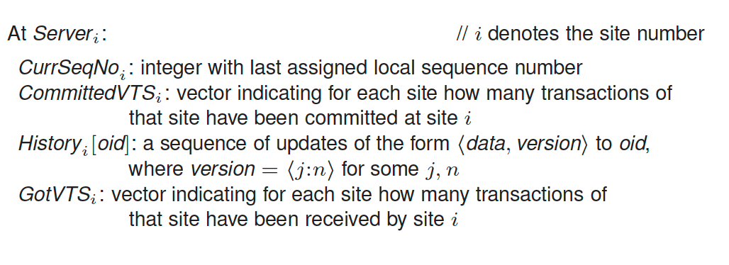
Variables at server on each site

Slide 19
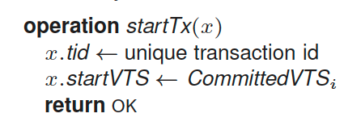
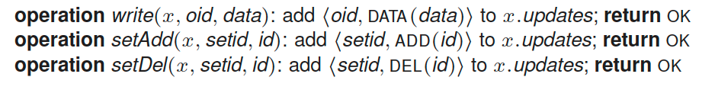
Executing transactions
startTx(x): obtains a new start vector timestamp startVTS
write an object: stores this update in a temporary buffer x.updates.

Slide 20
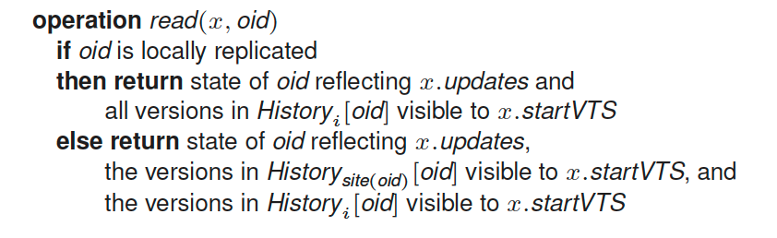
Executing transactions
read an object

Slide 21
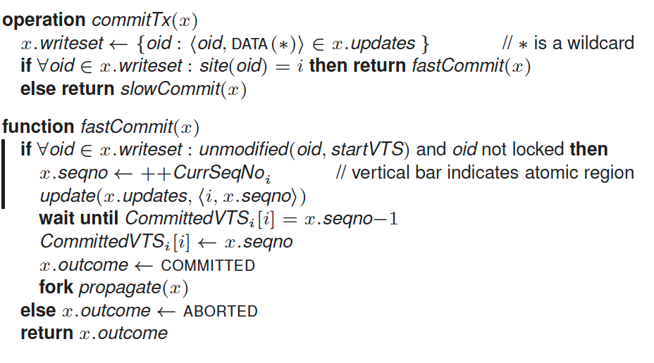
Fast commit
Write-set has only objects with a local preferred site.

Slide 22
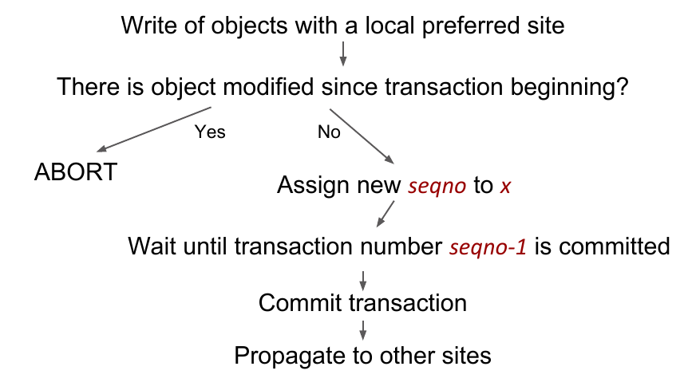
Fast commit

Slide 23
Slow commit
Write a regular object whose preferred site is not local.
Use two-phase commit to avoid conflicts with instances of fast commit and other instances of slow commit.

Slide 24
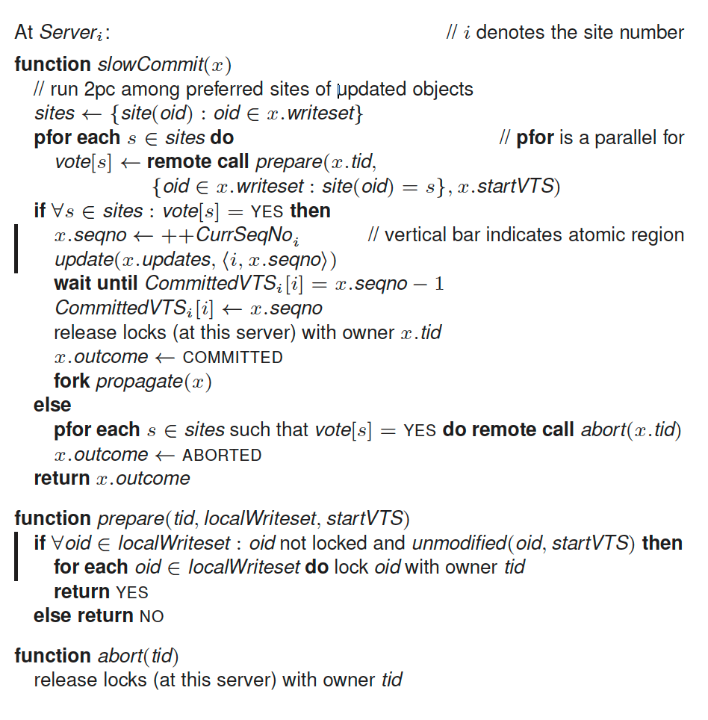
Slow commit

Slide 25
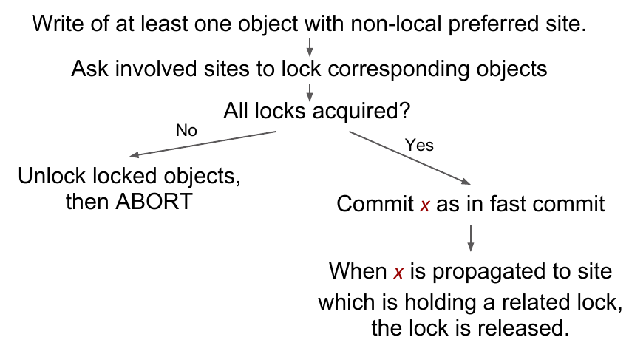
Slow commit

Slide 26
Asynchronous propagation
After commit, transactions are propagated to other sites.
Site receives a transaction x and sends an ACK.
When transaction is received by at least f+1 sites (for some), than it is marked as disaster-safe and all sites are notified.
Sites merges transaction x when all transactions from x.startVTS are merged and x is disaster-safe.
When x is committed at all sites, it is marked as globally-visible.

Slide 27
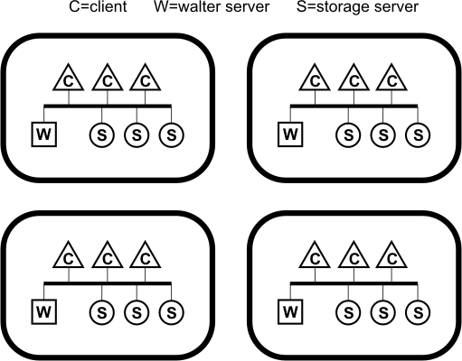
Architecture
configuration service

Slide 28
Scalability
walter server can be scalability bottleneck on site
solutions
  1. smaller sites, many per data center
  2. distribute walter server
    replace commit with distributed commit
data center 1
data center 1
data center 2
Notes:
smaller sites is possible because walter

Slide 29
Site failure
Two options to handle a site failure
  Conservative: block writes whose preferred site failed
  Aggressive: re-assign preferred site elsewhere
Warning: Committed but not-yet-replicated transactions may be lost

Slide 30
4. IMPLEMENTATION AND APPLICATIONS

Slide 31
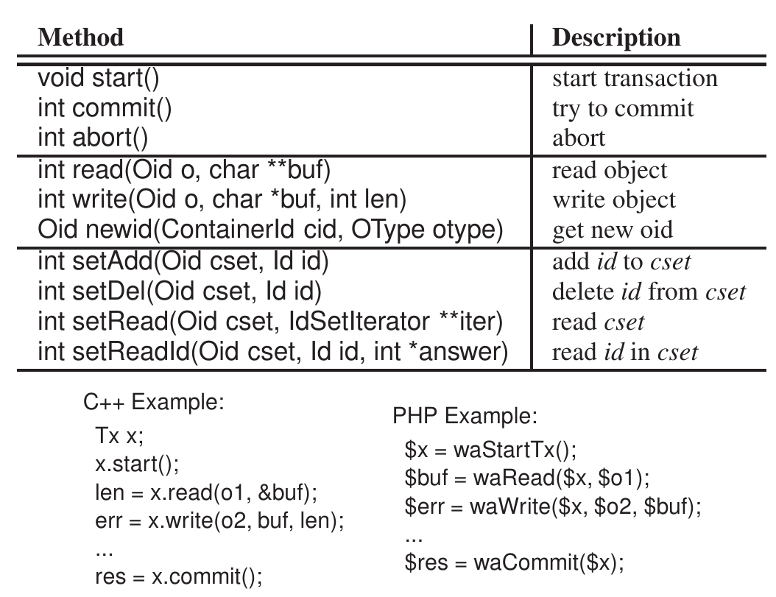
Walter API

Slide 32
WaltSocial
simple social networking application
supports common operations, such as
  befriend
  post message on wall
  read info
uses counting sets
  friends list, message list
preferred site
  site close to user
  where user logs into
/* befriend operation */
Tx x;
x.start();
x.read(oidA, &profileA);
x.read(oidB, &profileB);
x.setAdd(profileA.friendlist, oidB);
x.setAdd(profileB.friendlist, oidA);
success = x.commit();

Slide 33
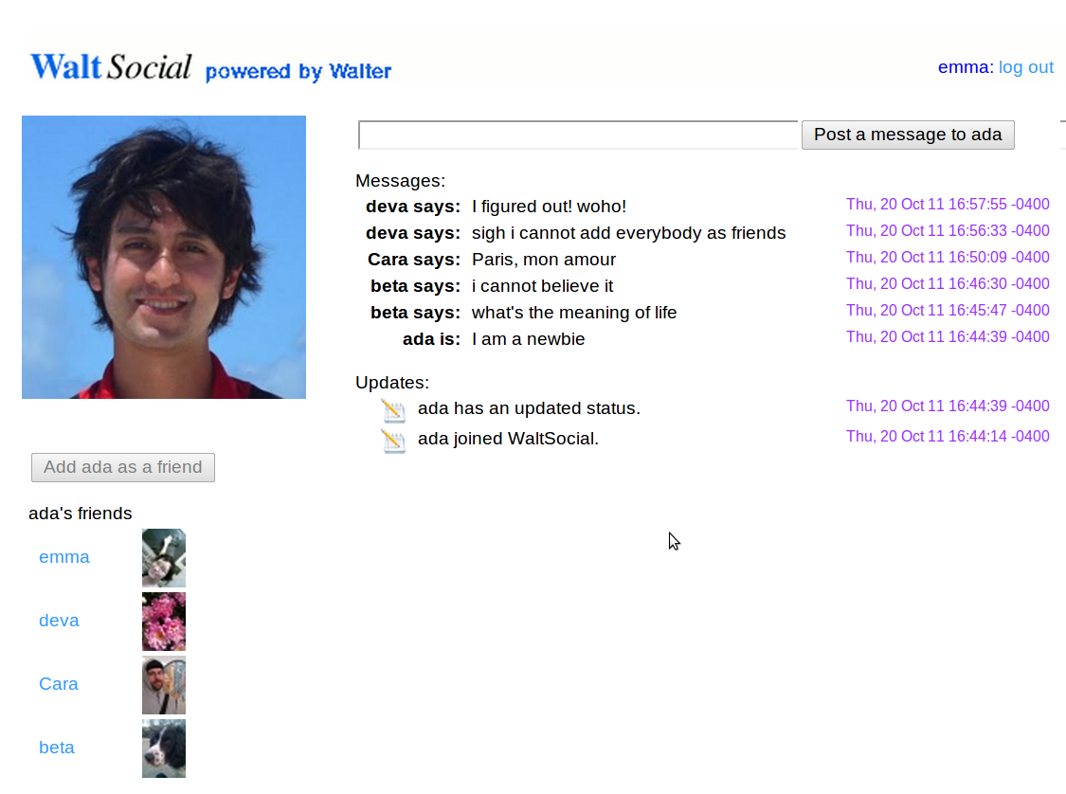

WaltSocial
Meow says: Meow Meow Meow
Bob-cat says: I saw a mouse
Bob-cat says: I saw a mouse
Peanut says: awldaiwdliawd
Meow says: I think I ate too much catnip last night. Meow.
Wall and Friendlist are
counting sets

Slide 34
ReTwis
twitter clone
uses redis key-value store
  supports atomic operations on lists, counters
  works on a single site (*)
  (*) redis supports replication across sites, but it is
  limited to a master-slave scheme
replaced redis with walter
  to support multi-site operation
  atomic operations replaced with transactions
  uses counting set to store timeline
port done in less than a day

Slide 35

ReTwis
Post-status transaction
write status to new object O
foreach f in user’s followers
add O to f’s timeline_cset
Each user’s timeline is a counting set

Slide 36
5. Evaluation

Slide 37
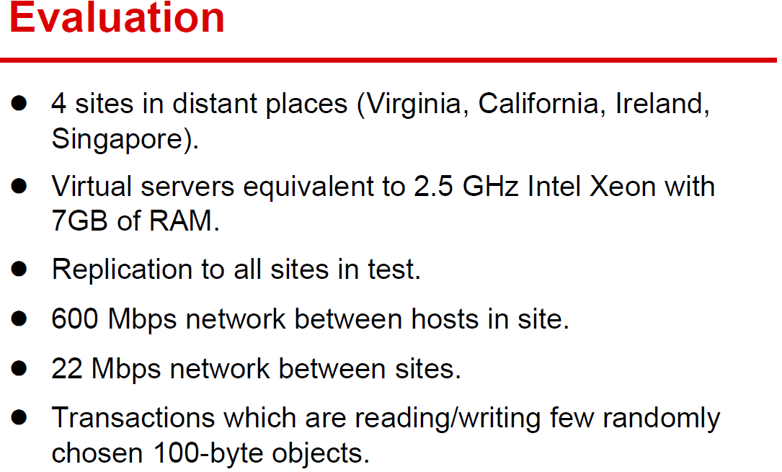

Slide 38
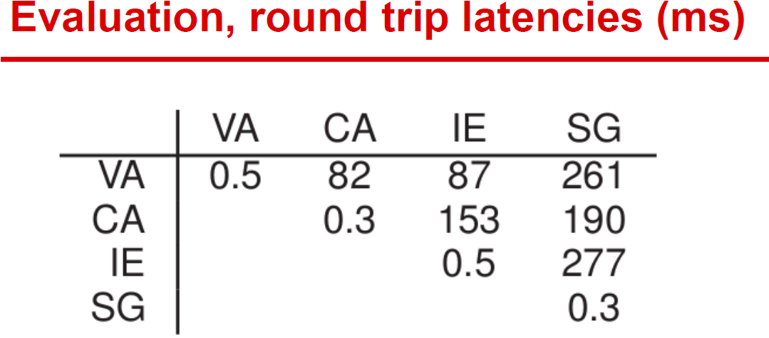

Slide 39
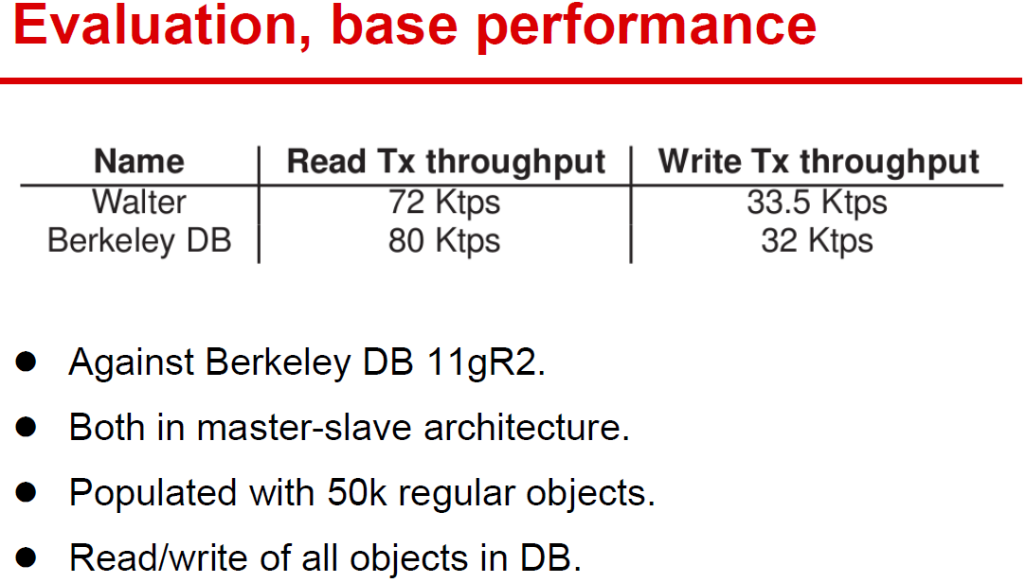

Slide 40
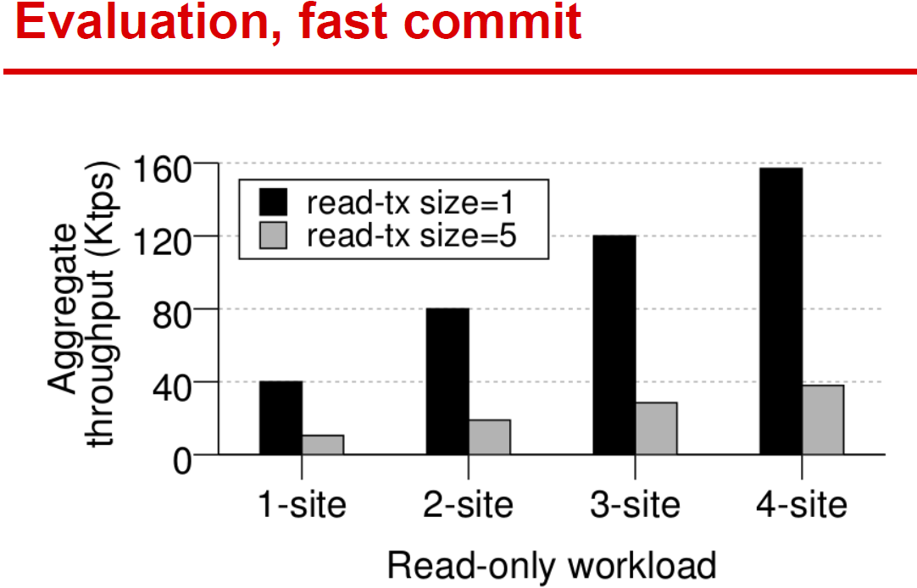

Slide 41
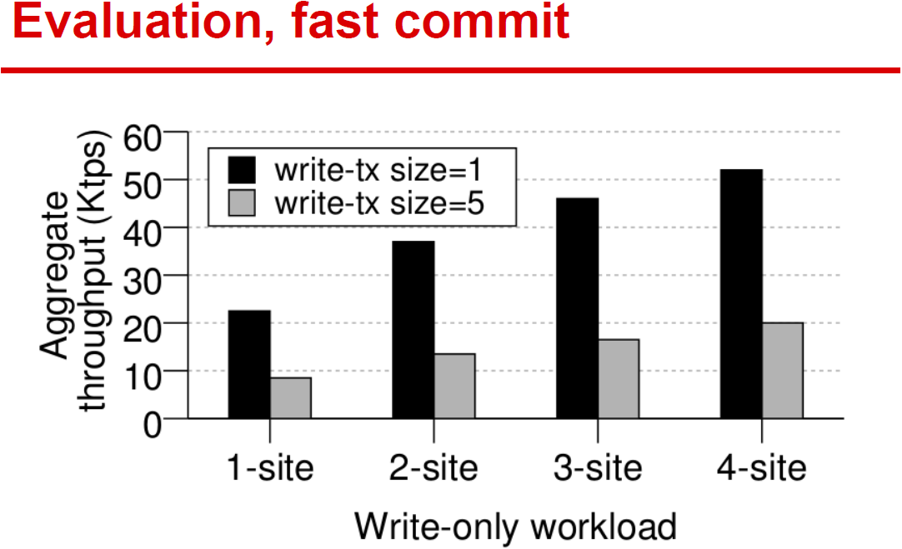

Slide 42
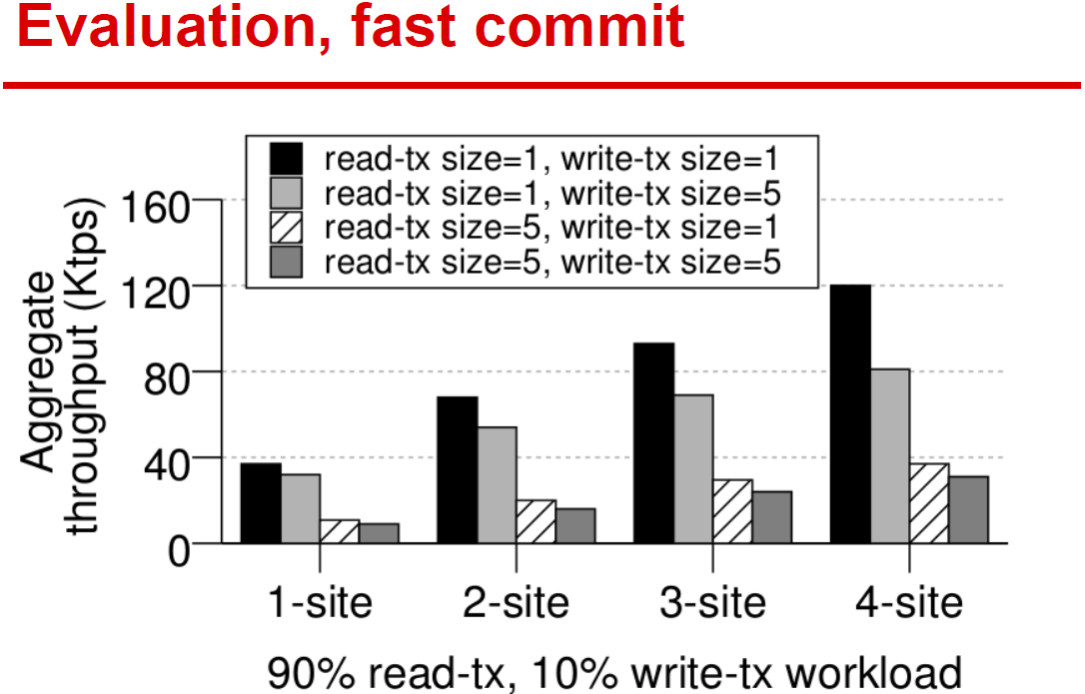

Slide 43
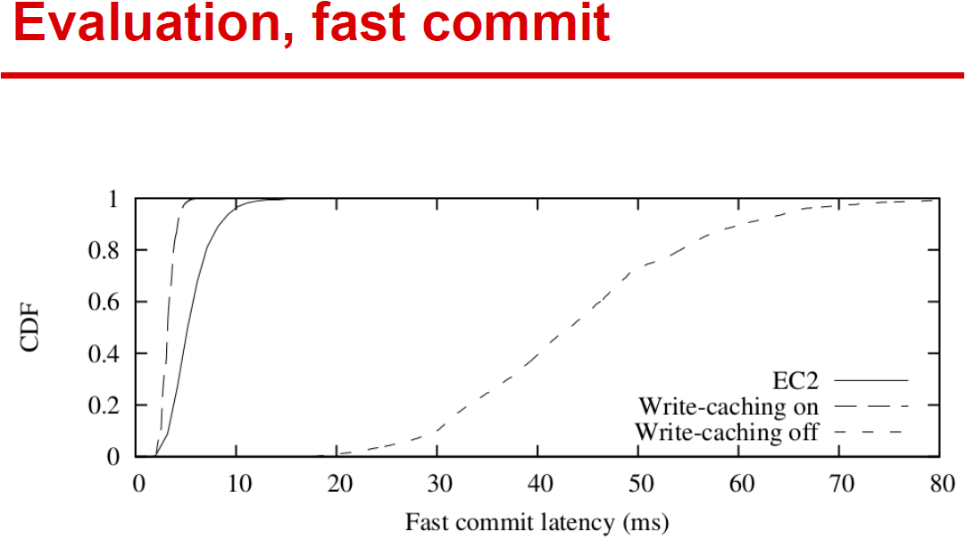

Slide 44
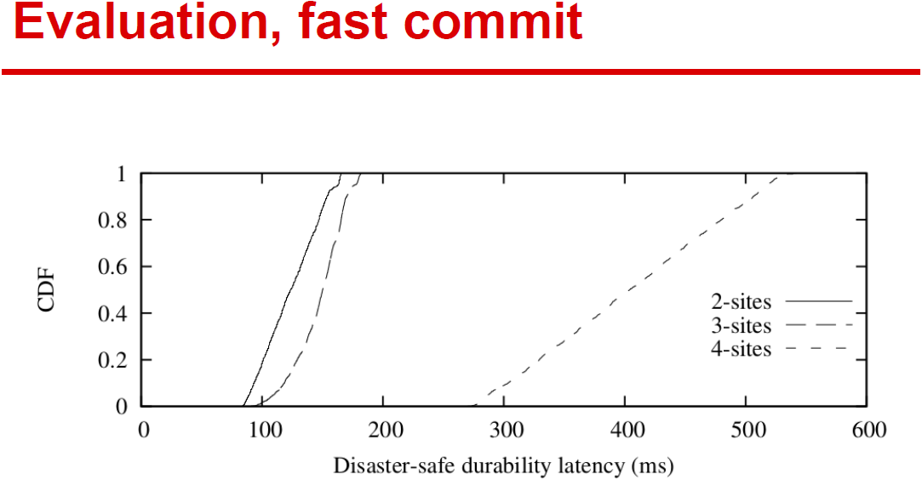

Slide 45
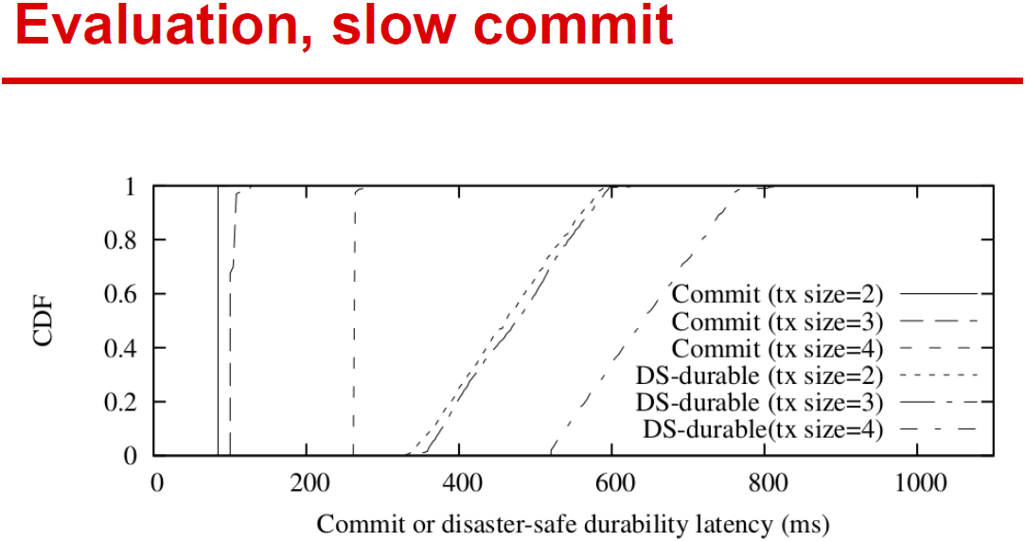

Slide 46
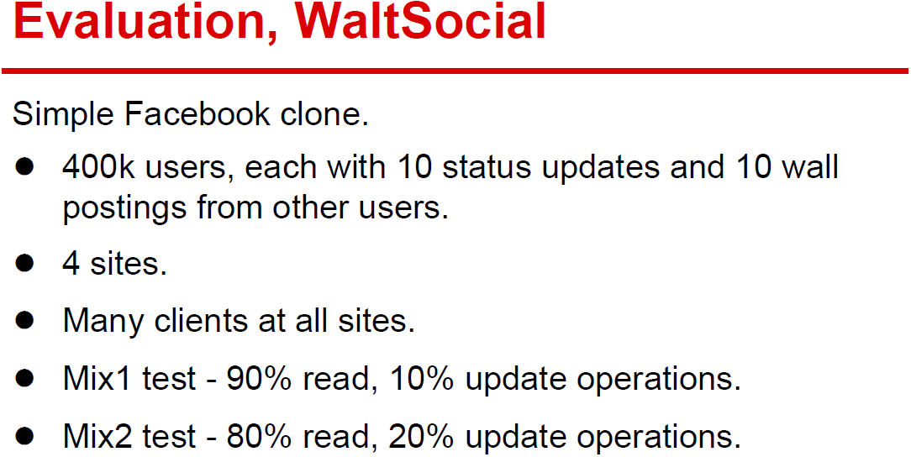

Slide 47
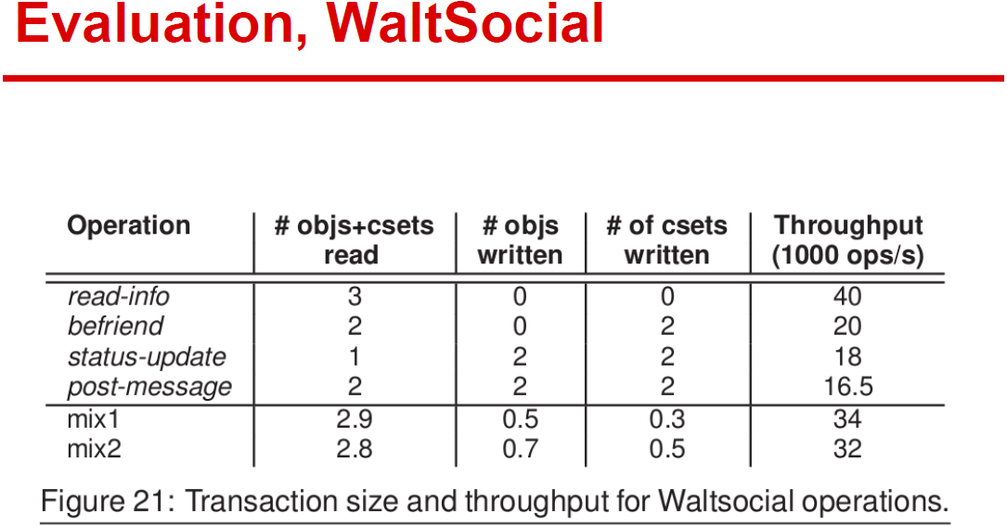

Slide 48
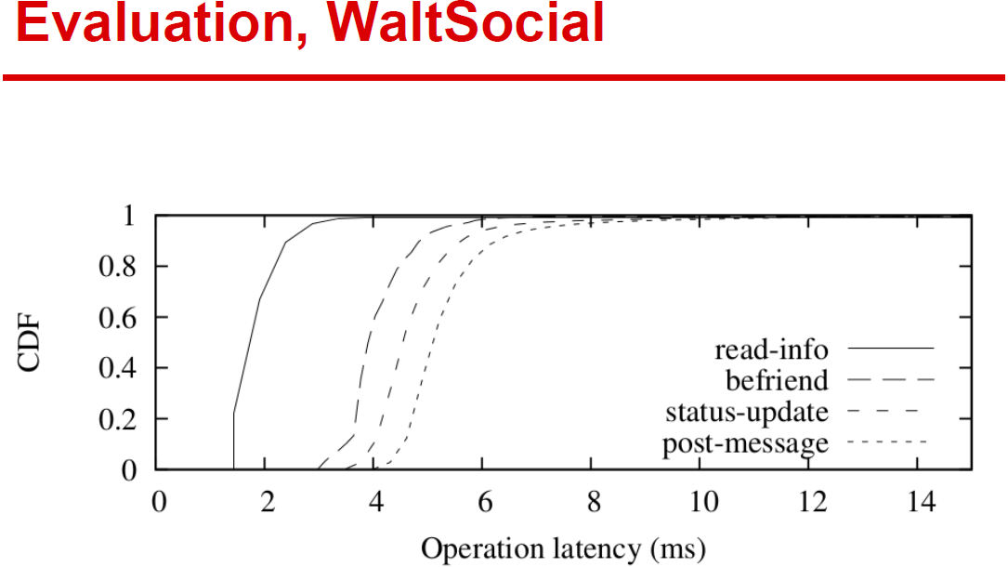

Slide 49
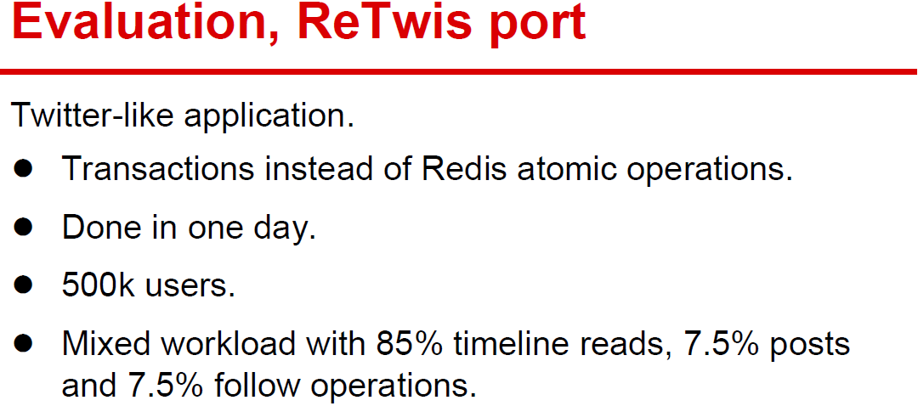

Slide 50
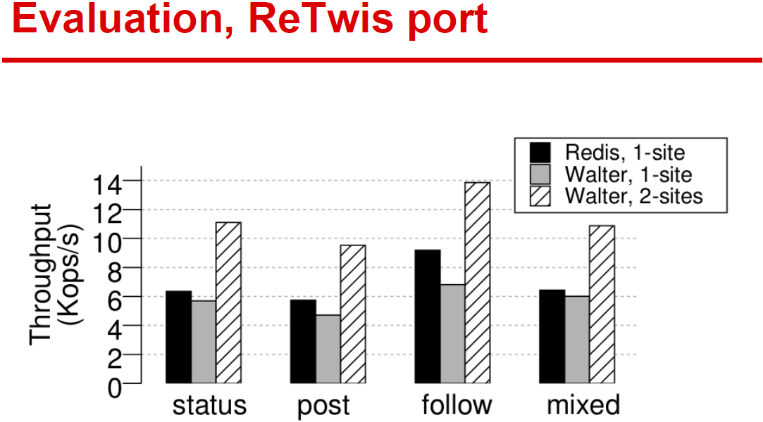

Slide 51
6. DEMOS

Slide 52
Demo
  Write Conflict case: Preferred site conflicts with Non-preferred site. Non-preferred site wins.
  We use two sites ,two transactions and one object as an example.
  Initial State
 | A(o preferred site) | B
CurrSeqNo | 6 | 7
CommittedVTS | <6,7> | <6,7>
History[o] | […,<A,5>] | […,<A,5>]
GotVTS | <6,7> | <6,7>

Slide 53
 | A_{o preferred site} | B
currSeqNo | 6 | 7
cmtdVTS | <6,7> | <6,7>
History[o] | […,<A,5>] | […,<A,5>]
GotVTS | <6,7> | <6,7>
A
B
a. startTx(x):
x.tid = tid_{A}
x.startVTS = <6,7>
1. startTx(y):
y.tid = tid_{B}
y.startVTS = <6,7>
b. writeTx(x, o, data):
x.updates <- <o, data>
2. writeTx(y, o, data):
y.updates <- <o, data>
 | x | y
tid | tid_{A} | tid_{B}
startVTS | <6,7> | <6,7>
update | […,<o,data>] | […,<0,data>]

Slide 54
 | A_{o preferred site} | B
currSeqNo | 6 | 7
cmtdVTS | <6,7> | <6,7>
History[o] | […,<A,5>] | […,<A,5>]
GotVTS | <6,7> | <6,7>
A
B
a. startTx(x):
x.tid = tid_{A}
x.startVTS = <6,7>
1. startTx(y):
y.tid = tid_{B}
y.startVTS = <6,7>
b. writeTx(x, o, data):
x.updates <- <o, data>
2. writeTx(y, o, data):
y.updates <- <o, data>
 | x | y
tid | tid_{A} | tid_{B}
startVTS | <6,7> | <6,7>
update | […,<o,data>] | […,<0,data>]
3. commit(y):
o preferred site ≠ B
=> Slow commit

Slide 55
 | A_{o preferred site} | B
currSeqNo | 6 | 7
cmtdVTS | <6,7> | <6,7>
History[o] | […,<A,5>] | […,<A,5>]
GotVTS | <6,7> | <6,7>
A
B
slowCommit
4. prepare(tid_{B}, {o} , <6,7>)
 | x | y
tid | tid_{A} | tid_{B}
startVTS | <6,7> | <6,7>
update | […,<o,data>] | […,<0,data>]

Slide 56
Site B slow commit
 | A_{o preferred site} | B
currSeqNo | 6 | 7
cmtdVTS | <6,7> | <6,7>
History[o] | […,<A,5>] | […,<A,5>]
GotVTS | <6,7> | <6,7>
lock[o] | tid_{B}
A
B
slowCommit
4. prepare(tid_{B}, {o} , <6,7>)
5. unlocked && unmodified
lock[o](tid_{B})
 | x | y
tid | tid_{A} | tid_{B}
startVTS | <6,7> | <6,7>
update | […,<o,data>] | […,<0,data>]

Slide 57
 | A_{o preferred site} | B
currSeqNo | 6 | 7
cmtdVTS | <6,7> | <6,7>
History[o] | […,<A,5>] | […,<A,5>]
GotVTS | <6,7> | <6,7>
lock[o] | tid_{B}
A
B
slowCommit
4. prepare(tid_{B}, {o} , <6,7>)
5. unlocked && unmodified
lock[o](tid_{B})
6. Yes
 | x | y
tid | tid_{A} | tid_{B}
startVTS | <6,7> | <6,7>
update | […,<o,data>] | […,<0,data>]

Slide 58
Site A commit
 | A_{o preferred site} | B
currSeqNo | 6 | 7
cmtdVTS | <6,7> | <6,7>
History[o] | […,<A,5>] | […,<A,5>]
GotVTS | <6,7> | <6,7>
lock[o] | tid_{B}
A
B
slowCommit
4. prepare(tid_{B}, {o} , <6,7>)
5. unlocked && unmodified
lock[o](tid_{B})
6. Yes
 | x | y
tid | tid_{A} | tid_{B}
startVTS | <6,7> | <6,7>
update | […,<o,data>] | […,<0,data>]
c. commit(x):
o preferred site == A
=> fast commit

Slide 59
Site A commit
 | A_{o preferred site} | B
currSeqNo | 6 | 7
cmtdVTS | <6,7> | <6,7>
History[o] | […,<A,5>] | […,<A,5>]
GotVTS | <6,7> | <6,7>
lock[o] | tid_{B}
A
B
slowCommit
4. prepare(tid_{B}, {o} , <6,7>)
5. unlocked && unmodified
lock[o](tid_{B})
6. Yes
 | x | y
tid | tid_{A} | tid_{B}
startVTS | <6,7> | <6,7>
update | […,<o,data>] | […,<0,data>]
c. commit(x):
o preferred site == A
=> fast commit
d. fastCommit(x)：
unmodified but locked
Return ABORTED

Slide 60
Site B slow commit
 | A_{o preferred site} | B
currSeqNo | 6 | 8
cmtdVTS | <6,7> | <6,7>
History[o] | […,<A,5>] | […,<A,5>,<B,8>]
GotVTS | <6,7> | <6,7>
lock[o] | tid_{B}
A
B
slowCommit
4. prepare(tid_{B}, {o} , <6,7>)
5. unlocked && unmodified
lock[o](tid_{B})
6. Yes
 | x | y
tid | tid_{A} | tid_{B}
startVTS | <6,7> | <6,7>
update | […,<o,data>] | […,<0,data>]
seqno |  | 8
7.(atom)
y.seqno = ++CurrSeqNo
History_{B}[o] <- <B, 8>

Slide 61
Site B slow commit
 | A_{o preferred site} | B
currSeqNo | 6 | 8
cmtdVTS | <6,7> | <6,8>
History[o] | […,<A,5>] | […,<A,5>,<B,8>]
GotVTS | <6,7> | <6,7>
lock[o] | tid_{B}
A
B
slowCommit
4. prepare(tid_{B}, {o} , <6,7>)
5. unlocked && unmodified
lock[o](tid_{B})
6. Yes
 | x | y
tid | tid_{A} | tid_{B}
startVTS | <6,7> | <6,7>
update | […,<o,data>] | […,<0,data>]
seqno |  | 8
7.(atom)
y.seqno = ++CurrSeqNo
History_{B}[o] <- <B, 8>
8. commitedVTS_{B}[B] = 8

Slide 62
Site B slow commit
 | A_{o preferred site} | B
currSeqNo | 6 | 8
cmtdVTS | <6,7> | <6,8>
History[o] | […,<A,5>] | […,<A,5>,<B,8>]
GotVTS | <6,7> | <6,7>
lock[o] | tid_{B}
A
B
slowCommit
4. prepare(tid_{B}, {o} , <6,7>)
5. unlocked && unmodified
lock[o](tid_{B})
6. Yes
 | x | y
tid | tid_{A} | tid_{B}
startVTS | <6,7> | <6,7>
update | […,<o,data>] | […,<0,data>]
seqno |  | 8
7.(atom)
y.seqno = ++CurrSeqNo
History_{B}[o] <- <B, 8>
8. commitedVTS_{B}[B] = 8
return COMMITTED
9. Fork propagate(x)

Slide 63
Site B slow commit
site | A_{o preferred site} | B
currSeqNo | 6 | 8
cmtdVTS | <6,7> | <6,8>
History[o] | […,<A,5] | […,<A,5>,<B,8>]
GotVTS | <6,7> | <6,8>
lock[o] | tid_{B}
A
B
1. propagate(y)
1. propagate(y)
2. Local propagate
=> GotVTS_{B}[B] = 8
transaction | x | y
tid | tid_{A} | tid_{B}
startVTS | <6,7> | <6,7>
update | […,<o,data>] | […,<0,data>]
seqno |  | 8

Slide 64
Site B slow commit
site | A_{o preferred site} | B
currSeqNo | 6 | 8
cmtdVTS | <6,7> | <6,8>
History[o] | […,<A,5>,<B, 8>] | […,<A,5>,<B,8>]
GotVTS | <6,8> | <6,8>
lock[o] | tid_{B}
A
B
1. propagate(y)
2. Remote propagate
=>
History_{A}[o] <- <B, 8>
GotVTS_{A}[B] = 8
1. propagate(y)
2. Local propagate
=> GotVTS_{B}[B] = 8
transaction | x | y
tid | tid_{A} | tid_{B}
startVTS | <6,7> | <6,7>
update | […,<o,data>] | […,<0,data>]
seqno |  | 8

Slide 65
Site B propagate
site | A_{o preferred site} | B
currSeqNo | 6 | 8
cmtdVTS | <6,7> | <6,8>
History[o] | […,<A,5>,<B, 8>] | […,<A,5>,<B,8>]
GotVTS | <6,8> | <6,8>
lock[o] | tid_{B}
A
B
1. propagate(y)
2. Remote propagate
=>
History_{A}[o] <- <B, 8>
GotVTS_{A}[B] = 8
1. propagate(y)
2. Local propagate
=> GotVTS_{B}[B] = 8
3. propagate-ack(tid_{B})
4. Mark y DS
transaction | x | y
tid | tid_{A} | tid_{B}
startVTS | <6,7> | <6,7>
update | […,<o,data>] | […,<0,data>]
seqno |  | 8

Slide 66
Site B propagate
site | A_{o preferred site} | B
currSeqNo | 6 | 8
cmtdVTS | <6,7> | <6,8>
History[o] | […,<A,5>,<B, 8>] | […,<A,5>,<B,8>]
GotVTS | <6,8> | <6,8>
lock[o] | tid_{B}
A
B
1. propagate(y)
2. Remote propagate
=>
History_{A}[o] <- <B, 8>
GotVTS_{A}[B] = 8
1. propagate(y)
2. Local propagate
=> GotVTS_{B}[B] = 8
3. propagate-ack(tid_{B})
4. Mark y DS
transaction | x | y
tid | tid_{A} | tid_{B}
startVTS | <6,7> | <6,7>
update | […,<o,data>] | […,<0,data>]
seqno |  | 8
5. ds-durable(y)
5. ds-durable(y)

Slide 67
Site B propagate
site | A_{o preferred site} | B
currSeqNo | 6 | 8
cmtdVTS | <6,8> | <6,8>
History[o] | […,<A,5>,<B, 8>] | […,<A,5>,<B,8>]
GotVTS | <6,8> | <6,8>
lock[o] | tid_{B}
A
B
1. propagate(y)
2. Remote propagate
=>
History_{A}[o] <- <B, 8>
GotVTS_{A}[B] = 8
1. propagate(y)
2. Local propagate
=> GotVTS_{B}[B] = 8
3. propagate-ack(tid_{B})
4. Mark y DS
transaction | x | y
tid | tid_{A} | tid_{B}
startVTS | <6,7> | <6,7>
update | […,<o,data>] | […,<0,data>]
seqno |  | 8
5. ds-durable(y)
6. CommittedVTS_{A}[B] = 8
release tid_{B} lock
5. ds-durable(y)

Slide 68
Site B propagate
site | A_{o preferred site} | B
currSeqNo | 6 | 8
cmtdVTS | <6,8> | <6,8>
History[o] | […,<A,5>,<B, 8>] | […,<A,5>,<B,8>]
GotVTS | <6,8> | <6,8>
lock[o]
A
B
1. propagate(y)
2. Remote propagate
=>
History_{A}[o] <- <B, 8>
GotVTS_{A}[B] = 8
1. propagate(y)
2. Local propagate
=> GotVTS_{B}[B] = 8
3. propagate-ack(tid_{B})
4. Mark y DS
transaction | x | y
tid | tid_{A} | tid_{B}
startVTS | <6,7> | <6,7>
update | […,<o,data>] | […,<0,data>]
seqno |  | 8
5. ds-durable(y)
6. CommittedVTS_{A}[B] = 8
release tid_{B} lock
5. ds-durable(y)
7. visible(y)
8. Mark y globally visible

Slide 69
Demo
  Write Conflict case: Preferred site conflicts with Non-preferred site. Preferred site wins.
  We use two sites ,two transactions and one object as an example.
  Initial State
 | A(o preferred site) | B
CurrSeqNo | 6 | 7
CommittedVTS | <6,7> | <6,7>
History[o] | […,<A,5>] | […,<A,5>]
GotVTS | <6,7> | <6,7>

Slide 70
 | A_{o preferred site} | B
currSeqNo | 6 | 7
cmtdVTS | <6,7> | <6,7>
History[o] | […,<A,5>] | […,<A,5>]
GotVTS | <6,7> | <6,7>
A
B
a. startTx(x):
x.tid = tid_{A}
x.startVTS = <6,7>
1. startTx(y):
y.tid = tid_{B}
y.startVTS = <6,7>
b. writeTx(x, o, data):
x.updates <- <o, data>
2. writeTx(y, o, data):
y.updates <- <o, data>
 | x | y
tid | tid_{A} | tid_{B}
startVTS | <6,7> | <6,7>
update | […,<o,data>] | […,<0,data>]

Slide 71
 | A_{o preferred site} | B
currSeqNo | 6 | 7
cmtdVTS | <6,7> | <6,7>
History[o] | […,<A,5>] | […,<A,5>]
GotVTS | <6,7> | <6,7>
A
B
a. startTx(x):
x.tid = tid_{A}
x.startVTS = <6,7>
1. startTx(y):
y.tid = tid_{B}
y.startVTS = <6,7>
b. writeTx(x, o, data):
x.updates <- <o, data>
2. writeTx(y, o, data):
y.updates <- <o, data>
 | x | y
tid | tid_{A} | tid_{B}
startVTS | <6,7> | <6,7>
update | […,<o,data>] | […,<0,data>]
c. commit(x):
o preferred site == A
=> fast commit
3. commit(y):
o preferred site ≠ B
=> Slow commit

Slide 72
 | A_{o preferred site} | B
currSeqNo | 7 | 7
cmtdVTS | <6,7> | <6,7>
History[o] | […,<A,5>,<A,7> ] | […,<A,5>]
GotVTS | <6,7> | <6,7>
A
B
FastCommit
d. unmodified && unlocked
=>
(atom)
x.seqno = ++CurrSeqNo
History_{A}[o] <- <A, 7>
 | x | y
tid | tid_{A} | tid_{B}
startVTS | <6,7> | <6,7>
update | […,<o,data>] | […,<0,data>]
seqno | 7

Slide 73
 | A_{o preferred site} | B
currSeqNo | 7 | 7
cmtdVTS | <6,7> | <6,7>
History[o] | […,<A,5>,<A,7> ] | […,<A,5>]
GotVTS | <6,7> | <6,7>
A
B
FastCommit
d. unmodified && unlocked
=>
(atom)
x.seqno = ++CurrSeqNo
History_{A}[o] <- <A, 7>
4. prepare(tid_{B}, {o} , <6,7>)
 | x | y
tid | tid_{A} | tid_{B}
startVTS | <6,7> | <6,7>
update | […,<o,data>] | […,<0,data>]
seqno | 7
5. unlocked but modified
6. No
7. Return ABORTED

Slide 74
 | A_{o preferred site} | B
currSeqNo | 7 | 7
cmtdVTS | <6,7> | <6,7>
History[o] | […,<A,5>,<A,7> ] | […,<A,5>]
GotVTS | <6,7> | <6,7>
A
B
FastCommit
d. unmodified && unlocked
=>
(atom)
x.seqno = ++CurrSeqNo
History_{A}[o] <- <A, 7>
 | x | y
tid | tid_{A} | tid_{B}
startVTS | <6,7> | <6,7>
update | […,<o,data>] | […,<0,data>]
seqno | 7

Slide 75
 | A_{o preferred site} | B
currSeqNo | 7 | 7
cmtdVTS | <7,7> | <6,7>
History[o] | […,<A,5>,<A,7> ] | […,<A,5>]
GotVTS | <6,7> | <6,7>
A
B
FastCommit
d. unmodified && unlocked
=>
(atom)
x.seqno = ++CurrSeqNo
History_{A}[o] <- <A, 7>
 | x | y
tid | tid_{A} | tid_{B}
startVTS | <6,7> | <6,7>
update | […,<o,data>] | […,<0,data>]
seqno | 7
e. CommittedVTS_{A}[A] = 7
return COMMITTED
fork propagate(x)

Slide 76
Demo
  Write Conflict case: Non-preferred site conflicts with Nonpreferred site.
  We use three sites ,two transactions and one object as an example.
  Initial State, A is preferred site.
 | B | C
CurrSeqNo | 7 | 8
CommittedVTS | <6,7,8> | <6,7,8>
History[o] | […,<A,5>] | […,<A,5>]
GotVTS | <6,7,8> | <6,7,8>

Slide 77
 | B | C
currSeqNo | 6 | 7
cmtdVTS | <6,7> | <6,7>
History[o] | […,<A,5>] | […,<A,5>]
GotVTS | <6,7> | <6,7>
B
C
a. startTx(y):
y.tid = tid_{B}
y.startVTS = <6,7>
1. startTx(z):
z.tid = tid_{B}
z.startVTS = <6,7>
b. writeTx(y, o, data):
y.updates <- <o, data>
2. writeTx(z, o, data):
z.updates <- <o, data>
 | y | z
tid | tid_{B} | tid_{C}
startVTS | <6,7> | <6,7>
update | […,<o,data>] | […,<0,data>]

Slide 78
 | B | C
currSeqNo | 6 | 7
cmtdVTS | <6,7> | <6,7>
History[o] | […,<A,5>] | […,<A,5>]
GotVTS | <6,7> | <6,7>
B
C
a. startTx(y):
y.tid = tid_{B}
y.startVTS = <6,7>
1. startTx(z):
z.tid = tid_{B}
z.startVTS = <6,7>
b. writeTx(y, o, data):
y.updates <- <o, data>
2. writeTx(z, o, data):
z.updates <- <o, data>
 | y | z
tid | tid_{B} | tid_{C}
startVTS | <6,7> | <6,7>
update | […,<o,data>] | […,<0,data>]
c. commit(y):
o preferred site ≠ A
=> Slow commit
3. commit(z):
o preferred site ≠ A
=> Slow commit

Slide 79
 | B | C
currSeqNo | 6 | 7
cmtdVTS | <6,7> | <6,7>
History[o] | […,<A,5>] | […,<A,5>]
GotVTS | <6,7> | <6,7>
B
A
C
Slow commit
Slow commit
4. prepare(tid_{C}, {o} , <6,7>)
5. unlocked && unmodified
lock[o](tid_{C})
 | y | z
tid | tid_{B} | tid_{C}
startVTS | <6,7> | <6,7>
update | […,<o,data>] | […,<0,data>]

Slide 80
 | B | C
currSeqNo | 6 | 7
cmtdVTS | <6,7> | <6,7>
History[o] | […,<A,5>] | […,<A,5>]
GotVTS | <6,7> | <6,7>
B
A
C
Slow commit
Slow commit
4. prepare(tid_{C}, {o} , <6,7>)
5. unlocked && unmodified
lock[o](tid_{C})
6. Yes
 | y | z
tid | tid_{B} | tid_{C}
startVTS | <6,7> | <6,7>
update | […,<o,data>] | […,<0,data>]

Slide 81
 | B | C
currSeqNo | 6 | 7
cmtdVTS | <6,7> | <6,7>
History[o] | […,<A,5>] | […,<A,5>]
GotVTS | <6,7> | <6,7>
B
A
C
Slow commit
Slow commit
4. prepare(tid_{B}, {o} , <6,7>)
5. unlocked && unmodified
lock[o](tid_{C})
6. Yes
 | y | z
tid | tid_{B} | tid_{C}
startVTS | <6,7> | <6,7>
update | […,<o,data>] | […,<0,data>]
d. prepare(tid_{B}, {o} , <6,7>)
e. unmodified but locked

Slide 82
 | B | C
currSeqNo | 6 | 7
cmtdVTS | <6,7> | <6,7>
History[o] | […,<A,5>] | […,<A,5>]
GotVTS | <6,7> | <6,7>
B
A
C
Slow commit
Slow commit
4. prepare(tid_{B}, {o} , <6,7>)
5. unlocked && unmodified
lock[o](tid_{B})
6. Yes
 | y | z
tid | tid_{B} | tid_{C}
startVTS | <6,7> | <6,7>
update | […,<o,data>] | […,<0,data>]
d. prepare(tid_{B}, {o} , <6,7>)
e. unmodified but locked
f. No
g. Return ABORTED

Slide 83
 | B | C
currSeqNo | 6 | 8
cmtdVTS | <6,7> | <6,8>
History[o] | […,<A,5>] | […,<A,5>,<C,8>]
GotVTS | <6,7> | <6,7>
B
A
C
Slow commit
Slow commit
4. prepare(tid_{B}, {o} , <6,7>)
5. unlocked && unmodified
lock[o](tid_{B})
6. Yes
 | y | z
tid | tid_{B} | tid_{C}
startVTS | <6,7> | <6,7>
update | […,<o,data>] | […,<0,data>]
d. prepare(tid_{B}, {o} , <6,7>)
7.(atom)
y.seqno = ++CurrSeqNo
History_{B}[o] <- <C, 8>
e. unmodified but locked
f. No
8. commitedVTS_{B}[B] = 8
return COMMITTED
9. Fork propagate(x)
g. Return ABORTED

Slide 84
Demo
  Causal consistency.
  We use two sites ,two transactions and two objects as an example.
  Initial State
 | A(o₁,o₂ preferred site) | B
currSeqNo | 6 | 7
cmtdVTS | <6,7> | <6,7>
History[o₁] | […,<A,5>] | […,<A,5>]
History[o₂] | […,<A,6>] | […,<A,6>]
GotVTS | <6,7> | <6,7>

Slide 85
 | A_{o1,o2 preferred site} | B
currSeqNo | 7 | 7
cmtdVTS | <7,7> | <6,7>
History[o₁] | […,<A,5>,<A,7>] | […,<A,5>]
History[o₂] | […,<A,6>] | […,<A,6>]
GotVTS | <6,7> | <6,7>
A
B
a. startTx(x):
x.tid = tid_{Ax}
x.startVTS = <6,7>
b. writeTx(x, o₁, data):
x.updates <- <o₁, data>
c. commit(x):
o₁ preferred site == A
=> fast commit
d. unmodified && unlocked
=> x.seqno = ++CurrSeqNo
History_{A}[o₁] <- <A, 7>
 | x | y
tid | tid_{A}
startVTS | <6,7>
update | […,<o,data>]
seqno | 7
e. CommittedVTS_{A}[A] = 7
return COMMITTED
fork propagate_o₁(x)

Slide 86
 | A_{o1,o2 preferred site} | B
currSeqNo | 8 | 7
cmtdVTS | <8,7> | <6,7>
History[o₁] | […,<A,5>,<A,7>] | […,<A,5>]
History[o₂] | […,<A,6>,<A8>] | […,<A,6>]
GotVTS | <6,7> | <6,7>
A
B
a. startTx(y):
y.tid = tid_{Ay}
y.startVTS = <6,7>
b. writeTx(y, o₂, data):
y.updates <- <o₂, data>
c. commit(y):
o₂ preferred site == A
=> fast commit
d. unmodified && unlocked
=> y.seqno = ++CurrSeqNo
History_{A}[o₂] <- <A, 8>
 | x | y
tid | tid_{Ax} | tid_{Ay}
startVTS | <6,7> | <7,7>
update | […,<o₁,data>] | […,<o₂,data>]
seqno | 7 | 8
e. CommittedVTS_{A}[A] = 8
return COMMITTED
fork propagate_o₂(y)

Slide 87
 | A_{o1,o2 preferred site} | B
currSeqNo | 8 | 7
cmtdVTS | <8,7> | <6,7>
History[o₁] | […,<A,5>,<A,7>] | […,<A,5>]
History[o₂] | […,<A,6>,<A,8>] | […,<A,6>]
GotVTS | <6,7> | <6,7>
A
B
propagate_o₂(y)
propagate_o₂(y)
GotVTS_{B}<y.startVTS
=> Do nothing
 | x | y
tid | tid_{Ax} | tid_{Ay}
startVTS | <6,7> | <7,7>
update | […,<o₁,data>] | […,<o₂,data>]
seqno | 7 | 8

Slide 88
 | A_{o1,o2 preferred site} | B
currSeqNo | 8 | 7
cmtdVTS | <8,7> | <6,7>
History[o₁] | […,<A,5>,<A,7>] | […,<A,5>,<A,7>]
History[o₂] | […,<A,6>,<A,8>] | […,<A,6>]
GotVTS | <7,7> | <7,7>
A
B
propagate_o₁(x)
GotVTS_{B}>=x.startVTS &&
GotVTS_{B}[A] == 7 - 1
=> History_{A}[o₁] <- <A, 7>
GotVTS_{B}[A] = 7
propagate_o₁(x)
 | x | y
tid | tid_{Ax} | tid_{Ay}
startVTS | <6,7> | <7,7>
update | […,<o₁,data>] | […,<o₂,data>]
seqno | 7 | 8

Slide 89
 | A_{o1,o2 preferred site} | B
currSeqNo | 8 | 7
cmtdVTS | <8,7> | <6,7>
History[o₁] | […,<A,5>,<A,7>] | […,<A,5>,<A,7>]
History[o₂] | […,<A,6>,<A8>] | […,<A,6>,<A8>]
GotVTS | <8,7> | <8,7>
A
B
propagate_o2(y)
GotVTS_{B}>=y.startVTS &&
GotVTS_{B}[A] == 8 - 1
=> History_{A}[o₂] <- <A, 8>
GotVTS_{A}[B] = 8
propagate_o2(y)
 | x | y
tid | tid_{Ax} | tid_{Ay}
startVTS | <6,7> | <7,7>
update | […,<o₁,data>] | […,<o₂,data>]
seqno | 7 | 8

Slide 90


