Slide 1
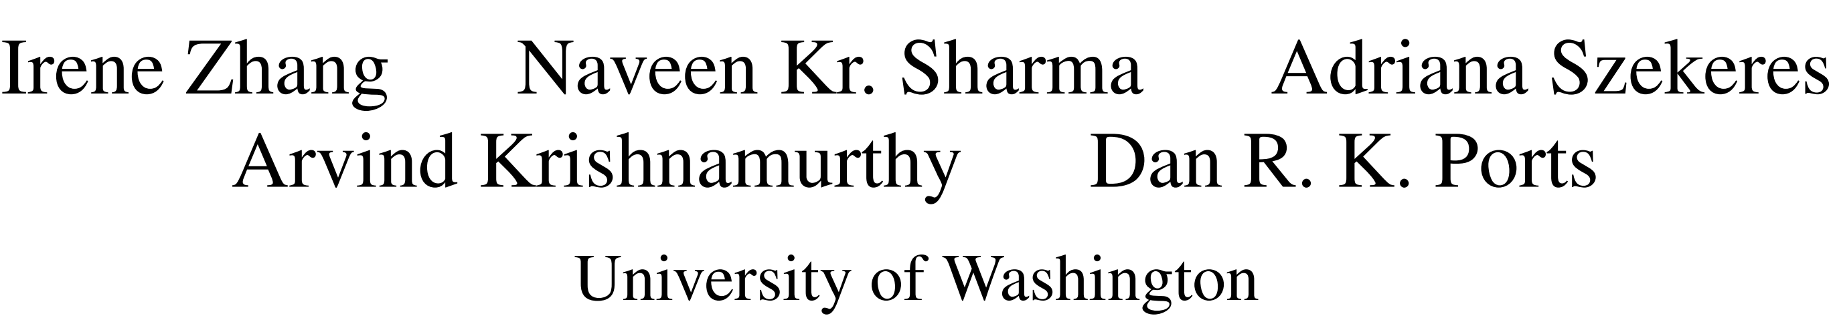
Building Consistent Transactions with Inconsistent Replication
SOSP 15

Slide 2
Outline
Background: Distributed Transaction System
IR – Inconsistent Replication Protocol
TAPIR – Transactional Application Protocol
Evaluation

Slide 3

Demands of Large-Scale Web Applications
Distributed storage system
  Fault tolerance
  Availability
Distributed transactions
  Strong consistency across regions and continents

Slide 4


Distributed Transaction
App Server
App Server
Paxos
Paxos
Paxos
Storage Partition
Storage Partition
Storage Partition

Slide 5
Distributed Transaction
App Server
App Server
Any Transaction Protocol Works (e.g., 2PC)
Paxos
Paxos
Paxos
Storage Partition
Storage Partition
Storage Partition

Slide 6
Cost for Simple Design
App Server
App Server
2 RTT
Bottleneck
Leader
Paxos
Storage Partition
Storage Partition
Storage Partition

Slide 7


Insight
Over-coordination
  Strong consistency provided by both Distributed Transaction and Replication protocol
Guarantees | Fault-tolerance | Scalability | Linearizable Ordering
Distributed Transaction Protocol
Replication Protocol

Slide 8
Design Overview
Building Consistent Transaction with Inconsistent Replication
  IR – Replication Protocol
    Provides fault tolerance without consistency
  TAPIR – Transactional Application Protocol for IR
    Leverage IR’s weak guarantees to provide high-performance linearizable transactions

Slide 9
Outline
Background: Distributed Transaction System
IR – Inconsistent Replication Protocol
TAPIR – Transactional Application Protocol
Evaluation

Slide 10
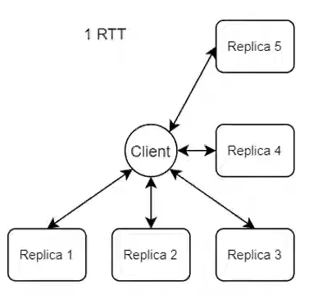
Inconsistent Replication (IR)
Store operations as unordered operation set (compared to ordered operation log e.g. Replicated State Machine)
Two types of operations:
  Inconsistent operation
    Execute in any order, persistent across failures
  Consenesus operation
    Exucute in any order, persistent across failures, return a single consensus result
Client-driven
  1 RTT from client to replicas in most time

Slide 11
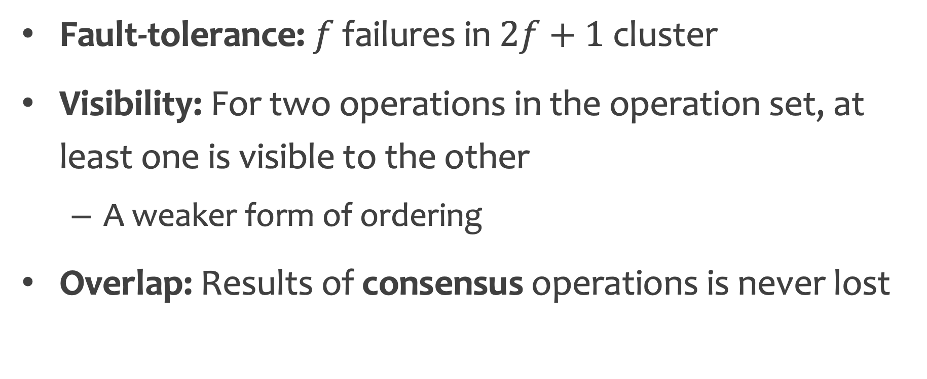
IR Guarantees
Fault-tolerance: $f$ failures in $2f+1$ cluster
Visibility: For two operations in the operation set, at least one is visible to the other
  A weaker form of ordering
Overlap: Results of consensus operations is never lost

Slide 12
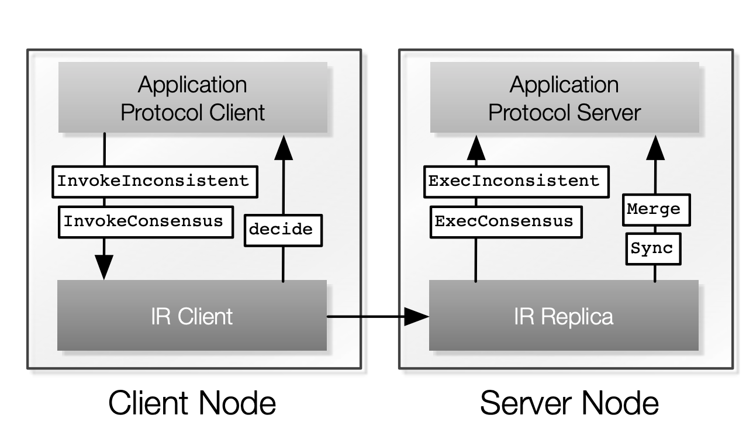
IR Interface

Slide 13
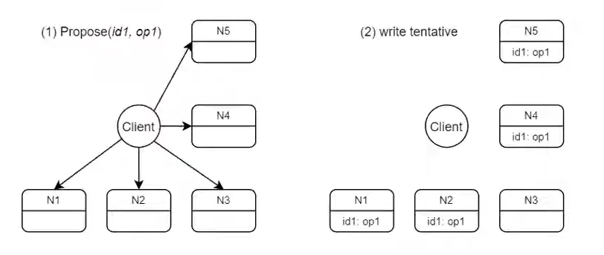
IR: Inconsistent Operation
Client initiate operation to all replicas
Replicas write operation locally as tentative

Slide 14
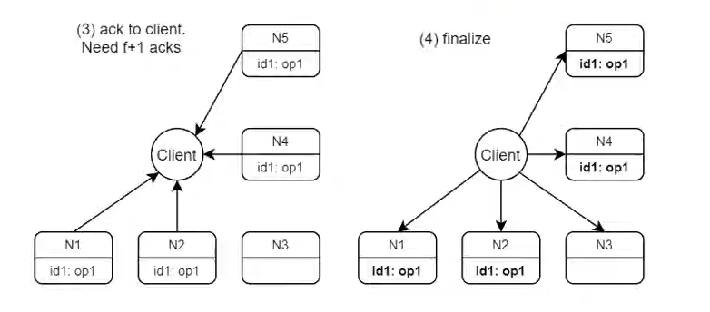
IR: Inconsistent Operation
Return to application logic after (3)
do (4) async-hronously
Only 1 RTT for Inconsistent Operation

Slide 15
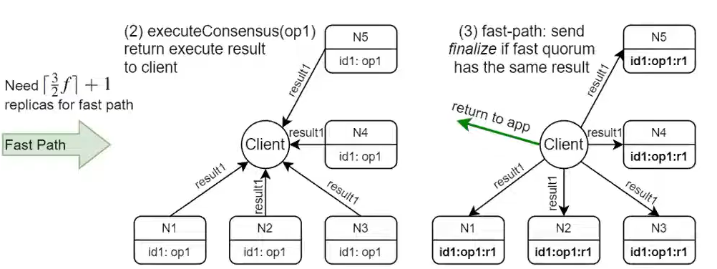
IR: Consistent Operation Fast Path
Fast Path: When there are more than $\left\lceil \frac{3}{2}f\right\rceil +1$ conseunsus result

Slide 16
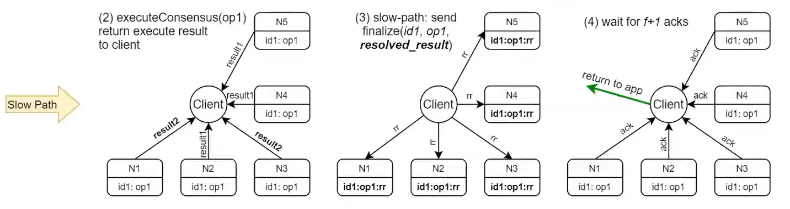
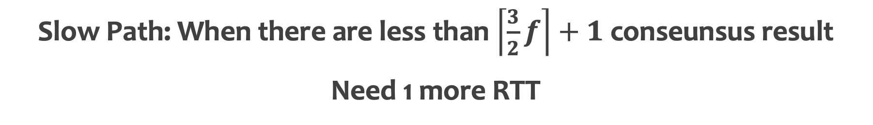
IR: Consistent Operation Slow Path
Slow Path: When there are less than $\left\lceil \frac{3}{2}f\right\rceil +1$ conseunsus result
Need 1 more RTT

Slide 17
IR: Recovery and Synchronization
Replicas may diverge, but need to make them converge
Use Merge & Sync for recovering failed replicas and running periodic sync
  Merge: Unite records from different replicas into master record
  Sync: Make each replica consistent with master record
Merge & Sync Logic are Defined by Application Logic

Slide 18
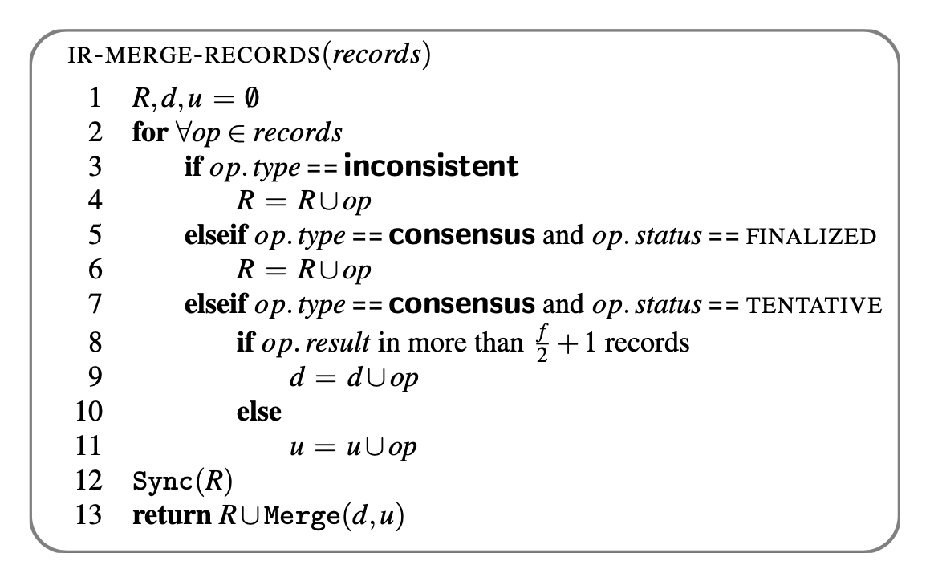
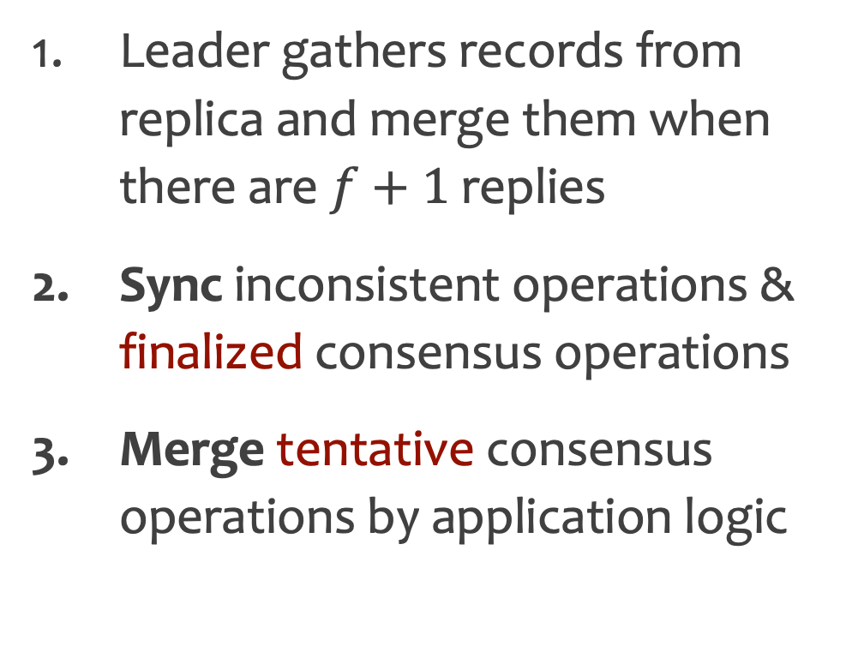
IR: Recovery and Synchronization
Leader gathers records from replica and merge them when there are $f+1$replies
Sync inconsistent operations & finalized consensus operations
Merge tentative consensus operations by application logic

Slide 19
IR Pros & Cons
Fast: 1 RTT fast path, 2RTT slow path
Efficient: No cross-replica coordination needed
Less General: Does not ensure replicas appears as a single machine
Need Co-design: Requires careful co-design for both correctness and performance

Slide 20
Outline
Background: Distributed Transaction System
IR – Inconsistent Replication Protocol
TAPIR – Transactional Application Protocol
Evaluation

Slide 21
IR Application Protocol Requirement
Invariant checks must be performed pairwise
  Weak ordering only provides pairwise visibility guarantees
Application protocols must be able to change consensus operation results
  Decide function

Slide 22
IR performance principle
Application protocols should not expect operations to execute in the same order
Use cheaper inconsistent op whenever possible rather than consensus op

Slide 23
TAPIR
Transaction Application Protocol for Inconsistent Replication
  Correctly and efficiently provides linearizable transactions with IR

Slide 24
TAPIR
Distributed transaction protocol
  2PC
Concurrency Control
  OCC
Replication Protocol
  IR

Slide 25
TAPIR
Consensus op
Inconsistent op

Slide 26
Challenges
Missing transactions
Reordered transactions
Incomplete history
A
shard1
client1
B
client2
shard2

Slide 27
Challenges
A
Missing transactions
Reordered transactions
Incomplete history
A
A
shard1
client1
B
client2
A
B
B
A
B
shard2

Slide 28
Ordering
Loosely synchronized clocks
optimistic timestamp ordering
  Validate transaction using timestamps
  Commit transaction in the timestamp order

Slide 29
OCC
Every conflict is detected at least one replicas
Full history is not necessary

Slide 30
Decide Function
Decide function merges inconsistent Prepare results from replicas into a single result

Slide 31
2PC/VR/S2PL vs TAPIR
TAPIR does not have any leaders or centralized coordination
TAPIR Reads always go to the closest replica
TAPIR Commit takes a single round-trip to the participants in the common case

Slide 32
Outline
Background: Distributed Transaction System
IR – Inconsistent Replication Protocol
TAPIR – Transactional Application Protocol
Evaluation

Slide 33
Evaluation
Target
  Latency & Throughput
  Abort rate
  Comparison to system with weak consistency
Setup
  Google Compute Engine across US, EU, Asia
  2.6GHz Intel Xeon, 8 GB RAM and 1Gb NIC
  Average clock skew 0.1-3.4ms

Slide 34
Counterpart & Workload
Counterpart
  OCC-STORE
    2PC & OCC + Multi-Paxos
  LOCK-STORE:
    2PC & S2PL + Multi-Paxos (similar to Google Spanner)
Workload
  Retwis
    Open-source Twitter clone designed to use the KV store
  YCSB+T
    An extension of YCSB

Slide 35
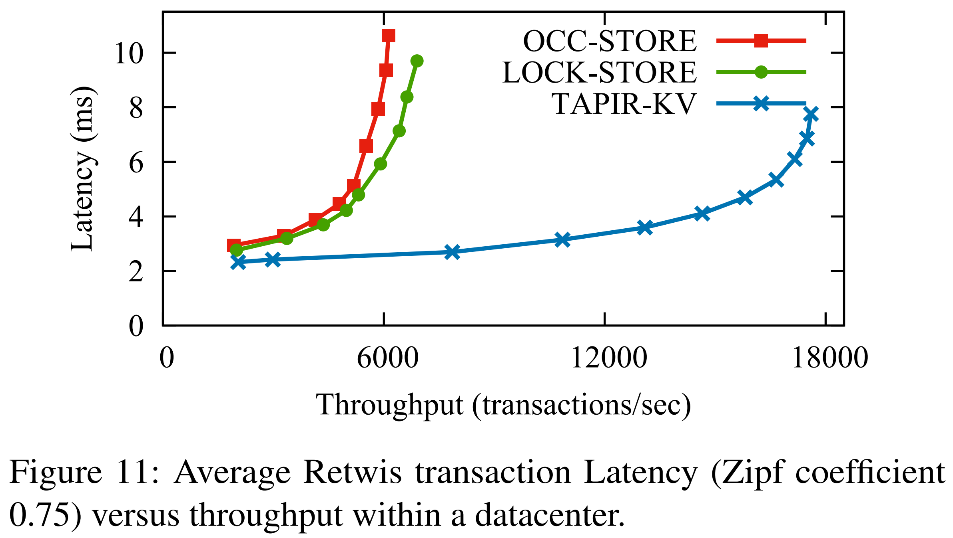
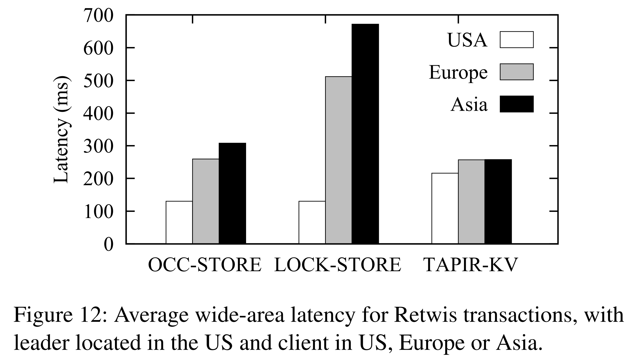
Transaction Latency & Throughput
Go to leader for read lock
Read local like
TAPIR
Wait for every replica
One round-trip
No cross-replica coordination

Slide 36
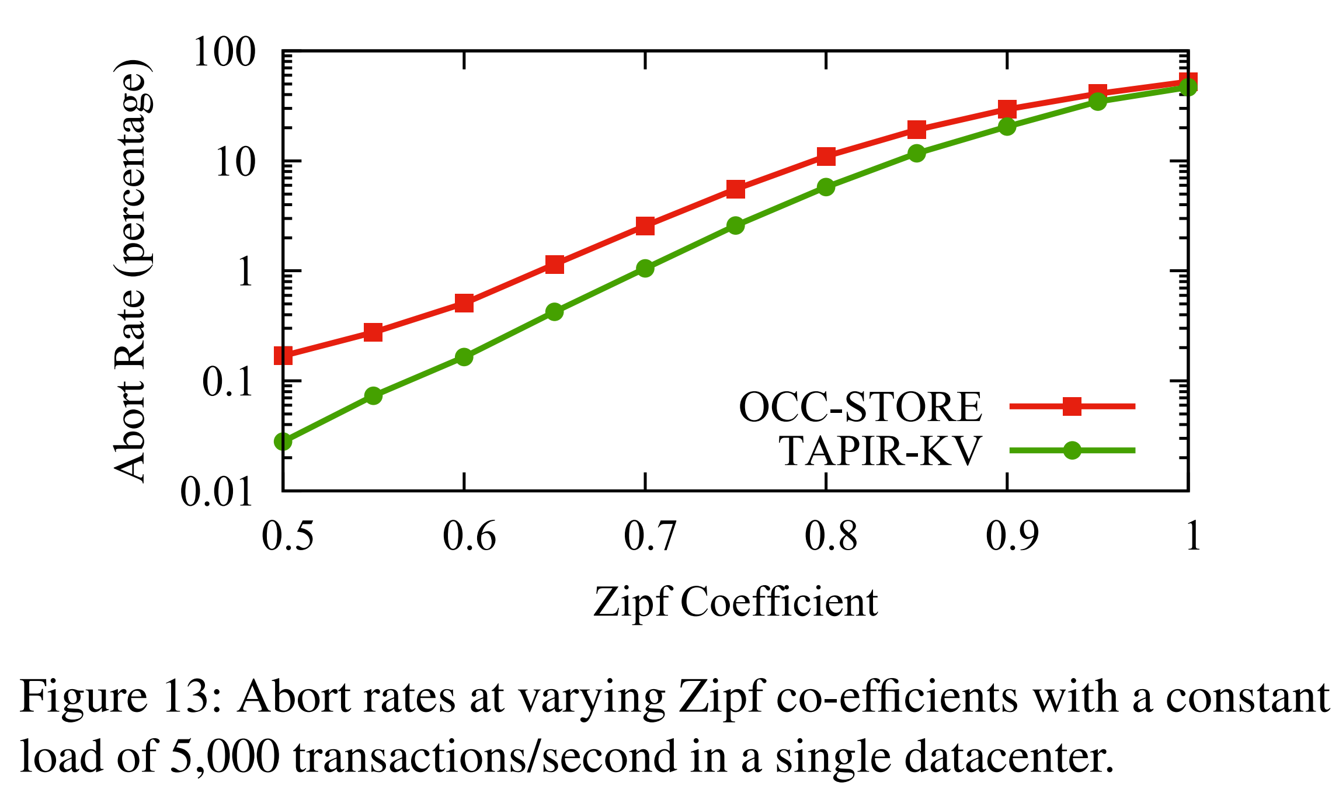
Abort Rate
Lower commit latency

Slide 37
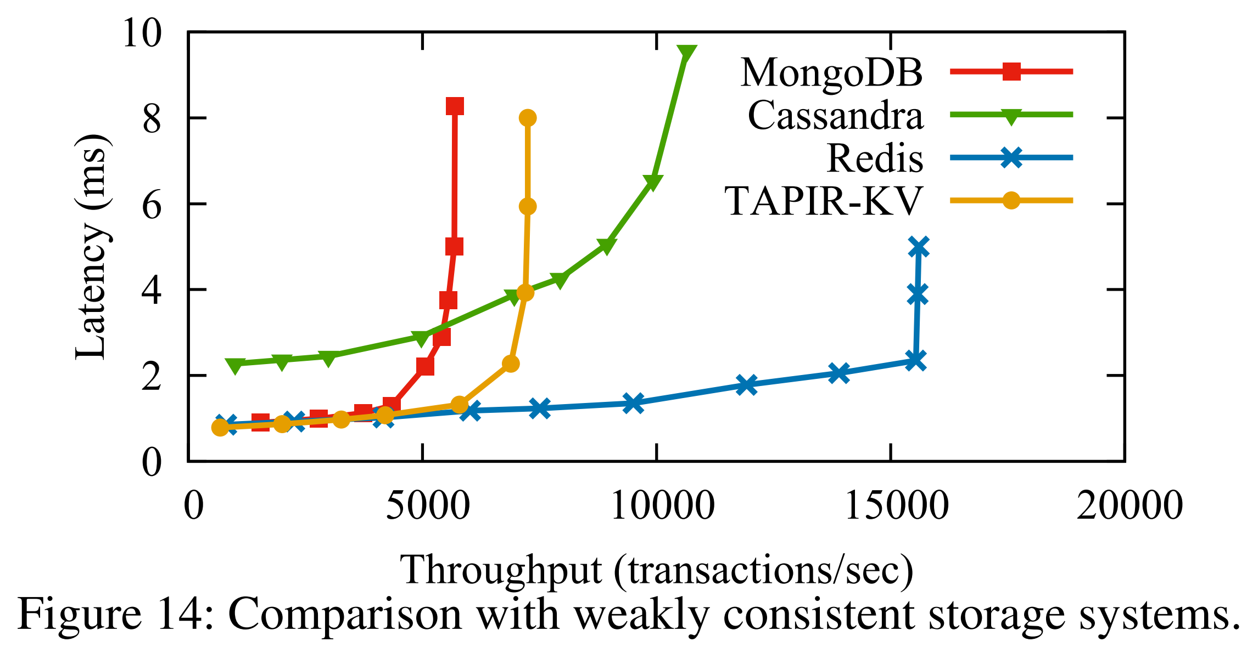
Comparison with Weakly Consistent Systems

Slide 38
Summary
Problem
  Strong replication in distributed transaction system is waste
Solution
  Co-design distributed transaction with replication protocol
Performance
  Improve latency (↓ 2x) and throughput (↑3x) significantly

Slide 39
Thanks
Q&A

Slide 40
Demo: a lock server

Slide 41
Settings
Lock Client
Lock server
  Lock: consensus operation
  Unlock: inconsistent operation
3 replicas (f=1): r1, r2, r3
2 locks: a, b
Invoke
Decide
IR Client
IR protocol
IR Replica 1
IR Replica 2
IR Replica 3
Exec
Sync, Merge
Lock Server
Lock Server
Lock Server

Slide 42
1. Lock(a)
InvokeConsensus(Lock(a))
Propose(Lock(a))
① InvokeConsensus(Lock(a))
IR Client
② Propose(Lock(a))
②
②
r1
r2
r3

Slide 43
1. Lock(a)
InvokeConsensus(Lock(a))
Propose(Lock(a))
ExecConsensus(Lock(a)), Reply(OK)
IR Client
③ Reply(ok)
③
③
③ ExecConsensus(Lock(a))
a
③
a
③
a
r1
r2
r3

Slide 44
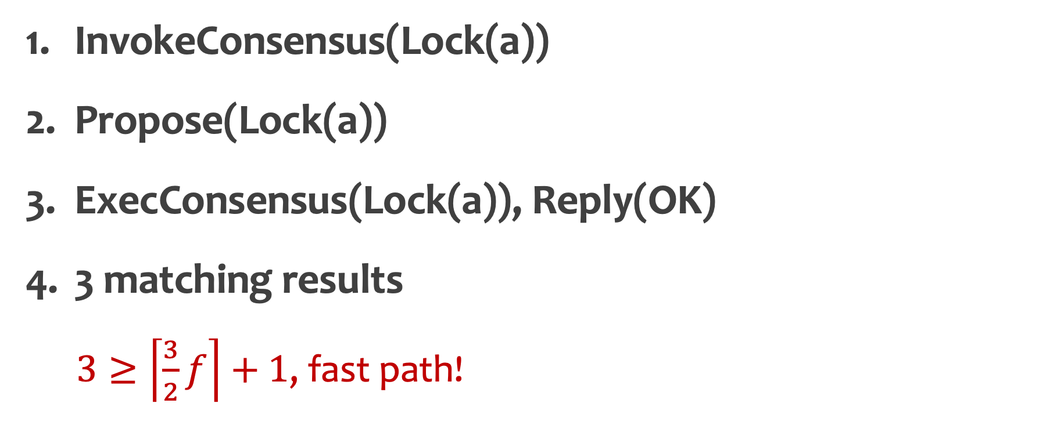
1. Lock(a)
InvokeConsensus(Lock(a))
Propose(Lock(a))
ExecConsensus(Lock(a)), Reply(OK)
3 matching results
  $3≥\left\lceil \frac{3}{2}f\right\rceil +1$, fast path!
④ Results {OK, OK, OK}
IR Client
a
a
a
r1
r2
r3

Slide 45
1. Lock(a)
InvokeConsensus(Lock(a))
Propose(Lock(a))
ExecConsensus(Lock(a)), Reply(OK)
3 matching results
Return result
Finalize (async)
⑤ OK
IR Client
⑥ Finalize
⑥
⑥
a
a
a
r1
r2
r3

Slide 46
2. Lock(b)
InvokeConsensus(Lock(b))
Propose(Lock(b))
① InvokeConsensus(Lock(b))
IR Client
② Propose(Lock(b))
②
②
a
a
a
r1 (down)
r2
r3

Slide 47
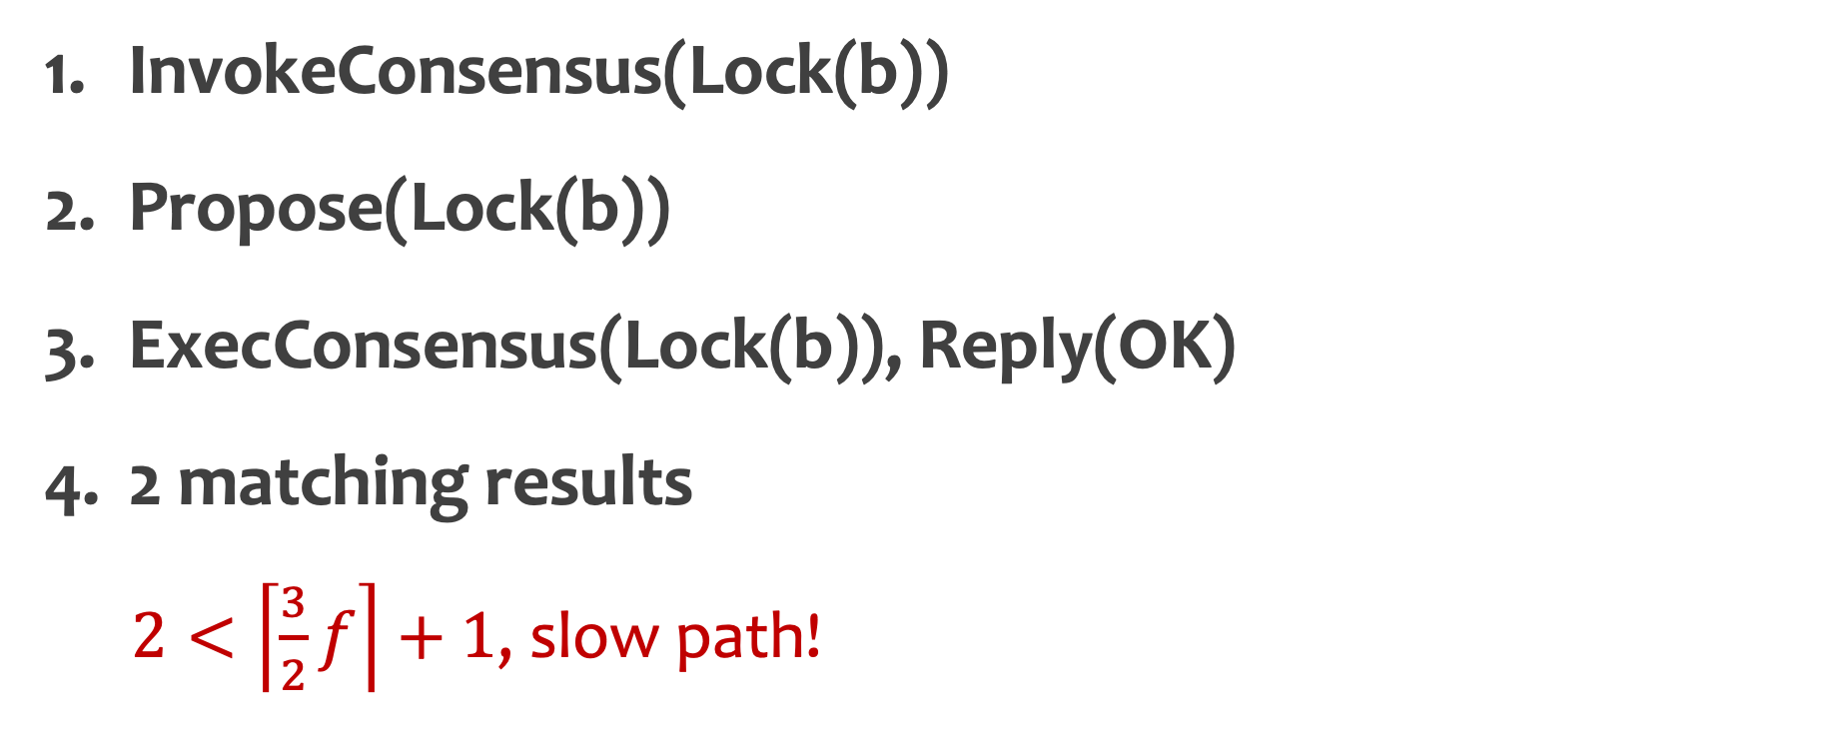
2. Lock(b)
InvokeConsensus(Lock(b))
Propose(Lock(b))
ExecConsensus(Lock(b)), Reply(OK)
2 matching results
  $2<\left\lceil \frac{3}{2}f\right\rceil +1$, slow path!
④ Results {OK, OK}
IR Client
③
③ Reply(OK)
a
a, b
a, b
a
a
a
r1 (down)
r2
r3
③ ExecConsensus(Lock(b))
③

Slide 48
2. Lock(b)
InvokeConsensus(Lock(b))
Propose(Lock(b))
ExecConsensus(Lock(b)), Reply(OK)
2 matching results
Decide(results) -> OK
Finalize
IR Client
⑤Decide(results) -> OK
⑥ Finalize
⑥
⑥
a
a, b
a, b
r1 (down)
r2
r3

Slide 49
2. Lock(b)
Confirm
Collect f+1 confirms, return OK
⑧ Collect f+1 confirms, OK
IR Client
⑦
⑦ Confirm
a
a, b
a, b
r1 (down)
r2
r3

Slide 50
2. Unlock(a)
InvokeInconsistent(Unlock(a))
Propose(Unlock(a))
① InvokeInconsistent(Unlock(a))
IR Client
② Propose(Unlock(a))
②
②
a
a, b
a, b
r1
r2
r3 (down)

Slide 51
2. Unlock(a)
InvokeInconsistent(Unlock(a))
Propose(Unlock(a))
Reply
IR Client
③ Reply
③
a
a, b
a, b
r1
r2
r3 (down)

Slide 52
2. Unlock(a)
InvokeInconsistent(Unlock(a))
Propose(Unlock(a))
Reply
Collect f+1 replies
Return OK
Finalize
⑤ Return OK
IR Client
④ Collect f+1 replies
⑥ Finalize (async)
⑥
⑥
a
a, b
a
a, b
a, b
r1
r2
r3 (down)

Slide 53
2. Unlock(b)
Similar procedures
IR Client
a
a, b
a, b
r1
r2
r3

Slide 54
3. View Change
Receive f+1 records from replicas in the latest view
Apply IR-MERGE-RECORDS in leader
  R={lock(a), lock(b), unlock(a), unlock(b)}
  d = ⌀, u = ⌀
a
a, b
a, b
r1 (leader)
r2
r3

Slide 55
3. View Change
Receive f+1 records from replicas in the latest view
Apply IR-MERGE-RECORDS in leader
  R={lock(a), lock(b), unlock(a), unlock(b)}
  d = ⌀, u = ⌀
a, b
a, b
a, b
r1 (leader)
r2
r3

Slide 56
3. View Change
Receive f+1 records from replicas in the latest view
Apply IR-MERGE-RECORDS in leader
  R={lock(a), lock(b), unlock(a), unlock(b)}
  d = ⌀, u = ⌀
a, b
a, b
a, b
r1 (leader)
r2
r3

Slide 57

Thanks
Q&A

