Slide 1
In Search of an Understandable
Consensus Algorithm
Diego Ongaro and John Ousterhout, Stanford University
^{USENIX ATC’ 2014}
Presented by 王鑫伟 裘鹏泽 应邦豪 潘子奕 陈奕君

Slide 2
What’s wrong WITH PAXOS?

Slide 3
Paxos
Drawbacks
  Paxos is exceptionally difficult to understand
    It is divided into two stages that do not have simple intuitive explanations and cannot be understood independently
  It does not provide a good foundation for building practical implementations
    No widely agreed-upon algorithm for multi-Paxos
  The Paxos architecture is a poor one for building practical systems
Notes:
Paxos非常不容易理解，并且缺少切实的实现

Slide 4
The RAFT Consensus algorithm

Slide 5
Raft basics
Goals:
  A complete and practical foundation for system building
  Safety, availability, efficiency
  Understandability
Problem decomposition
  Leader election
  Log replication
  Safety
Notes:
Raft被设计成一个完整的并且实用的一个分布式一致性算法，在提供了安全、高效这些外，易于理解是Raft相比Paxos的一大特点。
Raft将分布式一致性场景分解为三个问题：

Slide 6
Leader election

Slide 7
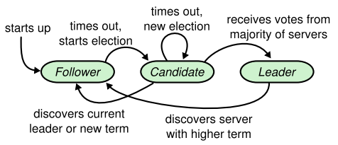
Leader election: State
State: leader, follower, candidate
  A server is in one of the following three states at any time
  “Leader” handles all client requests
  All nodes start with “Follower” state
Leader-based
consensus algorithm
Notes:
Raft算法中，集群里的机器可能的身份有三种：Leader，Follower 和Candidate
Leader负责处理client的请求，follower响应leader的请求

Slide 8
Heartbeat and Timeout
Heartbeat: AppendEntries RPC with empty entries
follower
Node B
Leader preodically sends heartbeat to followers
leader
Node A
At very beginning,
there is no leader.
Later… Timeout!
follower
Node C
Notes:
正常情况下，一个集群中有一个leader，其他都是follower。Leader不断地发送heartbeat表面自己还活着，follower收到leader的heartbeat后重置timer，如果follower在timer timeout之前没有收到心跳包，那就涉及到candidate这一身份。

Slide 9
Leader election: State
State: leader, follower, candidate
  “Leader” handles all client requests
  All nodes start with “Follwer” state
  “Follower” switches to “Candidate” if heartbeat timeout
Notes:
一个follower在等leader heartbeat，timer timeout后会转变成candidate，并进入到election阶段

Slide 10
Candidate and Election
follower
Node B
follower
RequestVote
RequestVote
Node A
Heartbeat Timeout!
Start Election
follower
candidate
Node C
Node C
Notes:
Node C一段时间没有收到Heartbeat，timeout后会发起一轮election，自己从follower变成candidate，给整个集群发RequestVote RPC。

Slide 11
Candidate and Election
follower
Node B
RequestVote RPC
Only two kinds of RPC
follower
RequestVote
RequestVote
Node A
Election Timeout（random in 150~300ms）
candidate
Win Election:
Receive majority votes
Node C
Notes:
Node C在timeout后变成candidate，然后给整个集群发RequestVote，它自己会给自己投票。如果它收到了过半数的票，就可以成为leader。

Slide 12
Candidate and Election
follower
Node B
follower
RequestVote
RequestVote
Node A
Election Timeout（random in 150~300ms）
candidate
Begin a new election again!
Node C
Notes:
如果在election期间没有收到过半的票数，那node C会发起新一轮的RequestVote

Slide 13
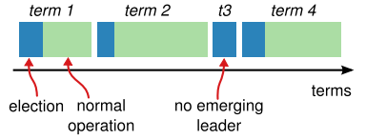
Leader election: Term
Term: act as a logical clock / mark the leader
  Terms are numbered with consecutive integers
  Each server stores a current term number(increase monotonically)
follower
Current term number: 1
Node A
Notes:
新一轮在Raft中意味着一个新的term。Term扮演了逻辑时钟的角色，每个server上都维护了自己当前的term，term是单调递增的。

Slide 14
Leader election: Term
Term: election, normal operation
  Each term begins with an election, followed by normal operation
  Split Vote! (we will discuss later)
  When to update term?
follower
Current term number: 1
Node A
Notes:
一个term可以对应现实任意长的时间，一般是前一段election，后一段normal operation。Term 3这种只有election的称为split vote，后面会讲到。

Slide 15
Term and State
AppendEntries: {}
Term: 2
Current term number: 2
Update current term to larger value!
follower
Current term number: 1
Node A
RequestVote
Term: 3
Current term number: 2
leader
candidate
Node B
Node C
Notes:
一个follower收到一个更大term的heartbeat，会更新自己的current term。
一个candidate或者一个leader收到一个term更大的RequestVote，会变成follower，并且更新自己的current term

Slide 16
Term and State
AppendEntries: {}
Term: 2
Current term number: 2
Update current term to larger value!
follower
Node A
RequestVote
Term: 3
Current term number: 3
Update current term,
And revert to follower!
follower
follower
Node B
Node C
Notes:
长时间收不到心跳包导致timeout

Slide 17
Leader election
What might happen during the leader election?
As for each candidate:
  Receive majority votes and win the election -> leader
  Discover new leader or new term -> follower
    Receive AppendEntries(term ≥ curterm) or RequestVote(term＞curterm)
  A period of time goes by with no winner -> candidate
    Election Timeout! Perhaps split vote!
    Add term and begin a new election again!
Notes:
在election阶段，follower仅投票，收到过半数票的candidate会成为leader，发现新的leader或者新的term会变成follower，如果都没发生在自身timeout后发起新一轮election。

Slide 18
Leader election(1)
follower
Current term number: 1
Node B
Current term number: 1
leader
Node A
Heartbeat
Timeout
follower
Current term number: 1
Node C
Notes:
集群中，如果leader挂了，follower发生timeout

Slide 19
Leader election(1)
follower
Current term number: 1
Node B
Current term number: 1
RequestVote
Term: 2
leader
(5)
RequestVote
Term: 2
Node A
(2)
Current term number: 2
(1)
(3)
Current term number: 1
candidate
voteFor: C
voteCount: 1
(4)
Node C
Notes:
Node C从follower变成candidate，增大自己的term，并向其他server发RequestVote RPC，

Slide 20
Leader election(1)
Current term number: 2
Vote Restriction:
(1) Vote for at most one candidate in a term
(2) First-come-first-served
(6)
follower
(7)
voteFor: C
Node B
Current term number: 1
leader
RequestVote
Term: 2
(8)
(5)
True
RequestVote
Term: 2
Node A
(2)
Current term number: 2
(1)
(3)
candidate
voteFor: C
voteCount: 2
voteFor: C
voteCount: 1
(4)
(9)
Node C
Notes:
Follower收到RequestVote RPC后，遵循两个原则：
一个term期间只能投一票
First Come First Serve，一个term期间，先收到谁的RequestVote RPC就投给谁

Slide 21
Leader election(1)
Current term number: 2
Vote Restriction:
(1) Vote for at most one candidate in a term
(2) First-come-first-served
(6)
follower
(7)
voteFor: C
Node B
Current term number: 1
leader
RequestVote
Term: 2
(8)
(5)
True
RequestVote
Term: 2
Node A
(2)
Current term number: 2
(1)
(10)
(3)
Win Election:
Receive majority votes
leader
voteFor: C
voteCount: 2
(4)
(9)
Node C
Notes:
在任一任期内，单个节点最多只能投一票
候选人知道的信息不能比自己的少（这一部分，后面介绍log replication和safety的时候会详细介绍）
first-come-first-served 先来先得

Slide 22
Leader Election(2)
follower
Current term number: 1
Node B
Current term number: 2
candidate
Current term number: 1
follower
voteFor: A
voteCount: 1
Node A
Node C
Current term number: 2
Current term number: 1
follower
candidate
voteFor: D
voteCount: 1
Node E
Node D
Notes:
如果有多个candidate，如node A和node D，谁获得过半数的vote，谁成为leader，其他candidate收到新leader的heartbeat就变成follower。
以5个机器的集群为例，A和D都timeout变成candidate，发出RequestVote RPC

Slide 23
Leader Election(2)
Current term number: 2
follower
voteFor: A
Node B
Current term number: 2
Current term number: 2
leader
follower
voteFor: A
voteCount: 3
voteFor: A
AppendEntries: {}
Term: 2
Node A
Node C
Current term number: 2
Current term number: 2
follower
candidate
voteFor: D
voteCount: 2
voteFor: D
Node E
Node D
Discover new leader,
Revert to follower
Notes:
B和C投给了A，A成为了leader，A给全体发heartbeat，

Slide 24
Leader Election(2)
Current term number: 2
follower
voteFor: A
Node B
Current term number: 2
Current term number: 2
leader
follower
voteFor: A
voteCount: 3
voteFor: A
AppendEntries: {}
Term: 2
Node A
Node C
Current term number: 2
Current term number: 2
follower
follower
voteFor: D
AppendEntries term≥self
Node E
Node D
Discover new leader,
Revert to follower
Notes:
D收到A的heartbeat后就变成follower

Slide 25
Leader Election(3)
Election Timeout（random in 150~300ms）
Current term number: 2
Current term number: 2
voteFor: A
voteCount: 2
candidate
follower
voteFor: A
Node A
Node B
Split Vote!
Current term number: 2
Current term number: 2
voteFor: D
voteCount: 2
candidate
follower
voteFor: D
Node D
Node C
Notes:
如果集群中有4个server，A和D都是candidate，B和C分别投给了A和D，A和D都没有得到过半数的票，导致这个term内无法产生leader，出现split vote现象。
解决Split vote的方法是等candidate timeout，每个candidate的election timeout在一个范围内随机，从而避免同时timeout

Slide 26
Leader Election(3)
Current term number: 3
Current term number: 3
RequestVote
Current term number: 2
candidate
follower
voteFor: A
voteCount: 4
leader
voteFor: A
voteCount: 1
voteFor: A
Node A
Node B
RequestVote
Term: 3
RequestVote
Term: 3
    Add term and begin
    a new election again!
RAFT prefer odd servers in cluster
Current term number: 2
Current term number: 3
Current term number: 3
Current term number: 2
follower
follower
voteFor: D
voteCount: 2
candidate
voteFor: A
voteFor: A
voteFor: D
RequestVote term＞self
It’s a new term,
can vote for others
Node D
Node C
Discover new term,
Revert to follower
Notes:
假设A先timeout了，发起新一轮的election，然后得到了过半数的票，就成为了leader。

Slide 27
Leader election
State: leader, follower, candidate
$1: Election Safety
At most one leader can be elected in a given term.
Notes:
在Raft中，需要过半数的限制保证了集群中至多有一个Leader。

Slide 28
Log replication

Slide 29
Log replication
Now we have elected a “Leader” and we can work.
  The leader handles all client requests
  If a client contacts a follower, the follower redirects it to the leader.
How to maintain consistency?
  Leader and followers execute client requests in the same order
    State machine
  Leader sends AppendEntries RPC to followers to do replication
    Log entry

Slide 30
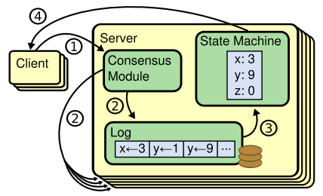
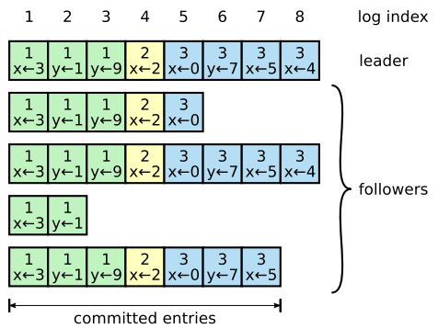
State machine and Log entry
Log Index
Same begin state + Same execute order = Same end state
Term number
Committed: once the leader has replicated the log entry on majority servers
Applied: once the server applied the log entry to state machine

Slide 31
Log replication
Send RPC Indefinitely until consistent！
follower
Current term number: 1
(7)
(3)
AppendEntries
Current term number: 1
Node B
(9)
(1)
(8)
Set x=3
True
1
(4)
State
Machine
1; x=3
client
leader
(3)
(7)
AppendEntries
commited
(6)
applied
Node A
Replicate on majority!
1
commited
(2)
1; x=3
follower
Current term number: 1
(5)
State
Machine
applied
Node C
Raft guarantees that committed entries are durable

Slide 32
Log replication
Raft guarantees that committed entries are durable and will eventually be executed by all state machines
  (1) Leader will indefinitely notify follower to apply committed log entries (AppendEntries RPC)
  (2) Leader will contain all committed log entries(including entries committed by previous leader)
  (3) Leader never overwrites or deletes its log

Slide 33

Log replication: Leader Append-Only
Raft guarantees that committed entries are durable and will eventually be executed by all state machines
  (1) Leader will indefinitely notify follower to apply committed log entries (AppendEntries RPC)
  (2) Leader will contain all committed log entries(including entries committed by previous leader)
  (3) Leader never overwrites or deletes its log
A leader never overwrites or deletes entries in its log; it only appends new entries.
$2: Leader Append-Only

Slide 34
Log matching
Raft maintains log matching property to ensure safety.
  If two entries in different logs have the same index and term, then they store the same command.
  If two entries in different logs have the same index and term, then the logs are identical in all preceding entries.
Leader Append-Only
Consistency check
  AppendEntries RPC!

Slide 35
prevLogIndex: index of log entry immediately preceding new ones
prevLogTerm: term of prevLogIndex entry
1, 1
entries[]: log entries to store(empty for heartbeat)
[1,1]
leaderCommit: leader’s commitIndex
1
2
AppendEntries
1
leader
follower
1
1
1
Node A
Node B
commitIndex: index of highest log entry known to be commited
2
1
commitIndex: index of highest log entry known to be commited
matchIndex[]: for each server, index of highest log entry known to be replicated on server
[A,B]=[2,1]
nextIndex[]: for each server, index of next log entry to send to that server
[A,B]=[3,2]

Slide 36
Log matching
Current term number: 6
follower
1
2
3
4
5
6
AppendEntries
Term: 6
1
1
2
2
3
3
Node B
Current term number: 6
prevLogIndex: 4
prevLogTerm: 5
Initial: logs[nextIndex[x]-1]
leader
AppendEntries
Term: 6
(2)
Node A
False
Current term number: 6
1
2
3
4
(4)
1
1
4
5
follower
1
2
3
Decrese nextIndex[] and try again!
commitIndex: 4
1
1
4
(3)
nextIndex[]: {5,5,5}
(1)
Node C
Initial: logIndex + 1

Slide 37
Log matching
Current term number: 6
A few rounds later…
follower
1
2
3
4
5
6
AppendEntries
Term: 6
1
1
2
2
3
3
Node B
Overwrite!
Current term number: 6
prevLogIndex: 3
prevLogTerm: 4
Initial: logs[nextIndex[x]-1]
leader
AppendEntries
Term: 6
(2)
Node A
True
Current term number: 6
1
2
3
4
(4)
1
1
4
5
follower
1
2
3
commitIndex: 4
1
1
4
nextIndex[]: {5,3,4}
(1)
Append!
Node C
(3)

Slide 38
Log matching
Current term number: 6
A few rounds later…
follower
1
2
3
4
AppendEntries
Term: 6
1
1
4
5
Node B
Current term number: 6
prevLogIndex: 3
prevLogTerm: 4
Initial: logs[nextIndex[x]-1]
leader
AppendEntries
Term: 6
(2)
Node A
True
Current term number: 6
1
2
3
4
(4)
1
1
4
5
follower
1
2
3
4
commitIndex: 4
1
1
4
5
(1)
nextIndex[]: {5,5,5}
(5)
Node C
(3)

Slide 39
Log matching
Raft maintains log matching property to ensure safety.
  If two entries in different logs have the same index and term, then they store the same command.
  If two entries in different logs have the same index and term, then the logs are identical in all preceding entries.
Leader Append-Only
Consistency check
If two logs contain an entry with the same index and term, then the logs are identical
in all entries up through the given index.
$3: Log Matching

Slide 40
Log replication: Leader Completeness
Raft guarantees that committed entries are durable and will eventually be executed by all state machines
  (1) Leader will indefinitely notify follower to apply committed log entries (AppendEntries RPC) -> Log matching
  (2) Leader contains all committed log entries(including entries committed by previous leader)
  (3) Leader never overwrites or deletes its log -> Leader Append-Only
If a log entry is committed in a given term, then that entry will be present in the logs of the leaders for all higher-numbered terms.
$4: Leader Completeness

Slide 41
Leader completeness
If a log entry is committed in a given term, then that entry will be present in the logs of the leaders for all higher-numbered terms.
  Log replication: commit once the leader has replicated the log entry on majority servers
  Leader election: voter denies RequestVote RPC if its own log is more up-to-date than that of the candidate
    New Vote Restrict!
  Commit majority and vote majority must overlap.

Slide 42
Up-to-date log
RequestVote
1
2
3
4
1
2
3
4
5
6
follower
candidate
1
1
4
5
1
1
2
2
3
3
False
Node B
Node C
lastLogTerm: 5
lastLogTerm: 3
RequestVote
1
2
3
1
2
3
4
follower
candidate
1
1
2
1
1
2
2
True
Node B
Node C
lastLogTerm: 2
lastLogIndex: 3
lastLogTerm: 3
lastLogIndex: 4

Slide 43
Leader completeness
Heartbeat
Timeout
Current term number: 7
voteFor: null
Current term number: 6
voteFor: null
follower
1
2
3
4
Current term number: 6
1
1
4
5
Node B
1
2
3
4
RequestVote
leader
False
lastLogIndex: 3
lastLogTerm: 4
1
1
4
5
RequestVote
Node A
Current term number: 7
voteFor: C
voteCount: 1
candidate
1
2
3
Node C
1
1
4
Notes:
长时间收不到心跳包导致timeout

Slide 44
Leader completeness
Current term number: 8
voteFor: B
voteCount: 1
candidate
1
2
3
4
Current term number: 6
RequestVote
1
1
4
5
Node B
1
2
3
4
RequestVote
leader
lastLogIndex: 4
lastLogTerm: 5
1
1
4
5
Node A
Current term number: 7
voteFor: C
voteCount: 1
candidate
1
2
3
Node C
1
1
4
Notes:
长时间收不到心跳包导致timeout

Slide 45
Leader completeness
Current term number: 8
voteFor: B
voteCount: 2
Commit majority: A/B
Vote majority: B/C
leader
1
2
3
4
Current term number: 6
RequestVote
1
1
4
5
Node B
1
2
3
4
RequestVote
leader
True
lastLogIndex: 4
lastLogTerm: 5
1
1
4
5
Node A
Current term number: 8
Vote Restrict:
(1) Vote for at most
one candidate in a term
(2) First-come-first-served
(3) Reject if log more up-to-date then candidate
follower
voteFor: B
1
2
3
Node C
1
1
4
Notes:
长时间收不到心跳包导致timeout

Slide 46
Log replication
Raft guarantees that committed entries are durable and will eventually be executed by all state machines
  (1) Leader will indefinitely notify follower to apply committed log entries (AppendEntries RPC) -> Log matching
  (2) Leader contains all committed log entries(including entries committed by previous leader) -> Leader completeness
  (3) Leader never overwrites or deletes its log -> Leader Append-Only

Slide 47
SATEFY
Notes:
接下来由我来给大家介绍raft中保证safety的机制。

Slide 48
State Machine Safety
If a server has applied a log entry at a given index to its state machine, no other server will ever apply a different log entry for the same index.
It seems obvious
  Leader Append-Only
  Log Matching
  Leader Completeness
But…
Notes:
raft可以保证state machine safety,也就是说apply到state machine的log entry是durable的，不同server在同一个index apply不同log entry的情况不会出现。根据前面介绍的Leader Append-Only，Log Matching和Leader Completeness三个机制，这个结论好像是显然成立的。但这三个机制还不够，我们看下面这个例子。

Slide 49
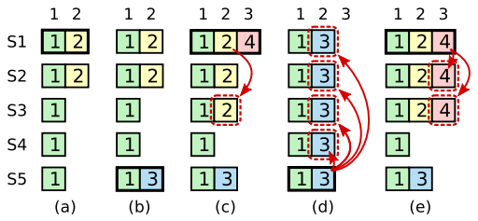
State Machine Safety
LogIndex 2 is
partially replicated
Notes:
首先，S1作为leader并且复制term为2的log

Slide 50
State Machine Safety
S1 Crash
S5 is elected leader, receive new entry
But haven’t replicated LogIndex 3
Notes:
在进行到一半的时候，S1发生故障下线了，这时候S5获得S3,S4和自己的选票成为新的leader，并且在第二个log的位置接受了一个term为3的新entry

Slide 51
State Machine Safety
S1 is elected leader, receive new entry
Continue replicate LogIndex 2
S5 Crash
Notes:
这时候S5发生故障下线了，S1重启并且再次成为leader，接受新的entry并且继续复制term为2的log，在图c的时候，term为2的log已经被复制到集群的majority上了，下一步就是commit

Slide 52
State Machine Safety
S1 Crash
S5’s log is up-to-date, is elected leader Replicate LogIndex 2
Overwrite LogIndex 2 !!!
Notes:
这时候S1又故障下线并且S5重启，这时候S5的log内容是最新的，因此S5可以拿到S2，S3和S4的选票成为leader，那么在S5复制term为3的log的时候就会覆盖S2和S3中的log

Slide 53
State Machine Safety
Anomaly: An old log entry is stored on a majority of servers, yet can still be overwritten by a future leader.
Raft never commits log entries from previous term.
When commit log entries from current term, all prior entries are committed indirectly.
  Log Matching Property
Notes:
在上面的例子中，就出现了majority上旧的log entry被新leader覆盖的情况。为了解决这个问题，Raft的做法是不显式地对之前term的log entry做commit，只对当前term的log entry做commit，而且之前介绍的Log Matching Property保证了在对当前term的log entry做commit的时候，之前的entry都会间接地被commit。

Slide 54
State Machine Safety
Commit LogIndex 2 indirectly
S5’s log is not up-to-date,
can’t win an election.
Notes:
图c就是没加限制之前在term4的时候显式commit term为2的log，图e就是加上限制之后，term为2的log只会在term为4的log commit的时候被间接commit，这时候如果S1宕机的话，S5的log不是最新的，不能成为leader，那么term为4的log就可以正常commit了，并且包括term为2的log在内的所有之前的log也都被commit了。

Slide 55
Timing and availability
The ability of the system to respond to clients in a timely manner must inevitably depend on timing.
broadcastTime << electionTimeout << MTBF
  broadcastTime: 0.5ms ~ 20ms
  electionTimeout: 10ms ~ 500ms
  MTBF: several months or more
Notes:
为了保证高可用，raft需要选择合适的系统时间参数。raft涉及broadcast Time,，election Timeout和MTBF三个参数。其中broadcast Time就是发送RPC的时间，MTBF就是服务器故障之间的时间间隔。这两个参数是硬件属性，broadcast Time在毫秒级别，MTBF在月级别。那么raft需要确定一个合适的election Timeout。election Timeout太小的话，没发几次RPC，election都还在推进的过程中就Timeout然后重做，浪费时间；太大的话，election阻塞之后继续等待是没有意义的，因此最终确定的election Timeout满足这条不等式，远大于broadcast Time并且远小于MTBF，这样既能保证election的顺利推进，也可以让集群保持一个相对稳定的leader，可以把更多的资源拿来跑实际负载。

Slide 56
Understandability and Performance
Notes:
最后就是evaluation部分，主要使用的是易懂性和性能两个标准。

Slide 57
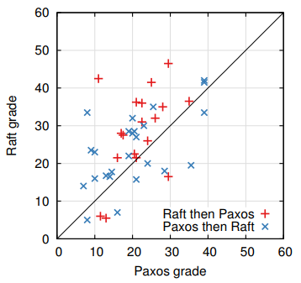
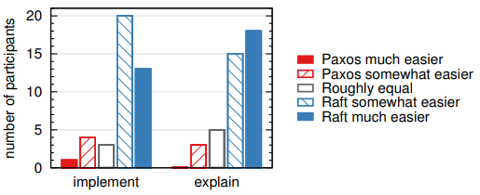
Understandability
Notes:
首先是易懂性，设计raft的初衷就是寻找一种比Paxos好理解的一致性算法。作者找了一批学生，给他们上了Paxos和Raft的课，通过客观成绩和主观感受来体现raft的易懂性。左边这张图是学生Raft和Paxos测试的成绩分布图。红色的点是先学Raft后学Paxos人的成绩，蓝色的点是先学Paxos后学Raft人的成绩。那么在这条黑线上面的就是Raft分更高的人。我们可以看到不管蓝色还是红色，黑线上面的人数都明显大于黑线下面，也就是在客观成绩上体现了Raft更易懂。右边这张图就是做了一个采访，可以看到认为Raft更简单的人占了大多数。

Slide 58
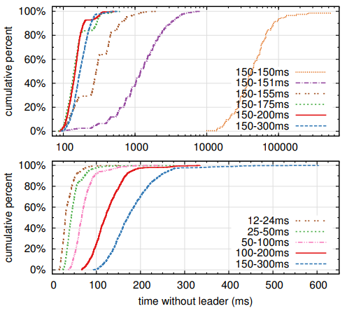
Performance
Notes:
然后是性能指标。作者在5个机器的集群上，通过不停crash leader来研究不同election Timeout对集群无leader时间的影响。每组实验都重复了一千次，横坐标就是无leader时间，纵坐标是累计百分比。比如横坐标1000ms，纵坐标40%就意味着1000次实验里，有40%次数的实验无leader时间在0到1000ms范围内。
我们先看上面这张图，在election Timeout固定在150ms的时候，无leader时间最长，超过了10秒，这是因为election Timeout导致了split vote。之前提到过通过election Timeout随机分布可以缓解split vote的影响。我们可以看到随机范围很小，只有1ms的时候也能大大减少无leader时间，在范围扩大到25ms的时候差不多达到最小值，进一步扩大范围对无leader时间的影响不大。下面这张图说明election Timeout越小，无leader时间越短。但是刚才提到如果election Timeout有一个远大于broadcast Time的下限。在这个实验中broadcast Time是15ms，因此最终还是保守地选择了150-300ms的范围，在保证election顺利推进的前提下提供良好的可用性。

Slide 59

Thanks
Notes:
谢谢大家，这是我们的二维码

