Slide 1
PowerGraph
2021.05.08

Slide 2
目录 Contents
1
Background
2
PowerGraph
3
Vertex-Cut
4
Evaluation
5
Summary

Slide 3

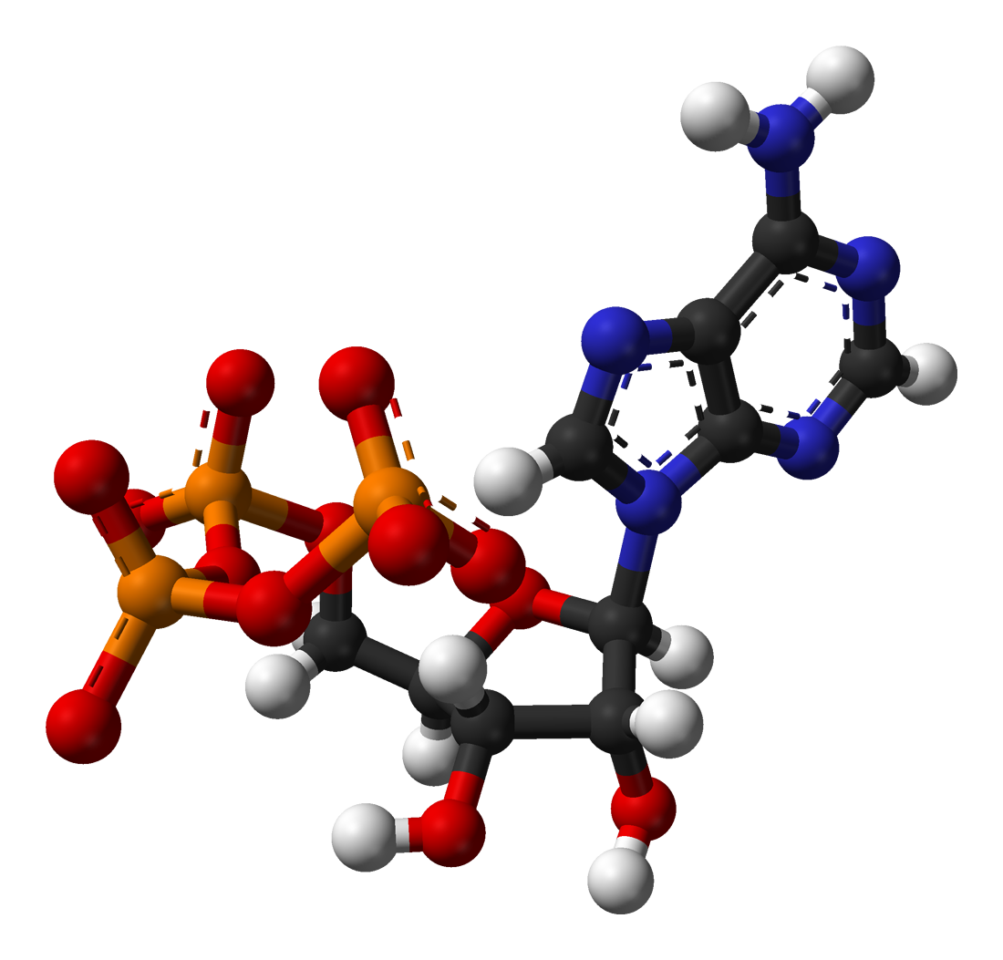

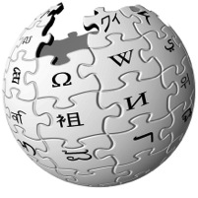




Current State
Graphs are ubiquitous..
Social Media
Science
Advertising
Web

Slide 4
Current State
Graphs encode relationships between:
People Products Facts Interests
Big: billions of vertices and edges and rich metadata

Slide 5
Current State
Graphs are Essential to
Data-Mining and Machine Learning
Identify influential people and information
Find communities
Target ads and products
Model complex data dependencies

Slide 6
Current State
Graphs are Essential to MLDM
Graph structured computation is important
Graphs are big
Current systems provide graph parallel computation
    Pregel
    GraphLab

Slide 7
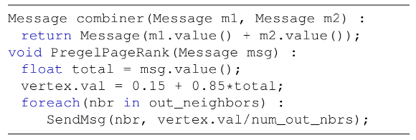
Graph-Parallel Abstractions
Pregel
Bulk Synchronous Parallel (BSP) model
Vertex-Programs interact by sending messages.
i

Slide 8
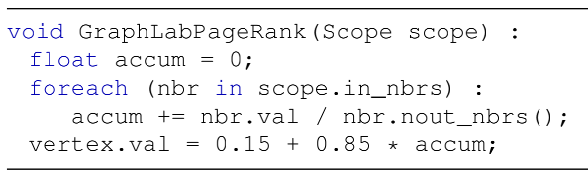
Graph-Parallel Abstractions
GraphLab
asynchronous distributed shared memory abstraction
Vertex-Programs directly read the neighbors state
i

Slide 9
Graph-Parallel Abstractions
GAS Decomposition
Gather: Accumulate information about neighborhood
Apply: Apply the accumulated value to center vertex
Scatter: Update adjacent edges and vertices

Slide 10

Graph-Parallel Abstractions
Gather
Apply
Scatter
Accumulate information about neighborhood
Apply the accumulated
value to center vertex
Update adjacent edges
and vertices.
User Defined:
User Defined:
Gather( ) → Σ
User Defined:
Scatter( ) →
Y
Apply( , Σ) →
Y’
Σ₁ + Σ₂ → Σ₃
Y
Y’
Σ
Y’
Y
Y’
Y
Update Edge Data &
Activate Neighbors
Parallel
Sum
+
+ … + →
Y
Y
Y

Slide 11
Natural Graphs
Existing distributed graph computation systems perform poorly on Natural Graphs.
Natural Graphs usually have power-law degree distributions.
power-law graphs are difficult to partition and represent in a distributed environment.

Slide 12
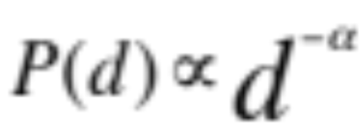
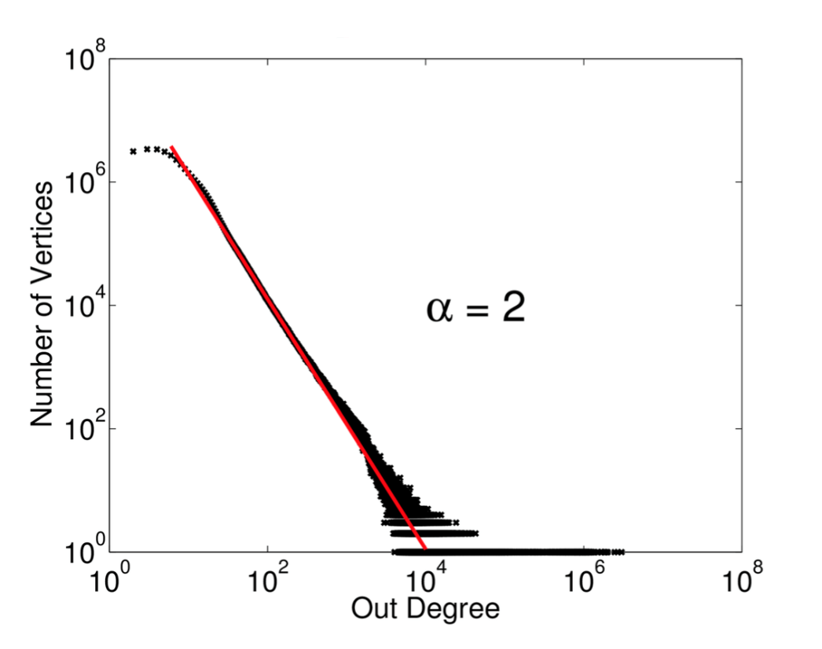
Natural Graphs
power-law degree distribution

Slide 13
Natural Graphs
Challenges of Natural Graphs
Work Balance
Partitioning
Communication
Storage
Computation
Notes:
传统的边划分把一个顶点及顶点的邻居信息交给一台机器处理：
1.不同度数的顶点的计算量之间可能会有很大不同，导致work imbalance。
2.传统的图计算方法为了work balance和并行计算把图进行划分，这在自然图中会是一个巨大的挑战。
3. Pregel，它处理高纬度点的缺陷是单个worker要发送大量消息给邻居节点。
4.单个机器存储点和邻居信息，高密度的点的存储会超过单机内存大小。
5.传统的并行计算是点与点之间的并行，高密度的点就会有很大延迟，带来性能瓶颈

Slide 14
目录 Contents
1
Background
2
PowerGraph
3
Vertex-Cut
4
Evaluation
5
Summary

Slide 15
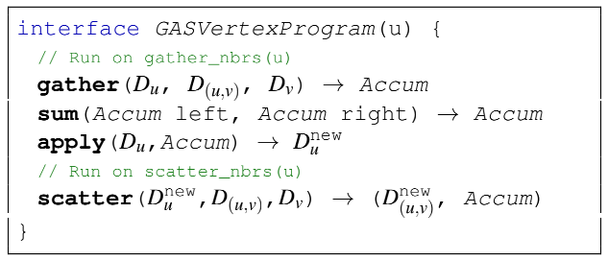
PowerGraph Abstraction
GAS Vertex-Programs

Slide 16
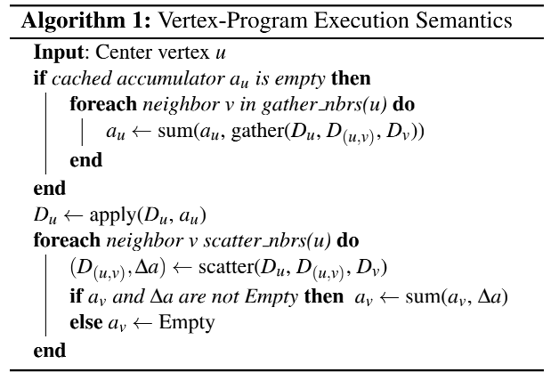
PowerGraph Abstraction
GAS Vertex-Programs

Slide 17
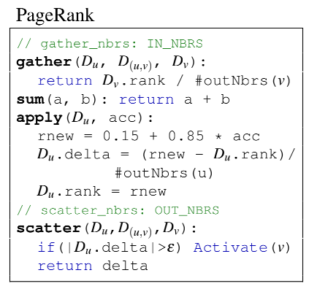
PowerGraph Abstraction
GAS Vertex-Programs

Slide 18
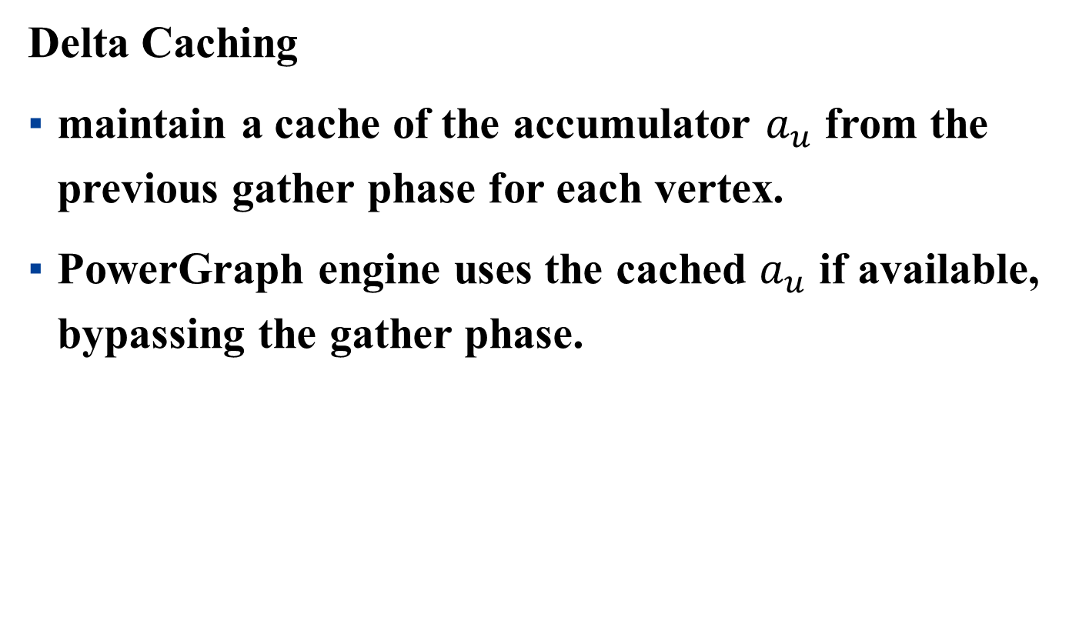
PowerGraph Abstraction
Delta Caching
maintain a cache of the accumulator $a_{u}$ from the previous gather phase for each vertex.
PowerGraph engine uses the cached $a_{u}$ if available, bypassing the gather phase.

Slide 19
PowerGraph Abstraction
Delta Caching
Notes:
PowerGraph engine缓存了上一个gather步骤每一个顶点的计算结果a，并且会在scatter阶段动态的更新这个值，在执行阶段，如果a存在，那么就可以直接使用a，跳过gather阶段，节省计算资源。

Slide 20
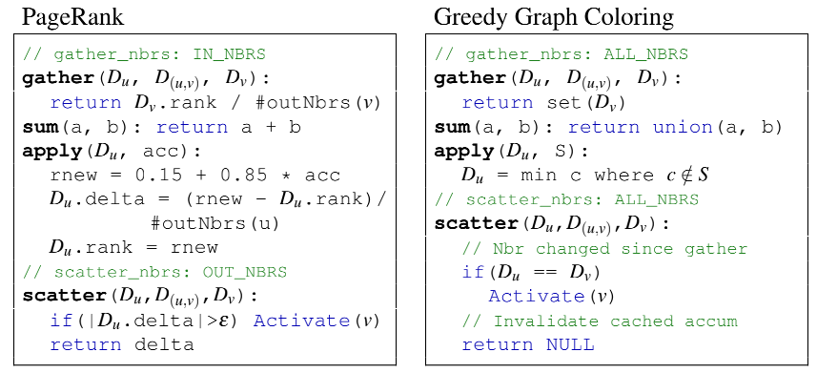
PowerGraph Abstraction
Delta Caching

Slide 21
PowerGraph Abstraction
Supports three execution modes:
Synchronous: Bulk-Synchronous GAS Phases
Asynchronous: Interleave GAS Phases
Asynchronous + Serializable: Neighboring vertices do not run simultaneously

Slide 22
Distributed Graph Placement
The placement of the data-graph structure and data plays a central role in minimizing communication and ensuring work balance.

Slide 23
目录 Contents
1
Background
2
PowerGraph
3
Vertex-Cut
4
Evaluation
5
Summary

Slide 24
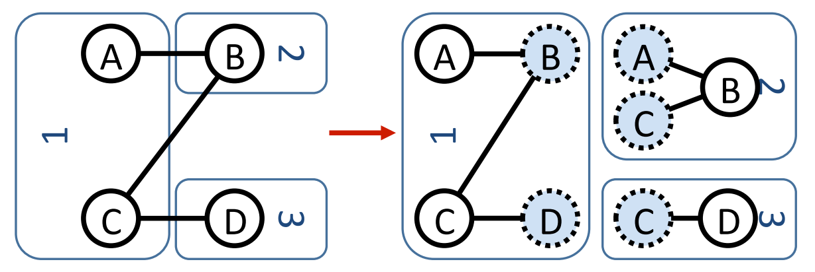
Vertex-Cut
A common approach to placing a graph on a cluster
of p machines is to construct a balanced p-way edge-cut

Slide 25
Vertex-Cut
A three-way edge-cut of a four vertex graph
resulting in five ghost vertices and all edge data being
replicated.

Slide 26
Vertex-Cut
Evenly assign edges to machines
  Minimize machines spanned by each vertex
Assign each edge as it is loaded
  Touch each edge only once

Slide 27
Vertex-Cut
PowerGraph allows a single vertex-program to span multiple machines, we can improve work balance and reduce communication and storage overhead by evenly assigning edges to machines and allowing vertices to span machines.
CPU 1
CPU 2
Y
Must synchronize
many edges
Y
CPU 1
CPU 2
Y
Y
Must synchronize
a single vertex

Slide 28
Vertex-Cut
New Theorem:
For any edge-cut we can directly construct a vertex-cut which requires strictly less communication and storage.

Slide 29
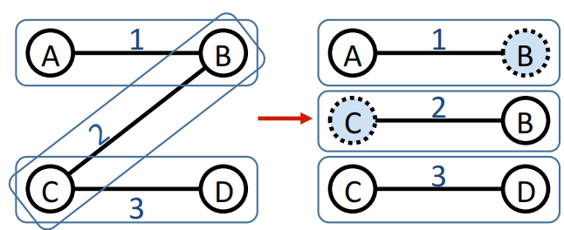
Vertex-Cut
For each vertex v with multiple replicas, one of the replicas is randomly nominated as the master which maintains the master version of the vertex data.
All remaining replicas of v are then mirrors and maintain a local cached read only copy of the vertex data.

Slide 30
Vertex-Cut
Vertex-Cut vs Edge-Cut

Slide 31
Vertex-Cut
Propose three distributed approaches:
  Random Edge Placement
  Coordinated Greedy Edge Placement
  Oblivious Greedy Edge Placement

Slide 32
Vertex-Cut —— Random
Randomly assign edges to machines
Machine 1
Machine 2
Machine 3
Balanced Vertex-Cut
Y
Spans 3 Machines
Y
Y
Y
Y
Y
Z
Y
Z
Y
Y
Y
Z
Z
Spans 2 Machines
Not cut!

Slide 33
Vertex-Cut —— Random
Expected number of machines spanned by a vertex:
Twitter Follower Graph
41 Million Vertices
1.4 Billion Edges
Accurately Estimate Memory and Comm.
Overhead

Slide 34
Vertex-Cut —— Random
Expected improvement from vertex-cuts:
Order of Magnitude
Improvement

Slide 35
Vertex-Cut —— Greedy
Place edges on machines which already have the vertices in that edge.
Machine1
Machine 2
A
B
B
C
A
D
B
E
B
E

Slide 36
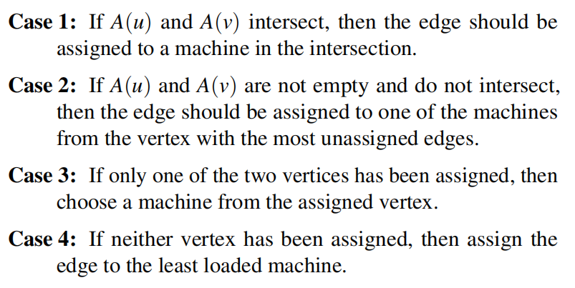
Vertex-Cut —— Greedy

Slide 37
Vertex-Cut
De-randomization → greedily minimizes the expected number of machines spanned
Coordinated Edge Placement
  Requires coordination to place each edge
  Slower: higher quality cuts
Oblivious Edge Placement
  Approx. greedy objective without coordination
  Faster: lower quality cuts

Slide 38
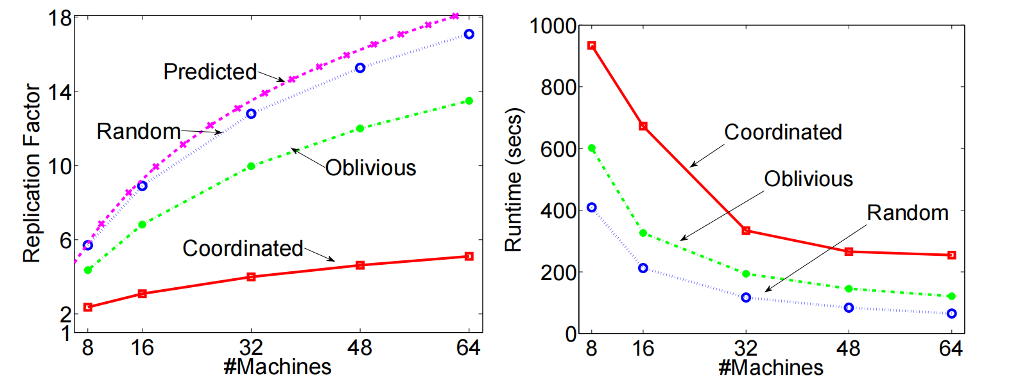
Vertex-Cut
Better
Oblivious balances cost and partitioning time.

Slide 39
Vertex-Cut
Greedy partitioning improves
computation performance.

Slide 40
目录 Contents
1
Background
2
PowerGraph
3
Vertex-Cut
4
Evaluation
5
Summary

Slide 41
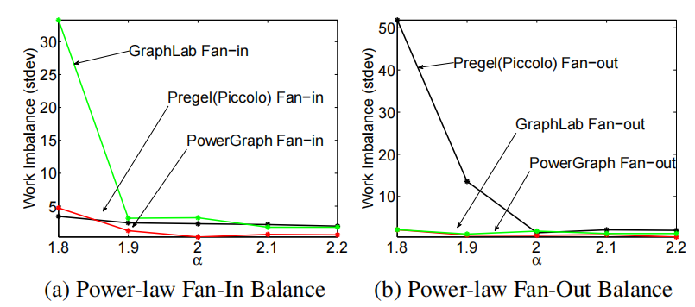
Compared with Pregel and GraphLab
Notes:
首先是对三种图抽象的比较：
在图a和图b中，作者对工作不平衡程度进行了度量，PowerGraph是最平衡的。

Slide 42
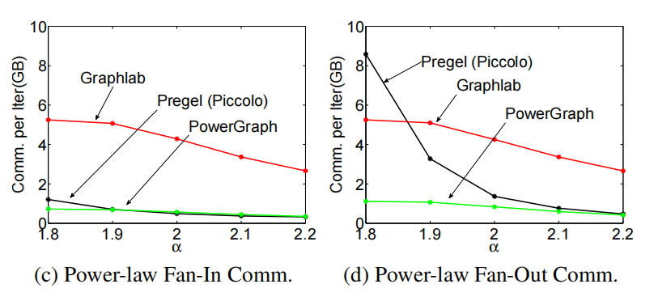
Compared with Pregel and GraphLab
Notes:
c,d两图是对通信量的评估，PowerGraph的通信量是最少的。

Slide 43
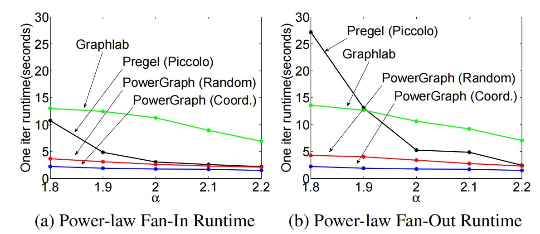
Compared with Pregel and GraphLab
Notes:
作者对每次迭代时间也进行了评估，在低α图上，PowerGraph明显优于GraphLab和Pregel。

Slide 44
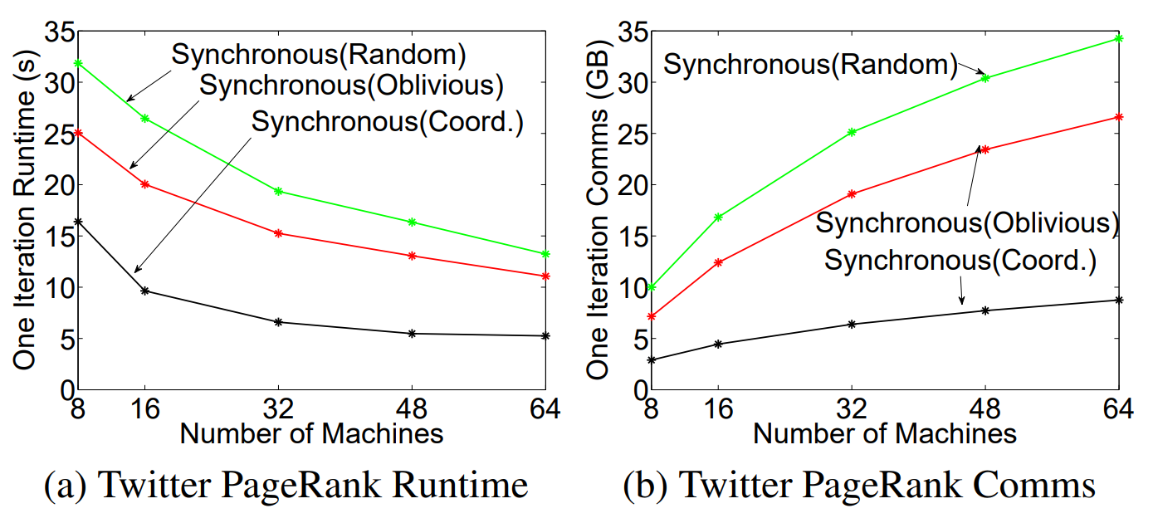
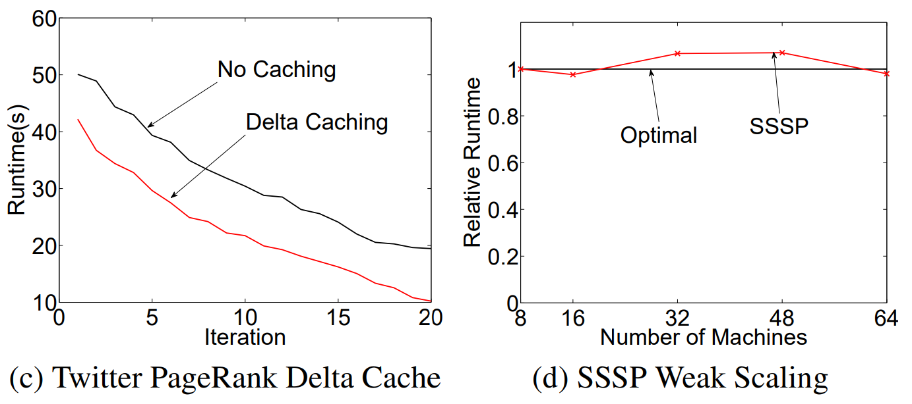
Synchronous Experiments
Notes:
在同步的PowerGraph的实现中：
图ab，在不同数量的机器上，coordinative划分方式均取得了最优效果，包括迭代一次的速度最快以及迭代一次的通信量最少。
图c，随着迭代次数增加，每次迭代需要的时间变少，同时有缓存的方式迭代速度更快。
图d，对扩展性测试，他们的实现展示了几乎最优的弱扩展性

Slide 45
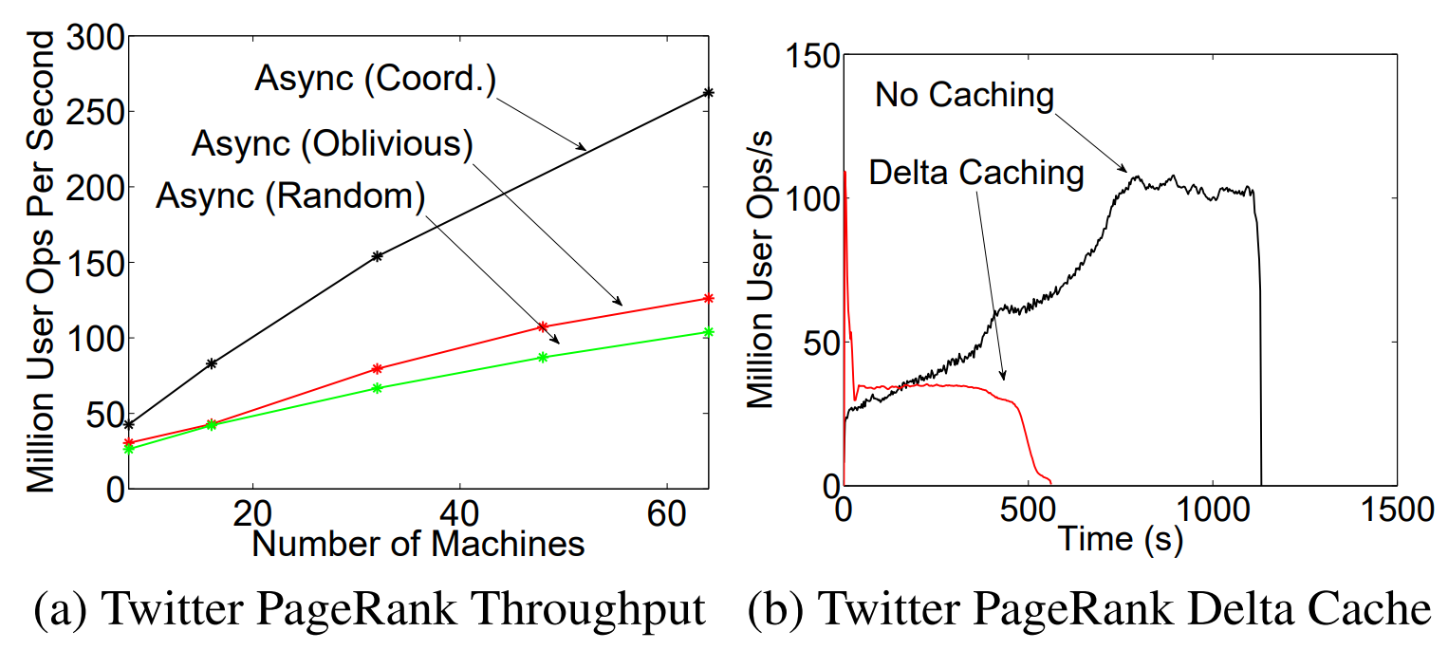
Asynchronous Experiments
Notes:
在异步的PowerGraph实现中，coordinative每秒用户操作数最多，random最少；同时有cache的情况下操作数会少很多。

Slide 46
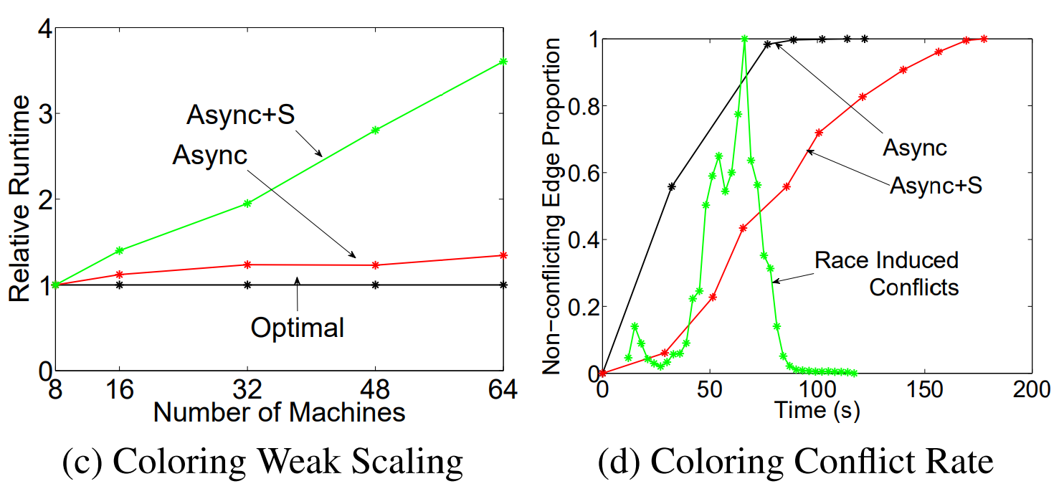
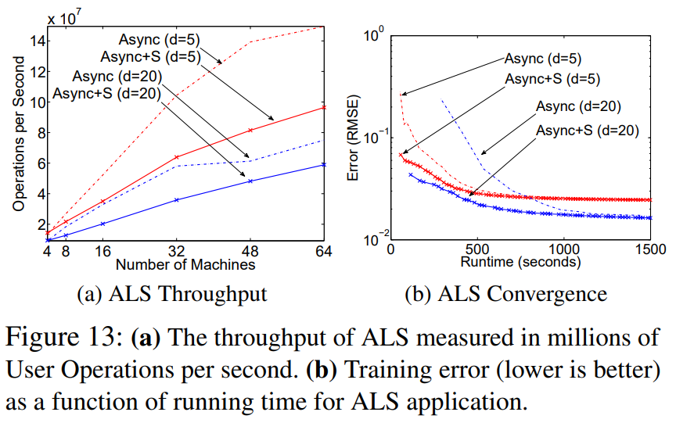
Asynchronous+S
Notes:
cd，作者评估了异步实现和异步可串行化实现在图着色问题上的表现，异步实现要比异步可串行化的实现运行速度快，但是会因为缺乏一致性而引入较多的冲突边。
ab，作者评估了异步实现和异步可串行化实现在ALS算法上的性能表现，实验表明，相比于异步的实现，异步可串行化的实现吞吐量会更低，但是收敛速度更快。

Slide 47
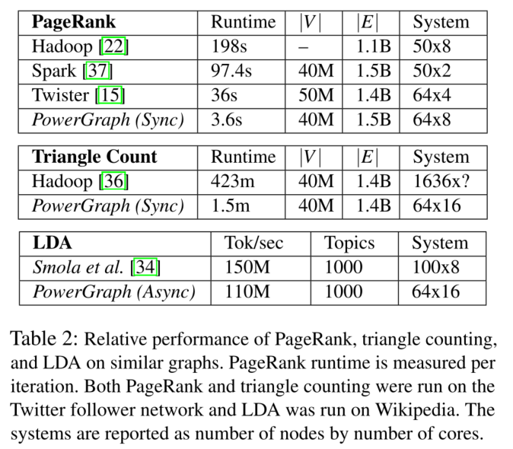
MLDM Applications
Notes:
作者对一些机器学习、数据挖掘方面的算法进行了性能测试，PowerGraph相比于Hadoop、Spark等要快得多。

Slide 48
目录 Contents
1
Background
2
PowerGraph
3
Vertex-Cut
4
Evaluation
5
Summary

Slide 49
Summary
Presentation and implementation of PowerGraph、
Compare PowerGraph with Pregel, GraphLab
Three implementation of PowerGraph
Notes:
简单总结一下，本文提出了一种新的图抽象PowerGraph，并与两种常用的图形并行系统Pregel、GraphLab进行了比较，然后给出了三种PowerGraph的实现方式

Slide 50


Slide 51
Demo1
Single-machine
  Intel Core i7-9700 CPU @ 3.00GHz
  GPU: GeForce RTX 2070
  Task: PageRank
  Graph: 1,000,000 vertices, 5,000,000 edges
 | 1-core | 2-core | 4-core | 8-core
Running Time(s) | 5.4 | 4.2 | 3.9 | 3.8

Slide 52
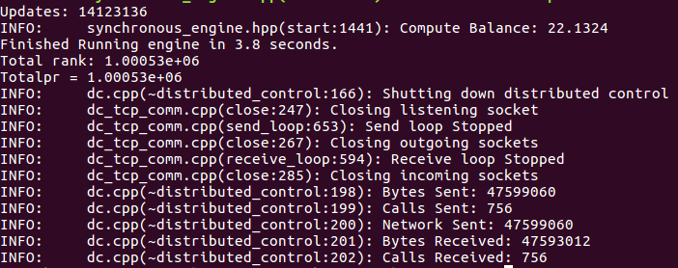
Demo1
Pagerank

Slide 53
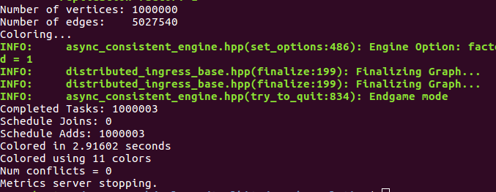
Demo1
Simple coloring

Slide 54
Demo2
Multi-instances
  Task: PageRank
  Graph: 1,000,000 vertices, 5,000,000 edges
One instance
Two instances
Three instances
Notes:
从一个实例到两个实例转变中，时间消耗增加很多。此时由于引入了数据传输的时间消耗。
而从两个实例到三个实例转变中，时间消耗却变少了。此时由于传输的数据量基本不变，引入分布式计算有效减少了计算时间。

Slide 55
Demo2
Simple-coloring
 | 1-instance | 2-instance | 3-instance
Running Time(s) | 4.21 | 7.73 | 6.54
Color used | 11 | 11 | 11
Notes:
可以看到涂色任务得到的结果也基本是一样的

Slide 56
Demo2
Engine/Ingress
  Task: PageRank
  3-instance
 | random | oblivious | coordinated
Synchronous | 24.5s | 20.9s | 16.2s
Asynchronous | 46.8s | 37s | 31.2s
Notes:
下面我们基于

Slide 57
谢谢！

