Slide 1
Exploring the Hidden Dimension in Graph Processing
Mingxing Zhang, Yongwei Wu, Kang Chen, *Xuehai Qian, Xue Li, and Weimin Zheng
Tsinghua University *University of Southern California
Presented by : Mingcong Han, Yusen Xu, Jiawei Tang, Tianlin Wen

Slide 2
Outline
Background and Motivation
Programming Model Design
CUBE Implementation
Evaluation

Slide 3
Outline
Background and Motivation
Programming Model Design
CUBE Implementation
Evaluation

Slide 4
Graph
MLDM as Graph Computing
- Collaborative Filtering
- SpMM
- Neural Network

Slide 5
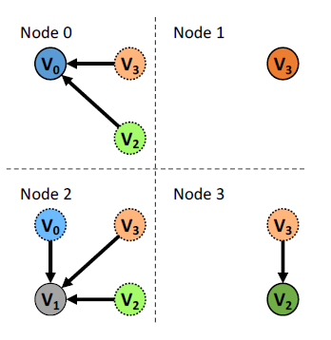
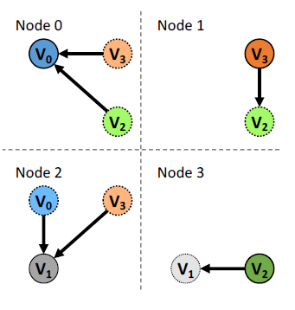
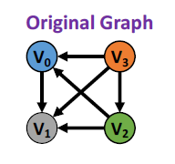
1D and 2D Partitioning
Each vertice/edge is indivisible
1D Partitioning
2D Partitioning

Slide 6
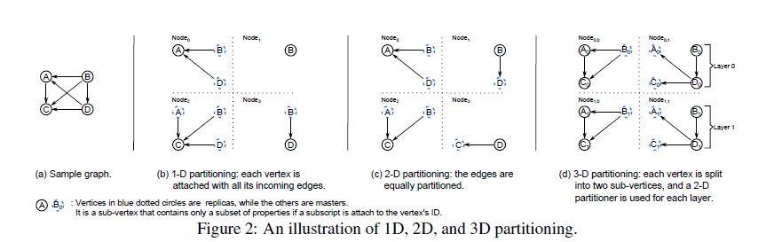
3D Partitioning
Each vertex/edge can be further partitioned

Slide 7
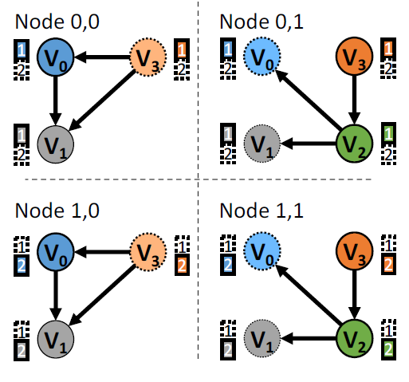
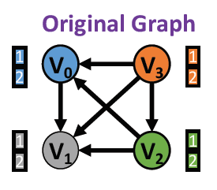
3D Partitioning
Layer 0
Partition into 4 nodes
2 Sub-graphs and 3 Replicas in each layer
Layer 1

Slide 8
Outline
Background and Motivation
Programming Model Design
CUBE Implementation
Evaluation

Slide 9
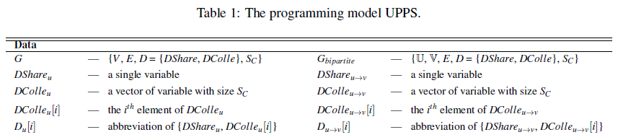
Data Structure
Sc: The collection size that defines the size of Dcolle vector

Slide 10
UPPS
Update: Takes all information to calculate the new value.
Push: Calculate vertex v with vertex u and edge (u,v).
Pull: Calculate vertex u with vertex v and edge (u,v).
Sink: Calculate edge (u,v) with vertex u and vertex v.

Slide 11
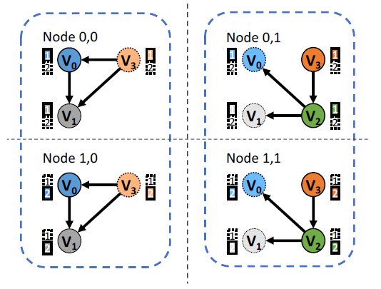
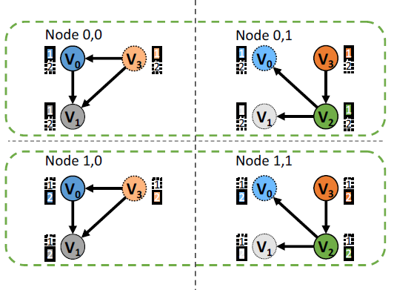
UPPS
Update: Vertical direction Push, Pull, Sink: Horizontal direction
Inter-layer Communication Intra-layer communication

Slide 12
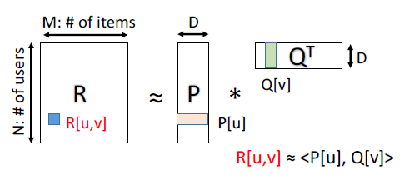
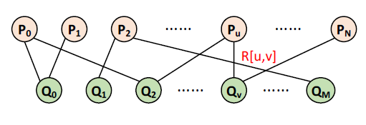
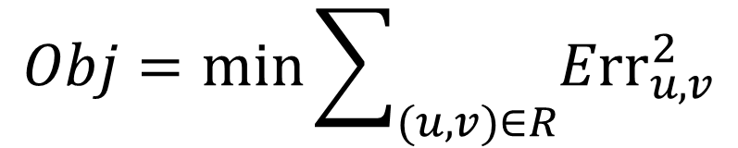
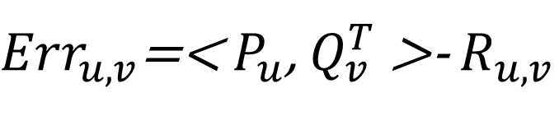
Example: Collaborative Filtering
Estimating missing ratings based on a given incomplete set of (user, item) ratings
${Err}_{u,v}$=< $P_{u}$, $Q_{v}^{T}$>- $R_{u,v}$
$$Obj=min\sum_{(u,v)∈R}{{Err}_{u,v}^{2}}$$

Slide 13
Example: Collaborative Filtering by GD
DShare of vertex: NOT USED
DShare of edge: {double Rate, double Err}
DColle of vertex/edge: a vector of double
DColle of vertex: Feature vector of user/item
DColle of edge: Dot production

Slide 14
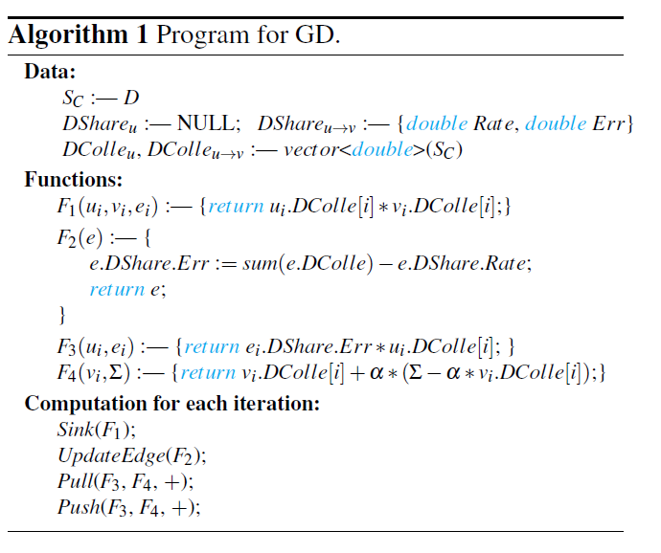

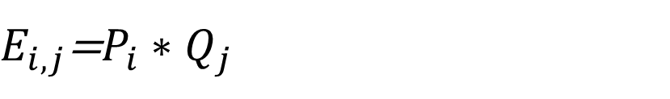
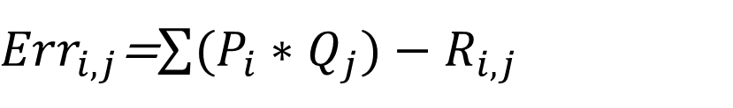
Example: Collaborative Filtering by GD
$E_{i,j}$=$P_{i}∗Q_{j}$
${Err}_{i,j}$=$\sum{(P_{i}∗Q_{j}})−R_{i,j}$

Slide 15
Outline
Background and Motivation
Programming Model Design
CUBE Implementation
Evaluation

Slide 16
Implement: CUBE
CUBE:
  an implement of UPPS model
  written in C++ and based on MPICH2

Slide 17
Implement: CUBE
1. Graph Loading and Partitioning——3D partitioning algorithm
  a layer count L
  a 2D partitioning algorithm P

Slide 18
Implement: CUBE
2. Update
  all the elements of DColle properties are needed
  => each vertex or edge is assigned a node as the master
  master:
    iterates all data
    applies the user-defined function
    scatters the updated values
Notes:
We allow users to define a local combiner for Update operations. With the local combiner, each node reduces its local DColle elements before sending the single value to its master.

Slide 19
Implement: CUBE
3. Push, Pull, Sink
  for Push and Pull, the user-defined gather function G is used to calculate the gather result for each vertex
  for Sink, the user defined function H is applied to each edge
Notes:
Similar to the Update, the sum function ⊕ is also used as a local combiner, so that the gather results are locally aggregated before sending.

Slide 20
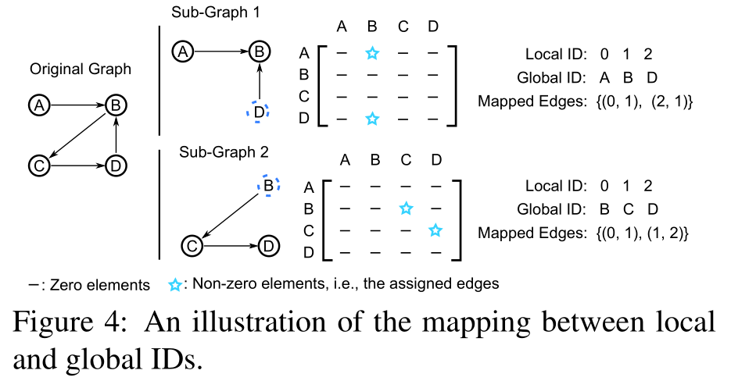
Implement: CUBE
4. Matrix-based data
structure
  edge:
    a sparse matrix
    COO format -- (source vertex ID, destination vertex ID, edge value)
  vertex:
    a continuous array
Notes:
a naive vertex-cenric implementation can be 2×−6× lower than matrix-based execution engines

Slide 21
Outline
Background and Motivation
Programming Model Design
CUBE Implementation
Evaluation

Slide 22
Evaluation
setup
  an 8-node Intel Xeon CPU E5-2640 based system
  1Gb Ethernet
  8 cores running at 2.50 GHz

Slide 23
Evaluation
compares it with two existing frameworks
  PowerGraph
  PowerLyra

Slide 24
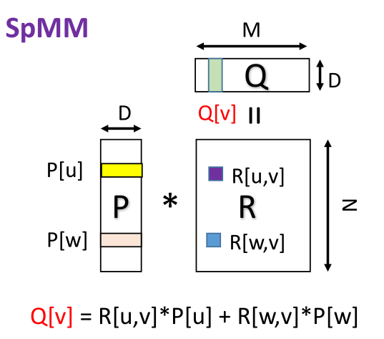
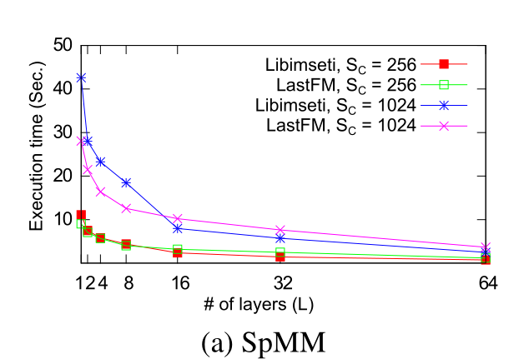
Evaluation--Micro Benchmarks
24

Slide 25
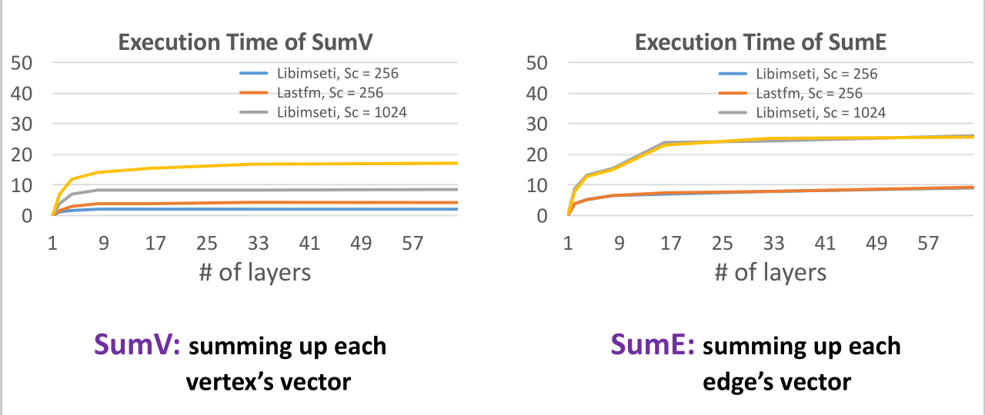
Evaluation--Micro Benchmarks
Notes:
In contrast, for operations that require inter-layer communications, the network traffic and execution time will increase with large L.

Slide 26
Evaluation--Real Applications
the GD and ALS algorithm
  GD
  ALS
Notes:
The UpdateEdge of GD can be optimized by the local combiner while ALS cannot

Slide 27
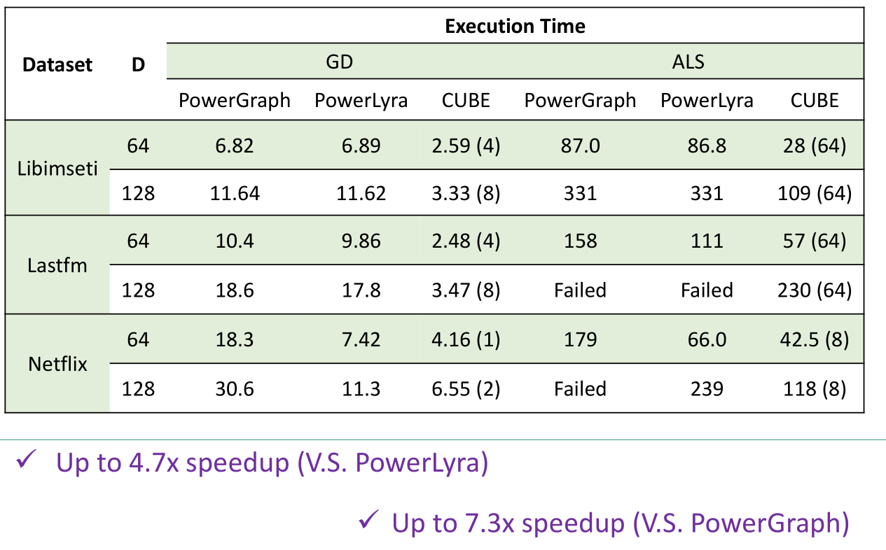
Evaluation--Real Applications

Slide 28
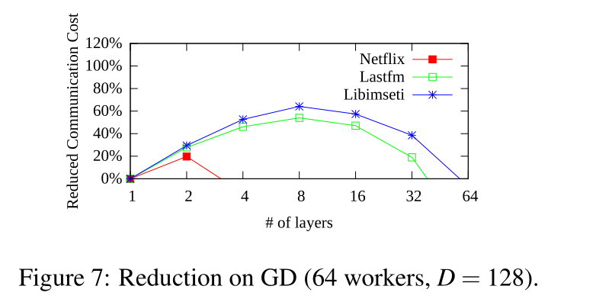
Evaluation--Real Applications
Communication Cost
  the improvement of CUBE is mainly from two aspects:
    1) reduction on network communications
    2) the adoption of a matrix backend.
Notes:
The network traffic reduction for GD is related to replication
Factor

Slide 29
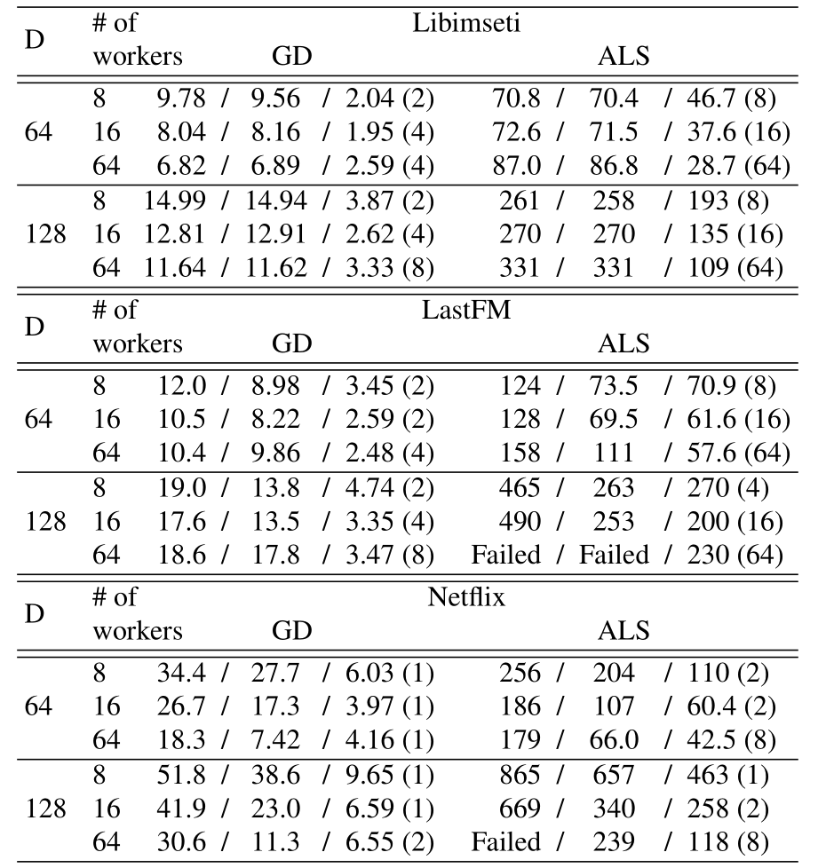

Evaluation
--Real Applications
Scalability
  Previous work
    The network time soon dominates the whole execution time
  CUBE
    3D partitioning algorithm reduces the network traffic, CUBE scales better than PowerGraph and PowerLyra.
Notes:
The execution time of PowerLyra actually increases after the number of workers reaches 16, while CUBE with lower network traffic can scale to 64 workers in most cases.

Slide 30
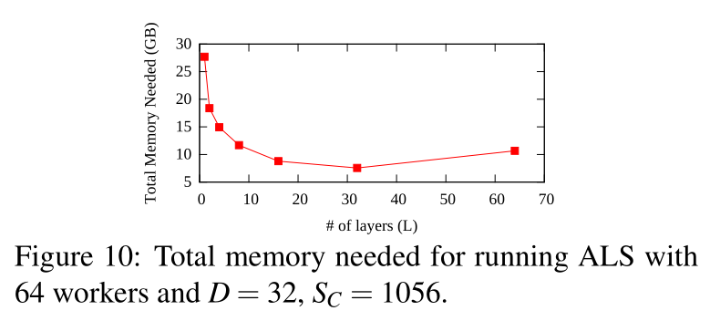
Evaluation--Real Applications
Notes:
On one side, when L increases, the size of memory for replicas of
DColle is reduced by the partition of property vector.
On the other side, the memory consumption could increase because DShare needs to be replicated on each layer.
The memory consumption with L = 64 is larger than L = 32, because the reduction on replicas of Dcolle data cannot offset the increase of shared DShare data.

Slide 31
Conclusion
Vertices and edges are divisible For MLDM problems
CUBE
  adopts 3D partitioning
  UPPS programming model
  uses matrix backend
  achieves up to 4.7x speedup

Slide 32
Cube Demo

Slide 33
Demo
Cube contributions:
  3D graph partition
  UPPS program model for 3D partition
  Cube prototype
  Systematical evaluation

Slide 34
Our Work
3D graph partition
  597 LOC C++ / 107 LOC python
UPPS program model for 3D partition
  1514 LOC C++
  Based on OpenMPI
Cube prototype
  Total 2111 LOC C++ / 107 LOC Python
Systematical evaluation
  Real-world application: Gradient Descent for Collaborative Filtering
  Real-world dataset (MovieLens)

Slide 35
3D Graph Partition
Divide vector data into multiple layers
2D graph partition in each layer
  Randomized edge partition
  Randomized Bi-cut [1]
Bi-cut: minimize number of replica for bipartite graph

Slide 36
UPPS Usage Example
User customize functions compose operators (UPPS)
Real-world application:
  Gradient Descent algorithm to solve Collaborative Filtering

Slide 37
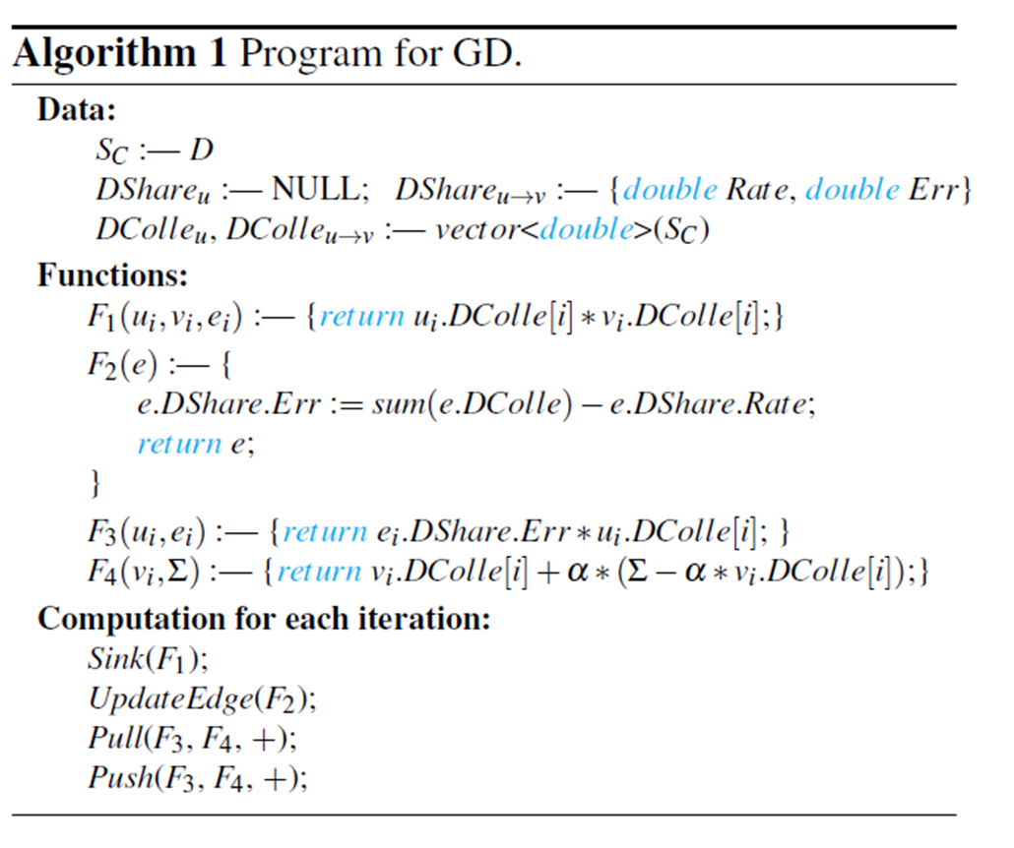
Gradient Descent
Steps for one iteration:
Sink
UpdateEdge
Pull
Push

Slide 38
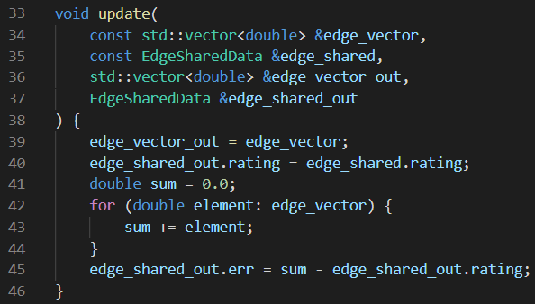
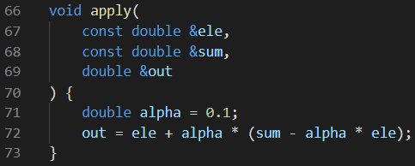
Gradient Descent
User defined functions
Operator
Operator consists of user defined functions

Slide 39
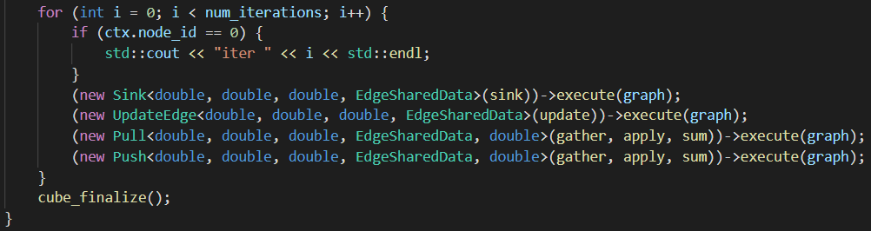
GD Iteration
Coding GD iteration like this

Slide 40
UPPS Implementation
Two operator examples:
  UpdateEdge
    For each edge: gather all vector data on this edge from all layers then calculate new value to apply
  Pull
    For each vertex: gather data from adjacent vertices and edges then calculate new value to apply

Slide 41




UpdateEdge
1. Gather
Layer 1
A
B
2. Compute
3. Sync
Layer 2
A
B

Slide 42


Pull for vertex A
1. Gather
2. Local Sum
Node 1
Node 2
3. Sync
New
Value
New
Value
A
B
A
D
4. Final Sum
C
5. Apply and scatter
Two nodes in same layer

Slide 43
Evaluation
Setup
  4 nodes with Intel(R) Xeon(R) CPU E5-2650
  1Gb Ethernet
  8 cores running at 2.20 GHz
  4 * 8 = 32 workers
Dataset
  MovieLens
  10M edges, 80K vertices

Slide 44
Evaluation

Slide 45
Evaluation
Best: 4 layers

Slide 46
Evaluation
Best: 4 layers

Slide 47
Demo Summary
Demo for all Cube contributions
  Include 3D partition and UPPS program model
  Total 2111 LOC C++ / 107 LOC Python
Open Source at
  https://github.com/Betterxuys/cube_demo (coming soon)
  https://ipads.se.sjtu.edu.cn:1312/mingcongh/cube_demo

Slide 48

Thanks
And
Questions?

