Slide 1
TuX²: Distributed Graph Computation for Machine Learning
Lei Zhanyao Mao Xin Gu Qiqi Chen Peiqi
NSDI 2017

Slide 2
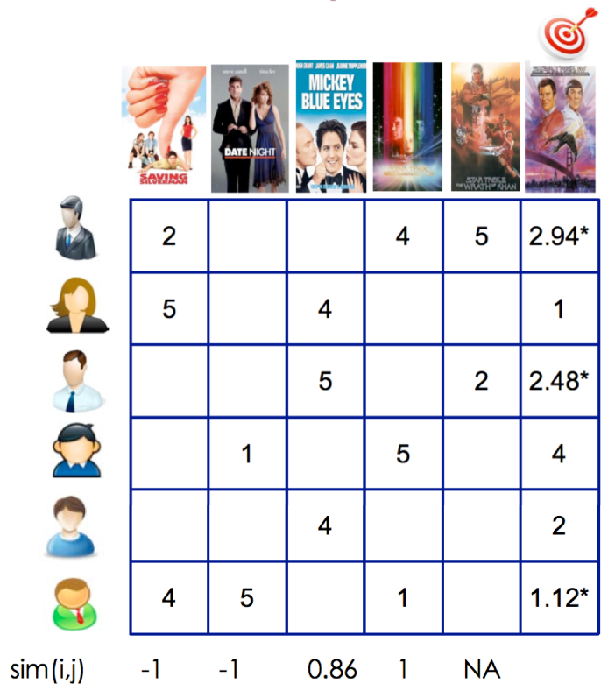
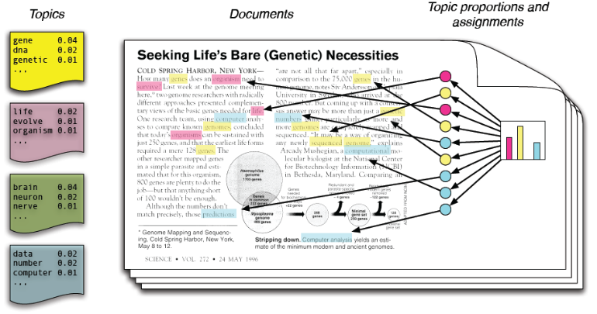
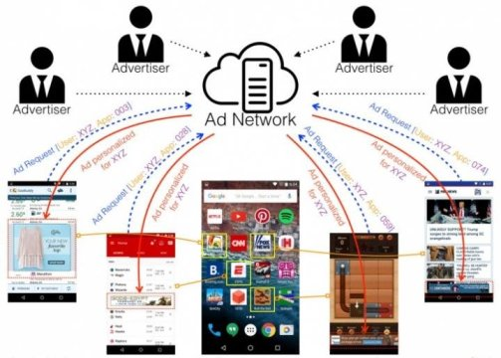

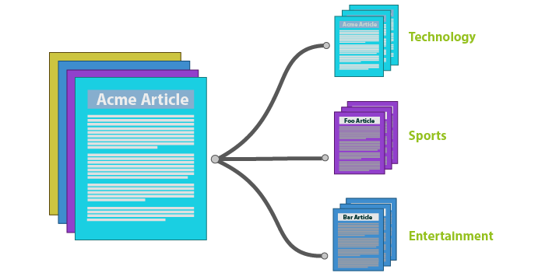
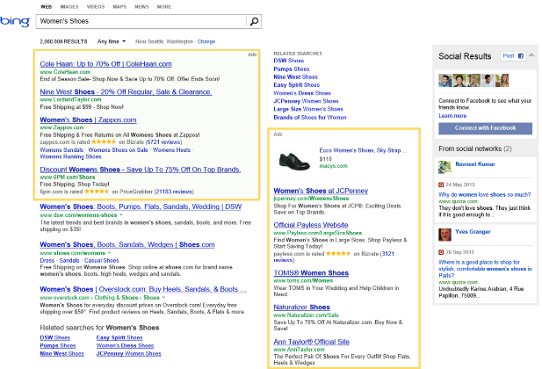
Machine Learning in real world
Recommendation
Topic Model
Click Prediction

Slide 3



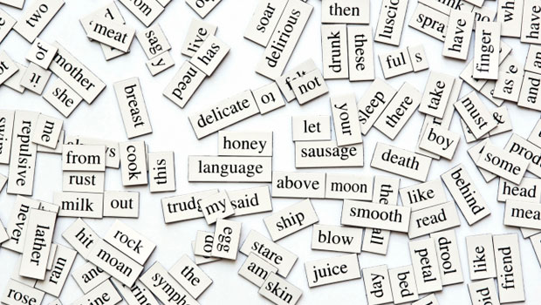




Machine Learning in real world
Recommendation
Topic Model
Click Prediction
Feature
Sample

Slide 4
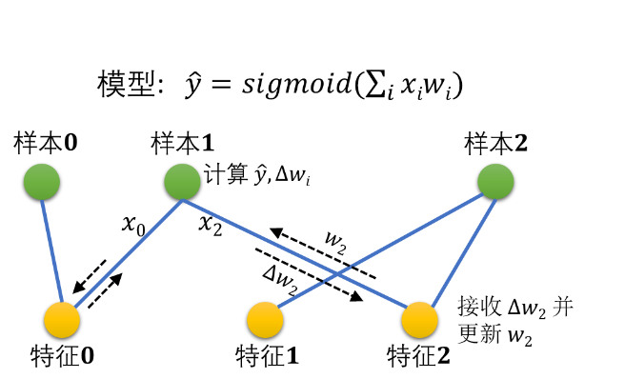
Logistic Regression -> Graph

Slide 5








Gaps for ML on Graph Engine
Gap 1: Data Model
PageRank
for WebPage Ranking
Matrix Factorization(MF)
for Recommendation

Slide 6
Gaps for ML on Graph Engine
Gap 2: Programming Model
PageRank
for WebPage Ranking
Matrix Factorization(MF)
for Recommendation

Slide 7
Gaps for ML on Graph Engine
Gap 3: Execution Scheduling
PageRank
for WebPage Ranking
Matrix Factorization(MF)
for Recommendation

Slide 8
TuX² (Tu Xue Xi)
Extension for distributed machine learning
DataModel: Hetergeneous data model
Scheduling: State Synchronous Parallel (SSP) based scheduling
Programming: MEGA (Mini-batch. Exchange, GlobalSync, and Apply) graph model
Performance
10x ↗ vs. PowerGraph/PowerLyra
48% ↗ vs. Petuum/Parameter-Server (P-S)

Slide 9





System Architecture
Overview
Vertex-cut approach
Effective for power-law graph
Naturally fits P-S model
- Master vertices as the global state
- Mirror vertices as the local cache
Partition 0
Partition n
Server role
Master vertices
…
…
…
…
$$V_{i}$$
$$V_{j}$$
Vertex array
Mirror vertices
…
$$V_{i}^{′}$$
$$V_{j}^{′}$$
…
…
…
$$V_{i}^{′}$$
…
Edge array
Worker role
Edge link
Master-mirror link

Slide 10
Key Design 1: Heterogeneous data model
Heterogeneous Vertices
  Different properties
    E.g. Logistic Regression
      Sample: Label; Feature: Weight, Gradient
Benefit
  Heterogeneity for compact data structure
  Heterogeneity for efficient execution
  Heterogeneity for less network traffic
Feature
Sample

Slide 11
Heterogeneity for compact data structure
E.g. Logistic Regression
- Sample: Label; Feature; Weight, Gradient
Feature
Sample
Vertex array:
Useless data fields
Homogeneous Vertex Data Structure

Slide 12
Heterogeneity for compact data structure
E.g. Logistic Regression
- Sample: Label; Feature; Weight, Gradient
Feature
Sample
Sample array:
Feature array:
Heterogeneous Vertex Data Structure

Slide 13
Heterogeneity for efficient execution
E.g. Mini-Batch MF for recommendation
Server role
Server role
Master vertex
Master vertex
Updated item vertices in a M-B
Updated user vertices in a M-B
Items
Items
Edge link
Users
Users
Master-mirror link
Worker role
Worker role
Scan user vertices
Scan item vertices

Slide 14
Key Design 2: SSP based scheduling
Slack of 1 clock as an example
  All servers finish clock1
0
1
2
3
clock
Server 0
Working set of current mini-batch
Updates guaranteed visible to all servers
…
Server n
Visible Task
Completed Task
Ongoing Task

Slide 15
Key Design 2: SSP based scheduling
Slack of 1 clock as an example
  Slowest server (n) is in clock2
  Fastest server (0) finishes clock2
0
1
2
3
clock
Server 0
…
Server n
Visible Task
Completed Task
Ongoing Task

Slide 16
Key Design 2: SSP based scheduling
Slack of 1 clock as an example
  Slowest server (n) is in clock2
  Fastest server (0) finishes clock2
    within the staleness bound
    continue
0
0
1
1
2
2
3
3
clock
Server 0
…
Server 0 continues
Server n
Visible Task
Completed Task
Ongoing Task

Slide 17
Key Design 2: SSP based scheduling
Slack of 1 clock as an example
  Slowest server (n) is in clock2
  Fastest server (0) finishes clock3
    reaching the max slack bound
    blocked
0
1
2
3
clock
Server 0
Server 0 is blocked
…
Server n
Visible Task
Completed Task
Ongoing Task

Slide 18
Key Design 3: MEGA graph model
MEGA
Mini-batch
Exchange
GlobalSync
Apply

Slide 19
ML Algorithms on TUX²
Latent Dirichlet Allocation (LDA)
Block Proximal Gradient (BlockPG)

Slide 20
#1 Latent Dirichlet Allocation (LDA)
SparseLDA
  vertices represent documents and words
  each edge between a document and a word means the document contains the word.
LDA UDFs for each stage
//ExchangeStage
Exchange(v_doc, v_word, edge,
a_doc, a_word, context){
…
//Gibbs sampling to compute a new topic
//topic accumulator
//update topic summary
}
//ApplyStage
Apply(ver, accum, ctx){
//Apply accumulated topic changes
ver.topics += accum;
}
//GlobalSyncStage
Combine(ctx1, ctx2){
ctx.topic_sum
= ctx1.topic_sum + ctx2.topic_sum;
return ctx;
}

Slide 21
#1 Latent Dirichlet Allocation (LDA)
SparseLDA
  vertices represent documents and words
  each edge between a document and a word means the document contains the word.
LDA UDFs for each stage
LDA stage sequence for a batch
LDA stage sequence for a mini-batch
void StageSequenceBuilder(ExecStages){
ExecStages.Add(ExchangeStage);
ExecStages.Add(ApplyStage);
ExecStages.Add(GlobalSyncStage);
}
void StageSequenceBuilder(ExecStages){
val mbStage = new MiniBatchStage;
mbStage.SetBatchSize(1000, asEdge);
mbStage.Add(ExchangeStage);
mbStage.Add(ApplyStage);
ExecStages.Add(mbStage);
ExecStages.Add(GlobalSyncStage);
}

Slide 22
#2 Block Proximal Gradient (BlockPG)
A bipartite graph
  features and samples as vertices
  an edge between a feature and a sample vertex indicating that the sample contains the feature
  randomly divides features into blocks and enumerates each block as a mini-batch
BlockPG UDFs for each stage
//ExchangeStage0&1
Exchange0(v_feature, v_sample, edge,
a_feature, a_sample, ctx){
(a_feature.g, a_feature.u) +=
FeatureGradient(v_feature,v_sample)
}
Exchange1(v_feature, v_sample, edge,
a_feature, a_sample, ctx){
v_sample.dual *=SampleDual(v_feature, v_sample)
}
//ApplyStage
Apply(v_feature, a_feature, ctx){
v_feature.weight +=
SolveProximal(v_feature,a_feature,ctx);
}
//GlobalSyncStage
Aggregate(ver, ctx){
ctx.obj += CalcObj(ver);
}
Combine(ctx1, ctx2){
ctx.obj = ctx1.obj + ctx2.obj;
return ctx; }

Slide 23
#2 Block Proximal Gradient (BlockPG)
A bipartite graph
  features and samples as vertices
  an edge between a feature and a sample vertex indicating that the sample contains the feature
  randomly divides features into blocks and enumerates each block as a mini-batch
BlockPG UDFs for each stage
BlockPG stage sequence for a mini-batch
void StageSequenceBuilder(ExecStages){
val mbStage = new MiniBatchStage;
mbStage.SetBatchSize(1000,asVertex,
"feature");
mbStage.Add(ExchangeStage0);
mbStage.Add(ApplyStage);
mbStage.Add(ExchangeStage1);
ExecStages.Add(mbStage);
ExecStages.Add(GlobalSyncStage);
}

Slide 24
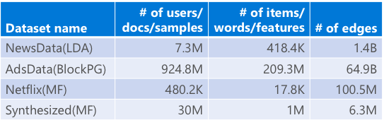
Implementation--Experimental Setup
Implement
  about 12,000 lines of C++ code
Machine Information
  dual 2.6 GHz Intel Xeon E5-2650 processors (16 physical cores), 256 GB of memory, InfiniBand NIC with 54 Gbps bandwidth
Typical ML Algorithms
  ML, LDA, BlockPG
Large-Scale Dataset
  up to 64 billion edges graph

Slide 25
Implementation--Programmability
Algorithm | ML systems | TUX² | LOC reduction
MF (Petuum) | > 300 | 50 | 83%
LDA (Petuum) | >950 | 252 | 73%
BlockPG (PS) | >350 | 79 | 77%

Slide 26
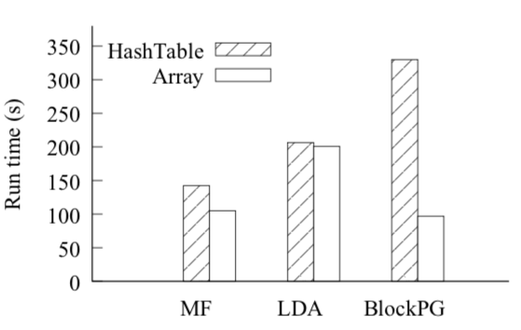
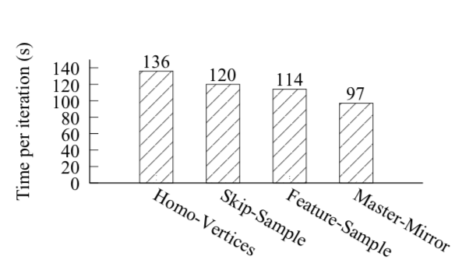
Evaluation
Managing ML Data as a Graph
Data layout Heterogeneity

Slide 27
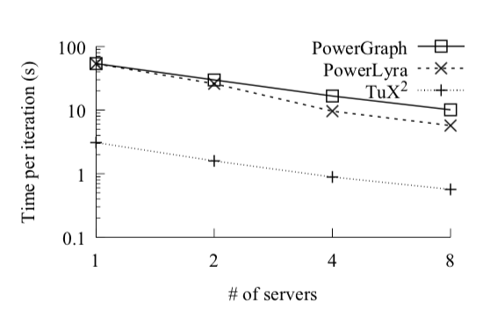
Evaluation
System Performance--#1
TUX² vs. PowerGraph and PowerLyra
  Algorithm: MF
  Dataset: Netflix

Slide 28
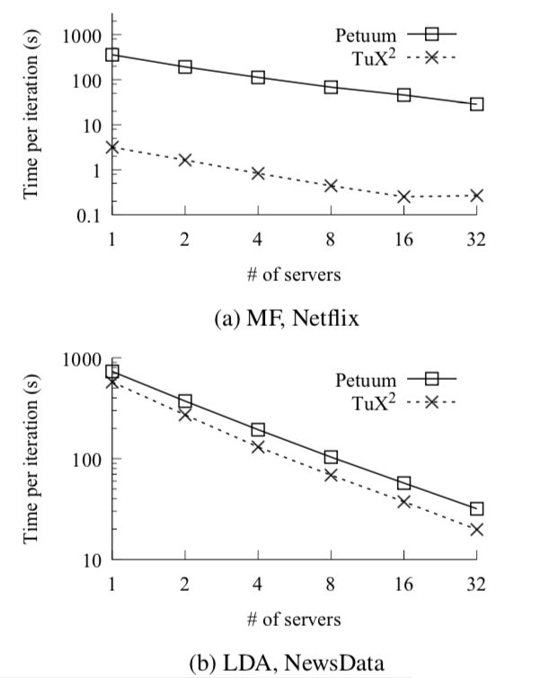
Evaluation
System Performance--#2
TUX² vs. machine learning systems：Petuum

Slide 29
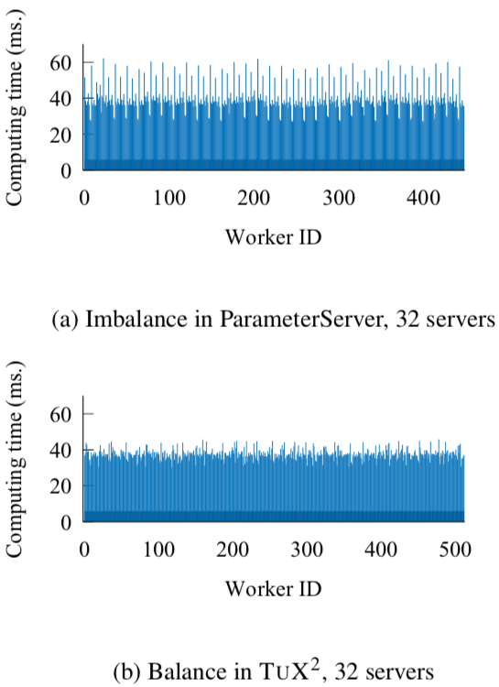
Evaluation
System Performance--#3
TUX² vs. machine learning systems：Parameter Server (PS)

Slide 30
Related Work
Iterative Graph Computation and Distributed Machine Learning Systems
  Pregel: vertex-program model
  PowerGraph: vertex-cut model
  PowerLyra, BiGraph, GraphChi, Grappa, ...
Parameter-server-based Distributed Machine Learning
  Petuum and its subsequent work on STRADS
  Parameter Server and its optimized layout in BlockPG
General Distributed Big-data Computing Platforms
  Mahout on Hadoop and MLI on Spark: ML on MapReduce-type frameworks
  Piccolo, GraphX, GAS, ...

Slide 31
Conclusion
TUX2: advocate the convergence of graph computation and distributed machine learning
Introduce important machine learning concepts to graph computation
Define a new, flexible graph model to express machine learning algorithms efficiently
Demonstrate the benefits through extensive evaluation on representative machine learning algorithms

Slide 32

Q&A

Slide 33
Demo: Matrix Factorization PowerGraph & TuX²
2021/5/10

Slide 34
Matrix Factorization
 | D1 | D2 | D3 | D4
U1 | 5 | 3 | - | 1
U2 | 4 | - | - | 1
U3 | 1 | 1 | - | 5
U4 | 1 | - | - | 4
U5 | - | 1 | 5 | 4
R(n, m) ≈ P(n, K) × Q(K, m)
R’
User: n=5
Item: m=4
Feature: K=3
 | K1 | K2 | K3
U1
U2
U3
U4
U5
 | D1 | D2 | D3 | D4
K1
K2
K3
×
Q
P

Slide 35
Matrix Factorization
 | D1 | D2 | D3 | D4
U1 | 5 | 3 | - | 1
U2 | 4 | - | - | 1
U3 | 1 | 1 | - | 5
U4 | 1 | - | - | 4
U5 | - | 1 | 5 | 4
R(n, m) ≈ P(n, K) * Q(K, m)
R’
User: n=5
Item: m=4
Feature: K=3
 | K1 | K2 | K3
U1
U2
U3
U4
U5
V11
 | D1 | D2 | D3 | D4
K1
K2
K3
V12
V21
V22
V23
V24
×
V13
V14
V15
Q
P

Slide 36
Matrix Factorization
 | K1 | K2 | K3
U1
U2
U3
U4
U5
V11
 | D1 | D2 | D3 | D4
K1
K2
K3
V12
V21
V22
V23
V24
×
V13
V14
V15
V11
5
V23
V21
3
4
1
1
V12
V22
5
1
V13
1
1
1
5
V15
V14
V24
5
4

Slide 37
PowerGraph：GAS
gather_type gather(icontext_type& context, const vertex_type& vertex,
  edge_type& edge) const {
  vec_type delta, other_delta;
  //this is user node
  if (vertex.num_in_edges() == 0){
    vertex_type my_vertex(vertex);
    vertex_type other_vertex(get_other_vertex(edge, vertex));
    //compute the prediction error
    double pred = vertex.data().pvec.dot(other_vertex.data().pvec);
    const float err = edge.data().obs - pred;
    //compute the change in gradient for this user node
    delta = GAMMA*(err*other_vertex.data().pvec - LAMBDA*vertex.data().pvec);
    //compute the change in gradient for this item node
    other_delta = GAMMA*(err*vertex.data().pvec - LAMBDA*other_vertex.data().pvec);
    context.signal(other_vertex, other_delta);
  }
  return gather_type(delta);
} // end of gather function
Error Computation
Gradient Computation

Slide 38
PowerGraph：GAS
void apply(icontext_type& context, vertex_type& vertex,
  const gather_type& sum) {
  vertex_data& vdata = vertex.data();
  //this is a user node, update the gradient using the comulative sum of gradient updates computed in gather
  if (sum.pvec.size() > 0){
    vdata.pvec += sum.pvec;
    assert(vertex.num_in_edges() == 0);
  }
  //if this is an item node, update the gradient using the received sum from the init() function
  else if (pmsg.size() > 0){
  vdata.pvec += pmsg;
  assert(vertex.num_out_edges() == 0);
  }
  ++vdata.nupdates;
} // end of apply

Slide 39
PowerGraph：GAS
void scatter(icontext_type& context, const vertex_type& vertex, edge_type& edge) const {
  edge_data& edata = edge.data();
  if(edata.role == edge_data::TRAIN) {
    const vertex_type other_vertex = get_other_vertex(edge, vertex);
    // Reschedule neighbors ------------------------------------------------
    if(other_vertex.data().nupdates < MAX_UPDATES)
      context.signal(other_vertex, vec_type::Zero(vertex_data::NLATENT));
  }
} // end of scatter function

Slide 40
TuX² ：MEGA
MEGA
Mini-batch
Exchange
GlobalSync
Apply
A Batched Implementation
void StageSequenceBuilder(ExecStages){
  ExecStages.Add(ExchangeStage);
  ExecStages.Add(ApplyStage);
  ExecStages.Add(GlobalSyncStage);
}

Slide 41






TuX² ：MEGA (Batched)
//ExchangeStage::
Exchange(v_user, v_item, edge,
a_user, a_item, context){
val pred = PredictRating(v_user,v_item);
val loss = pred - edge.rating;
context.loss += lossˆ2;
(a_user,a_item) +=
Gradient(loss,v_user,v_item);
}
$$U_{i}$$
$$I_{j}$$
V11
$$U_{i}$$
$$I_{j}$$
V21
V23
$$U_{i}$$
$$I_{j}$$
Rating
V12
V13
V22
V15
V14
V24

Slide 42
TuX² ：MEGA (Batched)
//ExchangeStage::
…… // Shown on last page
}
//ApplyStage::
Apply(ver, accum, ctx){
ver.data += accum; //Apply accumulated gradient
}
//GlobalSyncStage::
Combine(ctx1, ctx2){
ctx.loss = ctx1.loss + ctx2.loss;
return ctx;
}

Slide 43
Comparison
PowerGraph
TuX²
MEGA
+
Heterogeneity
GAS
+
Homogeneity
1 MEGA per edge
2 GAS per edge

Slide 44
TuX² : MEGA (Mini-batched)
Partition 0
Partition n
Server role
Compose stage
…
Apply
Mini-Batch
Exchange
Exchange
Exchange
Apply
Apply
Worker role
void StageSequenceBuilder(ExecStages){
mbStage = new MiniBatchStage();
mbStage.SetBatchSize(100, asEdge);
mbStage.Add(ExchangeStage);
mbStage.Add(ApplyStage);
ExecStages.Add(mbStage);
ExecStages.Add(GlobalSyncStage);
}
GlobalSync
Iteration Stage
Mini-batch Stage

Slide 45
Demo: Conclusion
Scenario : Matrix Factorization
  Implementation 1: PowerGraph
  Implementation 2: TuX² (batched version)
  Comparison between Implementation 1 & 2
  Implementation 3: TuX² (mini-batched version)

Slide 46
Q&A

Slide 47
Thanks！

