Slide 1
Threads and Memory Placement on
NUMA Systems: Asymmetry Matters
Baptiste Lepers, Alexandra Fedorova Simon Fraser University
Vivien Quéma
Grenzoble University
Presented by Ruizhe Tong, Wenli Du, Shengdong Cai, Yuxiao Wang, Yue Wang

Slide 2
Outline
Motivation
Design & Implementation
Evaluation
Demo

Slide 3
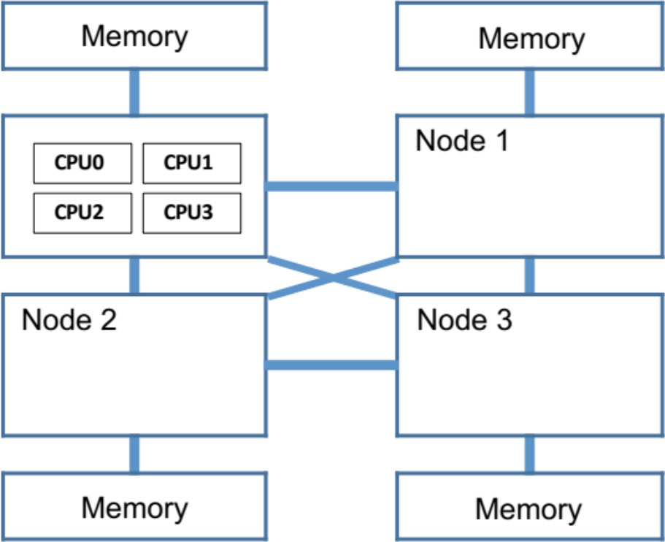
NUMA Machines

Slide 4
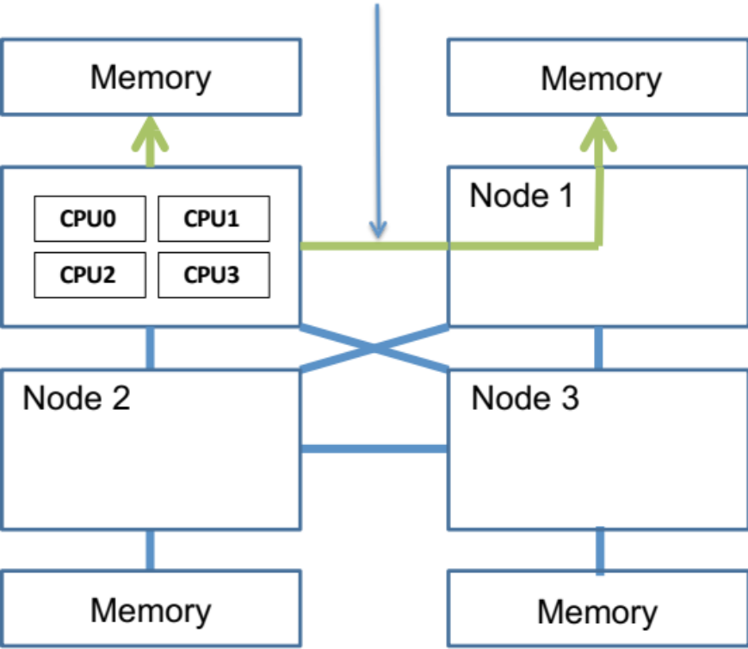
NUMA Machines
interconnect link

Slide 5
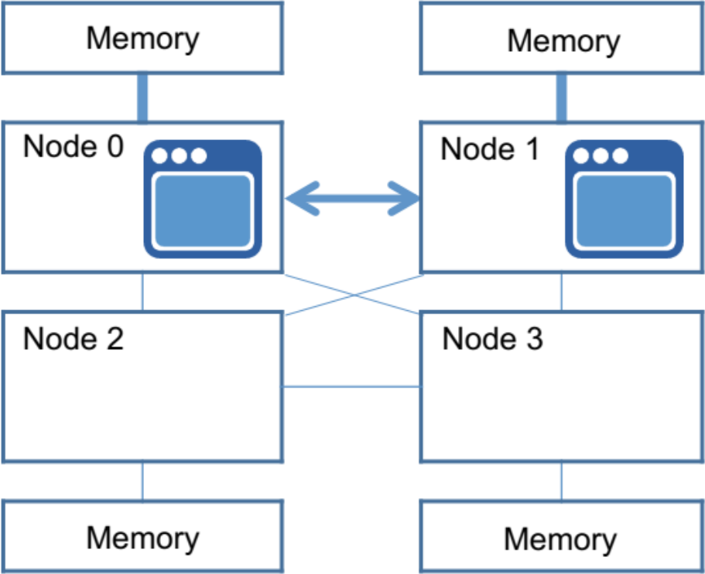
Interconnect Matters
Execution time:
149s
Notes:
处理器: 2个AMD opteron（皓龙) 6272处理器
每一个处理器2个NUMA node
共4个numa node
Application: Parsec benchmark中的stream cluster

Slide 6
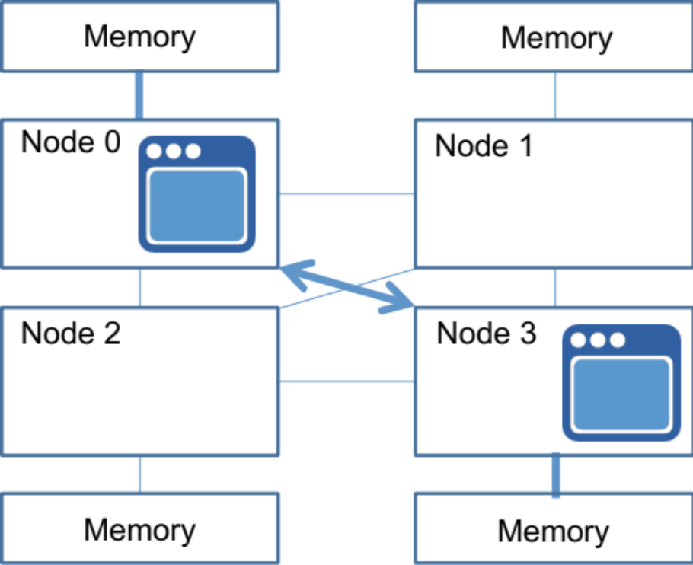
Interconnect Matters
Execution time:
277s!

Slide 7
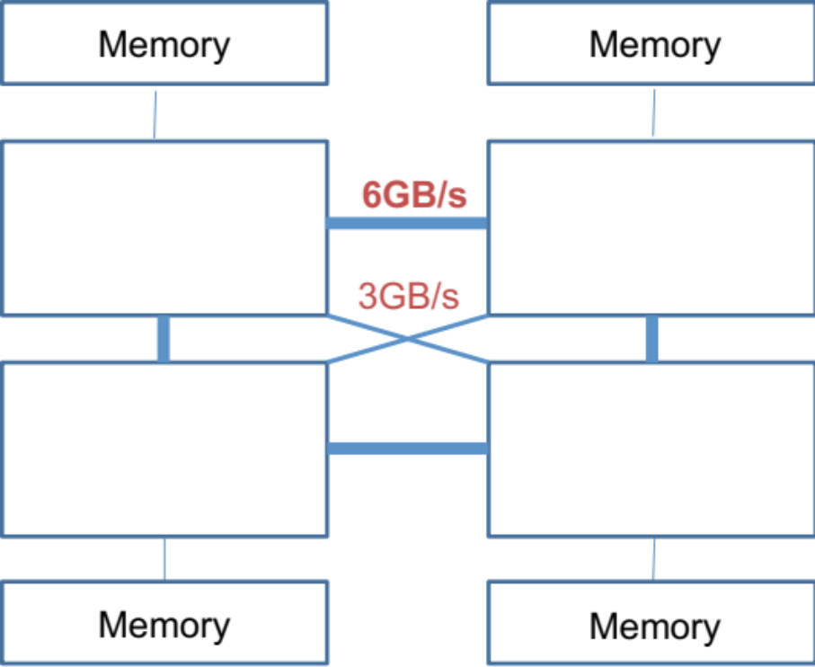
Asymmetric Interconnects
Interconencts have different bandwidths

Slide 8
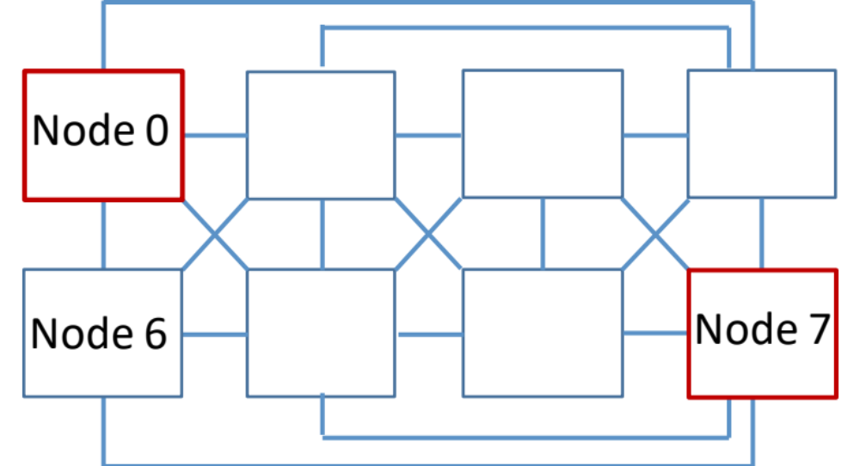
Asymmetric Interconnects
Partial Interconnect
No direct links from Node 0 to Node 7
Node 0 will do 2 hops to access Node 7

Slide 9
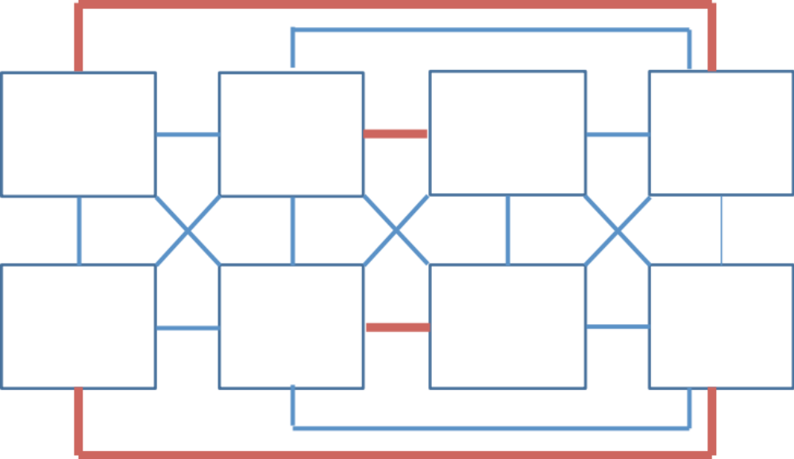
Asymmetric Interconnects
Interconnect of Different Bandwidths
3 GB/s
6 GB/s

Slide 10
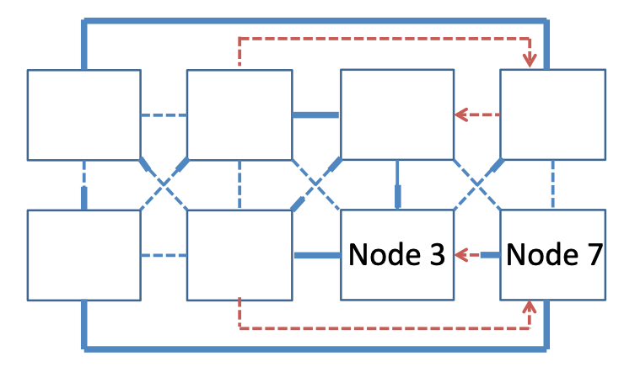
Asymmetric Interconnects
Unidirectional Links
Node 7 sends requests directly to Node 3
Node 3 routes replies via Node 2

Slide 11
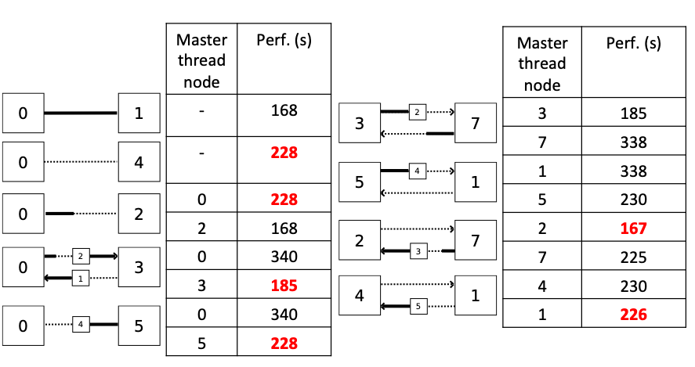
Streamcluster on 2 nodes

Slide 12

Streamcluster on 2 nodes
Performance ∝ Bandwidth ∝ Connectivity

Slide 13
Outline
Motivation
Design & Implementation
Evaluation
Demo
Notes:
基于上个同学所讲的 因此作者提出了最大化线程之间带宽的解决方案 asymsched

Slide 14
Design Overview
Threads clustering
Threads migration
  Place threads on well-connected nodes
Memory migration
  Dynamic memory migration
  Fast full memory migration otherwise
Continuous profiling and decision
  Take decisions every second
Notes:
Asymsched 的过程主要分为三步 分别是 线程集聚和线程迁移以及内存迁移

Slide 15
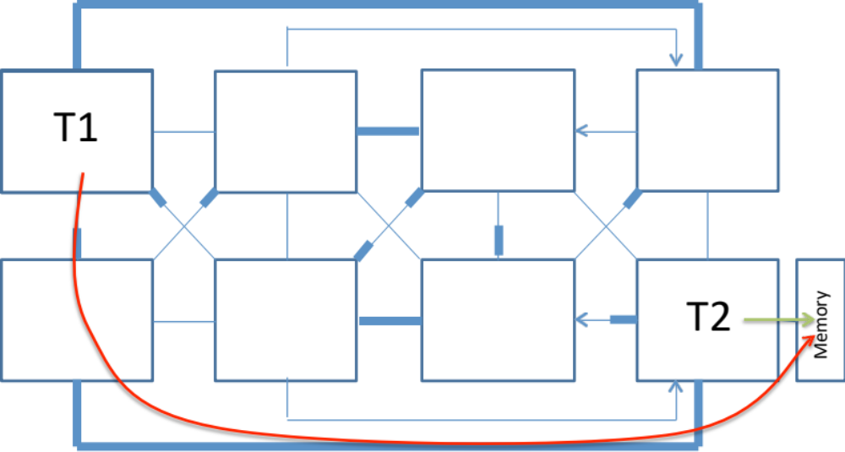
Step 1: Cluster Threads
Group in a cluster of threads that
  within the same applicatioon
  share data (access the same nodes)
Measurement component
  cpu to cpu
  cpu to memory
Notes:
那么是如何线程集聚的呢？首先是查找哪些线程利用了互连链接，从而找到哪些线程进行通信。然后如果两个线程同时访问一个内存，那我们就将他们集聚在一起。
AsymSched 持续收集 CPU 到 CPU 和 CPU 到内存的通信量的指标。实验中，有一个单一的计数器可以捕捉到这两方面的信息：它测量一个 CPU 对一个特定节点的数据访问数量，包括对缓存数据的访问（CPU 到 CPU 的通信）和对 RAM 中的数据的访问（CPU 到内存的通信）。理想情况下，我们希望测量每个 CPU 到其他 CPU 的通信量

Slide 16
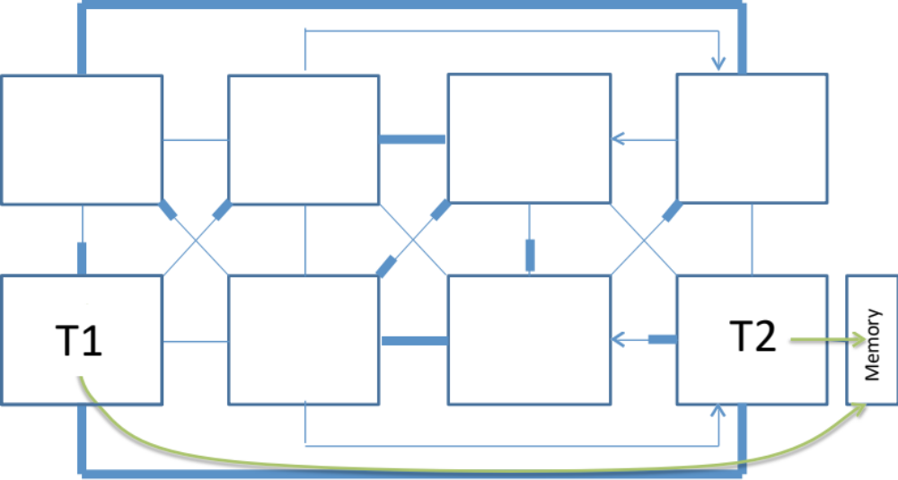
Step 2: Migrate Threads
Migrate threads in a cluster to nodes
  with high connecticity
  on a node basis
Decision component
  find the best placement
Notes:
一旦有了线程集群，那我们便可以迁移他们。我们可以看到线程 T1 从刚才的左上角跑到了左下角，使得和 T2 线程的链接为第一链接。Decision component 找到最好的放置位置 放置策略之后会讲。

Slide 17
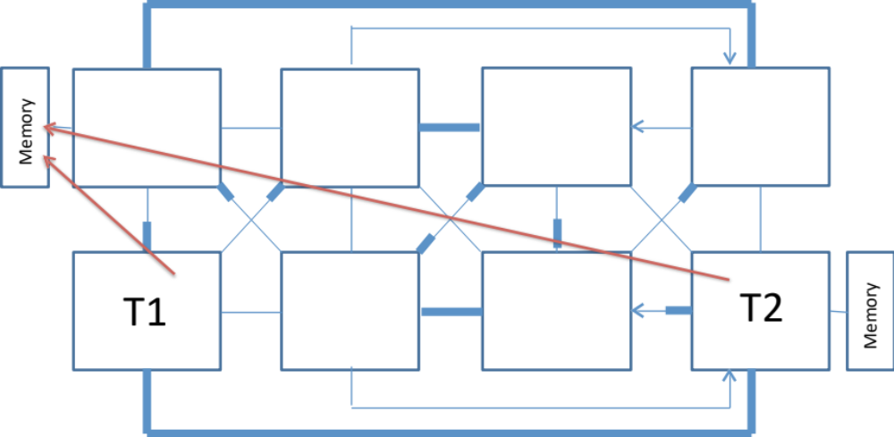
Step 3: Migrate Memory
Threads may access memory on old nodes
  dynamic migrate the memory pages
Migration component
  Calling system calls
Notes:
我们看到线程 T1 和线程 T2 的位置不错，它们传达唯一的第一链接。问题是他们可能会继续访问其他位置对象上的内存，这时候我们通过迁移组件进执行动态迁移策略或者全迁移策略进行内存迁移。

Slide 18
Memory Migration
Use IBS to detect accessed pages
  Instrcution-Based Sampling
Dynamic migration for active pages
If not sufficient => Full migration
  Migrate all old pages
Problem: Linux migrate_pages too slow!!
  0.2 GB per second
  Largely due to high lock contention
Notes:
传统的内存迁移是选择使用AMD的基于指令的采样(IBS不幸的是，为了准确地跟踪cpu到cpu的通信，IBS需要很高的采样率，这就带来了太多的开销。
当AsymSched执行全内存迁移时，位于一个节点上的所有页面都被迁移到另一个节点。我们测试的应用程序有很大的工作集(每个节点高达15GB)，迁移页面的成本很高。我们测量到，使用标准的migration -pages系统调用迁移10GB的数据平均需要51秒，这使得迁移大型应用程序变得不切实际。

Slide 19
Fast Memory Migration
Implementation
Optimizations
  No locks
  Can migrate multiple nodes in parallel
Results
  3.3 GB/s (17× faster than migrate_pages)
Freeze App
(SIGSTOP)
Compute pages to migrate
memcpy
PgTb modification
Notes:
因此，我们设计了一个新的内存迁移系统调用。在大多数情况下，这个系统调用在没有锁的情况下执行内存迁移，并利用了在多核机器上可用的并行性。
快速迁移的工作原理如下。(i)首先，我们“通过向所有线程发送SIGSTOP来冻结应用程序。冻结应用程序是为了确保应用程序在迁移期间不会分配或释放页面。这允许删除许多由Linux内存迁移机制占用的锁，并且由于高达80%的迁移时间可能会浪费在等待锁上，因此产生的性能改进是显著的。(ii)其次，我们解析应用程序的内存映射，并将所有页面存储在一个数组中然后运行调度应用程序的节点上的工作线程。工作线程以3万为块处理存储在数组中的页面。旧页被取消映射，数据被复制到新页，新页被重新映射，旧页被释放。共享页面或当前正在交换的页面将被忽略。
Result：
使用我们的系统调用，在两个节点之间迁移内存比使用默认的Linux系统调用平均快17倍，并且只受互连链路上可用带宽的限制。与Linux系统调用不同，我们的系统调用可以同时从多个节点迁移内存。因此，如果我们在不使用相同互连路径的两对节点之间同时迁移内存，我们的系统调用将会快大约34倍

Slide 20
Avoid evaluating all placements
Two Strategies
  Avoid “obviously” bad placement
  Avoid computing several equivalent configurations
Results
  allow skipping between 67% and 99% of computations in all tested configurations with clusters of 2, 3 or 5 nodes
create a hash
for each placement
dynamic
programming techniques
perform computations on non-equivalent configurations
Notes:
避免评估所有可能的placement。机器上所有可能的线程放置的数量可以非常大。我们使用了两种技术来避免计算所有的线程布局:(i)许多线程布局配置“显然”是糟糕的。例如，当通信密集型应用程序使用两个节点时，我们只考虑与16位链路连接的节点的配置。(ii)几种配置是等价的(例如，节点0和1之间和节点2和3之间的带宽是相同的)。为了避免估计所有位置的带宽，我们为每个位置创建一个散列。计算散列，以便等效配置具有相同的散列。使用简单的动态规划技术，我们只在非等效配置上执行计算。这两种技术允许在使用2、3或5个节点的集群的所有测试配置中跳过67%到99%的计算(例如，使用2个节点的4个集群，我们只评估5040个配置中的20个)。

Slide 21
Outline
Motivation
Design & Implementation
Evaluation
Demo

Slide 22
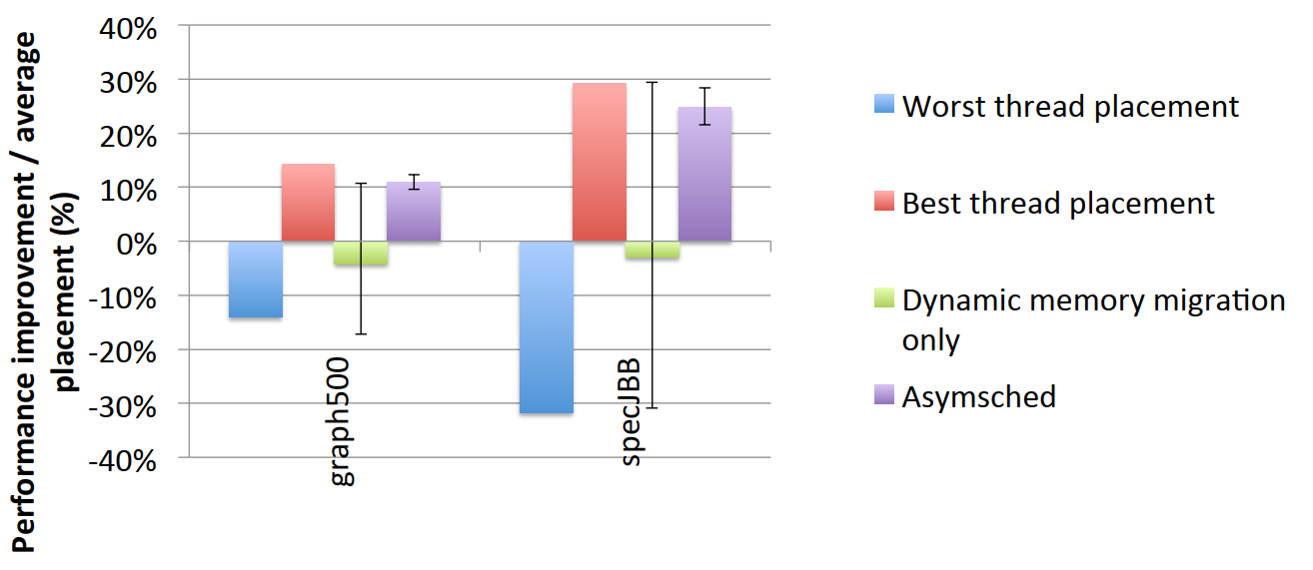
Evaluation: ﻿single application workloads
Notes:
处理器: 2个AMD opteron（皓龙) 6272处理器; 每一个处理器2个NUMA node, 每个node 8 cores; 共4个numa node
﻿the best and the worst static placements of data-sharing thread clusters.
Graph500: benchmark, metrics
﻿SPECjbb: ﻿industry-standard server-side java benchmark, JAVA server Business Benchmark（java服务器业务测试工具）
﻿dynamic mem﻿ory migration only
﻿turning off the parts performing thread placement
the minimum and maximum performance often being the same as that of the best and worst static thread placement
The thread placement has quite an impact
﻿AsymSched always performs close to the best static thread placement.
Not to do anything cuz of the app allocate the memory and freeze it immediately

Slide 23
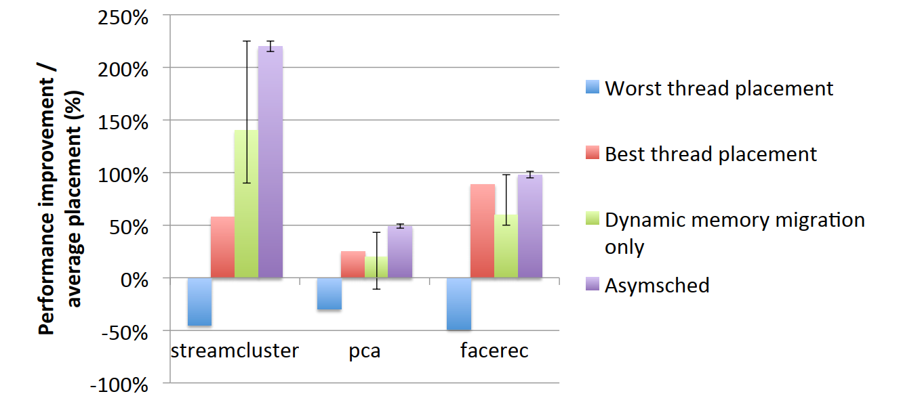
Evaluation: ﻿single application workloads
Notes:
﻿For applications that produce the highest degree of contention on the interconnect links (streamcluster, pca, and facerec),
AsymSched achieves much better performance than the best thread placement
because the dynamic memory migration component balances memory accesses across nodes,
thus reducing contention on interconnect links and memory controllers.
竞争
Dynamic memory migration Improve but still has a high standard deviation: runtime is not predictable

Slide 24
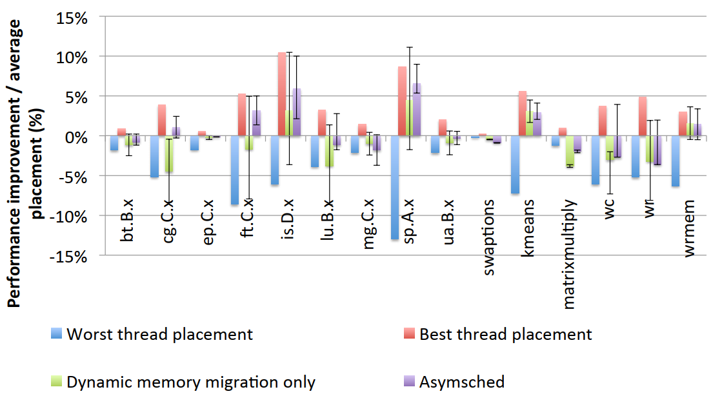
Evaluation: single application workloads
Notes:
Mean difference between the worst & the best is 14%
The placement impacts the applications quite a bit
A lot of other applications: NAS基准测试
﻿the NAS Parallel Benchmarks suite which is composed of numeric kernels

Slide 25
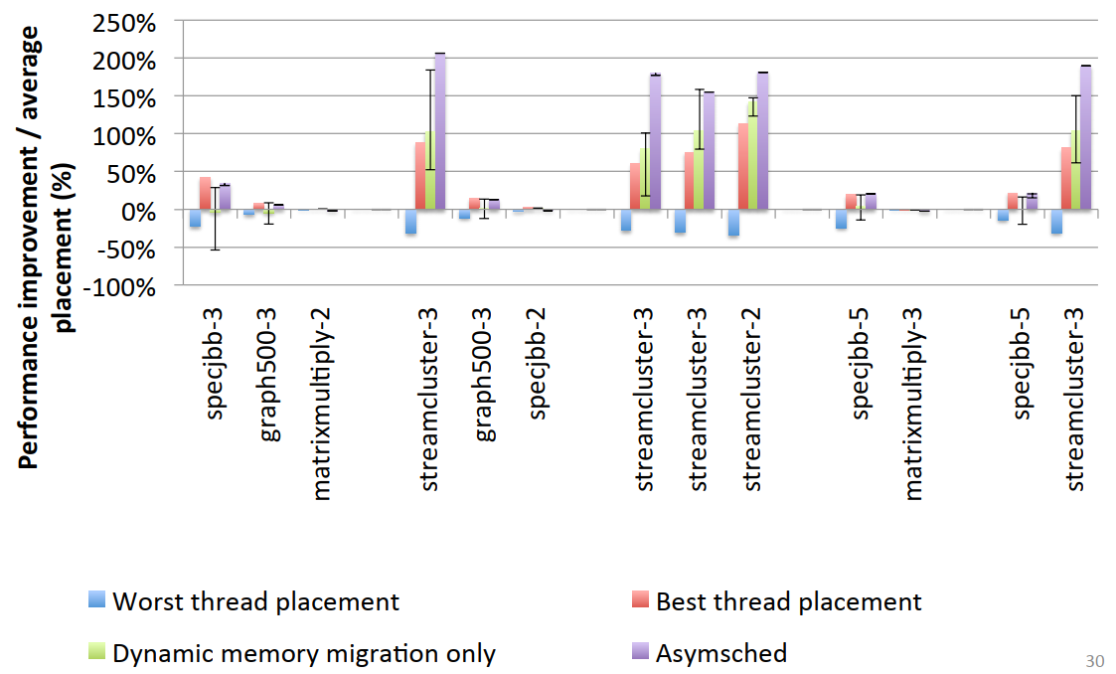
Evaluation: ﻿﻿multi application workloads
Notes:
Multi applications
﻿The numbers appended to the name of applications: the number of nodes on which the application runs.
1. ﻿close or better than the best static thread placement on Linux
2. produces a very low standard deviation

Slide 26
Conclusion
Systems should maximize bandwidth between threads
Asymsched
  Up to 200% faster than average placement
  Up to 91% faster than dynamic memory migration alone

Slide 27

Thanks!
Q & A

Slide 28
Outline
Motivation
Design & Implementation
Evaluation
Demo

Slide 29
Demo
Implement core algorithm in Python
  Around 350 lines
Inputs
  NUMA node connectivity (bandwidth)
  Node-to-node memory access
  Resident set size of app per node
  Other minor stuff
Output
  New placement

Slide 30
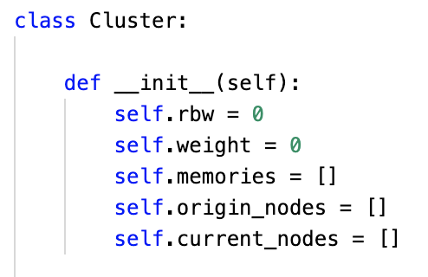
Core Data Structures
Cluster
  threads in a app that share data
Cluster.rbw
  mem bandwidth to remote nodes
Cluster.weight
  bandwidth priority
Cluster.memories
  per node resident size
Cluster.origin_nodes
Cluster.current_nodes
  Old/New no des allocated to the Cluster
input data
output data
object reference

Slide 31
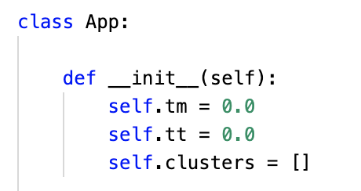
Core Data Structures
App
  stands for an application
App.tm
  time already spent migrating memory
App.tt
  dynamic running time of the app
App.clusters
  which clusters does the app belongs to
input data
output data
object reference

Slide 32
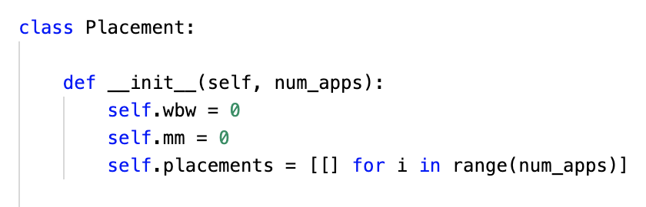
Core Data Structures
Placement
  A placement for apps
Placement.wbw
  Weight total bandwidth of P
Placement.mm
  Amount of memory that has to be migrate to use P
Placement.placements
  detailed per-app placements
input data
output data
object reference

Slide 33
Core Logic at a top level
Compute all placements
Compute wbw for each placement P
Filter and select P with min P.mm
Calculation

Slide 34
Core Logic at a top level
Compute all placements
Compute wbw for each placement P
whether to do the migration?
Filter and select P with min P.mm
Calculation
Decision

Slide 35
Core Logic at a top level
Compute all placements
Compute wbw for each placement P
whether to do the migration?
Filter and select P with min P.mm
Return
N
Calculation
Decision

Slide 36
Core Logic at a top level
Action
Compute all placements
Output the result
Compute wbw for each placement P
Migrate threads and memory
Y
whether to do the migration?
Filter and select P with min P.mm
Return
N
Calculation
Decision

Slide 37
A minimal test case
Node 0
3 GB/s
Node 1
1 GB/s
1 GB/s
Node 2
Node 3
7 GB/s

Slide 38
A minimal test case
App 0
Node 0
3 GB/s
Node 1
1 GB/s
1 GB/s
Node 2
Node 3
7 GB/s
App 1

Slide 39
A minimal test case
App 0
3GB/s
Node 0
3 GB/s
Node 1
1 GB/s
1 GB/s
Node 2
Node 3
7 GB/s
0.5KB/s
App 1

Slide 40
A minimal test case
App 1
0.5KB/s
Node 0
3 GB/s
Node 1
1 GB/s
1 GB/s
Node 2
Node 3
7 GB/s
3GB/s
App 0
Expect to grow!

Slide 41
Thanks!
Q & A

