Slide 1
Making Geo — Replicated Systems Fast as Possible Consistent when Necessary
小组成员：邓天迈、余兴梓、顾翼成、王笑然

Slide 2

Geo — replication is needed!
Geo — replication is used by major providers of Internet services.
– e.g., Google, Amazon, Facebook, etc

Slide 3
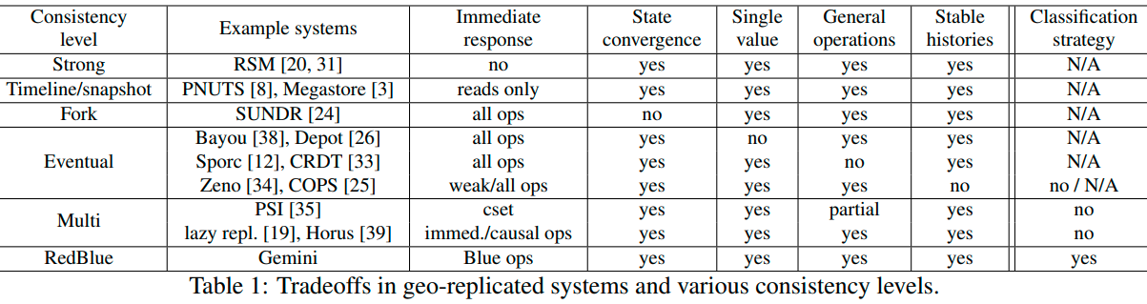
Consistency Related Work
Strong High latency
Timeline/snapshot Read-only replica
Fork Distinct causal histories & Hard to converge
Eventual Diverge state & Bad causality
Multi Challenge to developers

Slide 4





Consistency or performance?
Strong consistency
e.g., Paxos [TOCS’98]
Pros: Natural semantics
Cons: High latency
Eventual consistency
e.g., Dynamo [SOSP’07], Bayou [SOSP’95]
Pros: Low latency
Cons: Undesirable behaviors
Can we build geo — replicated systems that are both fast and consistent?

Slide 5
Outline
RedBlue Consistency and Side Effects
Gemini Design and Implementation
Evaluation

Slide 6
RedBlue Consistency and Side Effects

Slide 7











Balance strong/eventual consistency
Strong consistency
Eventual consistency
In order but Slow
Out of order but Fast
R1
A1
B1
B2
R2
A2
R3
B3

Slide 8









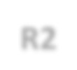





Balance strong/eventual consistency
Strong consistency RedBlue Eventual consistency
Low latency of eventual consistency when possible
Coordination for strong consistency only when necessary
R1 A1 B1 A1 B1
R1
B2
B2
R2
A2
R2
A2
R3
R3
B3
B3

Slide 9
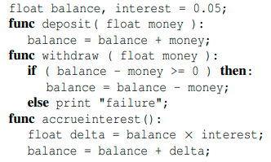
An Example
Alice in the EU and Bob in the US while Alice and Bob share a single bank account
They can deposit, withdraw and accrue interest

Slide 10
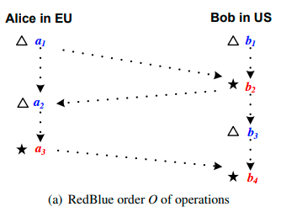
RedBlue Order
RedBlue order should have determined order of red ops while blue ops are lazily replicated with red ops
What about blue ops?

Slide 11
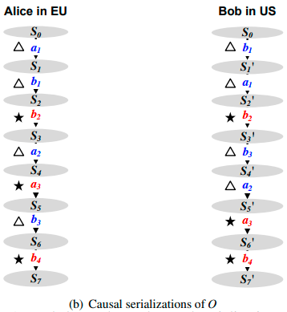
Casual Serialization
Satisfy both RedBlue Order and dependencies

Slide 12
RedBlue Consistency
Define RedBlue Consistency:
A replicated system is RedBlue consistent if each site i applies operations according to an i-causal serialization of RedBlue order O
But Notice: RedBlue Consistency doesn’t satisfy casual consistency

Slide 13
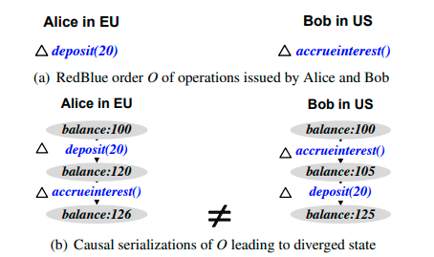
State Convergence
Problem! Not state convergent yet!
How to distinct red ops and blue ops?
If all blue operations are globally commutative, then any RedBlue consistent system is state convergent

Slide 14
Commutative ops
Deposit and accrue interest are noncommutative because :
Deposit is an add operation while
Accrue interest is a multiple operation
add and multiple ops are noncommutative!
accrue interest should be a red op.

Slide 15



Generator/Shadow operation
Intuitively, the execution of accrueinterest can be divided into:
  A generator operation
    decides how much interest to be accrued
    has no side effects
  A shadow operation
    adds the decided interest to the balance
$g_{a}$ no side effect, blue
$$a$$
$h_{a} shadow operation$, red or blue

Slide 16



Shadow operations
For lower latency, Can red op change to blue op? Yes!
$g_{a}$ no side effect
100 x$0.05$
$h_{a}:+5$ is a blue op
multiply op change to add op by generating shadow op
Divide red op to generator and shadow op and shadow op may change to blue op

Slide 17
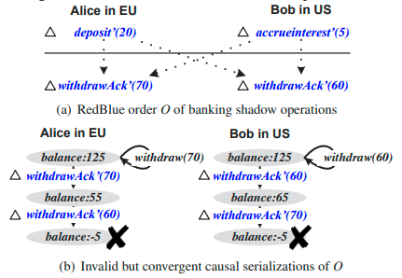
Invariant restrictions
Problem again! Consider Invalid situation!
Withdraw op may lead to balance < 0 and break invariant restrictions
Withdraw should be red op!

Slide 18
Recall Operations
Deposit op is a blue op
Accrue interest op is a red op but its shadow op can change to a blue op
Withdraw op is a red op because it may break Invariant restrictions.
Further more, withdraw success is a red op while withdraw failed is a blue op

Slide 19







Bank generator/shadow operations
Original/Generator operation Shadow operation
deposit(float m){ balance = balance + m;
deposit’(float m){ balance = balance + m;
produces
}
}
accrueinterest(){
float delta=balance × interest; balance=balance + delta;
produces
accrueinterest’(float delta){ balance=balance + delta;
}
}
withdraw(float m){
if(balance-­‐m>=0)
balance=balance -­‐ m;
else
print “Error”
}
produces
withdrawAck’(float m){
balance=balance -­‐ m;
}
produces
withdrawFail’(){
}

Slide 20











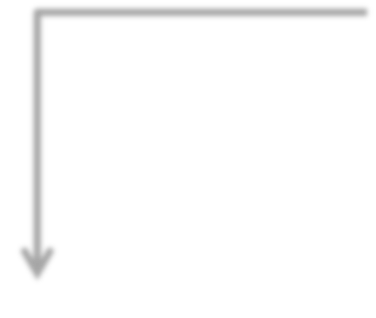














Which must be Red or can be Blue?
Ensuring state convergence
a shadow operation u
No
commutes with all others?
Ensuring invariant preservation
Yes
Yes
breaks invariants?
No
Red
Blue

Slide 21
Gemini Design and Implementation

Slide 22


























Gemini coordination system
A1
B1
R1
B2
Alice
Bob
R2
R2
B2
R1
B1
A1
Coo R1 ator
Coo R2 ator
r A1
din
rdin
B2
B1
Cross-­‐site communication
Storage engine
Storage engine

Slide 23









Gemini coordination system
A1
B1
R1
B2
Alice
Bob
R3
A2
R2
B4
A2
R3
B4
Coo R3 ator
Co B4 nator
r A2
din
ordi
B1
B2 R2
Cross-­‐site communication
Storage engine
Storage engine
A1
R1
B1
B2
A1
R1
R2

Slide 24
Evaluation

Slide 25
Questions
How common are blue operations?
Does RedBlue consistency improve user-­‐observed latency?
Does throughput scale with the number of sites?

Slide 26
Questions
How common are blue operations?
Does RedBlue consistency improve user-­‐observed latency?
Does throughput scale with the number of sites?

Slide 27
Case studies
Applications:
  Two e-­‐commerce benchmarks: TPC-­‐W, RUBiS
  One social networking app: Quoddy
Apps | # Original update txns | # Blue/Red update ops
TPC-­‐W | 7 | 0/7
RUBiS | 5 | 0/5
Quoddy | 4 | 0/4

Slide 28
Case studies
Applications:
  Two e-­‐commerce benchmarks: TPC-­‐W, RUBiS
  One social networking app: Quoddy
Apps | # Original update txns | # Blue/Red update ops | # Shadow ops | # Blue/Red update ops
TPC-­‐W | 7 | 0/7 | 16 | 14/2
RUBiS | 5 | 0/5 | 9 | 7/2
Quoddy | 4 | 0/4 | 4 | 4/0

Slide 29
How common are Blue operations?
Runtime Blue/Red ratio in different applications with different workloads:
Apps | workload | Originally
 |  | Blue (%) | Red(%)
TPC-­‐W | Browsing mix | 96.0 | 4.0
 | Shopping mix | 85.0 | 15.0
 | Ordering mix | 63.0 | 37.0
RUBiS | Bidding mix | 85.0 | 15.0
Quoddy | a mix with 15% update | 85.0 | 15.0

Slide 30
How common are Blue operations?
Runtime Blue/Red ratio in different applications with different workloads:
Apps | workload | Originally |  | With shadow ops
 |  | Blue (%) | Red(%) | Blue (%) | Red(%)
TPC-­‐W | Browsing mix | 96.0 | 4.0 | 99.5 | 0.5
 | Shopping mix | 85.0 | 15.0 | 99.2 | 0.8
 | Ordering mix | 63.0 | 37.0 | 93.6 | 6.4
RUBiS | Bidding mix | 85.0 | 15.0 | 97.4 | 2.6
Quoddy | a mix with 15% update | 85.0 | 15.0 | 100 | 0
The vast majority of operations are Blue.

Slide 31
Questions
How common are Blue operations?
Does RedBlue consistency improve user-­‐observed latency?
Does throughput scale with the number of sites?

Slide 32
Experimental setup
Experiments with:
  TPC-­‐W
Deployment in Amazon EC2
  spanning 5 sites (US-­‐East, US-­‐West, Ireland, Brazil, Singapore)
  locating users in all five sites and directing their requests to closest server

Slide 33
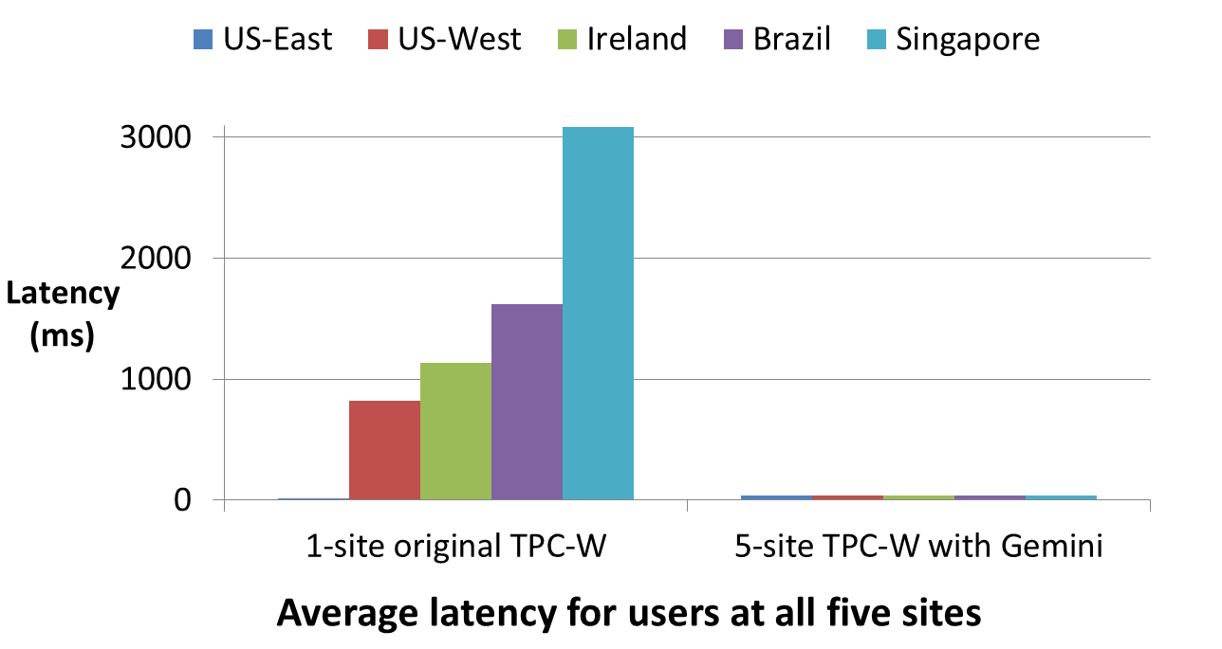


Does RedBlue consistency improve
user-­‐observed latency?

Slide 34
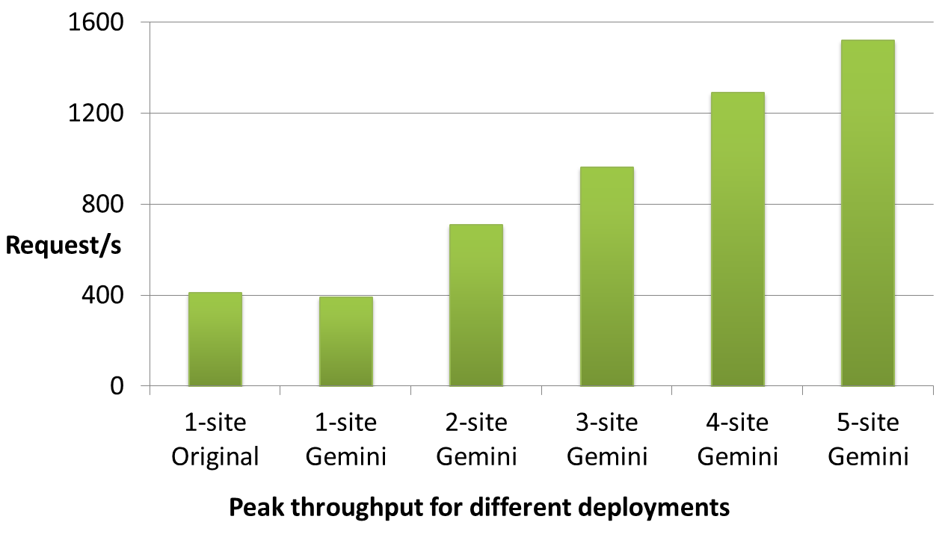


Does throughput scale with the
number of sites?

Slide 35
Conclusion
RedBlue consistency allows strong consistency and eventual consistency to coexist.
Generator/shadow operation extends the space of fast operations. But also make crash recovery more difficult.
Experimental results show this solution improves both latency and throughput.

Slide 36
THANK YOU!

