Slide 1
The FuzzyLog: A Partially Ordered Shared Log
Joshua Lockerman, Yale University; Jose M. Faleiro, UC Berkeley; Juno Kim, UC San Diego;
Soham Sankaran, Cornell University; Daniel J Abadi, University of Maryland, College Park;
James Aspnes, Yale University; Siddhartha Sen, Microsoft Research;
Mahesh Balakrishnan, Yale University / Facebook
OSDI 2018
2022.03.14 presented by 赵胜龙、岑少锋、薛宇豪、刘若晨

Slide 2
Background: Total and Partial Order
Total Order Set
  Any pair of elements in the set is comparable to each other.
  1、2 … N
Partial Order Set
  Only some elements in the set are comparable with each other.
1
2
3
…
4
1
2
3
…
4
a
b
c
…
n

Slide 3



Background: Shared Log
1
3
4
2
Sequencer
Total Order
Shared Log
1
2
3
4

Slide 4


Background: Shared Log
Consistency
Durability
Scalability
Availability
1
3
4
2
Sequencer
Total Order
Shared Log
1
2
3
4

Slide 5
Problem
Shared Log provides simplicity, but
total order
brings scalability and
availability problems.

Slide 6
Motivation
Can we provide the
simplicity of a shared log
without imposing a total order?

Slide 7
Observation
Sharding
Database
Alice
Bob

Slide 8

Observation
Sharding
Geo-distributed
Database
Alice
Bob

Slide 9
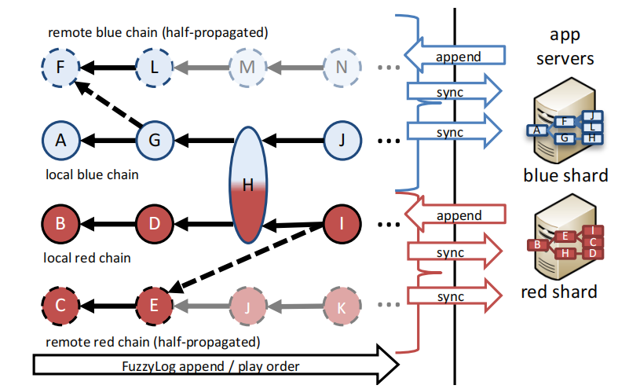
Design: Overview
Remote Region
Local Region
Notes:
每种颜色表示一个 data shard. （红色和蓝色）
每个颜色由一系列的链组成，一个 region 对应一条链（local 和 remote）。这些链是对数据的操作日志。
每条链由有向边连着，在后面的节点发生在前面的结点之后。
日志和用户的视图可能不同，比如上图，半透明的部分是日志里的节点，但是用户尚未进行同步。

Slide 10
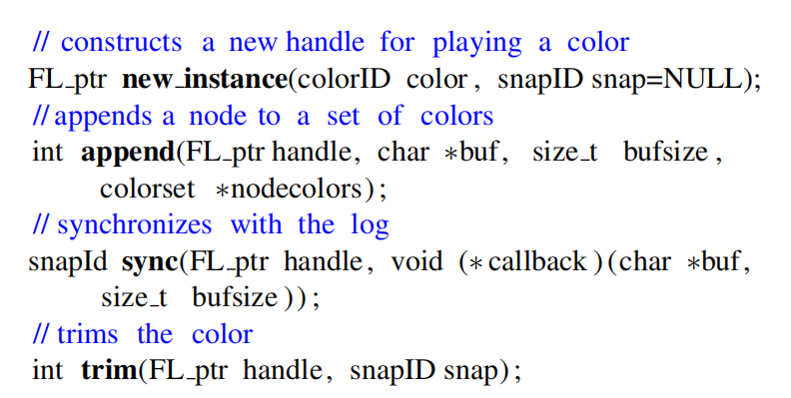
Design: FuzzyLog API

Slide 11
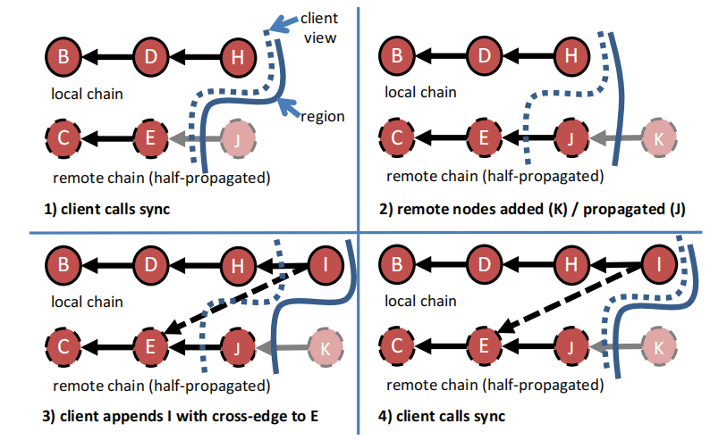
Design: FuzzyLog

Slide 12
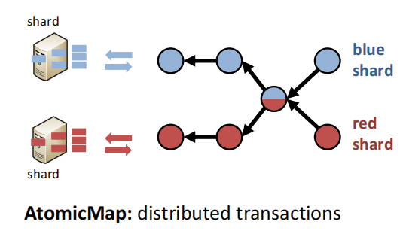
Applications: AtomicMap
Usage Scenarios:
  Applications that run within a single region and need to scale linearly.

Slide 13
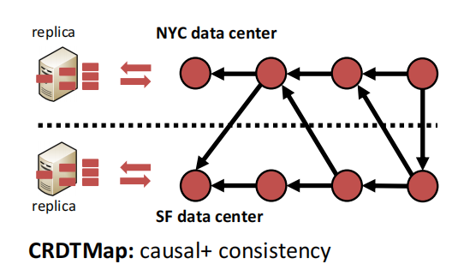
Applications: CRDTMap
Usage Scenarios:
  Applications can often tolerate weaker consistency guarantees across regions.

Slide 14
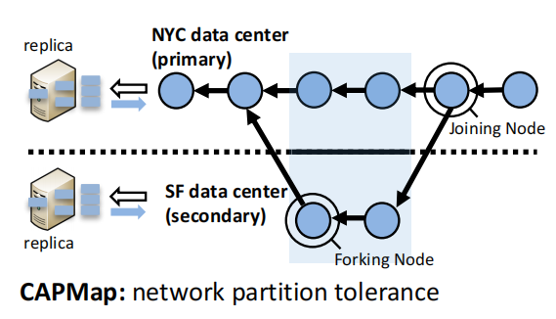
Applications: CAPMap
Usage Scenarios:
  Provides strict consistency guarantees in the absence of network partitions and causal consistency during network partitions.

Slide 15


Implementation: Single-color
append
FuzzyLog API
Low Level API
Log
Last Sync
Notes:
Scalability: reads、appends 应该随着 shards 及 FuzzyLog servers

Slide 16


Implementation: Single-Color
sync
FuzzyLog API
①
②
Low Level API
Current Tail
Log
From Last Sync .. Current Tail
Last Sync
Notes:
Scalability: reads、appends 应该随着 shards 及 FuzzyLog servers

Slide 17

Implementation: Multi-Color
Phase 1
Max: T₃
r₁
C1
{r₁:T₂}
T₂
{r₁:T₃}
T₃
Pending
To-Deliver
Notes:
Scalability: reads、appends 应该随着 shards 及 FuzzyLog servers

Slide 18
Implementation: Multi-Color
Phase 1
Phase 2
Max: T₃
r₁
{r₁:T₃}
C1
{r₁:T₂}
T₂
{r₁:T₃}
T₃
Pending
To-Deliver
Notes:
Scalability: reads、appends 应该随着 shards 及 FuzzyLog servers

Slide 19
Implementation: Multi-Color
Phase 1
Phase 2
Max: T₃
r₁
{r₁:T₃}
C1
{r₁:T₂}
T₂
{r₁:T₃}
T₃
Pending
To-Deliver
Notes:
Scalability: reads、appends 应该随着 shards 及 FuzzyLog servers

Slide 20
Implementation: Multi-Color
Phase 1
Phase 2
Max: T₃
r₁
{r₁:T₃}
ack
C1
{r₁:T₃}
T₂
{r₁:T₃}
T₃
Pending
To-Deliver
Notes:
Scalability: reads、appends 应该随着 shards 及 FuzzyLog servers

Slide 21
Evaluation: Setup
Amazon EC2
  8 virtual cores,
  15 GiB RAM
  Intel Xeon E5-2666 v3 processors
Tokyo
US-East
2 Regions with ping latency 168ms

Slide 22
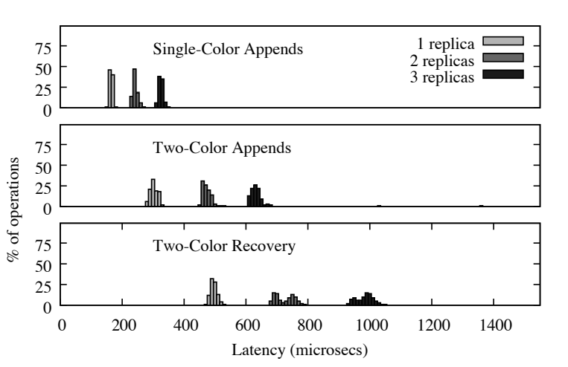
Evaluation: Micro-benchmark
1 Phase
2 Phases
3 Phases

Slide 23
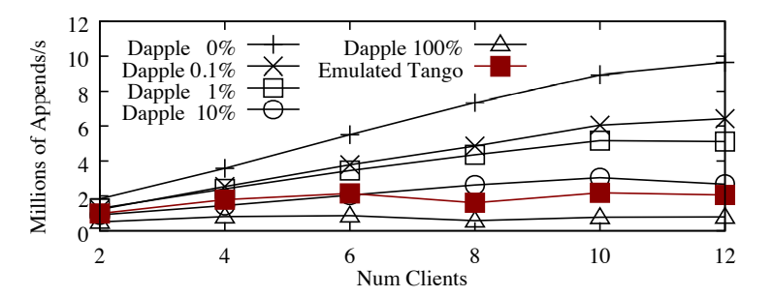
Evaluation: Compared with Tango
Percentage of multi-appends

Slide 24
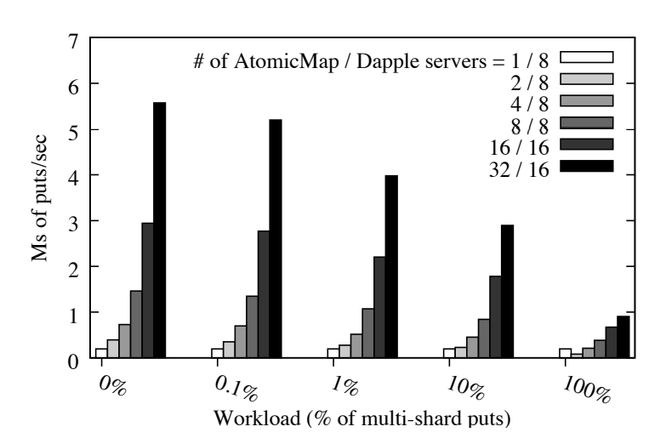

Evaluation: Applications

Slide 25
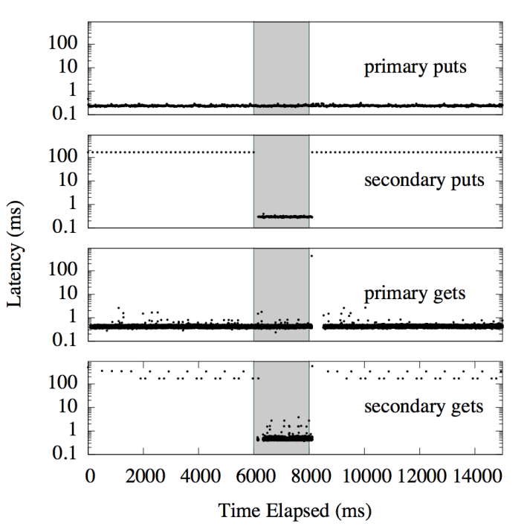

Evaluation: Applications
Network Partition

Slide 26
Thanks for listening!

Slide 27
Demo: Key Value Store
Single Region
get 1
Key Value Store
sync
Client
1:2
FuzzyLog
S,0,1
S,1,2
S,1,5

Slide 28
Demo: Key Value Store
Single Region
get 1
Key Value Store
return 5
0:1
sync
return
Client
1:5
FuzzyLog
S,0,1
S,1,2
S,1,5

Slide 29
Demo: Key Value Store
Single Region
set 4:8
Key Value Store
0:1
append
1:5
Client
1:5
FuzzyLog
S,0,1
S,1,2
S,1,5

Slide 30
Demo: Key Value Store
Single Region
set 4:8
Key Value Store
0:1
append
sync
1:5
Client
1:5
FuzzyLog
S,0,1
S,4,8
S,1,2
S,1,5

Slide 31
Demo: Key Value Store
Single Region
set 4:8
Key Value Store
0:1;4:8
append
sync
1:5
Client
1:5
FuzzyLog
S,0,1
S,4,8
S,1,2
S,1,5

Slide 32
Demo: Key Value Store
Across Region
get 1
get 0
Bei Jing
Shang Hai
sync
sync
0:1;1:2
1:2
Alice
Bob
FuzzyLog: Beijing’s Copy
FuzzyLog: Shanghai’s Copy
Local
S,0,1
S,1,2
S,1,5
Remote
S,1,2
S,1,5
S,0,1

Slide 33
Demo: Key Value Store
Across Region
get 1
get 0
Bei Jing
Shang Hai
sync
sync
0:1;1:5
1:2,0:1
Alice
Bob
FuzzyLog: Beijing’s Copy
FuzzyLog: Shanghai’s Copy
Local
S,0,1
S,1,2
S,1,5
Remote
S,1,2
S,1,5
S,0,1

Slide 34
Demo: Key Value Store
Across Region
set 1:7
set 2:8
Bei Jing
Shang Hai
append
append
0:1;1:5
1:2,0:1
Alice
Bob
FuzzyLog: Beijing’s Copy
FuzzyLog: Shanghai’s Copy
Local
S,0,1
S,1,2
S,1,5
Remote
S,1,2
S,1,5
S,0,1

Slide 35
Demo: Key Value Store
Across Region
set 1:7
set 2:8
Bei Jing
Shang Hai
append
append
0:1;1:7
1:2,0:1,2:8
Alice
Bob
FuzzyLog: Beijing’s Copy
FuzzyLog: Shanghai’s Copy
Local
S,0,1
S,1,7
S,1,2
S,1,5
S,2,8
Remote
S,1,2
S,1,5
S,0,1

Slide 36
Demo: Key Value Store
Across Region
set 1:7
set 2:8
Bei Jing
Shang Hai
append
sync
append
sync
0:1;1:7
1:2,0:1,2:8
Alice
Bob
FuzzyLog: Beijing’s Copy
FuzzyLog: Shanghai’s Copy
Local
S,0,1
S,1,7
S,1,2
S,1,5
S,2,8
Remote
S,1,2
S,1,5
S,2,8
S,0,1
S,1,7

Slide 37
Demo: Key Value Store
Across Region
set 1:7
set 2:8
Bei Jing
Shang Hai
append
sync
append
sync
0:1;1:7,2:8
1:7,0:1,2:8
Alice
Bob
FuzzyLog: Beijing’s Copy
FuzzyLog: Shanghai’s Copy
Local
S,0,1
S,1,7
S,1,2
S,1,5
S,2,8
Remote
S,1,2
S,1,5
S,2,8
S,0,1
S,1,7

Slide 38


Demo: Social Media
Alice & Bob
Alice’s Data & Bob’s Data
America & China

Slide 39
Demo: Social Media
Alice
Bob
1. Post a moment
Local
1
Local
Remote
Remote
Local
Local
Remote
Remote

Slide 40
Demo: Social Media
Alice
Bob
1. Post a moment
2. Like the moment
Local
1
2
Local
Remote
1
Remote
Local
Local
Remote
Remote

Slide 41
Demo: Social Media
Alice
Bob
3. Remove Bob
5. Change avatar
4. Post a moment
Local
1
3
4
2
Local
Remote
2
4
3
1
Remote
Local
5
Local
Remote
Remote

Slide 42


Demo: Social Media
Alice
Bob
Local
1
3
4
2
Local
Remote
2
4
3
1
Remote
Local
5
Local
Remote
Remote

Slide 43
Demo: Social Media
Alice
Bob
Local
1
3
4
2
Local
Remote
2
4
3
1
Remote
Local
5
Local
Remote
Remote

Slide 44
Demo: Social Media
Alice
Bob
Local
1
3
4
2
Local
Remote
2
4
3
1
Remote
Local
5
Local
Remote
5
Remote

Slide 45
Demo: Social Media
Alice
Bob
6. Transfer $520
Local
1
3
4
2
Local
Remote
2
4
3
1
Remote
Local
5
Local
Remote
5
Remote

Slide 46
Thanks for listening!

