Slide 1
Building Consistent Transactions with Inconsistent Replication
Irene Zhang Naveen Kr. Sharma Adriana Szekeres
Arvind Krishnamurthy Dan R. K. Ports
2022年3月28日
小组：吴晨鹏、薛景文、施乘宇、江建东

Slide 2
目录 Contents
1
Background
2
IR-Inconsistent Replication
3
TAPIR-Transactional Application Protocol for IR
4
Evaluation

Slide 3

Background
Demand of large-scale web application
  Fault-tolerance
  Availability
Balance between consistency and performance
consistency
performance
PAXOS

Slide 4

Distribution Transaction
Application Server
A
B*
C
A*
B
C
A
B
C*
Zone1
Zone2
Zone3
*:shard leader

Slide 5
Distribution Transaction
Distributed
Transaction
Protocol
(like 2PC)
Application Server
Replication
Protocol
(like Paxos)
A
B*
C
A*
B
C
A
B
C*
Zone1
Zone2
Zone3

Slide 6
Cost of Redundant Coordination
Execution
read(a)
Application Server
read(a)
A
B*
C
A*
B
C
A
B
C*
Zone1
Zone2
Zone3

Slide 7
Cost of Redundant Coordination
Execution
read(a)
write(b)
Application Server
write(b)
A
B*
C
A*
B
C
A
B
C*
Zone1
Zone2
Zone3

Slide 8
Cost of Redundant Coordination
Execution
read(a)
write(b)
read(c)
Application Server
read(c)
A
B*
C
A*
B
C
A
B
C*
Zone1
Zone2
Zone3

Slide 9
Cost of Redundant Coordination
Prepare
Coordinate across shards
Application Server
A
B*
C
A*
B
C
A
B
C*
Zone1
Zone2
Zone3

Slide 10
Cost of Redundant Coordination
Prepare
Coordinate across replicas
Application Server
A
B*
C
A*
B
C
A
B
C*
Zone1
Zone2
Zone3

Slide 11
Cost of Redundant Coordination
Commit
Application Server
At least 2 RTT
A
B*
C
A*
B
C
A
B
C*
Zone1
Zone2
Zone3

Slide 12
Overview
Use a weaker consistency protocol
  Eliminate the redundancy of strict serial ordering over the two layers
  Allows 1 RTT cost on transaction
Design Overview
  IR – Replication Protocol
    the first replication protocol to provide pure fault tolerance without consistency
  TAPIR – Transactional Application Protocol for IR
    the first transaction protocol designed to provide linearizable transactions on IR

Slide 13
IR-Inconsistent Replication
Consistency Guarantees
  Allows application protocol decide the outcome of conflicting operations and recover
Two types operation of IR
  Inconsistent Operation
    operations execute in any order. persist across failure
  Consensus Operation
    operations execute in any order. persist across failure, return a single consensus result

Slide 14
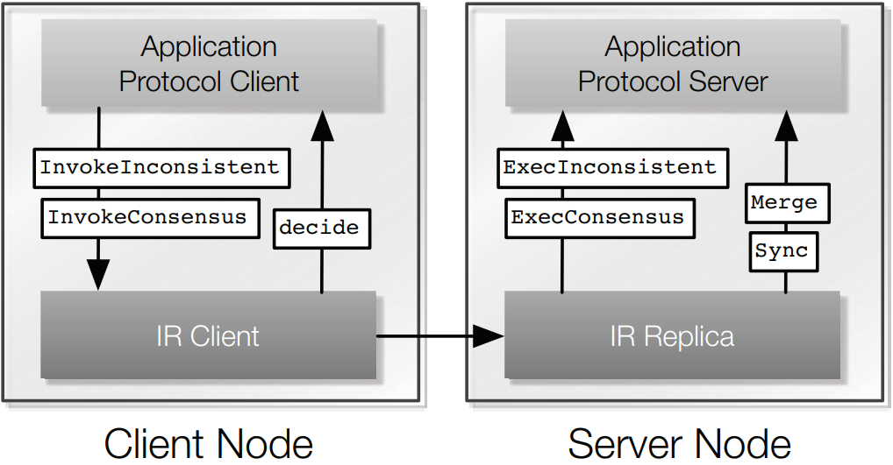
IR-Inconsistent Replication
IR Interface
Client Interface
Replica Upcalls

Slide 15
IR-Inconsistent Replication
IR Guarantees
  P1. [Fault tolerance]
    At any time, a operation in operation set is record in at least one of f+1 replicas
  P2. [Visibility]
    For any two operations in the operation set, at least one is visible to the other
  P3. [Consensus results]
    At any time, the result returned by a successful consensus operation is in the record of at least one replica

Slide 16


IR-Inconsistent Replication
IR Protocol
  IR client keeps an id and operation counter
  IR replica keeps an unordered record of executed operations and results for consensus operations.
In record
TENTATIVE
FINALIZED
TENTATIVE
A
A
FINALIZED
TENTATIVE
FINALIZED
TENTATIVE
B
B
Inconsistent
Consensus

Slide 17
IR-Inconsistent Replication
IR: Inconsistent Operation
IR Client
1. The client sends op and id to all replicas
<PROPOSE, id, op>
R1
R2
R3
R4
R5

Slide 18

IR-Inconsistent Replication
IR: Inconsistent Operation
IR Client
2. Each replica write op and id to record, marked TENTATIVE
R1
R2
R3
R4
R5
TENTATIVE
TENTATIVE
TENTATIVE
TENTATIVE
record
record
record
record

Slide 19
IR-Inconsistent Replication
IR: Inconsistent Operation
IR Client
3. Replica response client, client need f+1 acks (of 2f+1 replicas)
<REPLY, id>
R1
R2
R3
R4
R5
TENTATIVE
TENTATIVE
TENTATIVE
TENTATIVE
record
record
record
record

Slide 20
IR-Inconsistent Replication
IR: Inconsistent Operation
IR Client
4. Once receive f+1 acks, send finalize to all replicas asynchronously
5. replica marks op as FINALIZED
<FINALIZED, id>
R1
R2
R3
R4
R5
1 RTT
FINALIZED
FINALIZED
FINALIZED
FINALIZED
record
record
record
record

Slide 21
IR-Inconsistent Replication
IR: Consensus Operation
1. The client sends op and id to all replicas
2. Each replica write op, id, result to record, marked TENTATIVE
3. Replica response client id, result
IR Client
<PROPOSE, id, op>
R1
R2
R3
R4
R5

Slide 22
IR-Inconsistent Replication
IR: Consensus Operation
Fast Path: When there are more than ⌈3/2 f⌉+1 consensus result
Slow Path:
IR Client
R1
R2
R3
R4
R5
<result:1>
<result:1>
<result:1>
<result:1>
<result:1>

Slide 23
IR-Inconsistent Replication
IR: Consensus Operation
Return application protocol
Fast Path: When there are more than ⌈3/2 f⌉+1 consensus result
Slow Path:
IR Client
1 RTT
<FINALIZED, id, result>
R1
R2
R3
R4
R5
<result:1>
<result:1>
<result:1>
<result:1>
<result:1>

Slide 24
IR-Inconsistent Replication
IR: Consensus Operation
Fast Path: When there are more than ⌈3/2 f⌉+1 consensus result
Slow Path: When there are less than ⌈3/2 f⌉+1 consensus result
IR Client
1 RTT
R1
R2
R3
R4
R5
<result:1>
<result:2>
<result:2>
<result:1>
<result:1>

Slide 25
IR-Inconsistent Replication
IR: Consensus Operation
Fast Path: When there are more than ⌈3/2 f⌉+1 consensus result
Slow Path: When there are less than ⌈3/2 f⌉+1 consensus result
Receive f+1 result
IR Client
<FINALIZED, id, decide_result : 1>
1 RTT
R1
R2
R3
R4
R5
<result:1>
<result:2>
<result:2>
<result:1>
<result:1>

Slide 26
IR-Inconsistent Replication
CONFIRM, id
IR: Consensus Operation
Return application protocol
Fast Path: When there are more than ⌈3/2 f⌉+1 consensus result
Slow Path: When there are less than ⌈3/2 f⌉+1 consensus result
Receive f+1 acks
IR Client
1 RTT
<CONFIRM, id>
More than 1 RTT
R1
R2
R3
R4
R5
<result:1>
<result:1>
<result:1>
<result:1>
<result:1>

Slide 27
IR-Inconsistent Replication
IR: Recovery and Synchronization
  Replicas need to converge the result
IR use Merge and Sync function to recover failed replica and runs sync periodically
  Merge: Unite records from different replicas into master record
  Sync: Make replicas consistent with master record
Merge logic is defined by application protocol

Slide 28
IR-Inconsistent Replication
Group need one replica as leader to keep at least f+1 replicas up-to-date
On Merge and Sync:
  1. Leader gathers records from replica and merge them into master record, R, using IR-MERGE-RECORDS

Slide 29
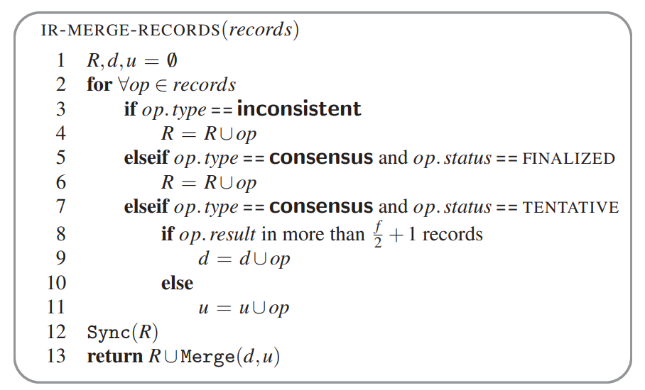
IR-Inconsistent Replication
Group need one replica as leader to keep at least f+1 replicas up-to-date
On Merge and Sync:
  1. Leader gathers records from replica and merge them into master record, R, using IR-MERGE-RECORDS

Slide 30
IR-Inconsistent Replication
On Merge and Sync:
  1. Leader gathers records from replica and merge them into master record, R, using IR-MERGE-RECORDS
  2. Sync inconsistent operations and finalized consensus operations
  3. Merge tentative consensus operations by application protocol
  4. Leader unites merge result to R and Sync to other replicas

Slide 31
IR Application Protocol Requirement:
Invariant checks must be performed pairwise.
  Weak ordering only provides pairwise visibility guarantees
Application protocols must be able to change consensus operation results.
  Finalize call provides final result that persists after op has already executed in application

Slide 32
IR performance principle:
Application protocols should not expect operations to execute in the same order
  optimistic timestamp ordering
Use cheaper inconsistent op whenever possible rather than consensus op
  optimistic transaction ordering & OCC

Slide 33
TAPIR-Transaction Application Protocol
Distributed transaction protocol
  2PC
Concurrency Control
  OCC with timestamp
Replication Protocol
  IR

Slide 34
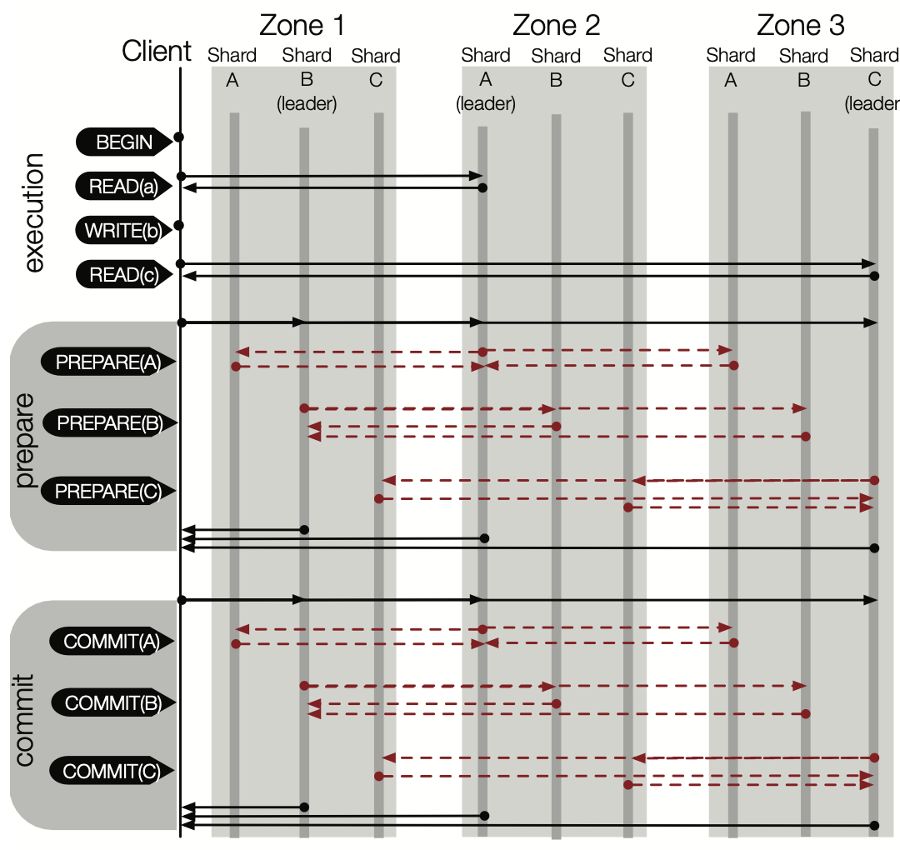
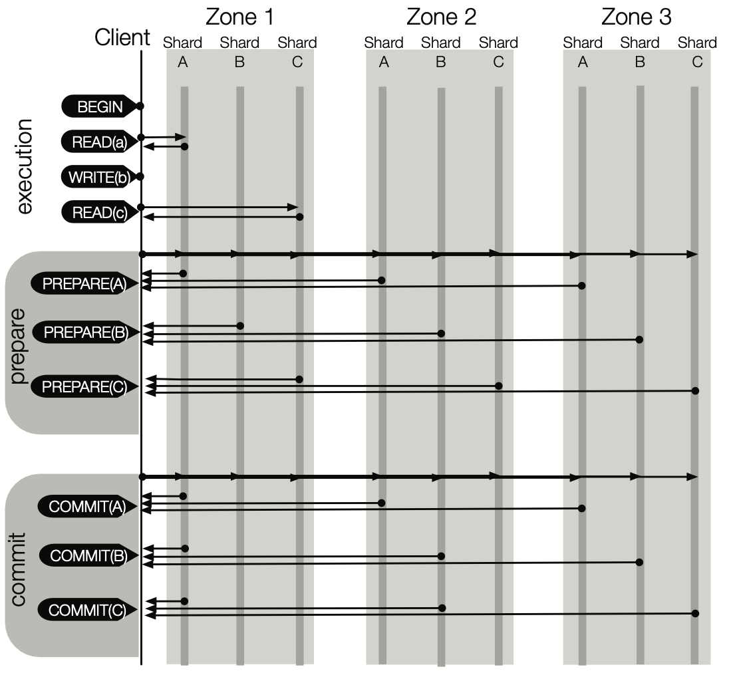
TAPIR-Transaction Application Protocol
TAPIR does not have any leaders or centralized coordination
TAPIR Reads always go to the closest replica
TAPIR Commit takes a single round-trip to the participants in the common case.

Slide 35
TAPIR Execution
Write to buffer
Read from
  write-set if exist
  cached copy if already read
  replica
Reads have timestamps of latest TX
write(key, obj)
buffer in write-set
Client
read(key)
read from cache / write-set / replica

Slide 36
TAPIR Commit
Select a proposed timestamp
Client

Slide 37
TAPIR Commit
Select a proposed timestamp
Start Prepare() as IR consensus operation
  Prepare(txn, timestamp)
P_{1,1}
Client
P_{1,2}
P_{1,3}
P_{2,1}
P_{2,2}
P_{2,3}

Slide 38
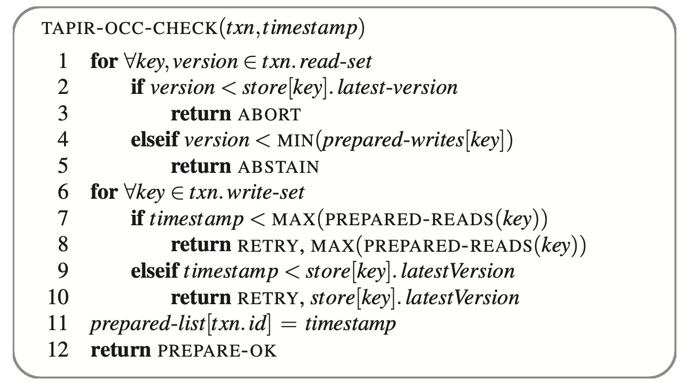
TAPIR Commit
Select a proposed timestamp
Start prepare() as IR consensus operation
Replica check whether to abort or not
  previously recorded as aborted
  OCC sees conflict in read/write sets
P_{1,1}
Client
P_{1,2}
P_{1,3}
P_{2,1}
P_{2,2}
P_{2,3}

Slide 39
TAPIR Commit
Select a proposed timestamp
Start prepare() as IR consensus operation
Replica check whether to abort or not
  previously recorded as aborted
  OCC sees conflict in read/write sets
Replicas reply Abort or Prepare-ok
  client return commit if all shards replied OK
P_{1,1}
Client
P_{1,2}
P_{1,3}
P_{2,1}
P_{2,2}
P_{2,3}

Slide 40
TAPIR Commit
Select a proposed timestamp
Start prepare() as IR consensus operation
Replica check whether to abort or not
  previously recorded as aborted
  OCC sees conflict in read/write sets
Replicas reply Abort or Prepare-ok
  client return commit if all shards replied OK
Client tells replicas to Commit/Abort
P_{1,1}
Client
P_{1,2}
P_{1,3}
P_{2,1}
P_{2,2}
P_{2,3}

Slide 41
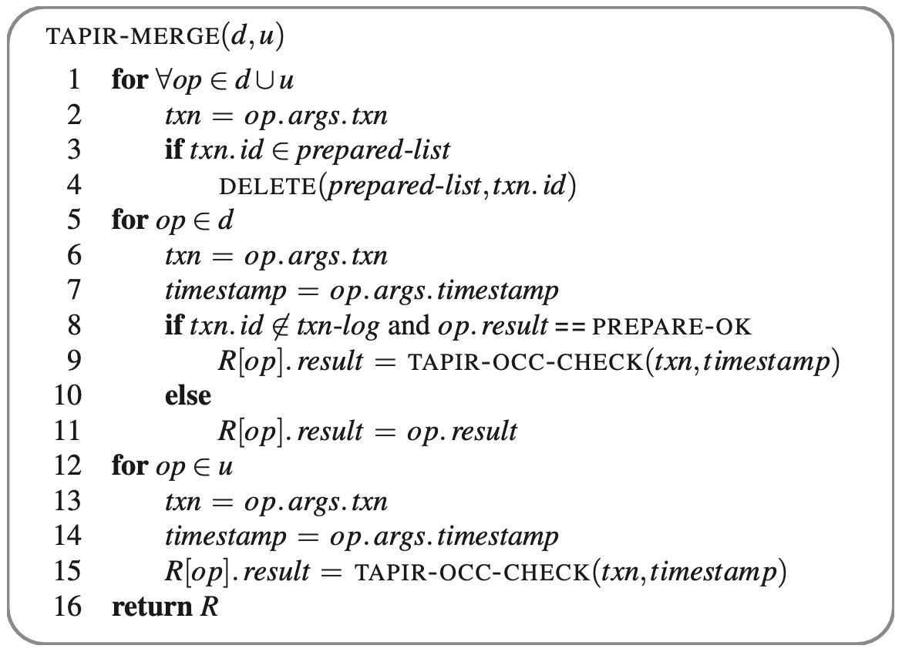
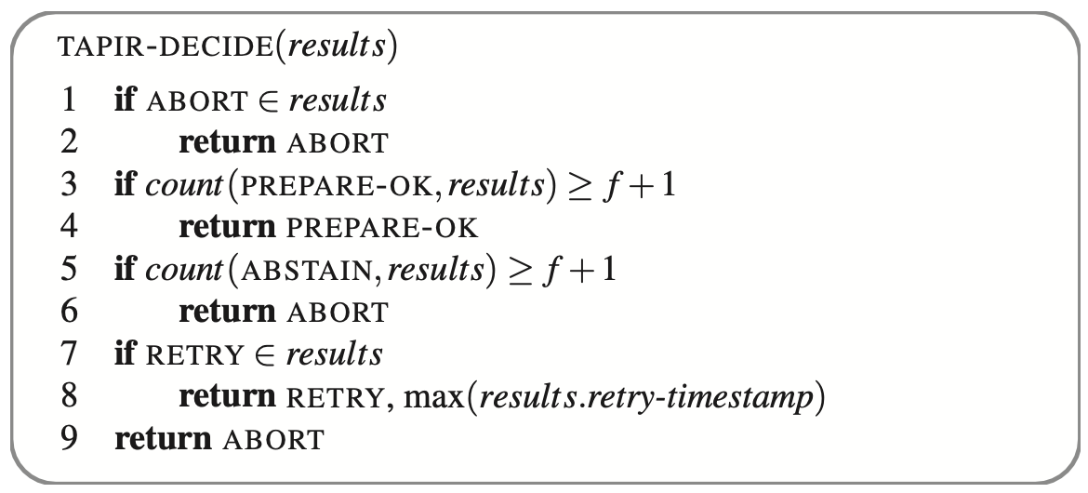
TAPIR IR Support
Decide function
Merge function

Slide 42
Evaluation
Target
  Latency & Throughput
  Abort rate
  Comparison to system with weak consistency
Setup
  Google Compute Engine across US, EU, Asia
  2.6GHz Intel Xeon, 8 GB RAM and 1Gb NIC
  Average clock skew 0.1-3.4ms (default)

Slide 43
Evaluation
Counterpart
  OCC-STORE
    2PC & OCC + Multi-Paxos
  LOCK-STORE:
    2PC & S2PL + Multi-Paxos (similar to Google Spanner)
Workload
  Retwis
    Open-source Twitter clone designed to use the KV store
  YCSB+T
    An extension of YCSB

Slide 44
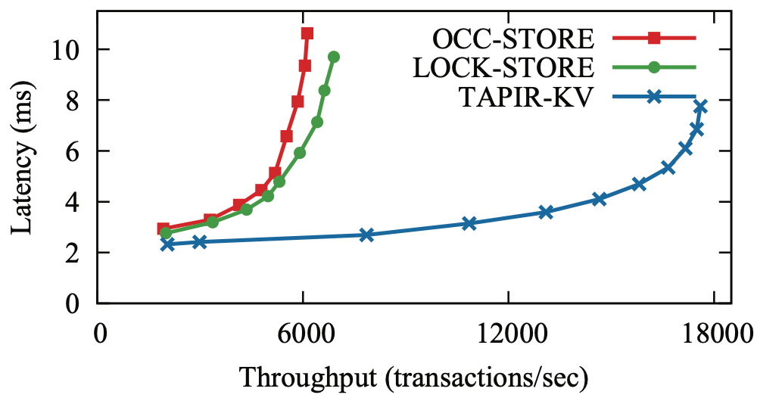
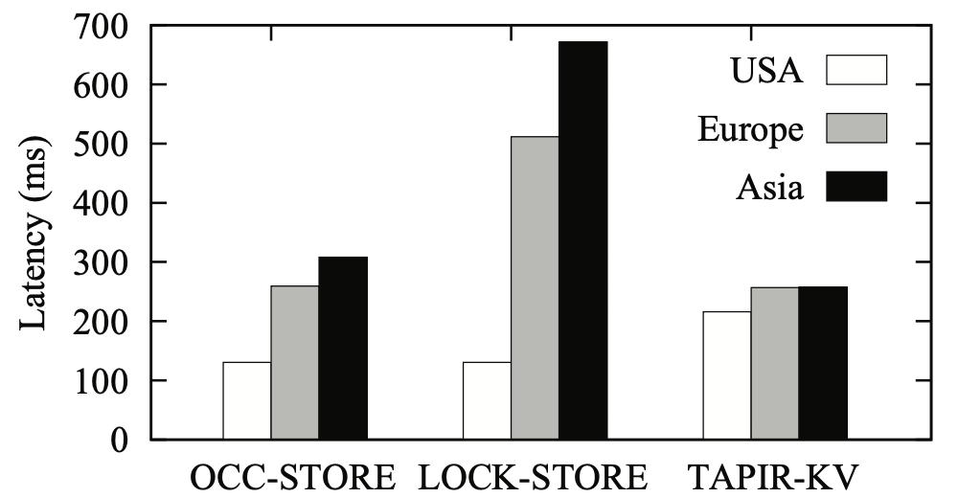
Evaluation
Single Data Center
  latency reduced by 50%: single round-trip
  peak throughput 3x: no leader & no cross-replica coordination
Wide-Area Latency
  local: wait for all replica
  remote: contact furthest replica

Slide 45
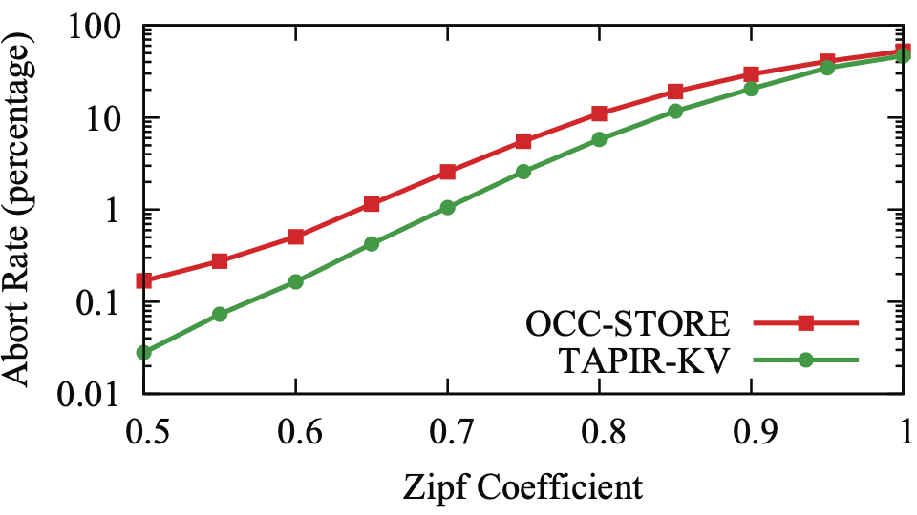
Evaluation
Uniform distribution: 10x lower
Heavy contention: 1.5x lower

Slide 46
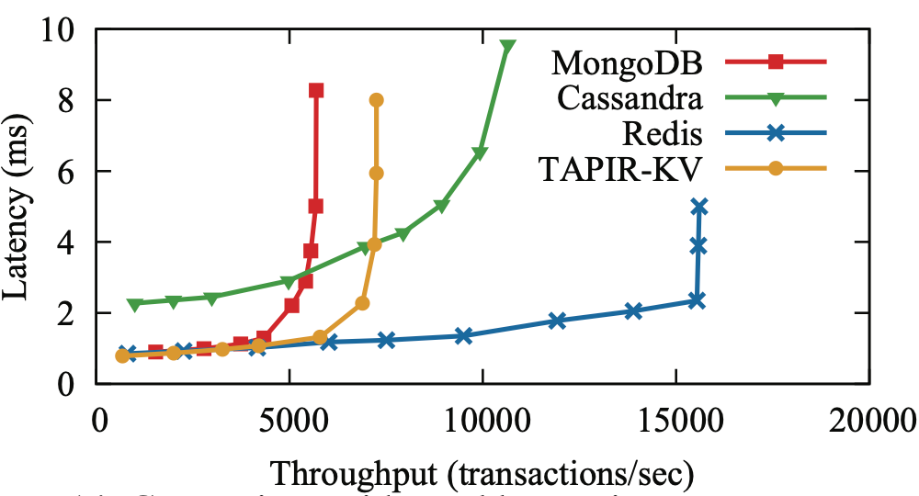
Evaluation
Latency: same or better
Throughput: 0.8-2x

Slide 47
Q&A

Slide 48
Thanks！

Slide 49
Demo: A lock server
Operations
  Lock : consensus operation
  Unlock : inconsistent operation
3 replicas
2 clients
Lock Client1
Lock Client2
Invoke
Decide
IR Client1
IR Client2
<PROPOSE, id, op>
IR Replica1
IR Replica2
IR Replica3
Exec
Sync, Merge
Lock Server1
Lock Server2
Lock Server3

Slide 50
Client1 invokes lock
1. InvokeConsensus(lock)
2. <propose,1-1,lock>
3. ExecConsensus(lock)
1. InvokeConsensus(lock)
IR Client1
2. <propose,1-1,lock>
2.
2.
IR Replica1
IR Replica2
IR Replica3
3. ExecConsensus(lock)
OK

Slide 51
Client1 invokes lock
1. InvokeConsensus(lock)
2. <propose,1-1,lock>
3. ExecConsensus(lock) -> OK
6. results{OK,OK,OK}
4. Add Record <1-1,lock,ok,tentative>
IR Client1
5. <reply,1-1,ok>
6. 3 matching results -> fast path
5. <reply,1-1,ok>
5. <reply,1-1,ok>
5. <reply,1-1,ok>
IR Replica1
IR Replica2
IR Replica3
<1-1,lock,ok,ten>
<1-1,lock,ok,ten>
<1-1,lock,ok,ten>

Slide 52
Client1 invokes lock
1. InvokeConsensus(lock)
2. <propose,1-1,lock>
3. ExecConsensus(lock) -> OK
7. Return result: OK
4. Add Record <1-1,lock,ok,tentative>
IR Client1
5. <reply,1-1,ok>
6. 3 matching results -> fast path
8. <finalize,1-1,ok>
8. <finalize,1-1,ok>
7. Return result: OK
8. <finalize,1-1,ok>
8. <finalize,1-1,ok>
IR Replica1
IR Replica2
IR Replica3
<1-1,lock,ok,ten>
<1-1,lock,ok,ten>
<1-1,lock,ok,ten>

Slide 53
Client1 invokes lock
1. InvokeConsensus(lock)
2. <propose,1-1,lock>
3. ExecConsensus(lock) -> OK
7. Return result: OK
4. Add Record <1-1,lock,ok,tentative>
IR Client1
5. <reply,1-1,ok>
6. 3 matching results -> fast path
8. <finalize,1-1,ok>
8. <finalize,1-1,ok>
7. Return result: OK
8. <finalize,1-1,ok>
8. <finalize,1-1,ok>
9. Update record
IR Replica1
IR Replica2
IR Replica3
<1-1,lock,ok,fin>
<1-1,lock,ok,fin>
<1-1,lock,ok,fin>

Slide 54
Client1 unlock & Client2 lock
1. Client1 invokes unlock, with one message lost (or unorderd)
IR Client1
IR Client2
2. Then, Client2 invokes lock
Inconsistent?
Lock
Lock
Unlock
Unlock
Unlock
Lock
IR Replica1
IR Replica2
IR Replica3
<1-1,lock,ok,fin>
<1-1,lock,ok,fin>
<1-1,lock,ok,fin>

Slide 55
Client1 invokes unlock
1. InvokeInconsistent(unlock)
2. <propose,1-2,unlock>
1. InvokeInconsistent(unlock)
3. Add record <1-2,unlock,ten>
IR Client1
2. <propose,1-2,unlock>
2. <propose,1-2,unlock>
IR Replica1
IR Replica2
IR Replica3
<1-1,lock,ok,fin>
<1-1,lock,ok,fin>
<1-1,lock,ok,fin>
<1-2,unlock,ten>
<1-2,unlock,ten>

Slide 56
Client1 invokes unlock
1. InvokeInconsistent(unlock)
2. <propose,1-2,unlock>
5. Receive 2 responses
3. Add record <1-2,unlock,ten>
4. <reply,1-2>
IR Client1
5. Receive 2 responses -> f+1
4. <reply,1-2>
4. <reply,1-2>
IR Replica1
IR Replica2
IR Replica3
<1-1,lock,ok,fin>
<1-1,lock,ok,fin>
<1-1,lock,ok,fin>
<1-2,unlock,ten>
<1-2,unlock,ten>

Slide 57
Client1 invokes unlock
1. InvokeInconsistent(unlock)
2. <propose,1-2,unlock>
3. Add record <1-2,unlock,ten>
6. Return
4. <reply,1-2>
IR Client1
5. Receive 2 responses -> f+1
6. Return
7. <finalize,1-2>
7. <finalize,1-2>
7. <finalize,1-2>
8. ExecInconsistent(unlock)
IR Replica1
IR Replica2
IR Replica3
<1-1,lock,ok,fin>
<1-1,lock,ok,fin>
<1-1,lock,ok,fin>
<1-2,unlock,ten>
<1-2,unlock,ten>
8. ExecInconsistent(unlock)
8. ExecInconsistent(unlock)

Slide 58
Client1 invokes unlock
1. InvokeInconsistent(unlock)
2. <propose,1-2,unlock>
3. Add record <1-2,unlock,ten>
6. Return
4. <reply,1-2>
IR Client1
5. Receive 2 responses -> f+1
6. Return
7. <finalize,1-2>
7. <finalize,1-2>
7. <finalize,1-2>
8. ExecInconsistent(unlock)
9. Update record
IR Replica1
IR Replica2
IR Replica3
<1-1,lock,ok,fin>
<1-1,lock,ok,fin>
<1-1,lock,ok,fin>
<1-2,unlock,fin>
<1-2,unlock,fin>
8. ExecInconsistent(unlock)
8. ExecInconsistent(unlock)

Slide 59
Client2 invokes lock
1. InvokeConsensus(lock)
2. <propose,2-1,lock>
1. InvokeConsensus(lock)
3. ExecConsensus(lock)
IR Client2
2. <propose,2-1,lock>
2. <propose,2-1,lock>
2. <propose,2-1,lock>
IR Replica1
IR Replica2
IR Replica3
<1-1,lock,ok,fin>
<1-1,lock,ok,fin>
<1-1,lock,ok,fin>
<1-2,unlock,fin>
<1-2,unlock,fin>
3. ExecConsensus(lock)
3. ExecConsensus(lock)
3. ExecConsensus(lock)

Slide 60
Client2 invokes lock
1. InvokeConsensus(lock)
2. <propose,2-1,lock>
3. ExecConsensus(lock)
IR Client2
IR Replica1
IR Replica2
IR Replica3
<1-1,lock,ok,fin>
<1-1,lock,ok,fin>
<1-1,lock,ok,fin>
<1-2,unlock,fin>
<1-2,unlock,fin>
OK
OK
NO

Slide 61
Client2 invokes lock
1. InvokeConsensus(lock)
2. <propose,2-1,lock>
3. ExecConsensus(lock)
6. Results {OK,OK,NO}
4. Add Record
IR Client2
5. <reply,2-1,ok/no>
6. Only 2 matching results -> slow path
5. <reply,2-1,no>
5. <reply,2-1,ok>
5. <reply,2-1,ok>
IR Replica1
IR Replica2
IR Replica3
<1-1,lock,ok,fin>
<1-1,lock,ok,fin>
<1-1,lock,ok,fin>
<1-2,unlock,fin>
<1-2,unlock,fin>
<2-1,lock,no,ten>
<2-1,lock,ok,ten>
<2-1,lock,ok,ten>

Slide 62
Client2 invokes lock
1. InvokeConsensus(lock)
2. <propose,2-1,lock>
7. decide({ok,ok,no})
ok
3. ExecConsensus(lock)
4. Add Record
IR Client2
5. <reply,2-1,ok/no>
6. Only 2 matching results -> slow path
8. <finalize,2-1,ok>
8. <finalize,2-1,ok>
7. Upcall decide function -> OK
8. <finalize,2-1,ok>
8. <finalize,2-1,ok>
IR Replica1
IR Replica2
IR Replica3
<1-1,lock,ok,fin>
<1-1,lock,ok,fin>
<1-1,lock,ok,fin>
<1-2,unlock,fin>
<1-2,unlock,fin>
<2-1,lock,no,ten>
<2-1,lock,ok,ten>
<2-1,lock,ok,ten>

Slide 63
Client2 invokes lock
1. InvokeConsensus(lock)
2. <propose,2-1,lock>
7. decide({ok,ok,no})
ok
3. ExecConsensus(lock)
4. Add Record
IR Client2
5. <reply,2-1,ok/no>
6. Only 2 matching results -> slow path
8. <finalize,2-1,ok>
8. <finalize,2-1,ok>
7. Upcall decide function -> OK
8. <finalize,2-1,ok>
8. <finalize,2-1,ok>
9. Update record
IR Replica1
IR Replica2
IR Replica3
<1-1,lock,ok,fin>
<1-1,lock,ok,fin>
<1-1,lock,ok,fin>
<1-2,unlock,fin>
<1-2,unlock,fin>
<2-1,lock,ok,fin>
<2-1,lock,ok,fin>
<2-1,lock,ok,fin>

Slide 64
Client2 invokes lock
1. InvokeConsensus(lock)
2. <propose,2-1,lock>
3. ExecConsensus(lock)
12. Return OK
4. Add Record
IR Client2
11. Receive 3 confirm
5. <reply,2-1,ok/no>
6. Only 2 matching results -> slow path
10. <confirm,2-1>
10. <confirm,2-1>
7. Upcall decide function -> OK
10. <confirm,2-1>
8. <finalize,2-1,ok>
9. Update record
IR Replica1
IR Replica2
IR Replica3
10. <confirm,2-1>
<1-1,lock,ok,fin>
<1-1,lock,ok,fin>
<1-1,lock,ok,fin>
11. Receive at least f+1 confirm
<1-2,unlock,fin>
<1-2,unlock,fin>
<2-1,lock,ok,fin>
12. Return OK
<2-1,lock,ok,fin>
<2-1,lock,ok,fin>

Slide 65
Replica Synchronization: view change
1. leader has received f +1 records from replicas in leatest view
IR Replica1
IR Replica2
IR Replica3
2. Call IR-Merge-Records(records)
R={<1-1,lock,ok,fin>,<1-2,unlock,fin>,<2-1,lock,ok,fin>}
d=⌀ , u=⌀
<1-1,lock,ok,fin>
<1-1,lock,ok,fin>
<1-1,lock,ok,fin>
<1-2,unlock,fin>
<1-2,unlock,fin>
<2-1,lock,ok,fin>
<2-1,lock,ok,fin>
<2-1,lock,ok,fin>
Call sync(R)
leader
Return R∪Merge(d,u)
sync(R)

Slide 66
Replica Synchronization: view change
1. leader has received f +1 records from replicas in leatest view
IR Replica1
IR Replica2
IR Replica3
2. Call IR-Merge-Records(records)
R={<1-1,lock,ok,fin>,<1-2,unlock,fin>,<2-1,lock,ok,fin>}
d=⌀ , u=⌀
<1-1,lock,ok,fin>
<1-1,lock,ok,fin>
<1-1,lock,ok,fin>
<1-2,unlock,fin>
<1-2,unlock,fin>
<2-1,lock,ok,fin>
<2-1,lock,ok,fin>
<2-1,lock,ok,fin>
Call sync(R)
leader
sync(R)
Return R∪Merge(d,u)
sync(R)
sync(R)
3. Send master records to other replicas
4. Replica call sync(R)

Slide 67
Replica Synchronization: view change
1. leader has received f +1 records from replicas in leatest view
IR Replica1
IR Replica2
IR Replica3
2. Call IR-Merge-Records(records)
R={<1-1,lock,ok,fin>,<1-2,unlock,fin>,<2-1,lock,ok,fin>}
d=⌀ , u=⌀
<1-1,lock,ok,fin>
<1-1,lock,ok,fin>
<1-1,lock,ok,fin>
<1-2,unlock,fin>
<1-2,unlock,fin>
<1-2,unlock,fin>
<2-1,lock,ok,fin>
<2-1,lock,ok,fin>
<2-1,lock,ok,fin>
Call sync(R)
leader
Return R∪Merge(d,u)
3. Send master records to other replicas
4. Replica call sync(R)
4. Replicas replace their own records with master records

