Slide 1


TFS: A Transparent File System for Contributory Storage
Authored by James Cipar et al.

Slide 2


Contributory applications
Distributed network
Computing
Storage
Unused resources
Endpoint device
Endpoint device
Endpoint device
Notes:
和p2p的区别：贡献的是资源本身而不是数据

Slide 3
Why contributory storage is harder?
Performance impact
User experience
Computing
resources
Trivial if CPU affinity
is properly set
Normal users are
unaware of CPU load
Storage
resources
Severely degrades file
system operation performance
Users view unused storage
space as a limited resource

Slide 4
Performance impact in detail
Design choices of contributory storage:
User files
Contributed space
Free disk space
Static design
Dynamic design
Restricted contributed space
Degraded FS performance
Notes:
动态设计导致性能下降的原因：
如果把空余空间全用上，每次用户占用空间增大都要先阻塞，等贡献出的空间腾出来
如果设置水位线，空闲磁盘空间减少会加剧碎片化（因为文件无法连续存放）并影响去碎片化机制的运行，从而增大seek时延

Slide 5
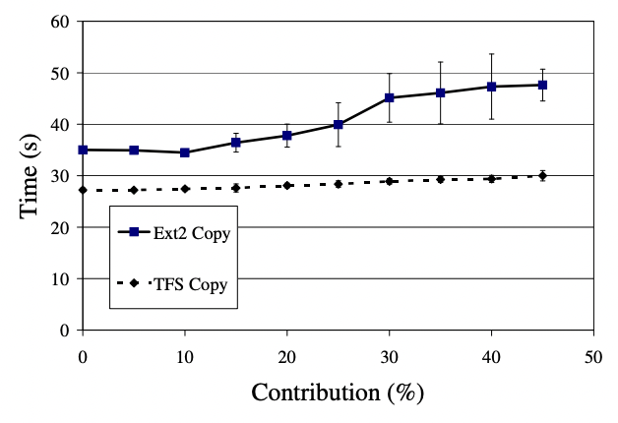
Performance impact in detail
Quantitative analysis:

Slide 6
Goal
Contributed files should be transparent:
No effect on file system performance
No effect on file system capacity
User FS operation performance
Contributing system performance
Trade-off

Slide 7
TFS’s key technique
Normal file system
TFS

Slide 8
TFS’s key technique
TFS
Two problem incurred by overwriting contributed data:
Contributed data loss
Transparent file owner’s direct access to user data

Slide 9
Preventing data loss
Distributed system
Replication
Replication-related algorithm are omitted due to the time limit

Slide 10
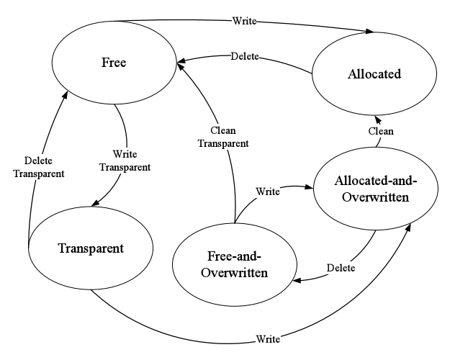
Prevent unauthorized access
Augmented block state machine
Overwritten blocks are represented by specific states
open() checks if all blocks are not overwritten, fails if false
Remove overwritten transparent file entry after a failed open()
Notes:
有一个后台的cleaner会异步地专门做被overwrite的文件的清理

Slide 11
Prevent unauthorized access
How about an opened file?
transparent file
user data
open()
overwrite
delete
open()
read()/write()
overwrite
Notes:
有一个后台的cleaner会异步地专门做被overwrite的文件的清理

Slide 12
Two performance concessions
Prevent user writes to opened transparent files
  Why not killing the file owner?
  Why not move the transparent block elsewhere?
Store transparent file metadata in ordinary blocks
  metadata occupy trivial space
  overwrite metadata corrupts much more blocks
Notes:
怎么知道一个块的owner是哪个进程？
Copy-on-write需要快速得知一个block属于哪个inode，大多数文件系统不支持

Slide 13
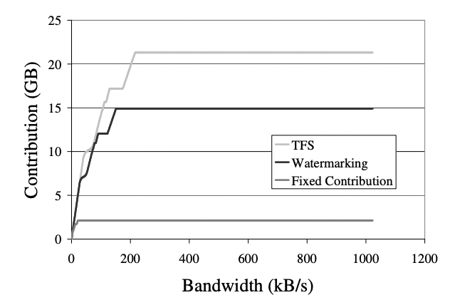
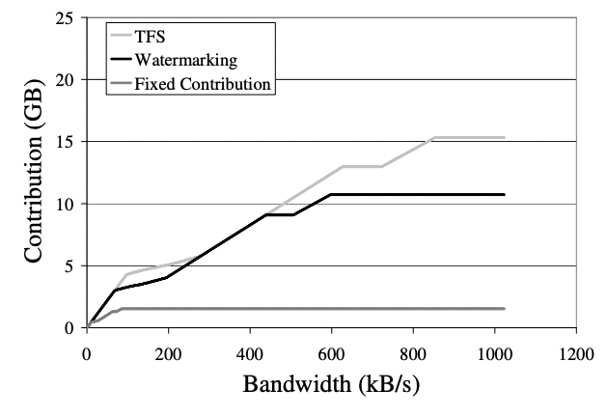
Amount of contribution
Corporate-like failure model
Internet-like failure model
Notes:
有坡度的原因：需要网络传输大量数据来进行错误恢复
前者比后者更加可靠，因此对带宽的要求更低

Slide 14
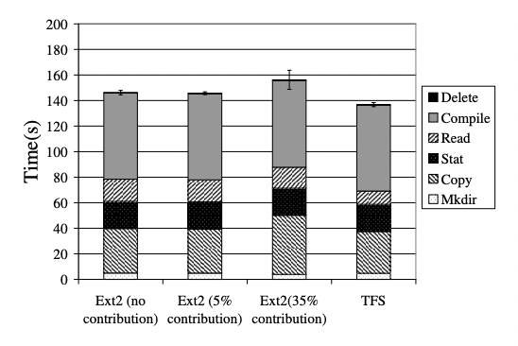
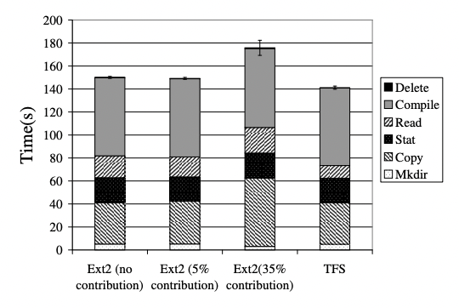
Normal file system operations
Unaged
Aged
Notes:
TFS比原生ext2还要强的原因是修改了块分配策略，导致在这个特定的benchmark下面表现更好

Slide 15
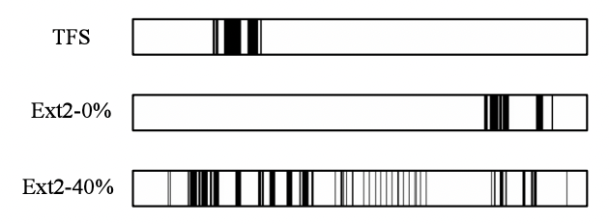
Block allocation locality

Slide 16
Thanks!

