Slide 1
PowerGraph: Distributed Graph-Parallel Computation on Natural Graphs
Joseph E. Gonzalez, Yucheng Low, Haijie Gu, Danny Bickson, and Carlos Guestrin
In OSDI’12
Presented by 王子博，涂冰洁，岑盛，潘启颖
Apr. 25, 2022
Notes:
Hello everyone. I am Zibo Wang from Shanghai Jiao Tong University supervised by Professor Yifei Zhu. I would like to present FedFPM, a unified federated analytics framework for collaborative frequent pattern mining with privacy preserved. My collaborators are Professor Dan Wang from the Hong Kong Polytechnic University and Professor Zhu Han from University of Houston.

Slide 2



Graphs are ubiquitous
Social relationship
Academic publication
Webpage

Slide 3
Graph analytics
By analyzing the graph data, we can do
Contact tracing
Community detection
……
Anomaly detection
Embedding learning

Slide 4
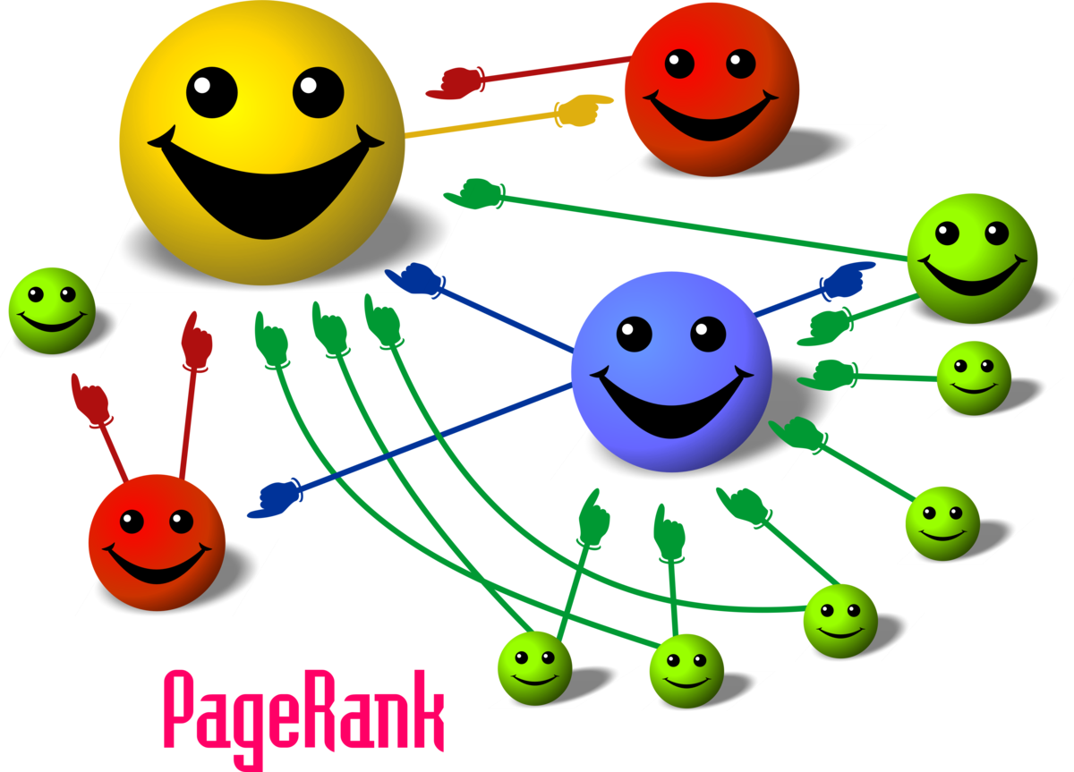
PageRank
Measure “importance” of websites in the Internet
  If a website is referenced by important websites, it is also important
  Derived as the probability to be visited by a random browser
Credit: Felipe Micaroni Lalli,
https://en.wikipedia.org/wiki/PageRank

Slide 5
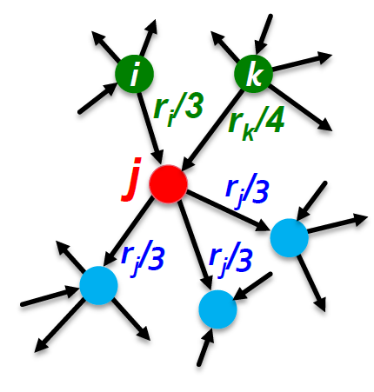
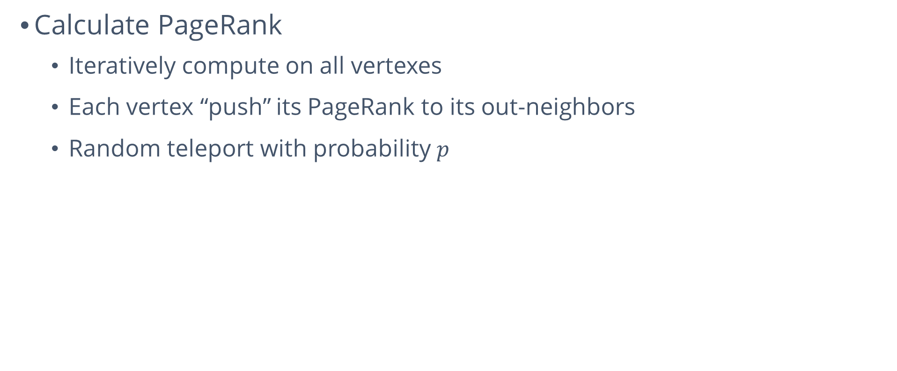

PageRank
Calculate PageRank
  Iteratively compute on all vertexes
  Each vertex “push” its PageRank to its out-neighbors
  Random teleport with probability $p$
$$r_{j}=\frac{p}{N}+(1−p)(\frac{r_{i}}{3}+\frac{r_{k}}{4})$$
Credit: Slides of Prof. Yifei Zhu in VE444

Slide 6
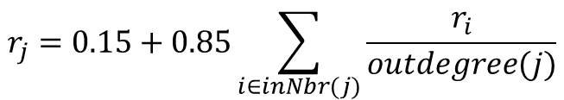
Parallel graph computation
Vertex program runs on each vertex
Multiple vertex programs run in parallel
Vertex program
$$r_{j}=0.15+0.85\sum_{i∈inNbr(j)}{\frac{r_{i}}{outdegree(j)}}$$

Slide 7
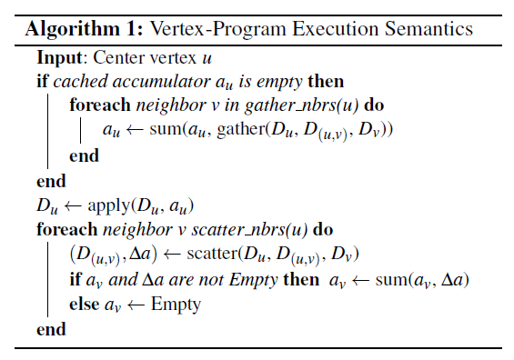
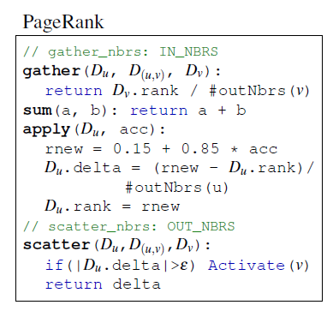
Gather-apply-scatter
Gather: the vertex collects edge attributes
Apply: the vertex updates its vertex attribute
Scatter: the vertex updates edge attributes

Slide 8
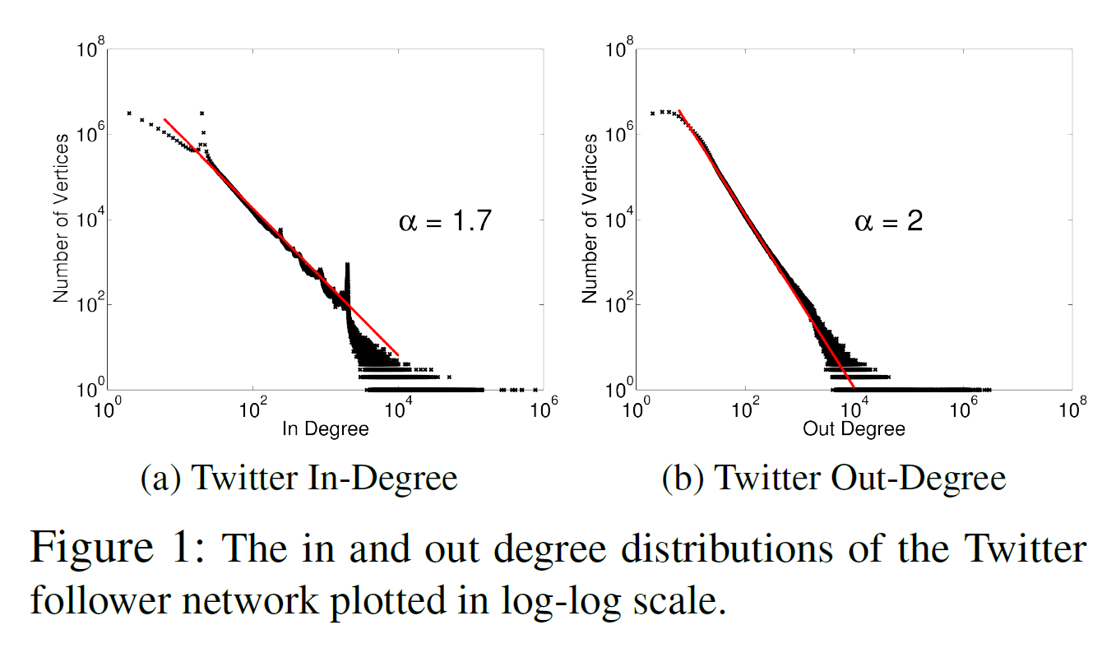
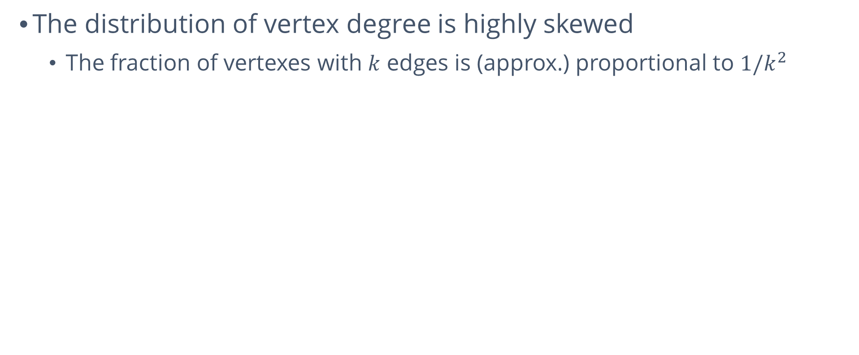
Power law graphs
The distribution of vertex degree is highly skewed
  The fraction of vertexes with $k$ edges is (approx.) proportional to $1/k^{2}$

Slide 9
Power law graphs
Existence of “star motif”
Difficulty in data partition
Machine 1
Machine 2

Slide 10
Pregel and GraphLab
Representative graph parallel computation solutions
Pregel: send message along the edge
  Synchronous
GraphLab: directly read attributes of neighbor vertexes
  Asynchronous

Slide 11
Pregel
Machine 1
Machine 2
Machine 1
Machine 2
+
Gather (Fan-in)
Scatter (Fan-out)
Low fan-in commun., high fan-out commun.

Slide 12
Pregel
Machine 1
Machine 2
Machine 1
Machine 2
+
Gather (Fan-in)
Scatter (Fan-out)
Send many identical massages
Enforce synchronization

Slide 13
GraphLab
Machine 1
Machine 2
Machine 1
Machine 2
Gather (Fan-in)
Scatter (Fan-out)
High and balanced commun.

Slide 14
GraphLab
Machine 1
Machine 2
Machine 1
Machine 2
Gather (Fan-in)
Scatter (Fan-out)
Read many remote vertexes
Lock the vertexes

Slide 15
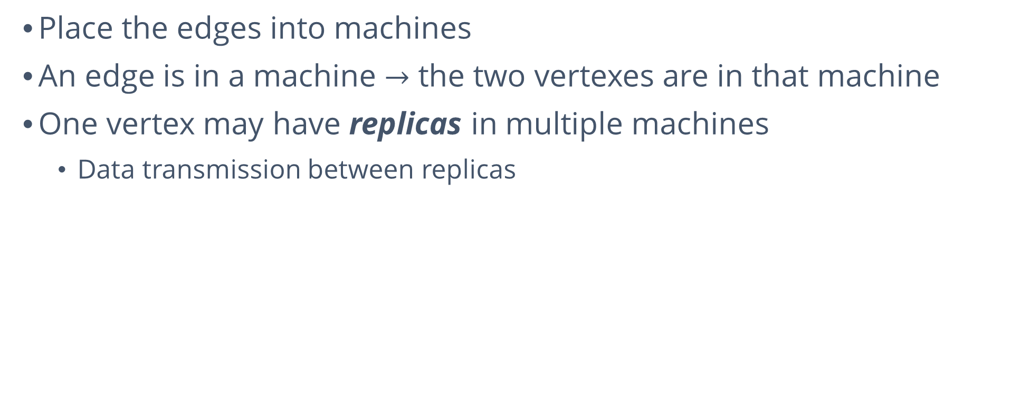
PowerGraph
Place the edges into machines
An edge is in a machine $→$ the two vertexes are in that machine
One vertex may have replicas in multiple machines
  Data transmission between replicas
Machine 1
Machine 2
b
e
c
a
a
f
d
g

Slide 16
PowerGraph
Find an edge placement to minimize total replicas
Machine 1
Machine 2
b
e
c
a
a
f
d
g

Slide 17
Constructing vertex-­cuts
Evenly assign edges to machines
  Minimize machines spanned by each vertex
Assign each edge as it is loaded
  Touch each edge only once
Propose three distributed approaches:
  Random edge placement
  Coordinated greedy edge placement
  Oblivious greedy edge placement

Slide 18
Random edge placement
Randomly assign edges to machines
Machine 1
Machine 2
Machine 3
Balanced Vertex-Cut
Y
Y
Spans 3 machines
Y
Y
Y
Y
Y
Y
Z
Y
Z
Y
Y
Z
Z
Spans 2 machines
Z
Y
Y
Y
Y
Y
Y
No cut!

Slide 19
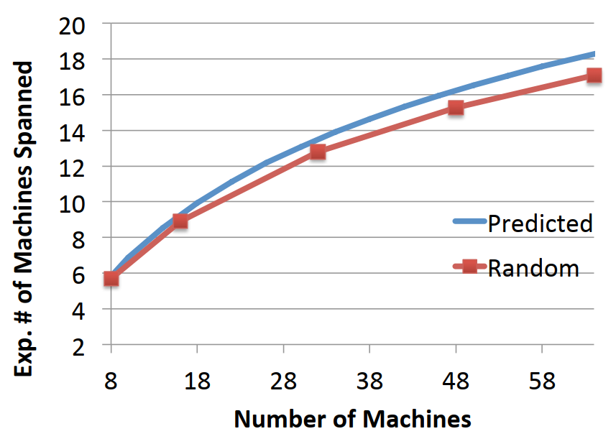
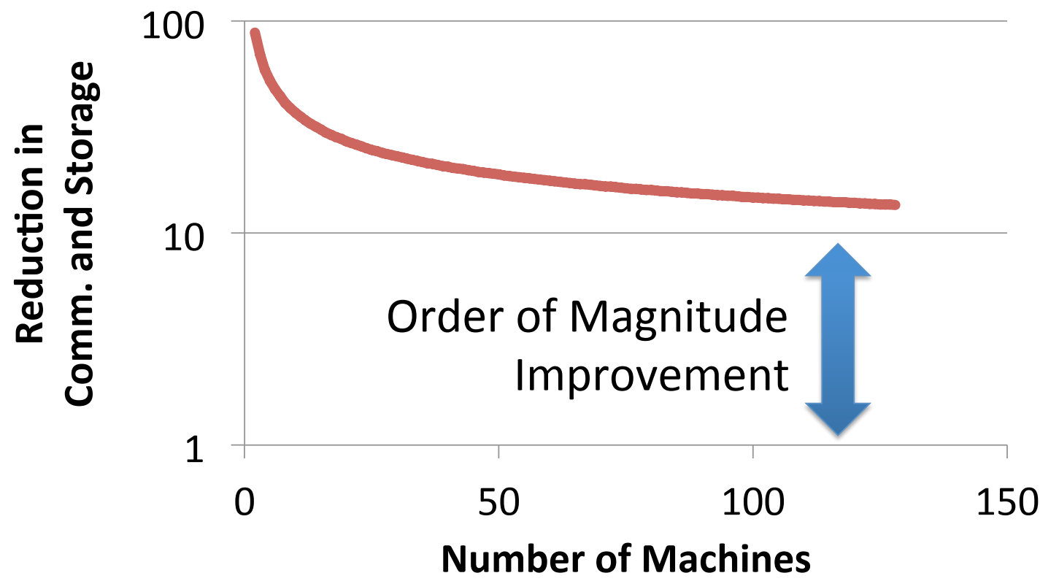
Analysis on random edge placement
Expected machines spanned by a vertex:
Random vertex‐cuts vs. edge-cuts
Expected improvement from vertex-­cuts:
Twitter follower graph
41M vertices
1.4B edges
Accurately estimate
memory and comm. overheads

Slide 20
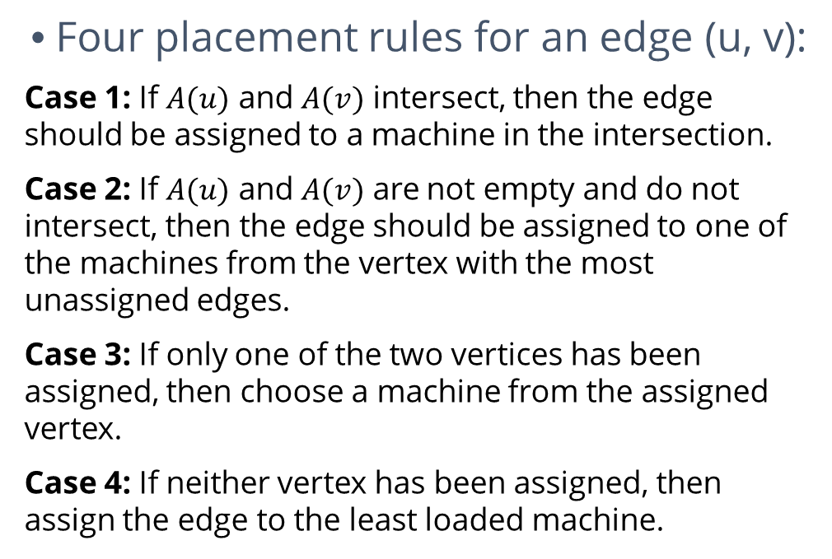
Greedy vertex-cuts
Four placement rules for an edge (u, v):
Case 1: If $A(u)$ and $A(v)$ intersect, then the edge should be assigned to a machine in the intersection.
Case 2: If $A(u)$ and $A(v)$ are not empty and do not intersect, then the edge should be assigned to one of the machines from the vertex with the most unassigned edges.
Case 3: If only one of the two vertices has been assigned, then choose a machine from the assigned vertex.
Case 4: If neither vertex has been assigned, then assign the edge to the least loaded machine.
Machine1
Machine2
A
B
B
C
B
D
A
D
A
C
B
E

Slide 21
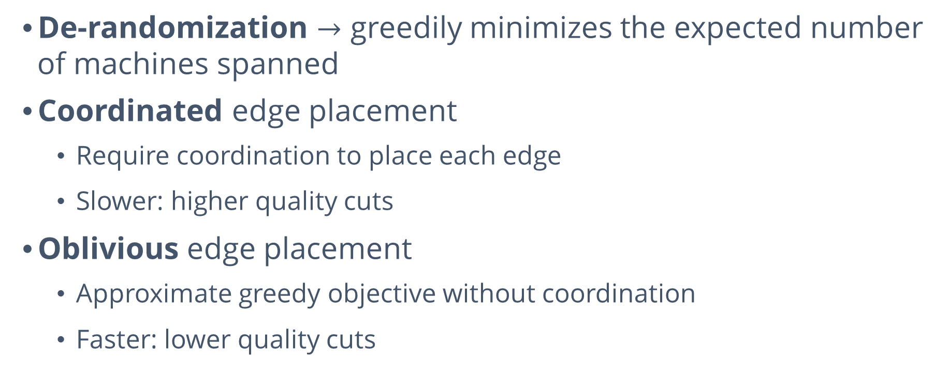
Greedy vertex-cuts
De-randomization $→$ greedily minimizes the expected number of machines spanned
Coordinated edge placement
  Require coordination to place each edge
  Slower: higher quality cuts
Oblivious edge placement
  Approximate greedy objective without coordination
  Faster: lower quality cuts

Slide 22
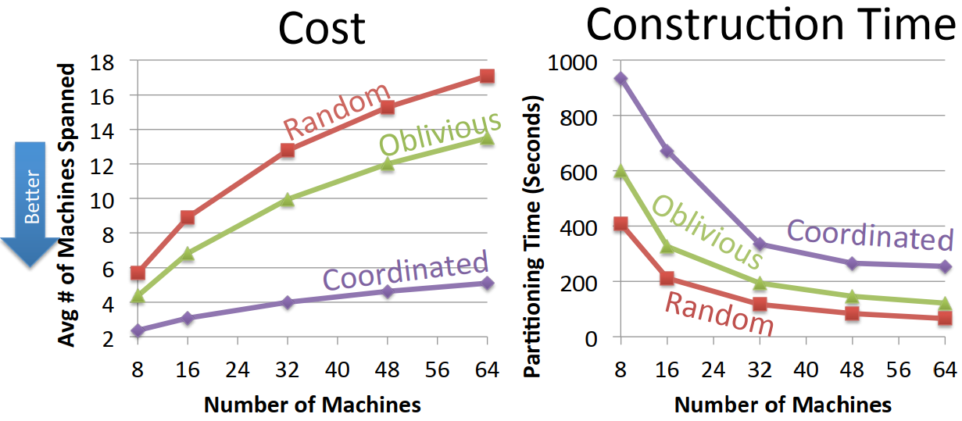
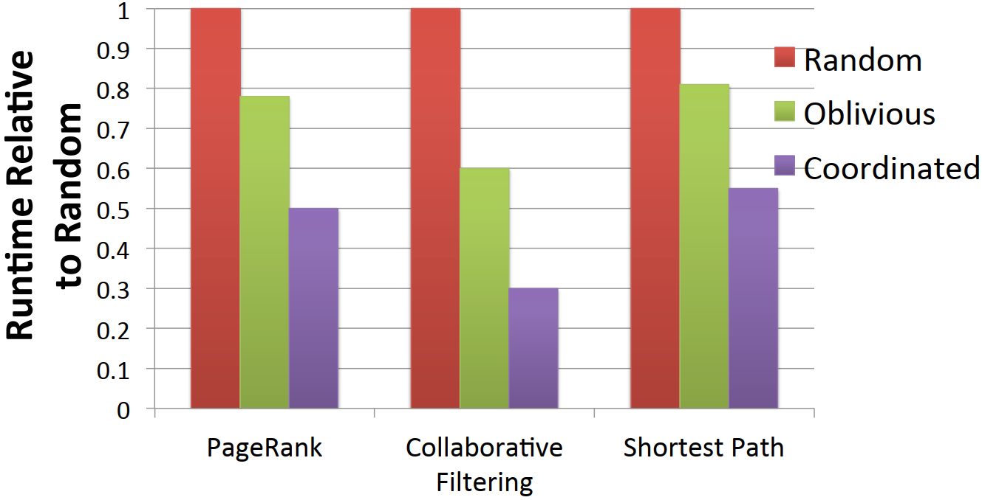
Greedy vertex-cuts improves performance
Twitter graph: 41M vertices, 1.4B edges
Oblivious placement balances cost and partitioning time.
Greedy partitions improves computation performance.

Slide 23
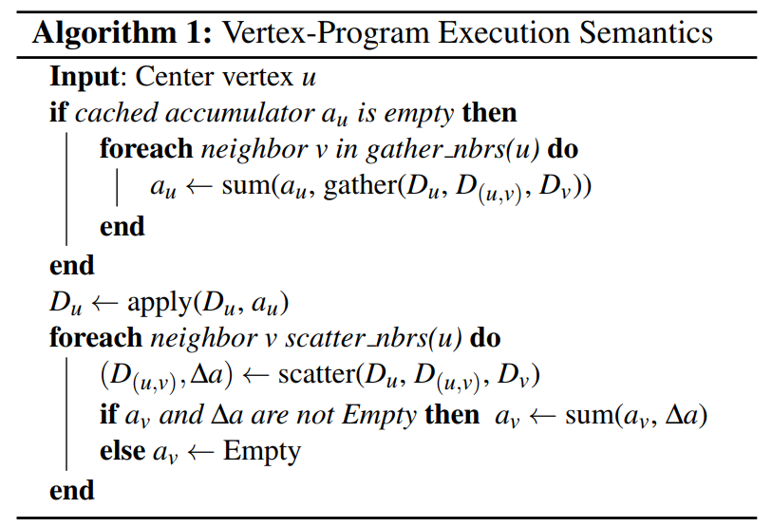
Other features
Three execution modes
  Synchronous: Bulk synchronous GAS phases
  Asynchronous: Interleave GAS phases
  Asynchronous + Serializable: Neighboring vertices do not run simultaneously
Delta caching
  Accelerate gather phase by caching partial sums for each vertex

Slide 24
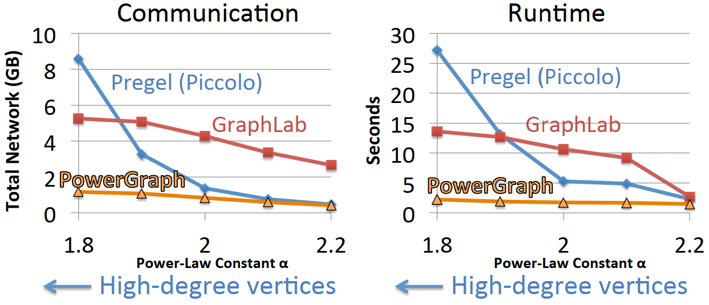
Comparison with GraphLab & Pregel
PageRank on synthetic power law graph
PowerGraph is robust to high-degree vertices.

Slide 25
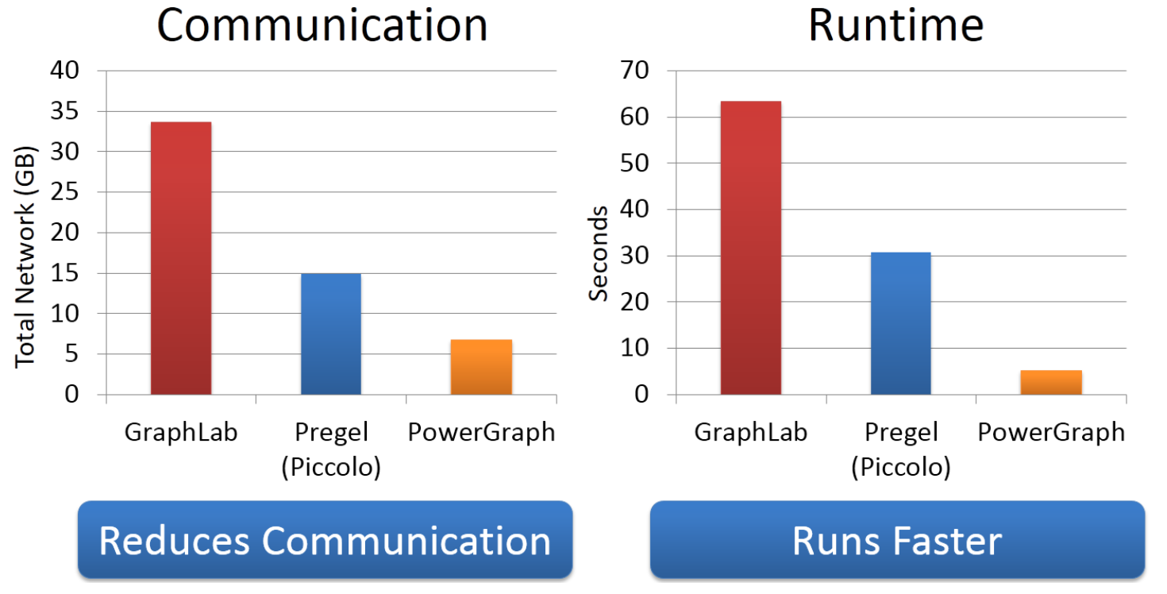
Comparison with GraphLab & Pregel
PageRank on the Twitter follower graph

Slide 26
Summary
Problem: Computation on Natural Graphs is challenging
  High-degree vertices
  Low-quality edge-cuts
Solution: PowerGraph
  GAS Decomposition: Split vertex programs
  Vertex partitioning: Distribute natural graphs
PowerGraph theoretically and experimentally outperforms existing graph-parallel systems.

Slide 27
Thanks for your listening!

