Slide 1
GridGraph: Large-Scale Graph Processing on a Single Machine Using 2-Level Hierarchical Partitioning
ATC’ 15
Team Members: Ji Haodi、Chen Peidong、Fu Liang、Chen Meng

Slide 2
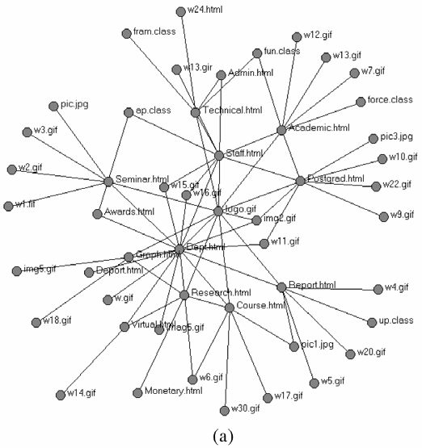
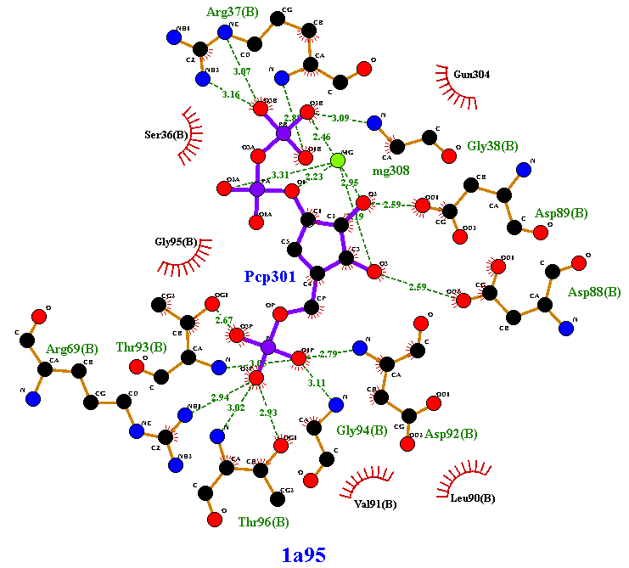

Background
Widely-used large-scale graphs in real world
Call for processing large-scale graphs efficiently
Social Network
Web Graphs
Protein Interaction

Slide 3
Existing Solutions
Distributed graph process systems
  GraphLab(PVLDB’ 12)、PowerGraph(OSDI’ 12)
  exploiting powerful distributed resources of clusters
Challenges
  hard to find efficient graph cuts that minimumize communication and also balanced
  fault tolerance、managing a cluster、debugging and optimizing

Slide 4
Existing Solutions
Out-of-core systems
  handle data that is too large for the main memory of a computer
  GraphChi(OSDI’ 12)、X-Stream(SOSP’ 13)

Slide 5
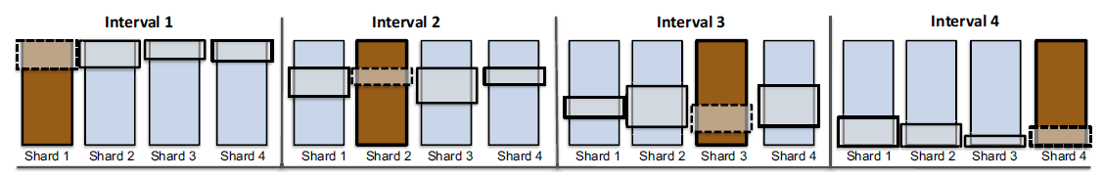
Existing Solutions
GraphChi
  partition vertices into intervals and edge list into shards
  using PSW method to reduce random I/O access
Problems
  require edge sorted by sources, time consuming since several passes over edges are needed
  fragment accesses decrease the usage of disk bandwidth

Slide 6
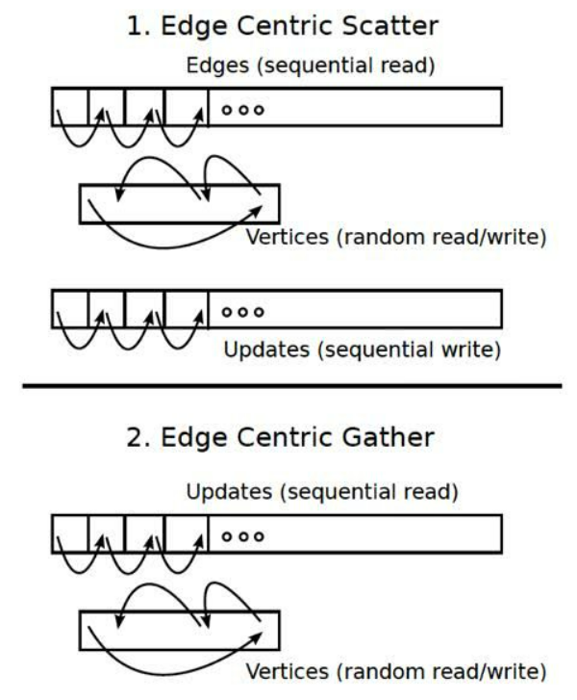
Existing Solutions
X-Stream
  edge centric “scatter-gather”
  access edges sequentially from disks
  access vertices randomly from memory
Problems
  generate large update list
  need shuffle
source
destination

Slide 7
Idea
X-Stream’ s bottleneck is in the update list due to its partition method
  if consider locality of both source and destination vertices
  2 phases → 1 phase ?
  on-the-fly updating

Slide 8
Design
Grid Format
  Dual Sliding Windows
2-Level Hierarchical Partitioning

Slide 9
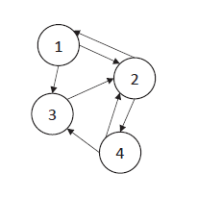
Design
Grid Format
  vertices partitioned into P equalized chunks
  edges partitioned into P×P blocks
    source row
    destination col
Chunk 1
P = 2
(1,2)
(2,1)
(1,3)
(2,4)
(3,2)
(4,2)
(4,3)
Chunk 2
Chunk1: {1,2}
Chunk2: {3,4}
Block(2,1)

Slide 10
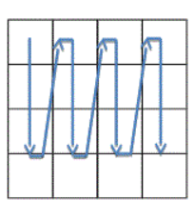
Design
Stream edges block by block
  each block corresponding to two vertex chunks
    source chunk and destination chunk
    fit into memory
Access sequence can be row-oriented or col-oriented
  we prefer col-oriented
    from top to bottom
  optimize write amount

Slide 11
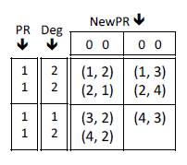
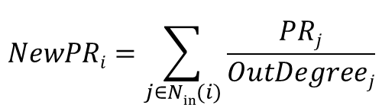
Design
Dual Sliding Windows
  source window slides as row moves
  destination window slides as col moves
destination window
source window
$$NewPRi=\sum_{j∈Nin(i)}{\frac{PRj}{OutDegreej}}$$

Slide 12
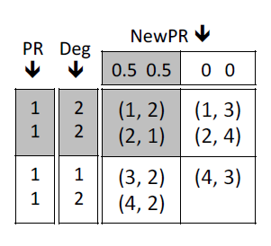
Design
Dual Sliding Windows
  source window slides as row moves
  destination window slides as col moves
$$NewPRi=\sum_{j∈Nin(i)}{\frac{PRj}{OutDegreej}}$$

Slide 13
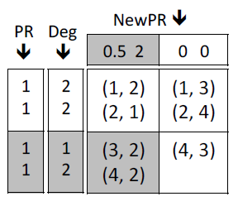
Design
Dual Sliding Windows
  source window slides as row moves
  destination window slides as col moves
$$NewPRi=\sum_{j∈Nin(i)}{\frac{PRj}{OutDegreej}}$$

Slide 14
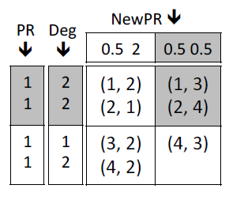
Design
Dual Sliding Windows
  source window slides as row moves
  destination window slides as col moves
$$NewPRi=\sum_{j∈Nin(i)}{\frac{PRj}{OutDegreej}}$$

Slide 15
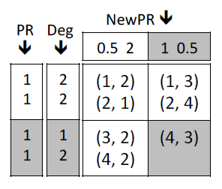
Design
Dual Sliding Windows
  source window slides as row moves
  destination window slides as col moves
$$NewPRi=\sum_{j∈Nin(i)}{\frac{PRj}{OutDegreej}}$$

Slide 16
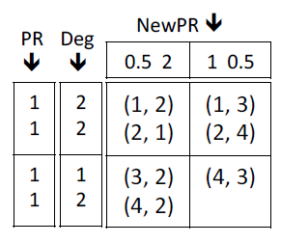
Design
Dual Sliding Windows
  source window slides as row moves
  destination window slides as col moves
$$NewPRi=\sum_{j∈Nin(i)}{\frac{PRj}{OutDegreej}}$$

Slide 17
I/O Access Amount
For 1 iteration
E + P× V + 2× V
E: 1 pass over the edges (read)
P: P pass over the source vertices (read)
2: 1 pass over the destination vertices (read + write)
P should be the minimum value that enables needed vertex data to be fit into memory

Slide 18
Selective Scheduling
Skip blocks with no active edges
  Very simple but important optimization
  Effective for lots of algorithms
    BFS, WCC, …

Slide 19
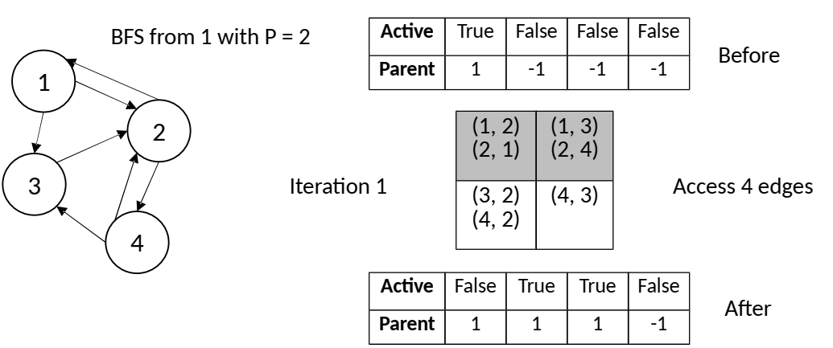
Selective Scheduling

Slide 20
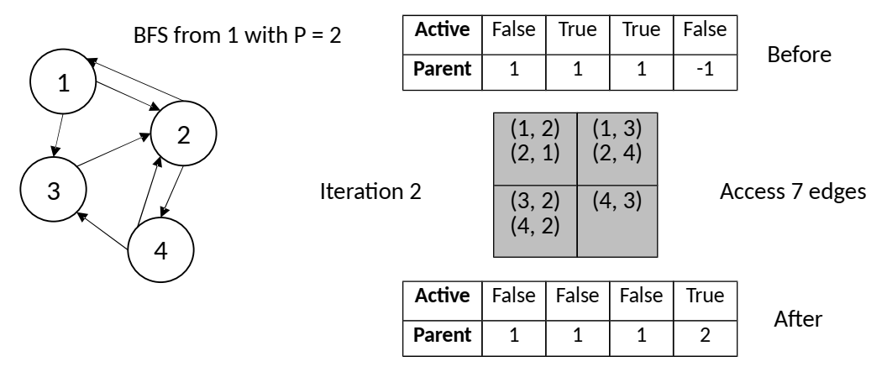
Selective Scheduling

Slide 21
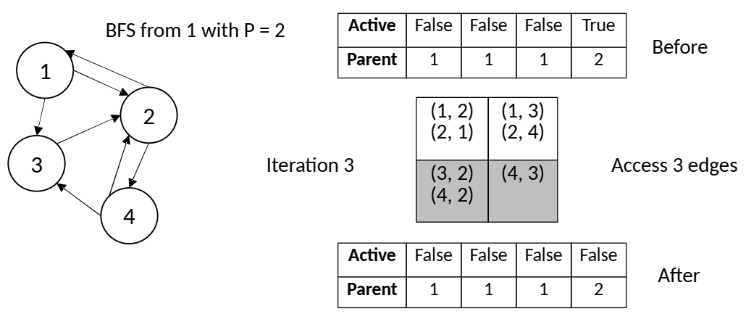
Selective Scheduling

Slide 22
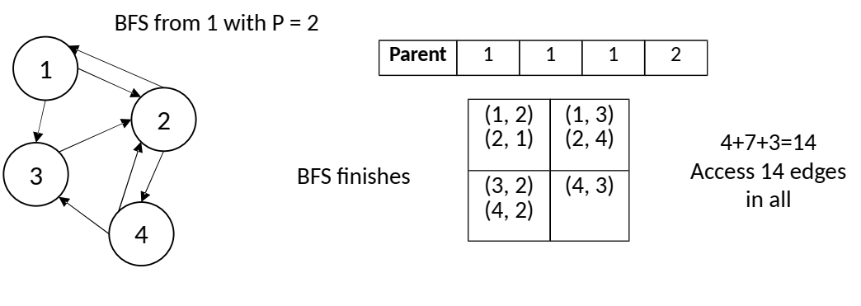
Selective Scheduling

Slide 23
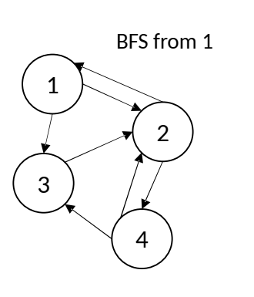
Impact of P on Selective Scheduling
P | 1 | 2 | 4
Edge Accesses | 21 (7+7+7) | 14 (4+7+3) | 7 (2+3+2)
Effect becomes better with more fine-grained partitioning
A larger value of P is preferred

Slide 24
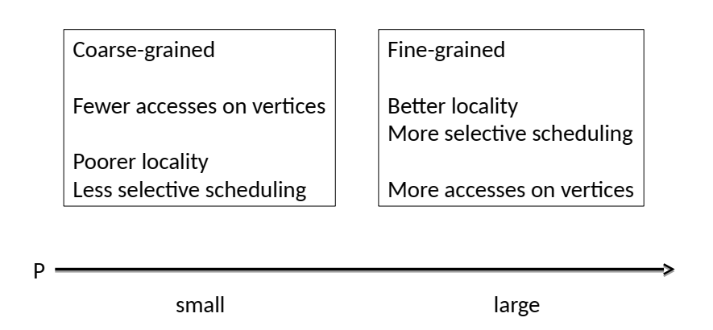
Dilemma on Selection of P

Slide 25
Dilemma from Memory Hierarchy
Different selections of P
  Disk – Memory hierarchy
    Fit hot vertex data into memory
  Memory – Cache hierarchy
    Fit hot vertex data into cache
  Disk – Memory – Cache
    ?
CACHE
MEMORY
DISK

Slide 26
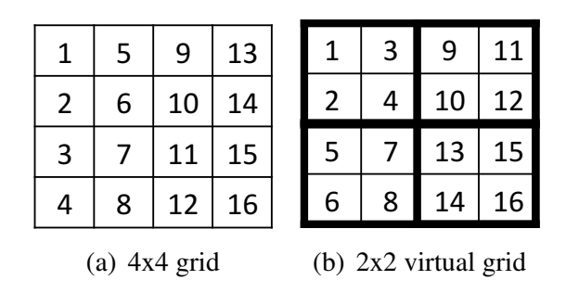
2-Level Hierarchical Partitioning
Apply a Q × Q partitioning over the P × P grid
  Group the small blocks into larger ones
  Q ≥ V / M
  P ≥ V / C
  C << M
  P >> Q
  P = number of partitions, M = memory capacity
  C = LLC capacity, V = size of vertices

Slide 27
Execution Implementation
Main thread
  pushes tasks to the queue
Worker thread
  fetches tasks from the queue until empty
  read data from specified location
  process each edge

Slide 28
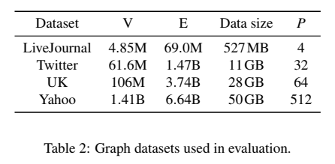
Evaluation
Test environment
  AWS EC2 i2.xlarge
    4 hyperthread cores
    30.5GB memory
    1 × 800GB SSD
  AWS EC2 d2.xlarge
    4 hyperthread cores
    30.5GB memory
    3 × 2TB HDD
Applications
  BFS, WCC, SpMV,
  PageRank

Slide 29
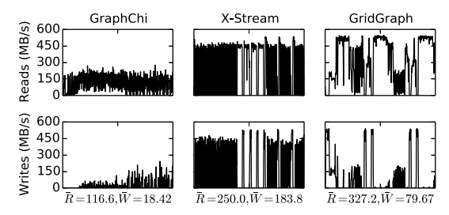
Disk Bandwidth Usage

Slide 30
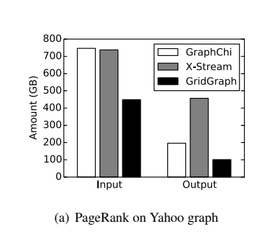
Effect of Dual Sliding Windows

Slide 31
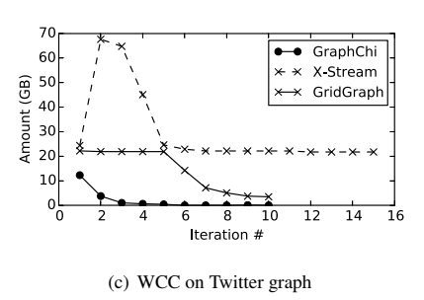
Effect of Selective Scheduling

Slide 32
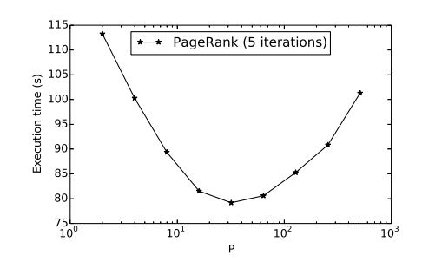
Impact of P on In-Memory Performance

Slide 33
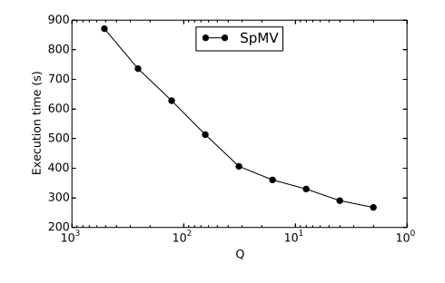
Impact of Q on Out-of-Core Performance

Slide 34
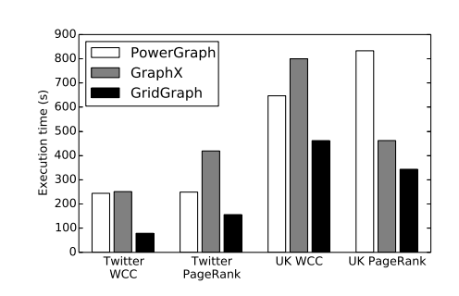
Comparison with Distributed Systems
PowerGraph, GraphX *
  16 × m2.4xlarge, $15.98/h
GridGraph
  i2.4xlarge, $3.41/h
    4 SSDs
    1.8GB/s disk bandwidth

Slide 35
Conclusion
GridGraph
  Dual sliding windows
    Reduce I/O amount, especially writes
  Selective scheduling
    Reduce unnecessary I/O
  2-level hierarchical grid partitioning
    Applicable to 3-level (cache-memory-disk) hierarchy

