Slide 1


Elastic model serving via efficient live migration & autoscaling
IPADS, Shanghai Jiao Tong University
https://ipads.se.sjtu.edu.cn/pub/members/xingda_wei

Slide 2
Outline of today’s lecture
A brief introduction of the (some) challenges met by today’s AI serving systems
  i.e., the trade-off in high performance & low costs
Some common approaches to cope with that
  And the challenges & solutions for these approaches
The two foundational approaches
  Live process migration
  Auto scaling

Slide 3
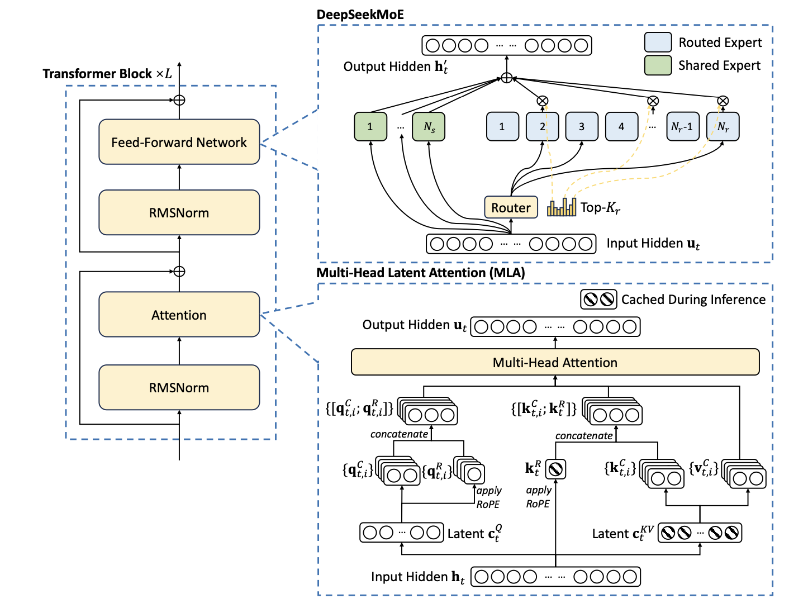


The case study: serving AI models
We want to build an application that uses the model to serve
We have an exemplified model
A serving system will bridge all these together
+ Achieving non-trivial design goals
We have a clusters of GPUs. e.g., on the cloud
Notes:
Let me introduce you with a simple example.
…
If we build all these ups, this would be an application. So what do we system researcher do?
We will find ways of building systems to satisfy so non-trivial requirements. Note the word non-trivial: if the task is trivial, it is engineering, not research.

Slide 4


System design goal#1: high performant
Low latency:
  how fast can a model react? (As short as possible)
High throughput:
  how many tokens can we generated on my GPUs? (As much as possible!)
Throughput is important to the latency: if insufficient throughput, then requests will be queued with increased latency
Notes:
Both factors matter

Slide 5
System design goal#2: high resource utilization
While being high performant, we should minimize the resources used for serving
  Being high performant is trivial given sufficient resources (Because ML workloads scales)
  Can serve 10 reqs/sec
10 Reqs
What if we have 30 reqs/sec?
10 reqs again?
GPU server 0
Three GPU servers
Three GPU servers
Server underloaded!
Model serving instance

Slide 6
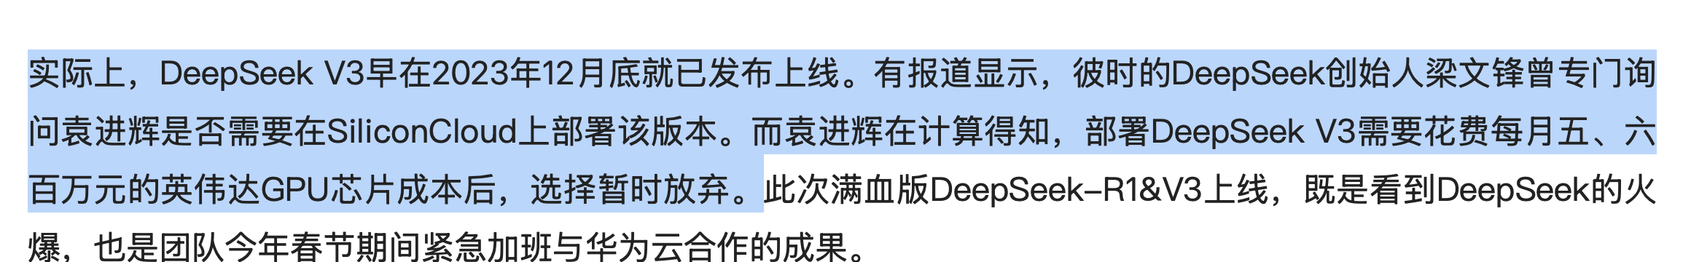

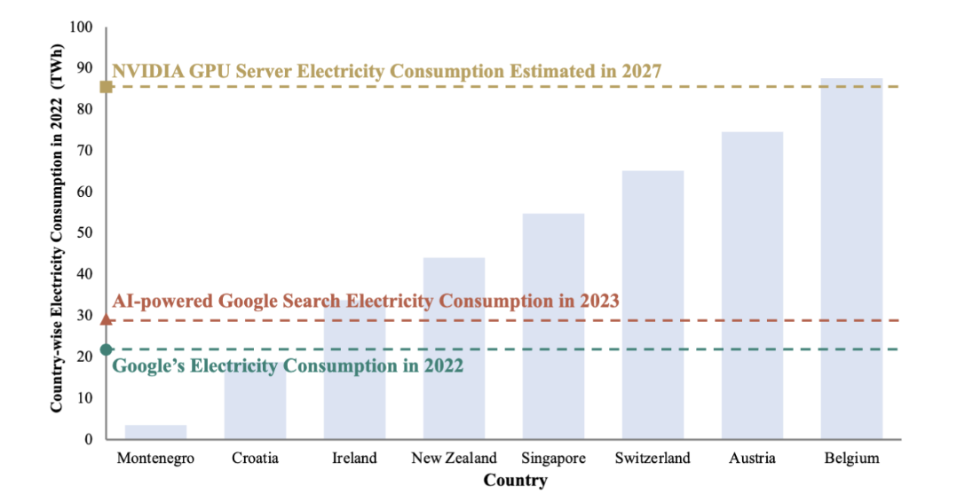
Why improving utilization? Accelerators for ML is costly
Both in term of Monetary & energy
Source#1: https://www.cls.cn/detail/1948025
Source#2: A survey of resource-efficient LLM and multimodal foundation models

Slide 7
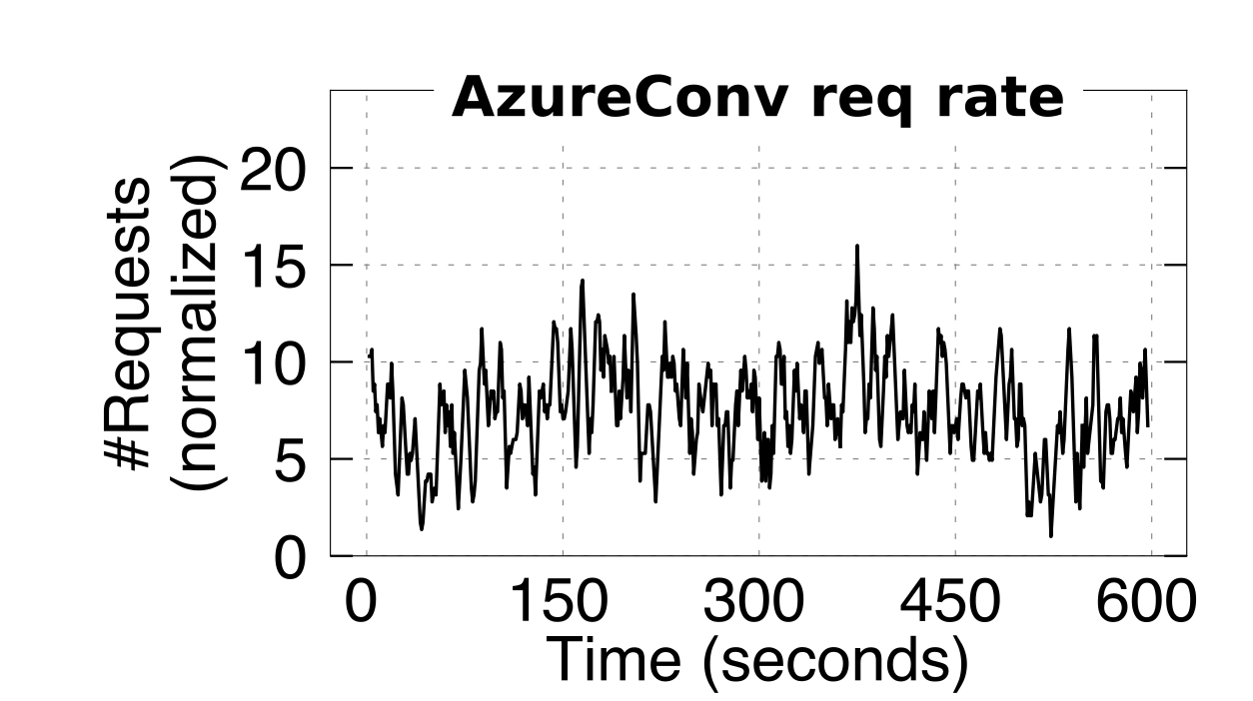
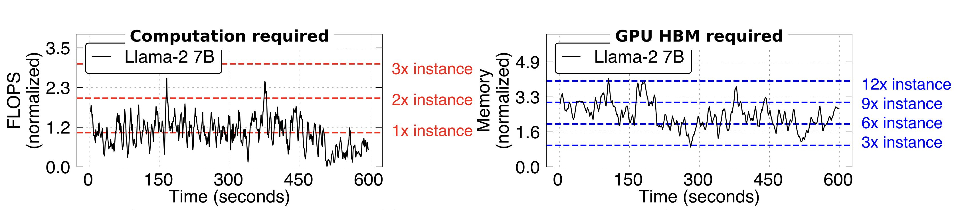
Achieving both goals is challenging in existing cloud environments
Why? Workload dynamics
  The request/second changes frequently
  The computing resources used by each request changes
  Sometimes unpredictable, e.g., LLM inference
[1]
[2]
Source #1: AZURE. Azure llm inference traces. https://github.com/Azure/AzurePublicDataset, 2024.
Source #2: Fast and Live Model Auto Scaling with O(1) Host Caching
Notes:
Two-dimension of fluctuations

Slide 8
Achieving both goals is challenging in existing cloud environments
Problem: the computing/memory requirements of AI serving changes overtime
Existing solution:
  Deploy a fixed number of jobs to handle the inference workloads (Serverful computing)
User requirements
Workload
Inference capability

Slide 9
Achieving both goals is challenging in existing cloud environments
Problem: the computing/memory requirements of AI serving changes overtime
Existing solution:
  Deploy a fixed number of jobs to handle the inference workloads (Serverful computing)
Wasted resources!
User requests
Workload
Inference capability

Slide 10
Achieving both goals is challenging in existing cloud environments
Problem: the computing/memory requirements of AI serving changes overtime
Existing solution:
  Deploy a fixed number of jobs to handle the inference workloads (Serverful computing)
Impact performance
User requests
Workload
Inference capability

Slide 11
Two classic solutions (Elastic computing systems)
Key insights: the system needs to be elastic
Co-location with job migration
Autoscaling
Both have challenges for AI workloads (& tackling them is our recent research focuses)

Slide 12

Approach #1: colocation + serving job migration
Setup: a distributed system, which runs multiple jobs (arbitrary AI tasks)
e.g., ResNET inference
e.g., Llama-2 inference
Users
Time 0: a user have a set of AI jobs
Notes:
https://www.nvidia.com/en-us/data-center/virtualization/virtual-gpu-migration/

Slide 13
Approach #1: colocation + serving job migration
Setup: a distributed system, which runs multiple jobs (arbitrary AI tasks)
  We can estimate the initial load of each job, and then distribute them to the machines
Loads
Loads
Loads
Loads
Users
ResNET inference
Llama-2 inference
Time 1: distributed the job evenly to the nodes
Notes:
https://www.nvidia.com/en-us/data-center/virtualization/virtual-gpu-migration/

Slide 14
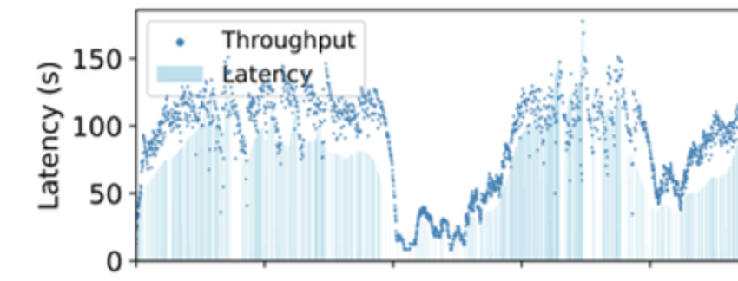
Approach #1: colocation + serving job migration
Setup: a distributed system, which runs multiple jobs (arbitrary AI tasks)
  We can estimate the initial load of each job, and then distribute them to the machines
  Overload!
  Underload!
Loads
Loads
Loads
Loads
User
  [1]
Time 2 (Problem): workload changes, causing load imbalance
  [1] Trace: BurstGPT
Notes:
https://www.nvidia.com/en-us/data-center/virtualization/virtual-gpu-migration/

Slide 15
Approach #1: colocation + serving job migration
Setup: a distributed system, which runs multiple jobs (arbitrary AI tasks)
  We can estimate the initial load of each job, and then distribute them to the machines
  Balanced!
Loads
Loads
Loads
Loads
Users
Time 3 (Solution): migrate the jobs between nodes to achieve load imbalance
Notes:
https://www.nvidia.com/en-us/data-center/virtualization/virtual-gpu-migration/

Slide 16

Why colocation + serving job migration works?
Setup: a distributed system, which runs multiple jobs (arbitrary AI tasks)
e.g., ResNET inference
e.g., Llama-2 inference
Users
Observation #1: a cloud may serve multiple tasks (up to 1K+ models) ^{[1]}
Observation #2: the aggregated workloads of all the model tend to be static ^{[2]}
Observation #3: a server can typically serve many models, though serve one is most efficient
[1] 阿里百炼
[2] SHEPHERD: Serving DNNs in the Wild, NSDI’22

Slide 17
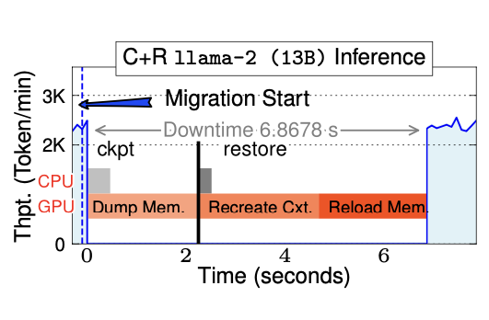
Challenge: performance overhead during migration
Case study: migrating a LLAMA-2 13B inference
  Even under 200Gbps network, migration still causes 6.9s down time
  Which is 263X slower than TTFT & TTBT

Slide 18
Challenge: performance overhead during migration
Case study: migrating a LLAMA-2 13B inference
  Even under 200Gbps network, migration still causes 6.9s down time
  Which is 263X slower than TTFT & TTBT
Microsoft has reported that 3.89% of its AI job’s quality issue is caused by job migration initiated by the platform [1]
Question: Where does the performance overhead come from?
& more importantly, how to reduce it?
[1] An Empirical Study on Quality Issues of Deep Learning Platform, ICSE’23

Slide 19
A little background: OS-level C/R for migration

Slide 20

OS-level checkpoint/restore (C/R) in a nutshell
Basically, C packs the job in a compact form that can be migrated/started quicky
  Includes: CPU pages, GPU buffers, Registers (program counter) & GPU kernels
AI job
CPU execution
Copy CPU pages
Time
CPU
GPU
GPU execution
Copy GPU buffers
Stop
Copy registers (including program counter, PC)

Slide 21
OS-level checkpoint/restore (C/R) in a nutshell
Basically, R re-creates the job from the compact form (checkpointed image)
  Ignores costly initialization phase like Python
Copy CPU pages
CPU execution
Time
CPU
GPU
Copy GPU buffers
GPU execution
Restore PC

Slide 22
Put it all together: OS-level C/R for job migration
Directly checkpoint the job‘s memory to the target machine
Time
CPU
GPU
Network
Migration start
Checkpoint
Restore
Restore execution
CPU
GPU

Slide 23
Goal: minimized downtime during migration
e.g., Job migration typically involves system downtime
Time
System downtime
CPU
GPU
Network
Migration start
Checkpoint
Restore
Restore execution
CPU
GPU

Slide 24
C/R acceleration has been extensively studied in the OS literature
Tons of works focus on improving its performance (w/o considering GPU)
  Key acceleration technique: overlapping
  i.e., continually let the GPU/CPU run during the checkpoint
Time
GPU execution
B0
B2
B0
B2
GPU
Modify B0
Modify B1
B1
B3
B1
B3
Copy buffers
B0
B1
B2
B3
B0
B1
B2
B3
Buffers checkpointed concurrently
Notes:
Why not work for AI applications?

Slide 25

Challenge: how to ensure correctness?
Required for correctness, i.e., the checkpointed data is correct
  A correct job image state should be atomically checkpointed
Time
Modify B0
Modify B1
B0
B2
B0
B2
GPU
B1
B3
B1
B3
B0
B1
B2
B3
Race condition
Inconsistency!
B0
B1
B2
B3
Checkpointed image
Notes:
But AI applications bypasses OS for a better performance!

Slide 26
Challenge: how to ensure correctness?
Required for correctness, i.e., the checkpointed data is correct
  A correct job image state should be atomically checkpointed
CPU can leverage the help of OS & paging for the detection (i.e., dirty bit)
Check dirty bits, found
B0, B1 dirty
Clear dirty bits of buffers
Modify B0
Modify B1
B0
B2
B0
B2
GPU
CPU
B1
B3
B1
B3
B0
B1
B2
B3
B0
B1
Recopy
B0
B1
B2
B3
B0
B1
Checkpointed image
Notes:
But AI applications bypasses OS for a better performance!

Slide 27
Challenge: how to ensure correctness?
Required for correctness, i.e., the checkpointed data is correct
  A correct job image state should be atomically checkpointed
CPU can leverage the help of OS & paging for the detection (i.e., dirty bit)
Check dirty bits
Clear dirty bits of buffers
Modify B0
Modify B1
B0
B2
B0
B2
Traditional jobs can leverage OS paging for such semantics,
But, what about AI jobs?
GPU
CPU
B1
B3
B1
B3
B0
B1
B2
B3
B0
B1
Race condition
Recopy
B0
B1
B2
B3
B0
B1
Checkpointed image
Notes:
But AI applications bypasses OS for a better performance!

Slide 28
Challenge for AI application: GPU bypasses OS & paging
Why? For high performance
  GPU hardware is designed for maximum computation
Not so good for C/R
  Because we currently have abandoned the overlapping design

Slide 29
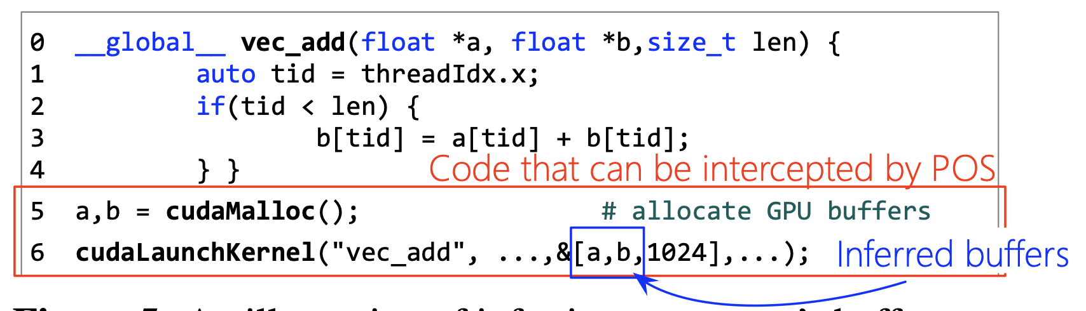
Our approach: inferring the access semantics of GPU kernels
Observation
  We can acquire the right semantics with speculation before & after the execution of kernels (which is very hard for CPU)
Why?
  GPU kernels have simple control flow, e.g., do a vector add or a matrix multiplication
GPU

Slide 30
Example: inferring dirty buffers during job migration
Speculate the candidate access buffers of each GPU kernel before execution
Guess: write B0
B0
B2
Mark B0 as dirty
B0
B2
GPU
B1
B3
B1
B3
B0
B1
B2
B3
B0
B1
Recopy
B0
B0
B1
B2
B3
B1

Slide 31
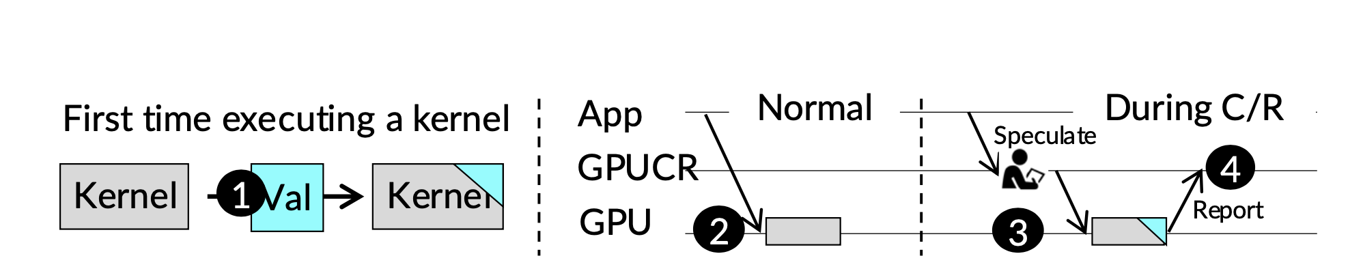
Problem: speculation failures & lightweight validation
What if we guess GPU writes B0, but actually it writes B2?
  We add a lightweight runtime validation to ensure correctness
How to validate? Dynamic instrumenting the GPU kernel code
Guess: write B0
Modify B1
Output whether our speculation is right

Slide 32
Put it all together: speculation + validation
Speculate the candidate access buffers of each GPU kernel before execution
  The speculation is validated with a lightweight patch to the kernel
Guess: write B0
B0
B2
Mark B0 as dirty
B0
B2
GPU
B1
B3
B1
B3
B0
B1
B2
B3
B0
B1
Recopy
B0
B0
B1
B2
B3
B1

Slide 33
Some discussion: why speculation but not pure validation?
Our current validation checks whether the speculation is correct
  But we can also let the instrumented code to output the modified buffers w/o speculation
Guess: write B0
Modify B1
Modify B1
Directly output the modified buffers
Output whether
our speculation is right
Two considerations
  Validation whether the speculation is right is more efficient
  Speculation can know which buffer to access in advance, which is required by some C/R cases other than the migration

Slide 34
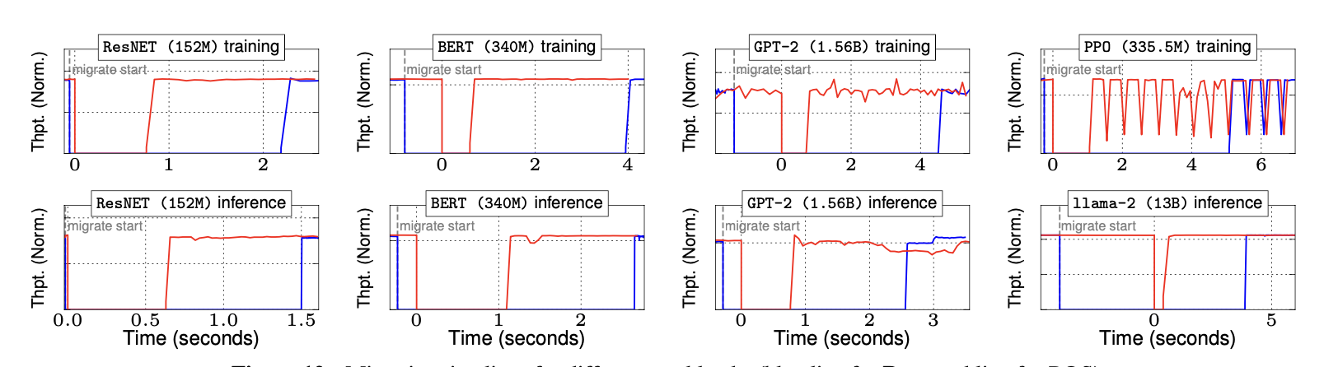
End-to-end result: job migration
Red line: our system (PhoenixOS)
Blue line: exising GPU C/R system (Singularity@Microsoft[1])
  Why not cuda-checkpoint from NVIDIA? It is even slower
0.7s downtime
  [1] Singularity Planet-Scale, Preemptive and Elastic Scheduling of AI Workloads

Slide 35
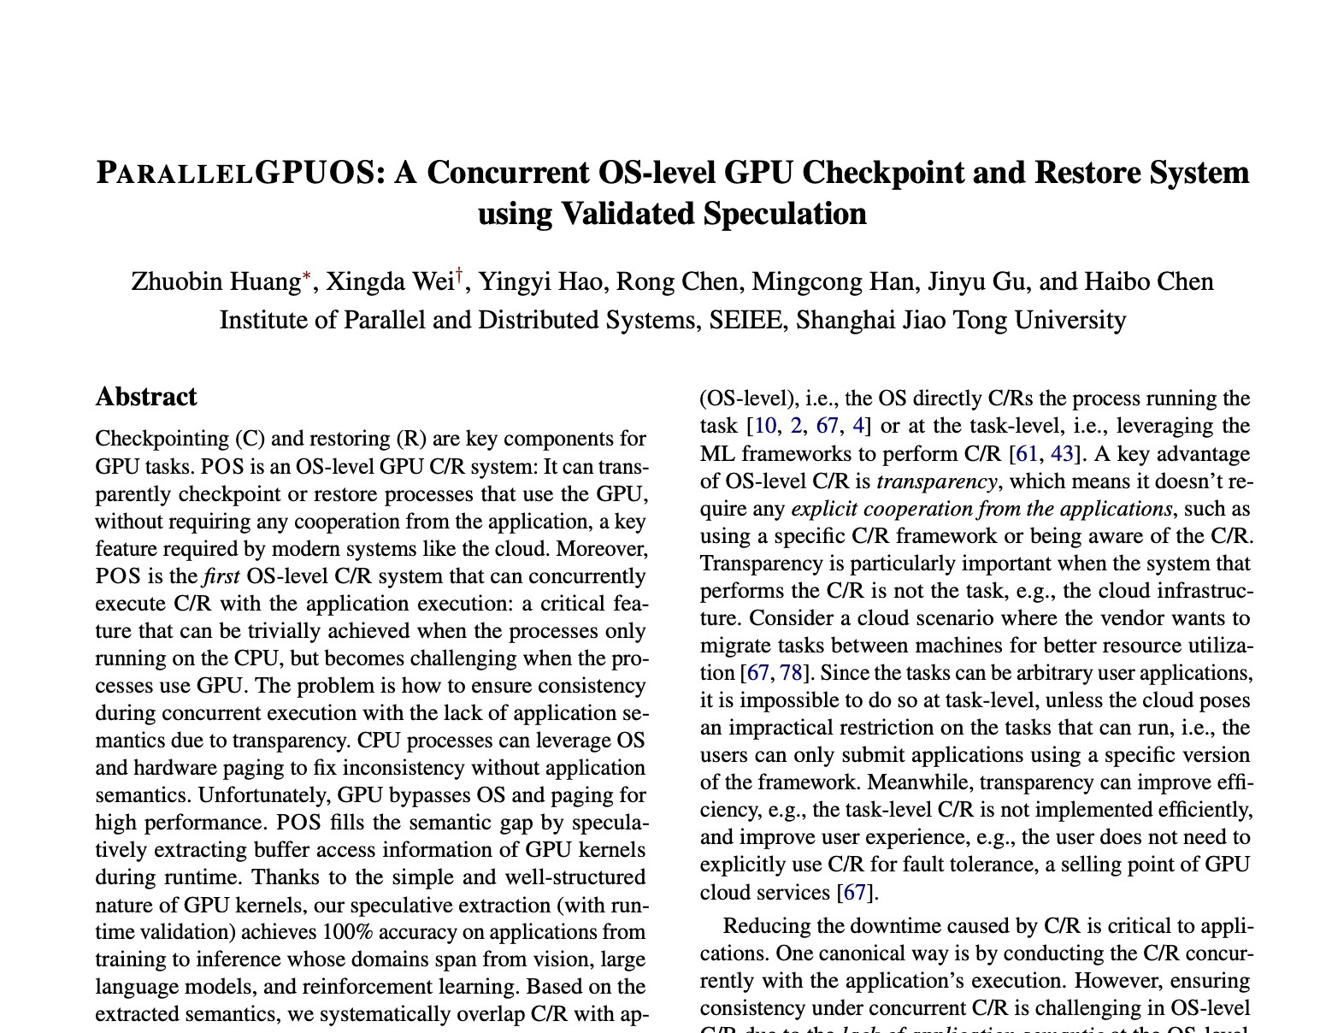



More on PhoenixOS
Techniques for accelerate GPU restore
  Overlapping alone is insufficient
  We need a GPU context resource pool
Other implementation details
  Fighting the close-sourced NVIDIA driver …
Runtime validation to ensure speculation correctness
Code
Paper (Preprint)

Slide 36
Question: does colocation + migration addresses all the problem?
Setup: a distributed system, which runs multiple jobs (arbitrary AI tasks)
  Goal: load balance between nodes
  Balanced!
Loads
Loads
Loads
Loads
User
  [1]
Notes:
https://www.nvidia.com/en-us/data-center/virtualization/virtual-gpu-migration/

Slide 37



Problem#1: little room for colocation especially for LLM
CPU/DRAM resource
Large language models (LLM) has no room for colocation
  Unlike CPU tasks or small models, LLMs are huge
  Only one model will use the entire GPU
  For flagship models, one GPU is even insufficient !
Service A
ServiceB
  GPU/HBM
  resource
Llama-3 405B service
37

Slide 38
Problem#2: insufficient computation capabilities
The requirement for
Loads
Loads
Loads
Loads
User
Scale more models!
What if all the GPU is reserved for a model, but the computation capabilities is still insufficient?

Slide 39
Two classic solutions
Key insights: the system needs to be elastically
Co-location with job migration (w/ PhoenixOS)
Autoscaling
Both have challenges for AI workloads (& tackling them is our recent research focuses)

Slide 40
Method: start (new) job elastically according to the workload requirements
If the workload is high
  Dynamically start new jobs
If the workload goes down
  Dynamically stop jobs to improve resource utilizations
Start more jobs
Stop jobs
User requests
Workload
Inference capability

Slide 41
Challenge: job startup cost for serving
Start a model serving job from scratch has nontrivial cost (not instant)
  And we should minimize it to avoid downtime
Remember the first time we start a Pytorch instance …
Requirement
System load
Ideal system
Resource
Allocated
Real system
Startup time
Performance loss
Time

Slide 42
First step: characterize the autoscale cost of serving instance
CPU initialization: Python runtime initialization (e.g., import torch)
GPU initialization:
  Context creation (e.g., cudaCtxCreate)
  Model loading (e.g., load the parameters into the GPU HBM)
docker run python llama.py …
Python initialization
GPU context
Model loading
“Good day …”
10 – 60 seconds
2 – 4 seconds
1 – 10 seconds
Time
MITOSIS@OSDI’23
PhoenixOS@arXiv
BlitzScale@OSDI’25

Slide 43
Model loading has non-trivial cost
Suppose in the common way, that we have a cloud store (e.g., Huggingface) for downloading the model
  Typical link speed: 5GB/s ^{[1]}
  A typical Llama-13B model is 26GB/s in size (16-bit precision)
  So loading the parameters in the optimal case take 5.2 secs.
In comparison, model inference time is tighter
  E.g., the TTFT* is 200ms
  Service level agreement can typically tolerate 4X latency (e.g., 800ms)
Source#1: ServerlessLLM: Low-Latency Serverless Inference for Large Language Models, OSDI’24
* Time to first token.

Slide 44


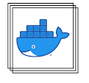

Why so slow? We first characterize container start (Cold start)
Start containers to run the application code involve many steps
  Download image: download the container image from a registry
  Containerization: setup cgroup and namespaces
  Runtime initialization: initialize Python runtime, import libraries (import torch)
docker run SOME_IMG python foobar.py
Where foobar runs:
Containerization
Runtime initialization
Network
Download image

Slide 45
Not all phases can be accelerated by existing solutions
They can partially address the issues but hot overall
  Download image: optimize the pull, but still has a huge cost ^{(e.g., [1])}
  Containerization: use cgroup and namespace pooling to hide its cost ^{[2]}
  Runtime initialization:
?
docker run SOME_IMG python foobar.py
Where foobar runs:
Containerization
Runtime initialization
Network
+ Fast network
?
+ pooling
Download image
1
2
3
  [1] FaaSNet: Scalable and Fast Provisioning of Custom Serverless Container Runtimes at Alibaba Cloud Function Compute, ATC’21
  [2] SOCK: Rapid Task Provisioning with Serverless-Optimized Containers, ATC’18

Slide 46
Idea: reusing initialized state from other containers
Key observation: runtime initialization == initialize container virtual memory
  We can inherit it from another container if it has initialized
In-memory state
…
Runtime initialization
3.1 load modules
3.2 Translate to byte code
3.3 Execute module functions

Slide 47

Idea: reusing initialized state from other containers
Key observation: runtime initialization == initialize container memory
  We can inherit it from another container if it has initialized
  No need to download the image or initialize the runtime
In-memory state
…
…
How to inherit?
Runtime initialization
…
Inherit
docker run borrow SOME_IMG python foobar.py

Slide 48



Ideal design requirement: no provisioned concurrency
Suppose we have n containers to start, how many initialized states to store?
  The number of stored states is usually termed as provisioned concurrency
No provisioned concurrency
  The provisioned case is irrelevant to the started containers, e.g., O(1)
…
n containers to start
Minimal resource used
…
…
Clusters to run the containers

Slide 49

Existing solutions need provisioned concurrency
Approach #1. Caching, a.k.a, warm start
  E.g., docker pause + docker unpause
Docker pause
  Stop a container and store its state in DRAM
Docker unpause
  Resume the container for execution
docker pause
docker unpause
What about starting container here?

Slide 50
Existing solutions need provisioned concurrency
Approach #1. Caching, a.k.a, warm start
  i.e., docker pause + docker unpause
Docker pause
  Stop a container and store its state in DRAM
Docker unpause
  Resume the container for execution
Cons: needs provisioned concurrency!
O(n) containers provisioned, n: the number of concurrent invocations
docker pause
docker unpause
What about starting container here?
docker pause
We need another paused container!

Slide 51
Existing solutions require non-trivial resource provisioned
Approach #2. Fork, a.k.a, start containers with the fork system call ^{[1]}
Pros:
  Each machine only needs 1 parent to concurrently start many containers
  Achieve O(1) resource provisioned on a single machine
Fork --- Create a new process from an existing one
docker pause
fork
Fork
Copy-on-write
  [1] Catalyzer: Sub-millisecond Startup for Serverless Computing with Initialization-less Booting, ASPLOS’20
51

Slide 52
Existing solutions require non-trivial resource provisioned
What if there is a load spikes that applications want start many containers?
  E.g., there is a load spike in the workload ( n > m)
  Fork still need provisioned concurrency (O(m)) : deploy one parent on each machine!
…
…
Reqs
O(m)
…
Clusters w/ m machines to run the containers

Slide 53
MITOSIS: remote fork no provisioned concurrency
Fork --- Create a new process from an existing one
Remote fork is a primitive for no provisioned concurrency
  Observation: one parent is sufficient for starting containers across machines
  A generalization of fork to remote enable no provisioned concurrency on a cluster
docker prepare SOME_IMG
192.168.12.113
Finished initialization
docker fork SOME_IMG 192.168.12.113

Slide 54


Remaining question: how to implement remote fork efficiently?
Current solution—Checkpoint & Restore (e.g., CRIU)
  Checkpoint: stop and dump the memory to a file
  Restore: reconstruct the page table from the file and resume the running process
Parent
Memory
checkpoint
Distributed file system
Restore
Child
Checkpoint
Transfer file
Restore

Slide 55
Current remote fork is not designed for RDMA
Start + Execution time(ms)
2) Transferring file via DFS
is also costly
1) Checkpoint entire container is costly
Evaluation setup: CRIU for C/R, file is transferred via RDMA and is stored in-memory

Slide 56

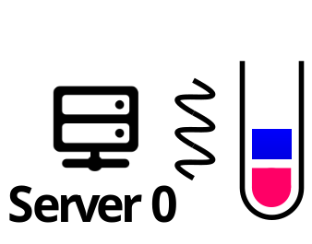
Opportunity: Remote Direct Memory Access (RDMA)
A fast datacenter networking feature that allows direct remote memory access
  High bandwidth (400Gbps) & low latency (600ns)
  CPU bypassing: the memory read/writes are offloaded to the NIC hardware
Read page at 0xdeadbeaf
Parent
NIC
TCP/IP
Network overhead
NIC
Child
DRAM
Memory copy overhead
Notes:
600ns is lower than the latency of page fault handler

Slide 57
Opportunity: Remote Direct Memory Access (RDMA)
A fast datacenter networking feature that allows direct remote memory access
  High bandwidth (400Gbps) & low latency (600ns)
  CPU bypassing: the memory read/writes are offloaded to the NIC hardware
Read page at 0xdeadbeaf
Read page at 0xdeadbeaf
Parent
Parent
NIC
NIC
TCP/IP
RDMA READ
NIC
Child
NIC
Child
DRAM
DRAM
We can imitate local fork w/ RDMA^{[1]}!
[1] LITE Kernel RDMA Support for Datacenter Applications, SOSP’17
Notes:
600ns is lower than the latency of page fault handler

Slide 58

MITOSIS co-design remote fork with RDMA
Upon fork, we first use RDMA-based RPC to read the page table to the child
  RDMA is not efficient at this step due to network amplification
Afterward, the child use RDMA to memory pages in a copy-on-write manner w/ RDMA
prepare
Parent
1. Mark as copy-on-write
2. RPC
3. RDMA
Fork
Child
3. Create a container w/ the read page table

Slide 59
MITOSIS co-design remote fork with RDMA
44—80% faster than basic C/R^{[1]} not co-designed with RDMA
  The C/R implementation has use RDMA-based DFS to restore states
Start + Execution time(ms)
Start + Execution time(ms)
C/R
MITOSIS
2) Transferring file via DFS
is also costly
1) Checkpoint entire container is costly
Parent container in-memory state (MB)
[1] CRIU: The state-of-the-art impl of C/R

Slide 60

A summary of MITOSIS vs. The state of the arts
Container startup performance
n: # containers to start
m: # machines to run containers
m = n / capacity_of_machine
Better
No provisioned concurrency
Warm start
e.g., AWS lambda
MITOSIS
Fork e.g., Catalyzer@ASPLOS20
C/R e.g., vHive@ASPLOS21
Cold
Start
0
1
O(m)
O(n)
Better
Concurrency provisioned

Slide 61




Killer application of MITOSIS: Serverless Computing
A new paradigm on building cloud applications
  User upload application as functions in containers
  Each function is executed in a container for the easy of deployment
Two key attributes to serverless computing
  Fast container startup for resource-efficient auto-scaling
  Fast state transfer between serverless functions---no (de)serialization !
AWS Lambda
Microsoft Azure
Google Functions
Huawei cloud functions
Opensoruce platforms

Slide 62
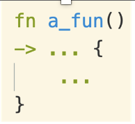


Case study #1. Resource-efficient auto-scaling
For elasticity, each serverless function invocation will start a new container
  The container is destroyed to save resources of the cloud provider
  Typically, the function is cached for a short period (e.g., 30 secs) to prevent cold start
Request
curl –H
http://call.a_fun.xxx
Gateway
Result
Start container
Cleanup
Machine
Run the function
In-memory
state

Slide 63
Case study #1. Resource-efficient auto-scaling
For elasticity, each serverless function invocation will start a new container
  The container is destroyed to save resources of the cloud provider
  Typically, the function is cached for a short period (e.g., 30 secs) to prevent cold start
Request
curl –H
http://call.a_fun.xxx
Gateway
Result
Result
Start container
Cleanup (Background)
Machine
Cached period
Run the function
Run the function
In-memory
state

Slide 64
Results: handling load spikes in a more resource efficient way
Workloads: trace from the Azure function ^{[1]} (Instance #660323)
  Concurrent function invocations in a load spike manner
  Setup: Fn , a local cluster w/ 24 machines; function: image processing
Function requests rate
Memory used per machine (MB)
CDF (%)
Tail latency reduction!
MITOSIS saves memory
thanks to no provisioned concurrency
Timeline (normalize)
Timeline (normalize)
Latency (ms)
[1] Serverless in the wild: Characterizing and optimizing the serverless workload at a large cloud provider. ATC’20

Slide 65
MITOSIS also has a comparable performance with few resources
Baselines. warmstart (docker unpause); C/R: CRIU, ColdStart: FaasNET^{[1]}
Workloads. Functions sampled from ServerlessBench^{[2]}, FunctionBench^{[3]} and SeBS^{[4]}
Function time
(ms)
16—73% latency improvements to Coldstart (FaasNET)
w/o image pull
Better
[1] Faasnet: Scalable and fast provisioning of custom serverless container runtimes at alibaba cloud function compute. ATC’21
[2] Characterizing serverless plat- forms with serverlessbench. SoCC’20
[3] Practical cloud workloads for server- less faas. SoCC’19
[4] Sebs: a serverless benchmark suite for function-as-a-service computing. Middleware’21

Slide 66

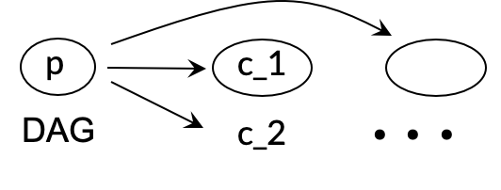
Case study #2: accelerate state transfer between functions
Serverless function can compose multiple functions together
  The functions are typically organized into a DAG (Direct acyclic graph)
p
c_1
c_3
...
DAG
c_2
DAG request
def produce():
data = pd.read_csv(some_csv)
return data
def consumer_1(data):
process_data_1(data)
...
Run the function

Slide 67
Case study #2: accelerate state transfer between functions
Serverless function can compose multiple functions together
  The functions are typically organized into a DAG (Direct acyclic graph)
  Problem: Transferring states are costly due to (de)serialization + memory copies
p
c_1
c_3
...
DAG
c_2
DAG request
def produce():
data = pd.read_csv(some_csv)
return data
def consumer_1(data):
process_data_1(data)
...
Data serialization, deserialization + memory copies

Slide 68

Case study #2: accelerate state transfer between functions
Remote fork can completely address the costs of (de)serialization + memory copies
  The data has been pre-materialized in the parent memory
  Which is directly inherited by the child containers w/ the help of remote fork
p
c_1
c_3
...
DAG
c_2
DAG request
def produce():
data = pd.read_csv(some_csv)
return data
Remote fork
def consumer_1(data):
process_data_1(data)
...
DAG execution accelerated

Slide 69
Transfer state has a high cost, MITOSIS can accelerate it!
Run rule 1
Workloads: FINRA---a real-world serverless application
  Validate trades concurrently with serverless functions
  Setup: Fn, baseline adopts pickle for (de)serialization
Fetch data
Run rule 2
FINRA DAG
...
Workflow
execution
Time (ms)
Not scale due to the cost of (de)serialization!
Better
Number of concurrent rules
[1] https://aws.amazon.com/cn/solutions/case-studies/finra-data-validation/

Slide 70
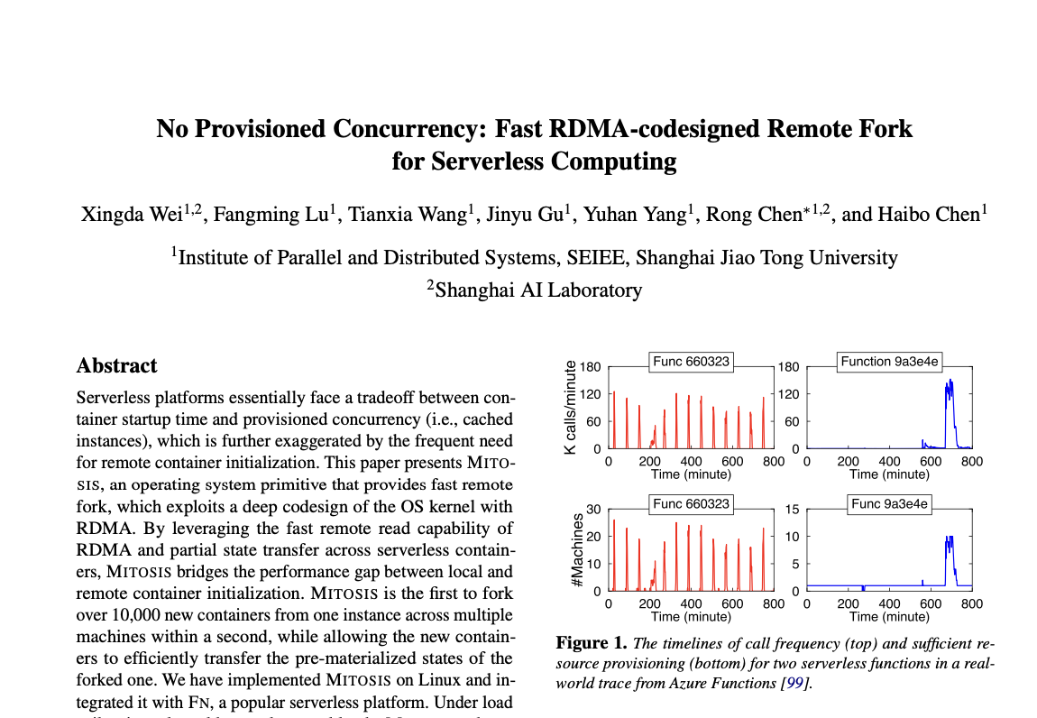
Many technical challenges to bring RDMA to remote fork
Detailed implementation w/ RDMA
  On-demand vs. eager state inherit
  Performance optimizations, e.g., caching or prefetch
Memory management w/ RDMA
  A co-design with advanced RDMA technologies
Integration w/ serverless framework
  A strong cooperation is needed so as to fully utilize the power of MITOSIS
More detailed evaluations
  Where the performance improvement comes, & the bottleneck of approach, etc.
Please check our paper if you have interests!

Slide 71

Short summary
MITOSIS: Fast remote fork design & implementation for starting containers
  With a codesign between OS and RDMA
Achieve no provisioned concurrency
  O(1) resource usage for starting serverless containers
Killer application: serverless computing
  Achieve resource—performance—efficient coldstart mitigation
  Achieve (de)serialization-free state transfer between serverless functions
Publicly available at:
https://github.com/ProjectMitosisOS/ProjectMitosisOS

Slide 72
A characterization of the startup cost of serving instance
CPU initialization: Python runtime initialization (e.g., import torch)
GPU initialization:
  Context creation (e.g., create cudacontext)
  Model loading (e.g., load the parameters into the GPU HBM)
docker run python llama.py …
Python initialization
GPU context
Model loading
“Good day …”
10 – 60 seconds
2 – 4 seconds
1 – 10 seconds
Time
MITOSIS@OSDI’23
PhoenixOS@arXiv
BlitzScale@OSDI’25

Slide 73


2. Eliminate GPU context creation via pooling
App issue kernels
GPU App
cuCtxCreate,cublasCreate, ...
…
GPU driver
Time
Key insight: GPU kernels execution is irrelevant of the context, so we can pre-create!
GPU App
cuCtxCreate,cublasCreate, ...
…
GPU driver
Time
Context pool

Slide 74
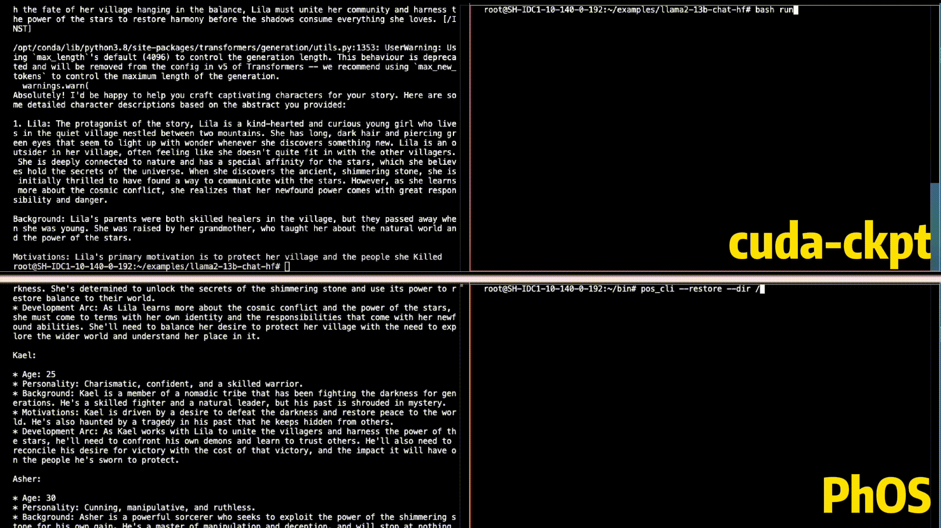
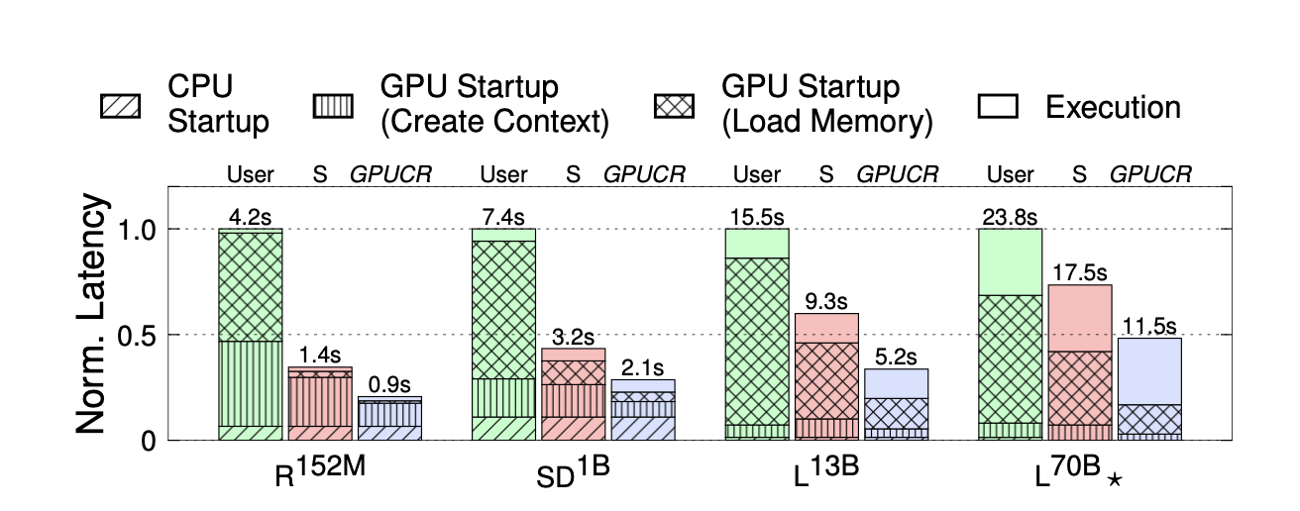
Put it all together
10X faster than NVIDIA’s closed-source solution
PhoenixOS restore = MITOSIS + GPU context pool
Fast GPU job startup
  Cold startup Llama-13B in 280ms
  Our code is also available (PhOS)
Code
Paper
(Preprint)
Orders of magnitude faster than baselines (Docker, cuda-ckpt)

Slide 75
A characterization of the startup cost of serving instance
CPU initialization: Python runtime initialization (e.g., import torch)
GPU initialization:
  Context creation (e.g., create cudacontext)
  Model loading (e.g., load the parameters into the GPU HBM)
docker run python llama.py …
Python initialization
GPU context
Model loading
“Good day …”
10 – 60 seconds
2 – 4 seconds
1 – 10 seconds
Time
MITOSIS@OSDI’23
PhoenixOS@arXiv
BlitzScale@arXiv

Slide 76
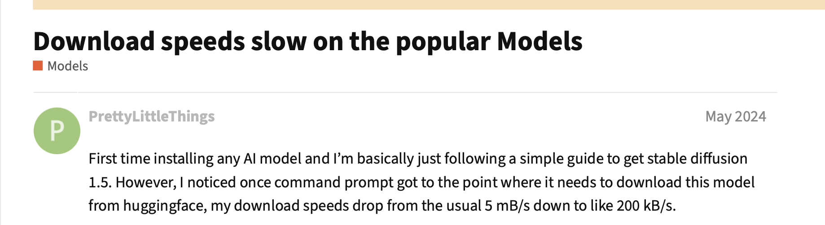
Question: how to accelerate model loading?
Essentially, it is all about choosing the link between servers & whatever that stores the model parameter
  Why? Model loading is bulk transfer, no random accesses
So we need to first ask, what are the available options?
A trivial example is cloud storage like HuggingFace
  But downloading models from the huggingface is extremely slow….

Slide 77


A little background: storage hierarchy in datacenters
Parameter storage has hierarchy
Trade-off between speed & costs
Speed
Cost & Capacity
GPU
∞
~100GB
CPU
25GB/s
~200 GB – 1TB
SSD
3-7GB/s
~1TB– 40TB
Our previous discussion
Cloud storage
1-5GB/s
∞

Slide 78
Strawman approach #1: storing at the CPU/GPU memory (caching)
Pros
  Fast model load speed
Cons
  Limited capacity
  Especially when many models sharing the same cluster
Thus, CPU/GPU memory is typically used for caching
  i.e., the model is stored elsewhere
  If CPU/GPU has space, then cache it here
Speed
Cost & Capacity
GPU
∞
~100GB
CPU
25GB/s
~200 GB – 1TB
SSD
3-7GB/s
~1TB– 40TB
Cloud storage
1-5GB/s
∞
Notes:
Joke: OS-level optimization can be categorized into three methods: caching, hashing + batching

Slide 79
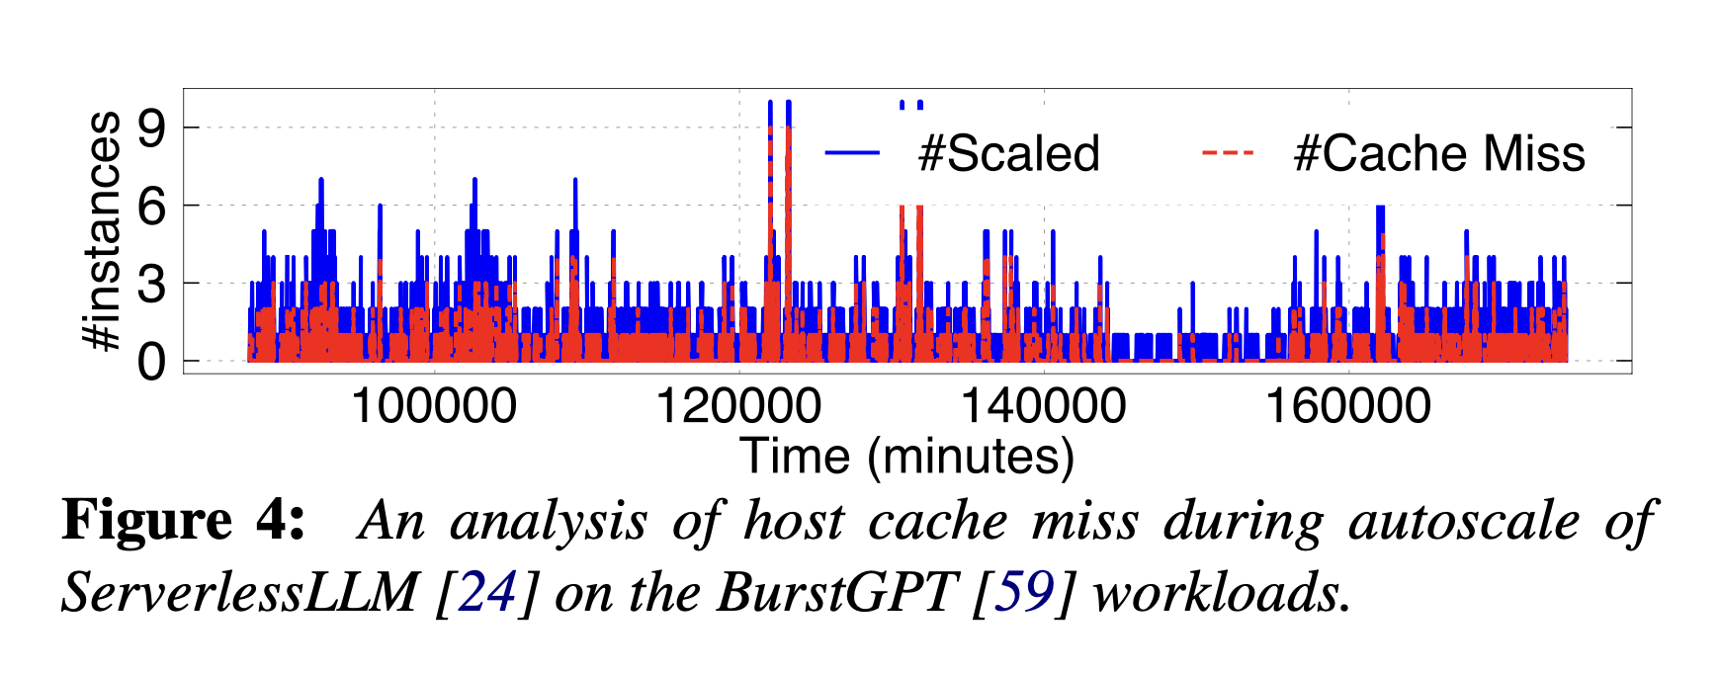
Problem: cache misses
If the model parameters are not cached, then fallback to the slow storage
Speed
Cost & Capacity
GPU
∞
~100GB
CPU
25GB/s
~200 GB – 1TB
SSD
3-7GB/s
~1TB– 40TB
Cloud storage
1-5GB/s
∞
Notes:
Joke: OS-level optimization can be categorized into three methods: caching, hashing + batching

Slide 80
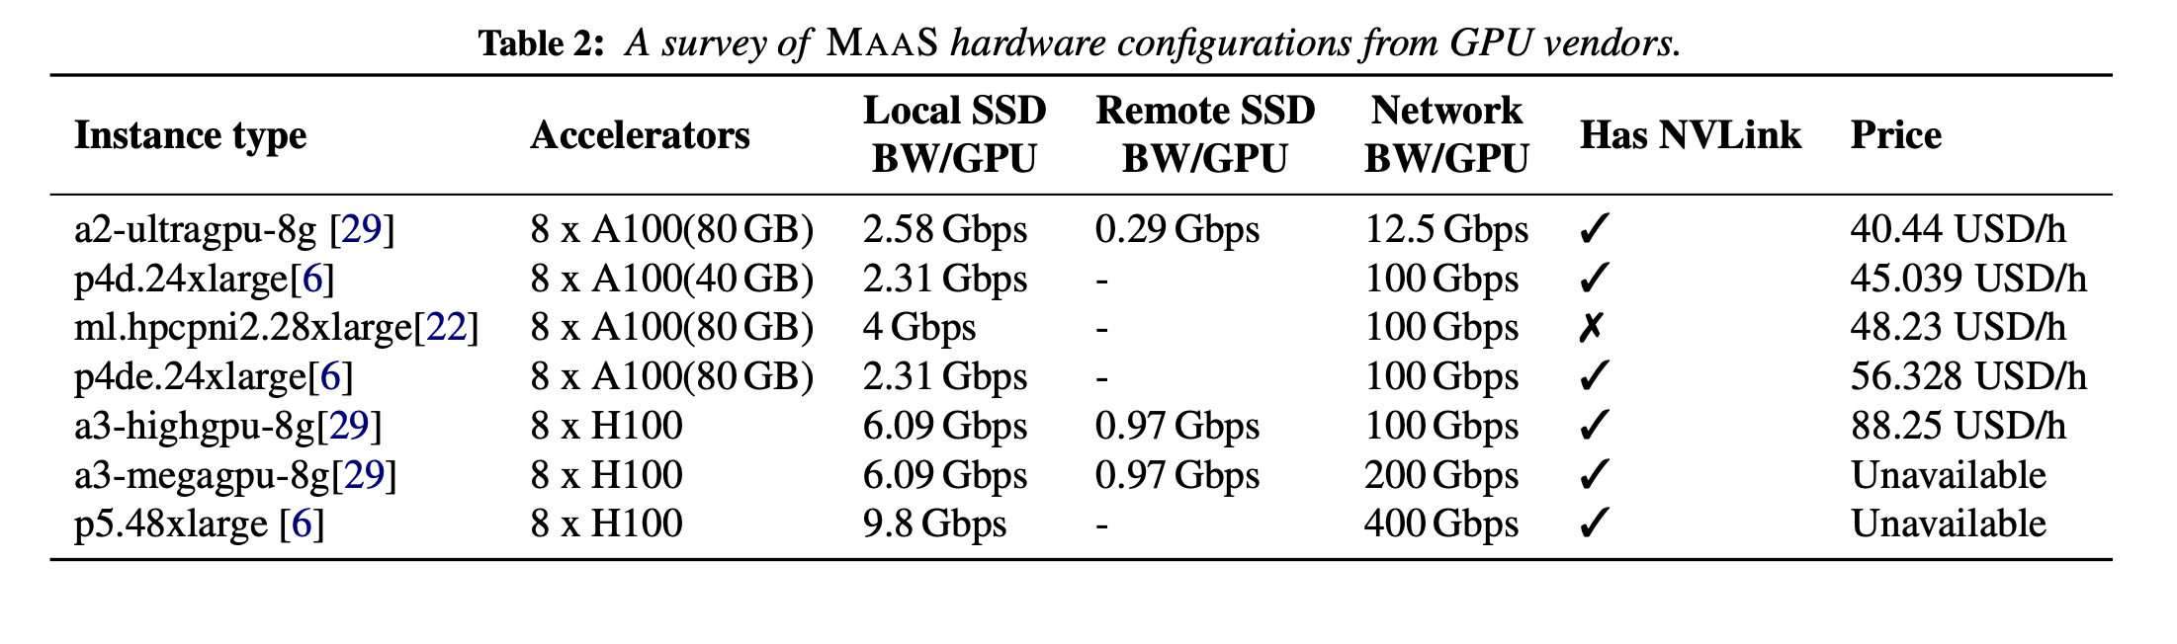
Strawman approach #2: SSD-optimized parameter loading
Benefits
  The SSD bandwidth can be aggregated w/ multiple SSDs
  E.g., with RAID
  Thus, it can in principle achieve similar to CPU
Unfortunately, cloud servers used for inference rarely use such a setup, e.g., SSD-less architecture
Speed
Cost & Capacity
GPU
∞
~100GB
CPU
25GB/s
~200 GB – 1TB
e.g., ServerlessLLM[1]
SSD
3-7GB/s
~1TB– 40TB
Cloud storage
1-5GB/s
∞
80

Slide 81

Our solution (BlitzScale^{[1]}): using remote memory for caching
GPU servers in a cluster is connected with high bandwidth networking
  Close to that of CPU
The capacity for caching can be amortized
  E.g., if the model has been deployed on a GPU
Speed
Cost & Capacity
GPU
∞
~100GB
CPU
25GB/s
~200 GB – 1TB
SSD
3-7GB/s
~1TB– 40TB
Fast networking
Remote memory
?
25GB/s
Cloud storage
1-5GB/s
∞
Deployed
To be deployed
81

Slide 82
The benefits of using network for model loading
#1. Fast speed (much faster than the SSD or cloud storage’s offering)
Sounds trivial, right? But there are more.

Slide 83



The benefits of using network for model loading
#2. Efficient scale out in O(1), not O(N), where N is the number instance to scale
  E.g., the time to scale out N node is the same as scale out to 1 node
  How? Network broadcast (& multicast)
Time ~= $\frac{M}{B}$
Time ~= 2X $\frac{M}{B}$
Time ~= $\frac{M}{B}$
…
Scale to 1
Scale to 2 (naïve)
Scale to 2 (multicast)

Slide 84
Challenge #1: network interference
Network does not come for free (There is no free lunch)
  The GPUs may heavily use it for inference, e.g., prefill & decode disaggregation
At a high level, LLM processing can be decoupled in two phases
  Prefill: process the whole context; Decode: iteratively generate tokens
  PD disaggregation: use different GPUs to process different phases
Reqs
Network interference!
For prefill
Load model parameters
KVCache
For decode
Tokens
Transfer
KVCache

Slide 85

Solution: model & network-aware interference-free plan
Observation #1 (model):
  The network usage of model serving is static
  E.g., KVCache only flows from the prefill GPUs to the decode GPUs
Observation #2 (network):
  A datacenter network is bidirectional, meaning that data flows in opposite directions do not interfere with each other
Network interference!
For prefill
KVCache
For decode
No interference
Tokens

Slide 86
Solution: model & network-based broadcast plan generation
Our planner will prune the available network paths for broadcasting
  E.g., always transfer parameters from decode GPUs instead of prefill GPUs
The problem may become small if the KVCache transfer is small, e.g., w/ MLA
Network interference!
For prefill
KVCache
For decode
No interference
Tokens
Multicast plan from our planner

Slide 87
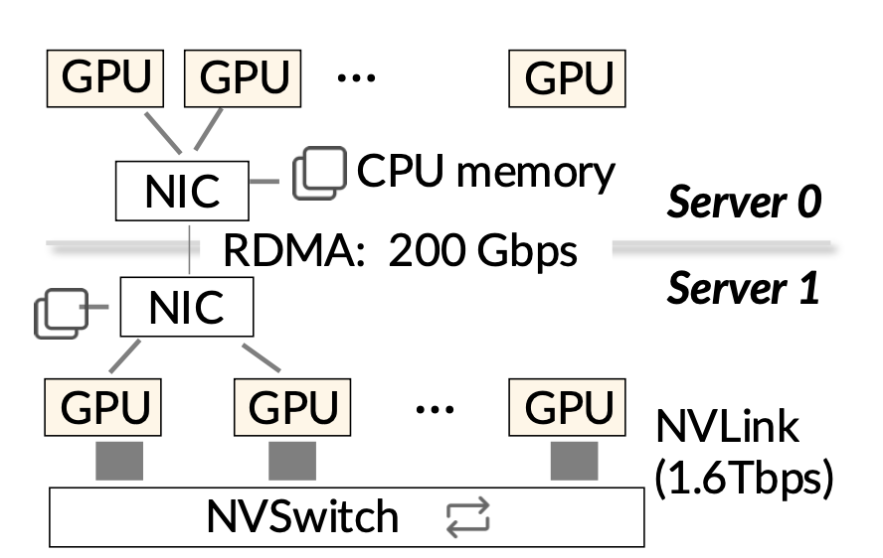
Challenge #2: optimal broadcast plan generation & solution
The broadcast plan generation is NP-hard [1] considering the heterogeneous network
  E.g., RDMA + NVLink
Yet, we need to quickly find a plan quickly
Observation: NVLink is orders of magnitude faster than other links (e.g., RDMA)
  Allow us to treat GPUs connected with NVLink as a super node
  Reduce the problem from heterogeneous to homogeneous: we first use RDMA for multicast, then use NVLink for multicast

Slide 88
Challenge #3: insufficient network bandwidth
Network speed can still have a limit
  And machines with slower network is cheaper
Root cause: we assume a fixed method for model loading and serving
  A relative naïve one: after we have loaded all the parameters, the model can serve

Slide 89
Can we do better? Live model load!

Slide 90
Traditional model loading is stop-of-the-world
Before the full copy of parameters are loaded, the model cannot do the inference
We want live:
  Before all the parameters have been loaded, the scaled GPU can improve system throughput !
=
A model is decomposed into a set of layers
New GPU (s) downtime
Tokens
Compute
Requests
Naïve loading, like ServerlessLLM, is not live

Slide 91
Can we do better than the naïve method to make it live?
We want live:
  before all the parameters have been loaded, the scaled GPU can improve system throughput !
A better approach: prefetching (e.g., Pipeswitch[1])
  Question: does it help? No! Because otherwise we still need to wait …
Tokens
…
[1] PipeSwitch: Fast Pipelined Context Switching for Deep Learning Applications, OSDI’20
Compute
Requests
PipeSwitch-like approach helps little if the computation is much faster

Slide 92
Model loading can be made live w/ model property
Observation: during scaling, there typically have model replica deploys elsewhere
  We can let both GPUs cooperate to become live!
Example: suppose a model has N layers, and is deployed on GPU0
  We load the layers from N -> 1 at GPU1
GPU0 + GPU1 throughput increases even before GPU1 has loaded all the layers!
Execute (1,N-1)
Load model parameters
Execute (1,N-2)
GPU0
…
GPU1
Request execution
Execute (N-1,N)

Slide 93
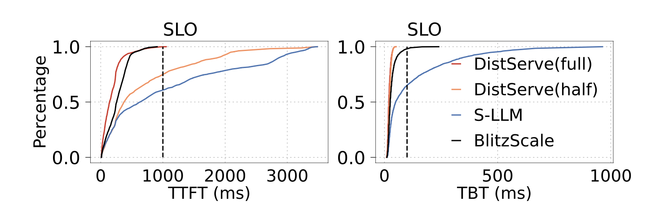
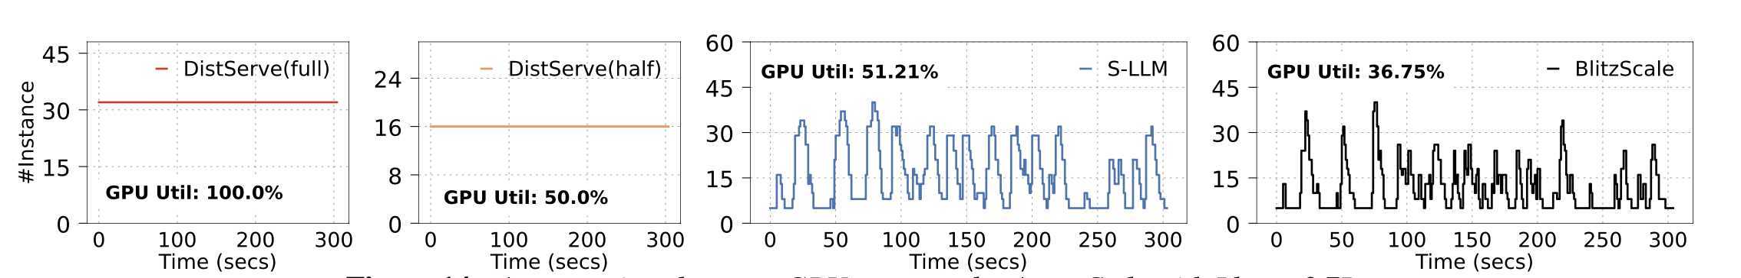
End-to-end system: BlitzScale
Baseline:
  DistServe@OSDI’24 (static)
  ServerlessLLM@OSDI’24 (autoscaling)
  Full: DistServe uses all the GPUs
BlitzScale has better performance and GPU utilizations

Slide 94
Summary of our work on LLM autoscaling
Autoscaling is non-trivial for LLM serving
  Because (1) model parameters are large & (2) they cannot be partially loaded
  Other overheads can be eliminated by PhoenixOS
In our work (BlitzScale), we show
Model loading can be made fast by carefully leveraging network between accelerators
Model loading can be made live by leveraging the model inference properties
We have mode design details, please check our preprint if you are interested ☺

Slide 95
Conclusion
Auto-scaling is a promising solution for achieving both high-performance & low cost
  The key success is to minimize the job startup cost
For these costs, we can systematically reduce them via system-model co-design
  Most of our paper is available; and most code is (and will be) available
Model serving auto scaling overhead
Python initialization
GPU context
Model loading
“Good day …”
10 – 60 seconds
2 – 4 seconds
1 – 10 seconds
Time
MITOSIS@OSDI’23
PhoenixOS@arXiv
BlitzScale@OSDI’25
[1] No Provisioned Concurrency: Fast RDMA-codesigned Remote Fork for Serverless Computing, OSDI’23
[2] ParallelGPUOS: a concurrent OS-level GPU checkpoint and restore system, arXiv’24
[3] Fast and Live Model Auto Scaling with O(1) Host Caching, OSDI’25

Slide 96
One more thing

Slide 97
Think: for autoscaling + live migration, which steps we are missing?
Live migration
  Migrate a GPU process from one machine to another through the network
Auto-scaling
  Load the model parameters through RDMA-based multicast
How to leverage the fast networking?

Slide 98
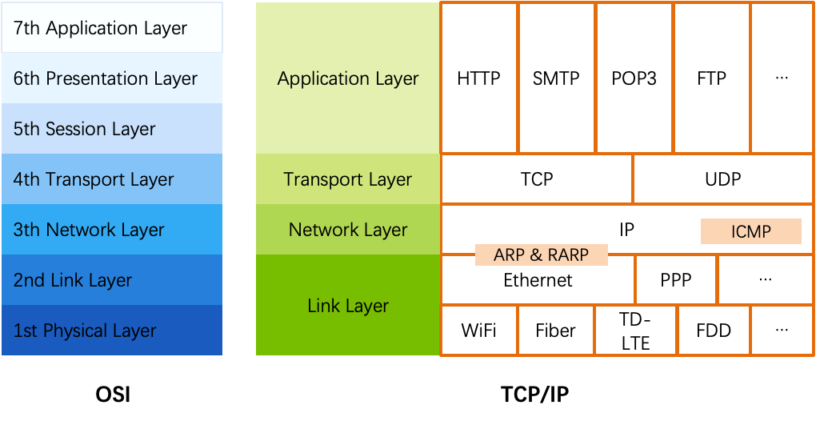
Review: RDMA
OSI: An overview of traditional networking
  The open systems interconnection (OSI) model
  7-layer architecture

Slide 99
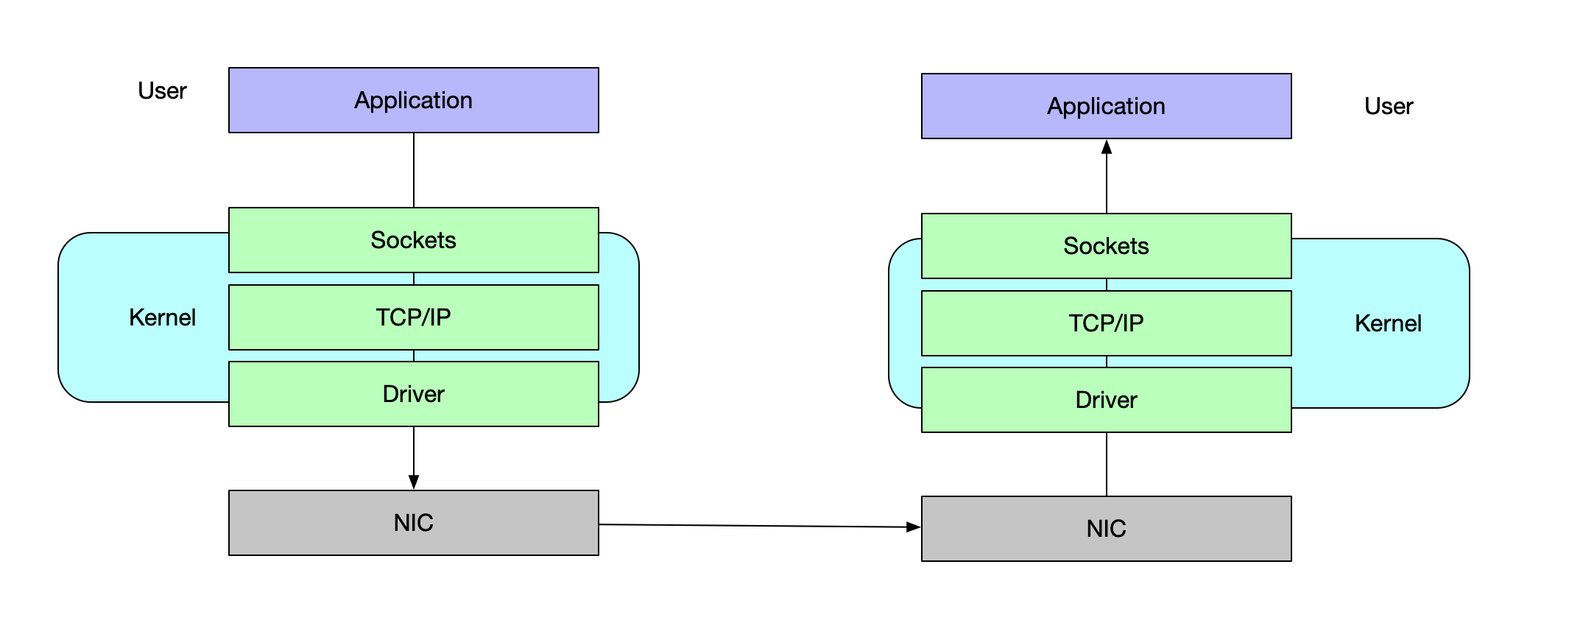
The OS implements the traditional network stack
CPU copy
CPU copy
Protocol
Processing
DMA copy
DMA copy

Slide 100
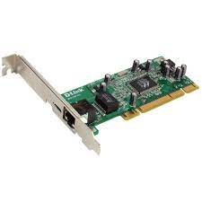

Packet processing in Linux
  Application
User space
  read(), write()
Kernel space
  Socket
  TCP/IP
  Driver
  Ring Buffer
Network card
  TX/RX queues

Slide 101
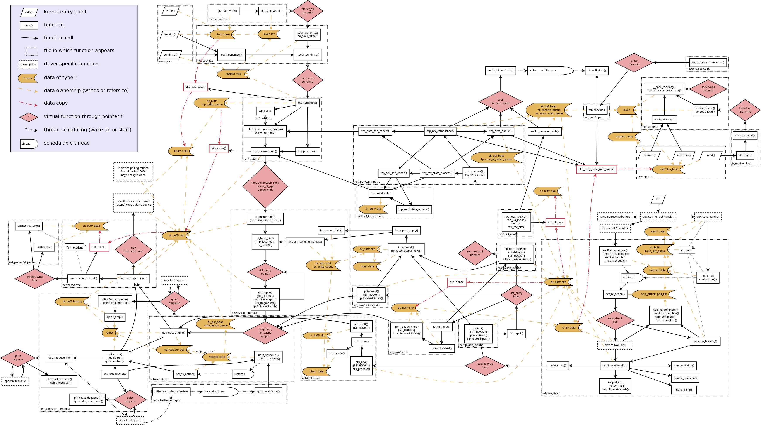
Linux networking software stack

Slide 102
What are the costs of such a complex networking stack?
Physical limit | ~1-10us
Linux/TCP/IP/stack | ~50-200us
Apps (e.g. KV) latency | ~8-100us
Notes:
包括call kernel的overhead和kernel-space 处理的开销

Slide 103
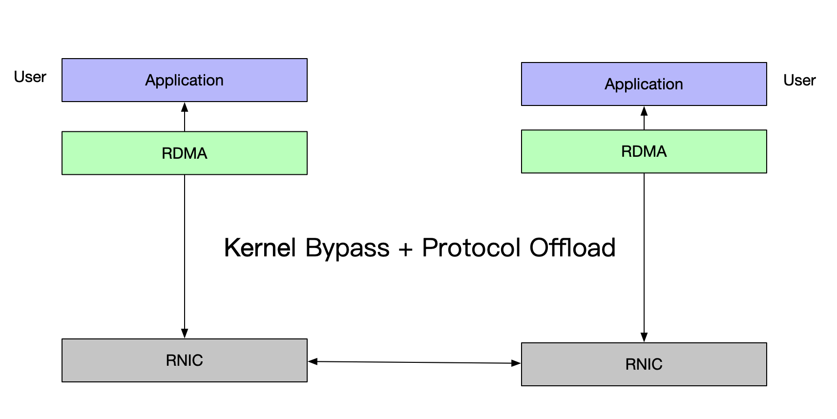
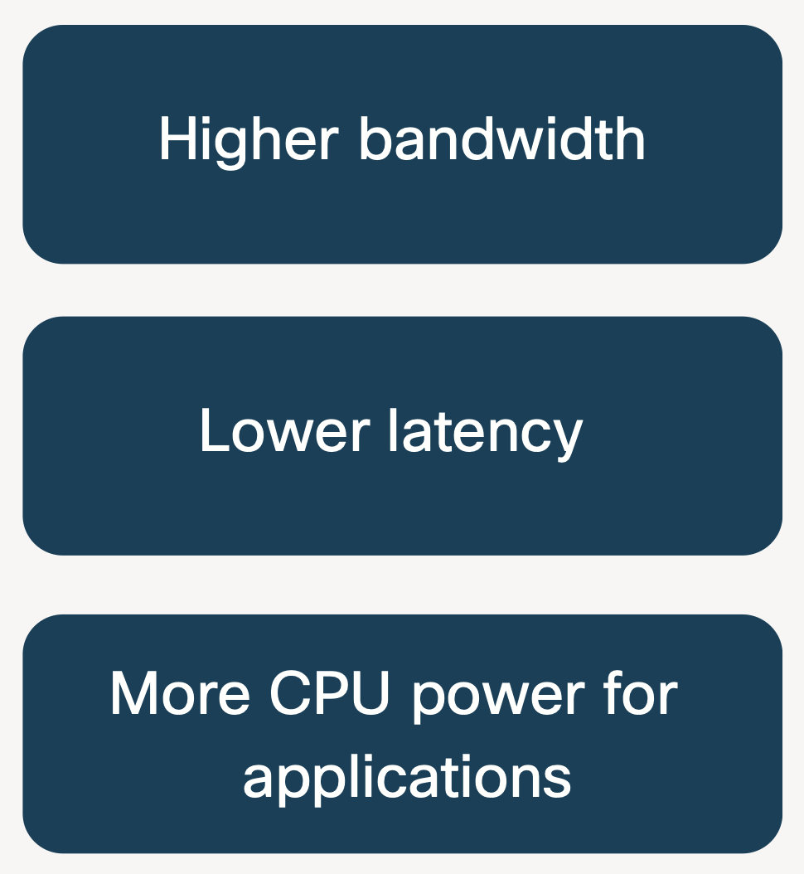
RDMA: offload the complete network stack to the NIC
RDMA = Remote Direct Memory Access
Direct memory-to-memory data communication over network.

Slide 104
Problem: RDMA network connection creation is extremely slow
Example: RDMA control path is extremely slow (1000X slower)
  Control path: mainly create RDMA-capable connection (RCQP)
  Data path: send/recv one-sided or two-sided RDMA requests w/ the RCQPs
Not a problem for traditional application, e.g., MPI application
  Once an RCQP is created, used for a long time
Become a problem for elastic application
  E.g., serverless functions (Lifecycle: 1--20ms)
  A connection is only used for 10—20ms *
15ms
2us
* Serverless function typically executes within 20ms, source: The state of serverless.
https://www. datadoghq.com/state-of-serverless/, 2022.

Slide 105
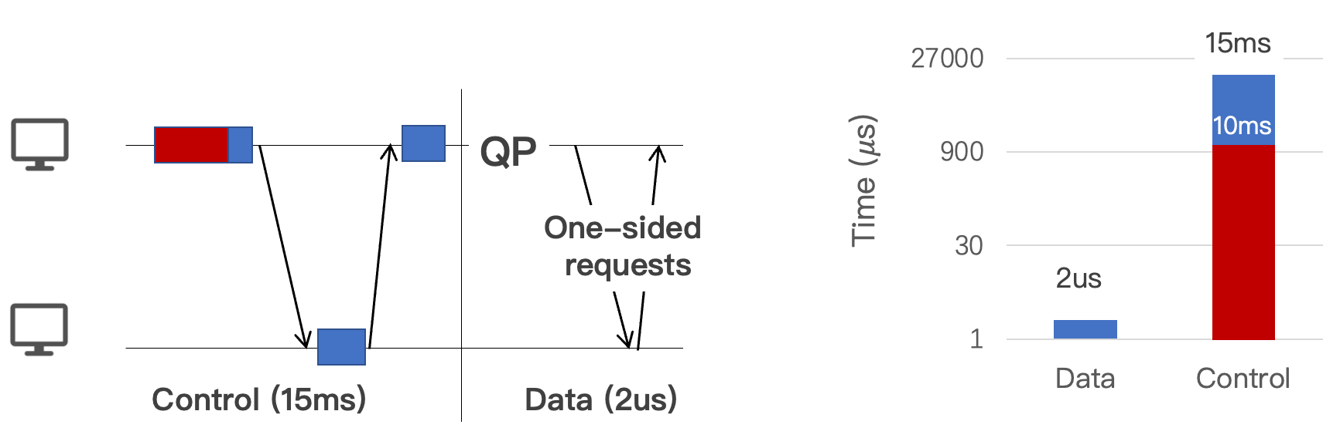
Why RDMA connection establishment is slow?
Characterizing the RDMA connection establishment process
  Loading the driver context at the user-space

Slide 106
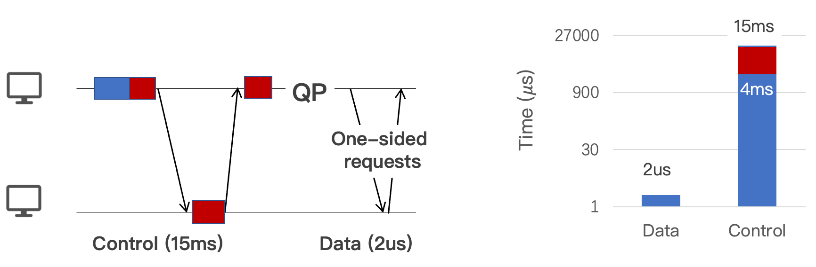
Why RDMA connection establishment is slow?
Characterizing the RDMA connection establishment process
  Loading the driver context at the user-space
  Creating and configuring the hardware queues (RCQPs)

Slide 107
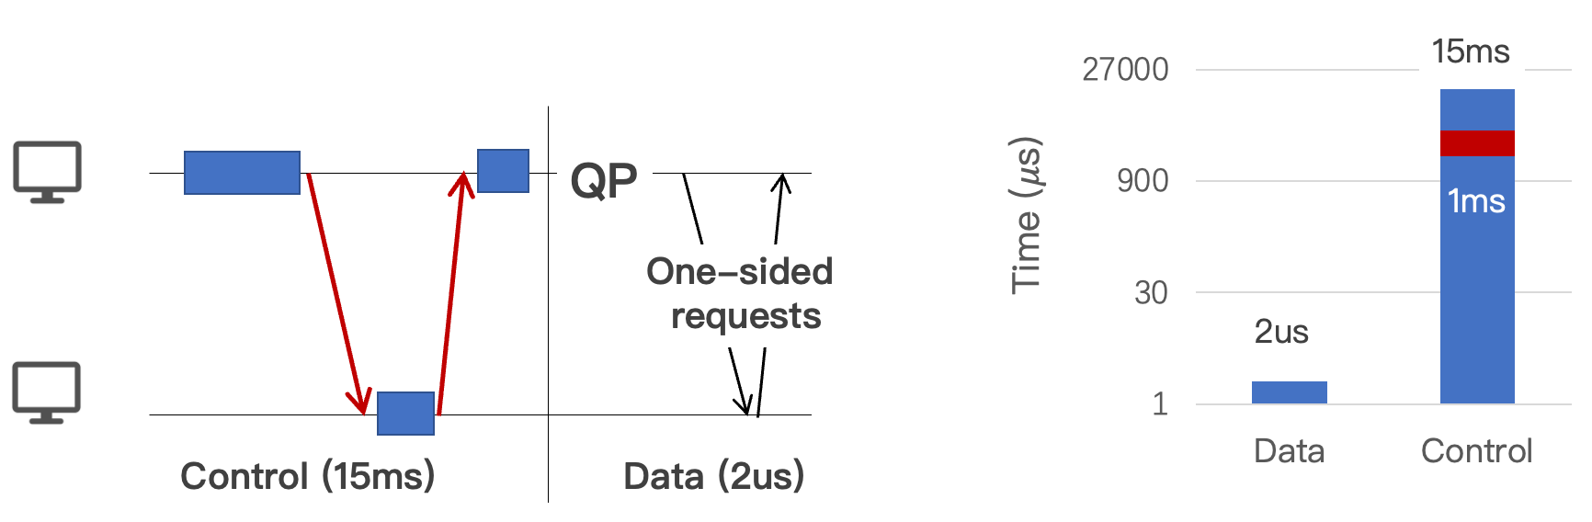
Why RDMA connection establishment is slow?
Characterizing the RDMA connection establishment process
  Loading the driver context at the user-space
  Creating and configuring the hardware queues (RCQPs)
  Exchange the connection information with remote end

Slide 108
Why RDMA connection establishment is slow?
Characterizing the RDMA connection establishment process
  Loading the driver context at the user-space
  Creating and configuring the hardware queues (RCQPs)
  Exchange the connection information with remote end
Challenge to reduce
Due to hardware setups

Slide 109
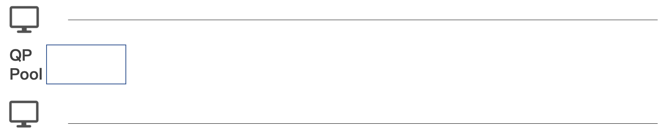
Some bad can be addressed by systems designs
KRCore: reduce RDMA control time from ms to us
  While being compatible to existing RDMA interface (verbs)
Basic idea: resource pooling
  Cache connected RCQPs in a connection pool that can be reused by APPs

Slide 110
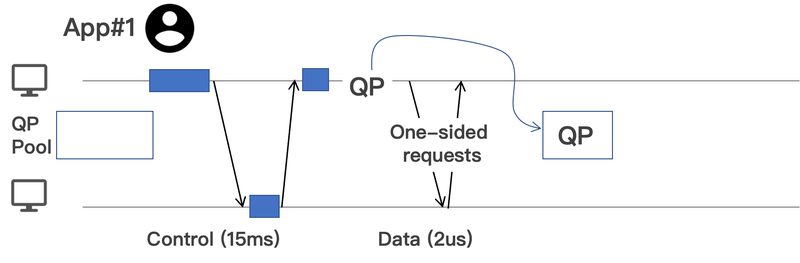
Some bad can be addressed by systems designs
KRCore: reduce RDMA control time from ms to us
  While being compatible to existing RDMA interface (verbs)
Basic idea: resource pooling
  Cache connected RCQPs in a connection pool that can be reused by APPs

Slide 111
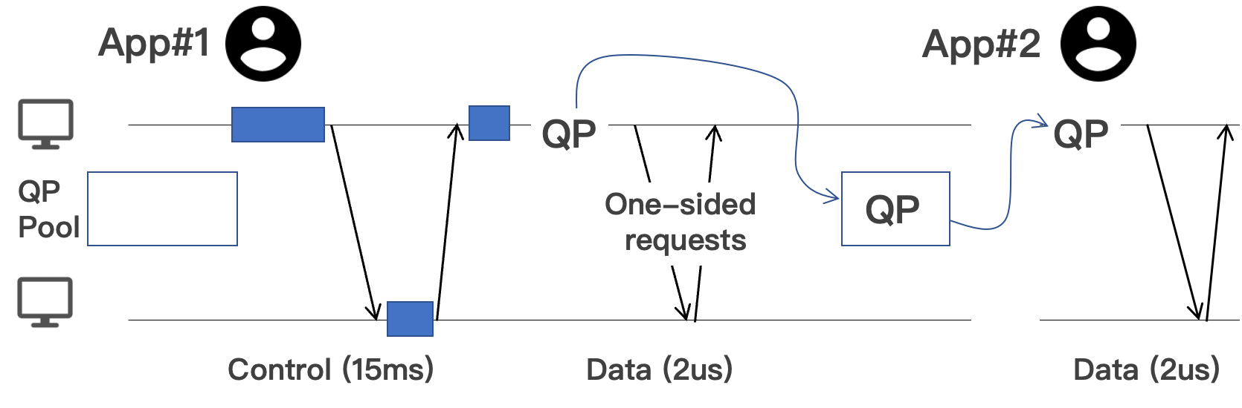
Some bad can be addressed by systems designs
KRCore: reduce RDMA control time from ms to us
  While being compatible to existing RDMA interface (verbs)
Basic idea: resource pooling
  Cache connected RCQPs in a connection pool that can be reused by APPs
Reuse

Slide 112
Challenge #1. sharing RDMA resources
RDMA QP is dedicated to a process for the best performance
  Sharing is hard to implement :
  The RCQP state is over user-space, kernel-space and hardware
ibv_context
QP#1
sq_buf
User
App#1
sq_buf
QP#2
...
App#2
ib_pd
mlx5_ib_qp
Kernel
...
NIC
Unknown
Hardware
Physical queues

Slide 113
Solution: Virtualize the QP API w/ shared kernel-space QP
Observation: RDMA QP has a limited thin API (i.e., verbs)
  E.g., ibv_post_send to send a request to the NIC
  So we can virtualize a kernel-space QP to different apps by providing the same API
QP#1
ibv_post_send
1
App#1
QP#2
App#2
System call
Virtualize
Kernel
1
ib_post_send // kernel’s RDMA interface
NIC
1
Physical queues

Slide 114
Challenge #2. Isolate shared QP
We must isolate requests sent/received to a shared QP
  App#1 must not read App#2’s data
  App#1’s malformed request will not corrupt App#2’s accesses
ibv_post_send
ibv_poll_recv
?
QP#1
1
App#1
QP#2
App#2
System call
System call
Virtualize
Kernel
2
2
1
NIC
1
2
Request sent to App#2
Physical queues
Notes:
RMDA malformed request 会把物理QP corrupt成一个错误的状态，无法继续使用

Slide 115
Solution: software-based RDMA requests prechecks
Krcore system call handler will check and dispatch requests carefully
  Not so easy: needs to handle various cases
  E.g., request validity, request destination, etc.
ibv_post_send
ibv_poll_recv
?
QP#1
1
App#1
QP#2
App#2
System call
System call
Virtualize
Kernel
2
2
1
NIC
1
2
Request sent to App#2
Physical queues
Notes:
RMDA malformed request 会把物理QP corrupt成一个错误的状态，无法继续使用

Slide 116
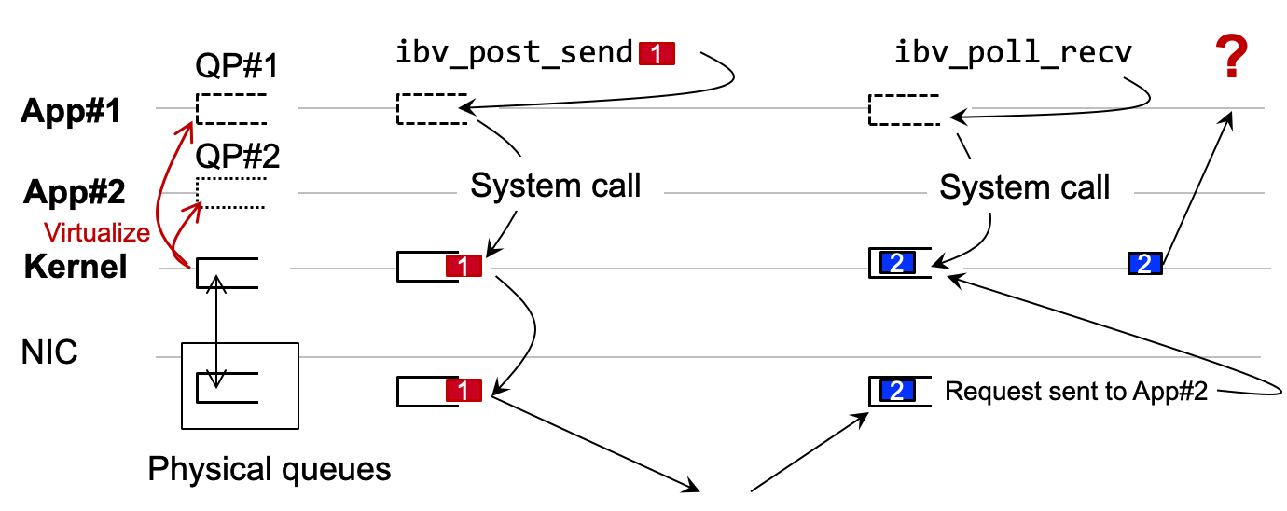
Solution: software-based RDMA requests prechecks
Krcore system call handler will check and dispatch requests carefully
  Not so easy: needs to handle various cases
  Reject if an RDMA request is not valid
1. No malformed requests
System call
2. No queue overflow
System call
3. Request/Completion owner
Notes:
RMDA malformed request 会把物理QP corrupt成一个错误的状态，无法继续使用

Slide 117
Challenge #3. Reduce memory consumption & Solution
Each machine need one dedicated RDMA QP to connect
  QP has not so small memory footprint: for queue and its metadata
  Our measurement: 159KB for each RCQP *
  For 10,000 machines, each machine needs to maintain a 1.59GB pool
Solution: retrofit DCQP—a new RDMA connection type
  One DCQP can communicate with multiple machines
  In a connectionless form
  * Excluding message buffers

Slide 118
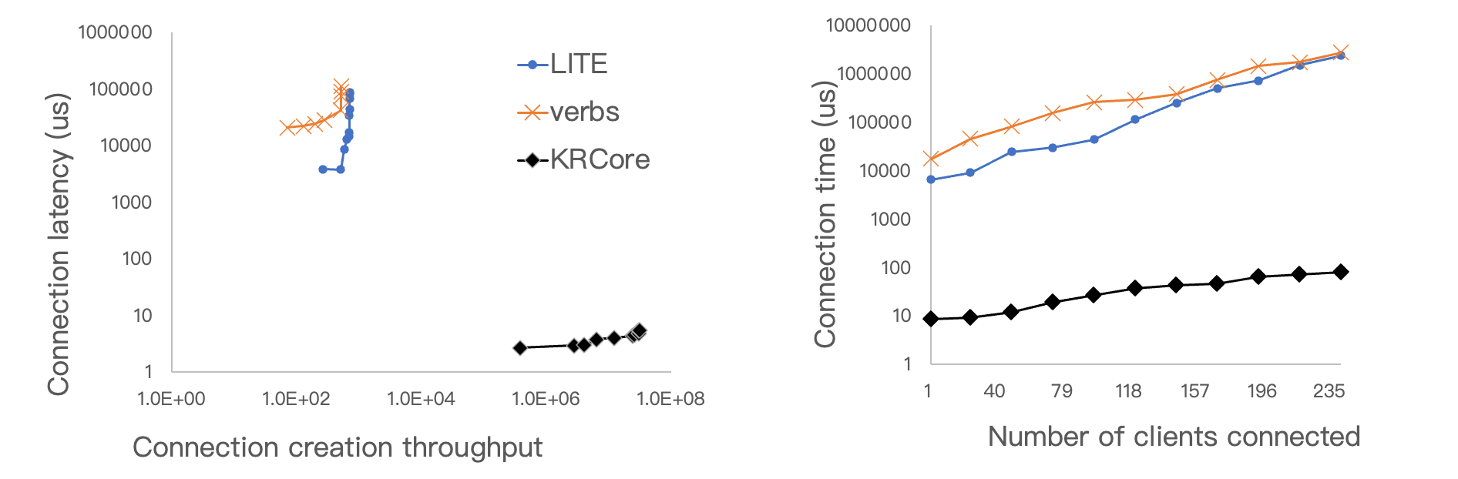
KRCore has a microsecond-scale control plane
verbs: The standard library for using RDMA
LITE^{[1]}: RDMA virtualization solution without control path optimization
Multiple client connecting to the same server
Creating full-mesh connections
  [1] LITE Kernel RDMA Support for Datacenter Applications, SOSP’17

Slide 119
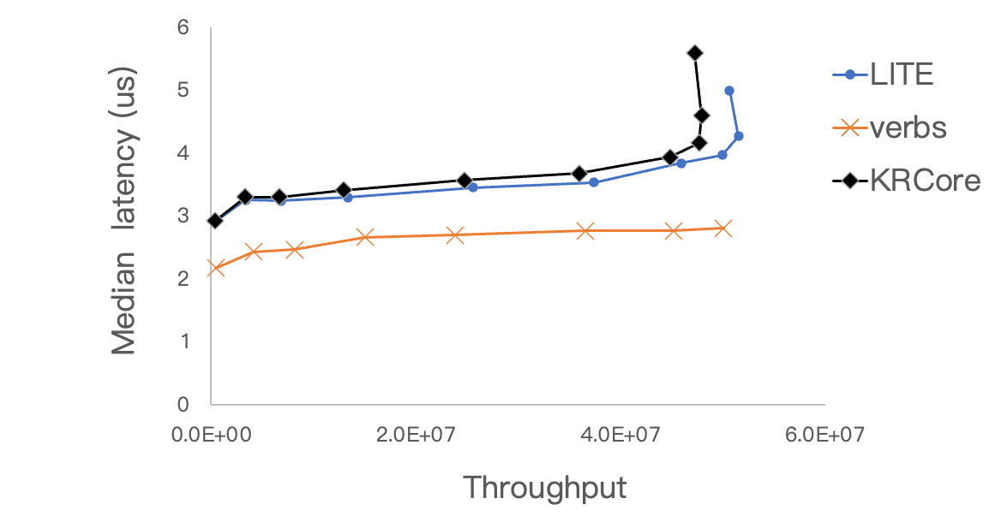
KRCore has a comparable data path performance
Workload: synchronous one-sided RDMA
  The client keeps sending one-sided RDMA READ to a server run to completion

Slide 120
KRCore has a comparable data path performance
Workload: synchronous one-sided RDMA
  The client keeps sending one-sided RDMA READ to a server run to completion
System call overhead (~1us)

Slide 121
KRCore has a comparable data path performance
Workload: synchronous one-sided RDMA
  The client keeps sending one-sided RDMA READ to a server run to completion
DCQP is slower than RCQP

Slide 122
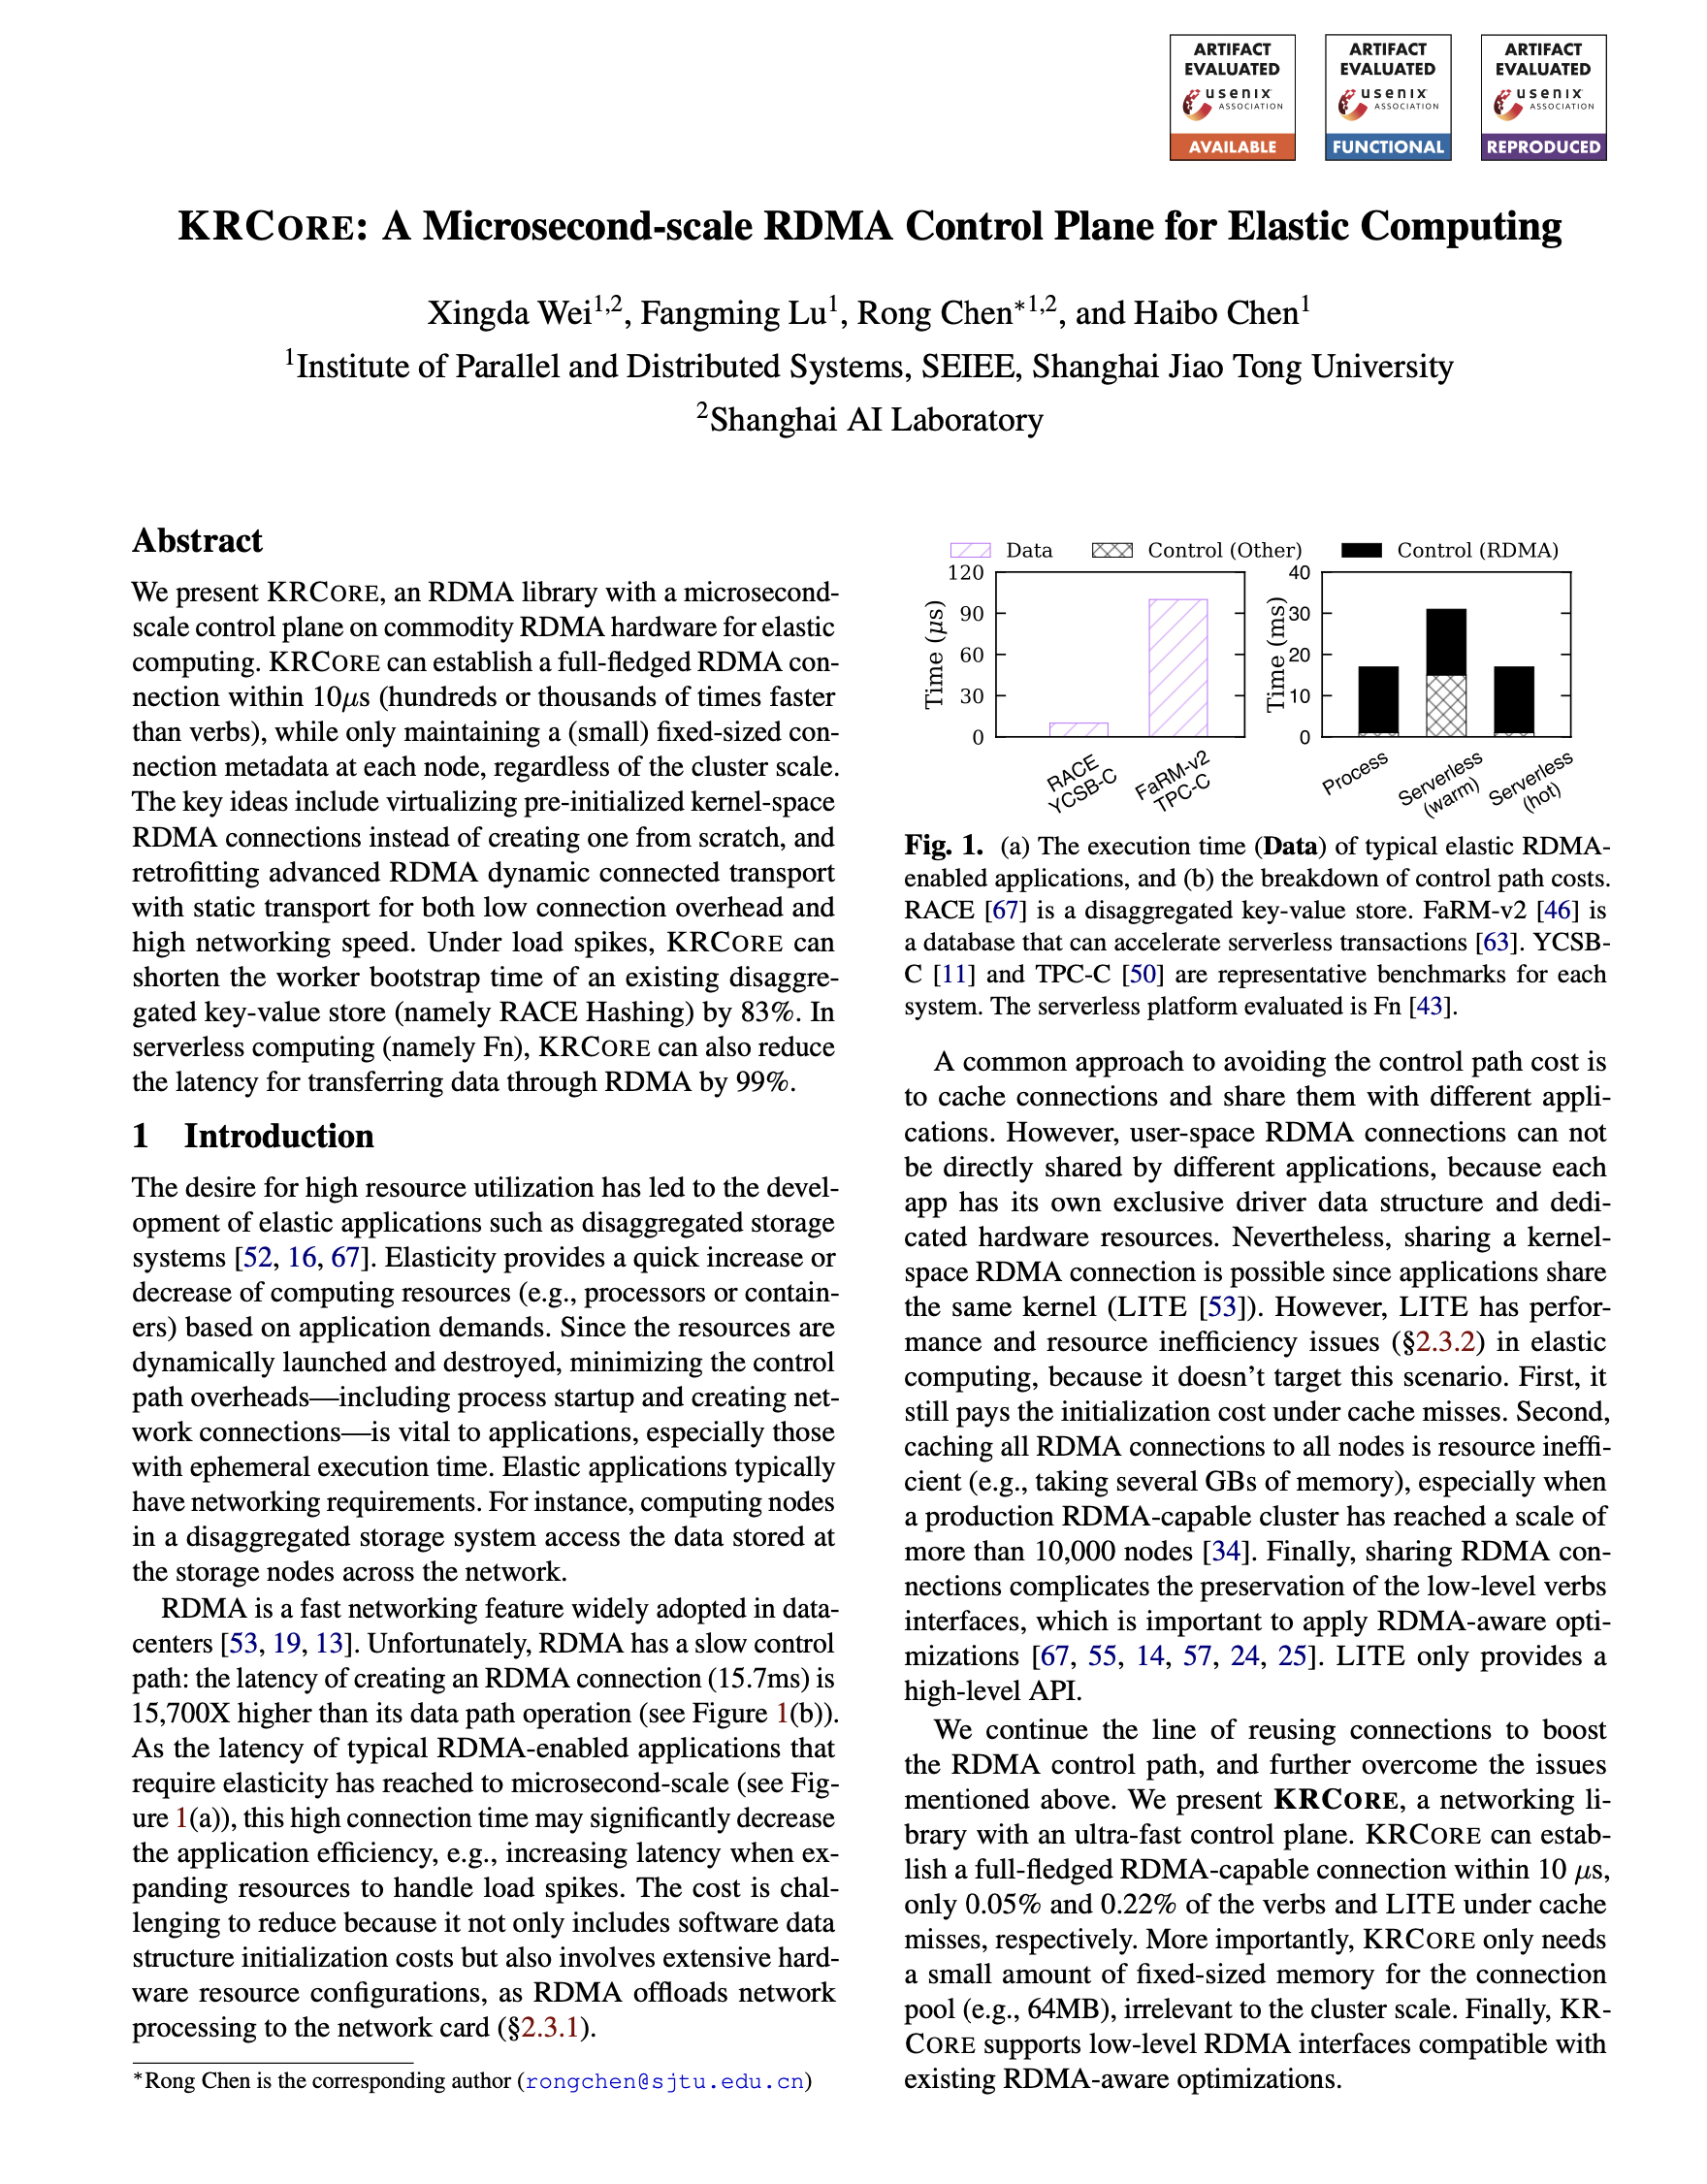
Summary and Conclusion of KRCore
The fastest RDMA control plane solution (microsecond-scale)
  On commodity RDMA hardware with unmodified interface *
Many other technical challenges to resolve, please refer to our paper!
  How to virtualize DCQP as RCQP
  How to optimize DCQP’s performance
  How to support elastic applications
  * Not completely supported yet.

Slide 123
Summary
Future computing (both general-purpose computing & AI) must be elastic
Elastic computing needs two foundational mechanisms
  Live migration
  Auto-scaling
Both mechanisms are not optimized for elastic computing
  Our recent works optimize the two methods in a full-stack way
There are many more things left, e.g., policies, which needs more research!
Thanks & QA

