Slide 1
Discrete Mathematics
(for Computer Science)
Zhaoguo Wang

Slide 2

范围1: 期末考试 （闭卷）
逻辑1, 2, 4, 5章
集合论 9, 10, 11.1,11.2 章节
一切以课本为准，不要使用DPLL等课本上没有的技术

Slide 3
友情提醒
可以使用课本的书后习题和Canvas上的课前/课后作业多加练习
  有任何问题欢迎随时向助教提问
证明题
  一定按照课本上的格式证明，不要跳步
  不要通过写一大段自然语言进行证明

Slide 4
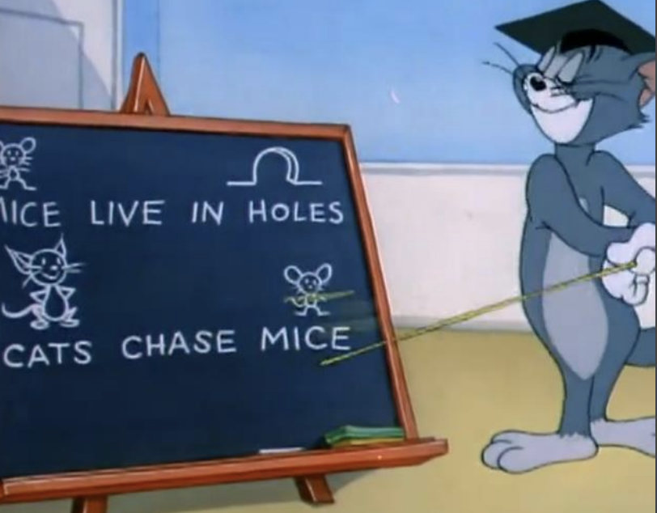
范围2: Quiz
形式化验证
  DPLL, convert program into SAT
  Lazy SMT, EUF, symbolic execution
  Hoare triple, Hoare inference rules, loop invariant(Quiz会给出invariant), weakest precondition
  不考WFF的自动识别, switch variables, strongest postcondition, LLM
自动机和图灵机
  DFA, Turing machine basics, the language of Turing machine
往年试题
  参见canvas（2019年2, 4.2不在考试范围，不要参考）

Slide 5
Quiz考试要求
Quiz为开卷随堂测验，时间是周一上午正常上课时间。
考生须持带有本人清晰头像的校园卡或身份证等有效身份证件，考试时放在桌角供监考老师检查证件和本人是否一致。
考生至少提前15分钟进入考场，Canvas会发布座位表，有两个考场，东上院312（上课教室）和东上院212，注意不要走错。
不得使用任何电子设备，携带者应在开考前关闭电子设备或静音，将电子设备和书包等其它考试无关的物品一起放置在讲台旁边。
仅可使用纸质参考资料（往年试卷、笔记、教材、打印的课件等），不得相互借阅。
考生自己准备文具，可自带草稿纸，答题纸由监考人员提供。
下课铃响时，考生应立即停止答题，并留在座位上等候，由监考人员统一收取试卷、答题纸等考试材料；经监考人员催促仍不交者，该生Quiz成绩将以0分计；监考人员对收回的考试材料数量核对无误后，所有考生方可离开考场，核对结束之前考生应该留在座位。

Slide 6
Understand the “law of physics” in CS
Applications
Package Manager
Program Verification
Program Synthesis
Program
Super-optimization
Verifiers
SAT Solver
SMT Solver
Dafny
Discrete Mathematics
Propositional Logic
Predicate Logic
Hoare Logic
Notes:
很有有意思的应用和强大的验证工具底层原理都是离散数学

Slide 7
Part I: Computer Aided Reasoning Overview
1.1 Propositional Logic
1.2 First Order Logic
1.3 Auto-active Proof
Step 1. Convert program into propositional formula.
Step 1. Convert program into first order logic formula.
Step 1. Hoare Logic
Step 2. Ask the computer
to solve the formula.
Step 2. Ask the computer
to solve the formula.
Step 2. Ask the computer
to check the invariants
We start at propositional logic, which is a simple logic. Computer has 1 and 0. Propositional logic has T and F.

Slide 8
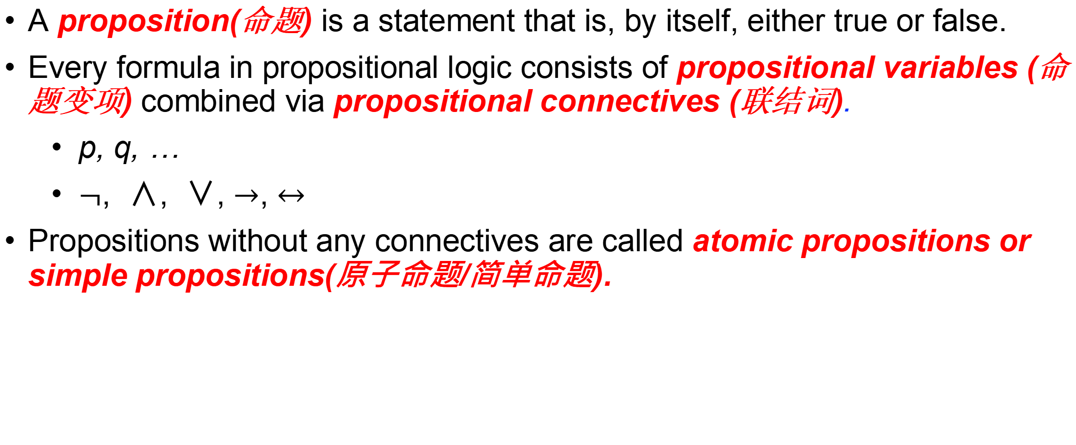
Propositional Logic
A proposition(命题) is a statement that is, by itself, either true or false.
Every formula in propositional logic consists of propositional variables (命题变项) combined via propositional connectives (联结词).
  p, q, …
  $¬$, ∧, ∨, $→$, $↔$
Propositions without any connectives are called atomic propositions or simple propositions(原子命题/简单命题).

Slide 9

Well-Formed Formulas (合式公式)
INDUCTIVE DEFINITION of WFF
1). Every single proposition (symbol) is WFF.
2). If A and B are WFF, so are ($¬$A), (A ∧ B), (A ∨ B), (A$→$ B), and (A$↔$ B).
3). No expression is WFF unless forced by 1) or 2).
We can omit some brackets.
All operators are left-associative.
Operator precedence:
Notes:
Examples: on board.

Slide 10

Exercise
How to parse this statement?
Operator precedence
All operators are left-associative

Slide 11

Exercise
How to parse this statement?
Operator precedence
All operators are left-associative

Slide 12

Exercise
How to parse this statement?
Operator precedence
All operators are left-associative

Slide 13

Exercise
How to parse this statement?
Operator precedence
All operators are left-associative

Slide 14
Exercise
How to parse this statement?
Operator precedence
All operators are left-associative

Slide 15
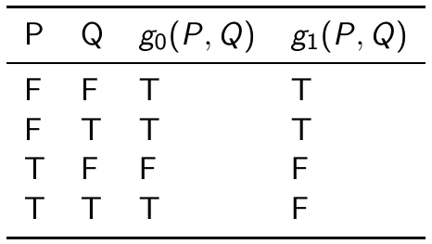
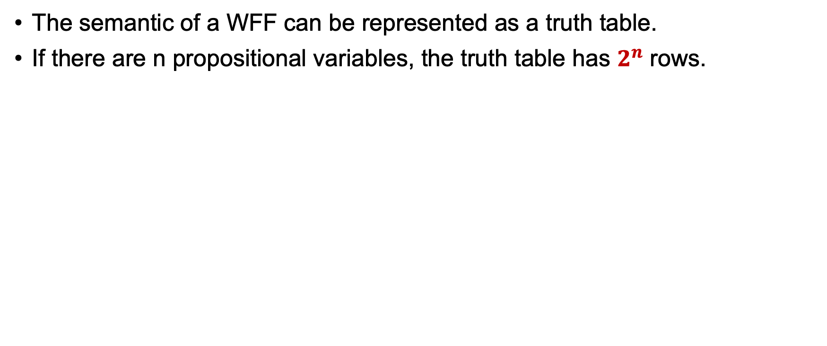
Truth Table (真值表)
The semantic of a WFF can be represented as a truth table.
If there are n propositional variables, the truth table has $2^{n}$ rows.

Slide 16
Truth Table (真值表)
How to convert truth table to a formula

Slide 17
Truth Table (真值表)
Step1: find all true rows

Slide 18



Truth Table (真值表)
Step1: find all true rows
Step2: generate a formula for every row

Slide 19
Truth Table (真值表)
Step1: find all true rows
Step2: generate a formula for every row
Step3: use “or” to connect these formulas

Slide 20
Truth Table (真值表)
Step1: find all true rows
Step2: generate a formula for every row
Step3: use “or” to connect these formulas
What about g1(P,Q)?

Slide 21
Truth Table (真值表)
Another algorithm

Slide 22
Truth Table (真值表)
Step1: find all false rows

Slide 23


Truth Table (真值表)
Step1: find all false rows
Step2: generate a formula for every row

Slide 24
Truth Table (真值表)
Step1: find all false rows
Step2: generate a formula for every row
Step3: use “and” to connect these formulas

Slide 25

Completeness Of Connectives
Step1: find all false rows
Step2: generate a formula for every row
Step3: use “and” to connect these formulas
What about g0(P,Q)?

Slide 26
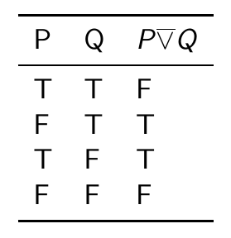
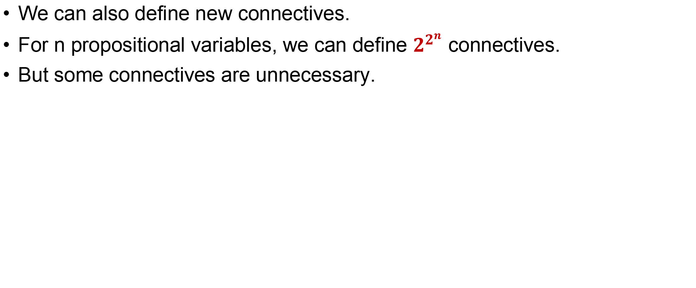
Truth Table (真值表)
We can also define new connectives.
For n propositional variables, we can define $2^{2^{n}}$ connectives.
But some connectives are unnecessary.

Slide 27
Completeness of Connectives (完备性)
DEFINITION
A group of connectives are complete if
  1). Every formula can be converted to an equivalent formula and
  2). The formula only includes connectives in the group.
{¬, ∧} and {¬, ∨} are all complete.
More examples in textbook 2.4.
We can determine equivalence via truth table or calculation via laws.

Slide 28
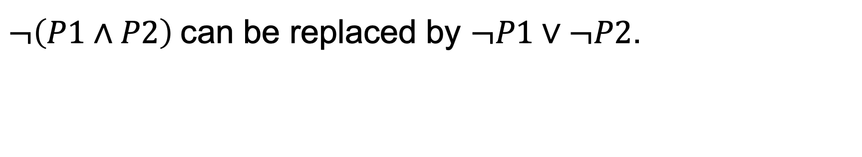

De Morgan‘s Laws（摩根律）
Theorem
De Morgan’s Laws:
$$¬\left(P∧Q\right)=¬P∨¬Q,¬\left(P∨Q\right)=¬P∧¬Q$$
$¬\left(P1∧P2\right)$can be replaced by $¬P1∨¬P2$.

Slide 29

More Laws
Theorem
Double Negation（双重否定律）:
$$¬¬P=P$$

Slide 30
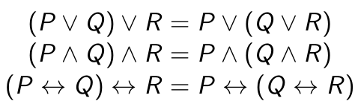
More Laws
Theorem
Associative Law（结合律）:
Warning!

Slide 31
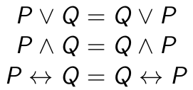



More Laws
Theorem
Commutative Law（交换律）:
It is wrong
F
T

Slide 32
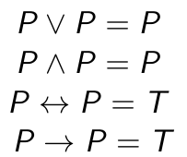
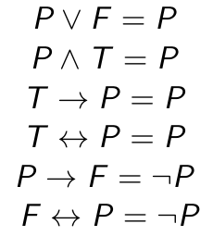
More Laws
Theorem
Idempotent Law（等幂率）：
Theorem
Identity Law（同一律）:

Slide 33
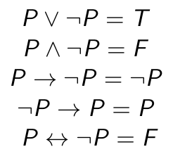
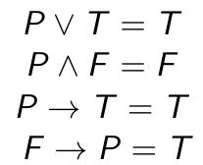
More Laws
Theorem
Complementary Law（补余律）:
Zero Law （零律）:

Slide 34



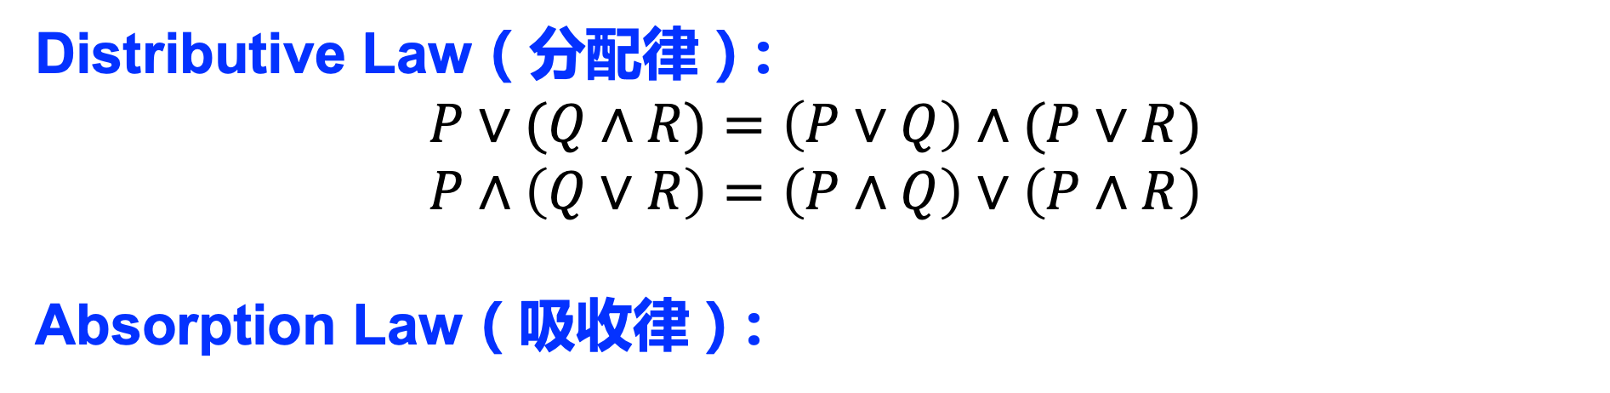
More Laws
Theorem
Theorem
Distributive Law（分配律）:
$$P∨(Q∧R)=\left(P∨Q\right)∧(P∨R)$$
$$P∧\left(Q∨R\right)=\left(P∧Q\right)∨\left(P∧R\right)$$
Absorption Law（吸收律）:
Distributive law（分配律）:
$$P∨(Q∧R)=\left(P∨Q\right)∧(P∨R)$$
$$P∧(Q∨R)=\left(P∧Q\right)∨(P∧R)$$

Slide 35


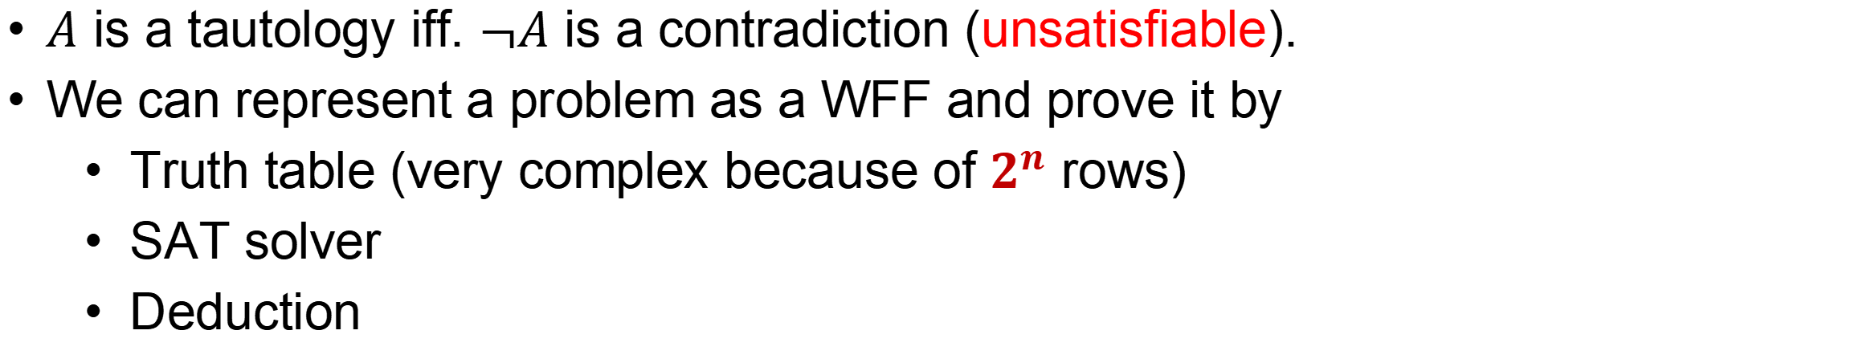
Special Formulas
DEFINITION
Tautology (重言式/永真式) is a proposition which is always true under any interpretation.
Contradiction (矛盾式) is a proposition which is always false under any interpretation.
If a proposition can be true under some interpretation, it is satisfiable (可满足).
$A$ is a tautology iff. $¬A$ is a contradiction (unsatisfiable).
We can represent a problem as a WFF and prove it by
  Truth table (very complex because of $2^{n}$ rows)
  SAT solver
  Deduction

Slide 36
SAT Solver
DEFINITION
In computer science, the satisfiability problem (abbreviated SATISFIABILITY or SAT) is the problem of determining if there exists an interpretation that satisfies a given formula.
$P3∧¬\left(P1∧P2\right)∧¬(P2∧P3)∧¬(P1∧P3)$ $∧¬(¬P1∧¬P2)$
SAT solver is used to solve SAT problem.
Given a WFF, SAT solver returns “sat” or “unsat”.
The WFF must be in a normal form (范式).

Slide 37


Normal Form
A literal（文字）is a propositional variable or its negation.
A clause（析取式/子句）is a disjunction of one or more literals.
A conjunctive clause（合取式） is a conjunction of one or more literals.
Conjunctive normal form (合取范式)
  A conjunction of one or more clauses.
Disjunctive normal form (析取范式)
  A disjunction of one or more conjunction clauses.
Every formula can be converted to CNF or DNF

Slide 38
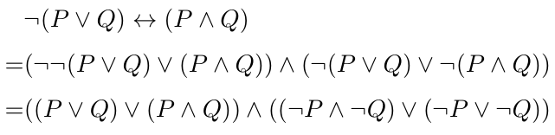
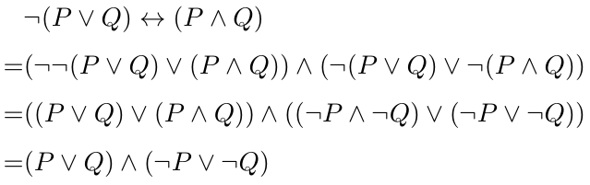
Converting to CNF
Step1: eliminate implication and biconditional connectives.
Step2: repeatedly use De Morgan's laws and double negation law to move “not” inside
Step3: repeatedly use distributive law to get CNF

Slide 39

Principle Normal Form (主范式)
Given n propositional variables, if every variable exists once in a conjunction clause, the clause is a minterm (极小项)
Principal Disjunction Normal Form (主析取范式)
  Disjunction of minterms
Given n propositional variables, if every variable exists once in a disjunction clause, the clause is a maxterm (极大项)
Principal Conjunction Normal Form (主合取范式)
  Conjunction of maxterms
SAT solver do not use PNF because CNF is enough

Slide 40
DPLL
DEFINITION
A literal is defined if its truth value has been guessed or inferred.
OVERVIEW
Iteratively process by following steps:
Guess the truth value of an undefined literal
Infer the truth value of other variables with inference rules
If a clause is false and there is a decision literal, backtrack and re-guess a variable

Slide 41
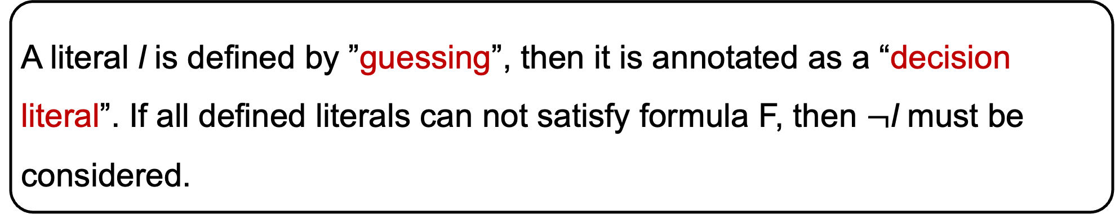
DPLL
DECIDE RULE
A literal l is defined by ”guessing”, then it is annotated as a “decision literal”. If all defined literals can not satisfy formula F, then $¬$l must be considered.
A is an undefined literal. We can guess A=F temporarily which makes A to be a decision literal.

Slide 42
DPLL
UNITPROPAGATE RULE
To satisfy a CNF formula, all its clauses have to be true. Hence, if a clause of F contains a literal l whose truth value is not defined by the current assignment while all the remaining literals of the clause are false, l must be defined to be true.
Because we guess A=F, then we can infer that B=F. Then we can infer C=F according to the second clause.

Slide 43
DPLL
BACKTRACK RULE
If a conflicting clause C is detected and there is defined decision literal l, then the rule backtracks by replacing the most recent decision literal l by ¬l and removing any subsequent literals in the current assignment. Note that ¬l is annotated as a non-decision literal, since the other possibility l has already been explored.
Because A=B=C=F, then the last clause is F. Now we can backtrack and guess A=T. Now A is not a decision literal.
A conflicting clause

Slide 44
DPLL
FAIL RULE
This rule detects a conflicting clause C and produces the FailState state whenever there is no decision literals defined.
We can backtrack because A is a decision literal. If there is no decision literal, we can conclude the formula is unsatisfiable.
A conflicting clause

Slide 45
DPLL
PURELITERAL RULE
If a literal l is pure in F, i.e., it occurs in F while its negation does not, then F is satisfiable only if it defines l to be true. Thus, we can define l to be true.
Actually, we don’t need to guess A here. Because A exists and ¬A doesn’t exist. So we can directly determine A=T.

Slide 46
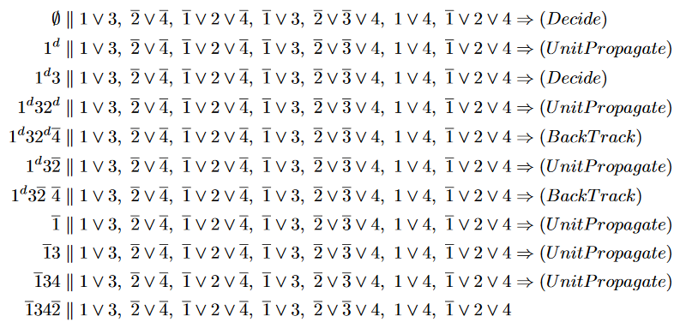
DPLL

Slide 47
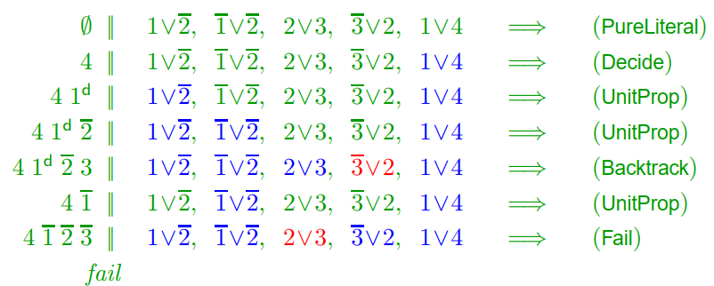
DPLL

Slide 48
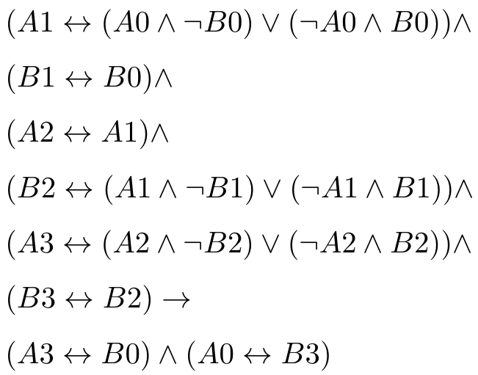
Convert Program to WFF
void swap(bool& a, bool& b)
{
a = a ^ b;
b = b ^ a;
a = a ^ b;
}
Program
a0
b0
state0
a = a ^ b;
a1
b1
state1
Assertion
b = b ^ a;
a2
b2
state2
a and b are swapped iff.
the WFF is a tautology.
a = a ^ b;
a3
b3
state3

Slide 49
Control Flow
void f(bool a, bool b)
{
bool x, y;
if (a)
x = true;
else
x = false;
if (b)
y = true;
else
y = false;
assert(x || y);
}
How to determine if the assertion will fail?

Slide 50
Program state
Control Flow
state0
Guard
a=T
a=F
void f(bool a, bool b)
{
bool x, y;
if (a)
x = true;
else
x = false;
if (b)
y = true;
else
y = false;
assert(x || y);
}
state1
x = true
state2
x = false
T
T
State transition
state3
b=T
b=F
state4
y = true
state5
y = false
T
T
state6

Slide 51

Control Flow
state0
a=T
a=F
state1
x = true
state2
x = false
T
T
state3
b=T
b=F
state4
y = true
state5
y = false
T
T
state6

Slide 52

Control Flow
state0
a=T
a=F
state1
x = true
state2
x = false
T
T
state3
b=T
b=F
state4
y = true
state5
y = false
T
T
state6

Slide 53
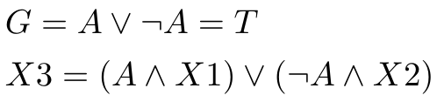
Control Flow
state0
a=T
a=F
state1
x = true
state2
x = false
T
T
state3
b=T
b=F
state4
y = true
state5
y = false
T
T
state6

Slide 54


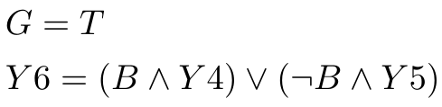
Control Flow
state0
a=T
a=F
state1
x = true
state2
x = false
T
T
state3
b=T
b=F
state4
y = true
state5
y = false
T
T
state6

Slide 55
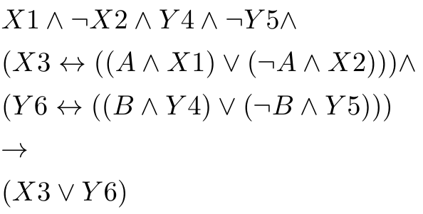
Control Flow
This can be represented in propositional logic
void f(bool a, bool b)
{
bool x, y;
if (a)
x = true;
else
x = false;
if (b)
y = true;
else
y = false;
assert(x || y);
}
Prove it is a tautology.

Slide 56
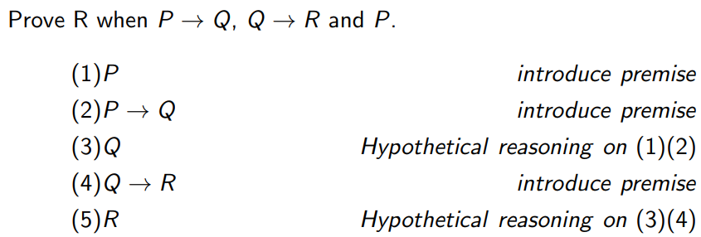
Deduction (推理演算)
前提引入
分离规则
We can also prove a formula by deduction.

Slide 57
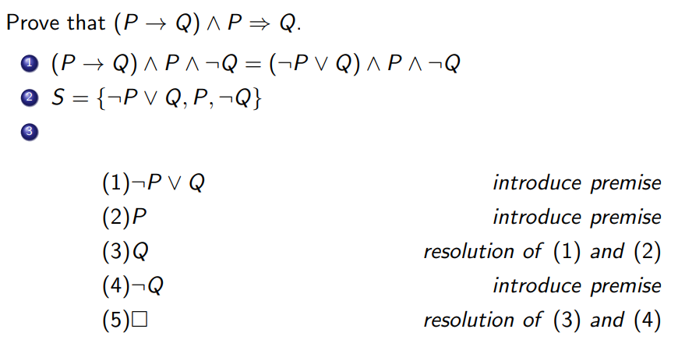
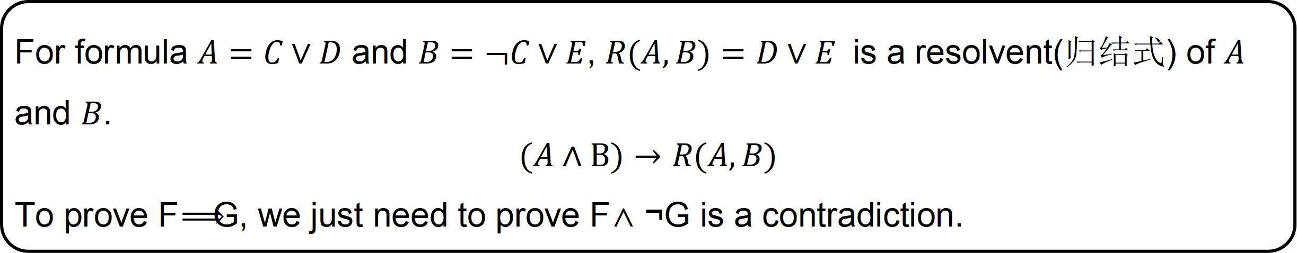
Deduction (归结推理法)
For formula $A=C∨D$ and $B=¬C∨E$, $R(A,B)=D∨E$ is a resolvent(归结式) of $A$ and $B$.
$$(A∧B)→R(A,B)$$
To prove F⟹G, we just need to prove F∧¬G is a contradiction.

Slide 58
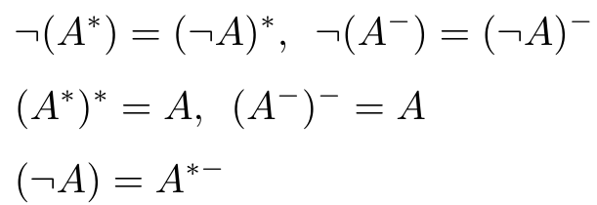
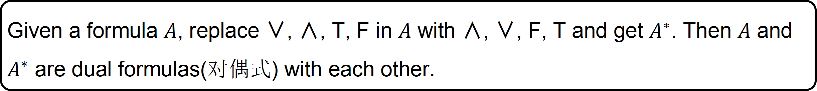
Dual Formulas (对偶式)
DEFINITION
Given a formula $A$, replace ∨, ∧, T, F in $A$ with ∧, ∨, F, T and get $A^{∗}$. Then $A$ and $A^{∗}$ are dual formulas(对偶式) with each other.
THEOREM
More theorems in 2.5.

Slide 59
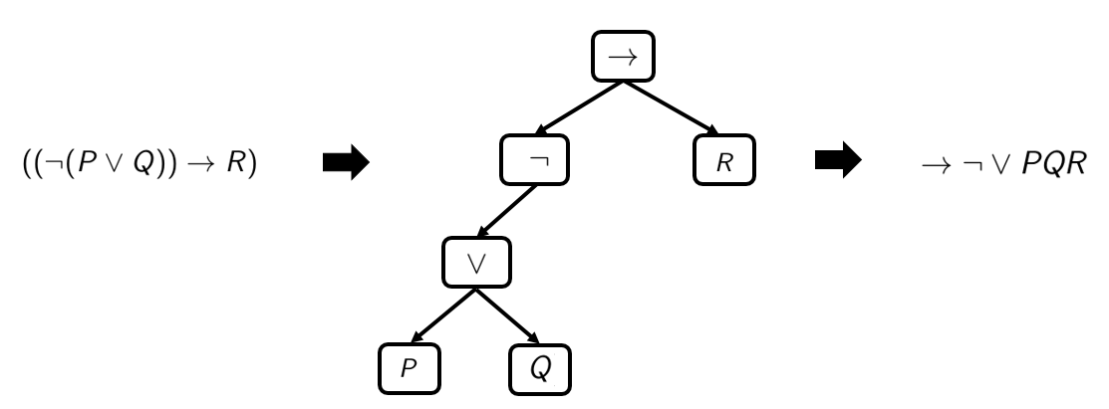
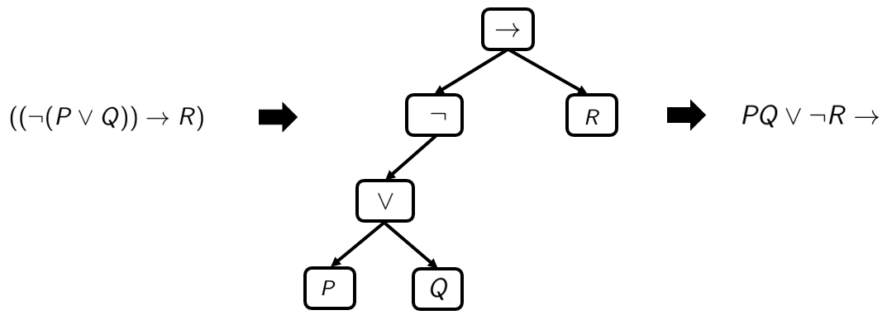
Polish Notation and Reverse Polish Notation
Polish Notation
(波兰表达式)
前序遍历
Reverse Polish Notation
(逆波兰表达式)
后序遍历

Slide 60
Part I: Computer Aided Reasoning Overview
1.1 Propositional Logic
1.2 First Order Logic
1.3 Auto-active Proof
Step 1. Convert program into propositional formula.
Step 1. Convert program into first order logic formula.
Step 1. Hoare Logic
Step 2. Ask the computer
to solve the formula.
Step 2. Ask the computer
to solve the formula.
Step 2. Ask the computer
to check the invariants
Propositional logic cannot express complex statements conveniently. Then we introduce predicate logic.

Slide 61
Predicate Logic
DEFINITION
Predicates (谓词) describe properties of individuals (个体词).
The range of individuals is domain of discourse (论域).
A function (函数) maps individuals to an individual instead of T or F.
 | arguments | results
connective | propositions | a proposition
predicate | individuals | a proposition
function | individuals | an individual

Slide 62

Quantifier (量词)
DEFINITION
A quantifier turns a formula about individuals having some property into a formula about the number (quantity) of individuals having the property.
The blue rectangle is the scope (辖域) of “exists x”.
X and y are all bound variables (约束变元).
The red rectangle is the scope of “for all y”.

Slide 63
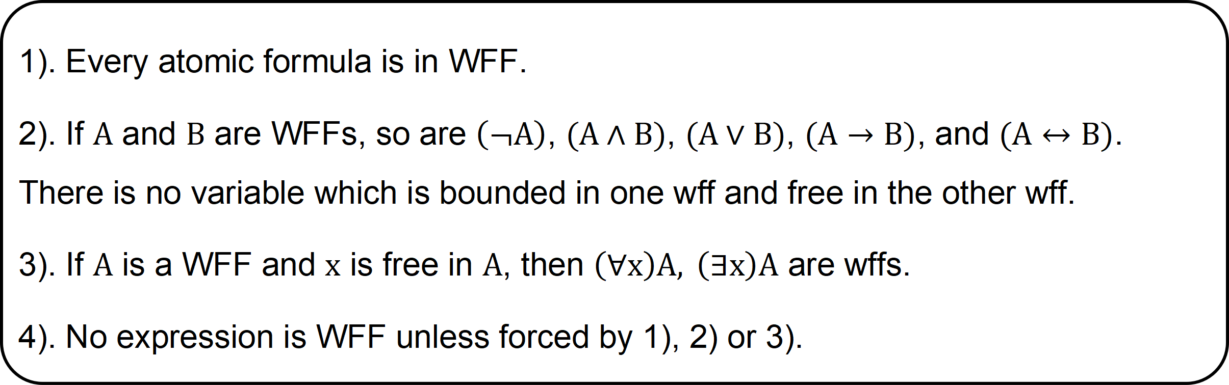
Well-formed Formula (合式公式)
INDUCTIVE DEFINITION of WFF
1). Every atomic formula is in WFF.
2). If $A$ and $B$ are WFFs, so are $\left(¬A\right)$, $(A∧B)$, $(A∨B)$, $(A→B)$, and $(A↔B)$. There is no variable which is bounded in one wff and free in the other wff.
3). If $A$ is a WFF and $x$ is free in $A$, then $\left(∀x\right)A, \left(∃x\right)A$ are wffs.
4). No expression is WFF unless forced by 1), 2) or 3).

Slide 64
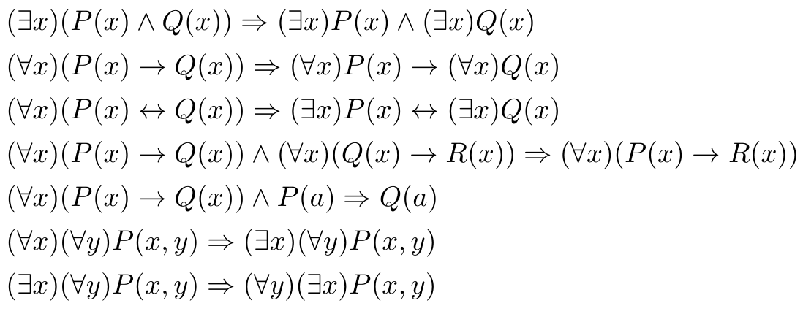
Deduction Formula（推理公式）
They can be understood through semantics.(5.4.3)

Slide 65
Decision Problem (判定问题)
DEFINITION
If a formula is true under some interpretation, it is satisfiable (可满足).
If a formula is always false under any interpretations, it is unsatisfiable (不可满足).
If a formula is always true under any interpretations, it is universally valid (普遍有效).
Decision problem in predicate logic is whether there is an effective algorithm to determine if a formula is universally valid.
Propositional logic is decidable but predicate logic is not decidable
We can represent a problem as a WFF and prove it by
  Deduction
  SMT solver
推理规则法（课本5.5）
归结推理法（课本5.6）

Slide 66
Deduction (归结推理法)
The basic idea is similar to that in propositional logic. But
we should eliminate quantifiers firstly.

Slide 67

Prenex Normal Form (前束范式)
DEFINITION
A formula of the predicate calculus is in prenex normal form(PNF) if it is written as a string of quantifiers and bound variables, followed by a quantifier-free part, called the matrix (母式/基式).
quantifiers
Every formula can be converted into equivalent PNFs. (定理5.3.1)

Slide 68
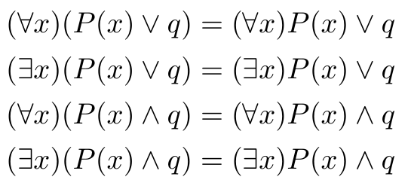
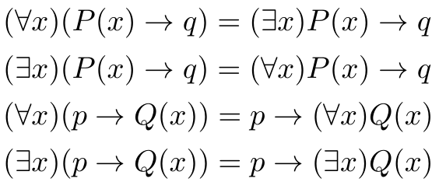
Equivalence (等值)
分配律
We use laws to convert formulas to PNF.
More laws in 5.1, 5.2.

Slide 69
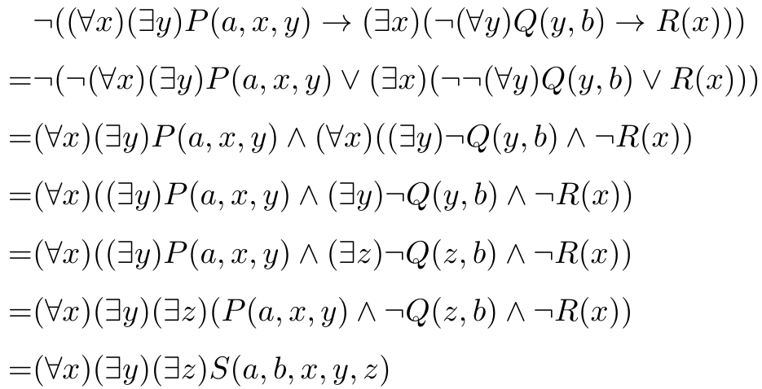
Prenex Normal Form (前束范式)

Slide 70
Skolem Normal Form (Skolem标准形)
DEFINITION
A formula is in Skolem normal form if it is in prenex normal form with only universal quantifiers.
THEOREM
Every formula A can be converted to corresponding Skolem normal form B. A is unsatisfiable iff B is unsatisfiable.
This transformation does not preserve the semantics but it preserves satisfiability.

Slide 71




Skolem Normal Form (Skolem标准形)
y depends on x
z depends on x
If x doesn’t depend on any variables, we replace x with a constant.

Slide 72
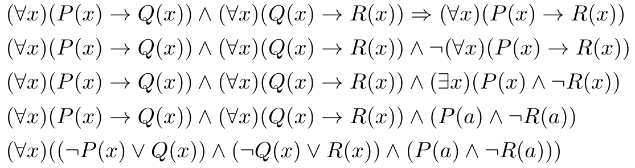



Deduction (归结推理法)
Skolem标准形
子句集

Slide 73
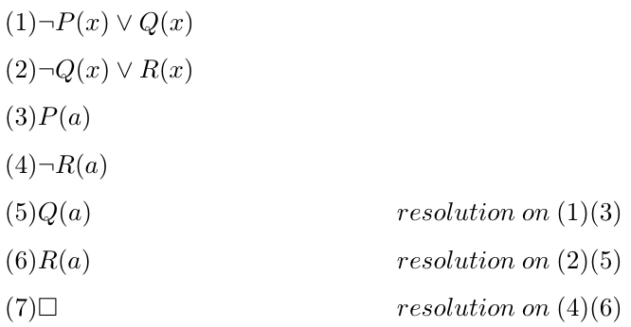
Deduction (归结推理法)

Slide 74
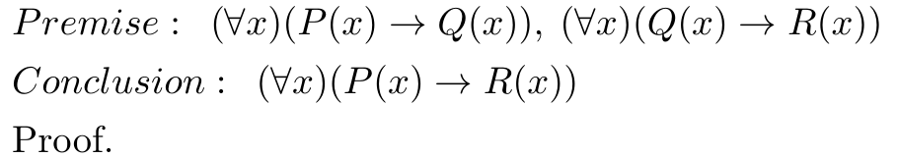
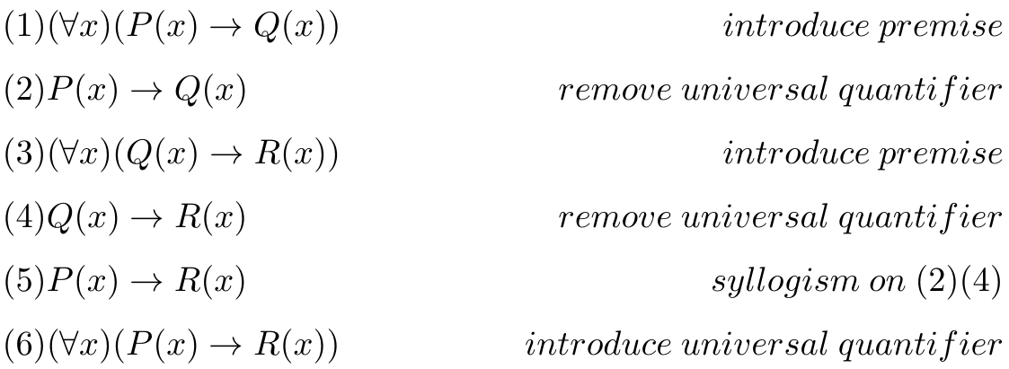
Deduction Calculus（推理演算）
We now introduce an example to explain deduction calculus.
We can still use some inference rules in propositional logic.

Slide 75
Deduction Calculus（推理演算）
We now introduce an example to explain deduction calculus.
（全称量词消去规则）X is an arbitrary individual in the domain and it is free in P and Q.

Slide 76
Deduction Calculus（推理演算）
We now introduce an example to explain deduction calculus.

Slide 77
Deduction Calculus（推理演算）
We now introduce an example to explain deduction calculus.
全称量词消去规则

Slide 78
Deduction Calculus（推理演算）
We now introduce an example to explain deduction calculus.
三段论

Slide 79
Deduction Calculus（推理演算）
We now introduce an example to explain deduction calculus.
（全称量词引入规则）If any element in the domain satisfies the property and x is free in P and R, we can use the rule.

Slide 80
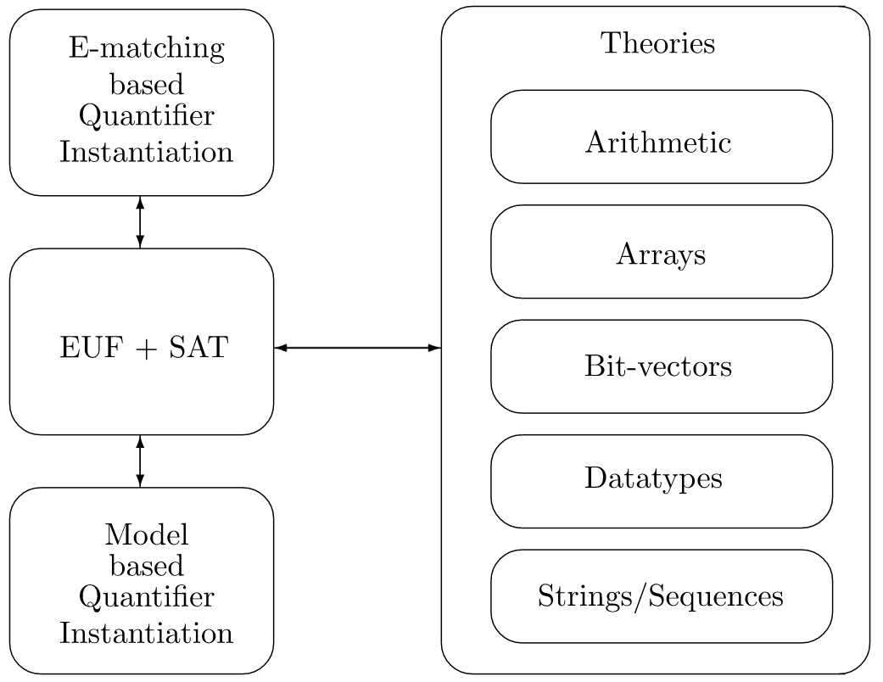
Lazy SMT Techniques
Integrate theory support with SAT solver
Architecture of Z3's SMT Core solver

Slide 81
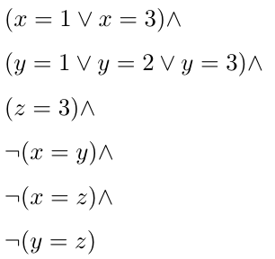
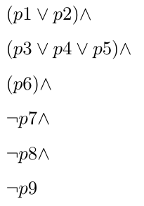
Lazy SMT Techniques
Step1: replace atomic formulas with fresh propositional variables.

Slide 82
Lazy SMT Techniques
If it is unsatisfiable, the original formula is also unsatisfiable.
DPLL
UNSAT
Step2: use SAT solvers to get assignments.

Slide 83
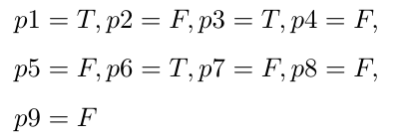
Lazy SMT Techniques
DPLL will not give this result. But to describe lazy SMT, we suppose this is the result.
DPLL
Step2: use SAT solvers to get assignments.

Slide 84
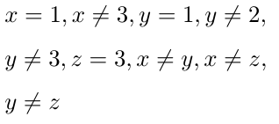

Lazy SMT Techniques
DPLL
Step3: use T-solvers to check the satisfiability.

Slide 85
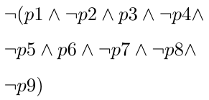
Lazy SMT Techniques
DPLL
If it is unsatisfiable, tell SAT solver to give another assignment.

Slide 86
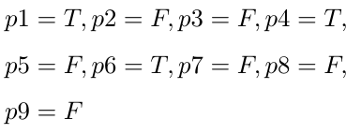
Lazy SMT Techniques
DPLL

Slide 87
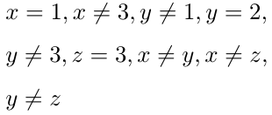

Lazy SMT Techniques
DPLL
SAT

Slide 88
Lazy SMT Techniques
In addition to EUF, there are many other theory solvers.
EUF is a theory solver.
Architecture of Z3's SMT Core solver

Slide 89
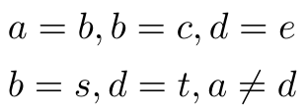
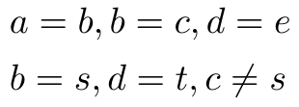


EUF
The logic of equality and uninterpreted function, EUF, is a basic ingredient for (first-order) predicate logic.
While formulas are not empty:
remove a=b;
merge(a, b);
If find(a) = find(b) for some a$≠$b
return false;
else
return true;
UNSAT

Slide 90

EUF
THEOREM
Congruence rule:
When there are functions, we can construct the graph with congruence rule.

Slide 91


EUF
introduce constants that can be used as shorthands for sub-terms.

Slide 92


EUF
2) Working bottom-up, the congruence rule dictates how to merge groups

Slide 93


EUF
2) Working bottom-up, the congruence rule dictates how to merge groups

Slide 94


EUF
2) Working bottom-up, the congruence rule dictates how to merge groups

Slide 95
EUF
3) Check satisfiability like before
UNSAT

Slide 96
Symbolic Execution
a=A_{sym}, b=B_{sym}
Symbolic store
Path constraint
True
void func(int a, int b) {
if(a > 0)
a = -b;
else
b = 2;
assert(a + b < 1);
}
if(a>0)
The next code
Symbolic execution uses the symbols to represent the value of variables.
It maintains 3 things to generate WFF.
Symbolic store: the value (symbolic expression) for each variable
Path constraints: the path condition
Next code: the next instruction to be executed

Slide 97
Symbolic Execution
a=A_{sym}, b=B_{sym}
a>0
True
void func(int a, int b) {
if(a > 0)
a = -b;
else
b = 2;
assert(a + b < 1);
}
if(a>0)
a=A_{sym}, b=B_{sym}
A_{sym}>0
a=-b

Slide 98
Symbolic Execution
a=A_{sym}, b=B_{sym}
a>0
True
void func(int a, int b) {
if(a > 0)
a = -b;
else
b = 2;
assert(a + b < 1);
}
if(a>0)
a=A_{sym}, b=B_{sym}
A_{sym}>0
a=-b
a=-B_{sym}, b=B_{sym}
A_{sym}>0
assert(a+b<1)

Slide 99

Symbolic Execution
a=A_{sym}, b=B_{sym}
a>0
True
void func(int a, int b) {
if(a > 0)
a = -b;
else
b = 2;
assert(a + b < 1);
}
if(a>0)
a=A_{sym}, b=B_{sym}
A_{sym}>0
a=-b
a=-B_{sym}, b=B_{sym}
A_{sym}>0
assert(a+b<1)
UNSAT

Slide 100
Symbolic Execution
a=A_{sym}, b=B_{sym}
a>0
a<=0
True
void func(int a, int b) {
if(a > 0)
a = -b;
else
b = 2;
assert(a + b < 1);
}
if(a>0)
a=A_{sym}, b=B_{sym}
a=A_{sym}, b=B_{sym}
A_{sym}>0
A_{sym}<=0
a=-b
b=2
a=-B_{sym}, b=B_{sym}
A_{sym}>0
assert(a+b<1)
UNSAT

Slide 101
Symbolic Execution
a=A_{sym}, b=B_{sym}
a>0
a<=0
True
void func(int a, int b) {
if(a > 0)
a = -b;
else
b = 2;
assert(a + b < 1);
}
if(a>0)
a=A_{sym}, b=B_{sym}
a=A_{sym}, b=B_{sym}
A_{sym}>0
A_{sym}<=0
a=-b
b=2
a=-B_{sym}, b=B_{sym}
a=A_{sym}, b=2
A_{sym}>0
A_{sym}<=0
assert(a+b<1)
assert(a+b<1)
UNSAT

Slide 102

Symbolic Execution
a=A_{sym}, b=B_{sym}
a>0
a<=0
True
void func(int a, int b) {
if(a > 0)
a = -b;
else
b = 2;
assert(a + b < 1);
}
if(a>0)
a=A_{sym}, b=B_{sym}
a=A_{sym}, b=B_{sym}
A_{sym}>0
A_{sym}<=0
a=-b
b=2
a=-B_{sym}, b=B_{sym}
a=A_{sym}, b=2
A_{sym}>0
A_{sym}<=0
assert(a+b<1)
assert(a+b<1)
Bug!
UNSAT
SAT

Slide 103
Symbolic Execution
a=A_{sym}, b=B_{sym}
a>0
a<=0
True
void func(int a, int b) {
if(a > 0)
a = -b;
else
b = 2;
assert(a + b < 1);
}
if(a>0)
a=A_{sym}, b=B_{sym}
a=A_{sym}, b=B_{sym}
A_{sym}>0
A_{sym}<=0
a=-b
b=2
a=-B_{sym}, b=B_{sym}
a=A_{sym}, b=2
A_{sym}>0
A_{sym}<=0
assert(a+b<1)
assert(a+b<1)
Bug!
UNSAT
Counterexample: A=-1

Slide 104
Part I: Computer Aided Reasoning Overview
1.1 Propositional Logic
1.2 First Order Logic
1.3 Auto-active Proof
Step 1. Convert program into propositional formula.
Step 1. Convert program into first order logic formula.
Step 1. Hoare Logic
Step 2. Ask the computer
to solve the formula.
Step 2. Ask the computer
to solve the formula.
Step 2. Ask the computer
to check the invariants
Previous verification method cannot address unbounded loop. We introduce Hoare logic.

Slide 105
Axiom System(公理系统)
DEFINITION
An axiom system is a logical system which possesses a group of axioms(公理) from which theorems(定理) can be derived.
We can firstly use propositional logic to explain the components of an axiom system.

Slide 106

Axiom System(公理系统)
DEFINITION
Initial symbols(初始符号) include all the symbols in the axiom system.
propositional variables
complete connectives
It is before a formula, denoting the formula is a tautology.

Slide 107
Axiom System(公理系统)
DEFINITION
Formation rules(形成规则) define the legal symbol strings in the axiom system.
INDUCTIVE DEFINITION of WFF
1). Every single proposition (symbol) is in WFF.
2). If A and B are WFF, so are ($¬$A) and (A ∨ B).
3). No expression is WFF unless forced by 1) or 2).

Slide 108

Axiom System(公理系统)
Sometimes we can define some new symbol strings for abbreviation.

Slide 109

Axiom System(公理系统)
DEFINITION
Axioms(公理) include some tautologies from which theorems can be derived. We don’t need to prove them in the axiom system.
They should be selected carefully. Otherwise, some theorems cannot be derived.

Slide 110




Axiom System(公理系统)
DEFINITION
Inference rules(变形规则/推导规则) defines how to infer new theorems from axioms and known theorems.
substitution rule(代入规则)
分离规则
If $⊢A$ , $⊢A→B$, then $⊢B$
Replace part of $A$ by equivalent(等值) expressions to get $B:$ if $⊢A$ , then $⊢B$
置换规则

Slide 111

Axiom System(公理系统)
DEFINITION
Building theorems(建立定理) includes all the tautologies and their proofs.

Slide 112
Axiom System(公理系统)
DEFINITION
Building theorems(建立定理) includes all the tautologies and their proofs.

Slide 113
Axiom System(公理系统)
DEFINITION
Building theorems(建立定理) includes all the tautologies and their proofs.

Slide 114

Axiom System(公理系统)
DEFINITION
Building theorems(建立定理) includes all the tautologies and their proofs.
Theorem 1

Slide 115

Axiom System(公理系统)
Theorem 2
$$⊢P→P$$
Proof.
$\left(1\right)⊢P→P∨Q$ Axiom 2
$\left(2\right)⊢P→P∨P$ Replace Q with P in (1)
$\left(3\right)⊢P∨P→P$ Axiom 1
$\left(4\right)⊢\left(Q→R\right)→\left(\left(P→Q\right)→\left(P→R\right)\right)$ Theorem 1
$\left(5\right)⊢((P∨P)→R)→(\left(P→(P∨P)\right)→\left(P→R\right))$ Replace Q with $P∨P$ in (4)
(6) $⊢((P∨P)→P)→(\left(P→(P∨P)\right)→\left(P→P\right))$ Replace R with P in (5)
$\left(7\right)⊢\left(P→(P∨P)\right)→\left(P→P\right)$ Hypothetical reasoning on (3) (6)
$\left(8\right)⊢P→P$ Hypothetical reasoning on (2) (7)

Slide 116

Axiom System(公理系统)
$$⊢P→P$$
Proof.
$\left(1\right)⊢P→P∨Q$ Axiom 2
$\left(2\right)⊢P→P∨P$ Replace Q with P in (1)
$\left(3\right)⊢P∨P→P$ Axiom 1
$\left(4\right)⊢\left(Q→R\right)→\left(\left(P→Q\right)→\left(P→R\right)\right)$ Theorem 1
$\left(5\right)⊢((P∨P)→R)→(\left(P→(P∨P)\right)→\left(P→R\right))$ Replace Q with $P∨P$ in (4)
(6) $⊢((P∨P)→P)→(\left(P→(P∨P)\right)→\left(P→P\right))$ Replace R with P in (5)
$\left(7\right)⊢\left(P→(P∨P)\right)→\left(P→P\right)$ Hypothetical reasoning on (3) (6)
$\left(8\right)⊢P→P$ Hypothetical reasoning on (2) (7)
Theorem 2
Theorem 3
$$⊢¬P∨P$$
Proof.
$\left(1\right)⊢P→P$ Theorem 2
$\left(2\right)⊢¬P∨P$ Definition of $→$ on (1)

Slide 117
Hoare logic is an axiom system
for program verification.
Hoare logic is designed specifically for program verification. It answers what is program correctness and how to formally prove the correctness.

Slide 118



Defining Correctness
DEFINITION
Program state includes the value of every variable used in the program.
DEFINITION
Pre-condition describes the program state before executing the program.
DEFINITION
Post-condition describes the program state after executing the program.
pre-condition
post-condition

Slide 119

Hoare Triples
DEFINITION
A program C is partially correct iff:
whenever C is executed in a state initially satisfying pre-condition and if the execution of C terminates, then the state in which C’s execution terminates satisfies post-condition.
We use Hoare triples to define program correctness.

Slide 120
Hoare Triples
DEFINITION
A program C is partially correct iff:
whenever C is executed in a state initially satisfying pre-condition and if the execution of C terminates, then the state in which C’s execution terminates satisfies post-condition.
pre-condition
post-condition
program

Slide 121
Hoare Triples
DEFINITION
A program C is partially correct iff:
whenever C is executed in a state initially satisfying pre-condition and if the execution of C terminates, then the state in which C’s execution terminates satisfies post-condition.
We don’t consider whether the given program can terminate(partially correct).

Slide 122



Hoare Logic
We need to formally prove whether a Hoare triple is right. In other words, we need to prove the program satisfies the specification.

Slide 123

Axioms
The abbreviation is AS-FW.
The abbreviation is AS.
Forward
Quantifier
Intuitive
Backward
Quantifier-free
Not intuitive
It is more widely used because it’s quantifier-free.

Slide 124

Axioms
v is a fresh variable.
simplification
This is correct and a forward assignment axiom.

Slide 125


Inference Rules
weak
strong
weakening consequent(WC)
The line means inference.

Slide 126


Inference Rules
weak
strong
We can also strengthen precedent(SP).

Slide 127
Inference Rules
Program structure
  Sequence : s1; s2
  Branch : if(b1) { s1 } then { s2 }
  Loop structure : while(b1) { s }
We will introduce inference rules for these structures.
This is what we want the most.

Slide 128



Inference Rules
The sequential composition rule(SC)

Slide 129
Inference Rules
The sequential composition rule(SC)

Slide 130
Inference Rules
The sequential composition rule(SC)

Slide 131
Inference Rules
The sequential composition rule(SC)

Slide 132
Inference Rules
The sequential composition rule(SC)

Slide 133
Inference Rules
the sequential composition rule(SC)
It’s clearly proved backwards.

Slide 134

Inference Rules
Convert b to a proposition.
Convert b to a proposition.
The conditional rule(CD)

Slide 135

Inference Rules

Slide 136
Inference Rules

Slide 137
Inference Rules

Slide 138
Inference Rules

Slide 139
Inference Rules

Slide 140
Inference Rules

Slide 141
Inference Rules

Slide 142
Inference Rules

Slide 143

Inference Rules
The while rule(WHP)
loop invariant
It says that
if executing C once preserves the truth of I, then executing C
any number of times also preserves the truth of I
after a while loop has terminated, the test must be false

Slide 144
Inference Rules
The while rule(WHP)
loop invariant
It can be proved by induction on number of loop times
If the loop execute for 0 time, I of course holds.
If I holds for n times loops, it holds for n+1 times because of
the condition above the line.

Slide 145
Loop Invariant
pre-condition
{a <= 10}
void f(unsigned &a)
{
while(a != 10)
{
a = a + 1;
}
}
{a = 10}
I: a <= 10
loop invariant
post-condition

Slide 146

Inference Rules

Slide 147
Inference Rules
loop invariant

Slide 148
Inference Rules

Slide 149
Inference Rules
loop invariant always holds.

Slide 150
Inference Rules

Slide 151
Inference Rules

Slide 152
Proving Correctness
Replace a in P with v
A Hoare triple can be proved by these axioms and inference rules.
Notes:
用v替代a；用e替代a

Slide 153



Weakest Precondition
weaker
stronger
DEFINITION
Given a program C and postcondition Q, P is the weakest precondition means for all P’, {P’} C {Q} iff P’ $→$ P. We use wp(C, Q) to denote P.
weakest precondition

Slide 154



Basic Idea of Automated Verification
To prove {P}C{Q}
Find the wp(C, Q), then prove P implies wp(C, Q).
If we can find wp, we can convert hoare triples to predicate logic formula.
We just need to prove it is unsatisfiable.

Slide 155

Weakest Precondition
We use wlp(C, Q) instead of wp(C, Q) in following slides:
C is the program, Q is the intended postcondition
Name stands for weakest “liberal” precondition: it ignores termination
For all C and Q, it is guaranteed that { wlp(C, Q) } C {Q} is true
For all P, C and Q, {P} C {Q} iff P$→$ wlp(C, Q)
Wlp must be computable. We will introduce the details.

Slide 156

Weakest Precondition
This is clear because skip does nothing.

Slide 157



Weakest Precondition
This is similar to AS in Hoare logic.

Slide 158


Weakest Precondition

Slide 159


Weakest Precondition

Slide 160
Weakest Precondition

Slide 161
Thanks & Questions

