Slide 1

Introduction to CSE
Computer System Engineering, Fall 2018 (IPADS, SJTU)
Coping with the complexity of computer system
Yubin Xia

Slide 2
What is a System?
System =
  Interacting set of components with a specified behavior at the interface with its environment
Examples
  Web, Apache web server, Android, Ext-4 file system, Linux, …

Slide 3
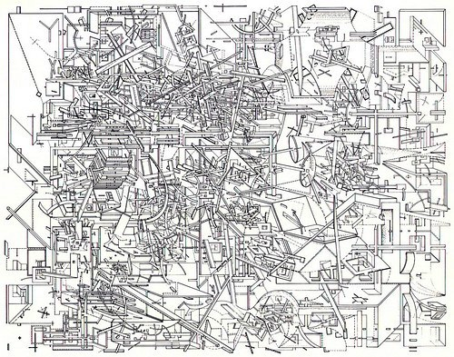
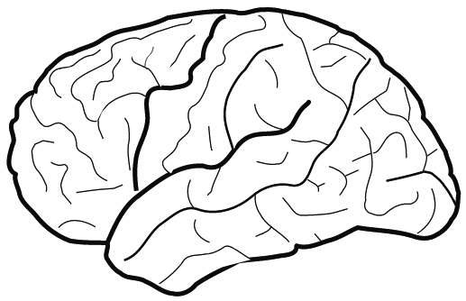
The Problem: Complexity of the Systems
Hard for human to fully understand
But, we can view from a system’s perspective

Slide 4
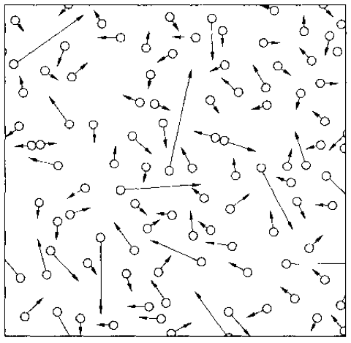
An Example: The Gas System
A systematical way to understand a complex system is needed
Notes:
system has properties that a node has not.
gas molecule properties: speed, a, m, size
gas system properties: pressure, temperature
Computer system properties: consistency, fault tolerance, performance,…

Slide 5
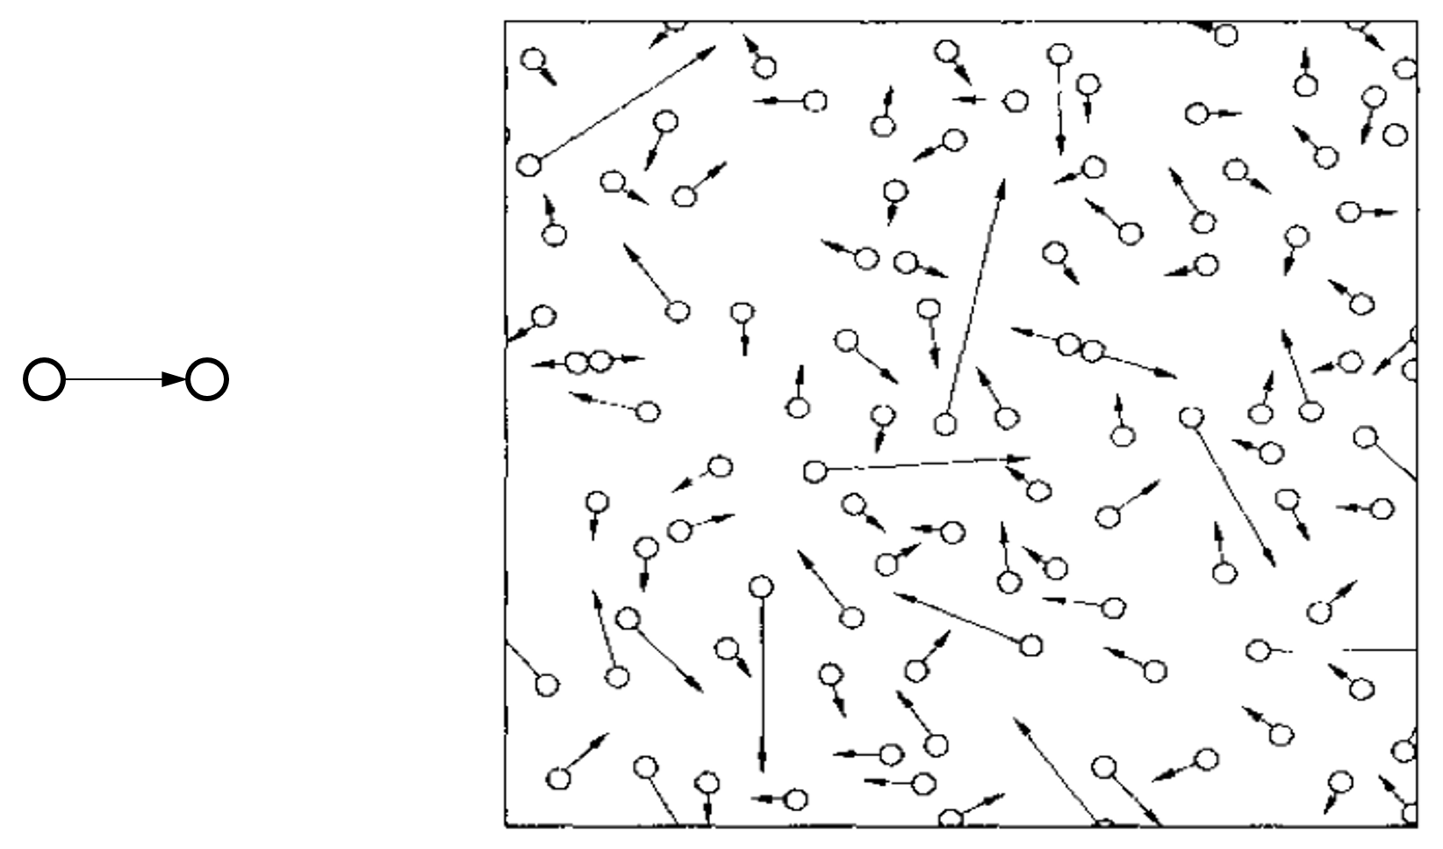
Compare with the Computer Systems
Programming / Data Structure
  LoC (Lines of Code): From hundreds to millions
Operating System / Architecture
  CPU cores: from one to hundreds
Network
  Nodes: from two to millions
Web Service
  Clients: from tens to millions
Notes:
Software Engineering:
Programmers: from one to thousands
More on people, not system

Slide 6
Example of Complex Systems: Linux Kernel
1975 Unix kernel: 10,500 LOC (Lines of Code)
2008 Linux 2.6.24 line counts:
  85,000 processes
  430,000 sound drivers
  490,000 network protocols
  710,000 file systems
  1,000,000 different CPU architectures
  4,000,000 drivers
  7,800,000 Total
Notes:
More: http://www.informationisbeautiful.net/visualizations/million-lines-of-code/

Slide 7
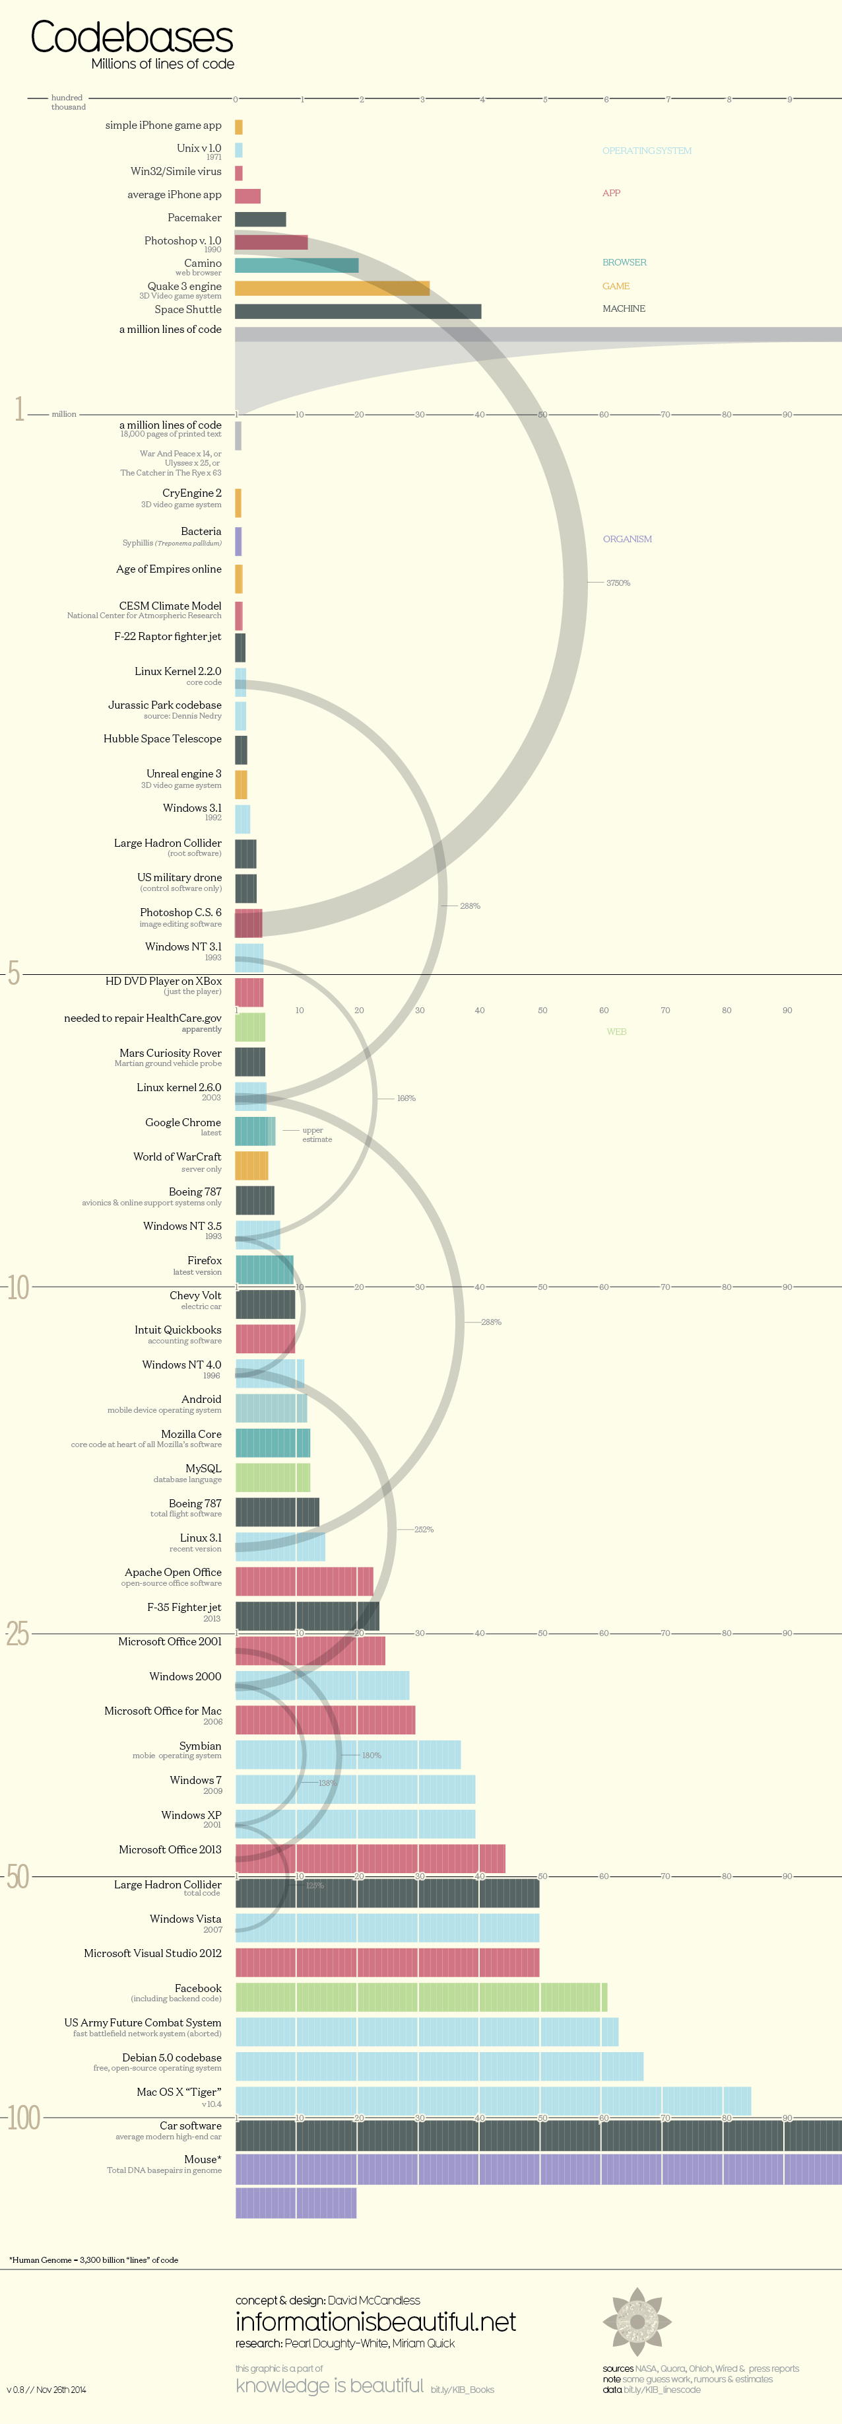
LOC (Lines Of Code)

Slide 8
Complexity of Computer Systems
Hard to define; but has some symptoms:
  Large number of components
  Large number of connections
  Irregular
  No short description
  Many people required to design/maintain
Technology rarely the limit
  Indeed tech opportunity is the problem
  Limit is usually designers’ understanding

Slide 9
System Complexity

Slide 10
Problem Types
Emergent properties (surprise!)
  The properties that are not considered at design time
Propagation of effects (butterfly effort)
  Small change -> big effect
Incommensurate scaling
  Design for small model may not scale
Trade-offs
  Waterbed effect

Slide 11
1. Emergent Properties
Features
  No evident in the individual components of a system
  But show up when combining those components
  Might also be called surprises
  An unalterable fact of life: some things turn up only when a system is built

Slide 12
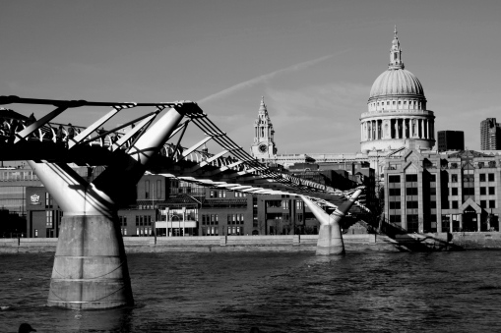
1. Emergent Properties
The Millennium Bridge
  For pedestrians over the River Thames in London
  Pedestrians synchronize their footsteps when the bridge sways, causing it to sway even more
  It had to be closed after only a few days

Slide 13
Emergent Property Example: Ethernet
All computers share single cable
Goal is reliable delivery
Listen while sending to detect collisions
  If two nodes sends data at the same time, then both cancel and wait for a random time
00011011
1101100
A
Max length: 1km
B

Slide 14
Does Collision Detection Work?
00011011
1101100
A
Max length: 1km
B
What if A finishes sending before data from B arrives?
  1km at 60% speed of light = 5 ms (microseconds)
  Original Ethernet Spec: 3 Mbit/sec
    A can send 15 bits before bit 1 arrives at B
    A must keep sending for 2*5 ms (to detect collision when first bit from B arrives)
  Minimum packet size is 5*2*3 = 30 bits
  The default header is 5 bytes (40 bits), so no problem for now

Slide 15
3 Mbit/s -> 10 Mbit/s, What will Happen?
First Ethernet standard: 10 Mbit/s, 2.5 km wire
  Must send for 2*12.5 µseconds = 250 bits @ 10 Mb/s
  Header was 14 bytes
  Needed to pad packets to at least 250 bits (~32 bytes)
Emergent property: Minimum packet size!
  The 250-bit minimum packet size is a surprise

Slide 16
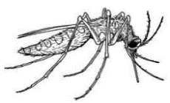
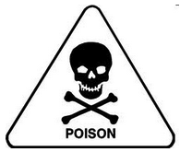
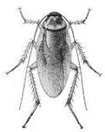
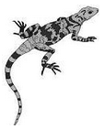


2. Propagation of Effects ^{[Cole’69]}
WHO: tried control malaria in North Borneo
  Sprayed villages with DDT
  Wiped out mosquitoes, but ….
  Roaches collected DDT in tissue
  Lizards ate roaches and became slower
  Easy target for cats
  Cats didn’t deal with DDT well and died
  Forest rats moved into villages
  Rats carried the bacillus for the plague
WHO just replaced malaria with the plague

Slide 17
Example: No Small Changes
Phone network features
  CF: Call Forwarding
  CNDB: Call Number Delivery Blocking
    The caller’s number should be hidden
  ACB: Automatic Call Back
  IB: Itemized Billing
CF
CF
A
C
??
CNDB
ACB + IB
  A calls B, B is busy
  Once B is done, B automatically calls A
  A’s (caller) number appears on B’s bill
A
B

Slide 18
3. Incommensurate Scaling
As a system increases in size or speed, not all parts of it follow the same scaling rules
  So things stop working
The mathematical description
  Different parts of the system exhibit different orders of growth

Slide 19
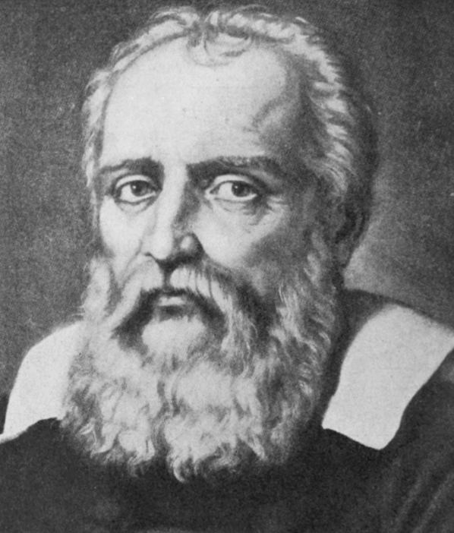
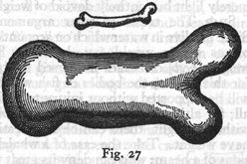
3. Incommensurate Scaling
Galileo in 1638
  To illustrate briefly, I have sketched a bone whose natural length has been increased three times and whose thickness has been multiplied until, for a correspondingly large animal, it would perform the same function which the small bone performs for its small animal.
  From the figures here shown
  you can see how out of pro-
  portion the enlarged bone
  appears.
Galileo

Slide 20
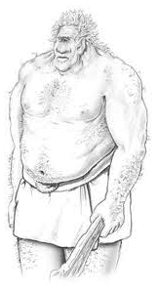
3. Incommensurate Scaling
Galileo in 1638
  Clearly then if one wishes to maintain in a great giant the same proportion of limb as that found in an ordinary man he must either find a harder and stronger material for making the bones, or he must admit a diminution of strength in comparison with men of
  medium stature; for if his height be increased
  inordinately he will fall and be crushed under
  his own weight.

Slide 21
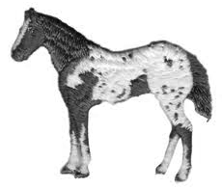

3. Incommensurate Scaling
Galileo in 1638
  Whereas, if the size of a body be diminished, the strength of that body is not diminished in the same proportion; indeed the smaller the body the greater its relative strength. Thus a small dog could probably carry on his back two or three dogs of his own size; but I believe that a horse could not carry even one of his own size.

Slide 22
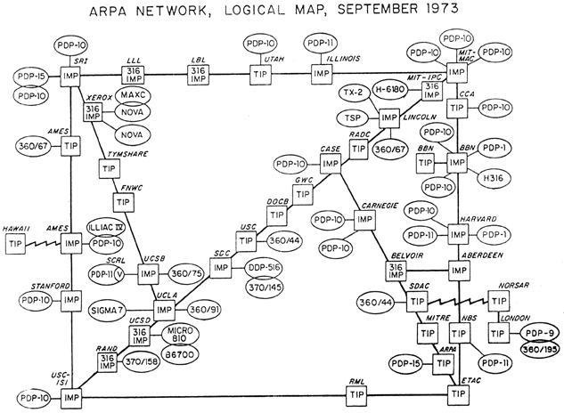
3. Incommensurate Scaling

Slide 23
Example: Scaling the Internet
Size routing tables (for shortest paths): O(n²)
  Hierarchical routing on network numbers
  Address: 16-bit network number and 16-bit host number
Limited networks (2¹⁶)
Solutions:
  NAT (Network Address Translators) and IPv6

Slide 24
4. Trade-offs
General models
  Limited amount of goodness
  Maximize the goodness
  Avoid wasting
  Allocate where helps most
Waterbed effect
  Pushing down on a problem at one point
  Causes another problem to pop up somewhere else

Slide 25
4. Trade-offs
Binary classification
  We wish to classify a set of things into two categories
    Based on presence or absence of some property
  But we lack a direct measure of that property
  So we identify some indirect measure instead
    Known as a proxy

Slide 26
4. Trade-offs
Binary classification (Cont.)
  Occasionally this scheme misclassifies something
  By adjusting parameters of the proxy
  The designer may be able to:
    reduce one class of mistakes
    but only at the cost of increasing some other class of mistakes

Slide 27

How to Handle?
Ideally, the “Constructive Theory”
  Allows the designer systematically to
    Synthesize a system from its specifications
    Make necessary trade-offs with precision
  Works in some fields
    Communication systems
    Linear control systems
    Design of bridge and skyscrapers (to a certain extent)

Slide 28
How to Handle?
In Computer Systems
  “We find that we were born too soon” -- Our textbook
  The problems
    We work almost entirely by analyzing ad hoc examples rather than by synthesizing
    So, in place of a well-organized theory, we use case studies

Slide 29
Limit the Levels of Complexity
All systems are indefinitely
  The deeper one digs, the more signs of complexity turn up
  A computer -> gates -> electrons -> quarks -> …
Abstraction: limits the depth of digging

Slide 30
Coping with complexity
M.A.L.H

Slide 31
M.A.L.H
Modularity
  Split up system
  Consider separately
Abstraction
  Interface/Hiding
  Avoid propagation of effects
Layering
  Gradually build up capabilities
Hierarchy
  Reduce connections
  Divide-and-conquer

Slide 32
Modularity
Analyze or design the system as a collection of interacting subsystems
  Subsystems called modules
  “Divide-and-conquer” technique
Modularity is the simplest, most important tool for reducing complexity
  Consider interactions among the components within a module without simultaneously thinking about the components that are inside other modules
Notes:
Brain has limitation.

Slide 33
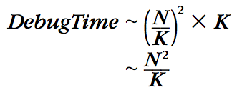
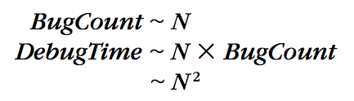
Modularity
Bug
Bug
Bug
Bug
Original System
System with Modularity
  Assumptions: consider the number of bugs is proportional to its size, and bugs are randomly distributed

Slide 34
Abstraction
Abstraction
  Treat a module based on external specifications, no need for details inside
Principles to divide a module
  Follow natural or effective boundaries
  Fewer interactions among modules (Chap.4 & 5)
  Less propagation of effects

Slide 35
Abstraction
Problem: minimizing interconnections among modules may be defeated
  Unintentional or accidental interconnections, arising from implementation errors
  Well-meaning design attempts to sneak past modular boundaries
    Improve performance
    Meet some other requirement
Notes:
E.g., OSDI’12 socket optimization~

Slide 36
Abstraction
Software is particularly subject to this problem
  The modular boundaries provided by the separately compiled subprograms are actually somewhat soft
  Is easily penetrated by errors in:
    using pointer;
    filling buffer;
    calculating array index;
    etc.
Notes:
Java: using get() instead of read field directly.
Buffer overflow attack.

Slide 37
Abstraction
Failure containment
  When a module does not meet its abstract interface specifications
  Limiting the impact of faults
    Well-designed and properly enforced modular abstractions
    Control propagation of effects
  Modules are the units of fault containment
Notes:
What about data flow?

Slide 38
Layering
Goal: Reduce module interconnections even more
How to do it?
  Build a set of mechanisms first (a lower layer)
  Use them to create a different complete set of mechanisms (an upper layer)
General rule: A module in one layer only interacts with:
  its peers in the same layer, and
  modules in the next lower layer / next higher layer

Slide 39
Layering
Application layer
OS layer
Processor & memory layer
Memory cells & gates layer
House:
  Inner layer of studs, joist, rafter (shape & strength )
  Layer of sheathing and drywall (wind out)
  Layer of siding, flooring and roof tiles (watertight)
  Cosmetic layer of paint (looks good)
Algebra:
  integer, complex number, polynomials, polynomials with polynomial coefficients

Slide 40
Hierarchy
Hierarchy: another module organization
  Start with a small group of modules
  Assemble them into a stable, self-contained subsystem with well defined interface
  Assemble a group of subsystems to a larger subsystem
Example
  1 manager leads N employees
  1 higher manager leads N
  lower managers

Slide 41
Hierarchy
There are many striking examples of hierarchy
  E.g., microscopic biological systems, assembly of Alexander’s empire
  Under evolution, such designs have a better chance of survival
Constrains interactions
  Permit interaction only among the components of a subsystem
  Reduces the number of potential interactions among modules from square-law to linear

Slide 42
Computer systems are different

Slide 43
Computer Systems are Different
Computer systems are the same as all other systems
  Certain common problems show up in all complex systems
  The techniques that have been devised for coping with complexity are universal
Yet, computer systems are different (sadly)
  The complexity is not limited by physical laws
  The rate of change of technology is unprecedented

Slide 44
Unbounded Composition
Two properties of computer systems
  1. Mostly digital
  2. Controlled by software
  Both relax the limits on complexity arising from physical laws in other systems

Slide 45
Computer System: Coping with Complexity
M.A.L.H are NOT enough
  Hard to choose the right modularity
  Hard to choose the right abstraction
  Hard to choose the right layer
  Hard to choose the right hierarchy

Slide 46
Class Plan
File System: Abstraction and layering
Enforced Modularity: Client & Server, virtualization
Performance: Systematic way for optimization
Network: Different layers, resource management
Fault Tolerance: Replication, logging
Transaction: Atomicity, isolation, consistency, availability
Security: threat model, authentication, attacking

Slide 47
Scores
Mid-Exam: 25%
Final-Exam: 35%
Lab: 30%
Homework: 10%

Slide 48


Textbook
Principles of Computer System Design: An Introduction
  Jerome H. Saltzer & M. Frans Kaashoek, June 2009.
Others
  Computer Systems: An Integrated Approach to Architecture and Operating Systems
  Distributed Systems: Principles and Paradigms, 2nd Edition

Slide 49
Where is CSE in Courses
Operating Systems
Architecture
Compilers
Networking
Computer Systems Engineering
Introduction to Computer Systems

Slide 50
Course Info
Website
  https://ipads.se.sjtu.edu.cn/courses/cse/
  https://ipads.se.sjtu.edu.cn/courses/qa
TAs
  Mo Zou
  Zinan Li
  Wentai Li
  Fuqian Huang

