Slide 1

Disk I/O
Computer System Engineering, Fall 2018. (IPADS, SJTU)
Interrupt, PIO, MMIO, DMA
Yubin Xia

Slide 2
Review: File Cursor Sharing
fd_table
file_table
fd
index
index
inode num
file cursor
refcnt
Process A
3
115
115
23
128
1
116
23
240
2
fd
index
Process B
3
116
...
fd
index
C is B’s child
3
116
Process A, B and C all open just one file with inode number 23
Process A and B open the same file, not share file cursor
Process B and C share the file cursor
Notes:
Note: the refcnt is not the refcnt of inode!

Slide 3
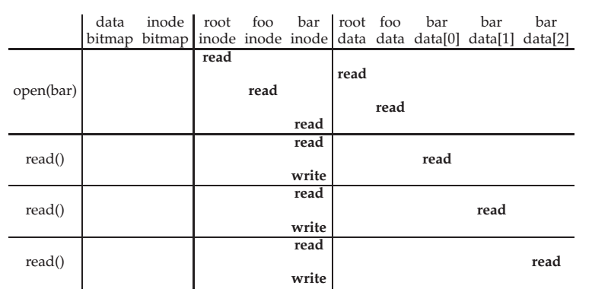
Review: File Open & Read Timeline
open("/foo/bar", O_RDONLY)

Slide 4
File Open & Read Timeline
open("/foo/bar", O_RDONLY)

Slide 5
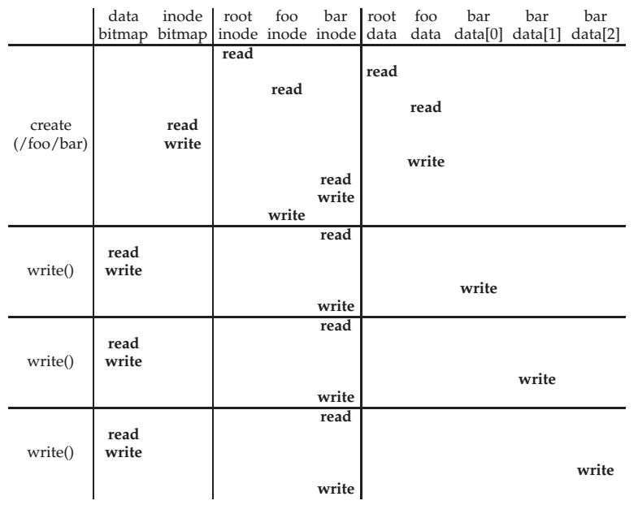
File Creation Timeline

Slide 6
WRITE & CLOSE
WRITE is similar to READ
  Allocate new block if necessary
  Update inode’s size and mtime
CLOSE
  Free the entry in the fd_table
  Decrease the reference counter in file table
  Free the entry in file table if counter is 0
Failures in the middle may cause inconsistency!

Slide 7
Questions
When writing, which order is preferred?
  Allocate new blocks, write new data, update size
  Allocate new blocks, update size, write new data
  Update size, allocate new blocks, write new data

Slide 8
Delete after OPEN but before CLOSE
One process has OPEN a file
Another process removes the last name pointing to the file
  Reference counter is now 0
The inode is not freed until the first process calls CLOSE

Slide 9
SYNC
Block cache
  Cache of recently used disk blocks
  Read from disk if cache miss
  Delay the writes for batching
  Improve performance
  Problem: may cause inconsistency if fail before write
SYNC
  Ensure all changes to the file have been written to the storage device

Slide 10
Canonical I/O Protocol

Slide 11
A Canonical Device
Registers
Status
Address
Data
Command
Interface
Micro-controller (CPU)
Memory (DRAM or SRAM or both)
Other Hardware-specific Chips
Internals

Slide 12
A Canonical Protocol
While(STATUS == BUSY)
; //wait until device is not busy
Write data to DATA register and address to ADDRESS register
Write command to COMMAND register
(Doing so starts the device and executes the command )
While(STATUS == BUSY)
; //wait until device is done with your request

Slide 13
A Canonical Protocol
While(STATUS == BUSY)
; //wait until device is not busy
Write data to DATA register and address to ADDRESS register
Write command to COMMAND register
(Doing so starts the device and executes the command )
While(STATUS == BUSY)
; //wait until device is done with your request
Polling: CPU waits until the device is ready to receive a command by repeatedly reading the status register

Slide 14
A Canonical Protocol
While(STATUS == BUSY)
; //wait until device is not busy
Write data to DATA register and address to ADDRESS register
Write command to COMMAND register
(Doing so starts the device and executes the command )
While(STATUS == BUSY)
; //wait until device is done with your request
If this were a disk, then multiple writes would need to take place to transfer a disk block (say 512 Bytes) to the device
When the main CPU is involved with the data movement (as in this example protocol), we refer to it as programmed I/O (PIO)

Slide 15
A Canonical Protocol
While(STATUS == BUSY)
; //wait until device is not busy
Write data to DATA register and address to ADDRESS register
Write command to COMMAND register
(Doing so starts the device and executes the command )
While(STATUS == BUSY)
; //wait until device is done with your request
OS writes a command to the command register; doing so implicitly lets the device know that both the data is present and that it should begin working on the command

Slide 16
A Canonical Protocol
While(STATUS == BUSY)
; //wait until device is not busy
Write data to DATA register and address to ADDRESS register
Write command to COMMAND register
(Doing so starts the device and executes the command )
While(STATUS == BUSY)
; //wait until device is done with your request
OS waits for the device to finish by again polling it
in a loop, waiting to see if it is finished
It may then get an error code to indicate success or failure

Slide 17
A Canonical Protocol
While(STATUS == BUSY)
; //wait until device is not busy
Write data to DATA register and address to ADDRESS register
Write command to COMMAND register
(Doing so starts the device and executes the command )
While(STATUS == BUSY)
; //wait until device is done with your request
Problem: polling wastes too much CPU
Solution: using interrupt

Slide 18
Interrupts
Lowering CPU Overhead

Slide 19
Lowering CPU Overhead With Interrupts
Instead of polling, the OS can issue a request, put the calling process to sleep, and context switch to another task
When the device finishes, it will raise a hardware interrupt
The CPU jumps into the OS at a pre-determined interrupt service routine (ISR) or more simply an interrupt handler
The handler is just a piece of OS code that will finish the request
  For example, by reading data and perhaps an error code from the device, and wake the process waiting for the I/O, which can then proceed as desired

Slide 20
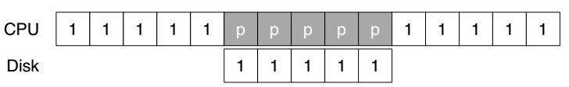
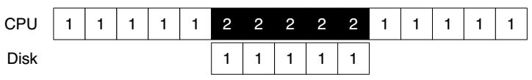
Lowering CPU Overhead With Interrupts
CPU runs thread 1
CPU is polling without doing anything
Using Polling
CPU can run thread 2
Using Interrupt

Slide 21
Example of Interrupt: Keyboard
When user depresses a key, keyboard SENDs a message to the processor containing the key value
As the processor is not ready, its bus interface:
  copies the data into a temporary register,
  acknowledges the keyboard,
  SENDs an interrupt signal to the processor
The processor handles the interrupt in the next cycle
  SENDs the value over the bus to memory module
Only suitable for slow device

Slide 22
Problem of Interrupt: Livelock
Using interrupts arises in networks
  When a huge stream of incoming packets each generate an interrupt it is possible for the OS to livelock
  Livelock: the CPU only processes interrupts and never allows a user-level process to run and actually service the requests
Solution: hybrid
  Default using interrupts
  When an interrupt happens, handle it and polling for a while to solve subsequence requests
  If no further request or time-out, fall back to interrupt again
  Used in Linux network driver with the name NAPI (New API)

Slide 23
Interrupt Coalescing for Optimization
A device which needs to raise an interrupt first waits for a bit before delivering the interrupt to the CPU
While waiting, other requests may soon complete, and thus multiple interrupts can be merged into a single interrupt delivery, thus lowering the overhead of interrupt processing
Note: waiting too long will increase the latency of a request, this is a common trade-off in systems

Slide 24
DMA
More Efficient Data Movement

Slide 25
DMA for Disk Device
DMA (Direct Memory Access)
  A processor SENDs a request to a disk controller to READ a block of data
  Including the address of a buffer in memory
The disk SENDs the data directly to memory
  Incrementing the memory address appropriately

Slide 26
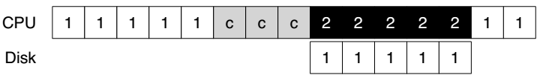
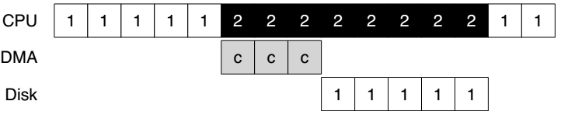
DMA for Disk Device
‘c’ is for copy
Without DMA
With DMA

Slide 27
DMA for Disk Device
Benefits of DMA
  Relieve the CPU’s load to execute other program
  Reduce one transfer (original two)
  Take better advantage of long message if the bus supports
  Amortize the overhead of the bus protocol

Slide 28
Methods of Device Interaction
Method-1: PIO through I/O instructions
  On x86, in and out instructions
  Must be executed in privileged mode (kernel mode)
Method-2: Memory-mapped I/O
  Using LOAD and STORE
  Can also be executed in unprivileged mode (user mode)

Slide 29
I/O Instructions
Example: send data to a device by out instruction
  out %eax, 0x120
  Specify a register with data (%eax)
  Specific an I/O Port which names the device (0x120)
    I/O port: another name space, not physical memory space
Privileged instructions
  Only the OS can directly communicate with devices

Slide 30
Memory Mapped I/O
Use LOAD and STORE instructions to address the register and buffer of the I/O modules
  Just like access memory
  Address is overloaded name with location info
Provide a uniform interface to bus modules
  MMU translates virtual address to physical address
    Physical address is system bus address
  I/O modules translate bus address to register address internally

Slide 31
Memory Mapped I/O
Processor
Virtual address
MMU
Physical address (System bus address)
Internally translate
to register address
Memory
Disk
Keyboard

Slide 32
NOTE: Volatile Address if using MMIO
void main(void)
{
void *pdev = (void *) 0x40400000;
size_t size = (1024*1024);
int *base;
volatile int *pcid, cid;
base = mmap(pdev, size, PROT_READ|PROT_WRITE,
MAP_ANONYMOUS|MAP_PRIVATE, -1, 0);
if (base == MAP_FAILED) errx(1, "mmap failure");
pcid = (int *) (((void *) base) + 0xf0704);
cid = *pcid;
printf(“cid = %d\n", cid);
cid = *pcid;
printf(“cid = %d\n", cid);
munmap(base, size);
}
If no volatile is used, the compiler will think
the two printf() are redundant and will
eliminate the second memory load operation

Slide 33
Sidebar: Another Volatile Example
#include <stdio.h>
void main()
{
int i = 10;
int a = i;
printf("i= %d\n",a);
// Change value of i
__asm {
mov dword ptr [ebp-4], 20h
}
int b = i;
printf("i= %d\n",b);
}
Is volatile needed here?
Notes:
Yes. The compiler does not know [ebp-4] is the address of i.

Slide 34
Case Study: IDE Disk Driver

Slide 35
IDE Protocol
Address 0x1F0 = Data Port
Address 0x1F1 = Error
Address 0x1F2 = Sector Count
Address 0x1F3 = LBA low byte
Address 0x1F4 = LBA mid byte
Address 0x1F5 = LBA hi byte
Address 0x1F6 = 1B1D TOP4LBA: B=LBA, D=drive
Address 0x1F7 = Command/status
Wait for drive to be ready (0x1F7)
  Read Status Register until drive is READY
  and not BUSY
Write parameters to command registers (0x1F2 – 0x1F6)
  Sector count
  Logical block address (LBA) of the sectors to be accessed
  Drive number
    Master=0x00 or slave=0x10, as IDE permits just two drives
Start the I/O (0x1F7)
  By issuing read/write to command register
  Write READ / WRITE command to command register

Slide 36
IDE Protocol
Address 0x1F0 = Data Port
Address 0x1F1 = Error
Address 0x1F2 = Sector Count
Address 0x1F3 = LBA low byte
Address 0x1F4 = LBA mid byte
Address 0x1F5 = LBA hi byte
Address 0x1F6 = 1B1D TOP4LBA: B=LBA, D=drive
Address 0x1F7 = Command/status
Data transfer (for writes)
  Wait until drive status is READY and
  DRQ (drive request for data)
  Write data to data port
Handle interrupts
  In the simplest case, handle an interrupt for each sector transferred
  More complex approaches allow batching and thus one final interrupt when the entire transfer is complete
Error handling
  After each operation, read the status register
  If the ERROR bit is on, read the error register for details

Slide 37
IDE Disk Driver using PIO
Address 0x1F0 = Data Port
Address 0x1F1 = Error
Address 0x1F2 = Sector Count
Address 0x1F3 = LBA low byte
Address 0x1F4 = LBA mid byte
Address 0x1F5 = LBA hi byte
Address 0x1F6 = 1B1D TOP4LBA: B=LBA, D=drive
Address 0x1F7 = Command/status
static int ide_wait_ready() {
while (((int r = inb(0x1f7)) & IDE_BSY) || !(r & IDE_DRDY))
; // loop until drive isn’t busy
}
static void ide_start_request(struct buf *b) {
ide_wait_ready();
outb(0x3f6, 0); // generate interrupt
outb(0x1f2, 1); // how many sectors?
outb(0x1f3, b->sector & 0xff); // Block address here ...
outb(0x1f4, (b->sector >> 8) & 0xff); // ... and here
outb(0x1f5, (b->sector >> 16) & 0xff); // ... and here!
outb(0x1f6, 0xe0 | ((b->dev&1)<<4) | ((b->sector>>24)&0x0f));
if(b->flags & B_DIRTY){
outb(0x1f7, IDE_CMD_WRITE); // this is a WRITE
outsl(0x1f0, b->data, 512/4); // transfer data too!
} else {
outb(0x1f7, IDE_CMD_READ); // this is a READ (no data)
}
}
Status
Register
(0x1F7):
7: BUSY
6: READY
5: FAULT
4: SEEK
3: DRQ
2: CORR
1: IDDEX
0: ERROR
Error
Register
(0x1F1):
7: BBK
6: UNC
5: MC
4: IDNF
3: MCR
2: ABRT
1: T0NF
0: AMNF
BBK = Bad Block
UNC = Uncorrectable data error
MC = Media Changed
IDNF = ID mark Not Found
MCR = Media Change Requested
ABRT = Command aborted
T0NF = Track 0 Not Found
AMNF = Address Mark Not Found

Slide 38
IDE Disk Driver using PIO
void ide_rw(struct buf *b) {
acquire(&ide_lock);
for (struct buf **pp = &ide_queue; *pp; pp=&(*pp)->qnext)
; // walk queue
*pp = b; // add request to end
if (ide_queue == b) // if q is empty
ide_start_request(b); // send req to disk
while ((b->flags & (B_VALID|B_DIRTY)) != B_VALID)
sleep(b, &ide_lock); // wait for completion
release(&ide_lock);
}

Slide 39
IDE Disk Driver using PIO
void ide_intr() {
struct buf *b;
acquire(&ide_lock);
if ((b = idequeue) == 0) {
release*&idelock); return;
}
idequeue = b-> next;
if (!(b->flags & B_DIRTY) && ide_wait_ready() >= 0)
insl(0x1f0, b->data, 512/4); // if READ: get data
b->flags |= B_VALID;
b->flags &= ~˜B_DIRTY;
wakeup(b); // wake waiting process
if (ide_queue != 0) // start next request
ide_start_request(ide_queue); // (if one exists)
release(&ide_lock);
}

