Slide 1

Condition Variable
Computer System Engineering, Fall 2018. (IPADS, SJTU)
Lock with yield()
Yubin Xia

Slide 2

Virtualization: C/S on a Single Machine
in order to enforce modularity + build an effective operating system
programs shouldn’t be able to refer to
(and corrupt) each others’ memory
Virtual memory
programs should be able to
communicate
Bounded buffer (virtualize communication links)
programs should be able to share a
CPU without one program halting the
progress of the other
Thread for multiplexing the processor

Slide 3
Review: Bounded Buffer
2^{n}
0
2^{n}
0
Bounded buffer: a buffer that stores (up to) N messages
Bounded buffer API
  send (m)
  m <- receive()
Module A
Module B
OS
Very similar with the C/S model

Slide 4
Bounded Buffer Send/Receive
send(bb, msg):
while True:
if bb.in – bb.out < N:
bb.buf[bb.in mod N] <- msg
bb.in <- bb.in + 1
return
send(bb, msg):
acquire(bb.lock)
while True:
if bb.in – bb.out < N:
bb.buf[bb.in mod N] <- msg
bb.in <- bb.in + 1
release(bb.lock)
return
Only work for single sender
Support multiple senders
Problem: lots of wasted loop

Slide 5
Review: The yield() System Call
Why yield()? Current thread is waiting for an event
Implementation of yield()
  Suspends running thread: save stack pointer and page-table register
  Chooses new thread: round-robin fashion until we hit a RUNNABLE thread (perhaps the one that just called yield)
  Resumes thread to run: reload state all of this happens as an atomic action
Data structures
  threads table, CPUs table, t_lock

Slide 6
YIELD() Implementation
yield():
acquire(t_lock)
id = cpus[CPU].thread
threads[id].state = RUNNABLE
threads[id].sp = SP
do:
id = (id + 1) mod N
while threads[id].state != RUNNABLE
SP = threads[id].sp
threads[id].state = RUNNING
cpus[CPU].thread = id
release(t_lock)
Suspend
running thread
Choose new
thread
Resume new
thread
t_lock
Atomically set threads[].state and .sp
Atomically find a RUNNABLE thread and mark it RUNNING

Slide 7
send() with yield()
send(bb, msg):
acquire(bb.lock)
while True:
if bb.in – bb.out < N:
bb.buf[bb.in mod N] <- msg
bb.in <- bb.in + 1
release(bb.lock)
return
send(bb, msg):
acquire(bb.lock)
while True:
if bb.in - bb.out < N:
bb.buf[bb.in mod N] <- msg
bb.in <- bb.in + 1
release(bb.lock)
return
yield()
Note that this version of send() is incorrect

Slide 8
send() with yield()
send(bb, msg):
acquire(bb.lock)
while True:
if bb.in – bb.out < N:
bb.buf[bb.in mod N] <- msg
bb.in <- bb.in + 1
release(bb.lock)
return
send(bb, msg):
acquire(bb.lock)
while True:
if bb.in - bb.out < N:
bb.buf[bb.in mod N] <- msg
bb.in <- bb.in + 1
release(bb.lock)
return
release(bb.lock)
yield()
acquire(bb.lock)
Note that this version of send() is still incorrect

Slide 9
A Lot of Wasting Checks
send(bb, msg):
acquire(bb.lock)
while True:
if bb.in - bb.out < N:
bb.buf[bb.in mod N] <- msg
bb.in <- bb.in + 1
release(bb.lock)
return
release(bb.lock)
yield()
acquire(bb.lock)
Problem: a lot of unnecessary checking as well as a lot of acquiring locks
Better solution: the sender (receiver) just got woken up when the buffer is not full (empty)

Slide 10
Condition Variables
Condition variables are synchronization primitives that enable threads to wait until a particular condition occurs.
  Let threads wait for events
  The threads get notified when the events occur
Condition variable API
  WAIT(cv): yield processor and wait to be notified of cv
  NOTIFY(cv): notify waiting threads of cv

Slide 11
Send with WAIT/NOTIFY (Incorrect Version)
send(bb, msg):
acquire(bb.lock)
while True:
if bb.in - bb.out < N:
bb.buf[bb.in mod N] <- msg
bb.in <- bb.in + 1
release(bb.lock)
return
release(bb.lock)
yield()
acquire(bb.lock)
send(bb, msg):
acquire(bb.lock)
while True:
if bb.in - bb.out < N:
bb.buf[bb.in mod N] <- msg
bb.in <- bb.in + 1
release(bb.lock)
notify(bb.not_empty)
return
release(bb.lock)
wait(bb.not_full)
acquire(bb.lock)
wait() will call yield()
Note that this version of send() is still incorrect

Slide 12
Really Need a while() loop with CV?
send(bb, msg):
acquire(bb.lock)
if bb.in - bb.out >= N:
release(bb.lock)
wait(bb.not_full)
acquire(bb.lock)
bb.buf[bb.in mod N] <- msg
bb.in <- bb.in + 1
release(bb.lock)
notify(bb.not_empty)
return
Problem: many senders might wake up from wait() after just one receive()
Thus, must re-check that there's still space after we re-acquired the lock (using loop)
What happens if send() notifies but there's no receiver waiting?
  No one gets woken up
  But that's OK: a later receiver will re-check (in>out)
No loop. Correct?

Slide 13
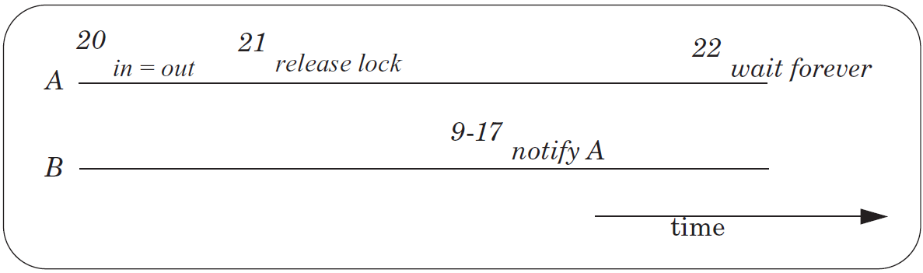
The Lost Notify Problem
Condition variable itself has no memory/state
  wait() and then notify(): wait() returns
  notify() and then wait(): wait() does not return
    This is potentially prone to race conditions

Slide 14
New API: WAIT(bb.full, bb.lock)
Old API
  WAIT(cv): yield processor and wait to be notified of cv
  NOTIFY(cv): notify waiting threads of cv
New API
  WAIT(cv, lock): release lock, yield CPU, wait to be notified
  NOTIFY(cv): notify waiting threads of cv

Slide 15
New API: WAIT(bb.full, bb.lock)
send(bb, msg):
acquire(bb.lock)
while True:
if bb.in - bb.out < N:
bb.buf[bb.in mod N] <- msg
bb.in <- bb.in + 1
release(bb.lock)
notify(bb.not_empty)
return
release(bb.lock)
wait(bb.not_full)
acquire(bb.lock)
send(bb, msg):
acquire(bb.lock)
while True:
if bb.in - bb.out < N:
bb.buf[bb.in mod N] <- msg
bb.in <- bb.in + 1
release(bb.lock)
notify(bb.not_empty)
return
release(bb.lock)
wait(bb.not_full)
acquire(bb.lock)
wait(bb.not_full, bb.lock)

Slide 16
WAIT Implementation
send(bb, msg):
acquire(bb.lock)
while True:
if bb.in - bb.out < N:
bb.buf[bb.in mod N] <- msg
bb.in <- bb.in + 1
release(bb.lock)
notify(bb.not_empty)
return
wait(bb.not_full, bb.block)
wait(cv, lock):
acquire(t_lock)
release(lock)
threads[id].cv = cv
threads[id].state = WAITING
yield_wait()
release(t_lock)
acquire(lock)
Not yield()
Using t_lock to ensure the atomic of release lock and yield
The order of t_lock and lock matters

Slide 17
WAIT & NOTIFY
wait(cv, lock):
acquire(t_lock)
release(lock)
threads[id].cv = cv
threads[id].state = WAITING
yield_wait()
release(t_lock)
acquire(lock)
notify(cv):
acquire(t_lock)
for I = 0 to N-1:
if threads[i].cv == cv && threads[i].state == WAITING:
threads[i].state = RUNNABLE
release(t_lock)

Slide 18
Recall YIELD()
yield():
acquire(t_lock)
id = cpus[CPU].thread
threads[id].state = RUNNABLE
threads[id].sp = SP
do:
id = (id + 1) mod N
while threads[id].state != RUNNABLE
SP = threads[id].sp
threads[id].state = RUNNING
cpus[CPU].thread = id
release(t_lock)
Suspend
running thread
Choose new
thread
Resume new
thread

Slide 19
YIELD_WAIT()
yield_wait(): // called by wait()
acquire(t_lock)
id = cpus[CPU].thread
threads[id].state = RUNNABLE
threads[id].sp = SP
do:
id = (id + 1) mod N
while threads[id].state != RUNNABLE
SP = threads[id].sp
threads[id].state = RUNNING
cpus[CPU].thread = id
release(t_lock)
wait(cv, lock):
acquire(t_lock)
release(lock)
threads[id].cv = cv
threads[id].state = WAITING
yield_wait()
release(t_lock)
acquire(lock)
The t_lock has already been hold by wait()
Current thread should not be RUNNABLE,
we add a new state: WAITING

Slide 20
YIELD_WAIT()
yield_wait(): // called by wait()
id = cpus[CPU].thread
threads[id].sp = SP
do:
id = (id + 1) mod N
while threads[id].state != RUNNABLE
SP = threads[id].sp
threads[id].state = RUNNING
cpus[CPU].thread = id
wait(cv, lock):
acquire(t_lock)
release(lock)
threads[id].cv = cv
threads[id].state = WAITING
yield_wait()
release(t_lock)
acquire(lock)
Problem: what if nothing is RUNNABLE?
yield_wait() will keep looping forever, while holding t_lock.
Other CPUs cannot acquire t_lock, even if they want to do a notify! ==> deadlock!
Notes:
This problem will not occur in previous yield() implementation. It is caused by the new state WAITING.

Slide 21
YIELD_WAIT()
yield_wait(): // called by wait()
id = cpus[CPU].thread
threads[id].sp = SP
do:
id = (id + 1) mod N
release(t_lock)
acquire(t_lock)
while threads[id].state != RUNNABLE
SP = threads[id].sp
threads[id].state = RUNNING
cpus[CPU].thread = id
wait(cv, lock):
acquire(t_lock)
release(lock)
threads[id].cv = cv
threads[id].state = WAITING
yield_wait()
release(t_lock)
acquire(lock)
Problem: Once yield_wait() releases t_lock, another CPU can run our current thread.
So now two CPUs have their SP pointing to the same thread's stack!
Can result in the stack being corrupted!
Notes:
SP currently points to the original thread‘s stack -- call it thread A.
Between release and acquire, another CPU could run thread A. This
means that two CPUs will have their stack pointer pointing to thread
A's stack. This is a very easy way for A's stack to get corrupted.

Slide 22
YIELD_WAIT()
yield_wait(): // called by wait()
id = cpus[CPU].thread
threads[id].sp = SP
SP = cpus[CPU].stack
do:
id = (id + 1) mod N
release(t_lock)
acquire(t_lock)
while threads[id].state != RUNNABLE
SP = threads[id].sp
threads[id].state = RUNNING
cpus[CPU].thread = id
wait(cv, lock):
acquire(t_lock)
release(lock)
threads[id].cv = cv
threads[id].state = WAITING
yield_wait()
release(t_lock)
acquire(lock)
Now we give each CPU a dedicated stack to run the scheduling loop.
Question: why there is no code to save the CPU’s SP?
Since the loop will not call any function, the SP will not change.

Slide 23
Preemption

Slide 24
Preemptive Scheduling
Non-preemptive Scheduling
  A thread continues to run until it gives up its processor (e.g., EXIT)
Cooperative Scheduling (cooperative multitasking)
  Every thread is supposed to call YIELD periodically
Preemptive Scheduling
  The thread manager forces a thread to give up its processor after a time interval (aka, time slice)

Slide 25
Implement Preemptive Scheduling
Set the interval timer of a clock device
When the timer expires
  The clock triggers an interrupt
  Switching to kernel mode to invoke clock interrupt handler
Clock interrupt handler invokes an exception handler
  Runs in the thread layer
  Forces the currently running thread to yield

Slide 26
Timer Interrupt Handler
yield():
acquire(t_lock)
id = cpus[CPU].thread
threads[id].state = RUNNABLE
threads[id].sp = SP
do:
id = (id + 1) mod N
while threads[id].state != RUNNABLE
SP = threads[id].sp
threads[id].state = RUNNING
cpus[CPU].thread = id
release(t_lock)
Note: not yield_wait()
timer_interrupt():
push PC // done by CPU
push registers
yield()
pop registers
pop PC

Slide 27
YIELD_WAIT()
yield_wait(): // called by wait()
id = cpus[CPU].thread
threads[id].sp = SP
SP = cpus[CPU].stack
do:
id = (id + 1) mod N
release(t_lock)
acquire(t_lock)
while threads[id].state != RUNNABLE
SP = threads[id].sp
threads[id].state = RUNNING
cpus[CPU].thread = id
wait(cv, lock):
acquire(t_lock)
release(lock)
threads[id].cv = cv
threads[id].state = WAITING
yield_wait()
release(t_lock)
acquire(lock)
Problem: What happens if timer interrupt occurs when CPU is running yield / yield_wait?
Since t_lock is already locked, When timer tries to call yield(), acquire(t_lock) will hang forever!

Slide 28
YIELD_WAIT()
yield_wait(): // called by wait()
id = cpus[CPU].thread
threads[id].sp = SP
SP = cpus[CPU].stack
do:
id = (id + 1) mod N
release(t_lock)
enable_interrupt()
disable_interrupt()
acquire(t_lock)
while threads[id].state != RUNNABLE
SP = threads[id].sp
threads[id].state = RUNNING
cpus[CPU].thread = id
wait(cv, lock):
disable_interrupt()
acquire(t_lock)
release(lock)
threads[id].cv = cv
threads[id].state = WAITING
yield_wait()
release(t_lock)
enable_interrupt()
acquire(lock)
Problem: if timer interrupt comes, we would put the wrong thread to sleep!

Slide 29
yield_wait(): // called by wait()
id = cpus[CPU].thread
cpus[CPU].thread = null
threads[id].sp = SP
SP = cpus[CPU].stack
do:
id = (id + 1) mod N
release(t_lock)
enable_interrupt()
disable_interrupt()
acquire(t_lock)
while threads[id].state != RUNNABLE
SP = threads[id].sp
threads[id].state = RUNNING
cpus[CPU].thread = id
yield(): // called by interrupt handler
acquire(t_lock)
id = cpus[CPU].thread
if (id == null)
release(t_lock)
return
threads[id].state = RUNNABLE
threads[id].sp = SP
do:
id = (id + 1) mod N
while threads[id].state != RUNNABLE
SP = threads[id].sp
threads[id].state = RUNNING
cpus[CPU].thread = id
release(t_lock)

Slide 30
Summary
Threads
  Virtualize a processor so that we can share it among programs
  yield() allows the kernel to suspend the current thread and resume another
Condition Variables
  Provide a more efficient API for threads
  Threads wait for an event and are notified when it occurs
  wait() requires a new version of yield(), yield_wait()
Preemption
  Forces a thread to be interrupted
    So that do not have to rely on programmers correctly using yield()
  Requires a special interrupt and hardware support to disable other interrupts

Slide 31
Eventcount & Sequencer

Slide 32
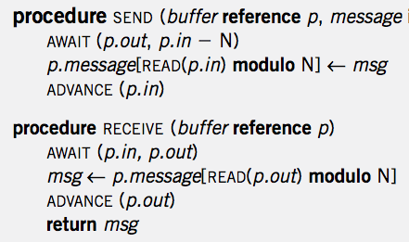
Single Sender and Single Receiver

Slide 33
4 Primitives
AWAIT (eventcount, value)
ADVANCE (eventcount)
TICKET (sequencer)
READ (eventcount or sequencer)

Slide 34
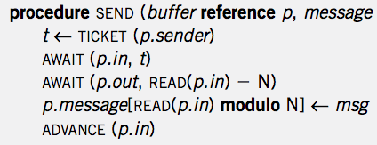
Multiple Senders and Single Receiver
No loop! Is it OK?

Slide 35
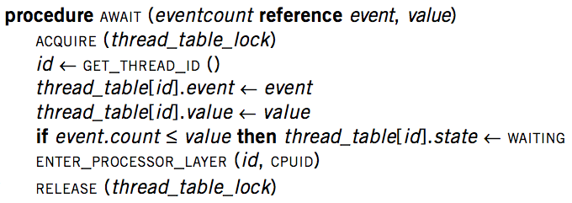
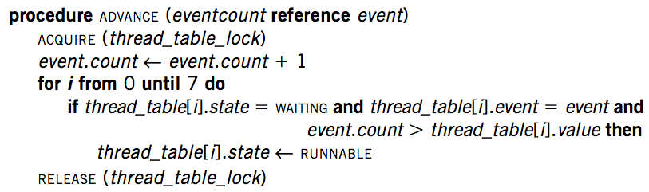
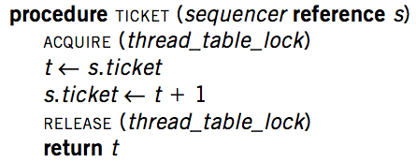
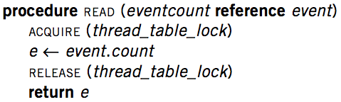
Implementation

Slide 36
Primitives for Sequence Coordination
AWAIT (eventcount, value) is a before-or-after action
  Compares eventcount to value
  If eventcount exceeds value
    AWAIT returns to its caller.
  If eventcount is less than or equal to value
    Changes the state of the calling thread to WAITING
    Places value and the name of eventcount in this thread’s entry in the thread table
    Yields its processor

Slide 37
Primitives for Sequence Coordination
ADVANCE (eventcount) is a before-or-after action
  Increments eventcount by one
  Searches the thread table for threads that are waiting on this eventcount
  For each one it finds,
    If eventcount now exceeds the value for which that thread is waiting
    Changes that thread’s state to RUNNABLE

Slide 38
Primitives for Sequence Coordination
TICKET (sequencer) is a before-or-after action
  Returns a non-negative value that increases by one on each call
  Two threads concurrently calling TICKET on the same sequencer
    Receive different values
    The ordering of the values returned corresponds to the time ordering of the execution of TICKET

Slide 39
Primitives for Sequence Coordination
READ (eventcount or sequencer) is a before-or-after action
  Returns to the caller the current value of the variable
  Having an explicit READ procedure is to assure before-or-after atomicity for eventcounts and sequencers whose value may grow to be larger than a memory cell

Slide 40
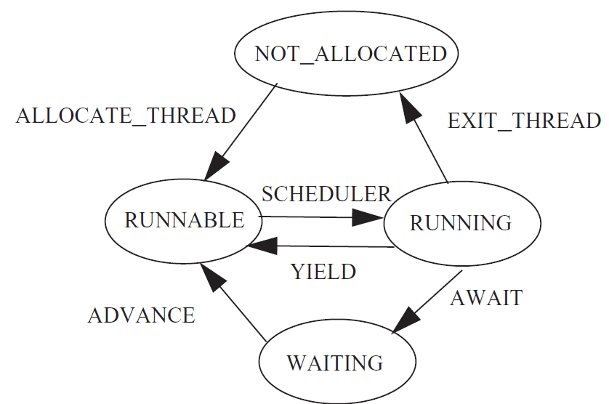
Thread State Diagram

