Slide 1

System Performance
Computer System Engineering, Fall 2018. (IPADS, SJTU)
Design for performance
Yubin Xia

Slide 2

Virtualization: C/S on a Single Machine
in order to enforce modularity + build an effective operating system
programs shouldn't be able to refer to
(and corrupt) each others' memory
Virtual memory
programs should be able to
communicate
Bounded buffer (virtualize communication links)
programs should be able to share a
CPU without one program halting the
progress of the other
Thread for multiplexing the processor
today: can we get systems to not just work, but to work well?

Slide 3
Improving Performance
Get faster hardware
Fix application: better algorithm, fewer features (not in CSE)
General system optimization techniques:
  Batching
  Caching
  Concurrency
  Scheduling
Application
System
Hardware

Slide 4
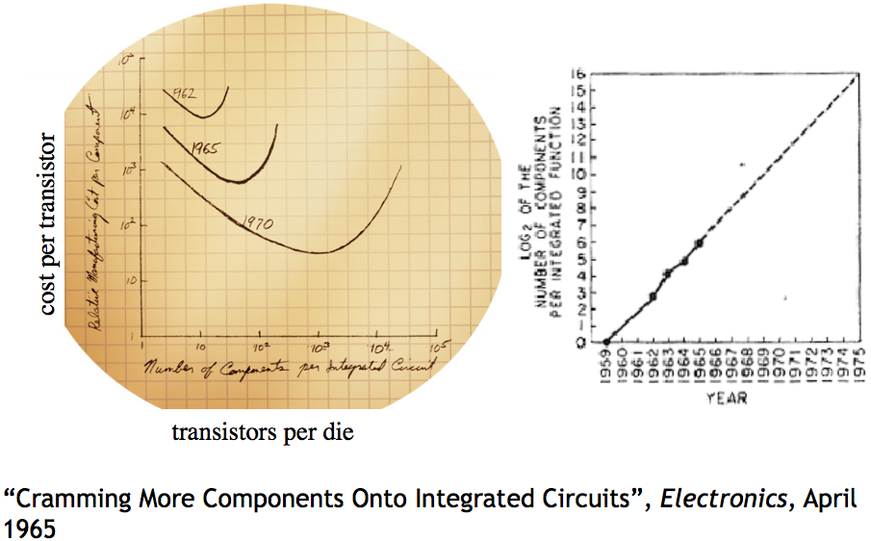
Moore's Law

Slide 5
Performance Metrics

Slide 6
Performance Metrics
Computer Systems can be viewed as interconnected modules
★ Capacity
★ Utilization
★ Latency
★ Throughput

Slide 7
Performance Metrics: Capacity
Capacity – Size or amount of a service
  Blocks on storage or memory devices
  Cycles on a processor
  Requests per second for a web server
  Bits per second on a network link

Slide 8
Performance Metrics: Utilization
Utilization – Fraction of capacity used by a workload
  CPU is 50% busy, rest in idle loop
  75% of disk blocks are allocated
  Webserver is running at 20% of capacity
  20% of the time network is busy

Slide 9
Performance Metrics: Latency
Request
Latency: the time it takes from start to finish
  Webserver – Time from request to response
  Network – Time from send() until receive() done
  Procedure – Time from call until return
For a multi-step process (Steps A + B)
  Latency_{A+B} ≥ LatencyA + Latency_{B}
Service
Stage-1
Stage-1
…
Stage-n
Response

Slide 10
Performance Metrics: Throughput
Throughput: rate at which work is done
  Webserver – Requests per second
  Network – Bytes per second
  Procedure – Calls per second
Pipeline of modules
  Thoughput_{A+B} ≤ minimum(Throughput_{A}, Throughput_{B})
  Bottleneck
1000
100
10

Slide 11
Relationship between Latency & Throughput
When processing is serial:
Throughput = 1 / (Latency)
When processing is parallel:
Throughput has no direct relationship
with latency
How to improve throughput? Reduce latency & Increase paralleling

Slide 12
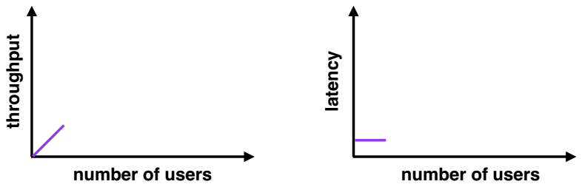
Throughput and Latency
Few users
  Low latency
  Low throughput (few users = few requests)

Slide 13
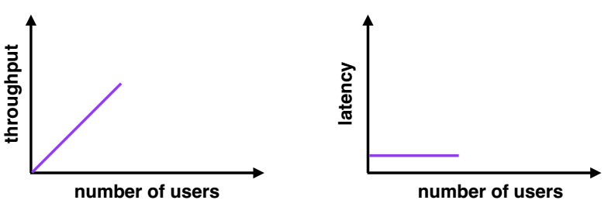
Throughput and Latency
Moderate users
  Low latency (new users consume previously idle resources)
  High throughput (more users = more requests)

Slide 14
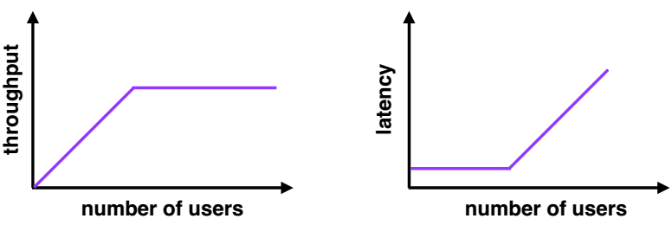
Throughput and Latency
Many users
  High latency (requests queue up)
  Throughput plateaus (cannot serve requests any faster)

Slide 15
Improving Bottlenecks
Latency is the harder of the problems
  Frequently fundamental limits
  Speed of CPU
  Speed of communication link (e.g., light)
Throughput frequently is a resource limit
  Example: Buy a fatter pipe but it costs more
  Famous saying: You can buy throughput but you can't bribe god

Slide 16
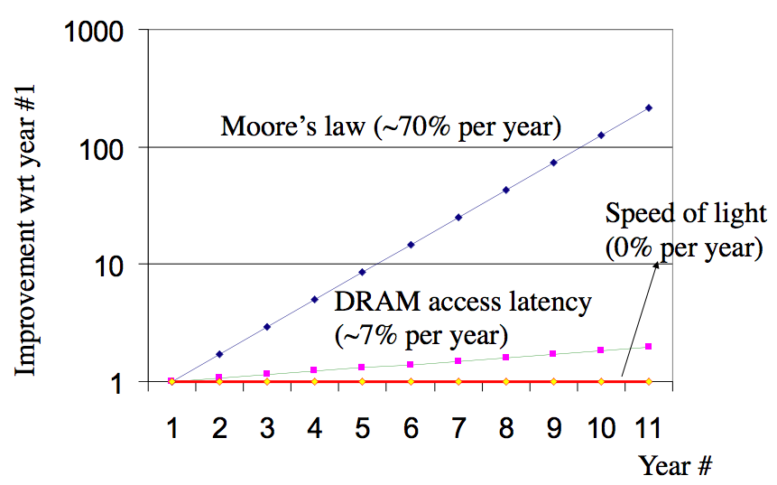
Latency Improves Slowly

Slide 17
Fast Path for Latency Optimizations
Request
Use knowledge of the workload
Make the common cases faster
E.g., cache hit VS. cache miss
if (WorksOnFastPath(request))
DoFastCase(request);
else
DoNormalCase(request);
Stage-1
Slow path
Fast path
Stage-2
Stage
…
Stage-n
Response

Slide 18
Fast Path for Latency Optimizations
AverageLatency = Frequencyfast x Latencyfast + Frequencyslow x Latencyslow
Is introducing a fast path worth the effort?
  depends on the difference of latency,
  and the frequency using fast path,
  which is dependent on the workload
Many workloads do not have a uniform distribution of requests,
  thus introducing a fast path works well

Slide 19
Caching: Classic Fast Path Optimization
Use knowledge of workload: memory abstractions
  Keep common requests in a fast local memory
  Check the local memory every access
CPU cache – Cache 1ns, Memory 100ns, 90% hit rate
  AverageLatency = 0.9 x 1ns + 0.1 x 100ns = 10.9 ns (100ns -> 10.9ns)
Used everywhere there are memory abstractions
  Processors, file systems, TLBs, browsers, DNS, etc.

Slide 20

Reducing Latency using Concurrency
Example: search engine
  Splits the index of the Web up in n pieces, each piece on a machine
  Frontend sends copies of requests and combines the response
If subtasks are independent to each other
  Can use n threads to get a speedup of n
  Hard to get the ideal speedup
    10 months a man -> 1 month 10 men?
Index Node
Frontend
Index Node
Index Node

Slide 21
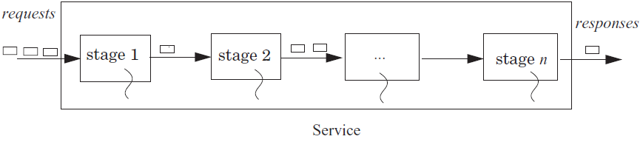
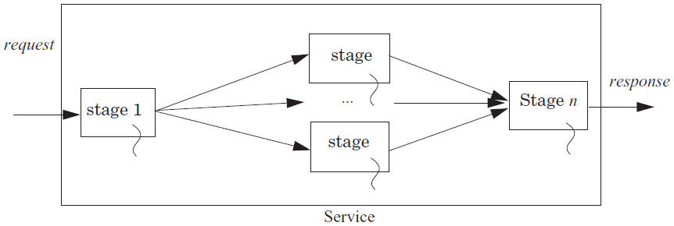
Using Concurrency to Improve Throughput

Slide 22
Hide Latency by Overlapping
Fetch (5 time units) and process (5 units) 2 blocks (20 units)
  Fetch B1; Process B1; Fetch B2; Process B2;
Fetch 2 blocks asynchronously (15 units)
  Send request for B1,B2;
  Receive B1; Process B1; Receive B2; Process B2
Processors prefetching memory requests
  File systems prefetching files
  Browser prefetching pages
Fetch B1,B2
Process B1
Process B2
Fetch B1
Process B1
Fetch B2
Process B2
Fetch B2

Slide 23
Queuing and Overload
Overload: whenever the offered load is greater than the capacity of a service for some duration
  E.g., 7 threads on 3 processors, must wait in queue (RUNNABLE)
The queuing theory
  Unit is the average service time
  The waiting time in a queue: 1/(1-ρ), ρ is the utilization
  Once the utilization approaches 1, the delay will grow without bound

Slide 24
Queuing and Overload
One solution
  Make the capacity match the offered load of requests
Example:
  CPU: one instruction per ns; Memory: respond takes 10 ns
  CPU must make a memory request 10 ns in advance
  Memory must serve 10 requests concurrently
    If half instructions are memory request, then only 5 concurrently
    But cannot predicate the pattern of memory access

Slide 25
Queuing and Overload
If overload appears short period of time
  A queue handles short bursts of too much demand by time-averaging with adjacent periods when there is excess capacity
If overload persists over long periods of time
  Increase the capacity of the system
  Shed load : reduce or limit the offered load

Slide 26
Queuing and Overload
Offered load: the rate of arrival of requests for service
Using bounded buffer to control offered load
  Self managing, if the a source needs the results of the output
  If source makes no request at all, then offered load decreases
  If source holds the request and resubmits it later, offered load doesn't decrease
  Put a quota on the source (e.g., max threads per application)
Reducing the offered load when a stage becomes overloaded: e.g., swapping

Slide 27
Fighting Bottlenecks

Slide 28
Why Performance Bottleneck?
1. Physical limitation
  Speed of light
  The capacity of memory
  …
2. Sharing
  Several users share a device
  Several clients share a server

Slide 29
How to Improve Performance?
1. Measure the system to find the bottleneck
2. Relax the bottleneck
  Batch requests
  Cache data
  Exploit concurrency
  Exploit parallelism

Slide 30
Batching
Frequently it is possible to group requests for more efficiency
  Amortize overheads of processing
  Schedule requests for better performance
Examples: N messages vs. one message with N requests Disks:
  Always transfer a bunch of bytes (sector or block)
  Schedule the disk motions

Slide 31
Dallying
Procrastination sometimes helps
  Temp files – deleted before written to disk
Examples:
  Caches – Write back policy: Write absorption
  Database transactions – group commit
    Might hold your ATM request until others arrive to do batching

Slide 32
Speculation
Guessing at an operation and performing it ahead a time
  Need to be able to undo changes if wrong
Examples:
  Processors guess at branches, memory access
  File systems guess at next file block needed (prefetching)
  Easier if space of possibilities is small
  Branch prediction versus value prediction

Slide 33
Challenges
Batching, dallying, and speculation introduce complexity
  They introduce concurrency
  Coordination is difficult to get right
  E.g., the Meltdown and Spectre attacks on Intel's CPU

Slide 34
Case: I/O Bottleneck

Slide 35
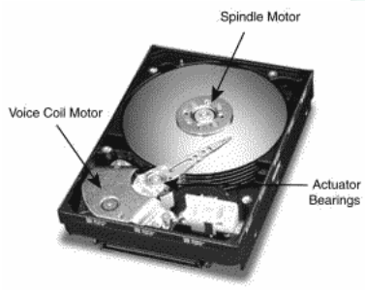
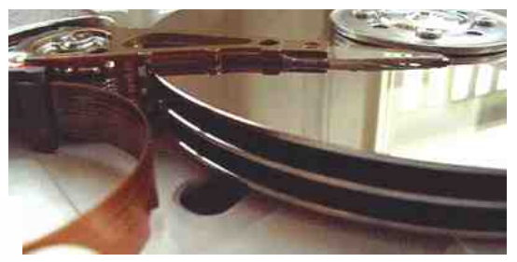
The I/O Bottleneck
Bits read from a disk encounter two potential transfer rate limits:
  The rate at which bits spin under the heads on their way to a buffer
  The rate at which the I/O channel or I/O bus can transfer the contents

Slide 36
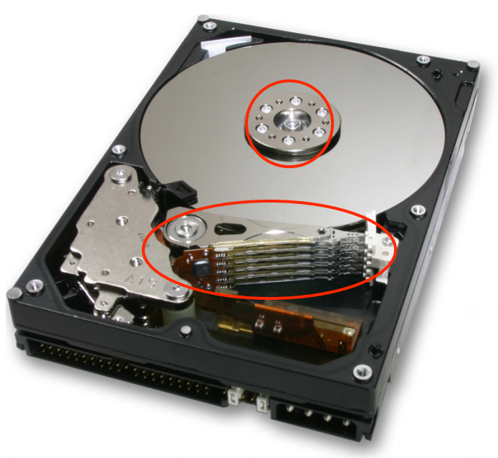
The I/O Bottleneck
Average seek latency: about 8 milliseconds
  Time to move the head over 1/3 of the disk
The average rotational latency: 4.17 milliseconds
  The disks spin at 7200 rotations/minute
  One rotation every 8.33 milliseconds (60/7200)
  On average, the disk has to wait a half rotation for the desired block to be under the disk head

Slide 37
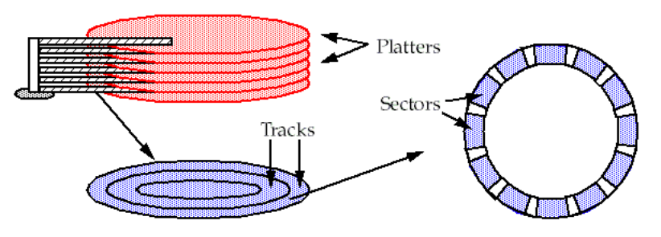
A Typical Modern 400 Gigabyte Disk
Has 16,383 cylinders, or about 24 megabytes per cylinder
Would have 8 two-sided platters and thus 16 read/write heads
Would be 24/16 = 1.5 megabytes per track
When rotating at 7200 revolutions per minute (120 per second)
The bits will go by a head at 180 megabytes per second (1.5 x 120)

Slide 38
Bottleneck
The IDE bus: 66 MB/S is common
The Serial ATA-3 bus: 6 Gbps
With IDE bus: The electronics would be the bottleneck
  at 66 MB/S
With SATA-3 bus: The mechanics would be the bottleneck
  at 180 MB/S

Slide 39
Latency of 4-KB Data Accessing (Using IDE)
The latency of reading a 4 kilobyte block chosen at random:
avg seek time + avg rotation latency + transmission of 4 kilobytes
  = 8 + 4.17 + (4 / (66 × 1024)) × 1000 milliseconds
  = 8 + 4.17 + 0.06 milliseconds
  = 12.23 milliseconds
The throughput for reading randomly-chosen blocks one by one is:
  = 1000/12.23 × 4 kilobytes per second
  = 327 kilobytes/second

Slide 40
Round-1: No Optimization
1 in ← OPEN (“in”, READ) // open “in” for reading
2 out ← OPEN (“out”, WRITE) // open “out” for reading
3
4 while not ENDOFFILE (in) do
5 block ← READ (in, 4096) // read 4 kilobyte block from in
6 block ← COMPUTE (block) // compute for 1 millisecond
7 WRITE (out, block, 4096) // write 4 kilobyte block to out
8 CLOSE (in)
9 CLOSE (out)
reading 4 kilobyte + 1 millisecond of computation + writing 4 kilobyte
  = 12.23 + 1+ 12.23 milliseconds
  = 25.46 milliseconds

Slide 41
Round-2
Modify the file system
  to layout the blocks of a file contiguously
  to prefetch an entire track of data on each read
Average seek time + 1 rotational delay
  = 8 + 8.33 milliseconds = 16.33 milliseconds

Slide 42
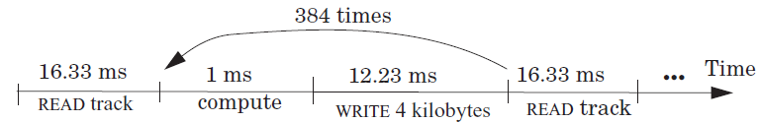
Round-2
File system issues 1 read request per 384 (1.5 MB per track / 4 KB) loop iterations
The average time for 384 iterations is:
reading 1536 kilobyte + 384× (1 millisecond of computation + writing 4 kilobyte)
  = 16.33 + 384 × (1 + 12.23) millisecond
  = 16.33 + 5080.32 milliseconds
  = 5096.65 milliseconds
Thus, the average time for a loop iteration is 5096.65/384 = 13.27 milliseconds

Slide 43
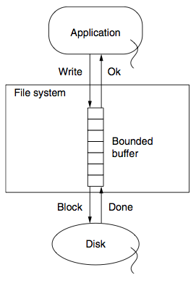
Round-3
Improve by dallying & batching write requests
Write to buffer in RAM and flush when buffer is full
Latency = (16.33 + 384 + 16.33)/384 milliseconds
= 1.09 milliseconds

Slide 44
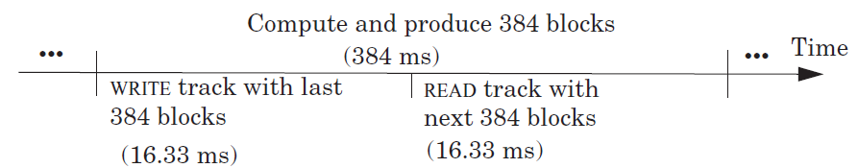
Round-4
Prefetch the next track before the 385th READ
Overlap computation and I/O completely
The average time around the loop is 1 millisecond
The bottleneck now is the CPU

