Slide 1

Isolation: 2-Phase Locking & OCC
Computer System Engineering, Fall 2018. (IPADS, SJTU)
Before-or-after Atomicity
Yubin Xia

Slide 2

Review: All-or-nothing

Slide 3
Review: Read & Write with Cache & Cell Storage
+-------+------+--------+-------+------+--------+-------+
TID | T1 | T1 | T1 | T2 | T2 | T2 | T3 |
OLD | A=0 | B=0 | | A=100 | B=50 | | A=80 |
NEW | A=100 | B=50 | COMMIT | A=80 | B=70 | COMMIT | A=110 |
+-------+------+--------+-------+------+--------+-------+
Cell Storage
A 110
B 70
Cache
A 110
B 70
read(var):
if var in cache:
return cache[var]
else: // may evict others from cache to cell storage
cache[var] = cell_read(var)
return cache[var]
write(var, value):
log.append(current_tid, update, var, read(var), value)
cache[var] = value
Problem: a write can be seen by other transactions before its COMMIT

Slide 4
Isolation: Before-or-after
If we guarantee isolation, then two actions A1 and A2 will appear to have run serially even if they were executed concurrently (i.e., A1 before A2, or vice versa)

Slide 5
Goal: Build Reliable Systems from Unreliable Components
The abstraction that makes that easier is transactions, which provide atomicity and isolation, while not hindering performance
atomicity
shadow copies (simple, poor performance) or logs (better performance, a bit more complex)
2PL (Two-phase locking) ,
or OCC (Optimistic Concurrency Control)
isolation
eventually, we also want transaction-based systems to be distributed: to run across multiple machines

Slide 6

Serialization
Goal: run transactions T1, T2, .., TN concurrently, and have it "appears" as if they ran sequentially
What does this mean?
T1
begin
read(x)
tmp = read(y)
write(y, tmp+10)
commit
T2
begin
write(x, 20)
write(y, 30)
commit

Slide 7
Init: x=0, y=0
T1
begin
read(x)
tmp = read(y)
write(y, tmp+10)
commit
T2
begin
write(x, 20)
write(y, 30)
commit
Possible sequential schedules
T1 -> T2: x=20, y=30
T2 -> T1: x=20, y=40
T2: write(x, 20)
T1: read(x)
T2: write(y, 30)
T1: tmp = read(y)
T1: write(y, tmp+10)
At end: x=20, y=40
T1: read(x)
T2: write(x, 20)
T1: tmp = read(y)
T2: write(y, 30)
T1: write(y, tmp+10)
At end: x=20, y=10

Slide 8
Init: x=0, y=0
T1
begin
read(x)
tmp = read(y)
write(y, tmp+10)
commit
T2
begin
write(x, 20)
write(y, 30)
commit
Possible sequential schedules
T1 -> T2: x=20, y=30
T2 -> T1: x=20, y=40
T2: write(x, 20)
T1: read(x)
T2: write(y, 30)
T1: tmp = read(y)
T1: write(y, tmp+10)
At end: x=20, y=40
x=0
T1: read(x)
T2: write(x, 20)
T2: write(y, 30)
T1: tmp = read(y)
T1: write(y, tmp+10)
At end: x=20, y=40
y=30
In the second schedule, the results are correct. But T1 reads x=0 and y=30; those reads are not possible in a sequential schedule. Is that okay?

Slide 9
It depends:
  There are many ways for multiple transactions to "appear" to have been run in sequence; there are different notions of serializability
  Chose a type of serializability depends on applications

Slide 10
Different Types of Serializability
Final-state serializability
  A schedule is final-state serializable if its final written state is equivalent to that of some serial schedule
Conflict serializability
View serializability
We will focus on it

Slide 11
Conflict Serializability

Slide 12
Conflict Serializability
Two operations conflict if :
  they operate on the same object, and
  at least one of them is write
  the actions belong to different transactions
Conflict serializability
  A schedule is conflict serializable if the order of its conflicts (the order in which the conflicting operations occur) is the same as the order of conflicts in some sequential schedule

Slide 13



Conflict Equivalence
=
conflict-equal
Schedule A
if
Schedule B
T1 → T2
T4 → T3
=
equal
Conflicts order A
Conflicts order B
If conflicts-order-A equals to conflicts-order-B,
then schedule-A conflict-equals to schedule-B

Slide 14
Init: x=0, y=0
T1
begin
read(x)
tmp = read(y)
write(y, tmp+10)
commit
T2
begin
write(x, 20)
write(y, 30)
commit
Possible sequential schedules
T1 -> T2: x=20, y=30
T2 -> T1: x=20, y=40
T1.1
T2.1
T1.2
T2.2
T1.3
Conflicts
T1.1 read(x) and T2.1 write(x,20) on x
T1.2 tmp = read(y) and T2.2 write(y,30) on y
T1.3 write(y, tmp+10) and T2.2 write(y,30) on y

Slide 15
Conflict Graph
Conflict Graph
  Nodes are transactions, edges are directed
  Edge between T_{i} and T_{j} if and only if:
    T_{i} and T_{j} have a conflict between them and
    the first step in the conflict occurs in T_{i}
A schedule is conflict serializable if and only if:
  It has an acyclic conflict graph

Slide 16
T1
begin
read(x)
tmp = read(y)
write(y, tmp+10)
commit
T2
begin
write(x, 20)
write(y, 30)
commit
Possible sequential schedules
T1 -> T2: x=20, y=30
T2 -> T1: x=20, y=40
Conflicts
T1.1 read(x) -> T2.1 write(x,20)
T1.2 tmp = read(y) -> T2.2 write(y,30)
T1.3 write(y, tmp+10) -> T2.2 write(y,30)
(T1 -> T2)

Slide 17
T1
begin
read(x)
tmp = read(y)
write(y, tmp+10)
commit
T2
begin
write(x, 20)
write(y, 30)
commit
Possible sequential schedules
T1 -> T2: x=20, y=30
T2 -> T1: x=20, y=40
Conflicts
T2.1 write(x,20) -> T1.1 read(x)
T2.2 write(y,30) -> T1.2 tmp = read(y)
T2.2 write(y,30) -> T1.3 write(y, tmp+10)
(T2 -> T1)

Slide 18
Conflicts
T2.1, T1.1
T2.2, T1.2
T2.2, T1.3
Conflict order for sequential schedules
T1.1 -> T2.1 T2.1 -> T1.1
T1.2 -> T2.2 or T2.2 -> T1.2
T1.3 -> T2.2 T2.2 -> T1.3
(T1 -> T2) (T2 -> T1)
T2: write(x, 20)
T1: read(x)
T2: write(y, 30)
T1: tmp = read(y)
T1: write(y, tmp+10)
T1: read(x)
T2: write(x, 20)
T2: write(y, 30)
T1: tmp = read(y)
T1: write(y, tmp+10)
T2.1 -> T1.1
T2.2 -> T1.2
T2.2 -> T1.3
T1.1 -> T2.1
T2.2 -> T1.2
T2.2 -> T1.3

Slide 19
Conflicts
T2.1, T1.1
T2.2, T1.2
T2.2, T1.3
Conflict order for sequential schedules
T1.1 -> T2.1 T2.1 -> T1.1
T1.2 -> T2.2 or T2.2 -> T1.2
T1.3 -> T2.2 T2.2 -> T1.3
(T1 -> T2) (T2 -> T1)
T2: write(x, 20)
T1: read(x)
T2: write(y, 30)
T1: tmp = read(y)
T1: write(y, tmp+10)
T2 -> T1
T1: read(x)
T2: write(x, 20)
T2: write(y, 30)
T1: tmp = read(y)
T1: write(y, tmp+10)
-->
<--
T2 T1
It's final-state serializable,
not conflict serializable
Both at end: x=20, y=40

Slide 20
View Serializability
T1 T2 T3
read(x)
write(x)
write(x)
write(x)
Conflict graph
T3
T2 T1
Cyclic -> Not conflict serializable
But compare it to running T1 then T2 then T3 (serially)
  Final-state is fine
  Intermediate reads are fine
Question: why shouldn't we allow this schedule?

Slide 21
View Serializability
Informal definition
  A schedule is view serializable if the final written state as well as intermediate reads are the same as in some serial schedule
Formally, for those interested
  Two schedules S and S' are view equivalent if:
    If T_i in S reads an initial value for X, so does T_i in S'
    If T_i in S reads the value written by T_j in S for some X, so does T_i in S'
    If T_i in S does the final write to X, so does T_i in S'
A schedule is view serializable if it is view equivalent to some serial schedule

Slide 22
Question
Why focus on conflict serializability when it seems too strict?
Why not focus on view serializability?
Final-state Serializability
View
Serializability
Conflict
Serializability
>
>
Care the final state
Care the final state as well as intermediate read
Care the final state as well as all the data dependency

Slide 23
Conflict Serializability VS. View Serializability
Conflict serializability is easy to test
  It's fast to check whether a graph is acyclic
  View serializability is hard to test (likely NP-hard)
Conflict serializable schedules are easy to generate
  Using 2-phase locking
Conflict serializable schedules are also view serializable
  No easy way to generate view schedules that allows for ones like the previous example

Slide 24
Conflict Serializability VS. View Serializability
Schedules that are view serializable but not conflict serializable involve blind writes:
  Blind writes: writes that are ultimately not read, which are not common in practice
Basically: conflict serializability has practical benefits

Slide 25
Generate Conflict-Serializable Schedules

Slide 26
How to Generate Conflict Serializable Schedules?
Problem: how to generate schedules that are conflict serializable?
  How about generating all possible schedules and check their conflict graphs?

Slide 27
How to Generate Conflict Serializable Schedules?
Pessimistic methods
  Presume that interference is likely
  Prevent any possibility of conflict actively
  E.g., global lock, 2-phase locking
Optimistic methods
  Allow write in any order and at any time
  If detect conflict, then "sorry, conflict write, please abort, clear the history and then retry"
  E.g., OCC

Slide 28
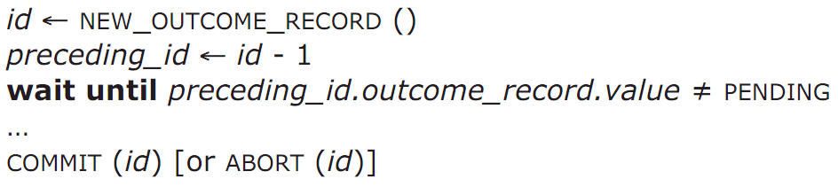
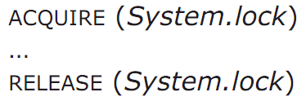
Global Lock: System-wide Locking
System-wide lock
  begin_transaction
  ACQUIRE (System.lock)
  …
  …
  RELEASE (System.lock)
  end_transaction
Allow only one transaction to run at a time
Serialize potentially concurrent transactions in the order that they call ACQUIRE

Slide 29
Simple Locking
Simple locking:
  1. Acquire a lock for every shared data in advance
  2. Release locks only after commit or abort
Lock point
  Lock set: locks acquired when reaches lock point
  Lock manager's enforcement
    Intercept read/write/commit/abort, and check
Problems
  How to enumerate all shared object to access?
  The set of might-access may be larger than does-access

Slide 30
Two-phase Locking
Two-phase locking:
  Each shared variable has a lock (fine-grained locking)
  Before any operation on the variable, the transaction must acquire the corresponding lock
  After transaction releases a lock, it cannot acquire any other locks
Features
  Avoids to know the lock set in advance
  Acquire locks as it proceeds, access data as soon as it acquires the lock

Slide 31
Question
Consider two transactions in a bank:
Is this schedule before-or-after?
T1:
Acquire (x1.lock)
Read(x1)
Write(x1)
Acquire (x2.lock)
Read(x2)
Write(x2)
Acquire (x3.lock)
Read(x3)
Write(x3)
Acquire (x4.lock)
Read(x4)
Write(x4)
Release (x1.lock)
Release (x2.lock)
Release (x3.lock)
Release (x4.lock)
T2:
Acquire (x3.lock)
Read(x3)
Write(x3)
Acquire (x4.lock)
Read(x4)
Write(x4)
Release (x3.lock)
Release (x4.lock)

Slide 32
Global Lock: System-wide Locking
Acquire global lock
Release global lock
Lock
Time

Slide 33
Simple Locking
Lock Point
Lock
Acquire lock-D
Release lock-D
Acquire lock-C
Release lock-C
Acquire lock-B
Release lock-B
Acquire lock-A
Release lock-A
Time

Slide 34
Two-phase Locking
Lock Point
Lock
Time

Slide 35
Optimizations: Read-write Locks
Lock compatibility modes
  Multiple-reader, single-writer protocol
    Any number of readers is safe
    Only one writer, waits for all reader to finish
    Suitable for applications with a lot of reading
    A writer may be delayed indefinitely
    Can release reader-locks after lock point (may before commit)
  More specific, more complex

Slide 36
Proof of 2PL
T1 and T2 conflict on x1
T2 and T3 conflict on x2
...
Tk and T1 conflict on x_k
Suppose 2PL does not generate conflict serializable schedule
Suppose the conflict graph produced by an execution of 2PL has a cycle, which without loss of generality, is:
T1 --> T2 --> ... --> Tk --> T1
Let the shared variable (the one that causes the conflict) between T_i and T_{i+1} be represented by x_i.
T1 acquires x1.lock
T2 acquires x1.lock and x2.lock
T3 acquires x2.lock and x3.lock
...
Tk acquires x_{k-1}.lock and x_k.lock
T1 acquires x_k.lock
T1 violates 2PL!
T1 acquires x1.lock
T1 releases x1.lock
...
...
...
T1 acquires x_k.lock
T1 acquires x1.lock
T1 releases x1.lock
T2 acquires x1.lock and x2.lock
...
Tk acquires x_{k-1}.lock and x_k.lock
T1 acquires x_k.lock

Slide 37
Problem: 2PL Can Result in Deadlock
acquire(x.lock)
read(x)
acquire(y.lock)
read(y)
release(x.lock)
release(y.lock)
acquire(y.lock)
read(y)
acquire(x.lock)
read(x)
release(y.lock)
release(x.lock)
Solution: global ordering on locks
Another Solution: take advantage of atomicity and abort one of the transactions (optimistic)!

Slide 38
OCC: Optimistic Concurrency Control

Slide 39
Concurrency Control (CC)
CC ensures correct results for concurrent operations
  A basic component in OS, DS, multiprocessors, databases, PL, …
  Ensures serializability of data accesses to the shared data sets
  Get results fast for high throughput and scalability
Optimistic Concurrency Control (OCC, Kung and Johnson, 1981) has been used in several production systems
  E.g., Microsoft Hekaton, Google App Engine, CoucDB, Silo, …

Slide 40
OCC Executes a Transaction in Three Phases
Phase 1: Concurrent local processing
  Reads tuples into a read set
  Buffers writes into a write set
Phase 2: Validation in critical section
  Validates whether serializability is guaranteed:
    Has any tuple in the read set been modified?
Phase 3: Commit the results in critical section or abort
  Aborts: aborts the transaction if validation fails
  Commits: installs the write set and commits the transaction

Slide 41
OCC: An Example
Tuple A in T1's read set has been changed by T2, thus T1 must be aborted.
Thread1
Thread2
T1:
B = A + B;
T2:
A = A * 1.1;
T2's read set remains unchanged, thus T2 is allowed to commit
BEGIN
BEGIN
T1's read set:
A (100)
B (100)
R(A);
R(A);
T2's read set:
A (100)
B (200)
R(B);
W(A);
T1's write set:
T2's write set:
A (110)
W(B);
Commit
Validation
Thread-local memory
Abort
Validation
Thread-local memory
Time
Database
storage
ID | Value
A | 110
B | 100
ID | Value
A | 100
B | 100

Slide 42
OCC's Advantages
Simple validation, which achieves high throughput and scalability at low contention
  Phase 1: Read
    Reads data into a read set
    Buffers writes into a write set
  Phase 2: Validation
    Validates whether serializability is guaranteed:
      Has any tuple in the read set been modified?
  Phase 3: Write
    Aborts: aborts the transaction if validation is failed
    Commits: installs the write set and commits the transaction
Operates in private workspace; rare inter-thread synchronization (optimistic)
Needs synchronization, but usually very short at low contention

Slide 43
Revisit the Serializability Theorem
The serializability theorem [Bernstein et al. 1987]
  A transaction schedule is (conflict) serializable if and only if its data dependency graph contains no cycles
Three types of data dependencies:
: T₂ reads a tuple that was earlier written by T₁
: T₂ writes a tuple that was earlier written by T₁
: T₁ reads a tuple that was later written by T₂
T₁
wr
T₂
ww
T₁
T₂
T₁
rw
T₂

Slide 44
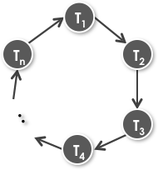
OCC: Serializable Scope
Ensures serializability by breaking the incoming RW edge of the earliest committed transaction in a possible cycle
T₂ will be aborted by OCC and thus avoids cycle
rw
cannot be ww or wr
T₃
The first committed transaction in the cycle

Slide 45
OCC's Problem: False Aborts
Some transactions aborted by OCC could have been allowed to commit without causing an unserializable schedule
Thread1
Thread2
T1:
B = A + B;
T2:
A = A * 1.1;
No cycle is formed
OCC only allows serialized execution of T2, T1, but is not able to recognize serialized execution of T1, T2.
T1 is falsely aborted.
BEGIN
BEGIN
R(A);
rw
R(A);
R(B);
W(A);
W(B);
Commit
Abort
Notes:
T2已经commit，所以如果T1commit成功，那么，从commit的角度看T2先于T1，从最后效果的角度看T1先于T2

Slide 46
Transactional Memory 101
Hardware TM to mass market
  Intel’s restricted transactional memory (RTM)
  IBM’s IBM Blue Gene/Q
  AMD advanced synchronization family (ASF proposal)
  Generally provides
  Opportunistic concurrency
  Strong atomicity: read set & write set
  Semantic of both all-or-nothing and before-or-after
  Real-world best-effort TM
  Limited read/write set
  System events may abort an TX

Slide 47
Programming with RTM
If transaction starts successfully
  Do work protected by RTM, and then try to commit
Fallback routine to handle abort event
  If abort, system rollback to _xbegin, return an abort code
Manually abort inside a transaction
if _xbegin() == _XBEGIN_STARTED:
if conditions:
_xabort()
critical code
_xend()
else
fallback routine
No conflict

Slide 48
Programming with RTM
If transaction start successfully
  Do work protected by RTM, and then try to commit
Fallback routine to handle abort event
  If abort, system rollback to _xbegin, return an abort code
Manually abort inside a transaction
if _xbegin() == _XBEGIN_STARTED:
if conditions:
_xabort()
critical code (access x)
_xend()
else
fallback routine
Another process
x = 1
Conflict!
Abort

Slide 49
Programming with RTM
If transaction start successfully
  Do work protected by RTM, and then try to commit
Fallback routine to handle abort event
  If abort, system rollback to _xbegin, return an abort code
Manually abort inside a transaction
if _xbegin() == _XBEGIN_STARTED:
if conditions:
_xabort()
critical code
_xend()
else
fallback routine
Manually
abort

Slide 50
BCC: Balanced CC
BCC: reducing false aborts in optimistic concurrency control with low cost for in-memory databases [VLDB'16]

Slide 51
Basic Structure of BCC
BCC is OCC based, retaining its merits
If OCC validation fails, BCC validation checks again
wr/ww/rw
rw
T₁
T₁
T₂
T₃
T₂
T₃ commits earlier than T₂
rw
T₁ must commit after T₂ starts
T₃

Slide 52
Theorem (Not in Exam)
Theorem-1: In databases that satisfy BCC's transaction model, when an unserializable transaction schedule is created, the schedule must contain the following transactions T1, T2 and T3 such that:
  T3 is the earliest committed transaction in the schedule;
  T2 rw → T3; and
  T1 → T2 and T1 commits after T2 starts.
Notes:
PROOF. When an unserializable transaction schedule is created, a cycle must exist in the transaction dependency graph. Let T3 be the first transaction committed in the schedule. To form the cycle, T3 must be dependent on another transaction (i.e. it should be pointed by an arrow in the dependency cycle). Since a transaction can only read committed tuples, this dependency cannot be a ww dependency or a wr dependency (otherwise there would exist another transaction in the schedule that committed earlier than T3 committed, which contradicts with the fact that T3 is the first committed transaction in the schedule). Thus, this dependency must be a rw dependency. Let the transaction T3 rw dependent on be T2 (i.e. T2 rw−→ T3). T3 must commit after T2 starts. To form the cycle, T2 must also be dependent on a transaction in the cycle. Let the transaction be T1 (i.e. T1 −→ T2). T1 must commit after T2 starts, because T3 commits after T2 starts and T1 commits later than T3 commits.

Slide 53
Theorem (Not in Exam)
Theorem-2: Transactions aborted by OCC may not be aborted by BCC, while transactions aborted by BCC will always be aborted by OCC
  OCC will abort T2 if T2 rw → T3
  BCC checks additional dependencies
Notes:
PROOF. The dependency T2 rw→ T3 in the essential patterns is the anti-dependency detected by OCC, and the essential patterns examine additional dependencies to decide whether a transaction should be aborted

Slide 54
BCC Validation is Complex
Goal: capture all essential patterns at the right time
T₁
T₂
T₁
T₂
T₁
T₂
T₁
T₂
Begin
Begin
Begin
Begin
Begin
Begin
Begin
Begin
W(A)
R(B)
W(A)
R(B)
R(A)
R(B)
Snapshot
W(A)
wr
ww
rw
rw
Commit
Commit
Commit
Commit
R(A)
W(A)
W(A)
R(A)
Commit
Commit
Commit
Commit
Dependency pattern is created at the time when T₂ commits
Dependency pattern is created at the time when T₁ commits
Notes:
Here T2 rw T3, is not shown.

Slide 55
BCC: Validation
If T's read set remains the same, commit T.
Otherwise:
(1) Validating T_{2:}
  If T is wr-, ww- or rw-dependent on T's concurrent transactions.
(2) Validating T₁:
  Only when T₁ is a snapshot transaction, can happen after T2 commits.
  If T is a snapshot transaction && the transaction T is anti-dependent on also has anti-dependency.
rw
T₁
T₂

Slide 56
BCC's Implementation
Baseline system: Silo (SOSP'13)
  Silo is a shared in-memory OCC database
  It avoids any centralized bottleneck in the design
Challenges: How to minimize validation overhead
  Extra information bookkeeping
    Maintains each transaction's read set
    Maintains anti-dependency information for validating T₁
  Inter-core synchronization

Slide 57
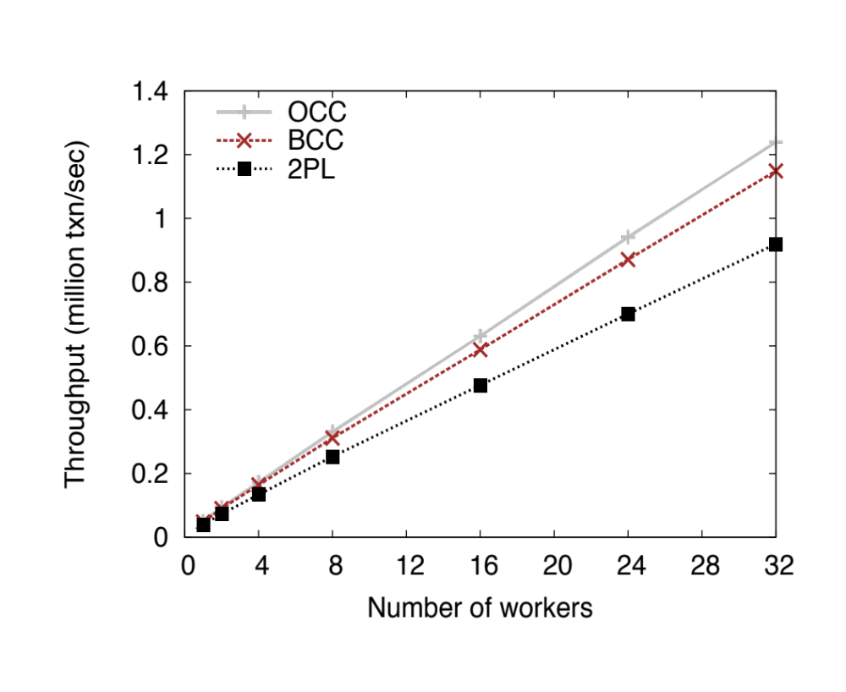
Comparable Performance in Low Contention
TPC-C (all-mix)
7.29% overhead over OCC

Slide 58
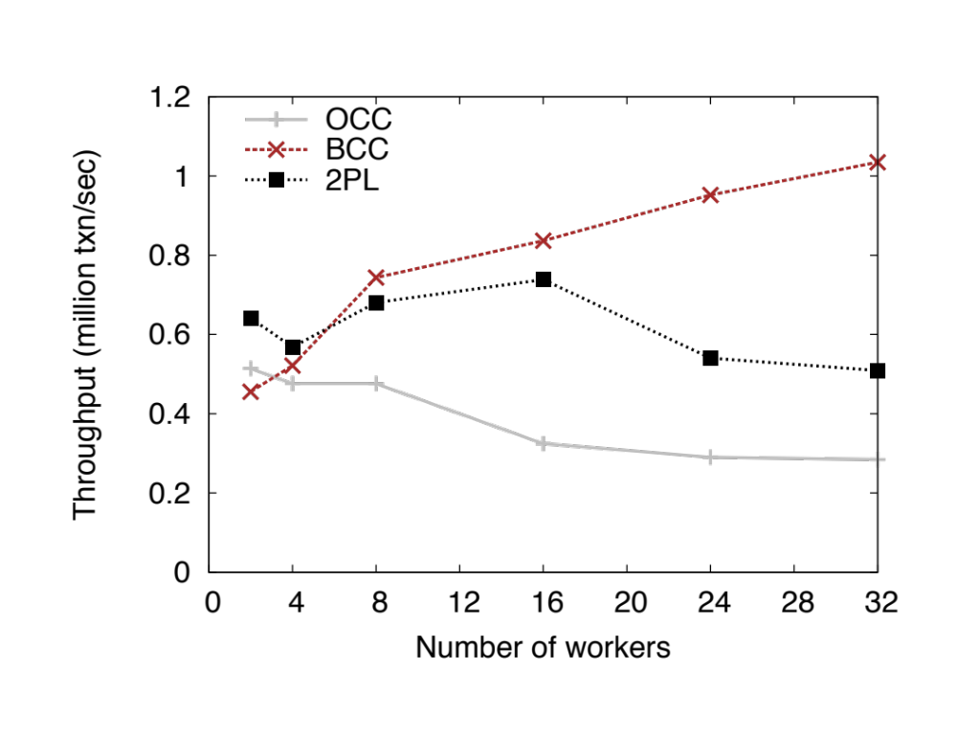
Effectiveness in High Contention (2PL is better than OCC)
TPC-W (Cart-Buy mix)
3.68x Improvement over OCC

Slide 59
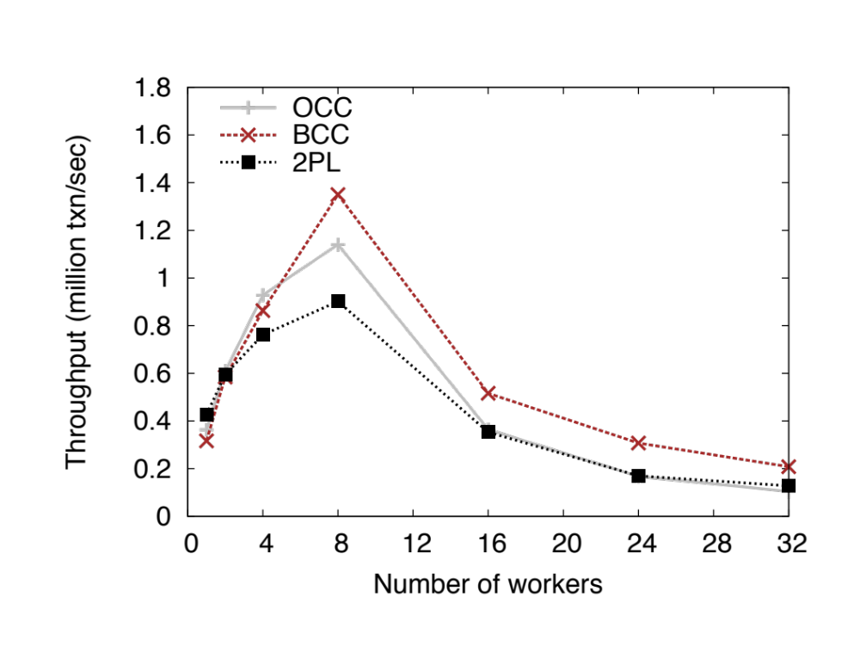
Effectiveness in High Contention (2PL is close to OCC)
YCSB (16-tuples)
1.99x Improvement over OCC

Slide 60
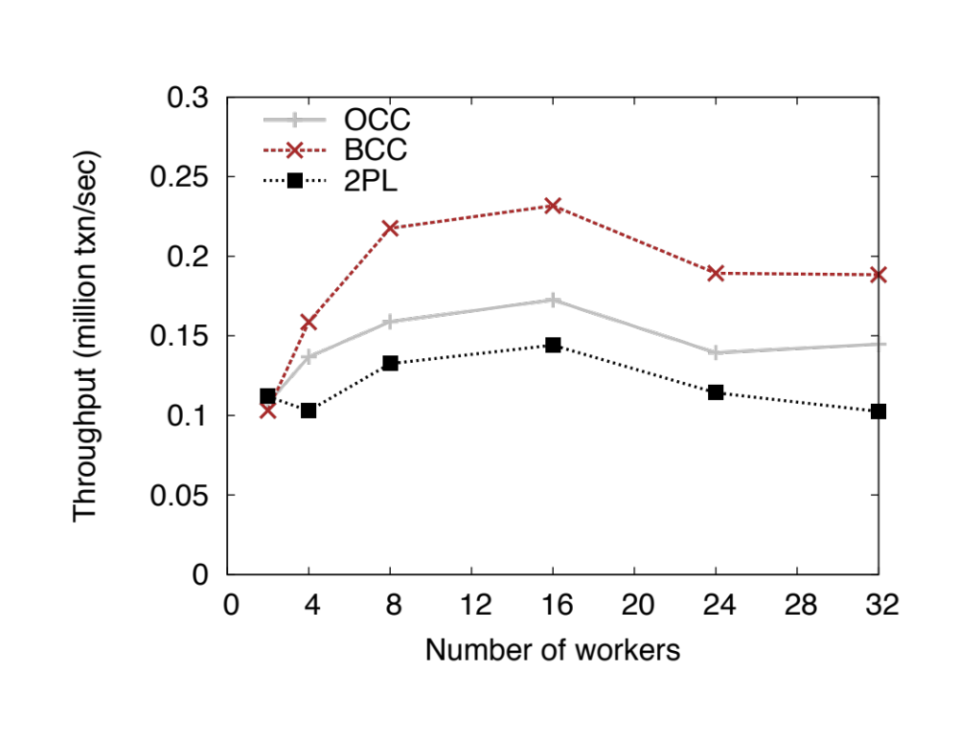
Effectiveness in High Contention (OCC is better than 2PL)
TPC-C (NewOrder-Payment mix)
35% Improvement over OCC

Slide 61
Conclusions
OCC's simple validation only work well in low contention
BCC makes a critical step on validation
The effectiveness of BCC is achieved by
  The correctness and tipping point of its validation
  Low overhead implementation of the validation
  Retaining all the merits of OCC

