Slide 1

iNode-based File System
Computer System Engineering, Fall 2020 (IPADS, SJTU)
Seven-layer abstraction
Yubin Xia

Slide 2
iNode-based File System

Slide 3
File
A file has two key properties
  It is durable & has a name
  It is a high-level version of the memory abstraction
System layer implements files using modules from hardware layer
  Divide-and-conquer strategy
  Makes use of several hidden layers of machine-oriented names (addresses), one on another, to implement files
  Maps user-friendly names to these files
Notes:
Everything is a file:
same operations: open, read, write, ioctl
same naming scheme

Slide 4
The Big Picture
User
App-1
App-2
App-3
OPEN("a.txt", "rw")
READ(…)
WRITE(…)
…
File System
Kernel
Disk Driver
READ(block-addr, buf)
WRITE(block-addr, buf)
Hardware
Memory
Disk
(4TB = 2³⁰ 4KB blocks)

Slide 5
Abstraction: API of UNIX File System
OPEN, READ, WRITE, SEEK, CLOSE
FSYNC
STAT, CHMOD, CHOWN
RENAME, LINK, UNLINK, SYMLINK
MKDIR, CHDIR, CHROOT
MOUNT, UNMOUNT
….

Slide 6
A Naive File System
Each file occupies one continuous range of blocks
Use block index as file name
Every file write will either append or reallocate
What are the problems?
101
102
103
104
105
106
107
108
109
110
111
112
113
114
115
116
117
118
119
120

Slide 7
inode: 7 software layers

Slide 8

The Naming Layers of the UNIX FS (version 6)

Slide 9

L1: Block Layer
Block num
Disk
Block
Mapping: block number -> block data
  How to know the size of block?
  How to know which block is free?
  These metadata will also be stored on the same disk
    Super block!

Slide 10
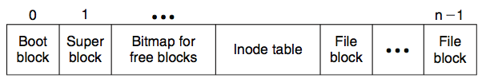
Super Block
Block num
Disk
Block
One superblock per file system
  Kernel reads superblock when mount the FS
Superblock contains
  Size of the inode list
  Number of free inodes
  A list of free inodes
  Index to next free inode
  Size of the blocks
  Number of free blocks
  A list of free blocks
  Index to next free block
  Lock field for free block and free inode lists
  Flag to indicate modification of superblock
...
Notes:
We need to organize the blocks to store larger size data

Slide 11
L1: Block Layer
Block num
Disk
Block
Block size: a trade-off
  Neither too small or too big
  Q: What will happen if the block size is too small? What if too big?

Slide 12
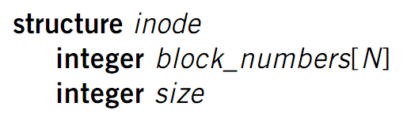
L2: File Layer
File
(inode)
Block num
Disk
Block
File requirements
  Store items that are larger than one block
  May grow or shrink over time
  A file is a linear array of bytes of arbitrary length
  Record which blocks belong to each file
inode (index node)
  A container for metadata about the file

Slide 13
inode for Larger Files
File
(inode)
Block num
Disk
Block
block
indirect block
double indirect block
triple indirect block
Data
Data
Data
Data
an inode
Data
Data
Notes:
with a 512 byte block size, and 4 byte block pointers, each indirect block can consist of 128 (512 / 4) pointers.
For one double indirect block: (128*128*512) / (1024*1024)

Slide 14
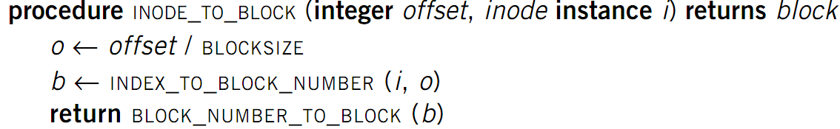
L2: File Layer
File
(inode)
Block num
Disk
Block
Given an inode, can map a block index number (of a file)
to a block number (of a disk)
  Index number: e.g., the 3rd block of a file is number 78

Slide 15
L3: inode Number Layer
Inode num
File
(inode)
Block num
Disk
Block
Mapping: inode number -> inode
inode table: at a fixed location on storage
  inode number is the index of inode table
  Track which inode number are in use, e.g. free list, a field in inode

Slide 16
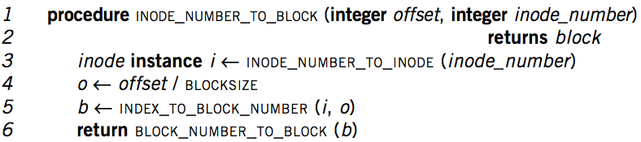
Put Layers so far Together
Inode num
File
(inode)
Block num
Disk
Block
inode number is enough to operate a file
However,
  inode numbers are convenient names only for computer
  inode numbers change on different storage device
A file needs a more user-friendly name!

Slide 17
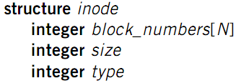
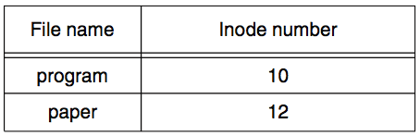
L4: File Name Layer
File
name
Inode num
File
(inode)
Block num
Disk
Block
File name
  Hide metadata of file management
  Files and I/O devices
Mapping
  Mapping table is saved in directory
  Default context: current working directory
    Context reference is also an inode number
    The inode number of current directory is also a file
  Max length of a file name is 14 bytes in UNIX version 6
This is what a directory looks like
Notes:
CHDIR can set working directory

Slide 18
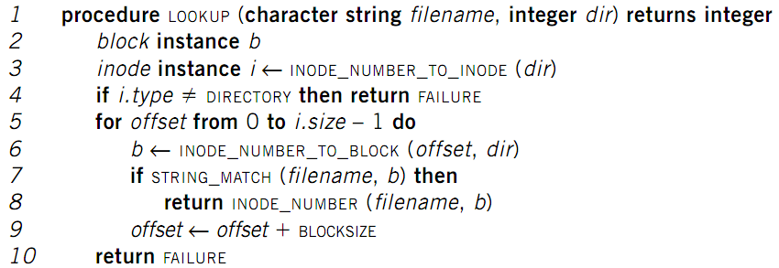
LOOKUP in a Directory
File
name
Inode num
File
(inode)
Block num
Disk
Block
Name compare method: STRING_MATCH
LOOKUP("program", dir) will return 10
Next problem: what if too many files?

Slide 19
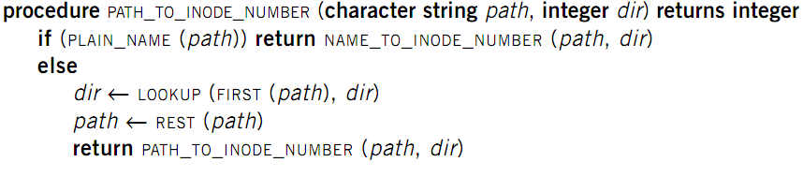
L5: Path Name Layer
File
name
Inode num
File
(inode)
Block num
Disk
Block
Path name
Hierarchy of directories and files
  Structured naming: E.g. "projects/paper"
    PLAIN_NAME() returns true if no '/' in the path
Context: the working directory

Slide 20
Links
File
name
Inode num
File
(inode)
Block num
Disk
Block
Path name
LINK: shortcut for long names
  LINK("Mail/inbox/new-assignment", "assignment")
  Turns strict hierarchy into a directed graph
    Users cannot create links to directories -> acyclic graph
  Different filenames, same inode number
UNLINK
  Remove the binding of filename to inode number
  If UNLINK last binding, put inode/blocks to a free-list
    A reference counter is needed

Slide 21
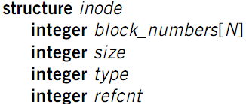
Links
File
name
Inode num
File
(inode)
Block num
Disk
Block
Path name
Reference count
  An inode can bind multiple file names
  +1 when LINK, -1 when UNLINK
  A file will be deleted when reference count is 0
  No cycle allowed
    Except for '.' and '..'
    Naming current and parent
    directory with no need to
    know their names

Slide 22

No Cycle for LINK
File
name
Inode num
File
(inode)
Block num
Disk
Block
Path name
x
x
x
a
a
a
25:1
25:2
25:1
b
c
b
c
b
/a/b is a directory
The refcnt of a is 1
a's inode num is 25
LINK ("/a/b/c", a")
Cause a cycle!
Refcnt of a is 2
UNLINK ("/a")
Refcnt of a is 1, so the inode 25 is not deleted
Now inode 25 is dis-connected from graph
No one can get it!
Think:
Why deleting a directory requires
to delete all the files in it first?

Slide 23
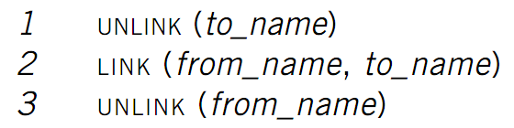
Renaming - 1
File
name
Inode num
File
(inode)
Block num
Disk
Block
Path name
Text edit usually save editing file in a temp file
  Edit in .a.txt.swp, then rename .a.txt.swp to a.txt
What if the computer fails between 1 & 2?
  The file to_name will be lost, which will surprise the user
  Need atomic action (in chap-9)

Slide 24

Renaming - 2
File
name
Inode num
File
(inode)
Block num
Disk
Block
Path name
Weaker specification without atomic actions
  1. Changes the inode number in for to_name to the inode number of from_name
  2. Removes the directory entry for from_name
If fails between 1 & 2
  Must increase reference count of from_name's inode on recovery
If to_name already exists
  It will always exist even if the machine fails between 1 & 2

Slide 25

L6: Absolute Path
Name Layer
Absolute path
File
name
Inode num
File
(inode)
Block num
Disk
Block
Path name
HOME directory
  Every user's default working directory
  Problem: no sharing of HOME files between users
Context: the root directory
  A universal context for all users
  Well-known name: '/'
  Both '/.' and '/..' are linked to '/'

Slide 26
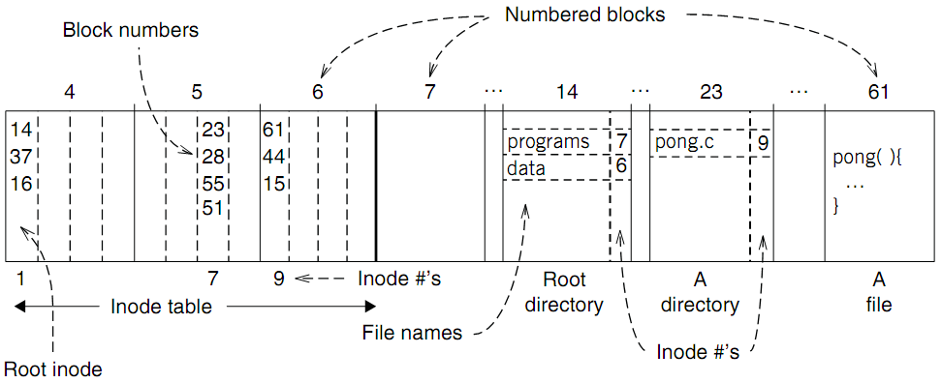
An Example: Find Blocks of "/programs/pong.c"

Slide 27
An Example: Find Blocks of "/programs/pong.c"
'/' root directory: inode is 1

Slide 28
An Example: Find Blocks of "/programs/pong.c"
Find the first directory in '/' by block number

Slide 29
An Example: Find Blocks of "/programs/pong.c"
Find '/programs' by comparing name

Slide 30
An Example: Find Blocks of "/programs/pong.c"
Find '/programs' inode by its inode number 7

Slide 31
An Example: Find Blocks of "/programs/pong.c"
Find the first file in '/programs/'

Slide 32
An Example: Find Blocks of "/programs/pong.c"
Find '/programs/pong.c' by comparing its name

Slide 33
An Example: Find Blocks of "/programs/pong.c"
Find inode of '/programs/pong.c' by the inode number 9

Slide 34
An Example: Find Blocks of "/programs/pong.c"
Find block number of '/programs/pong.c'

Slide 35
An Example: Find Blocks of "/programs/pong.c"
Find data of block 61 by its block number
  And data of block 44 & 15

Slide 36
L7: Symbolic Link Layer
Symbolic link
Absolute path
File
name
Inode num
File
(inode)
Block num
Disk
Block
Path name
Name files on other disks
  Inode is different on other disks
  Supports to attach new disks to the name space
Two options
  Make inodes unique across all disks (not good)
  Create synonyms for the files on the other disks
Soft link (symbolic link)
  SYMLINK
  Add another type of inode

Slide 37
Case Study: Ext4

Slide 38
Directly Dump a Directory
$ ls -ai temp
7536909 . 7530417 .. 7536939 a 7536940 b 7536941 c 7536942 d
$ echo “obase=16;7536909;7530417;7536939;7536940;7536941;7536942" | bc
73010D 72E7B1 73012B 73012C 73012D 73012E
$ sudo /sbin/debugfs /dev/sda1
debugfs 1.43.4 (31-Jan-2017)
debugfs: dump temp temp.out
debugfs: quit
$ xxd temp.out
0000000: 0d01 7300 0c00 0102 2e00 0000 b1e7 7200 ..s...........r.
0000010: 0c00 0202 2e2e 0000 2b01 7300 0c00 0101 ........+.s.....
0000020: 6100 0000 2c01 7300 0c00 0101 6200 0000 a...,.s.....b...
0000030: 2d01 7300 0c00 0101 6300 0000 2e01 7300 -.s.....c.....s.
0000040: c40f 0101 6400 0000 0000 0000 0000 0000 ....d...........
0000050: ...

Slide 39
Directly Dump a Directory
struct ext4_dir_entry {
uint32_t inode_number;
uint16_t dir_entry_length;
uint8_t file_name_length;
uint8_t file_type;
char name[EXT4_NAME_LEN];
}
0d01 7300 0c00 0102 2e00 0000
b1e7 7200 0c00 0202 2e2e 0000
2b01 7300 0c00 0101 6100 0000
2c01 7300 0c00 0101 6200 0000
2d01 7300 0c00 0101 6300 0000
2e01 7300 c40f 0101 6400 0000
File Type
0x0: Unknown
0x1: Regular file
0x2: Directory
0x3: Character device file
0x4: Block device file
0x5: FIFO
0x6: Socket
0x7: Symbolic link
0d01 7300 0c00 0102 2e00 0000
0d01 7300: inode number
0c00: entry length is 12 bytes
01: file name length is 1 byte
01: file type is regular file
2e00 0000: file name (2e -> ".")

Slide 40
Two Types of Links (Synonyms)
  Add link "assignment" to "Mail/new-assignment"
    Hard link
      No new file is created
      Just add a binding between a string and an existing inode
      Target inode reference count is increased
      If target file is deleted, the link is still valid
    Soft link
      A new file is created, the data is the string "Mail/new-assignment"
      Target inode reference count is not increased
      If target file is deleted, the link is not valid
Soft link can create cycle by SYMLINK("a", "a")
Notes:
Here comes a demo~

Slide 41
Directly Dump a Symbolic Link
$ ln -s "/tmp/abc" s-link
$ ls –l s-link
7536945 lrwxrwxrwx 1 xiayubin 8 Sep 20 08:01 s-link -> /tmp/abc
$ readlink s-link
/tmp/abc
$ cat s-link
cat: slink: No such file or directory
$ echo "hello, world" > /tmp/abc
$ cat s-link
hello, world
What does "8" means?
File size

Slide 42
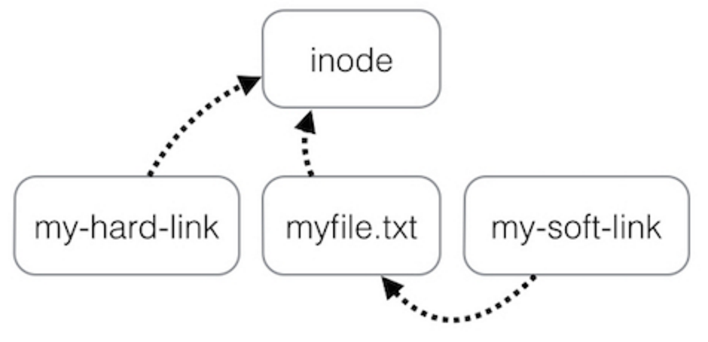
Two Types of Links (Synonyms)
By inode number
By inode number
By file name

Slide 43
Sidebar: Notice the Context Change
Another interesting behavior of soft link
  Current directory is "/Scholarly/programs/www"
  This directory contains a soft link
    "CSE-web" -> "Scholarly/programs/www"
  Run following commands
    cd CSE-web
    cd ..
  What is the current directory? Why?
    ".." is resolved in a new default context: by bash, not file system

Slide 44
Sidebar: Notice the Context Change
The bash tries to be "human-friendly"
  When you cd /into/a/symlink/, the shell remembers the old location (in $OLDPWD) and will use that directory when you cd .. under the assumption that you want to return to the directory you were just in
If you want to use the real .., then you must also use "cd -P .."
The -P option says to use the physical directory
structure instead of following symbolic links (see
also the -P option to the set builtin command);
the -L option forces symbolic links to be followed.
$ cd
$ cd a/b/symlink
$ cd -P ..
$ pwd -P
/home/sarnold
$

Slide 45
Summary of File System's 7 Layers
File name is not part of a file (neither data nor metadata!)
  Name is not a part of an inode
  Name is actually the data of a directory
  An inode can have several names (hard LINK)
Hard links are equal
  If a file has two names, both are links (instead of "a link and a name")
Directory size is small
  Only mapping from name to inode number
  The term "folder" is somewhat misleading
Notes:
Vnode is in Memory-only
It hides different FS implementation from upper layers
Vnode only exists when a file is open

Slide 46
L7: Symbolic Link Layer
Symbolic link
Absolute path
File
name
Inode num
File
(inode)
Block num
Disk
Block
Path name
MOUNT
  Record the device and the root inode number in memory
  Record in the in-memory version of the inode for "/dev/fd1" its parent's inode
  UNMOUNT undoes the mount
Change to the file name layer
  If LOOKUP runs into an inode on which a file system is mount, it uses the root inode of that file system for the lookup

Slide 47
Other Choices instead of inode
Method-1: use continue blocks
  Re-allocate if the file expands
  E.g., data in memory
  Why not?
How to integrate different FS?
  vnode (will discuss later)
  Interface is similar with inode
Method-2: use a linked list
  Each block links to its next block
  Use special one as EOF (End of File)
  E.g., FAT32
  Why not?

Slide 48
FAT (File Allocation Table) File System
File is collection of disk blocks
FAT is linked list 1-1 with blocks
File Number is index of root
of block list for the file
File offset (o = < B, x > )
Follow list to get block #
Unused blocks ⬄ FAT free list
FAT
Disk Blocks
file number
0:
0:
31:
File 31, Block 0
File 31, Block 1
free
File 31, Block 2
N-1:
N-1:
memory

Slide 49
FAT Properties
File is collection of disk blocks
FAT is linked list 1-1 with blocks
File Number is index of root
of block list for the file
File offset (o = < B, x > )
Follow list to get block #
Unused blocks ⬄ FAT free list
Ex: file_write(31, < 3, y >)
  Grab blocks from free list
  Linking them into file
FAT
Disk Blocks
file number
0:
0:
31:
File 31, Block 0
File 31, Block 1
File 31, Block 3
free
File 31, Block 2
N-1:
N-1:
memory

Slide 50
FAT File System
File allocation table (FAT)
  Organize files as linked lists
No inode
  File metadata: name & size
  Metadata are saved in dirs
Root dir at sector 0
Link? Permission?

Slide 51
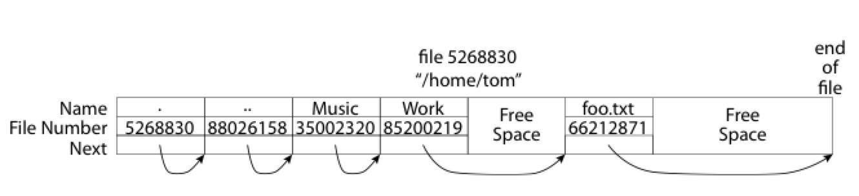
What about the Directory in FAT?
Essentially a file containing
<file_name: file_number> mappings
Free space for new entries
In FAT: file attributes are kept in directory (!!!)
Each directory a linked list of entries
Q: Where to find root directory ( "/" )?

Slide 52
Question
What are the differences between inode and FAT?
Support hard link? Soft link?

