Slide 1

File System and Disk I/O
Computer System Engineering, Fall 2020 (IPADS, SJTU)
Interrupt, PIO, MMIO, DMA
Yubin Xia

Slide 2
Review: The File System API
API
  CHDIR, MKDIR
  CREAT, LINK, UNLINK, RENAME
  SYMLINK
  MOUNT, UNMOUNT
  OPEN, READ, WRITE, CLOSE
  SYNC
Implemented as system calls to user applications
  Kernel has many sets of function pointers implementing the API
  Each set is specific to a FS (chose at mount point)
Notes:
What is the difference between FILE* and fd? Fopen and open?

Slide 3
Review: File Cursor Sharing
fd_table
file_table
fd
index
index
inode num
file cursor
refcnt
Process A
3
115
115
23
128
1
116
23
240
2
fd
index
Process B
3
116
...
fd
index
C is B's child
3
116
Process A, B and C all open just one file with inode number 23
Process A and B open the same file, not share file cursor
Process B and C share the file cursor
Notes:
Note: the refcnt is not the refcnt of inode!

Slide 4
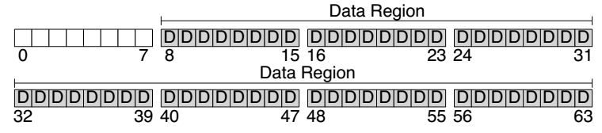
Disk Layout of a Simple File System

Slide 5
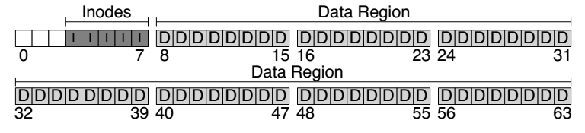
At the Head of a Disk Partition
S
i
d
i: inode free block bitmap
d: data free block bitmap
S: super-block
  How many inodes: 80
  How many data blocks: 56
  Where the inode table begins: block 3
  …
  A magic number to identify the file system type
The super-block is used when
the file system is mounted

Slide 6
Questions
How many read and write in a OPEN?
How many read and write in a READ?
How many read and write in a CREATION?

Slide 7
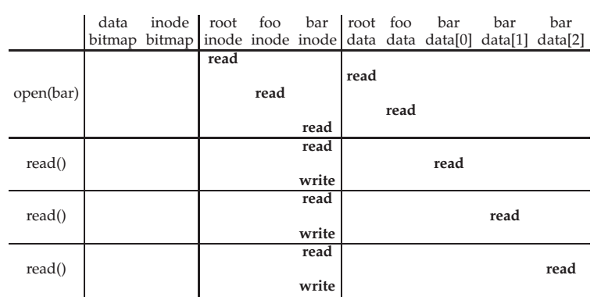
File Open & Read Timeline
open("/foo/bar", O_RDONLY)
Why "write" on bar inode in a read operation? Why no "write" on foo inodes?
Notes:
The write is to update atime
foo is directory, its atime is not updated (will be updated on readdir)
https://pubs.opengroup.org/onlinepubs/9699919799/

Slide 8
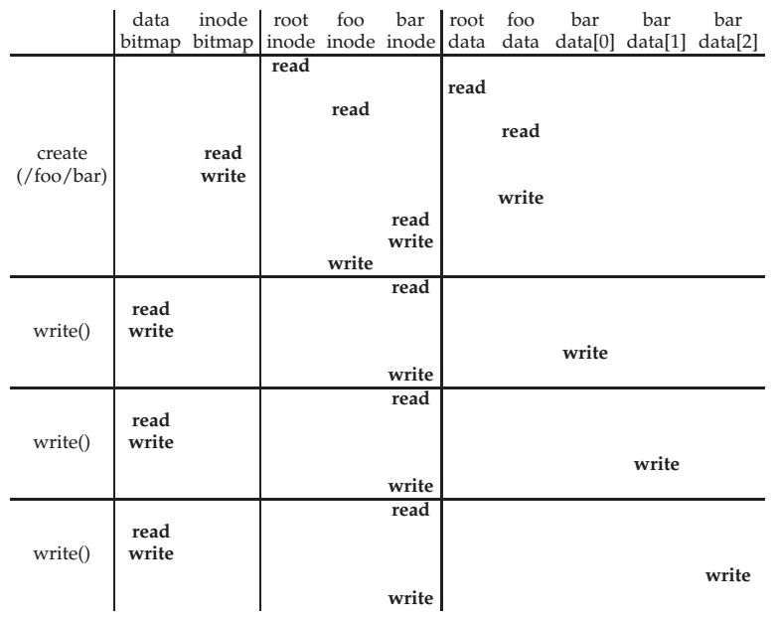
File Creation Timeline

Slide 9
WRITE & CLOSE
WRITE is similar to READ
  Allocate new block if necessary
  Update inode's size and mtime
CLOSE
  Free the entry in the fd_table
  Decrease the reference counter in file table
  Free the entry in file table if counter is 0
Failures in the middle may cause inconsistency!

Slide 10
Questions
When writing, which order is preferred?
  Allocate new blocks, write new data, update size
  Allocate new blocks, update size, write new data
  Update size, allocate new blocks, write new data

Slide 11
Delete after OPEN but before CLOSE
One process has OPENed a file
Another process delete the file
  by removing the last name pointing to the file
  reference counter is now 0
The inode is not freed until the first process calls CLOSE
  On Windows, it may forbid to delete an opened file

Slide 12
SYNC
Block cache
  Cache of recently used disk blocks
  Read from disk if cache miss
  Delay the writes for batching
  Improve performance
  Problem: may cause inconsistency if fail before write
SYNC
  Ensure all changes to a file have been written to the storage device

Slide 13
SYNC
Application
SYNC
File System
Buffer Cache
Block cache (aka., buffer cache)
  Cache of recently used disk blocks
  Read from disk if cache miss
  Delay the writes for batching
  Improve performance
  Problem: may cause inconsistency if fail before write
SYNC
  Ensure all changes to the file have been written to the storage device
  Note: FLUSH is a disk command of writing disk cache to platters
Disk Driver
FLUSH
Disk Cache
Magnetic Disk

Slide 14
Canonical I/O Protocol
How to control a disk?

Slide 15
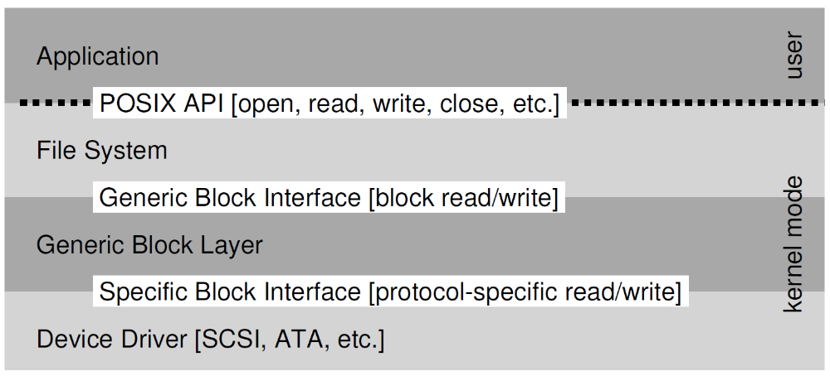
Review: Layers

Slide 16
A Canonical Device
Registers
Status
Address
Data
Command
Interface
Micro-controller (CPU)
Memory (DRAM or SRAM or both)
Other Hardware-specific Chips
Internals

Slide 17
A Canonical Protocol
While(STATUS == BUSY)
; //wait until device is not busy
Write data to DATA register and address to ADDRESS register
Write command to COMMAND register
(Doing so starts the device and executes the command )
While(STATUS == BUSY)
; //wait until device is done with your request

Slide 18
A Canonical Protocol
While(STATUS == BUSY)
; //wait until device is not busy
Write data to DATA register and address to ADDRESS register
Write command to COMMAND register
(Doing so starts the device and executes the command )
While(STATUS == BUSY)
; //wait until device is done with your request
Polling: CPU waits until the device is ready to receive a command by repeatedly reading the status register

Slide 19
A Canonical Protocol
While(STATUS == BUSY)
; //wait until device is not busy
Write data to DATA register and address to ADDRESS register
Write command to COMMAND register
(Doing so starts the device and executes the command )
While(STATUS == BUSY)
; //wait until device is done with your request
If this were a disk, then multiple writes would need to take place to transfer a disk block (say 512 Bytes) to the device
When the main CPU is involved with the data movement (as in this example protocol), we refer to it as programmed I/O (PIO)

Slide 20
A Canonical Protocol
While(STATUS == BUSY)
; //wait until device is not busy
Write data to DATA register and address to ADDRESS register
Write command to COMMAND register
(Doing so starts the device and executes the command )
While(STATUS == BUSY)
; //wait until device is done with your request
OS writes a command to the command register
Doing so implicitly lets the device know that both the data is present and that it should begin working on the command

Slide 21
A Canonical Protocol
While(STATUS == BUSY)
; //wait until device is not busy
Write data to DATA register and address to ADDRESS register
Write command to COMMAND register
(Doing so starts the device and executes the command )
While(STATUS == BUSY)
; //wait until device is done with your request
OS waits for the device to finish by again polling it in a loop, waiting to see if it is finished
It may then get an error code to indicate success or failure

Slide 22
A Canonical Protocol
While(STATUS == BUSY)
; //wait until device is not busy
Write data to DATA register and address to ADDRESS register
Write command to COMMAND register
(Doing so starts the device and executes the command )
While(STATUS == BUSY)
; //wait until device is done with your request
Problem: polling wastes too much CPU
Solution: using interrupt

Slide 23
Interrupts
Lowering CPU Overhead

Slide 24
Lowering CPU Overhead With Interrupts
Instead of polling, the OS can issue a request, put the calling process to sleep, and context switch to another task
When the device finishes, it will raise a hardware interrupt
The CPU jumps into the OS at a pre-determined interrupt service routine (ISR) or more simply an interrupt handler
The handler is just a piece of OS code that will finish the request
  For example, by reading data and perhaps an error code from the device, and wake the process waiting for the I/O, which can then proceed as desired

Slide 25
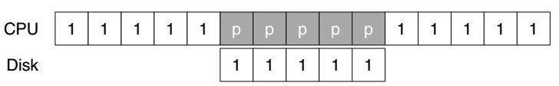
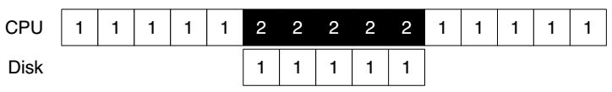
Lowering CPU Overhead With Interrupts
CPU runs thread 1
CPU is polling without doing anything
Using Polling
CPU can run thread 2
Using Interrupt

Slide 26
Example of Interrupt: Keyboard
When user depresses a key, keyboard SENDs a message to the processor containing the key value
As the processor is not ready, its bus interface:
  copies the data into a temporary register,
  acknowledges the keyboard,
  SENDs an interrupt signal to the processor
The processor handles the interrupt in the next cycle
  SENDs the value over the bus to memory module
Only suitable for slow device

Slide 27
Problem of Interrupt: Livelock
Using interrupts arises in networks
  When a huge stream of incoming packets each generate an interrupt it is possible for the OS to livelock
  Livelock: the CPU only processes interrupts and never allows a user-level process to run and actually service the requests
Solution: hybrid
  Default using interrupts
  When an interrupt happens, handle it and polling for a while to solve subsequence requests
  If no further request or time-out, fall back to interrupt again
  Used in Linux network driver with the name NAPI (New API)

Slide 28
Interrupt Coalescing for Optimization
A device which needs to raise an interrupt first waits for a bit before delivering the interrupt to the CPU
While waiting, other requests may soon complete, and thus multiple interrupts can be merged into a single interrupt delivery, thus lowering the overhead of interrupt processing
Note: waiting too long will increase the latency of a request, this is a common trade-off in systems

Slide 29
DMA, PIO, MMIO
More Efficient Data Movement

Slide 30
DMA for Disk Device
DMA (Direct Memory Access)
  A processor SENDs a request to a disk controller to READ a block of data
  Including the address of a buffer in memory
The disk SENDs the data directly to memory
  Incrementing the memory address appropriately

Slide 31
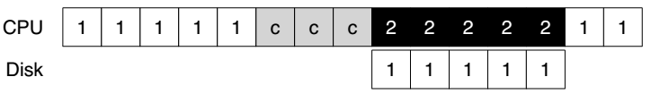
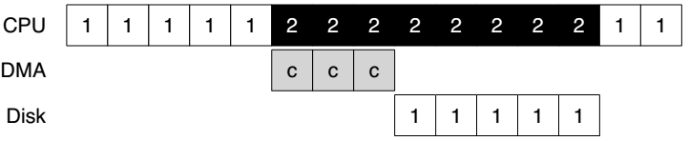
DMA for Disk Device
'c' is for copy
Without DMA
With DMA

Slide 32
DMA for Disk Device
Benefits of DMA
  Relieve the CPU's load to execute other program
  Reduce one transfer (original two)
  Take better advantage of long message if the bus supports
  Amortize the overhead of the bus protocol

Slide 33
Methods of Device Interaction
Method-1: PIO through I/O instructions
  On x86, IN and OUT instructions
  Must be executed in privileged mode (kernel mode)
Method-2: Memory-mapped I/O
  Using LOAD and STORE
  Can also be executed in unprivileged mode (user mode)

Slide 34
I/O Instructions
Example: send data to a device by OUT instruction
  out %eax, 0x120
  Specify a register with data (%eax)
  Specific an I/O Port which names the device (0x120)
    I/O port: another name space, not physical memory space
Privileged instructions
  Only the OS can directly communicate with devices

Slide 35
Memory Mapped I/O
Use LOAD and STORE instructions to address the register and buffer of the I/O modules
  Just like access memory
  Address is overloaded name with location info
Provide a uniform interface to bus modules
  MMU translates virtual address to physical address
    Physical address is system bus address
  I/O modules translate bus address to register address internally

Slide 36
Memory Mapped I/O
Processor
Virtual address
MMU
Physical address (System bus address)
Internally translate
to register address
Memory
Disk
Keyboard

Slide 37
NOTE: Volatile Address if using MMIO
void main(void)
{
void *pdev = (void *) 0x40400000;
size_t size = (1024*1024);
int *base;
volatile int *pcid, cid;
base = mmap(pdev, size, PROT_READ|PROT_WRITE,
MAP_ANONYMOUS|MAP_PRIVATE, -1, 0);
if (base == MAP_FAILED) errx(1, "mmap failure");
pcid = (int *) (((void *) base) + 0xf0704);
cid = *pcid;
printf(“cid = %d\n", cid);
cid = *pcid;
printf(“cid = %d\n", cid);
munmap(base, size);
}
If no volatile is used, the compiler will think
the two printf() are redundant and will
eliminate the second memory load operation

Slide 38
Sidebar: Another Volatile Example
#include <stdio.h>
void main()
{
int i = 10;
int a = i;
printf("i= %d\n",a);
// Change value of i
__asm {
mov dword ptr [ebp-4], 20h
}
int b = i;
printf("i= %d\n",b);
}
Is volatile needed here?
Notes:
Yes. The compiler does not know [ebp-4] is the address of i.

Slide 39
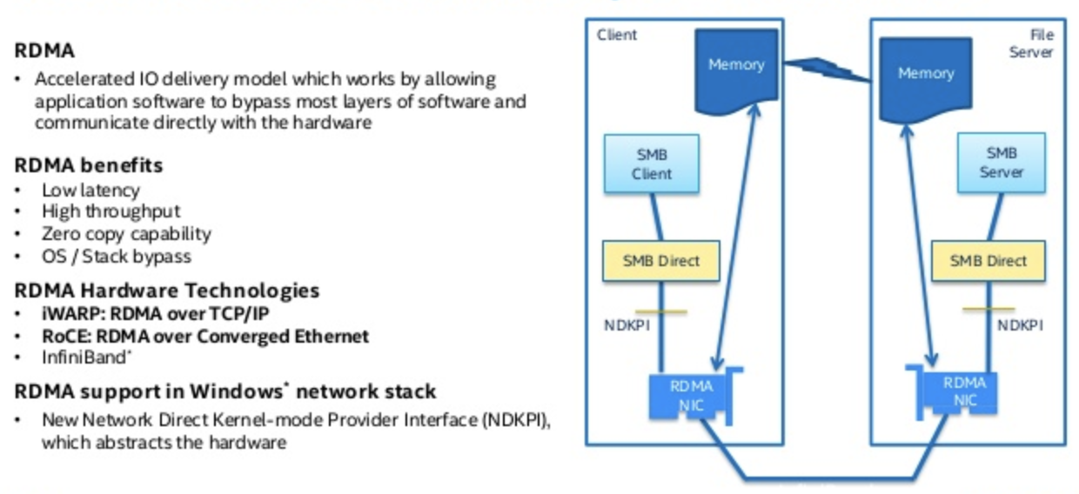
Sidebar: RDMA (Remote DMA)

Slide 40
Case Study: IDE Disk Driver
The code is from xv6

Slide 41
IDE Protocol
Address 0x1F0 = Data Port
Address 0x1F1 = Error
Address 0x1F2 = Sector Count
Address 0x1F3 = LBA low byte
Address 0x1F4 = LBA mid byte
Address 0x1F5 = LBA hi byte
Address 0x1F6 = 1B1D TOP4LBA: B=LBA, D=drive
Address 0x1F7 = Command/status
Wait for drive to be ready (read 0x1F7)
  Read Status Register until drive is READY
  and not BUSY
Write parameters to command registers (write 0x1F2 – 0x1F6)
  Sector count
  Logical block address (LBA) of the sectors to be accessed
  Drive number (Master=0x00 or slave=0x10, as IDE permits just two drives)
Start the I/O (write 0x1F7)
  By issuing read/write to command register
  Write READ / WRITE command to command register

Slide 42
IDE Protocol
Address 0x1F0 = Data Port
Address 0x1F1 = Error
Address 0x1F2 = Sector Count
Address 0x1F3 = LBA low byte
Address 0x1F4 = LBA mid byte
Address 0x1F5 = LBA hi byte
Address 0x1F6 = 1B1D TOP4LBA: B=LBA, D=drive
Address 0x1F7 = Command/status
Data transfer (for writes)
  Wait until drive status is READY and
  DRQ (drive request for data)
  Write data to data port
Handle interrupts
  In the simplest case, handle an interrupt for each sector transferred
  More complex approaches allow batching and thus one final interrupt when the entire transfer is complete
Error handling
  After each operation, read the status register
  If the ERROR bit is on, read the error register for details

Slide 43
IDE Disk Driver using PIO
Address 0x1F0 = Data Port
Address 0x1F1 = Error
Address 0x1F2 = Sector Count
Address 0x1F3 = LBA low byte
Address 0x1F4 = LBA mid byte
Address 0x1F5 = LBA hi byte
Address 0x1F6 = 1B1D TOP4LBA: B=LBA, D=drive
Address 0x1F7 = Command/status
static int ide_wait_ready() {
while (((int r = inb(0x1f7)) & IDE_BSY) || !(r & IDE_DRDY))
; // loop until drive isn't busy
}
static void ide_start_request(struct buf *b) {
ide_wait_ready();
outb(0x3f6, 0); // generate interrupt
outb(0x1f2, 1); // how many sectors?
outb(0x1f3, b->sector & 0xff); // Block address here ...
outb(0x1f4, (b->sector >> 8) & 0xff); // ... and here
outb(0x1f5, (b->sector >> 16) & 0xff); // ... and here!
outb(0x1f6, 0xe0 | ((b->dev&1)<<4) | ((b->sector>>24)&0x0f));
if(b->flags & B_DIRTY){
outb(0x1f7, IDE_CMD_WRITE); // this is a WRITE
outsl(0x1f0, b->data, 512/4); // transfer data too!
} else {
outb(0x1f7, IDE_CMD_READ); // this is a READ (no data)
}
}
Status
Register
(0x1F7):
7: BUSY
6: READY
5: FAULT
4: SEEK
3: DRQ
2: CORR
1: IDDEX
0: ERROR
Error
Register
(0x1F1):
7: BBK
6: UNC
5: MC
4: IDNF
3: MCR
2: ABRT
1: T0NF
0: AMNF
BBK = Bad Block
UNC = Uncorrectable data error
MC = Media Changed
IDNF = ID mark Not Found
MCR = Media Change Requested
ABRT = Command aborted
T0NF = Track 0 Not Found
AMNF = Address Mark Not Found

Slide 44
IDE Disk Driver using PIO
void ide_rw(struct buf *b) {
acquire(&ide_lock);
for (struct buf **pp = &ide_queue; *pp; pp=&(*pp)->qnext)
; // walk queue
*pp = b; // add request to end
if (ide_queue == b) // if q is empty
ide_start_request(b); // send req to disk
while ((b->flags & (B_VALID|B_DIRTY)) != B_VALID)
sleep(b, &ide_lock); // wait for completion
release(&ide_lock);
}

Slide 45
IDE Disk Driver using PIO
void ide_intr() {
struct buf *b;
acquire(&ide_lock);
if ((b = idequeue) == 0) {
release*&idelock); return;
}
idequeue = b-> next;
if (!(b->flags & B_DIRTY) && ide_wait_ready() >= 0)
insl(0x1f0, b->data, 512/4); // if READ: get data
b->flags |= B_VALID;
b->flags &= ~˜B_DIRTY;
wakeup(b); // wake waiting process
if (ide_queue != 0) // start next request
ide_start_request(ide_queue); // (if one exists)
release(&ide_lock);
}

Slide 46
BUS: a hardware layer

Slide 47
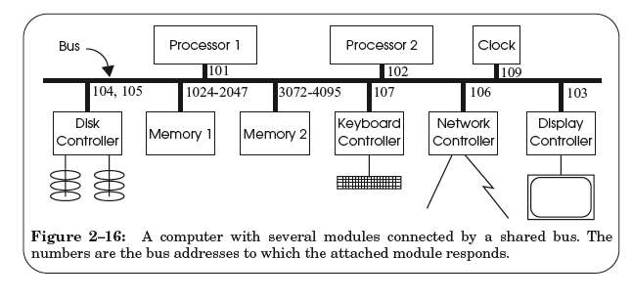
A Hardware Layer: the Bus

Slide 48
Bus Features
A set of wires
  Comprising address, data, control lines that connect to a bus interface on each module
Broadcast link
  Every module hears every message
  Bus address: identify the intended recipient, as the name
Bus arbitration protocol
  Decide which module may send or receive message at any particular time
  Bus arbiter (optional): a circuit to choose which modules can use the bus

Slide 49
Bus Transaction
Source module requires exclusive use of the bus: the data sender
Source module places a bus address of the destine module on the bus
Source module signals READY wire to alert the other module
The destine module singles ACKNOWLEDGE wire after copied the data
  If synchronized, then READY & ACKNOWLEDGE are not needed, just need to check the address lines on each clock cycle
Source module releases the bus

Slide 50
Memory Load Example: LOAD 1742, R1
Processor #2 => all bus modules: {1742, READ, 102}

Slide 51
Memory Load Example: LOAD 1742, R1
Memory 1 recognizes the address is within its range
  By examining just a few high-order address bits

Slide 52
Memory Load Example: LOAD 1742, R1
Memory 1 acknowledges and processor 2 releases the bus
Memory 1 performs the internal operation to get the value
  value <- READ (1742)

Slide 53
Memory Load Example: LOAD 1742, R1
Memory1 => all bus modules: {102, value}

Slide 54
Memory Load Example: LOAD 1742, R1
Processor 2 is waiting for this result, just copies the data on the bus to its register R1

Slide 55
Memory Load Example: LOAD 1742, R1
Processor 2 acknowledges and memory 1 releases the bus

Slide 56
Sync VS. Async
Sync data transfer
  Source & destination cooperate through a shared clock
Async data transfer
  Source and destination cooperate through explicit signal line
    E.g., acknowledge line

Slide 57
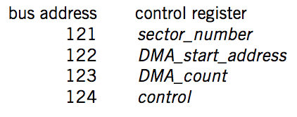
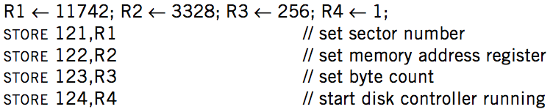

DMA on Bus

Slide 58
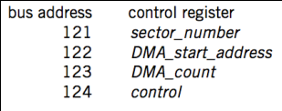
DMA Example
Processor 1
Processor 2
101
102
256-511
3072-4095
121-124
BIOS
Memory
Disk
Processor #1 => all bus modules: {121, WRITE, 11742}
  Disk acknowledge and write the value 11742 to its control register
Processor #1 => all bus modules: {122, WRITE, 3328}
Processor #1 => all bus modules: {123, WRITE, 256}
Processor #1 => all bus modules: {124, WRITE, 1}

Slide 59
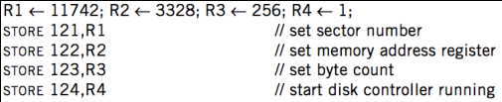
DMA Example
Processor 1
Processor 2
101
102
256-511
3072-4095
121-124
BIOS
Memory
Disk
Disk => all bus modules: {3328, WRITE, data[11742]}
  Memory acknowledge and save data[11742]
Disk => all bus modules: {3329, WRITE, data[11743]}
... (loop)
Disk => all bus modules: {3583, WRITE, data[11997]}

Slide 60
DMA Example
Processor 1
Processor 2
101
102
256-511
3072-4095
121-124
BIOS
Memory
Disk
When transferring is finished, disk controller SENDs message to the processor
  Just like keyboard controller does when press a key
Processor will enter interrupt handler next cycle
Now the processor knows that the DMA is done

Slide 61
Summary

Slide 62
Summary
CPU interacts with physical memory
  Through system bus that connects each other
  Using physical address to name memory content
CPU interacts with a device
  Also using physical address (aka., bus address)
  Polling, interrupt and DMA
  I/O instruction (PIO) or MMIO

Slide 63
Summary
Memory Load/Store
  Between CPU and memory
  Physical memory address space
I/O Operations
  MMIO: map device memory
  and registers into physical
  address space
DMA
  Also using physical address
Processor
PIO (in/out)
/MMIO (load/store)
load/store
Memory
DMA
I/O Device

Slide 64
Questions
Q: How are the physical addresses assigned?
  Memory physical addresses: by BIOS
  Some devices (e.g., keyboard, IDE): fixed for all time
  Other devices: assigned by the OS

Slide 65
Questions
Q: Why not map the whole disk to memory?
  So that the CPU can access a byte on the disk directly by system bus
  1. Too large
  2. Too slow
The principle of least astonishment:
People are part of the system. The design should match
the user's experience, expectations, and mental models
Q: now Intel's 3D-xpoint is 512GB memory, why disk?

