Slide 1

Crash Consistency
Computer System Engineering, Fall 2020 (IPADS, SJTU)
Keep metadata and data consistent
Yubin Xia

Slide 2
Review

Slide 3
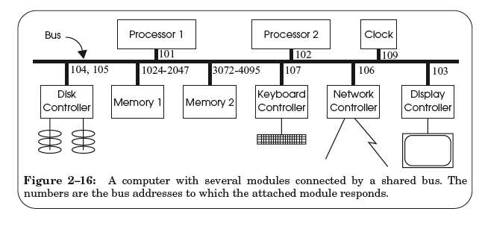
A Hardware Layer: the Bus

Slide 4
Bus Features
A set of wires
  Comprising address, data, control lines that connect to a bus interface on each module
Broadcast link
  Every module hears every message
  Bus address: identify the intended recipient, as the name
Bus arbitration protocol
  Decide which module may send or receive message at any particular time
  Bus arbiter (optional): a circuit to choose which modules can use the bus

Slide 5
Bus Transaction
Source module requires exclusive use of the bus: the data sender
Source module places a bus address of the destine module on the bus
Source module signals READY wire to alert the other module
The destine module singles ACKNOWLEDGE wire after copied the data
  If synchronized, then READY & ACKNOWLEDGE are not needed, just need to check the address lines on each clock cycle
Source module releases the bus

Slide 6
Memory Load Example: LOAD 1742, R1
Processor #2 => all bus modules: {1742, READ, 102}

Slide 7
Memory Load Example: LOAD 1742, R1
Memory 1 recognizes the address is within its range
  By examining just a few high-order address bits

Slide 8
Memory Load Example: LOAD 1742, R1
Memory 1 acknowledges and processor 2 releases the bus
Memory 1 performs the internal operation to get the value
  value <- READ (1742)

Slide 9
Memory Load Example: LOAD 1742, R1
Memory1 => all bus modules: {102, value}

Slide 10
Memory Load Example: LOAD 1742, R1
Processor 2 is waiting for this result, just copies the data on the bus to its register R1

Slide 11
Memory Load Example: LOAD 1742, R1
Processor 2 acknowledges and memory 1 releases the bus

Slide 12
Sync VS. Async
Sync data transfer
  Source & destination cooperate through a shared clock
Async data transfer
  Source and destination cooperate through explicit signal line
    E.g., acknowledge line

Slide 13
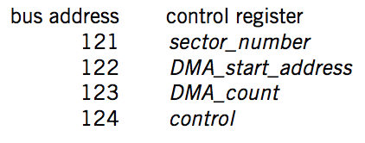
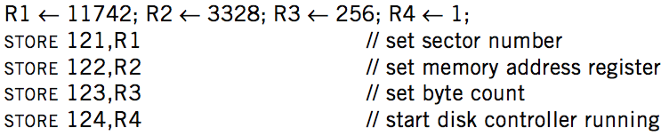

DMA on Bus

Slide 14
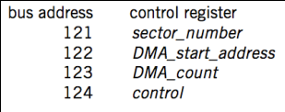
DMA Example
Processor 1
Processor 2
101
102
256-511
3072-4095
121-124
BIOS
Memory
Disk
Processor #1 => all bus modules: {121, WRITE, 11742}
  Disk acknowledge and write the value 11742 to its control register
Processor #1 => all bus modules: {122, WRITE, 3328}
Processor #1 => all bus modules: {123, WRITE, 256}
Processor #1 => all bus modules: {124, WRITE, 1}

Slide 15
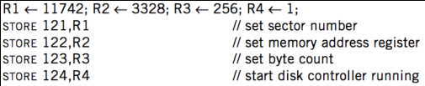
DMA Example
Processor 1
Processor 2
101
102
256-511
3072-4095
121-124
BIOS
Memory
Disk
Disk => all bus modules: {3328, WRITE, data[11742]}
  Memory acknowledge and save data[11742]
Disk => all bus modules: {3329, WRITE, data[11743]}
... (loop)
Disk => all bus modules: {3583, WRITE, data[11997]}

Slide 16
DMA Example
Processor 1
Processor 2
101
102
256-511
3072-4095
121-124
BIOS
Memory
Disk
When transferring is finished, disk controller SENDs message to the processor
  Just like keyboard controller does when press a key
Processor will enter interrupt handler next cycle
Now the processor knows that the DMA is done

Slide 17
Summary

Slide 18
Summary
CPU interacts with physical memory
  Through system bus that connects each other
  Using physical address to name memory content
CPU interacts with a device
  Also using physical address (aka., bus address)
  Polling, interrupt and DMA
  I/O instruction (PIO) or MMIO

Slide 19
Summary
Memory Load/Store
  Between CPU and memory
  Physical memory address space
I/O Operations
  MMIO: map device memory
  and registers into physical
  address space
DMA
  Also using physical address
Processor
PIO (in/out)
/MMIO (load/store)
load/store
Memory
DMA
I/O Device

Slide 20
Questions
Q: How are the physical addresses assigned?
  Memory physical addresses: by BIOS
  Some devices (e.g., keyboard, IDE): fixed for all time
  Other devices: assigned by the OS

Slide 21
Questions
Q: Why not map the whole disk to memory?
  So that the CPU can access a byte on the disk directly by system bus
  1. Too large
  2. Too slow
The principle of least astonishment:
People are part of the system. The design should match
the user's experience, expectations, and mental models
Q: now Intel's 3D-xpoint is 512GB memory, why disk?

Slide 22
Crash Consistency

Slide 23
File System: Durability != Consistency
Topic: tension between fs performance and crash recovery
Disk performance is often a #1 bottleneck
  "how many seeks will that take?"
Durability != Crash consistency
  "Here is all of my data. But some of the metadata is wrong."
Crash recovery is much harder than performance
  "what if a crash occurred at this point?"

Slide 24
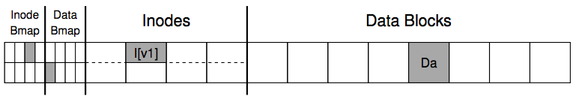
Recall the Example of Appending a File
Inside of I[v1]:
  owner : yubin
  permissions : read-only
  size : 4000
  pointer : 4
  pointer : null
  pointer : null
  pointer : null
Inside of I[v2]:
  owner : yubin
  permissions : read-only
  size : 5000
  pointer : 4
  pointer : 5
  pointer : null
  pointer : null

Slide 25
Crash Scenarios: 1 Succeeds
Imagine only a single write succeeds; there are thus three possible outcomes:
  1. Just the data block (Db) is written to disk
    What will happen?
  2. Just the updated inode (I[v2]) is written to disk
    What will happen?
  3. Just the updated bitmap (B[v2]) is written to disk
    What will happen?

Slide 26
Crash Scenarios: 2 Succeed
Two writes succeed and the last one fails:
  1. The inode (I[v2]) and bitmap (B[v2]) are written to disk, but not data (Db)
  2. The inode (I[v2]) and the data block (Db) are written, but not the bitmap (B[v2])
  3. The bitmap (B[v2]) and data block (Db) are written, but not the inode (I[v2])
Notes:
Metadata is ok, but data is garbage
Metadata inconsistency!
Block leakage. No idea which inode the block belongs to.

Slide 27
Our Expectation
After rebooting and running recovery code
  1. FS internal invariants maintained
    E.g., no block is both in free list and in a file
  2. All but last few operations preserved on disk
    E.g., data I wrote yesterday are preserved
    User might have to check last few operations
  3. No order anomalies
    $ echo 99 > result ; echo done > status

Slide 28
Recovering FS Metadata from Crash
1. Synchronous meta-data update + fsck
  During check, synchronize metadata, such as file size
2. Soft update (FreeBSD fs modified on FFS)
  not covered in this course
3. Logging (ext 3/4), xv6-rev6 and following versions
  Before doing actual meta-data update, log the event
  After crash, recover from log

Slide 29
Sync Metadata Update + fsck

Slide 30
What does fsck do?
1. Check superblock
  E.g., making sure the file system size is greater than the number of blocks allocated
  If error, use an alternate copy of the superblock
2. Check free blocks
  Scans the inodes, indirect blocks, double indirect blocks, etc.
  Uses this knowledge to produce a correct version of the allocation bitmaps
  Same for the inode bitmap

Slide 31
What does fsck do?
3. Check inode states
  Check type: regular file, dir, symbolic link, etc.
  Clear suspect inodes and clear the inode bitmap
4. Check inode links
  Check link count by scanning the entire fs tree
  If count mismatches, fix the inode
  If inode is allocated but no dir contains it, lost+found
5. Check duplicates
  Two inodes refer to the same block
  If one inode is obviously bad, clear it; otherwise, copy the block and give each a copy

Slide 32
What does fsck do?
6. Check bad blocks
  E.g., point to some out-of-range address
  What should fsck do? Just remove the pointer
7. Check directories
  The only file that fsck know more semantic
  Making sure that "." and ".." are the first entries
  Ensure no dir is linked more than once
  No same filename in one dir

Slide 33

Problem of fsck: Too Slow
How long would fsck take?
  an example server: fsck takes 10 minutes per 70GB disk w/ 2 million inodes
  clearly reading many inodes sequentially,
  not seeking
  still a long time, probably linear in disk size
Consider the example before:
  Scan the disk for only three disk block writes
  Just like find a key by searching the entire house

Slide 34
What's the right order of synchronous writes?
File creation
  1. mark inode as allocated
  2. create directory entry
File deletion
  1. erase directory entry
  2. erase inode addrs[], mark as free
  3. mark blocks free

Slide 35
Issues with Synchronous Write
Main issue
  Very slow during normal operation
  Very slow during recovery

Slide 36
Ordinary perf. of sync meta-data update?
Creating a file and writing a few bytes
  Takes 8 writes, probably 80 ms
  (ialloc, init inode, write dirent, alloc data block, add to inode, write data, set length in inode, xxx)
Can create only about a dozen small files per second!
  Think about un-tar or rm *

Slide 37
How to get better performance?
Reality:
  RAM is cheap
  Disk sequential throughput is high, 50 MB/sec
Why not use a big write-back disk cache?
  No sync meta-data update operations
  Only modify in-memory disk cache (no disk write)
  So creat(), unlink(), write() &c return almost immediately
    If cache is full, write LRU dirty block
    Write all dirty blocks every 30 seconds, to limit loss if crash
  This is how old Linux EXT2 file system worked

Slide 38
Write-back Cache
Would write-back cache improve performance?
Why performance would be improved?
  After all, you have to write the disk in the end anyway
Notes:
Write absorbtion

Slide 39
What can go wrong with write-back cache?
unlink() followed by create() an existing file x with some content, all safely on disk
One user runs unlink(x)
  1. delete x's dir entry **
  2. put blocks in free bitmap
  3. mark x's inode free; another user then runs create(y)
  4. allocate a free inode
  5. initialize the inode to be in-use and zero-length
  6. create y's directory entry **
  again, all writes initially just to disk buffer cache
  suppose only ** writes forced to disk, then crash
What is the problem? Can fsck detect and fix this?
Notes:
Problem: no mechanism to make unlink(), create(), &c atomic with respect to crashes and (unlike sync metadata update) no ordering hints for fsck

Slide 40
Barrier: Flush the Disk
Disk's write buffer
  Disk will inform the OS the write is complete when it simply has been placed in the disk's memory cache
  But the data is not on disk yet! No durability! No order!
One solution: disable the buffer
Another solution: using flush operation
  Force the disk to write data to disk media
  Aka., disk write barrier
However, disks may not do as they claim…
  Some disks just ignore the flush operation to be faster
  "the fast almost always beats out the slow, even if it is wrong" --- Kahan

Slide 41
Logging / Journaling

Slide 42
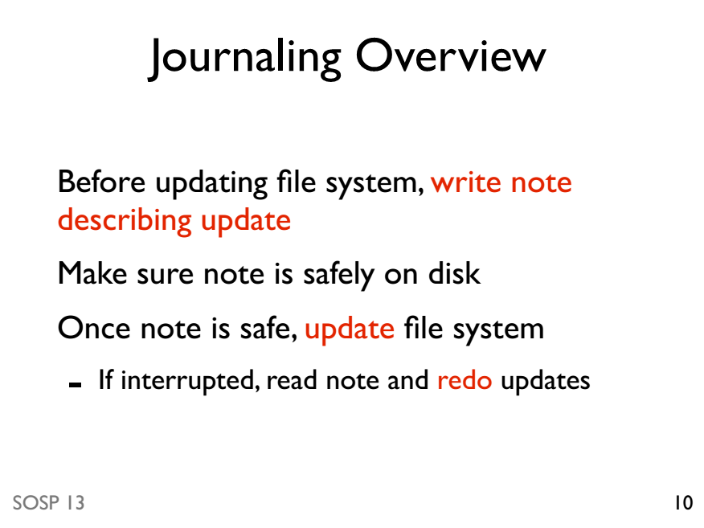

Slide 43
Journaling Mode
Writeback mode
  Only the metadata is journaled
  The data is written to the file on the disk
Ordered mode
  The data is written first before the metadata is journaled
Data mode: full journaling
  Both the metadata and file contents are journaled

Slide 44
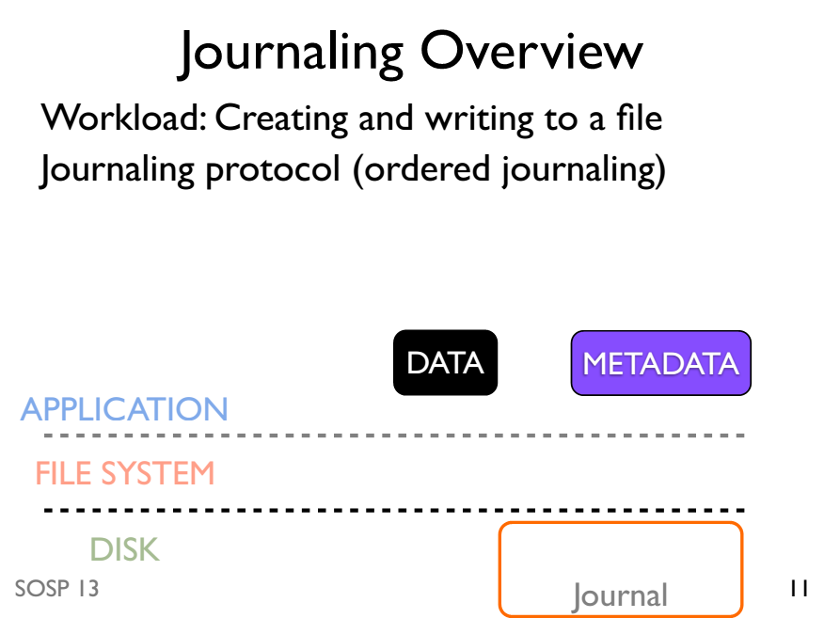

Slide 45
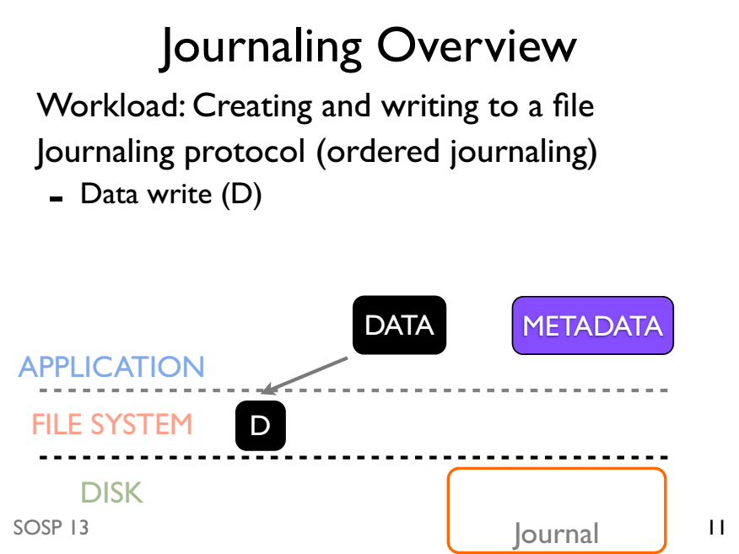

Slide 46
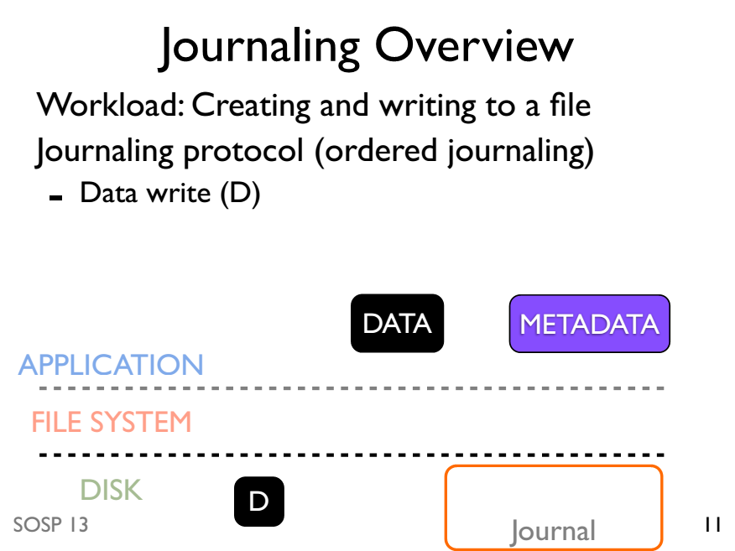

Slide 47
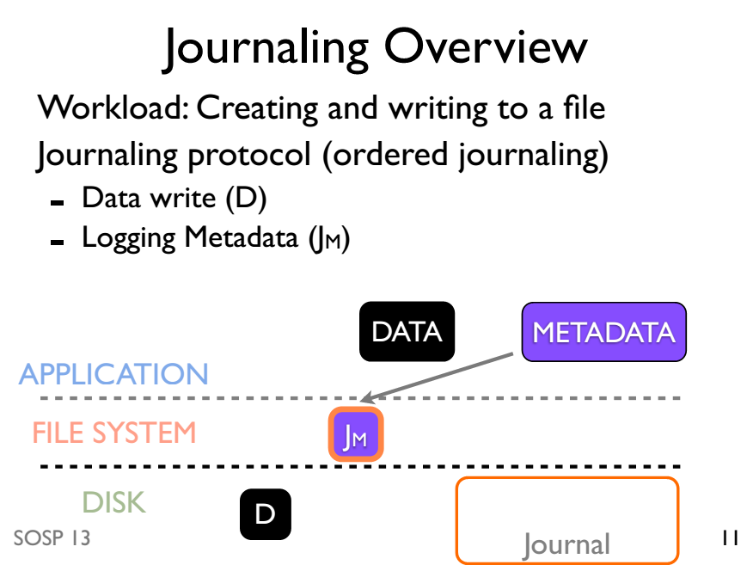

Slide 48
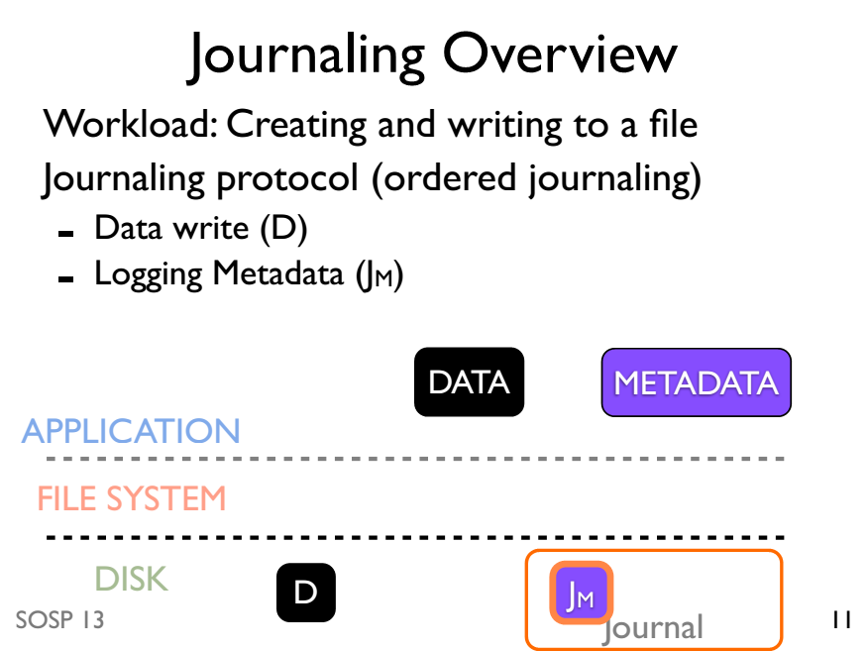

Slide 49
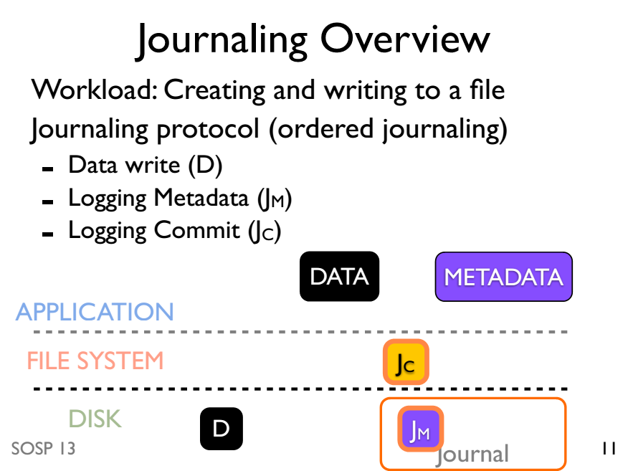

Slide 50
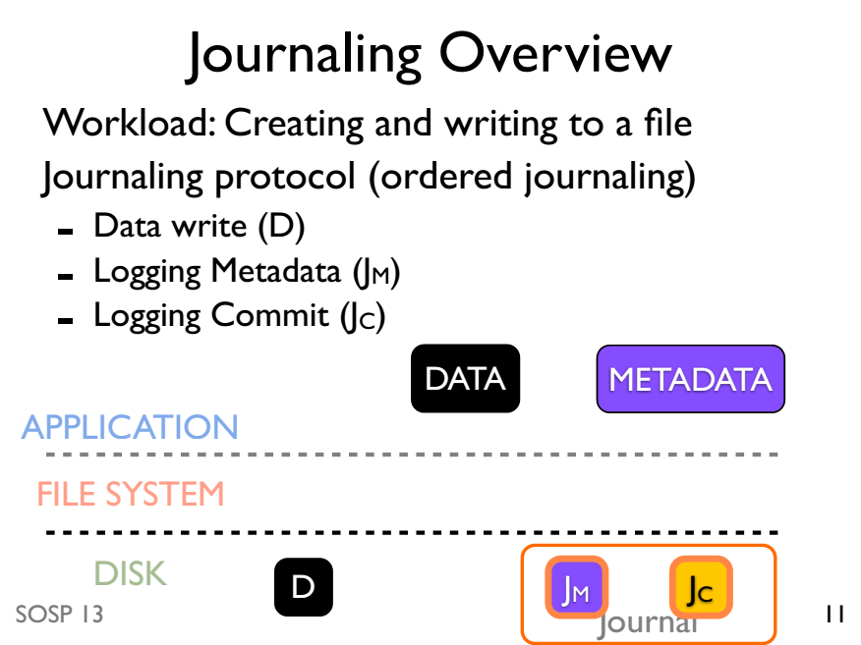

Slide 51
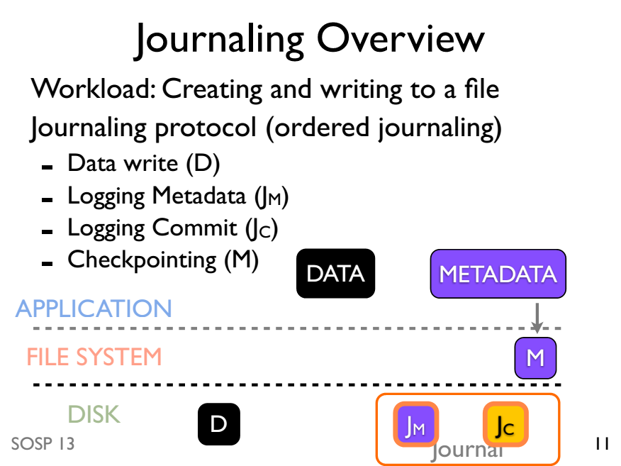

Slide 52
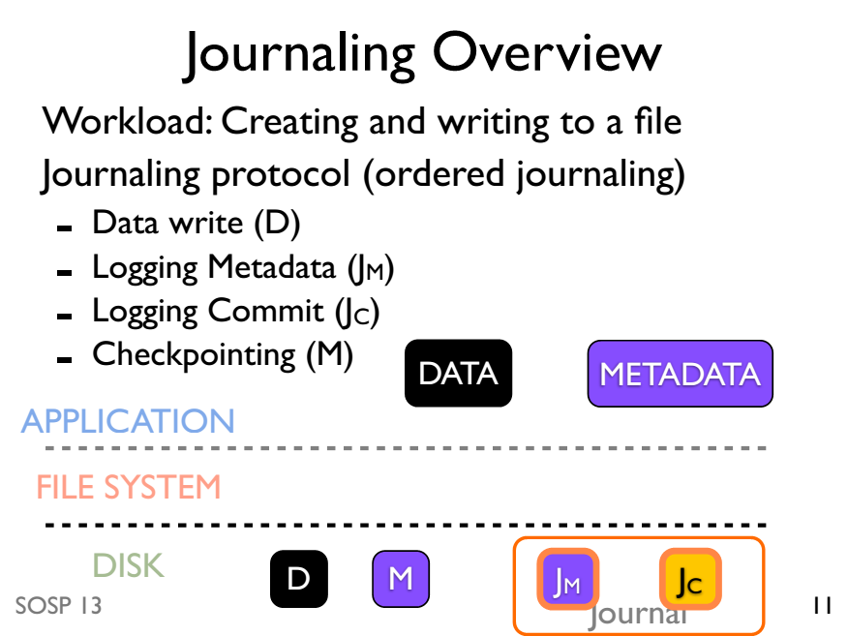

Slide 53
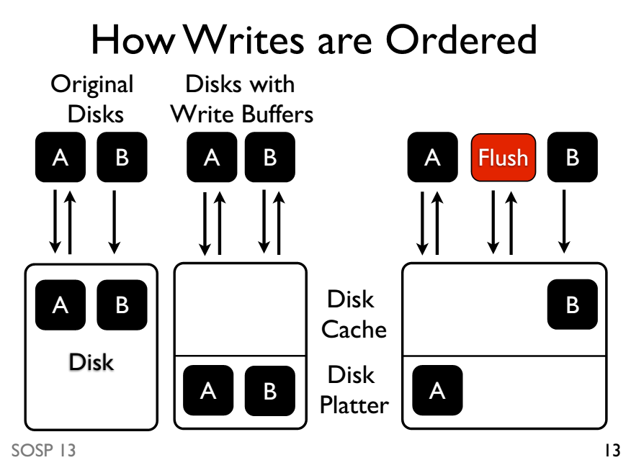

Slide 54
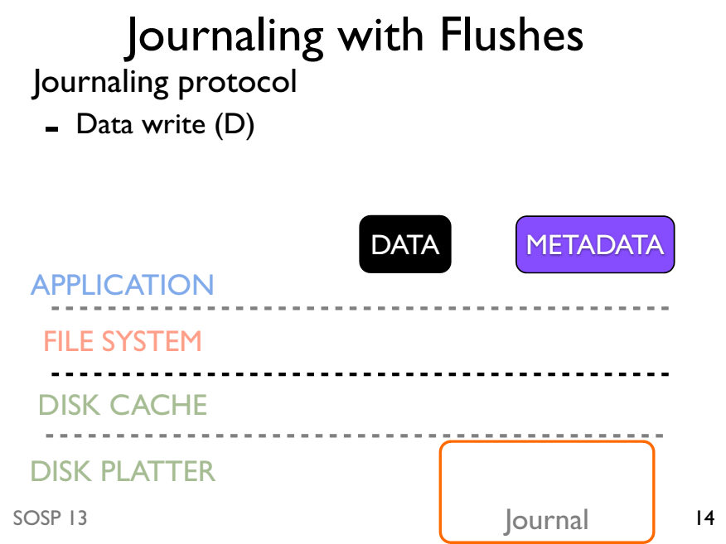

Slide 55
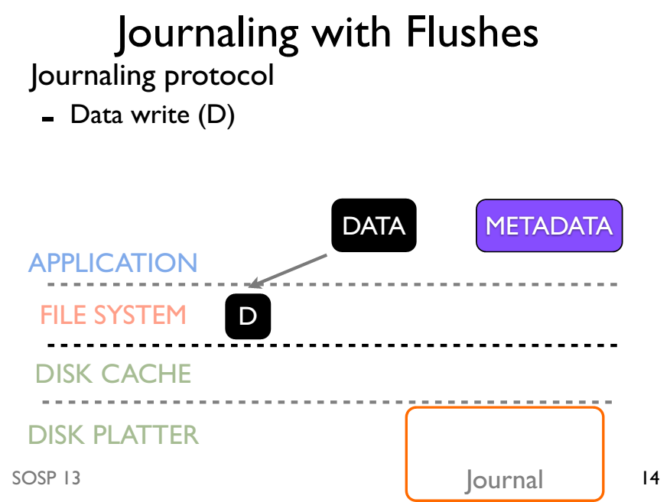

Slide 56
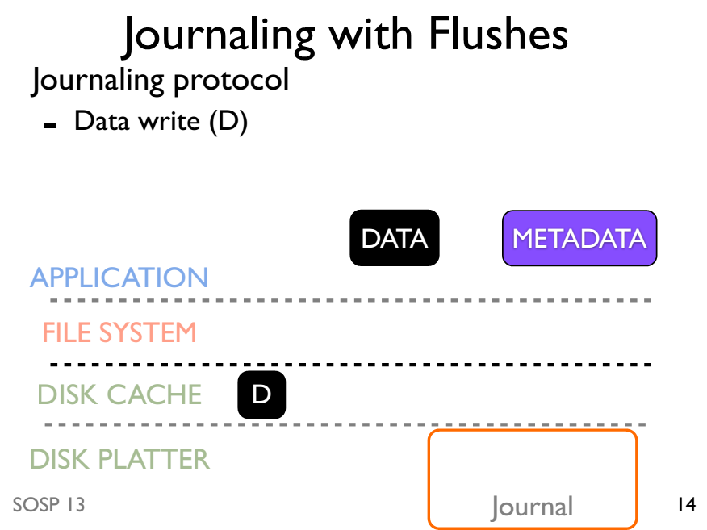

Slide 57
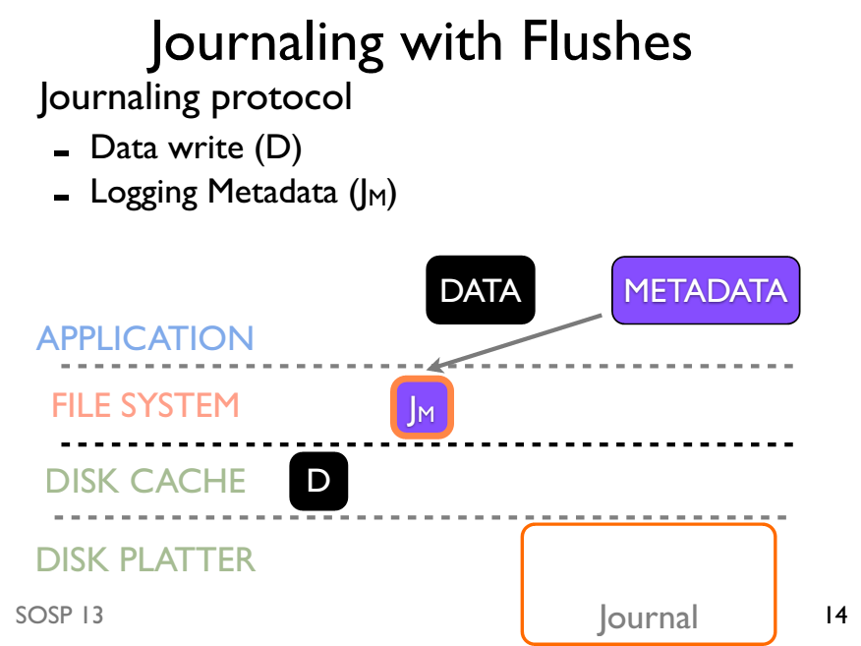

Slide 58
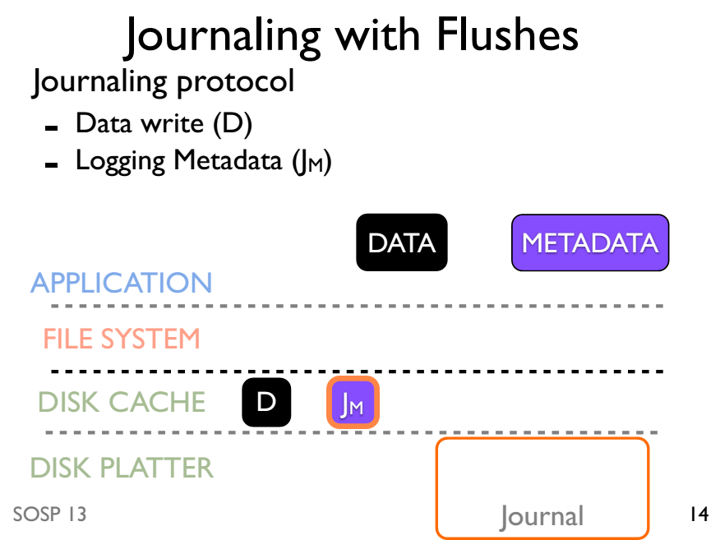

Slide 59
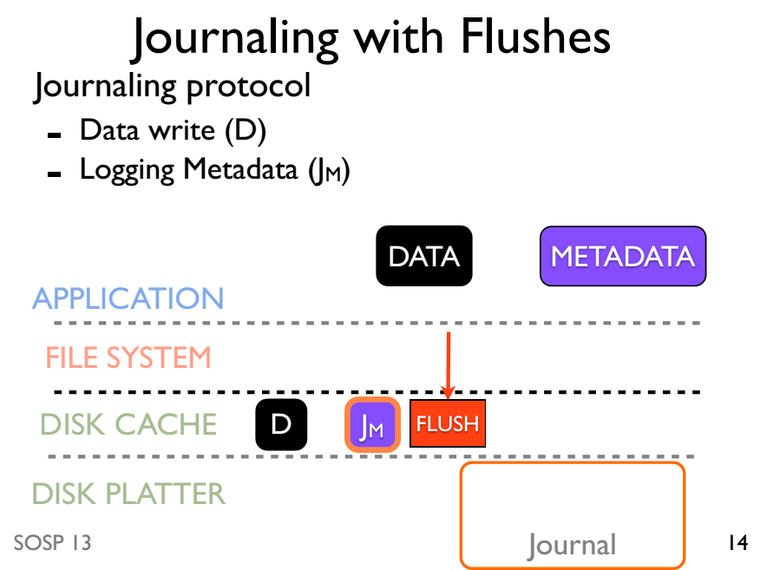

Slide 60
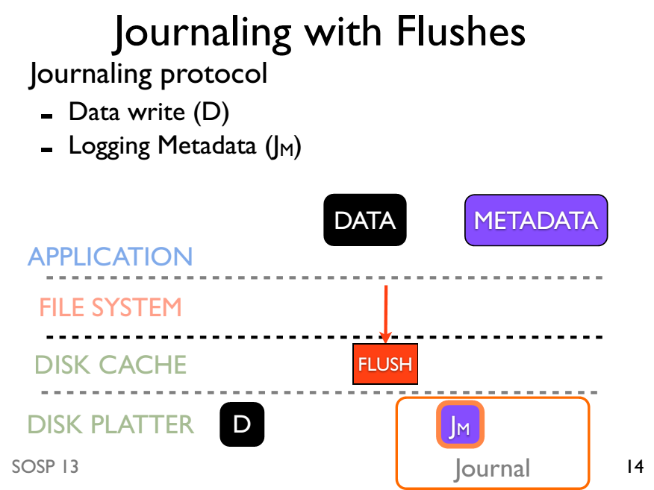

Slide 61
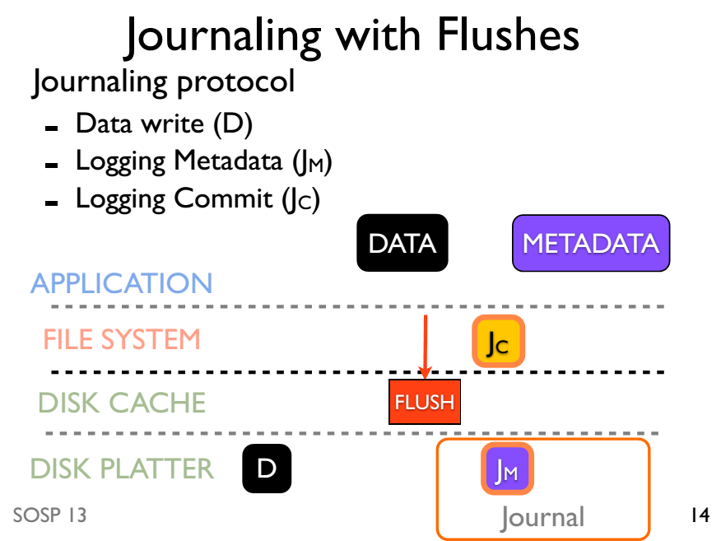

Slide 62
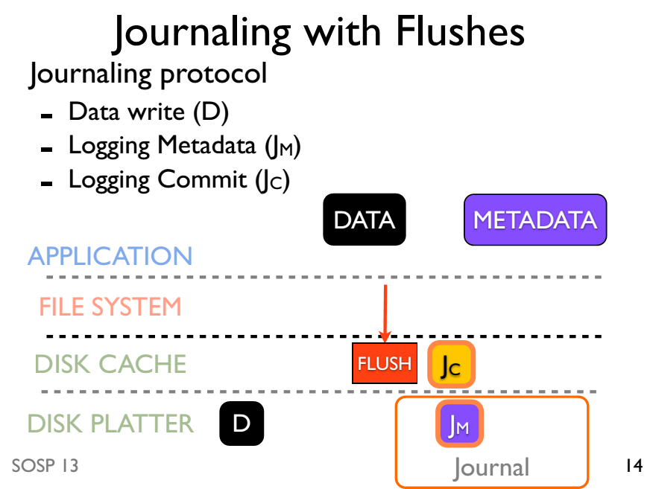

Slide 63
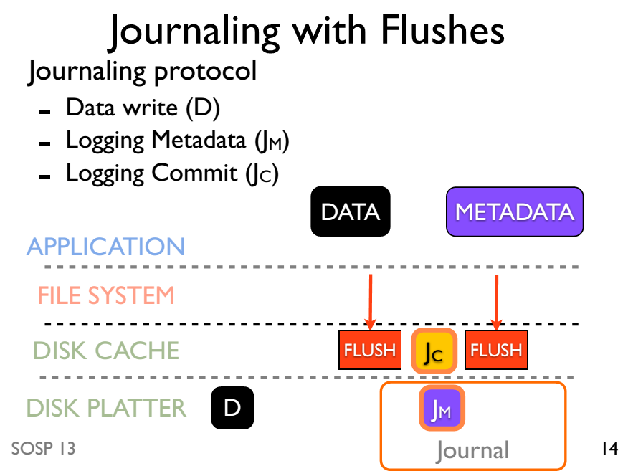

Slide 64
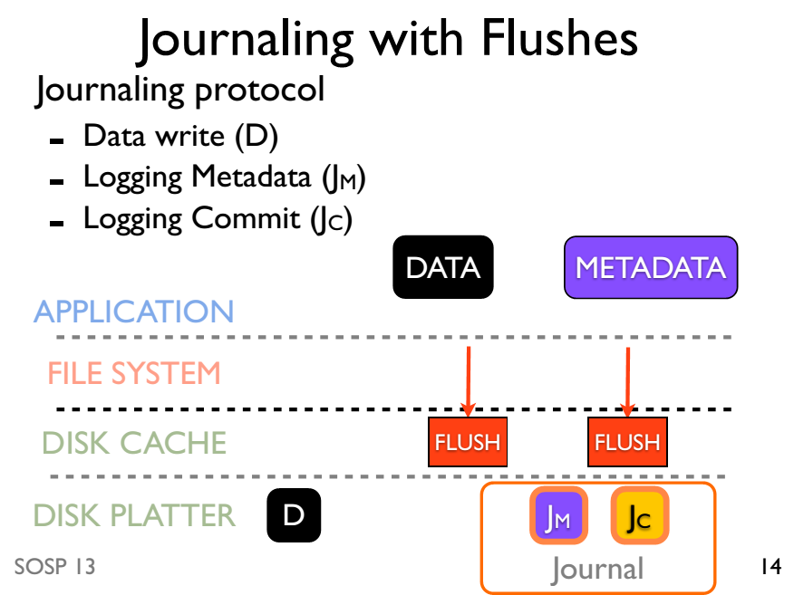

Slide 65
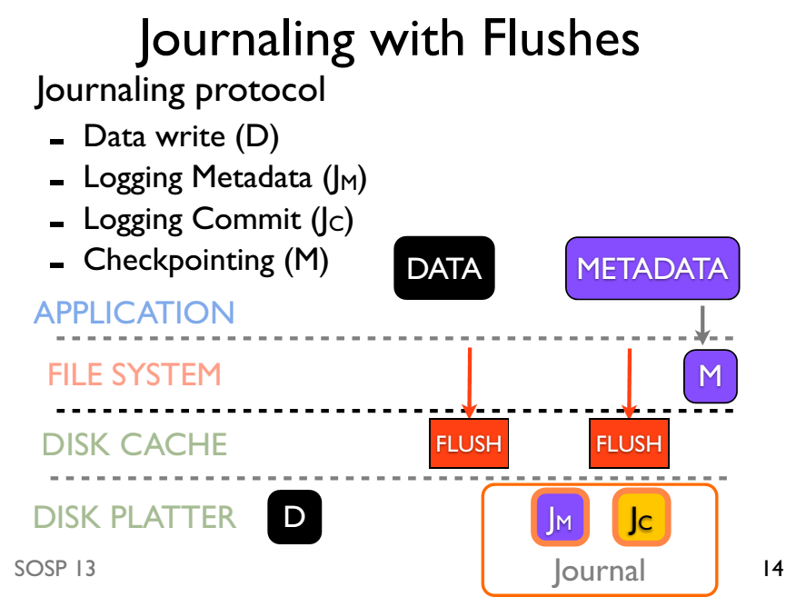

Slide 66
Journaling without ordering

Slide 67
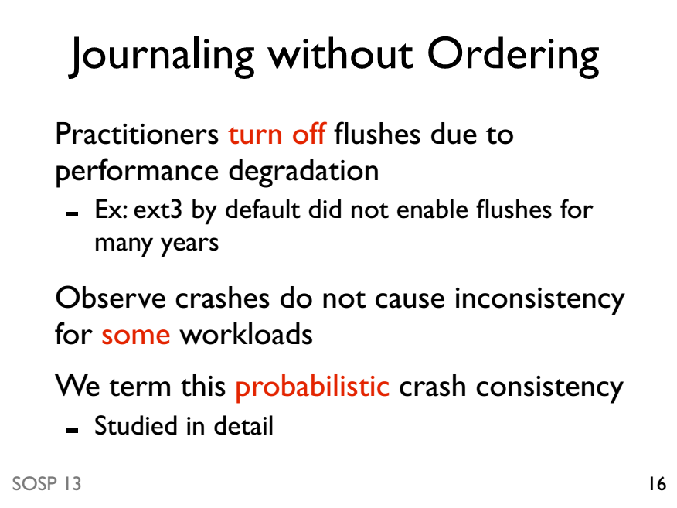

Slide 68
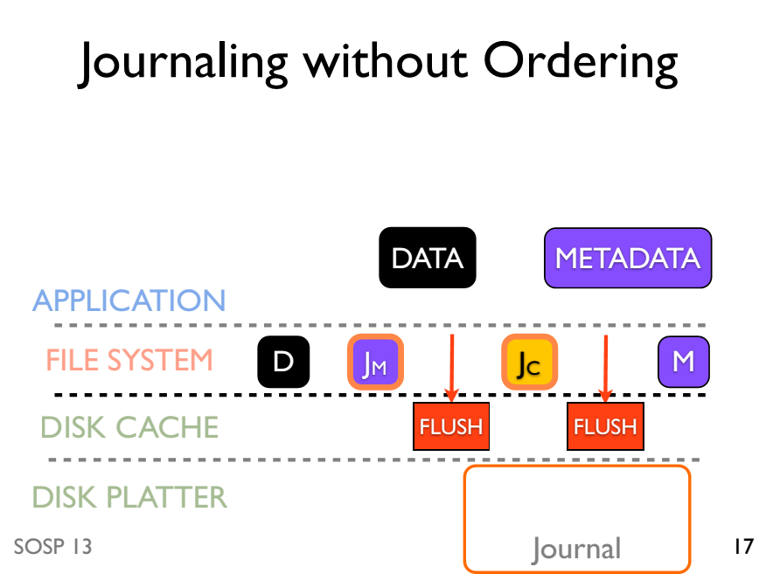

Slide 69
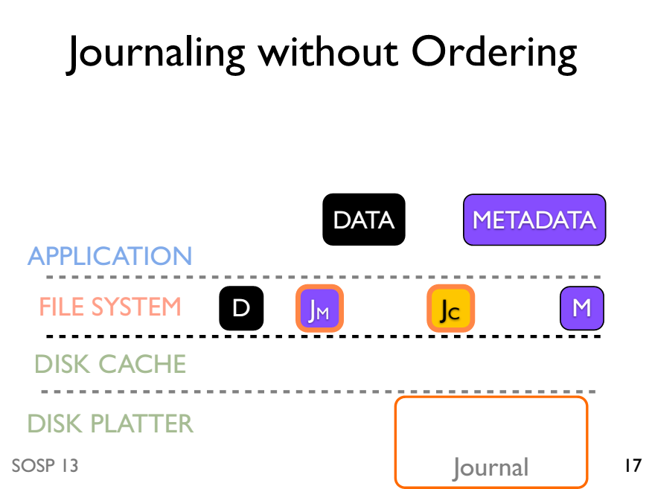

Slide 70
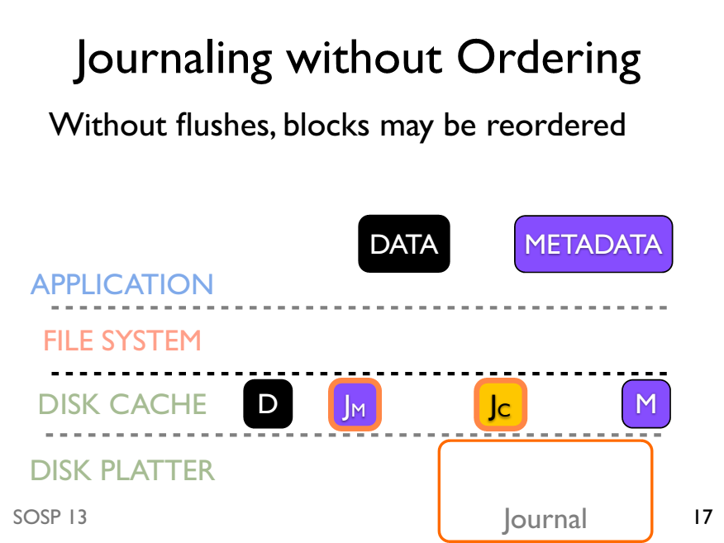

Slide 71
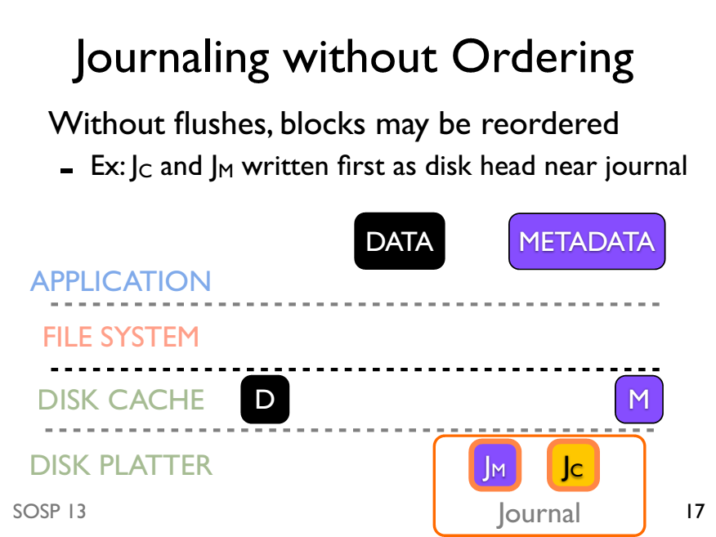

Slide 72
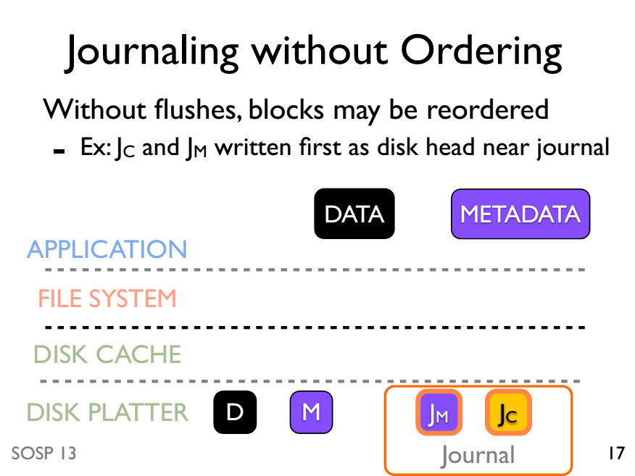

Slide 73
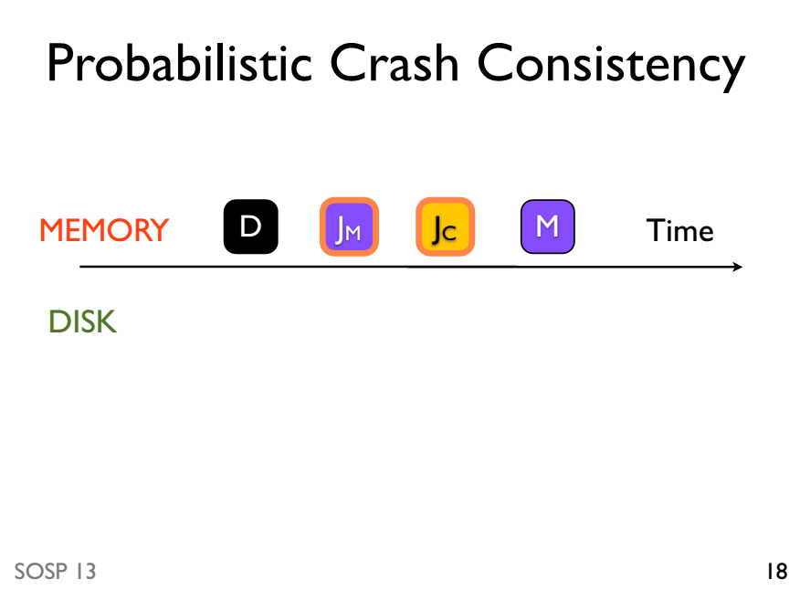

Slide 74
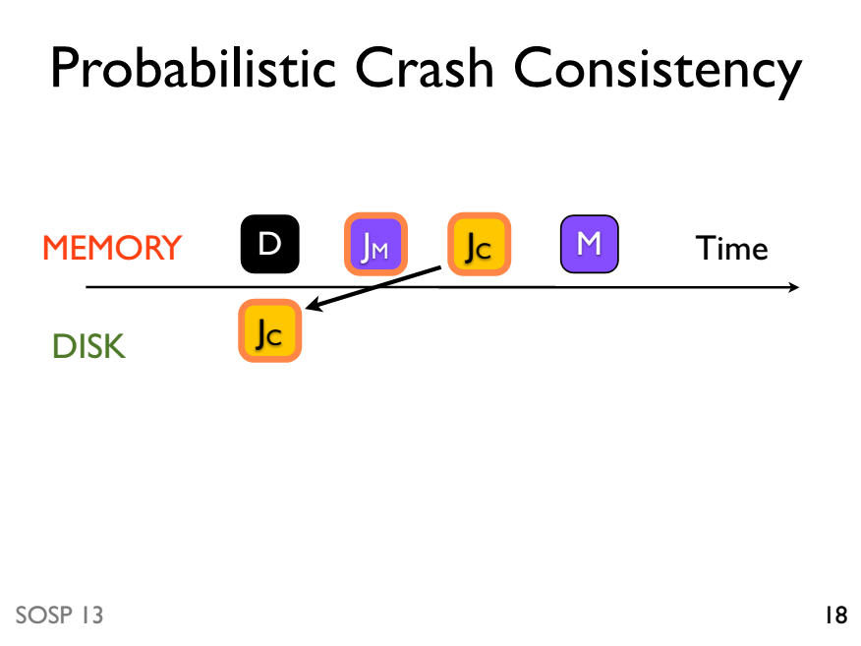

Slide 75
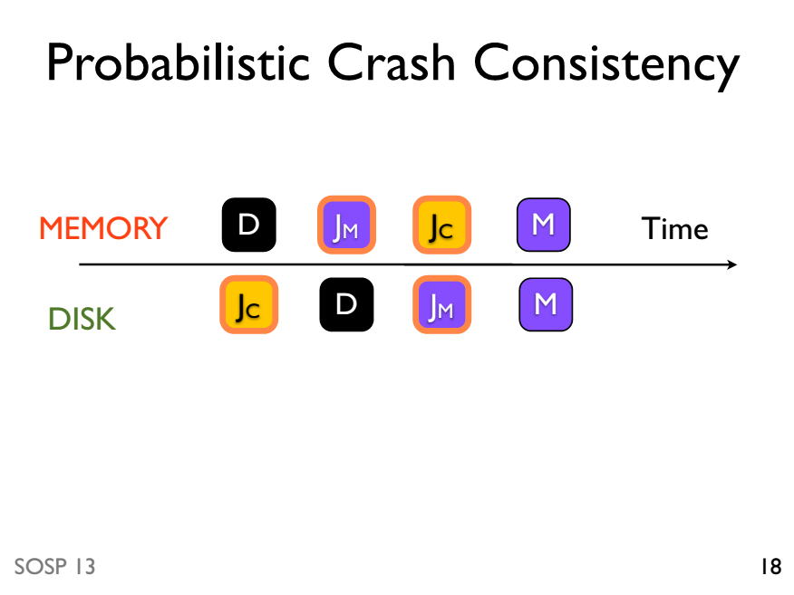

Slide 76
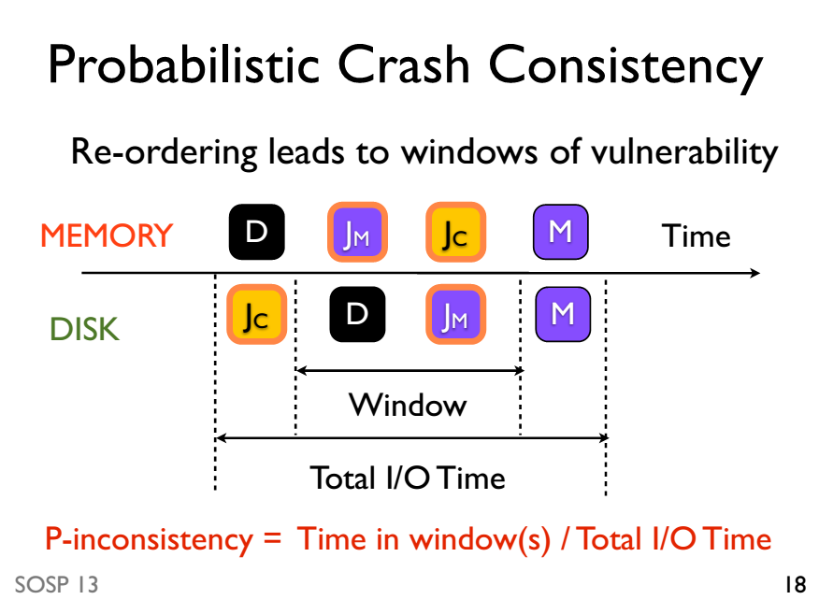

Slide 77
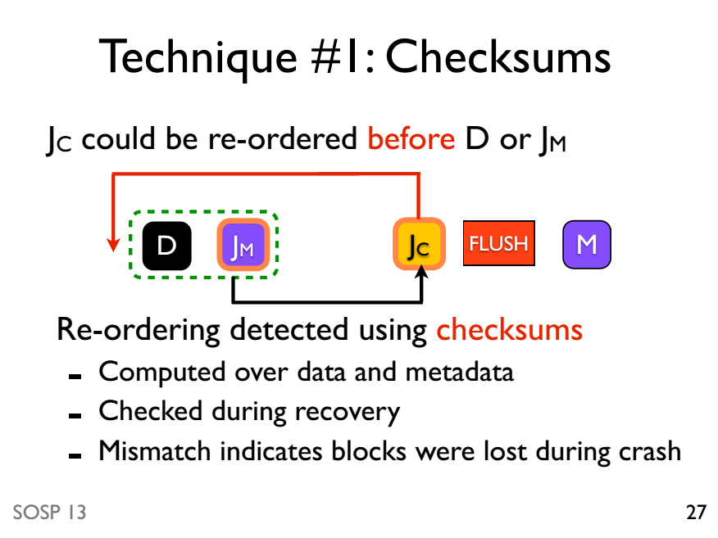

Slide 78
