Slide 1

Atomicity
Computer System Engineering, Fall 2020 (IPADS, SJTU)
All-or-nothing
Yubin Xia

Slide 2
Review: Recovering FS Metadata from Crash
1. Synchronous meta-data update + fsck
  During check, synchronize metadata, such as file size
2. Soft update (FreeBSD fs modified on FFS)
  not covered in this course
3. Logging (ext 3/4), xv6-rev6 and following versions
  Before doing actual meta-data update, log the event
  After crash, recover from log

Slide 3
All-or-Nothing

Slide 4
Atomicity: All-or-Nothing
An action is atomic if happens completely or not at all
  Atomicity makes it much easier to reason about failures
  Need to think about the consequences of the action happening or not happening, but not about the action partially happening

Slide 5
Atomicity Violation
Crash
  E.g., power failure
Interrupt
  E.g., I/O device interrupts
Parallelization
  E.g., two or more threads running concurrently
Notes:
Question: how to 100% ensure atomicity?

Slide 6
Example: the IBM System/370
Multi-operand character-editing instruction
  TRANSLATE contains 3 arguments
    Two address: string and table, 8-bit counter: length
    Takes 1 byte at a time from string, as an offset in table, get the byte in table, then replace the byte in string
  Problem: page fault
  Solution: dry run
    Hidden copy of register make no change to memory
    Maybe several dry run for one instruction, then run it again
  Problem again: what if another process snatch a page?

Slide 7

Commit Point

Slide 8
Shadow Copy

Slide 9
Bank Account Transfer
audit(bank):
xfer(bank, a, b, amt):
bank[a] = bank[a] – amt
bank[b] = bank[b] + amt
audit(bank):
sum = 0
for acct in bank:
sum = sum + bank[acct]
return sum
<- sum=200
<- sum=150
<- sum=200
Notes:
Demo: stresses inconsistent behavior due to concurrency (i.e., audit)

Slide 10
Shadow Copy
xfer(bank, a, b, amt):
bank[a] = read_accounts(bankfile)
bank[a] = bank[a] – amt
bank[b] = bank[b] + amt
write_accounts(#bankfile)
rename("#bankfile", bankfile)
Notes:
Idea: write to a shadow copy of the file first, then rename file in one step.
[ slide: file xfer with shadow ]
Here, we assume rename() will replace existing bankfile with "newfile".
If system crashes before rename, bank contains old balances.
If system crashes after rename, bank contains new balances.
Of course, we need to ensure that only one operation runs at a time,
but we will talk about concurrency later.
We call the rename a "commit point".
Commit point: crash before gives old value, crash after gives new value.
Commit point must be itself an all-or-nothing action.
Need rename (our commit point) to have all-or-nothing atomicity..

Slide 11
rename("#bank", "bank")
Directory data blocks:
  filename "bank" → inode 12
  filename "#bank" → inode 13
inode 12:
  data blocks: 3, 4, 5
  refcount: 1
inode 13:
  data blocks: 6, 7, 8
  refcount: 1
Notes:
If crash, then refcount is wrong.

Slide 12
rename("#bank", "bank")
Directory data blocks:
  filename "bank" → inode 13
  filename "#bank" → inode 13
inode 12:
  data blocks: 3, 4, 5
  refcount: 1
inode 13:
  data blocks: 6, 7, 8
  refcount: 1
Notes:
If crash, then refcount is wrong.

Slide 13
rename("#bank", "bank")
Directory data blocks:
  filename "bank" → inode 13
  filename "#bank" → inode 13
inode 12:
  data blocks: 3, 4, 5
  refcount: 1
inode 13:
  data blocks: 6, 7, 8
  refcount: 2

Slide 14
rename("#bank", "bank")
Directory data blocks:
  filename "bank" → inode 13
  filename "#bank" → inode 13
inode 12:
  data blocks: 3, 4, 5
  refcount: 0
inode 13:
  data blocks: 6, 7, 8
  refcount: 2

Slide 15
rename("#bank", "bank")
Directory data blocks:
  filename "bank" → inode 13
  filename "#bank" → inode 13
inode 12:
  data blocks: 3, 4, 5
  refcount: 0
inode 13:
  data blocks: 6, 7, 8
  refcount: 2

Slide 16
rename("#bank", "bank")
Directory data blocks:
  filename "bank" → inode 13
  filename "#bank" → inode 13
inode 12:
  data blocks: 3, 4, 5
  refcount: 0
inode 13:
  data blocks: 6, 7, 8
  refcount: 1

Slide 17
Problem
Q: If crash, what step will cause problem?
Two names point to fnew’s inode, but refcount is 1
  Problem: which reference is the correct one?

Slide 18
Second Try: Increase ref-count First
rename(x, y):
newino = lookup(x)
oldino = lookup(y)
incref(newino)
change y's dirent to newino
decref(oldino)
remove x's dirent
decref(newino)
Notes:
We never have too few refcounts, but still might have too many.

Slide 19
rename("#bank", "bank")
Directory data blocks:
  filename "bank" → inode 12
  filename "#bank" → inode 13
inode 12:
  data blocks: 3, 4, 5
  refcount: 1
inode 13:
  data blocks: 6, 7, 8
  refcount: 2

Slide 20
rename("#bank", "bank")
Directory data blocks:
  filename "bank" → inode 13
  filename "#bank" → inode 13
inode 12:
  data blocks: 3, 4, 5
  refcount: 1
inode 13:
  data blocks: 6, 7, 8
  refcount: 2

Slide 21
rename("#bank", "bank")
Directory data blocks:
  filename "bank" → inode 13
  filename "#bank" → inode 13
inode 12:
  data blocks: 3, 4, 5
  refcount: 0
inode 13:
  data blocks: 6, 7, 8
  refcount: 2

Slide 22
rename("#bank", "bank")
Directory data blocks:
  filename "bank" → inode 13
  filename "#bank" → inode 13
inode 12:
  data blocks: 3, 4, 5
  refcount: 0
inode 13:
  data blocks: 6, 7, 8
  refcount: 2

Slide 23
rename("#bank", "bank")
Directory data blocks:
  filename "bank" → inode 13
  filename "#bank" → inode 13
inode 12:
  data blocks: 3, 4, 5
  refcount: 0
inode 13:
  data blocks: 6, 7, 8
  refcount: 1
Q: where is the commit point?
Notes:
Q: What's the commit point? Modifying y's dirent.

Slide 24
What if crash during the commit point?
Assume that writing to one sector on disk is all-or-nothing
  Disk saves enough energy to complete one sector write
  Time spent writing a sector is small
  Small capacitor suffices to power disk for a few microseconds
  If write did not start, no need to complete it
    Still all-or-nothing

Slide 25
Recovery After Crash
salvage(disk):
for inode in disk.inodes:
inode.refcnt =
find_all_refs(disk.root_dir, inode)
if exists("#bank"):
unlink(“#bank”)
Notes:
Fixing up after a crash: salvage.
If we crash, our commit point ensures we have all-or-nothing atomicity.
But we still have a bit of a mess left over because of the crash.
If we crashed before commit: extra refcount on inode 13.
If we crashed after commit: extra refcount on inode 12.
In both cases: directory entry for "newfile" can be removed.
[ slide: salvage function ]

Slide 26
Shadow Copy
Write to a copy of data, atomically switch to new copy
Switching can be done with one all-or-nothing operation (sector write)
Requires a small amount of all-or-nothing atomicity from lower layer (disk)
Main rule: only make one write to current/live copy of data
  In our example, sector write for rename
  Creates a well-defined commit point

Slide 27
Shadow Copy
Does the shadow copy approach work in general?
  + Works well for a single file
  - Hard to generalize to multiple files or directories
    Have to place all files in a single directory, or rename subdirs
  - Requires copying the entire file for any (small) change
  - Only one operation can happen at a time
  - Only works for operations that happen on a single computer, single disk

Slide 28
Logging

Slide 29
Example: Bank Account App (Shadow Copy)
xfer(bank, a, b, amt):
copy(bank, tmp)
tmp[a] = tmp[a] – amt
tmp[b] = tmp[b] + amt
rename(tmp, bank)

Slide 30
Transaction Terminology
xfer(bank, a, b, amt):
begin
bank[a] = bank[a] – amt
bank[b] = bank[b] + amt
if bank[a] < 0:
abort //Not enough funds
else:
commit
xfer(bank, a, b, amt):
begin
write (a, read(a) – amt)
write (b, read(b) – amt)
if read (a) < 0:
abort //Not enough funds
else:
commit
Notes:
not everything can be a transaction.

Slide 31
Consider the Bank Account Example
Two accounts: A and B
  Accounts start out empty
  Run these all-or-nothing actions
Problem
  After crash, A=110, but T3 never committed
Solution
  Revert to A’s previous committed value
  T1 and T2: "All"
  T3: "Nothing"
begin // T1
A = 100
B = 50
"commit // A=100; B=50
begin // T2
A = A - 20
B = B + 20
"commit // A=80; B=70
begin // T3
A = A + 30 // A=110
--CRASH--
Notes:
Logging: only record the delta.

Slide 32
A Log Sample
+-------+------+--------+-------+------+--------+-------+
TID | T1 | T1 | T1 | T2 | T2 | T2 | T3 |
OLD | A=0 | B=0 | | A=100 | B=50 | | A=80 |
NEW | A=100 | B=50 | COMMIT | A=80 | B=70 | COMMIT | A=110 |
+-------+------+--------+-------+------+--------+-------+
begin // T1
A = 100
B = 50
"commit // A=100; B=50
begin // T2
A = A - 20
B = B + 20
"commit // A=80; B=70
begin // T3
A = A + 30 // A=110
--CRASH--

Slide 33
Five Operations Involved
Begin
Write variable
Read variable
Commit
Abort

Slide 34
Five Operations Involved
1. begin: allocate a new transaction ID
2. write variable: append an entry to the log
3. read variable: scan the log looking for last committed value
  As an aside: how to see your own updates?
  Read uncommitted values from your own TID

Slide 35
Five Operations Involved
4. Commit: write a commit record
  Expectedly, writing a commit record is the "commit point" for action, because of the way read works (looks for commit record)
  However, writing log records better be all-or-nothing
    One approach, from last time: make each record fit within one sector
5. Abort: Do nothing or write a record?
    Could write an abort record, but not strictly needed
Recover from a crash: do nothing

Slide 36
Read
+-------+------+--------+-------+------+--------+-------+
TID | T1 | T1 | T1 | T2 | T2 | T2 | T3 |
OLD | A=0 | B=0 | | A=100 | B=50 | | A=80 |
NEW | A=100 | B=50 | COMMIT | A=80 | B=70 | COMMIT | A=110 |
+-------+------+--------+-------+------+--------+-------+
read(log, var):
commits = {}
// scan backwards
for record r in log[len(log) - 1] .. log[0]:
// keep track of commits
if r.type == commit:
commits.add(r.tid)
// find var’s last committed value
if r.type == update and
r.tid in commits and
r.var == var:
return r.new_value
Notes:
Q: Which is a commit point?
Assumption: writing a single disk block is atomic. A partially written record is ignored.

Slide 37
Read
+-------+------+--------+-------+------+--------+-------+
TID | T1 | T1 | T1 | T2 | T2 | T2 | T3 |
OLD | A=0 | B=0 | | A=100 | B=50 | | A=80 |
NEW | A=100 | B=50 | COMMIT | A=80 | B=70 | COMMIT | A=110 |
+-------+------+--------+-------+------+--------+-------+
read(log, var):
commits = {}
// scan backwards
for record r in log[len(log) - 1] .. log[0]:
// keep track of commits
if r.type == commit:
commits.add(r.tid)
// find var’s last committed value
if r.type == update and
（r.tid in commits or r.tid == current_tid) and
r.var == var:
return r.new_value
Notes:
Q: Which is a commit point?
Assumption: writing a single disk block is atomic. A partially written record is ignored.

Slide 38
Performance Problem of Log-only Approach
Write performance is probably good
  Sequential writes, instead of random
  Need to write to disk twice instead of once
Read performance is terrible!
  Scan the log for every read!
Recovery is instantaneous
  Nothing to do

Slide 39
Performance Optimization
Keep both a log and cell storage
  Log as before: authoritative, provides all-or-nothing atomicity
  Cell storage: provides fast reads, but cannot provide all-or-nothing
  Both are stored on disk
Terminology
  "log" an update when it's written to the log
  "install" an update when it's written to cell storage
Notes:
[ board: log, cell storage; updates going to both, read from cell storage ]

Slide 40
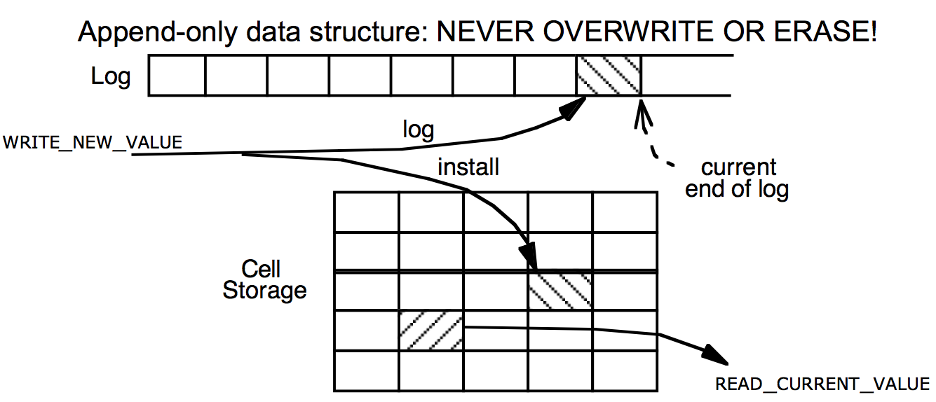
Cell Storage (Home) + Log Storage

Slide 41
Read / write with Cell Storage
Two questions we have to answer now:
  How to update both the log and cell storage when an update happens?
  How to recover cell storage from the authoritative log after crash?

Slide 42
Read / write with Cell Storage
+-------+------+--------+-------+------+--------+-------+
TID | T1 | T1 | T1 | T2 | T2 | T2 | T3 |
OLD | A=0 | B=0 | | A=100 | B=50 | | A=80 |
NEW | A=100 | B=50 | COMMIT | A=80 | B=70 | COMMIT | A=110 |
+-------+------+--------+-------+------+--------+-------+
Cell Storage
A 110
B 70
read(var):
return cell_read(var)
write(var, value):
log.append(cur_tid, update,
var, read(var), value)
cell_write(var, value)
Notes:
Recovery? Crash between logging and installing.
Write is not all-or-nothing! install value before commit? what if crash? Need to roll back to old value (which is saved in the log)
Log still contains the same things.
As we're running, maintain cell storage for A and B.
Except one problem: after crash, A's value in cell storage is wrong.
Last action aborted (due to crash), but its changes to A are visible.
We're going to have to repair this in our recovery function.
Good thing we have the log to provide authoritative information.

Slide 43
Order Matters
Ordering of logging and installing
  The two together do not have all-or-nothing atomicity
  Can crash in-between, so just one of the two might have taken place
What happens if we install first and then log?
  If we crash, no idea what happened to cell storage, or how to fix it
The rule for logging is the "Write-ahead-log protocol" (WAL)
  Log the update before installing it
If we crash, log is authoritative and intact, can repair cell storage
  Can think of it as not being the only copy, once it's in the log

Slide 44
Recovering Cell Storage
What happens if we log an update, install it, but then abort/crash?
  Need to undo that installed update
  Plan: scan log, determine what actions aborted ("losers"), undo them
Why do we have to scan backwards?
  Need to undo newest to oldest
  Also need to find outcome of action before we decide whether to undo

Slide 45
Recovery with Cell Storage
+-------+------+--------+-------+------+--------+-------+
TID | T1 | T1 | T1 | T2 | T2 | T2 | T3 |
OLD | A=0 | B=0 | | A=100 | B=50 | | A=80 |
NEW | A=100 | B=50 | COMMIT | A=80 | B=70 | COMMIT | A=110 |
+-------+------+--------+-------+------+--------+-------+
Cell Storage
A 110
B 70
commits = {}
recover(log):
commits = {}
for record r in log[len(log)-1] .. log[0]:
if r.type == commit:
commits.add(r.tid)
if r.type == update and r.tid not in commits:
cell_write(r.var, r.old_val) // undo
Notes:
Recovery? Crash between logging and installing.
Write is not all-or-nothing! install value before commit? what if crash? Need to roll back to old value (which is saved in the log)
Log still contains the same things.
As we're running, maintain cell storage for A and B.
Except one problem: after crash, A's value in cell storage is wrong.
Last action aborted (due to crash), but its changes to A are visible.
We're going to have to repair this in our recovery function.
Good thing we have the log to provide authoritative information.

Slide 46
Recovery with Cell Storage
+-------+------+--------+-------+------+--------+-------+
TID | T1 | T1 | T1 | T2 | T2 | T2 | T3 |
OLD | A=0 | B=0 | | A=100 | B=50 | | A=80 |
NEW | A=100 | B=50 | COMMIT | A=80 | B=70 | COMMIT | A=110 |
+-------+------+--------+-------+------+--------+-------+
Cell Storage
A 80
B 70
commits = {}
recover(log):
commits = {}
for record r in log[len(log)-1] .. log[0]:
if r.type == commit:
commits.add(r.tid)
if r.type == update and r.tid not in commits:
cell_write(r.var, r.old_val) // undo
Notes:
Recovery? Crash between logging and installing.
Write is not all-or-nothing! install value before commit? what if crash? Need to roll back to old value (which is saved in the log)
Log still contains the same things.
As we're running, maintain cell storage for A and B.
Except one problem: after crash, A's value in cell storage is wrong.
Last action aborted (due to crash), but its changes to A are visible.
We're going to have to repair this in our recovery function.
Good thing we have the log to provide authoritative information.

Slide 47
Recovery with Cell Storage
+-------+------+--------+-------+------+--------+-------+
TID | T1 | T1 | T1 | T2 | T2 | T2 | T3 |
OLD | A=0 | B=0 | | A=100 | B=50 | | A=80 |
NEW | A=100 | B=50 | COMMIT | A=80 | B=70 | COMMIT | A=110 |
+-------+------+--------+-------+------+--------+-------+
Cell Storage
A 80
B 70
commits = {T2}
recover(log):
commits = {}
for record r in log[len(log)-1] .. log[0]:
if r.type == commit:
commits.add(r.tid)
if r.type == update and r.tid not in commits:
cell_write(r.var, r.old_val) // undo

Slide 48
Recovery with Cell Storage
+-------+------+--------+-------+------+--------+-------+
TID | T1 | T1 | T1 | T2 | T2 | T2 | T3 |
OLD | A=0 | B=0 | | A=100 | B=50 | | A=80 |
NEW | A=100 | B=50 | COMMIT | A=80 | B=70 | COMMIT | A=110 |
+-------+------+--------+-------+------+--------+-------+
Cell Storage
A 80
B 70
commits = {T2, T1}
recover(log):
commits = {}
for record r in log[len(log)-1] .. log[0]:
if r.type == commit:
commits.add(r.tid)
if r.type == update and r.tid not in commits:
cell_write(r.var, r.old_val) // undo

Slide 49
Performance Now
Writes might still be OK
Reads are fast: just look up in cell storage
Recovery requires scanning the entire log
Remaining performance problems:
  We have to write to disk twice (log & install)
  Scanning the log will take longer and longer, as the log grows

Slide 50
Optimization 1: Improve Writes
Storing installing in a (volatile) cache, e.g., memory
  Writes can now be fast: just one write, instead of two
  Hope that variable is modified several times in cache before flush
Reads can also be benefited
  Reads go through the cache, since cache may contain more up-to-date values

Slide 51
Read & Write with Cache
+-------+------+--------+-------+------+--------+-------+
TID | T1 | T1 | T1 | T2 | T2 | T2 | T3 |
OLD | A=0 | B=0 | | A=100 | B=50 | | A=80 |
NEW | A=100 | B=50 | COMMIT | A=80 | B=70 | COMMIT | A=110 |
+-------+------+--------+-------+------+--------+-------+
Cell Storage
A 110
B 70
Cache
A 110
B 70
recover(log):
commits = {}
for record r in log[len(log)-1] .. log[0]:
if r.type == commit:
commits.add(r.tid)
if r.type == update and r.tid not in commits:
cell_write(r.var, r.old_val) // undo
for record r in log[0] .. log[len(log)-1]:
if r.type == update and r.tid in commits:
cell_write(r.var, r.new_value) // redo

Slide 52
Problem Brought by Cache
Atomicity problem: cell storage (on disk) may be out-of-date
  Is it possible to have changes that should be in cell storage, but aren't?
    Yes: might not have flushed the latest commits
  Is it possible to have changes that shouldn't be in cell storage, but are?
    Yes: flushed some changes that then aborted (same as before)
Solution: change the recover procedure
  Need a redo phase in addition to an undo phase in recovery
  Don't treat actions with an abort record as "done"
    There might be leftover changes from them in cell storage

Slide 53
Recover with Cache
+-------+------+--------+-------+------+--------+-------+
TID | T1 | T1 | T1 | T2 | T2 | T2 | T3 |
OLD | A=0 | B=0 | | A=100 | B=50 | | A=80 |
NEW | A=100 | B=50 | COMMIT | A=80 | B=70 | COMMIT | A=110 |
+-------+------+--------+-------+------+--------+-------+
Cell Storage
A 110
B 70
Cache
A 110
B 70
read(var):
if var in cache:
return cache[var]
else: // may evict others from cache to cell storage
cache[var] = cell_read(var)
return cache[var]
write(var, value):
log.append(current_tid, update, var, read(var), value)
cache[var] = value

Slide 54
Optimization 2: Truncate the Log
Current log grows without bound: not practical
  What part of the log can be discarded?
    Must know the outcome of every action in that part of log
    Cell storage must reflect all of those log records (commits, aborts).
  Truncating mechanism (assuming no pending actions):
    Flush all cached updates to cell storage
    Write a checkpoint record, to save our place in the log
    Truncate log prior to checkpoint record
    (Often log implemented as a series of files, so can delete old log files)
  With pending actions, delete before checkpoint & earliest undecided record

Slide 55
Checkpointing
Doing the following:
  1. Stop accepting new transactions
  2. Wait until all current transactions commit or abort and have written the COMMIT or ABORT to the log
  3. Flush the log to disk
  4. Write a log record <CKPT> and flush the log again
  5. Resume accepting transactions
No need to look in the log file prior to the last checkpoint

Slide 56
Non-quiescent Checkpointing
The problem with checkpointing:
  Need to stop the system until all current operations have committed or aborted
Non-quiescent checkpointing:
  1. Write a record <START CKPT(T1…Tk)> and flush log (T1,…Tk are the active transactions)
  2. Wait until all of T1, … Tk commit or abort, but allow new transactions to start
  3. When all of T1,…Tk have written COMMIT or ABORT, then write <END CKPT> to the log

Slide 57
Non-quiescent Checkpointing
If crash, then look backwards for the first <START CKPT(T1…Tk)> or <END CKPT>
  If see an <END CKPT>, only have to consider after this
  If see a <START CKPT(T1…Tk)> but no <END CKPT>, then only need to consider after the transactions T1, .. Tk began

Slide 58
Optimization-3: External Synchronous I/O
Problem: flush to disk is slow
  Lazy writing, even for the log file
  Some app, e.g., database, calls sync() to ensure flushing
  But sync() is slow…
Solution: External Sync
  Once the kernel return from sync(), the file may not be flushed
  It will be flushed if something externally visible happens
    E.g., print to the user, network sending, serial port outcome, etc.

Slide 59
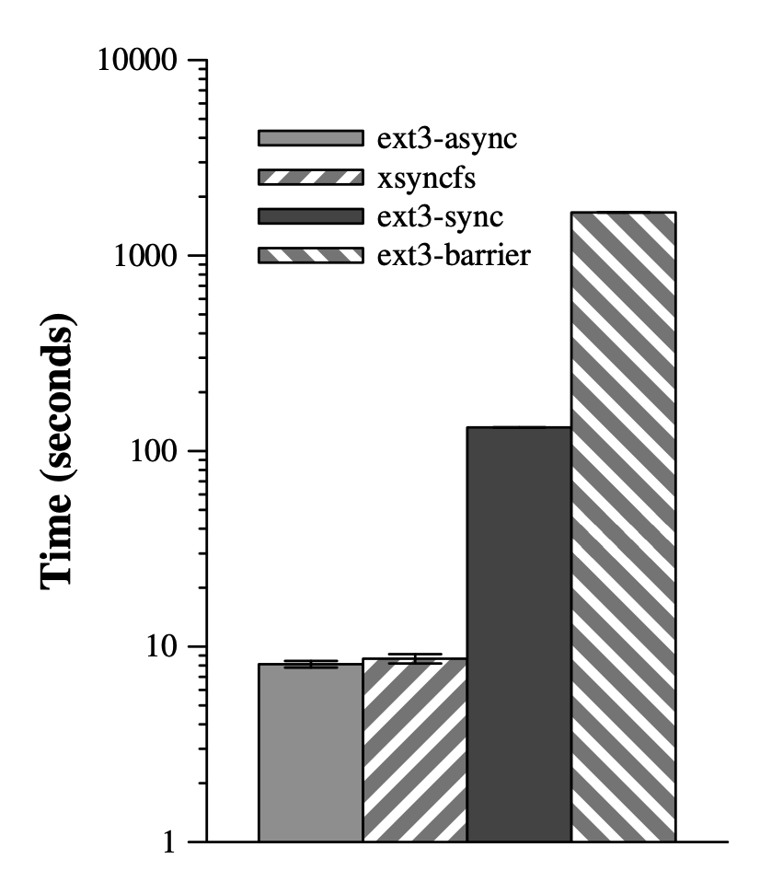
Optimization-3: External Synchronous I/O
Rethink the Sync, OSDI 2006
Two principles
  Define externally synchronous I/O by its externally observable behavior rather than by its implementation
  Application state is an internal property of the computer system
Since application state is not directly observable by external entities, the operating system need not treat changes to application state as an external output.

