Slide 1

RPC & NFS
Computer System Engineering, Fall 2020 (IPADS, SJTU)
Enabling the client/server model
Yubin Xia

Slide 2
Review: Fault Tolerance at Different Layers
Transaction layer: all-or-nothing atomicity
  By shadow copy or logging
  Depend on file system atomicity
File system layer: crash consistency
  By journaling (logging)
  Depend on disk sector atomicity
Disk layer: sector atomicity
  By a capacitance or writing three duplications
  Depend on disk reliability -> RAID can help

Slide 3
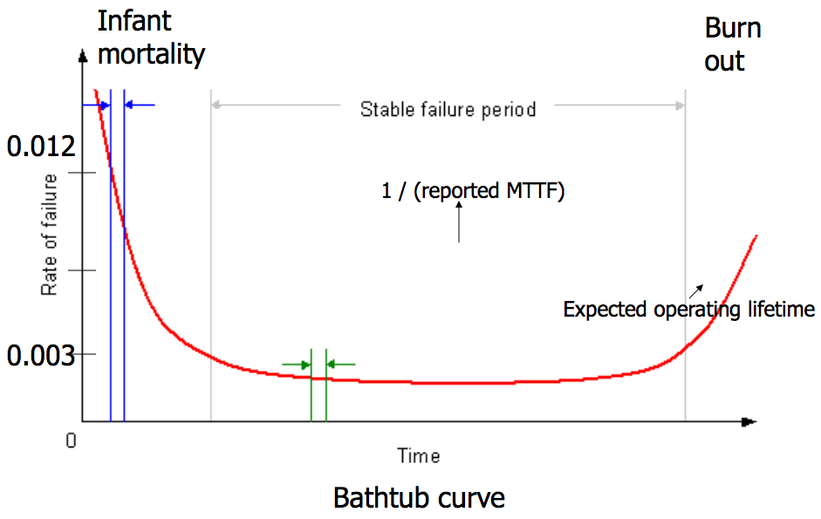
Bathtub Curve
  gross manufacturing defects
  run for a while before shipping
  accumulated ware and tear cause failure

Slide 4
Availability
Counting the number of nines
  E.g. 99.9% has 3-nines availability
  Often used in marketing
Corresponding down time
  E.g. 3-nines -> 8 hour/year
  E.g. 5-nines -> 5 min/year
  E.g. 7-nines -> 3 sec/year
  Without any information about MTTF
More fine-grained
  Fail-soft, as in 8.3

Slide 5
Systematically Applying Redundancy
Masking error
  Analog system designer: margin
  Digital system designer: redundancy
Outline
  Coding: incremental redundancy
  Replication: massive redundancy
  Voting
  Repair

Slide 6
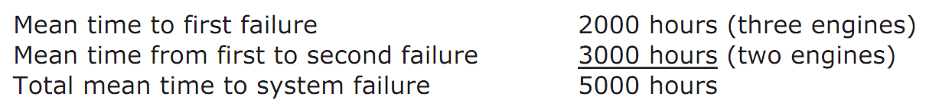
Voting
TMR can improve reliability
  If R(T) = 0.999, TMR's R(T) = 0.999997
But MTTF can be smaller
  If MTTF is 6,000 hours and fails independently, and the mechanism of failure is memoryless
  6,000 hours in only 2,000 hours of flying, first fail
  3,000 hours next and cause the second fail
  5,000 hours < 6,000 hours

Slide 7
MTTF-replica and MTTF-system
If MTTF-replica = 1, N replicas total
  Expected time until 1st failure is MTTF-replica/N
  Expected time from then until the 2nd is MTTF-replica/(N-1)
  Expected time until the system of N replicas fails is
  For large N is approximately ln(N)
If mission time is long compared with MTTF-replica
  Simple replication escalates the cost while providing little benefit

Slide 8
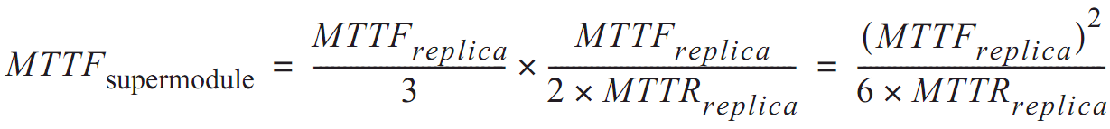
Repair
Return to fail-vote TMR supermodel
  Requires at least two replicas be working
  The rate of failure of 2 replicas is 2/MTTF
  If replacement takes 1 hour, chance is 1/3000
  If we have unlimited replacement for 10,000 hours
    MTTF = 6 million hours

Slide 9
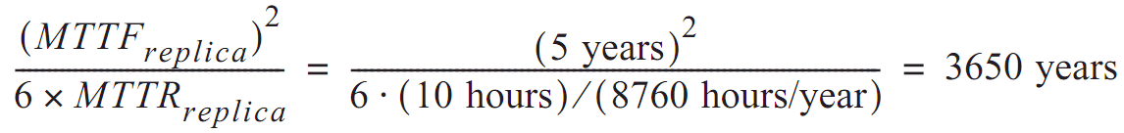
In another word
  Although MTTF is reduced by the factor of 3
  The availability of repair has increased MTTF by a factor equal to the ratio of the MTTF to MTTR of the remaining 2 engines
Disk with 3 replicas
  If MTTF is 5-year, repair in 10 hours

Slide 10
Review Overly Optimistic Assumptions
Disks fail independently?
  Same vendor, same fault
  Earthquake, whose MTTF is less than 3650 years
Disk failures are memoryless?
  Bathtub curve
Repair is a memoryless process?
  Stock enough spares
Repair is done flawlessly?
  Replace the wrong disk, forget to copy data, etc.

Slide 11
Summary
Systems have faults. We have to take them into account and build reliable, fault-tolerant systems. Reliability always comes at a cost: there are tradeoffs between reliability and cost, reliability and simplicity, etc.
Our main tool for improving reliability is redundancy. One form of redundancy is replication, which can be used to combat many things including disk failures (important, disk failures mean lost data).
RAID replicates data across disks in a smart way: RAID 5 protects against single-disk failures while maintaining good performance.

Slide 12


Current Status
We can build a Taobao from scratch on one machine!
Web Server
Accept requests & reply files in HTTP
7 layers, inode, FAT, VFS, FS API, Crash consistency
File System
Socket
Disk Driver
NIC Driver
Interrupt handling
System Bus
PIO, MMIO, DMA
Disk
NIC
Disk structure, SSD, Optimization

Slide 13



Challenges
One machine is NOT enough
  More and more pictures to save
  More and more clients to serve
Multiple servers are needed
  A server with large storage, with better fault tolerance
  Multiple servers run web server, to server more clients
How to build a Network File System (NFS)?
  Seems like every server can share the large storage

Slide 14
RPC
Remote Procedure Call

Slide 15
RPC
RPC （Remote Procedure Call)
  Allow a procedure to execute in another address space without coding the details for the remote interaction
RPC History
  Idea goes back in 1976
  Sun's RPC: first popular implementation on Unix
    Used as the basis for NFS
RMI (Remote Method Invocation)
  Object-oriented version of RPC, e.g. in Java

Slide 16
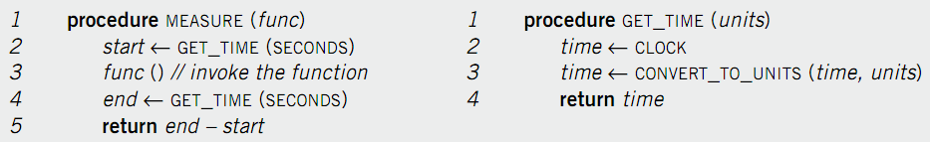
Example of RPC
Re-implement MEASURE and GET_TIME
  Run GET_TIME on a server
  Call GET_TIME on a client
Notes:
Occam's Razor.

Slide 17
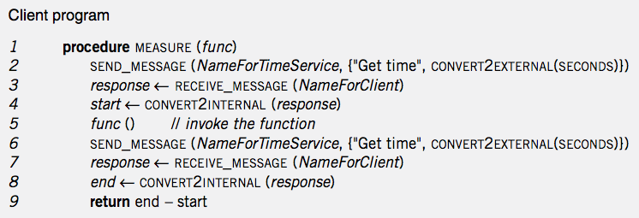
Client Program
Notes:
Marshal: line 2 6
unmarshal: line 4 8

Slide 18
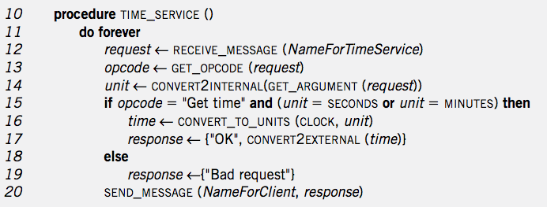
Service Program
Notes:
Marshal: 16-19
Unmarshal: 13 14

Slide 19
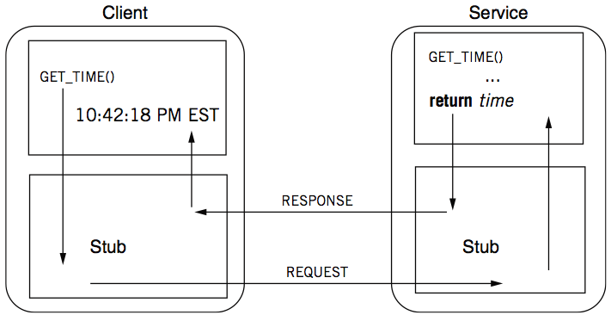
RPC Calling Process

Slide 20
RPC Stub
Client stub
  Put the arguments into a request
  Send the request to server
  Wait for a response
Service stub
  Wait for a message
  Get the parameters from the request
  Call the procedure (e.g. GET_TIME)
  Put the result into a response
  Send the response to the client
Stub: hide communication details from up-level code, so that up-level code does not change

Slide 21
Client Program using RPC
procedure MEASURE (func)
start <- GET_TIME(SECONDS)
func()
end <- GET_TIME(SECONDS)
return end - start
Note: this code is not changed
This is stub of client
procedure GET_TIME (units)
SEND_MESSAGE(ServerName, {"Get time", CONVERT2EXTERNAL(units)})
response <- RECEIVE_MESSAGE(ClientName)
if GET_RETCODE(response) != "OK"
HANDLE_ERROR(response)
else
return CONVERT2INTERNAL(GET_ARGUMENT(response))
Notes:
Marshal: line 2 6
unmarshal: line 4 8

Slide 22
Server Program using RPC
procedure GET_TIME (units)
time <- CLOCK
time <- CONVERT_TO_UNITS(time, units)
return time
Note: this code is not changed
This is stub of server
procedure TIME_SERVICE ()
do forever
request <- RECEIVE_MESSAGE(ServerName)
opcode <- GET_OPCODE(request)
arg <- CONVERT2INTERNAL(GET_ARGUMENT(request))
if opcode = "Get time" and (arg = SECONDS or arg = MINUTES) then
retval <- GET_TIME(arg)
response <- {"OK", CONVERT2EXTERNAL(retval)}
else
response <- {"Bad request"}
SEND_MESSAGE(ClientName, response)
Notes:
Marshal: line 2 6
unmarshal: line 4 8

Slide 23
Question
What is inside a message?
  Service ID (e.g., function ID)
  Service parameter (e.g., function parameter)
  Using marshal / unmarshal

Slide 24
RPC Request
  UDP header...
    Xid
    call/reply
    rpc version
    program #
    program version
    procedure #
    auth stuff
    arguments
X is short for "transaction"
Client reply dispatch uses xid
Client remembers the xid of each call
Server dispatch uses prog#, proc#

Slide 25
RPC Reply
  UDP header …
    Xid
    call/reply
    accepted? (vs bad rpc version, or auth failure)
    auth stuff
    success? (vs bad prog/proc #)
    results

Slide 26
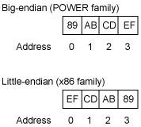
Marshal / Unmarshal
Marshal
  Convert an object into an array of bytes with enough annotation so that the unmarshall procedure can convert it back into an object
Serialization is not easy
  E.g., big endian VS. little endian
    Big endian on network
    Two functions: htons(), ntohs()
  Using IEEE 754 or not?
  What about an array?
  What about a pointer?

Slide 27
Automatic Stub Generation
Generate stubs from an interface specification
  Tool to look at argument and return types
  Generate marshal and unmarshal code
  Generate stub procedures
  Saves programming (thus less error)
  Ensures agreement on argument types
    E.g., consistent function ID

Slide 28
RPC System Components
1. Standards for wire format of RPC message and data types
2. Library of routines to marshal / unmarshal data
3. Stub generator, or RPC compiler, to produce "stubs"
  For client: marshal arguments, call, wait, unmarshal reply
  For server: unmarshal arguments, call real function, marshal reply

Slide 29
RPC System Components
4. Server framework:
  Dispatch each call message to correct server stub
5. Client framework:
  Give each reply to correct waiting thread / callback
6. Binding: how does client find the right server?

Slide 30
Client Framework
Keeps track of outstanding requests
  For each, xid and caller's thread / callback
Matches replies to caller
Might be multiple callers using one socket
Usually handles timing out and retransmitting

Slide 31
Server Framework
Type-1: Create a new thread per request
  Master thread reads socket[s]
Type-2: Use a fixed pool of threads
  Use a queue if too many requests
  E.g., NFS server
Type-3: Just one thread for serial execution
  Simplifies concurrency, e.g., the X server

Slide 32
Case Study: NFS

Slide 33
NFS (Network File System)
History
  Sun, 1980s, designed for workstations
  Centralized management: easy to share & backup files
  Cost benefit: workstations without disks
NFS goals
  Transparency: compatibility with existing applications
  OS independent: clients even in DOS
  Easy to deploy
  # mount –t nfs 10.131.250.6:/nfs/dir /mnt/nfs/dir

Slide 34
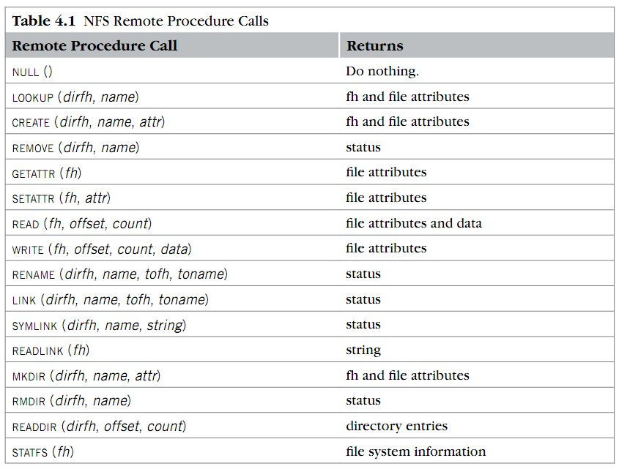
RPC in NFS
Where is OPEN and CLOSE?

Slide 35
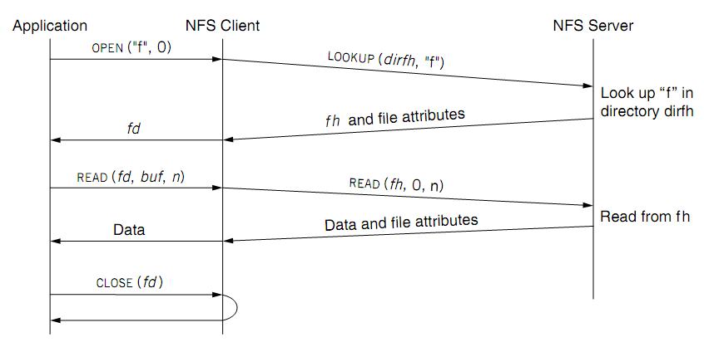
NFS Overview
fd <--> fh (file handler)
No state after open()

Slide 36
File Handler for a Client
File handler contains three parts
  File system identifier: for server to identify the file system
  inode number: for server to locate the file
  Generation number: for server to maintain consistency of a file
Can still work across server failures
  E.g., server reboot
Q: Why not put path name in the handle?

Slide 37
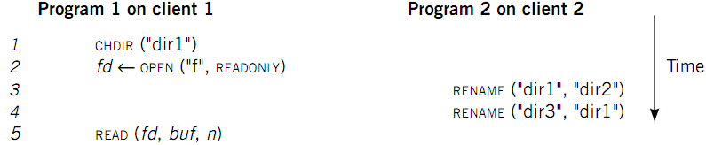
Case 1: Rename After Open
UNIX Spec:
  Program 1 should read "dir2/f"
  NFS should keep the spec

Slide 38
Stateless on NFS server
Stateless on NFS server
  Each RPC contains all the information
Q: What about states like file cursor?
  Client maintains the states, including the file cursor
Client can repeat a request until it receives a reply (at least once)
  Server may execute the same request twice
  Solution: each RPC is tagged with a transaction number, and server maintains some "soft" state: reply cache
  Q: What if the server fails between two same requests?
Notes:
What about the case of "delete-after-open"?

Slide 39
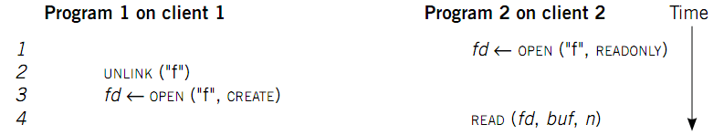
Case 2: Delete After Open
UNIX spec:
  On local FS, program 2 will read the old file
How to avoid program 2 reading new file?
  Generation number
  "stale file handler"
Not the same as UNIX spec! It's a tradeoff...

Slide 40
Cache on the Client
NFS client maintains various caches
  Stores a vnode for every open file
    Know the file handles
  Recently used vnodes, attributes, recently used blocks, mapping from path name to vnode
Cache benefits
  Reduce latency
  Less RPC, reduce load on server
Cache coherence is needed

Slide 41
Coherence
Type-1: Read/write coherence
  On local file system, READ gets newest data
  On NFS, client has cache
  NFS could guarantee read/write coherence for every operation, or just for certain operation
Type-2: Close-to-open consistency
  Higher data rate
  GETATTR when OPEN, to get last modification time
  Compare the time with its cache
  When CLOSE, send cached writes to the server
Notes:
Mixed blocks, old and new

Slide 42
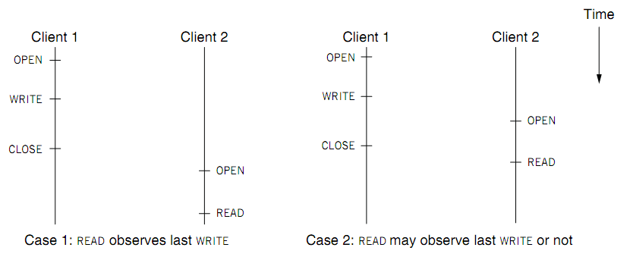
Coherence
Two cases of close-to-open consistency
More contents of consistency in chapter 9 and 10

Slide 43
Extend the UNIX FS to support NFS
Vnode
  Abstract whether a file or directory is local or remote
  In volatile memory (why?)
  Support several different local file system
  Where should vnode layer be inserted?
Vnode API
  Same as we learnt: OPEN, READ, WRITE, CLOSE…
  Code of fd_table, current dir, file name lookup, can be moved up to the file system call layer

Slide 44
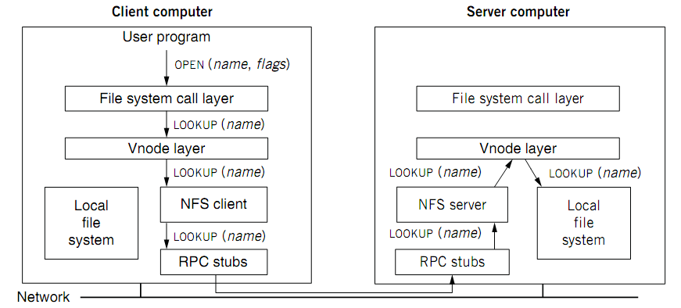
Extend the UNIX FS to support NFS

Slide 45
Reference Materials
Textbook
  Chapter 4.2 & 4.5
RFC 1831: RPC Specification
  http://www.ietf.org/rfc/rfc1831.txt?number=1831
RFC 1832: XDR Specification
  http://www.ietf.org/rfc/rfc1832.txt?number=1832

Slide 46
Client & Server (C/S Model)
Enforced modularity

Slide 47
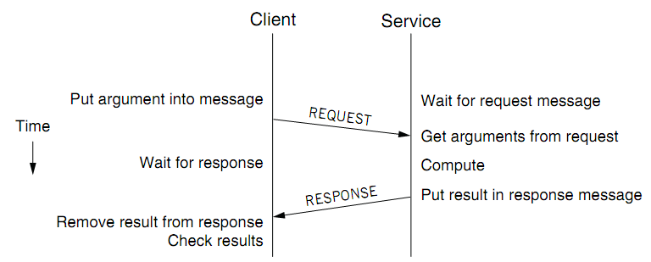
Client/Service Organization
Limit interactions to explicit messages
  Client: request; service: response or reply
  On different computers, connected by a wire
    Chap 5 will explain how to get them into one computer

Slide 48
C/S Model
Client/Service model
  Separates functions (abstraction)
  Enforces that separation (enforced modularity)
  Reduce fate sharing but not eliminate it
Notes:
Occam's Razor.

Slide 49
Multiple Clients and Services
One services can work for multiple clients
  E.g., one file server for multiple clients
One client can use several services
  E.g., one client can connect to multiple file servers
One module can be both a client and a service
  E.g., printer as a service for printing request, while also as a client of the file service

Slide 50
Trusted Intermediaries
Service as trusted 3rd party
  Run critical procedures as a service
  E.g., a file service to keep clients' file distinct, email service
  Enforces modularity among multiple clients
  Ensures that a fault in one client has limited effect on another client
Thin client computing (the ultimate version of C/S?)
  Simplify clients by having the trusted intermediary provide most functions
  Only the trusted intermediaries run on powerful computers
  What if the powerful computers fail…

Slide 51
RPC != PC
RPCs can reduce fate sharing
  Set a time-out for message lost or service failure
RPCs introduce new failures: no response
RPCs take more time
  Stub itself may cost more than a service
  Consider using RPC in device driver: time-out error
  Not suitable for all cases

Slide 52
RPC: Failure Handling
Most network systems and applications also have these considerations
1. At least once
  Client keeps resending until server responds
  Only OK if without side effects on server
2. At most once
  Client keeps resending (may time-out)
  Server remembers requests and suppress duplicates?
  Idempotent functions
3. Exactly once
  This is often what we really want
  Hard to do in a useful way, later in Chap-8 and 10
Most RPC systems do #1 or #2

Slide 53
Other Differences
Language support
  Some features do not combine well with RPC
    E.g., inter-procedure communicate through global variable
  Data structure that contains pointers
Security consideration
  Both client and server need authentication
  Side channel attacks through network pattern

Slide 54
Questions
Q: Why RPC and C/S?
  Programmers make mistakes
  Mistakes propagate easily
  Enforce modularity
Q: What does RPC do, exactly? Can we use other ways?
  E.g., socket? HTTP? Why not use them?
  Be more friendly for programmers

