Slide 1

Thread and Condition Variable
Computer System Engineering, Fall 2020 (IPADS, SJTU)
Lock with yield()
Yubin Xia

Slide 2
Review: Lock Granularity
Systems can be distinguished by number of locks and the amount of share data they protect
Developer must choose a locking scheme to provide the need amount of concurrency
  Frequently concurrency leads to complexity

Slide 3
Review: Deadlock
If we had modified the code so that both threads acquire the locks in the same order
  (L1 and then L2, or vice versa)
  No deadlock could have occurred
Again, small changes in the order of statements can result in good or bad behavior

Slide 4
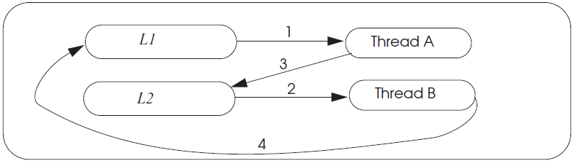
Review: Deadlock wait-for Graph

Slide 5
4 Necessary & Sufficient Conditions for Deadlock
1. Limited access
  Resource can only be shared with finite users.
2. No preemption
  Once resource granted, cannot be taken away.
3. Multiple independent requests (hold and wait)
  Don't ask all at once
4. Cycle in wait for graph

Slide 6
Review: Livelock
An interaction among a group of threads
  Each thread is repeatedly performing some operations
    E.g., context saving/restoring
  But never able to complete the whole sequence of operations
    E.g., process the network packets

Slide 7
Review: One-writer Principle
If each variable has only one writer
  Coordination becomes easier
  Concurrency and read-only data is easy
  Guide: Make as much data as you can have only a single writer
Privatization: Make data private to a thread
    Allocate on thread stack
    Array indexed by thread_id()
      E.g. privateData[thread_id()]...
Focus locking scheme on data shared read/write

Slide 8
Producer–consumer problem
Case of cooperation and concurrency

Slide 9
Bounded Buffer between Producer & Consumer
2^{n}
0
2^{n}
0
Module A
Module B
OS
Very similar with the C/S model

Slide 10
Enforce Modularity for Bounded Buffer
Adopt the same message-passing paradigm in C/S
  To enable communication while keep isolation
  Like RPC
Share buffer in kernel
  User mode cannot access the buffer directly
  Applications use API to operate the buffer
  Must transition to kernel mode to copy messages into/from the shared buffer

Slide 11
Bounded Buffer and its API
Bounded buffer: a buffer that stores (up to) N messages
Bounded buffer API
  send (m)
  m <- receive()

Slide 12
Enforce Modularity for Bounded Buffer
SEND() and RECEIVE()
  Supervisor calls (e.g., system calls)
  Copy the message from/to the thread's domain to/from the shared buffer
  Programs running in kernel mode is written carefully
  Transitions between user mode and kernel mode can be expensive

Slide 13
Virtual Communication Links
Producer and Consumer Problem
  Sender must wait when buffer is full
  Receiver must wait when buffer is empty
  Need sequence coordination

Slide 14
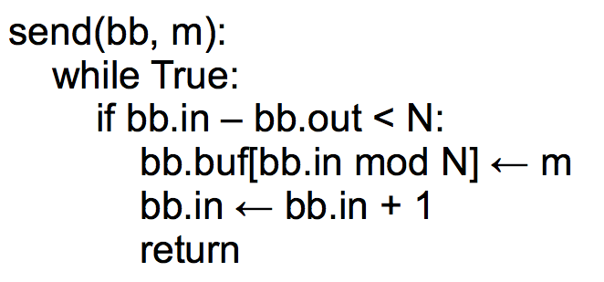
Bounded Buffer Send
Cannot switch the two
Notes:
Imagine that the buffer has zero elements in it. Program 1 has a
message to send. The if condition evaluates to True, and Program 1
increments bb.in. However, at the same time, Program 2 is trying to
read. Program 2's if-statement will also evaluate to true: right now,
bb.out = 0 and bb.in = 1. So Program 2 will try to read a message
from the buffer, but none has been written yet.

Slide 15
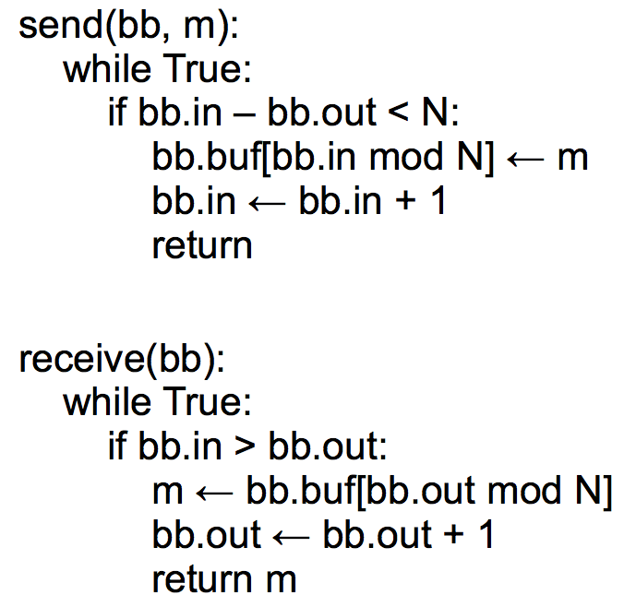
Bounded Buffer Send/Receive

Slide 16
Assumptions of the Previous Implementation
Single producer & Single consumer
Each on its own CPU
in and out do not overflow
read/write coherence (e.g., on cache)
in and out ensure before-or-after atomicity
The result of executing a statement becomes visible to other threads in program order
  Compilers cannot optimize it
Notes:
2. if not, busy wait will just cost all CPU

Slide 17
Concurrency
This implementation works on two CPUs
  One for a sender and one for a receiver
  which is surprising!
    Conventional wisdom tells us that if some resource is accessed by two (or more) CPUs at the same time, something might get wrong

Slide 18
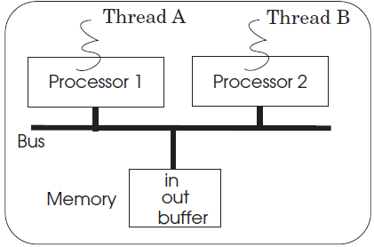
Multiple Senders
Multiple senders may send at the same time

Slide 19
Case 1
A
bb.in = 0, bb.out = 0
write m1 to buf[0]
set bb.in = 1
B
bb.in = 1, bb.out = 0
write m2 to buf[1]
set bb.in = 2
Everything works fine!

Slide 20
Case 2
A
bb.in = 0, bb.out = 0
write m1 to buf[0]
set bb.in = 1
B
bb.in = 0, bb.out = 0
write m2 to buf[0]
set bb.in = 1
m1 lost!

Slide 21
Send with Locking: Correct?
send(bb, message):
while True:
if bb.in – bb.out < N:
acquire(bb.send_lock)
bb.buf[bb.in mod N] <- message
bb.in <- bb.in + 1
release(bb.send_lock)
return
Notes:
Not correct. Concurrent senders will both think they can write.
One will get the lock and write, and then the other will get the lock,
but it might be that the first sender filled up the buffer (so that
the second shouldn't actually be writing).

Slide 22
Send with Locking: the Correct Version
send(bb, message):
acquire(bb.send_lock)
while True:
if bb.in – bb.out < N:
bb.buf[bb.in mod N] <- message
bb.in <- bb.in + 1
release(bb.send_lock)
return

Slide 23
Send with Locking: Another Version
send(bb, message):
while True:
acquire(bb.send_lock)
if bb.in – bb.out < N:
bb.buf[bb.in mod N] <- message
bb.in <- bb.in + 1
release(bb.send_lock)
return
release(bb.send_lock)

Slide 24
The Need for Yield()

Slide 25
The yield() System Call
When using locking, current thread is busy waiting for an event
Implementation of yield():
  Suspend running thread: save stack pointer and page-table register
  Choose new thread: round-robin fashion until we hit a RUNNABLE thread (perhaps the one that just called yield)
  Resume thread to run: reload state all of this happens as an atomic action
Data structures
  threads table, CPUs table, t_lock

Slide 26
send() with yield()
send(bb, msg):
acquire(bb.lock)
while True:
if bb.in – bb.out < N:
bb.buf[bb.in mod N] <- msg
bb.in <- bb.in + 1
release(bb.lock)
return
send(bb, msg):
acquire(bb.lock)
while True:
if bb.in - bb.out < N:
bb.buf[bb.in mod N] <- msg
bb.in <- bb.in + 1
release(bb.lock)
return
release(bb.lock)
yield()
acquire(bb.lock)
Note that this version of send() is incorrect.
We will first show YIELD() implementation.

Slide 27
YIELD() Implementation
yield():
// Suspend the running thread
// Choose a new thread
// Resume the new thread

Slide 28
YIELD() Implementation
yield():
acquire(t_lock)
id = id of current thread
threads[id].state = RUNNABLE
threads[id].sp = SP
// Choose a new thread
// Resume the new thread
release(t_lock)
Suspend
running thread
A table contains a list of all the current threads and some info about them, one per system
threads
t_lock
A lock protect the thread table (at least for now)

Slide 29
YIELD() Implementation
yield():
acquire(t_lock)
id = cpus[CPU].thread
threads[id].state = RUNNABLE
threads[id].sp = SP
// Choose a new thread
// Resume the new thread
release(t_lock)
Suspend
running thread
A table contains a list of all CPUs and the ID of the thread currently running on them, one per CPU
cpus
Question: why no cpu_lock needed?

Slide 30
YIELD() Implementation
yield():
acquire(t_lock)
id = cpus[CPU].thread
threads[id].state = RUNNABLE
threads[id].sp = SP
do:
id = (id + 1) mod N
while threads[id].state != RUNNABLE
// Resume new thread
release(t_lock)
Suspend
running thread
Choose new
thread
The state could be RUNNING, RUNNABLE (for now)

Slide 31
YIELD() Implementation
yield():
acquire(t_lock)
id = cpus[CPU].thread
threads[id].state = RUNNABLE
threads[id].sp = SP
do:
id = (id + 1) mod N
while threads[id].state != RUNNABLE
SP = threads[id].sp
threads[id].state = RUNNING
cpus[CPU].thread = id
release(t_lock)
Suspend
running thread
Choose new
thread
Resume new
thread
t_lock
Atomically set threads[ ].state and .sp
Atomically find a RUNNABLE thread and mark it RUNNING

Slide 32
Conditional Variables

Slide 33
Review: send() with Lock
send(bb, msg):
acquire(bb.lock)
while True:
if bb.in – bb.out < N:
bb.buf[bb.in mod N] <- msg
bb.in <- bb.in + 1
release(bb.lock)
return
send(bb, msg):
acquire(bb.lock)
while True:
if bb.in - bb.out < N:
bb.buf[bb.in mod N] <- msg
bb.in <- bb.in + 1
release(bb.lock)
return
release(bb.lock)
yield()
acquire(bb.lock)
Note that this version of send() is incorrect.

Slide 34
A Lot of Wasting Checks
send(bb, msg):
acquire(bb.lock)
while True:
if bb.in - bb.out < N:
bb.buf[bb.in mod N] <- msg
bb.in <- bb.in + 1
release(bb.lock)
return
release(bb.lock)
yield()
acquire(bb.lock)
Problem: a lot of unnecessary checking as well as a lot of acquiring locks
Better solution: the sender (receiver) just got woken up when the buffer is not full (empty)

Slide 35
Condition Variables
Condition Variable
  Let threads wait for events
  The threads get notified when the events occur
Condition variable API
  WAIT(cv): yield processor and wait to be notified of cv
  NOTIFY(cv): notify waiting threads of cv

Slide 36
Send with WAIT/NOTIFY (Incorrect Version)
send(bb, msg):
acquire(bb.lock)
while True:
if bb.in - bb.out < N:
bb.buf[bb.in mod N] <- msg
bb.in <- bb.in + 1
release(bb.lock)
return
release(bb.lock)
yield()
acquire(bb.lock)
send(bb, msg):
acquire(bb.lock)
while True:
if bb.in - bb.out < N:
bb.buf[bb.in mod N] <- msg
bb.in <- bb.in + 1
release(bb.lock)
notify(bb.not_empty)
return
release(bb.lock)
wait(bb.not_full)
acquire(bb.lock)
wait() will call yield()

Slide 37
Send with WAIT/NOTIFY
Do we really need a while loop with CV?
  Strawman alternative: if buffer is full, wait() and then store message
  Problem: many senders might wake up from wait() after just one receive()
  Must re-check that there's still space after we re-acquired the lock
What happens if send() notifies but there's no receiver waiting?
  No one gets woken up
  But that's OK: a later receiver will re-check (in>out)

Slide 38
The Lost Notify Problem
Condition variable itself has no memory/state
  wait() and then notify(): wait() returns
  notify() and then wait(): wait() does not return
    This is potentially prone to race conditions

Slide 39
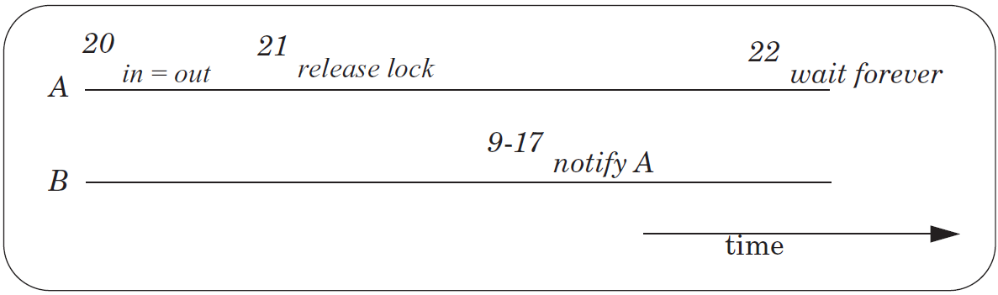
The Lost Notify Problem

Slide 40
New API: WAIT(bb.full, bb.lock)
Old API
  WAIT(cv): yield processor and wait to be notified of cv
  NOTIFY(cv): notify waiting threads of cv
New API
  WAIT(cv, lock): release lock, yield CPU, wait to be notified
  NOTIFY(cv): notify waiting threads of cv

Slide 41
New API: WAIT(bb.full, bb.lock)
send(bb, msg):
acquire(bb.lock)
while True:
if bb.in - bb.out < N:
bb.buf[bb.in mod N] <- msg
bb.in <- bb.in + 1
release(bb.lock)
notify(bb.not_empty)
return
release(bb.lock)
wait(bb.not_full)
acquire(bb.lock)
send(bb, msg):
acquire(bb.lock)
while True:
if bb.in - bb.out < N:
bb.buf[bb.in mod N] <- msg
bb.in <- bb.in + 1
release(bb.lock)
notify(bb.not_empty)
return
release(bb.lock)
wait(bb.not_full)
acquire(bb.lock)
wait(bb.not_full, bb.lock)

Slide 42
WAIT
send(bb, msg):
acquire(bb.lock)
while True:
if bb.in - bb.out < N:
bb.buf[bb.in mod N] <- msg
bb.in <- bb.in + 1
release(bb.lock)
notify(bb.not_empty)
return
wait(bb.not_full, bb.block)
wait(cv, lock):
acquire(t_lock)
release(lock)
threads[id].cv = cv
threads[id].state = WAITING
yield_wait()
release(t_lock)
acquire(lock)
Not yield()
Using t_lock to ensure the atomic of release lock and yield
The order of t_lock and lock matters

Slide 43
WAIT & NOTIFY
wait(cv, lock):
acquire(t_lock)
release(lock)
threads[id].cv = cv
threads[id].state = WAITING
yield_wait()
release(t_lock)
acquire(lock)
notify(cv):
acquire(t_lock)
for I = 0 to N-1:
if threads[i].cv == cv && threads[i].state == WAITING:
threads[i].state = RUNNABLE
release(t_lock)

Slide 44
Recall YIELD()
yield():
acquire(t_lock)
id = cpus[CPU].thread
threads[id].state = RUNNABLE
threads[id].sp = SP
do:
id = (id + 1) mod N
while threads[id].state != RUNNABLE
SP = threads[id].sp
threads[id].state = RUNNING
cpus[CPU].thread = id
release(t_lock)
Suspend
running thread
Choose new
thread
Resume new
thread

Slide 45
YIELD_WAIT()
yield_wait(): // called by wait()
acquire(t_lock)
id = cpus[CPU].thread
threads[id].state = RUNNABLE
threads[id].sp = SP
do:
id = (id + 1) mod N
while threads[id].state != RUNNABLE
SP = threads[id].sp
threads[id].state = RUNNING
cpus[CPU].thread = id
release(t_lock)
wait(cv, lock):
acquire(t_lock)
release(lock)
threads[id].cv = cv
threads[id].state = WAITING
yield_wait()
release(t_lock)
acquire(lock)
The t_lock has already been hold by wait()
Current thread should not be RUNNABLE

Slide 46
YIELD_WAIT()
yield_wait(): // called by wait()
id = cpus[CPU].thread
threads[id].sp = SP
do:
id = (id + 1) mod N
while threads[id].state != RUNNABLE
SP = threads[id].sp
threads[id].state = RUNNING
cpus[CPU].thread = id
wait(cv, lock):
acquire(t_lock)
release(lock)
threads[id].cv = cv
threads[id].state = WAITING
yield_wait()
release(t_lock)
acquire(lock)
Problem: what if nothing is RUNNABLE?
yield_wait() will keep looping forever, while holding t_lock.
Other CPUs cannot acquire t_lock, even if they want to do a notify! => deadlock!

Slide 47
YIELD_WAIT()
yield_wait(): // called by wait()
id = cpus[CPU].thread
threads[id].sp = SP
do:
id = (id + 1) mod N
release(t_lock)
acquire(t_lock)
while threads[id].state != RUNNABLE
SP = threads[id].sp
threads[id].state = RUNNING
cpus[CPU].thread = id
wait(cv, lock):
acquire(t_lock)
release(lock)
threads[id].cv = cv
threads[id].state = WAITING
yield_wait()
release(t_lock)
acquire(lock)
Problem: Once yield_wait() releases t_lock, another CPU can run our current thread.
So now two CPUs have their SP pointing to the same thread's stack!
Can result in the stack being corrupted!
Notes:
SP currently points to the original thread's stack -- call it thread A.
Between release and acquire, another CPU could run thread A. This
means that two CPUs will have their stack pointer pointing to thread
A's stack. This is a very easy way for A's stack to get corrupted.

Slide 48
YIELD_WAIT()
yield_wait(): // called by wait()
id = cpus[CPU].thread
threads[id].sp = SP
SP = cpus[CPU].stack
do:
id = (id + 1) mod N
release(t_lock)
acquire(t_lock)
while threads[id].state != RUNNABLE
SP = threads[id].sp
threads[id].state = RUNNING
cpus[CPU].thread = id
wait(cv, lock):
acquire(t_lock)
release(lock)
threads[id].cv = cv
threads[id].state = WAITING
yield_wait()
release(t_lock)
acquire(lock)

Slide 49
Preemption
For thread scheduling

Slide 50
Preemptive Scheduling
Non-preemptive Scheduling
  A thread continues to run until it gives up its processor
Cooperative Scheduling (cooperative multitasking)
  Every thread is supposed to call YIELD periodically
Preemptive Scheduling
  The thread manager force a thread to give up its processor after a time interval

Slide 51
Implement Preemptive Scheduling
Set the interval timer of a clock device
When the timer expires
  The clock triggers an interrupt
  Switching to kernel mode in the processor layer to invoke clock interrupt handler
The clock interrupt handler invokes an exception handler
  Runs in the thread layer
  Forces the currently running thread to yield

Slide 52
Timer Interrupt Handler
timer_interrupt():
push PC // done by CPU
push registers // this is not a function call;
// cannot assume compiler saves registers
yield()
pop registers
pop PC

Slide 53
YIELD_WAIT()
yield_wait(): // called by wait()
id = cpus[CPU].thread
threads[id].sp = SP
SP = cpus[CPU].stack
do:
id = (id + 1) mod N
release(t_lock)
acquire(t_lock)
while threads[id].state != RUNNABLE
SP = threads[id].sp
threads[id].state = RUNNING
cpus[CPU].thread = id
wait(cv, lock):
acquire(t_lock)
release(lock)
threads[id].cv = cv
threads[id].state = WAITING
yield_wait()
release(t_lock)
acquire(lock)
Problem: What happens if timer interrupt occurs when CPU is running yield / yield_wait?
Since t_lock is already locked, When timer tries to call yield(), acquire(t_lock) will hang forever!

Slide 54
YIELD_WAIT()
yield_wait(): // called by wait()
id = cpus[CPU].thread
threads[id].sp = SP
SP = cpus[CPU].stack
do:
id = (id + 1) mod N
release(t_lock)
enable_interrupt()
disable_interrupt()
acquire(t_lock)
while threads[id].state != RUNNABLE
SP = threads[id].sp
threads[id].state = RUNNING
cpus[CPU].thread = id
wait(cv, lock):
disable_interrupt()
acquire(t_lock)
release(lock)
threads[id].cv = cv
threads[id].state = WAITING
yield_wait()
release(t_lock)
enable_interrupt()
acquire(lock)
Problem: if timer interrupt comes, we would put the wrong thread to sleep!
Notes:
remember the yield(), which will change threads[id] to RUNNABLE. conflict!
should also change yield().

Slide 55
YIELD_WAIT()
yield_wait(): // called by wait()
id = cpus[CPU].thread
cpus[CPU].thread = null
threads[id].sp = SP
SP = cpus[CPU].stack
do:
id = (id + 1) mod N
release(t_lock)
enable_interrupt()
disable_interrupt()
acquire(t_lock)
while threads[id].state != RUNNABLE
SP = threads[id].sp
threads[id].state = RUNNING
cpus[CPU].thread = id
wait(cv, lock):
disable_interrupt()
acquire(t_lock)
release(lock)
threads[id].cv = cv
threads[id].state = WAITING
yield_wait()
release(t_lock)
enable_interrupt()
acquire(lock)

Slide 56
Summary
Threads
  Virtualize a processor so that we can share it among programs
  yield() allows the kernel to suspend the current thread and resume another
Condition Variables
  Provide a more efficient API for threads
  Threads wait for an event and are notified when it occurs
  wait() requires a new version of yield(), yield_wait()
Preemption
  Forces a thread to be interrupted
    So that do not have to rely on programmers correctly using yield()
  Requires a special interrupt and hardware support to disable other interrupts

Slide 57
Understanding The Code In Book

Slide 58
Thread Layer and Processor Layer
A thread runs in thread layer
A thread calls YIELD, enters processor layer
Saves the state of the running thread
  General purpose regs + PC + SP + CR3
Chose another runnable thread
Exit the processor layer and enter thread layer
The new thread runs in thread layer

Slide 59
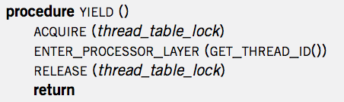
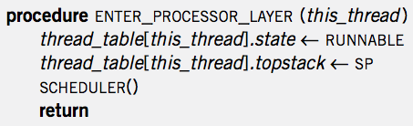
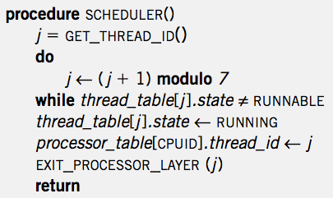

Context Switch
YIELD
ENTER
SCHED
EXIT
YIELD
YIELD
ENTER
SCHED
EXIT
YIELD
App
APP
APP
YIELD
YIELD
YIELD
YIELD
SP-1
ENTER
ENTER
SP-2
ENTER
ENTER
SP-2
SP-1
SCHED
SCHED
EXIT
EXIT
Notes:
Question-1: where is the point of context switch?
Question-2: why not save the PC of a thread?

Slide 60
Creating a Thread
ALLOCATE_THREAD
  Allocate a new stack
  Push address of EXIT_THREAD() as return address
  Push address of starting_procedure as return address
    starting_procedure is the start address of a thread
  Initialize an entry in thread_table
  Set state to RUNNABLE
Stack of a Thread
EXIT_THREAD
starting_procedure

Slide 61
Start the Scheduler
Processor Thread
  Create a separate thread for each processor first
  Its stack is not used for most of the time
    Only used when running scheduler()

Slide 62
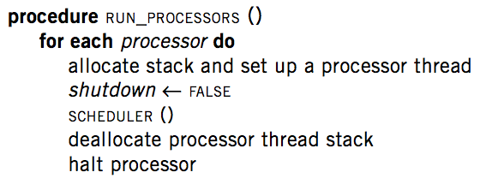
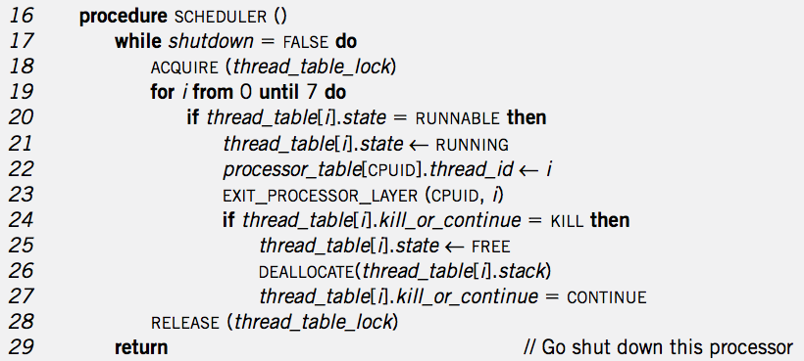
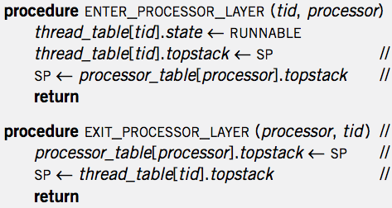
RUN_PROCESSOR
& Create Thread
Thread Create
RUN_PROCESSOR
EXIT_T
MAIN
APP
SCHED
EXIT_P

Slide 63
Thread Exit
1 procedure EXIT_THREAD()
2 ACQUIRE (threadtable_lock)
3 threadtable[tid].kill_or_continue ← KILL
4 ENTER_PROCESSOR_LAYER (GET_THREAD_ID (), CPUID)

Slide 64
Destroy a Thread
DESTROY_THREAD
  One thread kills another thread
  Problem: the target thread may be running, thus the calling thread cannot just free its resource
  Solution: asynchronization: set KILL and return
    Wait for the thread to be destroyed when SCHEDULER

Slide 65
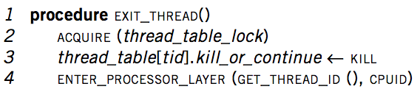
Thread Exit
Thread
Exit
APP
APP
EXIT_T
SCHED
YIELD
ENTER_P
EXIT_P
EXIT_P
ENTER_P

Slide 66
The New Scheduler()
16 procedure SCHEDULER ()
17 while shutdown = FALSE do
18 ACQUIRE (threadtable_lock)
19 for i from 0 until 7 do
20 if threadtable[i].state = RUNNABLE then
21 threadtable[i].state ← RUNNING
22 processor_table[CPUID].thread_id ← i
23 EXIT_PROCESSOR_LAYER (CPUID, i)
24 if threadtable[i].kill_or_continue = KILL then
25 threadtable[i].state ← FREE
26 DEALLOCATE(threadtable[i]. stack)
27 threadtable[i]. kill_or_continue = CONTINUE
28 RELEASE (threadtable_lock)
29 return // Go shut down this processor

Slide 67
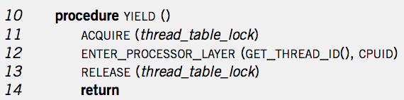
Context Switch
YIELD
ENTER
SCHED
EXIT
YIELD
YIELD
ENTER
SCHED
EXIT
YIELD
App
MAIN
APP
APP
MAIN
YIELD
SCHED
SCHED
YIELD
YIELD
SCHED
SCHED
SCHED
YIELD
ENTER
EXIT
EXIT
ENTER
ENTER
EXIT
EXIT
SP-1
SP-2
SP-2
ENTER
SP-1
SP of Processor Thread
SP of Processor Thread

Slide 68
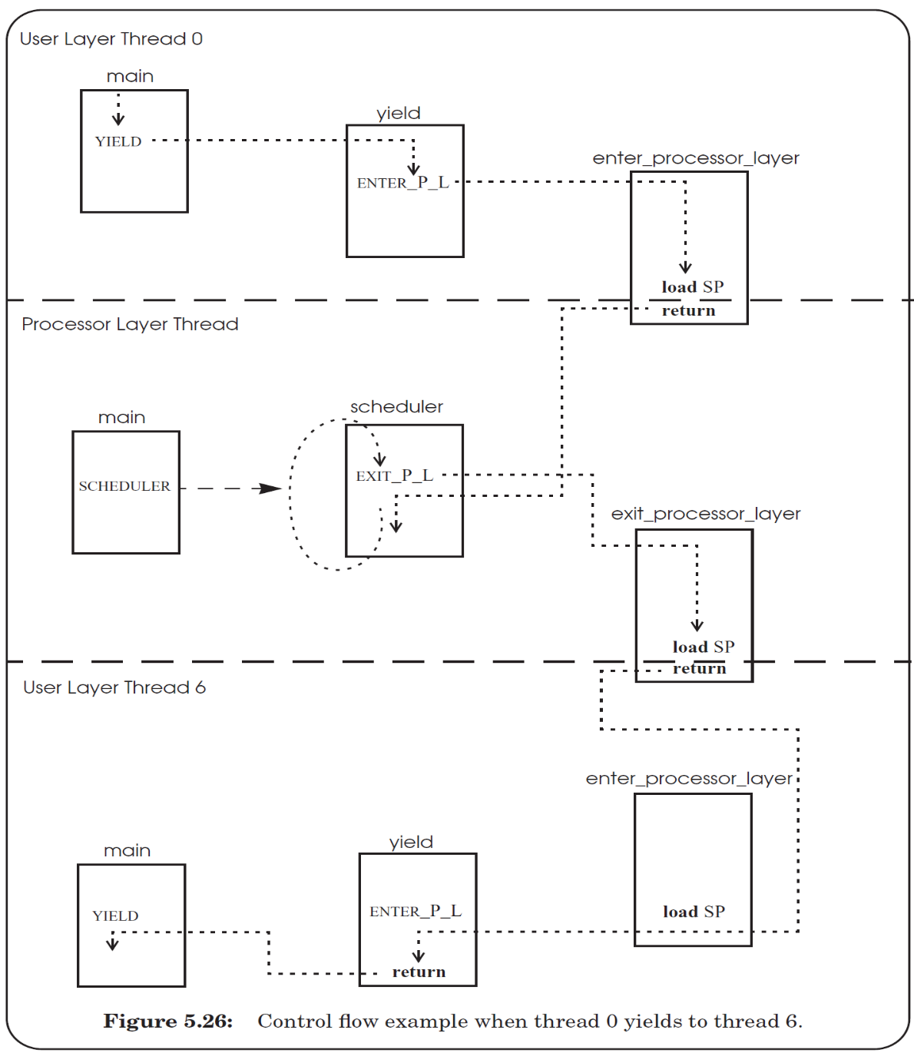

Slide 69
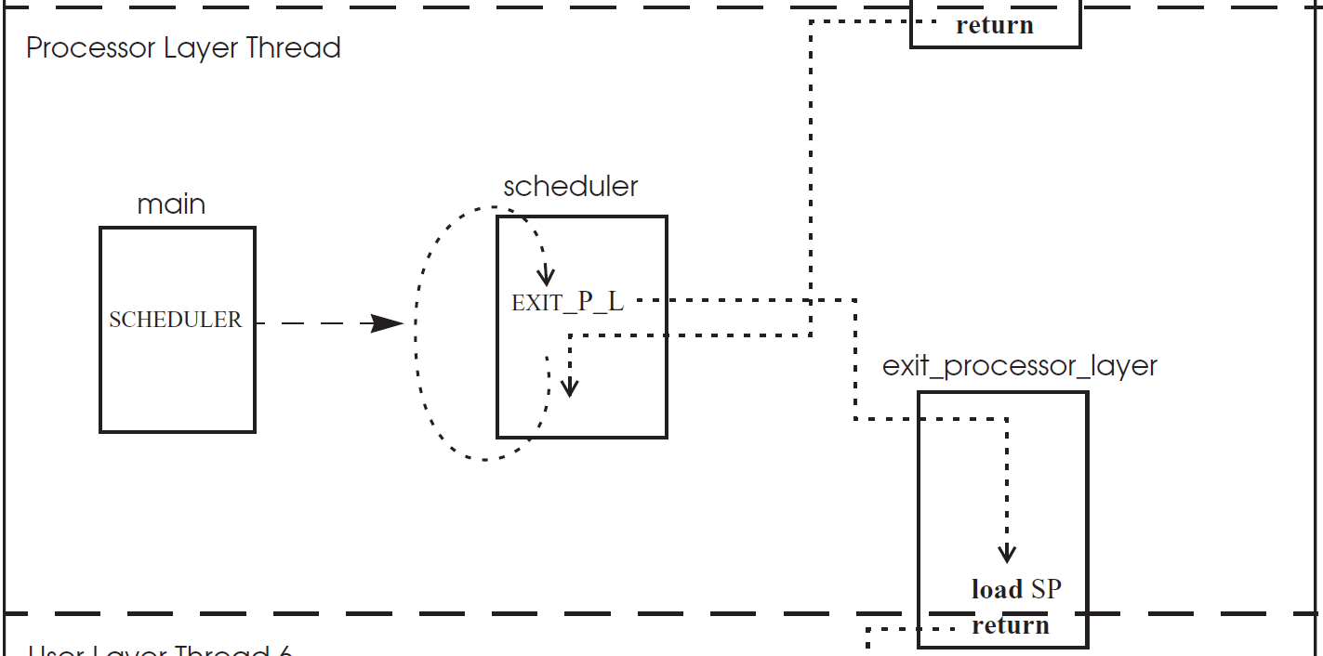

Slide 70
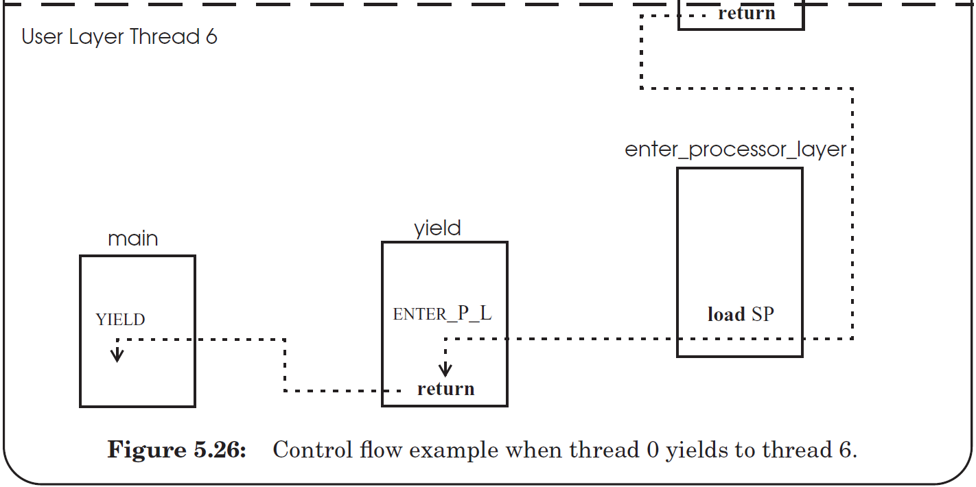

Slide 71
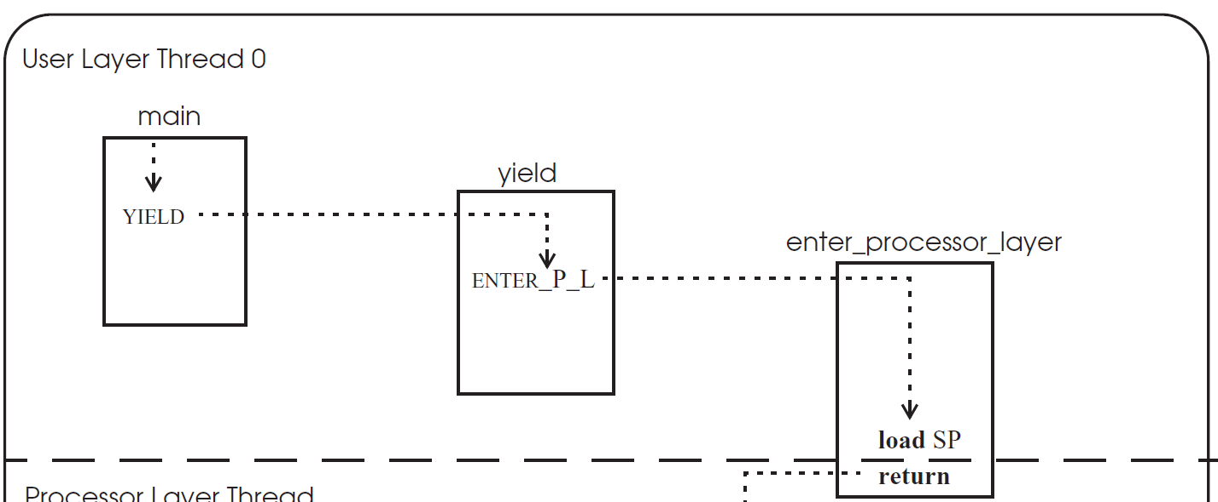

Slide 72
thread_table_lock
1
2
11
12
3
4
7
8
5
6
9
10

Slide 73
thread_table_lock
1
2
3
4
5
Stack changes to
processor thread
6
7
8
9
10
11
Stack changes back
12

Slide 74
First time of a thread
1
2
3
4
5
Stack changes to
processor thread
6
7
8
Q: still hold the lock?
9
10
11
start_procedure()
Stack changes back
Notes:
Answer: when create a new thread, the stack of the thread must be initialized to include YIELD(), and push the return address to the middle of YIELD(), so that when after return, the new thread will first release the lock, just as the previous slide. Then return again to the start_procedure (by pushing the address to the stack too).

Slide 75
Eventcount & Sequencer

Slide 76
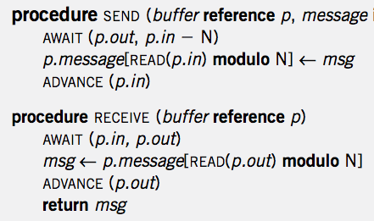
Single Sender and Single Receiver

Slide 77
4 Primitives
AWAIT (eventcount, value)
ADVANCE (eventcount)
TICKET (sequencer)
READ (eventcount or sequencer)

Slide 78
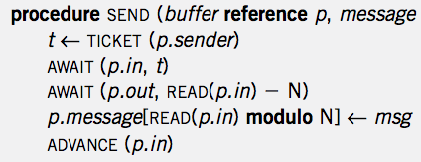
Multiple Senders and Single Receiver
No loop! Is it OK?

Slide 79
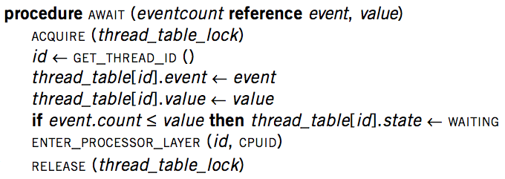
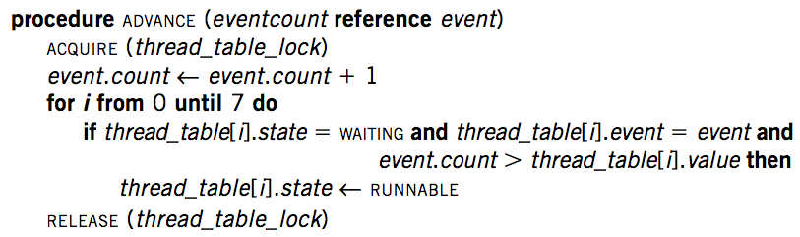
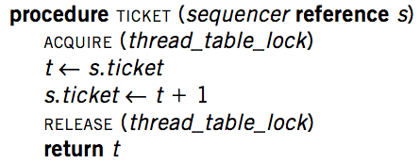
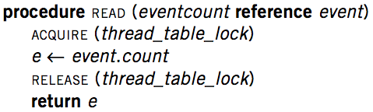
Implementation

Slide 80
Primitives for Sequence Coordination
AWAIT (eventcount, value) is a before-or-after action
  Compares eventcount to value
  If eventcount exceeds value
    AWAIT returns to its caller.
  If eventcount is less than or equal to value
    Changes the state of the calling thread to WAITING
    Places value and the name of eventcount in this thread's entry in the thread table
    Yields its processor

Slide 81
Primitives for Sequence Coordination
ADVANCE (eventcount) is a before-or-after action
  Increments eventcount by one
  Searches the thread table for threads that are waiting on this eventcount
  For each one it finds,
    If eventcount now exceeds the value for which that thread is waiting
    Changes that thread's state to RUNNABLE

Slide 82
Primitives for Sequence Coordination
TICKET (sequencer) is a before-or-after action
  Returns a non-negative value that increases by one on each call
  Two threads concurrently calling TICKET on the same sequencer
    Receive different values
    The ordering of the values returned corresponds to the time ordering of the execution of TICKET

Slide 83
Primitives for Sequence Coordination
READ (eventcount or sequencer) is a before-or-after action
  Returns to the caller the current value of the variable
  Having an explicit READ procedure is to assure before-or-after atomicity for eventcounts and sequencers whose value may grow to be larger than a memory cell

Slide 84
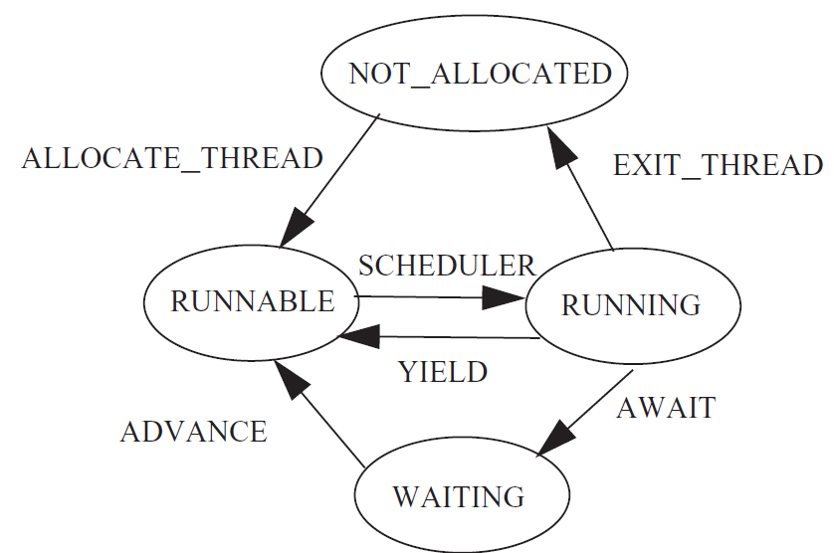
Thread State Diagram

