Slide 1

Thread and Condition Variable
Computer System Engineering, Fall 2020 (IPADS, SJTU)
Lock with yield()
Yubin Xia

Slide 2
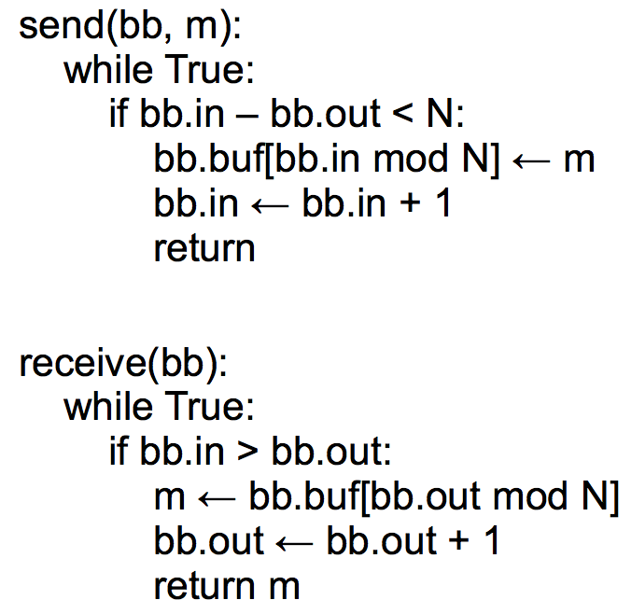
Review: Bounded Buffer Send/Receive

Slide 3
YIELD() Implementation
yield():
acquire(t_lock)
id = cpus[CPU].thread
threads[id].state = RUNNABLE
threads[id].sp = SP (SP is CPU reg)
do:
id = (id + 1) mod N
while threads[id].state != RUNNABLE
SP = threads[id].sp
threads[id].state = RUNNING
cpus[CPU].thread = id
release(t_lock)
Suspend
running thread
Choose new
thread
Resume new
thread
t_lock
Atomically set threads[ ].state and .sp
Atomically find a RUNNABLE thread and mark it RUNNING

Slide 4
send() with yield()
send(bb, msg):
acquire(bb.lock)
while True:
if bb.in – bb.out < N:
bb.buf[bb.in mod N] <- msg
bb.in <- bb.in + 1
release(bb.lock)
return
send(bb, msg):
acquire(bb.lock)
while True:
if bb.in - bb.out < N:
bb.buf[bb.in mod N] <- msg
bb.in <- bb.in + 1
release(bb.lock)
return
release(bb.lock)
yield()
acquire(bb.lock)
Still a lot of unnecessary checking

Slide 5
Condition Variables
Condition Variable
  Let threads wait for events
  The threads get notified when the events occur
Condition variable API
  WAIT(cv): yield processor and wait to be notified of cv
  NOTIFY(cv): notify waiting threads of cv

Slide 6
WAIT & NOTIFY
wait(cv, lock):
acquire(t_lock)
release(lock)
threads[id].cv = cv
threads[id].state = WAITING
yield_wait()
release(t_lock)
acquire(lock)
notify(cv):
acquire(t_lock)
for I = 0 to N-1:
if threads[i].cv == cv && threads[i].state == WAITING:
threads[i].state = RUNNABLE
release(t_lock)

Slide 7
Send with WAIT/NOTIFY (Incorrect Version)
send(bb, msg):
acquire(bb.lock)
while True:
if bb.in - bb.out < N:
bb.buf[bb.in mod N] <- msg
bb.in <- bb.in + 1
release(bb.lock)
return
release(bb.lock)
yield()
acquire(bb.lock)
send(bb, msg):
acquire(bb.lock)
while True:
if bb.in - bb.out < N:
bb.buf[bb.in mod N] <- msg
bb.in <- bb.in + 1
release(bb.lock)
notify(bb.not_empty)
return
release(bb.lock)
wait(bb.not_full)
acquire(bb.lock)
wait() will call yield()

Slide 8
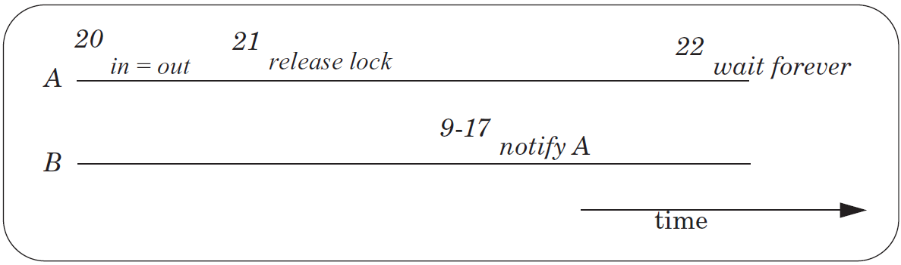
The Lost Notify Problem

Slide 9
New API: WAIT(bb.full, bb.lock)
send(bb, msg):
acquire(bb.lock)
while True:
if bb.in - bb.out < N:
bb.buf[bb.in mod N] <- msg
bb.in <- bb.in + 1
release(bb.lock)
notify(bb.not_empty)
return
release(bb.lock)
wait(bb.not_full)
acquire(bb.lock)
send(bb, msg):
acquire(bb.lock)
while True:
if bb.in - bb.out < N:
bb.buf[bb.in mod N] <- msg
bb.in <- bb.in + 1
release(bb.lock)
notify(bb.not_empty)
return
release(bb.lock)
wait(bb.not_full)
acquire(bb.lock)
wait(bb.not_full, bb.lock)

Slide 10
WAIT
send(bb, msg):
acquire(bb.lock)
while True:
if bb.in - bb.out < N:
bb.buf[bb.in mod N] <- msg
bb.in <- bb.in + 1
release(bb.lock)
notify(bb.not_empty)
return
wait(bb.not_full, bb.lock)
wait(cv, lock):
acquire(t_lock)
release(lock)
threads[id].cv = cv
threads[id].state = WAITING
yield_wait()
release(t_lock)
acquire(lock)
Not yield()
Using t_lock to ensure the atomic of release lock and yield
The order of t_lock and lock matters

Slide 11
Recall YIELD()
yield():
acquire(t_lock)
id = cpus[CPU].thread
threads[id].state = RUNNABLE
threads[id].sp = SP
do:
id = (id + 1) mod N
while threads[id].state != RUNNABLE
SP = threads[id].sp
threads[id].state = RUNNING
cpus[CPU].thread = id
release(t_lock)
Suspend
running thread
Choose new
thread
Resume new
thread

Slide 12
YIELD_WAIT()
yield_wait(): // called by wait()
acquire(t_lock)
id = cpus[CPU].thread
threads[id].state = RUNNABLE
threads[id].sp = SP
do:
id = (id + 1) mod N
while threads[id].state != RUNNABLE
SP = threads[id].sp
threads[id].state = RUNNING
cpus[CPU].thread = id
release(t_lock)
wait(cv, lock):
acquire(t_lock)
release(lock)
threads[id].cv = cv
threads[id].state = WAITING
yield_wait()
release(t_lock)
acquire(lock)
The t_lock has already been hold by wait()
Current thread should not be RUNNABLE

Slide 13
YIELD_WAIT()
yield_wait(): // called by wait()
id = cpus[CPU].thread
threads[id].sp = SP
do:
id = (id + 1) mod N
while threads[id].state != RUNNABLE
SP = threads[id].sp
threads[id].state = RUNNING
cpus[CPU].thread = id
wait(cv, lock):
acquire(t_lock)
release(lock)
threads[id].cv = cv
threads[id].state = WAITING
yield_wait()
release(t_lock)
acquire(lock)
Problem: what if nothing is RUNNABLE?
yield_wait() will keep looping forever, while holding t_lock.
Other CPUs cannot acquire t_lock, even if they want to do a notify! => deadlock!

Slide 14
YIELD_WAIT()
yield_wait(): // called by wait()
id = cpus[CPU].thread
threads[id].sp = SP
do:
id = (id + 1) mod N
release(t_lock)
acquire(t_lock)
while threads[id].state != RUNNABLE
SP = threads[id].sp
threads[id].state = RUNNING
cpus[CPU].thread = id
wait(cv, lock):
acquire(t_lock)
release(lock)
threads[id].cv = cv
threads[id].state = WAITING
yield_wait()
release(t_lock)
acquire(lock)
Problem: Once yield_wait() releases t_lock, another CPU can run our current thread.
So now two CPUs have their SP pointing to the same thread's stack!
Can result in the stack being corrupted!
Notes:
SP currently points to the original thread's stack -- call it thread A.
Between release and acquire, another CPU could run thread A. This
means that two CPUs will have their stack pointer pointing to thread
A's stack. This is a very easy way for A's stack to get corrupted.

Slide 15
YIELD_WAIT()
yield_wait(): // called by wait()
id = cpus[CPU].thread
threads[id].sp = SP
SP = cpus[CPU].stack
do:
id = (id + 1) mod N
release(t_lock)
acquire(t_lock)
while threads[id].state != RUNNABLE
SP = threads[id].sp
threads[id].state = RUNNING
cpus[CPU].thread = id
wait(cv, lock):
acquire(t_lock)
release(lock)
threads[id].cv = cv
threads[id].state = WAITING
yield_wait()
release(t_lock)
acquire(lock)

Slide 16
Preemption
For thread scheduling

Slide 17
Preemptive Scheduling
Non-preemptive Scheduling
  A thread continues to run until it gives up its processor
Cooperative Scheduling (cooperative multitasking)
  Every thread is supposed to call YIELD periodically
Preemptive Scheduling
  The thread manager forces a thread to give up its processor after a time interval

Slide 18
Implement Preemptive Scheduling
Set the interval timer of a clock device
When the timer expires
  The clock triggers an interrupt
  Switching to kernel mode in the processor layer to invoke clock interrupt handler
The clock interrupt handler invokes an exception handler
  Runs in the thread layer
  Forces the currently running thread to yield

Slide 19
Timer Interrupt Handler
timer_interrupt():
push PC // done by CPU
push registers // Invoking interrupt handler is not a function call;
// cannot assume compiler saves registers
yield()
pop registers
pop PC

Slide 20
YIELD_WAIT()
yield_wait(): // called by wait()
id = cpus[CPU].thread
threads[id].sp = SP
SP = cpus[CPU].stack
do:
id = (id + 1) mod N
release(t_lock)
acquire(t_lock)
while threads[id].state != RUNNABLE
SP = threads[id].sp
threads[id].state = RUNNING
cpus[CPU].thread = id
wait(cv, lock):
acquire(t_lock)
release(lock)
threads[id].cv = cv
threads[id].state = WAITING
yield_wait()
release(t_lock)
acquire(lock)
Problem: What happens if timer interrupt occurs when CPU is running yield / yield_wait?
Since t_lock is already locked, When timer tries to call yield(), acquire(t_lock) will hang forever!

Slide 21
YIELD_WAIT()
yield_wait(): // called by wait()
id = cpus[CPU].thread
threads[id].sp = SP
SP = cpus[CPU].stack
do:
id = (id + 1) mod N
release(t_lock)
enable_interrupt()
disable_interrupt()
acquire(t_lock)
while threads[id].state != RUNNABLE
SP = threads[id].sp
threads[id].state = RUNNING
cpus[CPU].thread = id
wait(cv, lock):
disable_interrupt()
acquire(t_lock)
release(lock)
threads[id].cv = cv
threads[id].state = WAITING
yield_wait()
release(t_lock)
enable_interrupt()
acquire(lock)
yield()
Problem: if timer interrupt comes, we would put the wrong thread to sleep!
Notes:
remember the yield(), which will change threads[id] to RUNNABLE. conflict!
should also change yield().

Slide 22
YIELD_WAIT()
yield_wait(): // called by wait()
id = cpus[CPU].thread
cpus[CPU].thread = null
threads[id].sp = SP
SP = cpus[CPU].stack
do:
id = (id + 1) mod N
release(t_lock)
enable_interrupt()
disable_interrupt()
acquire(t_lock)
while threads[id].state != RUNNABLE
SP = threads[id].sp
threads[id].state = RUNNING
cpus[CPU].thread = id
wait(cv, lock):
disable_interrupt()
acquire(t_lock)
release(lock)
threads[id].cv = cv
threads[id].state = WAITING
yield_wait()
release(t_lock)
enable_interrupt()
acquire(lock)

Slide 23
Summary
Threads
  Virtualize a processor so that we can share it among programs
  yield() allows the kernel to suspend the current thread and resume another
Condition Variables
  Provide a more efficient API for threads
  Threads wait for an event and are notified when it occurs
  wait() requires a new version of yield(), yield_wait()
Preemption
  Forces a thread to be interrupted
    So that do not have to rely on programmers correctly using yield()
  Requires a special interrupt and hardware support to disable other interrupts

Slide 24
Understanding The Code In Book

Slide 25
Thread Layer and Processor Layer
A thread runs in thread layer
A thread calls YIELD, enters processor layer
Saves the state of the running thread
  General purpose regs + PC + SP + CR3
Chose another runnable thread
Exit the processor layer and enter thread layer
The new thread runs in thread layer

Slide 26
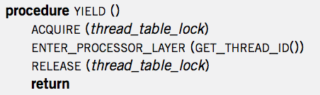
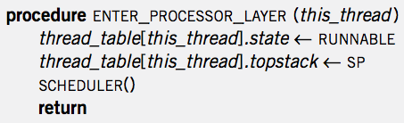
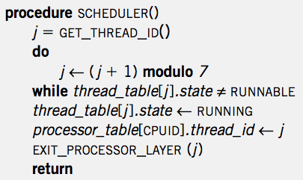

Context Switch
YIELD
ENTER
SCHED
EXIT
YIELD
YIELD
ENTER
SCHED
EXIT
YIELD
App
APP
APP
YIELD
YIELD
YIELD
YIELD
SP-1
ENTER
ENTER
SP-2
ENTER
ENTER
SP-2
SP-1
SCHED
SCHED
EXIT
EXIT
Notes:
Question-1: where is the point of context switch?
Question-2: why not save the PC of a thread?

Slide 27
Creating a Thread
ALLOCATE_THREAD
  Allocate a new stack
  Push address of EXIT_THREAD() as return address
  Push address of starting_procedure as return address
    starting_procedure is the start address of a thread
  Initialize an entry in thread_table
  Set state to RUNNABLE
Stack of a Thread
EXIT_THREAD
starting_procedure

Slide 28
Start the Scheduler
Processor Thread
  Create a separate thread for each processor first
  Its stack is not used for most of the time
    Only used when running scheduler()

Slide 29
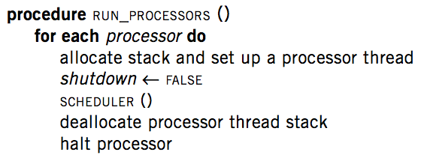
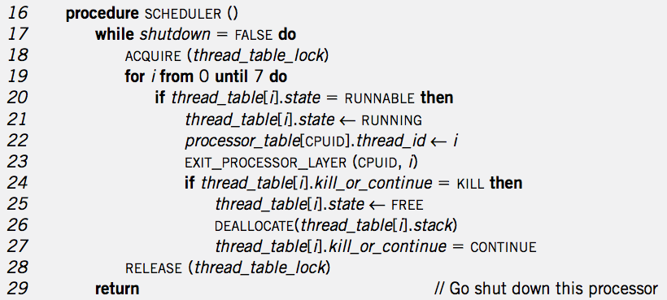
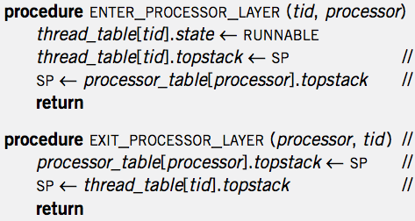
RUN_PROCESSOR
& Create Thread
Thread Create
RUN_PROCESSOR
EXIT_T
MAIN
APP
SCHED
EXIT_P

Slide 30
Thread Exit
1 procedure EXIT_THREAD()
2 ACQUIRE (threadtable_lock)
3 threadtable[tid].kill_or_continue ← KILL
4 ENTER_PROCESSOR_LAYER (GET_THREAD_ID (), CPUID)

Slide 31
Destroy a Thread
DESTROY_THREAD
  One thread kills another thread
  Problem: the target thread may be running, thus the calling thread cannot just free its resource
  Solution: asynchronization: set KILL and return
    Wait for the thread to be destroyed when SCHEDULER

Slide 32
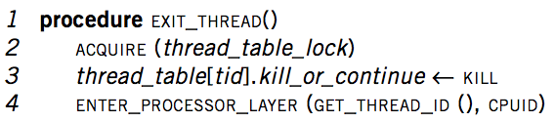
Thread Exit
Thread
Exit
APP
APP
EXIT_T
SCHED
YIELD
ENTER_P
EXIT_P
EXIT_P
ENTER_P

Slide 33
The New Scheduler()
16 procedure SCHEDULER ()
17 while shutdown = FALSE do
18 ACQUIRE (threadtable_lock)
19 for i from 0 until 7 do
20 if threadtable[i].state = RUNNABLE then
21 threadtable[i].state ← RUNNING
22 processor_table[CPUID].thread_id ← i
23 EXIT_PROCESSOR_LAYER (CPUID, i)
24 if threadtable[i].kill_or_continue = KILL then
25 threadtable[i].state ← FREE
26 DEALLOCATE(threadtable[i]. stack)
27 threadtable[i]. kill_or_continue = CONTINUE
28 RELEASE (threadtable_lock)
29 return // Go shut down this processor

Slide 34
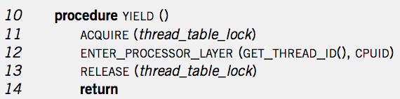
Context Switch
YIELD
ENTER
SCHED
EXIT
YIELD
YIELD
ENTER
SCHED
EXIT
YIELD
App
MAIN
APP
APP
MAIN
YIELD
SCHED
SCHED
YIELD
YIELD
SCHED
SCHED
SCHED
YIELD
ENTER
EXIT
EXIT
ENTER
ENTER
EXIT
EXIT
SP-1
SP-2
SP-2
ENTER
SP-1
SP of Processor Thread
SP of Processor Thread

Slide 35
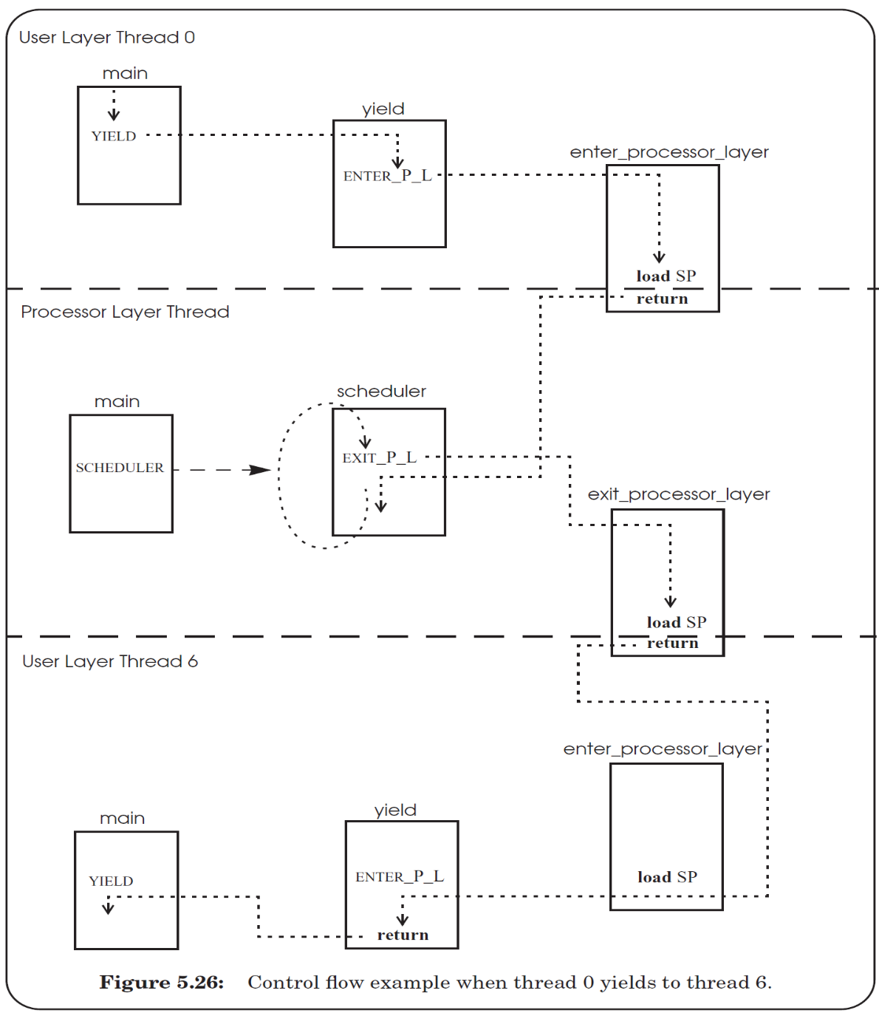

Slide 36
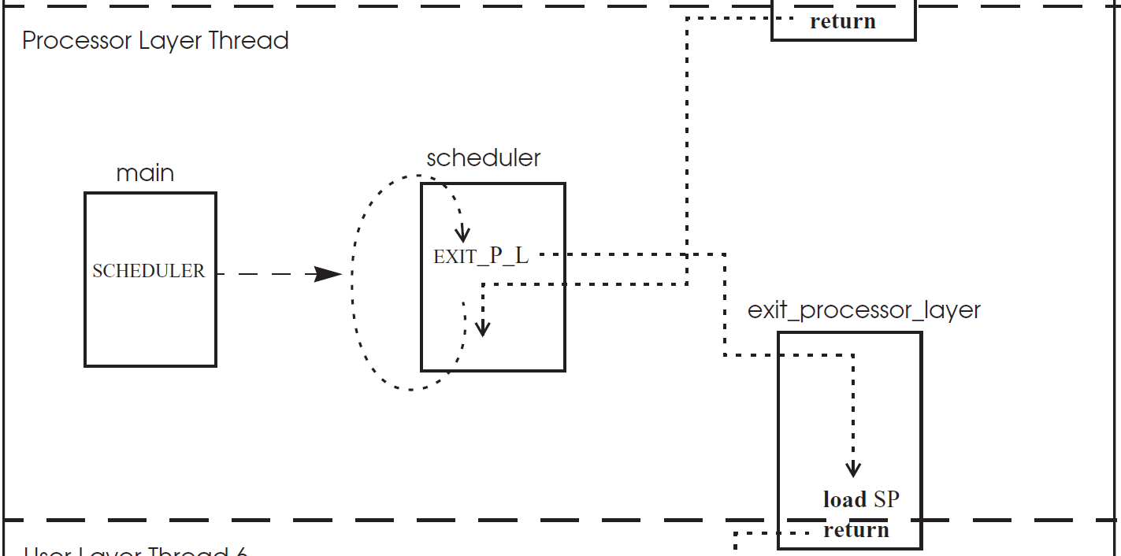

Slide 37
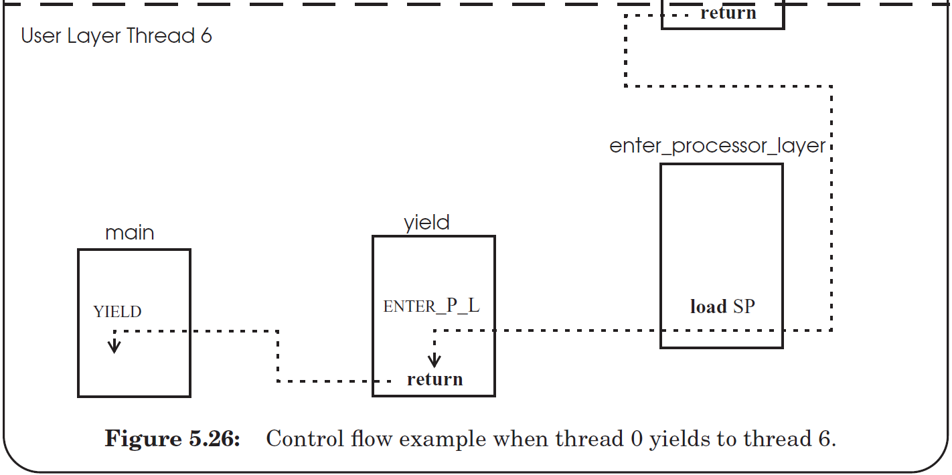

Slide 38
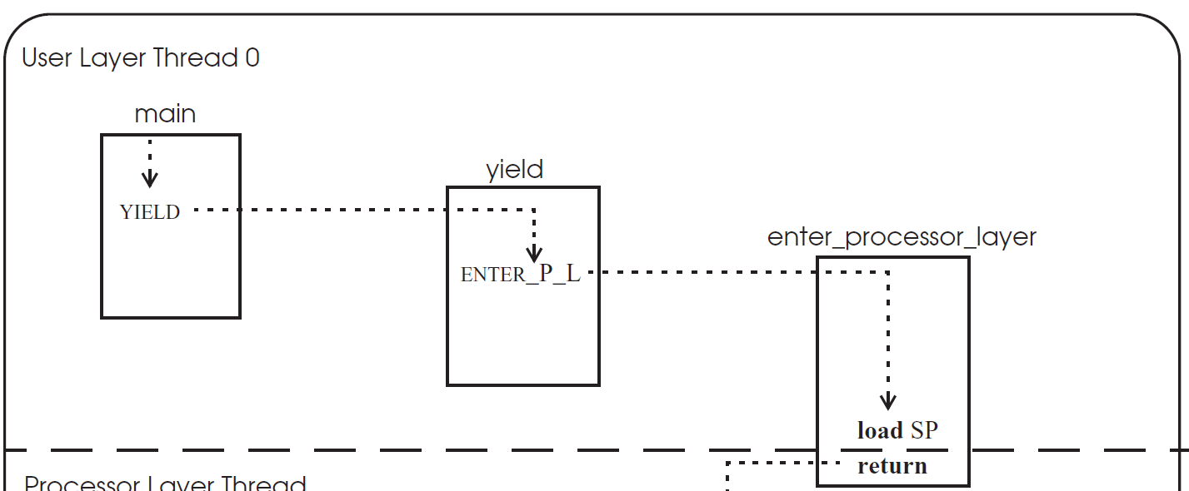

Slide 39
thread_table_lock
1
2
11
12
3
4
7
8
5
6
9
10

Slide 40
thread_table_lock
1
2
3
4
5
Stack changes to
processor thread
6
7
8
9
10
11
Stack changes back
12

Slide 41
First time of a thread
1
2
3
4
5
Stack changes to
processor thread
6
7
8
Q: still hold the lock?
9
10
11
start_procedure()
Stack changes back
Notes:
Answer: when create a new thread, the stack of the thread must be initialized to include YIELD(), and push the return address to the middle of YIELD(), so that when after return, the new thread will first release the lock, just as the previous slide. Then return again to the start_procedure (by pushing the address to the stack too).

Slide 42
Eventcount & Sequencer

Slide 43
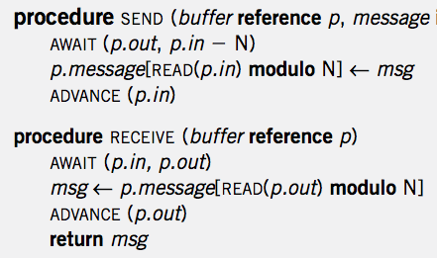
Single Sender and Single Receiver

Slide 44
4 Primitives
AWAIT (eventcount, value)
ADVANCE (eventcount)
TICKET (sequencer)
READ (eventcount or sequencer)

Slide 45
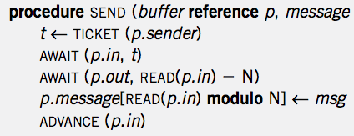
Multiple Senders and Single Receiver
No loop! Is it OK?

Slide 46
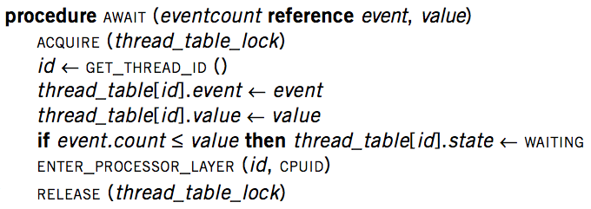
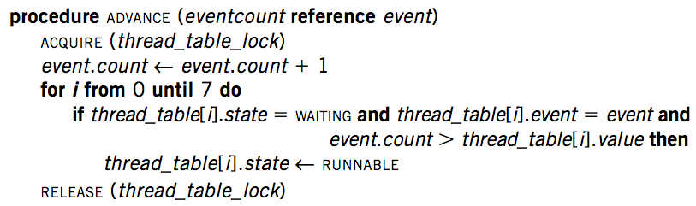
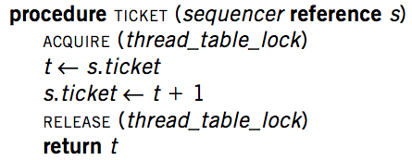
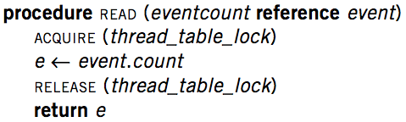
Implementation

Slide 47
Primitives for Sequence Coordination
AWAIT (eventcount, value) is a before-or-after action
  Compares eventcount to value
  If eventcount exceeds value
    AWAIT returns to its caller.
  If eventcount is less than or equal to value
    Changes the state of the calling thread to WAITING
    Places value and the name of eventcount in this thread's entry in the thread table
    Yields its processor

Slide 48
Primitives for Sequence Coordination
ADVANCE (eventcount) is a before-or-after action
  Increments eventcount by one
  Searches the thread table for threads that are waiting on this eventcount
  For each one it finds,
    If eventcount now exceeds the value for which that thread is waiting
    Changes that thread's state to RUNNABLE

Slide 49
Primitives for Sequence Coordination
TICKET (sequencer) is a before-or-after action
  Returns a non-negative value that increases by one on each call
  Two threads concurrently calling TICKET on the same sequencer
    Receive different values
    The ordering of the values returned corresponds to the time ordering of the execution of TICKET

Slide 50
Primitives for Sequence Coordination
READ (eventcount or sequencer) is a before-or-after action
  Returns to the caller the current value of the variable
  Having an explicit READ procedure is to assure before-or-after atomicity for eventcounts and sequencers whose value may grow to be larger than a memory cell

Slide 51
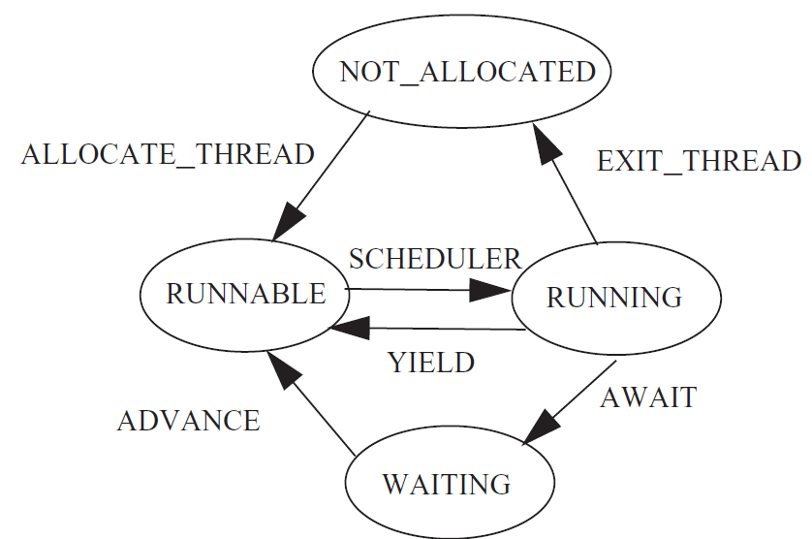
Thread State Diagram

