Slide 1

End-to-end Layer
Computer System Engineering, Fall 2020 (IPADS, SJTU)
Best-effort is not enough
Yubin Xia

Slide 2
Case Study: BGP
Border Gateway Protocol

Slide 3
Policy Routing
Regions also want to implement their own policies
  Switches make routing decisions based on some policies set by a human
  Routing protocol must disseminate enough info to enable those policies
What policies are typical in BGP?
  Regions don't want to send traffic on a path unless they have financial incentive to do so
  Mechanism of enforcement: selective advertisements
    Region-1 won't tell region-2 about a path unless it will make money by letting region-2 use the path
    Each region will have a different view of the network, and that view will (almost certainly) not contain every physical link

Slide 4
Typical BGP Relationships
Customer/provider
  Customers pay for access (transit), which the provider provides
Peers
  Peers provide mutual access to a subset of each's routing tables
    The subset that contains their transit customers
  Why peer? Can save money and improve performance
  Why not peer? You'd rather have customers

Slide 5
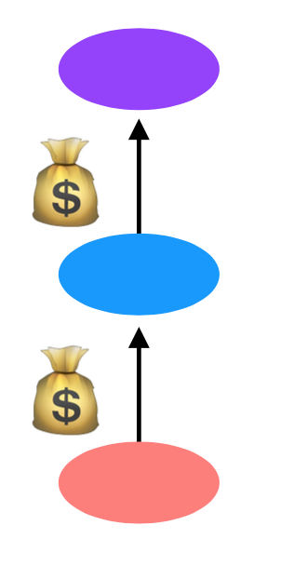
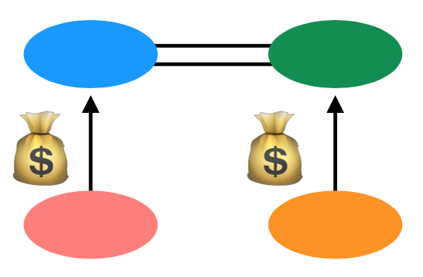
Customers and Peers
Customer/Provider ("transit")
  Customer pays provider for transit
Peers
  Peers allow (free) mutual access to each other's customers
buy
buy
buy

Slide 6
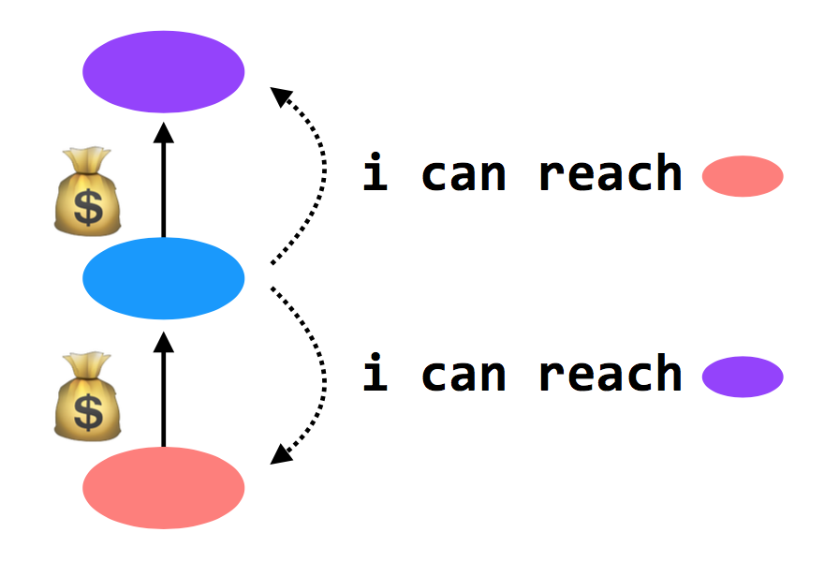
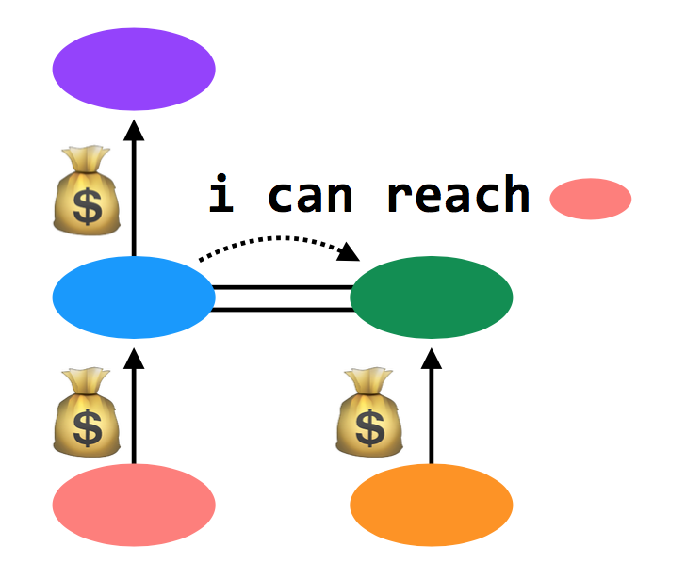
Customers and Peers
Customer/provider ("transit")
  Providers tell everyone about themselves their customers
  and tell their customers about everyone
Peers
  Peers tell each other about their customers

Slide 7
Import Policies
Customer > peer > provider
  And then a variety of other attributes when this rule isn't sufficient
Goal: make money

Slide 8
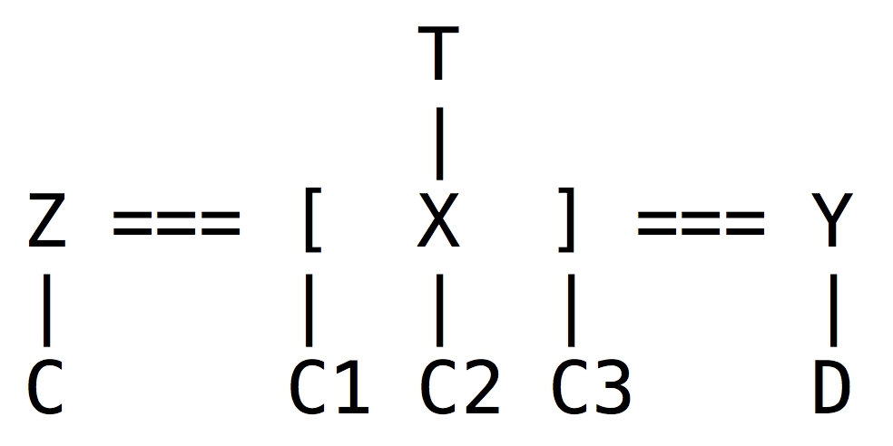

An Example
Z will tell X about C; C is a customer of Z, and X and Z are peers
X will tell Z and Y about C1, C2, and C3
Y will tell X about D
X will not tell Y about C; it makes no money to provide transit from Y to C
X doesn't tell Y about T; it would lose money to provide transit from Y to T
In example, Y appears disconnected from part of the network

Slide 9
An Example
BGP doesn't prevent this. In practice, it never happens. Because:
  Almost every AS is a customer of someone else (i.e., Y would buy transit from someone)
  Typically: small ASes buy Internet from Tier-3 ISPs, which buy Internet from Tier-2 ISPs, which buy Internet from Tier-1 ISPs. Tier-1's are huge; there are only a handful (10-15)
  Additionally, all Tier-1 ISPs peer with one another. So each Tier-1 ISP can provide global connectivity

Slide 10
BGP in Distributed Routing
HELLO protocol
  BGP sends KEEPALIVE messages to neighbors
Advertisements: Sent to neighbors
  BGP runs on top of TCP
  Doesn't have to do periodic advertisements to handle failure
Integration: via policies described above
Failures: routes can be explicitly withdrawn in BGP if fail
  Routing loops avoided because BGP is path-vector

Slide 11
Problems with BGP
Does it scale?
  Yes, it works on the Internet
  But, BGP routing tables are getting big
  Route instability due to misconfigurations or conflicting policies
  One region can buy Internet from more than one ISP -> bigger table
Is it simple?
  Yes to the protocol, but no to the implementation & operation
Is it secure?
  No. A region can advertise a fake vector

Slide 12
2017: BGP hijacking! Traffic for Google, Apple, Facebook, Microsoft and other tech giants routed through Russia
http://securityaffairs.co/wordpress/66838/hacking/bgp-hijacking-russia.html

Slide 13
End-to-end Layer

Slide 14
The End-to-end Layer
Network layer has no guarantees on:
  Delay - Order of arrival
  Certainty of arrival - Accuracy of content
  Right place to deliver
End-to-end layer
  No single design is likely to suffice
  Transport protocol for each class of application

Slide 15
Famous Transport Protocols
UDP (User Datagram Protocol)
  Be used directly for some simple applications
  Also be used as a component for other protocols
TCP (Transmission Control Protocol)
  Keep order, no missing, no duplication
  Provision for flow control
RTP (Real-time Transport Protocol)
  Built on UDP
  Be used for streaming video or voice, etc.
No "one size fits all"

Slide 16
Assurance of End-to-end Protocol
Assurance of at-least-once delivery
Assurance of at-most-once delivery
Assurance of data integrity
Assurance of stream order & closing of connections
Assurance of jitter control
Assurance of authenticity and privacy
Assurance of end-to-end performance

Slide 17
1. Assurance of At-least-once Delivery
RTT (Round-trip time)
  to_time + process_time + back_time (ack)
At least once on best effort network
  Send packet with nonce
  Sender keeps a copy of the packet
  Resend if timeout before receiving acknowledge
  Receiver acknowledges a packet with its nonce
Try limit times before returning error to app
A nonce is like a random number

Slide 18
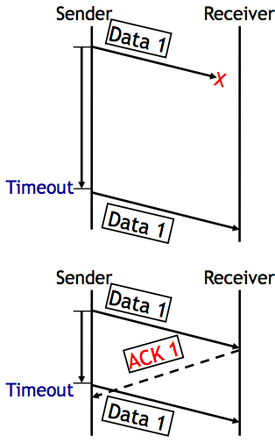
1. Assurance of At-least-once Delivery
Dilemma
  1. The data was not delivered
  2. The data was delivered, but no ACK received
  No way to know which situation
At-least-once delivery
  No absolute assurance for at-least-once
  Ensure if it is possible to get through, the message
  will get through eventually
  Ensure if impossible to confirm delivery, app will know
  No assurance for no-duplication

Slide 19
How to Decide Timeout?
Fixed timer: dilemma of fixed timer
  Too short? unnecessary resend
  Too long? take long time to discover lost packets
Adaptive timer
  E.g., adjust by currently observed RTT, set timer to 150%
  Exponential back-off: doubling from a small timer
NAK (Negative AcKnowledgment)
  Receiver sends a message that lists missing items
  Receiver can count arriving segments rather than timer
  Sender can have no timer (only once per stream)

Slide 20
Fixed Timer is Evil
Fixed timers lead to congestion collapse in NFS
Emergent phase synchronization of periodic protocols
Wisconsin time server meltdown

Slide 21
Emergent Phase Synchronization of Periodic Protocols
Periodic polling
  E.g. picking up mail, sending "are-you-there?"
  A workstation sends a broadcast packet every 5 minutes
  All workstations try to broadcast at the same time
Each workstation
  Send a broadcast
  Set a fixed timer
Lesson: Fixed timers have many evils. Do not assume that unsynchronized periodic activities will stay that way

Slide 22
Wisconsin Time Server Meltdown
NETGEAR added a feature to wireless router
  Logging packets -> timestamp -> time server (SNTP) -> name discovery -> 128.105.39.11
  Once per second (!) until receive a response
  Once per minute or per day after that
Wisconsin Univ.
  On May 14, 2003, at about 8:00 a.m
  From 20,000 to 60,000 requests per second, filtering 23457
  After one week, 270,000 requests per second, 150Mbps

Slide 23
Wisconsin Time Server Meltdown
Lesson(s)
  Fixed timers, again
  Fixed Internet address
  The client implements only part of a protocol
    There is a reason for features likes the "go away" response in SNTP

Slide 24
How to Decide Timeout?
Fixed timer: dilemma of fixed timer
  Too short: unnecessary resend
  Too long: take long time to discover lost packets
Adaptive timer
  E.g., adjust by currently observed RTT, set timer to 150%
  Exponential back-off: doubling from a small timer
NAK (Negative AcKnowledgment)
  Receiver sends a message that lists missing items
  Receiver can count arriving segments rather than timer
  Sender can have no timer (only once per stream)

Slide 25
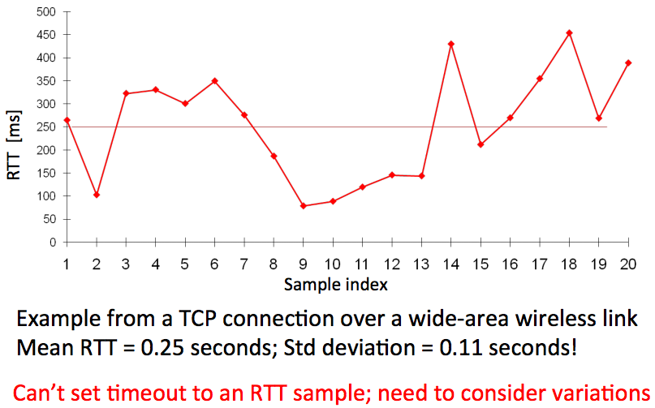
RTT Could be Highly Variable

Slide 26
Calculating RTT and Timeout (in TCP)
Exponentially Weighted Moving Average
  Estimate both the average rtt_avg and the deviation rtt_dev
  Procedure calc_rtt(rtt_sample)
    rtt_avg = a*rtt_sample + (1-a)*rtt_avg; /* a = 1/8 */
    dev = absolute(rtt_sample – rtt_avg);
    rtt_dev = b*dev + (1-b)*rtt_dev; /* b = 1/4 */
  Procedure calc_timeout(rtt_avg, rtt_dev)
    Timeout = rtt_avg + 4*rtt_dev

Slide 27
How to Decide Timeout?
Fixed timer: dilemma of fixed timer
  Too short: unnecessary resend
  Too long: take long time to discover lost packets
Adaptive timer
  E.g., adjust by currently observed RTT, set timer to 150%
  Exponential back-off: doubling from a small timer
NAK (Negative AcKnowledgment)
  Receiver sends a message that lists missing items
  Receiver can count arriving segments rather than timer
  Sender can have no timer (only once per stream)

Slide 28
2. Assurance of At-most-once Delivery
At-least-once delivery
  Remember state at the sending side
  Tends to generate duplicated requests
At-most-once delivery
  Maintains a table of nonce at the receiving side
  The table may grow indefinitely
    Space and search time
    Tombstones (something that cannot be deleted forever)
  Another way: Make the application tolerate duplicated requests
    Recall the NFS collapse case: server wastes time to execute duplicated requests

Slide 29
Duplicate Suppression
Monotonically increasing sequence number
  Receiver discards smaller nonce, only holds the last nonce, one per sender (tombstone)
Use a different port for each new request
  Should never reuse the old port number
  The old port is now tombstone!

Slide 30
Duplicate Suppression
Accept the possibility of making a mistake
  E.g., if sender always gives up after five RTT (cannot ensure at-least-once), then receiver can safely discard nonces that are older than five RTT
  It is possible that a packet finally shows up after long delay (solution: wait long time)
Receiver crashes and restarts: lose the table
  One solution is to use a new port number each time the system restarts
  Another is to ignore all packets until the number of RTT has passed since restarting, if sender tries limit times
Anyway, duplicate suppression makes the system complex

Slide 31
3. Assurance of Data Integrity
Data integrity
  Receiver gets the same contents as sender
Reliable delivery protocol
  Sender: adds checksum to the end-to-end layer
  Receiver: recalculates the checksum, discards if not match
Q: Is it redundant since link layer provides checksum?
  Besides network, there could be other errors, e.g., in memory copying
The assurance is not absolute
  What if a packet is mis-delivered and the receiver ACK?

Slide 32
4. Segments and Reassembly of Long Messages
Bridge the difference between message and MTU
  Message length: determined by application
  MTU: determined by network
Segment contains ID for where it fits
  E.g., "message 914, segment 3 of 7"
  Can be used for at-least-once and at-most-once delivery
Reassembly
  Out-of-order, mingled with other message's segments
  Allocating a buffer large enough to hold the message
  Keeping a checklist for segments not arrived

Slide 33
When Out of Order…
Solution-1: Receiver only ACK in order packets, discards others
  Waste of bandwidth
Solution-2: ACK every packet and hold early packets in buffer, release the buffer when all in order
  Need using large buffer when waiting for a bad packet
Solution-3: Combine the two above
  Discard if buffer is full
  New problem: how much buffer?
Speedup for common case
  NAK to avoid timeout
  If NAKs are causing duplicates, stop NAKs
TCP is based on ACK, not NAK

Slide 34
Closing of Connections
Open a stream
  Create a record to keep track of which elements have been sent, received, acknowledged
Close a stream
  When finish, it needs to report an end-of-stream
  Both ends need to agree last element is OK and then close
  1. Alice sends close request to Bob with stream record ID
  2. Bob checks and agrees, sends a close ACK
  3. Alice receives ACK, turn off sender, discard record
  4. Alice sends "all done" to Bob
  5. Bob receives "all done" and discard stream record
<- What if duplicate?

Slide 35
5. Assurance of Jitter Control
Real-time
  When reliability is less important than timely delivery
  A few error in a movie may not be noticed
  Jitter: variability in delivery time
Strategy
  Basic: delay all arriving segments

Slide 36
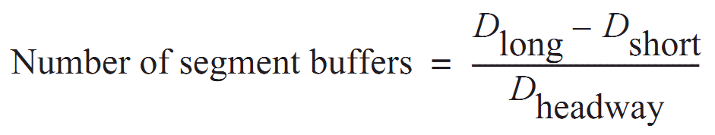
5. Assurance of Jitter Control
Measure the distribution of delays in a chart showing delay time vs. frequency of that delay
Choose an acceptable frequency of delivery failure
Determine D_{long} that longer than 99% delay
Determine the shortest delay, D_{short}
Calculate number of segment buffer:
  D_{headway} is average delay between arriving segments

Slide 37
6. Assurance of Authenticity and Privacy
Internet is dangerous
  Hostile intercepts and maliciously modifies packets
  Violate a protocol with malicious intent
Key-based mathematical transformations to data
  Sign and verify: establish the authenticity of the source and integrity of contents
  Encrypt and decrypt: maintain privacy of contents
Consideration
  False sense of security, worse than no assurance

Slide 38
6. Security: Asymmetric Encryption
Public Key VS. Private Key
  Public key: encrypt to identify reader (only me can read this)
  Private key: encrypt to identify writer (yes, it's me who wrote this)
  Poor performance, so just used to exchange symmetric key
Questions
  What is a certificate? Why using a CA (Certificate Authority)?
  How to exchange a symmetric key in HTTPS or SSH?
  What is the root of trust?
  Will be addressed later, in Security part

Slide 39
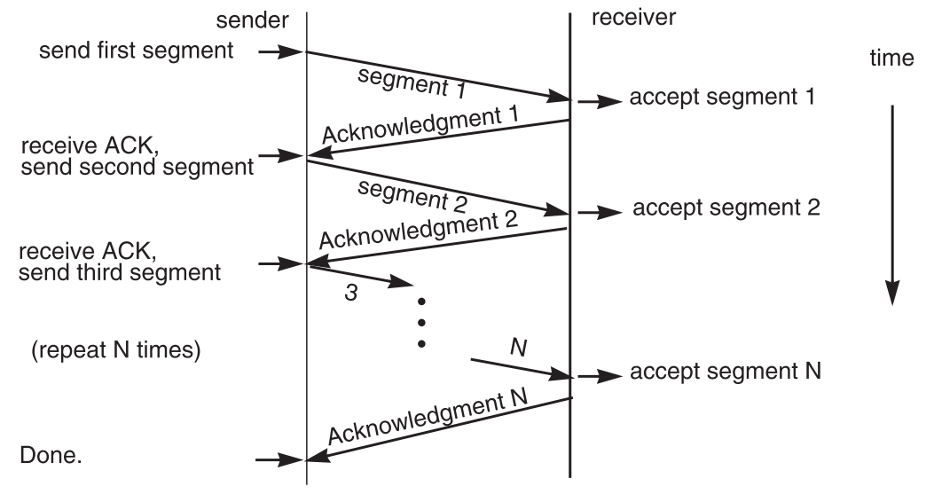
7. End-to-end Performance
Multi-segment message questions
  Trade-off between complexity and performance
  Lock-step protocol

Slide 40
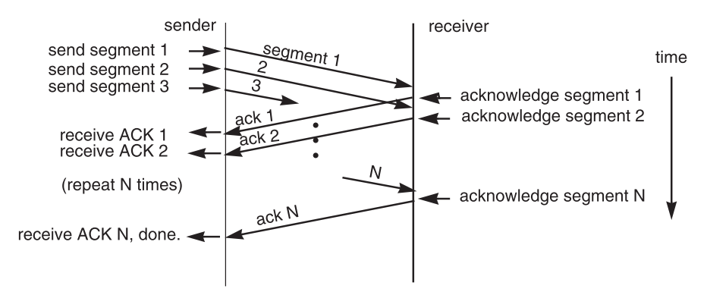
Overlapping Transmissions
Pipelining technique

Slide 41
Overlapping Transmissions: Problems
Packets or ACK may be lost
  Sender holds a list of segments sent, check it off when receives ACK
  Set a timer (according to RTT) for last segment
If list of missing ACK is empty, OK
If timer expires, resend packets and another timer

Slide 42
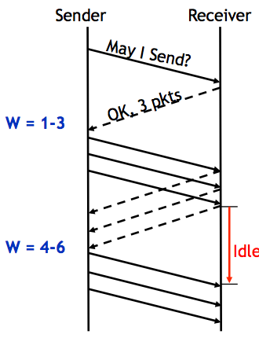
Fixed Window
Receiver tells the sender a window size
Sender sends window
Receiver acks each packet as before
Window advances when all packets in previous window are acked
  E.g., packets 4-6 sent, after 1-3 ack'd
If a packet times out -> resend packets
Still much idle time

Slide 43
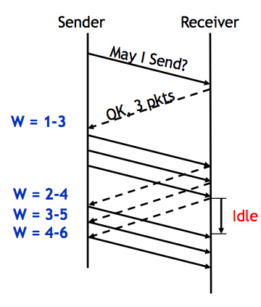
Sliding Window
Sender advances the window by 1 for each in-sequence ACK it receives
  Reduces idle periods
  Pipelining idea
But what's the correct value for the window?
  We'll revisit this question
  First, we need to understand windows

Slide 44
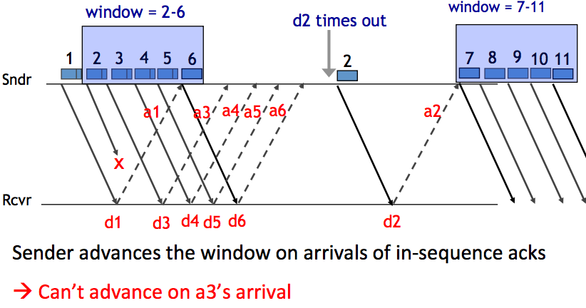
Handling Packet Loss

Slide 45
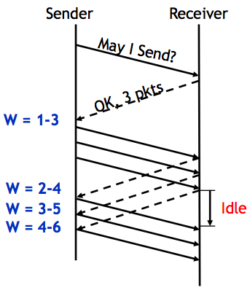
Chose the Right Window Size
If window is too small
  Long idle time
  Underutilized network
If window too large
  Congestion

Slide 46
Sliding Window Size
window size ≥ round-trip time × bottleneck data rate
Sliding window with one segment in size
  Data rate is window size / RTT
Enlarge window size to bottleneck data rate
  Data rate is window size / RTT
Enlarge window size further
  Data rate is still bottleneck
  Larger window makes no sense
- Receive 500 KBps
- Sender 1 MBps
- RTT 70ms
- A segment carries 0.5 KB
- Sliding window size = 35KB (70 segment)

Slide 47
Self-pacing: Sliding Window Size
Although the sender doesn't know the bottleneck, it is sending at exactly that rate
Once sender fills a sliding window, cannot send next data until receive ACK of the oldest data in the window
The receiver cannot generate ACK faster than the network can deliver data elements
RTT estimation still needed
Notes:
Consider RTT is 0. Similar as bounded-buffer on a single machine.

Slide 48
TCP Congestion Control

Slide 49
Congestion
Definition: Too many packets present in (a part of) the network causes packet delay and loss that degrades performance.
Network & End-to-end layers share the responsibility for handling congestion
1. Network layer
  Directly experiences the congestion
  Ultimately determine what to do with the excess packets
2. End-to-end layer
  Control to reduce the sending rate, is the most effective way

Slide 50
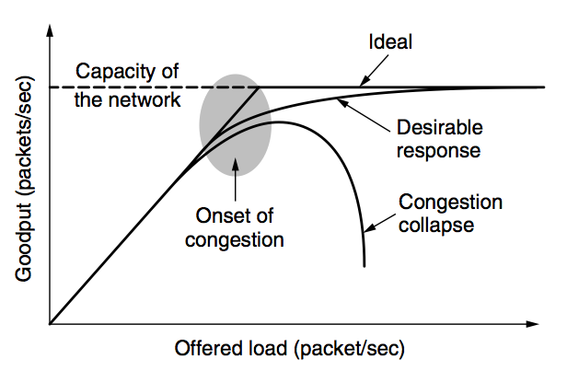
Network Congestion

Slide 51
Why Congest?
If all of a sudden, streams of packets begin arriving on three or four input lines and all need the same output line, a queue will build up
If there is insufficient memory to hold all of them, packets will be lost
Adding more memory may help up to a point, but
  Nagle (1987) realized that if routers have an infinite amount of memory, congestion gets worse, not better
  This is because by the time packets get to the front of the queue, they have already timed out (repeatedly) and duplicates have been sent

Slide 52
Load Shedding: Setting Window Size
For performance:
  window size ≥ round-trip time × bottleneck data rate
For congestion control:
  window size ≤ min(RTT x bottleneck data rate, Receiver buffer)
  Congestion window
2 windows become 1
  to achieve best performance and avoid congestion

Slide 53
Congestion Control
Basic idea:
  Increase congestion window slowly
  If no drops -> no congestion yet
  If a drop occurs -> decrease congestion window quickly
Use the idea in a distributed protocol that achieves:
  Efficiency: i.e., uses the bottleneck capacity efficiently
  Fairness, i.e., senders sharing a bottleneck get equal throughput (if they have demands)
Notes:
cwnd: congestion window

Slide 54
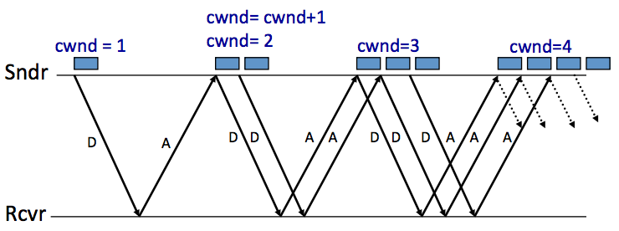
AIMD (Additive Increase, Multiplicative Decrease)
Every RTT:
  No drop: cwnd = cwnd + 1
  A drop: cwnd = cwnd / 2

Slide 55
Problems with AIMD
Increases very slowly at the beginning
Initial window size is 1
  Probably too small in practice
Solution: do multiplicative increase at the beginning
  Congestion_window _{init} = 1
  Initially, do Congestion_window ← 2 * Congestion_window each RTT until we hit congestion
  Named "slow start" (even though it's exponentially fast!)

Slide 56
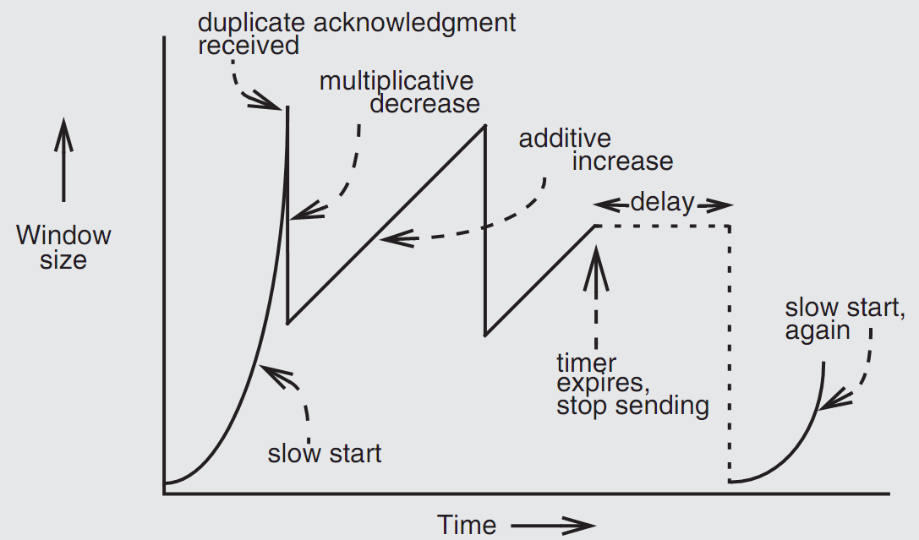
Retrofitting TCP
Notes:
Since TCP does not know whether a duplicate ACK is caused by a lost segment or just a reordering of segments, it waits for a small number of duplicate ACKs to be received.

Slide 57
Retrofitting TCP
1. Slow start: one packet at first, then double until
  Sender reaches the window size suggested by the receiver
  All the available data has been dispatched
  Sender detects that a packet it sent has been discarded
2. Duplicate ACK
  When receiver gets an out-of-order packet, it sends back a duplicate of latest ACK
3. Equilibrium
  Additive increase & multiplicative decrease
4. Restart, after waiting a short time

Slide 58
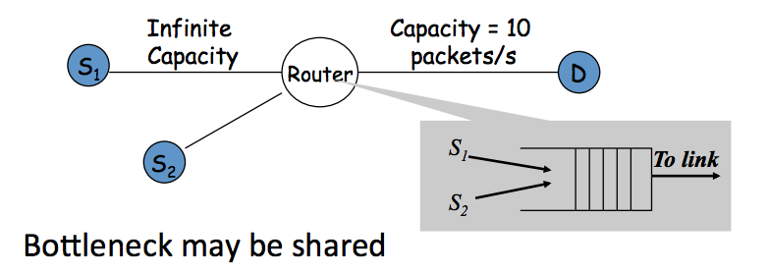
Fairness between Links

Slide 59
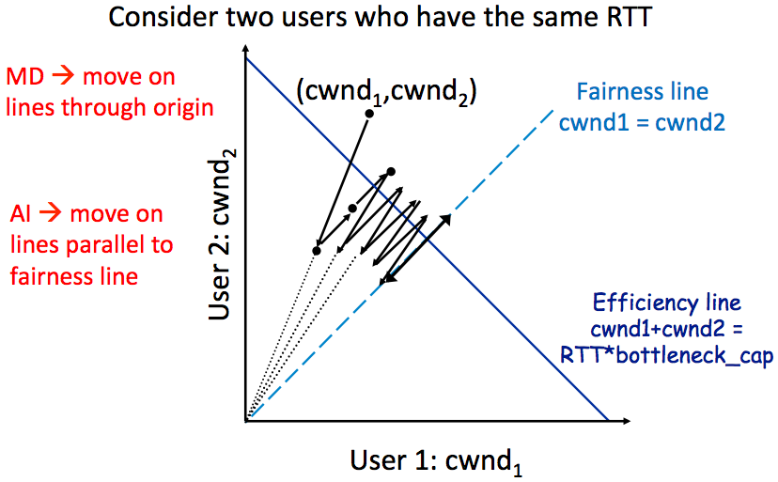
AIMD Leads to Efficiency and Fairness
Notes:
AIMD: addition increase, multiple decrease.

Slide 60
Q: Why not Additive Decrease
It does not converge to fairness
  from a congested point, (x',y'), reducing each by 1 worsens fairness and takes us away from the "ideal" outcome

Slide 61
Weakness of TCP
If routers have too much buffering, causes long delays
Packet loss is not always caused by congestion
  Consider wireless network: sender may send faster if losing packet
TCP does not perform well in datacenters
  High bandwidth, low delay situations
TCP has a bias against long RTTs
  Throughput inversely proportionally to RTT
  Consider when sending packets really far away vs really close
Assumes cooperating sources, which is not always a good assumption

Slide 62
Summary of Congestion Window
Reliability Using Sliding Window
  Tx Rate = W / RTT
Congestion Control
  W = min(Receiver_buffer, cwnd)
  Congestion window is adapted by the congestion control protocol to ensure efficiency and fairness
  TCP congestion control uses AIMD which provides fairness and efficiency in a distributed way

