Slide 1

DNS
Computer System Engineering, Fall 2020 (IPADS, SJTU)
Naming in the Internet
Yubin Xia

Slide 2
The Design of DNS
Domain Name Service

Slide 3
DNS: Binding IP and Domain Name
Names: hostname strings
  E.g., www.sjtu.edu.cn
Values: IP addresses
  E.g., 202.120.2.119
Look-up algorithm
  Resolves a hostname to an IP address so that your machine knows where to send packets

Slide 4
IP Address as a Type of Name
An IP address itself is a type of name
  A structured name that is used to locate an object
  Use IP address to identify the server
    Recall your labs in ICS on socket
  On Internet
    The router will know where to send a packet with destination IP
Hostname has no such semantic
  A router does not know how to send a packet to "baidu.com"

Slide 5
Why Not Just Using IP Address?
IPs are structured in a particular way for routing
  You cannot chose your IP address as you wish
    Note: usually an address cannot be picked
  While you can chose your host names
IPs are not user-friendly enough

Slide 6
Questions on DNS
Q: Can a name have multiple values (IP addresses)?
  Yes
  This allows a web server to balance its load over multiple machines
  Also allows a client to choice a nearest IP to access
Q: Can a single value have multiple names?
  Yes
  This allows server consolidation

Slide 7
Questions on DNS
Q: Can the value corresponding to a name change?
  Yes
  This allows to change the physical machine (with different IP) that stores the data without changing the hostname
  Such changing is hidden to clients

Slide 8
Look-up Algorithm
At first, each machine kept a "hosts.txt" for address binding
  E.g., "r900 202.120.224.83"
  Using table look-up to resolve the binding
  This method cannot scale in Internet
1984, four Berkeley students wrote BIND
  Berkeley Internet Name Domain
  Still the dominant DNS software in use

Slide 9
Distributing Responsibility
The binding
  Too large to be stored on a single machine
  Thus, the data are stored on many machines
    As known as "name servers"
How to know which name server has a particular binding?
  Solution: structure the hostname
  Names have a hierarchy, e.g., com, net, gov, correspond to "zones"
  Zones are mapped to name servers

Slide 10

Name Servers
The root zone
  Maintained by ICANN, non-profit
The ".com" zone
  Maintained by VeriSign, add for money
The ".sjtu.edu.cn" zone
  Maintained by SJTU

Slide 11
DNS Hierarchy (a partial view)
root
com
cn
net
org
gov
apple
google
com
edu
drive
mail
www
fudan
sjtu
se
seiee
ma
ipads
www

Slide 12
Basic DNS Look-up Algorithm
Example: lookup IP of "ipads.se.sjtu.edu.cn"
Traverse the name hierarchy from the root
  The root will tell us the "cn" name server IP,
  which will tell us the "edu.cn" name server IP,
  which will tell us the "sjtu.edu.cn" name server IP,
  which will tell us the "se.sjtu.edu.cn" name server IP,
  which finally tells us the "ipads.se.sjtu.edu.cn" IP
Such algorithm is called delegation

Slide 13
DNS Lookup
root
com
cn
com
edu
fudan
sjtu
se
ipads
www

Slide 14
DNS Lookup
198.41.0.4
root
cn: 202.112.0.44
com
cn
com
edu
fudan
sjtu
se
ipads
www
Notes:
com: 192.5.6.30
com.cn: 210.72.13.83

Slide 15
DNS Lookup
198.41.0.4
root
cn: 202.112.0.44
com
cn
edu.cn: 202.112.0.35
com
edu
fudan
sjtu
se
ipads
www
Notes:
com: 192.5.6.30
com.cn: 210.72.13.83

Slide 16
DNS Lookup
198.41.0.4
root
cn: 202.112.0.44
com
cn
edu.cn: 202.112.0.35
com
edu
sjtu.edu.cn: 202.120.2.101
fudan
sjtu
se
ipads
www
Notes:
com: 192.5.6.30
com.cn: 210.72.13.83

Slide 17
DNS Lookup
198.41.0.4
root
cn: 202.112.0.44
com
cn
edu.cn: 202.112.0.35
com
edu
sjtu.edu.cn: 202.120.2.101
fudan
sjtu
se.sjtu.edu.cn: 202.120.40.2
se
ipads
www
Notes:
com: 192.5.6.30
com.cn: 210.72.13.83

Slide 18
DNS Lookup
198.41.0.4
root
cn: 202.112.0.44
com
cn
edu.cn: 202.112.0.35
com
edu
sjtu.edu.cn: 202.120.2.101
fudan
sjtu
se.sjtu.edu.cn: 202.120.2.101
se
ipads.se.sjtu.edu.cn: 202.120.40.188
ipads
www
Notes:
com: 192.5.6.30
com.cn: 210.72.13.83

Slide 19
Context in DNS
Names in DNS are global (context-free)
  A hostname means the same thing everywhere in DNS
Actually, it should be "ipads.se.sjtu.edu.cn."
  A hostname is a list of domain names concatenated with dots
  The root domain is unnamed, i.e., "." + blank

Slide 20
Fault Tolerant
Each zone can have multiple name servers
  A delegation usually contains a list of name servers
  If one name server is down, others can be used

Slide 21
Three Enhancements on Look-up Algorithm
1. The initial DNS request can go to any name server, not just the root server
  Even on your own machine: /etc/hosts
  You can specific name servers in /etc/resolv.conf
  If no record, just returns address of the root server
  Q: what are the benefits?
Notes:
To minimize the load of the root server.

Slide 22
Three Enhancements on Look-up Algorithm
2. Recursion
  A client asks a name server "www.baidu.com"
  The name server does all the lookup through the tree and return the IP of Baidu to the client
  Usually, a name server has a better network connection

Slide 23
DNS Request Process
a.root.net
a.root.net
names.edu
names.edu
NS: for edu
ns.iss.edu
ns.iss.edu
NS: for
Scholarly.edu
ginger.
Scholar.edu
ginger.
Scholar.edu
ginger.
Scholar.edu
AP: for
ginger.Scholar.edu
Name client
Name client
Non-Recursion
Recursion

Slide 24
Three Enhancements on Look-up Algorithm
3. Caching
  DNS clients and name servers keep a cache of names
    Your browser will not do two look-ups for one address
  Cache has expire time limit
    Controlled by a time-to-live parameter in the response itself
    E.g., SJTU sets the TTL of www.sjtu.edu.cn to 24h
  TTL (Time To Live)
    Long TTL VS. short TTL
    Q: what are the tradeoffs?

Slide 25
Combine These Enhancements
If:
  Many machines at SJTU use the SJTU name server for their initial DNS query
  The name server offers recursive querying and caching
Then:
  The name server's cache will hold many bindings
  Performance benefits from this large cache

Slide 26
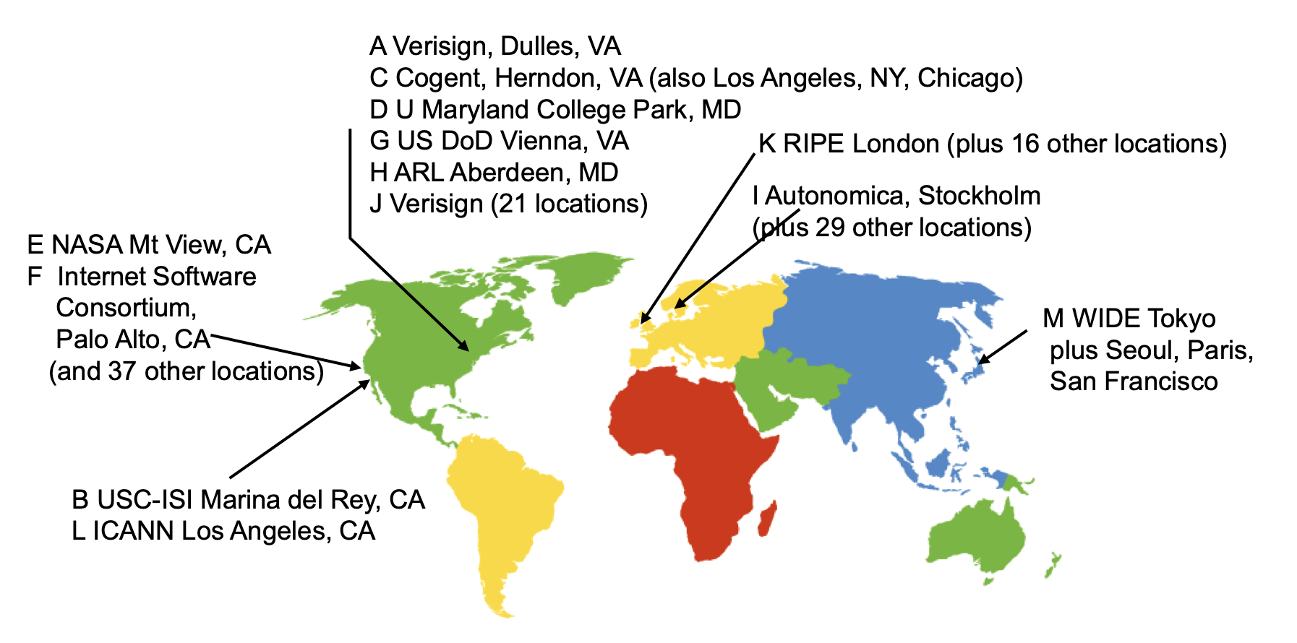
Other Features of DNS
At least two identical replica servers
  80 replicas of the root name server in 2008
  Replicas are placed separated around the world

Slide 27
Other Features of DNS
Organization's name server (e.g., SJTU)
  Several replicas in campus
    To enable communications within the organization
  At least one out of the campus
    To validate the address for outside world

Slide 28
Name Discovery in DNS (at the first place)
A client must discover the name of a nearby name server
  Name discovery broadcast to ISP at first time
  Ask network manager
  Ask by email, Google, etc.

Slide 29
Comparing Hostname & Filename
They are both for more user friendly
  File-name -> inode number
  Host-name -> IP address
  The file-name and host-name are hierarchical; inode num and IP address are plane
They are both not a part of the object
  File-name is not a part of a file (stored in directory)
  Host-name is not a part of a website (stored on name server)
Name and value binding
  File: 1-name -> N-values (no); N-name -> 1-value (yes)
  DNS: 1-name -> N-values (yes); N-name -> 1-value (yes)

Slide 30
Behind the DNS Design
Why was DNS designed in this way?

Slide 31
Benefits of Hierarchical Design
Hierarchies delegate responsibility
Each zone is only responsible for a small portion
Hierarchies also limit interaction between modules
  A type of de-centralization

Slide 32
Good Points on DNS Design
Global names (assuming same root servers)
  No need to specific a context
  DNS has no trouble generating unique names
  The name can also be user-friendly
Scalable in performance
  Simplicity: look-up is simple and can be done by a PC
  Caching: reduce number of total queries
  Delegation: many name severs handle lookups

Slide 33
Good Points on DNS Design
Scalable in management
  Each zone makes its own policy decision on binding
  Hierarchy is great here
Fault tolerant
  If one name server breaks, other will still work
  Duplicated name server for a same zone

Slide 34
Bad Points on DNS Design
Policy
  Who should control the root zone, .com zone, etc? Governments?
Significant load on root servers
  Many DNS clients starts by talking to root server
  Many queries for non-existent names, becomes a DoS attack
Security
  How does a client know if the response is correct?
  How does VeriSign know "change Amazon.com IP" is legal?

Slide 35
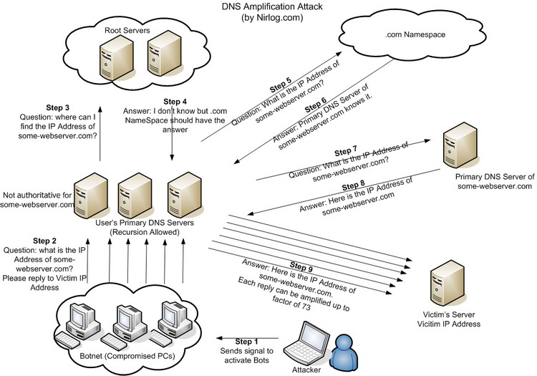
DNS Amplification Attack

Slide 36
DNS Security
DNS Hijack: Cutting the binding between name and IP
DNS DoS (Denial of Service) attack
  BAOFENG.com & DNSPod
  2009-5-18: DNSPod was attacked and banned
  2009-5-19: The Internet in China was almost down
  Fixed timer: query for BAOFENG.com once per second!
Solutions
  /etc/hosts, dnsmasq, OpenDNS, etc.
  DNS shield to defend against DoS attack

Slide 37

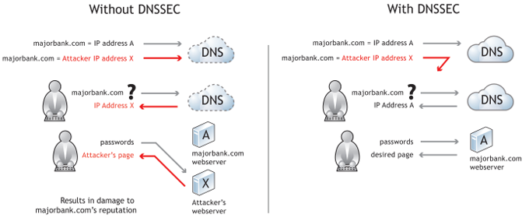
DNSSEC: Protect DNS Record
Only part of the zones are using DNSSEC, e.g., .gov, .org

Slide 38
Problem 4.5
While browsing the Web, you click on a link that identifies an Internet host named www.cslab.scholarly.edu. Your browser asks your Domain Name System (DNS) name server, M, to find an Internet address for this domain name. Under what conditions is each of the following statements true of the name resolution process?

Slide 39
Problem 4.5
To answer your query, M must contact one of the root name servers.
If M answered a query for www.cslab.scholarly.edu in the past, then it can answer your query without asking any other name server.
M must contact one of the name servers for cslab.scholarly.edu to resolve the domain name.
Notes:
Ex. 4.5
A is true only when M's cache misses and the prefix of the name has nothing in common with the domain that M serves.
B will be true only if the time-to-live of the DNS record cached by M has not expired. If the binding found by M in its cache for www.cslab.scholarly.edu has expired, then M must contact at least one other name server to resolve the domain name.
C is true only if M has no valid information in its cache for www.cslab.scholarly.edu.

Slide 40
Problem 4.5
If M has the current Internet address of a working name server for scholarly.edu cached, then that name server will be able to directly provide an answer.
If M has the current Internet address of a working name server for cslab.scholarly.edu cached, then that name server will be able to directly provide an answer.
Notes:
D is not usually true, because the scholarly.edu name service will normally refer M to the cslab.scholarly.edu name service, rather than answer the query itself. (Though it is possible to configure a name service to directly contain the data for one or more of its subdomains.)
E will normally be true, though it is possible that the name is a synonym that requires cslab.scholarly.edu to ask yet another name server for help.

Slide 41
Naming Scheme
Naming: the glue of modules

Slide 42
Naming in General
ipads.se.sjtu.edu.cn – hostname
steven@apple.com - email
steven – username
EAX - x86 processor register name
main() - function name
WebBrowser - class name
/courses/cse/index.html - path name (fully-qualified)
index.html - path name (relative)
http://ipads.se.sjtu.edu.cn/courses/cse/index.html - URL
13918275839- Phone number
202.120.40.188 - IP Address

Slide 43
Naming a Disk
File name: /dev/sda1
  As a special type of inode: device inode
  8,0 as (major, minor)
PCI address (name): 19:00.0
  SCSI storage controller: LSI Logic / Symbios Logic SAS1068E PCI-Express Fusion-MPT SAS (rev 08)

Slide 44
Naming for Modularity
Retrieval: e.g., using URL to get a web page
Sharing: e.g., passing an object reference to a function
  Save space as well: only sending the name, not the object
Hiding: e.g., using a file name without knowing file system
  Can support access control: use an object only if knowing its name
  E.g., Windows has many undocumented API
User-friendly identifiers: e.g., “homework.txt” instead of 0x051DE540
Indirection: e.g., OS can move the location of the file data without notifying the user
  Have you ever defragmented your hard driver?

Slide 45
Addresses as Names
Software uses these names in an obvious way
  E.g., memory addresses
Hardware modules connected to a bus
  Use bus addresses (a kind of name) for interconnection

Slide 46
Naming Schemes
A naming schemes contains three parts:
  1. Set of all possible names
    You cannot use ‘for’ as a variable in C
  2. Set of all possible values
  3. Look-up algorithm to translate a name into a value
    or a set of values, or “none”

Slide 47
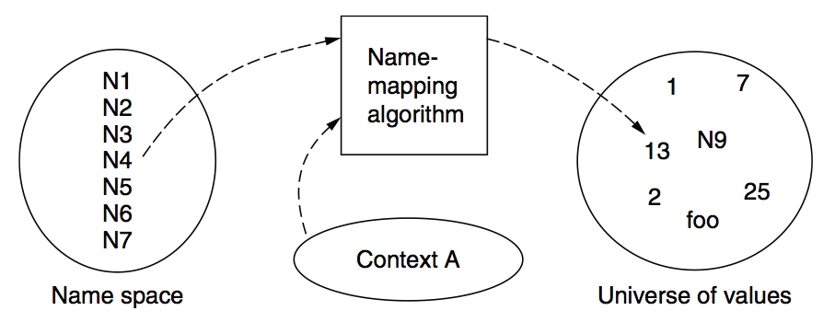
Naming Model

Slide 48
Naming Terminology
Binding – A mapping from a name to value
  Unbind is to delete the mapping
  A name that has a mapping is bound
A name mapping algorithm resolves a name

Slide 49
Naming Context
Type-1: context and name are separated
  E.g., inode number’s context is the file system
Type-2: context is part of the name
  E.g., xiayubin@sjtu.edu.cn
Name spaces with only one possible context are called universal name spaces
  Example: credit card number, UUID, email address

Slide 50
Determining Context - 1
Hard code it in the resolver
  Examples: Many universal name spaces work this way
Embedded in name itself
  cse@sjtu.edu.cn:
    Name = “cse”
    Context = “sjtu.edu.cn”
  /ipads.se.sjtu.edu.cn/courses/cse/README :
    Name = “README”
    Context = “/ipads.se.sjtu.edu.cn/courses/cse”

Slide 51
Determining Context - 2
Taken from environment (Dynamic)
  Unix cmd: “rm foo”:
    Name = “foo”, context is current dir
    Question: how to find the binary of “rm” command?
  Read memory 0x7c911109:
    Name = “0x7c911109”,
    Context is thread’s address space
Many errors in systems due to using wrong context

Slide 52
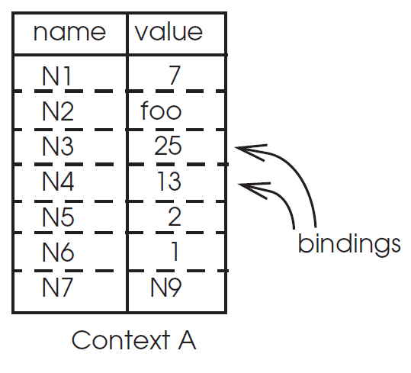
Name Mapping Algorithms - 1
Table lookup
  Find name in a table
    E.g., Phone book
  Context: which table?
    Implicit VS. explicit
    Default context

Slide 53
Name Mapping Algorithms - 2
Recursive lookup
  E.g., “/usr/bin/rm”
  First find “usr” in “/”, then find “bin” in “/usr”, then “rm”
  Each look-up process is the same
Multiple lookup
  Recall: how to find “rm” without absolute name?
  $PATH
    E.g., “/usr/local/sbin:/usr/local/bin:/usr/sbin:/usr/bin:/sbin:/bin”
  Look-up in a predefined list of context

Slide 54
Interpreter Naming API
value ← RESOLVE(name, context)
  Return the mapping of name in the context
status ← BIND(name, value, context)
  Establish a name to value mapping in the context
status ← UNBIND(name, context)
  Delete name from context
list ← ENUMERATE(context)
  Return a list of all bindings
result ← COMPARE(name1, name2)
  Check if name1 and name2 are equal

Slide 55
FAQ of Naming Scheme - 1
What is the syntax of names?
What are the possible value?
What context is used to resolve names?
Who specifies the context?
Is a particular name global (context-free) or local?

Slide 56
FAQ of Naming Scheme - 2
Does every name have a value?
  Or, can you have “dangling” names?
Can a single name have multiple values?
Does every value have a name?
  Or, can you name everything?
Can a single value have multiple names?
  Or, are there synonyms?
Can the value corresponding to a name change over time?

