Slide 1

P2P Network
Computer System Engineering, Fall 2020 (IPADS, SJTU)
Network Overlay for Decentralized System
Yubin Xia

Slide 2
P2P Network

Slide 3
Downsides of Centralized Infrastructure
Centralized point of failure
High management costs
  If one org has to host millions of files, etc.
Not suitable for many scenarios
  E.g., cooperation between you and me
Lack ability to aggregate clients

Slide 4
P2P (Peer-to-peer): No central servers!
How to track nodes and objects in the system?
How do you find other nodes in the system?
How should data be split up between nodes?
How to prevent data from being lost?
  How to keep it available?
How to provide consistency?
How to provide security? anonymity?

Slide 5
BitTorrent
Usage Model: Cooperative
  User downloads file from someone using simple user interface
  While downloading, BitTorrent serves file also to others
  BitTorrent keeps running for a little while after download completes
3 Roles
  Tracker: What peer serves which parts of a file
  Seeder: Own the whole file
  Peer: Turn a seeder once has 100% of a file
Notes:
** Challenges:
Tracking which peer has what
Handling high churn rates
Download rate proportional to upload rate

Slide 6
BitTorrent
Publisher a .torrent file on a Web server (e.g., suprnova.org)
  URL of tracker, file name, length, SHA1s of data blocks (64-512Kbyte)
Tracker
  Organizes a swarm of peers (who has what block?)
Seeder posts the URL for .torrent with tracker
  Seeder must have complete copy of file
Peer asks tracker for list of peers to download from
  Tracker returns list with random selection of peers
Peers contact peers to learn what parts of the file they have etc.
  Download from other peers

Slide 7
A torrent file
{
'announce': 'http://bttracker.debian.org:6969/announce',
'info':
{
'name': 'debian-503-amd64-CD-1.iso',
'piece length': 262144,
'length': 678301696,
'pieces':
'841ae846bc5b6d7bd6e9aa3dd9e551559c82abc1...d14f1631d
776008f83772ee170c42411618190a4'
}
}

Slide 8
Which Piece to Download?
Different policies: Order of parts downloading
  Strict?
  Rarest first?
  Random?
  Parallel?
BitTorrent
  Random for the first one
  Rarest first for the rest
  Parallel for the last one
Notes:
strict?
rarest first?
ensures that every piece is widely available
also helps with the seed and bootstrapping rapidly
won't retrieve the same piece multiple times from the seed
random?
avoid overloading seed when starting download
if peer has no piece, get as quickly as possible a piece so that it can upload
don't use rarest because it is likely only one peer has it
--> use random, can download subpieces in parallel
parallel download of same pieces?
avoid waiting on slowest

Slide 9
Drawback of BitTorrent
Rely on Tracker
  Tracker is central component
  Cannot scale to large number of torrents

Slide 10
Scalable Lookup: DHT
DHT: Distributed hash table
  Used to find the node responsible for a key quickly
  Distributed index: each node keeps a subset of the index
Typical DHT interface:
  put(key, value)
  get(key) -> value
  Loose guarantees about keeping data alive
Notes:
Two options: find the data, find the node ID, who knows the data. focus on the latter.

Slide 11
P2P Implementation of DHT
Overlay Network
  partition hash table over n nodes
  not every node knows about all other n nodes
  route to find right hash table
Goals
  log(n) hops
  Guarantees about load balance

Slide 12
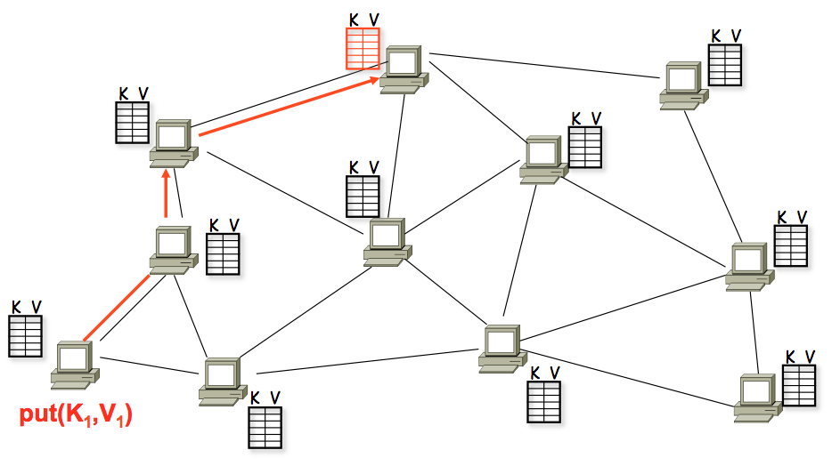
A DHT in Operation: put()

Slide 13
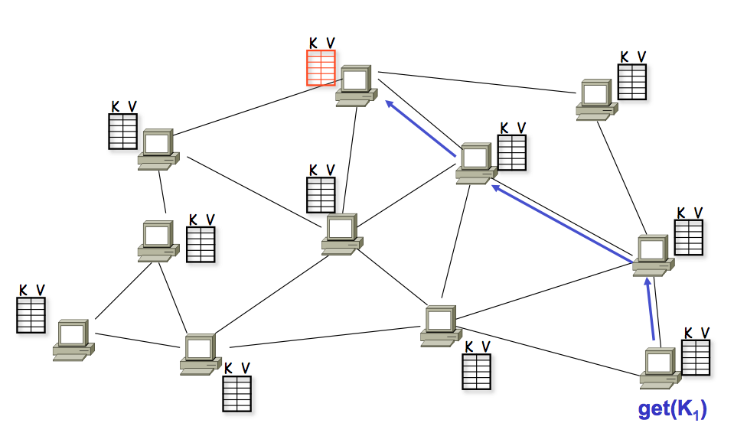
A DHT in Operation: get()

Slide 14
Chord Properties
Efficient: O(log(N)) messages per lookup
  N is the total number of servers
Scalable: O(log(N)) state per node
Robust: survives massive failures

Slide 15
Chord IDs
Key identifier = SHA-1(key)
  SHA-1 is a hash function
Node identifier = SHA-1(IP address)
Both are uniformly distributed
Both exist in the same ID space
How to map key IDs to node IDs? by mod?

Slide 16
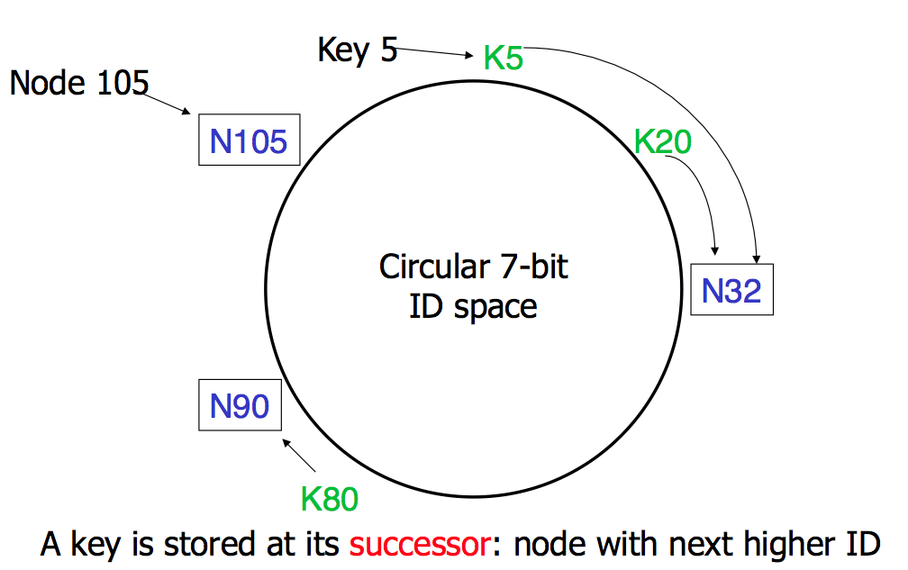
Consistent Hashing

Slide 17
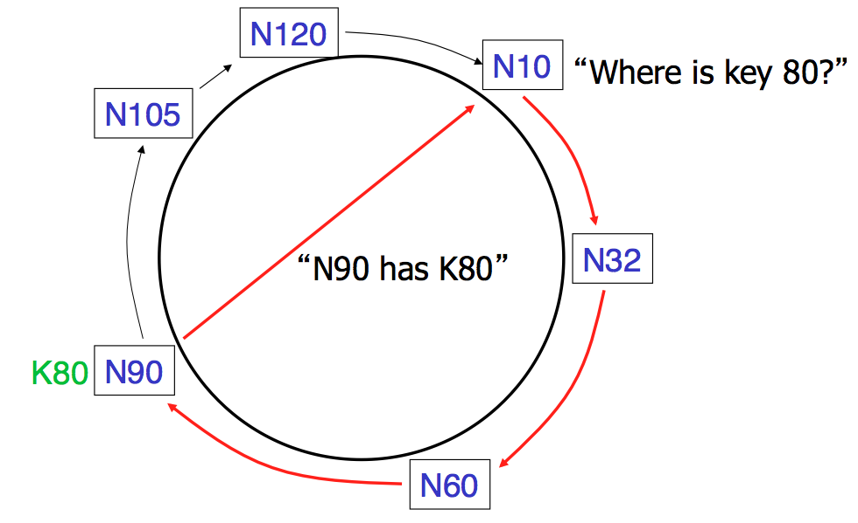
Basic Lookup

Slide 18
Simple Lookup Algorithm
Lookup(my-id, key-id)
n = my successor
if my-id < n < key-id
call Lookup(id) on node n // next hop
else
return my successor // done
Correctness depends only on successors

Slide 19
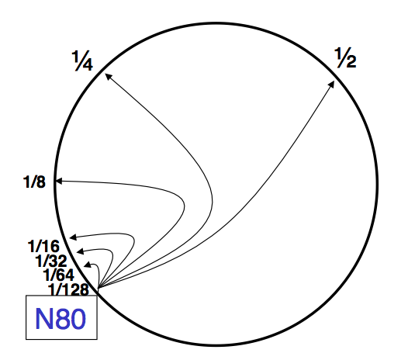
"Finger Table" allows log(N) lookups

Slide 20
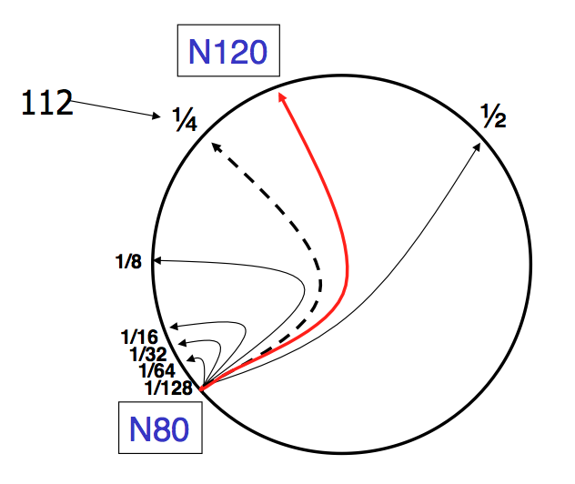
Finger i points to successor of n+2^{i}

Slide 21
Lookup with fingers
Lookup(my-id, key-id)
look in local finger table for
highest node n s.t. my-id < n < key-id
if n exists
call Lookup(id) on node n // next hop
else
return my successor // done

Slide 22
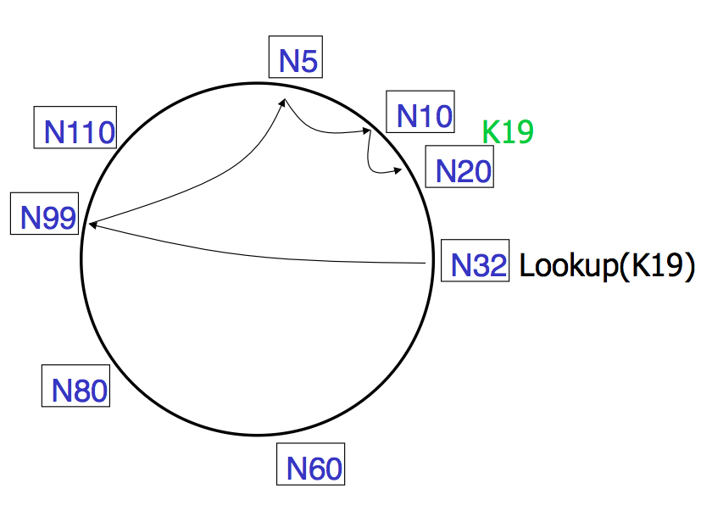
Lookups take O(log(N)) hops

Slide 23
Failures might cause incorrect lookup
N120
N10
N113
^{Lookup(90)}
N102
N85
N80
N80 doesn't know correct successor, so incorrect lookup

Slide 24
Solution: successor lists
Successor Lists
  Each node knows r immediate successors
  After failure, will know first live successor
  Correct successors guarantee correct lookups
Guarantee is with some probability

Slide 25
Join (1)
N25
N36
1. Lookup(36)
N40
K30
K38

Slide 26
Join (2)
N25
N36
1. Lookup(36)
N40
K30
K38

Slide 27
Join (3)
N25
N36
K30
1. Lookup(36)
N40
K30
K38

Slide 28
Join (4)
N25
4. Set N25's successor pointer
N36
K30
N40
K30
K38
Update finger pointers in the background Correct successors produce correct lookups

Slide 29
Solution: successor lists
Successor List Length
  Assume 1/2 of nodes fail
  P(successor list all dead) = (1/2)^{r}
    I.e. P(this node breaks the Chord ring)
    Depends on independent failure
  P(no broken nodes) = (1 – (1/2)^{r})^{N}
    r = 2log(N) makes prob. = 1 – 1/N

Slide 30
Virtual Nodes for Load Balance
Load balance could be a problem
  Some nodes have most value
Solution: virtual nodes
  Virtual nodes are distributed across the ring
  One physical node can have multiple virtual nodes
  More virtual nodes, better load balance

