Slide 1

BitCoin and Blockchain
Computer System Engineering, Fall 2020 (IPADS, SJTU)
The value of global consensus
Yubin Xia

Slide 2
Bitcoin & Blockchain

Slide 3
How to Get a Bitcoin Wallet?
Only need a pair of public key and private key
Public key as an identity
Private key for sign a transaction

Slide 4
Concurrency?
A ledger recording all the money
Why double-spending is possible?
  Y creates two transactions for same coin: Y->Z, Y->Q
    both with hash(T7)
  Y shows different transactions to Z and Q
    both transactions look good, including signatures and hash
    now both Z and Q will give hamburgers to Y
How to avoid double-spending?

Slide 5
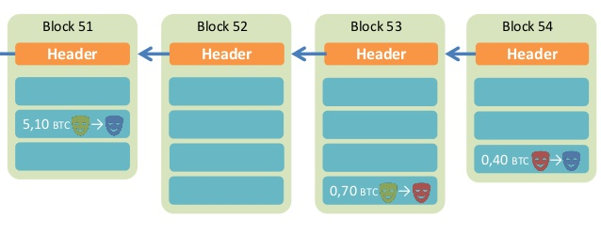
Overview of BitCoin
BitCoin is a decentralized public-accessable ledger
  Using hashes as a pointers, which form a chain
  Tamper-proof (assuming 51% honest)

Slide 6
Phases in Blockchain
Proposal phase
  Who to propose the block?
Validation phase
  Who to validate the block?
Usually all the participants in the network
  What if an attacker run multiple processes as fake nodes, in order to control 51% nodes?

Slide 7
Existing Solutions
Proof of Work (PoW)
  Brute force to solve a random number (nonce)
  Inefficient, waste of resources
Satisfy the number of first 0s
Tx data
Compute
the
hash
Output
Timestamp
Nonce
Nonce++
PreHash

Slide 8
Trust the Majority
If a majority of CPU power is controlled by honest nodes, the honest chain will grow the fastest and outpace any competing chains
To modify a past block, an attacker would have to redo the proof-of-work of the block and all blocks after it and then catch up with and surpass the work of the honest nodes

Slide 9
Network Steps
1) New transactions are broadcast to all nodes.
2) Each node collects new transactions into a block.
3) Each node works on finding a difficult proof-of-work for its block.
4) When a node finds a proof-of-work, it broadcasts the block to all nodes.
5) Nodes accept the block only if all transactions in it are valid and not already spent.
6) Nodes express their acceptance of the block by working on creating the next block in the chain, using the hash of the accepted block as the previous hash.

Slide 10
Incentive
By convention, the first transaction in a block is a special transaction that starts a new coin owned by the creator of the block
The incentive can also be funded with transaction fees
The incentive may help encourage nodes to stay honest
  If a greedy attacker is able to assemble more CPU power than all the honest nodes, he ought to find it more profitable to play by the rules than to undermine the system and the validity of his own wealth

Slide 11
Questions
Can some one other than the owner spend a coin?
What if I lose my private key?
Is it possible to have inflation?
Is mining really decentralized?
Is it necessary to use PoW? It's a waste of power!
How can I get bitcoin?

Slide 12
Questions
What if a malicious node gets a valid hash, but not broadcast it, in order to be faster than other nodes? (a.k.a., selfish mining)

Slide 13
Smart Contract
The nodes not only store transactions, but also code
... and also execute the code to gen new transaction!
The code is known as "smart contract"
  Execution can be triggered by events/invocations

Slide 14
Larger Storage
Store general data, instead of only transaction
Then a node needs to prove it does store the data
  Proof of retrievability, in challenge-response form
Examples: IPFS, STORJ

Slide 15
Permissioned Chain
Bitcoin is a permission-less chain
  Protect user's privacy by anonymity
  Also hard to track
Permissioned chain is not anonymous
  E.g., several companies build a chain used by themselves only
  It is just a multi-manager distributed database, which has nothing new

Slide 16
It's all about Trust
Why blockchain?
  We need a consensus for a ledger
  There is no third party to be trusted
If there is someone trusted by all, then blockchain is not needed
  Blockchain is slow and hard to use
  It is designed to be that way
    Considering the storage and bandwidth of the ledger

Slide 17
Questions
Why BitCoin is so valuable?
  A bit-string itself worthes nothing
  It is the consensus that matters
    A decentralized global consensus is hard to achieve
    Before BitCoin, it is even thought as impossible
    BitCoin solves this problem by incentive. Human is in!
How to ban BitCoin?

