Slide 1

System Performance
Computer System Engineering, Fall 2020 (IPADS, SJTU)
Design for performance
Yubin Xia

Slide 2
Performance Matters!
Requirements of computing systems
  Performance
  Correctness
  Fault tolerance
  Security

Slide 3
How to Improve Performance?
Buy new hardware!
However:
  Not all aspects improve at the same pace
  Moore's Law is plateauing
  Hardware improvements do not always keep pace with load increases
Conclusion
  Need to design for performance, potentially re-design as load increases

Slide 4
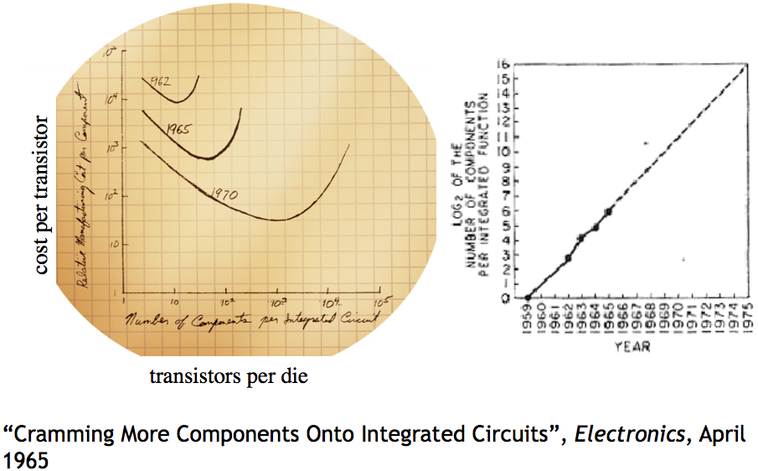
Moore's Law

Slide 5
How to Improve Performance
Step-1. measure the system, and compare it to our system model, to ﬁnd the bottleneck
Step-2. relax the bottleneck

Slide 6
Performance Metrics

Slide 7
Performance Metrics
Computer Systems as interconnected modules
★ Capacity
★ Latency
★ Throughput
★ Utilization

Slide 8
Performance Metrics: Capacity
Capacity – Size or amount of a service
  Blocks on storage devices
  Size of data on memory chips
  Cycles on a processor
  Bits per second on network devices
  ...
  Usually means the limitation of devices

Slide 9
Performance Metrics: Latency
Request
Latency: the time it takes from start to finish
  Webserver – Time from request to response
  Network – Time from send() until receive() done
  Procedure – Time from call until return
For a multi-step process (Steps A + B)
  Latency_{A+B} ≥ Latency_{A} + Latency_{B}
Stage-1
Stage-1
Service
…
Stage-n
Response

Slide 10
Performance Metrics: Throughput
Throughput: rate at which work is done
  Webserver – Requests per second
  Network – Bits per second
  Procedure – Calls per second
Pipeline of modules
  Thoughput_{A+B} ≤ minimum(Throughput_{A}, Throughput_{B})
  Bottleneck
1000
100
10
  Compare measured throughput to capability: utilization

Slide 11
Performance Metrics: Utilization
Utilization – Fraction of capacity used by a workload
  CPU is 50% busy, rest in idle loop
  75% of disk blocks are allocated
  Webserver is running at 20% of capacity
  20% of the time network is busy
  ...
Utilization means bottleneck obvious? Sometimes.
  Yes: e.g., CPU is 100% utilized vs. disk is 20% utilized
  No: e.g., CPU and disk are 50% utilized, and at alternating times

Slide 12
Relationship between Latency & Throughput
When processing is serial:
Throughput = 1 / (Latency)
When processing is parallel:
Throughput has no direct relationship
with latency
How to improve throughput? Reduce latency & Increase paralleling

Slide 13
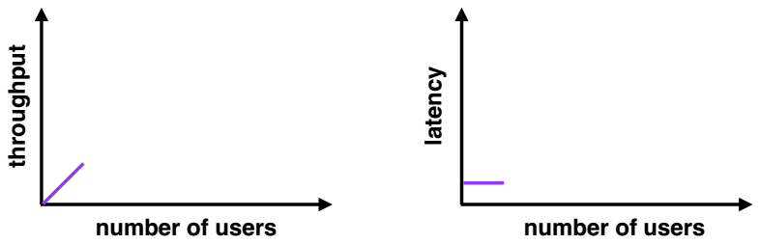
Throughput and Latency
Few users
  Low latency
  Low throughput (few users = few requests)

Slide 14
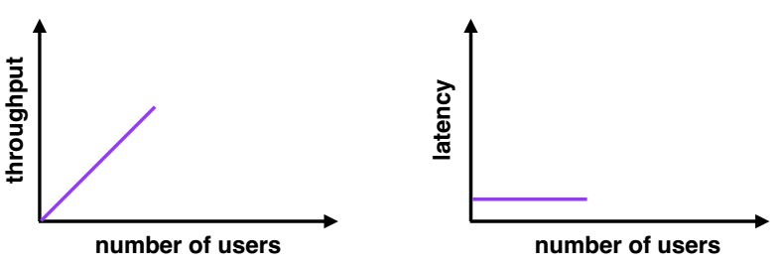
Throughput and Latency
Moderate users
  Low latency (new users consume previously idle resources)
  High throughput (more users = more requests)

Slide 15
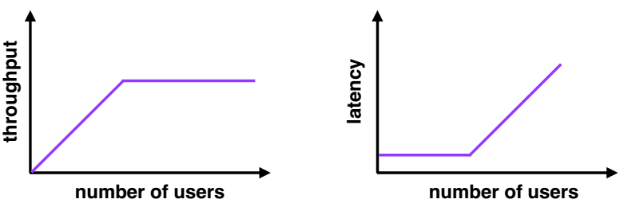
Throughput and Latency
Many users
  High latency (requests queue up)
  Throughput plateaus (cannot serve requests any faster)

Slide 16
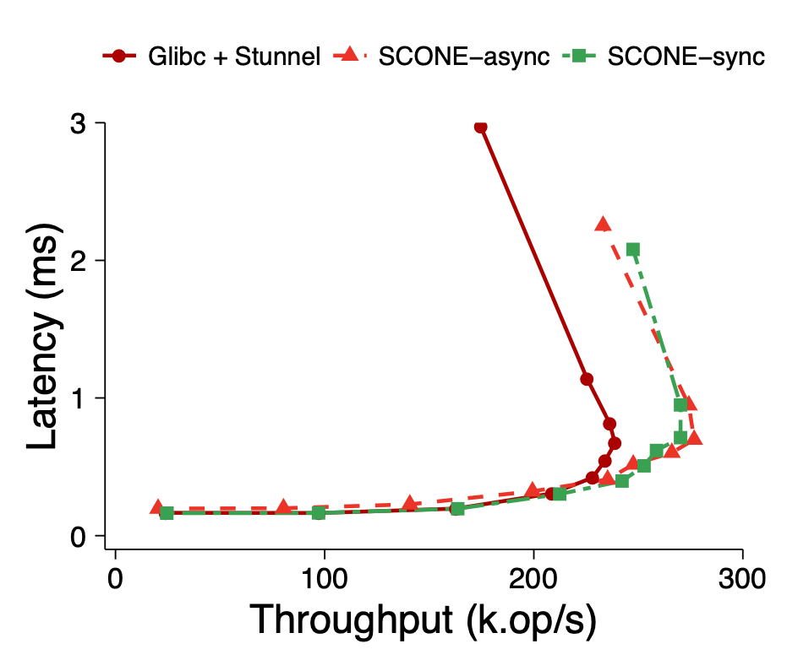
Throughput and Latency
  Sometimes you get data like this...

Slide 17
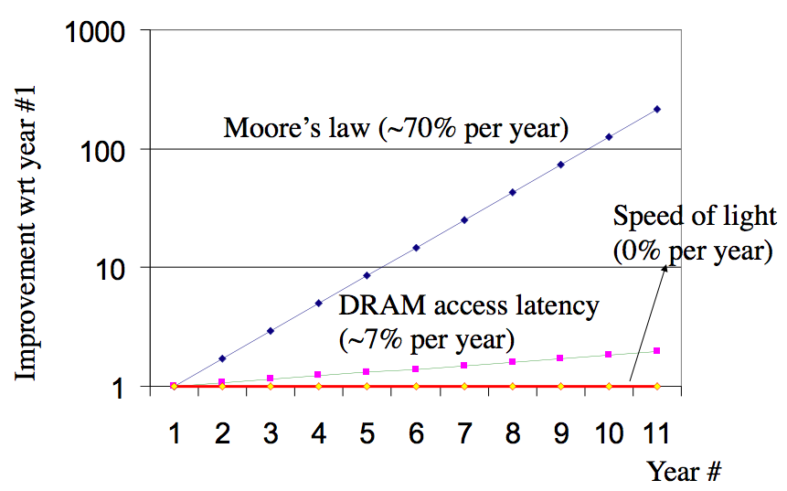
Improving Bottlenecks
Throughput usually is a resource limit
  Example: Buy a fatter pipe but it costs more
Latency improvement is harder
  Frequently fundamental limits
  Speed of CPU
  Speed of communication
  link (e.g., light)
  Famous saying: You can buy throughput but you can't bribe god

Slide 18
Fast Path for Latency Optimizations
Request
Use knowledge of the workload
Make the common cases faster
E.g., cache hit VS. cache miss
if (WorksOnFastPath(request))
DoFastCase(request);
else
DoNormalCase(request);
Stage-1
Slow path
Fast path
Stage-2
Stage
…
Stage-n
Response

Slide 19
Fast Path for Latency Optimizations
AverageLatency = Frequency_{Fast} x Latency_{Fast} + Frequency_{Slow} x Latency_{Slow}
Is introducing a fast path worth the effort?
  depends on the difference of latency,
  and the frequency using fast path, which is dependent on the workload
Many workloads do not have a uniform distribution of requests
  Thus introducing a fast path works well

Slide 20
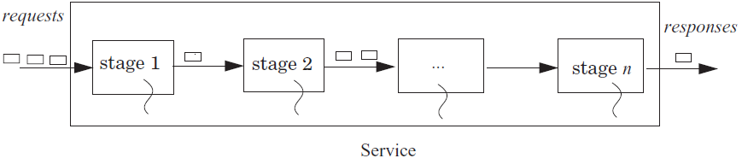
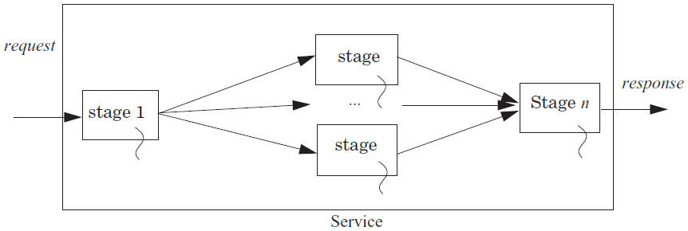
Improve Throughput with Concurrency

Slide 21

Reduce Latency with Concurrency
Example: search engine
  Splits the index of the Web up in n pieces, each piece on a machine
  Frontend sends copies of requests and combines the response
If subtasks are independent to each other
  Can use n threads to get a speedup of n
  Hard to get the ideal speedup
    10 months a man -> 1 month 10 men?
Index Node
Frontend
Index Node
Index Node

Slide 22
Hide Latency by Overlapping
Fetch (5 time units) and process (5 units) 2 blocks (20 units)
  Fetch B1; Process B1; Fetch B2; Process B2;
Fetch 2 blocks asynchronously (15 units)
  Send request for B1,B2;
  Receive B1; Process B1; Receive B2; Process B2
Processors prefetching memory requests
  File systems prefetching files
  Browser prefetching pages
Fetch B1,B2
Process B1
Process B2
Fetch B1
Process B1
Fetch B2
Process B2
Fetch B2

Slide 23
Queuing and Overload
Overload: whenever the offered load is greater than the capacity of a service for some duration
  E.g., 7 threads on 3 processors, must wait in queue (RUNNABLE)
The queuing theory
  Unit is the average service time
  The waiting time in a queue: 1/(1-ρ), ρ is the utilization
  Once the utilization approaches 1, the delay will grow without bound

Slide 24
Queuing and Overload
One solution
  Make the capacity match the offered load of requests
Example:
  CPU: one instruction per ns; memory: respond takes 10 ns
  CPU must make a memory request 10 ns in advance
  Memory must serve 10 requests concurrently
    If half instructions are memory request, then only 5 concurrently
    But cannot predicate the pattern of memory access

Slide 25
Queuing and Overload
If overload appears short period of time
  A queue handles short bursts of too much demand by time-averaging with adjacent periods when there is excess capacity
If overload persists over long periods of time
  Increase the capacity of the system
  Shed load: reduce or limit the offered load

Slide 26
Queuing and Overload
Offered load: the rate of arrival of requests for service
Using bounded buffer to control offered load
  Self managing, if the a source needs the results of the output
  If source makes no request at all, then offered load decreases
  If source holds the request and resubmits it later, offered load doesn't decrease
  Put a quota on the source (e.g., max threads per application)
Reducing the offered load when a stage becomes overloaded: e.g., swapping

Slide 27
Fighting Bottlenecks

Slide 28
Why Performance Bottleneck?
1. Physical limitation
  Speed of light
  The capacity of memory
  …
2. Sharing
  Several users share a device
  Several clients share a server

Slide 29
Improving Performance at 3 Layers
Hardware layer: get faster hardware
Application layer: better algorithm, fewer features
General system optimization techniques:
  Batching requests
  Caching data
  Concurrency
  Parallelism (scheduling)
Application
System
Hardware

Slide 30
Batching
Frequently it is possible to group requests for more efficiency
  Amortize overheads of processing
  Schedule requests for better performance
Examples: N messages vs. one message with N requests Disks:
  Always transfer a bunch of bytes (sector or block)
  Schedule the disk motions

Slide 31
Caching
Use knowledge of workload: memory abstractions
  Keep common requests in a fast local memory
  Check the local memory every access
CPU cache – Cache 1ns, Memory 100ns, 90% hit rate
  AverageLatency = 0.9 x 1ns + 0.1 x 100ns = 10.9 ns (100ns -> 10.9ns)
Used everywhere there are memory abstractions
  Processors, file systems, TLBs, browsers, DNS, etc.

Slide 32
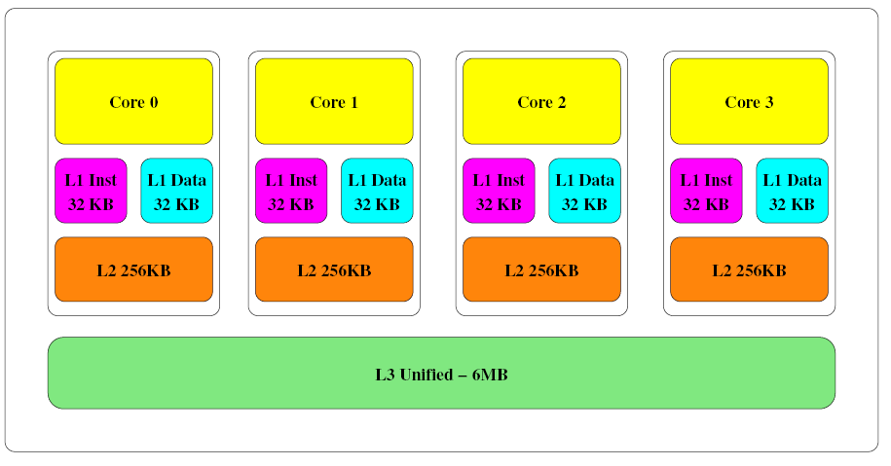
Memory Hierarchy
Intel Core-i5 Memory Architecture

Slide 33
Dallying
Procrastination sometimes helps
  Temp files – deleted before written to disk
Examples:
  Caches – Write back policy: write absorption
  Database transactions – group commit
    Might hold your ATM request until others arrive to do batching

Slide 34
Speculation
Guessing at an operation and performing it ahead
  Need to be able to undo changes if wrong
Examples:
  Processors guess at branches, memory access
  File systems guess at next file block needed (prefetching)
  Easier if space of possibilities is small
  Branch prediction versus value prediction

Slide 35
Speculative Execution in CPU
This is the process of executing an instruction in anticipation that it might be used
  This provides instruction level parallelism
For instance in a conditional statement, both the instructions in a condition might be executed
Depending on the condition, only one of the execution is retired or committed
  The other instruction is flushed from the pipeline
Tomasulo algorithm describes these details

Slide 36
Out-of-order Execution
Multiple instructions executed regardless of the actual program order
  lw $3, 100($4) in execution, cache miss
  sub $5, $6, $7 can execute during the cache miss
  add $2, $3, $4 waits until the miss is satisfied
The instructions are fetched, decoded and prepared for execution and pushed into a reservation station
Those instructions without data dependencies will execute in no specific order
  Others will stall until dependency is satisfied (resolving data hazards)

Slide 37
Challenges
Batching, dallying, and speculation introduce complexity
  They introduce concurrency
  Coordination is difficult to get right

Slide 38
Case: I/O Bottleneck

Slide 39
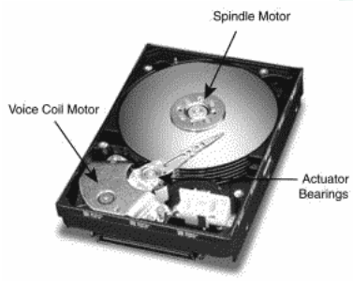
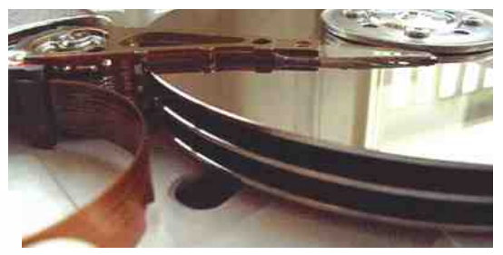
The I/O Bottleneck
Bits read from a disk encounter two potential transfer rate limits:
  The rate at which bits spin under the heads on their way to a buffer
  The rate at which the I/O channel or I/O bus can transfer the contents

Slide 40
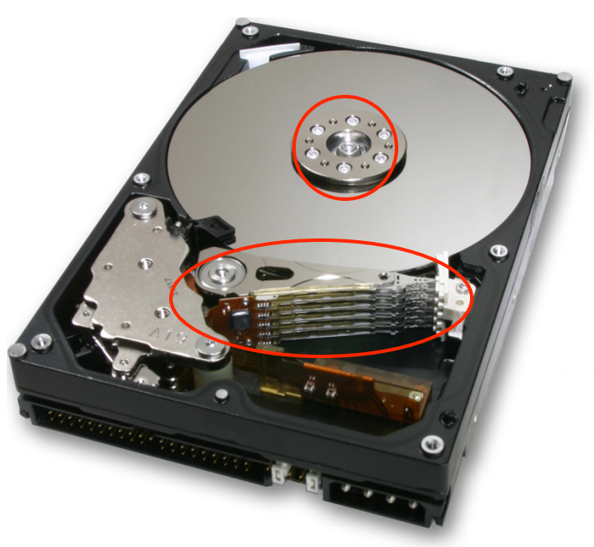
The I/O Bottleneck
Average seek latency: about 8 milliseconds
  Time to move the head over 1/3 of the disk
The average rotational latency: 4.17 milliseconds
  The disks spin at 7,200 rotations/minute
  One rotation every 8.33 milliseconds (60/7200)
  On average, the disk has to wait a half rotation for the desired block to be under the disk head

Slide 41
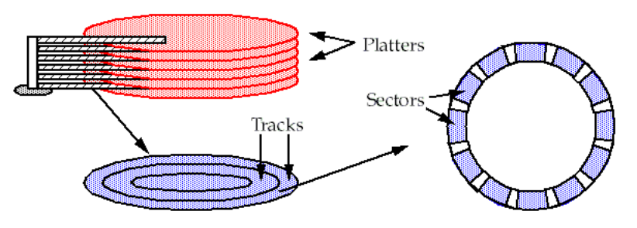
A Typical Modern 400 Gigabyte Disk
Has 16,383 cylinders, or about 24 megabytes per cylinder
Would have 8 two-sided platters and thus 16 read/write heads
Would be 24/16 = 1.5 megabytes per track
When rotating at 7200 revolutions per minute (120 per second)
The bits will go by a head at 180 megabytes per second (1.5 x 120)

Slide 42
Bottleneck
The IDE bus: 66 MB/S is common
The Serial ATA-3 bus: 6 Gbps
With IDE bus: The electronics would be the bottleneck
  at 66 MB/S
With SATA-3 bus: The mechanics would be the bottleneck
  at 180 MB/S

Slide 43
Latency of 4-KB Data Accessing (Using IDE)
The latency of reading a 4 kilobyte block chosen at random:
avg seek time + avg rotation latency + transmission of 4 kilobytes
  = 8 + 4.17 + (4 / (66 × 1024)) × 1000 milliseconds
  = 8 + 4.17 + 0.06 milliseconds
  = 12.23 milliseconds
The throughput for reading randomly-chosen blocks one by one is:
  = 1000/12.23 × 4 kilobytes per second
  = 327 kilobytes/second

Slide 44
Round-1: No Optimization
1 in ← OPEN ("in", READ) // open "in" for reading
2 out ← OPEN ("out", WRITE) // open "out" for reading
3
4 while not ENDOFFILE (in) do
5 block ← READ (in, 4096) // read 4 kilobyte block from in
6 block ← COMPUTE (block) // compute for 1 millisecond
7 WRITE (out, block, 4096) // write 4 kilobyte block to out
8 CLOSE (in)
9 CLOSE (out)
reading 4 kilobyte + 1 millisecond of computation + writing 4 kilobyte
  = 12.23 + 1+ 12.23 milliseconds
  = 25.46 milliseconds

Slide 45
Round-2
Modify the file system
  to layout the blocks of a file contiguously
  to prefetch an entire track of data on each read
Average seek time + 1 rotational delay
  = 8 + 8.33 milliseconds = 16.33 milliseconds

Slide 46
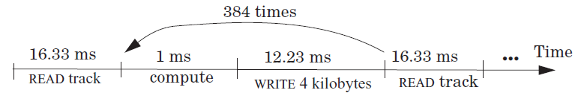
Round-2
File system issues 1 read request per 384 (1.5 MB per track / 4 KB) loop iterations
The average time for 384 iterations is:
reading 1536 kilobyte + 384× (1 millisecond of computation + writing 4 kilobyte)
  = 16.33 + 384 × (1 + 12.23) millisecond
  = 16.33 + 5080.32 milliseconds
  = 5096.65 milliseconds
Thus, the average time for a loop iteration is 5096.65/384 = 13.27 milliseconds

Slide 47
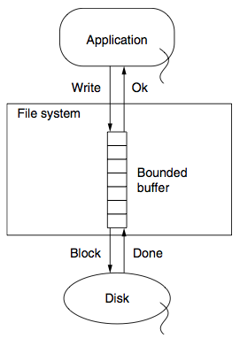
Round-3
Improve by dallying & batching write requests
Write to buffer in RAM and flush when buffer is full
Latency = (16.33 + 384 + 16.33)/384 milliseconds
= 1.09 milliseconds

Slide 48
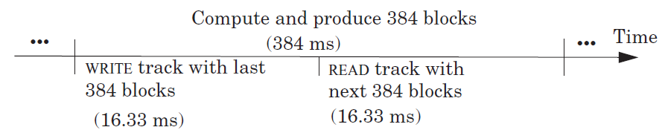
Round-4
Prefetch the next track before the 385th READ
Overlap computation and I/O completely
The average time around the loop is 1 millisecond
The bottleneck now is the CPU

Slide 49
Cache Policies
Multi-level Memory

Slide 50
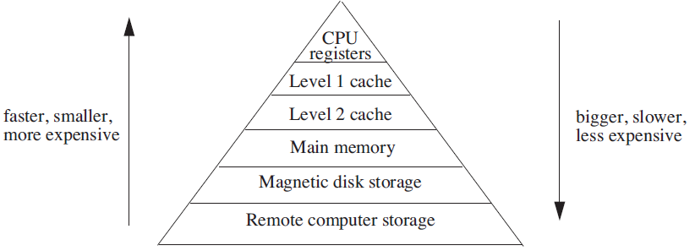
Analyzing Multilevel Memory Systems
Only consider the adjacent pair of levels
  View it as a two level multilevel memory system
  The 1st is primary device, the 2nd is secondary device

Slide 51
Locality of Reference and Working Sets
In many situations most memory references are to a small set of addresses for significant periods of time
As the application progresses, the area of concentration of access shifts, but its size still typically remains small
Called "locality of reference"
  Temporal locality and spatial locality
  Thrashing: repeated movement of data back and forth between two levels

Slide 52
Multilevel Memory Management Policies
Each level of multilevel memory system can be characterized by 4 items
  The string of references directed to that level
  The bring-in policy for that level
  The removal policy for that level
  The capacity of the level

Slide 53
Page-removal Policies
First-in, first-out (FIFO) page-removal policy
  Remove the page that has been in the primary device the longest
Belady's anomaly
  Performance drops with a larger primary device capacity!
Optimal (OPT) page-removal policy
  Choose for removal the page that will not be needed for the longest time
Least-recently-used (LRU) page-removal policy
  The page in the primary device that has not been used for the longest time

Slide 54
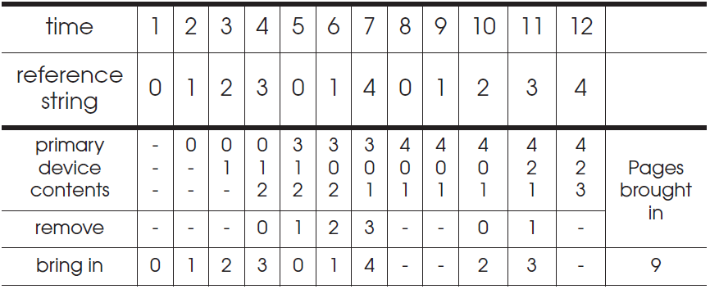
First-in, First-out (FIFO) Page-Removal Policy
The page for removal is the one that has been in the primary device the longest

Slide 55
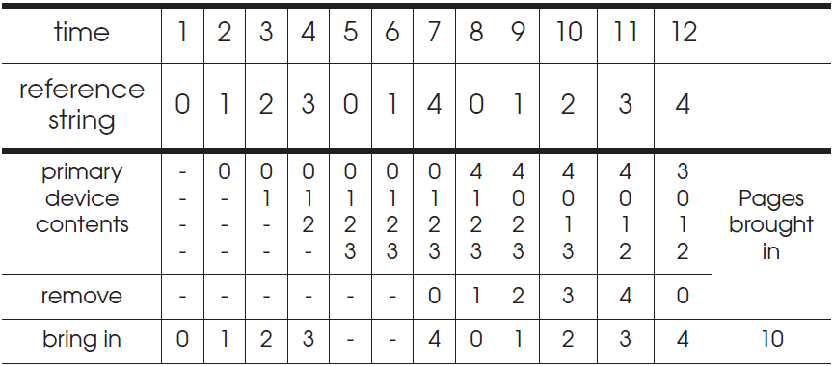
Belady's Anomaly
Increase of missing-page exception numbers with a larger primary device capacity

Slide 56
Stack Algorithms
Subset property
  For the optimal policy, at all times, the pages it keeps in the 3-page memory is a subset of that it keeps in the 4-page memory
No Belady's anomaly if subset property holds
  At all times and for every possible capacity of primary device, it creates a total ordering for pages at a given time

Slide 57
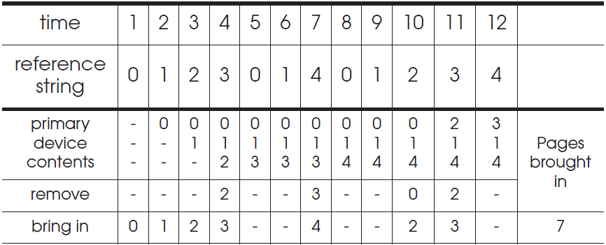
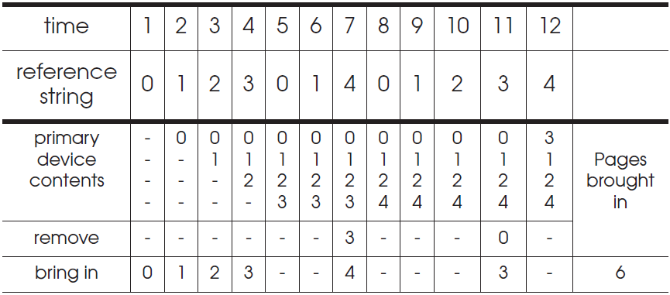
OPT (Optimal) Page-Removal Policy
Always choose for removal the page that will not be needed for the longest time

Slide 58
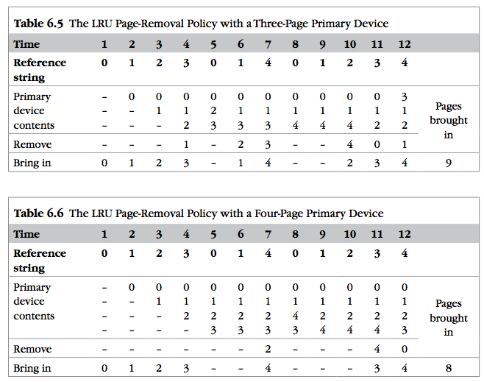
LRU
It is confirmed as an error, in errata part I.
Notes:
It is confirmed as an error, in errata part I.

Slide 59

Least-recently-used (LRU) Page Removal Policy
A program that runs from top to bottom
  the virtual memory that is larger than primary device
LRU: always evicts exactly the wrong page
Most-recently-used (MRU) page-removal policy

Slide 60
Comparative Analysis of Different Policies
Ways of deciding the following two things:
  How large the primary memory device should be?
  Which page removal policy to use?
Collecting traces of the reference strings of typical programs
Simulate the multilevel memory manager with:
  Different configurations - Size of primary device
  Page removal policy - Traces of memory access

Slide 61
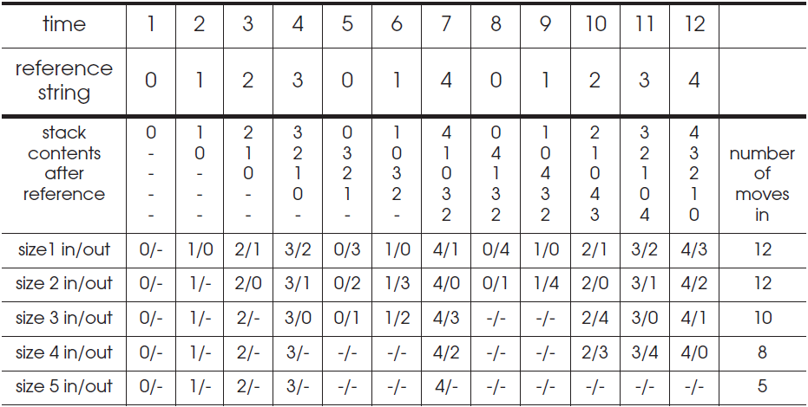
Stack Algorithms for LRU
It can perform a simulation for all possible primary memory size with a single pass through a given reference string

Slide 62
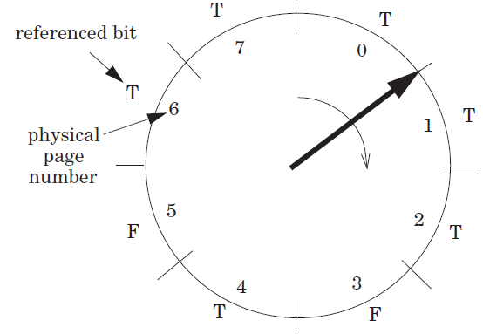
Efficiency of Page-Removal Policies
Clock page-removal algorithm
  Base on a hardware setting bit
  Reference bit
  Move clockwise
  If T, set F
  Choose as the victim otherwise
Random removal policy
  For TLB
Directed mapping

Slide 63
Scheduling

Slide 64
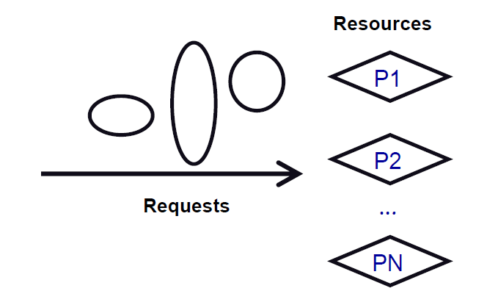
Scheduling
Algorithm that assigns requests to resources
Processor time – Threads
Physical memory – Address spaces
Printers – Printer jobs
Disks – Disk requests
Networks – Packets
Memory bus – Memory requests

Slide 65
Challenges of Scheduling
Easy, if number of requests ≤ resources
Difficulty: Lack of information
  Packet scheduling and streaming media
Difficulty: Lack of mechanism to enforce policies
  Give high priority to CPU, but can't get to disk or network
Difficulty: Getting mechanism right
  Many schedulers break rather than gracefully degrade under load

Slide 66
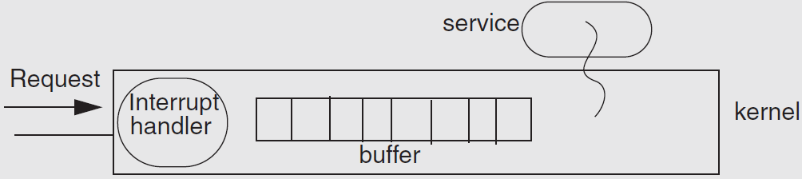
Example: Livelock under Overload
Web news server overloaded
  Most of the time is spend to handle interrupt and drop requests
  No progress at all!

Slide 67
The Ideal Scheduler
Mini latency: How long a service takes? E.g., Move mouse, cursor moves
Max throughput: Max jobs / time. E.g., Web server pages/second
Low overheads: Scheduler doesn't use any resources
Fairness: everyone gets to make progress, no one starves
Scales linearly up to capacity: Graceful handling of overload
System-level goal may conflict with the needs of individual threads
  System: minimal preemption
  Apps: finish as soon as possible

Slide 68
Measuring the Request's Response
Turn-around time: The length of time from when a request arrives at a service until it completes
Response time: The length of time from when a request arrives at a service until it starts producing output
Waiting time: The length of time from when a request arrives at a service until the service starts processing the request

Slide 69
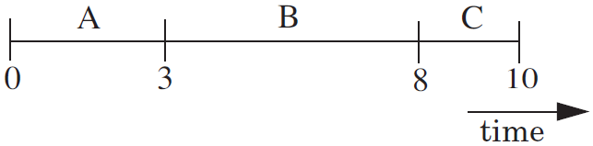
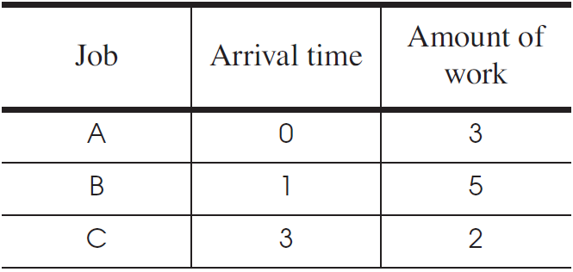
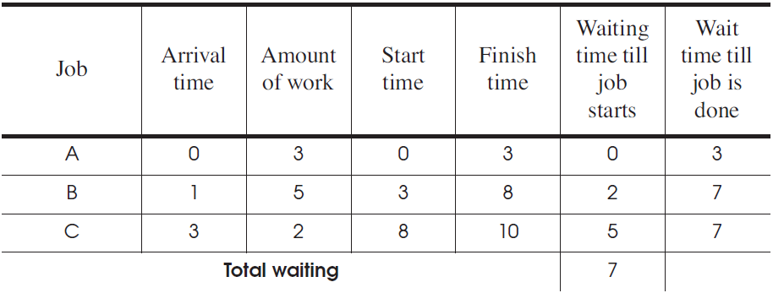
First Come First Server (FCFS)
Fairness paramount
Good for printer scheduler

Slide 70
First Come First Server (FCFS)
For the processor
  One thread that periodically waits for I/O but mostly computes
  Several threads that perform mostly I/O operations
For the scheduler
  It runs the I/O-bound threads first
  Then runs the computation intensive thread
  All quickly finished computations and waiting for I/O

Slide 71

Convoy Effect
When I/O devices are idle
  The I/O-bound threads will quickly finish computations and start I/O
  The processor-bound thread will run for a long time
  I/O-bound operations will finish I/O and queuing for computation
  All the I/O devices will become idle!
When processor is idle
  The processor-bound thread finishes computation and starts I/O
  The I/O-bound threads will quickly finish computations and start I/O
  Processor will become idle!
CPU
Device

Slide 72
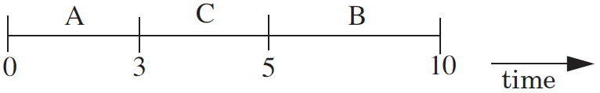
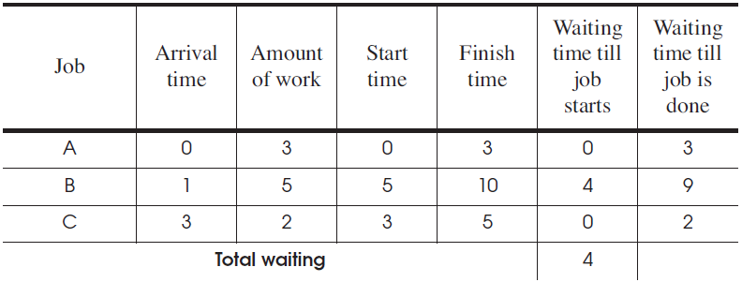
Shortest-Job-First
Chooses the job that has the shortest expected run time
Require a prediction of the running time of a job before running
Starvation: several short jobs makes a long job starve

Slide 73
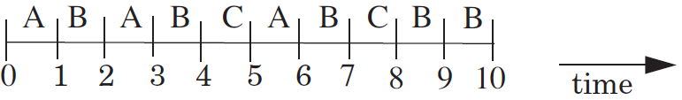
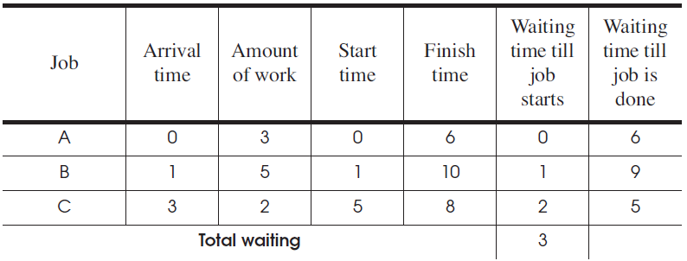
Round-Robin
Select the first job from queue as in the first-come first-serve policy
Stop the job after some period of time, and select a new job

Slide 74
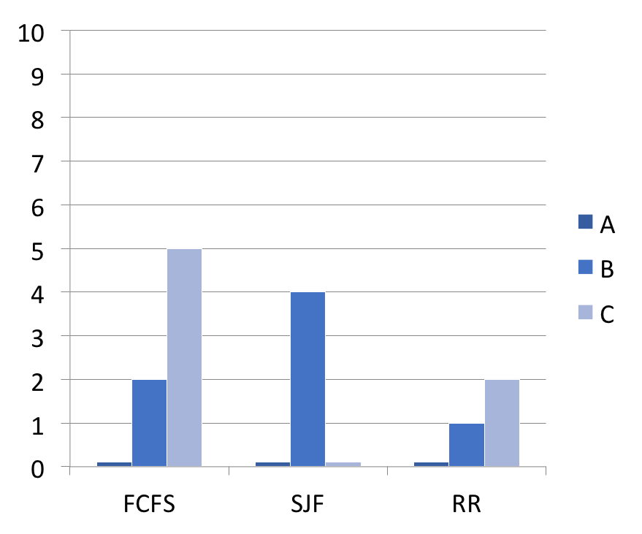
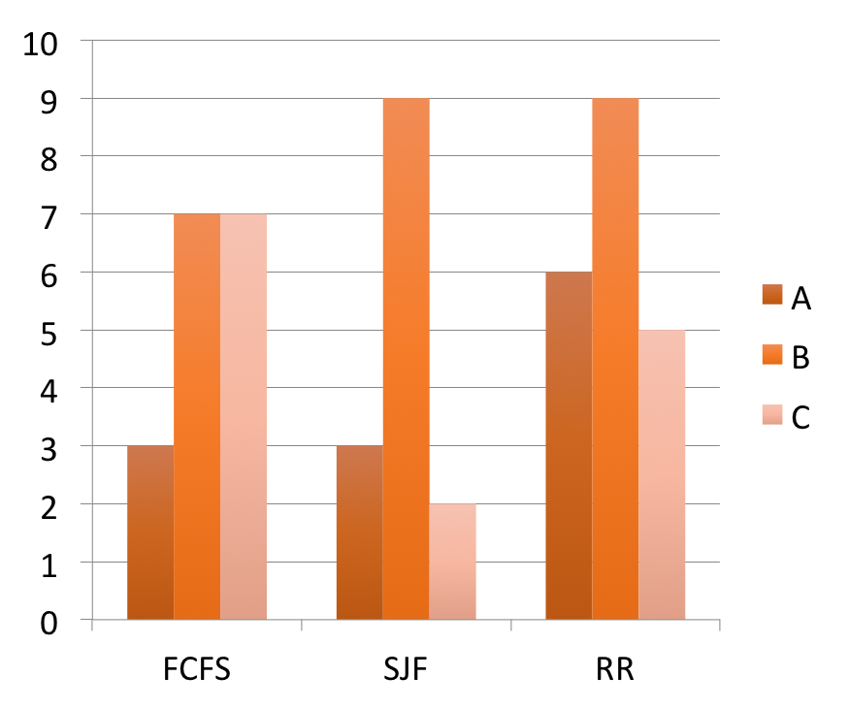
Comparing the Three Policies
Wait time before start
Wait time till done
Amount of work: A:3, B:5, C:2

Slide 75
Priority Scheduling Policy
Priority Scheduling Policy
  Assign each job a priority number (static vs. dynamic)
  Select the job with the highest priority number
  Must have some rule to break ties
Modern CPU schedulers have
  Priorities: Run job with the highest priority
  Round Robin: Alternate among jobs of same priority, preempt a job if it holds CPU too long

Slide 76
CPU Scheduling Policy
Assign priorities to jobs
  Give high priorities to I/O-bound jobs
  Give low priorities to CPU-bound jobs
  Handles I/O-bound and CPU-bound jobs nicely

Slide 77
CPU Scheduling Policy
Challenge: distinguish I/O-bound and CPU-bound
Look at past behavior to predict the future
  Linux: Priority of job is function of amount of CPU it has used
Counterintuitive:
  More CPU a job uses/needs, the lower its priority
  The less CPU it uses, the higher its priority
  Avoids starvation problems: Not running gives task a higher priority

Slide 78
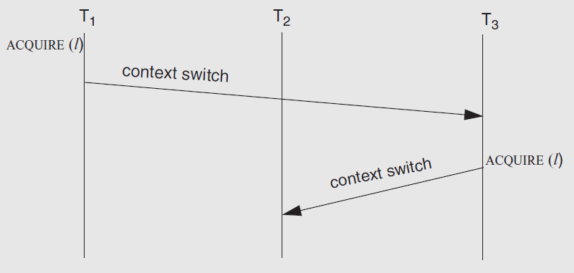
The Priority Inversion Problem
Problem: what if a high priority thread waits for a low priority one which holding a lock?
Solution: priority inheritance

Slide 79
Real-Time Scheduling
Missed deadline = incorrect behavior
Soft real time: Display video frame every 30th of sec
Hard real time: "apply-breaks" process in your car
Scheduling more than one thing: memory, network bandwidth, CPU all at once

Slide 80
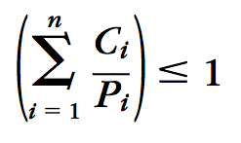
Earliest Deadline First (EDF)
Keep the queue of jobs sorted by deadline
Run the first of the queue
Minimize the total lateness of all the jobs
How to know deadline?
  Specified by tasks themselves
  In the form of (C, P), C for second, P for period
  The scheduler rejects new task if sum(Ci/Pi) > 1

Slide 81
Disk Scheduling: Goals
Minimize time spent waiting on disk mechanisms
  Moving the disk arm
  Waiting for sector to rotate under disk heads
Fairness
  Should not make requests wait too long

Slide 82
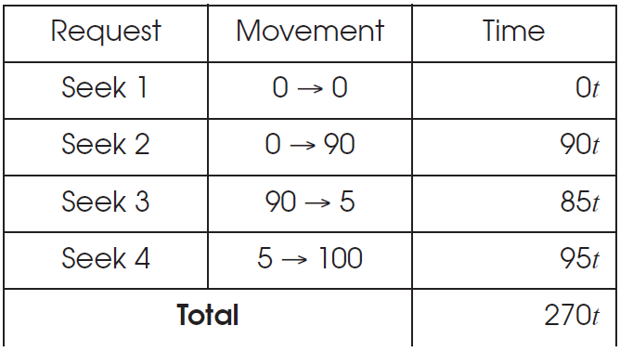
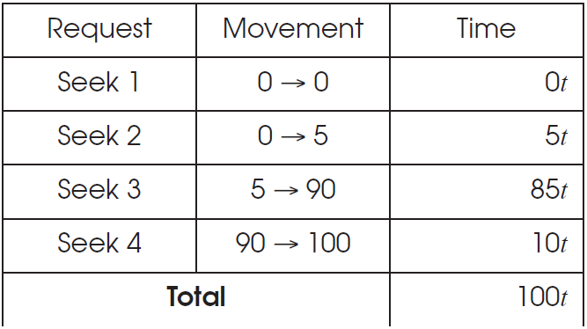
Disk Scheduling
First-come first-serve
Elevator Algorithm

Slide 83
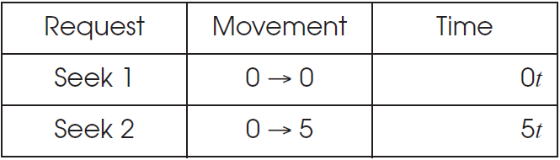
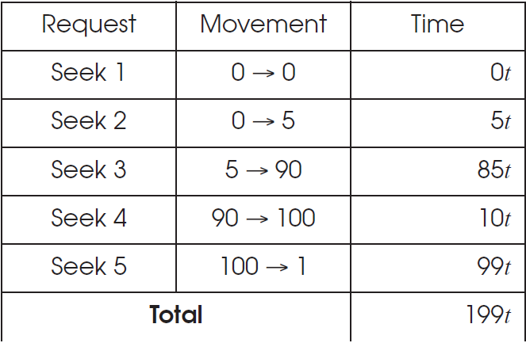
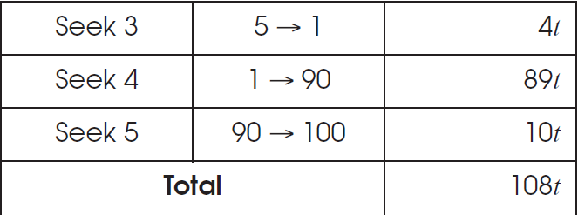
Disk Scheduling
Shortest-Seek-First
Elevator Algorithm

