Slide 1

System Performance
Computer System Engineering, Fall 2020 (IPADS, SJTU)
Fighting bottlenecks
Yubin Xia

Slide 2
Review: How to Improve Performance
Step-1. measure the system, and compare it to our system model, to find the bottleneck
Step-2. relax the bottleneck

Slide 3
Review: Performance Metrics
Computer Systems can be viewed as interconnected modules
★ Capacity
★ Latency
★ Throughput
★ Utilization

Slide 4
Review: Latency & Throughput
When processing is serial:
Throughput = 1 / (Latency)
When processing is parallel:
Throughput has no direct relationship
with latency
How to improve throughput? Reduce latency & Increase paralleling

Slide 5
Review: Improving Performance at 3 Layers
Get faster hardware
Fix application: better algorithm, fewer features (not in CSE)
General system optimization techniques:
  Batching
  Caching
  Concurrency
  Parallelism (scheduling)
Application
System
Hardware

Slide 6
Cache Policies
Multi-level Memory

Slide 7
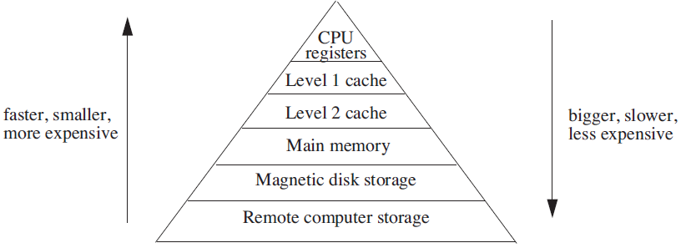
Analyzing Multilevel Memory Systems
Only consider the adjacent pair of levels
  View it as a two level multilevel memory system
  The 1st is primary device, the 2nd is secondary device

Slide 8
Locality of Reference and Working Sets
In many situations most memory references are to a small set of addresses for significant periods of time
As the application progresses, the area of concentration of access shifts, but its size still typically remains small
Called "locality of reference"
  Temporal locality and spatial locality
  Thrashing: repeated movement of data back and forth between two levels

Slide 9
Multilevel Memory Management Policies
Each level of multilevel memory system can be characterized by 4 items
  The string of references directed to that level
  The bring-in policy for that level
  The removal policy for that level
  The capacity of the level

Slide 10
Page-removal Policies
First-in, first-out (FIFO) page-removal policy
  Remove the page that has been in the primary device the longest
  Belady's anomaly
    Performance drops with a larger primary device capacity!
Optimal (OPT) page-removal policy
  Choose for removal the page that will not be needed for the longest time
Least-recently-used (LRU) page-removal policy
  The page in the primary device that has not been used for the longest time

Slide 11
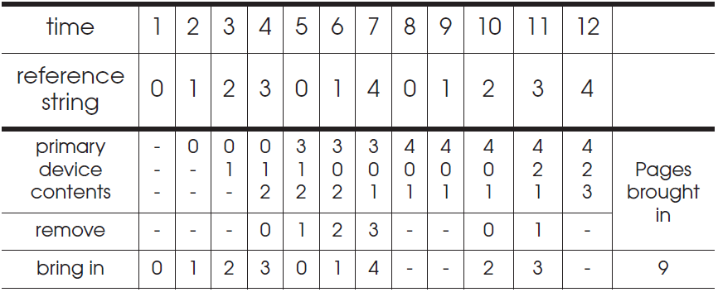
First-in, First-out (FIFO) Page-Removal Policy
The page for removal is the one that has been in the primary device the longest

Slide 12
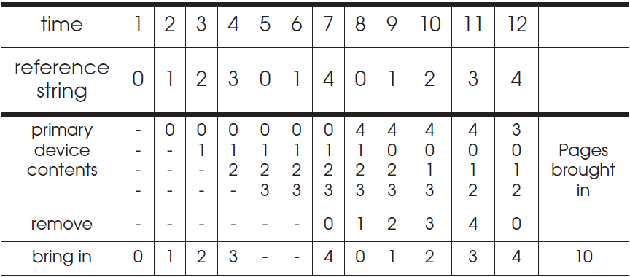
Belady's Anomaly
Increase of missing-page exception numbers with a larger primary device capacity

Slide 13
Stack Algorithms
Subset property
  For the optimal policy, at all times, the pages it keeps in the 3-page memory is a subset of that it keeps in the 4-page memory
No Belady's anomaly if subset property holds
  At all times and for every possible capacity of primary device, it creates a total ordering for pages at a given time

Slide 14
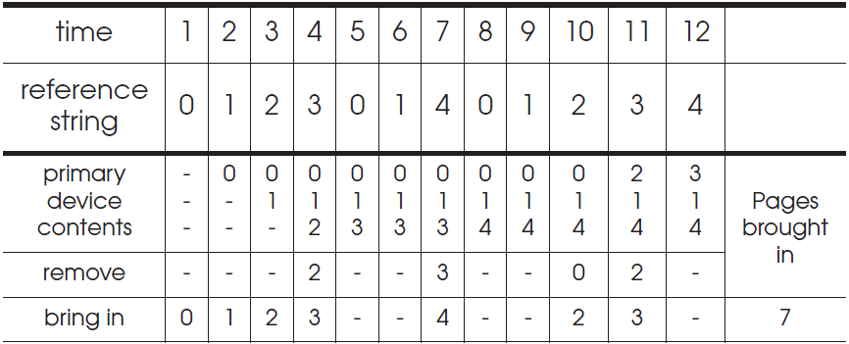
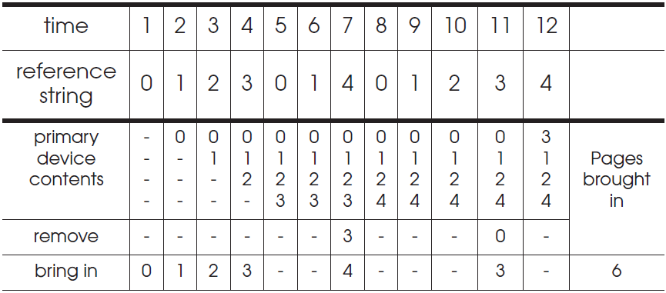
OPT (Optimal) Page-Removal Policy
Always remove the page that will not be needed for the longest time (assume knowing the future)

Slide 15
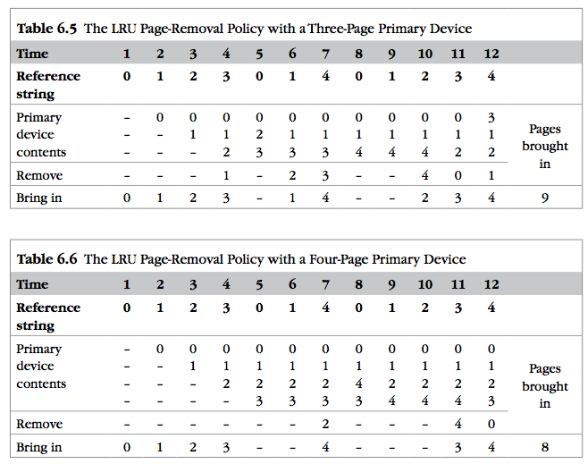
LRU
It is confirmed as an error, in errata part I.
Notes:
It is confirmed as an error, in errata part I.

Slide 16

Least-recently-used (LRU) Page Removal Policy
A program that runs from top to bottom
  the virtual memory that is larger than primary device
LRU: always evicts exactly the wrong page
Most-recently-used (MRU) page-removal policy

Slide 17
Comparative Analysis of Different Policies
Ways of deciding the following two things:
  How large the primary memory device should be?
  Which page removal policy to use?
Collecting traces of the reference strings of typical programs
Simulate the multi-level memory manager with:
  Different configurations - Size of primary device
  Page removal policy - Traces of memory access

Slide 18
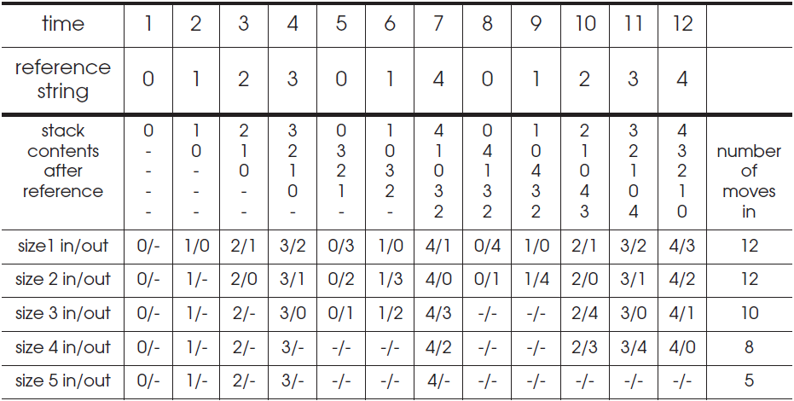
Stack Algorithms for LRU
It can perform a simulation for all possible primary memory size with a single pass through a given reference string

Slide 19
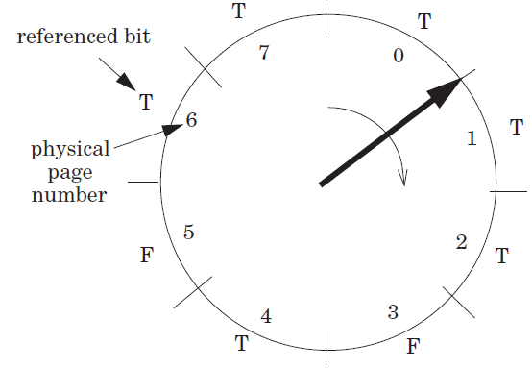
Efficiency of Page-Removal Policies
Clock page-removal algorithm
  Base on a hardware setting bit
  Reference bit
  Move clockwise
  If T, set F
  Choose as the victim otherwise
Random removal policy
  For TLB
Directed mapping

Slide 20
Scheduling

Slide 21
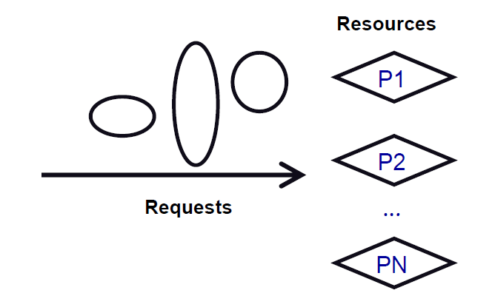
Scheduling
Algorithm that assigns requests to resources
Processor time – Threads
Physical memory – Address spaces
Printers – Printer jobs
Disks – Disk requests
Networks – Packets
Memory bus – Memory requests

Slide 22
Challenges of Scheduling
Easy, if number of requests ≤ resources
Difficulty: Lack of information
  Packet scheduling and streaming media
Difficulty: Lack of mechanism to enforce policies
  Give high priority to CPU, but can't get to disk or network
Difficulty: Getting mechanism right
  Many schedulers break rather than gracefully degrade under load

Slide 23
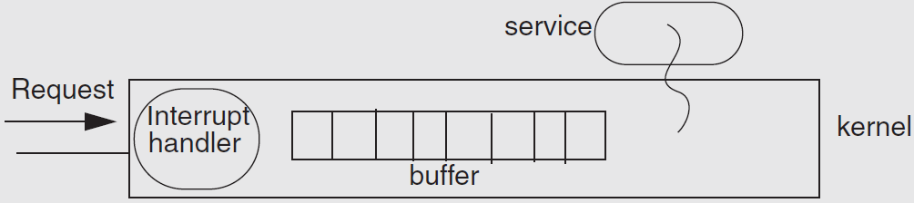
Example: Livelock under Overload
Web news server overloaded
  Most of the time is spend to handle interrupt and drop requests
  No progress at all!

Slide 24
The Ideal Scheduler
Min latency: How long a service takes? E.g., Move mouse, cursor moves
Max throughput: Max jobs / time. E.g., Web server pages/second
Low overheads: Scheduler doesn't use any resources
Fairness: everyone gets to make progress, no one starves
Scales linearly up to capacity: Graceful handling of overload
System-level goal may conflict with the needs of individual threads
  System: minimal preemption
  Apps: finish as soon as possible

Slide 25
Measuring the Request's Response
Turn-around time: The length of time from when a request arrives at a service until it completes
Response time: The length of time from when a request arrives at a service until it starts producing output
Waiting time: The length of time from when a request arrives at a service until the service starts processing the request

Slide 26
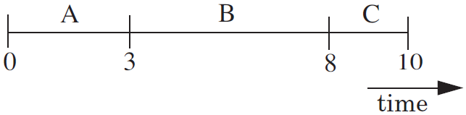
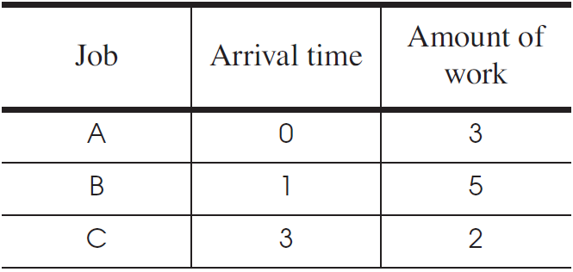
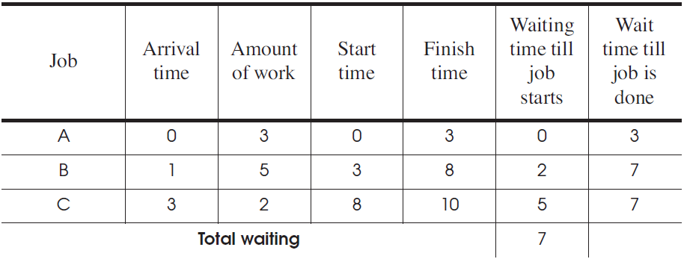
First Come First Server (FCFS)
Fairness paramount
Good for printer scheduler

Slide 27
First Come First Server (FCFS)
For the processor
  One thread that periodically waits for I/O but mostly computes
  Several threads that perform mostly I/O operations
For the scheduler
  It runs the I/O-bound threads first
  Then runs the computation intensive thread
  All quickly finished computations and waiting for I/O

Slide 28
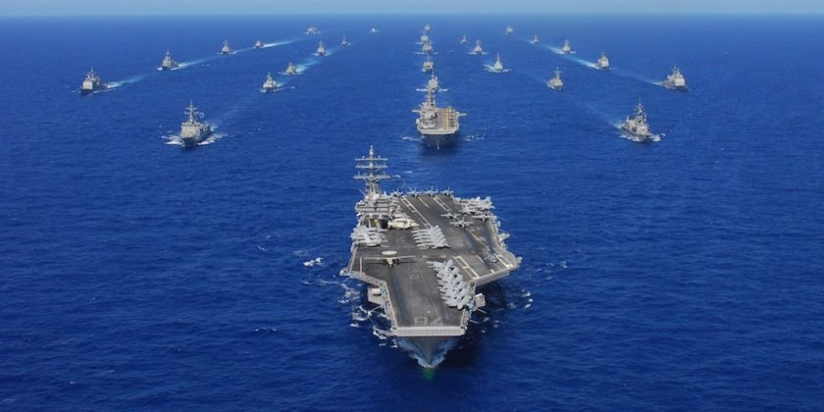
Convoy Effect
When I/O devices are idle
  The I/O-bound threads will quickly finish computations and start I/O
  The processor-bound thread will run for a long time
  I/O-bound operations will finish I/O and queuing for computation
  All the I/O devices will become idle!
When processor is idle
  The processor-bound thread finishes
  computation and starts I/O
  The I/O-bound threads will quickly
  finish computations and start I/O
  Processor will become idle!

Slide 29
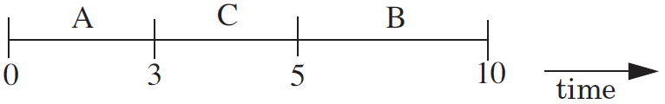
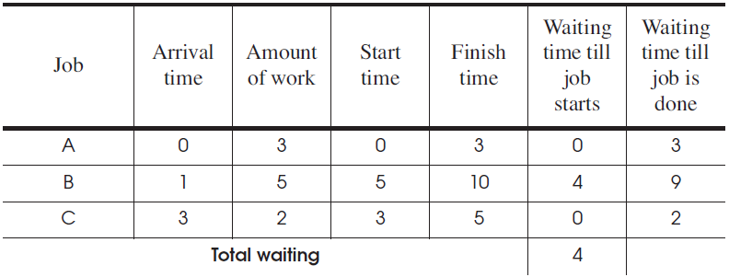
Shortest-Job-First
Chooses the job that has the shortest expected run time
Require a prediction of the running time of a job before running
Starvation: several short jobs makes a long job starve

Slide 30
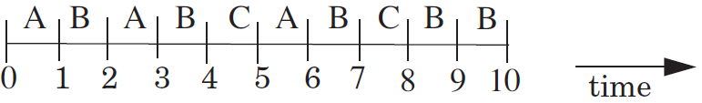
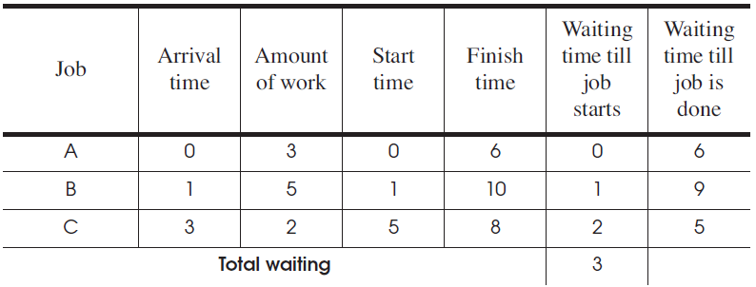
Round-Robin
Select the first job from queue as in the first-come first-serve policy
Stop the job after some period of time, and select a new job

Slide 31
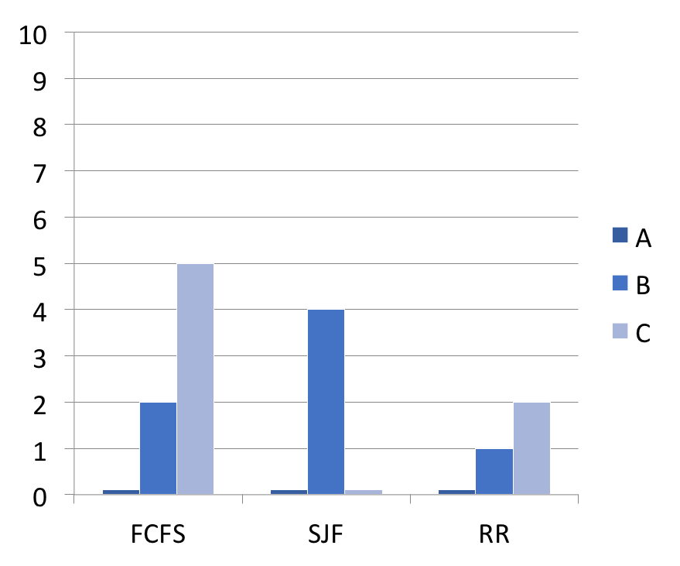
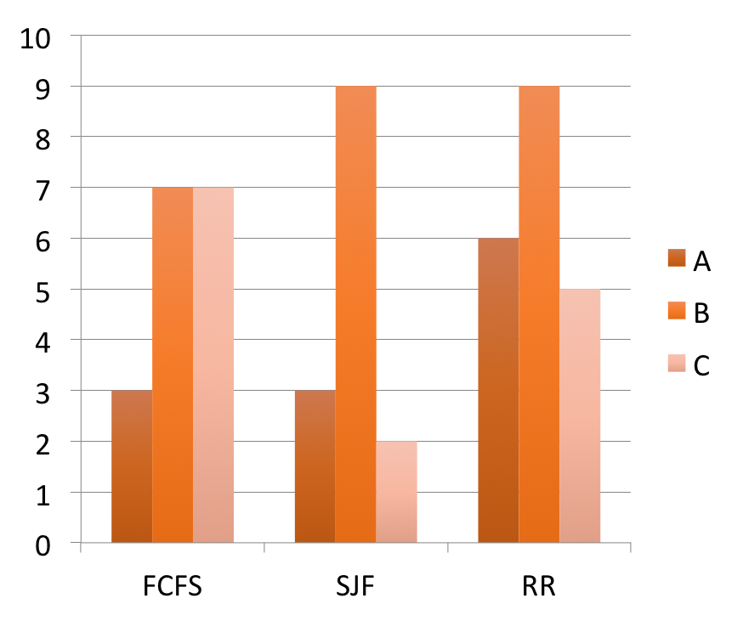
Comparing the Three Policies
Wait time before start
Wait time till done
Amount of work: A:3, B:5, C:2

Slide 32
Priority Scheduling Policy
Priority Scheduling Policy
  Assign each job a priority number (static vs. dynamic)
  Select the job with the highest priority number
  Must have some rule to break ties
Modern CPU schedulers have
  Priorities: Run job with the highest priority
  Round Robin: Alternate among jobs of same priority, preempt a job if it holds CPU too long

Slide 33
CPU Scheduling Policy
Assign priorities to jobs
  Give high priorities to I/O-bound jobs
  Give low priorities to CPU-bound jobs
  Handles I/O-bound and CPU-bound jobs nicely

Slide 34
CPU Scheduling Policy
Challenge: distinguish I/O-bound and CPU-bound
Look at past behavior to predict the future
  Linux: priority of job is function of amount of CPU it has used
Counterintuitive:
  More CPU a job uses/needs, the lower its priority
  The less CPU it uses, the higher its priority
  Avoids starvation problems: Not running gives task a higher priority

Slide 35
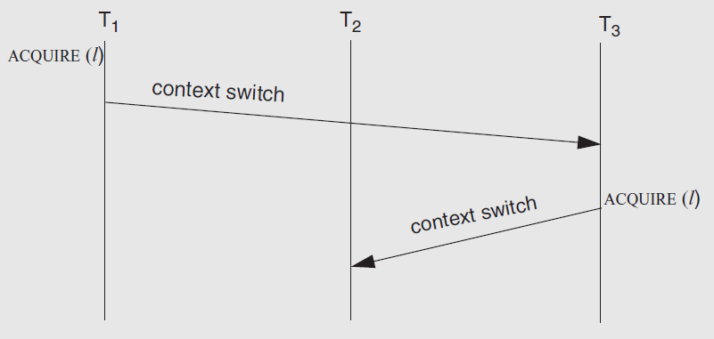
The Priority Inversion Problem
Problem: what if a high priority thread waits for a low priority one which holding a lock?
Solution: priority inheritance

Slide 36
Real-Time Scheduling
Missed deadline = incorrect behavior
Soft real time: Display video frame every 30th of sec
Hard real time: "apply-breaks" process in your car
Scheduling more than one thing: memory, network bandwidth, CPU all at once

Slide 37
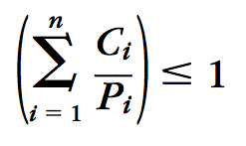
Earliest Deadline First (EDF)
Keep the queue of jobs sorted by deadline
Run the first of the queue
Minimize the total lateness of all the jobs
How to know deadline?
  Specified by tasks themselves
  In the form of (C, P), C for second, P for period
  The scheduler rejects new task if sum(Ci/Pi) > 1

Slide 38
Disk Scheduling: Goals
Minimize time spent waiting on disk mechanisms
  Moving the disk arm
  Waiting for sector to rotate under disk heads
Fairness
  Should not make requests wait too long

Slide 39
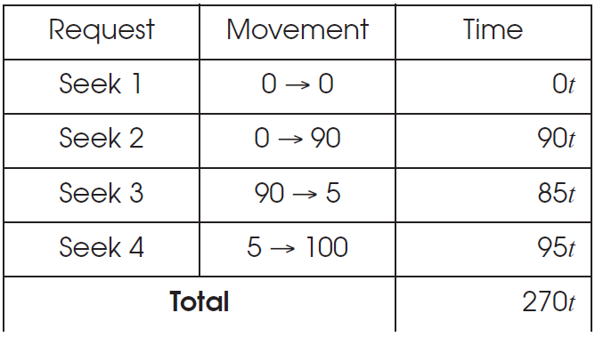
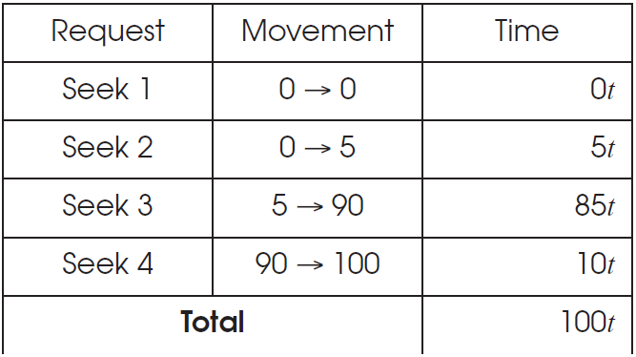
Disk Scheduling
First-come first-serve
Elevator Algorithm

Slide 40
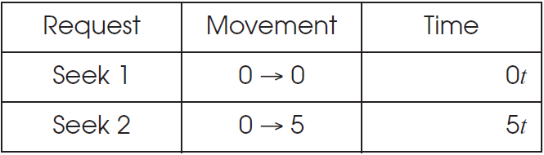
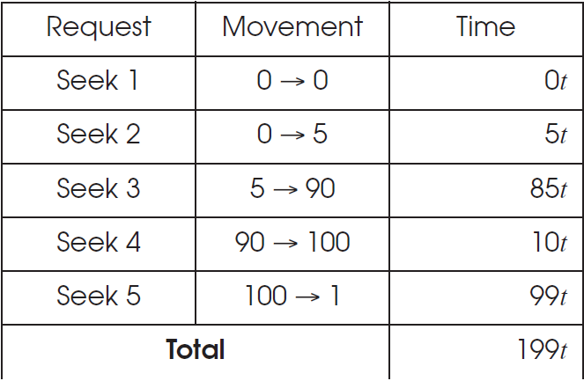
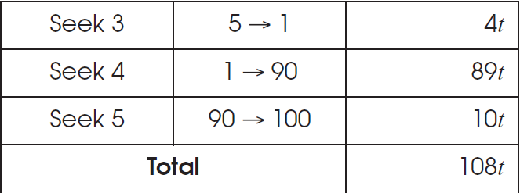
Disk Scheduling
Shortest-Seek-First
Elevator Algorithm

Slide 41
a Highly scalable Website

Slide 42

如何搭一个淘宝？从单机LAMP开始
HTML页面
  应用类课：HTML5/PHP
Web服务器
  ICS课：Apache
文件系统 / 数据库
  CSE课：Ext3 / MySQL
Linux操作系统
  OS课：Linux
LAMP: Linux + Apache + MySQL + PHP

Slide 43
以数据为核心，不同的数据组织形式
数据库
文件系统
键值存储
Session

Slide 44
0. 如何搭一个淘宝？从单机LAMP开始
图片文件
网页服务
价格数据

Slide 45
例：单机文件系统
从用户角度看
  打开、读取、写入、关闭文件的流程
  基本概念的辨析（如: Hard link / soft link、文件名不是文件一部分）
从inode角度看
  FS的数据结构和数据组织形式
  七个层次，每个层次具体的作用
从磁盘角度看
  一次文件访问到底有多少次磁盘操作
  若发生断电，如何保证元数据的一致性
Notes:
主要以what为主

Slide 46
1. 单机到多机：应用与数据分离
  应用服务器 → 需要处理业务逻辑 → 更多的CPU
  数据库服务器 → 磁盘读写缓存服务 → 更快的硬盘，更大的内存
  文件服务器 → 存储大文件图片等 → 更多的硬盘

Slide 47
2. 使用缓存改善服务器性能
例: memcached
  本地服务器缓存： 优：本地，快； 缺点：内存有限，会与应用竞争
  分布式缓存服务器：优：可使用集群，挑选大内存的专用缓存服务器
  系统优化的思路：缓存、fast path/slow patch、替换策略等

Slide 48
分布式缓存服务器：Memcached为例

Slide 49
一致性Hash算法：Key到服务器的映射
问题1：如何根据Key查找到服务器？
方案1：余数hash（简单方案）
问题2：增加物理节点导致大量miss
3台服务器 → 4台，75% miss
反而增加对数据库的访问
解决2：余数hash → 一致性hash
虚拟节点到物理节点的映射
3台服务器 → 4台，25% miss

Slide 50
3. 使用集群改善应用服务器性能
  应用服务器之间需要进行协同，实现并发控制
  Before-or-after、Stateless等

Slide 51
应用服务器：无状态
所有应用服务器均相同，同时提高了容错和可伸缩性

Slide 52
为无状态应用服务器提供状态
引入专门的session
服务器保存状态
（如购物车、登录）

Slide 53
4. 数据库性能和容错：读写分离和分库分表
  主从模式、容错、all-or-nothing、CAP
  例：淘宝和支付宝的差别

Slide 54
5. 使用CDN /
反向代理提
高网站性能
CDN
反向代理
  网络基础知识（包括网络的多个不同层次）
  DNS、BGP路由算法、NAT、TCP拥塞控制、CDN

Slide 55
6. 分布式文件系统
  网络/分布式文件系统
  RPC、NFS服务器无状态

Slide 56
7. 使用NoSQL和搜索引擎（非系统层面）
常用的NoSQL有mongodb、hbase、redis
搜索引擎有lucene、solr、elasticsearch
NoSQL
搜索引擎

Slide 57
8. 将应用服务器进行业务拆分（非系统层面）
  通信通过消息或共享数据库来实现
  如：微服务、Serverless等

