Slide 1

Security
Computer System Engineering, Fall 2020 (IPADS, SJTU)
Data Privacy
Yubin Xia

Slide 2
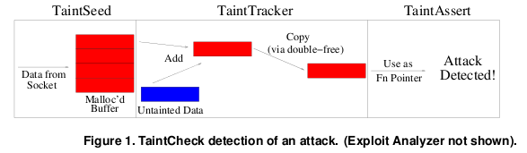
Review: TaintCheck Detection
TaintSeed: Mark untrusted data as tainted
TaintTracker: Track each instruction, determine if result is tainted
TaintAssert: Check is tainted data is used dangerously

Slide 3
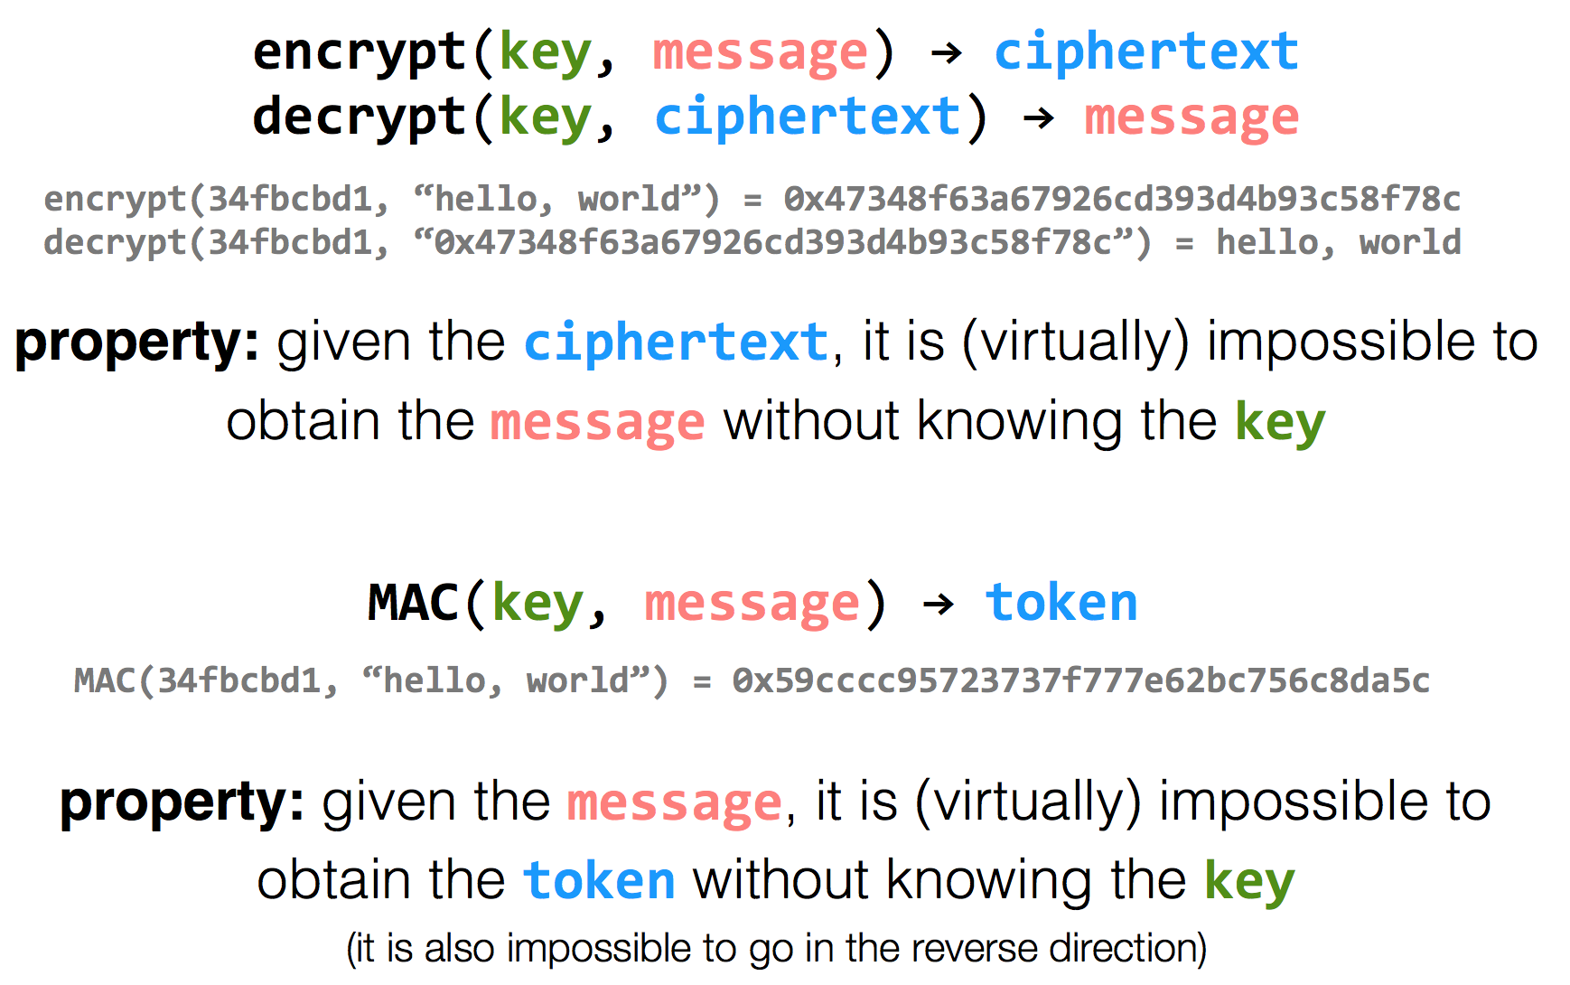
Review: Encryption Properties

Slide 4
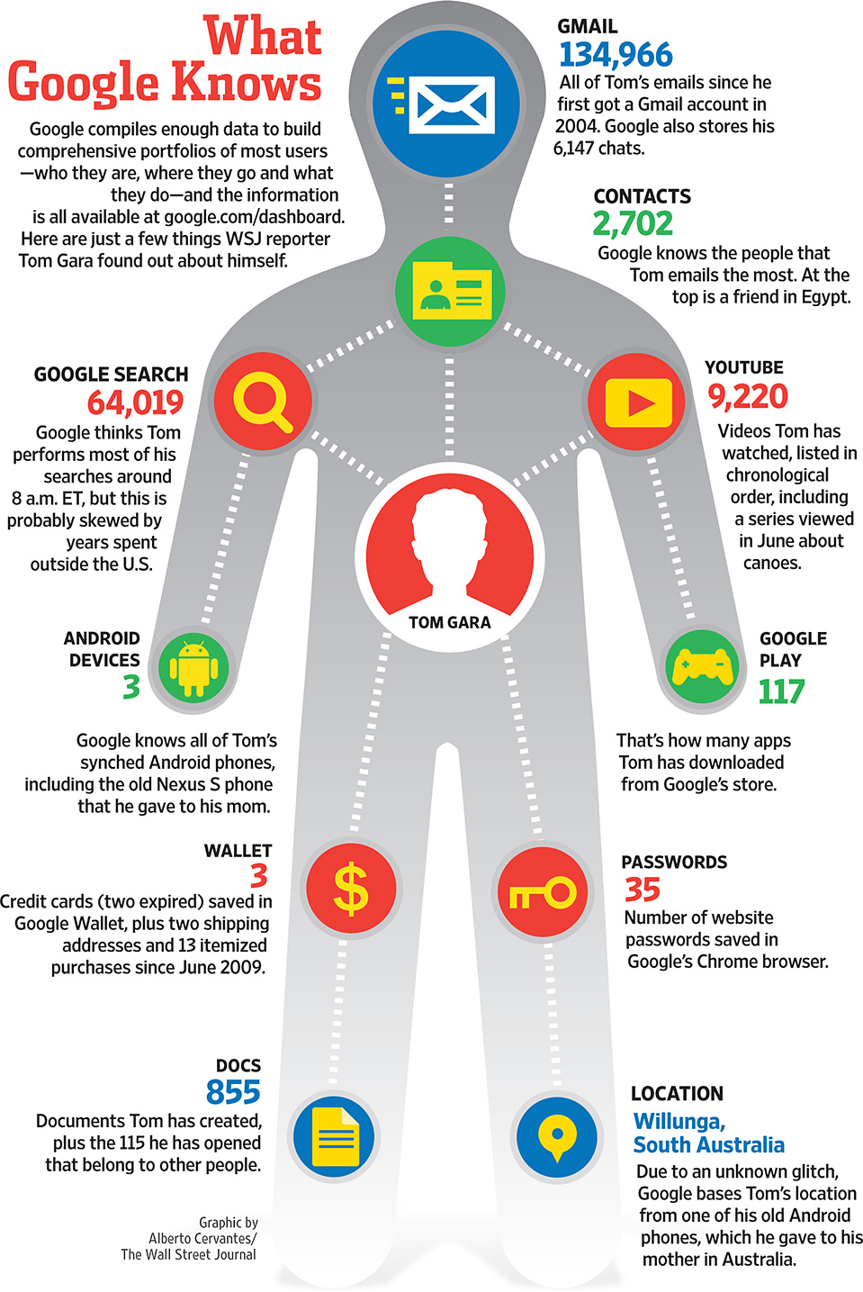

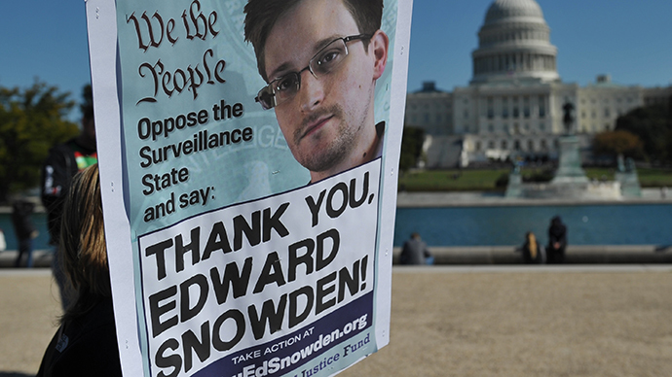
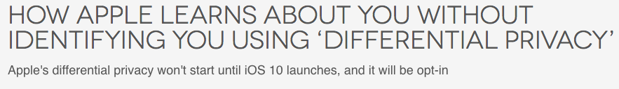

The Price of Free: Privacy

Slide 5
Data Privacy
Data can be used everywhere
  Risk management
  Medicine
  Recommended system
  …
Data can be stolen easily
  Everyone who uses your data can steal it

Slide 6
Common Attacks
An adversary may learn about data:
From ciphertext (ciphertext representation-based attack, e.g., order of values)
From prior knowledge of data distribution (frequency-count attack)
From knowledge of frequency of queries (workload-skew attack)
From the size of the output to a query (output-size attack)
From the access pattern used by the mechanism in answering a query (access-pattern attack)
From knowledge of queries that have executed (search-pattern attack)
Mix with adversarial background knowledge
Data Privacy compromised!!

Slide 7
Data Privacy
Will data be vulnerable to misuse?
What's the target of data privacy system?
  Allow data to be used, and
  Protect data from being stolen
What will be introduced?
  Basic data privacy method
    HE, ZKP, sMPC, SS, OT, GC, DP, TEE, …
  Systems which try to enforce data privacy

Slide 8
Zero-Knowledge Proof

Slide 9


Problem
I have the answer A of the problem P!
It's impossible!
Prove it!
A
Alice
Bob
Alice tries to prove to Bob that she has the answer of a difficult problem (e.g., a NP problem)
Naïve method: Sending A to Bob

Slide 10
Problem
I have the answer A of the problem P!
Thanks!
Now, I have the answer A.
A
Alice
Bob
Alice tries to prove to Bob that she has the answer of a difficult problem (e.g., a NP problem)
Naïve method: Sending A to Bob
  Problem: Bob will get the answer A

Slide 11

Zero-Knowledge Proof (ZKP)
I have the answer A of the problem P!
Thanks!
Now, I have the answer A.
proof
Alice
Bob
Alice tries to prove to Bob that she has the answer of a difficult problem (e.g., a NP problem)
Zero-Knowledge Proof
  Completeness: Alice can construct the proof if she has A
  Soundness: Alice cannot construct the proof if she doesn't have A
  Zero-knowledge: Bob knows nothing about A

Slide 12
Zero-Knowledge Proof (ZKP)
Scenario: Alice has Bob's public key. Alice wants Bob to prove his identity.
Alice
Bob
Bob's public key
Bob's private key
A random value r
E(r)
E(r) ← Enc(r, Key_{prv})
If Dec(E(r), Key_{pub}) → r, then Bob's identity can be proved

Slide 13
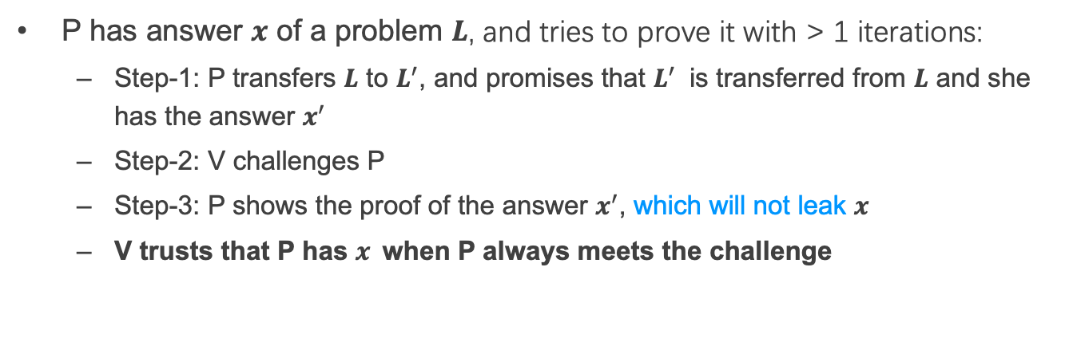
Interactive Zero-Knowledge Proof
I am verifier.
I am prover.
promise
1
challenge
Alice
response
Bob
2
P has answer $x$ of a problem $L$, and tries to prove it with > 1 iterations:
  Step-1: P transfers $L$ to $L^{′}$, and promises that $L^{′}$ is transferred from $L$ and she has the answer $x^{′}$
  Step-2: V challenges P
  Step-3: P shows the proof of the answer $x^{′}$, which will not leak $x$
  V trusts that P has $x$when P always meets the challenge

Slide 14
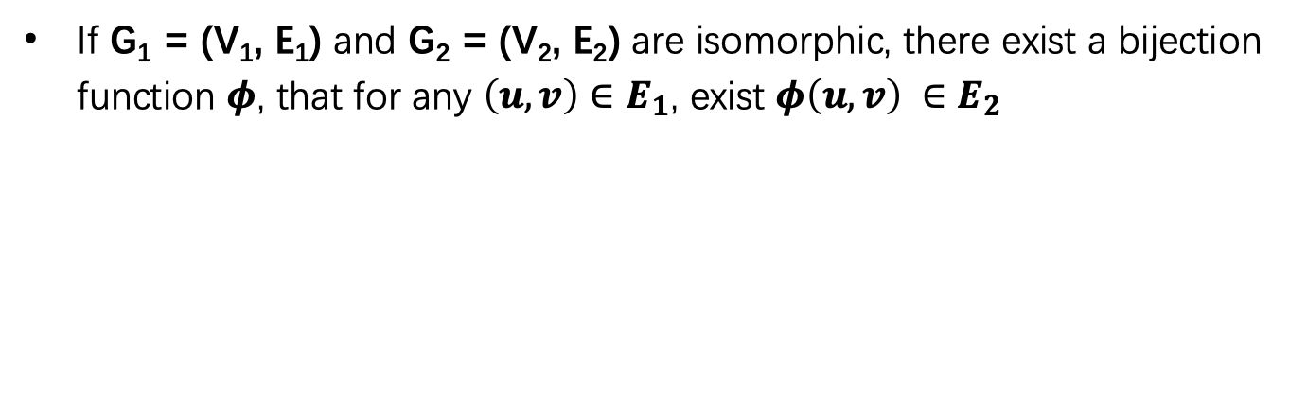
Scenario: Graph Isomorphism
2
1
1
4
2
4
3
3
6
5
5
6
G_{e}
G_{f}
If G₁ = (V₁, E₁) and G₂ = (V₂, E₂) are isomorphic, there exist a bijection function $φ$, that for any $\left(u, v\right)∈E_{1}$, exist $φ\left(u, v\right) ∈E_{2}$

Slide 15
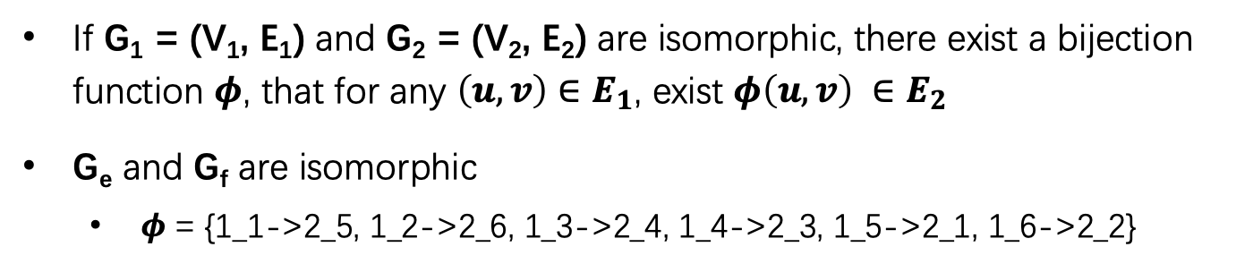

Scenario: Graph Isomorphism
2
1
1
$$G_{e}≃G_{f}$$
4
2
4
3
3
6
5
5
6
G_{e}
G_{f}
If G₁ = (V₁, E₁) and G₂ = (V₂, E₂) are isomorphic, there exist a bijection function $φ$, that for any $\left(u, v\right)∈E_{1}$, exist $φ\left(u, v\right) ∈E_{2}$
G_{e} and G_{f} are isomorphic
  $φ$ = {1_1->2_5, 1_2->2_6, 1_3->2_4, 1_4->2_3, 1_5->2_1, 1_6->2_2}

Slide 16


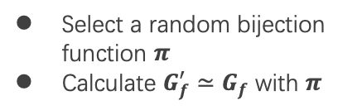

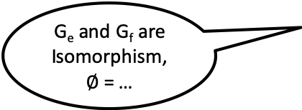


Graph Isomorphism w/ Interactive ZKP
G_{e} and G_{f} are Isomorphism, $∅$ = …
Alice
Bob
Select a random bijection function $π$
Calculate $G_{f}^{′}≃G_{f}$ with $π$
$G_{f}^{′}$ $≃G_{f}$ $≃G_{e}$
Ask Alice to prove ${G_{σ}≃G}_{f}^{′}$
Select a random $σ∈\left\{e, f\right\}$
If $σ$=f, send $π$
If $σ$ = e, send $π∙∅$
Verify that ${G_{σ}≃G}_{f}^{′}$
Require multiple interactions
Notes:
$∅$ Phi

Slide 17
PIR
Private Information Retrieval

Slide 18

Private Information Retrieval (PIR)
I want to know something about cancer.
query
Alice
Server
Alice wants to retrieve a file stored on a server without any information on which file is being retrieved
Naïve method: Download everything from server

Slide 19
Private Information Retrieval (PIR)
Goal: allow user to query database while hiding the identity of the data-items she is after.
Note: hides identity of data-items; not existence of interaction with the user.
Motivation: patient databases; stock quotes; web access; many more....
Paradox(?): imagine buying in a store without the seller knowing what you buy.

Slide 20
Private Information Retrieval (PIR)
Information-Theoretic PIR
  Replicate database among k servers.
  User queries all the servers.
Computational PIR
  Computational privacy, based on cryptographic assumptions.

Slide 21
2-Server PIR
n
0
1
0
0
1
1
0
1
0
0
1
0
S₁
i
S₂
i
U

Slide 22

2-Server PIR
n
0
1
0
0
1
1
0
1
0
0
1
0
S₁
i
S₂
Q₁ subset {1,…,n}
i
U

Slide 23
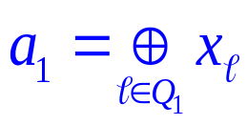
2-Server PIR
n
0
0
1
0
0
1
1
0
1
0
0
1
0
S₁
i
S₂
Q₁ subset {1,…,n}
i
U

Slide 24
2-Server PIR
n
0
0
1
0
0
1
1
0
1
0
0
1
0
S₁
i
S₂
Q₂=Q₁ + {i}
Q₁ subset {1,…,n}
i
U

Slide 25
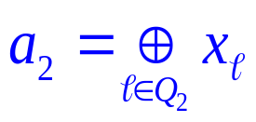
2-Server PIR
n
0
0
1
0
0
1
1
0
1
0
0
1
0
1
S₁
i
S₂
Q₂=Q₁ + {i}
Q₁ subset {1,…,n}
i
U
Weakness: Servers should not collude!

Slide 26
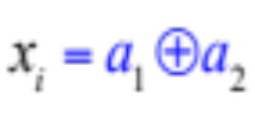
2-Server PIR
n
0
0
1
0
0
1
1
0
1
0
0
1
0
1
S₁
i
S₂
Q₂=Q₁ + {i}
Q₁ subset {1,…,n}
i
U
Notice: Servers should not collude!

Slide 27
OT
Oblivious Transfer

Slide 28
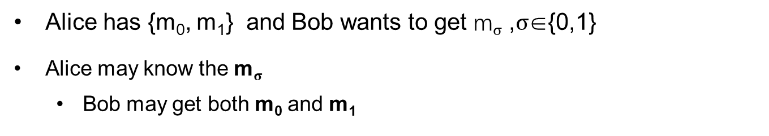
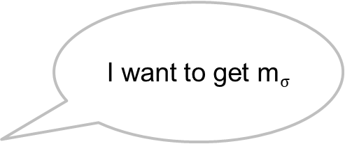
Problem
I have {m₀, m₁}
I want to get m$σ$
Alice
Bob
Alice has {m₀, m₁} and Bob wants to get m$σ$ ,$σ$∈{0,1}
Alice may know the m$σ$
  Bob may get both m₀ and m₁

Slide 29
Oblivious Transfer (OT)
Introduced by Michael O. Rabin, 1981
Scenario: message transfer
  A sender has a message list {m₀, m₁, … , m_{n}}
  A receiver wants to get k target messages from sender
Properties: oblivious and secure
  Oblivious: sender cannot know which messages are received
  Secure: receiver can only get the target messages

Slide 30
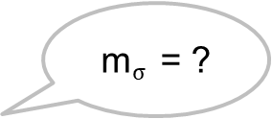
1-out-of-2 OT (Solution-1)
Scenario: RSA encryption
{m₀, m₁}
m$σ$ = ?
Alice
Bob
Generate 2 key pairs {K0_{pub}, K0_{prv}}, {K1_{pub}, K1_{prv}}
K0_{pub}, K1_{pub}
Generate a random number r
c ← Enc(Kσ_{pub}, r)
c
k₀ ← Dec(K0_{prv}, c)
k₁ ← Dec(K1_{prv}, c)
e₀ ← k₀ ⊕ m₀
e₁ ← k₁ ⊕ m₁
e₀, e₁
m_{σ} ← e_{σ} ⊕ r

Slide 31
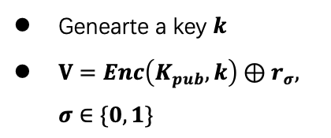


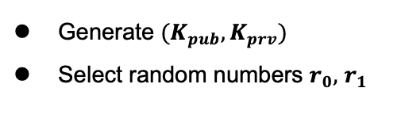

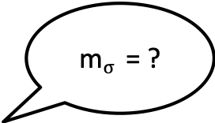
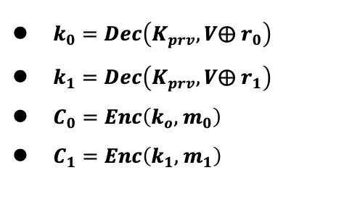

1-out-of-2 OT (Solution-2)
m$σ$ = ?
{m₀, m₁}
Alice
Bob
Generate ${(K}_{pub}, K_{prv})$
Select random numbers $r_{0},$ $r_{1}$
$$K_{pub}, r_{0},r_{1}$$
Genearte a key $k$
$V=Enc\left(K_{pub}, k\right)⊕r_{σ}, σ∈\{0,1\}$
$$V$$
$k_{0}=Dec\left(K_{prv},V⨁{ r}_{0}\right)$
$k_{1}=Dec\left(K_{prv},V⨁{ r}_{1}\right)$
$C_{0}=Enc\left(k_{o}, { m}_{0}\right)$
$C_{1}=Enc\left(k_{1}, { m}_{1}\right)$
$$C_{o},C_{1}$$
$m_{σ} =Dec\left(k, C_{σ}\right)$
Alice分别用两个解密结果加密她的两份消息，将加密结果送给Bob （Ci=E(ki, mi) i=0,1）
Bob用k解密两份密文，得到需要的秘密 s

Slide 32
More OT Protocols
Different numbers of selected messages
  1-out-of-2 OT
  1-out-of-n OT
  k-out-of-n OT
Implementation method
  Non-adaptive OT
  Adaptive OT
  Publicly Verifiable OT
  …

Slide 33
DP
Differential privacy

Slide 34


Problem
Name | Salary
Alice | 100
Bob | 80
Brown | 200
Tom | 120
SUM(Salary)
500
Alice can perform queries on Bob’s database, but cannot access a single database entry

Slide 35
Problem
Name | Salary
Alice | 100
Bob | 80
Brown | 200
Tom | 120
SUM(Salary) where Name == “Tom”
Reject
Alice can perform queries on Bob’s database, but cannot access a single database entry
  Naïve method: reject Alice to access single entry

Slide 36
Problem
Tom has 120
Name | Salary
Alice | 100
Bob | 80
Brown | 200
Tom | 120
SUM(Salary)
500
SUM(Salary) where Name != “Tom”
380
Alice can perform queries on Bob’s database, but cannot access a single database entry
  Naïve method: reject Alice to access single entry

Slide 37
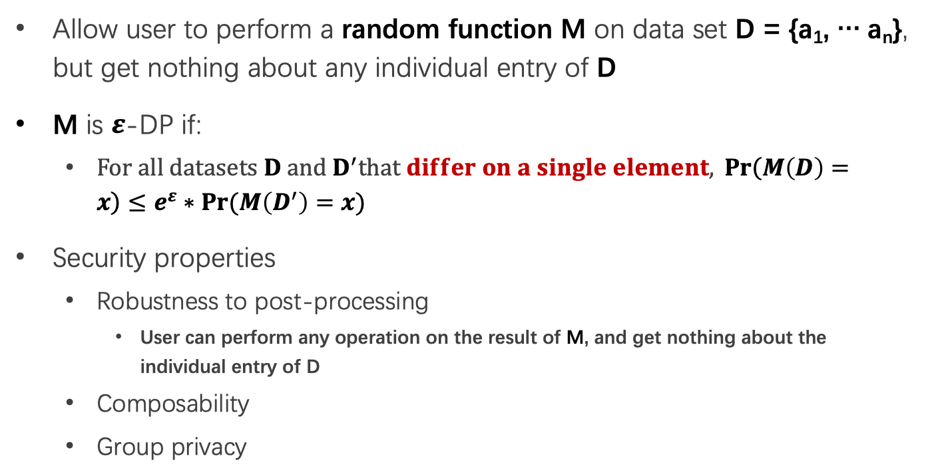
Differential privacy
Allow user to perform a random function M on data set D = {a₁, … a_{n}}, but get nothing about any individual entry of D
M is $ε$-DP if:
  $For all datasets D and D^{′}that differ on a single element,{Pr\left(M\left(D\right)=x\right)}≤e^{ε}∗Pr⁡(M\left(D^{′}\right)=x)$
Security properties
  Robustness to post-processing
    User can perform any operation on the result of M, and get nothing about the individual entry of D
  Composability
  Group privacy

Slide 38
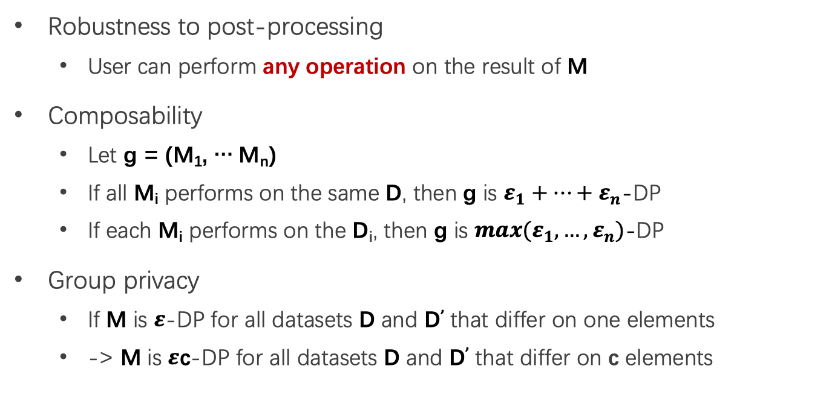
Properties of Differential privacy
Robustness to post-processing
  User can perform any operation on the result of M
Composability
  Let g = (M₁, … M_{n})
  If all M_{i} performs on the same D, then g is $ε_{1}+…+ε_{n}$-DP
  If each M_{i} performs on the D_{i}, then g is ${max(ε}_{1},…,ε_{n})$-DP
Group privacy
  If M is $ε$-DP for all datasets D and D’ that differ on one elements
  -> M is $ε$c-DP for all datasets D and D’ that differ on c elements

Slide 39
How to Implement a DP Algorithm
Adding noisy to the function that we want to compute
  Translate the function f to a random algorithm M
Existing Mechanism
  Laplace mechanism
  Gaussian mechanism
  …

Slide 40
When DP is Enabled
…
Name | Salary
Alice | 100
Bob | 80
Brown | 200
Tom | 120
SUM(Salary)
~480
SUM(Salary) where Name != “Tom”
~480

Slide 41
Secret Sharing

Slide 42
Secret Sharing
Introduced by Adi Shamir, 1979
Key Insight: One point constructs infinite number of lines, two points construct only one line
Key Idea: Split a secret data into n shares, at least k shares can reconstruct the secret ((k,n)-SS)

Slide 43

Secret Sharing
Each part cannot learn the secret S
Secret-Share Creation:
(under the assumption that no part will collude)
share 1
part 1
share 2
secret data S
part 2
share 3
secret owner
share n
part 3
Mathematical operations
f(x) = S + a₁x + a₂x + ... + a_{k-1}x^{k-1}
…
part n

Slide 44
Secret Sharing
Each part cannot learn the secret S
Secret Reconstruction:
(under the assumption that no part will collude)
share 1
part 1
share 2
secret data S
part 2
share k
secret owner
part 3
Lagrange Interpolation
…
part n

Slide 45
Secret Sharing
Each part cannot learn the secret S
Secret Reconstruction:
(under the assumption that no part will collude)
share 1
part 1
secret data S
part 2
share 3
share k
secret owner
part 3
Lagrange Interpolation
…
part n

Slide 46
Pros and Cons
An information-theoretically secure protocol (unconditionally secure, independent of adversary's computational capabilities → quantum-safe)
Ideal assumption (At least k parts never collude)
Communication overhead

Slide 47
Secure MPC
Multi-Party Computing

Slide 48
secure Multi-Party Computation (sMPC)
We want to calculate
f(data₁, data₂)
I have data₁
I have data₂
Alice
Bob
Multiple parties (at least 2) work together to calculate a function
  Enforce the data privacy for each party

Slide 49
Millionaire Problem
Money: Bob has i, Alice has j, i and j are between 1 to 10
Alice
Bob
  Chose a random big integer x
  K = enc{Key_{pub} of Bob, x}
  Decrypt with Key_{prv} of Bob ten number: c+1, c+2...c+10, get y1, y2... y10
  Chose a prime number p
  Calculate d1 = y1 mod p
  For n=i to 10, d_{n}++, other no change
c=K-j
d₁ to d₁₀
  Check dj, if dj == x mod p, then i >= j; else i < j

Slide 50
secure Multi-Party Computation (sMPC)
Semi-honest adversary
  Each party must follow the protocol
Generic protocol
  Can securely compute any functionality
Multi-party computation
  Secret sharing
2-party computation
  GC(Garbled Circuits) + OT(Oblivious Transfer)

Slide 51
Garbled Circuits
Represent functions as Boolean circuits
  Basic gates: AND, OR, NOT
  Adding numbers
  Comparing numbers
  Multiplying numbers
  Computing AES
Represent input and output as wires

Slide 52
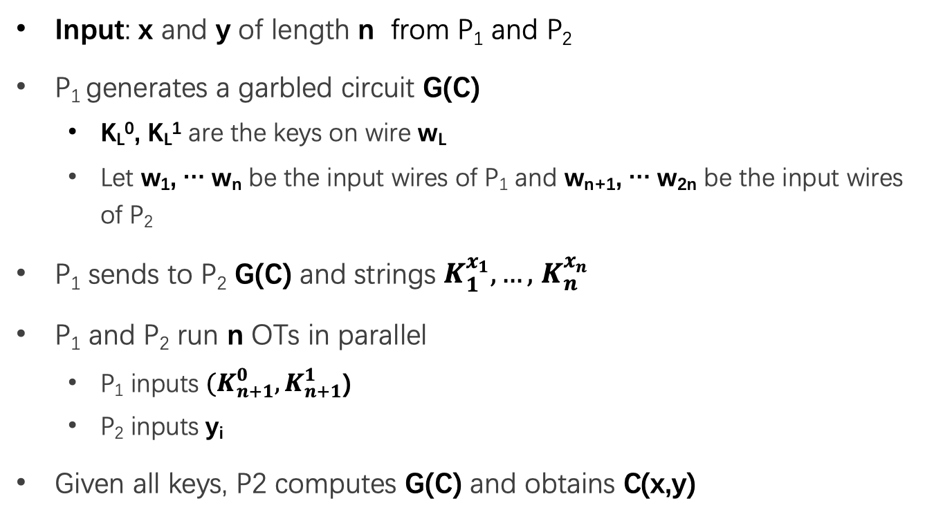
Yao's Protocol
Input: x and y of length n from P₁ and P₂
P₁ generates a garbled circuit G(C)
  K_{L}⁰, K_{L}¹ are the keys on wire w_{L}
  Let w₁, … w_{n} be the input wires of P₁ and w_{n+1}, … w_{2n} be the input wires of P₂
P₁ sends to P₂ G(C) and strings $K_{1}^{x_{1}},…,$ $K_{n}^{x_{n}}$
P₁ and P₂ run n OTs in parallel
  P₁ inputs ${(K}_{n+1}^{0},K_{n+1}^{1}$)
  P₂ inputs y_{i}
Given all keys, P2 computes G(C) and obtains C(x,y)

Slide 53
Different sMPC Protocols
Two-party
  Yao's protocol
  TinyOT protocol
  Obliv-C
Multi-party
  BMR protocol
  GMW protocol
  SPDZ protocol

Slide 54
Homomorphic Encryption

Slide 55

Problem
I have Data!
I have computing resource!
Data
Alice
Bob (cloud)
Alice wants to ask Bob (e.g., a cloud) to perform calculation on her data
Naïve method: Sending Data to Bob

Slide 56
Problem
I have Data!
I have computing resource!
Data
Alice
Bob (cloud)
Alice wants to ask Bob (e.g., a cloud) to perform calculation on her data
Naïve method: Sending Data to Bob
  Bob will get the data

Slide 57
Homomorphic Encryption (HE)
I have Data!
I have computing resource!
Alice
Bob (cloud)
CT=encrypt(Key, Data)
Function f()
CT'= Evaluate(f, CT) = Encrypt(Key, f(Data))
Get f(Data) = Decrypt(Key, CT')

Slide 58
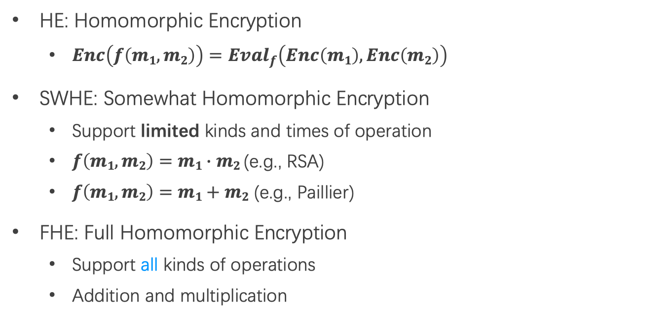
SWHE and FHE
HE: Homomorphic Encryption
  $Enc\left(f\left(m1,m2\right)\right)={Eval}_{f}\left(Enc\left(m1\right), Enc\left(m2\right)\right)$
SWHE: Somewhat Homomorphic Encryption
  Support limited kinds and times of operation
  $f\left(m1,m2\right)=m1∙m2$ (e.g., RSA)
  $f\left(m1,m2\right)=m1+m2$ (e.g., Paillier)
FHE: Full Homomorphic Encryption
  Support all kinds of operations
  Addition and multiplication

Slide 59
TEE
Trusted Execution Environment

Slide 60
Problem
I have Data!
I have computing resource!
Data
Alice
Bob (cloud)
Alice wants to ask Bob (e.g., a cloud) to perform calculation on her data
Naïve method: Sending Data to Bob

Slide 61
Trusted Execution Environment (TEE)
I have Data!
I have computing resource and TEE!
Data
Alice
Bob (cloud)
Alice wants to ask Bob (e.g., a cloud) to perform calculation on her data
Naïve method: Sending Data to Bob
Bob cloud construct a TEE

Slide 62
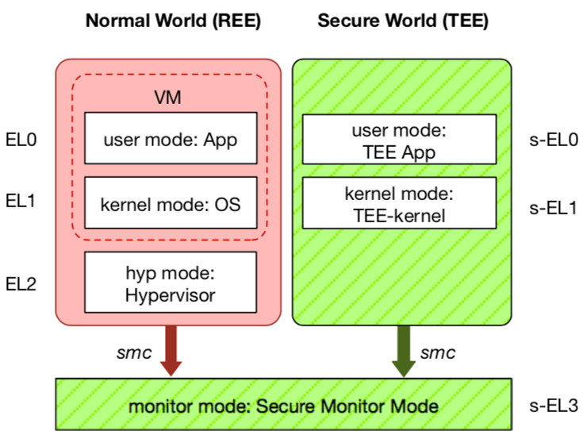
TEE: Trusted Execution Environment
Widely deployed on mobile devices
  Every Android device must deploy TEE
  Mostly based on ARM TrustZone
An isolated & privileged environment
  TEE can access all DRAM & peripherals
  REE cannot access TEE's resources
Designed to be secured and small
  For security-critical tasks (e.g., fingerprint
  checker, mobile payment, etc.)
Notes:
Before presenting virtualization of TEE, let me introduce TEE a little bit.
TEE is short for xxx. It has been widely deployed on mobile devices. Thanks to Google, now every Android phone needs to have TEE to pass Google's test.
On mobile phone, most TEE are based on ARM TrustZone.
TrustZone divides one system to two worlds: xxx and xxx.
The normal world, aka REE, runs rich OS like Android or iOS. It has three layers: one for hypervisor, one for kernel and one for application.
The secure world, aka TEE, has three layers: one for TEE OS and one for TEE applications.
There is a special layer, called monitor mode or s-EL3, is used for switching between the two worlds. It is also part of the secure world but share the same privilege with s-EL1.
The switching is done through smc instruction.
The green part is TEE, which is an isolated environment with higher privileged than the REE.
It means that xxx
The TEE is designed to xxx, its typical usage is xxx.

Slide 63
Different TEEs
Software TEE
  VM-based TEE
  Same privilege protection
ARM TrustZone
Intel SGX
AMD SME/SEV
SANCTUM
Notes:
However, the openness also leads to fragmentation.
Nowadays, there are many different kinds of TEE OS, from different venders.
Also, many other implementations based on OP-TEE.
This is not a good news for trusted app developers, since they need to port and trust.

Slide 64


System: EnclaveDB
TEE: yet another virtual secure co-processor (SGX, TrustZone)
Story: a tale of two databases, just like TrustedDB
Commodity DB
(MS SQL Server)
Transaction
In-Mem DB (Hekaton) 🔑
In-Mem Tables/Indexes
Compiled Queries
eStored Procs
Logging
eResult
Recovery
Users
Query
Compilation
Commodity OS
(Windows)
Trusted Kernel
(threading, memory management, storage)
Commodity CPU
Commodity CPU (SGX)
Storage
Intel Skylake
e/ocall
(Currently) 128M EPC

Slide 65
Comments on EnclaveDB
A follow-up of TrustedDB, but with CPU TEE
Performance degradation due to EPC constraint (like TrustedDB): 40% overhead for TPC-C
Large TCB: 300K Hekaton + 25K trusted kernel
Require rich clients:
  Client compiles SQL to StoreProcs
  Reducing attacks on SQL parsing and compilation

Slide 66
Open Problem
Support complex SQL queries
Support efficient memory and branch-oblivious computations

Slide 67
Summary: Why Data Privacy is Hard?
The more data, the more valuable
  Cause data aggregation
Data can be easily copied
  It's really hard to prevent data copying
  You can withdraw your money from bank, but how to revoke your data from the Internet?
More than tech
  Law, like GDPR in Euro

