Slide 1

Security
Computer System Engineering, Fall 2020 (IPADS, SJTU)
TEE / Enclave
Yubin Xia

Slide 2

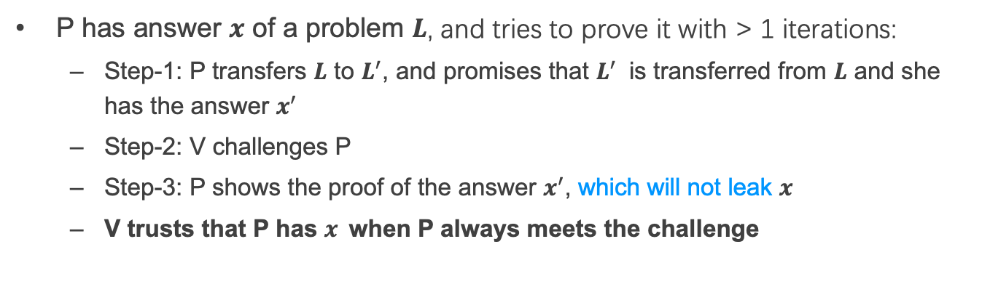
Review: Interactive Zero-Knowledge Proof
I am verifier.
I am prover.
promise
1
challenge
Alice
response
Bob
2
P has answer $x$ of a problem $L$, and tries to prove it with > 1 iterations:
  Step-1: P transfers $L$ to $L^{′}$, and promises that $L^{′}$ is transferred from $L$ and she has the answer $x^{′}$
  Step-2: V challenges P
  Step-3: P shows the proof of the answer $x^{′}$, which will not leak $x$
  V trusts that P has $x$when P always meets the challenge

Slide 3
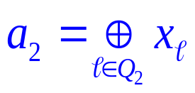
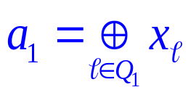

Review: 2-Server PIR
n
0
0
1
0
0
1
1
0
1
0
0
1
0
1
S₁
i
S₂
Q₂=Q₁ + {i}
Q₁ subset {1,…,n}
i
U
Weakness: Servers should not collude!

Slide 4

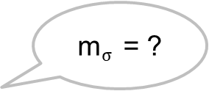
Review: 1-out-of-2 OT
Scenario: RSA encryption
{m₀, m₁}
m$σ$ = ?
Alice
Bob
Generate 2 key pairs {K0_{pub}, K0_{prv}}, {K1_{pub}, K1_{prv}}
K0_{pub}, K1_{pub}
Generate a random number r
c ← Enc(Kσ_{pub}, r)
c
k₀ ← Dec(K0_{prv}, c)
k₁ ← Dec(K1_{prv}, c)
e₀ ← k₀ ⊕ m₀
e₁ ← k₁ ⊕ m₁
e₀, e₁
m_{σ} ← e_{σ} ⊕ r

Slide 5


Review: DP
…
Name | Salary
Alice | 100
Bob | 80
Brown | 200
Tom | 120
SUM(Salary)
~480
SUM(Salary) where Name != “Tom”
~480

Slide 6

Review: Secret Sharing
Each part cannot learn the secret S
Secret Reconstruction:
(under the assumption that no part will collude)
share 1
part 1
secret data S
part 2
share 3
share k
secret owner
part 3
Lagrange Interpolation
…
part n

Slide 7
Review: MPC, the Millionaire Problem
Money: Bob has i, Alice has j, i and j are between 1 to 10
Alice
Bob
  Chose a random big integer x
  K = enc{Key_{pub} of Bob, x}
  Decrypt with Key_{prv} of Bob ten number: c+1, c+2...c+10, get y1, y2... y10
  Chose a prime number p
  Calculate d1 = y1 mod p
  For n=i to 10, d_{n}++, other no change
c=K-j
d₁ to d₁₀
  Check dj, if dj == x mod p, then i > j; else i <= j

Slide 8

Review: Homomorphic Encryption (HE)
I have Data!
I have computing resource!
Alice
Bob (cloud)
CT=encrypt(Key, Data)
Function f()
CT'= Evaluate(f, CT) = Encrypt(Key, f(Data))
Get f(Data) = Decrypt(Key, CT')

Slide 9
Using TEE
Trusted Execution Environment

Slide 10
Problem
I have Data!
I have computing resource!
Data
Alice
Bob (cloud)
Alice wants to ask Bob (e.g., a cloud) to perform calculation on her data
Naïve method: Sending Data to Bob

Slide 11
Trusted Execution Environment (TEE)
I have Data!
I have computing resource and TEE!
Data
Alice
Bob (cloud)
Alice wants to ask Bob (e.g., a cloud) to perform calculation on her data
Naïve method: Sending Data to Bob
Bob's cloud constructs a TEE

Slide 12
What is a TEE?
Trusted Execution Environment
  Isolated from other components, even the OS
  Can be remoted remotely attested, cannot be faked
    One private key embedded in the processor, usually
Also known as enclave
  Can be implemented by hardware or software, or both
TEE is a way to handle system complexity

Slide 13


System: EnclaveDB
TEE: yet another virtual secure co-processor (SGX, TrustZone)
Story: a tale of two databases, just like TrustedDB
Commodity DB
(MS SQL Server)
Transaction
In-Mem DB (Hekaton) 🔑
In-Mem Tables/Indexes
Compiled Queries
eStored Procs
Logging
eResult
Recovery
Users
Query
Compilation
Commodity OS
(Windows)
Trusted Kernel
(threading, memory management, storage)
Commodity CPU
Commodity CPU (SGX)
Storage
Intel Skylake
e/ocall
(Currently) 128M EPC

Slide 14
Comments on EnclaveDB
A follow-up of TrustedDB, but with CPU TEE
Performance degradation due to EPC constraint (like TrustedDB): 40% overhead for TPC-C
Large TCB: 300K Hekaton + 25K trusted kernel
Require rich clients:
  Client compiles SQL to StoreProcs
  Reducing attacks on SQL parsing and compilation

Slide 15
Open Problem
Support complex SQL queries
Support efficient memory and branch-oblivious computations

Slide 16
Summary: Why Data Privacy is Hard?
The more data, the more valuable
  Cause data aggregation
Data can be easily copied
  It's really hard to prevent data copying
  You can withdraw your money from bank, but how to revoke your data from the Internet?
More than tech
  Law, like GDPR in Euro

Slide 17
Enclave and TEE
Trusted Execution Environment

Slide 18
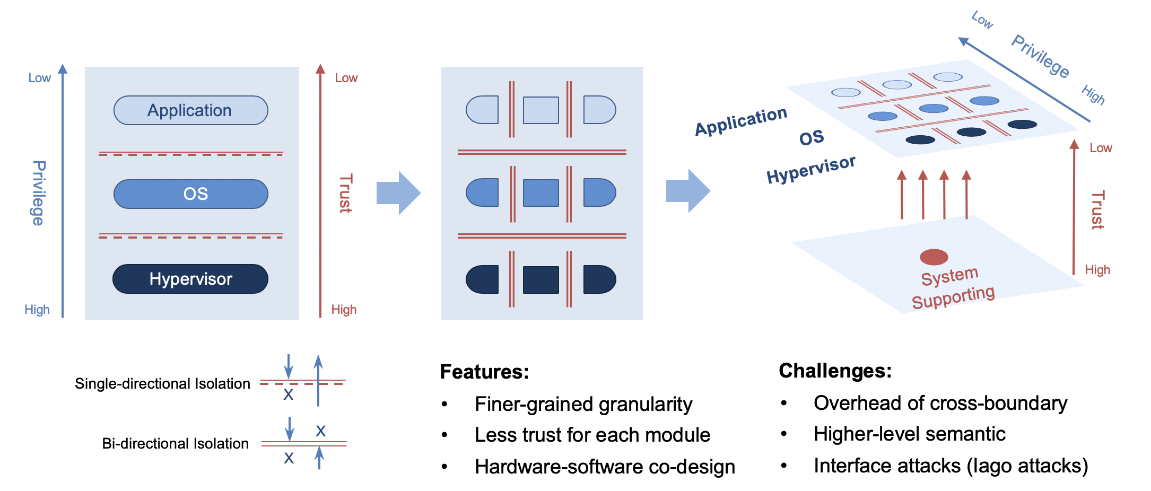
System Isolation

Slide 19
One Type of TEE/Enclave
Enclave
Trusted
Host App
Enclave App
Non-sensitive code/data
Sensitive code/data
User
OS
Supervisor
Hypervisor
Hypervisor
TEE/Enclave extension
Hardware

Slide 20
TEE Classification
By hardware or software?
By access-control or encryption?
System-level or user-level?

Slide 21
Case study: Intel SGX
By hardware, by access-control & encryption, user-level

Slide 22
History of Memory Encryption
AMD SME
Bastion
HyperCoffer
XOM
XOMOS
AEGIS
AISE-BMT
SecureME
Intel SGX
2000
2003
2007
2010
2011
2013
2016
2017
Counter-mode encryption
Merkle-tree based integrity check

Slide 23
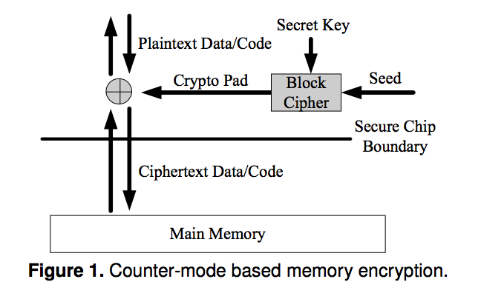
Counter-Mode Encryption
Security: Pad is unique
Approaches:
global counter
block address

Slide 24
Counter-Mode Encryption Problems
Seed with global counter
  Counter reuse
  Large on-chip counter cache storage
Seed with block address
  Physical address may change due to page swap
  Virtual address is vulnerable to pad reuse

Slide 25
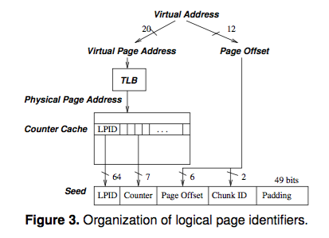
Address Independent Seed Encryption
For each chunk in the memory, its seed is the concatenation of:
  a Logical Page IDentifier (LPID)
  the page offset of the chunk's block
  the block's counter value
  the chunk id.

Slide 26
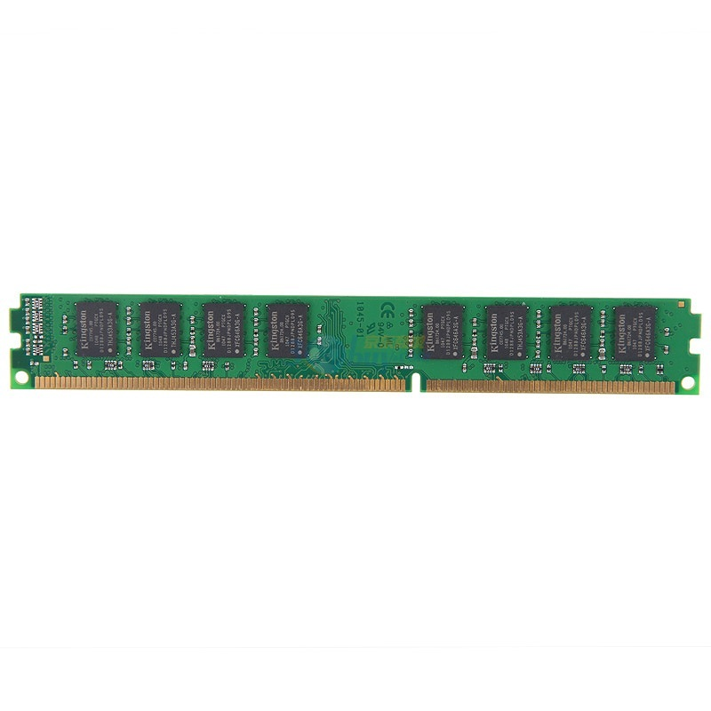
Data Privacy: AISE ^{[Rogers, Micro'07]}
Address
Data Cache
Counter Cache
Data (PlainText)
Counter
Encrypt
XOR
PAD
VM-Key
Secure Processor
Data (CypherText)
Counters
Notes:
AISE is short for address independent seed encryption. It is a technology for data encryption. The main idea is that instead of encrypt/decrypt the data directly, the processor encrypt counters into pad, and then XOR the pad with data for encryption and decryption. Meanwhile, there is a dedicated cache on-chip for the counters to improvement the performance.

Slide 27
Memory Integrity Verification
Replay attacks for simply computing MAC
Merkle tree verification
  Keeps hierarchical MACs organized as a tree
  The root of the tree is stored on-chip
  Verification by checking chain of MAC values up to the root MAC

Slide 28
Merkel Tree for Data Integrity
Secure Processor
Root
Data (CypherText)
Counters
Hash

Slide 29
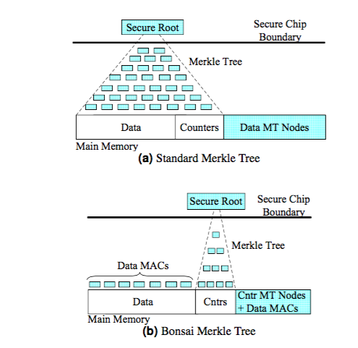
Bonsai Merkle Trees
Each block is protected by its own MAC, computed using a keyed hashing function (e.g. HMAC based on SHA-1),
The block's MAC includes the counter value and address of the block, and
The integrity of all counter values is guaranteed.

Slide 30
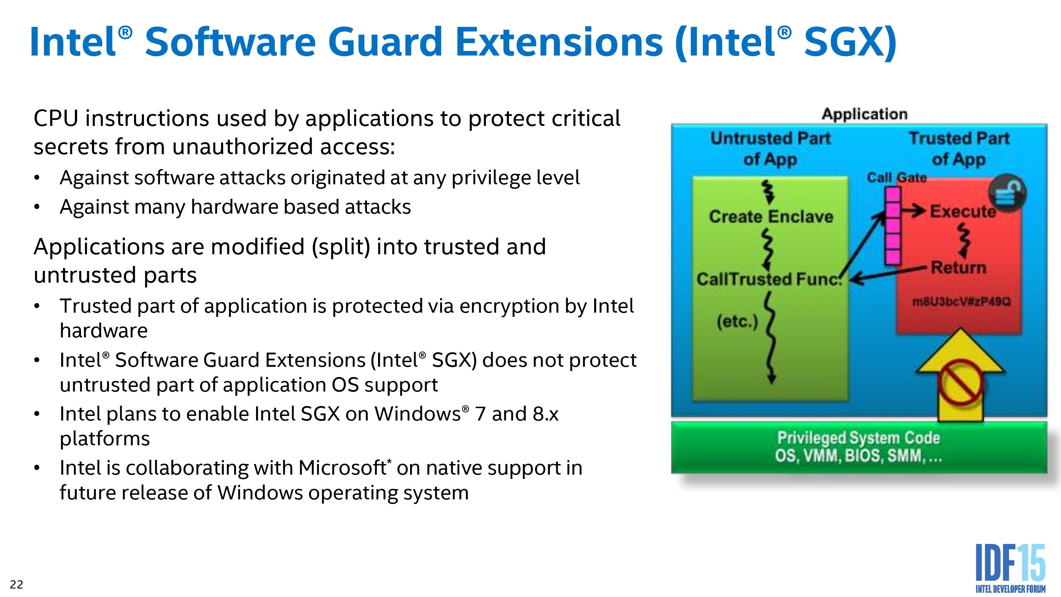

Slide 31
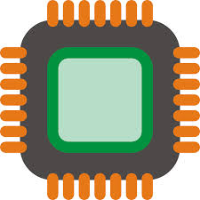

SGX : Isolated Execution
System Memory
CPU Package
Enclave
Access from
OS/VMM
Memory
Encryption
Engine (MEE)
Encrypted
code/data
Snooping
Application keeps its data/code inside the “enclave”
  Smallest attack surface by reducing TCB (App + processor)
  Protect app's secret from untrusted privilege software (e.g., OS, VMM)
Notes:
SGX allows part of application code to run in isolation inside an enclave. The enclave region of the main memory is encrypted. The content is only decrypted inside the CPU package using processor specific keys. Thus, even if a malicious adversary has full control over the hardware, it cannot access/modify the enclave. Also, the enclave is protected from other software running in the host, including the OS and hypervisor. In summary, the TCB is the CPU package and the application code running inside and enclave.

Slide 32
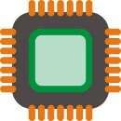



SGX : Remote Attestation
Remote platform
Host platform
Hash
1. Request
2. Calculate
MAC
Target Enclave
Challenger Enclave
CMAC
3. Send MAC
SGX CPU
SGX CPU
Quoting Enclave
4. Verify
6. Send signature
5. Sign with group key [EPID]
Attest an application on remote platform
Check the identity of enclave (hash of code/data pages)
Can establish a “secure channel” between enclaves
Notes:
SGX also support remote attestation. So an enclave program running on a host makes a remote attestation request. The remote platform creates a hash of the enclave or measurement. Then it passes this info to a specially purposed enclave who signs this with a group key. As part of the remote attestation, one can also exchange information, this is often used for Diffie-Hellman key exchange to bootstrap a secure channel between two enclaves.

Slide 33
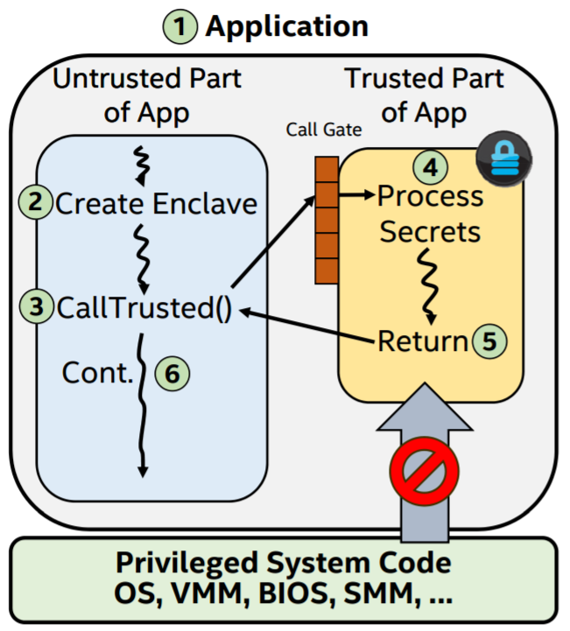
SGX Execution Flow
App built with trusted and untrusted parts
App runs & creates the enclave which is placed in trusted memory
Trusted function is called, execution transitioned to the enclave
Enclave sees all process data in clear; external access to enclave data is denied
Trusted function returns; enclave data remains in trusted memory
Application continues normal execution

Slide 34
Software Architectures of SGX
LibOS
Container
Application
Code Snippet
APP
APP
APP
APP trusted part
LibC interface
APP untrusted part
LibOS
LibC
Libc
Libc
OS
OS
OS
Virtual Machine
Virtual Machine
Virtual Machine
Virtual Machine
Hypervisor
Hypervisor
Hypervisor
Hypervisor
 | Compatibility | TCB Size | Ocall Num | Attack Surface | Protect OS
LibOS | Part | Large | Few | Small | ✔
Container | ✔ | Mid | Mid | Mid | ✘
Application | ✔ | Mid | Many | Large | ✘
Code Snippet | ✘ | Small | Few | Small | ✘

Slide 35
Case Study: ARM TrustZone
By hardware, system-control, system-level

Slide 36
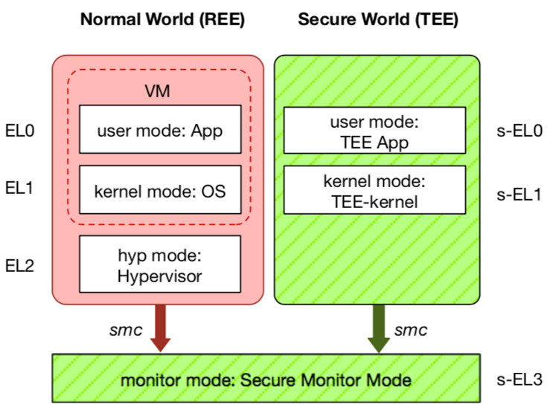
ARM TrustZone
Widely deployed on mobile devices
  Every Android device must deploy TEE
  Mostly based on ARM TrustZone
An isolated & privileged environment
  TEE can access all DRAM & peripherals
  REE cannot access TEE's resources
Designed to be secured and small
  For security-critical tasks (e.g., fingerprint
  checker, mobile payment, etc.)
Notes:
Before presenting virtualization of TEE, let me introduce TEE a little bit.
TEE is short for xxx. It has been widely deployed on mobile devices. Thanks to Google, now every Android phone needs to have TEE to pass Google's test.
On mobile phone, most TEE are based on ARM TrustZone.
TrustZone divides one system to two worlds: xxx and xxx.
The normal world, aka REE, runs rich OS like Android or iOS. It has three layers: one for hypervisor, one for kernel and one for application.
The secure world, aka TEE, has three layers: one for TEE OS and one for TEE applications.
There is a special layer, called monitor mode or s-EL3, is used for switching between the two worlds. It is also part of the secure world but share the same privilege with s-EL1.
The switching is done through smc instruction.
The green part is TEE, which is an isolated environment with higher privileged than the REE.
It means that xxx
The TEE is designed to xxx, its typical usage is xxx.

Slide 37
ARM TrustZone
Trust Application Layer: Trustlets
Secure world
  Running TEE
  Has different privilege
Normal world
  Running REE (Rich Execution
  Environment)
  E.g., Android
However, the data in memory is still in plaintext
  Can we use encrypted data in memory without decryption?
T-IDS
T-Proxy
T-PIN
T-UI
T-FIDO
Middle Layer
TEE
Secure Services
Secure Libraries
Secure Runtime
Kernel Layer
Secure Channel
Secure Drivers
T-Visor
Trusted OS
Inside TEE

Slide 38
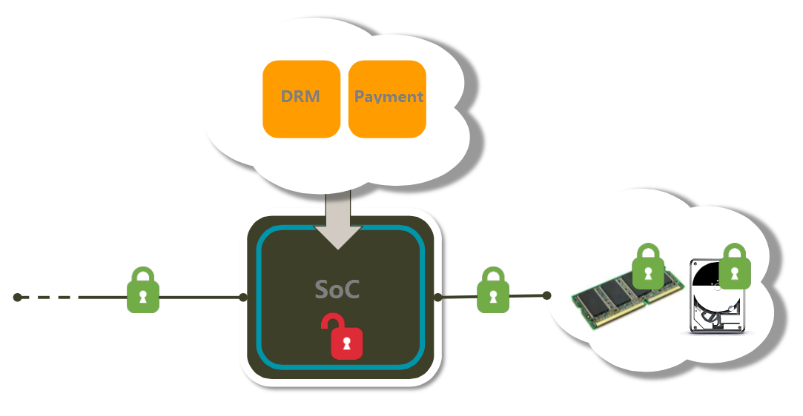
On-chip TEE with Memory Encryption
If space is not enough, "swap-out" to DRAM
On-SoC memory, like SRAM

Slide 39

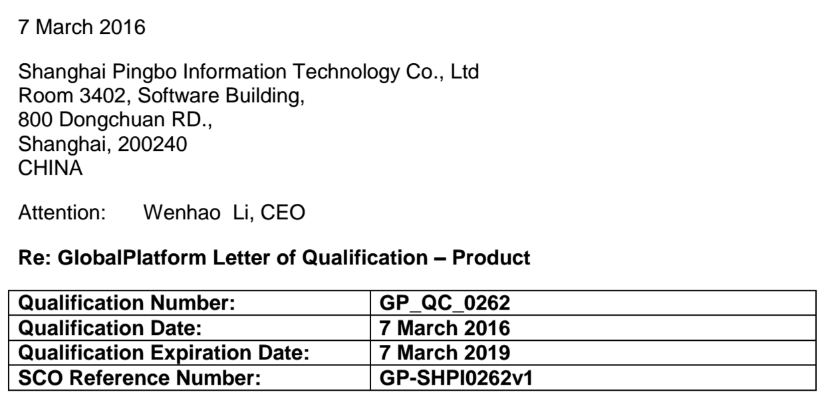
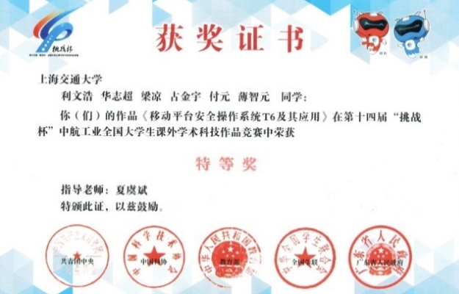
T6: ARM TrustZone OS
专注于操作系统与移动安全的核心技术研发
  2013级学生 利文浩 于2015年初成立（福布斯30U30精英榜）
  基于完全自主开发的移动安全操作系统：T6
  开发过程历时3年，VEE Best Paper
获得国内外知名企业的认可
  与国内外知名企业/机构合作，成为华为官方供应商
产品通过国内外专业机构的检测与安全认证
  获得了2015年挑战杯全国特等奖
  通过GP、工信部TAF、公安部三所等安全认证，实际部署近两亿
GP TEE 认证

Slide 40
Case study: 蓬莱 Enclave

Slide 41
Overview of Penglai
Secure communication channel
Host App
Enclave App
Enclave Service
User
Non-sensitive code/data
Sensitive code/data
FS code/data
ioctl()
Kernel module
OS
Supervisor
SBI interface wrapper
SBI
SBI
Hypervisor(Unused)
Security Monitor
Enclave management
Machine
Trusted
Hardware property:
Memory isolation
Cache partition
Untrusted

Slide 42
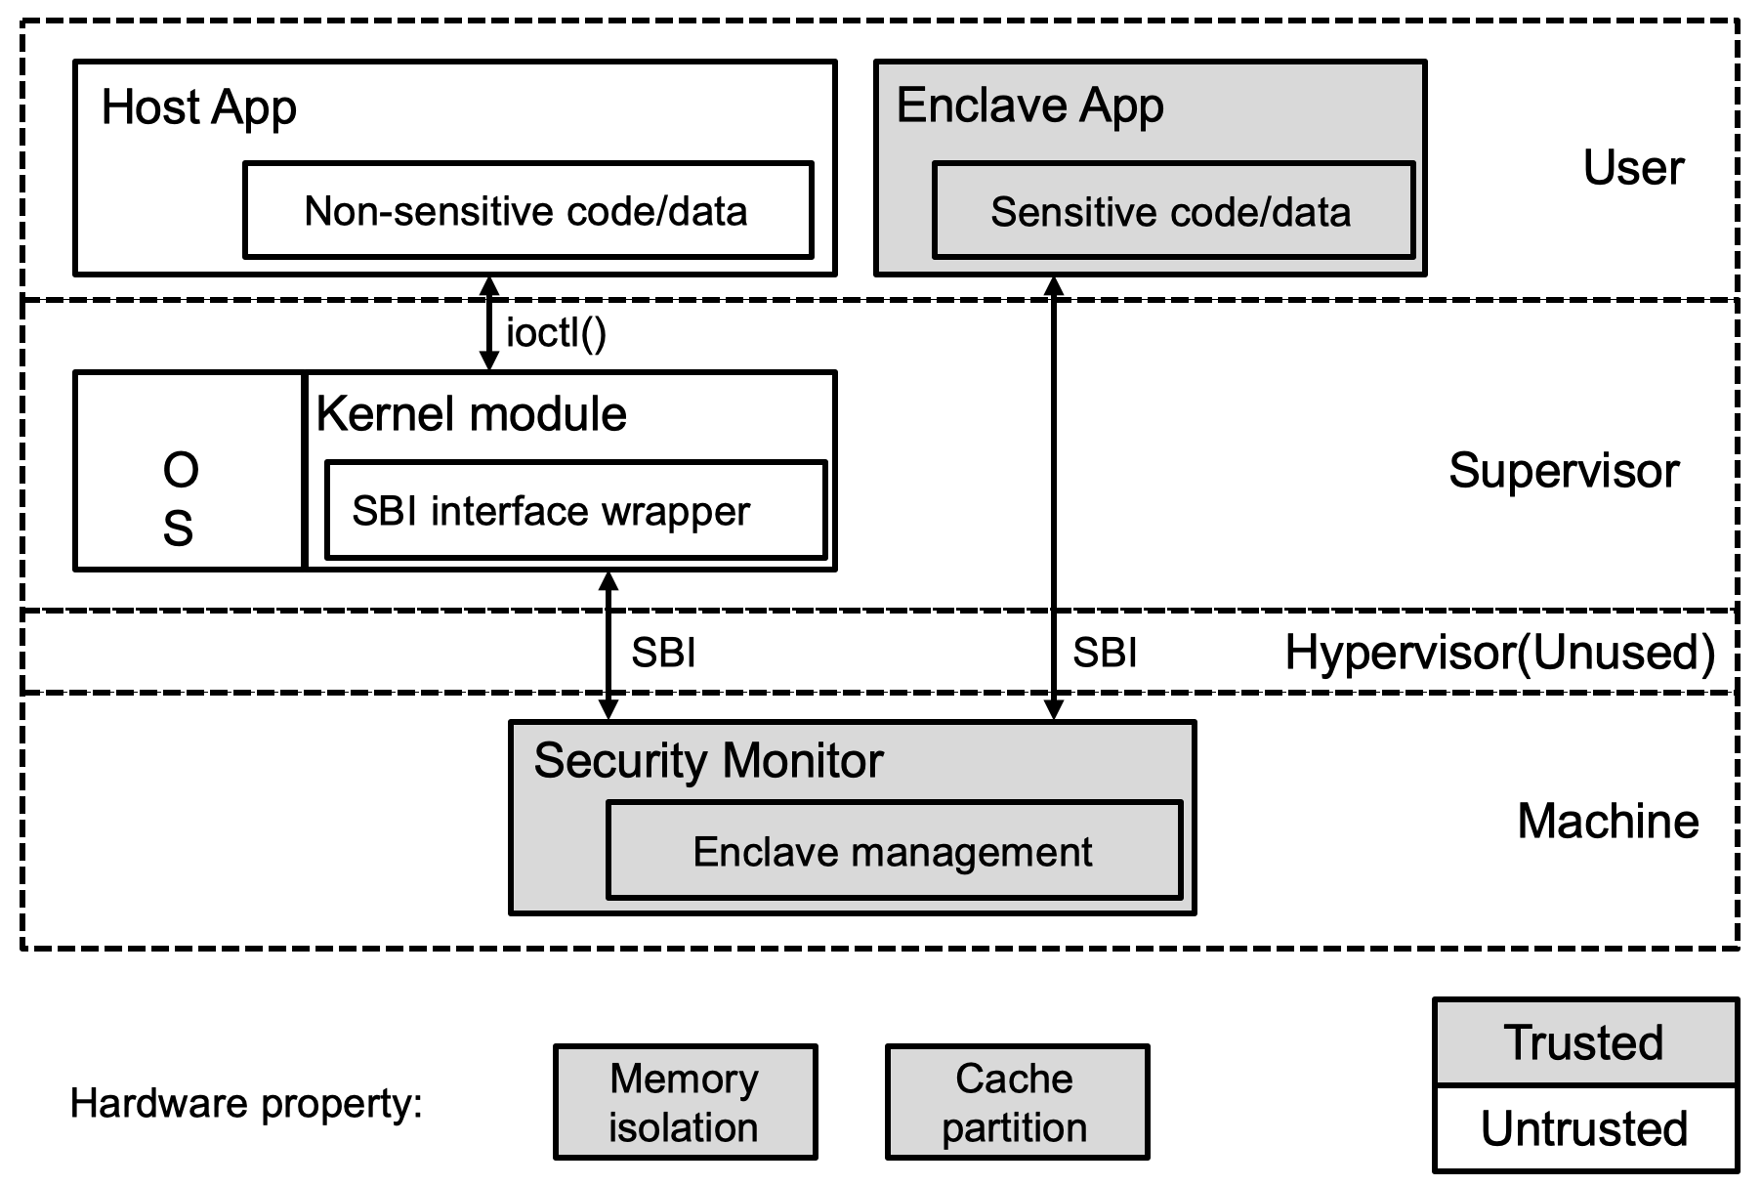
Overview of Penglai
Enclave on RISC-V ISA
Small TCB (Trusted Code Base)
  Only depends on CPU, no trust on external DRAM
  A small secure monitor on the most privileged mode
    Machine mode in RISC-V
  Formal verification on monitor (WIP)
Secure monitor is in charge of:
  Booting enclave and protecting enclave memory from untrusted applications and kernel via CPU features, and
  Providing SBI calls for kernel to use

Slide 43
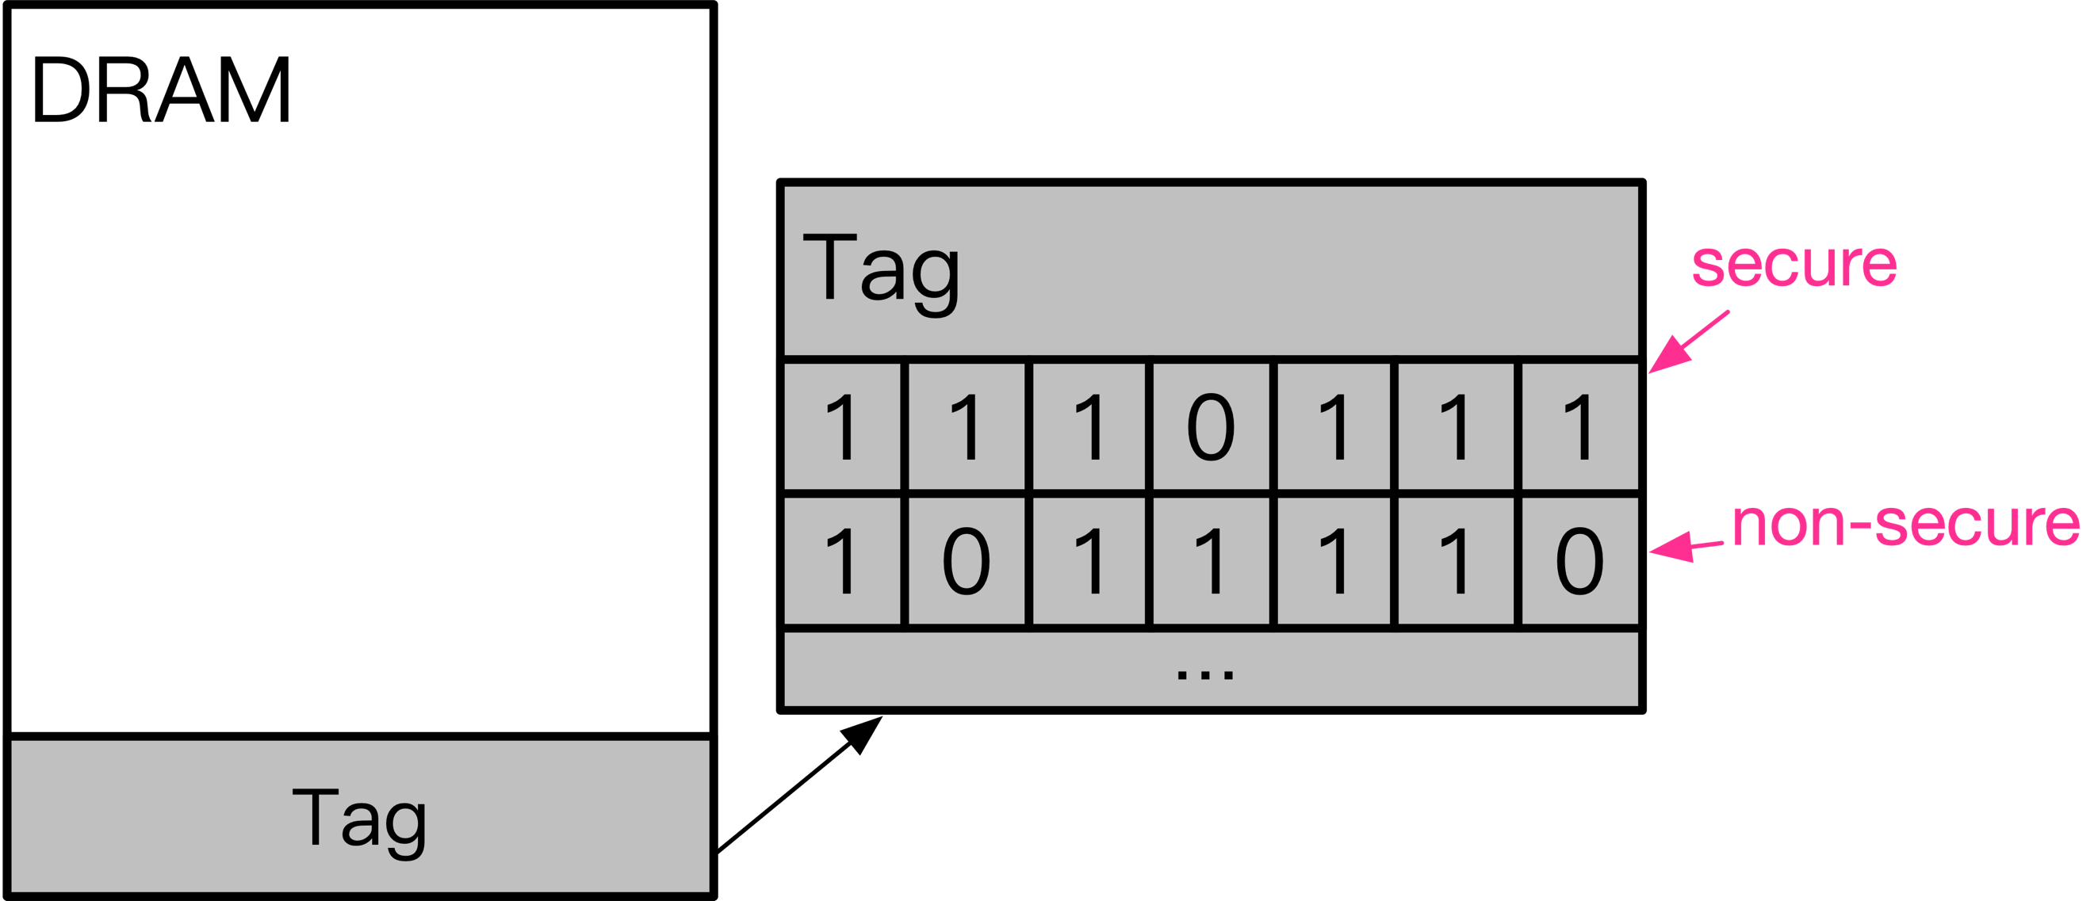
Fine-grained Memory Isolation: Naïve Way
1-bit tag for memory isolation
  Secure monitor reserves a bitmap in DRAM and protects it via PMP
  Each bit in bitmap corresponds to one physical page and indicate whether the page is enclave page
  CPU checks corresponding bit in bitmap before accessing certain physical page to prohibit kernel from accessing enclave memory

Slide 44
Fine-grained Memory Isolation: Naïve Way
Cons:
  Too much modification to hardware
  CPU extension introduces one extra memory access for querying bitmap
  Overhead can be alleviated via tag cache but can not be mitigated and introduces more modification

Slide 45
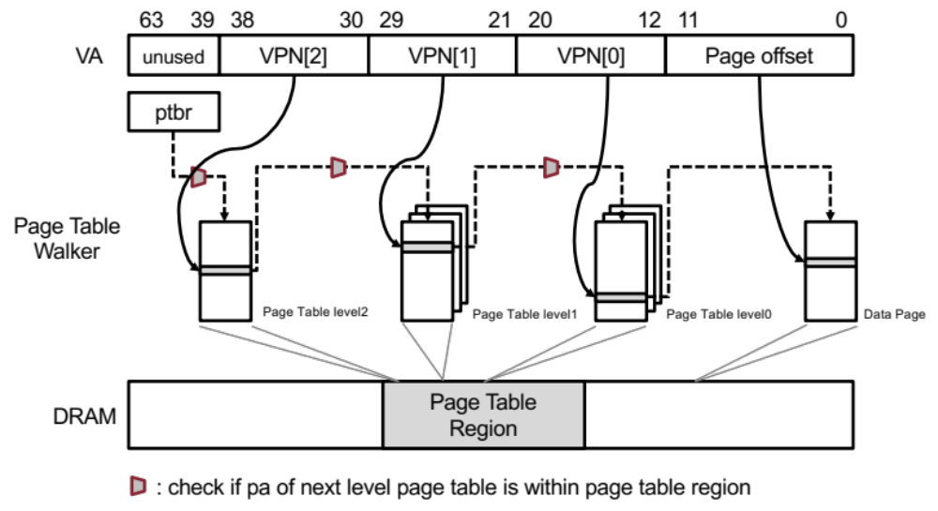
Fine-grained Memory Isolation: Hardware Solution
All unsecure page tables are stored in a reserved memory region (PT_AREA)
  New hardware feature is added in page table walker (PTW)
PT_AREA is isolated from kernel by PMP
OS kernel is still in charge of memory mappings but can not write PT_AREA directly
Secure monitor helps kernel set page table entry and check malicious mappings

Slide 46
Fast IPC
host application
enclave1
call
enclave2
server1
acquire server1
register server
grant handle
bind server name
secure monitor
Secure monitor allows an enclave to register itself as a server with certain name
Then secure monitor will bind the server enclave with its name
Other enclaves can request secure monitor for handle of server enclave with certain name
Then it can call server enclave with the handle

Slide 47
Fast IPC
host application
call
enclave1
call
enclave2
sever1
Penglai supports both host-enclave IPC and enclave-enclave IPC
Penglai supports fast ownership transfer between host and enclave via unmapping pages in PT_AREA, marking enclave pages and remapping them in enclave’s page table
Penglai supports fast ownership transfer between enclaves and enclave via unmapping and remapping pages in each enclave’s page table

Slide 48
Fast IPC
host application
ret
enclave1
ret
enclave2
sever1
Penglai supports both host-enclave IPC and enclave-enclave IPC
Penglai supports fast ownership transfer between host and enclave via unmapping pages in PT_AREA, marking enclave pages and remapping them in enclave’s page table
Penglai supports fast ownership transfer between enclaves and enclave via unmapping and remapping pages in each enclave’s page table
When enclave call is finished, pages’ owner-ship transfer can also happen in the opposite direction

Slide 49
Fast Fork
host application
enclave template1
create template
using certain code
secure monitor
Secure monitor allows host to create an enclave template

Slide 50
Fast Fork
enclave1
host application
enclave template1
enclave2
fast fork
enclave3
secure monitor
Secure monitor allows host to create an enclave template
Then host can request secure monitor to fast boot multiple enclaves based on template
The “fast” is reflected as:
  New enclaves share the read-only code and data segment with template
  Only writable parts are copied or allocated
  Enclave attestation only need to measure those copied/allocated parts

Slide 51
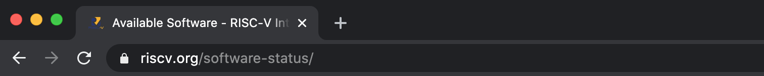
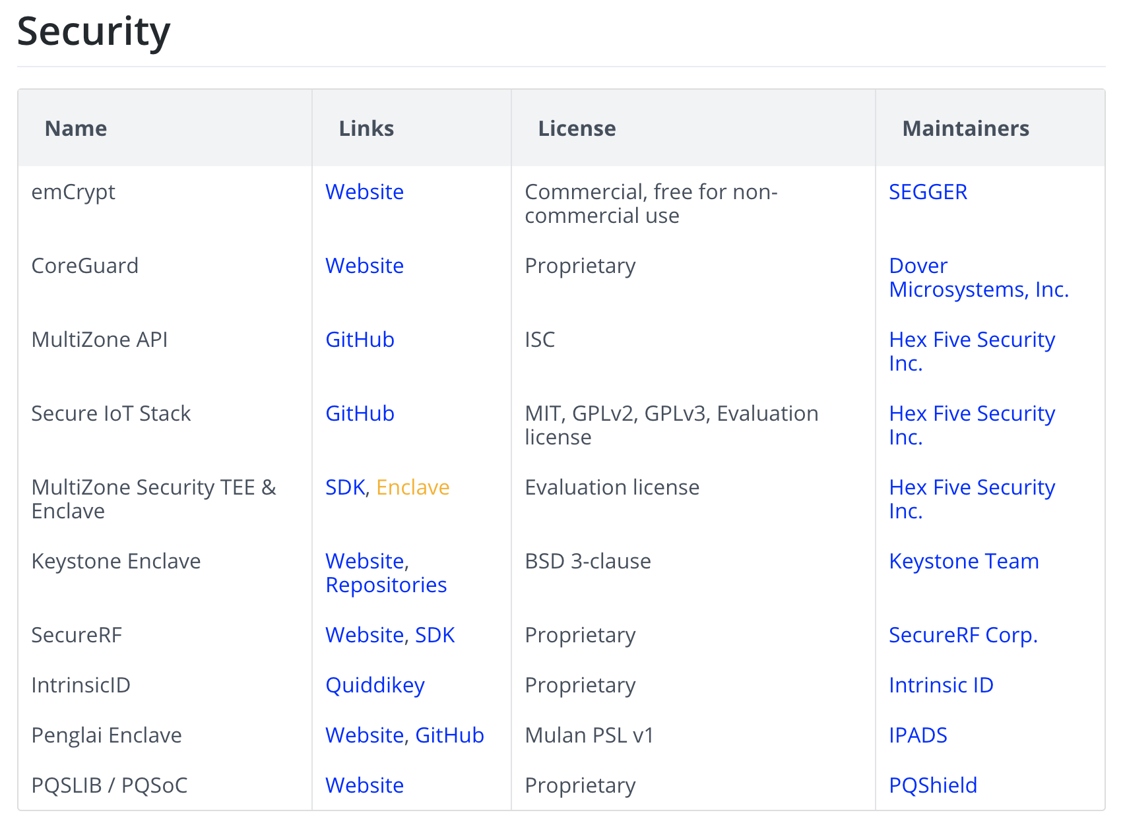
Penglai has been Open-sourced since Dec 2019
http://penglai-enclave.systems/

Slide 52
Still A Long Way to Go...

Slide 53
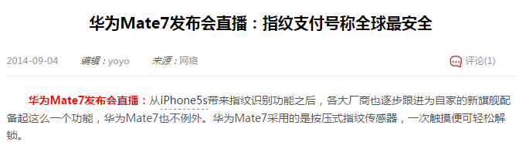
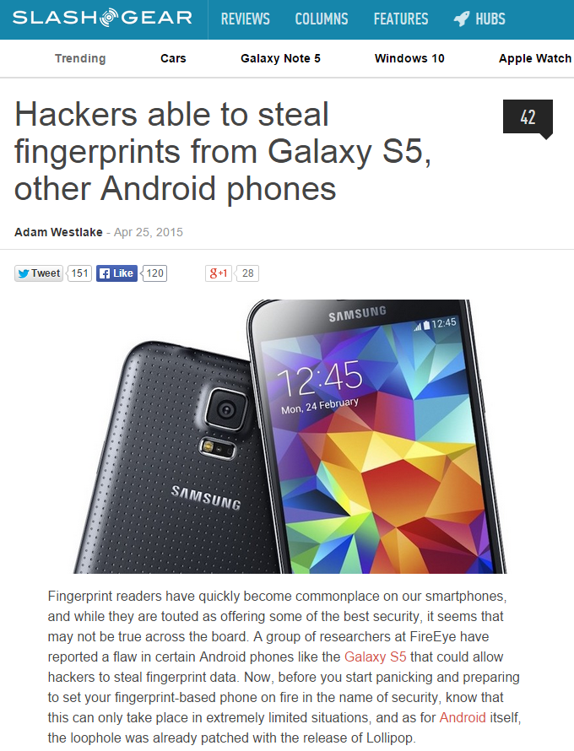
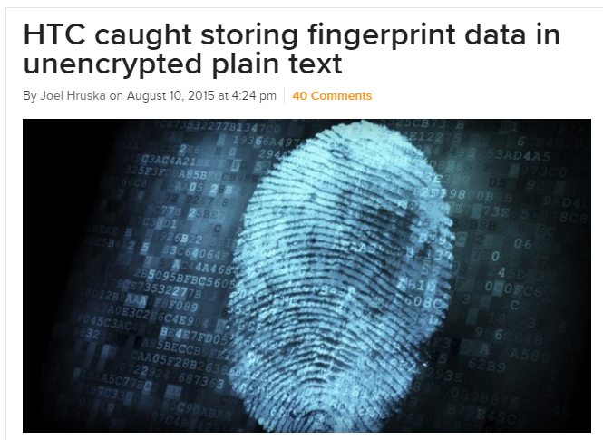

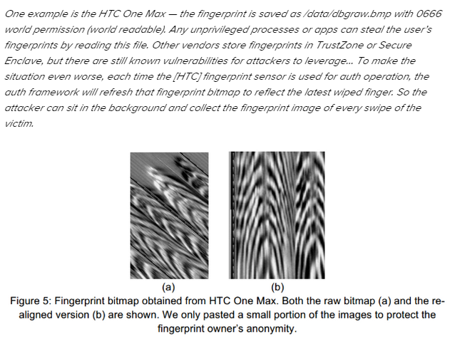
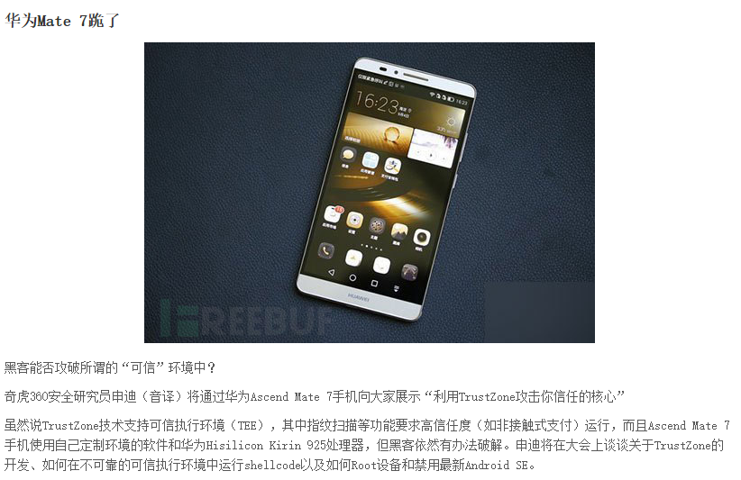
More and More TEE Vulnerabilities
http://www.extremetech.com/mobile/211985-htc-caught-storing-fingerprint-data-in-unencrypted-plain-text

Slide 54

CVE Example: The Boomerang Attack
Boomerang attack
  A time service running in the secure world
    Writing current time to a memory address (as parameter)
  The bug: no check on the address → arbitrary memory writes to REE
    Recall that TEE has higher privilege than REE
    Similar bugs exist in QualComm, Trustonic, SierrawareTEE, Huawei, OP-TEE
Deprivileged TEEs are needed
[NDSS'17] BOOMERANG: Exploiting the Semantic Gap in Trusted Execution Environments
Notes:
Let's show one example: the boomerang attack on 2016 and published on 2017.
In this example, a time service running in the secure world, which will write current time to a memory address which is passed to the service routine as a parameter. The bug, as many bugs, is that the routine forgets to check the range of the address.
Recall that the TEE has highest privilege, it can write to any memory address of the system with the value of current time, which can also be controlled.
Similar bugs are found in various TEE OS.
Thus, we argue that TEE should be deprivileged, otherwise a breached TEE may do arbitrary writing.

Slide 55
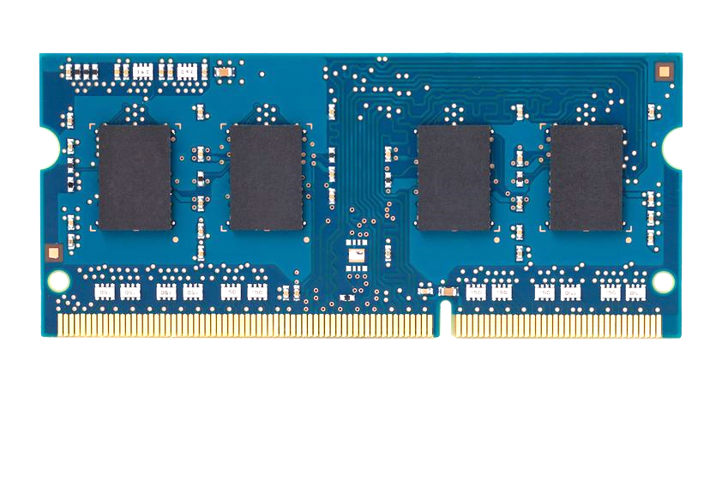
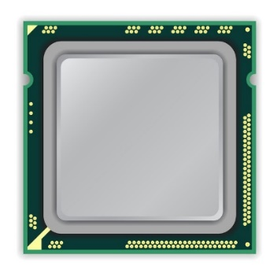
How to Induce Errors
x86 CPU
DRAM Module
DDR3
Avoid cache hits
  Flush X from cache
Avoid row hits to X
  Read Y in another row
111111111
X
111111111
111111111
111111111
Y
111111111
111111111
Notes:
This is the setup of the system where we induce disturbance errors. It has an x86 processor connected to a DRAM module, which is initially populated with a known data-pattern – in this case, all ‘1’s. Our goal, is to construct a program that repeatedly toggles the row at address X.
However, this cannot be achieved just by issuing many loads to address X. This is because of two reasons. First, cache hits in the processor prevent the load from reaching DRAM. But we can avoid this by flushing X from the cache. Second, when there are consecutive accesses to the same row, the processor keeps the row open without closing it. But we can avoid this by interleaving accesses to two different rows: X and Y.

Slide 56
How to Induce Errors
x86 CPU
DRAM Module
DDR3
loop:
mov (X), %eax
mov (Y), %ebx
clflush (X)
clflush (Y)
mfence
jmp loop
001110111
111111111
X
111111111
1111
111111111
101111101
110001011
111111111
Y
1111
111111111
011011110
111111111
Notes:
This is the assembly code that behaves precisely in the manner that I just described. It first opens row X and fetches a cacheline into the processor. But since the next access is to a different row, the processor is forced to close row X before opening row Y. And from row Y, another cacheline is fetched. Subsequently, the two flush instructions evict the cachelines from the processor. Each iteration of the code toggles the two rows X and Y, and after many iterations, many errors appear in adjacent rows.

Slide 57


Rowhammer
Row Buffer
Row 1
0
1
1
1
Row 2
Row 3
Row 4

Slide 58
Rowhammer
Row Buffer
Row 1
0
1
1
1
Row 2
Row 3
Row 4

Slide 59
Rowhammer
Row Buffer
Row 1
0
0
1
1
Row 2
Row 3
Row 4

Slide 60
Number of Disturbance Errors
In a more controlled environment, we can induce as many as ten million disturbance errors
Disturbance errors are a serious reliability issue
CPU Architecture | Errors | Access-Rate
Intel Haswell (2013) | 22.9K | 12.3M/sec
Intel Ivy Bridge (2012) | 20.7K | 11.7M/sec
Intel Sandy Bridge (2011) | 16.1K | 11.6M/sec
AMD Piledriver (2012) | 59 | 6.1M/sec
Notes:
When we executed the code on four different processors, all four of them yielded errors. Intel Haswell has the most errors, at 23 thousand, because it has the highest rate of accessing DRAM.
Later on, I’ll show that we can induce as many as ten million disturbance errors in a more controlled environment.
From this, we conclude that disturbance errors are a serious reliability issue.

Slide 61
Side Channel Attacks

Slide 62
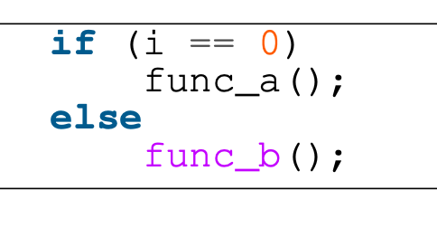
Cache Cache Channel
Infer information from pattern
  Which one is in cache?
  func_a or func_b -> i is 0 or 1
Four common types
  Flush+reload
  Flush+flush
  Prime+probe
  Evict+time

Slide 63
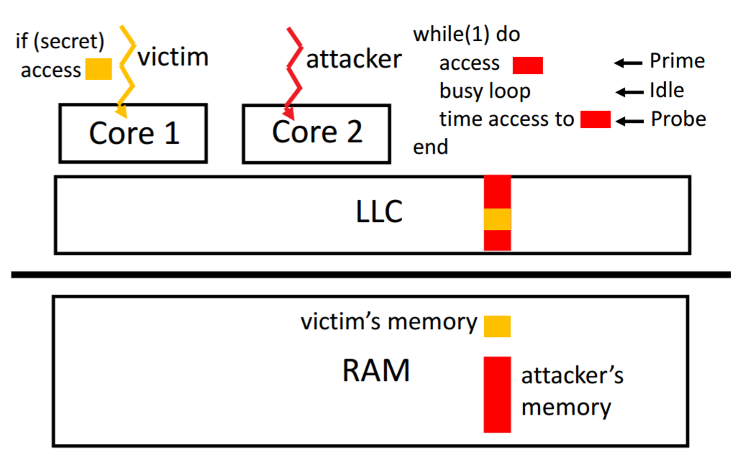
The PRIME+PROBE Attack

Slide 64
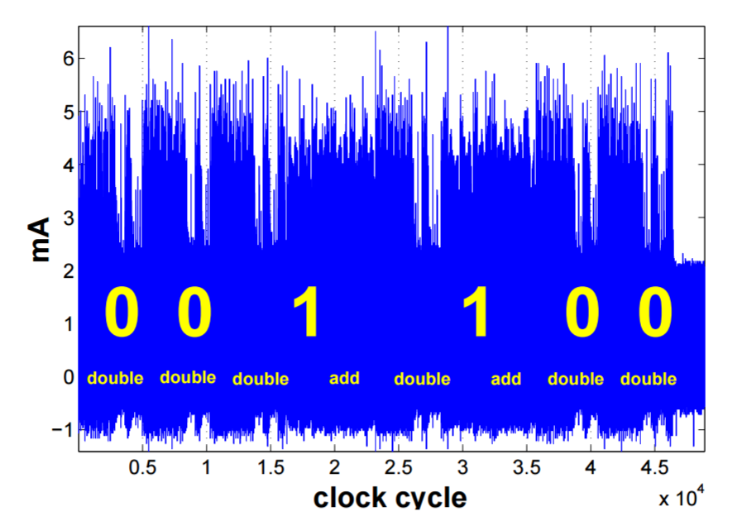
Cache Side-channel Attack
An attacker uses the side-channel information from one measurement directly to determine (parts of) the secret key
A simple analysis attack exploits the relationship between the executed operations and the side-channel information

Slide 65
Meltdown
    Break user/kernel isolation
Allow attacker to read arbitrary kernel data
    Hardware bug in architecture
Hard to be fixed by micro-code patch
    Exist in almost all Intel CPUs produced in past 20 years

Slide 66


Meltdown
key = 0x01
Mapped with kernel privilege in page table
Kernel
User
Access key
Permission Error!

Slide 67

Meltdown
key = 0x01
Mapped with kernel privilege in page table
Kernel
User
Meltdown
Can access key!

Slide 68



Meltdown
CPU
Instruction
Effect
Cache
Memory
key = 0x01
Kernel
User
Meltdown

Slide 69
Meltdown
CPU
Instruction
Effect
Permission Error!
1
Load key, %rax
%rax = 1
Reorder
Execution
Load buf[%rax], %rbx
Access buf[1]
2
Cache
Memory
key = 0x01
Kernel
Key = 1
… | buf[0] | buf[1] | buf[2] | … | buf[n] | …
User
Meltdown
buf
(Attack buffer)

Slide 70
Meltdown
CPU
Instruction
Effect
Permission Error!
1
Load key, %rax
%rax = 1
Reorder
Execution
Load buf[%rax], %rbx
Access buf[1]
2
Rollback status
w/o cache status!
Exception
3
Cache
Memory
key = 0x01
Kernel
2
Key = 1
buf[1]
… | buf[0] | buf[1] | buf[2] | … | buf[n] | …
2
User
Access
buf[1]
Fill buf[1]
to cache
Meltdown
buf
(Attack buffer)

Slide 71
Meltdown
CPU
Instruction
Effect
Permission Error!
1
Load key, %rax
%rax = 1
Attacker finds that buf[1] is in the cache, so that key equals to 1!
Reorder
Execution
Load buf[%rax], %rbx
Access buf[1]
2
Rollback status
w/o cache status!
Exception
3
Cache
Memory
key = 0x01
Kernel
2
Key = 1
buf[1]
… | buf[0] | buf[1] | buf[2] | … | buf[n] | …
2
User
Access
buf[1]
Fill buf[1]
to cache
Meltdown
buf
(Attack buffer)

Slide 72
Existing Solution
    KPTI (Kernel Page Table Isolation)
Two page tables for user and kernel space
  User page table only maps user space
  Kernel page table maps both user and kernel space
Switch the page table during user/kernel switching
  Add latency to syscalls, signal handler,…
Not suitable for the cloud environment

Slide 73
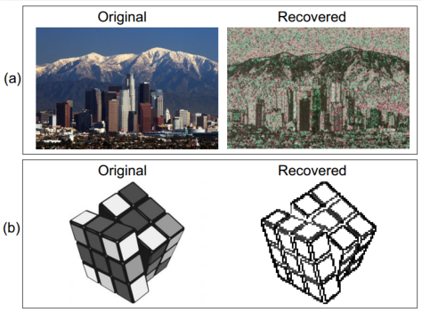
SGX's Vulnerabilities
Side channel attack
  Malicious OS still controls page fault handler
  If know the photo processing algorithm, can get the image by monitoring page fault
  Not 100% accurate, but still good enough

Slide 74
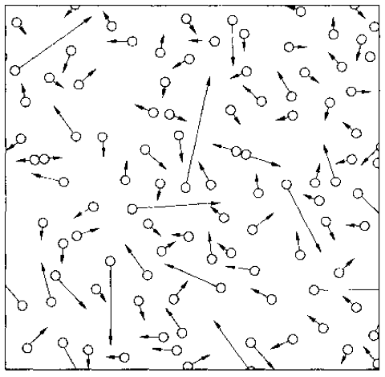
Summary
Complexity is inevitable
  From one node to multiple nodes
  From hundreds of LoC to millions of LoC
  From reliable environment to unreliable environment
  From trusted components to untrusted components
New properties from system's perspective
  All-or-nothing, before-or-after, isolation, throughput, latency, utilization, fault tolerance, security, scalability, TCB...

