Slide 1

Scalability in Practice
Computer System Engineering, Fall 2020 (IPADS, SJTU)
Put all together
Yubin Xia

Slide 2
a Highly scalable Website

Slide 3

如何搭一个淘宝？从单机LAMP开始
HTML页面
  应用类课：HTML5/PHP
Web服务器
  ICS课：Apache
文件系统 / 数据库
  CSE课：Ext3 / MySQL
Linux操作系统
  OS课：Linux
LAMP: Linux + Apache + MySQL + PHP

Slide 4
以数据为核心，不同的数据组织形式
数据库
文件系统
键值存储
Session

Slide 5
0. 如何搭一个淘宝？从单机LAMP开始
图片文件
网页服务
价格数据

Slide 6
例：单机文件系统
从用户角度看
  打开、读取、写入、关闭文件的流程
  基本概念的辨析（如: Hard link / soft link、文件名不是文件一部分）
从inode角度看
  FS的数据结构和数据组织形式
  七个层次，每个层次具体的作用
从磁盘角度看
  一次文件访问到底有多少次磁盘操作
  若发生断电，如何保证元数据的一致性
Notes:
主要以what为主

Slide 7
1. 单机到多机：应用与数据分离
  应用服务器 → 需要处理业务逻辑 → 更多的CPU
  数据库服务器 → 磁盘读写缓存服务 → 更快的硬盘，更大的内存
  文件服务器 → 存储大文件图片等 → 更多的硬盘

Slide 8
2. 使用缓存改善服务器性能
例: memcached
  本地服务器缓存： 优：本地，快； 缺点：内存有限，会与应用竞争
  分布式缓存服务器：优：可使用集群，挑选大内存的专用缓存服务器
  系统优化的思路：缓存、fast path/slow patch、替换策略等

Slide 9
分布式缓存服务器：Memcached为例

Slide 10
一致性Hash算法：Key到服务器的映射
问题1：如何根据Key查找到服务器？
方案1：余数hash（简单方案）
问题2：增加物理节点导致大量miss
3台服务器 → 4台，75% miss
反而增加对数据库的访问
解决2：余数hash → 一致性hash
虚拟节点到物理节点的映射
3台服务器 → 4台，25% miss

Slide 11
3. 使用集群改善应用服务器性能
  应用服务器之间需要进行协同，实现并发控制
  Before-or-after、Stateless等

Slide 12
应用服务器：无状态
所有应用服务器均相同，同时提高了容错和可伸缩性

Slide 13
为无状态应用服务器提供状态
引入专门的session
服务器保存状态
（如购物车、登录）

Slide 14
4. 数据库性能和容错：读写分离和分库分表
  主从模式、容错、all-or-nothing、CAP
  例：淘宝和支付宝的差别

Slide 15
5. 使用CDN /
反向代理提
高网站性能
CDN
反向代理
  网络基础知识（包括网络的多个不同层次）
  DNS、BGP路由算法、NAT、TCP拥塞控制、CDN

Slide 16
6. 分布式文件系统
  网络/分布式文件系统
  RPC、NFS服务器无状态

Slide 17
7. 使用NoSQL和搜索引擎（非系统层面）
常用的NoSQL有mongodb、hbase、redis
搜索引擎有lucene、solr、elasticsearch
NoSQL
搜索引擎

Slide 18
8. 将应用服务器进行业务拆分（非系统层面）
  通信通过消息或共享数据库来实现
  如：微服务、Serverless等

Slide 19
Review

Slide 20
Consensus

Slide 21
Two-phase Commit
Phase-1: preparation / voting
  Lower-layer transactions either aborts or tentatively committed
  Higher-layer transaction evaluate lower situation
Phase-2: commitment
  If top-layer, then COMMIT or ABORT
  If nested itself, then become tentatively committed

Slide 22
Multiple-site Atomicity
Worker: Bob, Charles, Dawn
  Does three transactions: X, Y, Z
Coordinator: Alice
  Create a higher-layer transaction
  Send three messages to the three workers
Challenge: un-reliable communication

Slide 23
Why Replication?
For performance
  Higher throughput: replicas can serve concurrently
  Lower latency: cache is also a form of replication
For fault tolerance
  Maintain availability even if some replicas fail

Slide 24
Replication Consistency
Optimistic Replication
  Tolerate inconsistency, and fix things up later
  Works well when out-of-sync replicas are acceptable
Pessimistic Replication
  Ensure strong consistency between replicas
  Needed when out-of-sync replicas can cause serious problems

Slide 25
Use of Time in Computer Systems
Time is used by many distributed systems
  E.g., cache expiration (DNS, HTTP), file synchronizers, Kerberos, ..
  Time intervals: how long did some operation take?
  Calendar time: what time/date did some event happen at?
  Ordering of events: in what order did some events happen?

Slide 26
Pessimistic Replication
Some applications may prefer not to tolerate inconsistency
  E.g., a replicated lock server, or replicated coordinator for 2PC
  E.g., better not give out the same lock twice
  E.g., better have a consistent decision about whether transaction commits
Trade-off between consistency and availability
  Stronger consistency with pessimistic replication means lower availability than what you might get with optimistic replication

Slide 27
Quorum
Define separate read &write quorums: Q_{r} & Q_{w}
  Q_{r} + Q_{w} > N_{replicas} (Why?)
    Confirm a write after writing to at least Q_{w} of replicas
    Read at least Q_{r} agree on the data or witness value
Example
  In favor of reading: N_{replicas} = 5, Q_{w} = 4, Q_{r} = 2
  In favor or updating: N_{replicas} = 5, Q_{w} = 2, Q_{r} = 4
  Enhance availability by Q_{w} = N_{replicas} & Q_{r} = 1

Slide 28
RSM: Replicated State Machines
A general approach to making consistent replicas of a server:
  Start with the same initial state on each server
  Provide each replica with the same input operations, in same order
  Ensure all operations are deterministic
    E.g., no randomness, no reading of current time, etc.
These rules ensure each server will end up in the same final state

Slide 29
RSM: Replicated State Machines
RSMs provide single-copy consistency
  Operations complete as if there is a single copy of the data
  Though internally there are replicas
RSMs use a primary-backup mechanism for replication
  Using view server to ensure only one replica acts as the primary
  It can also recruit new backups after servers fail

Slide 30
Primary/Backup Model
Primary does important stuff
  Ensures that it sends all updates to the backup before ACKing the coordinator
  Chooses an ordering for all operations, so that the primary and backup agree
  Decides all non-deterministic values (e.g., random(), time())

Slide 31
View Server
To discover failures
  Replicas ping to the view server
  If view server misses N pings in a row, it deems a server to be dead
Basic failure (actual worker crash):
  1. Primary fails; pings cease
  2. View server lets S2 know it's primary, and it handles any client requests
    Before S2 knowing it's the primary, it will simply reject requests that come directly from coordinators
  3. View server will eventually recruit a new idle server to act as backup

Slide 32
Paxos' properties: correct + fault-tolerance
    No guaranteed termination (i.e., lack of availability guarantee)
Goal: have all acceptors agree to a value V associated with a proposal
Proposer
Proposer
Proposer
E.g., a view
Acceptor
Client
Network
Acceptor
Acceptor
leader
Learner
Learner
quorum
Learner
Paxos: one machine may serve several roles

Slide 33
Paxos Summary
To make a change to the system
    Tell the proposer(leader) the event
    (NOTE: these requests may occur concurrently)
    The leader picks its next highest ID and asks proposal to all the acceptors with that ID
    When the majority of acceptors accept the proposal, accepted event are sent to learners
    The learners do event (e.g., update system state)

Slide 34
Paxos for RSM
Fault-tolerant RSM requires consistent replica view
    View: <primary, backups> (e.g., <node1, node2>)
All active nodes must agree on the sequence of view changes
    <vid-1, primary, backups>, . . .
Use Paxos to agree on the <primary, backups>
    Each Paxos instance agree to a single view
    (e.g., <2, Node1, Node2>)

Slide 36
Network

Slide 37
Layers in Network
Application
  Can be thought of as a fourth layer
  Not part of the network
End-to-end layer
  Everything else required to provide a comfortable application interface
Network layer
  Forwarding data through intermediate points to the place it is wanted
Link layer
  Moving data directly from one point to another

Slide 38
OSI, TCP/IP & Protocol Stack
7th Application Layer
Application Layer
HTTP
SMTP
POP3
FTP
…
End-to-end Layer
6th Presentation Layer
5th Session Layer
4th Transport Layer
Transport Layer
TCP
UDP
3th Network Layer
Network Layer
IP
Network Layer
ICMP
2nd Link Layer
Link Layer
ARP & RARP
Ethernet
PPP
…
Link Layer
1st Physical Layer
WiFi
Fiber
TD-LTE
FDD
…
OSI
TCP/IP
CSE

Slide 39
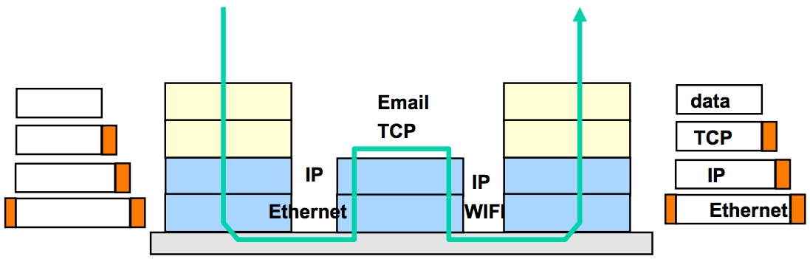
TCP/IP Architecture
Each layer adds/strips off its own header
Each layer may split up higher-level data
Each layer multiplexes multiple higher layers
Each layer is (mostly) transparent to higher layers

Slide 40
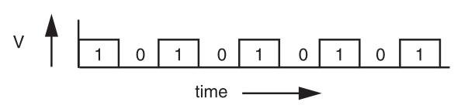
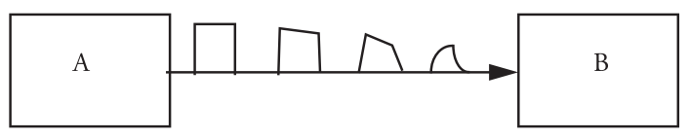
Signal Transmission on Analog Line
It is hard for B to understand the signal
  B doesn't have a copy of A's clock, so when to sample the signal?

Slide 41
Manchester Code
Solution: sender encodes the data to ensure transitions
Phase encoding: at least 1 level transition for a bit
  Manchester code: 0 -> 01, 1 -> 10
  Max data rate is only half, but simple enough
1
0
1
0
1
1
1
0
0
Polar NRZ
Manchester
Encoding

Slide 42
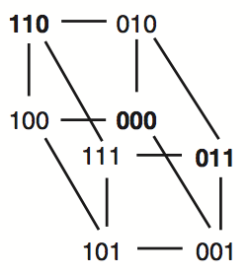
Example-1: Simple Parity Check
2 bits -> 3 bits
  Detect 1-bit errors
  8 patterns total
Only 4 correct patterns
  00 -> 000
  11 -> 110
  10 -> 101
  01 -> 011
Hamming distance of this code is 2
  1-bit flipping will cause incorrect pattern

Slide 43
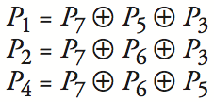
Example-2: 4-bit -> 7-bit
4 bits -> 7 bits (56 using only extra 7)
  3 extra bits to distinguish 8 cases
  e.g. 1101 -> 1010101
Correct 1-bit errors
  1010101 -> 1010001 : P1 & P4 not match
  1010101 -> 1110101 : P2 not match
Not Match | Error
None | None
P1 | P1
P2 | P2
P4 | P4
P1 & P2 | P3
P1 & P4 | P5
P2 & P4 | P6
P1 & P2 & P4 | P7
1 2 3 4 5 6 7
1
0
1
0
1
0
1
1
0
1
0
1
0
1
1
0
1
0
1
0
1

Slide 44
Control-plane VS. Data-plane
Control-plane
  Control the data flow by defining rules
  E.g., the routing algorithm
Data-plane
  The data-path which copies data according to the rules
  Performance critical
  E.g., the IP forwarding process
write
read
routing table
Notes:
The
Control-plane the table, data-plane reads the table

Slide 45
Two Types of Routing Protocol
Protocol 1: Link-state
  Nodes advertise to everyone their costs to their neighbors
    via flooding
  Integrate using Dijkstra's shortest path algorithm
Protocol 2: Distance-vector
  Nodes advertise to neighbors with their cost to all known nodes
  Update routes via Bellman-Ford integration

Slide 46
GIVE_TO_END_LAYER
NETWORK_SEND
GIVE_TO_NETWORK
_HANDLER
net_handler[]
struct packet
source
destination
end_protocol
payload
NETWORK_HANDLE
LOOKUP
LINK_SEND
LINK_RECEIVE
struct frame
struct checked_cnt
net_protocol
payload
checksum
link_protocol[]
sendproc
sendproc

Slide 47
NAT (Network Address Translation)
Private network
  Public routers do not accept routes to network 10 (e.g., 10.8.8.8)
NAT router: bridge the private networks
  Router between private & public network
  Send: modify source address to temp public address
  Receive: modify back by looking mapping table
Limitations
  Some end-to-end protocols place address in payloads
  The translator may become the bottleneck
  What if two private network merge?

Slide 48
Case Study: Mapping Internet to Ethernet
Listen-before-sending rule, collision
Ethernet: CSMA/CD
  Carrier Sense Multiple Access with Collision Detection
Ethernet type
  Experimental Ethernet, 3 mbps
  Standard Ethernet, 10 mbps
  Fast Ethernet, 100 mbps
  Gigabit Ethernet, 1000 mbps
Notes:
基带冲突检测的载波监听多路访问技术(载波监听多点接入/碰撞检测)

Slide 49
Defenses against ARP Spoofing
No Universal defense (!)
Use static ARP entries
  Cannot be updated
  Spoofed ARP replies are ignored
  ARP table needs a static entry for each machine on the network
  Large overhead
    Deploying these tables
    Keep the table up-to-date

Slide 50
Assurance of End-to-end Protocol
Assurance of at-least-once delivery
Assurance of at-most-once delivery
Assurance of data integrity
Assurance of stream order & closing of connections
Assurance of jitter control
Assurance of authenticity and privacy
Assurance of end-to-end performance

Slide 51
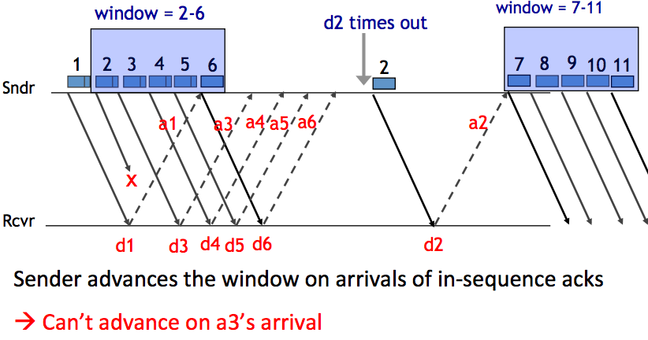
Handling Packet Loss

Slide 52
Sliding Window Size
window size ≥ round-trip time × bottleneck data rate
Sliding window with one segment in size
  Data rate is window size / RTT
Enlarge window size to bottleneck data rate
  Data rate is window size / RTT
Enlarge window size further
  Data rate is still bottleneck
  Larger window makes no sense
- Receive 500 KBps
- Sender 1 MBps
- RTT 70ms
- A segment carries 0.5 KB
- Sliding window size = 35KB (70 segment)

Slide 53
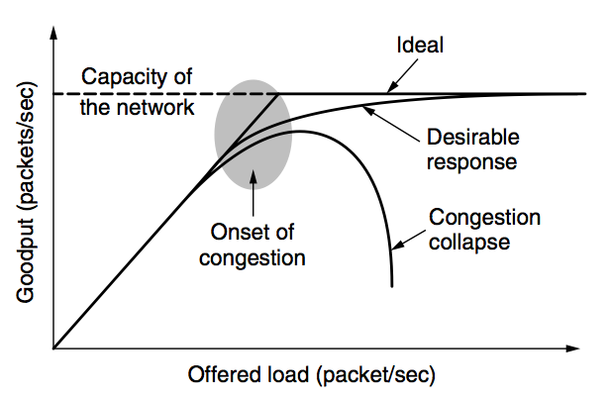
Network Congestion

Slide 54
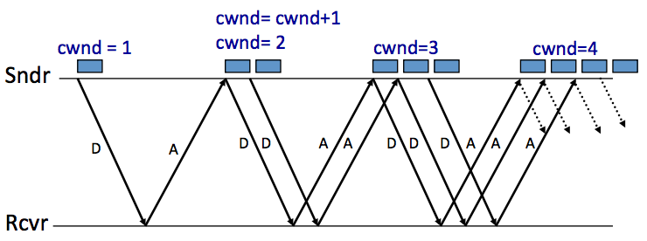
AIMD (Additive Increase, Multiplicative Decrease)
Every RTT:
  No drop: cwnd = cwnd + 1
  A drop: cwnd = cwnd / 2

Slide 55
Problems with AIMD
Increases very slowly at the beginning
Initial window size is 1
  Probably too small in practice
Solution: do multiplicative increase at the beginning
  Congestion_window _{init} = 1
  Initially, do Congestion_window ← 2 * Congestion_window each RTT until we hit congestion
  Named "slow start" (even though it's exponentially fast!)

Slide 56
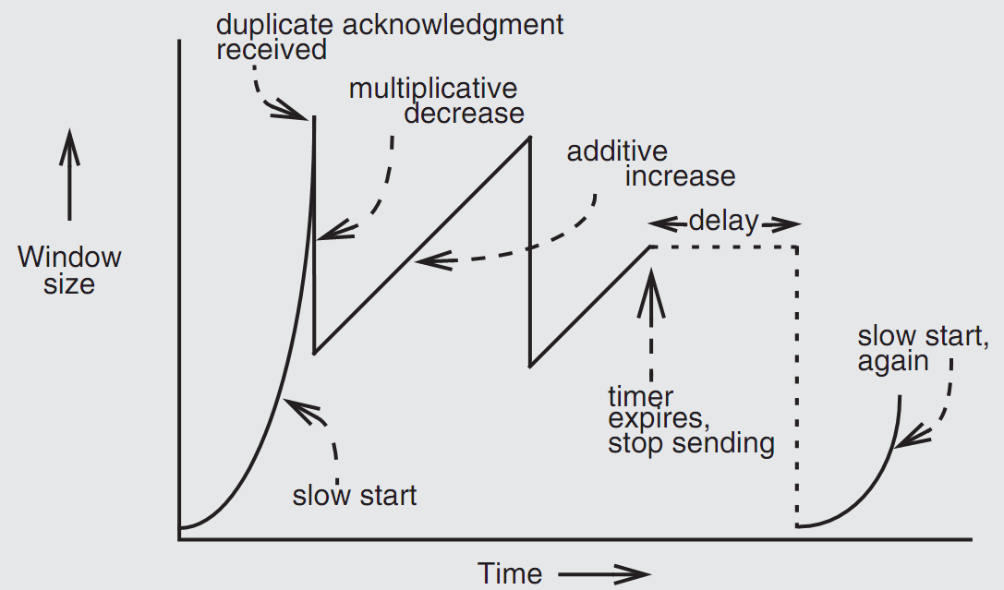
Retrofitting TCP
Notes:
Since TCP does not know whether a duplicate ACK is caused by a lost segment or just a reordering of segments, it waits for a small number of duplicate ACKs to be received.

Slide 57
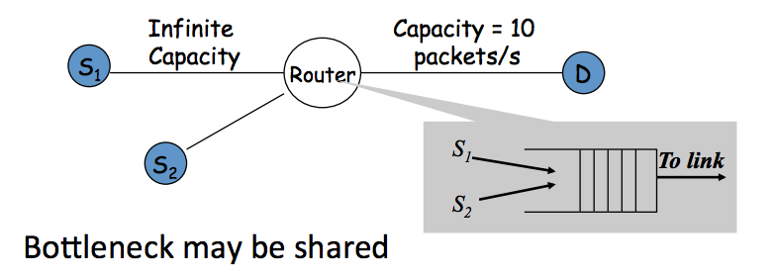
Fairness between Links

Slide 58
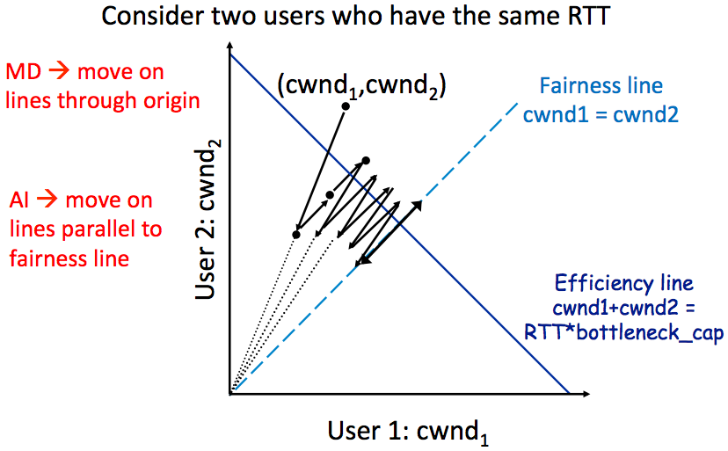
AIMD Leads to Efficiency and Fairness
Notes:
AIMD: addition increase, multiple decrease.

Slide 59
Weakness of TCP
If routers have too much buffering, causes long delays
Packet loss is not always caused by congestion
  Consider wireless network: sender may send faster if losing packet
TCP does not perform well in datacenters
  High bandwidth, low delay situations
TCP has a bias against long RTTs
  Throughput inversely proportionally to RTT
  Consider when sending packets really far away vs. really close
Assumes cooperating sources, which is not always a good assumption

Slide 60
Summary of Congestion Window
Reliability Using Sliding Window
  Tx Rate = W / RTT
Congestion Control
  W = min(Receiver_buffer, cwnd)
  Congestion window is adapted by the congestion control protocol to ensure efficiency and fairness
  TCP congestion control uses AIMD which provides fairness and efficiency in a distributed way

Slide 61
DNS Hierarchy (a partial view)
root
com
cn
net
org
gov
apple
google
com
edu
drive
mail
www
fudan
sjtu
se
seiee
ma
ipads
www

Slide 62
DNS Request Process
a.root.net
a.root.net
names.edu
names.edu
NS: for edu
ns.iss.edu
ns.iss.edu
NS: for
Scholarly.edu
ginger.
Scholar.edu
ginger.
Scholar.edu
ginger.
Scholar.edu
AP: for
ginger.Scholar.edu
Name client
Name client
Non-Recursion
Recursion

Slide 63
Three Enhancements on Look-up Algorithm
3. Caching
  DNS clients and name servers keep a cache of names
    Your browser will not do two look-ups for one address
  Cache has expire time limit
    Controlled by a time-to-live parameter in the response itself
    E.g., SJTU sets the TTL of www.sjtu.edu.cn to 24h
  TTL (Time To Live)
    Long TTL VS. short TTL
    Q: what are the tradeoffs?

Slide 64
Good Points on DNS Design
Global names (assuming same root servers)
  No need to specific a context
  DNS has no trouble generating unique names
  The name can also be user-friendly
Scalable in performance
  Simplicity: look-up is simple and can be done by a PC
  Caching: reduce number of total queries
  Delegation: many name severs handle lookups

Slide 65
Good Points on DNS Design
Scalable in management
  Each zone makes its own policy decision on binding
  Hierarchy is great here
Fault tolerant
  If one name server breaks, other will still work
  Duplicated name server for a same zone

Slide 66
Bad Points on DNS Design
Policy
  Who should control the root zone, .com zone, etc? Governments?
Significant load on root servers
  Many DNS clients starts by talking to root server
  Many queries for non-existent names, becomes a DoS attack
Security
  How does a client know if the response is correct?
  How does VeriSign know "change Amazon.com IP" is legal?

Slide 67
Naming Schemes
A naming schemes contains three parts:
  1. Set of all possible names
    You cannot use ‘for’ as a variable in C
  2. Set of all possible values
  3. Look-up algorithm to translate a name into a value
    or a set of values, or “none”

Slide 68
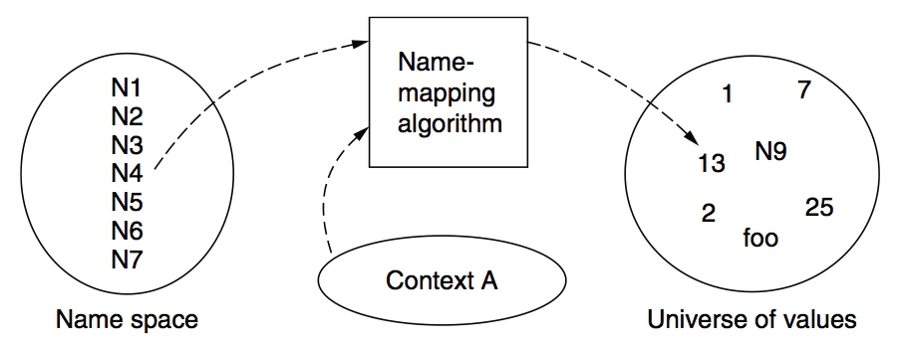
Naming Model

Slide 69
P2P (Peer-to-peer): No central servers!
How to track nodes and objects in the system?
How do you find other nodes in the system?
How should data be split up between nodes?
How to prevent data from being lost?
  How to keep it available?
How to provide consistency?
How to provide security? anonymity?

Slide 70
BitTorrent
Usage Model: Cooperative
  User downloads file from someone using simple user interface
  While downloading, BitTorrent serves file also to others
  BitTorrent keeps running for a little while after download completes
3 Roles
  Tracker: What peer serves which parts of a file
  Seeder: Own the whole file
  Peer: Turn a seeder once has 100% of a file
Notes:
** Challenges:
Tracking which peer has what
Handling high churn rates
Download rate proportional to upload rate

Slide 71
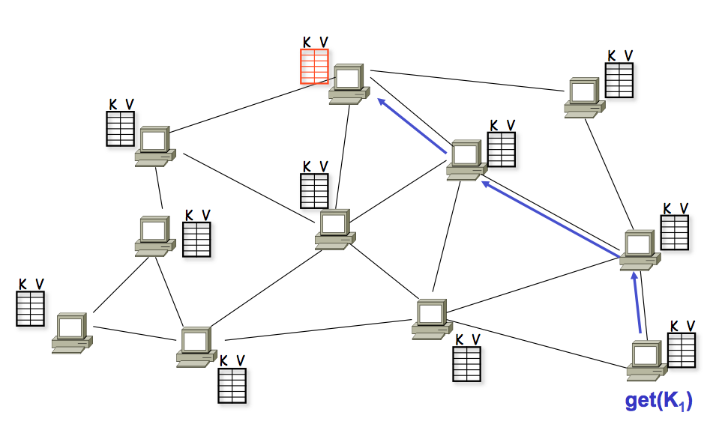
A DHT in Operation: get()

Slide 72
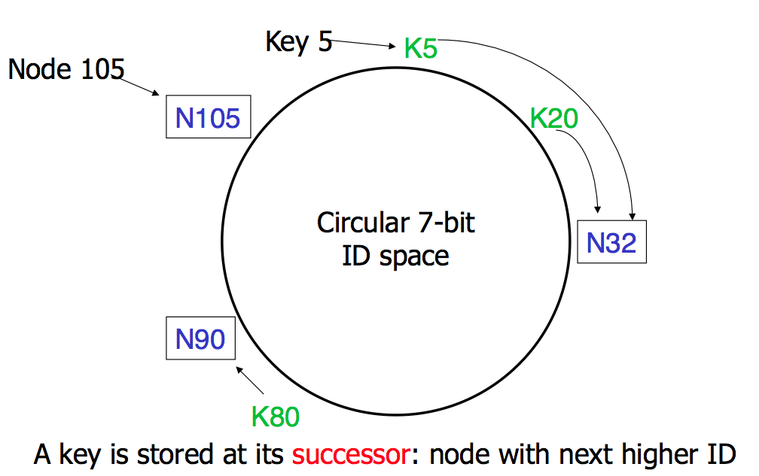
Consistent Hashing

Slide 73
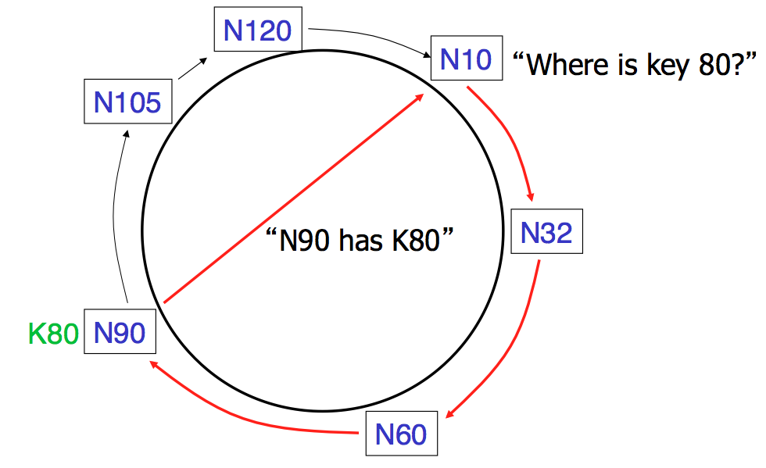
Basic Lookup

Slide 74
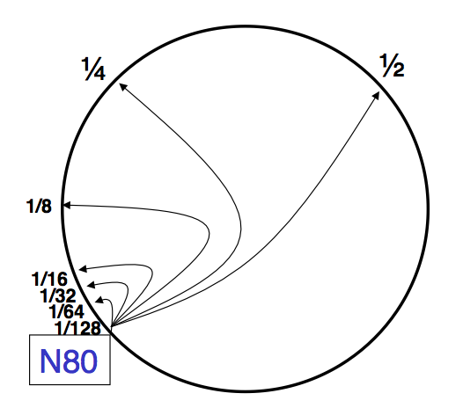
"Finger Table" allows log(N) lookups

Slide 75
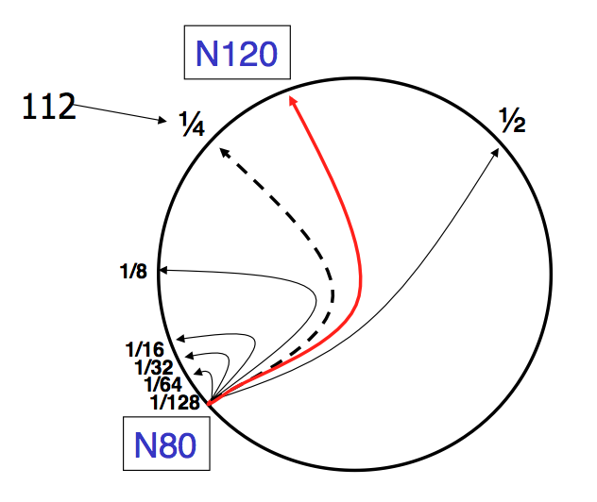
Finger i points to successor of n+2^{i}

Slide 76
Join (4)
N25
4. Set N25's successor pointer
N36
K30
N40
K30
K38
Update finger pointers in the background Correct successors produce correct lookups

Slide 77
Virtual Nodes for Load Balance
Load balance could be a problem
  Some nodes have most value
Solution: virtual nodes
  Virtual nodes are distributed across the ring
  One physical node can have multiple virtual nodes
  More virtual nodes, better load balance

Slide 78
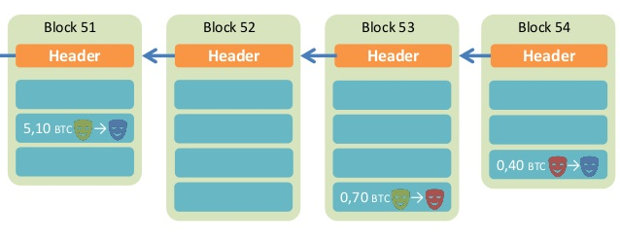
Overview of BitCoin
BitCoin is a decentralized public-accessable ledger
  Using hashes as a pointers, which form a chain
  Tamper-proof (assuming 51% honest)

Slide 79
Incentive
By convention, the first transaction in a block is a special transaction that starts a new coin owned by the creator of the block
The incentive can also be funded with transaction fees
The incentive may help encourage nodes to stay honest
  If a greedy attacker is able to assemble more CPU power than all the honest nodes, he ought to find it more profitable to play by the rules than to undermine the system and the validity of his own wealth

Slide 80
Smart Contract
The nodes not only store transactions, but also code
... and also execute the code to gen new transaction!
The code is known as "smart contract"
  Execution can be triggered by events/invocations

Slide 81
It's all about Trust
Why blockchain?
  We need a consensus for a ledger
  There is no third party to be trusted
If there is someone trusted by all, then blockchain is not needed
  Blockchain is slow and hard to use
  It is designed to be that way
    Considering the storage and bandwidth of the ledger

Slide 82
Performance

Slide 83
Performance Matters!
Requirements of computing systems
  Performance
  Correctness
  Fault tolerance
  Security

Slide 84
How to Improve Performance?
Buy new hardware!
However:
  Not all aspects improve at the same pace
  Moore's Law is plateauing
  Hardware improvements do not always keep pace with load increases
Conclusion
  Need to design for performance, potentially re-design as load increases

Slide 85
How to Improve Performance
Step-1. measure the system, and compare it to our system model, to ﬁnd the bottleneck
Step-2. relax the bottleneck

Slide 86
Performance Metrics
Computer Systems as interconnected modules
★ Capacity
★ Latency
★ Throughput
★ Utilization

Slide 87
Performance Metrics: Capacity
Capacity – Size or amount of a service
  Blocks on storage devices
  Size of data on memory chips
  Cycles on a processor
  Bits per second on network devices
  ...
  Usually means the limitation of devices

Slide 88
Performance Metrics: Latency
Request
Latency: the time it takes from start to finish
  Webserver – Time from request to response
  Network – Time from send() until receive() done
  Procedure – Time from call until return
For a multi-step process (Steps A + B)
  Latency_{A+B} ≥ Latency_{A} + Latency_{B}
Stage-1
Stage-1
Service
…
Stage-n
Response

Slide 89
Performance Metrics: Throughput
Throughput: rate at which work is done
  Webserver – Requests per second
  Network – Bits per second
  Procedure – Calls per second
Pipeline of modules
  Thoughput_{A+B} ≤ minimum(Throughput_{A}, Throughput_{B})
  Bottleneck
1000
100
10
  Compare measured throughput to capability: utilization

Slide 90
Performance Metrics: Utilization
Utilization – Fraction of capacity used by a workload
  CPU is 50% busy, rest in idle loop
  75% of disk blocks are allocated
  Webserver is running at 20% of capacity
  20% of the time network is busy
  ...
Utilization means bottleneck obvious? Sometimes.
  Yes: e.g., CPU is 100% utilized vs. disk is 20% utilized
  No: e.g., CPU and disk are 50% utilized, and at alternating times

Slide 91
Relationship between Latency & Throughput
When processing is serial:
Throughput = 1 / (Latency)
When processing is parallel:
Throughput has no direct relationship
with latency
How to improve throughput? Reduce latency & Increase paralleling

Slide 92
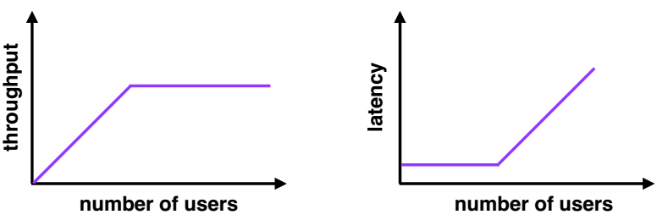
Throughput and Latency
Many users
  High latency (requests queue up)
  Throughput plateaus (cannot serve requests any faster)

Slide 93
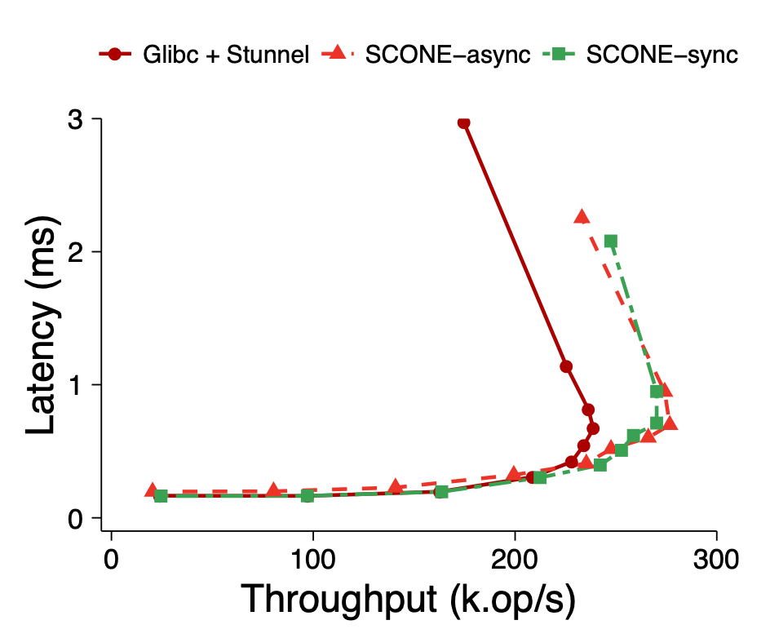
Throughput and Latency
  Sometimes you get data like this...

Slide 94
Improving Performance at 3 Layers
Hardware layer: get faster hardware
Application layer: better algorithm, fewer features
General system optimization techniques:
  Batching requests
  Caching data
  Concurrency
  Parallelism (scheduling)
Application
System
Hardware

Slide 95
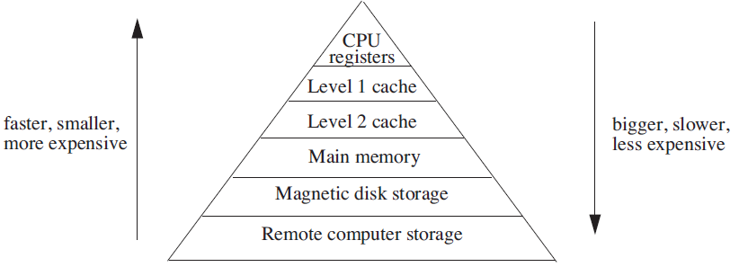
Analyzing Multilevel Memory Systems
Only consider the adjacent pair of levels
  View it as a two level multilevel memory system
  The 1st is primary device, the 2nd is secondary device

Slide 96
Locality of Reference and Working Sets
In many situations most memory references are to a small set of addresses for significant periods of time
As the application progresses, the area of concentration of access shifts, but its size still typically remains small
Called "locality of reference"
  Temporal locality and spatial locality
  Thrashing: repeated movement of data back and forth between two levels

Slide 97
Multilevel Memory Management Policies
Each level of multilevel memory system can be characterized by 4 items
  The string of references directed to that level
  The bring-in policy for that level
  The removal policy for that level
  The capacity of the level

Slide 98
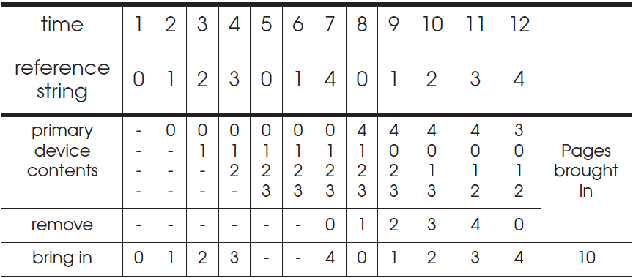
Belady's Anomaly
Increase of missing-page exception numbers with a larger primary device capacity

Slide 99
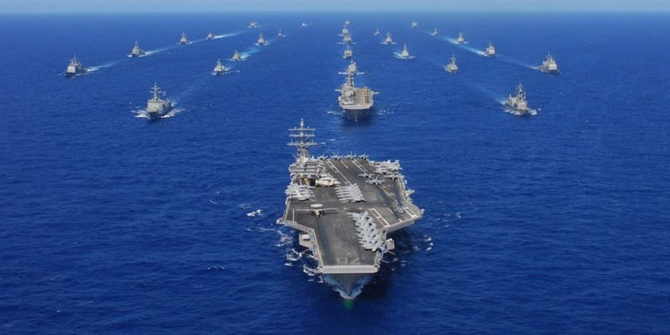
Convoy Effect
When I/O devices are idle
  The I/O-bound threads will quickly finish computations and start I/O
  The processor-bound thread will run for a long time
  I/O-bound operations will finish I/O and queuing for computation
  All the I/O devices will become idle!
When processor is idle
  The processor-bound thread finishes
  computation and starts I/O
  The I/O-bound threads will quickly
  finish computations and start I/O
  Processor will become idle!

Slide 100
Security

Slide 101
2 Steps towards a More Secure System
How to make progress in building a secure system?
  Be clear about goals: "policy"
  Be clear about assumptions: "threat model"

Slide 102
Review: Policy: Goals
Information security goals:
  Confidentiality: limit who can read data
  Integrity: limit who can write data
Liveness goals:
  Availability: ensure service keeps operating

Slide 103
Review: Threat Model: Assumptions
Often don't know in advance who might attack, or what they might do
  Adversaries may have different goals, techniques, resources, expertise
Cannot be secure against arbitrary adversaries
  as we saw with Ben vs. XYB
  Adversary might be your hardware vendor, software vendor, administrator, …
  Need to make some plausible assumptions to make progress

Slide 104
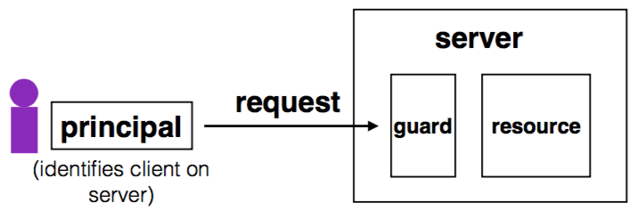
Review: Complete Mediation
Guard typically provides:
  Authentication: is the principal who they claim to be?
  Authorization: does principal have access to perform request on resource?

Slide 105
Review: Designing the Guard
Two functions often provided by a guard:
  Authentication: request -> principal
    E.g., client's username, verified using password
  Authorization: (request, principal, resource) -> allow?
    E.g., consult access control list (ACL) for resource
Simplifies security
  Can consider the guards under threat model
  But don't forget about complete mediation

Slide 106
An Example: Guessing Password (Tenex)
checkpw (user, passwd):
acct = accounts[user]
for i in range(0, len(acct.pw)):
if acct.pw[i] ≠ passwd[i]:
return False
return True
passwd:
P
A
S
S
W
O
R
D
X
acct.pw:
P
A
S
S
w
O
R
D

Slide 107
Salting
username | salt | hash(password | salt)
arya | 5334900209 | c5d2a9ffd6052a27e6183d60321c44c58c3c26cc
jon | 1128628774 | 624f0ffa577011e5704bdf0760435c6ca69336db
Sansa | 8188708254 | 5ee2b8effce270183ef0f4c7d458b1ed95c0cce5
Hodor | 6209415273 | f7e17e61376f16ca23560915b578d923d86e0319
check_password(username, inputted_password)
stored_hash = accounts_table[username]
inputted_hash = hash(inputted_password | salt)
return stored_hash == inputted_hash

Slide 108
Users Make Mistakes
Social engineering, phishing attacks
  How many of you really read the permission acquired by apps during installing?
Good idea: threat model should not assume users are perfect

Slide 109
Cost of Security
Security VS. Availability
  E.g., system requires frequent password changes -> users may write them down
How far should a teacher go to protect the exam file?
  Put the file on a separate computer, to avoid sharing a file system?
  Disconnect computer from the network, to avoid remotely exploitable OS bugs?
  Put the server into a separate machine room?
  Get a guard to physically protect the machine room?
  ...
Good idea: cost of security mechanism should be commensurate with value
Notes:
Most security goals/policies not infinitely valuable, can tolerate attacks.
Security mechanisms can be expensive (e.g., wasted user time).

Slide 110
Review: Stack Buffer Overflow
A Typical Buffer Overflow Attack
  Inject malicious code in buffer
    E.g., shellcode
  Overwrite return address to buffer
  Once return, the malicious code runs
01010110101010111010
return addr
ebp
saved ebp
0110110101010101010101101010101010101010
void function(char *str) {
char buf[16];
strcpy(buf,str);
}
buf

Slide 111
Defense
Hide the binary file
  No way to get any gadget
ASLR to randomize the code position
  Short for "Address Space Layout Randomization"
  Harder to find gadgets
Canary to protect the stack
  Try to detect stack overflow (e.g., overflow return address)

Slide 112
CFI: Control-Flow Integrity
Main idea: pre-determine control flow graph (CFG) of an application
  Static analysis of source code
  Static binary analysis ← CFI
  Execution profiling
  Explicit specification of security policy
Execution must follow the pre-determined control flow graph

Slide 113
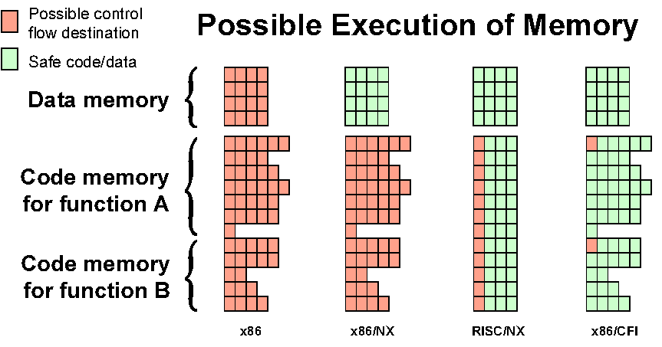
Possible Execution of Memory
[Erlingsson]

Slide 114
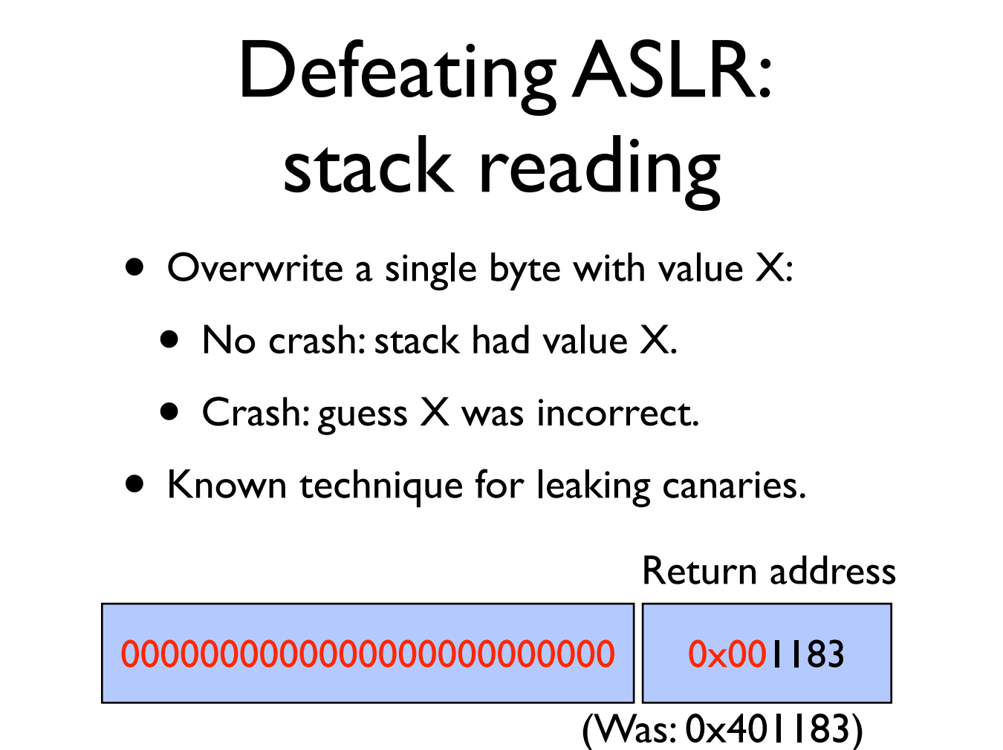

Slide 115
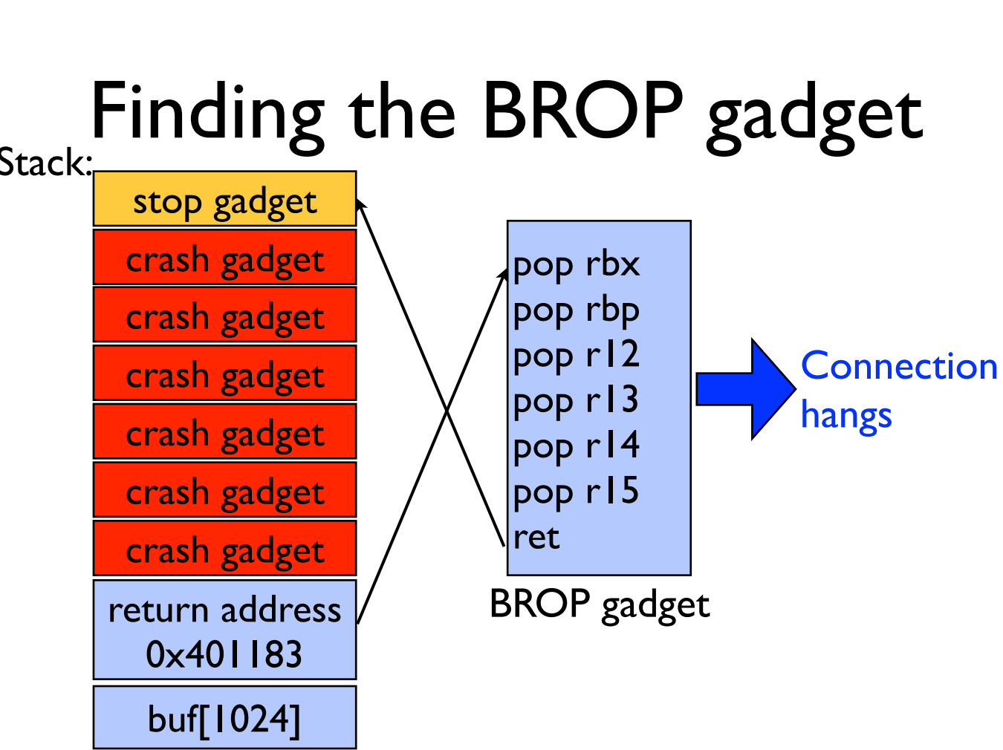

Slide 116
Tainting: Data Flow Tracking
Apply access policy along the data flow
  E.g., a password cannot be sent to Internet
  E.g., credit card number cannot be sent to other apps
  E.g., untrusted data cannot be executed

Slide 117
Two Usage of Data Flow Tracking
Usage-1: protect critical data
  E.g., track data to ensure none is leaked
Usage-2: defend against suspicious input data
  E.g., one input data cannot flow to return address!

Slide 118
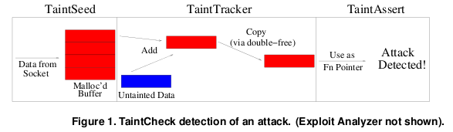
TaintCheck Detection Modules
TaintSeed: Mark untrusted data as tainted
TaintTracker: Track each instruction, determine if result is tainted
TaintAssert: Check is tainted data is used dangerously

Slide 119
Data Privacy
Will data be vulnerable to misuse?
What's the target of data privacy system?
  Allow data to be used, and
  Protect data from being stolen
What will be introduced?
  Basic data privacy method
    HE, ZKP, sMPC, SS, OT, GC, DP, TEE, …
  Systems which try to enforce data privacy

Slide 120
What is a TEE?
Trusted Execution Environment
  Isolated from other components, even the OS
  Can be remoted remotely attested, cannot be faked
    One private key embedded in the processor, usually
Also known as enclave
  Can be implemented by hardware or software, or both
  Smaller TCB
TEE is a way to handle system complexity

Slide 121
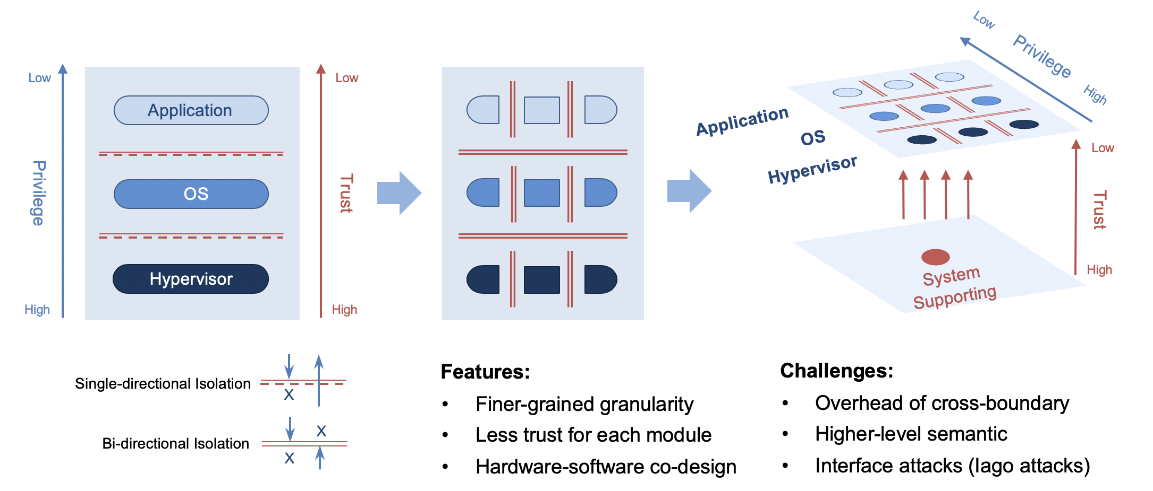
System Isolation

Slide 122
TCB: Trusted Computing Base
TCB is the parts that are trusted
  Process never trust another process, but trusts all its threads
  OS never trust a process, but trusts hardware
  VMM never trust a VM, but trust hardware
  Which parts do you trust in your laptop? Your phone?
TCB is the only metric of security
  Bug is inevitable

Slide 123
TEE Classification
By hardware or software?
By access-control or encryption?
System-level or user-level?

Slide 124
One Type of TEE/Enclave
Enclave
Trusted
Host App
Enclave App
Non-sensitive code/data
Sensitive code/data
User
OS
Supervisor
Hypervisor
Hypervisor
TEE/Enclave extension
Hardware

Slide 125
Software Architectures of SGX
LibOS
Container
Application
Code Snippet
APP
APP
APP
APP trusted part
LibC interface
APP untrusted part
LibOS
LibC
Libc
Libc
OS
OS
OS
Virtual Machine
Virtual Machine
Virtual Machine
Virtual Machine
Hypervisor
Hypervisor
Hypervisor
Hypervisor
 | Compatibility | TCB Size | Ocall Num | Attack Surface | Protect OS
LibOS | Part | Large | Few | Small | ✔
Container | ✔ | Mid | Mid | Mid | ✘
Application | ✔ | Mid | Many | Large | ✘
Code Snippet | ✘ | Small | Few | Small | ✘

Slide 126
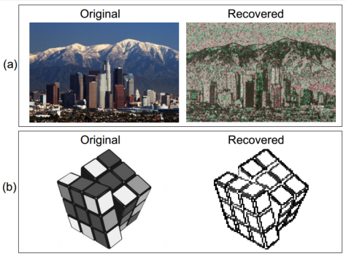
SGX's Vulnerabilities
Side channel attack
  Malicious OS still controls page fault handler
  If know the photo processing algorithm, can get the image by monitoring page fault
  Not 100% accurate, but still good enough

Slide 127
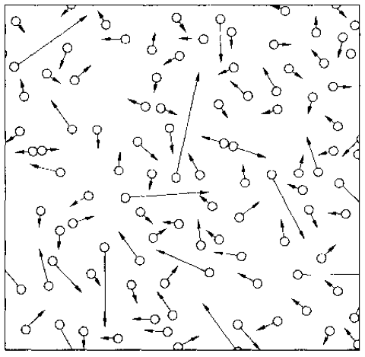
Summary
Complexity is inevitable
  From one node to multiple nodes
  From hundreds of LoC to millions of LoC
  From reliable environment to unreliable environment
  From trusted components to untrusted components
New properties from system's perspective
  All-or-nothing, before-or-after, isolation, throughput, latency, utilization, fault tolerance, security, scalability, TCB...

