Slide 1


Atomicity: Before-or-After
& Transaction
SE124 (2021 Fall)
IPADS, Shanghai Jiao Tong University
https://www.sjtu.edu.cn

Slide 2

Review: All-or-nothing

Slide 3
Review: methods to support atomicity
Shadow copy
Logging
  UNDO-REDO logging
  REDO logging
  UNDO logging

Slide 4

Logging: widely used in large-scale websites
Caching server
Caching server
…
Caching server
All can use logging to ensure
atomicity!
Caching
Caching
Caching
Distributed caching
Database server
Database server
CDN
Users
Application #1
generate the page
Database
user, price
…
Database
user, price
Application server
Distributed database
Internet
Load
Balance
Application #2
add the order
File server
File server
File server
File:
image
File:
image
…
File:
image
Application server
…
…
Message queue
Distributed file system

Slide 5
Bank Account: Transfer & Audit
transfer(bank, a, b, amt):
bank[b] = bank[b] + amt
bank[a] = bank[a] - amt
audit(bank):
sum = 0
for acct in bank:
sum = sum + bank[acct]
print(sum)
Notes:
Demo: stresses inconsistent behavior due to concurrency (i.e., audit)

Slide 6
Problem: What If transfer & audit run concurrently?
audit(bank):
Initial
<- sum=200
A = 100
B = 100
amt = 100
transfer(bank, a, b, amt):
bank[b] = bank[b] + amt
bank[a] = bank[a] - amt
audit(bank):
sum = 0
for acct in bank:
sum = sum + bank[acct]
print(sum)
<- sum=300
<- sum=200
Notes:
Demo: stresses inconsistent behavior due to concurrency (i.e., audit)

Slide 7

Problem: What If transfer & audit run concurrently?
transfer(bank):
audit(bank):
<- sum=200
<- sum=300
<- sum=300
<- sum=200
  Time
Notes:
Demo: stresses inconsistent behavior due to concurrency (i.e., audit)

Slide 8
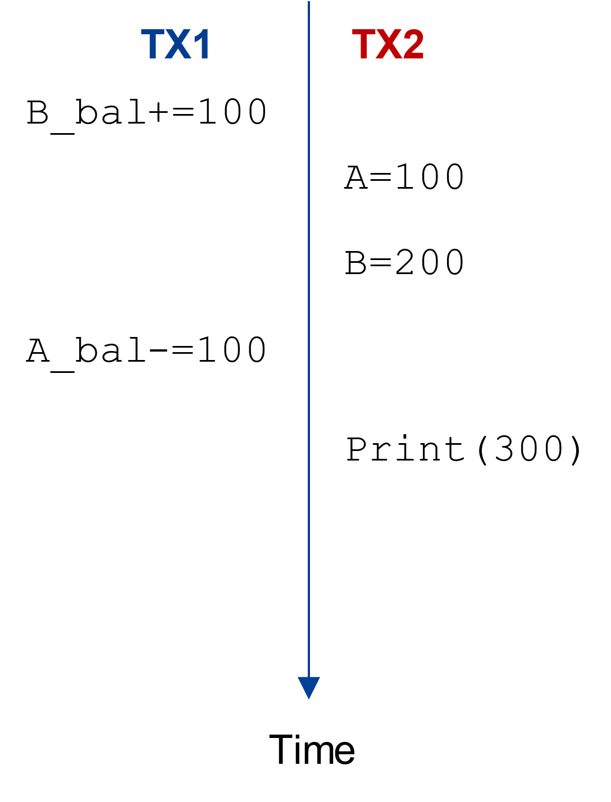
Problem: What If transfer & audit run concurrently?
A concurrent execution
TX1
transfer(bank, a, b, amt):
bank[b] = bank[b] + amt
bank[a] = bank[a] - amt
audit(bank):
sum = 0
for acct in bank:
sum = sum + bank[acct]
print(sum)
TX2

Slide 9
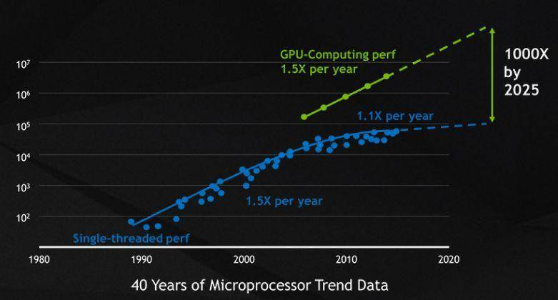
Problem: What If transfer & audit run concurrently?
transfer(bank):
audit(bank):
<- sum=200
<- sum=300
<- sum=300
<- sum=200
The end of Moore’s law!
  Time
Why we need concurrency?

Slide 10
Race condition

Slide 11
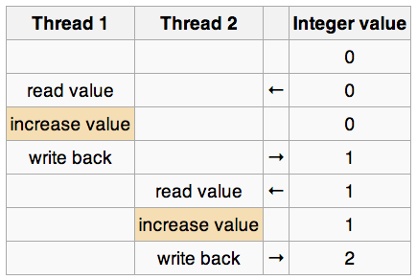
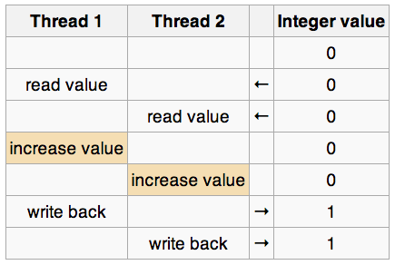
Race Condition
Race condition
  Timing dependent error involving shared state
  Whether it happens depends on how threads scheduled
  Considering "i++" by 2 threads concurrently, with i = 0:

Slide 12
Atomicity of the ++ operator
volatile int in;
  in++;
Works?
    mov in, %eax
    add $0x1, %eax
    mov %eax, in

Slide 13
Race Condition is Hard to Control
Must make sure all possible schedules are safe
  Number of possible schedules permutations is huge
  Bad schedules that will and will not work sometimes
They are intermittent
  Small timing changes between invocations might result in different behavior which can hide bug (e.g., Therac-25)
  Also known as Heisenbugs (Heisenberg uncertainty)
    Solution-1: DMT (Deterministic Multi-Threading)
    Solution-2: Record and Replay

Slide 14
Race Condition in Therac-25
The equipment control task did not properly synchronize with the operator interface task, so that race conditions occurred if the operator changed the setup too quickly. In three cases, the injured patients later died as a result of the overdose.

Slide 15

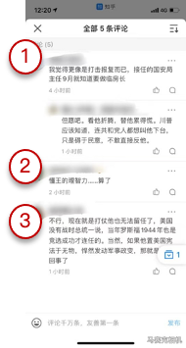
Race condition is bad, and is common
Bring unsatisfactory to the customers
  E.g., the comment system in
Show 5 comments;
But only 3 presented on the app

Slide 16
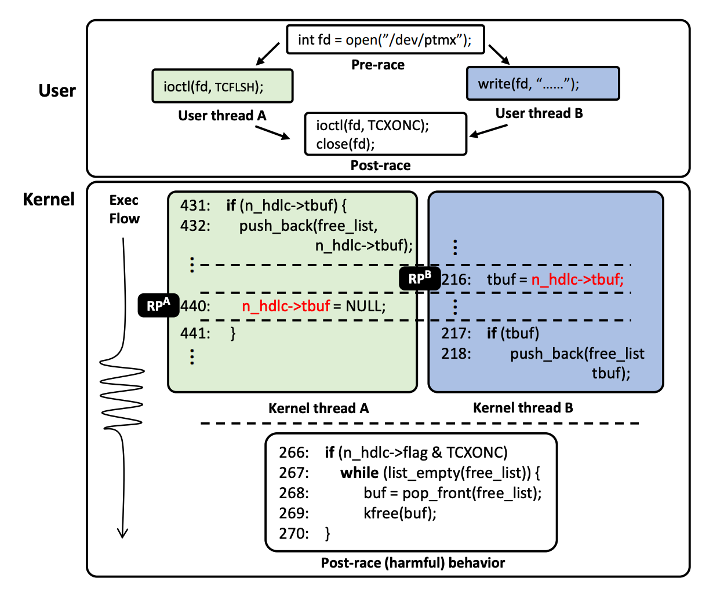
Race in Kernel
A simplified race example on CVE-2017-2636
As a user program executes two syscalls concurrently, a data race on n_hdlc->tbuf may occur depending on the execution order, which leads to a double-free issue allowing an attacker to launch privilege escalation attack
[S&P'19] RAZZER: Finding Kernel Race Bugs through Fuzzing

Slide 17
In summary: data management is hard
Every system that manages data continuously solve the same problems
  Crash consistency (see lecture 09)
  Atomicity (see lecture 10)
  Race condition (we should leverage multiple cores to boot performance!)
Development is challenging: we only want to write the application logic!
  E.g., only write the bank transfer program
Can we provide a systematic abstraction to simplify data management?

Slide 18
Transactions

Slide 19
What is a transaction (TX)?
An abstraction to manage the data
Data is also an abstract concept, can be arbitrary computing data. Concrete examples including:
  Key-value store entries
  File system metadata (e.g., directory, inode, etc)
  Processor’s metadata (e.g., child processors)
Look like similar program, with data managed by the TX system, and extra mark to denote the start/end of a TX

Slide 20
TX: an abstraction to ease data management
Transactions handle failure atomicity & race conditions
Writing with TX is straightforward
  Use TX.begin to mark when a TX starts
  Use TX.commit to commit the TX
  Rewrite the data read/write with TX’s interface
    E.g., bank[a] = bank[a] – amt
    tx.write(a, tx.read(a) – amt);
transfer(bank, a, b, amt, tx):
tx.begin()
tx.write(b, tx.read(b) + amt);
tx.write(a, tx.read(a) – amt);
tx.commit()
transfer(bank, a, b, amt):
bank[b] = bank[b] + amt
bank[a] = bank[a] - amt
Program
Transaction

Slide 21

What can a TX provide? ACID
The program btw { tx.begin() & tx.commit() } has the following properties:
A：Atomicity
C：Consistency
I：Isolation
D：Durability
...
tx.begin();
...
...
tx.commit();
...
ACID
Application program

Slide 22
Atomicity: All-or-nothing

Slide 23
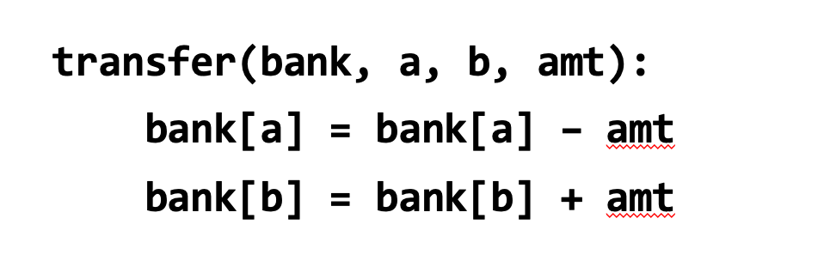
Consistency
Transaction must change the data from a consistent state to another
  Being consistent is defined by the applications
  E.g., transfer should leave the sum(bank[a] + bank[b]) unchanged
Transaction alone is not sufficient for consistency
  E.g., if the programmer writes the incorrect program...
    bank[a] = bank[a] - amt * 2

Slide 24
Isolation & Durability
Isolation: Two concurrently transactions are isolated
  E.g., not viewing the intermediate results of another TX
  Avoid the race conditions
Durability
  Once a transaction is committed, its changes (e.g., writes) must durably stored to a persistent storage
There are many isolation levels, we will talk about this later

Slide 25
How to enforce ACID?

Slide 26
Enforcing ACID properties
Enforcing A & D:
  Logging and recovery (see the last lecture)
Enforcing C:
  Database constraint system (not covered in this class)
Enforcing I:
  Concurrency control methods (this lecture)

Slide 27
Ideal isolation level: serializability

Slide 28
Serialization
Goal: run transactions T1, T2, .., TN concurrently, and have it "appears" as if they ran sequentially
What does this mean?
T1
begin
read(x)
tmp = read(y)
write(y, tmp+10)
commit
T2
begin
write(x, 20)
write(y, 30)
commit

Slide 29
Init: x=0, y=0
T1
begin
read(x)
tmp = read(y)
write(y, tmp+10)
commit
T2
begin
write(x, 20)
write(y, 30)
commit
Possible sequential schedules
T1 -> T2: x=20, y=30
T2 -> T1: x=20, y=40
T2: write(x, 20)
T1: read(x)
T2: write(y, 30)
T1: tmp = read(y)
T1: write(y, tmp+10)
At end: x=20, y=40
T1: read(x)
T2: write(x, 20)
T1: tmp = read(y)
T2: write(y, 30)
T1: write(y, tmp+10)
At end: x=20, y=10

Slide 30
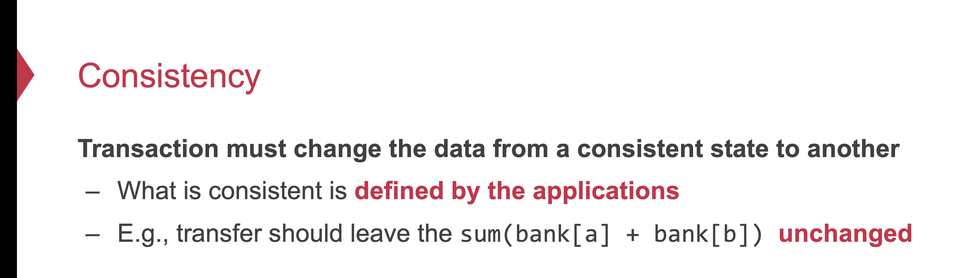
Why serializability is ideal?
Because it simplifies the programmer to enforce consistency
  Recall: consistency depends on how the programmer writes the program

Slide 31
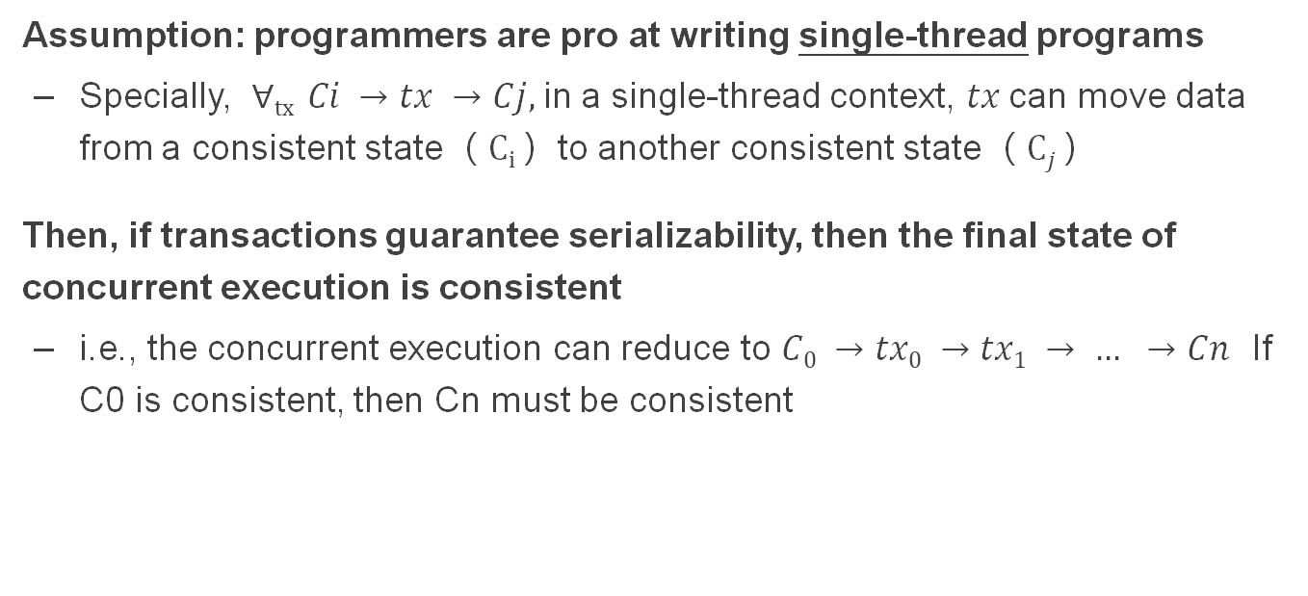
Why serializability is ideal?
Assumption: programmers are pro at writing single-thread programs
  Specially, $∀tx Ci →tx →Cj,$in a single-thread context, $tx$can move data from a consistent state（ $Ci$）to another consistent state（ $Cj$）
Then, if transactions guarantee serializability, then the final state of concurrent execution is consistent
  i.e., the concurrent execution can reduce to $C0 →tx0 →tx1 → … →Cn$ If C0 is consistent, then Cn must be consistent

Slide 32
Init: x=0, y=0
T1
begin
read(x)
tmp = read(y)
write(y, tmp+10)
commit
T2
begin
write(x, 20)
write(y, 30)
commit
Possible sequential schedules
T1 -> T2: x=20, y=30
T2 -> T1: x=20, y=40
T2: write(x, 20)
T1: read(x)
T2: write(y, 30)
T1: tmp = read(y)
T1: write(y, tmp+10)
At end: x=20, y=40
x=0
T1: read(x)
T2: write(x, 20)
T2: write(y, 30)
T1: tmp = read(y)
T1: write(y, tmp+10)
At end: x=20, y=40
y=30
In the second schedule, the results are correct. But T1 reads x=0 and y=30; those reads are not possible in a sequential schedule. Is that ok?

Slide 33
Init: x=0, y=0
Whether OK depends:
  There are many ways for multiple transactions to "appear" to have been run in sequence; there are different notions of serializability
  Chose a type of serializability depends on applications
T1
begin
read(x)
tmp = read(y)
write(y, tmp+10)
commit
T2
begin
write(x, 20)
write(y, 30)
commit
Possible sequential schedules
T1 -> T2: x=20, y=30
T2 -> T1: x=20, y=40
T2: write(x, 20)
T1: read(x)
T2: write(y, 30)
T1: tmp = read(y)
T1: write(y, tmp+10)
At end: x=20, y=40
x=0
T1: read(x)
T2: write(x, 20)
T2: write(y, 30)
T1: tmp = read(y)
T1: write(y, tmp+10)
At end: x=20, y=40
y=30
In the second schedule, the results are correct. But T1 reads x=0 and y=30; those reads are not possible in a sequential schedule. Is that ok?

Slide 34
Different Types of Serializability
Final-state serializability
  A schedule is final-state serializable if its final written state is equivalent to that of some serial schedule
Conflict serializability
View serializability
Our focus

Slide 35
Conflict Serializability

Slide 36
Conflict Serializability
Two operations conflict if:
  they operate on the same data object, and
  at least one of them is write, and
  they belong to different transactions
Conflict serializability
  A schedule is conflict serializable if the order of its conflicts (the order in which the conflicting operations occur) is the same as the order of conflicts in some sequential schedule

Slide 37
Init: x=0, y=0
T1
begin
read(x)
tmp = read(y)
write(y, tmp+10)
commit
T2
begin
write(x, 20)
write(y, 30)
commit
Possible sequential schedules
T1 -> T2: x=20, y=30
T2 -> T1: x=20, y=40
T1.1
T2.1
T1.2
T2.2
T1.3
Conflicts
T1.1 read(x) and T2.1 write(x,20) on x
T1.2 tmp = read(y) and T2.2 write(y,30) on y
T1.3 write(y, tmp+10) and T2.2 write(y,30) on y

Slide 38
Conflict Graph
Conflict Graph
  Nodes are transactions, edges are directed
  Edge between T_{i} and T_{j} if and only if:
    T_{i} and T_{j} have a conflict between them, and
    the first step in the conflict occurs in T_{i}
A schedule is conflict serializable if and only if:
  It has an acyclic conflict graph

Slide 39
T1
begin
read(x)
tmp = read(y)
write(y, tmp+10)
commit
T2
begin
write(x, 20)
write(y, 30)
commit
Possible sequential schedules
T1 -> T2: x=20, y=30
T2 -> T1: x=20, y=40
Conflicts
T1.1 read(x) -> T2.1 write(x,20)
T1.2 tmp = read(y) -> T2.2 write(y,30)
T1.3 write(y, tmp+10) -> T2.2 write(y,30)
(T1 -> T2)

Slide 40
T1
begin
read(x)
tmp = read(y)
write(y, tmp+10)
commit
T2
begin
write(x, 20)
write(y, 30)
commit
Possible sequential schedules
T1 -> T2: x=20, y=30
T2 -> T1: x=20, y=40
Conflicts
T2.1 write(x,20) -> T1.1 read(x)
T2.2 write(y,30) -> T1.2 tmp = read(y)
T2.2 write(y,30) -> T1.3 write(y, tmp+10)
(T2 -> T1)

Slide 41
Conflicts
T2.1, T1.1
T2.2, T1.2
T2.2, T1.3
Conflict order for sequential schedules
T1.1 -> T2.1 T2.1 -> T1.1
T1.2 -> T2.2 or T2.2 -> T1.2
T1.3 -> T2.2 T2.2 -> T1.3
(T1 -> T2) (T2 -> T1)
T2: write(x, 20)
T1: read(x)
T2: write(y, 30)
T1: tmp = read(y)
T1: write(y, tmp+10)
T1: read(x)
T2: write(x, 20)
T2: write(y, 30)
T1: tmp = read(y)
T1: write(y, tmp+10)
T2.1 -> T1.1
T2.2 -> T1.2
T2.2 -> T1.3
T1.1 -> T2.1
T2.2 -> T1.2
T2.2 -> T1.3

Slide 42
Conflicts
T2.1, T1.1
T2.2, T1.2
T2.2, T1.3
Conflict order for sequential schedules
T1.1 -> T2.1 T2.1 -> T1.1
T1.2 -> T2.2 or T2.2 -> T1.2
T1.3 -> T2.2 T2.2 -> T1.3
(T1 -> T2) (T2 -> T1)
T2: write(x, 20)
T1: read(x)
T2: write(y, 30)
T1: tmp = read(y)
T1: write(y, tmp+10)
T2 -> T1
T1: read(x)
T2: write(x, 20)
T2: write(y, 30)
T1: tmp = read(y)
T1: write(y, tmp+10)
-->
<--
T2 T1
It's final-state serializable,
not conflict serializable
Both at end: x=20, y=40

Slide 43



Conflict Equivalence
=
conflict-equal
Schedule A
if
Schedule B
T1 → T2
T4 → T3
=
equal
Conflicts order A
Conflicts order B
If conflicts-order-A equals to conflicts-order-B,
then schedule-A conflict-equals to schedule-B

Slide 44
View Serializability
T1 T2 T3
read(x)
write(x)
write(x)
write(x)
Conflict graph
T3
T2 T1
Cyclic -> Not conflict serializable
But compare it to running T1 then T2 then T3 (serially)
  Final-state is fine
  Intermediate reads are fine
Question: why shouldn't we allow this schedule?

Slide 45
View Serializability
Informal definition
  A schedule is view serializable if the final written state as well as intermediate reads are the same as in some serial schedule
Formally, for those interested
  Two schedules S and S' are view equivalent if:
    If T_{i} in S reads an initial value for X, so does T_{i} in S'
    If T_{i} in S reads the value written by T_{j} in S for some X, so does T_{i} in S'
    If T_{i} in S does the final write to X, so does T_{i} in S'
  A schedule is view serializable if it is view equivalent to some serial schedule

Slide 46
Question
Why conflict serializability when it seems too strict?
Why not focus on view serializability?
Final-state Serializability
View
Serializability
Conflict
Serializability
⊃
⊃
Care the final state only
Care the final state as well as intermediate read
Care the final state as well as all the data dependency

Slide 47
Conflict Serializability VS. View Serializability
Conflict serializability is easy to test
  i.e., check whether a graph is acyclic
  View serializability is hard to test (likely NP-hard)
Conflict serializable schedules are easy to generate
  Using concurrency control protocols. E.g., 2PL (two-phase-locking)
Conflict serializable schedules are also view serializable
  No easy way to generate view schedules that allows for ones like the previous example

Slide 48
Generate Conflict-Serializable Schedules

Slide 49
Basic idea: use locks
Lock: a synchronization primitive
  Once acquired, no concurrent threads/machine can acquire the same lock !
  Concrete example: pthread_mutex
In this lecture, we will assume the lock is off the shelf
  Efficiently implement the lock is non-trivial!
  E.g., acquiring the lock has overhead

Slide 50
Solution#1: Global lock
All TX must acquire the global lock before executing, and release it after it commits
  How to implement? Recall TX should call tx.begin()and tx.commit() before & after execution
  Acquire lock in tx.begin(), release lock in tx.commit
...
tx.begin();
...
...
tx.commit();
...
Acquire lock
Release lock

Slide 51
Recall: w/o locking, concurrent execution results in error
Initial
A = 100 B = 200 amt = 100
A concurrent execution
TX1
transfer(bank, a, b, amt):
bank[b] = bank[b] + amt
bank[a] = bank[a] - amt
audit(bank):
sum = 0
for acct in bank:
sum = sum + bank[acct]
print(sum)
TX1

Slide 52
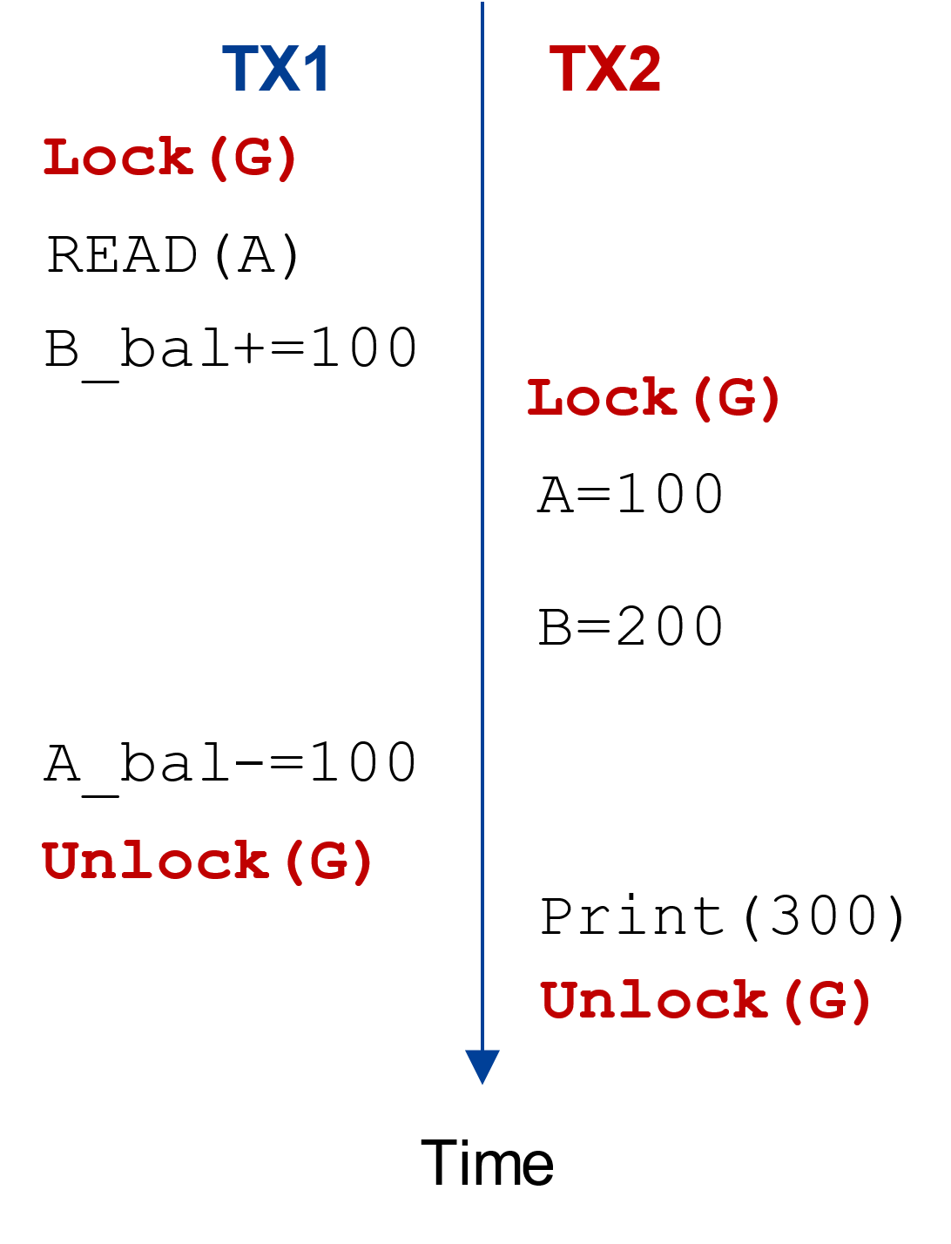
Solution#1: Global lock
Can the previous non-serializable execution happen?
+global lock

Slide 53
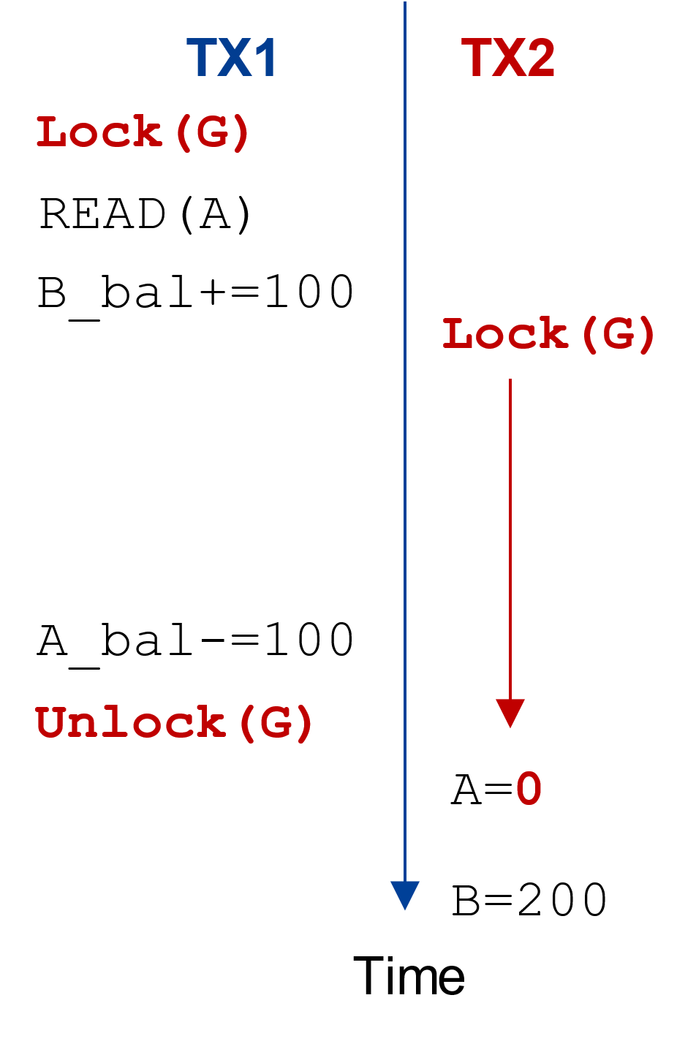
Solution#1: Global lock
No. The global lock prevents TX2 from execution when TX1 has not finished
+global lock
Suspend execution

Slide 54
Solution#1: Global lock
All TX must acquire the global lock before executing, and release it after it commits
Can trivially implement serializability
Drawback:
  Allow only one transaction to run at a time
  No concurrency at all! (Then why transaction?)

Slide 55
Solution#2: Simple fine-grained lock
Fine-grained lock
  Each data record has one lock
Only acquire the data lock before accessing
Release the lock after accessing it

Slide 56
Solution#2: Simple fine-grained lock
Only acquire the data lock before accessing
Release the lock after accessing it
How to implement?
  Recall that TX must call TX’s read/write interfaces to read/write data
  Intercept these call to add locks
...
tx.begin();
...
tx.read(A)
...
tx.commit();
...
Acquire lock
Read(A)
Release lock

Slide 57
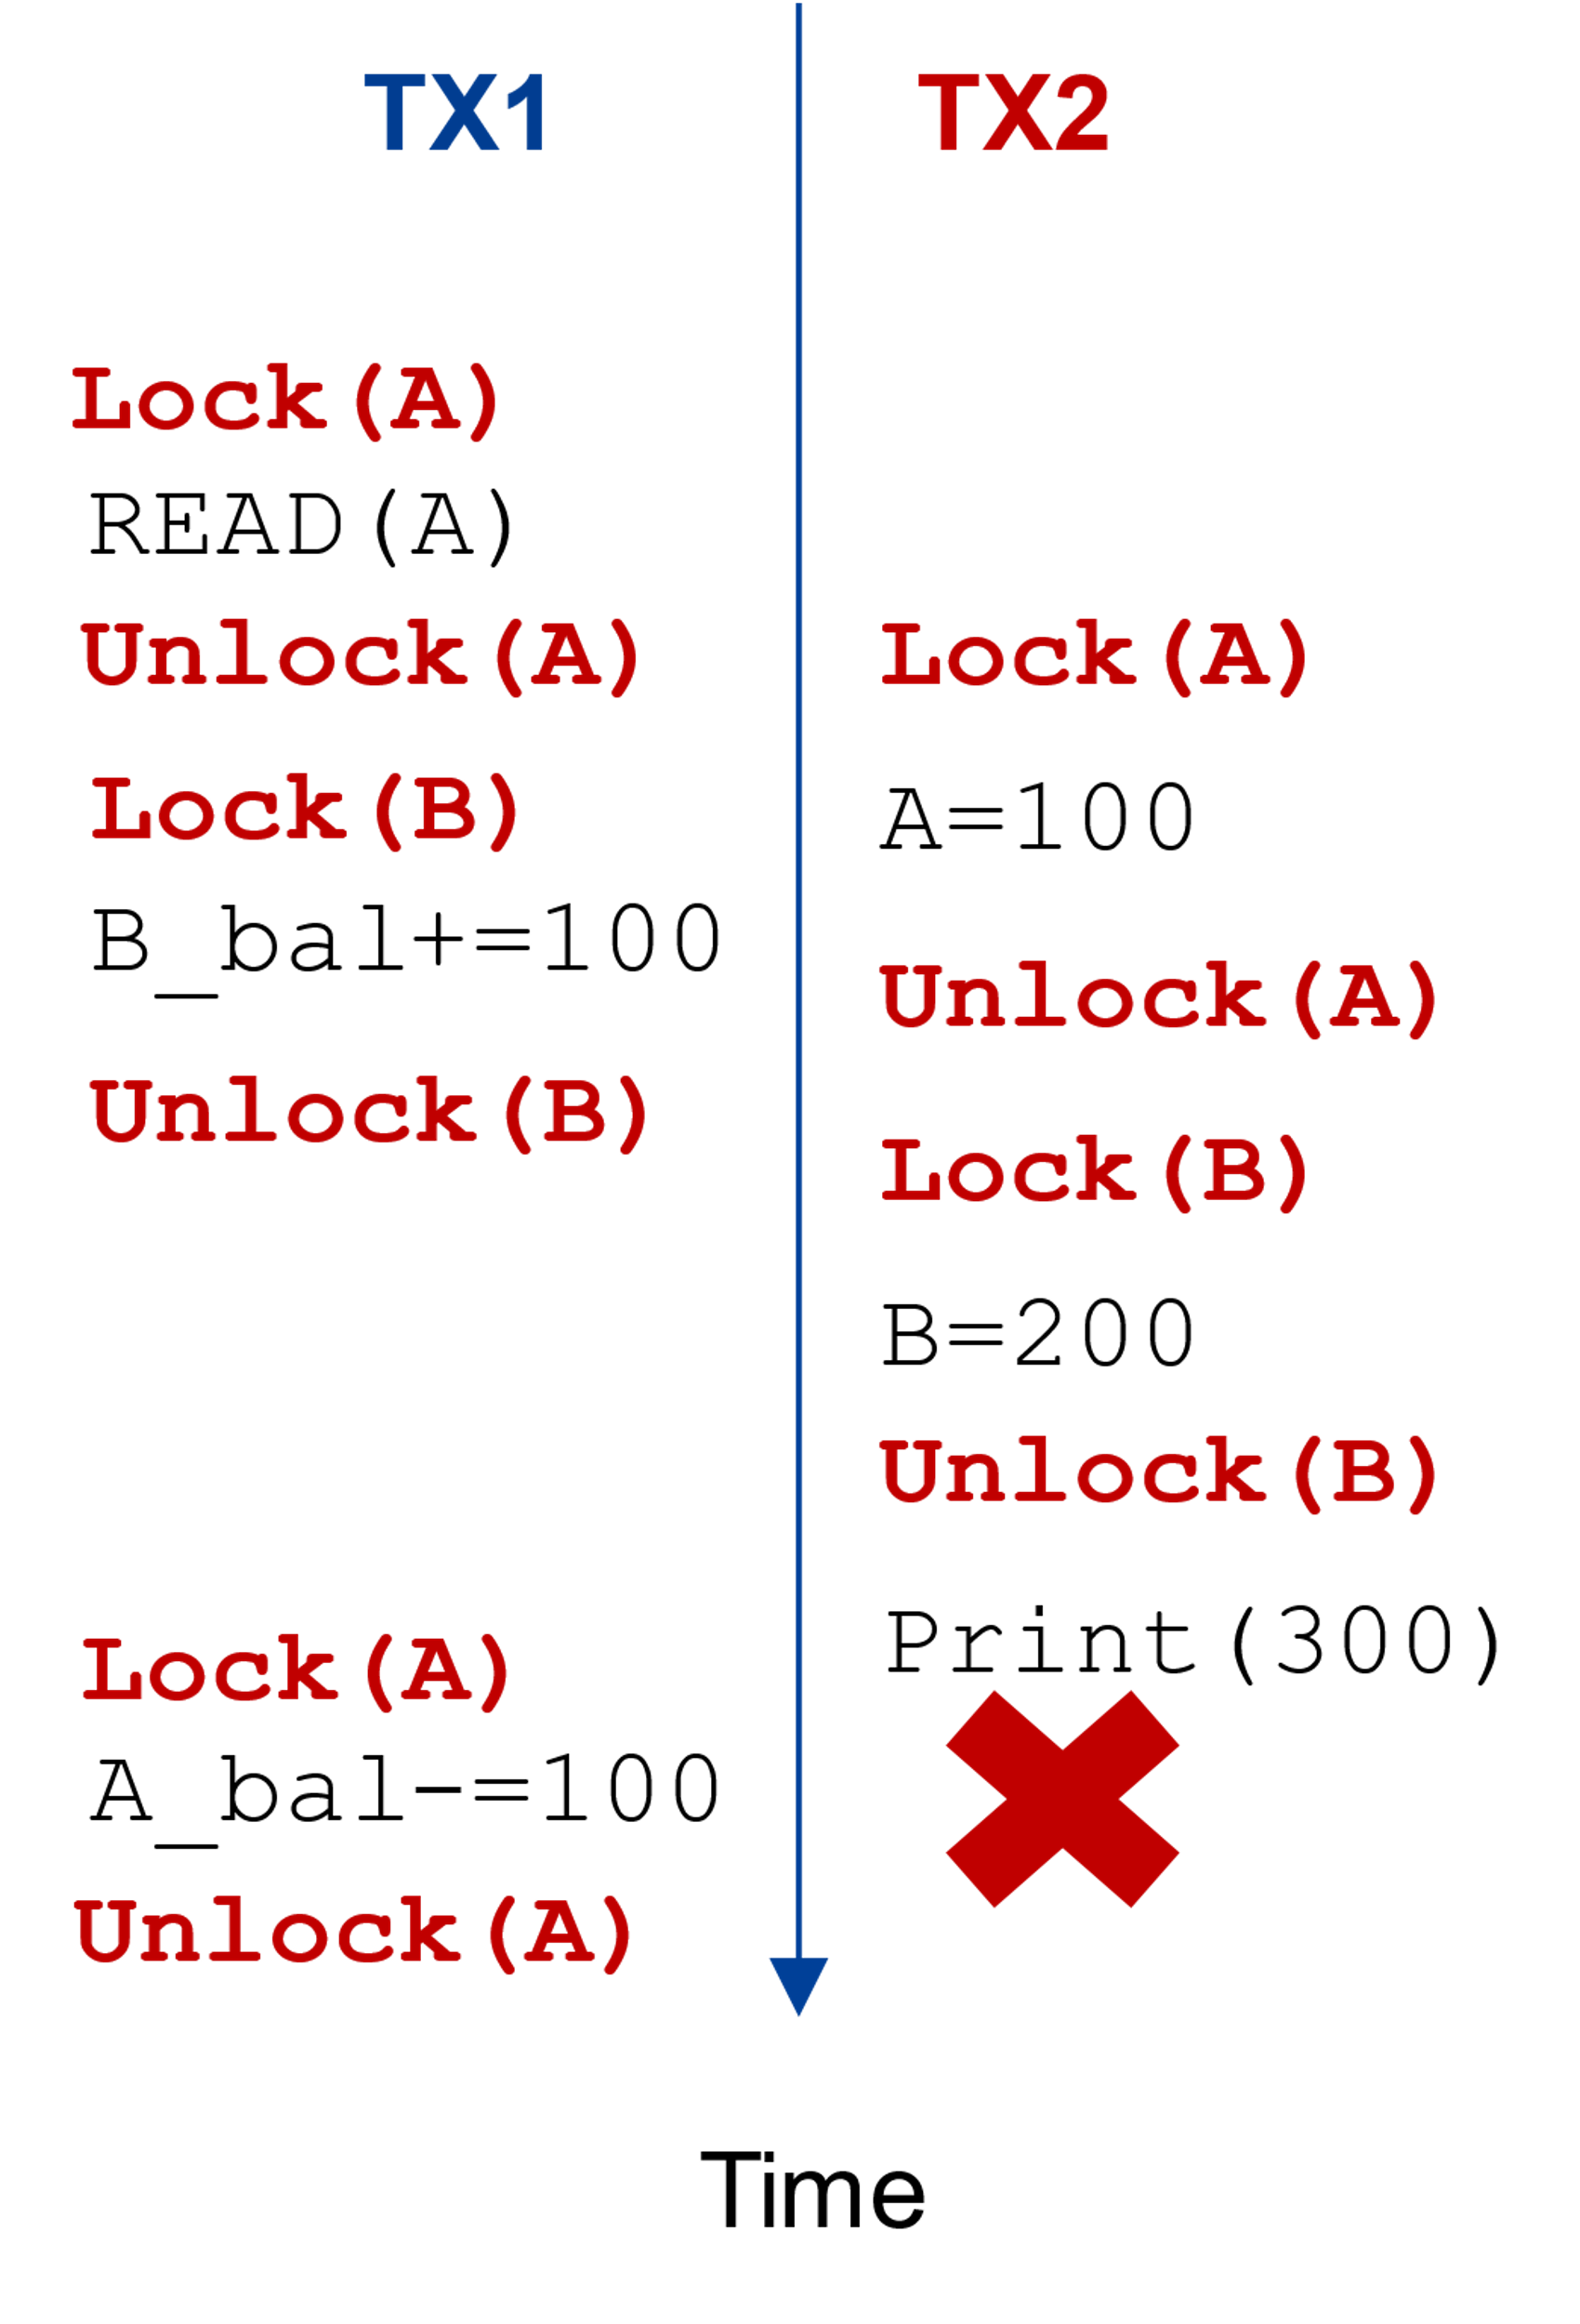
Solution#2: Simple fine-grained lock
Can the previous non-serializable execution happen?
TX1
transfer(bank, a, b, amt):
bank[b] = bank[b] + amt
bank[a] = bank[a] - amt
audit(bank):
sum = 0
for acct in bank:
sum = sum + bank[acct]
print(sum)
TX1

Slide 58
Solution#2: Simple fine-grained lock
Can the previous non-serializable execution happen?
TX1
transfer(bank, a, b, amt):
bank[b] = bank[b] + amt
bank[a] = bank[a] - amt
audit(bank):
sum = 0
for acct in bank:
sum = sum + bank[acct]
print(sum)
TX1
Problem: cannot release
the lock too early!

Slide 59
Solution#2: Simple fine-grained lock
Fine-grained lock
  Each data record has one lock
Only acquire the data lock before accessing
Release the lock after accessing it

Slide 60
Solution#3: Two-phase locking
Fine-grained lock
  Each data record has one lock
Only acquire the data lock before accessing
Release the lock after accessing it
Release the lock after the TX commits

Slide 61
Solution#3: Two-phase locking
Only acquire the data lock before accessing
Release the lock after the TX commits
How to implement?
  Recall that TX must call TX’s read/write interfaces to read/write data
  Co-locate the lock in the TX’s read/write
...
tx.begin();
...
tx.read(A)
...
tx.commit();
...
Lock_set = {}
Acquire(A)
Lock_set.add(A)
for r in Lock_set:
Release(r)

Slide 62
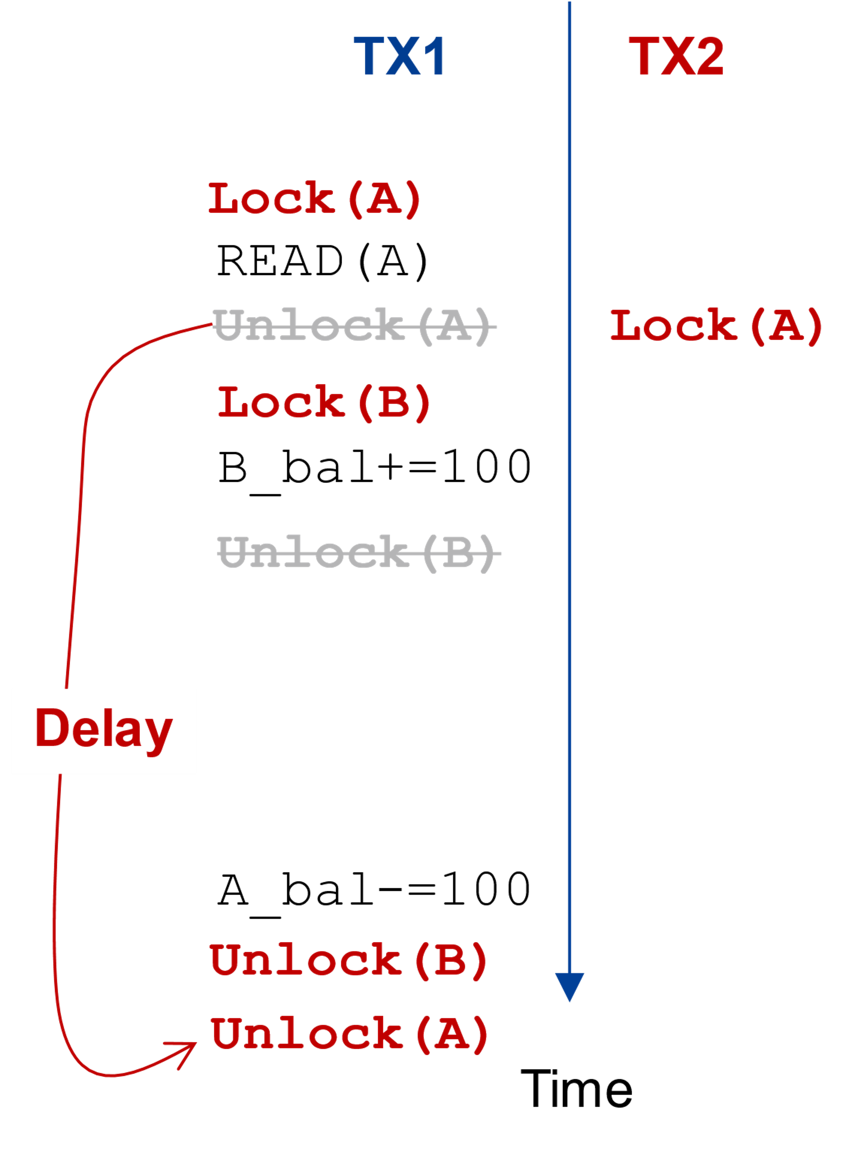
Solution#3: Two-phase locking
Can the previous non-serializable execution happen?
TX1
transfer(bank, a, b, amt):
bank[b] = bank[b] + amt
bank[a] = bank[a] - amt
audit(bank):
sum = 0
for acct in bank:
sum = sum + bank[acct]
print(sum)
TX1

Slide 63
Solution#3: Two-phase locking
Can the previous non-serializable execution happen?
TX1
transfer(bank, a, b, amt):
bank[b] = bank[b] + amt
bank[a] = bank[a] - amt
audit(bank):
sum = 0
for acct in bank:
sum = sum + bank[acct]
print(sum)
TX2 cannot read the
intermediate results of TX1
TX1

Slide 64
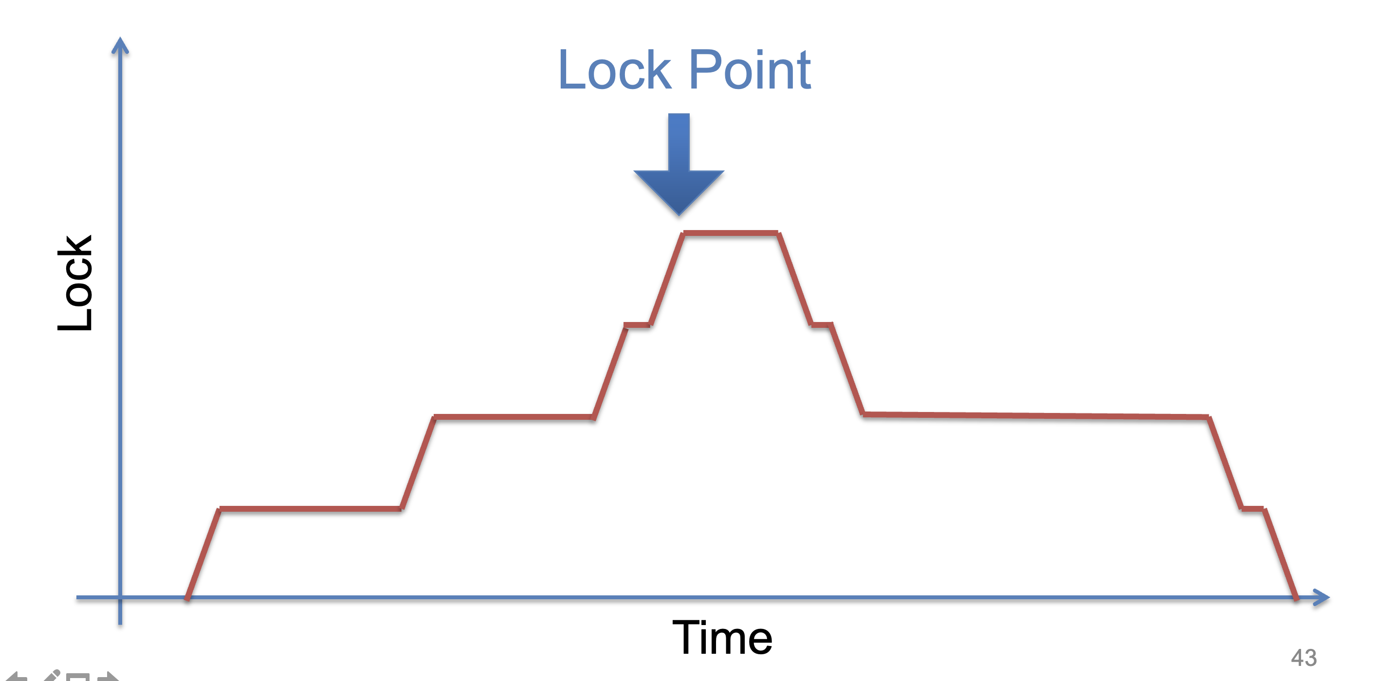
Solution#3: Two-phase locking
We can proof that two-phase locking can guarantee serializability
Why the name? Lock phase → lock point → unlock phase

Slide 65
Proof of 2PL
T1 and T2 conflict on x1
T2 and T3 conflict on x2
...
Tk and T1 conflict on x_k
Suppose 2PL does not generate conflict serializable schedule
Suppose the conflict graph produced by an execution of 2PL has a cycle, which without loss of generality, is:
T1 --> T2 --> ... --> Tk --> T1
Let the shared variable (the one that causes the conflict) between T_i and T_{i+1} be represented by x_i.
T1 acquires x1.lock
T2 acquires x1.lock and x2.lock
T3 acquires x2.lock and x3.lock
...
Tk acquires x_{k-1}.lock and x_k.lock
T1 acquires x_k.lock
T1 violates 2PL!
T1 acquires x1.lock
T1 releases x1.lock
...
...
...
T1 acquires x_k.lock
T1 acquires x1.lock
T1 releases x1.lock
T2 acquires x1.lock and x2.lock
...
Tk acquires x_{k-1}.lock and x_k.lock
T1 acquires x_k.lock

Slide 66
Optimizations: Read-write Locks
Lock compatibility modes
  Multiple-reader, single-writer protocol
    Any number of readers is safe
    Only one writer, waits for all reader to finish
    Suitable for applications with a lot of reading
    A writer may be delayed indefinitely
    Can release reader-locks after lock point (may before commit)
  More specific, more complex
    The implementation will be introduced in OS course

Slide 67
Is two-phase-locking sufficient?

Slide 68
Problem of 2PL: deadlock
Two-phase lock is pessimistic:
  Before proceed, each TX must wait for conflicting TX to release the lock
  What can happen if two TX are waiting for each other?

Slide 69
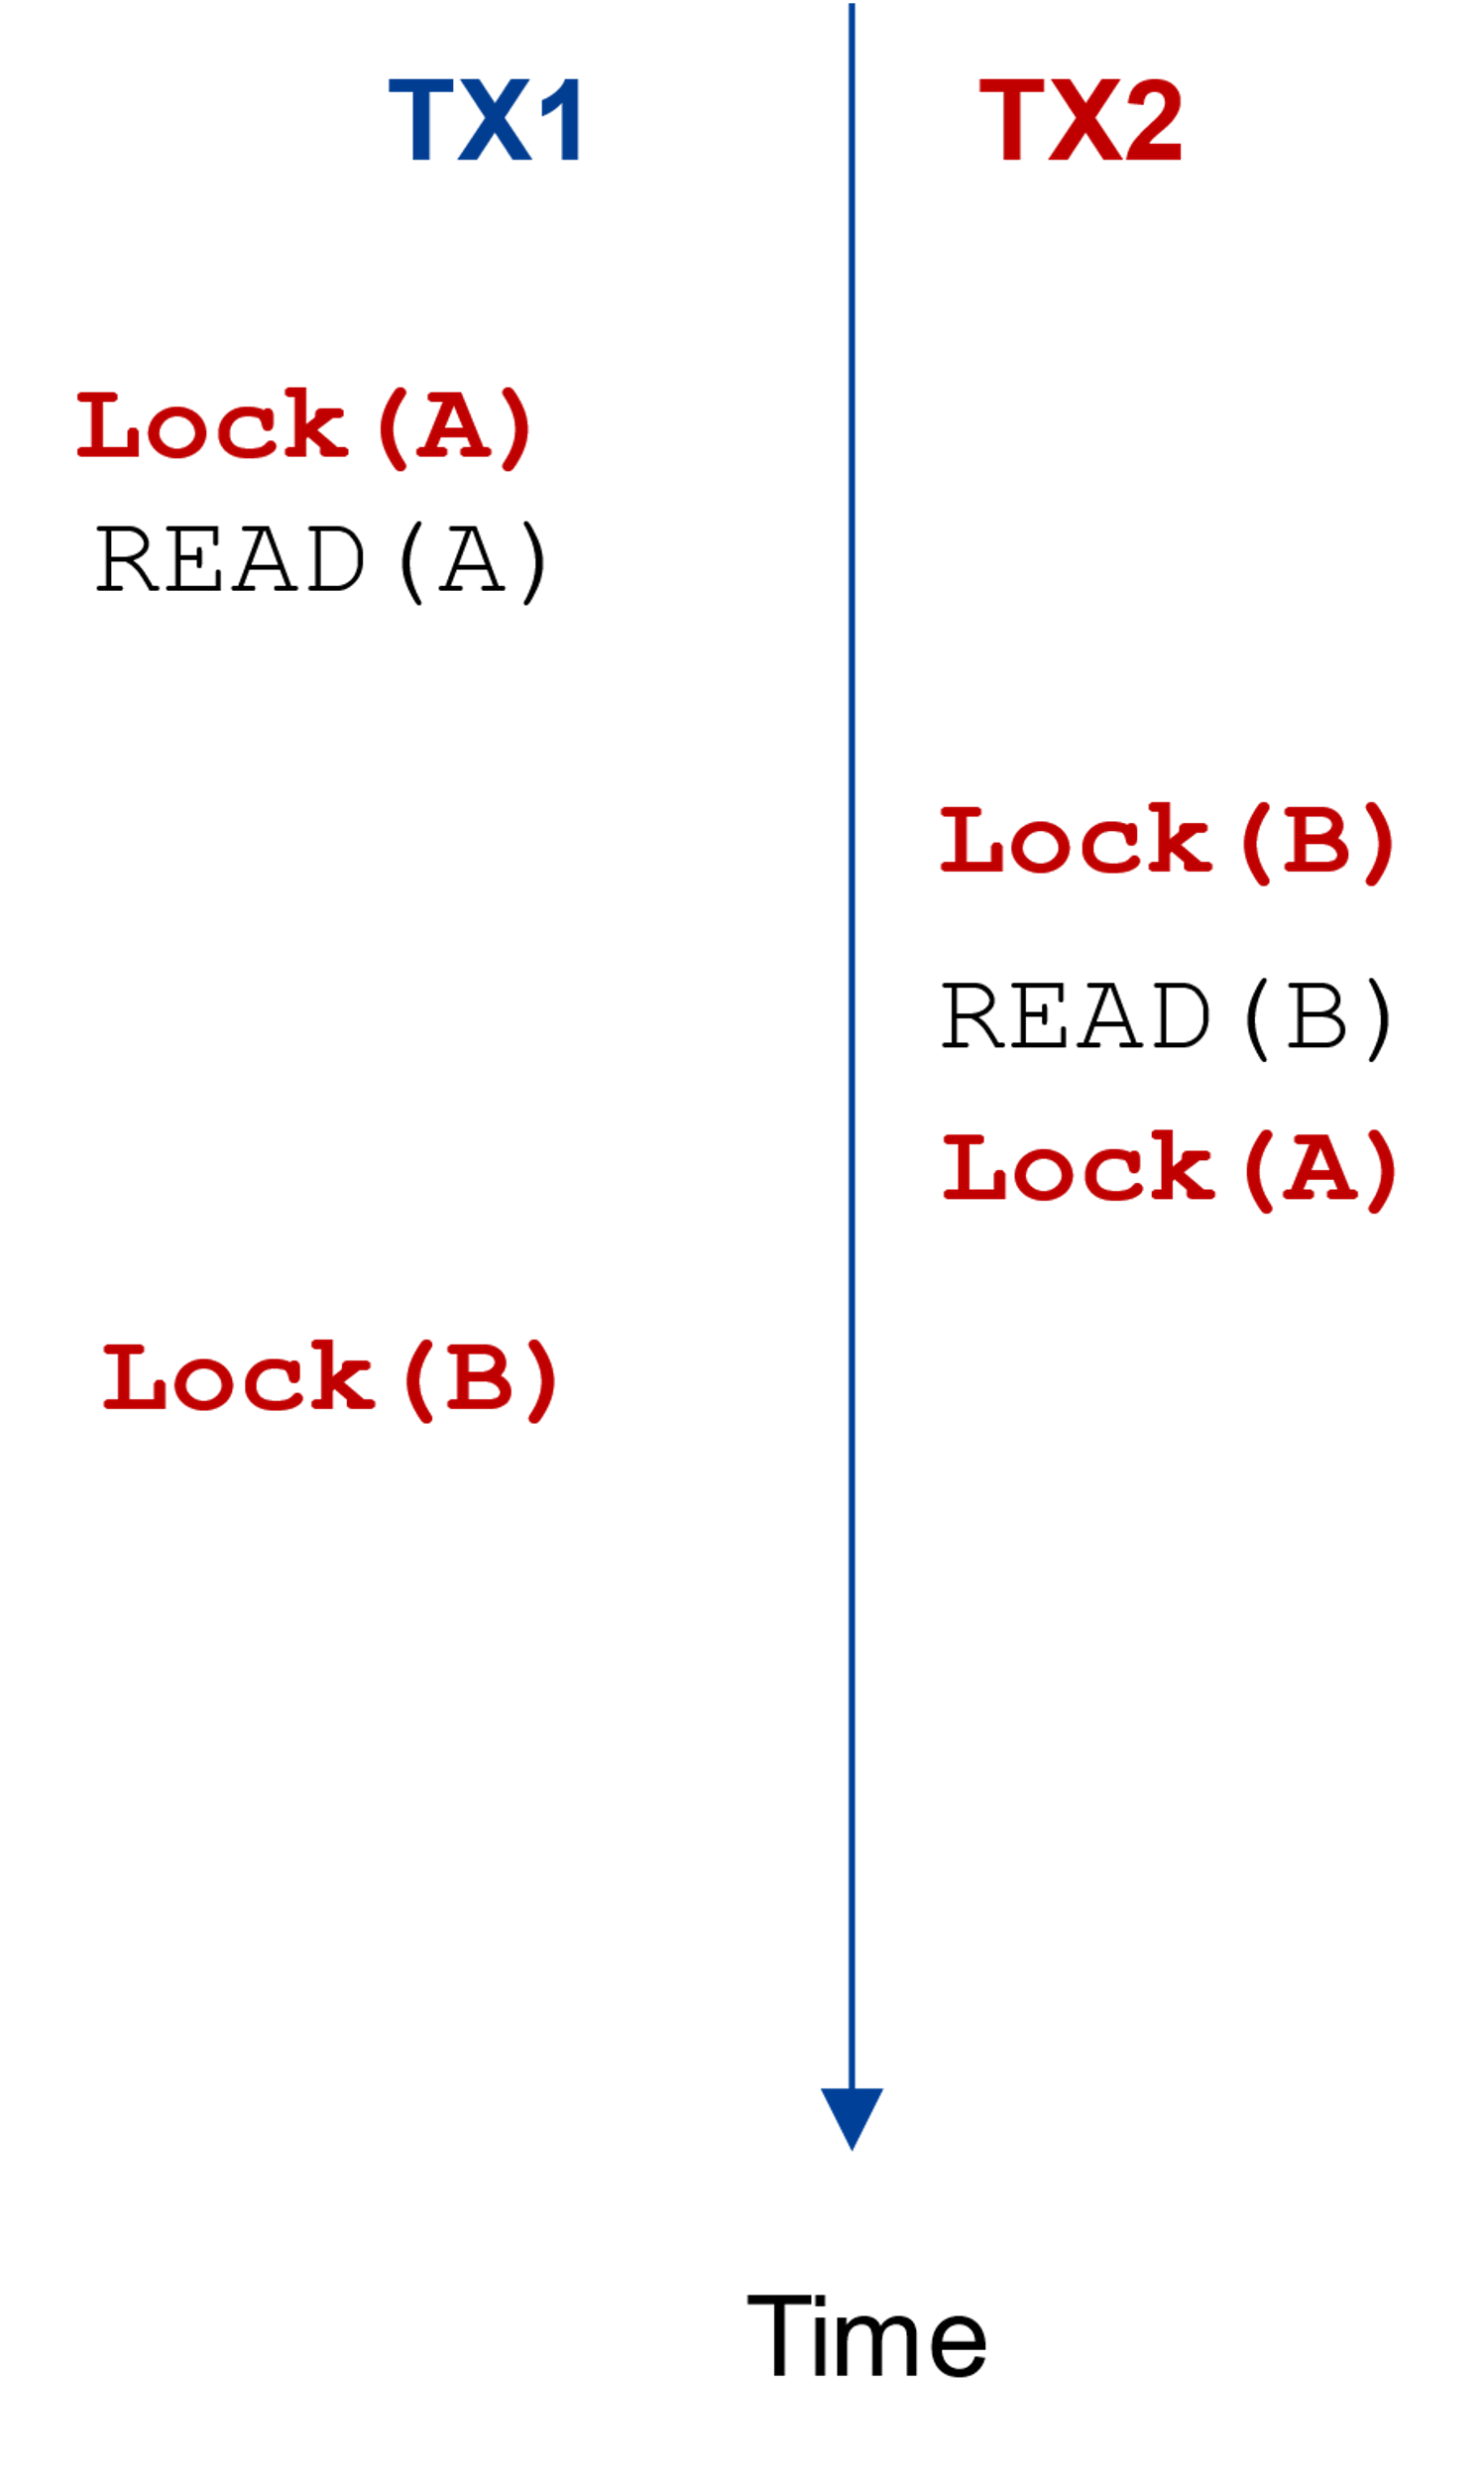
Problem of 2PL: deadlock
Suppose we change TX2 from first reading B instead of A
TX1
transfer(bank, a, b, amt):
bank[a] = bank[a] - amt
bank[b] = bank[b] + amt
audit(bank):
sum = 0
for acct in bank reversely:
sum = sum + bank[acct]
print(sum)
TX1

Slide 70
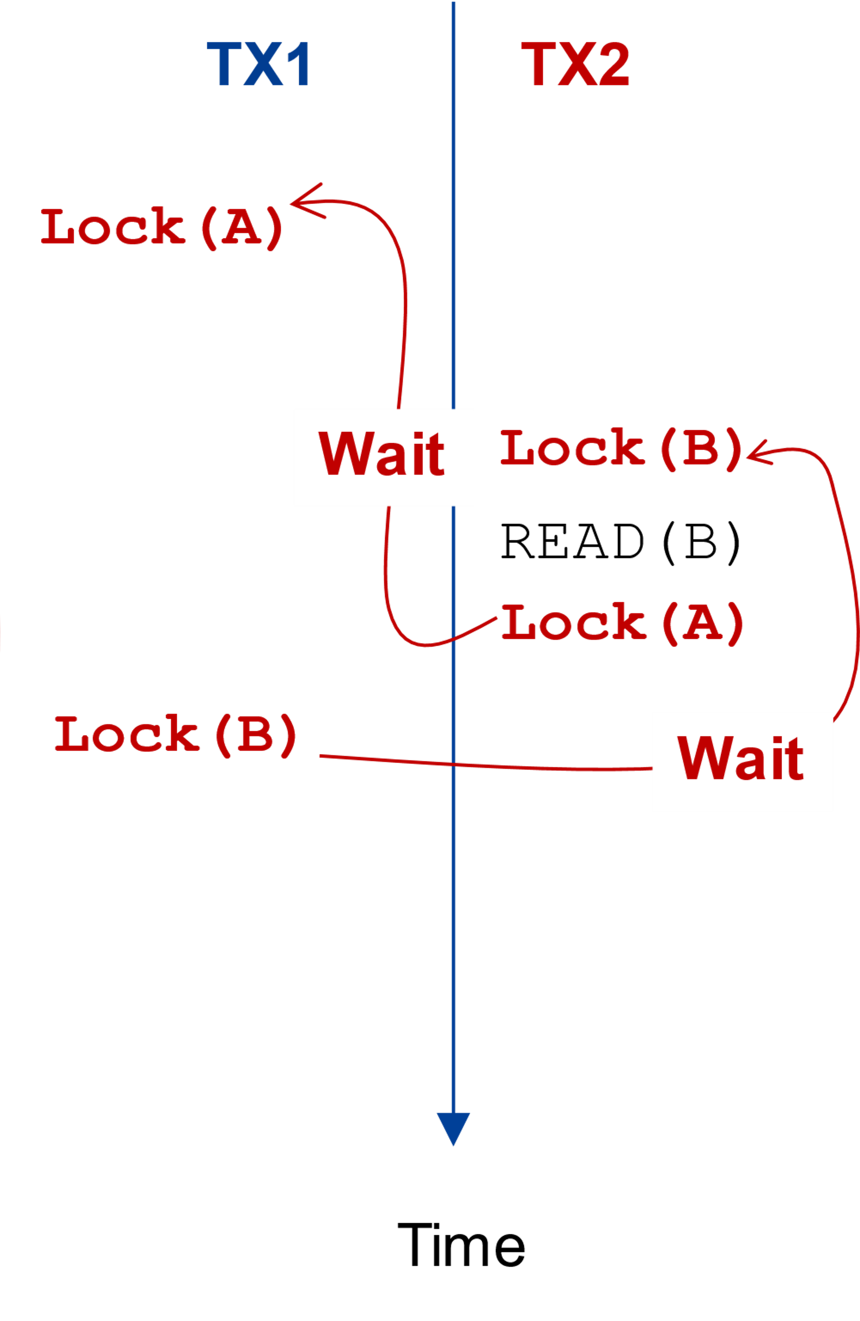
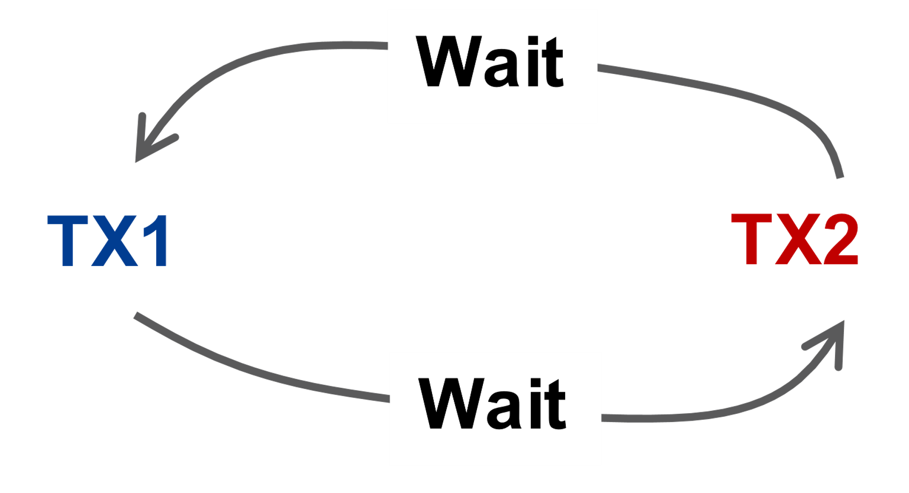
Problem of 2PL: deadlock
Suppose we change TX2 from first reading B instead of A
TX1
transfer(bank, a, b, amt):
bank[a] = bank[a] - amt
bank[b] = bank[b] + amt
audit(bank):
sum = 0
for acct in bank reversely:
sum = sum + bank[acct]
print(sum)
TX1

Slide 71
Resolving deadlock
1. Acquire locks in a pre-defined order
  Not support general TX: TX must know the read/write sets before execution
2. Detect deadlock by calculating the conflict graph
  If there is a cycle, then there must be a deadlock
  Abort one TX to break the cycle
  High cost for detection
3. Using heuristics (e.g., timestamp) to pre-abort the TXs
  May have false positive, or live locks

Slide 72
Can two-phase locking discussed above truly satisfy serializability?

Slide 73
Phantom Problem
T1
Update emp (set salary=1.1*salary) where dept=‘SS’
T2
Update emp (set dept=‘SS’) where emp.name=‘Rong’ or “Xujia”
Update Binyu
Update Haibo
Update Sandy
Update Yubin
Commit
Move Rong
Move Xujia
Commit (release all locks)
Only rong no xujia
R1(B)
R1(H)
W2(R)
W2(X)
C2
R1(R)
R1(S)
R1(Y)
C1

Slide 74
Phantom Problem
Issue:
  Only lock the things you touch,
  but must guarantee non-existence of any new ones!
Solutions
  Predicate locking
  Range locks in a B-tree index (e.g., assumes an index on dept),
  or lock entire table
  Often ignore in practice
Two operations conflict → they access the same data item and at least one is a write
e.g., object, row, list, entire table, ...

Slide 75
Transaction: widely used in large-scale websites
Caching server
Caching server
…
Caching server
All can use TX to manager data!
  e.g., FS meta data
Caching
Caching
Caching
Distributed caching
Database server
Database server
CDN
Users
Application #1
generate the page
Database
user, price
…
Database
user, price
Application server
Distributed database
Internet
Load
Balance
Application #2
add the order
File server
File server
File server
File:
image
File:
image
…
File:
image
Application server
…
…
Message queue
Distributed file system

Slide 76
Transaction: widely used in large-scale websites
if item.count > 0:
item.count -= 1
Cart.add(item)

