Slide 1


Network Layer
All about routing
SE124 (2021 Fall)
IPADS, Shanghai Jiao Tong University
https://www.sjtu.edu.cn
Credits to Katrina LaCurts, MIT

Slide 2
OSI, TCP/IP & Protocol Stack
7th Application Layer
Application Layer
HTTP
SMTP
POP3
FTP
…
End-to-end Layer
6th Presentation Layer
5th Session Layer
4th Transport Layer
Transport Layer
TCP
UDP
3th Network Layer
Network Layer
IP
Network Layer
ICMP
2nd Link Layer
Link Layer
ARP & RARP
Ethernet
PPP
…
Link Layer
1st Physical Layer
WiFi
Fiber
TD-LTE
FDD
…
OSI
TCP/IP
CSE

Slide 3
Network Layer

Slide 4
IP: Best-effort Network
1. Best-effort network
  If it cannot dispatch, may discard a packet
2. Guaranteed-delivery network
  Also called store-and-forward network, no discarding data
  Work with complete messages rather than packets
  Use disk for buffering to handle peaks
  Tracks individual message to make sure none are lost
In real world
  No absolute guarantee
  Guaranteed-delivery: higher layer; best-effort: lower layer

Slide 5
Duplicate Packets and Suppression
Discarding packets is common case
  Many network protocols include timeout and resend mechanism
When a congested forwarder discards a packet
  Client does not receive a response as quickly as originally hoped
  Users may prepared for duplicate requests and responses
  Detecting duplicates may or may not be important

Slide 6
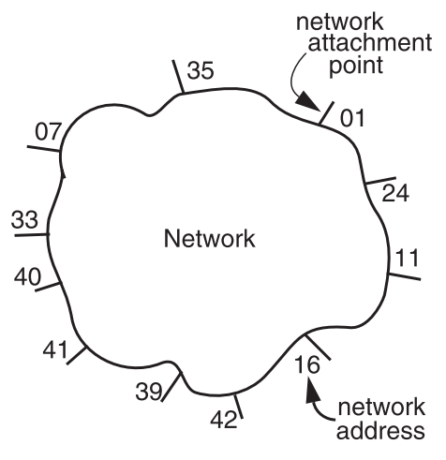
The Network Layer
Addressing interface
  Network attachment points
  Network address
  Source & destination
NETWORK_SEND
  (segment_buffer, destnation, network_protocol, end_layer_protocol)
NETWORK_HANDLE
  (packet, network_protocol)

Slide 7
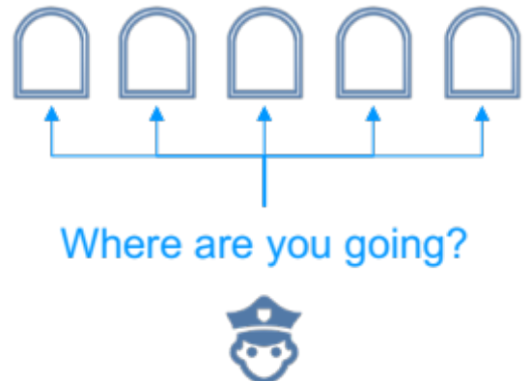
Managing the Forwarding Table: Routing
Routing (or path-finding)
  Constructing the tables
Impractical by hand
  Determining the best paths requires calculation
  Recalculating the table when links change
  Recalculating the table when link fails
  Adapt according to traffic congestion
Static routing vs. adaptive routing
  Adaptive routing requires exchange of info

Slide 8

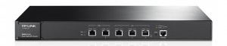
IP Route Table
Interface 1 … Interface N

Slide 9
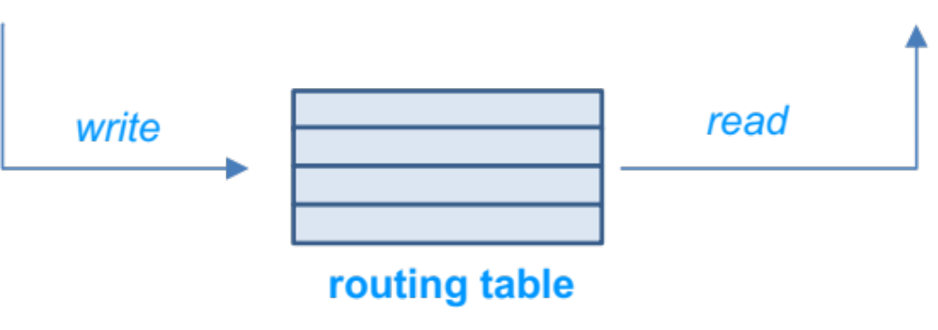
Control-plane VS. Data-plane
Control-plane
  Control the data flow by defining rules
  E.g., the routing algorithm
Data-plane
  Copies data according to the rules
  Performance critical
  E.g., the IP forwarding process

Slide 10
Routing
How to generate the routing table?

Slide 11

Goal of A Routing Protocol
Allow each switch to know, for every node dst in the network, a route to dst
Allow each switch to know, for every node dst in the network, a minimum-cost route to dst
Build a routing table at each switch, such that routing_table[dst] contains a minimum-cost route to dst

Slide 12
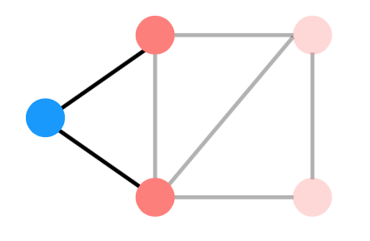
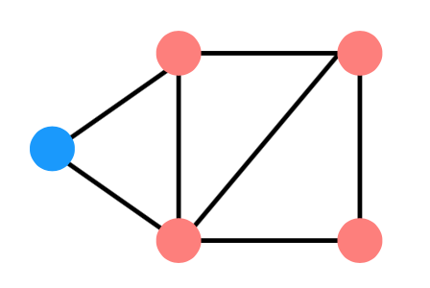
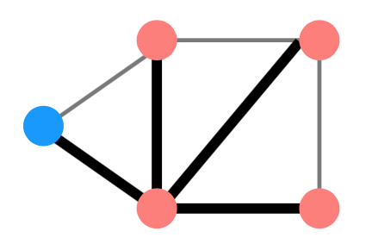
Distributed Routing: 3 Steps in General
Nodes learn about their neighbors via the HELLO protocol
Nodes learn about other reachable nodes via advertisements
Nodes determine the minimum-cost routes (of the routes they know about)

Slide 13
Two Types of Routing Protocol
Protocol 1: Link-state
  A node's advertisements contain a list of its neighbors and its link costs to those nodes
  Nodes advertise to everyone their costs to their neighbors
    via flooding
  Integrate using Dijkstra's shortest path algorithm
Protocol 2: Distance-vector
  Nodes advertise to neighbors with their cost to all known nodes
  Update routes via Bellman-Ford integration

Slide 14
link-state routing: disseminate full topology information so that nodes can run a shortest-path algorithm
link state
B
3
C
7
1
5
A
2
D
4
1
3
F
5
E

Slide 15
link-state routing: disseminate full topology information so that nodes can run a shortest-path algorithm
link state
B
3
C
what’s in an advertisement
its link costs to each of its neighbors
7
1
5
A
2
D
4
1
3
F
5
E

Slide 16
link-state routing: disseminate full topology information so that nodes can run a shortest-path algorithm
link state
B
3
C
what’s in an advertisement
its link costs to each of its neighbors
7
1
5
A
2
D
4
1
3
F E
5
A’s advertisement: [(B,7),(D,2),(F,1)]

Slide 17
link-state routing: disseminate full topology information so that nodes can run a shortest-path algorithm
link state
what’s in an advertisement
its link costs to each of its neighbors
who gets a node’s advertisement
B
3
C
7
1
5
A
2
D
4
1
3
F E
5
A’s advertisement: [(B,7),(D,2),(F,1)]

Slide 18
link-state routing: disseminate full topology information so that nodes can run a shortest-path algorithm
link state
what’s in an advertisement
its link costs to each of its neighbors
who gets a node’s advertisement
effectively, every other node (via flooding)
B
3
C
7
1
5
A
2
D
4
1
3
F E
5
A’s advertisement: [(B,7),(D,2),(F,1)]

Slide 19
link-state routing: disseminate full topology information so that nodes can run a shortest-path algorithm
link state
what’s in an advertisement
its link costs to each of its neighbors
who gets a node’s advertisement
effectively, every other node (via flooding)
B
3
C
7
1
5
A
2
D
4
1
3
F E
5
A’s advertisement: [(B,7),(D,2),(F,1)]

Slide 20
link-state routing: disseminate full topology information so that nodes can run a shortest-path algorithm
link state
what’s in an advertisement
its link costs to each of its neighbors
who gets a node’s advertisement
effectively, every other node (via flooding)
B
3
C
7
1
5
A
2
D
4
1
3
F E
5
A’s advertisement: [(B,7),(D,2),(F,1)]

Slide 21
link-state routing: disseminate full topology information so that nodes can run a shortest-path algorithm
link state
what’s in an advertisement
its link costs to each of its neighbors
who gets a node’s advertisement
effectively, every other node (via flooding)
B
3
C
7
1
5
A
2
D
4
1
3
F E
5
A’s advertisement: [(B,7),(D,2),(F,1)]

Slide 22
link-state routing: disseminate full topology information so that nodes can run a shortest-path algorithm
link state
what’s in an advertisement
its link costs to each of its neighbors
who gets a node’s advertisement
effectively, every other node (via flooding)
B
3
C
7
1
5
A
2
D
4
1
3
F E
5
A’s advertisement: [(B,7),(D,2),(F,1)]

Slide 23
link-state routing: disseminate full topology information so that nodes can run a shortest-path algorithm
link state
what’s in an advertisement
its link costs to each of its neighbors
who gets a node’s advertisement
effectively, every other node (via flooding)
B
3
C
7
1
5
A
2
D
4
1
3
F E
5
A’s advertisement: [(B,7),(D,2),(F,1)]

Slide 24
link-state routing: disseminate full topology information so that nodes can run a shortest-path algorithm
link state
what’s in an advertisement
its link costs to each of its neighbors
who gets a node’s advertisement
effectively, every other node (via flooding)
B
3
C
7
1
5
A
2
D
4
1
3
F E
5
A’s advertisement: [(B,7),(D,2),(F,1)]

Slide 25
link-state routing: disseminate full topology information so that nodes can run a shortest-path algorithm
link state
what’s in an advertisement
its link costs to each of its neighbors
who gets a node’s advertisement
effectively, every other node (via flooding)
B
3
C
7
1
5
A
2
D
4
1
3
F E
5
A’s advertisement: [(B,7),(D,2),(F,1)]

Slide 26
link-state routing: disseminate full topology information so that nodes can run a shortest-path algorithm
link state
what’s in an advertisement
its link costs to each of its neighbors
who gets a node’s advertisement
effectively, every other node (via flooding)
B
3
C
7
1
5
A
2
D
4
1
3
F E
5
A’s advertisement: [(B,7),(D,2),(F,1)]

Slide 27
link-state routing: disseminate full topology information so that nodes can run a shortest-path algorithm
link state
B
3
C
what’s in an advertisement
its link costs to each of its neighbors
7
1
5
who gets a node’s advertisement
A
2
D
effectively, every other node (via flooding)
4
1
3
F E
5
A’s advertisement: [(B,7),(D,2),(F,1)]
nodes keep track of which advertisements they’ve forwarded so that they don’t re-forward them

Slide 28
link-state routing: disseminate full topology information so that nodes can run a shortest-path algorithm
link state
B
3
C
what’s in an advertisement
its link costs to each of its neighbors
7
1
5
who gets a node’s advertisement
A
2
D
effectively, every other node (via flooding)
4
1
3
F E
5
A’s advertisement: [(B,7),(D,2),(F,1)]
nodes keep track of which advertisements they’ve forwarded so that they don’t re-forward them
they can also be a bit smarter about flooding, and not forward an advertisement back to the node that sent it

Slide 29
link-state routing: disseminate full topology information so that nodes can run a shortest-path algorithm
link state
B
3
C
what’s in an advertisement
its link costs to each of its neighbors
7
1
5
who gets a node’s advertisement
A
2
D
effectively, every other node (via flooding)
4
1
3
F
5
E
nodes integrate advertisements by running Dijkstra’s Algorithm

Slide 30
link-state routing: disseminate full topology information so that nodes can run a shortest-path algorithm
link state
B
3
C
what’s in an advertisement
its link costs to each of its neighbors
7
1
5
who gets a node’s advertisement
A
2
D
effectively, every other node (via flooding)
4
1
3
F
5
E
A’s routing table
dst | route | cost
B | | | A-B | | | 7
C | | | ? | | | ∞
D | | | A-D | | | 2
E | | | ? | | | ∞
F | | | A-F | | | 1

Slide 31
Link-state Routing
Keep track of W, the set of nodes haven't processed yet
  Initially, W is all nodes in the network
Keep track of the current costs and routes to all of the nodes. Initially:
  routing_table[self] = Self; routing_table[anyone else] = ?
  cost_table[self] = 0; cost_table[anyone else] = infinity
While W is not empty:
  1. u = the node in W we have the minimum cost to so far
  2. Remove u from W
  3. For every neighbor v of u:
  d = cost_table[u] + cost(u, v)
  if d < cost_table[v]
  cost_table[v] = d
  routing_table[v] = routing_table[u]

Slide 32
link-state routing: disseminate full topology information so that nodes can run a shortest-path algorithm
link state
B
3
C
what’s in an advertisement
its link costs to each of its neighbors
7
1
5
who gets a node’s advertisement
A
2
D
effectively, every other node (via flooding)
4
1
3
F
5
E
A’s routing table
dst | route | cost
B | | | A-B | | | 7
C | | | ? | | | ∞
D | | | A-D | | | 2
E | | | ? | | | ∞
F | | | A-F | | | 1

Slide 33
link-state routing: disseminate full topology information so that nodes can run a shortest-path algorithm
link state
B
3
C
what’s in an advertisement
its link costs to each of its neighbors
7
1
5
who gets a node’s advertisement
A
2
D
effectively, every other node (via flooding)
4
1
3
F
5
E
A’s routing table
dst | route | cost
B | | | A-B | | | 7
C | | | ? | | | ∞
D | | | A-D | | | 2
E | | | ? | | | ∞
F | | | A-F | | | 1

Slide 34
link-state routing: disseminate full topology information so that nodes can run a shortest-path algorithm
link state
B
3
C
what’s in an advertisement
its link costs to each of its neighbors
7
1
5
who gets a node’s advertisement
A
2
D
effectively, every other node (via flooding)
4
1
3
F
5
E
A’s routing table
dst | route | cost
B | | | A-B | | | 7
C | | | ? | | | ∞
D | | | A-D | | | 2
E | | | ? | | | ∞
F | | | A-F | | | 1

Slide 35
link-state routing: disseminate full topology information so that nodes can run a shortest-path algorithm
link state
B
3
C
what’s in an advertisement
its link costs to each of its neighbors
7
1
5
who gets a node’s advertisement
A
2
D
effectively, every other node (via flooding)
4
1
3
F
5
E
A’s routing table
dst | route | cost
B | | | A-B | | | 7
C | | | ? | | | ∞
D | | | A-D | | | 2
E | | | ? | | | ∞
F | | | A-F | | | 1
F does not provide A with a better route to D

Slide 36
link-state routing: disseminate full topology information so that nodes can run a shortest-path algorithm
link state
B
3
C
what’s in an advertisement
its link costs to each of its neighbors
7
1
5
who gets a node’s advertisement
A
2
D
effectively, every other node (via flooding)
4
1
3
F
5
E
A’s routing table
dst | route | cost
B | | | A-B | | | 7
C | | | ? | | | ∞
D | | | A-D | | | 2
E | | | ? | | | ∞
F | | | A-F | | | 1

Slide 37
link-state routing: disseminate full topology information so that nodes can run a shortest-path algorithm
link state
B
3
C
what’s in an advertisement
its link costs to each of its neighbors
7
1
5
who gets a node’s advertisement
A
2
D
effectively, every other node (via flooding)
4
1
3
F
5
E
A’s routing table
dst | route | cost
B | | | A-B | | | 7
C | | | ? | | | ∞
D | | | A-D | | | 2
E | | | A-F | | | 6
F | | | A-F | | | 1
= the cost from A to F + the cost from F to E

Slide 38
link-state routing: disseminate full topology information so that nodes can run a shortest-path algorithm
link state
B
3
C
what’s in an advertisement
its link costs to each of its neighbors
7
1
5
who gets a node’s advertisement
A
2
D
effectively, every other node (via flooding)
4
1
3
F
5
E
A’s routing table
dst | route | cost
B | | | A-B | | | 7
C | | | ? | | | ∞
D | | | A-D | | | 2
E | | | A-F | | | 6
F | | | A-F | | | 1

Slide 39
link-state routing: disseminate full topology information so that nodes can run a shortest-path algorithm
link state
B
3
C
what’s in an advertisement
its link costs to each of its neighbors
7
1
5
who gets a node’s advertisement
A
2
D
effectively, every other node (via flooding)
4
1
3
F
5
E
A’s routing table
dst | route | cost
B | | | A-B | | | 7
C | | | ? | | | ∞
D | | | A-D | | | 2
E | | | A-F | | | 6
F | | | A-F | | | 1

Slide 40
link-state routing: disseminate full topology information so that nodes can run a shortest-path algorithm
link state
B
3
C
what’s in an advertisement
its link costs to each of its neighbors
7
1
5
who gets a node’s advertisement
A
2
D
effectively, every other node (via flooding)
4
1
3
F
5
E
A’s routing table
dst | route | cost
B | | | A-B | | | 7
C | | | ? | | | ∞
D | | | A-D | | | 2
E | | | A-F | | | 6
F | | | A-F | | | 1

Slide 41
link-state routing: disseminate full topology information so that nodes can run a shortest-path algorithm
link state
B
3
C
what’s in an advertisement
its link costs to each of its neighbors
7
1
5
who gets a node’s advertisement
A
2
D
effectively, every other node (via flooding)
4
1
3
F
5
E
A’s routing table
dst | route | cost
B | | | A-B | | | 3
C | | | ? | | | ∞
D | | | A-D | | | 2
E | | | A-F | | | 6
F | | | A-F | | | 1

Slide 42
link-state routing: disseminate full topology information so that nodes can run a shortest-path algorithm
link state
B
3
C
what’s in an advertisement
its link costs to each of its neighbors
7
1
5
who gets a node’s advertisement
A
2
D
effectively, every other node (via flooding)
4
1
3
F
5
E
A’s routing table
dst | route | cost
B | | | A-B | | | 3
C | | | ? | | | ∞
D | | | A-D | | | 2
E | | | A-F | | | 6
F | | | A-F | | | 1

Slide 43
link-state routing: disseminate full topology information so that nodes can run a shortest-path algorithm
link state
B
3
C
what’s in an advertisement
its link costs to each of its neighbors
7
1
5
who gets a node’s advertisement
A
2
D
effectively, every other node (via flooding)
4
1
3
F
5
E
A’s routing table
dst | route | cost
B | | | A-B | | | 3
C | | | A-D | | | 7
D | | | A-D | | | 2
E | | | A-F | | | 6
F | | | A-F | | | 1

Slide 44
link-state routing: disseminate full topology information so that nodes can run a shortest-path algorithm
link state
B
3
C
what’s in an advertisement
its link costs to each of its neighbors
7
1
5
who gets a node’s advertisement
A
2
D
effectively, every other node (via flooding)
4
1
3
F
5
E
A’s routing table
dst | route | cost
B | | | A-B | | | 3
C | | | A-D | | | 7
D | | | A-D | | | 2
E | | | A-F | | | 6
F | | | A-F | | | 1

Slide 45
link-state routing: disseminate full topology information so that nodes can run a shortest-path algorithm
link state
B
3
C
what’s in an advertisement
its link costs to each of its neighbors
7
1
5
who gets a node’s advertisement
A
2
D
effectively, every other node (via flooding)
4
1
3
F
5
E
A’s routing table
dst | route | cost
B | | | A-B | | | 3
C | | | A-D | | | 7
D | | | A-D | | | 2
E | | | A-D | | | 5
F | | | A-F | | | 1

Slide 46
link-state routing: disseminate full topology information so that nodes can run a shortest-path algorithm
link state
what’s in an advertisement
its link costs to each of its neighbors
who gets a node’s advertisement
effectively, every other node (via flooding)
B
3
C
7
1
5
A
2
D
4
1
3
F
5
E
A’s routing table
dst | route | cost
B | | | A-B | | | 3
C | | | A-D | | | 7
D | | | A-D | | | 2
E | | | A-D | | | 5
F | | | A-F | | | 1
we don’t need to “visit” F; we already know the shortest path to it

Slide 47
link-state routing: disseminate full topology information so that nodes can run a shortest-path algorithm
link state
B
3
C
what’s in an advertisement
its link costs to each of its neighbors
7
1
5
who gets a node’s advertisement
A
2
D
effectively, every other node (via flooding)
4
1
3
F
5
E
A’s routing table
dst | route | cost
B | | | A-B | | | 3
C | | | A-D | | | 7
D | | | A-D | | | 2
E | | | A-D | | | 5
F | | | A-F | | | 1

Slide 48
link-state routing: disseminate full topology information so that nodes can run a shortest-path algorithm
link state
B
3
C
what’s in an advertisement
its link costs to each of its neighbors
7
1
5
who gets a node’s advertisement
A
2
D
effectively, every other node (via flooding)
4
1
3
F
5
E
A’s routing table
dst | route | cost
B | | | A-B | | | 3
C | | | A-D | | | 7
D | | | A-D | | | 2
E | | | A-D | | | 5
F | | | A-F | | | 1

Slide 49
link-state routing: disseminate full topology information so that nodes can run a shortest-path algorithm
link state
what’s in an advertisement
its link costs to each of its neighbors
who gets a node’s advertisement
effectively, every other node (via flooding)
B
3
C
7
1
5
A
2
D
4
1
3
F
5
E
A’s routing table
dst | route | cost
B | | | A-B | | | 3
C | | | A-D | | | 6
D | | | A-D | | | 2
E | | | A-D | | | 5
F | | | A-F | | | 1
notice that A’s route doesn’t change, but the cost needs to update
(and the actual path of the packets from A to C has changed)

Slide 50
link-state routing: disseminate full topology information so that nodes can run a shortest-path algorithm
link state
B
3
C
what’s in an advertisement
its link costs to each of its neighbors
7
1
5
who gets a node’s advertisement
A
2
D
effectively, every other node (via flooding)
4
1
3
F
5
E
A’s routing table
dst | route | cost
B | | | A-B | | | 3
C | | | A-D | | | 6
D | | | A-D | | | 2
E | | | A-D | | | 5
F | | | A-F | | | 1

Slide 51
link-state routing: disseminate full topology information so that nodes can run a shortest-path algorithm
link state
B
3
C
what’s in an advertisement
its link costs to each of its neighbors
7
1
5
who gets a node’s advertisement
A
2
D
effectively, every other node (via flooding)
4
1
3
F
5
E
A’s routing table
dst | route | cost
B | | | A-B | | | 3
C | | | A-D | | | 6
D | | | A-D | | | 2
E | | | A-D | | | 5
F | | | A-F | | | 1

Slide 52
link-state routing: disseminate full topology information so that nodes can run a shortest-path algorithm
link state
B
3
C
what’s in an advertisement
its link costs to each of its neighbors
7
1
5
who gets a node’s advertisement
A
2
D
effectively, every other node (via flooding)
4
1
3
F
5
E
A’s routing table
dst | route | cost
B | | | A-B | | | 3
C | | | A-D | | | 6
D | | | A-D | | | 2
E | | | A-D | | | 5
F | | | A-F | | | 1

Slide 53
link-state routing: disseminate full topology information so that nodes can run a shortest-path algorithm
link state
B
3
C
what’s in an advertisement
its link costs to each of its neighbors
7
1
5
who gets a node’s advertisement
A
2
D
effectively, every other node (via flooding)
4
1
3
what happens when things fail?
flooding makes link- state routing very resilient to failure
F
5
E
what limits scale?
the overhead of flooding

Slide 54
Distance-vector Routing
In link-state, nodes calculate full shortest paths. But actually they only need the route (first-hop) to a destination
Advertisement format: Each node's advertisement is a list of all the nodes it knows about, and its current costs to those nodes
  Initially, this advertisement is just [(self, 0)].
Nodes who receive an advertisement: Node X's advertisement will be received only by its neighbors
Integrate step: When node X receives an advertisement from its neighbor Y, this advertisement will be a list of [(dst, cost)] pairs. Each cost represents Y's cost to dst

Slide 55
Distance-vector Routing
For each (dst, cost) in the advertisement, X needs to check for two things:
  If X is already using Y to get to dst, update the cost information (remember, costs can change!)
  If X is not already using Y to get to dst, see if Y could provide a better path; if so, update the routing and cost information

Slide 56
distance-vector routing: disseminate information about the current costs to each node, rather than the actual topology
link state distance vector
what’s in an advertisement
B
3
C
its link costs to each of its neighbors
7
1
5
who gets a node’s advertisement
A
2
D
effectively, every other node (via flooding)
4
1
3
what happens when things fail?
flooding makes link- state routing very resilient to failure
F
5
E
what limits scale?
the overhead of flooding

Slide 57
distance-vector routing: disseminate information about the current costs to each node, rather than the actual topology
link state distance vector
what’s in an advertisement
B
3
C
its link costs to each of its neighbors
its current costs to
every node it’s aware of
7
1
5
who gets a node’s advertisement
A
2
D
effectively, every other node (via flooding)
4
1
3
what happens when things fail?
flooding makes link- state routing very resilient to failure
F
5
E
what limits scale?
the overhead of flooding

Slide 58
distance-vector routing: disseminate information about the current costs to each node, rather than the actual topology
link state distance vector
what’s in an advertisement
B
3
C
its link costs to each of its neighbors
its current costs to
every node it’s aware of
7
1
5
who gets a node’s advertisement
A
2
D
effectively, every other node (via flooding)
4
1
3
what happens when things fail?
flooding makes link- state routing very resilient to failure
F E
5
A’s first advertisement: [(B,7),(D,2),(F,1)]
A could also include (A,0) here
A’s routing table
what limits scale?
the overhead of flooding
dst | route | cost
A’s advertisement reflects its routing table, and right now, A only knows about its neighbors
B | A-B | 7 D | A-D | 2
F
|
A-F
|
1

Slide 59
distance-vector routing: disseminate information about the current costs to each node, rather than the actual topology
link state distance vector
what’s in an advertisement
B
3
C
its link costs to each of its neighbors
its current costs to
every node it’s aware of
7
1
5
who gets a node’s advertisement
A
2
D
effectively, every other node (via flooding)
only its neighbors
4
1
3
what happens when things fail?
flooding makes link- state routing very resilient to failure
F E
5
A’s first advertisement: [(B,7),(D,2),(F,1)]
A could also include (A,0) here
A’s routing table
what limits scale?
the overhead of flooding
dst | route | cost
A’s advertisement reflects its routing table, and right now, A only knows about its neighbors
B | A-B | 7 D | A-D | 2
F
|
A-F
|
1

Slide 60
distance-vector routing: disseminate information about the current costs to each node, rather than the actual topology
link state distance vector
what’s in an advertisement
B
3
C
its link costs to each of its neighbors
its current costs to
every node it’s aware of
7
1
5
who gets a node’s advertisement
A
2
D
effectively, every other node (via flooding)
only its neighbors
4
1
3
what happens when things fail?
flooding makes link- state routing very resilient to failure
F E
5
A’s first advertisement: [(B,7),(D,2),(F,1)]
A could also include (A,0) here
A’s routing table
what limits scale?
the overhead of flooding
dst | route | cost
A’s advertisement reflects its routing table, and right now, A only knows about its neighbors
B | A-B | 7 D | A-D | 2
F
|
A-F
|
1

Slide 61
distance-vector routing: disseminate information about the current costs to each node, rather than the actual topology
link state distance vector
what’s in an advertisement
B
3
C
its link costs to each of its neighbors
its current costs to
every node it’s aware of
7
1
5
who gets a node’s advertisement
A
2
D
effectively, every other node (via flooding)
only its neighbors
4
1
3
what happens when things fail?
flooding makes link- state routing very resilient to failure
F E
5
A’s first advertisement: [(B,7),(D,2),(F,1)]
A could also include (A,0) here
A’s routing table
what limits scale?
the overhead of flooding
dst | route | cost
A’s advertisement reflects its routing table, and right now, A only knows about its neighbors
B | A-B | 7 D | A-D | 2
F
|
A-F
|
1

Slide 62
distance-vector routing: disseminate information about the current costs to each node, rather than the actual topology
link state distance vector
what’s in an advertisement
B
3
C
its link costs to each of its neighbors
its current costs to
every node it’s aware of
7
1
5
who gets a node’s advertisement
A
2
D
effectively, every other node (via flooding)
only its neighbors
4
1
3
what happens when things fail?
flooding makes link- state routing very resilient to failure
F E
5
A’s first advertisement: [(B,7),(D,2),(F,1)]
what limits scale?
A’s routing table
dst | route | cost
the overhead of flooding
A’s neighbors do not forward A’s advertisements; they do send advertisements of their own to A
B | A-B | 7 D | A-D | 2
F
|
A-F
|
1

Slide 63
distance-vector routing: disseminate information about the current costs to each node, rather than the actual topology
link state distance vector
what’s in an advertisement
B
3
C
its link costs to each of its neighbors
its current costs to
every node it’s aware of
7
1
5
who gets a node’s advertisement
A
2
D
effectively, every other node (via flooding)
only its neighbors
4
1
3
what happens when things fail?
flooding makes link- state routing very resilient to failure
F E
5
A’s first advertisement: [(B,7),(D,2),(F,1)]
what limits scale?
A’s routing table
dst | route | cost
the overhead of flooding
A’s neighbors do not forward A’s advertisements; they do send advertisements of their own to A
B | A-B | 7 D | A-D | 2
F
|
A-F
|
1

Slide 64
distance-vector routing: disseminate information about the current costs to each node, rather than the actual topology
link state distance vector
what’s in an advertisement
B
3
C
its link costs to each of its neighbors
its current costs to
every node it’s aware of
7
1
5
who gets a node’s advertisement
A
2
D
effectively, every other node (via flooding)
only its neighbors
4
1
3
what happens when things fail?
flooding makes link- state routing very resilient to failure
F E
5
A’s first advertisement: [(B,7),(D,2),(F,1)]
what limits scale?
A’s routing table
dst | route | cost
the overhead of flooding
A’s neighbors do not forward A’s advertisements; they do send advertisements of their own to A
B | A-B | 7 D | A-D | 2
F
|
A-F
|
1

Slide 65
distance-vector routing: disseminate information about the current costs to each node, rather than the actual topology
link state distance vector
what’s in an advertisement
B
3
C
its link costs to each of its neighbors
its current costs to
every node it’s aware of
7
1
5
who gets a node’s advertisement
A
2
D
effectively, every other node (via flooding)
only its neighbors
4
1
3
what happens when things fail?
flooding makes link- state routing very resilient to failure
F E
5
A’s first advertisement: [(B,7),(D,2),(F,1)]
what limits scale?
A’s routing table
dst | route | cost
the overhead of flooding
A’s neighbors do not forward A’s advertisements; they do send advertisements of their own to A
B | A-B | 7 D | A-D | 2
F
|
A-F
|
1

Slide 66
distance-vector routing: disseminate information about the current costs to each node, rather than the actual topology
link state distance vector
what’s in an advertisement
B
3
C
its link costs to each of its neighbors
its current costs to
every node it’s aware of
7
1
5
who gets a node’s advertisement
A
2
D
effectively, every other node (via flooding)
only its neighbors
4
1
3
what happens when things fail?
flooding makes link- state routing very resilient to failure
F
5
E
what limits scale?
A’s routing table
dst | route | cost
B’s | first | adv: | [(A,7), | (C,3), | (D,1)]
D’s | first | adv: | [(B,1), | (C,5), | (E,3), | (F,4)]
F’s | first | adv: | [(A,1), | (D,4), | (E,5)]
the overhead of flooding
B | A-B | 7 D | A-D | 2
F
|
A-F
|
1
A receives advertisements
from B, D, and F

Slide 67
distance-vector routing: disseminate information about the current costs to each node, rather than the actual topology
link state distance vector
what’s in an advertisement
B
3
C
its link costs to each of its neighbors
its current costs to
every node it’s aware of
7
1
5
who gets a node’s advertisement
A
2
D
effectively, every other node (via flooding)
only its neighbors
4
1
3
what happens when things fail?
flooding makes link- state routing very resilient to failure
F
5
E
what limits scale?
A’s routing table
dst | route | cost
B’s | first | adv: | [(A,7), | (C,3), | (D,1)]
D’s | first | adv: | [(B,1), | (C,5), | (E,3), | (F,4)]
F’s | first | adv: | [(A,1), | (D,4), | (E,5)]
the overhead of flooding
B | A-B | 7 D | A-D | 2
F
|
A-F
|
1

Slide 68
distance-vector routing: disseminate information about the current costs to each node, rather than the actual topology
link state distance vector
what’s in an advertisement
B
3
C
its link costs to each of its neighbors
its current costs to
every node it’s aware of
7
1
5
who gets a node’s advertisement
A
2
D
effectively, every other node (via flooding)
only its neighbors
4
1
3
what happens when things fail?
flooding makes link- state routing very resilient to failure
F
E
what limits scale?
A’s routing table
dst | route | cost
B’s | first | adv: | [(A,7), | (C,3), | (D,1)]
the overhead of flooding
B | A-B | 7 D | A-D | 2
F
|
A-F
|
1

Slide 69
distance-vector routing: disseminate information about the current costs to each node, rather than the actual topology
link state distance vector
what’s in an advertisement
B
3
C
its link costs to each of its neighbors
its current costs to
every node it’s aware of
7
1
5
who gets a node’s advertisement
A
2
D
effectively, every other node (via flooding)
only its neighbors
4
1
3
what happens when things fail?
flooding makes link- state routing very resilient to failure
F
5
E
what limits scale?
A’s routing table
dst | route | cost
B’s | first | adv: | [(A,7), | (C,3), | (D,1)]
the overhead of flooding
B | A-B | 7 C | A-B | 10
D | A-D | 2
A's cost to B + B's cost to C
F
|
A-F
|
1

Slide 70
distance-vector routing: disseminate information about the current costs to each node, rather than the actual topology
link state distance vector
what’s in an advertisement
B
3
C
its link costs to each of its neighbors
its current costs to
every node it’s aware of
7
1
5
who gets a node’s advertisement
A
2
D
effectively, every other node (via flooding)
only its neighbors
4
1
3
what happens when things fail?
flooding makes link- state routing very resilient to failure
F
5
E
what limits scale?
A’s routing table
dst | route | cost
B’s | first | adv: | [(A,7), | (C,3), | (D,1)]
D’s | first | adv: | [(B,1), | (C,5), | (E,3), | (F,4)]
F’s | first | adv: | [(A,1), | (D,4), | (E,5)]
the overhead of flooding
B | A-B | 7 C | A-B | 10
D | A-D | 2
F
|
A-F
|
1

Slide 71
distance-vector routing: disseminate information about the current costs to each node, rather than the actual topology
link state distance vector
what’s in an advertisement
B
3
C
its link costs to each of its neighbors
its current costs to
every node it’s aware of
7
1
5
who gets a node’s advertisement
A
2
D
effectively, every other node (via flooding)
only its neighbors
4
1
3
what happens when things fail?
flooding makes link- state routing very resilient to failure
F
5
E
what limits scale?
A’s routing table
dst | route | cost
the overhead of flooding
D’s first adv: [(B,1), (C,5), (E,3), (F,4)]
B | A-B | 7 C | A-B | 10
D | A-D | 2
F
|
A-F
|
1

Slide 72
distance-vector routing: disseminate information about the current costs to each node, rather than the actual topology
link state distance vector
what’s in an advertisement
B
3
C
its link costs to each of its neighbors
its current costs to
every node it’s aware of
7
1
5
who gets a node’s advertisement
A
2
D
effectively, every other node (via flooding)
only its neighbors
4
1
3
what happens when things fail?
flooding makes link- state routing very resilient to failure
F
5
E
what limits scale?
A’s routing table
dst | route | cost
the overhead of flooding
D’s first adv: [(B,1), (C,5), (E,3), (F,4)]
B | A-D | 3 C | A-B | 10
D | A-D | 2
F
|
A-F
|
1

Slide 73
distance-vector routing: disseminate information about the current costs to each node, rather than the actual topology
link state distance vector
what’s in an advertisement
B
3
C
its link costs to each of its neighbors
its current costs to
every node it’s aware of
7
1
5
who gets a node’s advertisement
A
2
D
effectively, every other node (via flooding)
only its neighbors
4
1
3
what happens when things fail?
flooding makes link- state routing very resilient to failure
F
5
E
what limits scale?
A’s routing table
dst | route | cost
the overhead of flooding
D’s first adv: [(B,1), (C,5), (E,3), (F,4)]
B | A-D | 3 C | A-D | 7
D | A-D | 2
F
|
A-F
|
1

Slide 74
distance-vector routing: disseminate information about the current costs to each node, rather than the actual topology
link state distance vector
what’s in an advertisement
B
3
C
its link costs to each of its neighbors
its current costs to
every node it’s aware of
7
1
5
who gets a node’s advertisement
A
2
D
effectively, every other node (via flooding)
only its neighbors
4
1
3
what happens when things fail?
flooding makes link- state routing very resilient to failure
F
5
E
what limits scale?
A’s routing table
dst | route | cost
the overhead of flooding
D’s first adv: [(B,1), (C,5), (E,3), (F,4)]
B | A-D | 3 C | A-D | 7
D | A-D | 2
E | A-D | 5
F
|
A-F
|
1

Slide 75
distance-vector routing: disseminate information about the current costs to each node, rather than the actual topology
link state distance vector
what’s in an advertisement
B
3
C
its link costs to each of its neighbors
its current costs to
every node it’s aware of
7
1
5
who gets a node’s advertisement
A
2
D
effectively, every other node (via flooding)
only its neighbors
4
1
3
what happens when things fail?
flooding makes link- state routing very resilient to failure
F
5
E
what limits scale?
A’s routing table
dst | route | cost
B’s | first | adv: | [(A,7), | (C,3), | (D,1)]
D’s | first | adv: | [(B,1), | (C,5), | (E,3), | (F,4)]
F’s | first | adv: | [(A,1), | (D,4), | (E,5)]
the overhead of flooding
B | A-D | 3 C | A-D | 7
D | A-D | 2
E | A-D | 5
F
|
A-F
|
1

Slide 76
distance-vector routing: disseminate information about the current costs to each node, rather than the actual topology
link state distance vector
what’s in an advertisement
B
3
C
its link costs to each of its neighbors
its current costs to
every node it’s aware of
7
1
5
who gets a node’s advertisement
A
2
D
effectively, every other node (via flooding)
only its neighbors
4
1
3
what happens when things fail?
flooding makes link- state routing very resilient to failure
F
5
E
what limits scale?
A’s routing table
dst | route | cost
the overhead of flooding
F’s first adv: [(A,1), (D,4), (E,5)]
B | A-D | 3 C | A-D | 7
D | A-D | 2
E | A-D | 5
F
|
A-F
|
1

Slide 77
distance-vector routing: disseminate information about the current costs to each node, rather than the actual topology
link state distance vector
what’s in an advertisement
B
3
C
its link costs to each of its neighbors
its current costs to
every node it’s aware of
7
1
5
who gets a node’s advertisement
A
2
D
effectively, every other node (via flooding)
only its neighbors
4
1
3
what happens when things fail?
flooding makes link- state routing very resilient to failure
F
5
E
this is A’s routing table after one round of advertisements; note that it does not have knowledge of the min-cost route to C yet
what limits scale?
A’s routing table
dst | route | cost
the overhead of flooding
B | A-D | 3 C | A-D | 7
D | A-D | 2
E | A-D | 5
F
|
A-F
|
1

Slide 78
distance-vector routing: disseminate information about the current costs to each node, rather than the actual topology
link state distance vector
what’s in an advertisement
B
3
C
its link costs to each of its neighbors
its current costs to
every node it’s aware of
7
1
5
who gets a node’s advertisement
A
2
D
effectively, every other node (via flooding)
only its neighbors
4
1
3
what happens when things fail?
flooding makes link- state routing very resilient to failure
F
5
E
what limits scale?
A’s routing table
dst | route | cost
A’s second adv:
[(B,3), (C,7), (D,2), (E,5), (F,1)]
the overhead of flooding
B | A-D | 3 C | A-D | 7
D | A-D | 2
E | A-D | 5
F
|
A-F
|
1

Slide 79
distance-vector routing: disseminate information about the current costs to each node, rather than the actual topology
link state distance vector
what’s in an advertisement
B
3
C
its link costs to each of its neighbors
its current costs to
every node it’s aware of
7
1
5
who gets a node’s advertisement
A
2
D
effectively, every other node (via flooding)
only its neighbors
4
1
3
what happens when things fail?
flooding makes link- state routing very resilient to failure
F
5
E
what limits scale?
A’s routing table
dst | route | cost
A’s second adv:
[(B,3), (C,7), (D,2), (E,5), (F,1)]
the overhead of flooding
B | A-D | 3 C | A-D | 7
D | A-D | 2
E | A-D | 5
A will learn about the correct min-cost path to C in the next round of advertisements; try that out for yourself!
F
|
A-F
|
1

Slide 80
distance-vector routing: disseminate information about the current costs to each node, rather than the actual topology
link state distance vector
what’s in an advertisement
B
3
C
its link costs to each of its neighbors
its current costs to
every node it’s aware of
7
1
5
who gets a node’s advertisement
A
2
D
effectively, every other node (via flooding)
only its neighbors
4
1
3
what happens when things fail?
flooding makes link- state routing very resilient to failure
failures can be complicated because of timing
F
5
E
what limits scale?
the overhead of flooding
failure handling

Slide 81
Problem of INFINITY
When a node A has no route to destination B, it will advertise a cost of INFINITY to B
  A cost of INFINITY B is interpreted as there being no route to B
  So INFINITY must be larger than the longest path in the network
But because the order in which advertisements are sent matters, sometimes nodes can incorrectly think there's a route when there isn't one
This can last for up to INFINITY steps (usually 16 or 32)

Slide 82
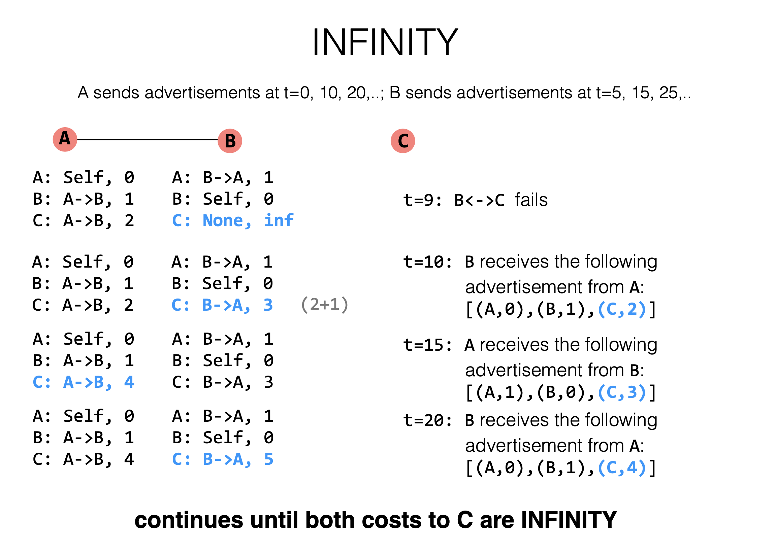

A: Self, 0
B: A->B, 1
C: A->B, 2
A: B->A, 1
B: Self, 0
C: B->C, 1

Slide 84
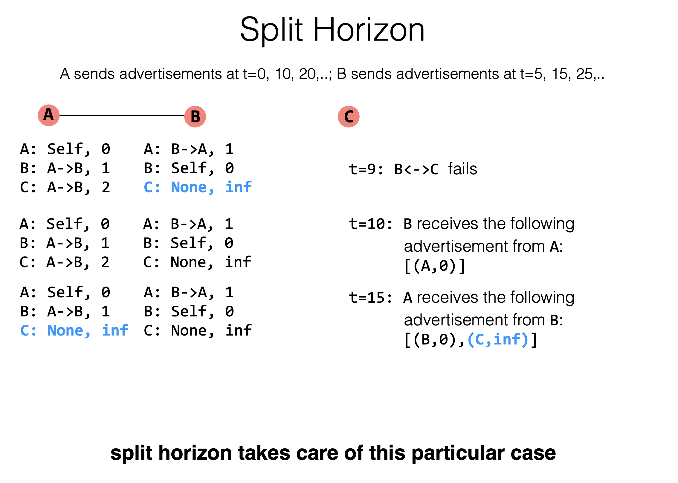
Notes:
从一端收到的路由信息，不能再从原路被发送回去。

Slide 85
Link-State Summary
Pros:
  Fast convergence
Cons:
  flooding is costly: 2 x #Node x #Line advertisements
Only good for small networks

Slide 86
Distance Vector
Pros:
  Low overhead: 2x #Line advertisements
Cons:
  Convergence time is proportional to longest path
  The infinity problem
Only good for small networks

Slide 87
How to Scale the Routing?

Slide 88
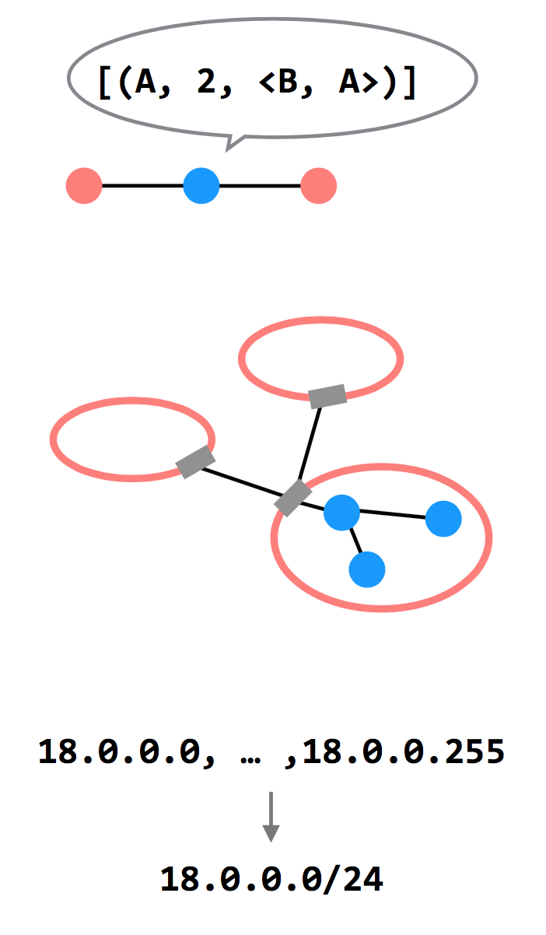
3 Ways to Scale
Path-vector Routing
  Advertisements include the path, to better
  detect routing loops
Hierarchy of Routing
  Route between regions, and then within a
  region
Topological Addressing
  Assign addresses in contiguous blocks to
  make advertisements smaller

Slide 89
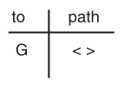
Path Vector Exchange
Each participant maintains a path vector
  A complete path to some destination
  E.g., zero-length path to itself
  Gradually learns about other paths
  Construct a new forwarding table from its new path vector
Algorithm
  Advertising
  Path selection

Slide 90
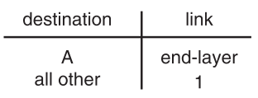
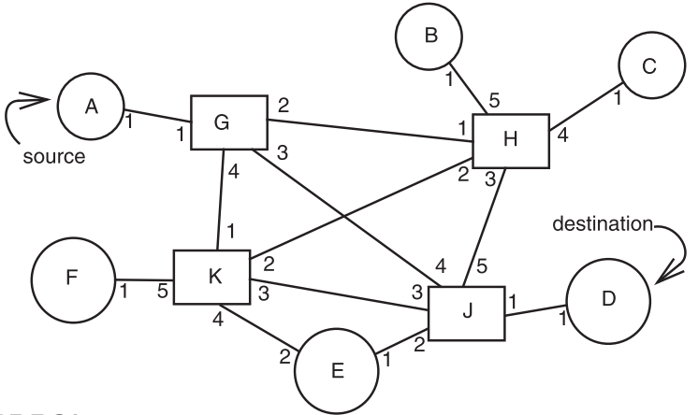
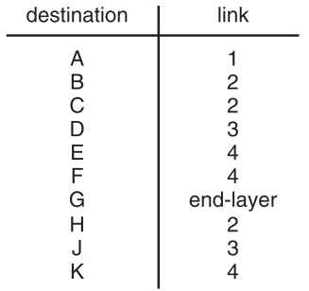
Path Vector Exchange
A
G
Need coordination to ensure no loop

Slide 91
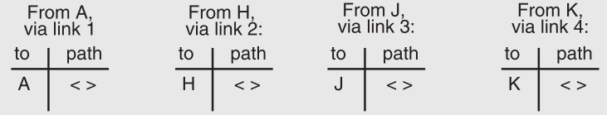
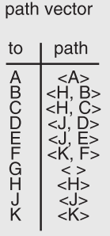
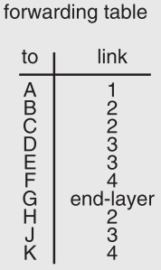
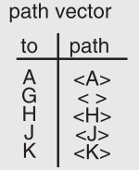
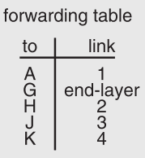
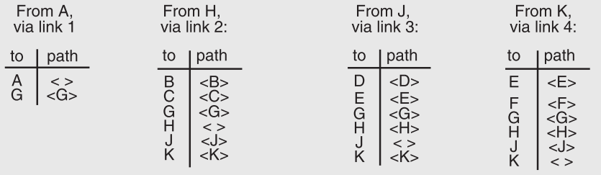
91

Slide 92
Path Vector Exchange
Better for scaling
  Like Distance-Vector, but include the full path in the routing advertisements
  Overhead increases (advertises are larger), but convergence time decreases (avoid counting to infinity)
  Overhead is still lower than Link-State

Slide 93
Questions on Path Vector
How do we avoid permanent loops?
  When a node updates its paths, it never accepts a path that has itself
What happens when a node hears multiple paths to the same destination?
  It picks the better path
What happens if the graph changes?
  Algorithm deals well with new links
  To deal with links that go down, each router should discard any path that a neighbor stops advertising

Slide 94
Hierarchical Address Assignment & Routing
Two problems of the path vector implementation
  Every attachment point must have a unique address
  The path vector grows in size with the number of attachment points
Hierarchy for better scalability
  Two parts of network address: region & station, e.g., "11,75"
  Regions correspond to the set of closely-connected entities
  E.g., region-11 has only 1 entry in other region routers' table

Slide 95
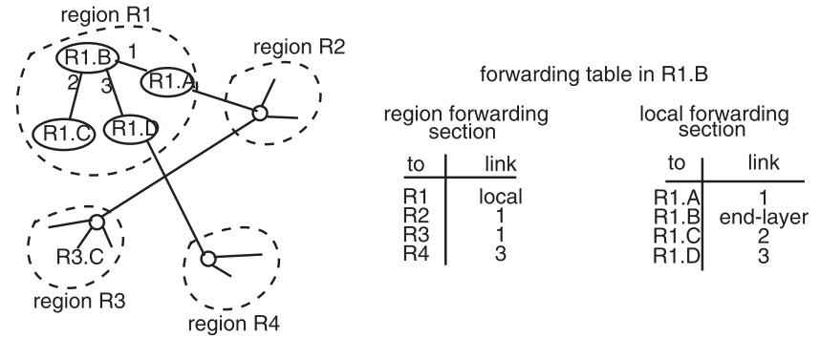
Hierarchical Address Assignment & Routing
Region is also as known as AS: Autonomous System

Slide 96
Hierarchical Address Assignment & Routing
Problems introduced by hierarchy: more complex
  Binding address with location
    Has to change address after changing location
  Paths may no longer be the shortest possible
    Algorithm has less detailed information
More about hierarchy
  Can extend to more levels
  Different places can have different levels

Slide 97
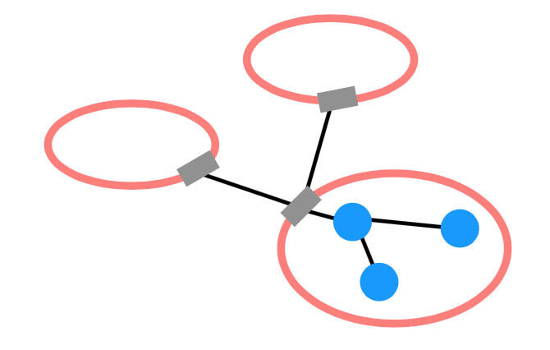
Routing Hierarchy
Across Region
  Use one routing protocol to route across regions, and a
  different protocol to route within regions
  Implies that there are devices on the edge of each region that can "translate" between or "speak" both protocols
BGP is the path-vector protocol used across regions
  Border Gateway Protocol

Slide 98
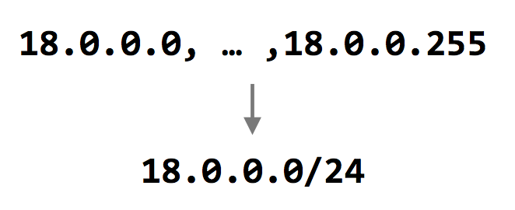
Topological Addressing
Further reduce the routing table
  Despite being between regions, BGP still routes to IP addresses (e.g., to 18.0.0.1, not to region-3 )
  Addresses are given to regions in contiguous blocks, so that they can be specified succinctly via a particular notation ("CIDR" notation)
    CIDR: Classless Inter Domain Routing
  Keeps advertisements small
CIDR Notation

Slide 99
Data Plane: Packet Forwarding

Slide 100
Network Layer Interface
structure packet
bit_string source
bit_string destination
bit_string end_protocol
bit_string payload

Slide 101
1 procedure NETWORK_SEND (segment_buffer, destination,
2 net_protocol, end_protocol)
3 packet instance outgoing_packet
4 outgoing_packet.payload ← segment_buffer
5 outgoing_packet.end_protocol ← end_protocol
6 outgoing_packet.source ← MY_NETWORK_ADDRESS
7 outgoing_packet.destination ← destination
8 NETWORK_HANDLE (outgoing_packet, net_protocol)
9 procedure NETWORK_HANDLE (net_packet, net_protocol)
10 packet instance net_packet
11 if net_packet.destination != MY_NETWORK_ADDRESS then
12 next_hop ← LOOKUP (net_packet.destination, forwarding_table)
13 LINK_SEND (net_packet, next_hop, link_protocol, net_protocol)
14 else
15 GIVE_TO_END_LAYER (net_packet.payload,
16 net_packet.end_protocol, net_packet.source)

Slide 102
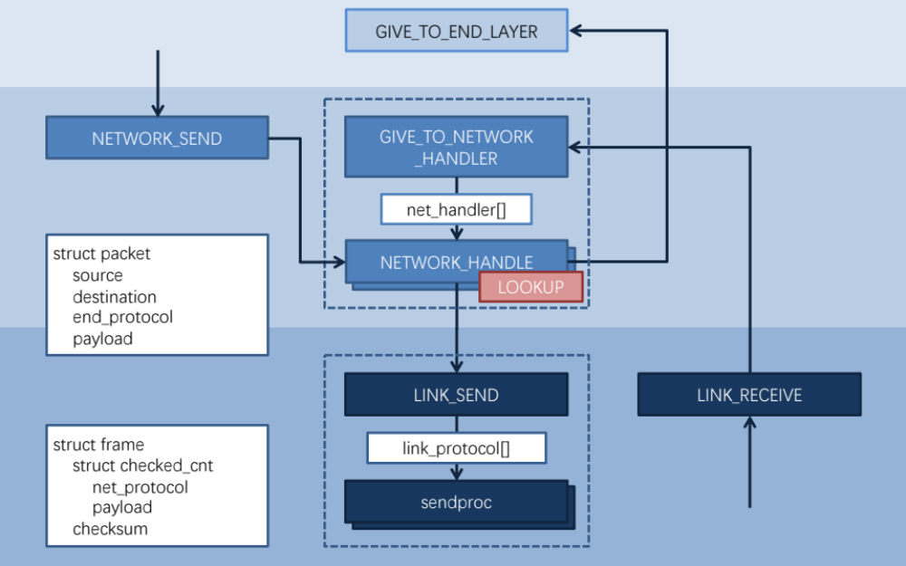

Slide 103
Forwarding an IP Packet
Lookup packet's destination in forwarding table
  If known, find the corresponding outgoing link
  If unknown, drop packet
Decrement TTL (Time To Live)
  Drop packet if TTL is zero
Update header checksum
Forward packet to outgoing port
Transmit packet onto link

Slide 104
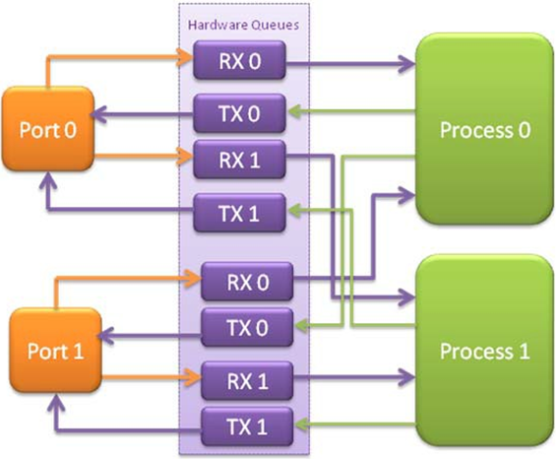
Data-plane Case Study: Intel's DPDK
DPDK: Data Plane Development Kit
  Bypass kernel
Network card
  Has several ports
  A port has RX/TX
Processor
  Read packets from RX
    Polling
  Find output port
  Write packets to TX
RX for receiving
TX for sending

Slide 105
NAT

Slide 106
NAT (Network Address Translation)
Private network
  Public routers do not accept routes to network 10 (e.g., 10.8.8.8)
NAT router: bridge the private networks
  Router between private & public network
  Send: modify source address to temp public address
  Receive: modify back by looking mapping table
Limitations
  Some end-to-end protocols place address in payloads
  The translator may become the bottleneck
  What if two private network merge?

Slide 107
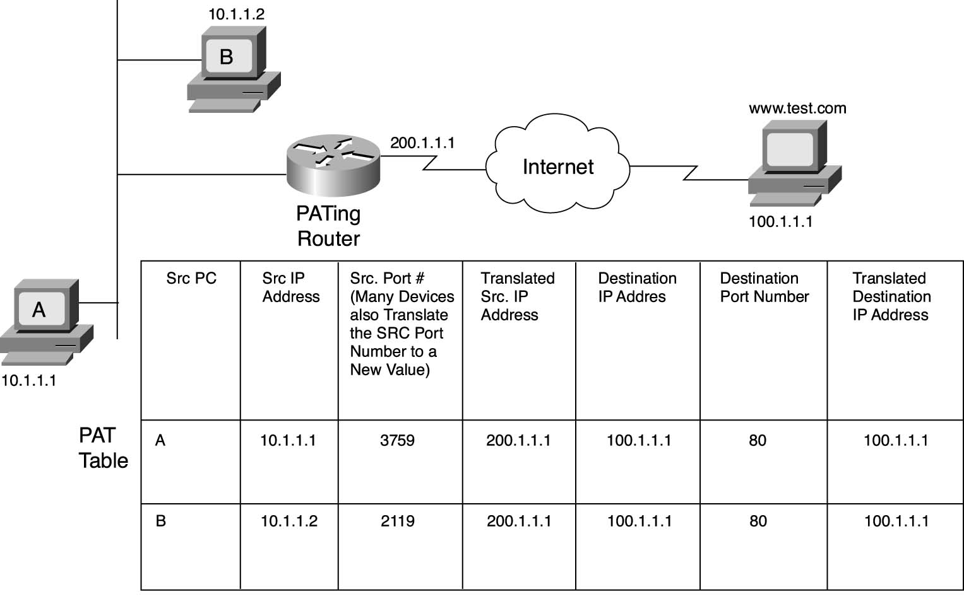
NAT

Slide 108
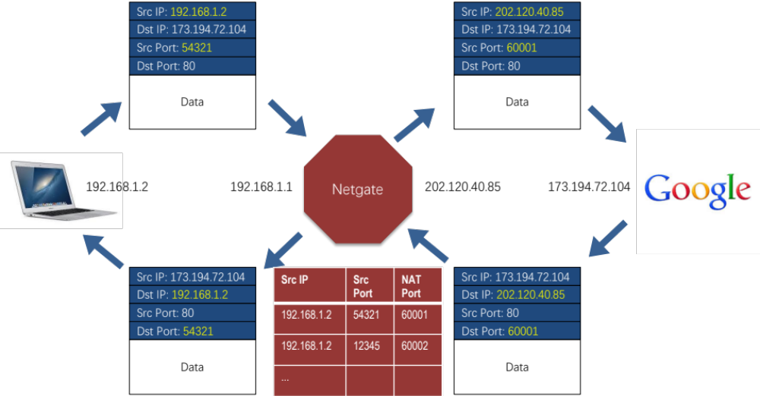

Slide 109
CASE: Ethernet Mapping
Mapping Internet to Ethernet

Slide 110
Case Study: Mapping Internet to Ethernet
Listen-before-sending rule, collision
Ethernet: CSMA/CD
  Carrier Sense Multiple Access with Collision Detection
Ethernet type
  Experimental Ethernet, 3 mpbs
  Standard Ethernet, 10 mbps
  Fast Ethernet, 100 mbps
  Gigabit Ethernet, 1000 mbps

Slide 111
Overview of Ethernet
A half duplex Ethernet
  The max propagation time is less than the 576 bit times, the shortest allowable packet
  So that two parties can detect a collision together
  If collision: wait random first time, exponential backoff if repeat
A full duplex & point-to-point Ethernet
  No collisions & the max length of the link is determined by the physical medium

Slide 112
Difference between Hub and Switch
Hub
  A frame is "broadcast" to every one of its ports
  A 10/100Mbps hub must share its bandwidth with each port
Switch
  Keeps a record of the MAC addresses of all the devices
  A 10/100Mbps switch will allocate a full 10/100Mbps to each of its ports

Slide 113
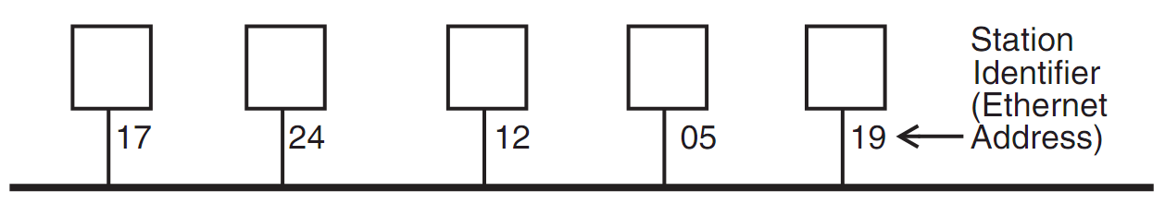
Broadcast Aspects of Ethernet
Broadcast network
  Every frame is delivered to every station
  (Compare with forwarding network)
ETHERNET_SEND
  Pass the call along to the link layer
ETHERNET_HANDLE
  Simple, can even be implemented in hardware

Slide 114
Broadcast Aspects of Ethernet
procedure ETHERNET_HANDLE (net_packet, length)
destination ← net_packet.target_id
if destination = my_station_id
then
GIVE_TO_END_LAYER (net_packet.data,
net_packet.end_protocol,
net_packet.source_id)
else
ignore packet
no need to do any forwarding

Slide 115
Broadcast Aspects of Ethernet
procedure ETHERNET_HANDLE (net_packet, length)
destination ← net_packet.target_id
if destination = my_station_id
or destination = BROADCAST_ID
then
GIVE_TO_END_LAYER (net_packet.data,
net_packet.end_protocol,
net_packet.source_id)
else
ignore packet

Slide 116
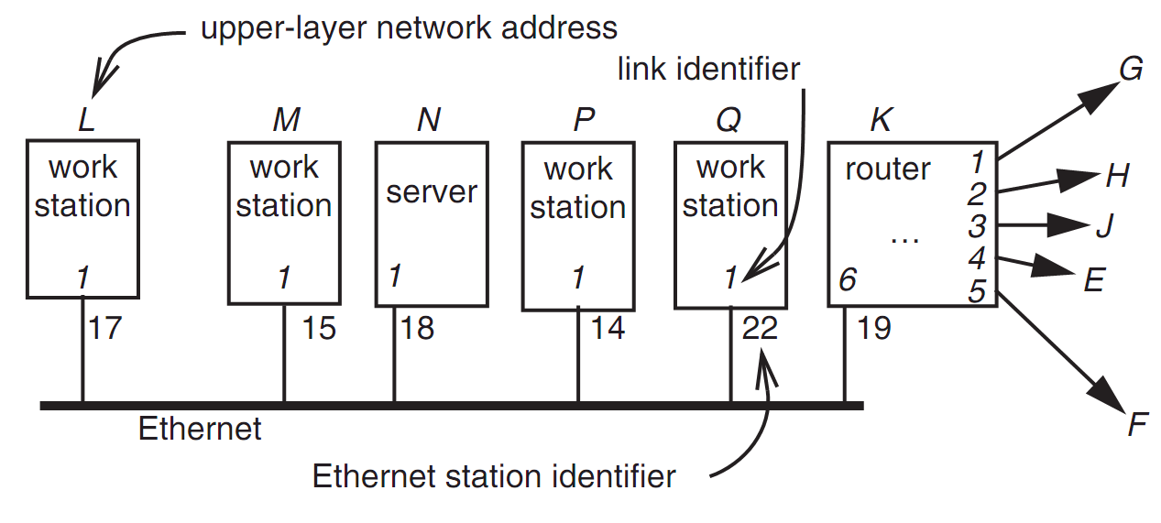
Layer Mapping: Attach Ethernet to Forwarding Network
15
L sends a RPC to N by sending to station 18 of link 1
L sends a RPC to E by sending to K, E may have 15 as address, as well as M

Slide 117
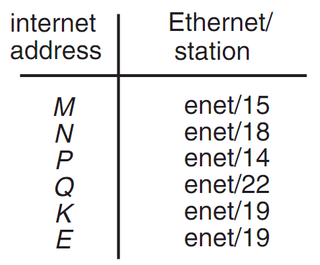
Layer Mapping
The Internet network layer
  NETWORK_SEND (data, length, RPC, INTERNET, N)
  NETWORK_SEND (data, length, RPC, ENET, 18)
L must maintain a table

Slide 118
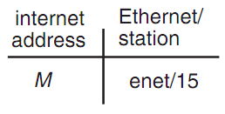
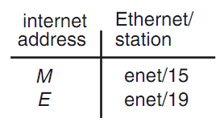
ARP (Address Resolution Protocol)
NETWORK_SEND ("where is M?", 11, ARP, ENET, BROADCAST)
NETWORK_SEND ("M is at station 15", 18, ARP, ENET, BROADCAST)
L asks E's Ethernet address, E does not hear the Ethernet broadcast, but the router at station 19 does, and it sends a suitable ARP response instead
Manage forwarding table as a cache

Slide 119
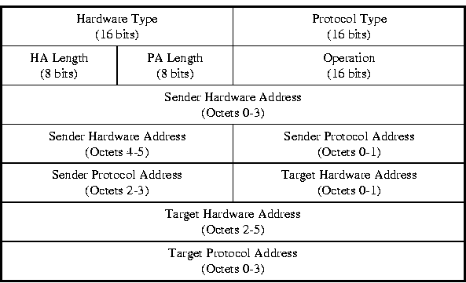
ARP & RARP Protocol
Name mapping: IP address <-> MAC address

Slide 120
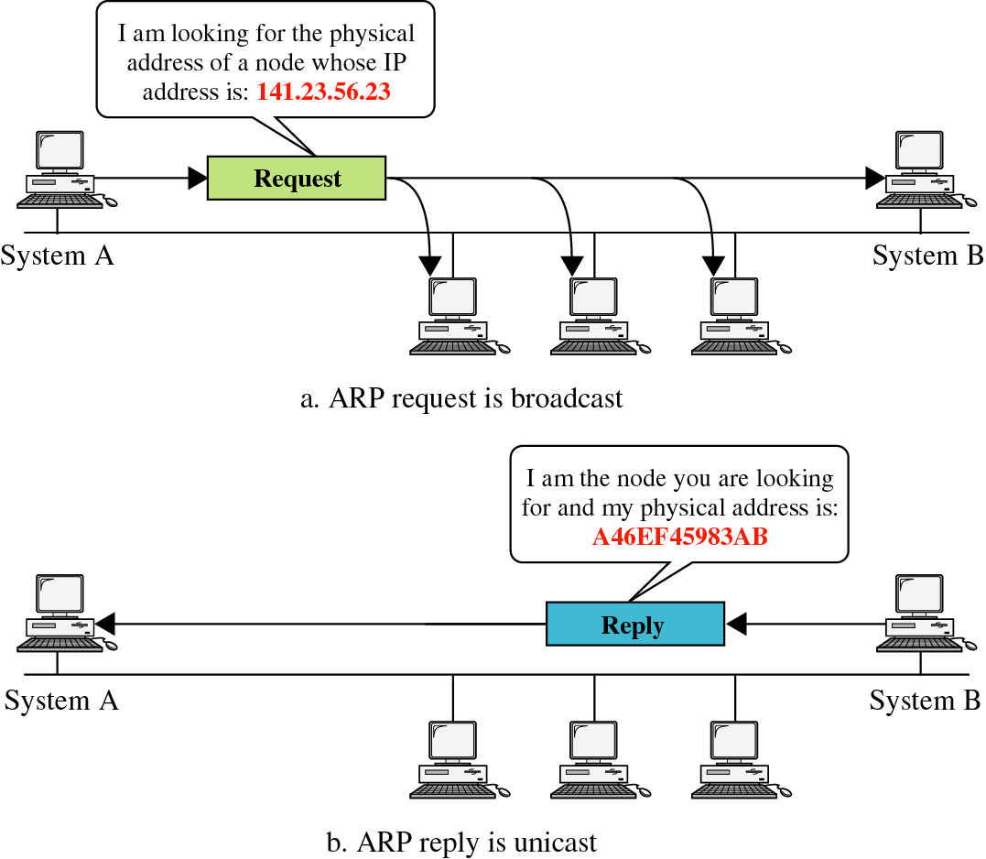
ARP &
RARP

Slide 121
Network Topology
Take SJTU network for example
  Subnet: usually like 192.168.0.2 or 10.0.0.2
  Gateway: usually like 192.168.0.1
    Get the global IP address: 202.120.40.82
    A gateway usually has two (or more) IP address
  Proxy: get proxy's address
    E.g., 106.185.46.164 (Japan)

Slide 122
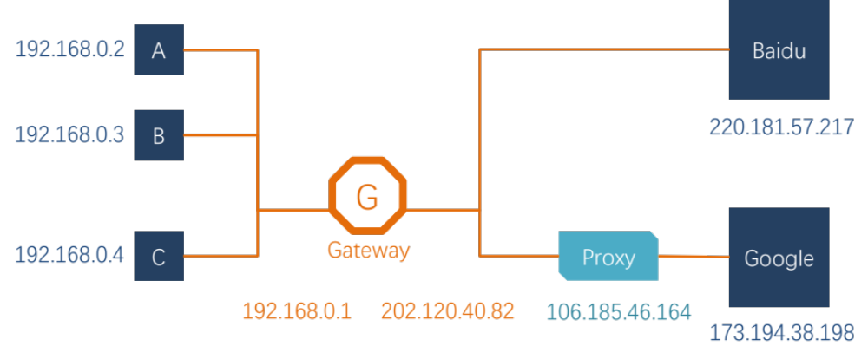
Network Topology

Slide 123
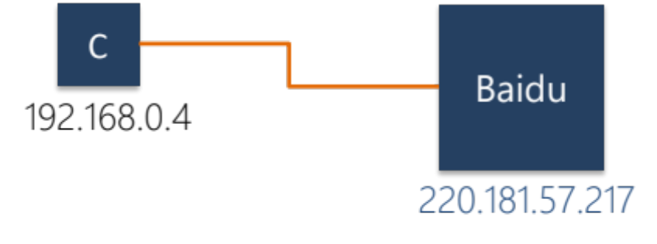
How to Use socket to Access www.baidu.com ?
You code as if your PC connect directly with Baidu
  Call connect() with Baidu's IP address
But how does the system find next hop?

Slide 124
Putting All Together
App: I want to send a packet to Baidu, here is the packet with Baidu's IP in its header as target IP, and client's IP as source IP (Node-C)
OS: I don't know how to get to Baidu, I'll just send it to the router (gateway). But I cannot change the source IP of the packet, so I'll just change the MAC target address of the packet to the router's MAC address

Slide 125
Putting All Together
The router-1 (gateway): I get a packet with my MAC as target address. Is it my IP? No… So I'll just forward it to next hop, by changing the target MAC address to next hop's MAC address (NAT: change source IP and source port as well)
Router-2: I connect directly to Baidu, I'll just change the target MAC address to Baidu

Slide 126
ARP Spoofing
Construct spoofed ARP replies
A target computer could be convinced to send frames destined for computer A to instead go to computer B
Computer A will have no idea that this redirection took place
This process of updating a target computer's ARP cache is referred to as "ARP poisoning"

Slide 127
Spoofed ARP reply
IP:10.0.0.2
MAC:cc:cc:cc:cc
Spoofed ARP reply
IP:10.0.0.2
MAC:cc:cc:cc:cc
switch
Spoofed ARP reply
IP:10.0.0.2
MAC:cc:cc:cc:cc
A
IP:10.0.0.1
MAC:aa:aa:aa:aa
B
IP:10.0.0.2
MAC:bb:bb:bb:bb
Hacker
IP:10.0.0.3
MAC:cc:cc:cc:cc
ARP cache
ARP cache
IP | MAC
10.0.0.2 | bb:bb:bb:bb
IP | MAC
10.0.0.1 | aa:aa:aa:aa

Slide 128
switch
A
IP:10.0.0.1
MAC:aa:aa:aa:aa
B
IP:10.0.0.2
MAC:bb:bb:bb:bb
Hacker
IP:10.0.0.3
MAC:cc:cc:cc:cc
A's cache is poisoned
ARP cache
ARP cache
IP | MAC
10.0.0.2 | cc:cc:cc:cc
IP | MAC
10.0.0.1 | aa:aa:aa:aa

Slide 129
ARP Spoofing
Now all the packets that A intends to send to B will go to the hacker's machine
Cache entry would expire, so it needs to be updated by sending the ARP reply again
  How often?
  depends on the particular system
  Usually every 40s should be sufficient
In addition the hacker may not want his Ethernet driver talk too much
  Accomplish with ifconfig -arp

Slide 130
Man-in-the-Middle Attack
A hacker inserts his computer between the communications path of two target computers
The hacker will forward frames between the two target computers so communications are not interrupted
E.g., Hunt, Ettercap, etc.
  Can be obtained easily in many web archives

Slide 131
Man-in-the-Middle Attack
The attack is performed as follows:
  Suppose X is the hacker's computer
  T1 and T2 are the targets
  X poisons the ARP cache of T1 and T2
  T1 associates T2's IP with X's MAC
  T2 associates T1's IP with X's MAC
  All of T1 and T2's traffic will then go to X first, instead of directly to each other

Slide 132
Spoofed ARP reply
IP:10.0.0.2
MAC:cc:cc:cc:cc
Spoofed ARP reply
IP:10.0.0.2
MAC:cc:cc:cc:cc
switch
Spoofed ARP reply
IP:10.0.0.2
MAC:cc:cc:cc:cc
T1
IP:10.0.0.1
MAC:aa:aa:aa:aa
T2
IP:10.0.0.2
MAC:bb:bb:bb:bb
Hacker
IP:10.0.0.3
MAC:cc:cc:cc:cc
ARP cache
ARP cache
IP | MAC
10.0.0.2 | bb:bb:bb:bb
IP | MAC
10.0.0.1 | aa:aa:aa:aa

Slide 133
switch
T1
IP:10.0.0.1
MAC:aa:aa:aa:aa
T2
IP:10.0.0.2
MAC:bb:bb:bb:bb
Hacker
IP:10.0.0.3
MAC:cc:cc:cc:cc
ARP cache
ARP cache
IP | MAC
10.0.0.2 | cc:cc:cc:cc
IP | MAC
10.0.0.1 | aa:aa:aa:aa
T1's cache is poisoned

Slide 134
Forged ARP replies
IP:10.0.0.1
MAC:cc:cc:cc:cc
switch
Forged ARP replies
IP:10.0.0.1
MAC:cc:cc:cc:cc
T1
IP:10.0.0.1
MAC:aa:aa:aa:aa
T2
IP:10.0.0.2
MAC:bb:bb:bb:bb
Hacker
IP:10.0.0.3
MAC:cc:cc:cc:cc
ARP cache
ARP cache
IP | MAC
10.0.0.2 | cc:cc:cc:cc
IP | MAC
10.0.0.1 | aa:aa:aa:aa

Slide 135
switch
T1
IP:10.0.0.1
MAC:aa:aa:aa:aa
T2
IP:10.0.0.2
MAC:bb:bb:bb:bb
Hacker
IP:10.0.0.3
MAC:cc:cc:cc:cc
ARP cache
ARP cache
IP | MAC
10.0.0.2 | cc:cc:cc:cc
IP | MAC
10.0.0.1 | cc:cc:cc:cc
T2's cache is poisoned

Slide 136
Message intended to send to T2
switch
Hacker will
relay the
message
T1
IP:10.0.0.1
MAC:aa:aa:aa:aa
T2
IP:10.0.0.2
MAC:bb:bb:bb:bb
Hacker
IP:10.0.0.3
MAC:cc:cc:cc:cc
ARP cache
ARP cache
IP | MAC
10.0.0.2 | cc:cc:cc:cc
IP | MAC
10.0.0.1 | cc:cc:cc:cc

Slide 137
Hacker will relay the message
switch
Message
intended to
send to T1
T1
IP:10.0.0.1
MAC:aa:aa:aa:aa
T2
IP:10.0.0.2
MAC:bb:bb:bb:bb
Hacker
IP:10.0.0.3
MAC:cc:cc:cc:cc
ARP cache
ARP cache
IP | MAC
10.0.0.2 | cc:cc:cc:cc
IP | MAC
10.0.0.1 | cc:cc:cc:cc

Slide 138
Defenses against ARP Spoofing
No Universal defense (!)
Use static ARP entries
  Cannot be updated; Spoofed ARP replies are ignored
  ARP table needs a static entry for each machine on the network
  Large overhead
    Deploying these tables; Keep the table up-to-date
Arpwatch
  A free UNIX program which listens for ARP replies on a network
  Build a table of IP/MAC associations and store it in a file
  When a MAC/IP pair changes (flip-flop), an email is sent to an administrator

