Slide 1


Before-or-after atomicity, Serializability
& Transaction
SE3331-1 (2022 Fall)
Yubin Xia
IPADS, Shanghai Jiao Tong University
https://www.sjtu.edu.cn

Slide 2
Consistency can break under fault, even for the strongest consistency model

Slide 3
Review: All-or-Nothing atomicity
An action is atomic if it happens completely or not at all
  Action is an abstraction, can contain many operations
    E.g., multiple disk writes, multiple memory reads/writes
Atomicity makes it much easier to reason about failures
  Need to think about the consequences of the action happening or not happening, but not about the action partially happening
An action can be a group of other atomic actions
  Under certain scenarios, a group of action is not atomic even all its sub-op is atomic! E.g., write the disk page containing record A

Slide 4
Review: techniques to support all-or-nothing
Systematic methods to support all-or-nothing atomicity
  Shadow copy
  Logging
Logging
  REDO logging
  UNDO-REDO logging
  UNDO-only logging

Slide 5
Consistency can break under concurrency, even for the strongest consistency model + all-or-nothing atomicity

Slide 6
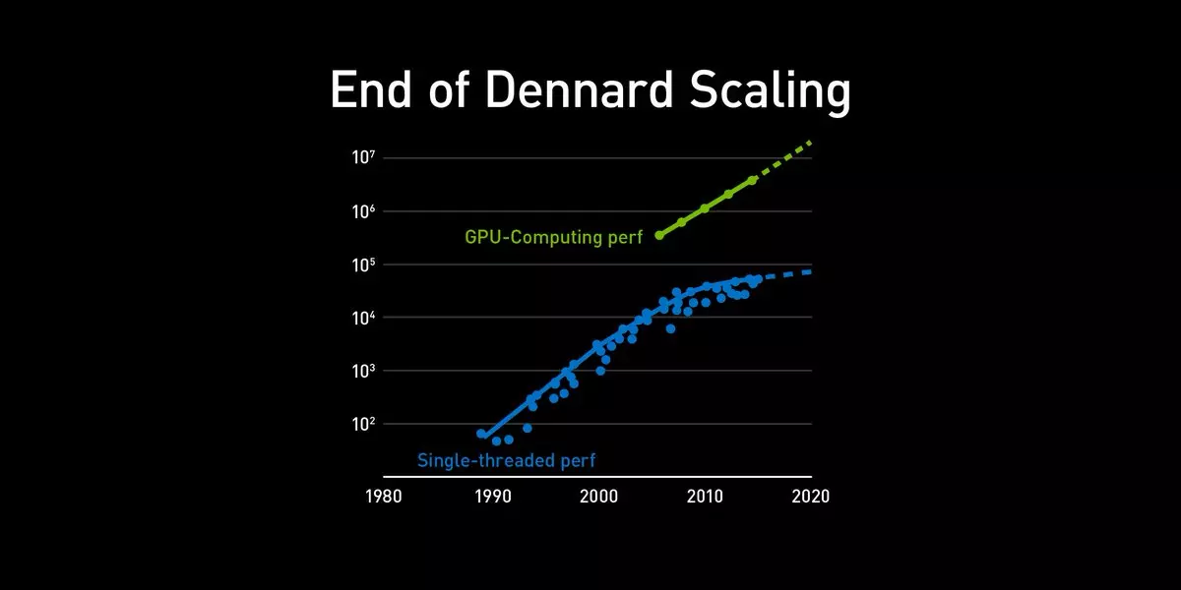

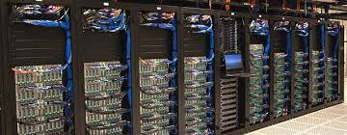
Why we need concurrency?
In order to scale to a higher performance
Single-thread is insufficient
  The end of Moore‘s Law and Dennard's scaling: single core perf. doesn’t grow
Scale up
  Using multiple cores
Scale out
  Using multiple machines
Scale up
Scale out

Slide 7



Example: bank account deposit
…
Bob: 0¥
Bank = [ ... ]
Single-thread (core)
  Expected performance: D
Multiple-core (scale up)
  Expected performance: D * C
Multiple-machine (scale out)
  Expected performance: D * C * M
Alice: 0¥
Deposit(bank, acct, amt):
bank[acct] += amt
Single-thread
Multiple-core
Multiple-machine
Deposit(bank,"alice”,10)
Time
…

Slide 8
Motivating example
Example: consider two threads access the same account concurrently
T0
T1
Deposit(bank,"alice”,10)
Deposit(bank, acct, amt):
bank[acct] += amt
Time
Question: what would happen?

Slide 9
Problem: missing updates
Example: consider two threads access the same account concurrently
T0
T1
Deposit(bank,"alice”,10)
Deposit(bank, acct, amt):
bank[acct] += amt
Time
Question: what would happen?
Alice: 0¥
Alice: 10¥ (20¥)
Notes:
这个例子里，没有all-or-nothing的问题

Slide 10
Core problem: atomicity of the + operator
Example: consider two threads access the same account concurrently
Why would this happen?
  The deposit function is not atomic
    Because CPU can only guarantee the atomicity of one instruction
    mov acct, %eax
    add $amt, %eax
    mov %eax, acct
Deposit(bank, acct, amt):
bank[acct] += amt
Developer’s written code
Compiler’s generated code

Slide 11
Core problem: atomicity of the + operator
    mov acct, %eax
    add $amt, %eax
    mov %eax, acct
Deposit(bank, acct, amt):
bank[acct] += amt
Developer’s written code
Compiler’s generated code
Thread 0
Thread 1
Bank[Alice]
0
T0
T1
Deposit(bank,"alice”,10)
Time

Slide 12
Core problem: atomicity of the + operator
    mov acct, %eax
    add $amt, %eax
    mov %eax, acct
Deposit(bank, acct, amt):
bank[acct] += amt
Developer’s written code
Compiler’s generated code
Thread 0
Thread 1
Bank[Alice]
0
Read acct
0
T0
T1
Deposit(bank,"alice”,10)
Time

Slide 13
Core problem: atomicity of the + operator
    mov acct, %eax
    add $amt, %eax
    mov %eax, acct
Deposit(bank, acct, amt):
bank[acct] += amt
Developer’s written code
Compiler’s generated code
Thread 0
Thread 1
Bank[Alice]
0
Read acct
0
T0
T1
Read acct
0
Deposit(bank,"alice”,10)
Time

Slide 14
Core problem: atomicity of the + operator
    mov acct, %eax
    add $amt, %eax
    mov %eax, acct
Deposit(bank, acct, amt):
bank[acct] += amt
Developer’s written code
Compiler’s generated code
Thread 0
Thread 1
Bank[Alice]
0
Read acct
0
T0
T1
Read acct
0
Deposit(bank,"alice”,10)
0
Increase
Time

Slide 15
Core problem: atomicity of the + operator
    mov acct, %eax
    add $amt, %eax
    mov %eax, acct
Deposit(bank, acct, amt):
bank[acct] += amt
Developer’s written code
Compiler’s generated code
Thread 0
Thread 1
Bank[Alice]
0
Read acct
0
T0
T1
Read acct
0
Deposit(bank,"alice”,10)
0
Increase
Increase
0
Time

Slide 16
Core problem: atomicity of the + operator
    mov acct, %eax
    add $amt, %eax
    mov %eax, acct
Deposit(bank, acct, amt):
bank[acct] += amt
Developer’s written code
Compiler’s generated code
Thread 0
Thread 1
Bank[Alice]
0
Read acct
0
T0
T1
Read acct
0
Deposit(bank,"alice”,10)
0
Increase
Increase
0
Write acct
10
Time

Slide 17
Core problem: atomicity of the + operator
    mov acct, %eax
    add $amt, %eax
    mov %eax, acct
Deposit(bank, acct, amt):
bank[acct] += amt
Developer’s written code
Compiler’s generated code
Thread 0
Thread 1
Bank[Alice]
0
Read acct
0
T0
T1
Read acct
0
Deposit(bank,"alice”,10)
0
Increase
Increase
0
Write acct
10
Time
Write acct
10

Slide 18
The race condition problem
When two or more threads access shared data and at least one is write
Timing dependent error involving shared state
  Whether it happens depends on how threads scheduled
Thread 0
Thread 1
Bank[Alice]
Thread 0
Thread 1
Bank[Alice]
0
0
Read acct
0
Read acct
0
Read acct
0
Increase
0
Increase
0
Write acct
10
Increase
0
Read acct
10
Write acct
10
Increase
10
Write acct
10
Write acct
20

Slide 19
Race condition is hard to control
Must make sure all possible schedules are safe
  Number of possible schedules permutations is huge
  Bad schedules that will and will not work sometimes
They are intermittent
  Small timing changes between invocations might result in different behavior which can hide bug (e.g., Therac-25)
  Also known as Heisenbugs (Heisenberg uncertainty)
    Possible system solution-1: DMT (Deterministic Multi-Threading)
    Possible system solution-2: Record and Replay
    Both are hard in either correctness or cost, or both

Slide 20


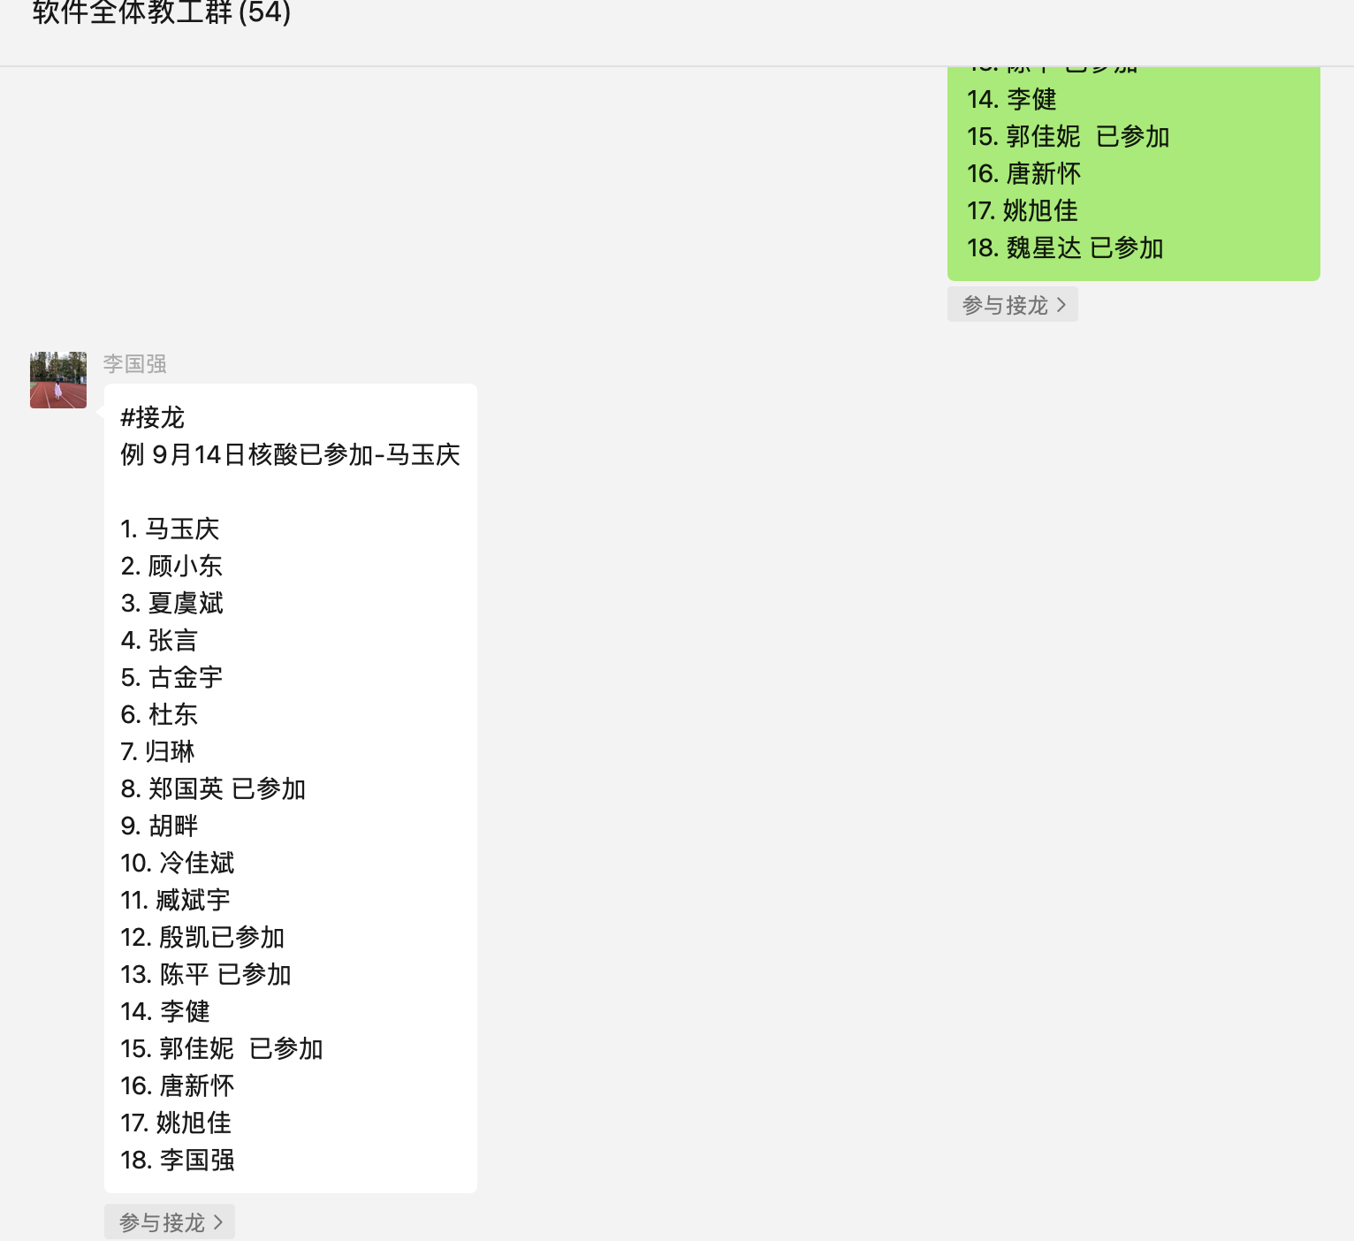
Race condition is bad, and is common
Real-world computing systems embrace concurrency
  E.g., embrace the design of distributed systems
Bad: race condition brings unsatisfactory to the customers
  E.g., the comment system in
Show 5 comments;
But only 3 presented on the app

Slide 21
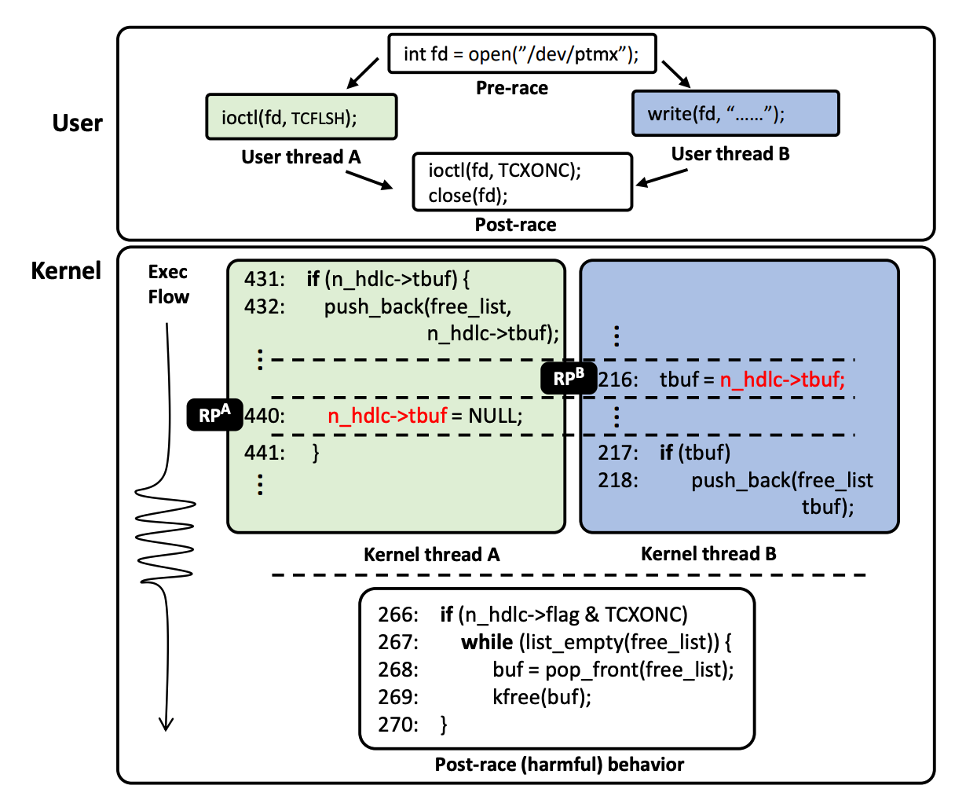
Race in Kernel
A simplified race example on CVE-2017-2636
As a user program executes two syscalls concurrently, a data race on n_hdlc->tbuf may occur depending on the execution order, which leads to a double-free issue allowing an attacker to launch privilege escalation attack
[S&P'19] RAZZER: Finding Kernel Race Bugs through Fuzzing

Slide 22
Race condition in Therac-25
The equipment control task did not properly synchronize with the operator interface task, so that race conditions occurred if the operator changed the setup too quickly. In three cases, the injured patients later died as a result of the overdose.

Slide 23
Before-or-After Atomicity

Slide 24
Goal: before-or-after atomicity
To prevent hazard produced by race condition, we need concurrent actions to be atomic
  E.g., cannot see/overwrites the intermediate states of a concurrent action
Thread 1 should not see the intermediate states of thread 0
Thread 0
Thread 1
Bank[Alice]
0
Read acct
0
Read acct
0
Increase
0
Increase
0
Write acct
10
Write acct
10

Slide 25
Goal: before-or-after atomicity (a.k.a, Isolation)
To prevent hazard produced by race condition, we need concurrent actions to be atomic
  E.g., cannot see/overwrites the intermediate states of a concurrent action
Before or after atomicity
Concurrent actions have the before-or-after property if their effect from the point of view of their invokers is as if the actions occurred either completely before or completely after one another

Slide 26
Use locking to achieve before-or-after
Locks: allow only one CPU to be inside a piece of code at a time
  Programs can acquire and release the lock
  Example: pthread_mutex
Implementing the locks efficiently is a broad topic
  And is non-trivial: out of the scope of this lecture

Slide 27
Use locking to achieve before-or-after: global lock
Locks: allow only one CPU core to run a piece of code at a time
  Programs can acquire and release the lock
Global lock:
  The action must acquire the global lock before executing, and release it after it commits
Deposit(bank, lock, acct, amt):
acquire(lock)
bank[acct] += amt
release(lock)
Deposit(bank, acct, amt):
bank[acct] += amt

Slide 28
Use locking to achieve before-or-after: global lock
Deposit(bank, lock, acct, amt):
acquire(lock)
bank[acct] += amt
release(lock)
Deposit(bank, acct, amt):
bank[acct] += amt
Thread 0
Thread 1
Bank[Alice]
Thread 0
Thread 1
Bank[Alice]
0
0
Read acct
0
Read acct
0
Increase
0
Increase
0
Write acct
10
Write acct
10
Notes:
Can global lock prevent our previous race condition?

Slide 29
Use locking to achieve before-or-after: global lock
Deposit(bank, lock, acct, amt):
acquire(lock)
bank[acct] += amt
release(lock)
Deposit(bank, acct, amt):
bank[acct] += amt
Thread 0
Thread 1
Bank[Alice]
Thread 0
Thread 1
Bank[Alice]
0
0
Read acct
0
Acquire(lock)
0
Read acct
0
Increase
0
Increase
0
Write acct
10
Write acct
10
Notes:
Can global lock prevent our previous race condition?

Slide 30
Use locking to achieve before-or-after: global lock
Deposit(bank, lock, acct, amt):
acquire(lock)
bank[acct] += amt
release(lock)
Deposit(bank, acct, amt):
bank[acct] += amt
Thread 0
Thread 1
Bank[Alice]
Thread 0
Thread 1
Bank[Alice]
0
0
Read acct
0
Acquire(lock)
0
Read acct
0
Read acct
0
Increase
0
Increase
0
Write acct
10
Write acct
10
Notes:
Can global lock prevent our previous race condition?

Slide 31
Use locking to achieve before-or-after: global lock
Deposit(bank, lock, acct, amt):
acquire(lock)
bank[acct] += amt
release(lock)
Deposit(bank, acct, amt):
bank[acct] += amt
Thread 0
Thread 1
Bank[Alice]
Thread 0
Thread 1
Bank[Alice]
0
0
Read acct
0
Acquire(lock)
0
Read acct
0
Read acct
0
Increase
0
Acquire(lock)
0
Increase
0
Write acct
10
Write acct
10
Notes:
Can global lock prevent our previous race condition?

Slide 32
Use locking to achieve before-or-after: global lock
Deposit(bank, lock, acct, amt):
acquire(lock)
bank[acct] += amt
release(lock)
Deposit(bank, acct, amt):
bank[acct] += amt
Thread 0
Thread 1
Bank[Alice]
Thread 0
Thread 1
Bank[Alice]
0
0
Read acct
0
Acquire(lock)
0
Read acct
0
Read acct
0
Increase
0
Acquire(lock)
0
Increase
0
Read acct
0
Write acct
10
Write acct
10
Can this happen?
Notes:
Can global lock prevent our previous race condition?

Slide 33
Use locking to achieve before-or-after: global lock
Deposit(bank, lock, acct, amt):
acquire(lock)
bank[acct] += amt
release(lock)
Deposit(bank, acct, amt):
bank[acct] += amt
Thread 0
Thread 1
Bank[Alice]
Thread 0
Thread 1
Bank[Alice]
0
0
Read acct
0
Acquire(lock)
0
Read acct
0
Read acct
0
Increase
0
Acquire(lock)
0
Increase
0
Write acct
10
Write acct
10
Notes:
Can global lock prevent our previous race condition?

Slide 34
Use locking to achieve before-or-after: global lock
Deposit(bank, lock, acct, amt):
acquire(lock)
bank[acct] += amt
release(lock)
Deposit(bank, acct, amt):
bank[acct] += amt
Thread 0
Thread 1
Bank[Alice]
Thread 0
Thread 1
Bank[Alice]
0
0
Read acct
0
Acquire(lock)
0
Read acct
0
Read acct
0
Increase
0
Acquire(lock)
0
Increase
0
Increase
Acquire(lock)
0
Write acct
10
Write acct
10
Thread is stuck at the acquiring the lock
Notes:
Can global lock prevent our previous race condition?

Slide 35
Use locking to achieve before-or-after: global lock
Deposit(bank, lock, acct, amt):
acquire(lock)
bank[acct] += amt
release(lock)
Deposit(bank, acct, amt):
bank[acct] += amt
Thread 0
Thread 1
Bank[Alice]
Thread 0
Thread 1
Bank[Alice]
0
0
Read acct
0
Acquire(lock)
0
Read acct
0
Read acct
0
Increase
0
Acquire(lock)
0
Increase
0
Increase
Acquire(lock)
0
Write acct
10
Write back
Acquire(lock)
10
Write acct
10
Notes:
Can global lock prevent our previous race condition?

Slide 36
Use locking to achieve before-or-after: global lock
Deposit(bank, lock, acct, amt):
acquire(lock)
bank[acct] += amt
release(lock)
Deposit(bank, acct, amt):
bank[acct] += amt
Thread 0
Thread 1
Bank[Alice]
Thread 0
Thread 1
Bank[Alice]
0
0
Read acct
0
Acquire(lock)
0
Read acct
0
Read acct
0
Increase
0
Acquire(lock)
0
Increase
0
Increase
Acquire(lock)
0
Write acct
10
Write back
Acquire(lock)
10
Write acct
10
Release(lock)
Acquire(lock)
10
Notes:
Can global lock prevent our previous race condition?

Slide 37
Use locking to achieve before-or-after: global lock
Deposit(bank, lock, acct, amt):
acquire(lock)
bank[acct] += amt
release(lock)
Deposit(bank, acct, amt):
bank[acct] += amt
Thread 0
Thread 1
Bank[Alice]
Thread 0
Thread 1
Bank[Alice]
0
0
Read acct
0
Acquire(lock)
0
Read acct
0
Read acct
0
Increase
0
Acquire(lock)
0
Increase
0
Increase
Acquire(lock)
0
Write acct
10
Write back
Acquire(lock)
10
Write acct
10
Release(lock)
Acquire(lock)
10
Increase
10
Notes:
Can global lock prevent our previous race condition?

Slide 38
Use locking to achieve before-or-after: global lock
Deposit(bank, lock, acct, amt):
acquire(lock)
bank[acct] += amt
release(lock)
Deposit(bank, acct, amt):
bank[acct] += amt
Thread 0
Thread 1
Bank[Alice]
Thread 0
Thread 1
Bank[Alice]
0
0
Read acct
0
Acquire(lock)
0
Read acct
0
Read acct
0
Increase
0
Acquire(lock)
0
Increase
0
Increase
Acquire(lock)
0
Write acct
10
Write back
Acquire(lock)
10
Write acct
10
Release(lock)
Acquire(lock)
10
Increase
10
Write back
20
Notes:
Can global lock prevent our previous race condition?

Slide 39
Use locking to achieve before-or-after: global lock
Deposit(bank, lock, acct, amt):
acquire(lock)
bank[acct] += amt
release(lock)
Deposit(bank, acct, amt):
bank[acct] += amt
Thread 0
Thread 1
Bank[Alice]
Thread 0
Thread 1
Bank[Alice]
0
0
Read acct
0
Acquire(lock)
0
Read acct
0
Read acct
0
Increase
0
Acquire(lock)
0
Increase
0
Increase
Acquire(lock)
0
Write acct
10
Write back
Acquire(lock)
10
Write acct
10
Release(lock)
Acquire(lock)
10
Increase
10
Write back
20
Release(lock)
20
Notes:
Can global lock prevent our previous race condition?

Slide 40
Use locking to achieve before-or-after: global lock
Locks: allow only one CPU to be inside a piece of code at a time
  Programs can acquire and release the lock
Global lock:
  The action must acquire the global lock before executing, and release it after it commits
Drawback
  Only allow one action to run at a time
+ global lock
T0
T1
T0
T1
Requiring Lock
Deposit(Alice)
Deposit(bob)
Time

Slide 41

Use locking to achieve before-or-after: fine-grained locking
…
Fine-grained locking:
  Each shared data has one lock
  E.g., a lock for Alice & a lock for Bob
Locking rule:
  The action must acquire the shared data’s lock before access it, and releases it after the data access finishes
Bank = [
Alice: 0¥
Bob: 0¥
Lock = [
Deposit(bank, lock, acct, amt):
acquire(lock)
bank[acct] += amt
release(lock)
Deposit(bank, lock, acct, amt):
acquire(lock[acct])
bank[acct] += amt
release(lock[acct])

Slide 42
Use locking to achieve before-or-after: fine-grained locking
Global
Fine-grained
Deposit(bank, lock, acct, amt):
acquire(lock)
bank[acct] += amt
release(lock)
Deposit(bank, lock, acct, amt):
acquire(lock[acct])
bank[acct] += amt
release(lock[acct])
Thread 0
Thread 1
Bank[Alice]
Thread 0
Thread 1
Bank[Alice]
0
0
Acquire(lock)
0
Acquire(lock[alice])
0
Read acct
0
Read acct
0
Acquire(lock)
0
Acquire(lock[alice])
0
Increase
Acquire(lock)
0
Increase
Acquire(lock[alice])
0
Write back
Acquire(lock)
10
Write back
Acquire(lock[alice])
10
Release(lock)
Acquire(lock)
10
Release(
lock[alice])
Acquire(lock[alice])
10
Increase
10
Increase
10
Write back
20
Write back
20
Release(lock)
20
Release(lock[alice])
20
Notes:
Correctness

Slide 43
Use locking to achieve before-or-after: fine-grained locking
Fine-grained locking allows more concurrency
  If the deposits operate on different accounts, they can run concurrently
Thread 0
Thread 1
Bank[Alice]
Bank[Bob]
T0
T1
Acquire(lock[alice])
Acquire(lock[bob])
0
0
Read acct
Read acct
0
0
Increase
Increase
0
0
Write back
Write back
10
10
Release(lock[alice])
Release(lock[bob])
10
10
Time
Two deposits can run concurrently!
👍
Deposit(Alice)
Deposit(bob)
Notes:
Performance

Slide 44
Use locking to achieve before-or-after: fine-grained locking
…
Fine-grained locking:
  Each data record has one lock
  E.g., a lock for Alice & a lock for Bob
Lock acquire rule:
  The action must acquire the account lock before access it, and releases it after the data access finishes
Bank = [
Alice: 0¥
Bob: 0¥
Lock = [
Question: can fine-grained locking avoids all the race conditions?

Slide 45
Another example: multiple records
…
Alice: 10¥
Bob: 10¥
Transfer + Audit for the bank application
Transfer(bank, locks, a, b, amt):
Acquire(lock[b])
bank[b] += amt
Release(lock[b])
Acquire(lock[a])
bank[a] -= amt
Release(lock[a])
Audit(bank):
sum = 0
for acct in bank:
Acquire(locks[acct])
sum += bank[acct]
Release(locks[acct])
print(sum)
Question: what is the ideal output of Audit?

Slide 46
Accessing multiple records
Transfer
(alice, bob, 10)
Audit()
Thread 0 (Transfer) | Thread 1 (Audit) | Bank[Alice] | Bank[bob] | Sum
 |  | 10 | 10 | 0
Time

Slide 47
Accessing multiple records
Transfer
(alice, bob, 10)
Audit()
Thread 0 (Transfer) | Thread 1 (Audit) | Bank[Alice] | Bank[bob] | Sum
 |  | 10 | 10 | 0
Acquire(lock[b]) | Acquire(lock[b]) | 10 | 10 | 0
Time

Slide 48
Accessing multiple records
Transfer
(alice, bob, 10)
Audit()
Thread 0 (Transfer) | Thread 1 (Audit) | Bank[Alice] | Bank[bob] | Sum
 |  | 10 | 10 | 0
Acquire(lock[b]) | Acquire(lock[b]) | 10 | 10 | 0
Read(b) = 10 | Acquire(lock[b]) | 10 | 10 | 0
Time

Slide 49
Accessing multiple records
Transfer
(alice, bob, 10)
Audit()
Thread 0 (Transfer) | Thread 1 (Audit) | Bank[Alice] | Bank[bob] | Sum
 |  | 10 | 10 | 0
Acquire(lock[b]) | Acquire(lock[b]) | 10 | 10 | 0
Read(b) = 10 | Acquire(lock[b]) | 10 | 10 | 0
Write(b) = 20 | Acquire(lock[b]) | 10 | 20 | 0
Time

Slide 50
Accessing multiple records
Transfer
(alice, bob, 10)
Audit()
Thread 0 (Transfer) | Thread 1 (Audit) | Bank[Alice] | Bank[bob] | Sum
 |  | 10 | 10 | 0
Acquire(lock[b]) | Acquire(lock[b]) | 10 | 10 | 0
Read(b) = 10 | Acquire(lock[b]) | 10 | 10 | 0
Write(b) = 20 | Acquire(lock[b]) | 10 | 20 | 0
Release(lock[b]) | Acquire(lock[b]) | 10 | 20 | 0
Time

Slide 51
Accessing multiple records
Transfer
(alice, bob, 10)
Audit()
Thread 0 (Transfer) | Thread 1 (Audit) | Bank[Alice] | Bank[bob] | Sum
 |  | 10 | 10 | 0
Acquire(lock[b]) | Acquire(lock[b]) | 10 | 10 | 0
Read(b) = 10 | Acquire(lock[b]) | 10 | 10 | 0
Write(b) = 20 | Acquire(lock[b]) | 10 | 20 | 0
Release(lock[b]) | Acquire(lock[b]) | 10 | 20 | 0
 | Read(b) = 20 | 10 | 20 | 20
Time

Slide 52
Accessing multiple records
Transfer
(alice, bob, 10)
Audit()
Thread 0 (Transfer) | Thread 1 (Audit) | Bank[Alice] | Bank[bob] | Sum
 |  | 10 | 10 | 0
Acquire(lock[b]) | Acquire(lock[b]) | 10 | 10 | 0
Read(b) = 10 | Acquire(lock[b]) | 10 | 10 | 0
Write(b) = 20 | Acquire(lock[b]) | 10 | 20 | 0
Release(lock[b]) | Acquire(lock[b]) | 10 | 20 | 0
 | Read(b) = 20 | 10 | 20 | 20
 | Release(lock[b]) | 10 | 20 | 20
Time

Slide 53
Accessing multiple records
Transfer
(alice, bob, 10)
Audit()
Thread 0 (Transfer) | Thread 1 (Audit) | Bank[Alice] | Bank[bob] | Sum
 |  | 10 | 10 | 0
Acquire(lock[b]) | Acquire(lock[b]) | 10 | 10 | 0
Read(b) = 10 | Acquire(lock[b]) | 10 | 10 | 0
Write(b) = 20 | Acquire(lock[b]) | 10 | 20 | 0
Release(lock[b]) | Acquire(lock[b]) | 10 | 20 | 0
 | Read(b) = 20 | 10 | 20 | 20
 | Release(lock[b]) | 10 | 20 | 20
 | Acquire(lock[a]) | 10 | 20 | 20
Time

Slide 54
Accessing multiple records
Transfer
(alice, bob, 10)
Audit()
Thread 0 (Transfer) | Thread 1 (Audit) | Bank[Alice] | Bank[bob] | Sum
 |  | 10 | 10 | 0
Acquire(lock[b]) | Acquire(lock[b]) | 10 | 10 | 0
Read(b) = 10 | Acquire(lock[b]) | 10 | 10 | 0
Write(b) = 20 | Acquire(lock[b]) | 10 | 20 | 0
Release(lock[b]) | Acquire(lock[b]) | 10 | 20 | 0
 | Read(b) = 20 | 10 | 20 | 20
 | Release(lock[b]) | 10 | 20 | 20
 | Acquire(lock[a]) Read(a) = 10 | 10 10 | 20 20 | 20 30
Time

Slide 55
Accessing multiple records
Transfer
(alice, bob, 10)
Audit()
Thread 0 (Transfer) | Thread 1 (Audit) | Bank[Alice] | Bank[bob] | Sum
 |  | 10 | 10 | 0
Acquire(lock[b]) | Acquire(lock[b]) | 10 | 10 | 0
Read(b) = 10 | Acquire(lock[b]) | 10 | 10 | 0
Write(b) = 20 | Acquire(lock[b]) | 10 | 20 | 0
Release(lock[b]) | Acquire(lock[b]) | 10 | 20 | 0
 | Read(b) = 20 | 10 | 20 | 20
 | Release(lock[b]) | 10 | 20 | 20
 | Acquire(lock[a]) Read(a) = 10 | 10 10 | 20 20 | 20 30
 | Release(lock[a]) | 10 | 20 | 30
Time

Slide 56
Accessing multiple records
Transfer
(alice, bob, 10)
Audit()
Thread 0 (Transfer) | Thread 1 (Audit) | Bank[Alice] | Bank[bob] | Sum
 |  | 10 | 10 | 0
Acquire(lock[b]) | Acquire(lock[b]) | 10 | 10 | 0
Read(b) = 10 | Acquire(lock[b]) | 10 | 10 | 0
Write(b) = 20 | Acquire(lock[b]) | 10 | 20 | 0
Release(lock[b]) | Acquire(lock[b]) | 10 | 20 | 0
 | Read(b) = 20 | 10 | 20 | 20
 | Release(lock[b]) | 10 | 20 | 20
 | Acquire(lock[a]) Read(a) = 10 | 10 10 | 20 20 | 20 30
 | Release(lock[a]) | 10 | 20 | 30
Acquire(lock[a]) |  | 10 | 20 | 30
Time

Slide 57
Accessing multiple records
Transfer
(alice, bob, 10)
Audit()
Thread 0 (Transfer) | Thread 1 (Audit) | Bank[Alice] | Bank[bob] | Sum
 |  | 10 | 10 | 0
Acquire(lock[b]) | Acquire(lock[b]) | 10 | 10 | 0
Read(b) = 10 | Acquire(lock[b]) | 10 | 10 | 0
Write(b) = 20 | Acquire(lock[b]) | 10 | 20 | 0
Release(lock[b]) | Acquire(lock[b]) | 10 | 20 | 0
 | Read(b) = 20 | 10 | 20 | 20
 | Release(lock[b]) | 10 | 20 | 20
 | Acquire(lock[a]) Read(a) = 10 | 10 10 | 20 20 | 20 30
 | Release(lock[a]) | 10 | 20 | 30
Acquire(lock[a]) Read(a) = 10 |  | 10 10 | 20 20 | 30 30
Time

Slide 58
Accessing multiple records
Transfer
(alice, bob, 10)
Audit()
Thread 0 (Transfer) | Thread 1 (Audit) | Bank[Alice] | Bank[bob] | Sum
 |  | 10 | 10 | 0
Acquire(lock[b]) | Acquire(lock[b]) | 10 | 10 | 0
Read(b) = 10 | Acquire(lock[b]) | 10 | 10 | 0
Write(b) = 20 | Acquire(lock[b]) | 10 | 20 | 0
Release(lock[b]) | Acquire(lock[b]) | 10 | 20 | 0
 | Read(b) = 20 | 10 | 20 | 20
 | Release(lock[b]) | 10 | 20 | 20
 | Acquire(lock[a]) Read(a) = 10 | 10 10 | 20 20 | 20 30
 | Release(lock[a]) | 10 | 20 | 30
Acquire(lock[a]) Read(a) = 10 |  | 10 10 | 20 20 | 30 30
Write(a) = 0 |  | 0 | 20 | 30
Time

Slide 59
Accessing multiple records
Transfer
(alice, bob, 10)
Audit()
Thread 0 (Transfer) | Thread 1 (Audit) | Bank[Alice] | Bank[bob] | Sum
 |  | 10 | 10 | 0
Acquire(lock[b]) | Acquire(lock[b]) | 10 | 10 | 0
Read(b) = 10 | Acquire(lock[b]) | 10 | 10 | 0
Write(b) = 20 | Acquire(lock[b]) | 10 | 20 | 0
Release(lock[b]) | Acquire(lock[b]) | 10 | 20 | 0
 | Read(b) = 20 | 10 | 20 | 20
 | Release(lock[b]) | 10 | 20 | 20
 | Acquire(lock[a]) Read(a) = 10 | 10 10 | 20 20 | 20 20
 | Release(lock[a]) | 10 | 20 | 30
Acquire(lock[a]) Read(a) = 10 |  | 10 10 | 20 20 | 30 30
Write(a) = 0 |  | 0 | 20 | 30
Release(lock[a]) |  | 0 | 20 | 30
Time

Slide 60
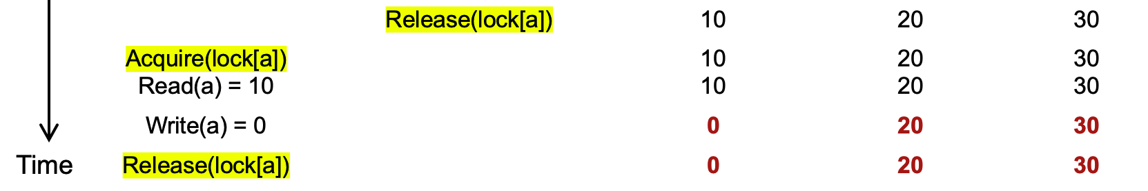
Problem: accessing multiple records
Question #1:
  Is the final state of the program correct? Yes.
Question #2:
  Is the sum of the audit correct? No !

Slide 61
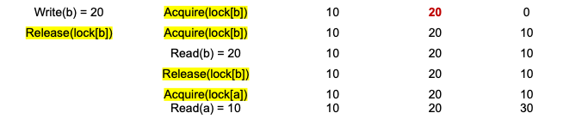
Problem: accessing multiple records
Core problem
  Thread 1 is seeing Thread 0‘s action’s intermediate result
Insight
  we need to delay the lock release time for each shared data
    Until all the transaction’s updates finish

Slide 62
Solution: acquire all locks first, and release them at last
Lock Point
Lock
Acquire lock-D
Release lock-D
Acquire lock-C
Release lock-C
Acquire lock-B
Release lock-B
Acquire lock-A
Release lock-A
Time

Slide 63
Two-phase locking (2PL)
…
Fine-grained locking:
  Each shared data has one lock
  E.g., a lock for Alice & a lock for Bob
2PL locking rule:
  The action must acquire the shared data’s lock before access it, and releases it after the data access finishes and release it until the action finishes
Bank = [
Alice: 0¥
Bob: 0¥
Lock = [

Slide 64
Two-phase locking (2PL)
2PL Lock acquire rule:
  The action must acquire the shared data’s lock before access it, and release it until all the action finishes
Fine-grained locking
Fine-grained locking + 2PL
Transfer(bank, locks, a, b, amt):
Acquire(lock[b]
bank[b] += amt
Release(lock[b])
Acquire(lock[a])
bank[a] -= amt
Release(lock[a])
Transfer(bank, locks, a, b, amt):
Acquire(lock[b]
bank[b] += amt
Acquire(lock[a])
bank[a] -= amt
Release(lock[a])
Release(lock[b])

Slide 65
Two-phase locking (2PL)
Transfer
(alice, bob, 10)
Transfer
(alice, bob, 10)
Audit()
Audit()
Thread 0 (Transfer) | Thread 1 (Audit) | Bank[Alice] | Bank[bob] | Sum
 |  | 10 | 10 | 0
Acquire(lock[b]) | Acquire(lock[b]) | 10 | 10 | 0
Read(b) = 10 | Acquire(lock[b]) | 10 | 10 | 0
Write(b) = 20 | Acquire(lock[b]) | 10 | 20 | 0
Release(lock[b]) | Acquire(lock[b]) | 10 | 20 | 0
Time
Time

Slide 66
Two-phase locking (2PL)
Transfer
(alice, bob, 10)
Transfer
(alice, bob, 10)
Audit()
Audit()
Thread 0 (Transfer) | Thread 1 (Audit) | Bank[Alice] | Bank[bob] | Sum
 |  | 10 | 10 | 0
Acquire(lock[b]) | Acquire(lock[b]) | 10 | 10 | 0
Read(b) = 10 | Acquire(lock[b]) | 10 | 10 | 0
Write(b) = 20 | Acquire(lock[b]) | 10 | 20 | 0
Acquire(lock[a]) | Acquire(lock[b]) | 10 | 20 | 0
Time
Time

Slide 67
Two-phase locking (2PL)
Transfer
(alice, bob, 10)
Transfer
(alice, bob, 10)
Audit()
Audit()
Thread 0 (Transfer) | Thread 1 (Audit) | Bank[Alice] | Bank[bob] | Sum
 |  | 10 | 10 | 0
Acquire(lock[b]) | Acquire(lock[b]) | 10 | 10 | 0
Read(b) = 10 | Acquire(lock[b]) | 10 | 10 | 0
Write(b) = 20 | Acquire(lock[b]) | 10 | 20 | 0
Acquire(lock[a]) | Acquire(lock[b]) | 10 | 20 | 0
Read(a) = 10 | Acquire(lock[b]) | 10 | 10 | 0
Time
Time

Slide 68
Two-phase locking (2PL)
Transfer
(alice, bob, 10)
Transfer
(alice, bob, 10)
Audit()
Audit()
Thread 0 (Transfer) | Thread 1 (Audit) | Bank[Alice] | Bank[bob] | Sum
 |  | 10 | 10 | 0
Acquire(lock[b]) | Acquire(lock[b]) | 10 | 10 | 0
Read(b) = 10 | Acquire(lock[b]) | 10 | 10 | 0
Write(b) = 20 | Acquire(lock[b]) | 10 | 20 | 0
Acquire(lock[a]) | Acquire(lock[b]) | 10 | 20 | 0
Read(a) = 10 | Acquire(lock[b]) | 10 | 10 | 0
Write(a) = 0 | Acquire(lock[b]) | 0 | 20 | 0
Time
Time

Slide 69
Two-phase locking (2PL)
Transfer
(alice, bob, 10)
Transfer
(alice, bob, 10)
Audit()
Audit()
Thread 0 (Transfer) | Thread 1 (Audit) | Bank[Alice] | Bank[bob] | Sum
 |  | 10 | 10 | 0
Acquire(lock[b]) | Acquire(lock[b]) | 10 | 10 | 0
Read(b) = 10 | Acquire(lock[b]) | 10 | 10 | 0
Write(b) = 20 | Acquire(lock[b]) | 10 | 20 | 0
Acquire(lock[a]) | Acquire(lock[b]) | 10 | 20 | 0
Read(a) = 10 | Acquire(lock[b]) | 10 | 10 | 0
Write(a) = 0 | Acquire(lock[b]) | 0 | 20 | 0
Release(lock[b]) | Acquire(lock[b]) | 0 | 20 | 0
Time
Time

Slide 70
Two-phase locking (2PL)
Transfer
(alice, bob, 10)
Transfer
(alice, bob, 10)
Audit()
Audit()
Thread 0 (Transfer) | Thread 1 (Audit) | Bank[Alice] | Bank[bob] | Sum
 |  | 10 | 10 | 0
Acquire(lock[b]) | Acquire(lock[b]) | 10 | 10 | 0
Read(b) = 10 | Acquire(lock[b]) | 10 | 10 | 0
Write(b) = 20 | Acquire(lock[b]) | 10 | 20 | 0
Acquire(lock[a]) | Acquire(lock[b]) | 10 | 20 | 0
Read(a) = 10 | Acquire(lock[b]) | 10 | 10 | 0
Write(a) = 0 | Acquire(lock[b]) | 0 | 20 | 0
Release(lock[b]) Release(lock[a]) | Acquire(lock[b]) | 0 | 20 | 0
 | Read(b) = 20 | 0 | 20 | 20
Time
Time

Slide 71
Two-phase locking (2PL)
Transfer
(alice, bob, 10)
Transfer
(alice, bob, 10)
Audit()
Audit()
Thread 0 (Transfer) | Thread 1 (Audit) | Bank[Alice] | Bank[bob] | Sum
 |  | 10 | 10 | 0
Acquire(lock[b]) | Acquire(lock[b]) | 10 | 10 | 0
Read(b) = 10 | Acquire(lock[b]) | 10 | 10 | 0
Write(b) = 20 | Acquire(lock[b]) | 10 | 20 | 0
Acquire(lock[a]) | Acquire(lock[b]) | 10 | 20 | 0
Read(a) = 10 | Acquire(lock[b]) | 10 | 10 | 0
Write(a) = 0 | Acquire(lock[b]) | 0 | 20 | 0
Release(lock[b]) Release(lock[a]) | Acquire(lock[b]) | 0 | 20 | 0
 | Read(b) = 20 Acquire(lock[a]) | 0 0 | 20 20 | 20 20
Time
Time

Slide 72
Two-phase locking (2PL)
Transfer
(alice, bob, 10)
Transfer
(alice, bob, 10)
Audit()
Audit()
Thread 0 (Transfer) | Thread 1 (Audit) | Bank[Alice] | Bank[bob] | Sum
 |  | 10 | 10 | 0
Acquire(lock[b]) | Acquire(lock[b]) | 10 | 10 | 0
Read(b) = 10 | Acquire(lock[b]) | 10 | 10 | 0
Write(b) = 20 | Acquire(lock[b]) | 10 | 20 | 0
Acquire(lock[a]) | Acquire(lock[b]) | 10 | 20 | 0
Read(a) = 10 | Acquire(lock[b]) | 10 | 10 | 0
Write(a) = 0 | Acquire(lock[b]) | 0 | 20 | 0
Release(lock[b]) Release(lock[a]) | Acquire(lock[b]) | 0 | 20 | 0
 | Read(b) = 20 Acquire(lock[a]) Read(a) = 0 | 0 0 0 | 20 20 20 | 20 20 20
Time
Time

Slide 73
Two-phase locking (2PL)
Transfer
(alice, bob, 10)
Transfer
(alice, bob, 10)
Audit()
Audit()
Thread 0 (Transfer) | Thread 1 (Audit) | Bank[Alice] | Bank[bob] | Sum
 |  | 10 | 10 | 0
Acquire(lock[b]) | Acquire(lock[b]) | 10 | 10 | 0
Read(b) = 10 | Acquire(lock[b]) | 10 | 10 | 0
Write(b) = 20 | Acquire(lock[b]) | 10 | 20 | 0
Acquire(lock[a]) | Acquire(lock[b]) | 10 | 20 | 0
Read(a) = 10 | Acquire(lock[b]) | 10 | 10 | 0
Write(a) = 0 | Acquire(lock[b]) | 0 | 20 | 0
Release(lock[b]) Release(lock[a]) | Acquire(lock[b]) | 0 | 20 | 0
 | Read(b) = 20 Acquire(lock[a]) Read(a) = 0 Release(lock[a]) | 0 0 0 0 | 20 20 20 20 | 20 20 20 20
Time
Audit appears to run after the transfer
Time

Slide 74
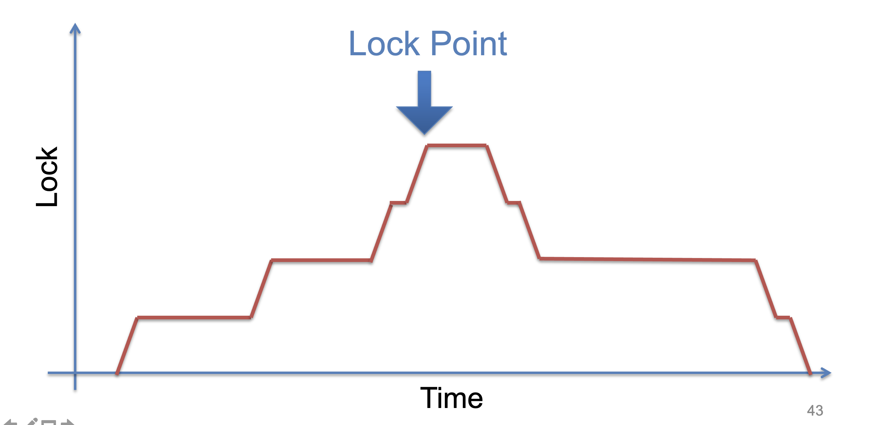
Two-phase locking (2PL)

Slide 75
Use locking to achieve before-or-after: 2PL
2PL can guarantee before or after atomicity with serializability
  Run actions T1, T2, .., TN concurrently, and have it "appears" as if they ran sequentially (we will prove it later)
Before or after atomicity
Concurrent actions have the before-or-after property if their effect from the point of view of their invokers is as if the actions occurred either completely before or completely after one another

Slide 76
Serializability
2PL can guarantee before or after atomicity with serializability
  Run actions T1, T2, .., TN concurrently, and have it "appears" as if they ran sequentially (we will prove it later)
What does this mean?

Slide 77
Serializability
2PL can guarantee before or after atomicity with serializability
  Run actions T1, T2, .., TN concurrently, and have it "appears" as if they ran sequentially (we will prove it later)
What does this mean?
T1
begin
read(x)
tmp = read(y)
write(y, tmp+10)
commit
T2
begin
write(x, 20)
write(y, 30)
commit
Action start
Action end

Slide 78
Init: x=0, y=0
T1
begin
read(x)
tmp = read(y)
write(y, tmp+10)
commit
T2
begin
write(x, 20)
write(y, 30)
commit
Possible sequential schedules
T1 -> T2: x=20, y=30
T2 -> T1: x=20, y=40
T2: write(x, 20)
T1: read(x)
T2: write(y, 30)
T1: tmp = read(y)
T1: write(y, tmp+10)
At end: x=20, y=40
T1: read(x)
T2: write(x, 20)
T1: tmp = read(y)
T2: write(y, 30)
T1: write(y, tmp+10)
At end: x=20, y=10

Slide 79
Init: x=0, y=0
T1
begin
read(x)
tmp = read(y)
write(y, tmp+10)
commit
T2
begin
write(x, 20)
write(y, 30)
commit
Possible sequential schedules
T1 -> T2: x=20, y=30
T2 -> T1: x=20, y=40
T2: write(x, 20)
T1: read(x)
T2: write(y, 30)
T1: tmp = read(y)
T1: write(y, tmp+10)
At end: x=20, y=40
x=0
T1: read(x)
T2: write(x, 20)
T2: write(y, 30)
T1: tmp = read(y)
T1: write(y, tmp+10)
At end: x=20, y=40
y=30
In the second schedule, the results are correct. But T1 reads x=0 and y=30; those reads are not possible in a sequential schedule. Is that ok?

Slide 80
Init: x=0, y=0
Whether OK depends:
  There are many ways for multiple transactions to "appear" to have been run in sequence; there are different notions of serializability
  Chose a type of serializability depends on applications
T1
begin
read(x)
tmp = read(y)
write(y, tmp+10)
commit
T2
begin
write(x, 20)
write(y, 30)
commit
Possible sequential schedules
T1 -> T2: x=20, y=30
T2 -> T1: x=20, y=40
T2: write(x, 20)
T1: read(x)
T2: write(y, 30)
T1: tmp = read(y)
T1: write(y, tmp+10)
At end: x=20, y=40
x=0
T1: read(x)
T2: write(x, 20)
T2: write(y, 30)
T1: tmp = read(y)
T1: write(y, tmp+10)
At end: x=20, y=40
y=30
In the second schedule, the results are correct. But T1 reads x=0 and y=30; those reads are not possible in a sequential schedule. Is that ok?

Slide 81
Serializability has many types
Final-state serializability
  A schedule is final-state serializable if its final written state is equivalent to that of some serial schedule
Conflict serializability
View serializability
Final-state serializability
Our focus
x=0
T1: read(x)
T2: write(x, 20)
T2: write(y, 30)
T1: tmp = read(y)
T1: write(y, tmp+10)
At end: x=20, y=40
y=30

Slide 82
Conflict Serializability

Slide 83
Conflict Serializability
Two operations conflict if:
  they operate on the same data object, and
  at least one of them is write, and
  they belong to different transactions
Conflict serializability
  A schedule is conflict serializable if the order of its conflicts (the order in which the conflicting operations occur) is the same as the order of conflicts in some sequential schedule

Slide 84
Init: x=0, y=0
T1
begin
read(x)
tmp = read(y)
write(y, tmp+10)
commit
T2
begin
write(x, 20)
write(y, 30)
commit
Possible sequential schedules
T1 -> T2: x=20, y=30
T2 -> T1: x=20, y=40
T1.1
T2.1
T1.2
T2.2
T1.3
Conflicts
T1.1 read(x) and T2.1 write(x,20) on x
T1.2 tmp = read(y) and T2.2 write(y,30) on y
T1.3 write(y, tmp+10) and T2.2 write(y,30) on y

Slide 85
Conflict Graph
Conflict Graph
  Nodes are transactions, edges are directed
  Edge between T_{i} and T_{j} if and only if:
    T_{i} and T_{j} have a conflict between them, and
    the first step in the conflict occurs in T_{i}
A schedule is conflict serializable if and only if:
  It has an acyclic conflict graph

Slide 86
T1
begin
read(x)
tmp = read(y)
write(y, tmp+10)
commit
T2
begin
write(x, 20)
write(y, 30)
commit
Possible sequential schedules
T1 -> T2: x=20, y=30
T2 -> T1: x=20, y=40
Conflicts
T1.1 read(x) -> T2.1 write(x,20)
T1.2 tmp = read(y) -> T2.2 write(y,30)
T1.3 write(y, tmp+10) -> T2.2 write(y,30)
(T1 -> T2)

Slide 87
T1
begin
read(x)
tmp = read(y)
write(y, tmp+10)
commit
T2
begin
write(x, 20)
write(y, 30)
commit
Possible sequential schedules
T1 -> T2: x=20, y=30
T2 -> T1: x=20, y=40
Conflicts
T2.1 write(x,20) -> T1.1 read(x)
T2.2 write(y,30) -> T1.2 tmp = read(y)
T2.2 write(y,30) -> T1.3 write(y, tmp+10)
(T2 -> T1)

Slide 88
Conflicts
T2.1, T1.1
T2.2, T1.2
T2.2, T1.3
Conflict order for sequential schedules
T1.1 -> T2.1 T2.1 -> T1.1
T1.2 -> T2.2 or T2.2 -> T1.2
T1.3 -> T2.2 T2.2 -> T1.3
(T1 -> T2) (T2 -> T1)
T2: write(x, 20)
T1: read(x)
T2: write(y, 30)
T1: tmp = read(y)
T1: write(y, tmp+10)
T1: read(x)
T2: write(x, 20)
T2: write(y, 30)
T1: tmp = read(y)
T1: write(y, tmp+10)
T2.1 -> T1.1
T2.2 -> T1.2
T2.2 -> T1.3
T1.1 -> T2.1
T2.2 -> T1.2
T2.2 -> T1.3

Slide 89
Conflicts
T2.1, T1.1
T2.2, T1.2
T2.2, T1.3
Conflict order for sequential schedules
T1.1 -> T2.1 T2.1 -> T1.1
T1.2 -> T2.2 or T2.2 -> T1.2
T1.3 -> T2.2 T2.2 -> T1.3
(T1 -> T2) (T2 -> T1)
T2: write(x, 20)
T1: read(x)
T2: write(y, 30)
T1: tmp = read(y)
T1: write(y, tmp+10)
T2 -> T1
T1: read(x)
T2: write(x, 20)
T2: write(y, 30)
T1: tmp = read(y)
T1: write(y, tmp+10)
-->
<--
T2 T1
It's final-state serializable,
not conflict serializable
Both at end: x=20, y=40

Slide 90



Conflict Equivalence
=
conflict-equal
Schedule A
if
Schedule B
T1 → T2
T4 → T3
=
equal
Conflicts order A
Conflicts order B
If conflicts-order-A equals to conflicts-order-B,
then schedule-A conflict-equals to schedule-B

Slide 91
View Serializability
T1 T2 T3
read(x)
write(x)
write(x)
write(x)
Conflict graph
T3
T2 T1
Cyclic -> Not conflict serializable
But compare it to running T1 then T2 then T3 (serially)
  Final-state is fine
  Intermediate reads are fine
Question: why shouldn't we allow this schedule?

Slide 92
View Serializability
Informal definition
  A schedule is view serializable if the final written state as well as intermediate reads are the same as in some serial schedule
Formally, for those interested
  Two schedules S and S' are view equivalent if:
    If T_{i} in S reads an initial value for X, so does T_{i} in S'
    If T_{i} in S reads the value written by T_{j} in S for some X, so does T_{i} in S'
    If T_{i} in S does the final write to X, so does T_{i} in S'
  A schedule is view serializable if it is view equivalent to some serial schedule

Slide 93
Question
Why conflict serializability when it seems too strict?
Why not focus on view serializability?
Final-state Serializability
View
Serializability
Conflict
Serializability
⊃
⊃
Care the final state only
Care the final state as well as intermediate read
Care the final state as well as all the data dependency

Slide 94
Conflict Serializability VS. View Serializability
Conflict serializability is easy to test
  i.e., check whether a graph is acyclic
  View serializability is hard to test (likely NP-hard)
Conflict serializable schedules are easy to generate
  Using concurrency control protocols. E.g., 2PL (two-phase-locking)
Conflict serializable schedules are also view serializable
  No easy way to generate view schedules that allows for ones like the previous example

Slide 95
Use locking to achieve before-or-after: 2PL
2PL can guarantee before or after atomicity
  Run actions T1, T2, .., TN concurrently, and have it "appears" as if they ran sequentially
2PL locking rule:
  The action must acquire the shared data’s lock before access it and release it until the action finishes
Question
  Which serializability does 2PL guarantee?
  Conflict serializability!

Slide 96
Proof of 2PL
T1 and T2 conflict on x1
T2 and T3 conflict on x2
...
Tk and T1 conflict on x_k
Suppose 2PL does not generate conflict serializable schedule
Suppose the conflict graph produced by an execution of 2PL has a cycle, which without loss of generality, is:
T1 --> T2 --> ... --> Tk --> T1
Let the shared variable (the one that causes the conflict) between T_i and T_{i+1} be represented by x_i.
T1 acquires x1.lock
T2 acquires x1.lock and x2.lock
T3 acquires x2.lock and x3.lock
...
Tk acquires x_{k-1}.lock and x_k.lock
T1 acquires x_k.lock
T1 violates 2PL!
T1 acquires x1.lock
T1 releases x1.lock
...
...
...
T1 acquires x_k.lock
T1 acquires x1.lock
T1 releases x1.lock
T2 acquires x1.lock and x2.lock
...
Tk acquires x_{k-1}.lock and x_k.lock
T1 acquires x_k.lock

Slide 97
Serializability simplifies enforcing concurrent correctness / data consistency

Slide 98
Correctness (app-semantic consistency)
Correctness is hard for computer system to enforce
  It is at the application level, with application specific semantic
  E.g., developer can write a buggy program, even no concurrency (single-threaded)
To ensure concurrent correctness, we need assumptions
  i.e., The single-threaded implementation of actions must be correct
Buggy
Transfer(bank, a, b, amt):
bank[b] += amt
bank[a] -= amt
Transfer(bank, a, b, amt):
bank[b] += amt * 2
bank[a] -= amt

Slide 99
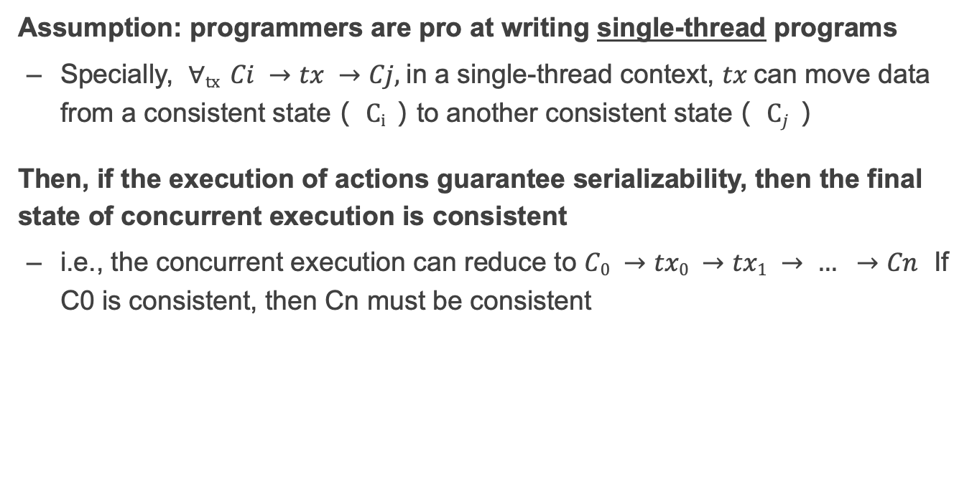
Correctness and serializability
Assumption: programmers are pro at writing single-thread programs
  Specially, $∀tx Ci →tx →Cj,$in a single-thread context, $tx$can move data from a consistent state（ $Ci$）to another consistent state（ $Cj$）
Then, if the execution of actions guarantee serializability, then the final state of concurrent execution is consistent
  i.e., the concurrent execution can reduce to $C0 →tx0 →tx1 → … →Cn$ If C0 is consistent, then Cn must be consistent

Slide 100
Question: what are the drawbacks of 2PL?

Slide 101
Deadlock
Two-phase lock is pessimistic:
  Before proceed, each TX must wait for conflicting TX to release the lock
  What can happen if two TX are waiting for each other?

Slide 102
Deadlock: what if Thread 1 first acquires lock[a]?
Thread 0 (Transfer) | Thread 1 (Audit) | Bank[Alice] | Bank[bob] | Sum
 |  | 10 | 10 | 0
Acquire(lock[b]) | Acquire(lock[b]) | 10 | 10 | 0
Read(b) = 10 | Acquire(lock[b]) | 10 | 10 | 0
Write(b) = 20 | Acquire(lock[b]) | 10 | 20 | 0
Acquire(lock[a]) | Acquire(lock[b]) | 10 | 20 | 0
Read(a) = 10 | Acquire(lock[b]) | 10 | 10 | 0
Write(a) = 0 | Acquire(lock[b]) | 0 | 20 | 0
Release(lock[b]) | Acquire(lock[b]) | 0 | 20 | 0
 | Read(b) = 20 Acquire(lock[a]) Read(a) = 0 Release(lock[a]) | 0 0 0 0 | 20 20 20 20 | 20 20 20 20

Slide 103
Deadlock: what if Thread 1 first acquires lock[a]?
Thread 0 (Transfer) | Thread 1 (Audit) | Bank[Alice] | Bank[bob] | Sum
 |  | 10 | 10 | 0
Acquire(lock[b]) | Acquire(lock[a]) | 10 | 10 | 0

Slide 104
Deadlock: what if Thread 1 first acquires lock[a]?
Thread 0 (Transfer) | Thread 1 (Audit) | Bank[Alice] | Bank[bob] | Sum
 |  | 10 | 10 | 0
Acquire(lock[b]) | Acquire(lock[a]) | 10 | 10 | 0
Read(b) = 10 | Read(a) = 10 | 10 | 10 | 10

Slide 105
Deadlock: what if Thread 1 first acquires lock[a]?
Thread 0 (Transfer) | Thread 1 (Audit) | Bank[Alice] | Bank[bob] | Sum
 |  | 10 | 10 | 0
Acquire(lock[b]) | Acquire(lock[a]) | 10 | 10 | 0
Read(b) = 10 Acquire(lock[a]) | Read(a) = 10 Acquire(lock[b]) | 10 | 10 | 10

Slide 106
Deadlock: what if Thread 1 first acquires lock[a]?
Thread 0 (Transfer) | Thread 1 (Audit) | Bank[Alice] | Bank[bob] | Sum
 |  | 10 | 10 | 0
Acquire(lock[b]) | Acquire(lock[a]) | 10 | 10 | 0
Read(b) = 10 Acquire(lock[a]) Acquire(lock[a]) | Read(a) = 10 Acquire(lock[b]) Acquire(lock[b]) | 10 | 10 | 10
Question: can thread 0 or thread 1 finishes the execution?

Slide 107
Resolving deadlock
1. Acquire locks in a pre-defined order
  Not support general TX: TX must know the read/write sets before execution
2. Detect deadlock by calculating the conflict graph
  If there is a cycle, then there must be a deadlock
  Abort one TX to break the cycle
  High cost for detection
3. Using heuristics (e.g., timestamp) to pre-abort the TXs
  May have false positive, or live locks

Slide 108
Recap data management in a distributed setting is hard
Need consider multiple atomicity
  All-or-nothing Atomicity, when an action container multiple steps
  Before-or-after Atomicity , when actions can run concurrently (this lecture)
To distinguish these, we typically use different terms
  Atomicity -> commonly known as all-or-nothing
  Isolation -> common refer to before-or-after
Resolving all these issues are challenging for the developers
  Logging, recovery, locking, deadlock, etc.
Can we provide a systematic abstraction to simplify data management?

Slide 109
Transactions

Slide 110
What is a transaction (TX)?
An abstraction to manage the data
Data is also an abstract concept, can be arbitrary computing data. Concrete examples including:
  Key-value store entries
  File system metadata (e.g., directory, inode, etc)
  Processor’s metadata (e.g., child processors)
Look like similar program, with data managed by the TX system, and extra mark to denote the start/end of a TX

Slide 111
TX: an abstraction to ease data management
Transactions handle failure atomicity & race conditions
Writing with TX is straightforward
  Use TX.begin to mark when a TX starts
  Use TX.commit to commit the TX
  Rewrite the data read/write with TX’s interface
    E.g., bank[a] = bank[a] – amt
    tx.write(a, tx.read(a) – amt);
transfer(bank, a, b, amt, tx):
tx.begin()
tx.write(b, tx.read(b) + amt);
tx.write(a, tx.read(a) – amt);
tx.commit()
transfer(bank, a, b, amt):
bank[b] = bank[b] + amt
bank[a] = bank[a] - amt
Program
Transaction

Slide 112

What can a TX provide? ACID
The program btw { tx.begin() & tx.commit() } has the following properties:
A：Atomicity
  All or nothing atomicity
C：Consistency
I：Isolation
  (informally) before-of-after atomicity
D：Durability
  Committed TX’s data on durable storage
...
tx.begin();
...
...
tx.commit();
...
ACID
Application program

Slide 113
Atomicity
An action is atomic if happens completely or not at all
  Action is an abstraction, can contain many operations
    E.g., multiple disk writes, multiple memory reads/writes
Tools & techniques to achieve so
  Logging

Slide 114
Isolation & Durability
Isolation: Two concurrently transactions are isolated
  E.g., not viewing the intermediate results of another TX
  Avoid the race conditions
    Serializability is the ideal one (Achieved via 2PL & others)
Durability
  Once a transaction is committed, its changes (e.g., writes) must durably stored to a persistent storage
But there are other isolation levels, we will talk about this later

Slide 115
What about consistency? Do logging & locking sufficient to ensure consistency?

Slide 116
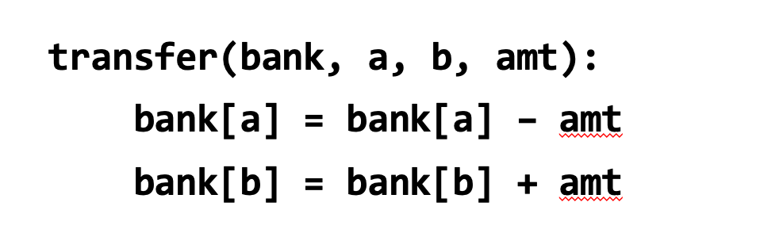
Consistency
Transaction must change the data from a consistent state to another
  Being consistent is defined by the applications
  E.g., transfer should leave the sum(bank[a] + bank[b]) unchanged
Transaction alone is not sufficient for consistency
  E.g., if the programmer writes the incorrect program...
    bank[a] = bank[a] - amt * 2

Slide 117
Enforcing ACID properties
Enforcing A & D:
  Logging and recovery (see the last lecture)
Enforcing C:
  Database constraint system (not covered in this class)
Enforcing I:
  Concurrency control methods (this lecture)
Transactions will automatically & transparently apply these techniques for the programmer
  E.g., acquire locking during tx.read() / tx.write()

Slide 118
Summary of systems that support transactions
e.g., relational databases
Easy of programming
  E.g., Developers don’t need to consider race condition
Consistency
  Support Serializability
Fault tolerance
  Durability (But no availability)
Performance & scalability
  ACID comes at costs!
Scalability
Ease of
programming
Performance
Consistency
Fault tolerance

