Slide 1


Atomicity across multiple transactions, multiple sites
SE3331-1 (2022 Fall)
Yubin Xia
IPADS, Shanghai Jiao Tong University
https://www.sjtu.edu.cn
Credits: Rong Chen@IPADS

Slide 2

Review: The ACID property of TX
The program btw { tx.begin() & tx.commit() } has the following properties:
A：Atomicity (all-or-nothing)
C：Consistency
I：Isolation (before-or-after)
D：Durability
...
tx.begin();
...
...
tx.commit();
...
ACID
Application program

Slide 3



We talked about before-or-after in previous lectures
Before-or-nothing allows two transactions correctly running concurrently
Why do we particularly care about concurrency?
  In order to scale to a higher performance
    Single-thread doesn’t scale
  Scale up & Scale out
Scale up
Scale out

Slide 4
Tools to achieve before-or-after
Pessimistic
  Two-phase locking
Optimistic
  Optimistic concurrency control

Slide 5
Review: optimistic concurrency control
Phase 1: Concurrent local processing
  Reads data into a read set
  Buffers writes into a write set
Phase 2: Validation in critical section
  Validates whether serializability is guaranteed:
  Has any data in the read set been modified?
Phase 3: Commit the results in critical section or abort
  Aborts: aborts the transaction if validation fails
  Commits: installs the write set and commits the transaction

Slide 6
Review: OCC Executes a Transaction in 3 Phases
Phase 3:
  Aborts: aborts the transaction if validation fails
  Commits: installs the write set and commits the transaction
Phase 2 & 3 should execute in a critical section
  Otherwise, what if a value has changed during validation?
...
tx.begin();
...
tx.read(A)
...
tx.commit();
...
Critical section
for d in read-set:
if d has changed:
abort()
for d in write-set:
write(d)

Slide 7
How to implement the critical section for phase 2 & 3?
Global lock may satisfy
  The phase 2 & 3 are typically short
    No TX logic is executed, only the validation
def validate_and_commit() // phase 2 & 3
global_lock.lock()
for d in read-set:
if d has changed:
abort()
for d in write-set:
write(d)
global_lock.unlock()

Slide 8
How to implement the critical section for phase 2 & 3?
Using two-phase locking
  Allow more concurrency
  What about the problem of deadlock? We can pre-sort all the locks
def validate_and_commit() // phase 2 & 3
for d in read-set:
d.lock()
if d has changed:
abort() // abort will release all the held lock
for d in write-set:
d.lock()
write(d)
// release the locks
...

Slide 9
How to implement the critical section for phase 2 & 3?
Using two-phase locking
  Allow more concurrency
  Use sort to avoid deadlock
  Question: do we need to lock the read-set?
def validate_and_commit() // phase 2 & 3
for d in sorted(read-set + write-set):
d.lock()
for d in read-set:
if d has changed:
abort()
for d in write-set:
write(d)
// release the locks
...

Slide 10
How to implement the critical section for phase 2 & 3?
Observation (for the read-set):
  If the validation passes, then it “appears ” that a lock is held during
def validate_and_commit() // phase 2 & 3
for d in sorted(read-set + write-set):
d.lock()
for d in read-set:
if d has changed:
abort()
for d in write-set:
write(d)
// release the locks
...

Slide 11
How to implement the critical section for phase 2 & 3?
Observation (for the read-set):
  If the validation passes, then it “appears ” that a lock is held during
def validate_and_commit() // phase 2 & 3
for d in sorted(write-set):
d.lock()
for d in read-set:
if d has changed:
abort()
for d in write-set:
write(d)
// release the locks
...
What if we remove read-set?

Slide 12

Problem: read-write conflict
T1:
A += B
T2:
B += A
Time
T1
T2
Read(A_{T0})
Phase #1
Read(B_{T0})
Read(A_{T0})
Read(B_{T0})
Missing the lock!
Phase #2
Lock(A)
Validate(B_{T0})
Lock(B)
Validate(A_{T0})
Write(A, A_{T0} + B_{To})
Write(B, A_{T0} + B_{To})

Slide 13
How to implement the critical section for phase 2 & 3?
Use two-phase locking + read validation
  Only lock the write set, after that,
  Check the read set has not changed & locked
def validate_and_commit() // phase 2 & 3
for d in sorted(write-set):
d.lock()
for d in read-set:
if d has changed or d has been locked:
abort()
for d in write-set:
write(d)
// release the locks
...

Slide 14
OCC's Problem: False Aborts
Some transactions aborted by OCC could have been allowed to commit without causing an unserializable schedule
Especially for TXs with a lot of reads
  E.g., read a lot of items → large read set → easier to abort
  May abort even under low-contention
Notes:
因为执行的时间很长，所以会abort

Slide 15
Can we avoid locking/validation for reads?
Maybe use weaker isolation level?

Slide 16
Multi-version Concurrency Control
Each data item has multiple versions
  When accessing different versions of data, probably no conflict!
Key (high-level) idea
  Writes don’t overwrite the original data
  Instead, writes install new versions of data
  Reads read from a "snapshot" of data
Benefits: no lock or validation during TX’s execution
bankA: 100, ver: 12, pre:xx
bankA: 100
bankA: 200, ver: 10, pre:xx
Single-version
Multi-version

Slide 17
Snapshot Isolation
A popular multi-version concurrency control (MVCC) scheme
  Transactions will get start and commit timestamp
  Use start timestamp to find the snapshot to read
  Use commit timestamp to install new versions
Transactions:
  WRITEs a local buffer (similar to OCC)
  READs a “snapshot” of entire data image
  COMMIT only if no write-write conflict
    Install new versions of data

Slide 18
Snapshot Isolation Implementation
T is assigned a commit timestamp T.cts
System checks all data within T.wset,
if T.sts < X.cts < T.cts, then abort T
Update all data within T.wset with T.cts
T is assigned a start timestamp T.sts
T
START
READ(X)
WRITE(X)
COMMIT
Time
T reads the biggest version of X(i), such that X(i).cts <= T.sts
T buffers writes to X and adds X to its write-set, T.wset += {X}

Slide 19
Time in Snapshot Isolation
Timestamp of start & commit should be assigned in a increasing order
  E.g., global counters with atomic increase
  Question: can we directly use the physical clock of the machine?
    It depends. If all cores have global order of physical clock, then yes; otherwise not.
T is assigned a commit timestamp T.cts
System checks all data within T.wset,
if T.sts < X.cts < T.cts, then abort T
Update all data within T.wset with T.cts
T is assigned a start timestamp T.sts
T
START
COMMIT
Time
Notes:
answer: depends. if all cores have global order of physical clock, then yes. otherwise not.

Slide 20
Snapshot Isolation Example (T1)
5
10
40
50
60
70
Time
T1
S
R(A)
R(B)
W(A)
W(B)
C
T2
S
R(A)
R(B)
C
T3
S
R(A)
R(B)
C
10
T.sts =
R(A) =
R(B) =
T.cts =
W(A) =
W(B) =
A₀
A₂
A₇
A₅₀
A₇
B₈
B₀
B₃
B₈
B₅₀
50
A₅₀
B₅₀

Slide 21
Snapshot Isolation Example (T2)
5
10
40
50
60
70
Time
T1
S
R(A)
R(B)
W(A)
W(B)
C
T2
S
R(A)
R(B)
C
T3
S
R(A)
R(B)
C
10
40
T.sts =
R(A) =
R(B) =
T.cts =
W(A) =
W(B) =
T.sts =
R(A) =
R(B) =
T.cts =
A₀
A₂
A₇
A₅₀
A₇
A₇
B₈
B₈
B₀
B₃
B₈
B₅₀
50
70
A₅₀
B₅₀
No uncommitted-read (A₅₀)

Slide 22
Snapshot Isolation Example (T3)
5
10
40
50
60
70
Time
T1
S
R(A)
R(B)
W(A)
W(B)
C
T2
S
R(A)
R(B)
C
T3
S
R(A)
R(B)
C
5
10
40
T.sts =
R(A) =
R(B) =
T.cts =
T.sts =
R(A) =
R(B) =
T.cts =
W(A) =
W(B) =
T.sts =
R(A) =
R(B) =
T.cts =
A₀
A₂
A₇
A₅₀
A₇
A₇
A₂
B₈
B₈
B₃
50
70
60
B₀
B₃
B₈
B₅₀
A₅₀
B₅₀
No unrepeatable-read

Slide 23
Snapshot Isolation Example
5
10
40
50
60
70
Time
T1
S
R(A)
R(B)
W(A)
W(B)
C
T2
S
R(A)
R(B)
C
T3
S
R(A)
R(B)
C
Equivalent Serial Order
A₀
A₂
A₇
A₅₀
T3
A₇
B₈
T2
T1
B₀
B₃
B₈
B₅₀
Can Snapshot Isolation guarantee serializable or not ?

Slide 24
Question of Snapshot Isolation
Snapshot isolation (SI) differs from serializability due to one anomaly that is possible under SI but not under serializability.
Describe the anomaly and also give a concrete application for which the anomaly is undesirable.
T1
S
R(X)
W(Y)
C
R(X) = X₀
W(Y) = Y₁
T2
S
R(Y)
W(X)
C
R(Y) = Y₀
W(X) = X₁
Possible Serial Order
X₀
X₁
T1
T2
Y₀
Y₁
T2
T1

Slide 25
Write skew & DSM
Recall our memory consistency problem in DSM
  Suppose both TX reads from an early snapshot of x & y (w/ 0)
extern int x; //0
extern int y; //0
x = 1
if (y==0)
critical sec
CPU1
extern int x;//0
extern int y;//0
y = 1
if (x==0)
critical sec
CPU0
Read/Write
DSM

Slide 26
Recap till now
Transactions provide ACID properties
OCC & 2PL are basic protocols to provide serializability
  Problem of 2PL: locking & deadlock
  Problem of OCC: False abort & livelock
Hardware transactional memory (HTM)
  Advanced CPU features inspired by ACID properties of TXs
  Commercial implementation of HTM uses OCC
    Leads to several drawbacks
The cost of concurrency control can be reduced w/ relaxed isolation level
  Snapshot Isolation (require global counter, not serializable)

Slide 27
Is 2PL + OCC sufficient?

Slide 28
Review bank transfer
Transfer(bank, locks, a, b, amt):
bank[b] += amt
bank[a] -= amt
All-or-nothing atomicity
  Write ahead logging (WAL)
Before-or-after atomicity
  Two-phase locking (2PL), OCC.
Yet, techniques so far (WAL + 2PL + OCC) is insufficient for all the TXs

Slide 29
Case study #1:
Nested transaction

Slide 30
Nested transactions
发工资(bank, accts, amt):
for acct in accts:
deposit(bank, acct, amt)
Deposit(bank, a, amt):
tx.begin()
bank[a] += amt
tx.commit()

Slide 31
Nested transactions
What will happen if any one in the middle fails?
  The atomicity of 「发工资」is broken
  Even if we assume that each transfer is atomic (ACID transaction)
发工资
Deposit(…)
Deposit(…)
Deposit(…)
Deposit(…)
Time
Goal: the entire 「发工资」 should be atomic

Slide 32
Case study #2:
Multi-site transaction

Slide 33



Multi-site transaction
Accounts are shared over multiple sites
  i.e., a single site cannot store all the bank accounts
The setup
  Client + coordinator + two servers
  One server handles bank accounts A-M
  The other server handles bank accounts N-Z
  Coordinator and servers all have logs to ensure single transaction atomicity
Coordinators
e.g., frontend servers
Storage servers
e.g., key-value stores
Clients,
e.g., iPhone
A - M
N - Z

Slide 34

Nested transactions across multiple sites
Multi-site transaction
Single transactions whose values across sites
Coordinator sends multiple deposit to different servers
  They use RPCs to send requests to the server to execute transaction
发工资(bank, accts, amt):
for acct in accts:
deposit(bank, acct, amt)
发工资
Coordinator
Server 0
Audit(“Alice”)
Audit(“Zack”)
Server 1
Time

Slide 35
Multi-site transaction
Nested transactions across multiple sites
Single transactions whose values across sites
Coordinator sends multiple deposit to different servers
  They use RPCs to send requests to the server to execute transaction
发工资(bank, accts, amt):
for acct in accts:
deposit(bank, acct, amt)
发工资
Coordinator
Server 0
deposit(“Alice”)
deposit(“Zack”)
Server 1
Time
What if one server commits and the other aborts?

Slide 36
Single transactions whose values across sites
transfer(bank, accts, first, second, amt):
accts[first] -= amt
accts[second] += amt

Slide 37
Single transactions whose values across sites
transfer(bank, accts, “alice”, “bob”, amt):
accts[“alice"] -= amt
accts[“bob"] += amt
Coordinator
Storage server
A - M
begin
ok
A - amt
ok
B + amt
ok
Commit
ok
Notes:
讲单机

Slide 38
Single transactions whose values across sites
transfer(bank, accts, “alice”, “bob”, amt):
accts[“alice"] -= amt
accts[“zack"] += amt
Coordinator
Storage server
A - M
Storage server
N - Z
begin
ok
A - amt
ok
Z + amt
ok
Commit
ok
Notes:
讲单机

Slide 39
Multi-site transaction
Can single transactions whose values across sites be viewed as a special form of nested transactions across multiple sites?
  Yes: each modifications to a value can be viewed as a low-level transaction
Problems remain: What if one TX commits and others not?
begin
ok
A - amt
ok
B + amt
ok
Commit
ok

Slide 40
Problems so far
Transaction atomicity may across
  Nested transactions
  Multiple-sites
Sub-transactions (Actions) may fail to commit at the same time
  One commits while the other crashes, or
  One commits while the other aborts, etc.
Current solutions (e.g., OCC) focus on a single transaction
We can glue multiple transactions together with a single protocol
  Two-phase commit

Slide 41
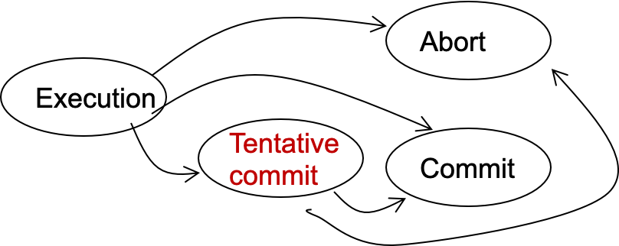
Two-phase Commit
Phase-1: preparation / voting
  Delay the commitment of low-layer TXs
  Lower-layer transactions either abort or tentatively committed
  Higher-layer transaction evaluate lower situation
Phase-2: commitment
  If top-layer, then COMMIT or ABORT
  If nested itself, then become tentatively committed
State transitions of a TX

Slide 42
Two-phase commit in nested transaction
High-layer TX
  Transaction that calls the other transactions
Low-layer TX
  Transactions other than the high-layer TX
Higher-layer transaction evaluate lower situation
发工资(bank, accts, amt):
tx.high_begin()
for acct in accts:
deposit(bank, acct, amt)
tx.high_commit()
High-layer TX
Deposit(bank, a, amt):
tx.begin()
bank[a] += amt
tx.commit()
Low-layer TX

Slide 43
Two-phase commit in nested transaction
High-layer TX
发工资(bank, accts, amt):
tx.high_begin()
for acct in accts:
deposit(bank, acct, amt)
tx.high_commit()
High_begin
  Mark itself as a high-level transaction
High_commit
  Send prepare messages to the low-level transactions to check whether it can commit
tx.high_begin()
tx.high_commit()
for each deposit:
if deposit.abort: abort()
for each deposit:
deposit.commit()
Deposit(…)
Deposit(…)
Time

Slide 44
Question: what about the log content?
Low-layer TX
Deposit(bank, a, amt):
tx.begin()
bank[a] += amt
tx.commit()
Recall: the WAL logging in lecture xx
  At commit point, append a commit record to the log
Question
  Can we directly append the commit record to the lower-level transaction log?
...
log.append("TX {id} commit”).sync()
...
Commit
No! The high-level transaction can abort
Log

Slide 45
Question: what to log under 2PC?
Suppose the coordinator passes the first phase (can commit)
  Do we need to log the prepare information?
tx.high_begin()
tx.high_commit()
for each deposit:
if deposit.abort: abort()
for each deposit:
deposit.commit()
Deposit(…)
Deposit(…)
Time

Slide 46
Question: what to log under 2PC?
Suppose the coordinator passes the first phase (can commit)
  Do we need to log the prepare information?
  Yes. Otherwise, a TX will be undo even the prepare passes
    E.g., Deposit2 in the following example
tx.high_begin()
tx.high_commit()
All deposits agree to commit
Deposit(…)
Deposit(…)
Write commit record of Deposit1
Time
Crash

Slide 47
Logging rule of WAL under 2PC
High-layer transaction （Responsible for commit of low-layer TXs)
  REDO-UNDO log entries: like normal (high-layer TX can also do read/writes)
  Log the prepare log as a commitment of a high-layer TX
Low-layer transaction
  REDO-UNDO log entries: like normal
  Commit log entry -> Tentative commit log entry
    Contains a reference to the high-layer TX

Slide 48

Recovery rules under 2PC
Rules:
  Travel from end to start
  Mark all transaction’s log record without CMT log and append ABORT log
    If a TXs log record is tentative, check whether its referenced high-layer TX has a CMT entry. If no, mark it as abort. Otherwise, mark it as commit
  UNDO ABORT logs from end to start
  REDO CMT logs from start to end
Log

Slide 49
Question: what about the lock release?
Low-layer TX
Deposit(bank, a, amt):
tx.begin()
bank[a] += amt
tx.commit()
Recall: the 2PL in previous lecture
  Transaction must release the lock of its records upon the commitment
Question:
  Can we release the lock upon the low-level commitment?
...
Release(bank[a].lock)
...

Slide 50
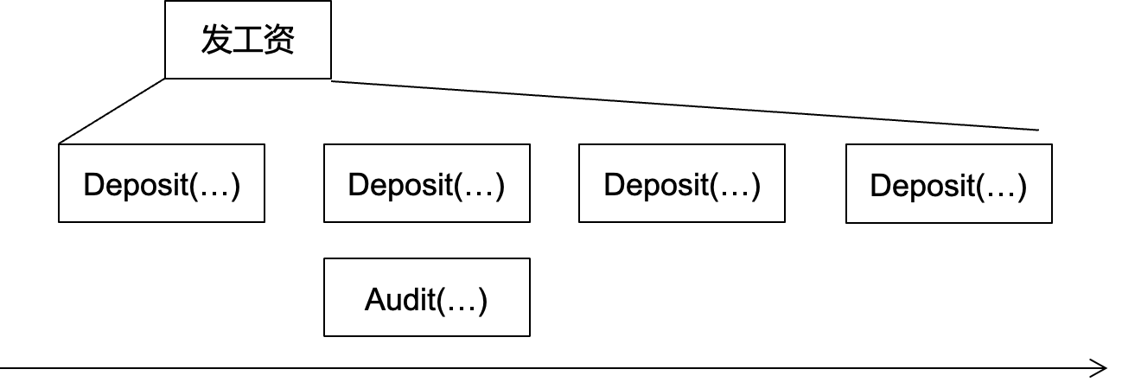
Question: what about the lock release?
Low-layer TX
Deposit(bank, a, amt):
tx.begin()
bank[a] += amt
tx.commit()
Recall: the 2PL in previous lecture
  Transaction must release the lock of its records upon the commitment
Question:
  Can we release the lock upon the low-level commitment?
...
Release(bank[a].lock)
...
No!
  e.g., a concurrently audit can read
  an internal value of 发工资
Read uncommitted value

Slide 51
Lock releases in nested transaction
If a low-level TX commits
  It can only release locks to other low-level TXs belonging to the same high-level TX
  But not other TXs

Slide 52
Short summary: 2PC for nested transaction
Lower-layer transaction
  Upon commit, only mark itself in a "can commit" state
  The high-level transaction is responsible to commit the transaction under the second phase of 2PC
High-layer transaction
  Check whether all lower-level transaction can commit
  Commit all the lower-level TX if the check passes
发工资(bank, accts, amt):
tx.high_begin()
for acct in accts:
deposit(bank, acct, amt)
tx.high_commit()
High-layer TX
Deposit(bank, a, amt):
tx.begin()
bank[a] += amt
tx.commit()
Low-layer TX
Write the commit log, release locks

Slide 53
2PC for multi-site TX

Slide 54
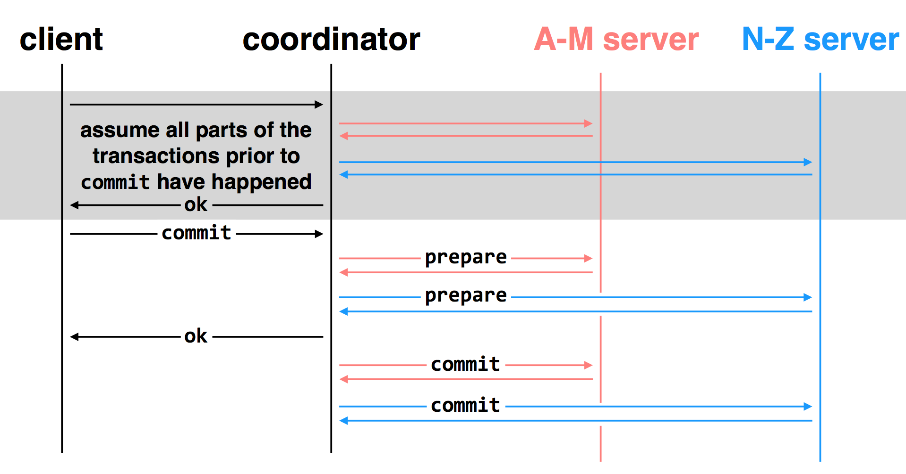
Multi-site transactions under two-phase commit
two-phase commit: nodes agree that they are ready to commit before committing

Slide 55
Multiple-site Atomicity
Worker: Bob, Charles, Dawn
  Does three transactions: X, Y, Z
Coordinator: Alice
  Create a higher-layer transaction
  Send three messages to the three workers
More Challenging: un-reliable communication

Slide 56
Deal with the Network
Message may be lost, delayed or duplicated
Use RPC to communicate
  Ensure at-least-once by persistent sender
  Ensure at-most-once by duplicate suppression
  However, neither is enough to ensure atomicity here

Slide 57
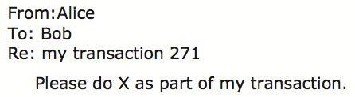
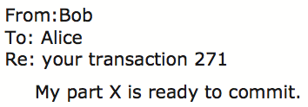
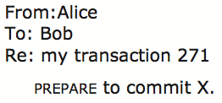

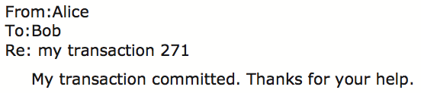
Commit Phase-1
Bob: tentative committed
State: PREPARED
Commit Phase-2
Bob: COMMITTED
Bob will perform post-commit

Slide 58
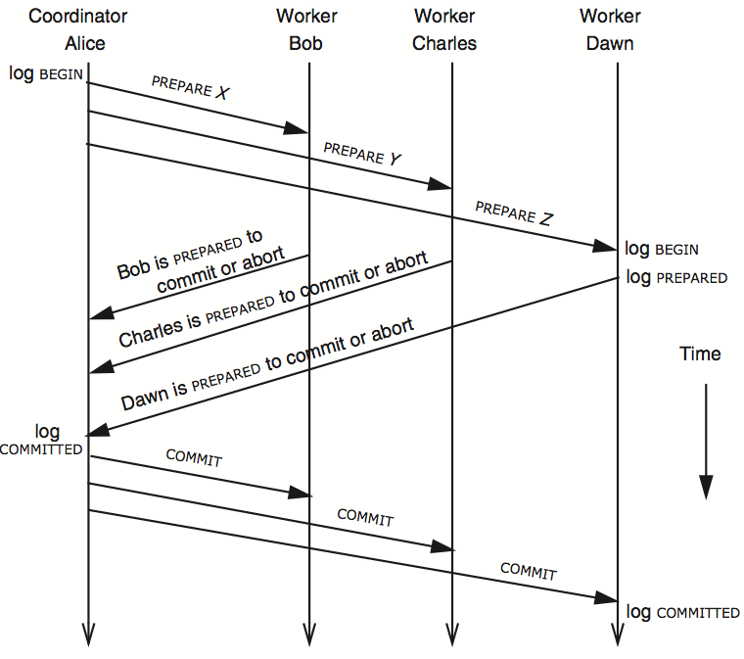
3N messages

Slide 59
Multiple-site Atomicity
Coordinator
  Collect some ABORT or nothing: ABORT or assign the work to another worker
  Collect all COMMIT: then COMMIT
Worker
  When receive nothing: resend PREPARED
  - Coordinator will send current state if it receives duplicate message
  When receive COMMIT: then COMMIT

Slide 60
client
coordinator
A-M server
N-Z server
assume all parts of the transactions prior to
commit have happened
OK
commit
prepare
prepare
OK
commit
commit
two-phase commit: nodes agree that they are ready to commit before committing

Slide 61
client
coordinator
A-M server
N-Z server
OK
commit
X
prepare
timeout; resend
prepare
prepare
OK
commit
commit
failure: lost prepare

Slide 62
client
coordinator
A-M server
N-Z server
OK
commit
prepare
X
timeout; resend
prepare
prepare
OK
failure: lost ACK for prepare

Slide 63

client
coordinator
A-M server
N-Z server
OK
commit
prepare
prepare
abort
abort
failure: worker failure during prepare
coordinator can safely abort transaction, will send explicit abort messages to live workers

Slide 64
client
coordinator
A-M server
N-Z server
OK
commit
prepare
prepare
OK
commit
X
Why? Just wait..
tx?
timeout; resend
commit
commit
failure: lost commit message

Slide 65
client
coordinator
A-M server
N-Z server
OK
commit
prepare
prepare
OK
commit
X
timeout; resend
commit
commit
failure: lost ACK of commit message

Slide 66

client
coordinator
A-M server
N-Z server
OK
commit
prepare
prepare
OK
commit
commit
failure: worker failure during commit
Notes:
workers write PREPARE records once prepared. the recovery process — reading through the log — will indicate which transactions are prepared but not committed

Slide 67
Worker Failure During Commit
If workers fail after the commit point
  We cannot ABORT the transaction
  Workers must be able to recover into a prepared state
  Workers write PREPARE records to log once prepared
The recovery process will:
  Read through the log, and
  Indicate which transactions are prepared but not committed
  Prepared workers must commit the transaction during recovery

Slide 68

client
coordinator
A-M server
N-Z server
OK
commit
prepare
prepare
OK
commit
commit
tx?
restart
commit
failure: worker failure during commit

Slide 69

client
coordinator
A-M server
N-Z server
OK
commit
prepare
coordinator recovers
abort
abort
failure: coordinator failure during prepare

Slide 70
client
coordinator
A-M server
N-Z server
OK
commit
prepare
prepare
OK
commit
coordinator recovers
commit
commit
failure: coordinator failure during commit

Slide 71
Summary of 2-phase Commit
Two-phase commit allows us to achieve multi-site (nested) atomicity: transaction remains atomic even when they require communication with multiple machines
In two-phase commit, failures prior to the commit point can be aborted. If workers (or the coordinator) fail after the commit point, they recover into the PREPARED state, and complete the transaction

Slide 72
Case study
2PC in a real systems: Sinfonia@SOSP’07

Slide 73
Problems Statement of Sinfonia
Target:
  The systems or infrastructural apps within a datacenter
Sinfonia: a shared data store service
  Span multiple servers
  Address space sharding
Goal:
  Reduce development efforts for system programmers

Slide 74
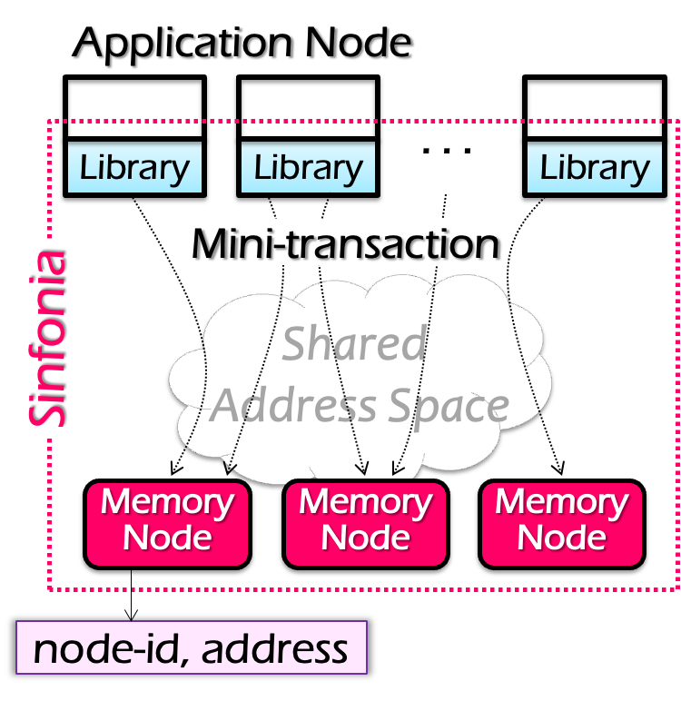
System Architecture
Application node
  E.g., frontend servers
Interface: transaction + simple read/write
  An optimized version of two-phase commit (mini-transaction) given some workloads
Why not DSM?
  Single global manager limits the performance & scalability
  False sharing
Notes:
Application
减少一个RTT
Interface
- 用户可以自己选择是否需要TX

Slide 75
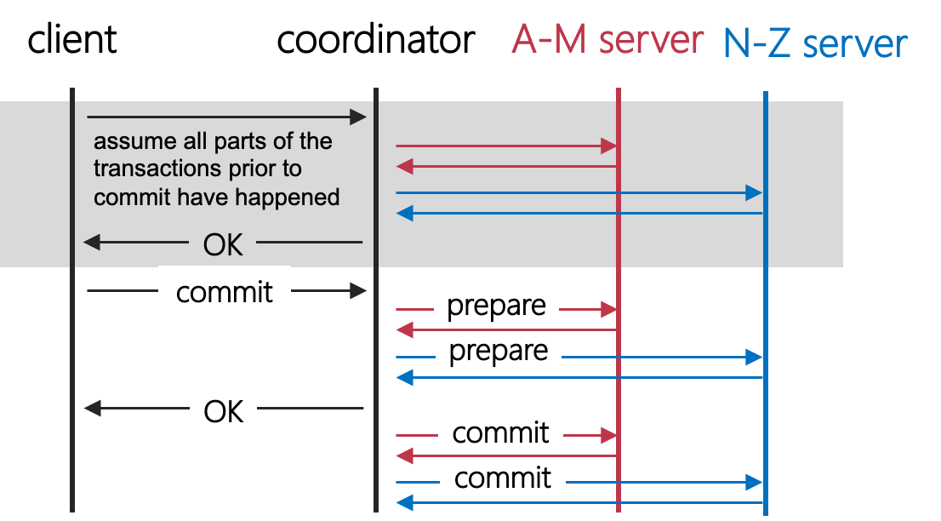
Review of 2PC: optimization spaces
Question: how many roundtrips are there for this simple TX?
Can we reduce the RTTs?

Slide 76
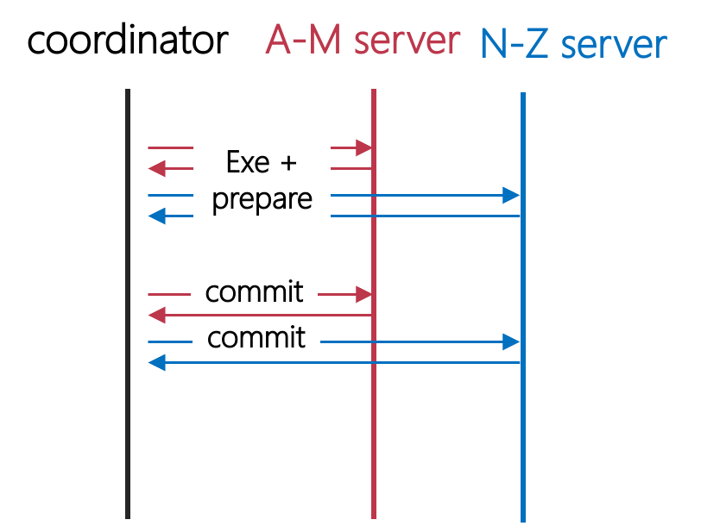
Observation
Send the prepare w/ the last action sending to a server
  Question: when can we piggyback these two RPCs together?
Only when the execution of the last operation does not affect the overall commit/abort decision

Slide 77
Mini-transactions
Provide atomicity and concurrency control
Trade off expressiveness for efficiency
  Fewer network round-trip-times to execute
  Less flexible, general-purpose than traditional transactions
    Only the transaction’s last action does not affect the coordinator’s decision to abort or commit is allowed
Mini-transactions
  A lightweight, short-lived type of transaction
  Over unstructured data (partitioned shared address spaces)
  Use re-do log to tolerate failures

Slide 78
Mini-transactions in details
Only supports a limited operations
  E.g., read/write operations and they cannot alter the decisions of the coordinator
Semantics of a mini-transaction
  Check data by CMP ops (no if: only use CMP to decide whether a TX can commit or not)
  if all match then → retrieve data by READ ops
Mini-
Transaction:
WRITE
READ
+
CMP
COMMIT & EXEC
t = new tx()
a = t->read(n1:A, 4)
b = t->read(n2:B, 4)
if (a==3000 && b==2000){
t->write(n1:A, 4, 2000)
t->write(n2:B, 4, 3000)
}
stat = t->commit()
COMMIT
t = new mini_tx()
t->cmp(n1:A, 4, 3000)
t->cmp(n2:B, 4, 2000)
t->write(n1:A, 4, 2000)
t->write(n2:B, 4, 3000)
Stat = t->exec_commit()
Notes:
4: data length
可以看到， 左边的coordinator是没有abort的判断；

Slide 79
Mini-transactions in details
Question:
  What is the minimal RTTs does this TX commit? (2)
t = new mini_tx()
t->cmp(n1:A, 4, 3000)
t->cmp(n2:B, 4, 2000)
t->write(n1:A, 4, 2000)
t->write(n2:B, 4, 3000)
Stat = t->exec_commit()
Coordinator
Memory (A)
Memory (B)
Prepare
ok
Cmp
Write
Cmp
Write
Prepare
ok
Commit

Slide 80
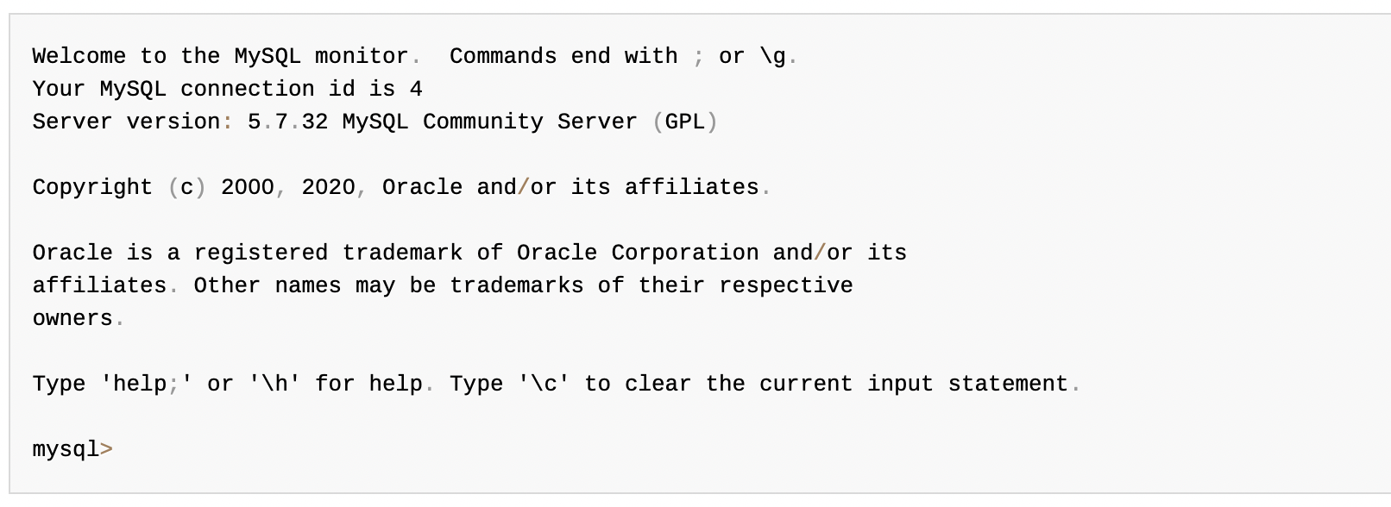
Mini-transactions trade expressiveness
Case study: cannot support interactive applications
  E.g., MySQL terminal
Why? Because the code of mini-transactions must be known beforehand
  Otherwise, you never know which instruction is the last one!

Slide 81
But still many use cases of mini-transaction
Atomic swap operation
Atomic read of multiple data
Validate cache then change data
…

Slide 82
Example: SinfoniaFS
SinfoniaFS: file system based on Sinfonia
  Hosts share the same set of files (in Sinfonia)
  Scalability: performance improves with more memory nodes
    i.e., inodes sharded at the memory nodes
SinfoniaFS exports a NFS interface
  It simplifies the implementation of a distributed file system
    E.g., Each NFS operation → one mini-transaction
    E.g., No need for a fault tolerant design, the mini-transaction has provided redo logging!

Slide 83
SinfoniaFS Architecture
SinfoniaFS
NFS
NFS
NFS
cache:
inode
bolcks
. . .
cache:
inode
bolcks
. . .
cache:
inode
bolcks
. . .
. . .
superblock
superblock
Library
Library
Library
inodes
inodes
free block
bitmap
free block
bitmap
Mini-transaction
data blocks
data blocks
Sinfonia
Shared
Address Space
. .
. . .
. . .
Memory
Node
Memory
Node
Memory
Node
NFS image

Slide 84
setattr
void setattr(ino_t inum, sattr_t newattr){
do {
addr = ... // get address of inode
curr_version = inode->version;
t = new mini_transaction();
t->cmp(addr, 4, curr_version);
t->write(addr, 4, curr_version + 1);
t->write(addr, 20, newattr);
} while(t->status == fail);
}
General use of mini-transaction in SinfoniaFS
  If local cache is empty, load it
  Make modifications to local cache
  Issue a mini-transaction to check the validity of cache, apply modification
  If mini-transaction fails, reload cached item and try again

Slide 85
2PC and CAP

Slide 86
Review of The CAP theorem: 2 out of 3
It is impossible for a distributed computer system to simultaneously provide all three of the following guarantees
  Consistency (all nodes see the same data at the same time)
  Availability (a guarantee that every request receives a response about whether it succeeded or failed)
  Partition tolerance (the system continues to operate despite arbitrary message loss or failure of part of the system)
v₀
v₀
v₀
v₀
v₁
v₀
v₁
v₀
v₁
v₀
S₁
S₂
S₁
S₂
S₁
S₂
S₁
S₂
S₁
S₂
S₁
S₂
A=v₁
done
A=?
1. A=v₀
C
C
C
C
C
C
2. Not available

Slide 87
Review of The CAP theorem: 2 out of 3
It is impossible for a distributed computer system to simultaneously provide all three of the following guarantees
  Consistency (all nodes see the same data at the same time)
  Availability (a guarantee that every request receives a response about whether it succeeded or failed)
  Partition tolerance (the system continues to operate despite arbitrary message loss or failure of part of the system)
Question: which property does 2PC achieve?
v₀
v₀
v₀
v₀
v₁
v₀
v₁
v₀
v₁
v₀
S₁
S₂
S₁
S₂
S₁
S₂
S₁
S₂
S₁
S₂
S₁
S₂
A=v₁
done
A=?
1. A=v₀
C
C
C
C
C
C
2. Not available

Slide 88
2PC only guarantees consistency!
If the coordinator failure before sending the commit
  All other transaction must wait until it wake about
  The coordinator logs its decisions and recovery & resume after the failure
Question: can we tolerate coordinator failure for mini-transaction?
  Yes, the coordinator can also keep no log!

Slide 89
Sinfonia’s two-phase commit Protocol
transfer between app-nodes (failure)
TC keeps no log
  A transaction is committed iff
  all participants have “YES” in their logs
Recovery TC cleans up
  Ask all participants for existing vote
  (or vote “NO” if not voted “YES”)
  COMMIT iff all vote “YES”
Transaction blocks if a memory node crashes
  Must wait for memory node to recovery

Slide 90
Summary of 2PC
2PC
DSM
2PC w/ miniTX
Scalability
Ease of
programming
Performance
Consistency
Fault tolerance

