Slide 1


Distributed Computing frameworks
Batch processing systems
SE3331-1 (2023 Fall)
Xingda Wei, Yubin Xia
IPADS, Shanghai Jiao Tong University
https://www.sjtu.edu.cn
Credits: Rong Chen@IPADS, CMU15-418

Slide 2
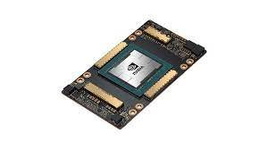
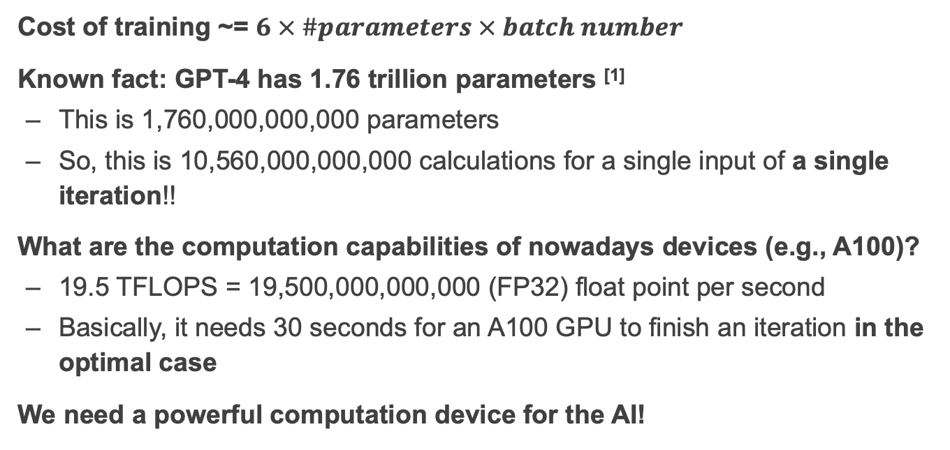
Review: (Approximate) computation for NN like ChatGPT
Cost of training ~= $6 × \#parameters × batch number$
Known fact: GPT-4 has 1.76 trillion parameters ^{[1]}
  This is 1,760,000,000,000 parameters
  So, this is 10,560,000,000,000 calculations for a single input of a single iteration!!
What are the computation capabilities of nowadays devices (e.g., A100)?
  19.5 TFLOPS = 19,500,000,000,000 (FP32) float point per second
  Basically, it needs 30 seconds for an A100 GPU to finish an iteration in the optimal case
We need a powerful computation device for the AI!
[1] https://the-decoder.com/gpt-4-has-a-trillion-parameters/

Slide 3
Review: parallelism on a single device
3 parallelism strategies on a single device
  Single core+: pipeline + super scalar with instruction level parallelism (ILP)
  Single core++: added SIMD support
  Multiple core: a single core (single core, single core+, single core++) can be glued together !
Question: what’s next? Single core+++++?
  Solution (Out of the scope of this lecture): domain-specific accelerators !

Slide 4
Single core+++++: domain-specific accelereators

Slide 5
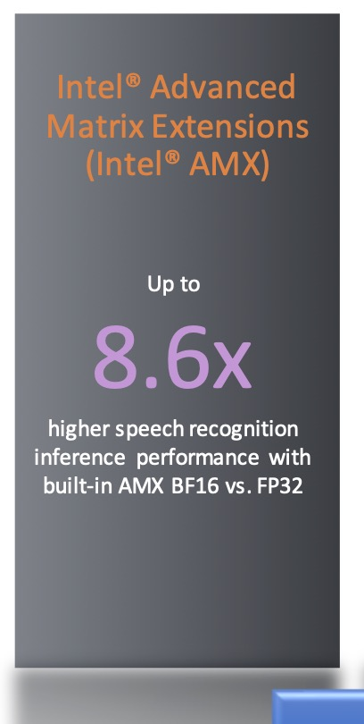
The era of domain-specific accelerators
Accelerators (even on general-purpose computing devices)
  Hardware designed to fulfill a single task
  Typically are not general-purpose, e.g., not programmable
CPU:
  SIMD + Matrix accelerators (e.g., Intel’s AMX accelerators)
GPU:
  Tensorcore: accelerators for matrix operations
TPU (Tensor processing unit):
  tensor process (optimized for large matrix operations)

Slide 6
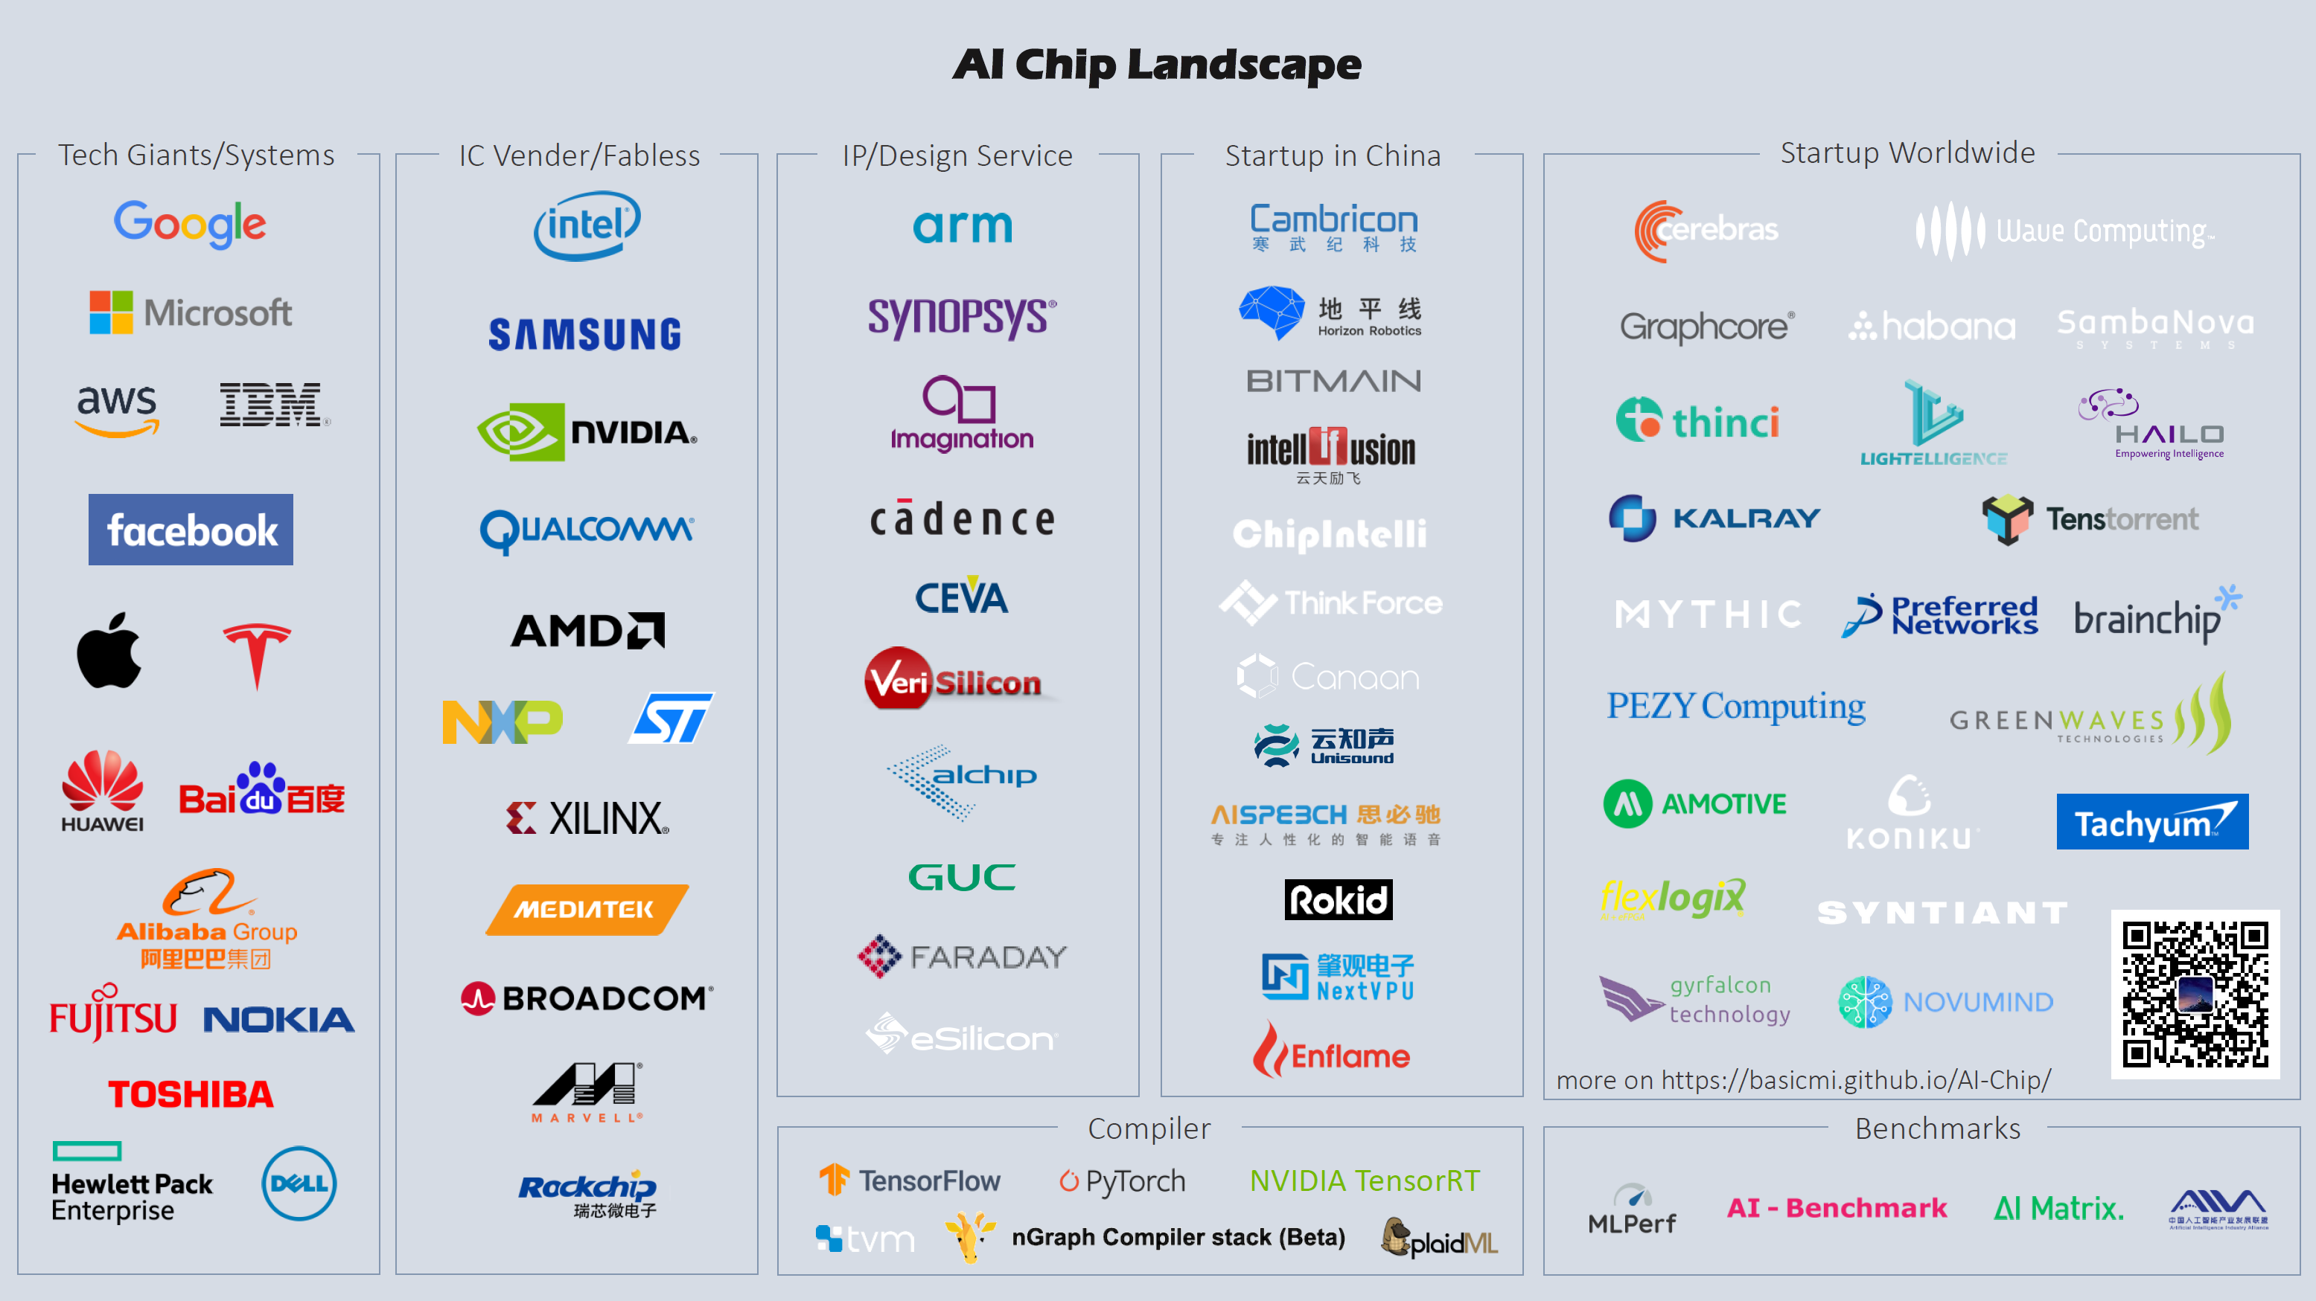

Slide 7
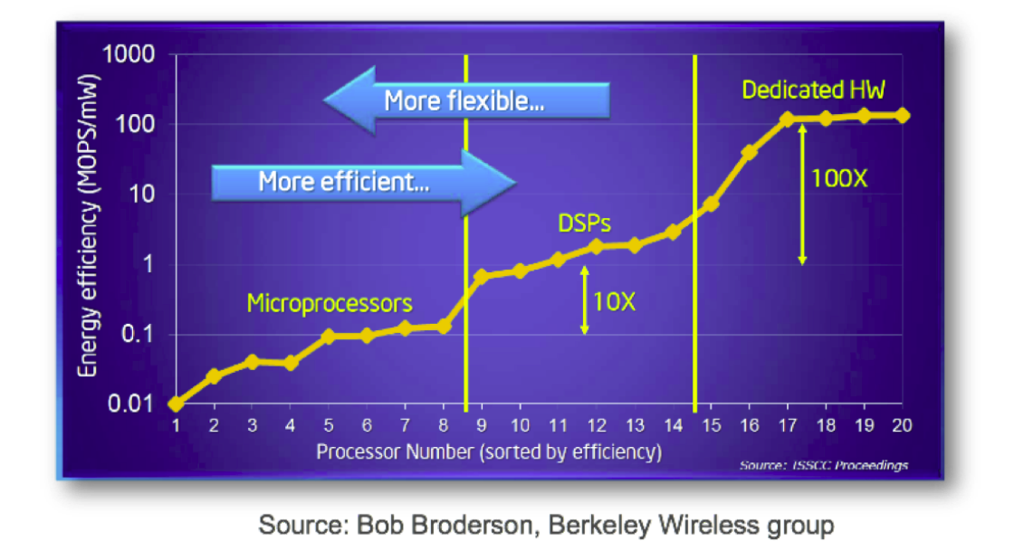
Accelerators: Flexibility vs. Efficiency Tradeoffs
Notes:
Domain-Specific Processors

Slide 8
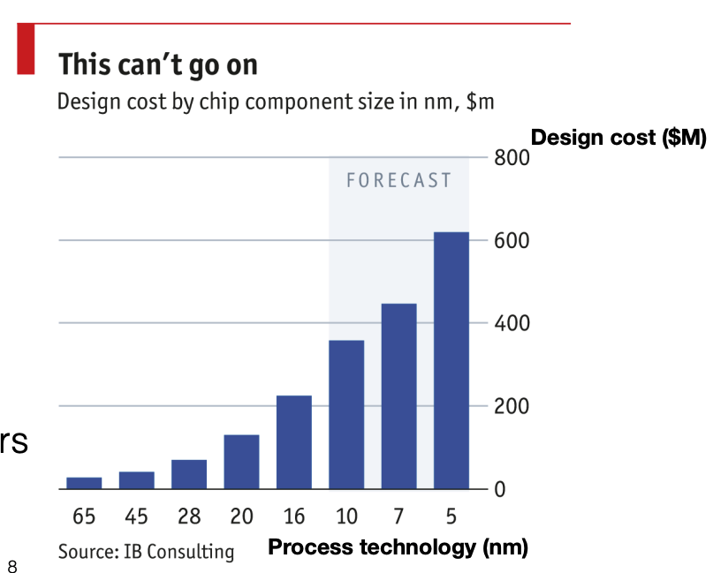
Specialization Challenge
Tape-out costs for accelerators ASICs is exorbitant 10x cost gap between 16nm and 65nm
  Risky bet to design hardware accelerators for ever-changing applications

Slide 9
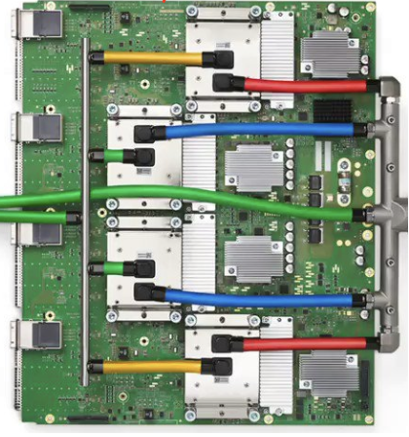



Review: Spectrum of computation device available
Programmability
Intel i5-9600K,
single core: 6.3GFLOPS
Multiple cores: 37.7GFLOPS
Mate60 GPU
2.3 TFLOPs
Apple M2
GPU 3.6 TFLOPs
NVIDIA A100
GPU 19.5 TFLOPs
Google TPUv4
275 TFLOPS
Performance
Notes:
Source: Wikipedia
Mate60: https://nanoreview.net/en/soc-compare/qualcomm-snapdragon-875-vs-hisilicon-kirin-9000
Intel CPU: https://setiathome.berkeley.edu/cpu_list.php

Slide 10
Remaining question: is a single device sufficient?
A device has limited physical capacity to store “cores” (chip size)
  Our cores are generalized, e.g., can either be CPU cores, GPU cores (cores w/o cache coherence + many SIMD ALUs, etc.), domain-specific cores
How to make a single device faster?
  Increasing clock rate (has a limit)
  Put more cores on a single chip, but has physical limits, e.g., chip size

Slide 11
Question: is a single device sufficient?
A device has limited physical capacity to store “cores” (chip size)
  Our cores are generalized, e.g., can either be CPU cores, GPU cores (cores w/o cache coherence + many SIMD ALUs, etc.), domain-specific cores
Why? Recall our previous calculation
  Basically, a A100 needs 30 seconds for an A100 GPU to finish an iteration on a single input (a.k.a, token) in the optimal case
  How many tokens are trained? 13T tokens! [1]
  To use one A100 to train GPT-4, we need about 412 years to finish the training
[1] https://the-decoder.com/gpt-4-has-a-trillion-parameters/

Slide 12
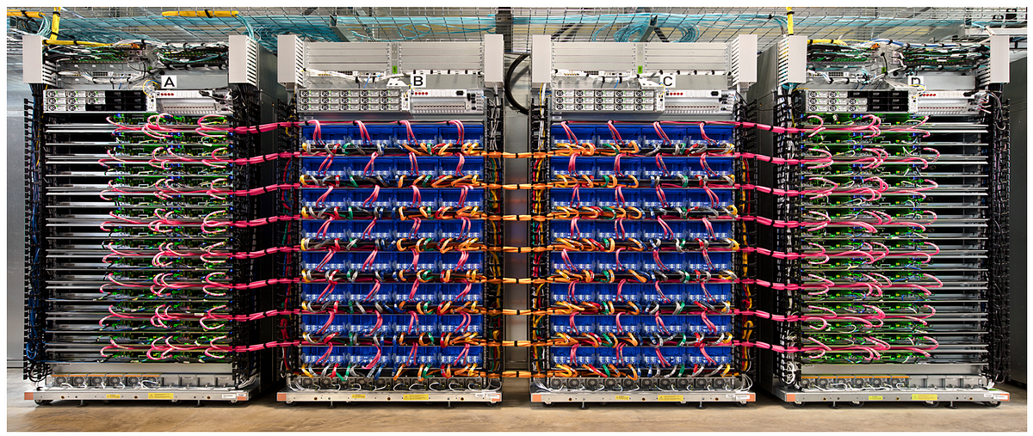
The case for distributed computing
Example: Google’s TPU v4 cluster

Slide 13
Spectrum of computation device available
Mate60 GPU
2.3 TFLOPs
Apple M2
GPU 3.6 TFLOPs
NVIDIA A100
GPU 19.5 TFLOPs
Google TPUv4
275 TFLOPS
A cluster
? TFLOPS
Performance
Notes:
Source: Wikipedia
Mate60: https://nanoreview.net/en/soc-compare/qualcomm-snapdragon-875-vs-hisilicon-kirin-9000
Intel CPU: https://setiathome.berkeley.edu/cpu_list.php

Slide 14

Not so easy: many tedious things to cope with

Slide 15




Use distributed computing frameworks for complex queries
Each fits a common application scenario
  One sit (typically) does not fit all!
Batch processing system
  Spark, Hadoop, etc.
Graph processing system
  GraphLab, etc.
Machine learning system
  TensorFlow, Pytorch, etc.
Note that we can also use one for another
  At the cost of programming effort and performance
Today’s focus

Slide 16



Why traditional distributed computing frameworks first?
We need weapons to cope with the AI workload!
  The fundamental system requirements & techniques are similar
Boss(Training LLM)
You need weapons (from existing frameworks)
You

Slide 17
Example: batching processing
Suppose our web server records every requests in a log file
  E.g., using nginx log format, a log record looks like this:
216.58.210.78 - - [27/Feb/2015:17:55:11 +0000]
"GET /css/typography.css HTTP/1.1" 200 3377 "http://martin.kleppmann.com/"
"Mozilla/5.0 (Macintosh; Intel Mac OS X 10_9_5) AppleWebKit/537.36 (KHTML, like Gecko) Chrome/40.0.2214.115 Safari/537.36"
Abstract format: $remote_addr - $remote_user [$time_local] "$request" $status $body_bytes_sent
"$http_referer" "$http_user_agent"
  Task (simple log analysis): how to find top five popular pages?

Slide 18
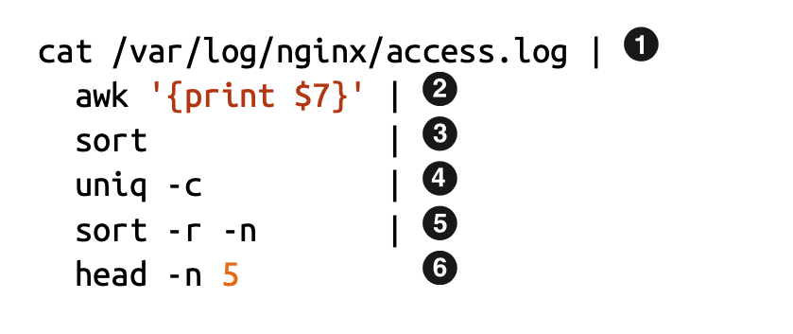
Old days: using command line to process the log
216.58.210.78 - - [27/Feb/2015:17:55:11 +0000]
"GET /css/typography.css HTTP/1.1" 200 3377 "http://martin.kleppmann.com/"
"Mozilla/5.0 (Macintosh; Intel Mac OS X 10_9_5) AppleWebKit/537.36 (KHTML, like Gecko) Chrome/40.0.2214.115 Safari/537.36"
Find top five most popular pages w/ command line tools

Slide 19
Use command line tools for batch processing
Find top five most popular pages
1
Read log file
4
Aggregate, with a counter for each line
Filter the line, pick the 7th token,
i.e., /css/typography.css
Sort again (using the counter)
2
5
3
Sort so that the same requests come together
6
Print 1-5 items

Slide 20
Does batch processing with command line tools scale?
Command line tools are mostly single-threaded, and single-machine
  : scalability is restricted by the disk capacity
  ～ : restricted by single-thread computing power
  ～ : also restricted by the machine’s DRAM capacity
1
Scale using GFS
2
6
2
6

Slide 21
Process to scale a computation to distributed computing
A large problem to solve, e.g., log processing, AI training
Decompose
Sub-problems. Many alias, e.g., sub-tasks, sub-jobs (or simply jobs)
Assignment
A set of physical programs that can run on parallel units, e.g., a thread or a GPU kernel
Runtime Orchestration (or scheduling)

Slide 22
Amdahl’s Law revisited
Let S = the fraction of sequential execution that is inherently sequential
  Then maximum speedup due to parallel execution ≤ 1/S
Consider our previous log process example (simplified)
  Sort the input file
  Print the first K (5) entries
Suppose the file size is N
Parallelism
nlogn
5
Sequential execution
Execution time

Slide 23
Parallelize with M machines (single-threaded)
Strategy (in theory)
  Step 1: decompose the file into M pieces, count top 5 concurrently
  Step 2: merge the top 5 from all the others & calculate the final top 5
Parallelism
Parallelism
N/M log(N / M)
nlogn
~=0
M

Slide 24
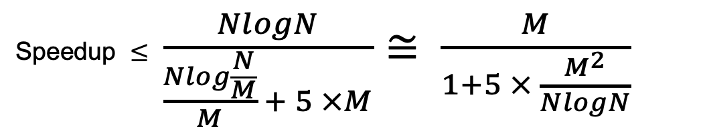
Parallelize with M machines (single-threaded)
Strategy (in theory)
  Step 1: decompose the file into M pieces, count top 5 concurrently
  Step 2: merge the top 5 from all the others & calculate the final top 5
Speedup ~= M if N >> M
Speedup $≤$ $\frac{NlogN}{\frac{Nlog\frac{N}{M}}{M} + 5 ×M}≅ \frac{M}{1+5 × \frac{M^{2}}{NlogN}}$
Notes:
Why <= ? Communication cost

Slide 25

But what if we want to calculate top-K?
$$\frac{M}{1+K × \frac{M^{2}}{NlogN}}$$
K is a relatively large number
  E.g., very close to N
  If K grows, the speedup decreases
There are optimization, but is more complex
Sequential part
Parallelism
Parallelism
Nlogn / M
nlogn
~=0
M * K

Slide 26
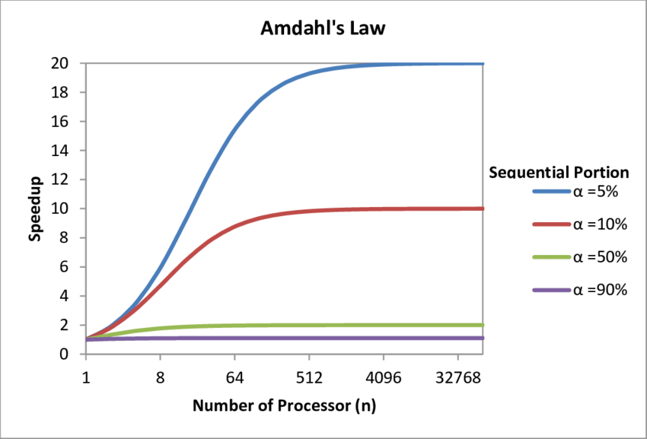
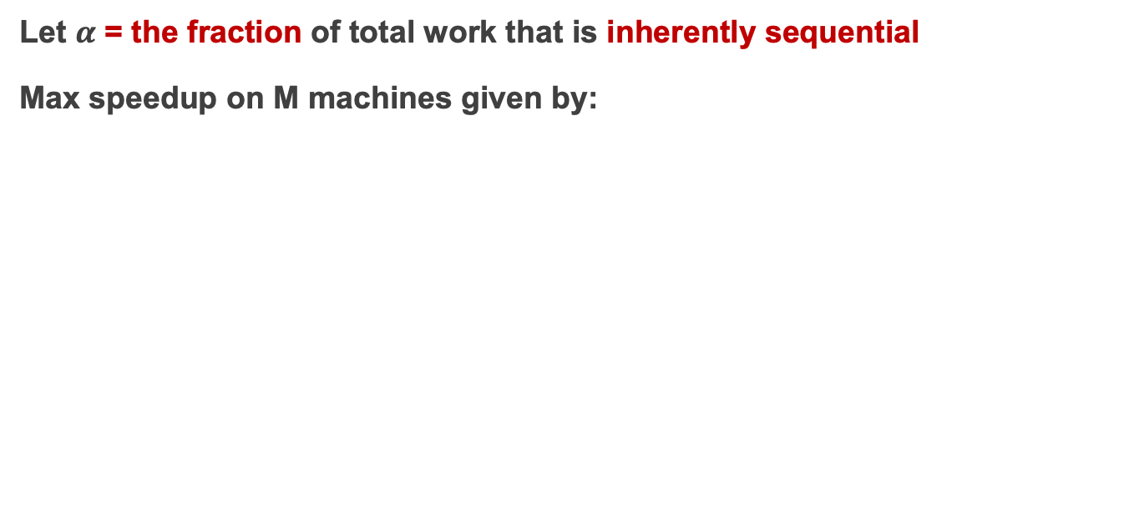

Amdahl’s Law revisited
Let $α$ = the fraction of total work that is inherently sequential
Max speedup on M machines given by:
Speedup $≤$ $\frac{1}{α+ \frac{1−α}{M} }$
Source: https://www.researchgate.net/figure/Graph-demonstrating-Amdahls-Law_fig2_315696585
Notes:
Amdahl law can consider heterogeneous version, e.g., different parallel cores have different parallel processing capabilities.

Slide 27
From theory to reality
Strategy (in theory)
  Step 1: decompose the file into M pieces, count top 5 concurrently
  Step 2: merge the top 5 from all the others & calculate the final top 5
Step #1
  How to decompose? How to assign threads to do chunks?
  Try #1: ssh to M machines, run the program, each given a different file

Slide 28

Scaling log processing using ssh: step #1
for w in workers:
execute_command(w,...) // parallelly
res = []
for machines in workers:
res.append(get_res(w))
.3
.4
…

Slide 29
From theory to reality
Strategy (in theory)
  Step 1: decompose the file into M pieces, count top 5 concurrently
  Step 2: merge the top 5 from all the others & calculate the final top 5
Step #1
  How to decompose? How to assign threads to do chunks?
  Try #1: ssh to M machines, run the program, each given a different file
Step #2
  How can we collect the results from all the others?

Slide 30
Scaling log processing using RPC: step #2
for w in workers:
execute_command(w,...) // parallelly
res = []
for machines in workers:
res.append(get_res(w))
.3
.4
…

Slide 31
Building application with distributed computing
Graduate Student
ML experts repeatedly solve the same parallel design challenges
  Implement and debug complex parallel & distributed systems
  Tune for a specific parallel platform
6 months later, a conference paper contains:
However, the resulting code will be difficult to maintain and extend
“We implemented ____ in parallel.”
couples computation task with distributed implementation

Slide 32
Challenges programmers facing
Communicating between two machines
can be simple, e.g., with RPC
But, what about 10,000 machines?
Sending data to/from nodes
Coordinating among nodes
Recovering from node failure
Optimizing for locality
Partition data to to enable more parallelism

Slide 33
Challenges programmers facing
Sending data to/from nodes
Coordinating among nodes
Recovering from node failure
Optimizing for locality
Partition data to to enable more parallelism
When can we collect computing results from all the computing nodes?

Slide 34
Challenges programmers facing
Sending data to/from nodes
Coordinating among nodes
Recovering from node failure
Optimizing for locality
Partition data to to enable more parallelism
Failure is common,
especially at large-scale

Slide 35
Challenges programmers facing
Sending data to/from nodes
Coordinating among nodes
Recovering from node failure
Optimizing for locality
Partition data to to enable more parallelism
Transferring data over network is usually much slower than local data access

Slide 36
Challenges programmers facing
Sending data to/from nodes
Coordinating among nodes
Recovering from node failure
Optimizing for locality
Partition data to to enable more parallelism
Reduce the bottleneck of sequential part

Slide 37
Idea: we build a framework to hide the above tasks
Goal
  Reduce programmer’s effort in solving the above challenges
Challenges
  What are the abstraction? Thread & RPC is insufficient
  More general, harder to provide the above property
  E.g., if a thread fails, how can we know its progress?
    It’s a very hard problem, we will come back to it later

Slide 38
MapReduce: Simplified Data Processing on Large Clusters

Slide 39
MapReduce: a distributed batch processing system
Created by Google (OSDI’04)
  Jeffrey Dean and Sanjay Ghemawat
Inspired by LISP (function language)
  Map (function, set of values)
    Applies function to each value in the set
  Reduce (function, set of values)
    Combines all the values using a function (e.g., +)
      (map #‘length’ (() (a) (a b) (a b c))) → (0 1 2 3)
      (reduce #‘+’ (1 2 3 4 5)) → 15

Slide 40
MapReduce abstraction matches our requirements well
Sending data to/from nodes
  Data is sent between Map & Reduce
Coordinating among nodes
  Use the MapReduce semantic to coordinate
    i.e.， only need to schedule the reducer after the mapper
Recovering from node failure
  Will be talked about later
Optimizing for locality
  Will be talked about later
Partition data to to enable more parallelism
  Map reduce enable arbitrary partition of the data

Slide 41
MapReduce Programming Model
Allows user to process huge amounts of data on thousands of nodes
Framework for data-parallel computing
  Programmers get simple yet restricted API
Users don’t have to worry about handling:
  parallelization
  data distribution
  load balancing
  fault tolerance

Slide 42

MapReduce Programming Model
Functionality
Parallelization
Data Distribution
Fault Tolerance
user
Load Balance

Slide 43
MapReduce Programming Model
Functionality
Two Primitives:
Map (input)
Parallelization
Data Distribution
MapReduce
Runtime
Reduce (key, values)
Fault Tolerance
user
Load Balance

Slide 44
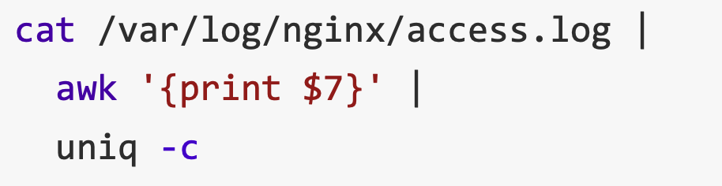
MapReduce example：Word count
Word Count: Count # occurrences of each word in a collection of documents
A simplified process of our previous log analysis example
1
2
3

Slide 45
MapReduce example：Word count
Word Count: Count the occurrences number of each word in a collection of documents
Map:
  Parse data and emit each word with a count (1)
Reduce:
  Reduce: sum together counts each key (words)
map (input) # a shard of file
  for each word w in input
  EmitIntermediate (w, “1”);
Reduce (String key, Iterator values)
  int result = 0;
  for each v in values
    result += ParseInt (v);
  emit (AsString (result));

Slide 46
MapReduce Programming Model
E.g., to find the most
popular keywords (热词)
Two Primitive:
Map (input)
for each word in input
emit (word, 1)
Word Count
Functionality
MapReduce
Runtime
Reduce (key, values)
int sum = 0;
for each value in values
sum += value;
emit (word, sum)
user

Slide 47
MapReduce Programming Interface
Map: (input shard) → intermediate (k/v pairs)
  Partition the input data into M “shards”
  Group all intermediate values associated with the same key
  Pass them to the Reduce function
Reduce: intermediate (k/v pairs) → (results)
  Partition the key space into R “pieces” using a Partition function
    E.g., hash(key) mod R (unsorted)
  Accept a key & a set of values
  Merge these values to form result of the key
Notes:
Why sorted is important? E.g., sometimes the output keys are URLs, and we want all entries for a single host to end up in the same output file.

Slide 48
MapReduce Execution Flow
Map
Grab the relevant data from the source
User function gets called for each chunk of input
Map Worker
Reduce Worker
Reduce
Aggregate the results
User function gets called for each unique key

Slide 49
MapReduce Execution Flow
Map
Grab the relevant data from the source
User function gets called for each chunk of input
Partition
Identify which Reducers will handle which keys
Map partitions data to target Reducers
Map Worker
Reduce Worker
Sort
(Optional) Fetch the relevant partition data from all mappers
Sort by keys
Reduce
Aggregate the results
User function gets called for each unique key

Slide 50
MapReduce: The Complete Picture
Client
Master
assign
tasks
Shard 0
Map
Worker
IF
Shard 1
Shard 2
Reduce
Worker
Output
File 1
M items
Shard 3
Map
Worker
IF
R items
...
Reduce
Worker
Output
File 2
Shard M-2
Shard M-1
Map
Worker
IF
Input
Files
Map Workers
Intermediate Files
Reduce Workers
Output
Files
Notes:
具体到实现，以文件作为input

Slide 51
MapReduce: The Complete Picture
Step1: (Client/Master) split input files into chunks (shards)
  Typically, 64MB
  Why? Fit the GFS chunk size, so one RPC is sufficient to read the chunk
Shard 0
Shard 1
Shard 2
Shard 3
...
Shard M-1
Input Files
Divided into M shards

Slide 52
MapReduce: The Complete Picture
Step2: (remote) fork processes
Start up many copies of the program on cluster
  1 master: scheduler & coordinator
  Lots of workers
Idle workers are assigned either
  Map tasks (each works on a shard)
  Reduce tasks (each works on intermediate files)
Client
remote
fork
Master
...
Map
Worker
..
Map
Worker
Reduce
Worker
..
Reduce
Worker

Slide 53
MapReduce: The Complete Picture
Step3: map task
  Reads contents of the input shard assigned to it
  Parses key/value pairs out of the input data
  Passes each pair to a user-defined Map function
    Produces intermediate key/value pairs
    These are buffered in memory
read
Map
Worker
Shard 2

Slide 54
MapReduce: The Complete Picture
Step4: create intermediate files
  Intermediate k/v pairs buffered in memory and periodically written to the local disk
    Partitioned into R regions by a Partition function
  Notifies master when complete
    Passes location of intermediate data to the master
    Master forwards locations to the Reduce worker
Intermediate File
read
Map
Worker
local
write
partition 1
Shard 2
partition 2
partition R

Slide 55
MapReduce: The Complete Picture
Step4a: partitioning
  Map data will be processed by reduce workers
    The user’s Reduce function will be called once
    per unique key
  Sort all the (key, value) data by keys
  Partition function: decides which of R reduce workers will work on which key
    Default function: hash(key) mod R
    Map worker partitions the data by keys
  Each reduce worker will read their partition from every map worker

Slide 56
MapReduce: The Complete Picture
Step5: sorting intermediate data
  Notified by master about the location of intermediate files for its partition
  Uses RPCs to read the data from the local disks of map workers
  Sorts the data by the intermediate keys
  => All occurrences of the same key are grouped
local
write
remote
read
Map
Worker
Intermediate file
Reduce
Worker
Map
Worker
local
write
Intermediate file
remote
read
Reduce
Worker
Notes:
XD： 为什么mapreduce需要sort key？加速reduce worker的merge key过程

Slide 57
MapReduce: The Complete Picture
Step6: reduce task
  Groups data with a unique intermediate key
  User’s Reduce function is given the key and the set of intermediate values for that key
    <key, (value1, value2, ...)>
  The output is appended to an output file
Intermediate file
Intermediate file
remote
read
Reduce
Worker
write
Output
File 1
Intermediate file

Slide 58
MapReduce: The Complete Picture
Step7: return to user
  When all map and reduce tasks have completed
  Master wakes up the user program
  The MapReduce call in the user program returns, and the program can resume execution
    Output of MapReduce is available in R output files

Slide 59
Recall MapReduce example：Word count
Word Count: Count # occurrences of each word in a collection of documents
Map:
  Parse data and emit each word with a count (1)
Reduce:
  Reduce: sum together counts each key (words)
map (input)
  for each word w in input
  EmitIntermediate (w, “1”);
Reduce (String key, Iterator values)
  int result = 0;
  for each v in values
    result += ParseInt (v);
  emit (AsString (result));

Slide 60
MapReduce example re-visited：Word count
After Map
After Sort
After Reduce
Input file
[Intermediate]
It will be seen that this mere painstaking burrower and grub-worm of a poor devil of a Sub-Sub appears to have gone through the long Vaticans and streetstalls of the earth, picking up whatever random allusions to whales he could anyways find in any book whatsoever, sacred or profane. Therefore you must not, in every case at least, take the higgledy-piggledy whale statements, however authentic, in these extracts, for veritable gospel cetology. Far from it. As touching the ancient authors generally, as well as the poets here appearing, these extracts are solely valuable or entertaining, as affording a glancing bird's eye view of what has been promiscuously …
...
it 1
will 1
be 1
seen 1
that 1
this 1
mere 1
painstaking 1
burrower 1
and 1
grub-worm 1
of 1
a 1
poor 1
devil 1
of 1
a 1
sub-sub 1
…
...
a 1
a 1
aback 1
aback 1
abaft 1
abaft 1
abandon 1
abandon 1
abandon 1
abandoned 1
abandoned 1
abandoned 1
abandoned 1
abandoned 1
abandoned 1
abandoned 1
abased 1
abased 1
…
a 4736
aback 2
abaft 2
abandon 3
abandoned 7
abased 2
abasement 1
abashed 2
abate 1
abated 3
abatement 1
abating 2
abbreviate 1
abbreviation 1
abeam 1
abed 2
abednego 1
abel 1
abhorred 3
...
Map
Reduce

Slide 61
Other examples of MapReduce
Distributed grep
  Search for words in lots of documents
  Map: emit a line if it matches a given pattern
  Reduce: just output the intermediate data
Count URL access frequency
  Find the frequency of each URL in web logs
  Map: process logs of web page access;
  output <URL, 1>
  Reduce: add all values for the same URL

Slide 62
Other examples of MapReduce
Inverted index
  Find what documents contain a specific word
  Map: parse document, emit <word, doc-ID>
  Reduce: sort the doc-ID for each word, and output <word, list(doc-ID)>
Reverse web-link graph
  Find where page links come from
  Map: output <target, source> for each link to target in a page source
  Reduce: concatenate all source for each target, output <target, list(source)>

Slide 63
Other examples of MapReduce
Google used MapReduce to support distributed computing
  Large-scale machine learning jobs
  Large-scale graph analytic jobs
  Etc.

Slide 64
Recall, common challenges of Distributed Computing
Sending data to/from nodes
Coordinating among nodes
Recovering from node failure
Optimizing for locality
Partition the data to enable more parallelism
How does MapReduce handle these challenges?
Same for
all problems

Slide 65
Fault tolerance of MapReduce
Machine failures are common in datacenters
  A MapReduce job can possibly run on thousands of machines
MapReduce simplifies fault tolerance due to the following two choices:
  Programming model simplifies fault recovery
    e.g., no side-effect: a map or a reduce can simply re-execute the computation to recover from failures
    A DSM must ensure all the memory is fault tolerant
  Builds on a reliable service (i.e., GFS)

Slide 66
Fault tolerance of MapReduce
Worker failure
  Master pings each worker periodically via heartbeat
  If no response is received within a certain time (timeout), the worker is marked as failed
  Map or reduce tasks given to this worker are reset back to the initial state and rescheduled for other worker (re-execution)
  Robust: lost 1,600 of 1,800 machines once, but finished fine

Slide 67
Fault tolerance of MapReduce
Master failure
  Master’s state is persisted to GFS
  Recover master from GFS and continue
For each mapper & reduce
  Executing state: idle, in-progress or completed
  Locations of intermediate files
The state is checkpointed to GFS for fault tolerance
  Yet, master is unlikely to fail, since there is only one!

Slide 68
Fault tolerance of MapReduce
Skipping Bad Records
  Map/Reduce functions sometimes fail for some inputs
  Best solution is to debug & fix, but not always possible
  On segmentation fault:
    Send UDP packet to master from signal handler
    Include sequence number of record being processed
  If master sees two failures for same record:
    Next worker is told to skip the record
Effect: Can work around bugs in third-party libraries

Slide 69
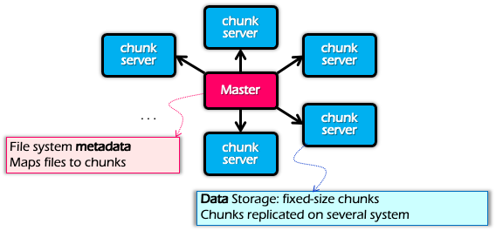
Optimization for Locality
Problem: the bandwidth of datacenter network (at that time) is scarce
  If a Map worker reads all the data from the network, it would be slow
Google: Input and Output files are stored on GFS
  Google File System (SOSP’03), see previous lectures
  Each chunk is replicated on multiple servers (3)
A review of GFS architecture

Slide 70
Optimization for Locality
Problem: the bandwidth of datacenter network (at that time) is scarce
  If Map worker reads all the data from the network, it would be slow
Google: Input and Output files are stored on GFS
  Google File System (SOSP’03), see previous lectures
  Each chunk is replicated on multiple servers (3)
MapReduce runs on GFS chunkservers
  Collocate computation and storage
Master tries to schedule map workers on one of the nodes that has a copy of the input chunk it needs

Slide 71
Refinement: redundant execution
Some workers can be slower than others, aka, stragglers
  Other jobs consuming resources on machine
  Bad disks with soft errors transfer data slowly
  Weird things: processor caches disabled ☹
Near end of phase, MapReduce spawn backup copies of tasks
  Whichever one finishes first “wins” ☺
  Dramatically shortens job completion time:“significantly reduces the time to complete large MapReduce operations ”(check the paper)

Slide 72
Summary of MapReduce
Get a lot of data from input files
Map
  Parse & extract items of interest
Partition & Sort
Reduce
  Aggregate results
Write results to output files
All the other issues, scheduling, fault-tolerance, data partitioning, are handled by the framework

Slide 73
Summary of MapReduce
The user does not need to care concurrency, fault-tolerant, data transfer, etc.
Reduce the user code burden and quality:
  Sort: only needs 50 LoC
  Indexing: reduce the code lines from 3800 LoC to 700LoC

Slide 74
Summary of MapReduce
MapReduce
Single device computing
Pros:
  Easy to scale
  Fault tolerant
  Good performance (depends!)
    Good for tasks that suits MapReduce, e.g., wordcount
Cons
  Limited programming abstraction
Scalability
Ease of
programming
Performance
Consistency
Fault tolerance

Slide 75
MapReduce cannot address all the issues
MapReduce was used to process webpage data collected by Google’s crawlers
  It would extract the links and metadata needed to search the pages
  Determine the site’s PageRank
The process took around eight hours
  Results were moved to search servers
  This was done continuously
Web
crawlers
MapReduce
Migrate to
search server
~8 hours!

Slide 76

MapReduce cannot address all the issues
Web has become more dynamic
  An 8+ hour delay is a lot for some sites
Goal: refresh certain pages within seconds
MapReduce
  Batch-oriented
  Huge performance overhead
  Not suited for near-real-time processes
  Cannot start a new phase util previous completed
  Not optimized for specific tasks (e.g., Graph, ML)

Slide 77


MapReduce cannot address all the issues
Time
Graph
Graph analytics frameworks
MapReduce
Machine
Learning
…
Machine learning
frameworks
Caffeine
Search
Engine
Google’s new search
engine

Slide 78
Restrictiveness of MapReduce Programming Model
Question#1
  How can we use MapReduce to implement “find the five most popular pages”?
Hint:
  We can chain multiple MapReduce tasks together

Slide 79
Restrictiveness of MapReduce Programming Model
Question#2:
  Is chaining multiple MapReduce tasks a good solution?
    E.g., programming is not easy
    Fault tolerance of multiple map-reduce tasks is not supported, should be handled by the users

Slide 80
Performance issues of multiple-sages execution
MapReduce runtime is not optimized for iteration
  Persistent I/O (e.g., GFS)
. . .
Awk
sort
Time
Data
Data
Map
Reduce
Map
Reduce
Data
Data
Data
Map
Reduce
Map
Reduce
Startup Penalty
Disk Penalty
Startup Penalty
Disk Penalty
Data
Data
Map
Reduce
Data
Data
Data
Map
Reduce
Map
Reduce
Data

Slide 81
From MapReduce to DAG (Computation graph)

Slide 82
The computation graph abstraction
Computations are expressed as a graph (Directly acrylic graph)
  Vertices are computations
  Edges are communication channels
  Each vertex has several input and output edges
Outputs
Processing
Vertices
Channels
(file, pipe, memory)
Inputs

Slide 83
Dataflow graph can support a wide-range of jobs
Distributed computing Job = Directed Acyclic Graph (DAG)
Back to our log analysis example, we can express the program as a graph
…
unique
sort
awk
Inputs

Slide 84
A typical DAG runtime
Vertices (V) run arbitrary app code, exchange data through
TCP pipes etc., and communicate with JM to report status
Job Schedule
Data Plane
Files FIFO Network
V
V
V
JM
NS
D
D
D
Control Plane

Slide 85
A typical DAG runtime
Job Manager (JM) consults name server (NS) to discover available nodes, and maintains job graph and schedules vertices
Job Schedule
Data Plane
Files FIFO Network
V
V
V
JM
NS
D
D
D
Control Plane
85

Slide 86
A typical DAG runtime
Daemon process (D) executes vertices
Job Schedule
Data Plane
Files FIFO Network
V
V
V
JM
NS
D
D
D
Control Plane

Slide 87
Scheduling in job manager
General scheduling rules
  Vertex can run anywhere once all its inputs are ready
    Prefer executing a vertex near its inputs (locality)
Fault tolerance
  Vertex fails → run it again
  Vertex’s inputs are gone → run upstream vertices again (recursively)
  Vertex is slow → run another copy elsewhere and use output from whichever finishes first
What if the vertex execution is non-idempotent？

Slide 88
Dryad proposes the DAG as distributed computing abstraction
Created by Microsoft (EuroSys’07)
  Authors: Michael Isard, Andrew Birrell, et al.
Similar goals as MapReduce
  A general-purpose distributed execution engine for coarse-grain data-parallel applications
  Focus on throughput, not latency
  Automatic management of scheduling, distribution, and fault tolerance
But needs application-specific semantic to split the nodes
  Otherwise, the graph fallback to a chain, so there is no parallelism
  A little harder than MapReduce, but also hides the distributed execution details

Slide 89
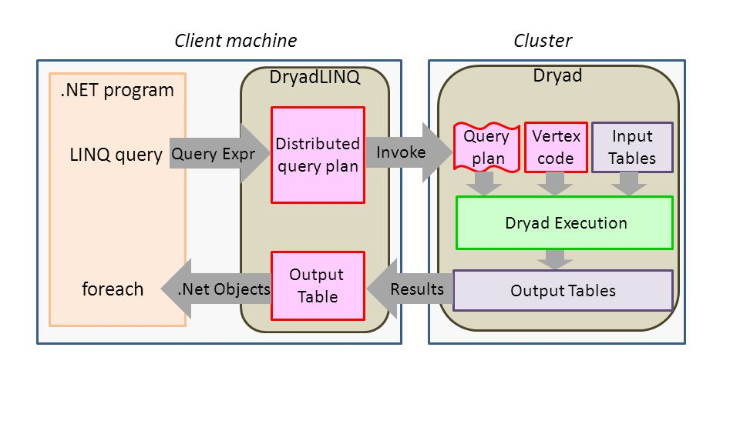
DryadLINQ: Dryad + LINQ (SQL like)
More friendly to traditional data programmers: use LINQ (SQL-like language)

Slide 90
Summary
Dryad lets developers easily create large-scale distributed apps without requiring them to master any concurrency techniques beyond being able to draw a graph of the data dependencies of their algorithms. -- Michael Isard
Sacrifice some architectural simplicity compared with MapReduce system design
Provide more flexible abstract to developers expressing their code as a DAG

