Slide 1


Distributed file system (DFS):
NFS & GFS
SE3331-1 (2025 Fall)
Yubin Xia/Xingda Wei
IPADS, Shanghai Jiao Tong University
https://www.sjtu.edu.cn
Credits: Rong Chen@IPADS

Slide 2

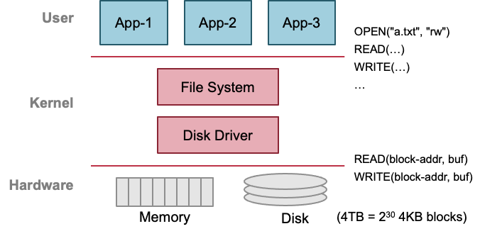
Previous lecture: single-machine file system
Storage as files
Caching server
Caching server
…
Caching server
Caching
Caching
Caching
Distributed caching
Database server
Database server
CDN
Users
Application #1
generate the page
Database
user, price
…
Database
user, price
Application server
Distributed database
Internet
Load
Balance
Application #2
add the order
File server
File server
File server
File:
image
File:
image
…
File:
image
Application server
…
…
Message queue
Distributed file system

Slide 3
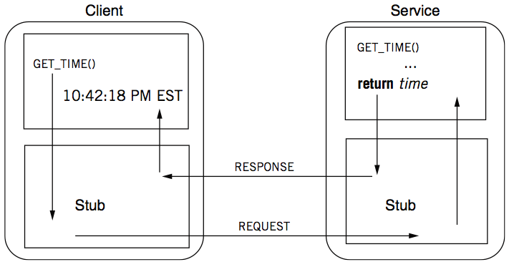
Review: RPC -- a complete calling process

Slide 4
Distributed file system
Key components in distributed systems
  Stores large blob of data, intermediate results, database/KV backends, etc.
Caching server
Caching server
Caching server
…
Caching
Caching
Caching
Distributed caching
Database server
Database server
CDN
Users
Application #1
generate the page
Database
user, price
…
Database
user, price
Application server
Distributed database
Internet
Load
Balance
Application #2
add the order
File server
File server
File server
File:
image
File:
image
…
File:
image
Application server
…
…
Message queue
Distributed file system

Slide 5
With the help of RPC
We can now build distributed file system!

Slide 6
Ways for accessing remote files
Many familiar ways, FTP, telnet, 网盘…
  Explicit access (knowing it is a distributed file system)
  User-directed connection to access remote resource
There is also transparent approach
  E.g., NFS, GFS, etc.
  Applications access the remote files like a local file

Slide 7
Distributed File Service Types
Upload/Download model (E.g., FTP)
  Read file: copy file from server to client
  Write file: copy file from client to server
Advantage
  Simple
Problems
  Wasteful “what if client needs small pieces?”
  Problematic “what if client does not have enough space?”
  Consistency “what if others modify the same file?”

Slide 8
Distributed File Service Types
Remote access model
  File service provide functional interface with RPC
  (create, delete, read, write, etc.)
Advantage
  Client gets only what’s needed
  Server can manage a consistent view of file system
Problem
  Possible server and network problem (e.g., congestion)
    Servers are accessed for duration of file access
    Same data may be requested repeatedly

Slide 9
NFS with RPC

Slide 10
NFS: Network File System
Design Goals (by Sun, 1980s, designed for workstations)
  Any machine can be a client or a server
  Support diskless workstations
  Support Heterogeneous deployment
    Different HW, OS, underlying file system
  Access transparency
    Use remote access model
  Recovery from failure
    Stateless, UDP, client retries
  High performance
    Use caching and read-ahead
Notes:
Support disk-less workstations: 避免反复存OS镜像

Slide 11
Question: can we simply replace the APIs (e.g., open, read/write, etc) in the inode filesystem to the RPC part for DFS?

Slide 12
Recall: the file system API
API
  CHDIR, MKDIR
  CREAT, LINK, UNLINK, RENAME
  SYMLINK
  MOUNT, UNMOUNT
  OPEN, READ, WRITE, APPEND, CLOSE
  SYNC
Implemented as system calls to user applications
Remote procedure call

Slide 13
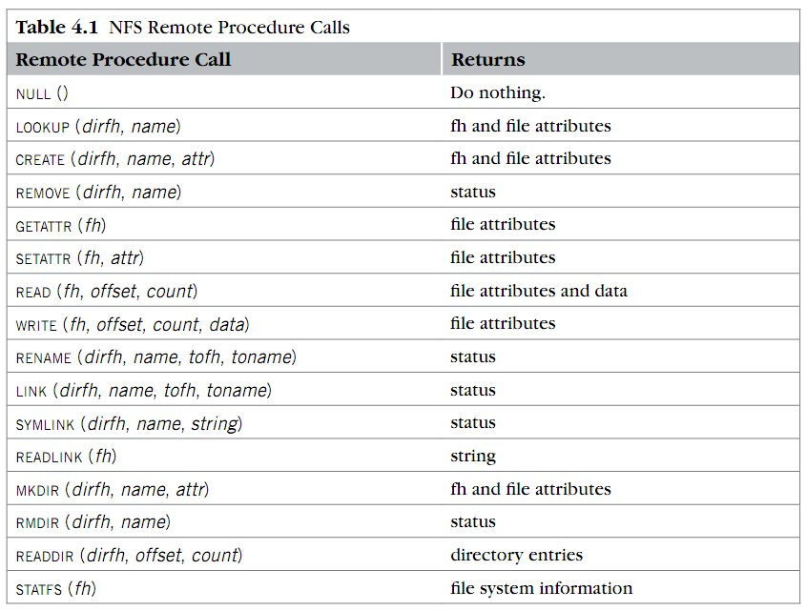
RPC implemented in NFS
Where is OPEN and CLOSE?
why offset?
What is fh?

Slide 14
NFS Protocols step-by-step: Mount
Static mounting
  mount request contacts server
Server:
add list of shared directories to /etc/exports
Client:
mount 192.168.1.100:/users/paul /home/paul

Slide 15
NFS Protocols step-by-step: Mount
Protocol:
  Request access to exported directory tree
    Requests permission to access contents
  Server returns file handle (fh), the name of the remote file
Client: parses pathname
contacts server for file handle
Server: a standard inode filesystem that implements the NFS RPC callbacks
Client: create in-memory VFS inode (vnode) at
mount point internally points to remote files
Executes full file system APIs described in the last lectures using NFS RPCs

Slide 16
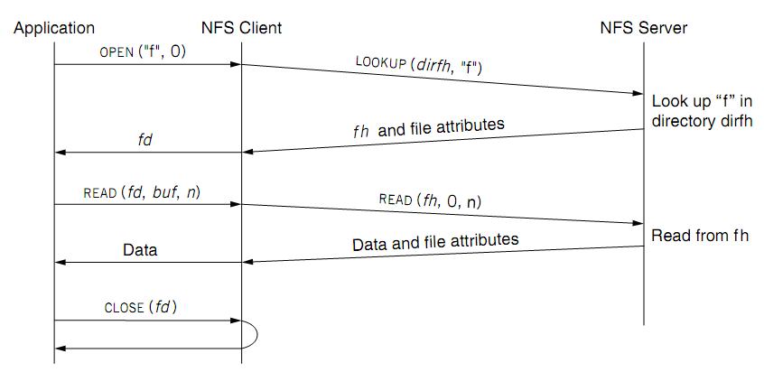
NFS Protocols: read a file
fd <--> fh (file handler)

Slide 17
Design choice: No open RPC in NFS
The NFS client library executes the open locally
  By issuing lookup API instead, why?
To answer this, we need to recall what does open do

Slide 18
Review: open
Check user's permission
Update last access time
Return a short name for a file
  File descriptor (fd)
  fd is used by READ, WRITE, CLOSE, etc.
The FD is stored in an FD_table
  Stores other things like cursor

Slide 19
What if we faithfully implement the open w/ RPC?
For each client, we need to store its opened file information in the table
  So the RPC is stateful
Stateful RPC is generally less performant/scalable than stateless one
  What if the server crashes, and then reboot?
  What if many clients connected to the server?
NFS chooses a simple design: no open and the RPCs are stateless
  For better fault tolerance & scalability

Slide 20
Stateless on NFS server
Stateless on NFS server
  Each RPC contains all the information
Q: What about states like file cursor?
  Client maintains the states, including the file cursor
Stateless simplifies failure handling
  Client can repeat a request until it receives a reply (at least once)
But, naïve retry stateless operations are not always good
  Server may execute the same request twice
  Solution: each RPC is tagged with a transaction number, and server maintains some "soft" state: reply cache (recall, at-most-once RPC)
  Q: What if the server fails between two same requests?

Slide 21
NFS Protocols: read a file
What is a file handler?

Slide 22
What is a file handler?
Basically, it is used to name the remote file
  i.e., identifying which file to access on the server
  Question: how to implement it?
We cannot use FD, because the server has no file table ☺
What are the other options?
  Path name
  Inode number
Q: Can we use path name in the handle?

Slide 23
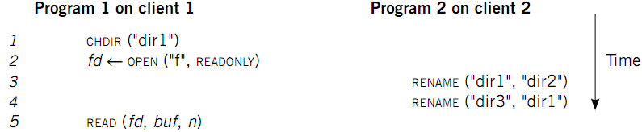
Case 1: Rename After Open
UNIX Spec:
  Program 1 should read "dir2/f"
  NFS should keep the spec

Slide 24
What is a file handler?
Basically, it is a naming
  i.e., which file to access on the server
We cannot use FD, because the server has no file table ☺
What are the other options?
  Path name
  Inode number
Q: Can we directly use the inode number ?

Slide 25
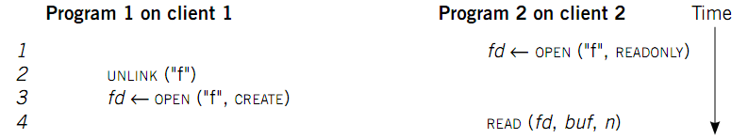
Case 2: Delete After Open
Remedy: let program 2 read the previous file, or return error
  Cannot read the wrong file!
How to avoid program 2 reading the wrong file?
  Generation number: a number incremented upon assigning an inode number to a new file
  The fh contains both inode number & generation number
  If read’s fh does not match the current generation, then abort

Slide 26
Case 2: Delete After Open
How to avoid program 2 reading new file?
  Generation number: a number incremented upon assigning an inode number to a new file
UNIX spec:
  On local FS, program 2 will read the old file
Not the same as UNIX spec! It's a tradeoff...

Slide 27
Put it all together: file handler
File handler contains two main parts
  inode number: for server to locate the file
  Generation number: for server to maintain consistency of a file
  Some other less important information, e.g., file system type

Slide 28
NFS Protocols: read a file
fd <--> fh (file handler)
Question: why the READ of NFS is different from the inode file system?

Slide 29
Problem: performance overheads
Usually slower than local, but not always
  Question: depends on what?
Optimization: caching at client
  Goal: reduce number of remote ops
  Caching: read, readlink, getattr, lookup, readdir
      Cache file data at client (buffer cache)
      Cache file attribute information at client
      Cache pathname bindings for faster lookup
Server side
  Caching is “automatic” via buffer cache
  File server performance & network speed

Slide 30
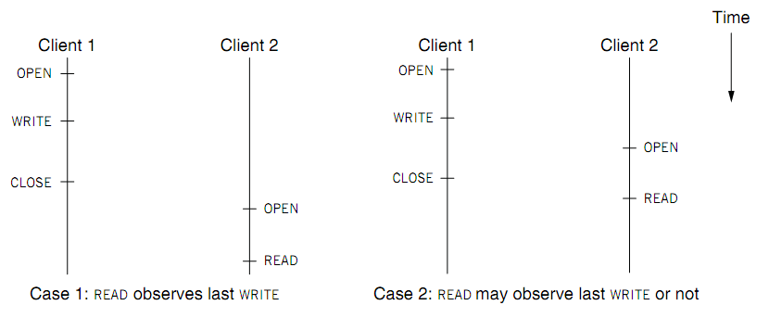
Challenge of caching: cache coherence

Slide 31
Challenge of caching: cache coherence
Type-1: Close-to-open consistency
  Higher data rate
  GETATTR when OPEN, to get last modification time
  Compare the time with its cache
  When CLOSE, send cached writes to the server
Type-2: Read/write coherence
  On local file system, READ gets newest data
  On NFS, client has cache
  NFS could guarantee read/write coherence for every operation, or just for certain operation
Notes:
Mixed blocks, old and new

Slide 32
Handling inconsistency
Inconsistencies may arise in NFS
For close-to-open consistency
  Flush the cache upon close
  If data block is modified, it is:
    Marked dirty, then flushed on file close
For read/write coherence
  Resolve inconsistencies with validation
  Both server and client save timestamp of files
  When file opened or server contacted for new
    Compare last modification time
    If remote is more recent, invalidate cached data
  Always invalidate data after some time
    open files (3 sec), directories (30 sec)

Slide 33
Improving Read Performance
Transfer data in large chunks
  8KB default
Read-ahead
  Optimize for sequential file access
  Send requests to read disk blocks before they are requested by the applications

Slide 34
Not an ending story: NFS is continuously improving
Version 3
Version 4
User-level lock manager
NVRAM support
Adjust RPC retries dynamically
Client-side disk caching
Support 64-bit file sizes
TCP support and large-block transfers
Commit operation
…
More state: control of caching, notify of file changes
Server export a single name space (pseudo file system)
Compound RPC support
Extended attribute and ACL
Negotiate security mechanism on mount
…

Slide 35
Reference Materials
RFC 1831: RPC Specification
  http://www.ietf.org/rfc/rfc1831.txt?number=1831
RFC 1832: XDR Specification
  http://www.ietf.org/rfc/rfc1832.txt?number=1832

Slide 36
Case study: GFS
The Google File System
  Sanjay Ghemawat, “The Google File System”. SOSP, 2003
Notes:
Based on our previous illustration, but make some extension based on Google’s internal need, or made some trade-offs

Slide 37
Design Assumptions: environments
Assumptions for conventional file systems don’t work
  E.g., “most files are small”, “short lifetimes”
Files are huge: n-GB/TB files are the norm, e.g., large web index
  I/O ops and block size choices are affected
Component failures are the norm, not an exception
  File system = thousands of storage machines
  Some % not working at any given time (recall from lecture2)

Slide 38
More Design Assumptions: File Access
Most files are appended, not overwritten (why? E.g., add new web pages to the Google’s global store)
  Random writes within a file are rare
    Means we need to provide efficient appends
Workload is mostly:
  mostly reads: large streaming reads;
    Once created, files are mostly read; often sequential (e.g., read a previous archived page)
We should
designing the FS API with the design of apps benefits the system

Slide 39
GFS design goals
Scalable distributed file system
  E.g., Can NFS stores a very large file?
Designed for large data-intensive applications
  Essential for distributed computing frameworks, e.g., MapReduce
Fault-tolerant; runs on commodity hardware
  E.g., what if a server crashes, in the case of NFS?
Delivers high performance to a large number of clients

Slide 40
GFS interface
GFS does not have a standard OS-level API
  No full POSIX API
  It provides user-level API
Operations
  Basic ops: create/delete/open/close/read/write
  Additional ops: snapshot/append
  Not supported ops: link, symlink, rename
  Why not rename? As I illustrated before, hard to ensure consistency under failures (no mature distributed TX---see later lectures---at that time)
Notes:
The assumptions are just listed in the paper, lack a detailed descriptions

Slide 41
GFS architecture
A GFS cluster = 1 Master (Distributed inode layer) + N Chunkservers (Distributed blocks layer + replication)
chunk
server
chunk
server
chunk
server
Master
. . .
chunk
server
File system metadata
Maps files to chunks
chunk
server
Data Storage: fixed-size chunks
Chunks replicated on several system

Slide 42
GFS files
A File is made of 64MB chunks, possibly spawn multiple machines
That are replicated for fault-tolerance
Chunks live on chunkservers
chunkserver
chunkserver
chunkserver
Used for fault tolerance, talked later
checkpoint
image
operation
log
The master manages
the file system namespace
master
In-memory FS metadata

Slide 43
Why Large Chunks?
Default chunks size = 64MB
  Compare to Linux ext4 block size: 4KB~1MB
Benefits:
  Reduce the need for frequent communication with master for chunk location info
  Makes it feasible to keep a TCP connection open for an extended time
    Establishing a TCP connect can be costly (two-way handshake, see later lectures)
  Master can store all metadata in memory
Notes:
Why frequent communication? Reduce communicate to the master for append, which is common in GFS
What does TCP mean? Reduce #communications

Slide 44
Chunks (Blocks) and Chunkservers
Chunk size = 64 MB (default)
  32-bit checksum with each chunk
Chunk handle
  Globally unique 64-bit number
  Assigned by the master when creation
Chunks are stored on local disk as Linux files (aka. file system overlay)
Each chunk is replicated on multiple nodes
  Three replicas (default)
  More replicas for popular files to avoid hotspots

Slide 45
Short summary: GFS vs. naïve filesystem?
Master stores current locations of chunks (blocks)
  Unlike naïve distributed file, which store the locations in the inode block
  Why? For performance & simplified correctness management
Data are stored in large chunks
Chunks are replicated for fault tolerance & high performance
  Our previous design does not replicate the data

Slide 46
GFS uses one master, why? Make the design simple
All metadata stored in master’s memory
  Super-fast access
Name-to-chunk maps (e.g., using an in-memory tree)
  Stored in memory
  Also persist in an operation log on the disk (talk about in later chapters)
Stores chunk ID-to-chunk location maps in memory (and no need for log)
  This is queried from all the chunkservers at startup
  Can keep up-to-date: maste`r controls all the management
  Benefits: simpler for consistency management

Slide 47
Client-GFS interaction model
GFS client code linked into each app
  No OS-level API
  Interacts with master for metadata-related ops
  Interacts directly with chunkservers for data
    Master is not a point of congestion
No caching: neither clients nor chunkservers cache data
  Except for the system buffer cache
  Why? Large files offer little opportunity for caching
Clients cache metadata
  e.g., location of a file’s chunks
Notes:
Why no caching? “Client caches offer little benefit because most applications stream through huge files or have working sets too large to be cached.”

Slide 48
Reading a file in GFS
Reading a file is simple in GFS
1. Contact the master
2. Get file’s metadata: chunk handles
3. Get the location of each of the chunk handles
  Multiple replicated chunkservers per chunk
4. Contact any available chunkserver for chunk
Can be omitted if cached

Slide 49
Writing a File in GFS (More complicated due to replication)
Less frequent than reading
  But is more complex, because we need to deal with the consistency issues
  GFS adopts a relaxed consistency model (see later lectures)
  Benefits: simple & efficient to implement
Design goals
  Each replica eventually have the same data
  Reduced communication with the master

Slide 50
Writing a File in GFS (More complicated due to replication)
To ensure convergence, we need a single primary for coordinating the writes
  Why we need the coordination? Think about concurrent writes
How to choose the primary?
  Can we designate one? No. Because the primary can fail
Master grants a chunk lease to one of the replicas
  This replica will be the primary chunkserver
    The only one that can modify the chunk
  Primary can request extensions (of lease), if needed
    Master increases the chunk version number and informs replicas

Slide 51
Writing a File in GFS: Two-phases
Phase 1: send data
Deliver data but don’t write to the file
  A client is given a list of replicas
    Identifying the primary and secondaries
  Client writes to the closest replica
    Pipeline forwarding
  Chunkservers store this data in a cache (in memory)
Client
App
chunkserver
1
chunkserver
2
chunkserver
3
Notes:
Why two phases? Primary should guarantee the same order for applying chunks.

Slide 52
Writing a File in GFS: Two-phases
Phase 2: write data
Add the data to the file (commit)
  Client waits for replicas’ ack of receiving data
  Send a write request to the primary
  The primary is responsible for serialization of writes (applying then forwarding)
  Once all acks have been received
  → The primary sends ack the client
secondary
chunkserver
Client
App
Primary
chunkserver
secondary
chunkserver

Slide 53
Writing a File in GFS: Two-phases
Data flow (phase 1) is different from control flow (phase 2)
Data flow
  Client → chunkserver → chunkserver → ...
  Order does not matter
Control flow
  Client → primary → all secondaries
  Order maintained (also for concurrent writes from multiple clients)
Chunk version numbers are used to detect if any replica has stale data
  Is maintained by the primary chunkserver
  If a replica has stale data, it shall be replaced

Slide 54
Naming in GFS: simple flat naming
No per-directory data structure like most file systems
  E.g., directory file contains names of all files in the directory
No aliases (i.e., no hard or symbolic links)
Namespace is a single lookup table
  Maps pathnames to metadata

Slide 55
Summary: GFS in Google cluster
Google cluster environment
  Core services: GFS + cluster scheduling system
  Typically, 100s to 1000s of active jobs
  200+ clusters, many with 1000s of machines
  Pools of 1000s of clients
  4+ PB filesystems, 40GB/s read/write loads
Job-1
Job-2
Job-3
Chunk
Server
Scheduling
Slave
GFS
Master
File system
Master
. . .
Linux
Scheduling
Master
Job Scheduler
Commodity Hardware

Slide 56











HDFS: another popular (open-source) DFS
Hadoop Distributed FS
Primary storage system for Hadoop apps
A framework that allows for the distributed processing of large data sets across clusters of computers

Slide 57
Design Goals & Assumptions of HDFS
HDFS is an open source (Apache) implementation inspired by GFS design
Similar goals as GFS
  Run on commodity hardware
  Highly fault tolerant
  High throughput & large-scale deployments
  …

Slide 58
Recall GFS files
A File is made of 64MB chunks, possibly spawn multiple machines
That are replicated for fault-tolerance
Chunks live on chunkservers
chunkserver
chunkserver
chunkserver
checkpoint
image
operation
log
The master manages
the file system metadata
master
In-memory FS metadata

Slide 59
HDFS files
A File is made of 64MB blocks, possibly spawn multiple machines
That are replicated for fault-tolerance
Blocks live on DataNodes
DataNode
DataNode
DataNode
FSImage
EditLog
NameNode
The NameNode manages
the file system metadata
In-memory FS metadata

Slide 60
Summary
Designing distributed file system (DFS) is not simply
  Single-node file system + RPC
Many design choices for performance, consistency model & failure handling
  Interface
  Caching
  Access model
Two case studies
  NFS: transparent access files on a remote server
  GFS: highly-scalable & fault-tolerant DFS optimized for Google’s workload

Slide 61
GFS or NFS are not Perfect
NFS
  Can not scale
  Is not fault-tolerant
  But is well-enough for many workloads, e.g., sharing the data for experiments in our lab ☺
GFS
  Relaxed consistency model: the results of concurrent mutations are undefined
  Single-node master: single point of failures (though next-generation of GFS refines this, with more advanced techniques developed later)
  Work well in Google’s datacenter workloads

Slide 62
GFS or NFS are not Perfect
NFS
  Can not scale
  Is not fault-tolerant
  But is well-enough for many workloads, e.g., sharing the data for experiments in the lab
GFS
  Relaxed consistency model: the results of concurrent mutations are undefined
  Single-node master: single point of failures (though next-generation of GFS refines this)
  Work well in Google’s datacenter workloads
We will see system principles to cope with them in future lectures.
For other workloads (e.g., Database) may not sufficient.

