Slide 1


Before-or-after atomicity and Serializability
SE3331-1 (2025 Fall)
Xingda Wei, Yubin Xia
IPADS, Shanghai Jiao Tong University
https://www.sjtu.edu.cn

Slide 2
Review: checkpointing
Checkpoint: save the system state to a compact form such that the re-execution (restore) is faster
  Example system state#1: files after recovering the logs
  Example system state#2: trained parameters of LLMs
  Example system state#3: process memory (including CPUs and GPUs)
  Example system state#4: chat history in our eventually consistent ChatAPP
The high-level concept is similar, but the detailed checkpoint method is workload/system (e.g., LLM training or eventual consistency) dependent
Notes:
TBD: ask GPT whwat is checkpoint

Slide 3
Case study#3: checkpoint in an eventually consistent system

Slide 4
Review: eventual consistency
A specific of weak consistency model, informally:
  All servers eventually receive all writes, and servers holding the same set of writes will have the same data contents
  Thus, if no new updates are made to the data, eventually all accesses will return the last update value

Slide 5
Review: implementing eventual consistency w/ logging
Syncing: ensure both nodes have the same updates in log
Ordered list of updates at each node
  Record the updates in a log, and sort it according to the same order
X
Y
Client
SRV1
SRV2
iPhone
Post x
Post Y
sync
Post X
Post Y
Post Y
Time
Post X
Log
Log
Notes:
不能直接apply；要delay
sync：保证大家的write都一样了；然后再apply
讲动画

Slide 6
Review: implementing eventual consistency w/ logging
Syncing: ensure both nodes have the same updates in log
Ordered list of updates at each node
  Record the updates in a log, and sort it according to the same order
X
Y
Client
SRV1
SRV2
iPhone
Post X
Post Y
Sort
sync
Sort
Post X
Post X
Post Y
Time
Post Y
Log
Log
Notes:
不能直接apply；要delay
sync：保证大家的write都一样了；然后再apply
讲动画

Slide 7
Review: implementing eventual consistency w/ logging
Syncing: ensure both nodes have the same updates in log
Ordered list of updates at each node
  Record the updates in a log, and sort it according to the same order
Re-apply sorted updates after the sync; overwrite existing content if necessary
X
Y
Client
SRV1
SRV2
iPhone
Post X
Post Y
sync
Post X
X
X
Post X
Post Y
Y
Time
Y
Post Y
Notes:
不能直接apply；要delay
sync：保证大家的write都一样了；然后再apply
讲动画

Slide 8
Question: what will happen if the log continuously growing?
Issue
  The syncing process become slower
  The space used by the log is becoming larger
Goal
  Avoid re-run all the operations
  Reduce the log size
Method
  Using checkpoint!
Challenge
  We cannot simply apply the operations because they can be reordered!
Notes:
inefficient:
- sync performance
- log size
想想：怎么才能做呢？

Slide 9
Idea: distinguish tentative writes from stable ones
Each server’s log consists of 2 portions:
  Stable writes, followed by
  Tentative writes
Stable writes are not rolled backup upon sync
  They cannot be reordered
Question
  How to determine which writes are stable? (hint: using the lamport clock!)
Answer
  An update (W) is stable iff no entries will have a lamport timestamp < W

Slide 10
De-centralized approach
Commit (write) scheme
  Update <10, A> is stable if all nodes have seen all updates with time <= 10
    Because it will never see a timestamp < 10 (according to the rule of lamport time)
Problem: If any node is offline, the stable portion of all logs stops growing

Slide 11
Centralized approach
Commit scheme
  One server designated “primary”
    Assign a total commit order: CSN to each write
    Complete timestamp: <CSN, local-TS, SrvID>
    Any write with a known CSN is stable
  All stable writes are ordered before tentative writes
  CSNs are exchanged between servers
    CSNs define a total order for committed update
CSN: Commit-Seq-No
Advantage: as long as the primary is up, writes can be committed and stabilized
Notes:
Any write with a known CSN is stable
Why? Because later writes will have a larger CSN
中央服务器怎么容错？可以放数据中心，网络连接比较稳定

Slide 12
Does CSN order preserve causality?
Complete timestamp: <CSN, local-TS, SrvID>
Should do some works
  A server asks the primary to assign CSN for all tentative writes (include those received from others)
    i.e., the primary can assign a larger CSN for a dependent write

Slide 13
Next: Before-or-after atomicity

Slide 14
Outline of today’s lecture
Concurrency (parallelism) is important to improve throughput
  Throughput is the key to service providers
The challenge of enabling concurrency is correctness
  We need a consistency model even stronger than linearizability!
The desired model: before-or-after
Locking-based method to implement before-or-after (2PL)
How to check the before-or-after of a locking protocol

Slide 15
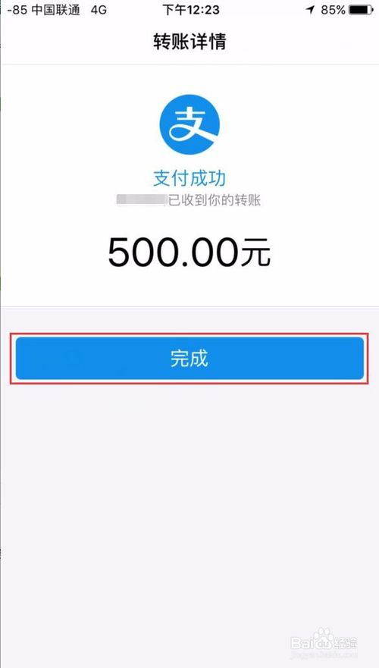

Motivating example: bank service
Suppose you are operating a bank service
  And deploy a system using a single-threaded setup
Question: what is the maximum throughput of it?
  And more importantly: why does it matter?
RPC
Internet
A Bank Service

Slide 16


Motivating example: bank service
Maintaining high throughput is the key to online services
Why? Let’s consider the system model (Queued system model)
User
Bank

Slide 17
Motivating example: bank service
Maintaining high throughput is the key to online services
Why? Let’s consider the system model (Queued system model)
User
Bank
How to process this?
User

Slide 18
Motivating example: bank service
Maintaining high throughput is the key to online services
Why? Let’s consider the system model (Queued system model)
User
Bank
Queued
User

Slide 19
Motivating example: bank service
Maintaining high throughput is the key to online services
Why? Let’s consider the system model (Queued system model)
User
Bank
Processed later
User

Slide 20
Motivating example: bank service
Maintaining high throughput is the key to online services
Why? Let’s consider the system model (Queued system model)
User
Queued latency
Bank
Process latency
User

Slide 21
Question: what if request arrival rate (λ) > system throughput (Thpt) ?
Queued latency = Waiting for the queued request to be processed
  The number equals to (λ-Thpt) * T, T = service time
  Approaching to infinity with more service time!
User
Queued latency
Bank
Process latency

Slide 22
Motivating example: bank service
Suppose you are operating a bank service
  And deploy a system using a single-threaded setup
Question: what is the maximum throughput of it?
  And more importantly: why does it matter? => Avoid queued latency under a given workload
RPC
Internet
A Bank Service
Notes:
Pollaczek-Khinchin

Slide 23
Motivating example: bank service
what is the maximum throughput of it?
  Thpt ~-= 1/request process time
User
Bank
Request process time
User

Slide 24
Question: how can we improve system throughput?
Before 2004:
  Just wait 6 months and buy a new computer!
After 2004:
  You need to write a parallel program, either on a multi-core machine or on a cluster of machines

Slide 25

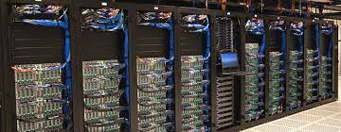
Using concurrent execution to scale the throughput!
Concurrency: apps run on multiple sources (e.g., CPU) concurrently
  Scale-up: run computations using multiple threads concurrently
  Scale-out: run computations using multiple machines concurrently
However, taming concurrency is hard
Scale up
Scale out
Notes:
既然说race condition是在 并发情况下才会发生，那我们得先说下何为并发。
并发就是指xxxx
其中有两种：xxxx。
为什么需要并发呢？ 因为我们处在一个多核和多机的时代：
1） 摩尔定律的消失
2）算力需求的增大

Slide 26

Motivating example
Example: consider two threads access the same account concurrently
  We have a in-memory array to store all the accounts w/o losing generality
T0
T1
Action
Action implementation
Deposit(bank,"alice”,10)
Deposit(bank, acct, amt):
bank[acct] += amt
Time
Question: What are the expected behavior?

Slide 27

Motivating example
Example: consider two threads access the same account concurrently
  We have a in-memory array to store all the accounts w/o losing generality
T0
T1
Action
Action implementation
Deposit(bank,"alice”,10)
Deposit(bank, acct, amt):
bank[acct] += amt
Time
Question: What are the expected behavior?
Alice: 0¥
Alice: 10¥? (Expected result: 20¥)

Slide 28
Atomicity of the + operator
Example: consider two threads access the same account concurrently
  Even a simple + operator is non-atomic
Why would this happen?
  The deposit function is not atomic, even assuming each mov is linearizable!
    CPU can only guarantee the atomicity of one memory op, but it has two
    mov acct, %eax
    add $amt, %eax
    mov %eax, acct
Deposit(bank, acct, amt):
bank[acct] += amt
Developer’s written code
Compiler’s generated code

Slide 29
Atomicity of the + operator
    mov acct, %eax
    add $amt, %eax
    mov %eax, acct
Deposit(bank, acct, amt):
bank[acct] += amt
Developer’s written code
Compiler’s generated code
Thread 0
Thread 1
Bank[Alice]
0
T0
T1
Deposit(
bank,"alice”,10)
Time

Slide 30
Atomicity of the + operator
    mov acct, %eax
    add $amt, %eax
    mov %eax, acct
Deposit(bank, acct, amt):
bank[acct] += amt
Developer’s written code
Compiler’s generated code
Thread 0
Thread 1
Bank[Alice]
0
Read acct
0
T0
T1
Deposit(
bank,"alice”,10)
Time

Slide 31
Atomicity of the + operator
    mov acct, %eax
    add $amt, %eax
    mov %eax, acct
Deposit(bank, acct, amt):
bank[acct] += amt
Developer’s written code
Compiler’s generated code
Thread 0
Thread 1
Bank[Alice]
0
Read acct
0
T0
T1
Read acct
0
Deposit(
bank,"alice”,10)
Time

Slide 32
Atomicity of the + operator
    mov acct, %eax
    add $amt, %eax
    mov %eax, acct
Deposit(bank, acct, amt):
bank[acct] += amt
Developer’s written code
Compiler’s generated code
Thread 0
Thread 1
Bank[Alice]
0
Read acct
0
T0
T1
Read acct
0
Deposit(
bank,"alice”,10)
0
Increase
Time

Slide 33
Atomicity of the + operator
    mov acct, %eax
    add $amt, %eax
    mov %eax, acct
Deposit(bank, acct, amt):
bank[acct] += amt
Developer’s written code
Compiler’s generated code
Thread 0
Thread 1
Bank[Alice]
0
Read acct
0
T0
T1
Read acct
0
Deposit(
bank,"alice”,10)
0
Increase
Increase
0
Time

Slide 34
Atomicity of the + operator
    mov acct, %eax
    add $amt, %eax
    mov %eax, acct
Deposit(bank, acct, amt):
bank[acct] += amt
Developer’s written code
Compiler’s generated code
Thread 0
Thread 1
Bank[Alice]
0
Read acct
0
T0
T1
Read acct
0
Deposit(
bank,"alice”,10)
0
Increase
Increase
0
Write acct
10
Time

Slide 35
Atomicity of the + operator
    mov acct, %eax
    add $amt, %eax
    mov %eax, acct
Deposit(bank, acct, amt):
bank[acct] += amt
Developer’s written code
Compiler’s generated code
Thread 0
Thread 1
Bank[Alice]
0
Read acct
0
T0
T1
Read acct
0
Deposit(
bank,"alice”,10)
0
Increase
Increase
0
Write acct
10
Time
Write acct
10

Slide 36
The correctness issue caused by race condition
When two or more threads access shared data and at least one is write
Timing dependent error involving shared state
  i.e., whether the scheduling will cause reading a non-atomic update state
Thread 0
Thread 1
Bank[Alice]
Thread 0
Thread 1
Bank[Alice]
0
0
Read acct
0
Read acct
0
Read acct
0
Increase
0
Increase
0
Write acct
10
Increase
0
Read acct
10
Write acct
10
Increase
10
Write acct
10
Write acct
20

Slide 37
Race condition is hard to control
Must make sure all possible schedules are safe
  Number of possible schedules permutations is huge
  Bad schedules that will and will not work sometimes
They are intermittent
  Small timing changes between invocations might result in different behavior which can hide bug
  Also known as Heisenbugs (Heisenberg uncertainty)
    Possible system solution-1: DMT (Deterministic Multi-Threading)
    Possible system solution-2: Record and Replay
    Both are hard in either correctness or cost, or both
Notes:
Intermittent: 间断的

Slide 38


Race condition is common (benign case)
Real-world computing systems embrace concurrency
  E.g., embrace the design of distributed systems
Bad: race condition brings unsatisfactory to the customers
  E.g., the comment system in
Show 5 comments;
But only 3 presented on the app

Slide 39
Race condition may be dangerous (Serious case)
The equipment control task did not properly synchronize with the operator interface task, so that race conditions occurred if the operator changed the setup too quickly. In three cases, the injured patients later died as a result of the overdose.
Notes:
T1:
status = light
Reduce light
T2:
If status == light
Release config

Slide 40

Race condition may be dangerous
https://aws.amazon.com/cn/message/101925/

Slide 41
Race condition may be dangerous
Simplified process
T1:
  Update the plan (to 15:07)
  Cleanup plans older than 15:07
T2:
  Update the plan (to 16:07)
  Cleanup plans older than 16:07
https://aws.amazon.com/cn/message/101925/

Slide 42
What is a strong consistency model
It's easy for users to reason about correctness assuming
  Everything has only one-copy
  The overall behavior is equivalent to some serial behavior
  The operations that need to be executed in an atomic unit (usually called operations belonging to a transaction) are executed on a machine that happens completely or not at all (all-or-nothing atomicity)

Slide 43



Review: serial execution of reads/writes
Time
The system
Reads/writes are executed concurrently
Replicated KVSes
Time
One logical KVS
Reads/writes are executed logically in a serial manner.

Slide 44
One step further: serial execution of actions
Time
Read (A)
Write (B)
…
The system
Actions
Reads/writes are executed concurrently
Replicated KVSes
Time
One logical KVS
Reads/writes are executed logically in a serial manner.
Actions

Slide 45
Before-or-After Atomicity

Slide 46
Goal: before-or-after atomicity (a.k.a, Isolation)
To prevent hazard produced by race condition, we need a group of reads/writes to be atomic
  E.g., cannot see/overwrites the intermediate states of a concurrent action
  A concurrent action may have multiple linearizable reads/writes
Before or after atomicity
Concurrent actions have the before-or-after property if their effect from the point of view of their invokers is as if the actions occurred either completely before or completely after one another

Slide 47
Use locking to achieve before-or-after
Locks: a data structure that allows only one CPU acquire at a given time
  Programs can acquire and release the lock
  If the acquisition fails, then the CPU will wait until it is succeed
  Example: pthread_mutex
Implementing the locks efficiently is a broad topic
  And is non-trivial: out of the scope of this lecture

Slide 48
Use locking to achieve before-or-after: global lock
Locks: a data structure that allows only one CPU acquire at a given time
  Programs can acquire and release the lock
  If the acquisition fails, then the CPU will wait until it is succeed
  Example: pthread_mutex
Global lock:
  The action must acquire the global lock before executing, and release it after it commits
Deposit(bank, lock, acct, amt):
acquire(lock)
bank[acct] += amt
release(lock)
Deposit(bank, acct, amt):
bank[acct] += amt

Slide 49
Use locking to achieve before-or-after: global lock
Locks: a data structure that allows only one CPU acquire at a given time
  Programs can acquire and release the lock
Global lock:
  The action must acquire the global lock before executing, and release it after it commits
Drawback: trade performance for correctness
  Only allow one action to run at a time
  Even they don’t read/write each other
  Slower than the single-thread!
+ global lock
T0
T1
T0
T1
Requiring Lock
Deposit(Alice)
Deposit(bob)
Time

Slide 50
Question: how to optimize?
Reduce the locked scope
  Not all code that needs to be blocked!
Improve the performance of acquiring (& releasing) the lock
  Out of the scope of this lecture

Slide 51


Use locking to achieve before-or-after: fine-grained locking
…
Fine-grained locking:
  Each shared data has one lock
  E.g., a lock for Alice & a lock for Bob
Locking rule:
  The action must acquire the shared data’s lock before access it, and releases it after the data access finishes
Bank = [
Alice: 0¥
Bob: 0¥
Lock = [
Deposit(bank, lock, acct, amt):
acquire(lock)
bank[acct] += amt
release(lock)
Deposit(bank, lock, acct, amt):
acquire(lock[acct])
bank[acct] += amt
release(lock[acct])

Slide 52
Use locking to achieve before-or-after: fine-grained locking
Fine-grained locking allows more concurrency
  If the deposits operate on different accounts, they can run concurrently
Thread 0
Thread 1
Bank[Alice]
Bank[Bob]
T0
T1
Acquire(lock[alice])
Acquire(lock[bob])
0
0
Read acct
Read acct
0
0
Increase
Increase
0
0
Write back
Write back
10
10
Release(lock[alice])
Release(lock[bob])
10
10
Time
Two deposits can run concurrently!
👍
Deposit(Alice)
Deposit(bob)
Notes:
Performance

Slide 53
Use locking to achieve before-or-after: fine-grained locking
…
Fine-grained locking:
  Each data record has one lock
  E.g., a lock for Alice & a lock for Bob
Lock acquire rule:
  The action must acquire the account lock before access it, and releases it after the data access finishes
Bank = [
Alice: 0¥
Bob: 0¥
Lock = [
Question: can fine-grained locking avoids any the race conditions?

Slide 54
More example: multiple records
…
Alice: 10¥
Bob: 10¥
Transfer + Audit for the bank application
Transfer(bank, locks, a, b, amt):
Acquire(lock[b])
bank[b] += amt
Release(lock[b])
Acquire(lock[a])
bank[a] -= amt
Release(lock[a])
Audit(bank):
sum = 0
for acct in bank:
Acquire(locks[acct])
sum += bank[acct]
Release(locks[acct])
print(sum)
Question: what is the ideal output of Audit?

Slide 55
Accessing multiple records
Transfer
(alice, bob, 10)
Audit()
Thread 0 (Transfer) | Thread 1 (Audit) | Bank[Alice] | Bank[bob] | Sum
 |  | 10 | 10 | 0
Time

Slide 56
Accessing multiple records
Transfer
(alice, bob, 10)
Audit()
Thread 0 (Transfer) | Thread 1 (Audit) | Bank[Alice] | Bank[bob] | Sum
 |  | 10 | 10 | 0
Acquire(lock[b]) | Acquire(lock[b]) | 10 | 10 | 0
Time

Slide 57
Accessing multiple records
Transfer
(alice, bob, 10)
Audit()
Thread 0 (Transfer) | Thread 1 (Audit) | Bank[Alice] | Bank[bob] | Sum
 |  | 10 | 10 | 0
Acquire(lock[b]) | Acquire(lock[b]) | 10 | 10 | 0
Read(b) = 10 | Acquire(lock[b]) | 10 | 10 | 0
Time

Slide 58
Accessing multiple records
Transfer
(alice, bob, 10)
Audit()
Thread 0 (Transfer) | Thread 1 (Audit) | Bank[Alice] | Bank[bob] | Sum
 |  | 10 | 10 | 0
Acquire(lock[b]) | Acquire(lock[b]) | 10 | 10 | 0
Read(b) = 10 | Acquire(lock[b]) | 10 | 10 | 0
Write(b) = 20 | Acquire(lock[b]) | 10 | 20 | 0
Time

Slide 59
Accessing multiple records
Transfer
(alice, bob, 10)
Audit()
Thread 0 (Transfer) | Thread 1 (Audit) | Bank[Alice] | Bank[bob] | Sum
 |  | 10 | 10 | 0
Acquire(lock[b]) | Acquire(lock[b]) | 10 | 10 | 0
Read(b) = 10 | Acquire(lock[b]) | 10 | 10 | 0
Write(b) = 20 | Acquire(lock[b]) | 10 | 20 | 0
Release(lock[b]) | Acquire(lock[b]) | 10 | 20 | 0
Time

Slide 60
Accessing multiple records
Transfer
(alice, bob, 10)
Audit()
Thread 0 (Transfer) | Thread 1 (Audit) | Bank[Alice] | Bank[bob] | Sum
 |  | 10 | 10 | 0
Acquire(lock[b]) | Acquire(lock[b]) | 10 | 10 | 0
Read(b) = 10 | Acquire(lock[b]) | 10 | 10 | 0
Write(b) = 20 | Acquire(lock[b]) | 10 | 20 | 0
Release(lock[b]) | Acquire(lock[b]) | 10 | 20 | 0
 | Read(b) = 20 | 10 | 20 | 20
Time

Slide 61
Accessing multiple records
Transfer
(alice, bob, 10)
Audit()
Thread 0 (Transfer) | Thread 1 (Audit) | Bank[Alice] | Bank[bob] | Sum
 |  | 10 | 10 | 0
Acquire(lock[b]) | Acquire(lock[b]) | 10 | 10 | 0
Read(b) = 10 | Acquire(lock[b]) | 10 | 10 | 0
Write(b) = 20 | Acquire(lock[b]) | 10 | 20 | 0
Release(lock[b]) | Acquire(lock[b]) | 10 | 20 | 0
 | Read(b) = 20 | 10 | 20 | 20
 | Release(lock[b]) | 10 | 20 | 20
Time

Slide 62
Accessing multiple records
Transfer
(alice, bob, 10)
Audit()
Thread 0 (Transfer) | Thread 1 (Audit) | Bank[Alice] | Bank[bob] | Sum
 |  | 10 | 10 | 0
Acquire(lock[b]) | Acquire(lock[b]) | 10 | 10 | 0
Read(b) = 10 | Acquire(lock[b]) | 10 | 10 | 0
Write(b) = 20 | Acquire(lock[b]) | 10 | 20 | 0
Release(lock[b]) | Acquire(lock[b]) | 10 | 20 | 0
 | Read(b) = 20 | 10 | 20 | 20
 | Release(lock[b]) | 10 | 20 | 20
 | Acquire(lock[a]) | 10 | 20 | 20
Time

Slide 63
Accessing multiple records
Transfer
(alice, bob, 10)
Audit()
Thread 0 (Transfer) | Thread 1 (Audit) | Bank[Alice] | Bank[bob] | Sum
 |  | 10 | 10 | 0
Acquire(lock[b]) | Acquire(lock[b]) | 10 | 10 | 0
Read(b) = 10 | Acquire(lock[b]) | 10 | 10 | 0
Write(b) = 20 | Acquire(lock[b]) | 10 | 20 | 0
Release(lock[b]) | Acquire(lock[b]) | 10 | 20 | 0
 | Read(b) = 20 | 10 | 20 | 20
 | Release(lock[b]) | 10 | 20 | 20
 | Acquire(lock[a]) Read(a) = 10 | 10 10 | 20 20 | 20 30
Time

Slide 64
Accessing multiple records
Transfer
(alice, bob, 10)
Audit()
Thread 0 (Transfer) | Thread 1 (Audit) | Bank[Alice] | Bank[bob] | Sum
 |  | 10 | 10 | 0
Acquire(lock[b]) | Acquire(lock[b]) | 10 | 10 | 0
Read(b) = 10 | Acquire(lock[b]) | 10 | 10 | 0
Write(b) = 20 | Acquire(lock[b]) | 10 | 20 | 0
Release(lock[b]) | Acquire(lock[b]) | 10 | 20 | 0
 | Read(b) = 20 | 10 | 20 | 20
 | Release(lock[b]) | 10 | 20 | 20
 | Acquire(lock[a]) Read(a) = 10 | 10 10 | 20 20 | 20 30
 | Release(lock[a]) | 10 | 20 | 30
Time

Slide 65
Accessing multiple records
Transfer
(alice, bob, 10)
Audit()
Thread 0 (Transfer) | Thread 1 (Audit) | Bank[Alice] | Bank[bob] | Sum
 |  | 10 | 10 | 0
Acquire(lock[b]) | Acquire(lock[b]) | 10 | 10 | 0
Read(b) = 10 | Acquire(lock[b]) | 10 | 10 | 0
Write(b) = 20 | Acquire(lock[b]) | 10 | 20 | 0
Release(lock[b]) | Acquire(lock[b]) | 10 | 20 | 0
 | Read(b) = 20 | 10 | 20 | 20
 | Release(lock[b]) | 10 | 20 | 20
 | Acquire(lock[a]) Read(a) = 10 | 10 10 | 20 20 | 20 30
 | Release(lock[a]) | 10 | 20 | 30
Acquire(lock[a]) |  | 10 | 20 | 30
Time

Slide 66
Accessing multiple records
Transfer
(alice, bob, 10)
Audit()
Thread 0 (Transfer) | Thread 1 (Audit) | Bank[Alice] | Bank[bob] | Sum
 |  | 10 | 10 | 0
Acquire(lock[b]) | Acquire(lock[b]) | 10 | 10 | 0
Read(b) = 10 | Acquire(lock[b]) | 10 | 10 | 0
Write(b) = 20 | Acquire(lock[b]) | 10 | 20 | 0
Release(lock[b]) | Acquire(lock[b]) | 10 | 20 | 0
 | Read(b) = 20 | 10 | 20 | 20
 | Release(lock[b]) | 10 | 20 | 20
 | Acquire(lock[a]) Read(a) = 10 | 10 10 | 20 20 | 20 30
 | Release(lock[a]) | 10 | 20 | 30
Acquire(lock[a]) Read(a) = 10 |  | 10 10 | 20 20 | 30 30
Time

Slide 67
Accessing multiple records
Transfer
(alice, bob, 10)
Audit()
Thread 0 (Transfer) | Thread 1 (Audit) | Bank[Alice] | Bank[bob] | Sum
 |  | 10 | 10 | 0
Acquire(lock[b]) | Acquire(lock[b]) | 10 | 10 | 0
Read(b) = 10 | Acquire(lock[b]) | 10 | 10 | 0
Write(b) = 20 | Acquire(lock[b]) | 10 | 20 | 0
Release(lock[b]) | Acquire(lock[b]) | 10 | 20 | 0
 | Read(b) = 20 | 10 | 20 | 20
 | Release(lock[b]) | 10 | 20 | 20
 | Acquire(lock[a]) Read(a) = 10 | 10 10 | 20 20 | 20 30
 | Release(lock[a]) | 10 | 20 | 30
Acquire(lock[a]) Read(a) = 10 |  | 10 10 | 20 20 | 30 30
Write(a) = 0 |  | 0 | 20 | 30
Time

Slide 68
Accessing multiple records
Transfer
(alice, bob, 10)
Audit()
Thread 0 (Transfer) | Thread 1 (Audit) | Bank[Alice] | Bank[bob] | Sum
 |  | 10 | 10 | 0
Acquire(lock[b]) | Acquire(lock[b]) | 10 | 10 | 0
Read(b) = 10 | Acquire(lock[b]) | 10 | 10 | 0
Write(b) = 20 | Acquire(lock[b]) | 10 | 20 | 0
Release(lock[b]) | Acquire(lock[b]) | 10 | 20 | 0
 | Read(b) = 20 | 10 | 20 | 20
 | Release(lock[b]) | 10 | 20 | 20
 | Acquire(lock[a]) Read(a) = 10 | 10 10 | 20 20 | 20 20
 | Release(lock[a]) | 10 | 20 | 30
Acquire(lock[a]) Read(a) = 10 |  | 10 10 | 20 20 | 30 30
Write(a) = 0 |  | 0 | 20 | 30
Release(lock[a]) |  | 0 | 20 | 30
Time

Slide 69
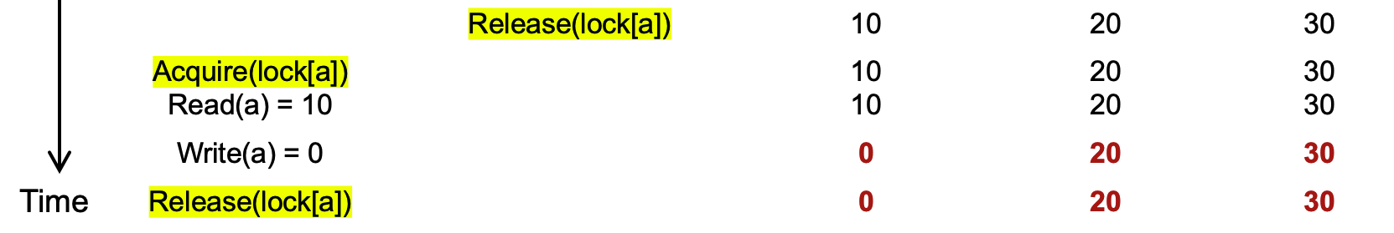
Problem: accessing multiple records
Question #1:
  Is the final state of the program correct (i.e., bank accounts) ?
Question #2:
  Is the sum of the audit correct?
Notes:
Q1: yes
Q2: no

Slide 70
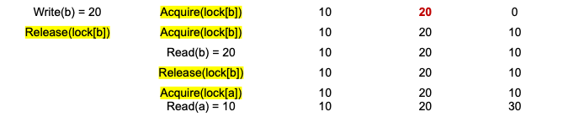
Problem: accessing multiple records
Core problem
  Simple fine-grained locking does not prevent the exposure of intermediate result
Insight
  we need to delay the lock release time for each shared data
    Until all the transaction’s updates finish

Slide 71
Solution: acquire all locks first, and release them at last
Lock Point
Lock
Acquire lock-D
Release lock-D
Acquire lock-C
Release lock-C
Acquire lock-B
Release lock-B
Acquire lock-A
Release lock-A
Time

Slide 72
What are the drawbacks?
Notes:
Long lock held time
Must known the lock set

Slide 73
Two-phase locking (2PL)
…
Fine-grained locking:
  Each shared data has one lock
  E.g., a lock for Alice & a lock for Bob
2PL locking rule:
  The action must acquire the shared data’s lock before access it, and releases it after the data access finishes ; and once the lock is released, no locks can be held.
Bank = [
Alice: 0¥
Bob: 0¥
Lock = [

Slide 74
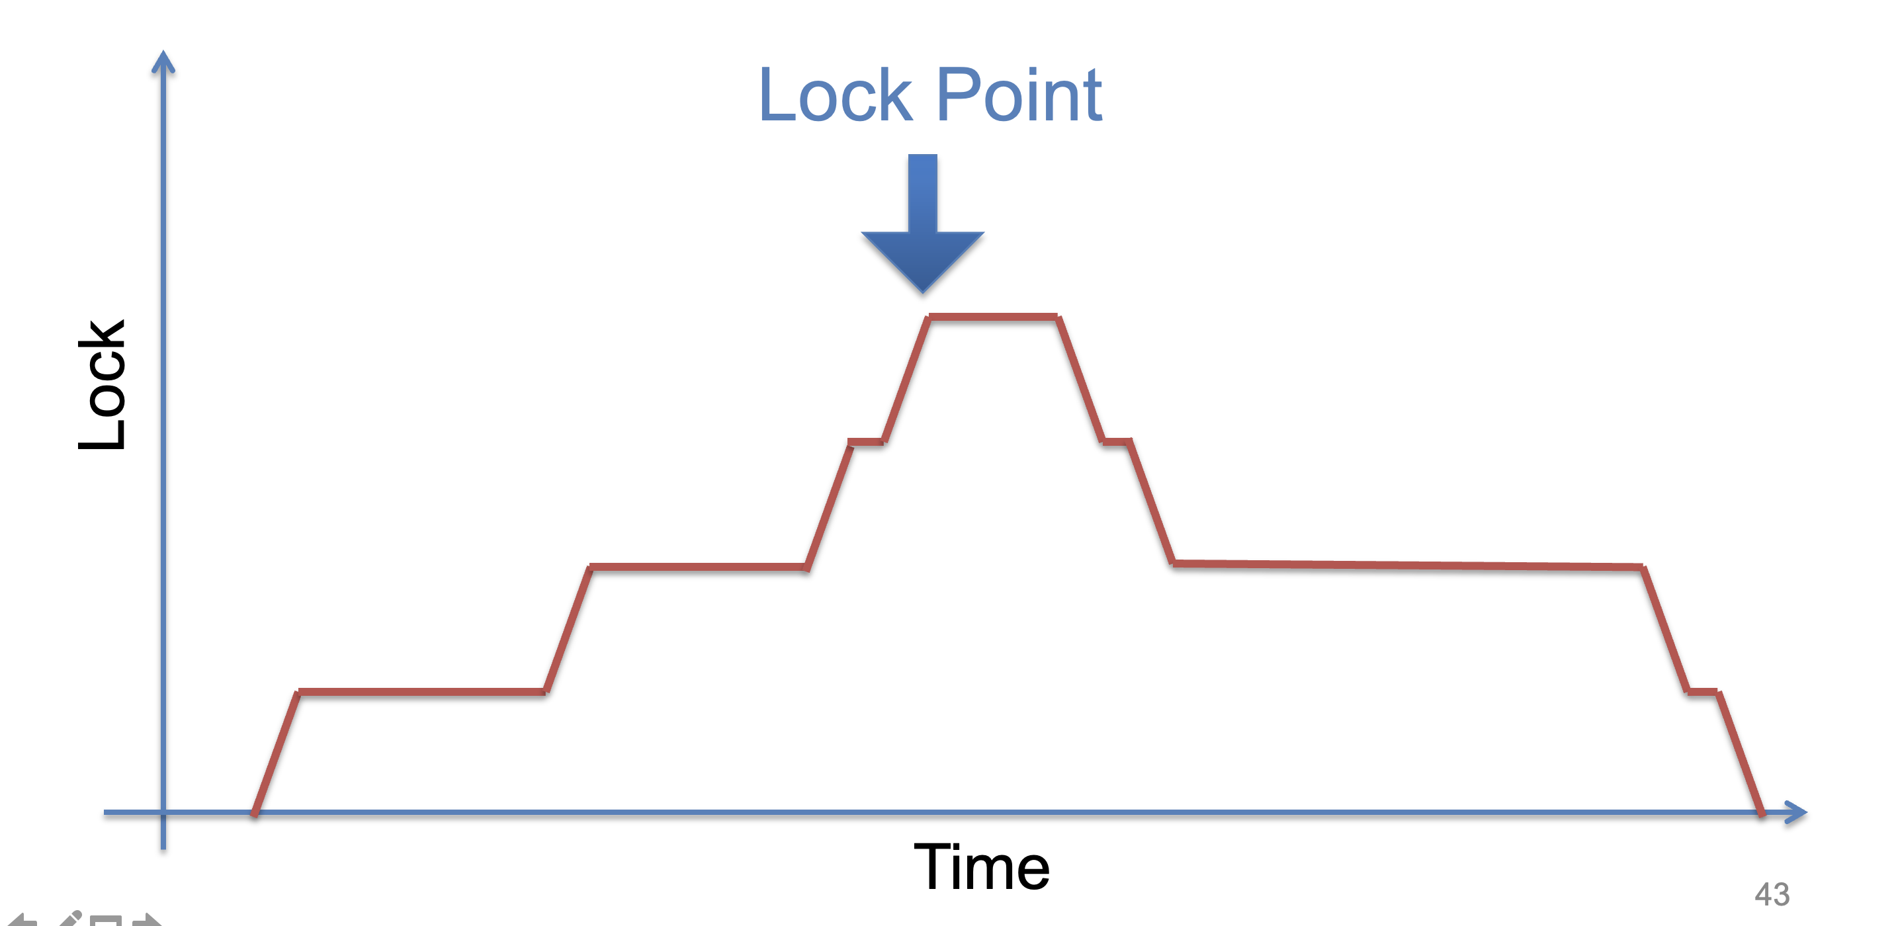
Two-phase locking (2PL)

Slide 75
Use locking to achieve before-or-after: 2PL
2PL can guarantee before or after atomicity with serializability
  Run actions T1, T2, .., TN concurrently, and have it "appears" as if they ran sequentially (we will prove it later)
Before or after atomicity also is usually termed as serializability
Before or after atomicity
Concurrent actions have the before-or-after property if their effect from the point of view of their invokers is as if the actions occurred either completely before or completely after one another

Slide 76
Serializability
2PL can guarantee before or after atomicity with serializability
  Run actions T1, T2, .., TN concurrently, and have it "appears" as if they ran sequentially (we will prove it later)
How can we check it?

Slide 77
Serializability
2PL can guarantee before or after atomicity with serializability
  Run actions T1, T2, .., TN concurrently, and have it "appears" as if they ran sequentially (we will prove it later)
How can we check it?
T1
begin
read(x)
tmp = read(y)
write(y, tmp+10)
commit
T2
begin
write(x, 20)
write(y, 30)
commit
Action start
Action end

Slide 78
Init: x=0, y=0
T1
begin
read(x)
tmp = read(y)
write(y, tmp+10)
commit
T2
begin
write(x, 20)
write(y, 30)
commit
Possible sequential schedules
T1 -> T2: x=20, y=30
T2 -> T1: x=20, y=40
T2: write(x, 20)
T1: read(x)
T2: write(y, 30)
T1: tmp = read(y)
T1: write(y, tmp+10)
At end: x=20, y=40
T1: read(x)
T2: write(x, 20)
T1: tmp = read(y)
T2: write(y, 30)
T1: write(y, tmp+10)
At end: x=20, y=10
Concurrent schedule

Slide 79
Init: x=0, y=0
T1
begin
read(x)
tmp = read(y)
write(y, tmp+10)
commit
T2
begin
write(x, 20)
write(y, 30)
commit
Possible sequential schedules
T1 -> T2: x=20, y=30
T2 -> T1: x=20, y=40
T2: write(x, 20)
T1: read(x)
T2: write(y, 30)
T1: tmp = read(y)
T1: write(y, tmp+10)
At end: x=20, y=40
x=0
T1: read(x)
T2: write(x, 20)
T2: write(y, 30)
T1: tmp = read(y)
T1: write(y, tmp+10)
At end: x=20, y=40
y=30
In the second schedule, the results are correct. But T1 reads x=0 and y=30; those reads are not possible in a sequential schedule. Is that ok?

Slide 80
View Serializability
Informal definition
  A schedule is view serializable if the final written state as well as intermediate reads are the same as in some serial schedule
Formally, for those interested
  Two schedules S and S' are view equivalent if:
    If T_{i} in S reads an initial value for X, so does T_{i} in S'
    If T_{i} in S reads the value written by T_{j} in S for some X, so does T_{i} in S'
    If T_{i} in S does the final write to X, so does T_{i} in S'
  A schedule is view serializable if it is view equivalent to some serial schedule

Slide 81
Question: is it possible to check a schedule is view serializable?

Slide 82
Conflict Serializability

Slide 83
Conflict Serializability
Two operations conflict if:
  they operate on the same data object, and
  at least one of them is write, and
  they belong to different transactions
Conflict serializability
  A schedule is conflict serializable if the order of its conflicts (the order in which the conflicting operations occur) is the same as the order of conflicts in some sequential schedule

Slide 84
Init: x=0, y=0
T1
begin
read(x)
tmp = read(y)
write(y, tmp+10)
commit
T2
begin
write(x, 20)
write(y, 30)
commit
Possible sequential schedules
T1 -> T2: x=20, y=30
T2 -> T1: x=20, y=40
T1.1
T2.1
T1.2
T2.2
T1.3
Conflicts
T1.1 read(x) and T2.1 write(x,20) on x
T1.2 tmp = read(y) and T2.2 write(y,30) on y
T1.3 write(y, tmp+10) and T2.2 write(y,30) on y

Slide 85
Conflict Graph
Conflict Graph
  Nodes are transactions, edges are directed
  Edge between T_{i} and T_{j} if and only if:
    T_{i} and T_{j} have a conflict between them, and
    the first step in the conflict occurs in T_{i}
A schedule is conflict serializable if and only if:
  It has an acyclic conflict graph
Why? We can sort the graph nodes according to the edges if the graph is acyclic

Slide 86
T1
begin
read(x)
tmp = read(y)
write(y, tmp+10)
commit
T2
begin
write(x, 20)
write(y, 30)
commit
Possible sequential schedules
T1 -> T2: x=20, y=30
T2 -> T1: x=20, y=40
Conflicts
T1.1 read(x) -> T2.1 write(x,20)
T1.2 tmp = read(y) -> T2.2 write(y,30)
T1.3 write(y, tmp+10) -> T2.2 write(y,30)
(T1 -> T2)

Slide 87
T1
begin
read(x)
tmp = read(y)
write(y, tmp+10)
commit
T2
begin
write(x, 20)
write(y, 30)
commit
Possible sequential schedules
T1 -> T2: x=20, y=30
T2 -> T1: x=20, y=40
Conflicts
T2.1 write(x,20) -> T1.1 read(x)
T2.2 write(y,30) -> T1.2 tmp = read(y)
T2.2 write(y,30) -> T1.3 write(y, tmp+10)
(T2 -> T1)

Slide 88
Conflicts
T2.1, T1.1
T2.2, T1.2
T2.2, T1.3
Conflict order for sequential schedules
T1.1 -> T2.1 T2.1 -> T1.1
T1.2 -> T2.2 or T2.2 -> T1.2
T1.3 -> T2.2 T2.2 -> T1.3
(T1 -> T2) (T2 -> T1)
T2: write(x, 20)
T1: read(x)
T2: write(y, 30)
T1: tmp = read(y)
T1: write(y, tmp+10)
T1: read(x)
T2: write(x, 20)
T2: write(y, 30)
T1: tmp = read(y)
T1: write(y, tmp+10)
T2.1 -> T1.1
T2.2 -> T1.2
T2.2 -> T1.3
T1.1 -> T2.1
T2.2 -> T1.2
T2.2 -> T1.3

Slide 89
Conflicts
T2.1, T1.1
T2.2, T1.2
T2.2, T1.3
Conflict order for sequential schedules
T1.1 -> T2.1 T2.1 -> T1.1
T1.2 -> T2.2 or T2.2 -> T1.2
T1.3 -> T2.2 T2.2 -> T1.3
(T1 -> T2) (T2 -> T1)
T2: write(x, 20)
T1: read(x)
T2: write(y, 30)
T1: tmp = read(y)
T1: write(y, tmp+10)
T2 -> T1
T1: read(x)
T2: write(x, 20)
T2: write(y, 30)
T1: tmp = read(y)
T1: write(y, tmp+10)
-->
<--
T2 T1
Both at end: x=20, y=40

Slide 90



Conflict Equivalence
=
conflict-equal
Schedule A
if
Schedule B
T1 → T2
T4 → T3
=
equal
Conflicts order A
Conflicts order B
If conflicts-order-A equals to conflicts-order-B,
then schedule-A conflict-equals to schedule-B

Slide 91
View Serializability vs. Conflict Serializability
T1 T2 T3
read(x)
write(x)
write(x)
write(x)
Conflict graph
T3
T2 T1
Cyclic -> Not conflict serializable
But compare it to running T1 then T2 then T3 (serially)
  Final-state is fine
  Intermediate reads are fine
Question: why shouldn't we allow this schedule?

Slide 92
View Serializability vs. Conflict Serializability
View
Serializability
Conflict
Serializability
⊃
Care the final state as well as intermediate read
Care the final state as well as all the data dependency

Slide 93
Conflict Serializability VS. View Serializability
Conflict serializability is easy to test (& enforce)
  i.e., check whether a graph is acyclic
  View serializability is hard to test (likely NP-hard)
Conflict serializable schedules are easy to generate
  Using concurrency control protocols. E.g., 2PL (two-phase-locking)
Conflict serializable schedules are also view serializable
  No easy way to generate view schedules that allows for ones like the previous example

Slide 94
Use locking to achieve before-or-after: 2PL
2PL can guarantee before or after atomicity
  Run actions T1, T2, .., TN concurrently, and have it "appears" as if they ran sequentially
2PL locking rule:
  The action must acquire the shared data’s lock before access it, and releases it after the data access finishes ; and once the lock is released, no locks can be held.
Question
  Which serializability does 2PL guarantee?
  Conflict serializability!

Slide 95
Proof of 2PL
T1 and T2 conflict on x1
T2 and T3 conflict on x2
...
Tk and T1 conflict on x_k
Suppose 2PL does not generate conflict serializable schedule
Suppose the conflict graph produced by an execution of 2PL has a cycle, which without loss of generality, is:
T1 --> T2 --> ... --> Tk --> T1
Let the shared variable (the one that causes the conflict) between T_i and T_{i+1} be represented by x_i.
T1 acquires x1.lock
T2 acquires x1.lock and x2.lock
T3 acquires x2.lock and x3.lock
...
Tk acquires x_{k-1}.lock and x_k.lock
T1 acquires x_k.lock
T1 violates 2PL!
T1 acquires x1.lock
T1 releases x1.lock
...
...
...
T1 acquires x_k.lock
T1 acquires x1.lock
T1 releases x1.lock
T2 acquires x1.lock and x2.lock
...
Tk acquires x_{k-1}.lock and x_k.lock
T1 acquires x_k.lock

Slide 96
Serializability simplifies enforcing concurrent correctness / data consistency

Slide 97
Correctness (app-semantic consistency)
Correctness is hard for computer system to enforce
  It is at the application level, with application specific semantic
  E.g., developer can write a buggy program, even no concurrency (single-threaded)
To ensure concurrent correctness, we need assumptions
  i.e., The single-threaded implementation of actions must be correct
Buggy
Transfer(bank, a, b, amt):
bank[b] += amt
bank[a] -= amt
Transfer(bank, a, b, amt):
bank[b] += amt * 2
bank[a] -= amt

Slide 98
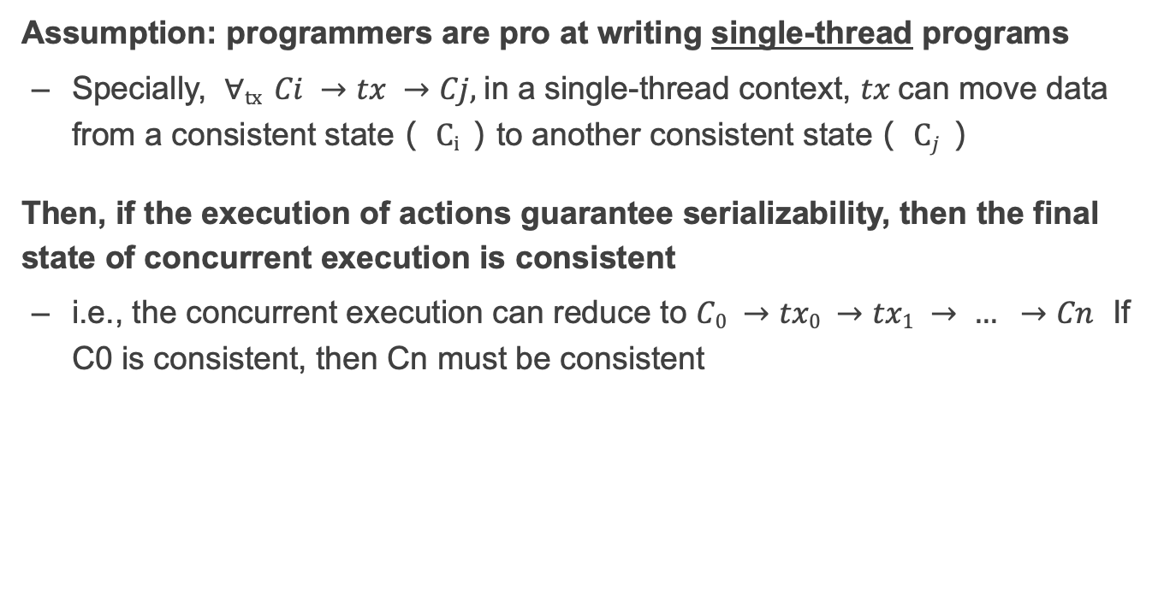
Correctness and serializability
Assumption: programmers are pro at writing single-thread programs
  Specially, $∀tx Ci →tx →Cj,$in a single-thread context, $tx$can move data from a consistent state（ $Ci$）to another consistent state（ $Cj$）
Then, if the execution of actions guarantee serializability, then the final state of concurrent execution is consistent
  i.e., the concurrent execution can reduce to $C0 →tx0 →tx1 → … →Cn$ If C0 is consistent, then Cn must be consistent

Slide 99
The deadlock issue of 2PL

Slide 100
Deadlock
Two-phase lock is pessimistic:
  Before proceed, each TX must wait for conflicting TX to release the lock
  What can happen if two TX are waiting for each other?

Slide 101
Deadlock: what if Thread 1 first acquires lock[a]?
Thread 0 (Transfer) | Thread 1 (Audit) | Bank[Alice] | Bank[bob] | Sum
 |  | 10 | 10 | 0
Acquire(lock[b]) | Acquire(lock[b]) | 10 | 10 | 0
Read(b) = 10 | Acquire(lock[b]) | 10 | 10 | 0
Write(b) = 20 | Acquire(lock[b]) | 10 | 20 | 0
Acquire(lock[a]) | Acquire(lock[b]) | 10 | 20 | 0
Read(a) = 10 | Acquire(lock[b]) | 10 | 10 | 0
Write(a) = 0 | Acquire(lock[b]) | 0 | 20 | 0
Release(lock[b]) | Acquire(lock[b]) | 0 | 20 | 0
 | Read(b) = 20 Acquire(lock[a]) Read(a) = 0 Release(lock[a]) | 0 0 0 0 | 20 20 20 20 | 20 20 20 20

Slide 102
Deadlock: what if Thread 1 first acquires lock[a]?
Thread 0 (Transfer) | Thread 1 (Audit) | Bank[Alice] | Bank[bob] | Sum
 |  | 10 | 10 | 0
Acquire(lock[b]) | Acquire(lock[a]) | 10 | 10 | 0

Slide 103
Deadlock: what if Thread 1 first acquires lock[a]?
Thread 0 (Transfer) | Thread 1 (Audit) | Bank[Alice] | Bank[bob] | Sum
 |  | 10 | 10 | 0
Acquire(lock[b]) | Acquire(lock[a]) | 10 | 10 | 0
Read(b) = 10 | Read(a) = 10 | 10 | 10 | 10

Slide 104
Deadlock: what if Thread 1 first acquires lock[a]?
Thread 0 (Transfer) | Thread 1 (Audit) | Bank[Alice] | Bank[bob] | Sum
 |  | 10 | 10 | 0
Acquire(lock[b]) | Acquire(lock[a]) | 10 | 10 | 0
Read(b) = 10 Acquire(lock[a]) | Read(a) = 10 Acquire(lock[b]) | 10 | 10 | 10

Slide 105
Deadlock: what if Thread 1 first acquires lock[a]?
Thread 0 (Transfer) | Thread 1 (Audit) | Bank[Alice] | Bank[bob] | Sum
 |  | 10 | 10 | 0
Acquire(lock[b]) | Acquire(lock[a]) | 10 | 10 | 0
Read(b) = 10 Acquire(lock[a]) Acquire(lock[a]) | Read(a) = 10 Acquire(lock[b]) Acquire(lock[b]) | 10 | 10 | 10
Question: can thread 0 or thread 1 finishes the execution?

Slide 106
Resolving deadlock
1. Acquire locks in a pre-defined order
  Not support general TX: TX must know the read/write sets before execution
2. Detect deadlock by calculating the conflict graph
  If there is a cycle, then there must be a deadlock
  Abort one TX to break the cycle
  High cost for detection
3. Using heuristics (e.g., timestamp) to pre-abort the TXs
  May have false positive, or live locks

