Slide 1


Serializability, OCC
& Transaction
SE3331-1 (2025 Fall)
IPADS, Shanghai Jiao Tong University
https://www.sjtu.edu.cn

Slide 2


Review: what if request arrival rate (λ) > system throughput (Thpt) ?
Queued latency = Waiting for the queued request to be processed
  The number equals to (λ-Thpt) * T, T = service time
  Approaching to infinity with more service time!
User
Queued latency
Bank
Process latency

Slide 3
Review: using concurrent execution to scale the throughput!
Concurrency: apps run on multiple sources (e.g., CPU) concurrently
  Scale-up: run computations using multiple threads concurrently
  Scale-out: run computations using multiple machines concurrently
However, taming concurrency is hard
Notes:
既然说race condition是在 并发情况下才会发生，那我们得先说下何为并发。
并发就是指xxxx
其中有两种：xxxx。
为什么需要并发呢？ 因为我们处在一个多核和多机的时代：
1） 摩尔定律的消失
2）算力需求的增大

Slide 4
Review: The race condition problem
When two or more threads access shared data and at least one is write
Timing dependent error involving shared state
  i.e., whether the scheduling will cause reading a non-atomic update state
Thread 0
Thread 1
Bank[Alice]
Thread 0
Thread 1
Bank[Alice]
0
0
Read acct
0
Read acct
0
Read acct
0
Increase
0
Increase
0
Write acct
10
Increase
0
Read acct
10
Write acct
10
Increase
10
Write acct
10
Write acct
20

Slide 5
Review: before-or-after atomicity (a.k.a, Isolation)
To prevent hazard produced by race condition, we need a group of reads/writes to be atomic
  E.g., cannot see/overwrites the intermediate states of a concurrent action
  A concurrent action may have multiple linearizable reads/writes
Before or after atomicity
Concurrent actions have the before-or-after property if their effect from the point of view of their invokers is as if the actions occurred either completely before or completely after one another

Slide 6

Review: Use locking to achieve before-or-after
Locks: a data structure that allows only one CPU acquire at a given time
  Programs can acquire and release the lock
Global lock:
  The action must acquire the global lock before executing, and release it after it commits
Drawback: trade performance for correctness
  Only allow one action to run at a time
  Even they don’t read/write each other
  Slower than the single-thread!
Fine-grained lock
  The lock is per-data
+ global lock
T0
T1
T0
T1
Requiring Lock
Deposit(Alice)
Deposit(bob)
Time

Slide 7
Review: fine-grained locking
Lock Point
Lock
Acquire lock-D
Release lock-D
Acquire lock-C
Release lock-C
Acquire lock-B
Release lock-B
Acquire lock-A
Release lock-A
Time

Slide 8



Review: Two-phase locking (2PL)
…
Fine-grained locking:
  Each shared data has one lock
  E.g., a lock for Alice & a lock for Bob
2PL locking rule:
  The action must acquire the shared data’s lock before access it, and releases it after the data access finishes ; and once the lock is released, no locks can be held.
Bank = [
Alice: 0¥
Bob: 0¥
Lock = [

Slide 9
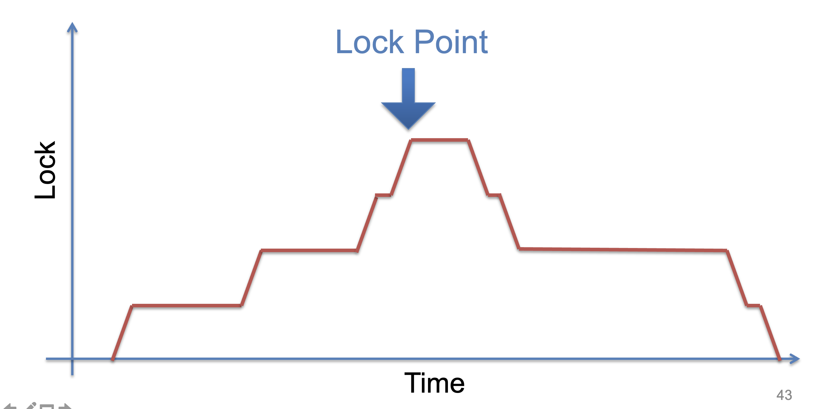
Review: Two-phase locking (2PL)

Slide 10
Review: Use 2PL to achieve before-or-after
2PL can guarantee before or after atomicity with serializability for TXs
  Run actions T1, T2, .., TN concurrently, and have it "appears" as if they ran sequentially (we will prove it later)
Before or after atomicity also is usually termed as serializability
How to check this?
Before or after atomicity
Concurrent actions have the before-or-after property if their effect from the point of view of their invokers is as if the actions occurred either completely before or completely after one another

Slide 11
Review: View Serializability
Informal definition
  A schedule is view serializable if the final written state as well as intermediate reads are the same as in some serial schedule
Formally, for those interested
  Two schedules S and S' are view equivalent if:
    If T_{i} in S reads an initial value for X, so does T_{i} in S'
    If T_{i} in S reads the value written by T_{j} in S for some X, so does T_{i} in S'
    If T_{i} in S does the final write to X, so does T_{i} in S'
  A schedule is view serializable if it is view equivalent to some serial schedule

Slide 12
Challenge: it is hard to check view serializability (NP hard)

Slide 13
Review: Conflict Serializability
Two operations conflict if:
  they operate on the same data object, and
  at least one of them is write, and
  they belong to different transactions
Conflict serializability
  A schedule is conflict serializable if the order of its conflicts (the order in which the conflicting operations occur) is the same as the order of conflicts in some sequential schedule

Slide 14
Review: Detect Satisfaction via Conflict Graph
Conflict Graph
  Nodes are transactions, edges are directed
  Edge between T_{i} and T_{j} if and only if:
    T_{i} and T_{j} have a conflict between them, and
    the first step in the conflict occurs in T_{i}
A schedule is conflict serializable if and only if:
  It has an acyclic conflict graph
Why? We can sort the graph nodes according to the edges if the graph is acyclic

Slide 15
T1
begin
read(x)
tmp = read(y)
write(y, tmp+10)
commit
T2
begin
write(x, 20)
write(y, 30)
commit
Possible sequential schedules
T1 -> T2: x=20, y=30
T2 -> T1: x=20, y=40

Slide 16
Conflicts
T2.1, T1.1
T2.2, T1.2
T2.2, T1.3
Conflict order for sequential schedules
T1.1 -> T2.1 T2.1 -> T1.1
T1.2 -> T2.2 or T2.2 -> T1.2
T1.3 -> T2.2 T2.2 -> T1.3
(T1 -> T2) (T2 -> T1)
T2: write(x, 20)
T1: read(x)
T2: write(y, 30)
T1: tmp = read(y)
T1: write(y, tmp+10)
T2 -> T1
T1: read(x)
T2: write(x, 20)
T2: write(y, 30)
T1: tmp = read(y)
T1: write(y, tmp+10)
-->
<--
T2 T1
Both at end: x=20, y=40

Slide 17
Review: View Serializability
Time
T1 T2 T3
read(x)
write(x)
write(x)
write(x)
Conflict graph
T3
T2 T1
Cyclic -> Not conflict serializable
But compare it to running T1 then T2 then T3 (serially)
  Final-state is fine (T3)
  Intermediate reads are fine (T1 reads the initial value of x)

Slide 18
Conflict Serializability VS. View Serializability
Conflict serializability is easy to test (& enforce)
  i.e., check whether a graph is acyclic
  View serializability is hard to test (likely NP-hard)
Conflict serializable schedules are also view serializable
  No easy way to generate view schedules that allows for ones like the previous example
Next: we show 2PL generates conflict serializability!

Slide 19
Use 2PL to achieve before-or-after
2PL can guarantee before or after atomicity
  Run actions T1, T2, .., TN concurrently, and have it "appears" as if they ran sequentially, i.e., conflict serializability
2PL locking rule:
  The action must acquire the shared data’s lock before access it, and releases it after the data access finishes ; and once the lock is released, no locks can be held.
Question
  Why 2PL can generate conflict serializability?

Slide 20
Proof of 2PL
T1 and T2 conflict on x1
T2 and T3 conflict on x2
...
Tk and T1 conflict on x_k
Suppose 2PL does not generate conflict serializable schedule
Suppose the conflict graph produced by an execution of 2PL has a cycle, which without loss of generality, is:
T1 --> T2 --> ... --> Tk --> T1
Let the shared variable (the one that causes the conflict) between T_i and T_{i+1} be represented by x_i.
T1 acquires x1.lock
T2 acquires x1.lock and x2.lock
T3 acquires x2.lock and x3.lock
...
Tk acquires x_{k-1}.lock and x_k.lock
T1 acquires x_k.lock
T1 violates 2PL!
T1 acquires x1.lock
T1 releases x1.lock
...
...
...
T1 acquires x_k.lock
T1 acquires x1.lock
T1 releases x1.lock
T2 acquires x1.lock and x2.lock
...
Tk acquires x_{k-1}.lock and x_k.lock
T1 acquires x_k.lock

Slide 21
Discussion: lock scope vs. conflict serializability

Slide 22
Case study: the software department’s salary system
A system to manage the salary of the employers of the software department
  Data to store: the employers
Operations
  Update the salaries of a group of people
  Print the status of a group of employers satisfying a condition
  Add new employers
  Others
Detailed system implementations
  For simplicity, we use a simple linked list to store all the emplyers
  The list is stored in-memory
    Fault tolerance can be realized with logging

Slide 23
Implementing the software department’s salary system
Data layout
  In-memory vector to storing all the employers
  Each employer has a fine-grained lock to realize 2PL
database = std::List<Employer *>;
Struct Employer {
Lock lock;
string name;
double salary;
}

Slide 24
Employments
T1
Update emp (set salary=1.1*salary where salary >= 3000)
Print emp where salary > 3000
T2
Insert emp (
Xingda, 3100,
Yubin, 3100)
Xingda
3100
Yubin
3100
Haibo
3000
Rong
3000
Sees Xingda & Yubin but w/o updates
U1(H)
U1(R)
Ins(X)
Ins(Y)
R1(H)
R1(R)
R1(X)
R1(Y)
Time
Problem
  If T1 sees Xingda & Yubin, it must have updated it
  But T1 misses the insertions on the first updates

Slide 25
Phantom Problem
Issue
  Only lock the things you touch is insufficient!
We must guarantee any conflicts are tracked by a lock
Solutions
  Predicate locking
  Range locks in a B-tree index (e.g., assumes an index on salary),
  or lock entire table
  Sometimes being ignored in practice
Two operations conflict → they access the same data item and at least one is a write
The data item is abstract, e.g., can be the entire database.
Our lock should capture all possible conflicts for before-or-after.

Slide 26
Remaining issue: deadlock

Slide 27
Deadlock
Two-phase lock is pessimistic:
  Before proceed, each TX must wait for conflicting TX to release the lock
  What can happen if two TX are waiting for each other?
Fine-grained locking + 2PL
Transfer(bank, locks, a, b, amt):
Acquire(lock[b]
bank[b] += amt
Acquire(lock[a])
bank[a] -= amt
Release(lock[a])
Release(lock[b])
Audit(bank):
sum = 0
for acct in bank:
Acquire(locks[acct])
sum += bank[acct]
print(sum)
ReleaseAllLocks(...)

Slide 28
Deadlock: what if Thread 1 first acquires lock[a]?
Thread 0 (Transfer) | Thread 1 (Audit) | Bank[Alice] | Bank[bob] | Sum
 |  | 10 | 10 | 0
Acquire(lock[b]) | Acquire(lock[b]) | 10 | 10 | 0
Read(b) = 10 | Acquire(lock[b]) | 10 | 10 | 0
Write(b) = 20 | Acquire(lock[b]) | 10 | 20 | 0
Acquire(lock[a]) | Acquire(lock[b]) | 10 | 20 | 0
Read(a) = 10 | Acquire(lock[b]) | 10 | 10 | 0
Write(a) = 0 | Acquire(lock[b]) | 0 | 20 | 0
Release(lock[b]) | Acquire(lock[b]) | 0 | 20 | 0
 | Read(b) = 20 Acquire(lock[a]) Read(a) = 0 Release(lock[a]) | 0 0 0 0 | 20 20 20 20 | 20 20 20 20

Slide 29
Deadlock: what if Thread 1 first acquires lock[a]?
Thread 0 (Transfer) | Thread 1 (Audit) | Bank[Alice] | Bank[bob] | Sum
 |  | 10 | 10 | 0
Acquire(lock[b]) | Acquire(lock[a]) | 10 | 10 | 0

Slide 30
Deadlock: what if Thread 1 first acquires lock[a]?
Thread 0 (Transfer) | Thread 1 (Audit) | Bank[Alice] | Bank[bob] | Sum
 |  | 10 | 10 | 0
Acquire(lock[b]) | Acquire(lock[a]) | 10 | 10 | 0
Read(b) = 10 | Read(a) = 10 | 10 | 10 | 10

Slide 31
Deadlock: what if Thread 1 first acquires lock[a]?
Thread 0 (Transfer) | Thread 1 (Audit) | Bank[Alice] | Bank[bob] | Sum
 |  | 10 | 10 | 0
Acquire(lock[b]) | Acquire(lock[a]) | 10 | 10 | 0
Read(b) = 10 Acquire(lock[a]) | Read(a) = 10 Acquire(lock[b]) | 10 | 10 | 10

Slide 32
Deadlock: what if Thread 1 first acquires lock[a]?
Thread 0 (Transfer) | Thread 1 (Audit) | Bank[Alice] | Bank[bob] | Sum
 |  | 10 | 10 | 0
Acquire(lock[b]) | Acquire(lock[a]) | 10 | 10 | 0
Read(b) = 10 Acquire(lock[a]) Acquire(lock[a]) | Read(a) = 10 Acquire(lock[b]) Acquire(lock[b]) | 10 | 10 | 10
Question: can thread 0 or thread 1 finishes the execution?

Slide 33
Methods for resolving the deadlock
1. Acquire locks in a pre-defined order
  Not support general TX: TX must know the read/write sets before execution
2. Detect deadlock by calculating the conflict graph
  If there is a cycle, then there must be a deadlock
  Problem: Abort one TX to break the cycle
  High cost for detection
3. Using heuristics (e.g., timestamp) to pre-abort the TXs
  May have false positive, or live locks
Prevention
Detection
Retry

Slide 34
Summary of today so far + last lecture
Concurrency (parallelism) is important to improve throughput
  Throughput is the key to service providers
The challenge of enabling concurrency is correctness
  We need a consistency model even stronger than linearizability!
The desired model: before-or-after
Locking-based method to implement before-or-after (2PL)
How to check the before-or-after of a locking protocol
Some important issues of locking-based protocols?
  Phantom issue (Can be fixed)
  Deadlock issue (A general solution is hard to obtain)

Slide 35
How to avoid the deadlock issue?

Slide 36



Optimistic concurrency control
Executing TXs optimistically w/o acquiring the lock
Checks the results of TX before it commits
  If violate serializability, then aborts & retries
First proposed in 1981, widely used today

Slide 37
OCC Executes a Transaction in 3 Phases
Phase 1: Concurrent local processing
  Reads data into a read set
  Buffers writes into a write set
Phase 2: Validation serializability in critical section
  Validates whether serializability is guaranteed:
  Has any data in the read set been modified?
Phase 3: Commit the results in critical section or abort
  Aborts: aborts the transaction if validation fails
  Commits: installs the write set and commits the transaction

Slide 38
OCC Executes a Transaction in 3 Phases
Before phase one, TX needs to allocate the execution context
  Read-set & write set
...
tx.begin();
...
tx.read(A)
...
tx.commit();
...
Init read_set
Init write_set

Slide 39
OCC Executes a Transaction in 3 Phases
Phase 1:
  Reads data into a read set
  Buffers writes into a write set
This step should be atomic!
...
tx.begin();
...
tx.read(A)
...
tx.commit();
...
val_a = read(A)
read_set.add(val_a)

Slide 40
OCC Executes a Transaction in 3 Phases
Phase 1:
  Reads data into a read set
  Buffers writes into a write set
...
tx.begin();
...
tx.read(A)
tx.write(A)
tx.commit();
...
Write_set[A] = ..
if A in read_set:
read_set[A] = ..
Notes:
假设A之前没有被TX写过，即A只写一次

Slide 41
OCC Executes a Transaction in 3 Phases
Phase 2:
  Validates whether serializability is guaranteed:
  Has any data in the read set been modified?
...
tx.begin();
...
tx.read(A)
...
tx.commit();
...
for d in read_set:
if d has changed:
abort()

Slide 42
OCC Executes a Transaction in 3 Phases
Phase 3:
  Aborts: aborts the transaction if validation fails
  Commits: installs the write set and commits the transaction
...
tx.begin();
...
tx.read(A)
...
tx.commit();
...
for d in read-set:
if d has changed:
abort()
for d in write_set:
write(d)

Slide 43
OCC Executes a Transaction in 3 Phases
Phase 3:
  Aborts: aborts the transaction if validation fails
  Commits: installs the write set and commits the transaction
Phase 2 & 3 should execute in a critical section
  Otherwise, what if a value has changed during validation?
...
tx.begin();
...
tx.read(A)
...
tx.commit();
...
Critical section
for d in read_set:
if d has changed:
abort()
for d in write_set:
write(d)

Slide 44
Why phase 2 & phase 3 must be in critical section?
Both TX:
A += 1
B += 1
Time
T1
T2
Read(A_{T0})
Phase #1
Read(B_{T0})
Read(A_{T0})
Read(B_{T0})
Phase #2
Validate(A_{T0})
Validate(B_{T0})
Validate(A_{T0})
Validate(B_{T0})

Slide 45
Why phase 2 & phase 3 must be in critical section?
Both TX:
A += 1
B += 1
Time
T1
T2
Read(A_{T0})
Phase #1
Read(B_{T0})
Read(A_{T0})
Read(B_{T0})
Phase #2
Validate(A_{T0})
What happen we execute phase #3?
Validate(B_{T0})
Validate(A_{T0})
Validate(B_{T0})
Phase #3
Write(A, A_{T0} + 1)
Write(A , A_{T0} + 1)

Slide 46
How to implement the critical section for phase 2 & 3?
Global lock may satisfy
  The phase 2 & 3 are typically short
    No TX logic is executed, only the validation
def validate_and_commit() // phase 2 & 3
global_lock.lock()
for d in read-set:
if d has changed:
abort()
for d in write-set:
write(d)
global_lock.unlock()

Slide 47
How to implement the critical section for phase 2 & 3?
Using two-phase locking
  Allow more concurrency
  What about the problem of deadlock?
def validate_and_commit() // phase 2 & 3
for d in read-set:
d.lock()
if d has changed:
abort() // abort will release all the held lock
for d in write-set:
d.lock()
write(d)
// release the locks
...

Slide 48
How to implement the critical section for phase 2 & 3?
Using two-phase locking
  Allow more concurrency
  Use sort to avoid deadlock; but can we do better?
  Question: do we need to lock the read-set?
def validate_and_commit() // phase 2 & 3
for d in sorted(read-set + write-set):
d.lock()
for d in read-set:
if d has changed:
abort()
for d in write-set:
write(d)
// release the locks
...

Slide 49
How to implement the critical section for phase 2 & 3?
Observation (for the read-set):
  If the validation passes, then it ”appears“ that a lock is held during
def validate_and_commit() // phase 2 & 3
for d in sorted(read-set + write-set):
d.lock()
for d in read-set:
if d has changed:
abort()
for d in write-set:
write(d)
// release the locks
...

Slide 50
How to implement the critical section for phase 2 & 3?
Observation (for the read-set):
  If the validation passes, then it ”appears“ that a lock is held during
  Question: is the following implementation correct?
def validate_and_commit() // phase 2 & 3
for d in sorted(write-set):
d.lock()
for d in read-set:
if d has changed:
abort()
for d in write-set:
write(d)
// release the locks
...

Slide 51

Problem: read-write conflict
T1:
A += B
T2:
B += A
Time
T1
T2
Read(A_{T0})
Phase #1
Read(B_{T0})
Read(A_{T0})
Read(B_{T0})
Missing the lock!
Phase #2
Lock(A)
Validate(B_{T0})
Lock(B)
Validate(A_{T0})
Write(A, A_{T0} + B_{To})
Write(B, A_{T0} + B_{To})

Slide 52
How to implement the critical section for phase 2 & 3?
Use two-phase locking + read validation
  Only lock the write set, after that,
  Check the read set has not changed & locked
def validate_and_commit() // phase 2 & 3 with before-or-after
for d in sorted(write-set):
d.lock()
for d in read-set:
if d has changed or d has been locked:
abort()
for d in write-set:
write(d)
// release the locks
...
Notes:
check完相当于放锁

Slide 53
OCC Advantages
Phase 1: Concurrent local processing
  Reads data into a read set
  Buffers writes into a write set
Phase 2: Validation in critical section
  Validates whether serializability is guaranteed:
  Has any data in the read set been modified?
Phase 3: Commit the results in critical section or abort
  Aborts: aborts the transaction if validation fails
  Commits: installs the write set and commits the transaction
Operates in private workspace; rare inter-thread synchronization (optimistic)

Slide 54
OCC Advantages
Phase 1: Concurrent local processing
  Reads data into a read set
  Buffers writes into a write set
Phase 2: Validation in critical section
  Validates whether serializability is guaranteed:
  Has any data in the read set been modified?
Phase 3: Commit the results in critical section or abort
  Aborts: aborts the transaction if validation fails
  Commits: installs the write set and commits the transaction
Needs synchronization (e.g., with lock), but usually very short at low contention

Slide 55
OCC Advantages (Using system model to analyze)
Use reads more than writes (for each read-only data access)
  OCC (in the optimal case, i.e., no abort)
    1 read to read the data value
    1 read to validate whether the value has been changed or not (as well as locked)
  2PL
    1 operation to acquire the lock (typically an atomic CAS)
    1 read to read the data value
    1 write to release the lock
      A single CPU write is atomic, no need to do the atomic CAS
Locking is costly especially compared to reads

Slide 56
Locking preliminary
Many implementation exists to achieve the best performance & scalability
  Still an active topic in system research
We will focus on the basic design
  The details (& advanced methods) will be left to the OS class
Basic impl: using a flag to indicate whether the log is hold
  Acquire: read the current flag, if not locked, then set it as locked
Interestingly, acquiring the lock itself also requires before-of-after
  Both threads will read the current lock status
  If the status is not locked, update it to locked
    What if two threads concurrently read an unlocked state?

Slide 57
Locking preliminary: atomic compare and swap
Hardware primitive to guarantee before-or-after atomicity
  Compare-and-swap (on SPARC)
  Compare-and-exchange (on x86)
  Lock prefix to ensure an instruction is atomically executed on a memory address
1 int CompareAndSwap(int *ptr, int expected, int new) {// with the lock prefix
2 int actual = *ptr;
3 if (actual == expected)
4 *ptr = new;
5 return actual;
6 } // hardware ensures atomicity with the lock prefix
Notes:
x86 provides a “lock” prefix that tells the hardware:
“don’t let anyone read/write the value until I’m done with it”
An instruction for atomic CAS
---
Dekker’s and Peterson’s Algorithms

Slide 58
Locking (Spin Lock) using Compare-and-swap
1 typedef struct __lock_t {
2 int flag;
3 } lock_t;
4
5 void init(lock_t *lock) {
6 // 0 indicates that lock is available, 1 that it is held
7 lock->flag = 0;
8 }
9
10 void lock(lock_t *lock) {
11 while (CompareAndSwap(&lock->flag, 0, 1) == 1)
12 ; // spin-wait (do nothing)
13 }
14
15 void unlock(lock_t *lock) {
16 lock->flag = 0;
17 }

Slide 59
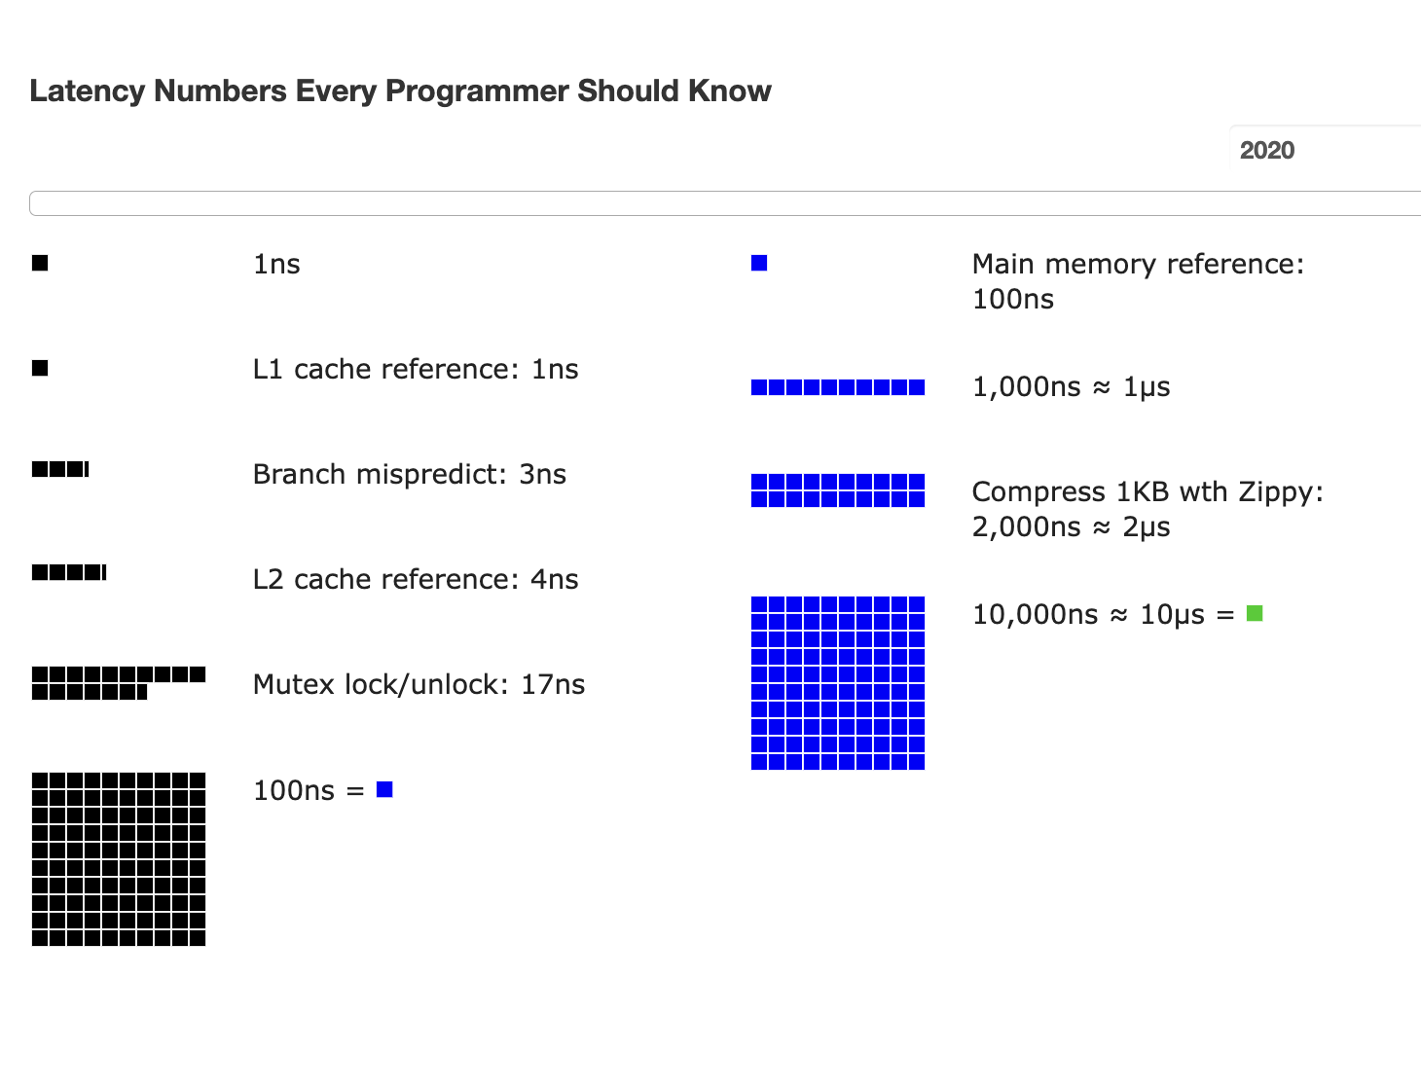
Atomic operations are costly for spin lock

Slide 60
Put it all together: OCC in an example
Tuple A in T1's read set has been changed by T2, thus T1 must be aborted.
Thread1
Thread2
T1:
B = A + B;
T2:
A = A * 1.1;
T2's read set remains unchanged, thus T2 is allowed to commit
BEGIN
BEGIN
T1's read set:
A (100)
B (100)
R(A);
R(A);
T2's read set:
A (100)
B (200)
R(B);
W(A);
T1's write set:
T2's write set:
A (110)
W(B);
Commit
Validation
Thread-local memory
Abort
Validation
Thread-local memory
Time
Database
storage
ID | Value
A | 110
B | 100
ID | Value
A | 100
B | 100

Slide 61
OCC's Problem: False Aborts
Some transactions aborted by OCC could have been allowed to commit without causing an unserializable schedule
Thread1
Thread2
T1:
B = A + B;
T2:
A = A * 1.1;
No cycle is formed
OCC only allows serialized execution of T2, T1, but is not able to recognize serialized execution of T1, T2.
T1 is falsely aborted
BEGIN
BEGIN
R(A);
rw
R(A);
R(B);
W(A);
W(B);
Commit
Abort

Slide 62
OCC's Problem: False Aborts
Some transactions aborted by OCC could have been allowed to commit without causing an unserializable schedule
Especially for TXs with a lot of reads
  E.g., read a lot of items → large read set → easier to abort
  May abort even under low-contention
Notes:
因为执行的时间很长，所以会abort

Slide 63
OCC’s Problem: livelock
Under high contention, OCC may continuously abort
  Especially with large read/write sets, or long execution time
  Transaction is executing, but no progress!

Slide 64
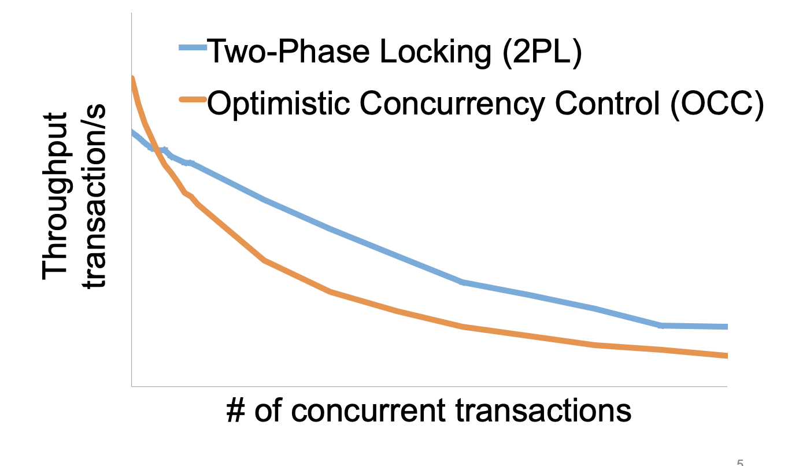
2PL vs. OCC: in a nutshell
Source: Extracting More Concurrency from Distributed Transactions [OSDI'14]

Slide 65
Question: implementing 2PL & OCC is challenging, can we avoid it?

Slide 66

Hardware Transactional Memory
A new CPU feature for writing multi-core concurrent programs
CPU guarantees the before-or-after atomicity of memory reads/writes
  i.e., no race conditions & no need for 2PL & OCC!
  Benefits: near zero costs if execute normally + easy to program
Intel supports HTM named as RTM
  Restricted Transactional Memory
  First released in its Haswell processor
Other implementations also exist
  E.g., ARM Transactional Memory Extension (TME)

Slide 67
A little introduction to RTM’s ISA
ISA support for transactional memory
Recall: Writing with TX is straightforward
  Use TX.begin to mark when a TX starts
  Use TX.commit to commit the TX
In RTM, the concept is similar (using new instructions)
  Use xbegin to mark an RTM execution start
  Use xend to mark an RTM end

Slide 68
Programming with RTM
If transaction starts successfully
  Do work protected by RTM, and then try to commit
Fallback routine to handle abort event
  If abort, system rollback to xbegin, return an abort code
Manually abort inside a transaction
if _xbegin() == _XBEGIN_STARTED:
if conditions:
_xabort()
critical code
_xend()
else
fallback routine

Slide 69
Programming with RTM
If an HTM transaction starts successfully
  Do work protected by RTM, and then try to commit
Fallback routine to handle abort event
  If abort, CPU rollbacks to line xbegin, return an abort code, and goto fallback
Manually abort inside a transaction
if _xbegin() == _XBEGIN_STARTED:
if conditions:
_xabort()
critical code (access x)
_xend()
else
fallback routine
Another process
x = 1

Slide 70
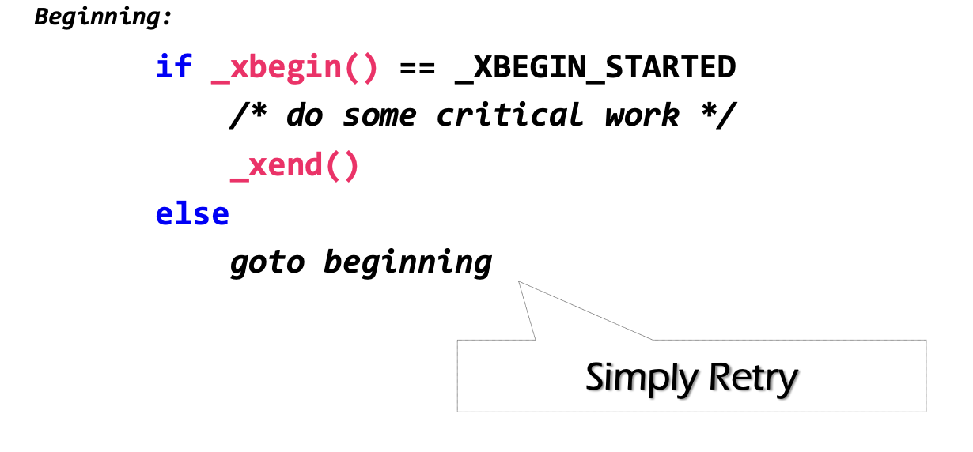
Challenge: how to handle aborts?
RTM provides new instruction set
  xbegin(), xend() & xabort()
Problem: RTM cannot guarantee success

Slide 71
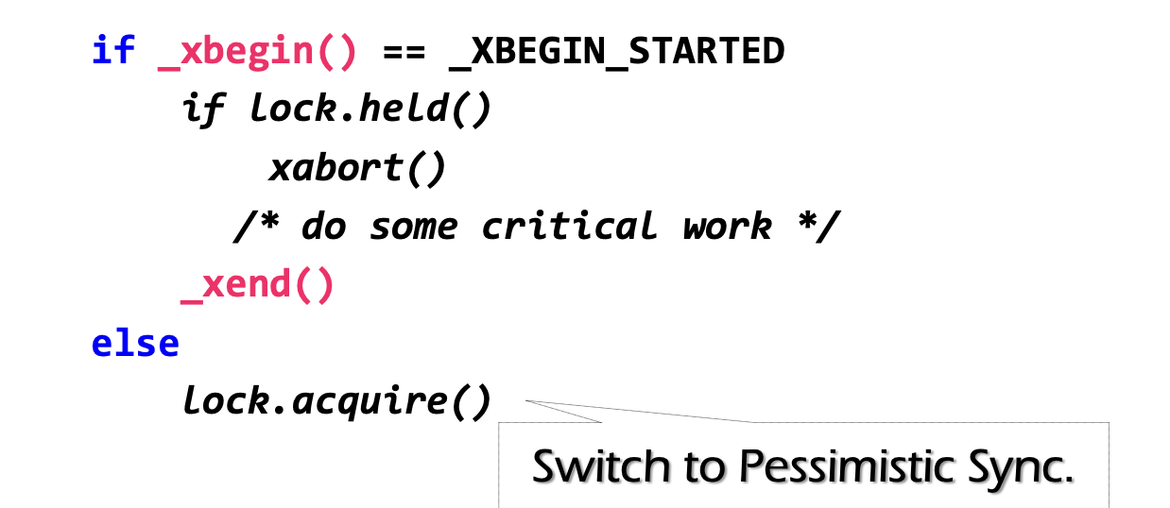
Can we use simple retry? No
Problem: RTM cannot guarantee success
  Similar to OCC, code in RTM can be frequently aborted due to conflicts
Must switch to a fallback path after some reties (e.g., using a counter)
  E.g., degrade to use lock in the fallback path; typically use global locking to simplify coding
check lock status to avoid conflict with fallback handlers on other CPU

Slide 72
Why RTM cannot guarantee success? Fun facts about the hardware implementation of RTM
The benefits of RTM
  Memory operations between xbegin() & xend()satisfy ACI properties
  No need to implement OCC / 2PL manually
  High performance if no abort happens
Drawbacks
  Cannot guarantee success

Slide 73
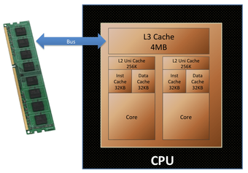
Implementation of RTM: OCC!
Background: Intel implements RTM using OCC
  Use CPU cache to track the read/write sets
  How to detect conflicts? Based on cache coherence protocols
Key to high performance

Slide 74
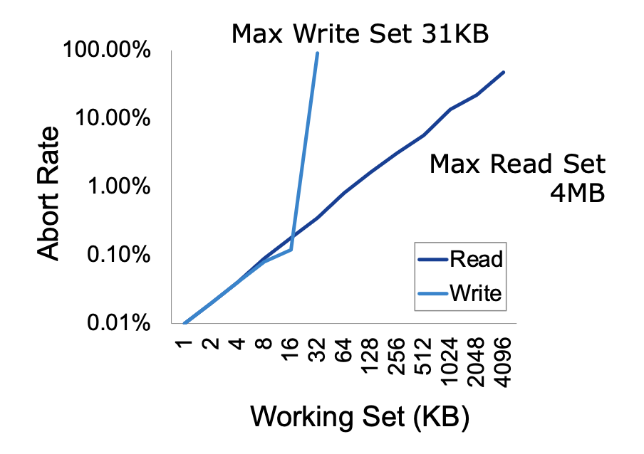
Issue: Limited working set
Reason: CPU has limited cache size
How big is the RTM read/write sets?
  Depends on various factors
    Hardware setup (e.g., CPU cache size)
    Access pattern: read or write
    L1 cache tracks all the writes
    L2, or L3 to tracks all the reads

Slide 75
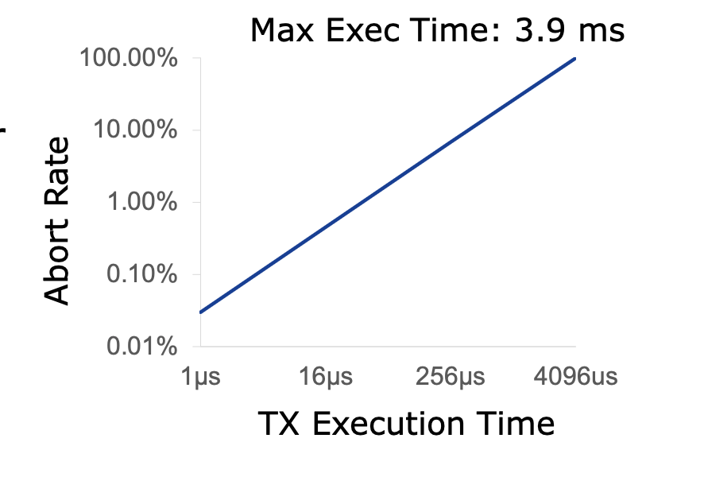
Issue: External events break the RTM execution
HTM TX cannot run a very long time
  The longer the execution, the higher the probability a TX aborts
Affected by external events, because cache is evicted
  Network IO, interrupt, etc.

Slide 76
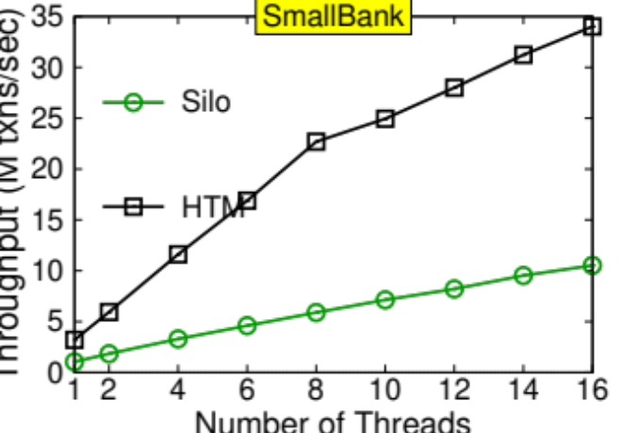
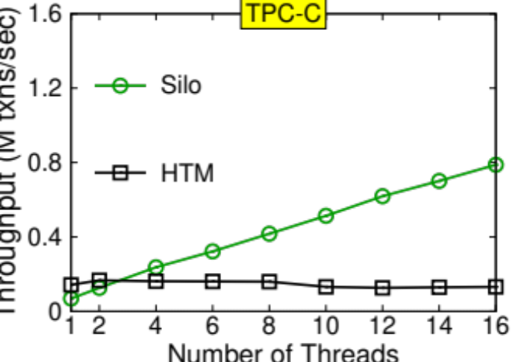
Hardware vs. Software-based OCC
Naïve: using HTM to execute the in-memory transaction
  Smallbank: transfer &. Audit
  TPC-C: much complex, insert 10+ orders and update 10+ stocks
Silo@SOSP’13: the fastest in-memory OCC implementation

Slide 77
Short summary of HTM
Hardware support for transactional memory
  Easy programming model for the programmer (no need to wrap transaction in read/write API of the transaction)
    As long as the programmer do the in-memory computations, e.g., in-memory database
  Good performance if using properly
    No need for locking & atomic operations
  However, the programmer should handle its pitfalls
It is an application of OCC (in the hardware)
  OCC is a general technique that can be applied to many fields

Slide 78
Put it all together: Transactions

Slide 79

Widely used transaction (TX)s
Caching server
Caching server
…
Caching server
All can use TX to manager data!
  e.g., FS meta data
Caching
Caching
Caching
Distributed caching
Database server
Database server
CDN
Users
Application #1
generate the page
Database
user, price
…
Database
user, price
Application server
Distributed database
Internet
Load
Balance
Application #2
add the order
File server
File server
File server
File:
image
File:
image
…
File:
image
Application server
…
…
Message queue
Distributed file system

Slide 80
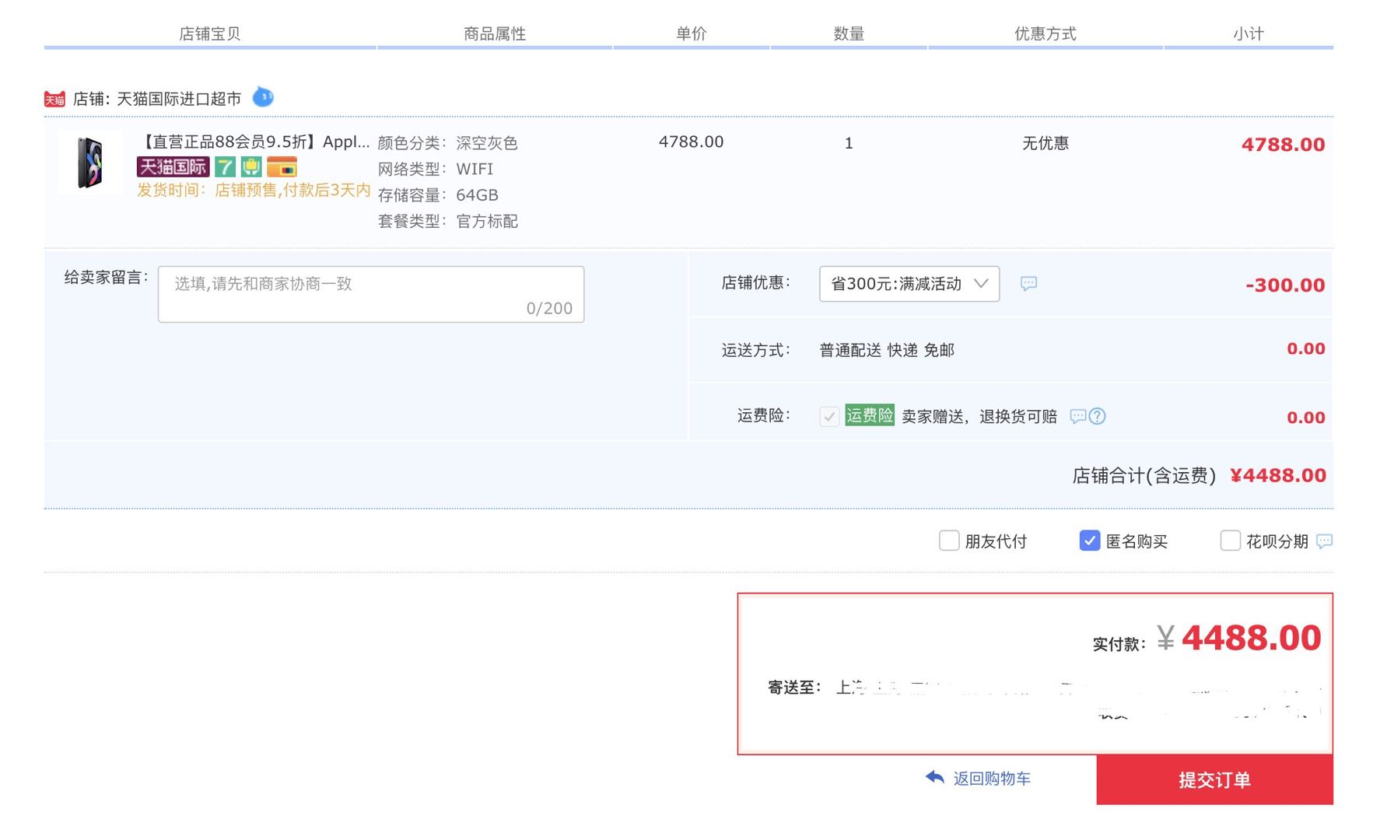
Widely used transaction (TX)s
if item.count > 0:
item.count -= 1
Cart.add(item)

Slide 81
What is a transaction?
An abstraction to manage the data
Data is also an abstract concept, can be arbitrary computing data. Concrete examples including:
  Key-value store entries
  File system metadata (e.g., directory,, inode, etc)
  Processor’s metadata (e.g., child processors)
Look like similar program, with data managed by the TX system, and extra mark to denote the start/end of a TX

Slide 82

What is special of TX? It provides ACID
The program btw { tx.begin() & tx.commit() } has the following properties:
A：Atomicity
C：Consistency
I：Isolation
D：Durability
...
tx.begin();
...
...
tx.commit();
...
ACID
Application program

Slide 83

Atomicity: All-or-nothing

Slide 84
Isolation & Durability
Isolation: Two concurrently transactions are isolated
  E.g., not viewing the intermediate results of another TX
  Avoid the race conditions
Durability
  Once a transaction is committed, its changes (e.g., writes) must durably stored to a persistent storage

Slide 85
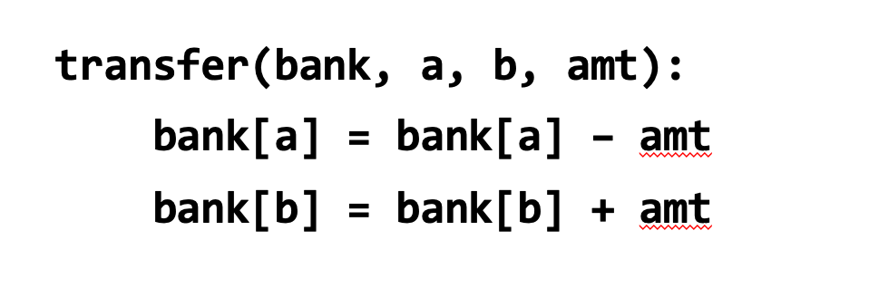
Consistency
Transaction must change the data from a consistent state to another
  What is consistent is defined by the applications
  E.g., transfer should leave the sum(bank[a] + bank[b]) unchanged
Transaction alone is not sufficient for application consistency
  E.g., If the programmer writes the incorrect program.
    bank[a] = bank[a] - amt * 2

Slide 86
Enforcing ACID properties (in the single-machine case)
Enforcing A & D:
  Logging and recovery (see the last last lecture)
Enforcing C:
  Database constraint system (not covered in this class)
Enforcing I:
  Concurrency control methods (last & this lecture)

Slide 87
Review: Serialization
Goal: run transactions T1, T2, .., TN concurrently, and have it "appears" as if they ran sequentially
T1
begin
read(x)
tmp = read(y)
write(y, tmp+10)
commit
T2
begin
write(x, 20)
write(y, 30)
commit

Slide 88
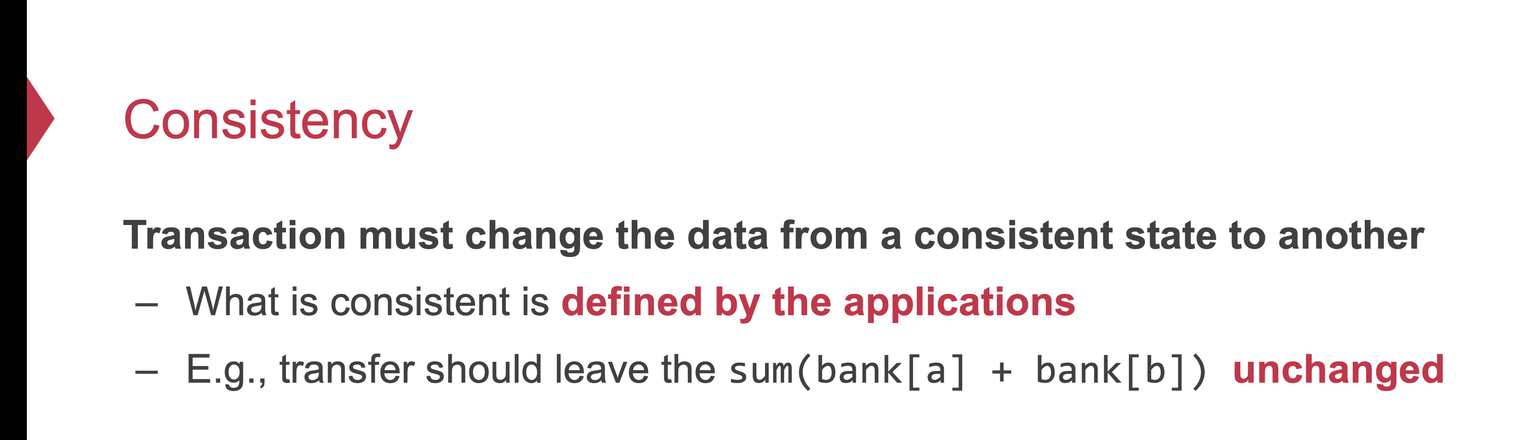
Why is isolation typically related to consistency?
Because it simplifies the programmer to enforce consistency
  Recall: consistency depends on how the programmer writes the program

Slide 89
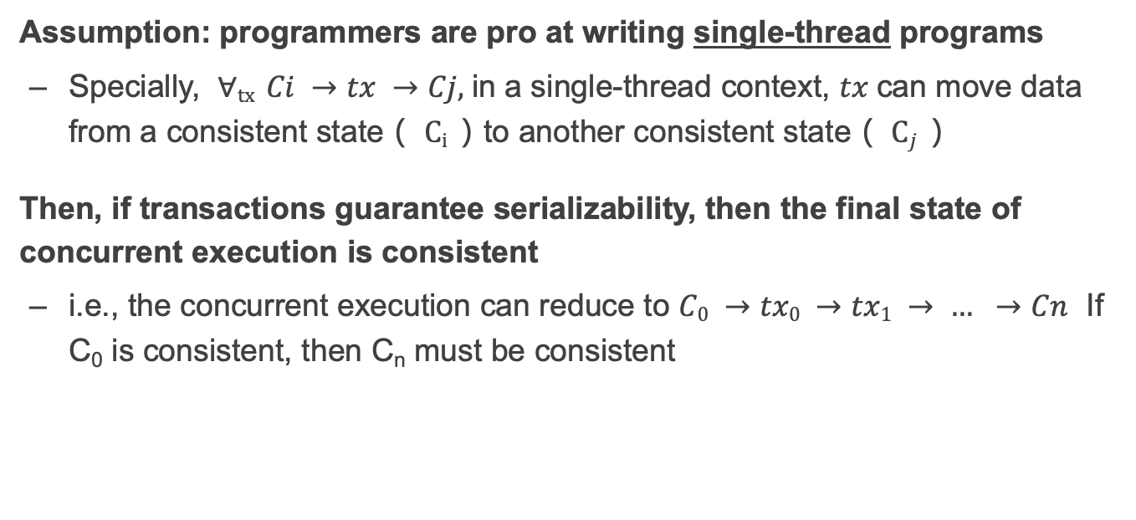
Why serializability is ideal?
Assumption: programmers are pro at writing single-thread programs
  Specially, $∀tx Ci →tx →Cj,$in a single-thread context, $tx$can move data from a consistent state（ $Ci$）to another consistent state（ $Cj$）
Then, if transactions guarantee serializability, then the final state of concurrent execution is consistent
  i.e., the concurrent execution can reduce to $C0 →tx0 →tx1 → … →Cn$ If C₀ is consistent, then C_{n} must be consistent

Slide 90
Why we need to use a TX?
Programmers can manually add logging & locking to their program
  Can guarantee all-or-nothing and before-of-after
However, this is a typically bad idea
  Question: what if the programmer falsely releases the lock (like the fine-grained lock example in our previous lecture?)
  What if the program fails to obtain the right locks? (The phantom problem described in this lecture)
  What if the programmer write the wrong logging & recovery mechanism?

Slide 91
Review of TX: an abstraction to ease data management
Handle failure atomicity (all-or-nothing) & race conditions (before-or-after)
Writing with TX is straightforward, the atomicity is left to the system
  Use TX.begin to mark when a TX starts
  Use TX.commit to commit the TX
  Rewrite the data read/write with TX’s interface
    E.g., bank[a] = bank[a] – amt
    tx.write(a, tx.read(a) – amt);
transfer(bank, a, b, amt, tx):
tx.begin()
tx.write(b, tx.read(b) + amt);
tx.write(a, tx.read(a) – amt);
tx.commit()
transfer(bank, a, b, amt):
bank[b] = bank[b] + amt
bank[a] = bank[a] - amt
Program
Transaction

Slide 92
Summary
OCC & 2PL are basic protocols to provide serializability
  Problem of 2PL: locking overhead & deadlock
  Problem of OCC: False abort & livelock
Hardware transactional memory (HTM)
  Advanced CPU features inspired by ACID properties of TXs
  Commercial implementation of HTM uses OCC
    Leads to several drawbacks
Transactions provide ACID properties

