Slide 1


Consistency under partial failure: 2PC & replicated state machine
SE3331-1 (2025 Fall)
IPADS, Shanghai Jiao Tong University
https://www.sjtu.edu.cn

Slide 2
Outline of today’s content
Review of 2PC, and how to handle partial failure
The issue of 2PC: does not support availability by default
Supporting availability & consistency (linearizability)
  Approach #1: Primary-backup replication
  Approach #2: Paxos & Multi-paxos

Slide 3

Review: Multi-site transaction
Coordinator sends multiple deposit to different servers
  They use RPCs to send requests to the server to execute transaction
发工资(bank, accts, amt):
for acct in accts:
deposit(bank, acct, amt)
发工资
Coordinator
Server 0
deposit(“Alice”)
deposit(“Zack”)
Server 1
Time
What if one server commits and the other aborts?

Slide 4
Goal: all sites either all commits or all aborts
Under partial failure!

Slide 5
Two-phase Commit: a way to ensure multi-site atomicity
High-layer TX
  The high-level view of the TX
Low-layer TX
  Specific reads and writes that executed on a single machine
Higher-layer transaction coordinates the execution of lower-layer TXs
  All low-layer TX either all commits or all aborts
发工资(bank, accts, amt):
tx.high_begin()
for acct in accts:
deposit(bank, acct, amt)
tx.high_commit()
High-layer TX
Deposit(bank, a, amt):
tx.low_begin()
bank[a] += amt
tx.low_commit()
Low-layer TX

Slide 6
Two-phase Commit: a way to ensure multi-site atomicity
High-layer TX
发工资(bank, accts, amt):
tx.high_begin()
for acct in accts:
deposit(bank, acct, amt)
tx.high_commit()
High_begin
  Mark itself as a high-level transaction
High_commit
  Send prepare messages to the low-level transactions to check whether it can commit
tx.high_begin()
tx.high_commit()
for each deposit:
if deposit.abort: abort()
for each deposit:
deposit.commit()
Deposit(…)
Deposit(…)
Time

Slide 7
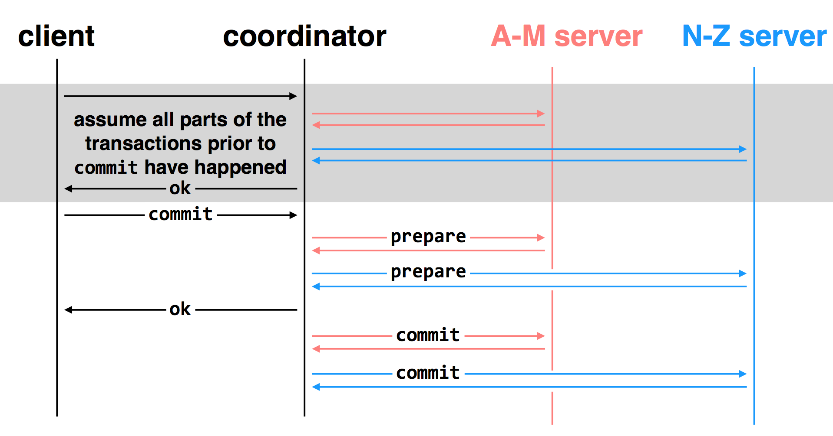
Multi-site transactions under two-phase commit
Idea: the coordinator is responsible for committing all the TXs
    By sending RPCs or Messages to all the other servers

Slide 8
Challenge: unreliable communications, coordinator & worker; how to ensure our protocol still ensures correctness?

Slide 9
client
coordinator
A-M server
N-Z server
OK
commit
X
prepare
timeout; resend
prepare
prepare
OK
commit
commit
failure: lost prepare

Slide 10
client
coordinator
A-M server
N-Z server
OK
commit
prepare
X
timeout; resend
prepare
prepare
OK
failure: lost ACK for prepare

Slide 11

client
coordinator
A-M server
N-Z server
OK
commit
prepare
prepare
abort
abort
failure: worker failure during prepare
coordinator can safely abort transaction, will send explicit abort messages to live workers
Or, we can wait for it to reboot

Slide 12
Case: worker failure before the coordinate commits
Question: how worker recover after failure?
  Can worker individually decide to commit?

Slide 13
Multiple-site Atomicity
Principles:
  Following the coordinator’s decision
  Log sufficient state to tolerate failures (e.g., the coordinator’s decision)
Coordinator (do the decision & maintain the state)
  Collect some ABORT or nothing: ABORT or retry
  Collect all COMMIT: then COMMIT
Worker passively react to the coordinator’s actions
  If no message is sent from the coordinator, just wait
  When receive COMMIT: then COMMIT
Commit point: the coordinator made a decision + log the decision

Slide 14
client
coordinator
A-M server
N-Z server
OK
commit
prepare
prepare
OK
commit
X
Why? Just wait..
tx?
timeout; resend
commit
commit
failure: lost commit message

Slide 15
client
coordinator
A-M server
N-Z server
OK
commit
prepare
prepare
OK
commit
X
timeout; resend
commit
commit
failure: lost ACK of commit message

Slide 16

client
coordinator
A-M server
N-Z server
OK
commit
prepare
prepare
OK
commit
commit
failure: worker failure during commit
Notes:
workers write PREPARE records once prepared. the recovery process — reading through the log — will indicate which transactions are prepared but not committed

Slide 17

client
coordinator
A-M server
N-Z server
OK
commit
prepare
prepare
OK
commit
commit
tx?
restart
commit
failure: worker failure during commit

Slide 18

client
coordinator
A-M server
N-Z server
OK
commit
prepare
coordinator recovers
abort
abort
failure: coordinator failure during prepare

Slide 19
client
coordinator
A-M server
N-Z server
OK
commit
prepare
prepare
OK
commit
coordinator recovers
commit
commit
failure: coordinator failure during commit
Must log the decision before sending the commit messages

Slide 20
Extension to current methods
2PL + OCC
  2PL: each low-layer TX cannot release its lock until the high-layer TX decides to commit
OCC: the validation & commit phases are done by the coordinator
Logging
  Nearly identical, except that the coordinator needs to log the decision, and the low-level transaction needs to mark a partial-checkpoint state
Checkpoint
  Cannot reclaim the log of a partially updated transaction

Slide 21
Summary of 2-phase Commit
Two-phase commit allows us to achieve multi-site atomicity: transaction remains atomic even when they require communication with multiple machines
In two-phase commit, failures prior to the commit point can be aborted. If workers (or the coordinator) fail after the commit point, they recover into the PREPARED state, and complete the transaction
Remaining challenge: availability under coordinator failures
  Follow the coordinator’s decision simplifies achieving multi-site atomicity, but what if the coordinator crashes for a long time?
  We will see how to make the coordinator available in the next lecture

Slide 22
2PC and CAP

Slide 23
Review of The CAP theorem: 2 out of 3
It is impossible for a distributed computer system to simultaneously provide all three of the following guarantees
  Consistency (e.g., linearizability + all-or-nothing + before-or-after + …)
  Availability (a guarantee that every request receives a response about whether it succeeded or failed)
  Partition tolerance (the system continues to operate despite arbitrary message loss or failure of part of the system)

Slide 24
2PC only guarantees consistency!
If the coordinator fails before sending the commit
  All other transaction must wait until it wakes up
  The coordinator logs its decisions to recovery & resume after the failure
If one site fails during the transaction’s execution
  All TX requiring this site’s involvement must wait until it wakes up
Only some corner cases can ensure availability or partition tolerant of a TX
  By aborting TXs. But it doesn’t help much.
How to achieve (high) availability? Replication!

Slide 25
Replication is everywhere
Recall:
  GFS in distributed file system
  ChatAPP
For performance
  Higher throughput: replicas can serve concurrently
  Lower latency: cache is also a form of replication
For fault tolerance
  Maintain availability even if some replicas fail

Slide 26
Clients
Servers
C₁
S₁
write₁(x)
C₂
S₂
write₂(x)
(replica of S₁)

Slide 27
Clients
Servers
C₁
S₁
write₁(x)
write₂(x)
C₂
S₂
write₁(x)
write₂(x)
(replica of S₁)

Slide 28
Clients
Servers
C₁
S₁
write₂(x)
write₁(x)
C₂
S₂
write₁(x)
write₂(x)
(replica of S₁)
problem: How to ensure the order of operations?

Slide 29
Problem: inconsistency of Replicas
Clients send requests to different servers can arrive in different order
  How do we ensure the servers remain consistent?
Optimistic Replication (e.g., eventual consistency)
  Tolerate inconsistency, and fix things up later
  Works well when out-of-sync replicas are acceptable
Pessimistic Replication (e.g., linearizability)
  Ensure strong consistency between replicas
  Needed when out-of-sync replicas can cause serious problems
Question: which replication is desirable for 2PC?

Slide 30
Primary-backup model revisited in the context of RSM
Replicated state machine (RSM): A general model to simplify consistent replicas of a server:
  Start with the same initial state on each server
  Provide each replica with the same input operations, in the same order
  Ensure all operations are deterministic
    E.g., no randomness, no reading of current time, etc.
An RSM with the above three assumptions will ensure single-copy consistency
Storage applications (e.g., ChatAPP) can be abstracted in this form

Slide 31
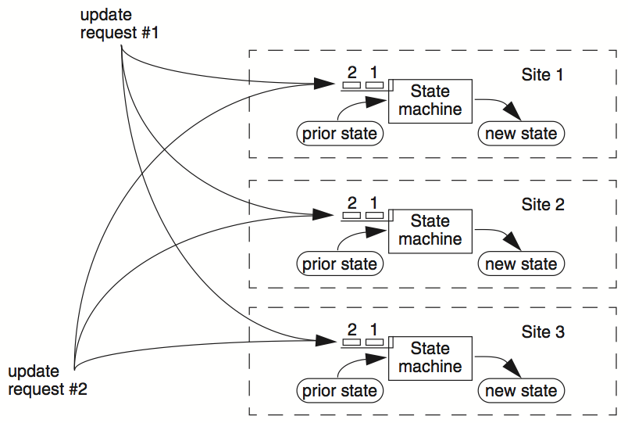
RSM

Slide 32
Primary Backup model
One server is responsible for ordering inputs received from clients
Primary does important stuff
  Ensures that it sends all inputs to the backup before ACKing the ops
  Chooses an ordering for all operations, so that the primary and backup agree (i.e., one writer)
  Decides all non-deterministic values (e.g., random(), time())
It can also recruit new backups after servers fail, but needs to take care (see later)
Primary-backup can trivially support single-copy, like what we did in linearizability, but what is the problem of our previous protocol ?

Slide 33
What if Primary Fails? We want availability
Idea 1: Have human decide when to switch from primary to backup
  Reasonable for small web services
Idea 2: Coordinator (a computer problem) knows about both primary and backup, and decides which to use automatically
  Won't work if using multiple coordinators: the "split brain" syndrome
  Multiple coordinators come to independent, and different, conclusions about who is primary when there are network partitions
Idea 3: we have some black magic to select the primary after a previous primary fails ☺ (Will talk about in the later part of this course)

Slide 34
Primary/Backup Model
(primary)
Clients
Coordinator
S₁
C
S₂
if primary fails, C knows about S₂, and switches
(backup)
attempt: coordinators communicate with primary
servers, who communicate with backup servers

Slide 35
Primary/Backup Model
(primary)
X
Clients
Coordinator
S₁
C
S₂
if primary fails, C knows about S₂, and switches
(backup)
attempt: coordinators communicate with primary
servers, who communicate with backup servers

Slide 36
Multiple Coordinators + the Network = ?
X
Clients
Coordinator
S₁
C
S₂
if primary fails, C knows about S₂, and switches
(primary)
attempt: coordinators communicate with primary
servers, who communicate with backup servers

Slide 37
Multiple Coordinators + the Network = Problems
(primary)
C₁
S₁
network partition
C₂
S₂
(backup)
attempt: coordinators communicate with primary
servers, who communicate with backup servers

Slide 38
Multiple Coordinators + the Network = Problems
(primary)
C₁
S₁
network partition
C₂
S₂
(backup, but primary for C₂)
C₁ and C₂ are using different primaries;
S₁ and S₂ are no longer consistent

Slide 39
View Server
The view server keeps a table that maintains a sequence of "view"
  Each view contains view number, primary server, and backup servers
The view server alerts each server as to whether it's the primary or the backup
Upon receiving any updates, the primary will receive an ACK from the backup before responding to the view server (just as before)
Coordinators make requests to the view server asking who is primary in the background & cache the primary status locally
  Coordinators then contact the primary

Slide 40

View Server
(primary)
S₁
S₁
primary
C
primary?
VS
S₁
backup
1: S₁, S₂
S₂
(backup)
Use a view server, which determines which replica is the primary

Slide 41
View Server
To discover failures via heartbeats
  Replicas ping to the view server
  If view server misses N pings in a row, it deems a server to be dead
Basic failure (actual worker crash):
  1. Primary fails; pings cease
  2. View server lets S2 know it's primary, and it handles any client requests
    Before S2 knowing it's the primary, it will simply reject requests that come directly from the coordinator
  3. View server will eventually recruit a new idle server to act as backup

Slide 42
Failure of Primary
(dead)
X
S₁
C
VS
lack of pings indicates to VS that S₁ is down
1: S₁, S₂
S₂
(backup)
Use a view server, which determines which replica is the primary

Slide 43
Failure of Primary
(dead)
X
S₁
C
primary?
VS
S₂
primary
1: S₁, S₂
2: S₂, --
S₂
S₂
(primary)

Slide 44
Network Partitions
Network Partition between VS and S₁
(primary)
S₁
lack of pings indicates to VS that S₁ is down
S₁
C
VS
1: S₁, S₂
S₂
(backup)
But: S₁ is still functioning as a primary, how to prevent split brain?

Slide 45
Rules when Facing Network Partitions (and similar cases)
Primary must wait for backups to accept each request
  A backup accepts a request if it is in the same view of the primary
Non-primary must reject direct coordinator requests
  That's what happened in the earlier failure, in the interim between the failure and S2 hearing that it was primary
Primary must reject forwarded requests
  i.e., it won't accept an update from the backup
Primary in view i must have been primary or backup in view i-1
  Otherwise, the backup’s data may not catch up

Slide 46
Network Partitions
Network Partition between VS and S₁
(primary)
S₁
S₁
VS makes S₂ primary
C
VS
primary
1: S₁, S₂
2: S₂, --
S₂
rejected by S₂
(backup)
it's okay! S2 will act as backup
(accept updates from S1, reject coordinator's requests)
problem: what happens before S₂ knows it's the primary?

Slide 47
Network Partitions
Network Partition between VS and S₁
rejected by S₁
(Cannot get ACK from S₂)
(primary)
S₁
S₁
C
VS
1: S₁, S₂
2: S₂, --
S₂
(primary)
also okay! S1 won't be able to act as primary
(can't accept client requests because it won't get ACKs from S2)
problem: what happens after S2 knows it's the primary,
but S1 also thinks it is?

Slide 48
Consider S₁ being Partitioned from the VS
Before S2 hears about View #2:
  S1 can process operations from coordinators, S2 will accept forwarded requests (because they are all on view #1)
  S2 will reject operations from coordinators who have heard about view #2
After S2 hears about View #2:
  If S1 receives coordinator requests, it will forward. S2 will reject (not ACK), so S1 can no longer act as primary
  S1 will send error to coordinator, coordinator will ask VS for new view, learn about view #2, and coordinator will re-send to S2
The commit point of switch-over:
  When S2 hears about View #2

Slide 49
Question: what if a backup fails?
Can we proceed with primary-backup replication?
  Not if the primary must wait for the backup to ack!
Question: what if the primary does not wait for the backup?
(primary)
S₁
S₂
(backup)

Slide 50
Waiting for all the backups’ ack is a bad idea
Why? Because with more replicas, the more likely there is some backup fails!
Question: we need to wait for a few backups before the ack, but how many?
  Goal: if the request is acked to the client, the request must persist after the primary & backup failures
To achieve so, we need to enforce some rules on which backup can become the primary

Slide 51
Quorum
Simplified assumption: there is only one writer (e.g., primary)
  Goal: the reader reads the write if the writer returns OK
Define separate read &write quorums: Q_{r} & Q_{w}
  Qr + Qw > Nreplicas (Why?)
    Confirm a write after writing to at least Qw of replicas
    Read at least Qr agree on the data or witness value
Example
  In favor of reading: N_{replicas} = 5, Q_{w} = 4, Q_{r} = 2
  In favor or updating: N_{replicas} = 5, Q_{w} = 2, Q_{r} = 4
  Enhance availability by Q_{w} = N_{replicas} & Q_{r} = 1

Slide 52
Put it all together: the complete data path of primary backup
1. One server is responsible for ordering inputs received from clients
2. After receives an input, sync to up to W backups before ack
3. If the primary fails, select R backups, and chooses the one with the most up-to-date inputs, i.e., inputs with the largest sequence number
  R + W > N (Total number of replicas)
  The primary must collect logs from these backups to form a complete log, and replicates to remaining backups (The recovery process)
The recovery typically is within 30ms measured

Slide 53
Final issue: what if view server fails?
(primary)
S₁
S₁
C
X
VS
1: S₁, S₂
S₂
(backup)
problem: what if view server fails?
Now, we need Paxos

Slide 54
Paxos
Distributed consensus mechanism

Slide 55

Leslie Lamport
http://ipads.se.sjtu.edu.cn/courses/cse-g/2012f/Schedule_files/paxos-simple.pdf

Slide 56

Paxos solves the consensus problem

Slide 57
Single-decree Paxos
Agree on a single value w/o a view server

Slide 58
Question: how can we agree on a single value?
e.g., multiple client wants to write a value VA that is replicated on a set of servers
  How can we ensure that, once VA is acked by the system (written), VA does not change, and can tolerate failures?
Question: when is this question becomes trivial?
  The question is trivial if there is only a single writer
Challenge: support multiple (concurrent) writers

Slide 59
Paxos' properties: correct + fault-tolerance
    Assumption: majority of servers are alive
    No guaranteed termination (i.e., lack of availability guarantee)
Goal: have all acceptors agree to a value V associated with a proposal
Proposer
Proposer
Proposer
E.g., a view
Acceptor
Client
Network
Acceptor
Acceptor
leader
Learner
Learner
quorum
Learner
Paxos: one machine may serve several roles

Slide 60
Paxos Players
Client
makes a request
Proposer
Get a request and run the protocol
Leader = elected Coordinator
Acceptor
Remember the state of the protocol
Quorum = any majority of Acceptors
Learner
When agreement has been reached,
a Learner executes the request and/or sends a response back to the Client

Slide 61
Paxos Setup
Client
Client
Paxos Node
Paxos Node
Paxos Node
Proposer
Proposer
Proposer
Acceptor
Acceptor
Acceptor
. . .
Learner
Learner
Learner

Slide 62
General Approach
One proposer decides to be the leader (optional)
Leader proposes to write a value and solicits acceptance from acceptors (majority)
Leader announces result or try again

Slide 63
Paxos Setup
Client
Client
Paxos Node
Paxos Node
Paxos Node
Proposer
Proposer
Proposer
Acceptor
Acceptor
Acceptor
. . .
Learner
Learner
Learner
M_{n}: my proposal number
V_{a}: accepted value of N_{a} (Value agreed on)
N_{a}: highest proposal number accepted
N_{h}: highest proposal number seen
On each Node

Slide 64
Paxos in Action: Phase 0
Client sends a request to a proposer
Proposer
request
Acceptor
Client
Network
Acceptor
Acceptor
quorum
Learner

Slide 65
Paxos in Action: Phase 1a (Prepare)
Leader creates a proposal N and send to quorum
N is greater than any previous
proposal number seen by this proposer
Leader
proposal N
Acceptor
Client
Network
Acceptor
Acceptor
quorum
Learner

Slide 66
Paxos in Action: Phase 1b (Prepare)
Acceptor: if proposal ID > any previous proposal
reply with the highest past proposal number and value
promise to ignore all IDs < N
else ignore (proposal is rejected)
Leader
promise N
Acceptor
Client
Network
Acceptor
Acceptor
quorum
Learner

Slide 67
Paxos in Action: Phase 2a (Accept)
Leader: if receive enough promise
set a value V to the proposal V, if any accepted value returned, replace V with the returned one
send accept request to quorum with
the chosen value V
Leader
accept request(N, V)
Acceptor
Client
Network
Acceptor
Acceptor
quorum
Learner
Ignore all proposals < N

Slide 68
Paxos in Action: Phase 2b (Accept)
Acceptor: if the promise still holds
register the value V
send accepted message to Proposer/Learners
else ignore the message
Leader
accepted
Acceptor
Client
Network
Acceptor
Acceptor
accepted
quorum
Learner
Learner
Ignore all proposals < N

Slide 69
Paxos in Action: Phase 3 (Learn)
Learner: responds to Client and/or take action on the request
Leader
Acceptor
Client
Network
Acceptor
Acceptor
quorum
Learner
Learner
Ignore all proposals < N

Slide 70
Question: what if a value has been written?
e.g., if a leader with propose #5 writes x on majority of acceptors, and a later leader tries to write y w/ propose #6?

Slide 71
Paxos Setup
Client
Client
Paxos Node
Paxos Node
Paxos Node
Proposer
Proposer
Proposer
Acceptor
Acceptor
Acceptor
. . .
Learner
Learner
Learner
M_{n}: my proposal number
N_{h}: highest proposal number seen
V_{a}: accepted value of N_{a} (Value agreed on)
N_{a}: highest proposal number accepted
On each Node

Slide 72
Paxos in Action: Phase 1b (Prepare)
Acceptor: if proposal ID > any previous proposal
reply with the highest past proposal number and value
promise to ignore all IDs < N
else ignore (proposal is rejected)
Leader
promise N
Acceptor
Client
Network
Acceptor
Acceptor
quorum
Learner

Slide 73
Paxos in Action: Phase 2a (Accept)
Leader: if receive enough promise
set a value V to the proposal V, if any accepted value returned, replace V with the returned one
send accept request to quorum with
the chosen value V
Leader
accept request(N, V)
Acceptor
Client
Network
Acceptor
Acceptor
quorum
Learner
Ignore all proposals < N

Slide 74
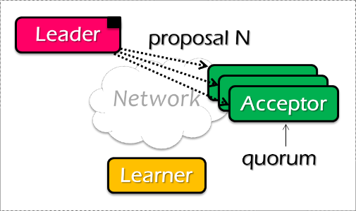
Paxos Pseudo-code
N_{a}: highest proposal number accepted
V_{a}: accepted value of N_{a}
N_{h}: highest proposal number seen
M_{n}: my proposal number
A node decides to be Leader
Leader chooses M_{n} > N_{h}
Leader sends <proposal, M_{n} > to all nodes
Acceptor receives <proposal, N>
if N < N_{h}
reply <promise-reject>
else
N_{h} = N
reply <promise-ok, N_{a}, V_{a}>
Ignore all proposals < N_{h}

Slide 75

Paxos Pseudo-code
N_{a}: highest proposal number accepted
V_{a}: accepted value of N_{a}
N_{h}: highest proposal number seen
M_{n}: my proposal number
If Leader gets promise-ok from a majority
If Leader fails to get majority promise-ok
Upon receiving <accept, N, V>
if V != null, V = the value of the highest N_{a} received
if V = null, then Leader can pick any V
send <accept, M_{n}, V> to all nodes
delay and restart Paxos
if N < N_{h}
reply <accept-reject>
else
N_{a} = N; V_{a} = V; N_{h} = N;
reply <accept-ok>

Slide 76
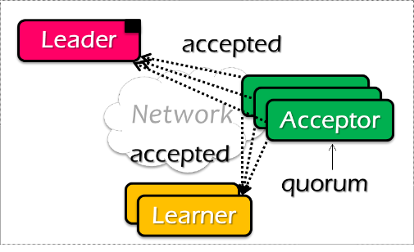
Paxos Pseudo-code
N_{a}: highest proposal number accepted
V_{a}: accepted value of N_{a}
N_{h}: highest proposal number seen
M_{n}: my proposal number
If Leader gets accept-ok from a majority
If Leader fails to get majority accept-ok
send <decide, V_{a}> to all nodes
delay and restart Paxos

Slide 77
Paxos Pseudo-code
N_{a}: highest proposal number accepted
V_{a}: accepted value of N_{a}
N_{h}: highest proposal number seen
M_{n}: my proposal number
N_{a} = V_{a} = null
N_{h} = N0:0
N_{a} = V_{a} = null
N_{h} = N1:0
N_{a} = V_{a} = null
N_{h} = N2:0
M_{n} = N1:1
<proposal, N1:1>
<proposal, N1:1>
N_{h} = N1:1
N_{a} = null
V_{h} = null
N_{h} = N1:1
N_{a} = null
V_{h} = null
<promise, null, null>
<promise, null, null>
<accept, N1:1, V1>
<accept, N1:1, V1>
N_{h} = N1:1
N_{a} = N1:1
V_{h} = V1
N_{h} = N1:1
N_{a} = N1:1
V_{h} = V1
<accept-ok>
<accept-ok>
<decide, V1>
<decide, V1>
Time

Slide 78
General Approach
One proposer decides to be the leader (optional)
Leader proposes to write a value and solicits acceptance from acceptors (majority)
Leader announces result or try again
What if >1 proposers become leaders simultaneously?
What if there is a network partition?
What if a leader crashes in the middle of solicitation?
What if a leader crashes after deciding but before announcing results?
. . .

Slide 79
Inside of Paxos
N_{a}: highest proposal number accepted
V_{a}: accepted value of N_{a}
N_{h}: highest proposal number seen
M_{n}: my proposal number
When is the value V chosen?
    Leader receives a majority <promise, …>
    A majority acceptors receive <accept, N, V>
    Leader receives a majority <accepted, …>
What if acceptor fails after sending promise?
    Must remember N_{h}
What if acceptor fails after receiving accept?
    Must remember N_{h} and N_{a} V_{a}
What if leader fails while sending accept?
    Propose M_{n} again
Notes:
When is the value V chosen?
- As long as majority send <accepted>, even if the leader has not received that much.
Why not the second case?
- The acceptor may receive the request, than fail
If not remember Nh, than another leader may get the same promise

Slide 80
Question
N_{a}: highest proposal number accepted
V_{a}: accepted value of N_{a}
N_{h}: highest proposal number seen
M_{n}: my proposal number
Suppose that the acceptors are A, B, and C. A and B are also proposers. How does Paxos ensure that the following sequence of events can't happen? What actually happens, and which value is ultimately chosen?
A sends <prepare, 1> requests with proposal number 1, and gets responses from A, C
A sends <accept,1, "foo"> to A and C and gets responses from both. Because a majority accepted, A thinks that "foo" has been chosen. However, A crashes before sending an <accept, 1, "foo"> to B
B sends <prepare, 2> messages with proposal number 2, and gets responses from B and C
B sends <accept, 2, "bar"> messages to B and C and gets responses from both, so B thinks that "bar" has been chosen

Slide 81

Question
N_{a}: highest proposal number accepted
V_{a}: accepted value of N_{a}
N_{h}: highest proposal number seen
M_{n}: my proposal number
A
C
M_{n} = 1
<proposal, 1>
<promise, …>
B
<accept, 1, foo>
M_{n} = 2
<proposal, 2>
<promise, …>
<accept, 2, bar>
Time

Slide 82
Question
N_{a}: highest proposal number accepted
V_{a}: accepted value of N_{a}
N_{h}: highest proposal number seen
M_{n}: my proposal number
A
C
M_{n} = 1
<proposal, 1>
<promise, …>
B
<accept, 1, foo>
M_{n} = 2
<proposal, 2>
<promise, 1, foo>
<accept, 2, foo>
Time

Slide 83
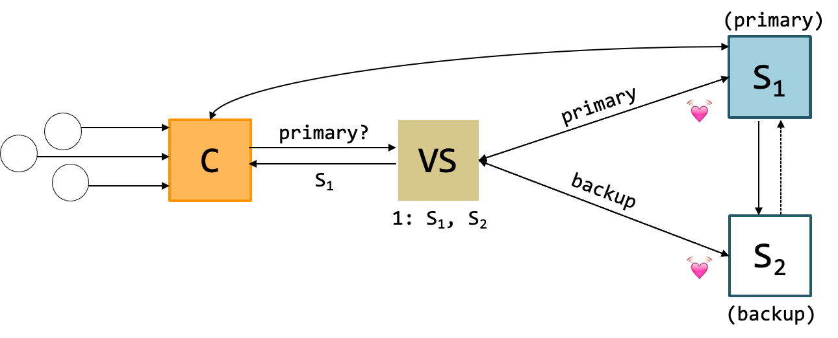
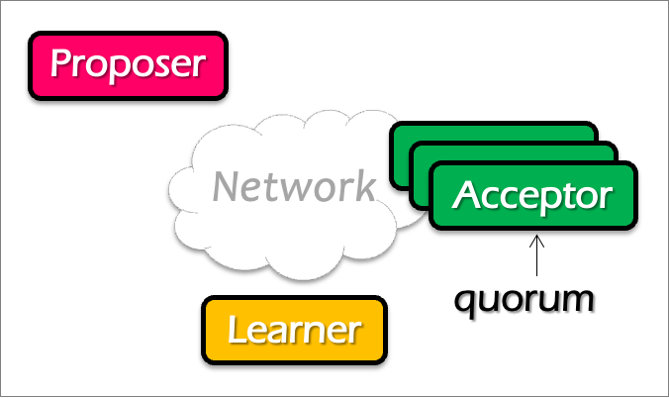
Question
Does single-decree Paxos works fine for our view server example?
  When can it go wrong? Accepting a single value is not enough (because view can change)
Notes:
No. What about configuration updates?

Slide 84
Multi-Paxos
Agree on a sequence of values

Slide 85
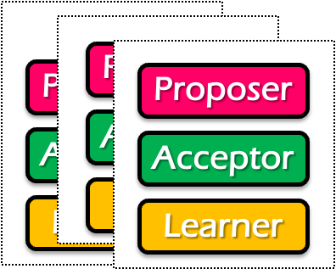
Single-decree Paxos vs. Multi-Paxos
0
1
2
Log
add
cmp
xxx
Client
Client
Proposer
Proposer
Proposer
Acceptor
Acceptor
Acceptor
Learner
Learner
Learner
Single-decree Paxos
Single-decree
instance for 0
Single-decree
instance for 1
Single-decree
instance for 2
Multi-Paxos

Slide 86
Note
The proposers/acceptors can of different instances can be on the same machine

Slide 87
Basic Multi-Paxos
Server simultaneously acts as proposer, acceptor & learner
Example
  Suppose we want to append an entry to the log
Client
0
1
2
S1
add
cmp
xxx
S1
S2
add
cmp
xxx
S2
S3
add
cmp
xxx
S3
Notes:
初始状态： 每个server都确认了0，1，2的value

Slide 88
Basic Multi-Paxos
Question: what could happen if instance 3 has already gotten a value?
After receiving the request from a client, the server will
  Decide the number of the instance to append (3 in our example)
  Do the single-decree paxos to append the log entry to the instance 3
    Prepare + Accept
Client
0
1
2
3
Prepare
Accept
S1
add
cmp
xxx
yyy
S1
Select 3
yyy
S2
add
cmp
xxx
yyy
S2
yyy
S3
add
cmp
xxx
yyy
S3

Slide 89
Basic Multi-Paxos
Question: what could happen if instance 3 has already gotten a value?
Example: S1 receives the request, but S2 and S3 has already accepted the value (zzz)
  Our single-decree paxos will not choose the value client sent
Client
0
1
2
3
Prepare
Accept
S1
add
cmp
xxx
zzz
S1
Select 3
zzz
add
cmp
xxx
xxx
S2
zzz
S2
zzz
add
cmp
xxx
xxx
S3
zzz
S3
Notes:
初始状态： 每个server都确认了0，1，2的value

Slide 90
Basic Multi-Paxos
In case of conflict, S1 will choose a larger instance (e.g., 4)
  And re-run the instance until find the largest available instance
  May possible try many times until find an available slot
Client
0
1
2
3
4
Prepare
Accept
Prepare
S1
add
cmp
xxx
zzz
yyy
S1
Select 3
Select 4
zzz
add
cmp
xxx
xxx
yyy
S2
zzz
S2
zzz
add
cmp
xxx
xxx
yyy
S3
zzz
S3

Slide 91
Question
How many RTTs are required for appending a single log entry?

Slide 92
Basic Multi-Paxos is correct but inefficient
2 rounds of RPCs for each value chosen in the optimal case
  Prepare, Accept
With multiple concurrent proposers, conflicts and restarts are likely
  1. The server may conflict on the position of the new log entry to insert
  (our previous example)
  2. Even in the same Paxos instance, different proposer may conflict
    Only the proposers with the highest number can win
Solution
  Select a leader: most of the time, only one server can propose
  Batch the prepare requests from multiple instances sent from a leader

Slide 93
Benefits of leader election: prepare message batching
Suppose S1 is the leader (w/o batching)
Paxos 0
Paxos 1
Paxos 2
Paxos 3
N_{a} : S1.19
V_{a} : add
N_{h} : S1.19
M_{h} : S1.19
N_{a} : S1.19
V_{a} : cmp
N_{h} : S1.19
M_{h} : S1.19
N_{a} :
V_{a} :
N_{h} :
M_{h} :
N_{a} :
V_{a} :
N_{h} :
M_{h} :
S1.19
S1.19
xxx
yyy
S1.19
S1.19
S1.19
S1.19
Client
0
1
2
3
xxx, yyy
Prepare
Accept
Prepare
Accept
S1
add
cmp
xxx
yyy
S1
Select
2
Select
3
xxx
yyy
S2
add
cmp
xxx
yyy
S2
xxx
yyy
S3
add
cmp
xxx
yyy
S3

Slide 94
Benefits of leader election: prepare message batching
Suppose S1 is the leader (+ batching)
Paxos 0
Paxos 1
Paxos 2
Paxos 3
N_{a} : S1.19
V_{a} : add
N_{h} : S1.19
M_{h} : S1.19
N_{a} : S1.19
V_{a} : cmp
N_{h} : S1.19
M_{h} : S1.19
N_{a} :
V_{a} :
N_{h} :
M_{h} :
N_{a} :
V_{a} :
N_{h} :
M_{h} :
S1.19
S1.19
xxx
xxx
S1.19
S1.19
S1.19
S1.19
Client
0
1
2
3
xxx, yyy
Prepare 2 + 3
Accept
Accept
Select
3
S1
add
cmp
xxx
yyy
S1
Select
2
xxx
yyy
S2
add
cmp
xxx
yyy
S2
xxx
yyy
S3
add
cmp
xxx
yyy
S3

Slide 95
Multi-paxos uses a distinguished proposer (leader)
Distinguished proposer (aka. leader)
  The only one that issues proposals
    i.e., no proposer conflicts in the optimal case
Client only sends the commands to the leader
  Decides the value position
Question: is single leader necessary for multi-paxos?
  No: if two or more servers act as proposers at the same time, the protocol still works correctly

Slide 96
Problem: hole in the log
0
1
2
3
Suppose S1 is the leader (with batching)
  What happens after S1 crashes w/ unfinished entry?
  Entry 2 will be empty
Application should fill the gap itself, e.g., w/ no-op
S1
add
cmp
yyy
S2
add
cmp
add
yyy

Slide 97
Summary of Multi-Paxos
Based on single-decree Paxos, realizing RSM
  i.e., agree on a sequence of values
Needs non-trivial application efforts to make it work
  E.g., should use a leader for better performance
  Should fill the holes of the log entries
  Paxos itself is not friendly to the programmers

