Slide 1


Paxos (continued), Raft & Review
SE3331-1 (2025 Fall)
IPADS, Shanghai Jiao Tong University
https://www.sjtu.edu.cn

Slide 2
Review of last day’s content & Today’s lecture
Review of 2PC, and how to handle partial failure
The issue of 2PC: does not support availability by default
Supporting availability & consistency (linearizability)
  Approach #1: Primary-backup replication
  Approach #2: Paxos & Multi-paxos
  Approach #3: Raft (not included in the mid-term exam!)

Slide 3
Review of The CAP theorem: 2 out of 3
It is impossible for a distributed computer system to simultaneously provide all three of the following guarantees
  Consistency (e.g., linearizability + all-or-nothing + before-or-after + …)
  Availability (a guarantee that every request receives a response about whether it succeeded or failed)
  Partition tolerance (the system continues to operate despite arbitrary message loss or failure of part of the system)

Slide 4
Key for availability: Replication
The program (including its data) is replicated
  Hopefully, the system respond if some replicas are alive
Challenge
  The replica’s received execution order is different!

Slide 5
Problem: inconsistency of Replicas
Clients send requests to different servers can arrive in different order
  How do we ensure the servers remain consistent?
Optimistic Replication (e.g., eventual consistency)
  Tolerate inconsistency, and fix things up later
  Works well when out-of-sync replicas are acceptable
Pessimistic Replication (e.g., linearizability)
  Ensure strong consistency between replicas
  Needed when out-of-sync replicas can cause serious problems

Slide 6
Review: primary-backup replication
1. One server is responsible for ordering inputs received from clients
2. After receives an input, sync to up to W backups before ack
3. If the primary fails, select R backups, and chooses the one with the most up-to-date inputs, i.e., inputs with the largest sequence number
  R + W > N (Total number of replicas)
  The primary must collect logs from these backups to form a complete log, and replicates to remaining backups (The recovery process)
4. A view server is used to ensure at most one server is conducting the operations

Slide 7

Final issue: what if view server fails?
(primary)
S₁
S₁
C
X
VS
1: S₁, S₂
S₂
(backup)
problem: what if view server fails?
Now, we need Paxos

Slide 8
Single-decree Paxos
Agree on a single value w/o a view server

Slide 9
Question: how can we agree on a single value?
e.g., multiple client wants to write a value VA that is replicated on a set of servers
  How can we ensure that, once VA is acked by the system (written), VA does not change, and can tolerate failures?
Question: when is this question becomes trivial?
  The question is trivial if there is only a single writer
Challenge: support multiple (concurrent) writers

Slide 10
General Approach
One proposer decides to be the leader (optional)
Leader proposes to write a value and solicits acceptance from acceptors (majority)
Leader announces result or try again

Slide 11
Paxos Setup
Client
Client
Paxos Node
Paxos Node
Paxos Node
Proposer
Proposer
Proposer
Acceptor
Acceptor
Acceptor
. . .
Learner
Learner
Learner
M_{n}: my proposal number
V_{a}: accepted value of N_{a} (Value agreed on)
N_{a}: highest proposal number accepted
N_{h}: highest proposal number seen
On each Node

Slide 12
Paxos Pseudo-code
N_{a}: highest proposal number accepted
V_{a}: accepted value of N_{a}
N_{h}: highest proposal number seen
M_{n}: my proposal number
N_{a} = V_{a} = null
N_{h} = N0:0
N_{a} = V_{a} = null
N_{h} = N1:0
N_{a} = V_{a} = null
N_{h} = N2:0
M_{n} = N1:1
<proposal, N1:1>
<proposal, N1:1>
N_{h} = N1:1
N_{a} = null
V_{h} = null
N_{h} = N1:1
N_{a} = null
V_{h} = null
<promise, null, null>
<promise, null, null>
<accept, N1:1, V1>
<accept, N1:1, V1>
N_{h} = N1:1
N_{a} = N1:1
V_{h} = V1
N_{h} = N1:1
N_{a} = N1:1
V_{h} = V1
<accept-ok>
<accept-ok>
<decide, V1>
<decide, V1>
Time

Slide 13
Question
N_{a}: highest proposal number accepted
V_{a}: accepted value of N_{a}
N_{h}: highest proposal number seen
M_{n}: my proposal number
Suppose that the acceptors are A, B, and C. A and B are also proposers. How does Paxos ensure that the following sequence of events can't happen? What actually happens, and which value is ultimately chosen?
A sends <prepare, 1> requests with proposal number 1, and gets responses from A, C
A sends <accept,1, "foo"> to A and C and gets responses from both. Because a majority accepted, A thinks that "foo" has been chosen. However, A crashes before sending an <accept, 1, "foo"> to B
B sends <prepare, 2> messages with proposal number 2, and gets responses from B and C
B sends <accept, 2, "bar"> messages to B and C and gets responses from both, so B thinks that "bar" has been chosen

Slide 14

Question
N_{a}: highest proposal number accepted
V_{a}: accepted value of N_{a}
N_{h}: highest proposal number seen
M_{n}: my proposal number
A
C
M_{n} = 1
<proposal, 1>
<promise, …>
B
<accept, 1, foo>
M_{n} = 2
<proposal, 2>
<promise, …>
<accept, 2, bar>
Time

Slide 15
Question
N_{a}: highest proposal number accepted
V_{a}: accepted value of N_{a}
N_{h}: highest proposal number seen
M_{n}: my proposal number
A
C
M_{n} = 1
<proposal, 1>
<promise, …>
B
<accept, 1, foo>
M_{n} = 2
<proposal, 2>
<promise, 1, foo>
<accept, 2, foo>
Time

Slide 16
Inside of Paxos
N_{a}: highest proposal number accepted
V_{a}: accepted value of N_{a}
N_{h}: highest proposal number seen
M_{n}: my proposal number
When is the value V chosen?
    Leader receives a majority <promise, …>
    A majority acceptors receive <accept, N, V>
    Leader receives a majority <accepted, …>
What if acceptor fails after sending promise?
    Must remember N_{h}
What if acceptor fails after receiving accept?
    Must remember N_{h} and N_{a} V_{a}
What if leader fails while sending accept?
    Propose M_{n} again
Notes:
When is the value V chosen?
- As long as majority send <accepted>, even if the leader has not received that much.
Why not the second case?
- The acceptor may receive the request, than fail
If not remember Nh, than another leader may get the same promise

Slide 17
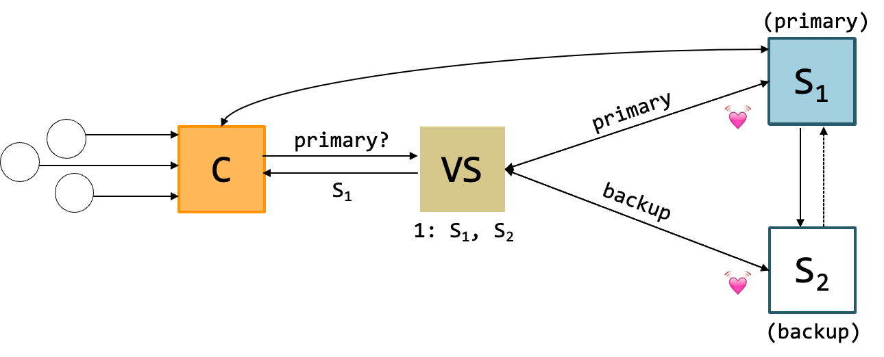
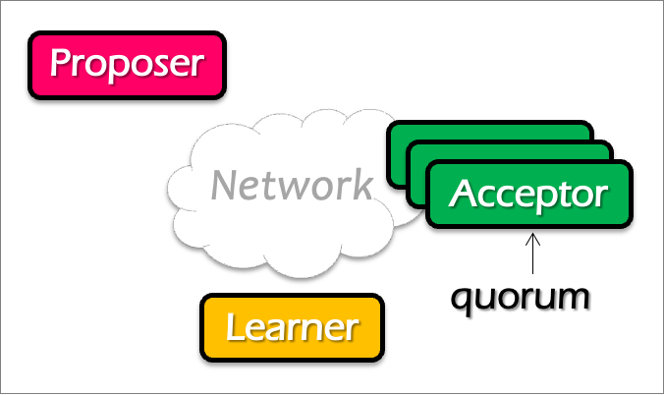
Question
Does single-decree Paxos works fine for our view server example?
  When can it go wrong? Accepting a single value is not enough (because view can change)
Notes:
No. What about configuration updates?

Slide 18
Multi-Paxos
Agree on a sequence of values

Slide 19
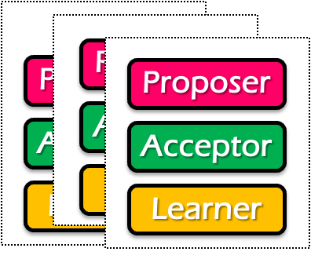
Single-decree Paxos vs. Multi-Paxos
0
1
2
Log
add
cmp
xxx
Client
Client
Proposer
Proposer
Proposer
Acceptor
Acceptor
Acceptor
Learner
Learner
Learner
Single-decree Paxos
Single-decree
instance for 0
Single-decree
instance for 1
Single-decree
instance for 2
Multi-Paxos

Slide 20
Note
The proposers/acceptors can of different instances can be on the same machine

Slide 21
Basic Multi-Paxos
Server simultaneously acts as proposer, acceptor & learner
Example
  Suppose we want to append an entry to the log
Client
0
1
2
S1
add
cmp
xxx
S1
S2
add
cmp
xxx
S2
S3
add
cmp
xxx
S3
Notes:
初始状态： 每个server都确认了0，1，2的value

Slide 22
Basic Multi-Paxos
Question: what could happen if instance 3 has already gotten a value?
After receiving the request from a client, the server will
  Decide the number of the instance to append (3 in our example)
  Do the single-decree paxos to append the log entry to the instance 3
    Prepare + Accept
Client
0
1
2
3
Prepare
Accept
S1
add
cmp
xxx
yyy
S1
Select 3
yyy
S2
add
cmp
xxx
yyy
S2
yyy
S3
add
cmp
xxx
yyy
S3

Slide 23
Basic Multi-Paxos
Question: what could happen if instance 3 has already gotten a value?
Example: S1 receives the request, but S2 and S3 has already accepted the value (zzz)
  Our single-decree paxos will not choose the value client sent
Client
0
1
2
3
Prepare
Accept
S1
add
cmp
xxx
zzz
S1
Select 3
zzz
add
cmp
xxx
xxx
S2
zzz
S2
zzz
add
cmp
xxx
xxx
S3
zzz
S3
Notes:
初始状态： 每个server都确认了0，1，2的value

Slide 24
Basic Multi-Paxos
In case of conflict, S1 will choose a larger instance (e.g., 4)
  And re-run the instance until find the largest available instance
  May possible try many times until find an available slot
Client
0
1
2
3
4
Prepare
Accept
Prepare
S1
add
cmp
xxx
zzz
yyy
S1
Select 3
Select 4
zzz
add
cmp
xxx
xxx
yyy
S2
zzz
S2
zzz
add
cmp
xxx
xxx
yyy
S3
zzz
S3

Slide 25
Question
How many RTTs are required for appending a single log entry?

Slide 26
Basic Multi-Paxos is correct but inefficient
2 rounds of RPCs for each value chosen in the optimal case
  Prepare, Accept
With multiple concurrent proposers, conflicts and restarts are likely
  1. The server may conflict on the position of the new log entry to insert
  (our previous example)
  2. Even in the same Paxos instance, different proposer may conflict
    Only the proposers with the highest number can win
Solution
  Select a leader: most of the time, only one server can propose
  Batch the prepare requests from multiple instances sent from a leader

Slide 27
Benefits of leader election: prepare message batching
Suppose S1 is the leader (w/o batching)
Paxos 0
Paxos 1
Paxos 2
Paxos 3
N_{a} : S1.19
V_{a} : add
N_{h} : S1.19
M_{h} : S1.19
N_{a} : S1.19
V_{a} : cmp
N_{h} : S1.19
M_{h} : S1.19
N_{a} :
V_{a} :
N_{h} :
M_{h} :
N_{a} :
V_{a} :
N_{h} :
M_{h} :
S1.19
S1.19
xxx
yyy
S1.19
S1.19
S1.19
S1.19
Client
0
1
2
3
xxx, yyy
Prepare
Accept
Prepare
Accept
S1
add
cmp
xxx
yyy
S1
Select
2
Select
3
xxx
yyy
S2
add
cmp
xxx
yyy
S2
xxx
yyy
S3
add
cmp
xxx
yyy
S3

Slide 28
Benefits of leader election: prepare message batching
Suppose S1 is the leader (+ batching)
Paxos 0
Paxos 1
Paxos 2
Paxos 3
N_{a} : S1.19
V_{a} : add
N_{h} : S1.19
M_{h} : S1.19
N_{a} : S1.19
V_{a} : cmp
N_{h} : S1.19
M_{h} : S1.19
N_{a} :
V_{a} :
N_{h} :
M_{h} :
N_{a} :
V_{a} :
N_{h} :
M_{h} :
S1.19
S1.19
xxx
xxx
S1.19
S1.19
S1.19
S1.19
Client
0
1
2
3
xxx, yyy
Prepare 2 + 3
Accept
Accept
Select
3
S1
add
cmp
xxx
yyy
S1
Select
2
xxx
yyy
S2
add
cmp
xxx
yyy
S2
xxx
yyy
S3
add
cmp
xxx
yyy
S3

Slide 29
Multi-paxos uses a distinguished proposer (leader)
Distinguished proposer (aka. leader)
  The only one that issues proposals
    i.e., no proposer conflicts in the optimal case
Client only sends the commands to the leader
  Decides the value position
Question: is single leader necessary for multi-paxos?
  No: if two or more servers act as proposers at the same time, the protocol still works correctly

Slide 30
Problem: hole in the log
0
1
2
3
Suppose S1 is the leader (with batching)
  What happens after S1 crashes w/ unfinished entry?
  Entry 2 will be empty
Application should fill the gap itself, e.g., w/ no-op
S1
add
cmp
yyy
S2
add
cmp
add
yyy

Slide 31
Summary of Multi-Paxos
Based on single-decree Paxos, realizing RSM
  i.e., agree on a sequence of values
Needs non-trivial application efforts to make it work
  E.g., should use a leader for better performance
  Should fill the holes of the log entries
  Paxos itself is not friendly to the programmers

Slide 32
More: Raft replicated log
A different approach for consensus
  Paxos’s approach (bottom-up)
    solve single-decree consensus first
    replicate a sequence of values using single-decree consensus
  Raft’s approach (top-down)
    directly solve log replication without first solving single-decree consensus

Slide 33






Why learn raft?
Raft is described in a concrete form that favors system design & impl.
  Widely implemented and deployed nowadays
  Especially for open-source projects

Slide 34

Abstraction of the operations: replicated log
Clients
shl
Consensus
Module
State
Machine
Consensus
Module
State
Machine
Consensus
Module
State
Machine
Servers
Log
Log
Log
add
jmp
mov
shl
add
jmp
mov
shl
add
jmp
mov
shl
Replicated log => replicated state machine
  All servers execute same (deterministic) commands in same order
Consensus module ensures proper logs are the same!

Slide 35
Raft’s high-level approach: problem decomposition
Leader election
  Select one server as the leader (Similar to primary-backup, w/o replication)
  Detect crashes, choose new leader
Log replication (normal operation)
  Leader accepts commands from clients, append to its log
  Leader replicates its log to other servers (overwrites inconsistencies)
Safety
  Keep logs consistent (e.g., out-of-order log entries are not exposed)
Notes:
Safety can violate if a replication happens partially

Slide 36
Raft server states
Server
Server
Network
At any time, each server is either:
  Leader: handles all client interactions, log replication
    Invariant achieved: At most 1 viable leader at a time
  Follower: passive (only responds to incoming RPCs)
  Candidate: used to elect a new leader
Normal workloads
  1 server is the leader, others are the followers
Server
Servers communicates
w/ RPCs
Timeout, start election
Receive acks from majority of servers
Start
Follower
Candidate
Leader
Discover current server or
w/ high term
Discover server w/ high term

Slide 37
Raft server states
Leader is active
  Receive client requests, replicate logs to the followers
Followers are passive
  Only respond to the requests from leaders or candidates
Recall: our single-write rule
Passive
Activate
Follower
Candidate
Leader

Slide 38
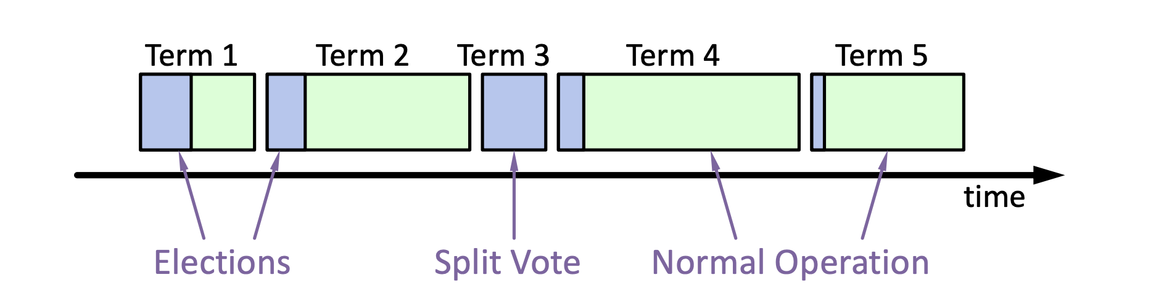
Raft basics: terms for one leader
Raft divides time into terms (with arbitrary length):
  Each term starts with an election
  Ends with one leader or no leader
  At most one leader per term
Each leader is uniquely associated with a term
  Key role: identify obsolete information
Notes:
obsolete information, e.g., as stale leaders
Servers exchange with others to build the global view of the terms

Slide 39
Raft server state switch: Heartbeats & Timeouts
Servers start as followers (except one server is assigned as the leader)
  Followers expect to receive RPCs from leaders or candidates
Leaders must send heartbeats to maintain authority in a term
  If election timeout elapses with no RPCs:
    Follower assumes leader has crashed
    Follower starts new election
    Timeouts typically 100-500ms
Notes:
election timeout: a follower receives no communication over a period of time

Slide 40
Election Basics
Change its state to the candidate state
Increment current term
Vote for itself
  Send RequestVote RPCs to all other servers, retry until either
    Receive votes from majority of servers ➔ Become the leader!
    Receiver RPC from a valid leader ➔ Return to the follower
Question: what is the condition for the follower to vote?
The leader’s term >= self’s term & never vote before
Notes:
Use heartbeat to announce the leadership.

Slide 41
Election Basics
Change its state to the candidate state
Increment current term
Vote for itself
  Send RequestVote RPCs to all other servers, retry until either
    Receive votes from majority of servers ➔ Become the leader!
    Receiver RPC from a valid leader ➔ Return to the follower
    No one wins election (timeouts on the election) ➔ Increase the term, start the new election

Slide 42
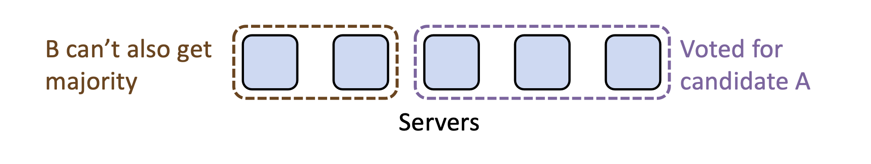
Election requirements: safety
At most one winner per term
  How to achieve so? Each server only gives one vote per term (persist on disk)
  Majority ensures at least one leader (similar to phase #1 of Paxos)
Question
  Can different candidates exist in the same term?
  Yes. Each server should keep a VotedFor variable to ensure it only gives vote to one candidate.

Slide 43
Election requirements: liveness
Some candidate must eventually win
  If multiple candidates started, non will win
Raft’s key idea: use random timeout before the retry
  So as to minimize the possibilities that two candidates retry at the same time
  Typically, it randomly selects a time between [T, 2T]
    T is the election timeout
Notes:
Liveness: something good happens

Slide 44
Persistent state of each server so far
currentTerm
  Latest term server has seen (initialized to 0 on first boot)
votedFor
  Candidate Id that received vote in current term (or null if none)

Slide 45
Basic request vote RPC so far
Invoked by candidates to gather votes.
Arguments:
candidateId candidate requesting vote
term candidate's term
Results:
term currentTerm, for candidate to update itself
voteGranted true means candidate received vote
Implementation:
If term > currentTerm, currentTerm ← term
(step down if leader or candidate)
If term == currentTerm, votedFor is null or candidateId, grant vote and reset election timeout

Slide 46
Raft’s high-level approach: problem decomposition
Leader election
  Select one server as the leader (Similar to primary-backup, w/o replication)
  Detect crashes, choose new leader
Log replication (normal operation)
  Leader accepts commands from clients, append to its log
  Leader replicates its log to other servers (overwrites inconsistencies)
Safety
  Keep logs consistent (e.g., out-of-order log entries are not exposed)
Notes:
Safety can violate if a replication happens partially

Slide 47
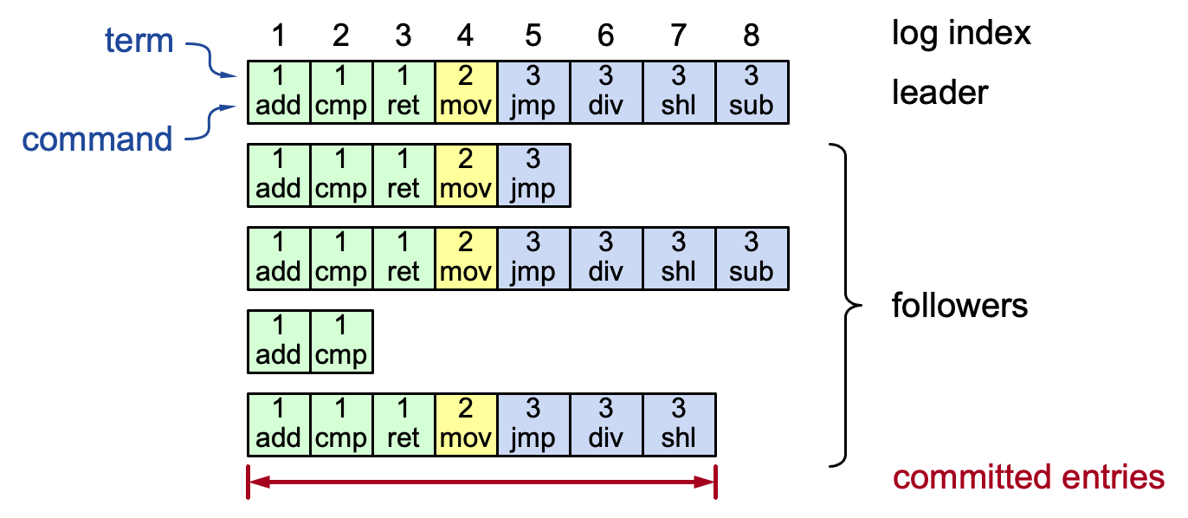
Log structure
Log entry = index, term, command
  Stored on the disk to tolerate failures
A log is committed if it can be safely applied to the state machine
  i.e., eventually stored on all the servers with the same value
Not all entries are committed (will talk about later)
Notes:
Interesting things:
Each log entry store an additional term
Commit: can safely execute on the state machine, no others will execute a different command

Slide 48
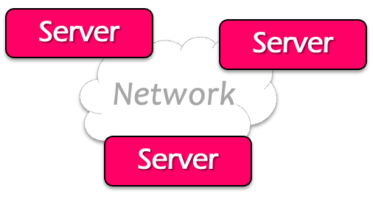

Normal operations to update the log
Command
Client
Send command to the leader
Leader appends command to its log
Leader sends AppendEntries RPCs to followers
Once a new entry (of log) committed:
  Leader passes command to its state machine, returns results to client
  Notifies followers of committed entries, Follower pass committed commands to their state machines

Slide 49
Normal operations to update the log
Command
Client
Crashed/slow followers?
  Leader retries RPCs until they succeed (at least once)
Performance is optimal in the common case (like Multi-Paxos w/ batching)
  One successful RPC to any majority of servers

Slide 50

Challenge: crash can cause log to inconsistencies
Case: an old leader is unaware of the new leader due to network partition
  Yet, it can still get commands from the clients
Leader
Leader
Leader (stale)
S1
1
add
1
cmp
S1
1
add
1
cmp
S1
1
add
1
cmp
1
xxx
S2
1
add
1
cmp
S2
1
add
1
cmp
S2
1
add
1
cmp
2
shi
S3
1
add
1
cmp
S3
1
add
1
cmp
S3
1
add
1
cmp
2
shi
2
ret
Leader (term2)
Term 1
Term 2

Slide 51
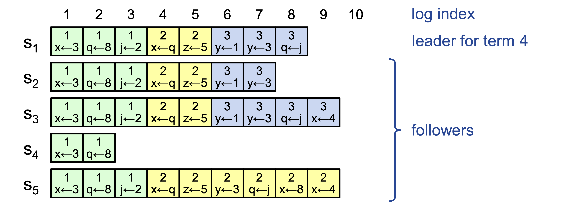
Challenge: crash can cause log to inconsistencies
Raft minimizes special code for repairing inconsistencies
  Leaders assume its log is correct
  Normal operation will repair all inconsistencies
Notes:
Case in the example: server 4 crashes
Server 5 becomes the leader for 2, and keeps appending the logs from the clients

Slide 52
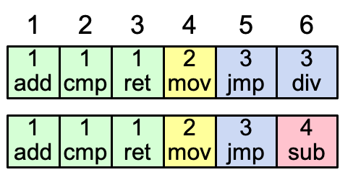
Consistency of the log
Question: how to achieve this property?
High level of coherency between logs maintained by the raft:
  If log entries on different servers have the same index & term
    They store the same command
    The logs are identical in all preceding entries
If a given entry is committed, all preceding entries are also committed
  Note that not all log entries are committed
Notes:
Commands must be equal: issued by the same leader

Slide 53
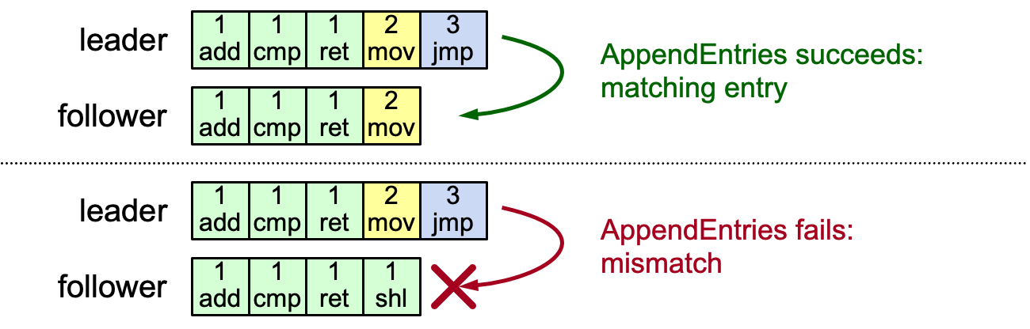
AppendEntries consistency checks
Implements an induction step, ensures coherency
Each RPC argument contains
  Append index, term, term of entry preceding new ones
Follower checks whether it has the matching entry
  Otherwise, it rejects the request

Slide 54
Why can rejection happens? Leader changes
At beginning of new leader’s term:
  Old leader may have left entries partially replicated
No special steps by new leader: just start normal operation, w/ different position
  Leader’s log is “the truth”
  Will eventually make follower’s logs identical to leader’s (overwrite the divergent log entries with the leader’s ones)
The rejected entries will be overwritten by the leader’s log entry

Slide 55
Handle rejections
Implements an induction step, ensures coherency
In this example, the leader will
  Overwrite index 4 with [2 mov] with AppendEntries
  Then append entry [3 jmp] to the end of the follower
Fail to append case
Overwrite mismatched entry
L
1
add
1
cmp
1
ret
2
mov
3
jmp
L
1
add
1
cmp
1
ret
2
mov
3
jmp
1
ret
2
mov
F
1
add
1
cmp
1
ret
1
shi
F
1
add
1
cmp
1
shi
L
1
add
1
cmp
1
ret
2
mov
3
jmp
Append the new entry
1
ret
2
mov
3
jmp
F
1
add
1
cmp
1
shi

Slide 56
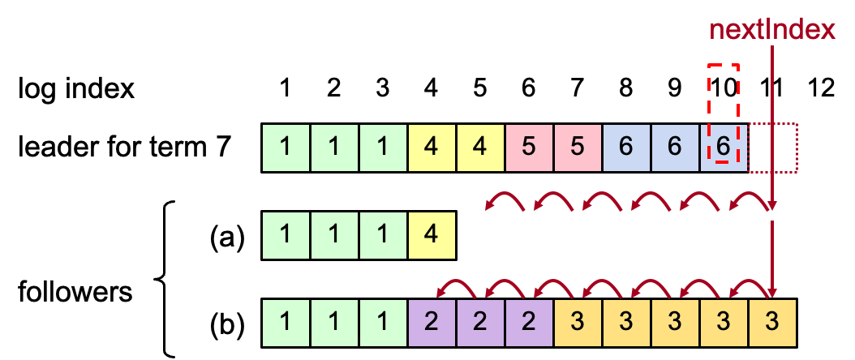
More on Repairing Follower Logs
New leader must make follower logs consistent with its own
  Delete extraneous entries
  Fill in missing entries
Leader keeps nextIndex for each follower:
  Index of next log entry to send to that follower
  Initialized to (1 + leader’s last index)

Slide 57
Overwrite can ensure consistency.
But it makes a subtle issue:
When can we commit a log entry? (Since an appended log entry may be overwritten)

Slide 58
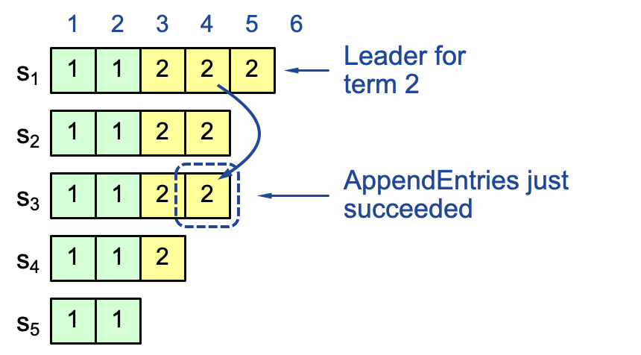
Intuitive result: replicating on a majority
If the log is replicated on a majority of servers, it can be applied on the state machine
  Not always true on raft so far
Question: can index 4 be overwritten after appending to S3?

Slide 59
Case study: raft overwriting
Question: can index 4
be overwritten?
Leader S1
Leader ?
Leader S3
1
2
3
4
1
2
3
4
1
2
3
4
s₁
1
1
2
2
2
s₁
1
1
2
2
2
1
1
2
2
s₂
1
1
2
2
s₂
1
1
2
2
s₂
1
1
2
2
s₃
1
1
2
2
s₃
1
1
2
2
3
s₃
1
1
2
s₄
1
1
2
s₄
1
1
2
s₄
1
1
s₅
1
1
s₅
1
1
s₅
Term 2
S1 crashes
Term 3

Slide 60
Case study: raft overwriting
Question: can index 4
be overwritten?
Leader S1
Leader ?
Leader S5
1
2
3
4
1
2
3
4
1
2
3
4
s₁
1
1
2
2
2
s₁
1
1
2
2
2
1
1
2
2
1
1
2
2
s₂
1
1
2
2
s₂
3
s₂
1
1
2
2
1
1
2
2
s₃
1
1
2
2
s₃
3
s₃
1
1
3
1
1
2
s₄
1
1
2
s₄
2
s₄
1
1
s₅
1
1
s₅
1
1
3
3
s₅
Term 2
S1 crashes
Term 3

Slide 61
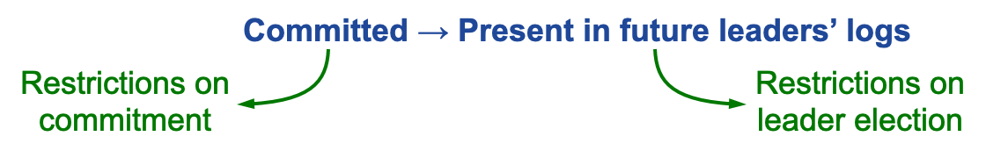
Safety requirement of the commit entry
Once a log entry has been applied to a state machine, no other state machine must apply a different value for that log entry
Raft safety property:
  If a leader has decided that a log entry is committed, that entry will be present in the logs of all future leaders (no overwritten)
This guarantees the safety requirement
  Leaders never overwrite entries in their logs
  Only entries in the leader’s log can be committed
  Entries must be committed before applying to state machine
Notes:
1. Delay the commitment of an entry until we know it is committed

Slide 62
Goal: if a log entry has been replicated to majority followers, it is likely to commit, i.e., be in the log of future leaders

Slide 63
Committing Entry from the Current Term
Case #1/2: Leader decides entry in current term is committed
Question: how to prevent index 4 from being overwritten? Prevent S4 or S5 from becoming the leader

Slide 64
Picking the Best Leader
During elections, choose candidate with log most likely to contain all committed entries
  Candidates include log info in RequestVote RPCs
  (index & term of last log entry)
  Voting server V denies vote if its log is “more complete”:
  (lastTermV > lastTermC) ||
  (lastTermV == lastTermC) && (lastIndexV > lastIndexC)
  Leader will have “most complete” log among electing majority

Slide 65
Comparing the best leader
(lastTermV > lastTermC) ||
(lastTermV == lastTermC) && (lastIndexV > lastIndexC)
s₁
1
1
2
2
2
s₁
1
1
2
2
2
s₂
1
1
2
2
s₂
1
1
2
3
Question: which log is longer?
  S1 & S2, respectively

Slide 66
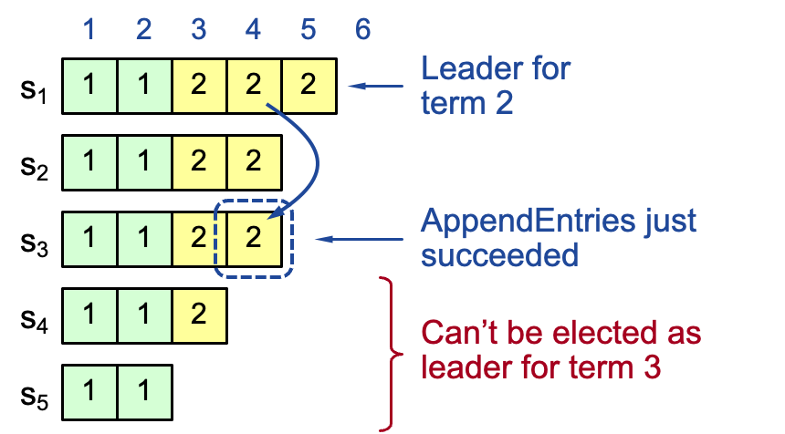
Committing Entry from the Current Term
Leader decides entry in current term is committed
Safe: leader for term 3 must contain entry 4

Slide 67
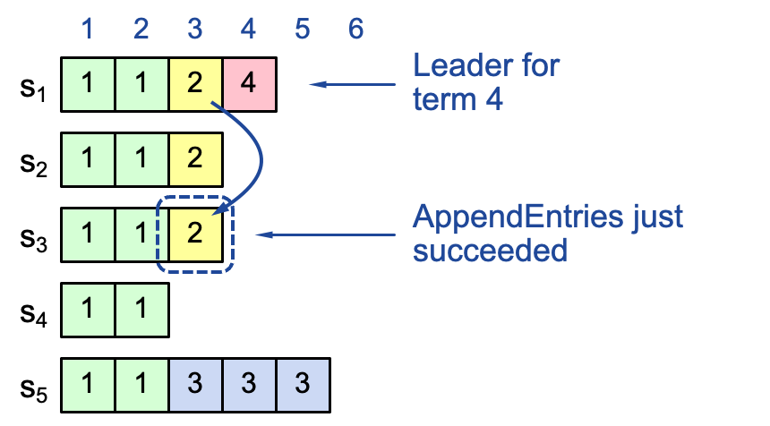
Commit rule for raft so far
If the log entry from the leader term is replicated to a majority of followers
  Then we can treat it as committed
    The later leader must contain the entry
But, what about replicating log entry from a previous term?
  The previous term’s entry may fail to reach a majority

Slide 68
Case study: a majority replicated entry can be overwritten
Leader S1
Leader S5
Question: who can become the leader for term 3?
1
2
3
1
2
1
2
3
4
s₁
1
1
2
s₁
1
1
2
1
1
2
s₂
1
1
2
s₂
1
1
2
1
1
2
s₃
1
1
s₃
1
1
1
1
s₄
1
1
s₄
1
1
1
1
s₅
1
1
s₅
1
1
1
1
3
3
Partition again!!!
Term 2
Partition!!!
Term 3

Slide 69
Case study: a majority replicated entry can be overwritten
Leader S5
Leader S1
Leader S5
Leader S5
1
2
3
4
1
2
3
4
5
1
2
3
4
1
1
2
1
1
2
4
1
1
2
1
1
2
1
1
2
1
1
2
3
1
1
1
1
2
1
1
2
1
1
3
1
1
1
1
1
1
1
1
3
1
1
3
3
1
1
3
3
3
1
1
3
3
3
1
1
3
3
3
Partition on term 3!!
Term 4
S1 crashes
Term 5

Slide 70
Committing Entry from Earlier Term
Case #2/2: Leader is trying to finish committing entry from an earlier term
Entry 3 not safely committed:
  S5 can still be elected as leader for term 5
  If elected, it will overwrite entry 3 on S1, S2 and S3 (recall our previous example)

Slide 71
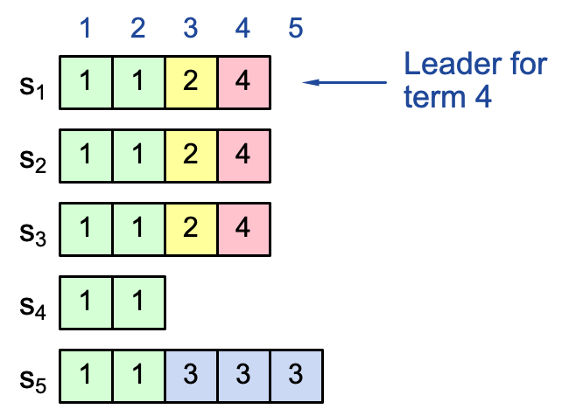
Commit rules
For a leader to decide an (previous) entry is committed:
  Must be stored on a majority of servers
  At least one new entry from leader’s term must also be stored on majority of servers
This is because once entry 4 committed:
  s₅ cannot be elected leader for term 5
  Entries 3 and 4 both safe
Combination of election rules & commitment rules makes Raft safe

Slide 72
Review

Slide 73

Review: scalable websites powered by distributed systems!
Distributed system: A distributed system is a collection of independent computers that appears to its users as a single coherent system.
- DISTRIBUTED SYSTEMS Principles & Paradigms, Second Edition
Caching server
Caching server
Caching server
…
Caching
Caching
Caching
Distributed caching
Database server
Database server
CDN
Users
Application #1
generate the page
Database
user, price
…
Database
user, price
Application server
Distributed database
Internet
Load
Balance
Application #2
add the order
File server
File server
File server
File:
image
File:
image
…
File:
image
Application server
…
…
Message queue
Distributed file system

Slide 74
Distributed systems are built from bottom up
e.g., we first need to understand how to build single-machine systems => move on to distributed systems
  E.g., single-node filesystem to distributed file systems
  Single-node transaction systems to distributed transaction systems

Slide 75

Review: What is a file?
Storage as files
File is the most nature way to store the data
A file has two key properties:
  It is durable & has a name
  It is a high-level version of the memory abstraction
System layer implements files using modules from hardware layer
  Divide-and-conquer strategy
  Makes use of several hidden layers of machine-oriented names (addresses), one on another, to implement files
  Maps user-friendly names to these files

Slide 76
Review: The Big Picture of a File System
User
App-1
App-2
App-3
OPEN("a.txt", "rw")
READ(…)
WRITE(…)
…
File System
Kernel
Disk Driver
Read(block-addr, buf)
Write(block-addr, buf)
Hardware
Memory
Disk
(4TB = 2³⁰ x 4KB blocks^{[1]})
[1] The block size depends on the device type, e.g., can be 512B, 256 & many others

Slide 77

The Naming Layers of the UNIX FS (version 6)
Notes:
TODO: redraw

Slide 78
Review: simple operations like lookup
procedure LOOKUP(string filename, integer dir)-> integer
block b
inode i = INODE_NUMBER_TO_INODE(dir)
if i.type != DIRECTORY then return FAIURE
for offset from 0 to i.size – 1 do
b <- INODE_NUMBER_TO_BLOCK(offset, dir)
if STRING_MATCH(filename, b) then
return INODE_NUMBER(filename, b)
offset <- offset + BLOCKSIZSE
return FAILURE
Overview of a directory inode content
File name | inode num
helloworld.txt | 12
cse2021.md | 73
Name comparing method: STRING_MATCH
  LOOKUP(”cse2021", dir) will return 73
Fun fact:
  Max length of a file name is 14 bytes in UNIX version 6 (what does it mean? Why?)

Slide 79
Review: relative complex operations like Links
LINK: create shortcut for long names
  LINK("Mail/inbox/new-assignment", "assignment")
  Turns strict hierarchy into a directed graph
    Users cannot create links to directories -> acyclic graph
  Different filenames, same inode number
UNLINK
  Remove the binding of filename to inode number
  If UNLINK last binding, put inode/blocks to a free-list
    A reference counter is needed

Slide 80
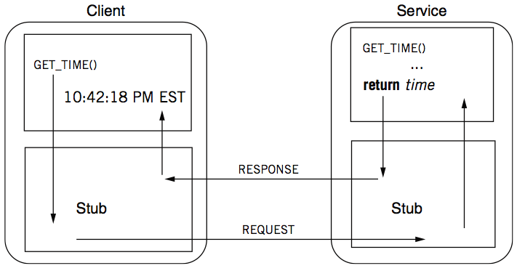
From single-node filesystem to distributed filesystem
We need RPC!

Slide 81
Review: parameter passing
Pass by value?
  Easy: just copy data to network message
Pass by reference?
  Makes no sense without shared memory
Needs a conversion between data used in a program vs. data that can be transferred through the network
  Client converts data structure into pointerless representation
  Client transmits data to the server
  Server reconstructs structure with local pointers

Slide 82
Review: when RPC meets failures
Local procedure calls do not fail (most of the time)
  If that happens, the entire process dies
RPC may meet many different failures
  Parameter error -> just return
  Server crash -> how the client copes with it?
Crash can happen even the remote procedure runs correctly!

Slide 83
Review: RPC semantic under failure
Most RPC systems will offer either:
  At-least-once semantics (e.g., RPC in raft)
  At-most-once semantics
Simple retransmission leads to "at-least-once"
Birrell’s RPC semantics (1984) :
  server says OK: executed once
  server says CRASH: zero or one time

Slide 84
Review: Distributed file system
Key components in distributed systems
  Stores large blob of data, intermediate results, database/KV backends, etc.
Caching server
Caching server
Caching server
…
Caching
Caching
Caching
Distributed caching
Database server
Database server
CDN
Users
Application #1
generate the page
Database
user, price
…
Database
user, price
Application server
Distributed database
Internet
Load
Balance
Application #2
add the order
File server
File server
File server
File:
image
File:
image
…
File:
image
Application server
…
…
Message queue
Distributed file system

Slide 85
Review of NFS: Network File System
Design Goals (by Sun, 1980s, designed for workstations)
  Any machine can be a client or a server
  Support diskless workstations
  Support Heterogeneous deployment
    Different HW, OS, underlying file system
  Access transparency
    Use remote access model
  Recovery from failure
    Stateless, UDP, client retries
  High performance
    Use caching and read-ahead
Notes:
Support disk-less workstations: 避免反复存OS镜像

Slide 86
Recall: the file system API
API
  CHDIR, MKDIR
  CREAT, LINK, UNLINK, RENAME
  SYMLINK
  MOUNT, UNMOUNT
  OPEN, READ, WRITE, APPEND, CLOSE
  SYNC
Implemented as system calls to user applications
Remote procedure call

Slide 87
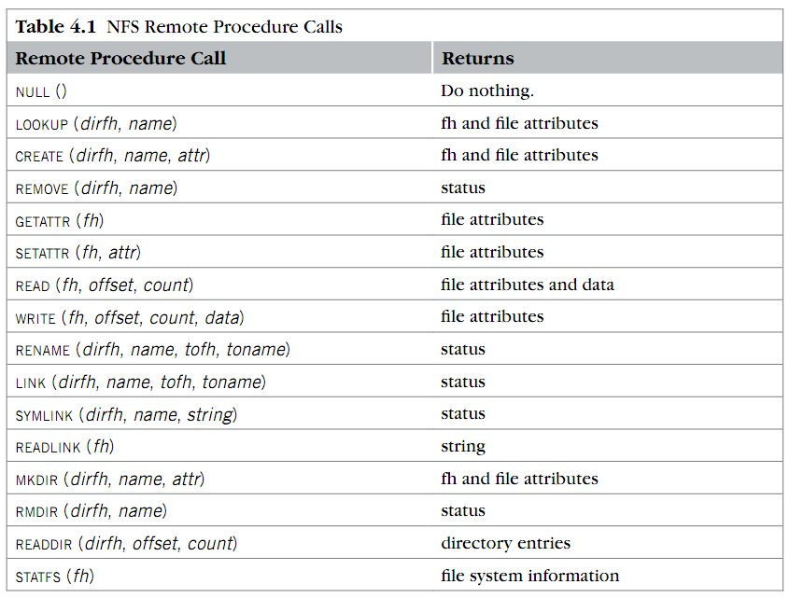
Review: RPC implemented in NFS (what are the differences compared to single-node filesystem? )
Where is OPEN and CLOSE?
why offset?
What is fh?

Slide 88
Drawback of NFS
NFS does not scale in capacity & processing capabilities!
  E.g., the filesystem capacity is bottlenecked by the single-node capacitiy
  The processing capability is similar
NFS does not support availability
  E.g., what if the server crashes?
GFS (not in the midterm exam) partially addresses the issue
  By replication
Challenge: consistency!

Slide 89
Review: consistency model
Consistency model defines rules for the apparent order and
visibility of updates (by different observers) , and it is a continuum with tradeoffs.
        - Todd Lipcon
No Right or Wrong consistency models
  Tradeoffs between ease of programmability & performance
Consistency is hard in (distributed) systems
  Data replication (& caching)
  Concurrency (multi-core & multi-host)
  Failures (e.g., single-machine & multi-machines )

Slide 90
Review: Spectrum of Consistency Models
Better performance/
Fault tolerance
Sequential
Strict
Eventual
Causal
Linearizability
Easy to use
Note that many other models exists

Slide 91
Review: Eventual consistency
A specific weak consistency model, informally:
  All servers eventually receive all writes, and servers holding the same set of writes will have the same data contents
  Thus, if no new updates are made to the data, eventually all accesses will return the last update value
No restrictions on read/write, can freely choose the solution for “always-on” experience!
  Read: return the latest local copies of the data
  Write: write locally (and directly returns), propagate the writes to all the servers in background (e.g., upon sync), which is the optimal

Slide 92
Review: implementing eventual consistency
X
Y
Client
SRV1
SRV2
iPhone
Post X
Post Y
sync
X (pos=10)
Y (pos=10)
Y (pos=11)
Time
X (pos=11)
Will Server1 show X in front of Y, and Server2 show Y in front of X?
Challenge: how to decide the ordering?

Slide 93
Solution: deterministic sort all posts upon syncing
Syncing: ensure both nodes have the same updates in log
Ordered list of updates at each node
  Record the updates in a log, and sort it according to the same order
Re-apply sorted updates after the sync; overwrite existing content if necessary
X
Y
Client
SRV1
SRV2
iPhone
Post X
Post Y
sync
Post X
X
X
Post X
Post Y
Y
Time
Y
Post Y
Notes:
不能直接apply；要delay
sync：保证大家的write都一样了；然后再apply
讲动画

Slide 94
Review: notes on the ordering
The sort key is important!
Possible candidates
  Lamport clock
  Vector clock
  Physical clock (?)
We need to understand the trade-off between these methods

Slide 95
Choosing a stronger consistency model
Better performance/
Fault tolerance
Sequential
Strict
Eventual
Casual
Linearizability
Easy to use
Note that many other models exists

Slide 96



What does a strong consistency model presents?
From a developer’s perspective
  Everything has one copy
  The overall operations executed by the system corresponds to a serial execution
Different models have different orders
Time
The system
Reads/writes are executed concurrently
Replicated list
Time
From any observers
One logical list

Slide 97
Strong consistency model: what is the order provided?
#1. Global issuing order (strict consistency)
#2. Global "completion-to-issuing" order (linearizability)
  Given by our centralized approach
Why linearizability is important?
  It can be implemented in a distributed setup!
  The strongest consistency model practically implemented in a distributed setup (Paxos, Raft, and primary backup)
  In contrast, the strict consistency cannot be practical implemented

Slide 98
A stronger model is typically insufficient
If a program contains multiple reads and writes, what could go wrong?

Slide 99

We need all-or-nothing
e.g., what will the data become if the system fails?
Ideal application semantic of an application
  Money not loss, e.g., bank(a) + bank(b) never changes
Without taking care, the money could lose, e.g., only finishes bank[a] not [b]
transfer(bank, a, b, amt):
bank[a] = bank[a] – amt
bank[b] = bank[b] + amt

Slide 100
What is a strong consistency model (continued)
It's easy for users to reason about correctness assuming
  Everything has only one-copy
  The overall behavior is equivalent to some serial behavior
  The operations that need to be executed in an atomic unit (usually called operations belonging to a transaction) are executed on a machine that happens completely or not at all (all-or-nothing atomicity)
All-or-nothing atomicity makes it much easier to reason about failures
  Need to think about the consequences of the action happening or not happening, but not about the action partially happening

Slide 101
Techniques to achieve all-or-nothing
Logging (journaling)
  Redo-only logging
  Redo-undo logging
Checkpointing

Slide 102
The correctness issue caused by race condition
When two or more threads access shared data and at least one is write
Timing dependent error involving shared state
  i.e., whether the scheduling will cause reading a non-atomic update state
Thread 0
Thread 1
Bank[Alice]
Thread 0
Thread 1
Bank[Alice]
0
0
Read acct
0
Read acct
0
Read acct
0
Increase
0
Increase
0
Write acct
10
Increase
0
Read acct
10
Write acct
10
Increase
10
Write acct
10
Write acct
20

Slide 103
Goal: before-or-after atomicity (a.k.a, Isolation)
To prevent hazard produced by race condition, we need a group of reads/writes to be atomic
  E.g., cannot see/overwrites the intermediate states of a concurrent action
  A concurrent action may have multiple linearizable reads/writes
Before or after atomicity
Concurrent actions have the before-or-after property if their effect from the point of view of their invokers is as if the actions occurred either completely before or completely after one another

Slide 104
Review: serial execution of reads/writes
Time
The system
Reads/writes are executed concurrently
Replicated KVSes
Time
One logical KVS
Reads/writes are executed logically in a serial manner.

Slide 105
One step further: serial execution of actions
Time
Read (A)
Write (B)
…
The system
Actions
Reads/writes are executed concurrently
Replicated KVSes
Time
One logical KVS
Reads/writes are executed logically in a serial manner.
Actions

Slide 106
Techniques to achieve before-or-after
Two-phase locking (2PL)
  It’s pros and cons
Optimistic concurrency control (OCC)
  It’s pros and cons
Multi-version concurrency control (MVCC)
  Addresses the cons of both 2PL & OCC in read-only or read-mostly cases

Slide 107
Techniques to check before-or-after
Different kinds of serializability
  View and conflict
View
Serializability
Conflict
Serializability
⊃
Care the final state as well as intermediate read
Care the final state as well as all the data dependency

Slide 108
Final step: providing availability under partial failure
On a single computer, it either works or it doesn’t
But in a distributed system, some parts of the system can be broken in some unpredictable way
  Such failure is partial (aka., grey failure)
Since most parts of the system are OK, we want the system still working!

Slide 109
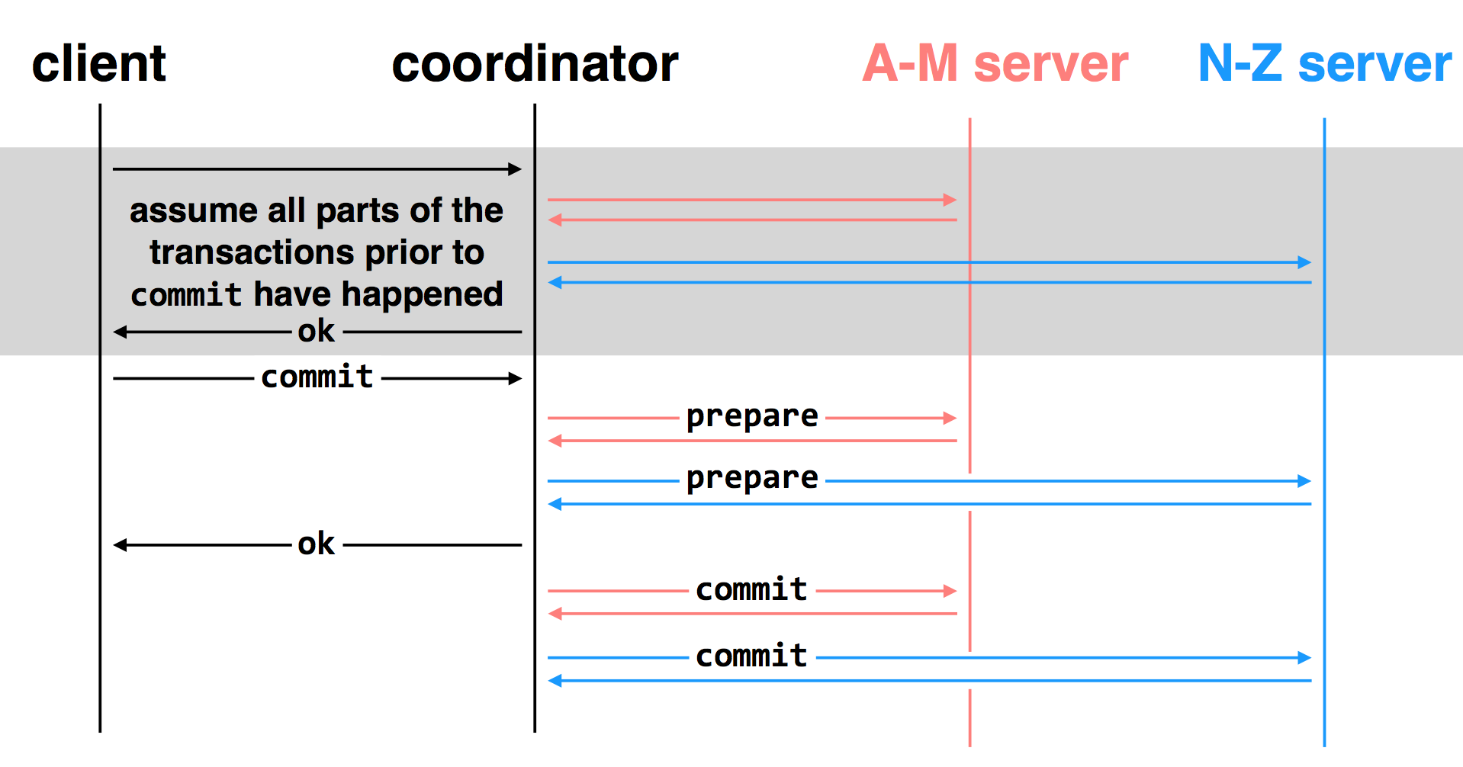
Consistency under partial failure: two-phase commit

Slide 110
Consistency + availability under partial failure: replicated state machine & its implementations
The main content of today and last lecture
Main techniques
  Primary-backup protocols
  Single-decree paxos & Multi paxos
  Raft (not covered in the midterm exam)

Slide 111
Final notes, some important system techniques
System modelling
  Build an internal abstraction of the system, distill the main components that determine the system behavior (e.g., performance)
  Qualitative models: the abstraction can directly yield performance numbers
Acceleration methods
  E.g., fast path & slow path
  Concurrency (should take care of consistency)

